Slide 1
ElQA Test Results on QDS and DQHDS Sample Instrumentation Cables
Mateusz Bednarek and Greg West

Slide 2
Introduction
The test voltage of instrumentation cables is defined in:
  ELECTRICAL DESIGN CRITERIA FOR THE HL-LHC CIRCUIT COMPONENTS OPERATING AT ROOM TEMPERATURE, https://edms.cern.ch/document/2824470
  Criteria for leakage current at 1 kV: I_{leak} < 100 nA
  Test wire-wire at 2.7 kV without breakdown
The cables in IT String and HL-LHC are not specified for such high voltage, they are tested by EN-EL at 1 kV(?)
The question arises about the possible insulation ageing that could be induced during ELQA tests at 2.7 kV
Tests of sample cables were proposed – the sample cables are built and tested by EN-EL according to the same procedures and using the same components as in the IT String, then they are tested by ELQA:
  Continuity
  HV: 1 kV, 2.7 kV, 3 kV, then selected wires are tested up to the breakdown to probe the cable limits
  Report:
    https://edms.cern.ch/document/3121209
    https://elqa-results.web.cern.ch/at_results/asset_followup.php?asset_id=14

Slide 3
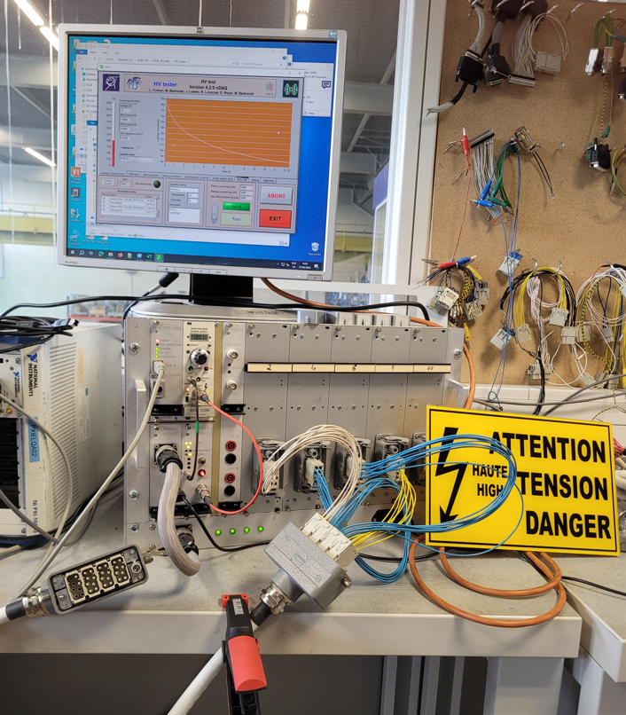
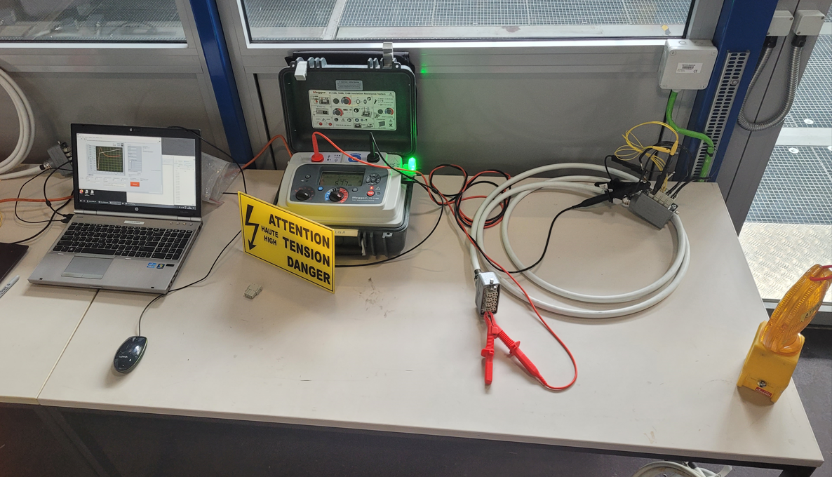
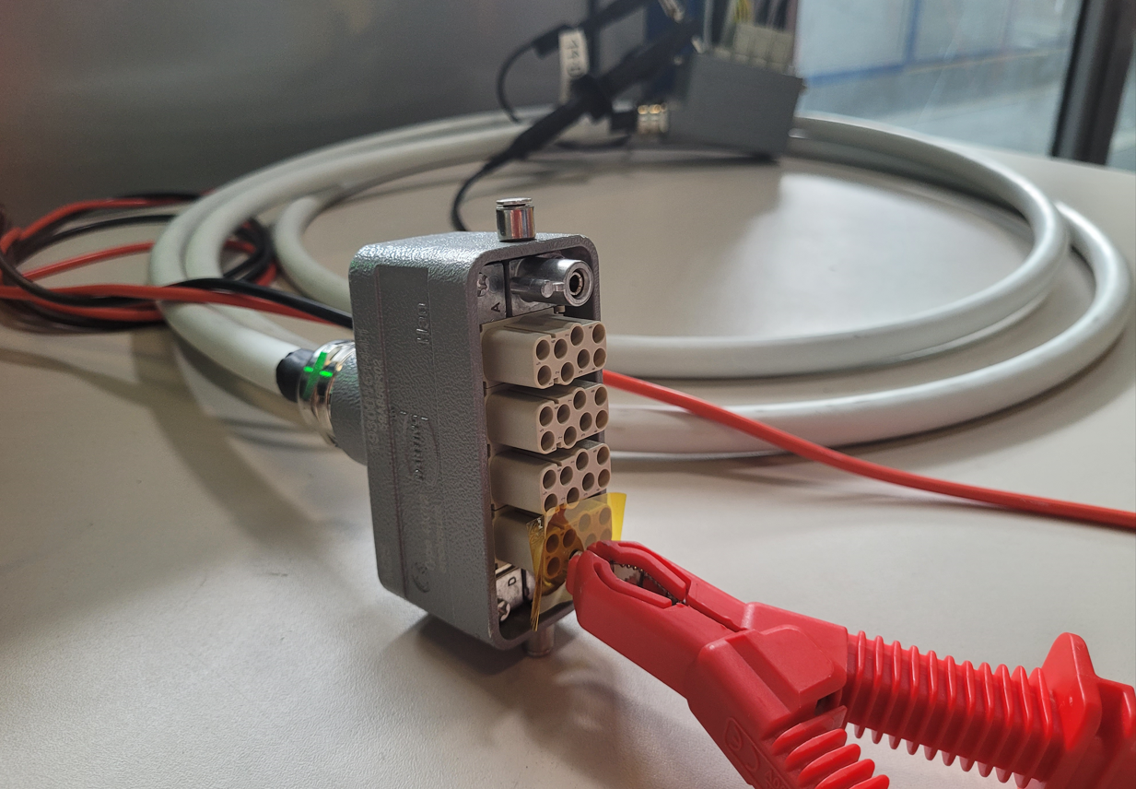
Test set-up
Megger S1-1568 was used with the help of a software application that allowed for a controlled ramp with a plateau and for storing the recorded data
Additional insulation at the level of female connectors: distances between pins are not suitable for voltages >5 kV
ELQA multichannel HV tester

Slide 4
A couple of examples of executed tests

Slide 5
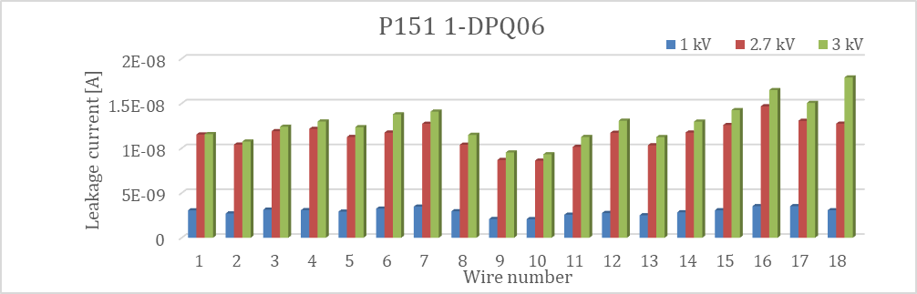
P151 1-DPQ06
Cable used: DRAKA CERN NE18 12W03.
The connectors have 4 modules of 8 pins. In module C there are only 2 pins, no pins in module D
Continuity: Cable is correctly wired 1-1. Shield continuity is correct
External insulation has a ‘spongy’ feel and does not inspire confidence
Good level of leakage currents
Both tested pins withstand 12 kV
Voltage | Date | Comments | Operator name | Temperature | Humidity
1 kV | 2024-05-30 11:38 | P151 1-DPQ06 | Mateusz | 27 | 42
2.7 kV | 2024-05-30 12:13 | P151 1-DPQ06 | Mateusz | 27 | 42
3 kV | 2024-05-30 14:35 | P151 1-DPQ06 | Mateusz | 27 | 42

Slide 6
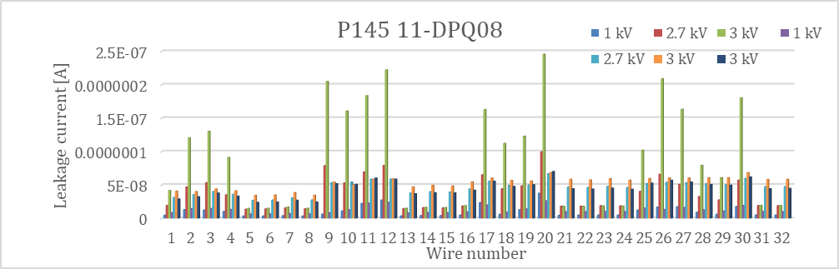
P145 11-DPQ08 (1/2)
Cable used: DRAKA CERN NE18 12W03.
The connectors have 4 modules of 8 pins. There are only 4 pins in modules A, B, C and 2 pins in module D.
Continuity: Cable is correctly wired 1-1. Shield continuity is correct.
All pins were HV tested – Offset of the test equipment can be assessed
Initially poor leakage currents, tests repeated 1 month later (after storage in ambient air in a warm lab), the leakage currents became very low.

Slide 7
P145 11-DPQ08 (2/2)
5 tested wires, all withstand >11.5 kV
Good insulation

Slide 8
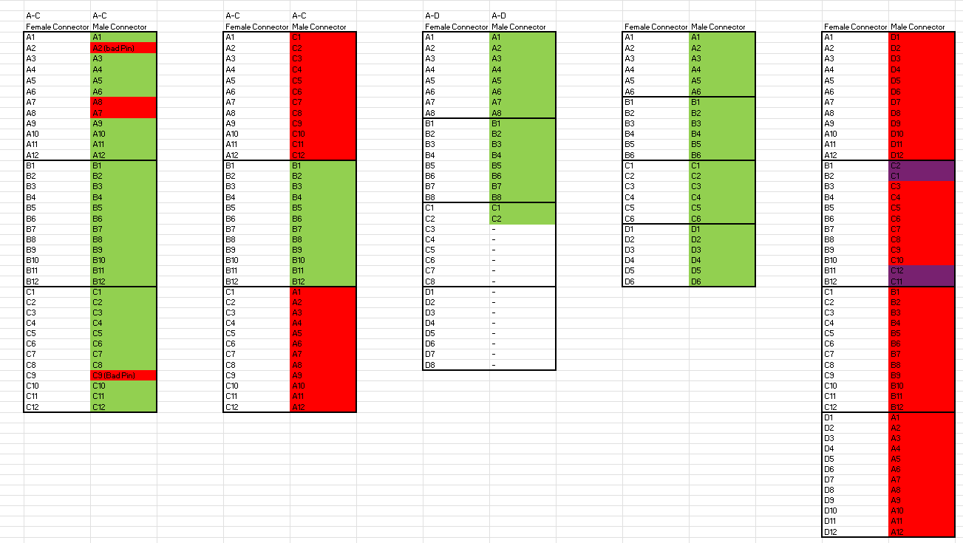
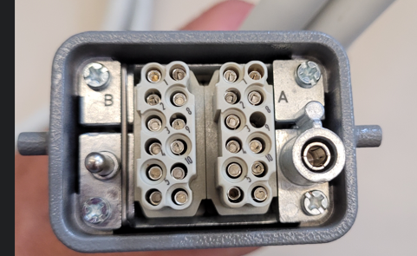
Continuity tests
Several types of continuity issues were identified:
  Recessed pins,
  Pins swapped
  Modules swapped

Slide 9
Summary of tests
Cable identifier | Cable used | Connectors | Continuity | HV
P151 1-DPQ06 | DRAKA CERN NE18 12W03 | 4x8 pin | OK | OK
P152 2-DPQ09 | CERN 04.10.20.140.4 NG18 2019/10 | 4x2 pin | OK | OK
P143 3-DPC04 | CERN 04.10.20.140.4 NE26 2022/10 | 4x8 pin | OK | OK
P144 4-DPC05 | CERN 04.10.20.140.4 NE26 2022/10 | 2x12 pin | Not OK | OK
P145 5-DPC05 | CERN 04.10.20.140.4 NE26 2022/10 | 2x12 pin | OK | Warning
P146 6-DPC06 | DRAKA CERN NE36 14w05 | 3x12 pin | Not OK | OK
P147 7-DPC06 | DRAKA CERN NE36 14w05 | 3x12 pin | Not OK | OK
P141 8-DPQ05 | DRAKA CERN NE18 12w03 | 4x8 pin | OK | OK
P149 9-DPQ04 | CERN 04.10.20.140.4 NE26 2022/10 | 4x6 pin | OK | OK
P150 10-DPQ13 | DRAKA CERN NE48 19w07 | 4x12 pin | Not OK | OK
P145 11-DPQ08 | DRAKA CERN NE18 12W03 | 4x8 pin | OK | Warning
P146 12-DPQ07 | DRAKA CERN NE18 12W03 | 3x8 pin | OK | OK
P147-1 13-DPQ12 | CERN 04.10.20.140.4 NE26 2022/10 | 4x8 pin | OK | OK
P147-2 14-DPQ03 | CERN 04.10.20.140.4 NE26 2022/10 | 4x8 pin | Not OK | OK
P148-1 15-DPQ11 | DRAKA CERN 12W03 NE18 | 3x8 pin | Not OK | OK
16 | DRAKA CERN 12W03 NE18 | 3x8 pin | OK | OK
P143 17 | DRAKA CERN NE36 14w05 | 4x8 pin | Not OK | OK
P143 18 | DRAKA CERN NE36 14w05 | 4x8 pin | OK | OK
P143 19-DPQ10 | DRAKA CERN NE36 13W41 | 4x8 pin | Not OK | Warning
P143 20 | DRAKA CERN NE36 14w05 | 4x8 pin | Not OK | OK
P221 21-DPH04 | CERN 04.10.10.571.6 2022. Black colour. | 1x4 pin + 2x3 pin | OK | Warning
P221-1 22 | CERN 04.10.10.571.6 2022. Black colour. | 1x4 pin + 2x3 pin | OK | Warning
23-DPV12 | DRAKA CERN NE36 13W41 | 1x32 pin | OK | -

Slide 10
Conclusion
The continuity is largely incorrect: out of 23 cables 9 are non-conform. Several types of issues were detected.
The cables need to be retested before they are put in service.
Based on tests of all wires at 1 kV, 2.7 kV and 3 kV one can conclude that the cables have a sufficient insulation margin for the use in the HL-LHC installation. The leakage currents introduced by the cables are very low for most of the cables.
In all cases where the leakage current seemed to be relatively high, the cables did not show any anomaly during the subsequent test at higher voltages. Therefore, these single cases are not considered to be a problem.
The limits of the insulation were tested on multiple cables. The limits are well above 10 kV, except for the cables equipped with 12 pin modules where the voltage level reached was at the level of 6 kV. The weak point being the distance between pins in Harting connectors (on the inside or outside of the housings).
The observed breakdowns never led to a degradation, meaning that no carbon path was created. The breakdowns never happened at the level of the cable insulation and tests executed on bare cable samples every time reached 15 kV.
This means that the test levels required by the EDC document are not excessive and will not cause the insulation to age or lose its properties.
The only caveat is that the tested cables seem to originate from old stocks and might not be fully representative for the new HL-LHC installations, where dedicated sample tests need to be carried out.

