Slide 2
Hysteresis losses in EuroCirCol: model and measurements
Susana Izquierdo Bermudez
26/09/2024

Slide 3
Outline
Introduction
EuroCirCol case study
Conclusions

Slide 4
Outline
Introduction
EuroCirCol case study
Conclusions

Slide 5
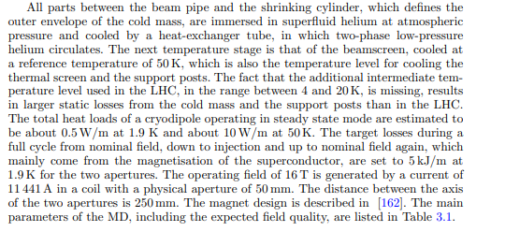
Introduction
Goal: re-call the origin of the 5 kJ/m of magnetization loss that we wrote in the FCC-hh conceptual design report (2017-2018)
FCC-hh Conceptual design Report (Page 836)

Slide 6
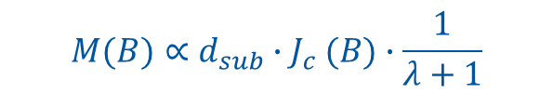
Magnetization loss
AC losses are dominated by the persistent current effects (with cored cables inter-strand and inter-filament currents are negligible for the typical ramp of this kind of magnets). Magnetization loss mainly depends on:
  Filament size and geometry
  Critical current of the superconductor.
    For low external field, the critical current density is larger and therefore the induced magnetization is larger
    For higher temperature, the current density is lower and therefore the induced magnetization is lower
$$M(B)∝d_{sub}{∙J}_{c}(B)∙\frac{1}{λ+1}$$

Slide 7
Magnetization loss
Here we always report on the total dissipated energy from nominal field, down to injection and up to nominal field again
  The power will depend on the ramping time.
Due to the larger strand magnetization at low field, most of the energy is deposited at the end of the ramp down and beginning of the ramp up.
Example of the total computed hysteresis energy loss for a typical current profile in the 11 T single aperture magnet.

Slide 8
Magnetization modelling
Loss per cycle per aperture
Semi-analytical hysteresis model implemented in ROXIE, benchmarked against HL-LHC short model magnets (11 T and MQXF), some details in EDMS 2036614.
The model typically over-estimates the AC loss at low current by 25 %
Comparison between the measured and computed hysteresis loss
Magnet | I_{min} [kA] | I_{max} [kA] | W_{hyst} [kJ] Measured | W_{hyst} [kJ/m] Measured | W_{hyst}[kJ/m] Model | Error [%]
MBHSP102 | 0.1 | 6 | 3.86 | 2.27 | 3.01 | 25
MBHSP102 | 6 | 11.85 | 2.29 | 1.35 | 1.27 | -6
MQXFS5 | 0.2 | 8.2 | 5.48 | 4.57 | 6.00 | 24
MQXFS5 | 8.2 | 16.5 | 3.49 | 2.91 | 2.80 | -4
MBHSP107 | 0.1 | 6 | 3.88 | 2.28 | 3.01 | 24
MBHSP107 | 6 | 11.85 | 2.20 | 1.29 | 1.27 | -2

Slide 9
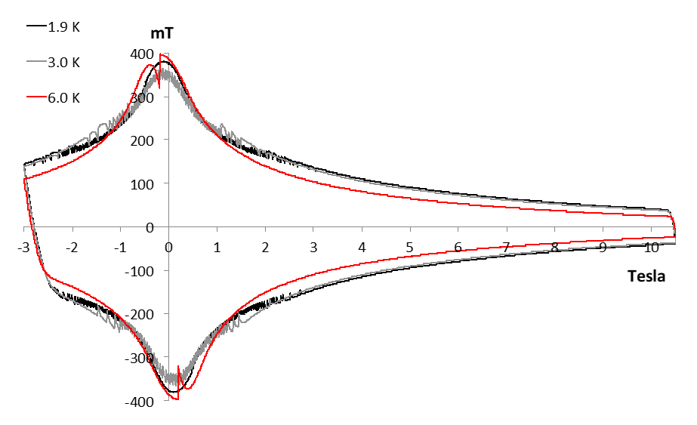
Magnetization modelling
State of the art Nb₃Sn wires, below 3 T there are flux jumps which limit the conductor magnetization.
  At 1.9 K, the jumps are continuous, and their amplitude gets smaller and smaller when reducing the field.
  When increasing the temperature there are fewer jumps with larger amplitude.
This is the source of the 25 % overestimation of the magnetization loss at low current
Magnetization of a MQXF RRP wire at different temperature levels. Measurements courtesy of D. Richter, image courtesy of B. Bordini.
Strand magnetization, model vs measured
Comparison between the measured and computed hysteresis loss
Magnet | I_{min} [kA] | I_{max} [kA] | W_{hyst} [kJ] Measured | W_{hyst} [kJ/m] Measured | W_{hyst}[kJ/m] Model | Error [%]
MBHSP102 | 0.1 | 6 | 3.86 | 2.27 | 3.01 | 25
MBHSP102 | 6 | 11.85 | 2.29 | 1.35 | 1.27 | -6
MQXFS5 | 0.2 | 8.2 | 5.48 | 4.57 | 6.00 | 24
MQXFS5 | 8.2 | 16.5 | 3.49 | 2.91 | 2.80 | -4
MBHSP107 | 0.1 | 6 | 3.88 | 2.28 | 3.01 | 24
MBHSP107 | 6 | 11.85 | 2.20 | 1.29 | 1.27 | -2

Slide 10
Outline
Introduction
EuroCirCol case study
Conclusions

Slide 11
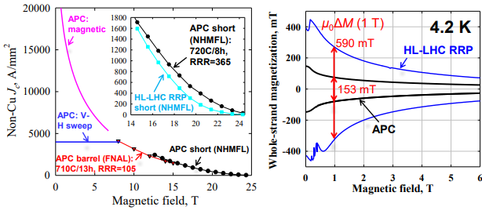
Conductor – cases studied
FCC targets: D_{eff} = 20 μm; J_{c} > 1500 A/mm² at 16 T , 4.2 K
Cases studied* | µ₀∆M (1 T, 1.9 K), mT
D_{eff} = 50 μm, grain boundary | 590
D_{eff} = 20 μm, grain boundary | 150
D_{eff} = 20 μm, artificial pinning | 60
Cases studied in 2017
Xingchen Xu, APC in Nb3Sn, 2024 (short UL)
*For details on conductor parameters, see additional slides

Slide 12
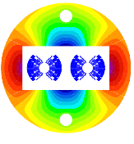
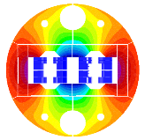
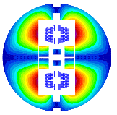
Magnet design
Estimates were done for the EuroCirCol 16 T magnet designs
  Operation field 16 T, with 14 % margin in the load line at 1.9 K and graded (w_{eq} ≈ 50 mm)
  For details, see EDMS 2036614.
Magnetic cross section of the cosθ [2], block [3] and common-coil [4] designs.
[1] Tommasini, Status of the 16 T Dipole Development Program for a Future Hadron Collider, IEEE Transactions on Applied Superconductivity ( Volume: 28, Issue: 3, April 2018 )
[2] V. Marinozzi et al. "Conceptual design of a 16 T cosθ bending dipole for the future circular collider" IEEE Transactions on Applied Superconductivity ( Volume: 28, Issue: 3, April 2018)
[3] C. Lorin M. Durante H. Felice M. Segreti " Design of a Nb 3 Sn 16 T block dipole for the future circular collider " IEEE Transactions on Applied Superconductivity ( Volume: 28, Issue: 3, April 2018 )
[4] 10. F. Toral J. Munilla "Magnetic and mechanical design of a 16 T common coil dipole for FCC" IEEE Transactions on Applied Superconductivity (Volume: 28, Issue: 3, April 2018 )

Slide 13
Magnet design – main parameters
With respect the HL-LHC 11 T magnet, the 16 T EuroCirCol dipoles had:
  2 times more superconductor
  50 % higher Non-Cu J_{c}
If we use HL-LHC conductor in terms of D_{eff} but with higher J_{c}, to the first order one expects ≈ 3.8 kJ/m/aperture * 2 apertures * 2 * 1500/1000 ≈ 23 kJ* (≈ 19 kJ if we account for the lower magnetization at low field due to the flux jumps)
 |  | MQXF | 11 T | Block CEA |  | Cos-theta INFN |  | BOND
 |  | HL-LHC |  | 2017 (EuroCirCol) |  | 2017 (EuroCirCol) |  | 2024 (HFM)
 |  |  |  | HF | LF | HF | LF
Strand diameter | mm | 0.85 | 0.7 | 1.1 | 0.7 | 1.1 | 0.7 | 1.1
Cu to non-copper ratio |  | 1.2 | 1.15 | 0.8 | 1.6 | 0.85 | 2.15 | 0.9
Non-Cu Jc @ 16 T 4.2 K | A/mm² | 1000 | 1000 | 1500 | 1500 | 1500 | 1500 | 1200
Number of turns per coil |  | 50 | 56 | 24 | 90 | 34 | 68 | 52
equivalent coil width, mm | mm | 37 | 29 | 54 |  | 49 |  | 57
Total area of superconductor/aperture | mm² | 4127 | 1604 | 3295 |  | 2733 |  | 4578
Nominal current | A | 16230 | 11850 | 10930 | 10930 | 11180 | 11180 | 19380
Nominal field | T | n.a. | 11.2 | 16 |  | 16 |  | 14
Peak field | T | 11.3 | 11.6 |  |  |  |  | 14.5
Engineering Current Denisty | A/mm² | 715 | 770 | 479 | 728 | 535 | 807 | 463
Overall Current Denisty | A/mm² | 462 | 522 | 316 | 463 | 370 | 511 | 313
Ratio LF/JF Joverall |  | n.a. | n.a. | 1.47 |  | 1.38 |  | n.a.
*2 apertures full cycle down from nominal current to injection and back to nominal

Slide 14
Results
With the detailed model in ROXIE, and assuming a reset current of 100 A, one is not far from the expected 20 kJ/m, and is weakly dependent on the coil geometry
  Remember the model over-estimates the loss by 15-20 % with the state-of-the-art conductor and its behavior in terms of flux jumps.
Coil lay-out |  | Cos-theta | Block | Common Coil
D_{eff} | µm | 50
Strand Technology |  | Grain Boundary
µ₀∆M (1 T, 1.9 K) | mT | 590
Reset Current | A | 100 | 100 | 100
Magnetization-loss (2 apertures) | kJ/m | 18 | 20 | 23
Magnetization-loss/A_{sc} | J/cm³ | 4.7 | 4.6 | 4.8

Slide 15
Results – sensitivity to conductor layout
We studied different cases in terms of effective filament size and ‘strand technology’
5 kJ/m for a full ramp of magnetization loss for the two apertures for a full cycle from nominal to injection current and back to nominal was considering a reasonable target
  With the conductor we have today, the loss is 4 times more, but there are developments on going at the level of the conductor giving promising results.
D_{eff} (HF/LF) | µm | 50/50 | 50(HF)/20(LF) | 20/20 | 20/20
Coil lay-out |  | Cos-theta | Cos-theta | Cos-theta | Cos-theta
Strand technology |  | Grain Boundary |  |  | Artificial pinning
µ₀∆M (1 T, 1.9 K) | mT | 590 | 590/150 | 150 | 60
Reset Current | A | 100 | 100 | 100 | 100
Magnetization-loss (2 apertures) | kJ/m | 18 | 14 | 8 | 3

Slide 16
Outline
Introduction
EuroCirCol case study
Conclusions

Slide 17
Conclusions
Based on ‘state of the art conductor’ (50 µm D_{eff}, FCC Jc target) is ≈ 20 kJ/m for the 2 apertures, for a full cycle form nominal to injection and back to nominal.
  This estimate is conservative, in state-of-the-art Nb₃Sn wires, below 3 T there are flux jumps which limit the conductor magnetization. Based on our experience with HL-LHC magnets the loss is 15-20 % lower than estimated with the model.
5 kJ/m was set as a reasonable target for FCC to dimension the cryogenic system, reachable if the developments at the level of the conductor towards smaller filaments with lower magnetization are successful
  Note that if 5 kJ/m is not reach, one can still play with the ramp-up and ramp-down time to have the same power.

Slide 19
Assumptions on conductor properties
Pinning method | Grain Boundary | Grain Boundary | Point Pinning
Effective filament diameter, D_{eff} [µm] | 50 | 20 | 20
p [--] | 0.5 | 0.5 | 1
q [--] | 2 | 2 | 2
T_{c0} [K] | 16 | 16 | 16
B_{c20}[T] | 29.38 | 29.38 | 29.38
α | 0.96 | 0.96 | 0.96
C₀[A/mm²T] | 1.03*267845 | 1.03*267845 | 1.03*338485
Cabling degradation [%] | 3 | 3 | 3

