Slide 1
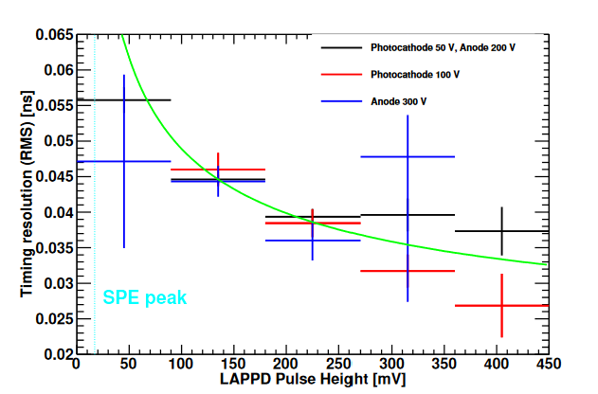
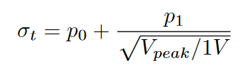
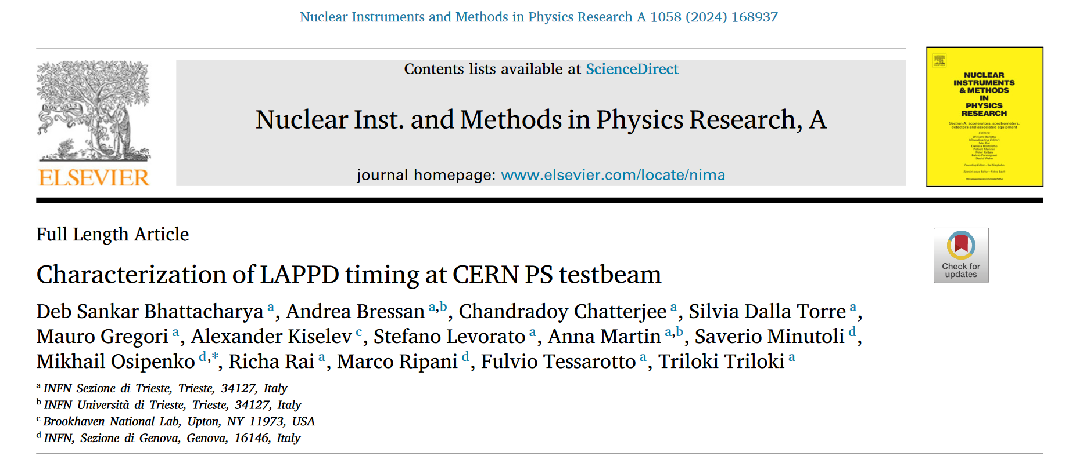
LAPPD studies by INFN-TS group - HIGHLIGHTS
Timing characterization at test beam, analysis finalized and data published
Single photon time resolution: 75 ps
Asymptotic limit for large amplitude (multiple detected photons) : 18 ps

Slide 2
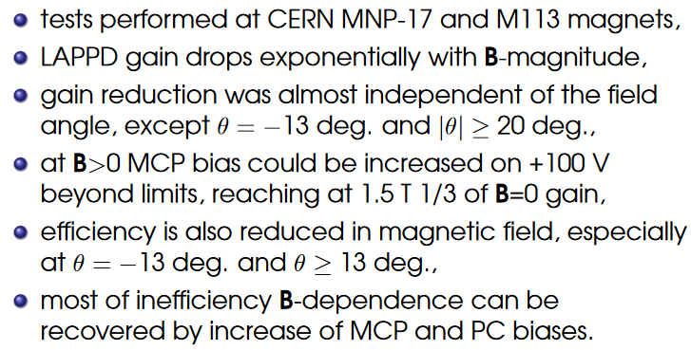
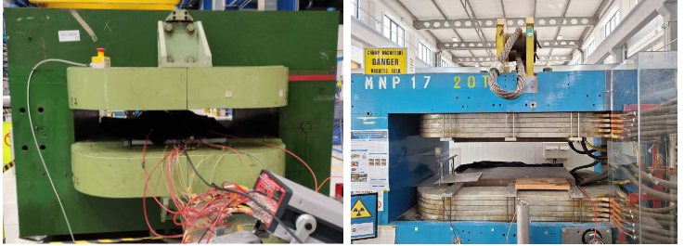
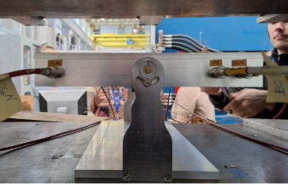
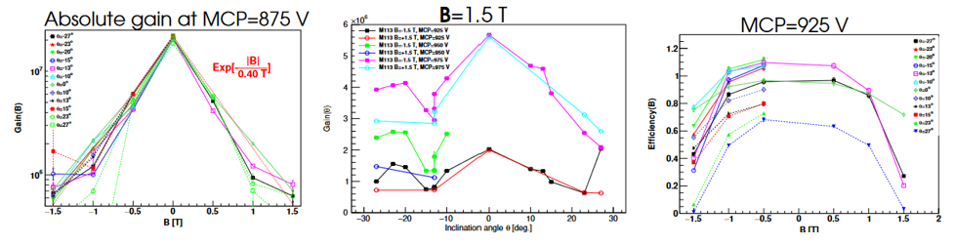
LAPPD studies by INFN-TS group - HIGHLIGHTS
LAPPD performance in magnetic field
First campaign with field intensity up to 0.5 T (November 2023)
Second campaign with field intensity up to 1.5 T (March 2024)
  LAPPD renting could be prolonged thanks to 2024 financial support
NIMA publication on the way !

Slide 3
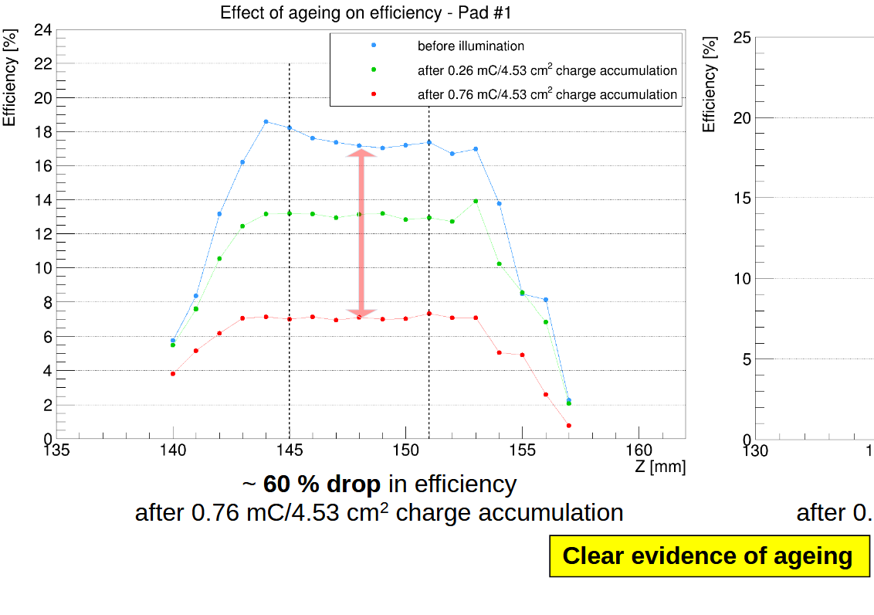
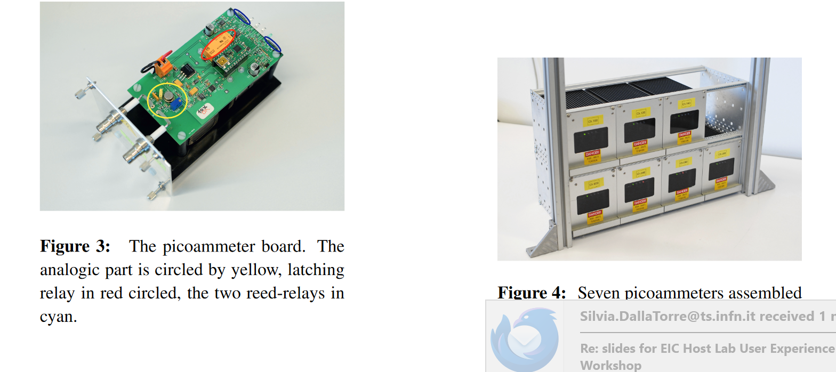
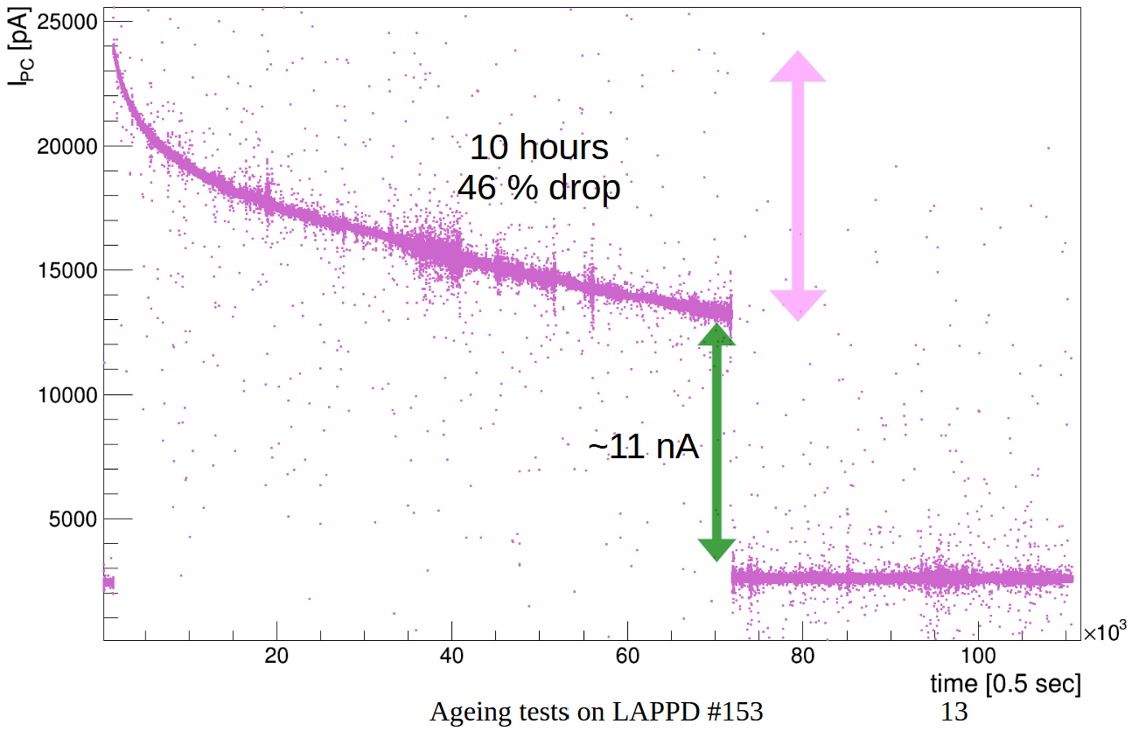
LAPPD studies by INFN-TS group - HIGHLIGHTS
LAPPD ageing studies, preliminary as preparatory exercise for the HRPPD ageing studies (when an HRPPD will become available at INFN) (possible thanks to rental prolongation)
  Ageing studies illuminating a group of 4 (6 x 6) mm² pads
    A second group of pads of 4 pads used as detector performance control
  A characterizing aspect of our approach:
    thanks to the availability of fully floating picoampermeters (custom RHIP: http://dx.doi.org/10.22323/1.322.0068 ) we can measure the current at the photocathode and, therefore, directly monitor the number of extracted photoelectrons; this approach makes possible the direct extrapolation of the ageing studies to the experiment needs
Illumination ON
Before ageing
After 1.6 x 10¹⁵ photoel.s
1.5 C at anode
RHIP
Efficiency Monitor
INTEGRAL:
31 x 10¹⁴ p.e.
Illumination
OFF
After 4.7 x 10¹⁵ photoel.s
4.8 C at anode

Slide 4
LAPPD studies by INFN-TS group –
activity completion in 2025
An HRPPD will be available at Trieste towards the end ageing studies
  Jlab property, we only pay transportation and customs procedure
Goals:
  Ageing studies
  Performance in magnetic field
NOTE
  This activity had to be moved to 2025 because od the late availability of an HRPPD unit

