Slide 1
Research and Training Programs for US ATLAS Graduate Students
Joe Haley (Oklahoma State U.)
On behalf of US ATLAS

Slide 2
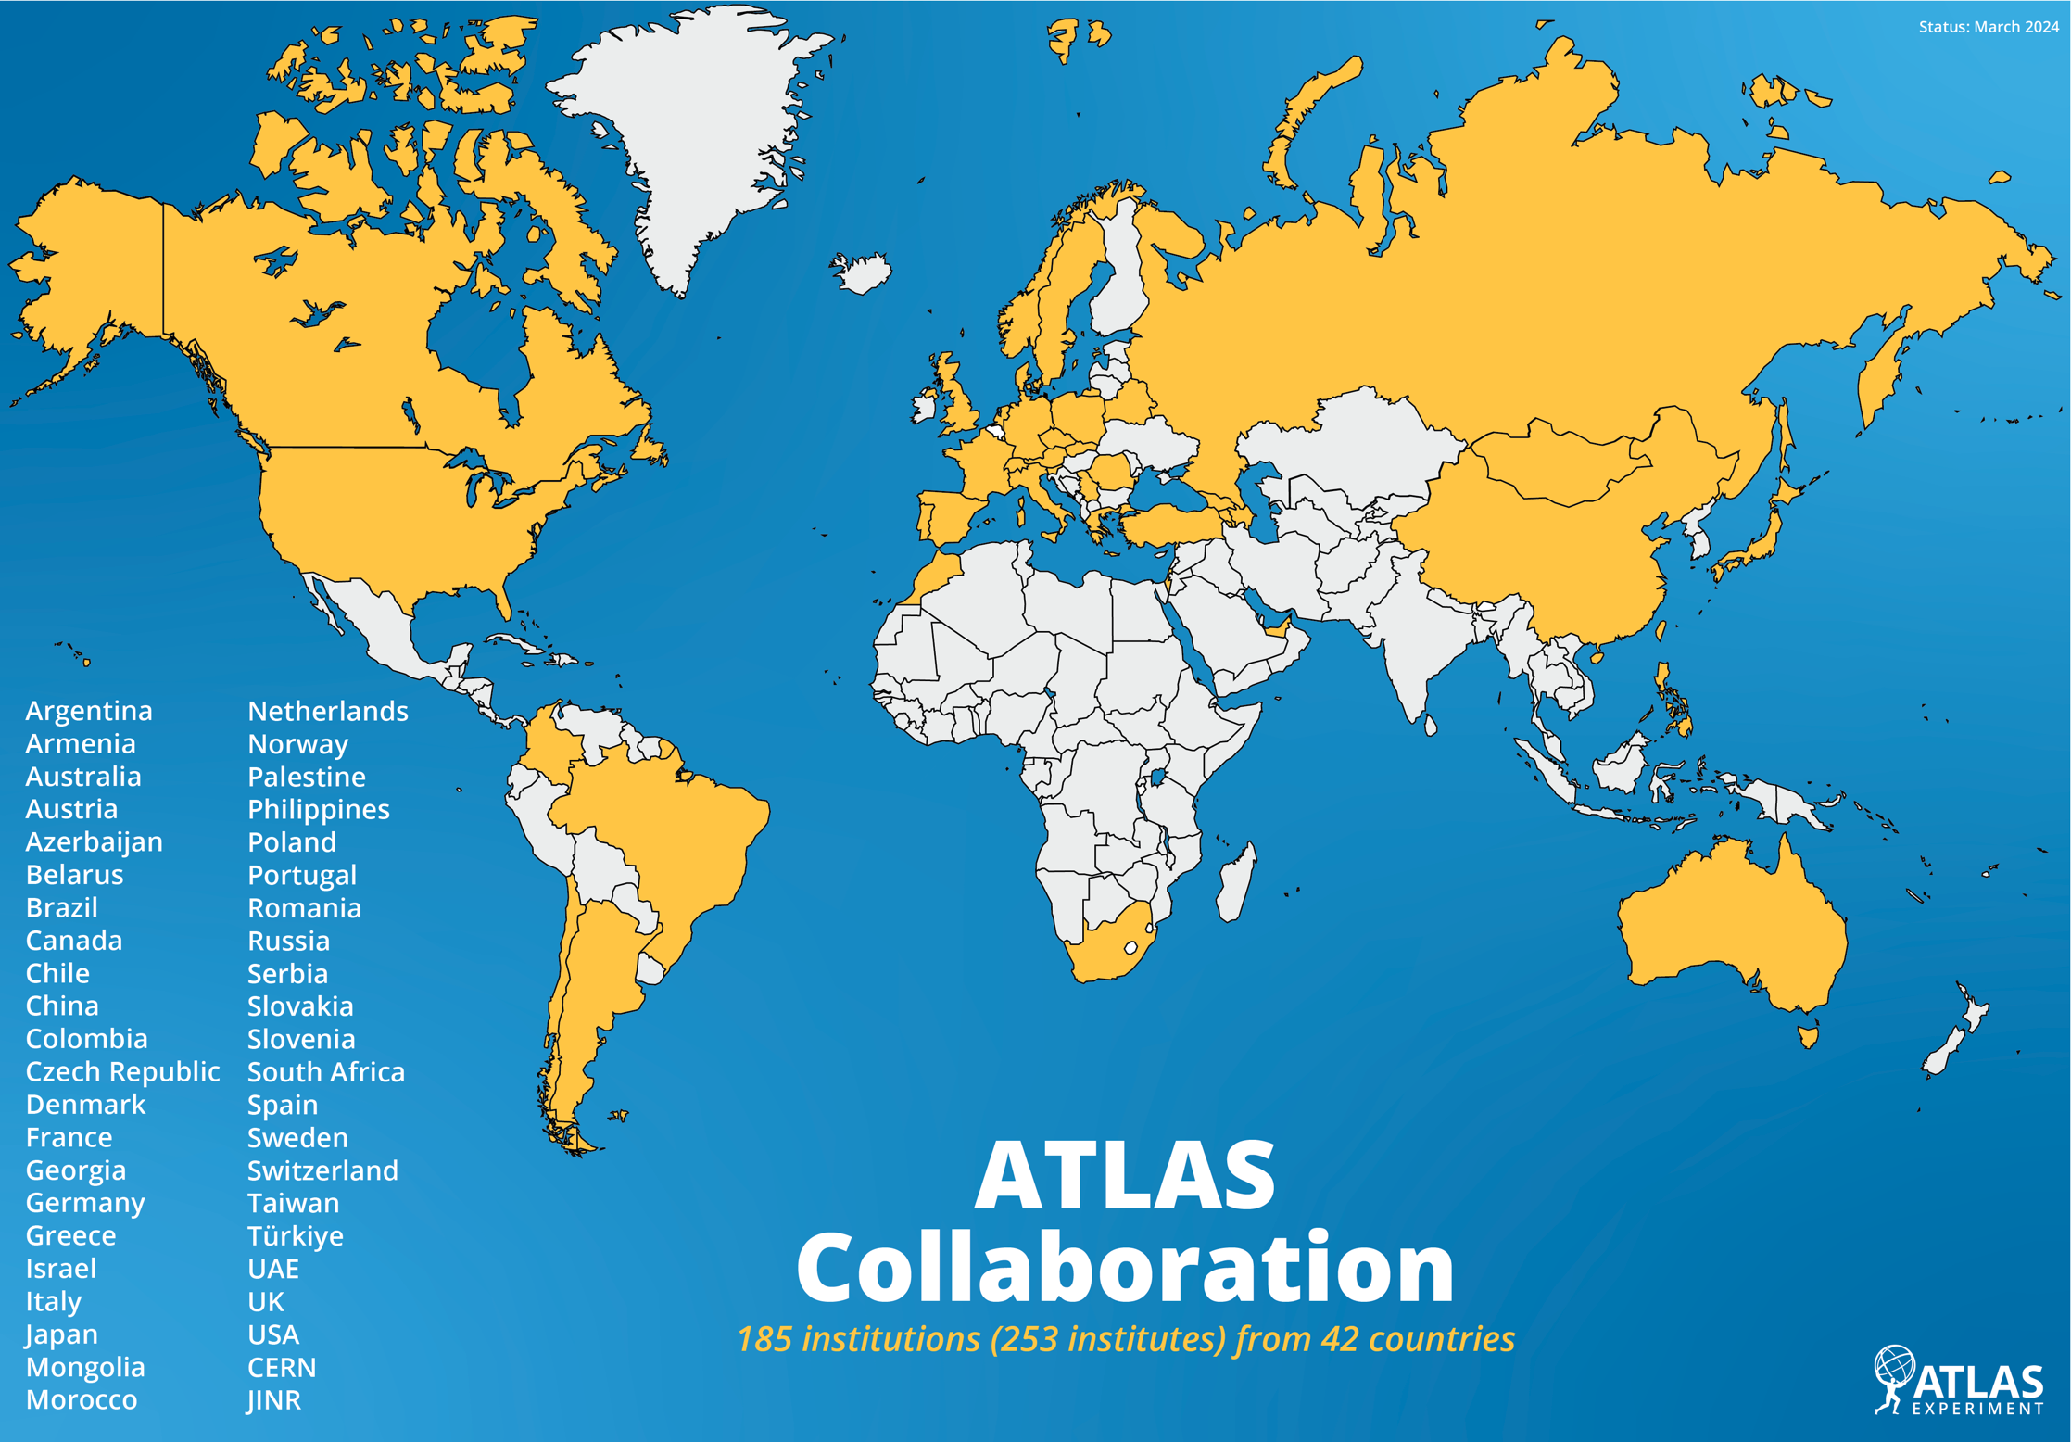
Overview of ATLAS & US ATLAS
ATLAS
253 Institutes from 42 Countries and 20 clusters, plus 17 Associate institutes and 15 Technical Associate Institutes
US ATLAS
39 institutes and 7 Associate Institutes
Argonne (ANL), Arizona, UT
Argonne (ANL), Arizona, UT Arlington, UT Austin, Berkeley, LBNL, Boston, Boulder, Brandeis, Brookhaven (BNL), Chicago, Columbia, Duke, CalState Consortium (East Bay, Sacramento, Stanislaus), Harvard, Indiana, Iowa, LLNL, Louisiana Tech, Louisville, U Mass Amherst, Michigan, Michigan State, NYU, New Mexico, Northern Illinois, Ohio State, Oklahoma, Oklahoma State, Oregon, Pennsylvania, Pittsburgh, SLAC, UC Santa Cruz, Washington, Washington College, SMU, Stanford, Stony Brook, Tufts, UC Irvine, UI Urbana Champaign, Westmont College, Wisconsin, Yale

Slide 3
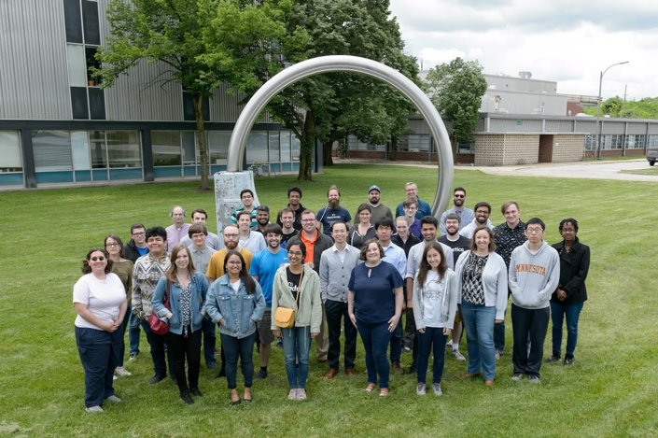
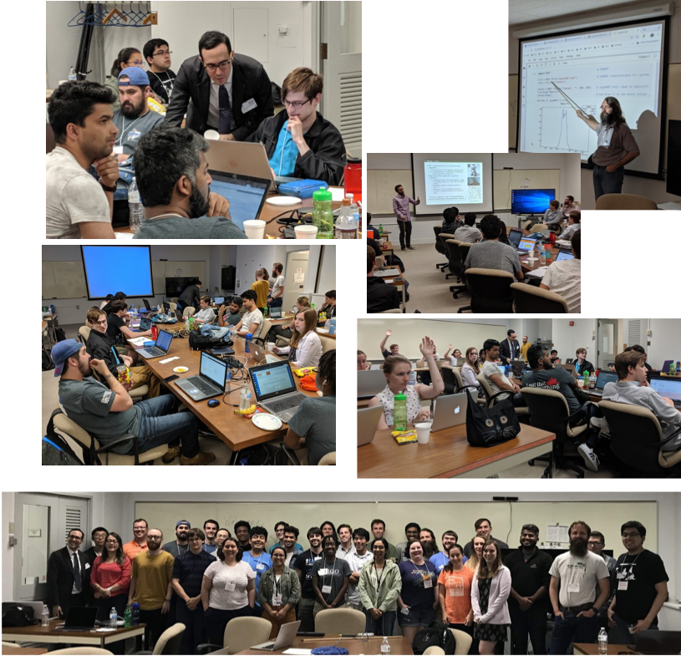
CAMPFIRE
Brings together new US ATLAS graduate students
  Introduction to ATLAS Detector, Software, Statistics, Communication, …
  Connection/community building
Frist edition in 2019
  June 9-15 at ANL (indico.cern.ch/event/811577/)

Slide 4
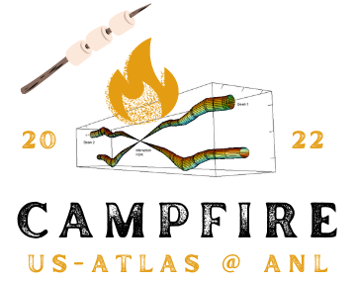
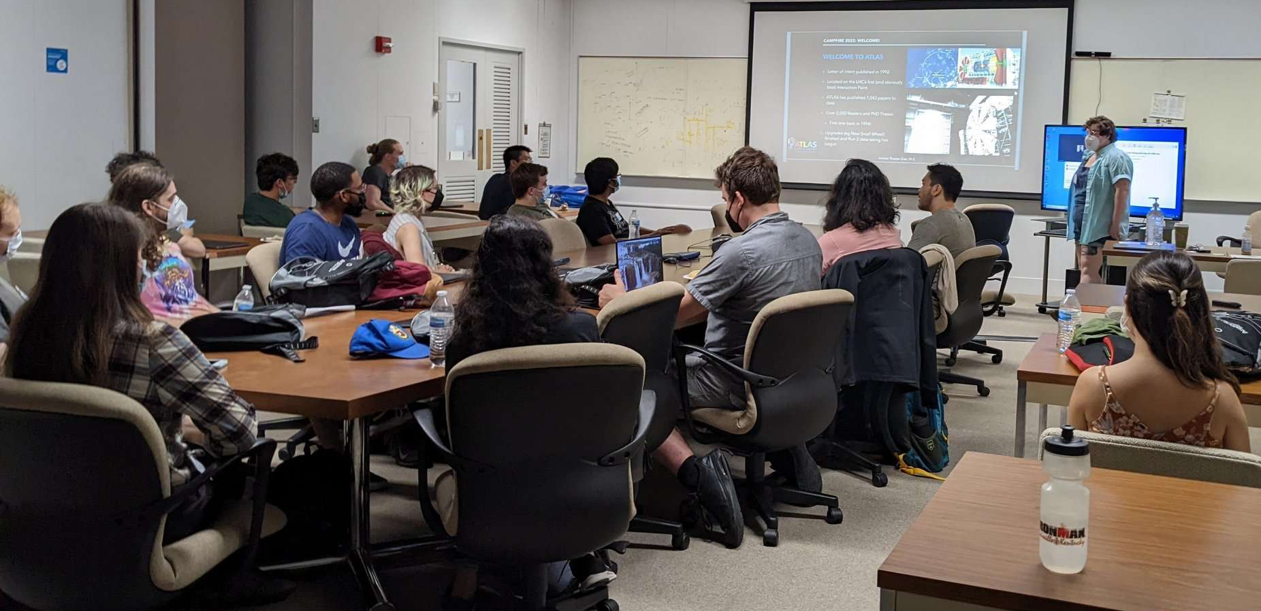
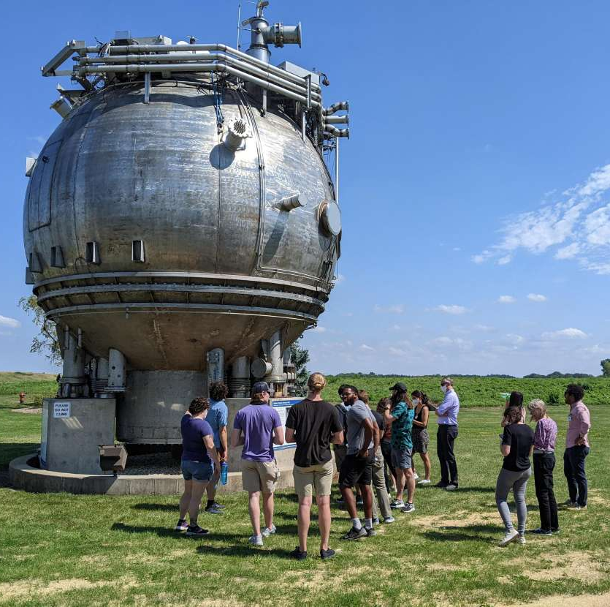
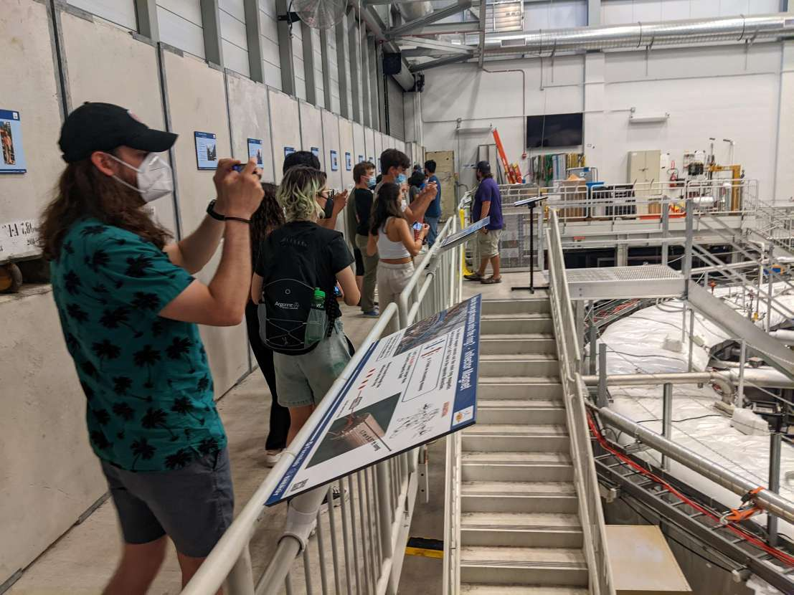
CAMPFIRE
Brings together new US ATLAS graduate students
  Introduction to ATLAS Detector, Software, Statistics, Communication, …
  Connection/community building
Frist edition in 2019
  June 9-15 at ANL (indico.cern.ch/event/811577/)
CAMPFIRE 2022
  Aug. 1-6 at ANL (www.usatlas.org/event/campfire-2023)
  ATC Training Event at ANL (PI Walter Hopkins)
    23 students, ATC support for reg/travel/lodging

Slide 5
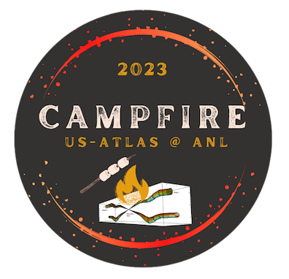
CAMPFIRE
Brings together new US ATLAS graduate students
  Introduction to ATLAS Detector, Software, Statistics, Communication, …
  Connection/community building
Frist edition in 2019
  June 9-15 at ANL (indico.cern.ch/event/811577/)
CAMPFIRE 2022
  Aug. 1-6 at ANL (www.usatlas.org/event/campfire-2022)
  ATC Training Event at ANL (PI Walter Hopkins)
    23 students, ATC support for reg/travel/lodging
CAMPFIRE 2023
  July 9-15 at ANL (www.usatlas.org/event/campfire-2023)
  ATC Training Event at ANL (PI Walter Hopkins)
    20 students, ATC support for
      Lodging at ANL during workshop
      Partial support for travel and registration

Slide 6
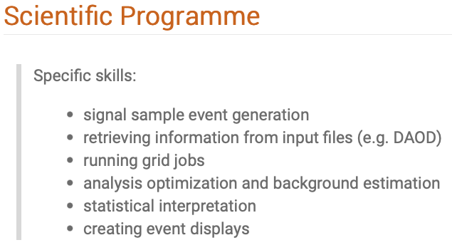
US ATLAS Computing Tutorials
Aimed at new US ATLAS students and postdocs
    Teach basic ATLAS analysis tools by reproducing an actual ATLAS analysis
    Introductory material for physics
    principles, followed by hands-on
    activities to implement ATLAS
    methods
    Travel and housing for 23 students
2021 Computing Bootcamp
  October 18-20 at SLAC + remote (indico.cern.ch/event/1075740)
2022 How to do Analysis beginning to end
  October 10-12 at SLAC + remote (indico.cern.ch/event/1181243)
2023 How to do ATLAS analysis – a hands on tutorial
  October 9-12 at SLAC + remote (indico.cern.ch/event/1309794)

Slide 7
Other Training Events
Machine Learning Training Workshop
  Developed and organized by Aishik Ghosh (UC Irvine), Elham E Khoda (U. Washington), Ben Nachman (LBNL)
Machine Learning Training 2022 (first edition):
  July 27-30 at LBNL (indico.cern.ch/event/1169324)
  20 in-person and 80 remote participants (+ recorded for longevity)
Machine Learning Training 2023
  July 25-28 at LBNL (indico.cern.ch/event/1264566)
  28 in-person and 60+ remote registered as of June 24
  Main ATC support:
    Housing at ANL for in-person participants and non-local organizers/instructors
    (Partial) travel for students and organizers/instructors
    Intro to Machine Learning
    Intro to Scikit-learn, XGBoost (hands-on)
    Intro to NNs with Keras (hands-on)
    Overview of ML in particle physics
    Practitioners guide to handling particle physics datasets
    Uncertainty treatment
    Simulator Based Inference
    Unfolding
    Exploiting symmetries in physics data (hands-on)
    Graph NNs in particle physics (hands-on)
    Anomaly detection (hands-on)
    Deploying NNs in C++: ONNX Runtime (hands-on)
    Deploying NNs on fast hardware: HLS4ML (hands-on)

Slide 8




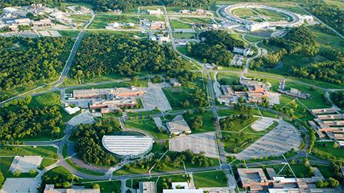
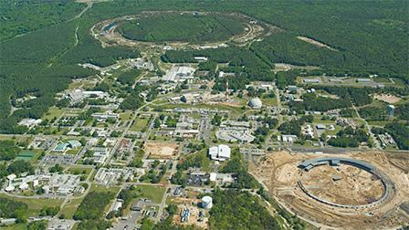
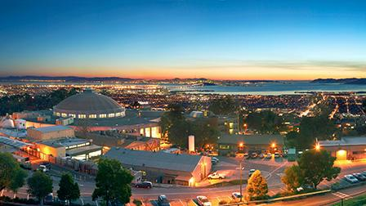
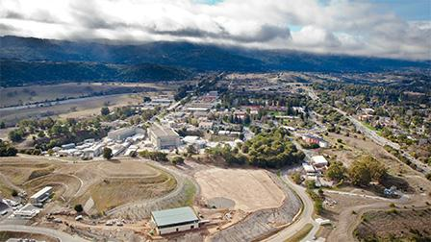




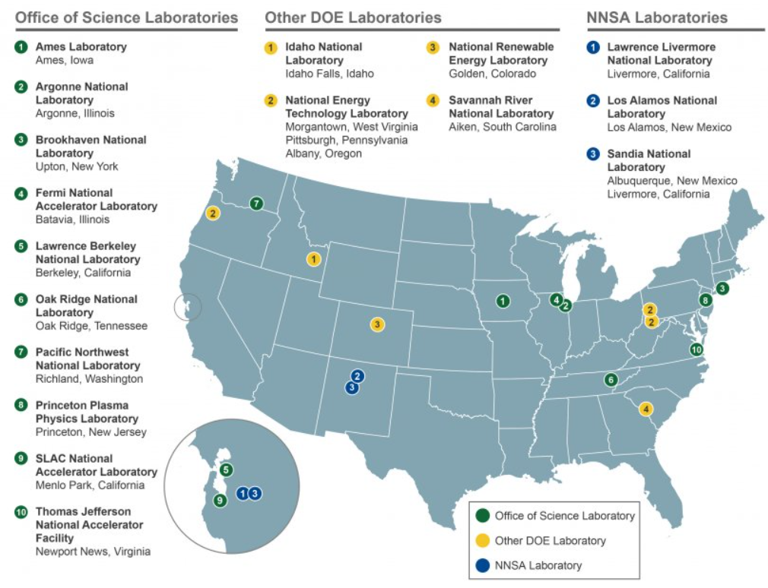
ATLAS Technical Center (ATC)
ANL
W. Hopkins (lab)
F. Rizatdinova (uni)
BNL
V. Cavaliere (lab)
M. Morii (uni)
LBNL
T. Heim (lab)
L. Jeanty (uni)
SLAC
C. Young (lab)
K. Grimm (uni)
Bay Area
Travel & COLA for work at the labs
(about $1500 per month)
Duration can be anywhere
from 1 week to 1 year
Labs still have various levels of restrictions, but ATC contacts have been very effective in helping our students and postdocs retain access to their work.
8

Slide 9
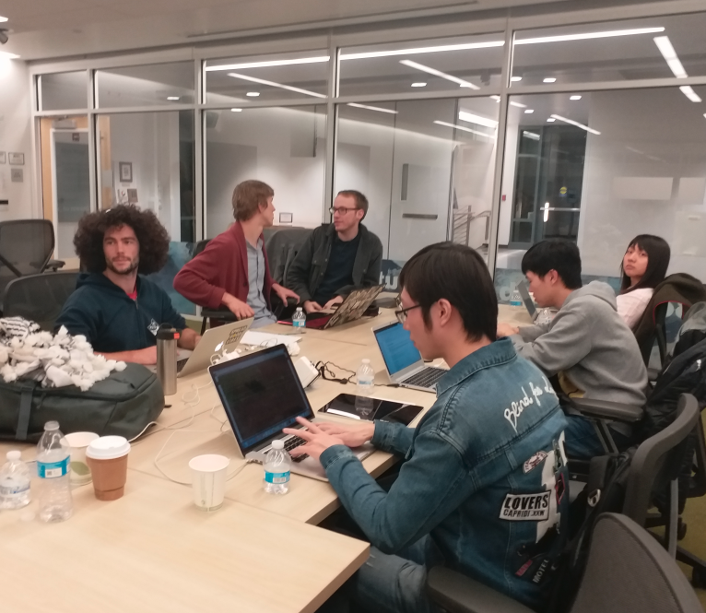
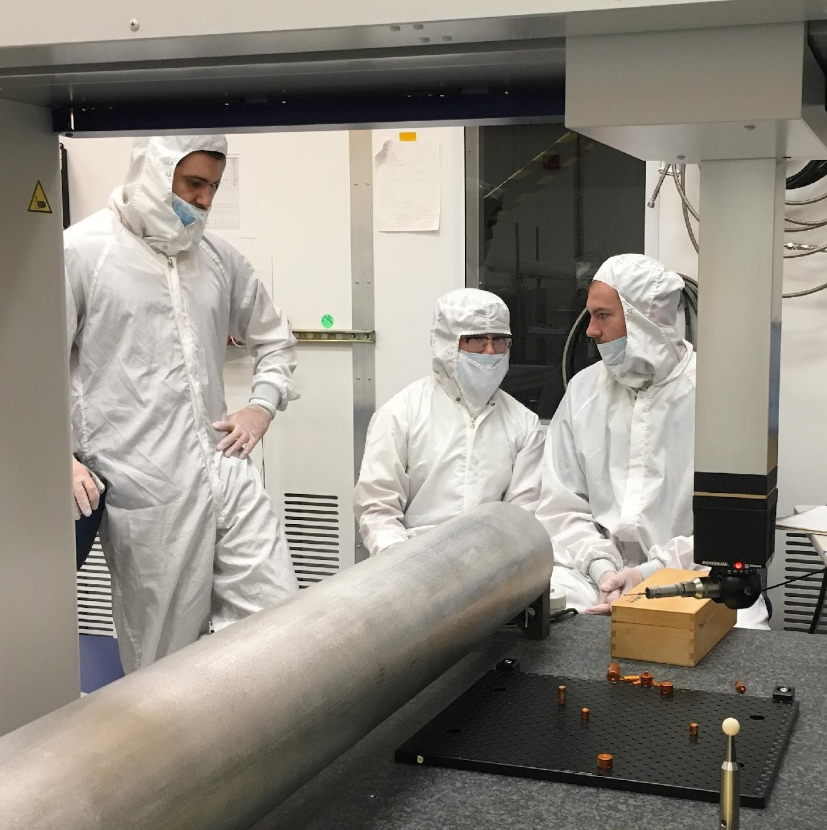
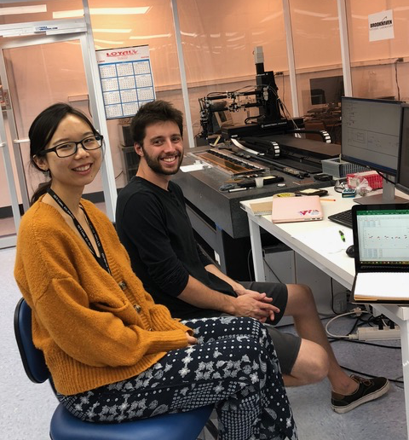
ATC Program
https://www.usatlas.org/atlas-center-atc
US ATLAS funding to support people and activities at the national laboratories, including:
  Direct support for students and postdocs based at (or traveling to) the national labs for ATLAS research
  Educational programs: tutorials, bootcamps, workshops, lecture series
Broad focus covering all
aspects of ATLAS program
  Physics analysis
  Computing and software
  Performance tools
  R&D hardware and electronics
  Qualification tasks

Slide 10
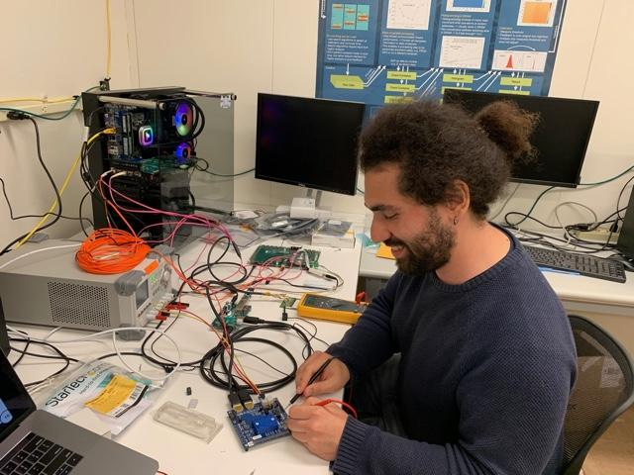
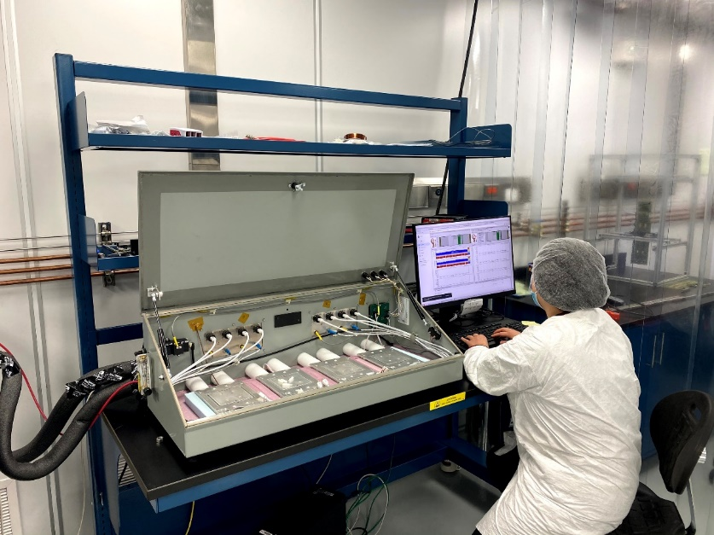
ATC Program
Two “tracks” for proposals:
  Direct support for research collaboration
    Proposal submitted by student/postdoc
    Must have a lab supervisor
  Education and training programs
    Proposal submitted by primary organizer
    Not required to be physically at a lab, but strongest proposals will leverage lab/ATC resources (facilities, people, etc)
Deadline for guaranteed review once each year in fall (then rolling review as funding allows)
  Call for proposals sent out by email
  How to apply: www.usatlas.org/how-submit-atc-proposal

Slide 11
ATC Proposal Guidance
Direct Support:
  Priority given to students/postdocs who have not accessed ATC funding before, and/or who will learn new skills through proposed work.
  How will supported individual contribute to US-ATLAS facilities more broadly (at 5-10% of ATC-supported time).
    Helping with ATC educational program, develop docs for Shared T3s, …
Educational Programs:
  Be sure to include any costs needed for accessibility (e.g. captioning)
General Guidance:
  Reviewers will look at how the proposed work supports a diverse and inclusive culture within US-ATLAS.
  Best-reviewed proposals leverage ATC resources in multiple ways, e.g. working with ATC experts on both hardware and physics.
  Explain how robust the proposed work is to closures or travel disruptions.

Slide 12
Backup
-
Programs for
Undergraduate Students

Slide 13
Undergraduate Research
Many ways to get involved with research as an undergraduate:
Research Experience for Undergraduates (REU)
  Many around the country, on ATLAS and other projects
Programs at DOE National Laboratories
  Science Undergraduate Laboratory Internships (SULI)
  Community College Internships (CCI)
Programs associated with Morgan State U.
Programs run by experiments
  PURSUE (run by US-CMS)
  SUPER (run by US-ATLAS)

Slide 14
REU Programs
REU’s are located all over the country, focusing on a number of different areas of science
Over 60 different programs in physics! www.nsf.gov/crssprgm/reu/
Funded by the National Science Foundatio
ATLAS-specific programs at Columbia, Michigan, Indiana, Stony Brook, Oklahoma State, and others
Funded, summer-long program with mentoring
Most applications due December/January, some in February
  Applications are to individual REU sites!

Slide 15
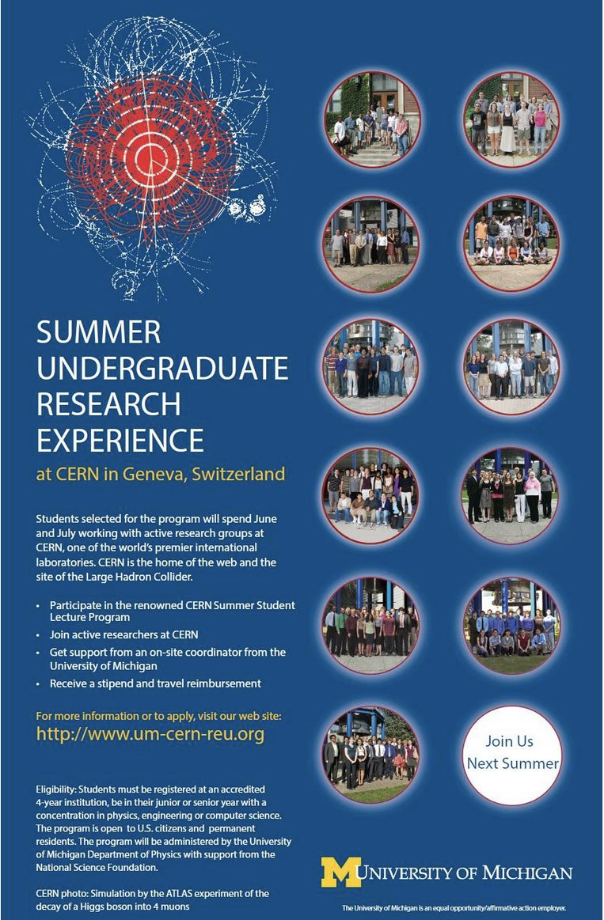
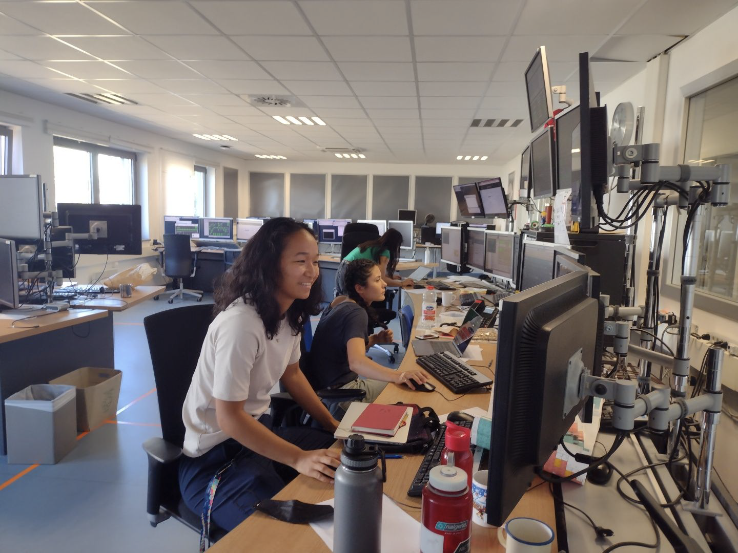
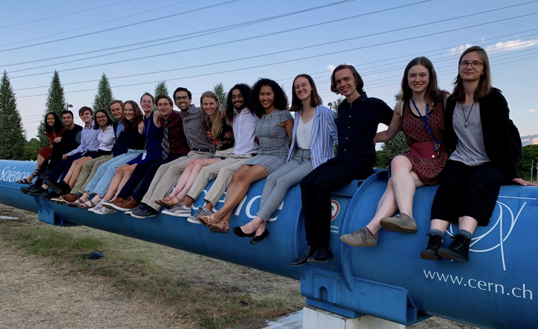
REU @ CERN
One REU programs is associated with the CERN Summer Student Program!
See the Univ. of Michigan REU page for information
  sites.google.com/a/umich.edu/um-cern-reu/

Slide 16
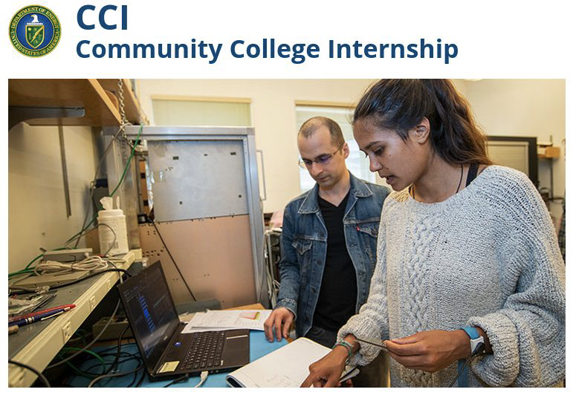
Undergrad Research at National Labs
Science Undergraduate Laboratory Internships (SULI)
Sessions in Summer (10 weeks), Fall and Spring (16 weeks)
Opportunities at ≈17 national labs across the country
Wide variety of research areas, including ATLAS
  Lawrence Berkeley National Lab (LBNL); Berkeley, CA
  Argonne National Lab (ANL); near Chicago, IL
  SLAC National Accelerator Lab (SLAC); Palo Alto, CA
  Brookhaven National Lab (BNL); New York, NY
Applications due in January
Community College Internship (CCI)
Similar in structure to SULI
Aimed at technical careers that
support laboratory science

Slide 17
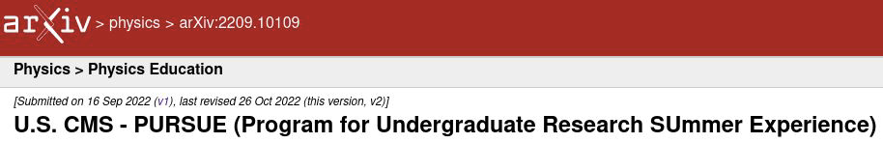
PURSUE (US-CMS)
Program for Undergraduate Research Summer Experience
Launched by CMS is 2022
Similar in scope to the ATLAS SUPER program (next slide), but was run as a pure-virtual program in 2022
  Students matched with mentors to work on projects
  10 weeks, $6000 stipend
Lots of training activities, networking events, lectures, etc.

Slide 18
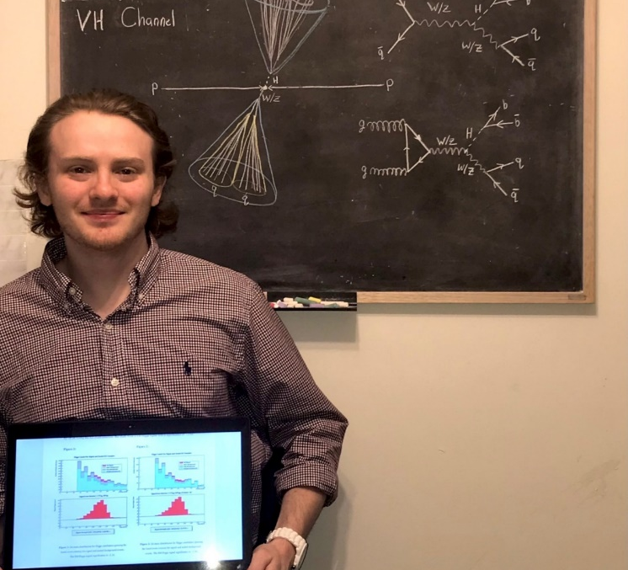
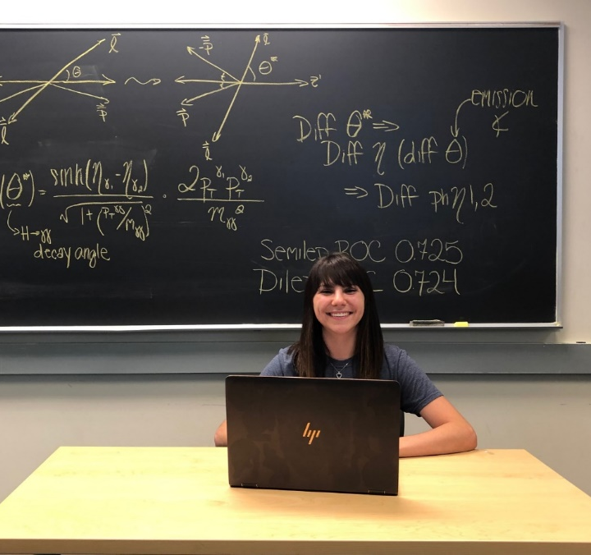
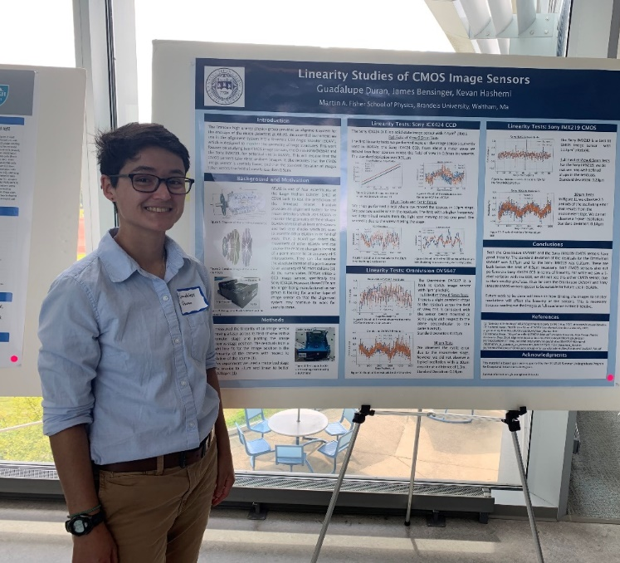
SUPER (US-ATLAS)
Summer Undergraduate Program for Exceptional Researchers
Run by US ATLAS since 2019
  Supports undergraduates to work US ATLAS research project
  $6000 stipend for 8-weeks of summer research (flexible start/end)
Two tracks:
Students already doing work with a US-ATLAS researcher
  Stipend to continue work for 8 weeks over the summer
Students at Minority Serving Insts. without an ATLAS group
  Matches student with US-ATLAS mentor
  Up to $4500 travel support to spend
  8 weeks at mentor’s university/lab
  working on research project
18
Notes:
From 2019 cohort of 9 students, 7 are pursuing graduate studies in Physics or Mathematics at UNC Chapel Hill, UIUC, MIT, U. Toronto, Oklahoma State, Columbia and Yale

Slide 19
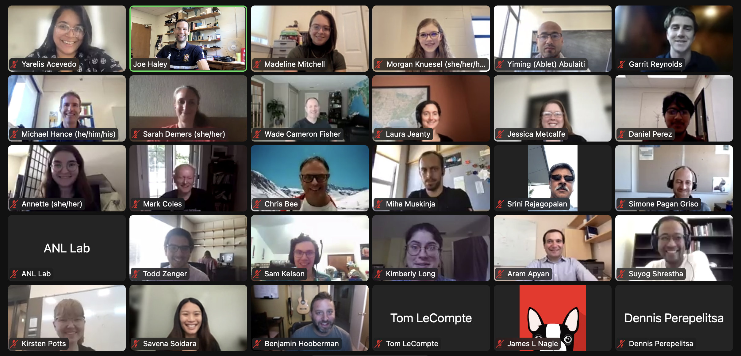
SUPER (US-ATLAS)
Program running for five years:
More details
End-of-summer symposium with talks by SUPER participants
Prizes for best presentation
Applications due in February
  (2 from MSU this year!)
Application materials:
  Personal statement
  CV (or Resume)
  Letter of Reference
More information on the program website: https://www.usatlas.org/super-program
 | 2019 | 2020 | 2021 | 2022 | 2023
Students | 9 | 9 | 11 | 10 (3 MSI) | 11 (1 MSI)
2022 SUPER Symposium Zoom
Notes:
From 2019 cohort of 9 students, 7 are pursuing graduate studies in Physics or Mathematics at UNC Chapel Hill, UIUC, MIT, U. Toronto, Oklahoma State, Columbia and Yale

Slide 20
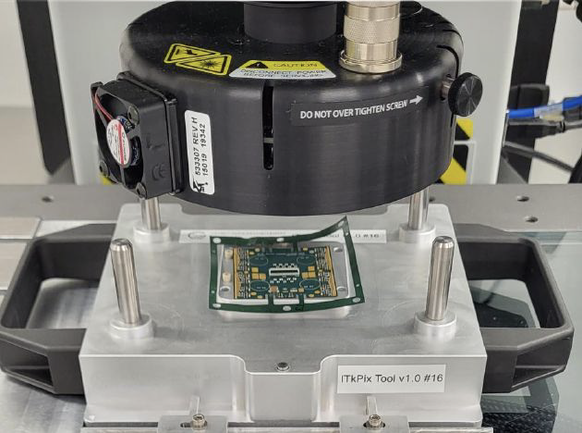
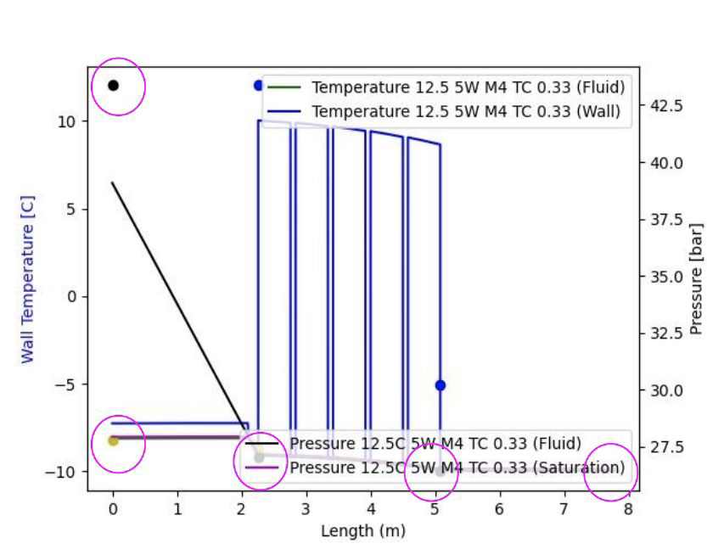
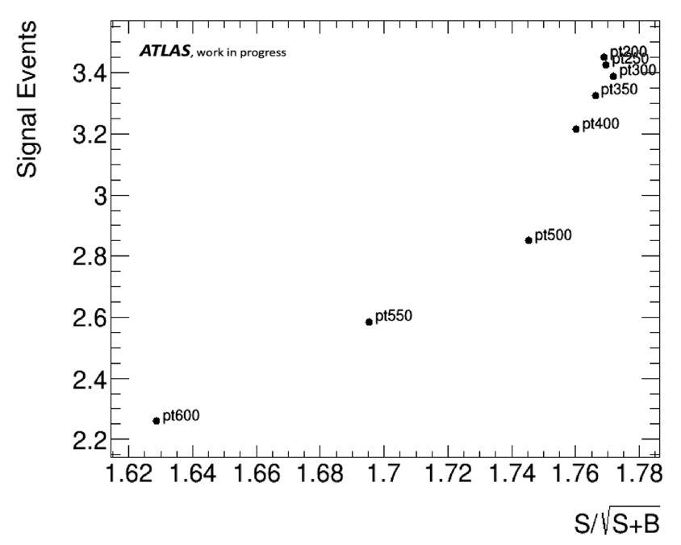
SUPER (US-ATLAS)
Examples of MSI student projects:
Metrology of silicon pixel modules for the ATLAS inner tracker upgrade (Daniel Perez @ Argonne National Lab)
Simulating an evaporative cooling system for the ATLAS pixel tracker upgrade (Savena Soidara @ Univ. of Massachusetts)
Optimizing a search for Vector-Like Quarks (Yarelis Acevedo @ Oklahoma State Univ.)
Notes:
From 2019 cohort of 9 students, 7 are pursuing graduate studies in Physics or Mathematics at UNC Chapel Hill, UIUC, MIT, U. Toronto, Oklahoma State, Columbia and Yale

Slide 21
Conclusion
Many ways to get involved!
Lots of support and resources for US ATLAS students
Summer programs are a good way to meet new colleagues, learn new skills, and work on real research projects
Notes:
From 2019 cohort of 9 students, 7 are pursuing graduate studies in Physics or Mathematics at UNC Chapel Hill, UIUC, MIT, U. Toronto, Oklahoma State, Columbia and Yale

Slide 22
Thank you!

