Slide 1
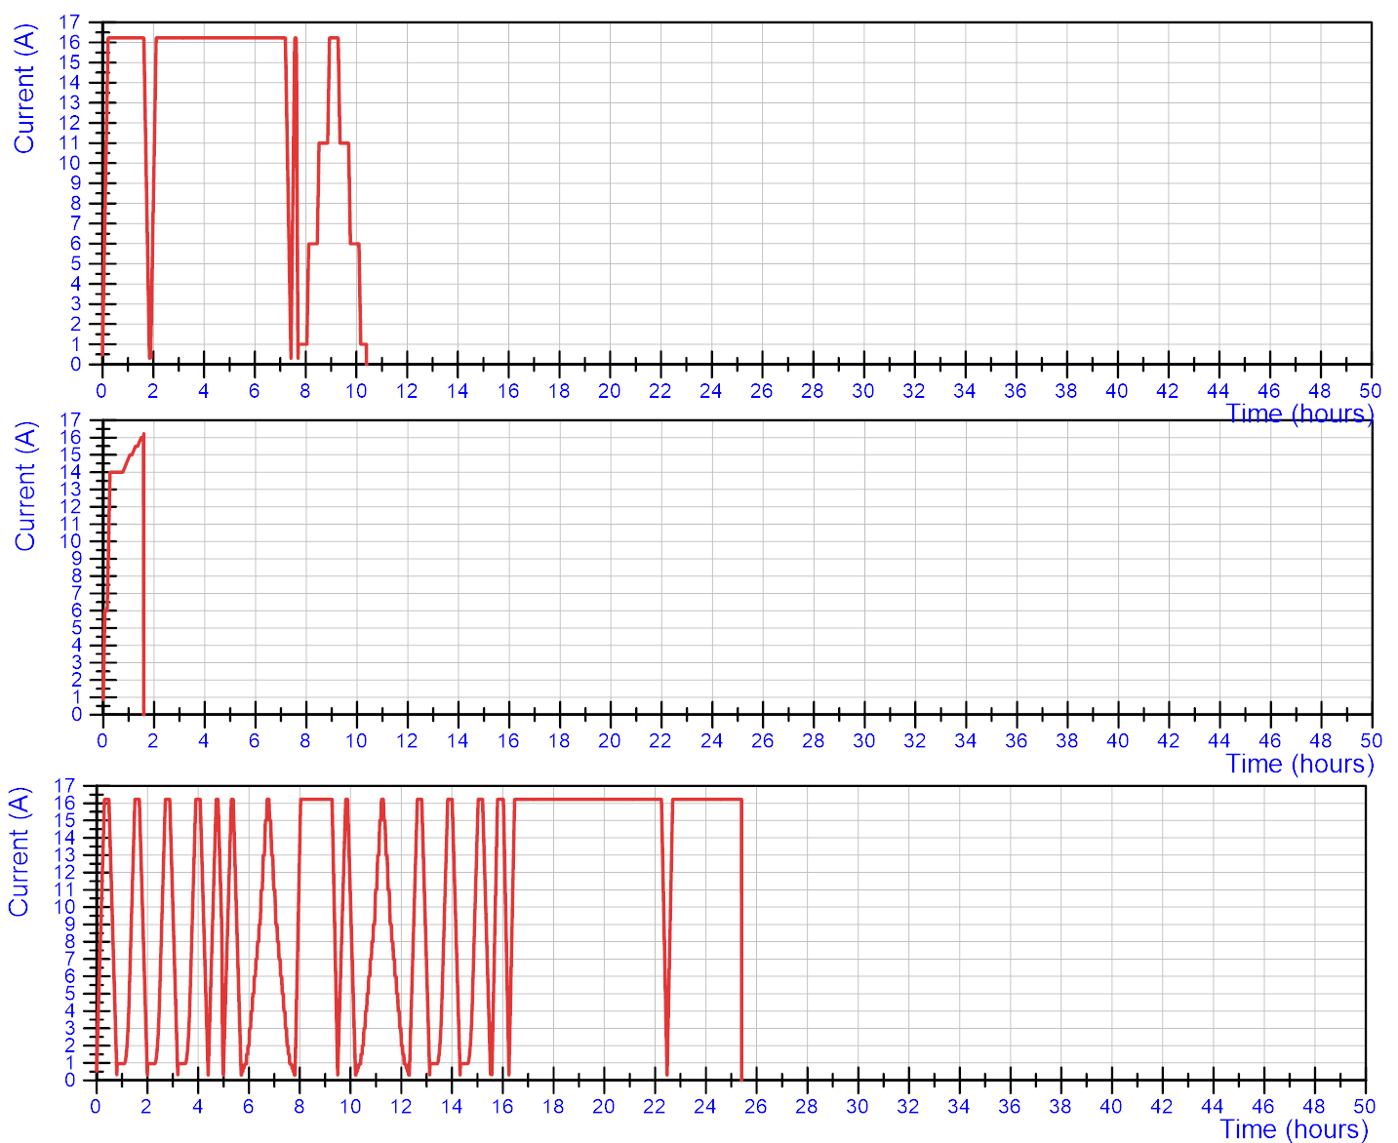
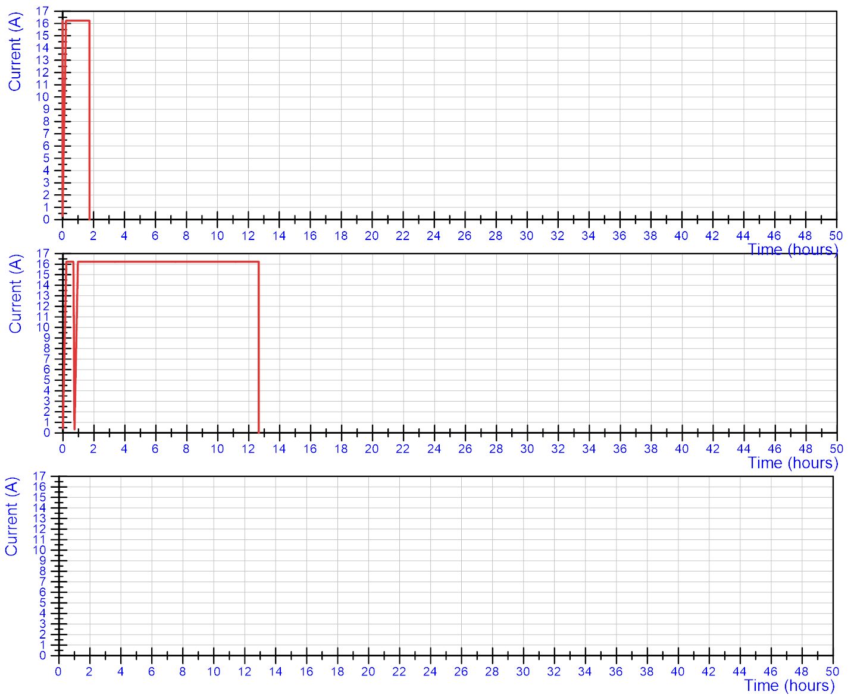
Cool down 1: powering cycles from virgin conditions
‘Virgin conditions’ definition: All induced currents/magnetization have been cancelled by a (provoked) quench of the coil.
First training at 1.9 K: no quench
Quench in Q3a-P1 after 1h30
4.5 K V-I cycle
Quench in Q3a-P2
Cycles at 1.9 K. Quench in Q3a-P3
Many magnetic measurement cycles at 1.9 K. Quench in Q3a-P3

Slide 2
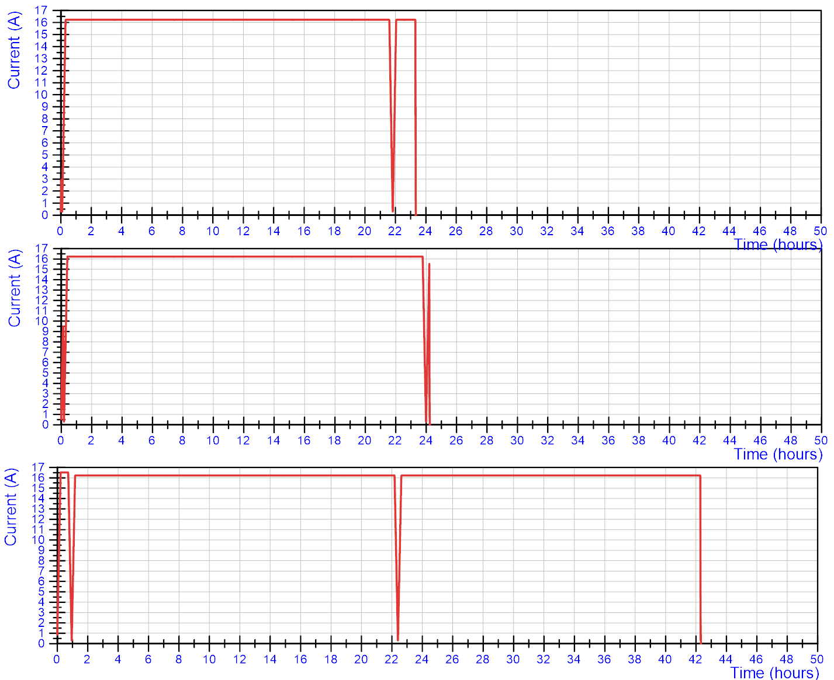
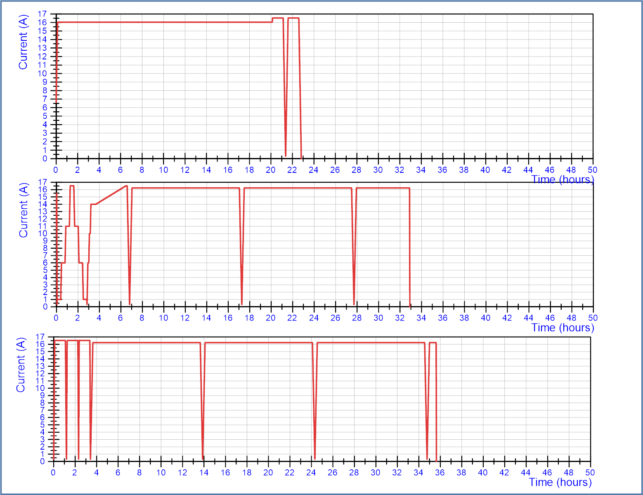
Cool down 2: powering cycles from virgin conditions
‘Virgin conditions’ definition: All induced currents/magnetization have been cancelled by a (provoked) quench of the coil.
1.9 K. Quench in Q3a-P3
1.9 K. No quench
(long plateau at 16.03 kA, followed by 16.53 kA)
4.5 K. Quench in Q3a-P3 at end of second ramp
1.9 K. Quench in Q3a-P3.
(after reaching 16.53 kA twice)
Training to 16.53 kA
1.9 K. Quench in Q3a-P3
1.9 K. Quench in Q3a-P3.
(after reaching 16.53 kA three times)
Consistent results:
All seven quenches in Q3a-P3 at 1.9 K occurred all after minimum 12 hours at nominal current and maximum 42 hours.
It always occurred in the second or later ramp (but this may be coincidence, since we did not often start with a very long ramp).

Slide 3
