Slide 1

Asset Management Structure for the Full Remote Alignment System
Mamta S. Dandekar
On behalf of HPA
BE-Seminar – CERN – 20.09.2024

Slide 2
Table of Contents
FRAS
Asset Management
Process
Future steps
Notes:
2. Hello Everyone! For the talk on Asset Management Structure for the Full Remote Alignment System we will look at it in 4 different parts.
First we will understand a bit about the Full Remote Alignment System or FRAS, second we will understand about Asset Management and why we need it?
Next, the process that we used for developing the Asset Management structure for the Full Remote Alignment System and the Future steps and improvements that could be explored.

Slide 3
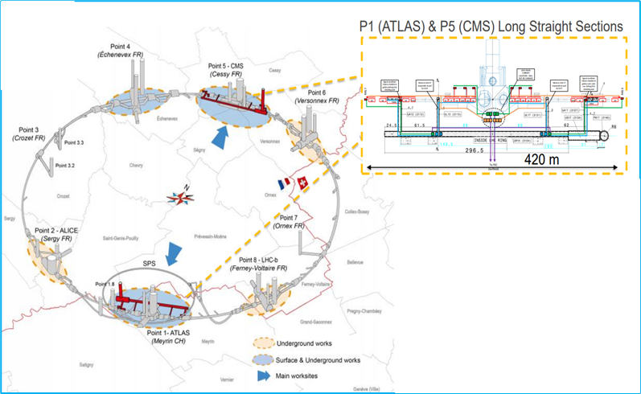
FRAS
Remote
Determination of Position
FRAS
Environmental sensors
Motorized jacks
internal monitoring systems
Alignment sensors
Motorized universal alignment platforms (UAP)
Wire Replacement system, diagnostic system
The Full Remote Alignment System (FRAS):
  a multi-sensor alignment monitoring and remote adjustment system
  part of the HL-LHC project
  approximately 1,150 sensors and 344 actuators
Validation of Alignment Sensors (WPS)
Monitoring
Remote Alignment
Monitoring
Remote Alignment
Notes:
3. First starting with a brief introduction to The Full Remote Alignment System
FRAS is a multi-sensor alignment monitoring and remote adjustment system that is being developed as part of the Hi-Luminosity project.
It will enable the remote adjustment of motorized components between Q1 and Q5 on both sides of P1 and P5 i.e. ATLAS and CMS experiments.
The system will consist of approximately 1150 sensors and 344 actuators.
The Full Remote Alignment System is broadly sorted into 6 groups:
Alignment sensors for remote position determination of components
Environmental sensors for monitoring of environmental factors that could affect the sensors and components
Internal monitoring systems for monitoring cold mass
Motorized jacks for remote alignment
Motorized universal alignment platforms (UAP) for remote alignment
Remote diagnostic system(s) for validation of alignment sensors

Slide 4
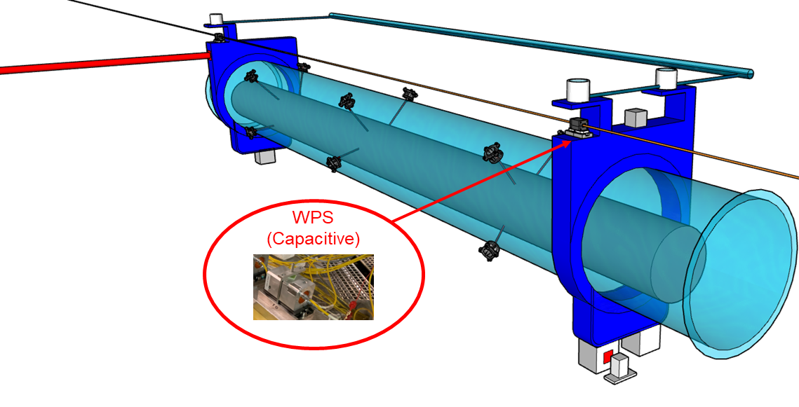
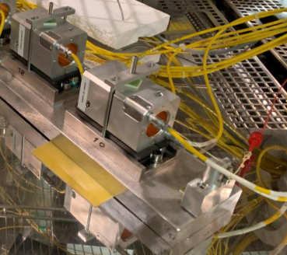
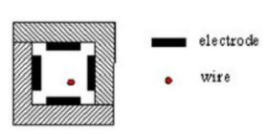
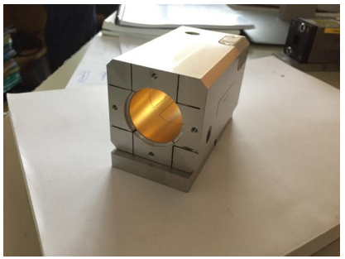
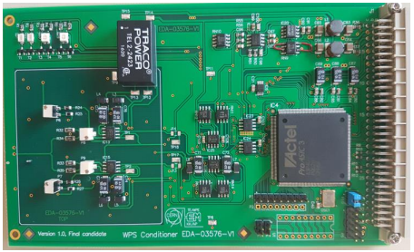
FRAS
FRAS
Environmental sensors
Motorized jacks
internal monitoring systems
Alignment sensors
Motorized universal alignment platforms (UAP)
Wire Replacement system, diagnostic systems
WPS Capacitive
HLS
FSI Inclinometers
FSI Distance measurement sensor (Long, short)
Load sensor
Notes:
4. First, lets start with Alignment sensors
Alignment sensors are installed on the components to determine their position remotely Starting with:
Wire Positioning Sensors (WPS) which measure radial and vertical offsets w.r.t. a stretched wire; then

Slide 5
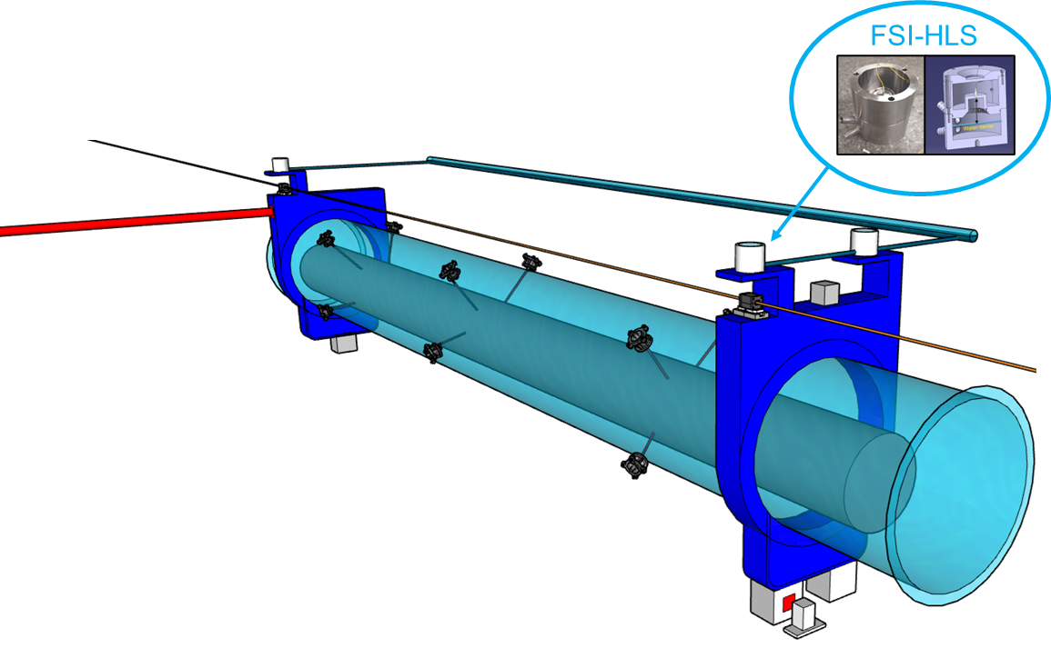
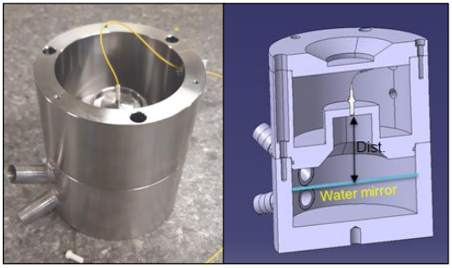
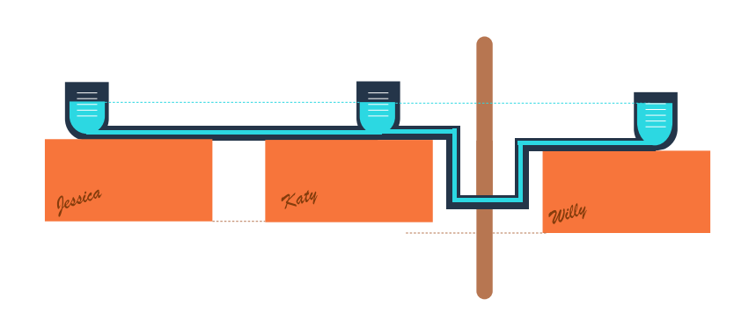
FRAS
FRAS
Environmental sensors
Motorized jacks
internal monitoring systems
Alignment sensors
Motorized universal alignment platforms (UAP)
Wire Replacement system, diagnostic systems
WPS Capacitive
HLS
FSI Inclinometers
FSI Distance measurement sensor (Long, short)
Load sensor
Notes:
5. Hydrostatic Levelling Sensors (HLS) which measure vertical offsets w.r.t. a water surface then

Slide 6
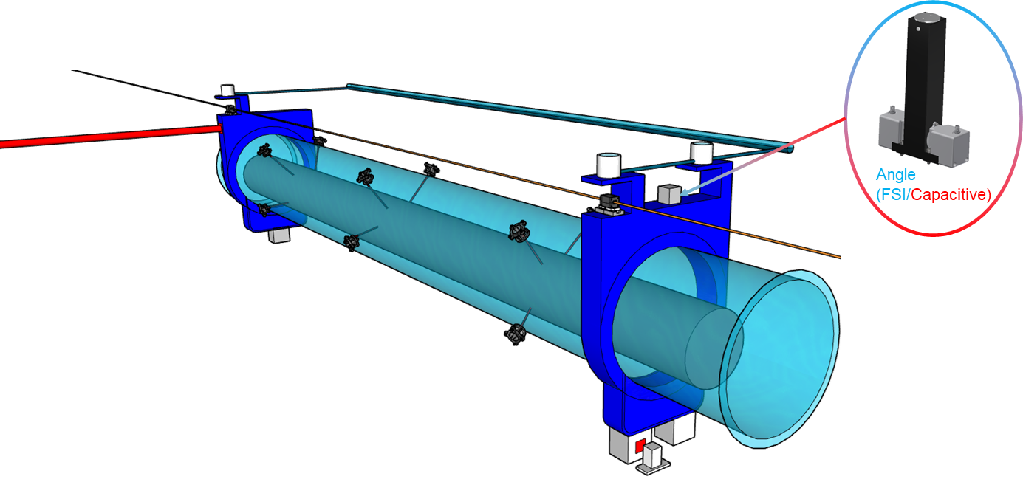
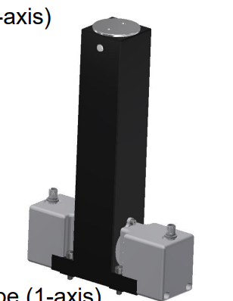
FRAS
FRAS
Environmental sensors
Motorized jacks
internal monitoring systems
Alignment sensors
Motorized universal alignment platforms (UAP)
Wire Replacement system, diagnostic systems
WPS Capacitive
HLS
FSI Inclinometers
FSI Distance measurement sensor (Long, short)
Load sensor
Notes:
6. Frequency Scanning Interferometry (MT-FSI) inclinometers which measure the roll angle of magnets, collimators and masks; then

Slide 7
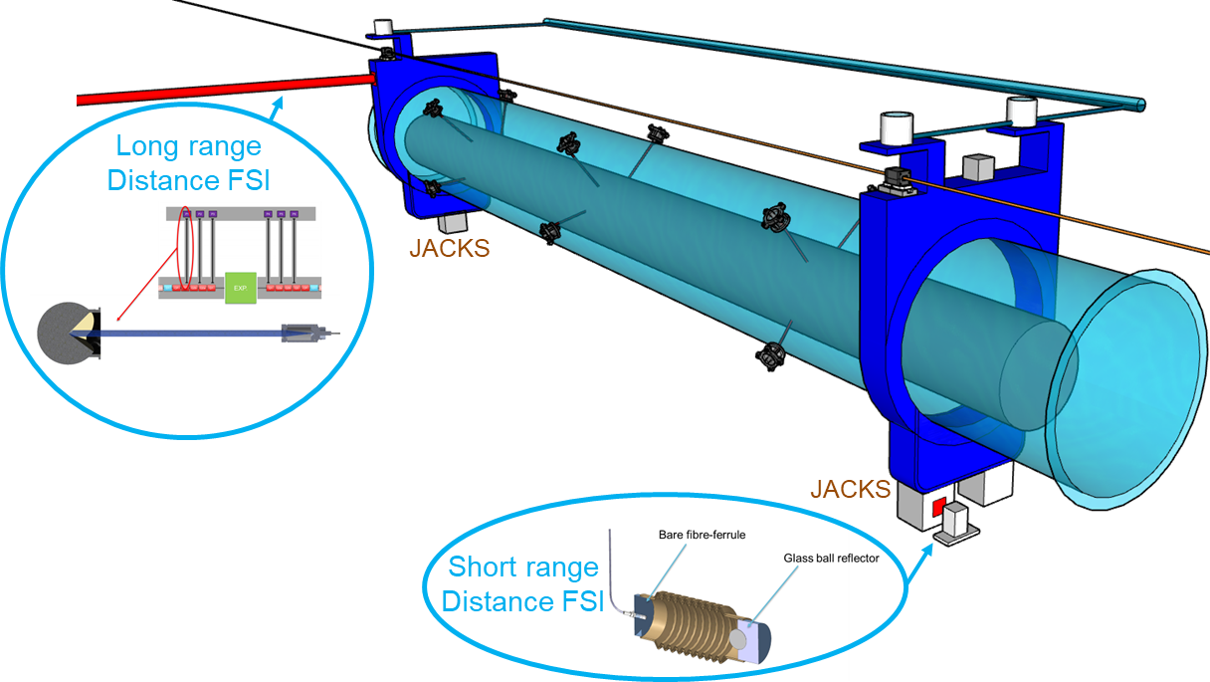
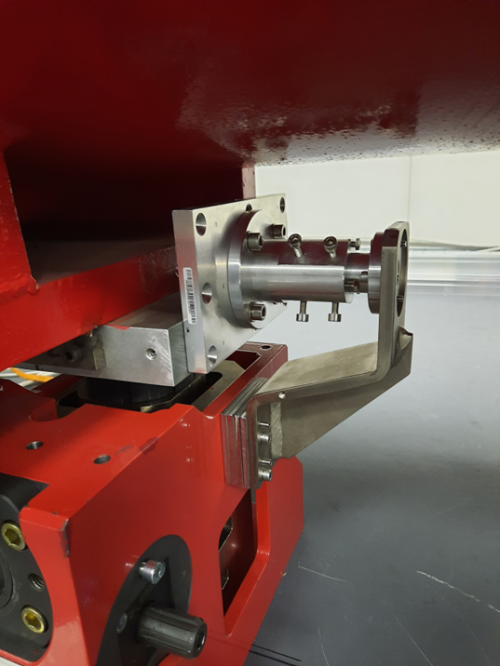
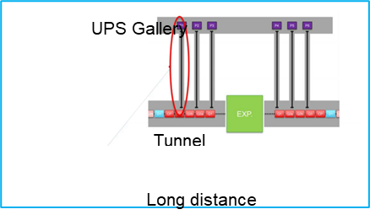
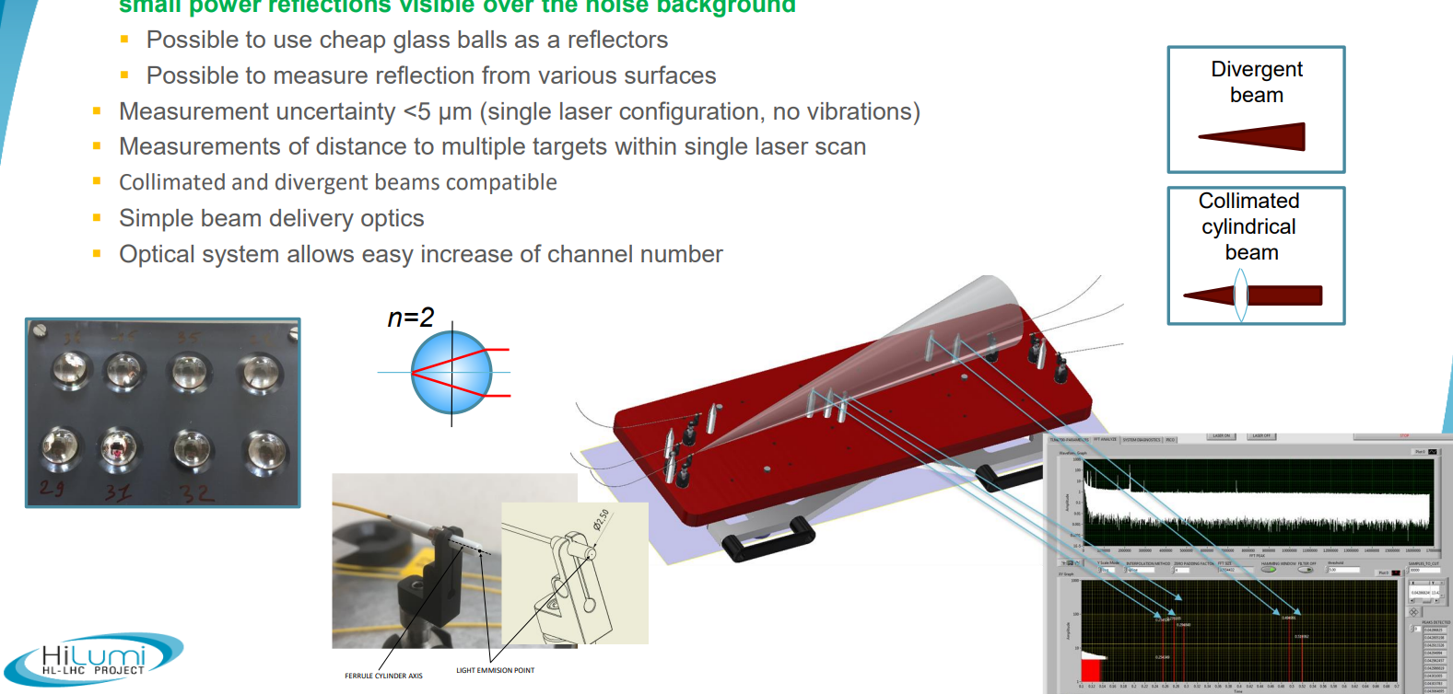
FRAS
FRAS
Environmental sensors
Motorized jacks
internal monitoring systems
Alignment sensors
Motorized universal alignment platforms (UAP)
Wire Replacement system, diagnostic systems
WPS Capacitive
HLS
FSI Inclinometers
FSI Distance measurement sensor (Long, short)
Load sensor
MT-FSI
Multi-Target Frequency Scanning Interferometry
Notes:
7. FSI distance measurement sensors which measure the distance between stretched wires installed in the UPS galleries and LHC tunnel, (short) measuring the longitudinal position of components;
Load sensors which are integrated in motorized jacks to monitor the reaction forces during alignment actions

Slide 8
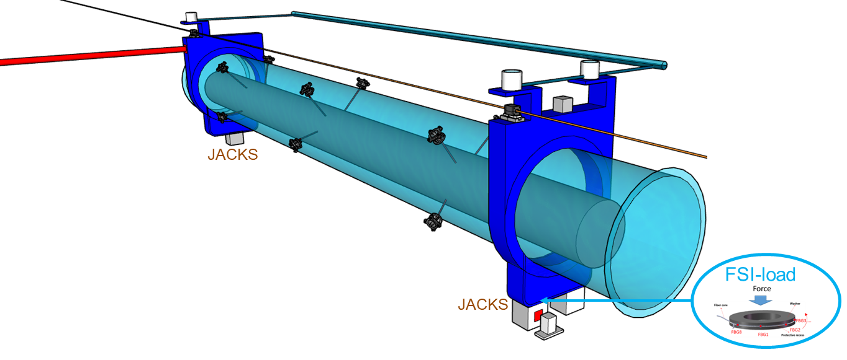
FRAS
FRAS
Environmental sensors
Motorized jacks
internal monitoring systems
Alignment sensors
Motorized universal alignment platforms (UAP)
Wire Replacement system, diagnostic systems
WPS Capacitive
HLS
FSI Inclinometers
FSI Distance measurement sensor (Long, short)
Load sensor
Temperature
Pressure
Humidity
Notes:
8. Load sensors which are integrated in motorized jacks to monitor the reaction forces during alignment actions
Environmental sensors to measure the factors that could influence the sensor behaviour including temperature, atmospheric pressure, humidity

Slide 9
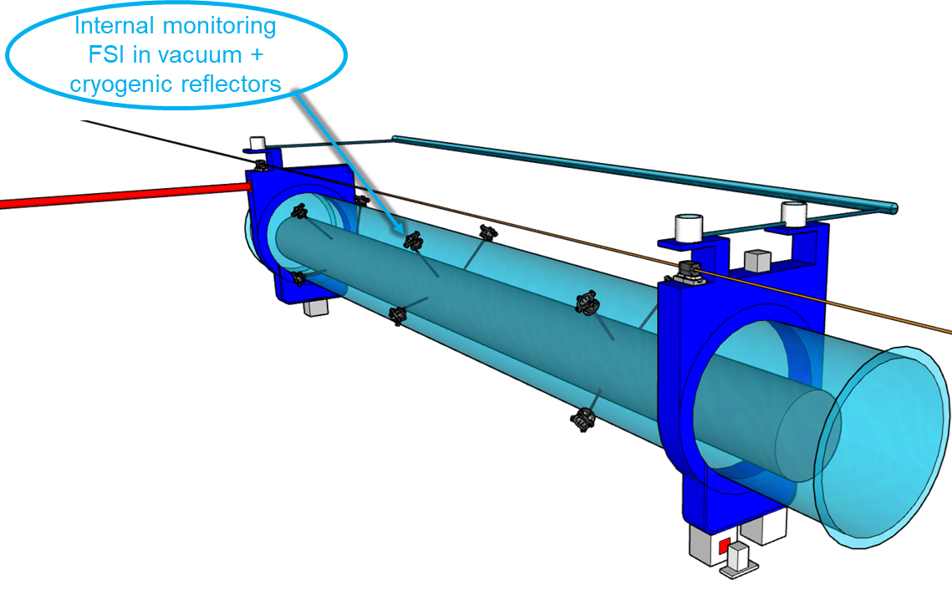
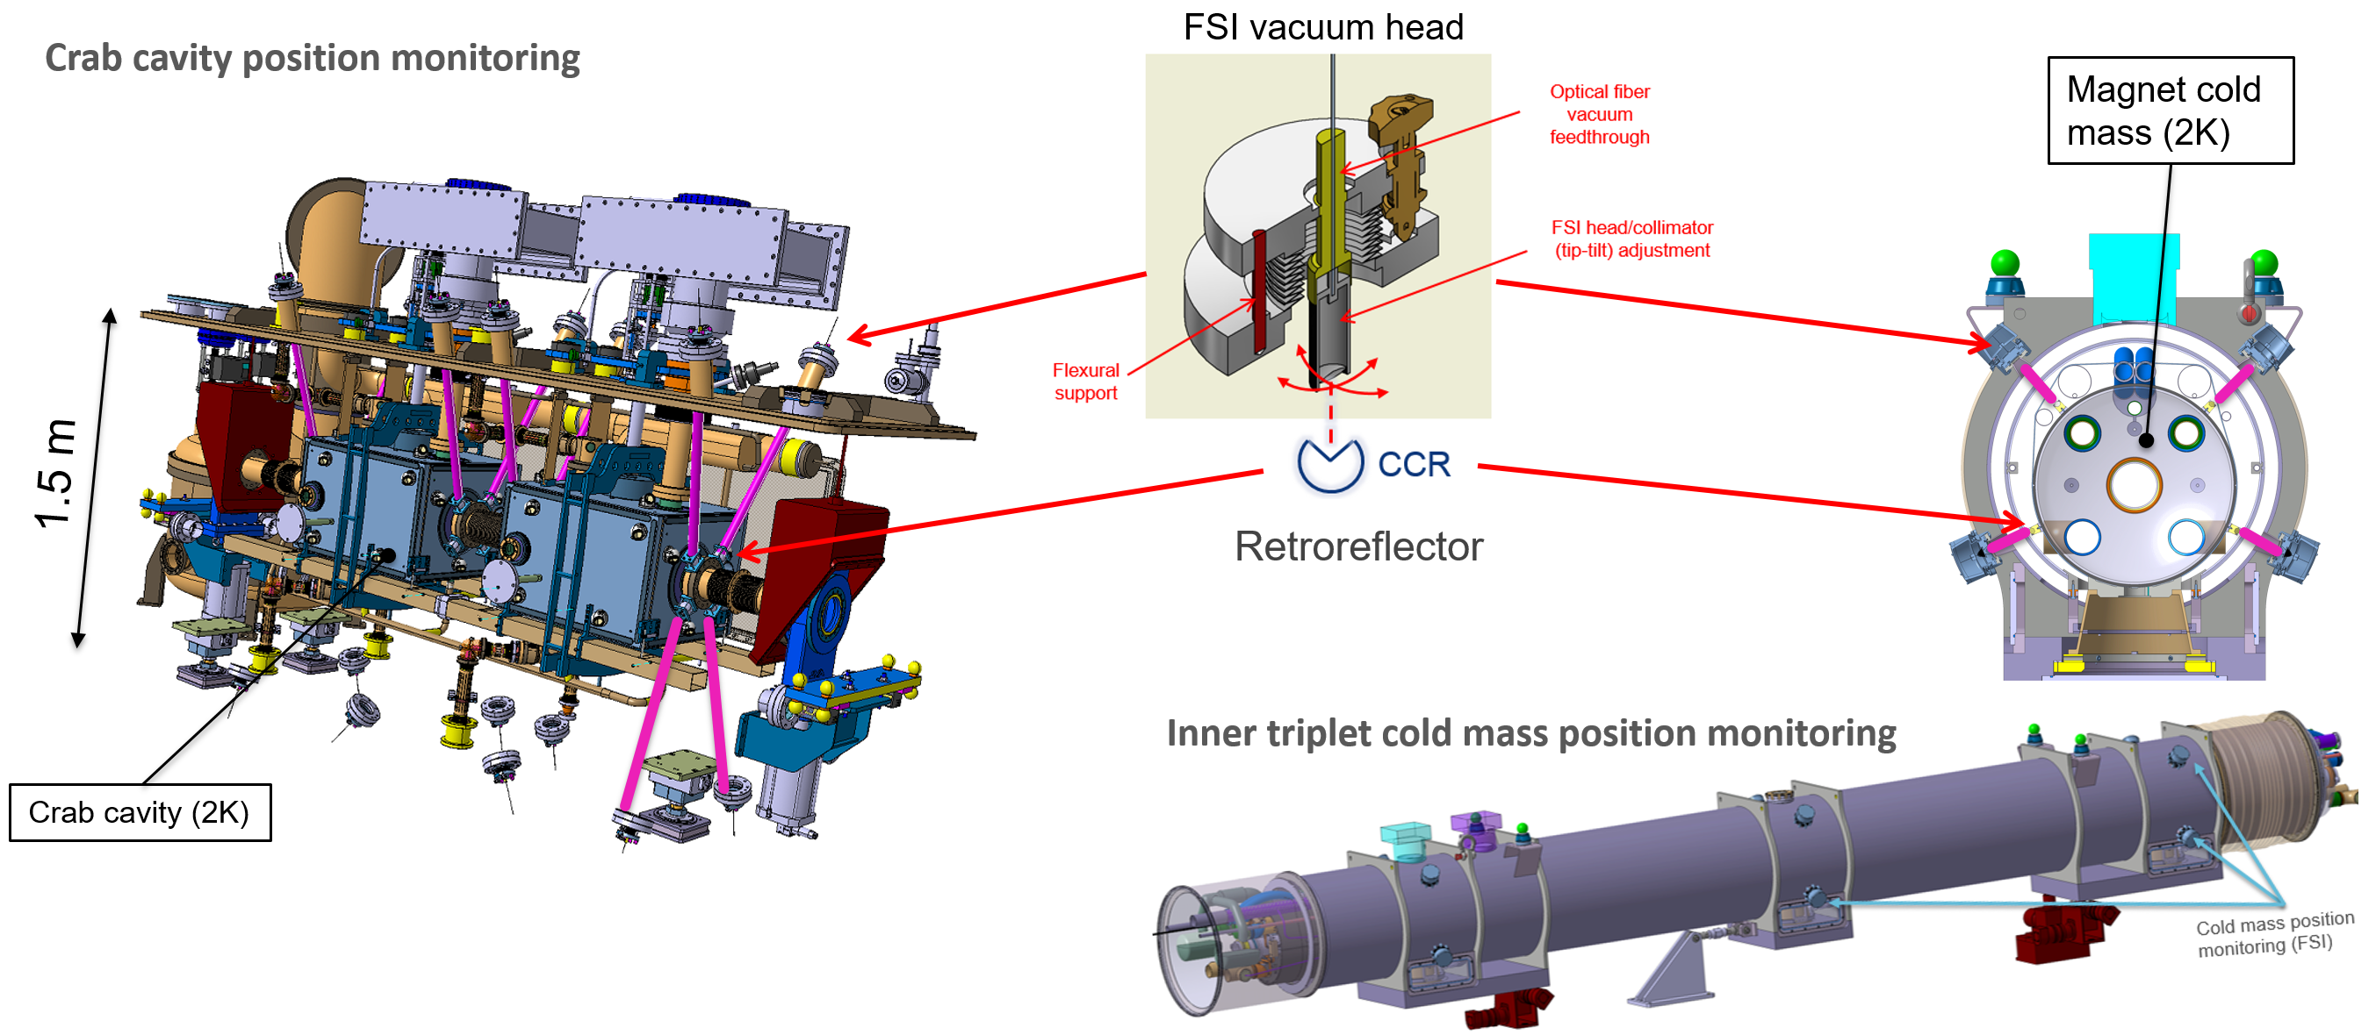
FRAS
FRAS
Environmental sensors
Motorized jacks
internal monitoring systems
Alignment sensors
Motorized universal alignment platforms (UAP)
Wire Replacement system, diagnostic systems
WPS Capacitive
HLS
FSI Inclinometers
FSI Distance measurement sensor (Long, short)
Load sensor
Internal Monitoring Systems
Notes:
9. Internal monitoring systems, based on FSI technology, to determine and monitor the position of critical objects (inner triplet cold mases, crab-cavities) inside their cryostats.

Slide 10
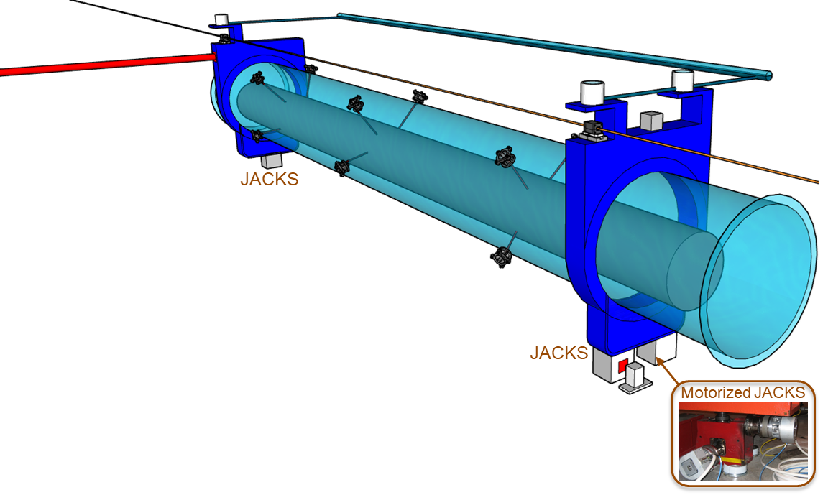
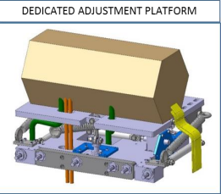
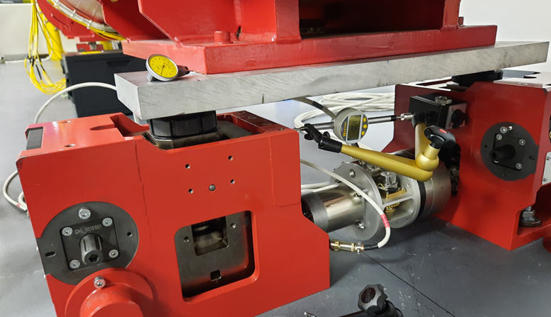
FRAS
FRAS
Environmental sensors
Motorized jacks
internal monitoring systems
Alignment sensors
Motorized universal alignment platforms (UAP)
Wire Replacement system, diagnostic systems
WPS Capacitive
HLS
FSI Inclinometers
FSI Distance measurement sensor (Long, short)
Load sensor
Motorized Universal Adjustment Platforms (<2t)
Motorized Jacks (>2t)
Notes:
10. Motorized jacks supporting components with a weight above 2 t: inner triplet quadrupoles, separation and recombination dipoles, corrector packages, TAXN and crab cavity cryomodules. Used to adjust the components at their nominal position.
Motorized universal alignment platforms (UAP) supporting lighter components with a weight below 2 t: collimators, masks. Used to adjust the components at their nominal position.

Slide 11
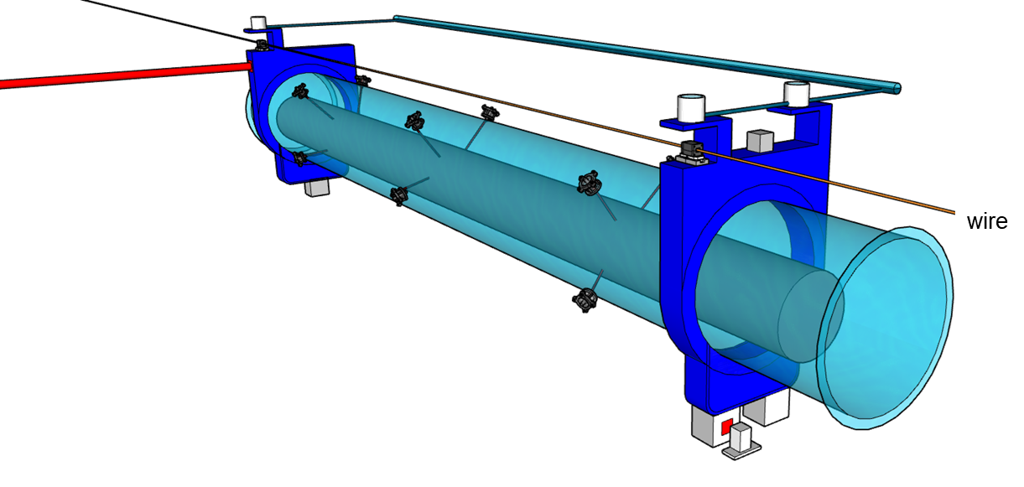
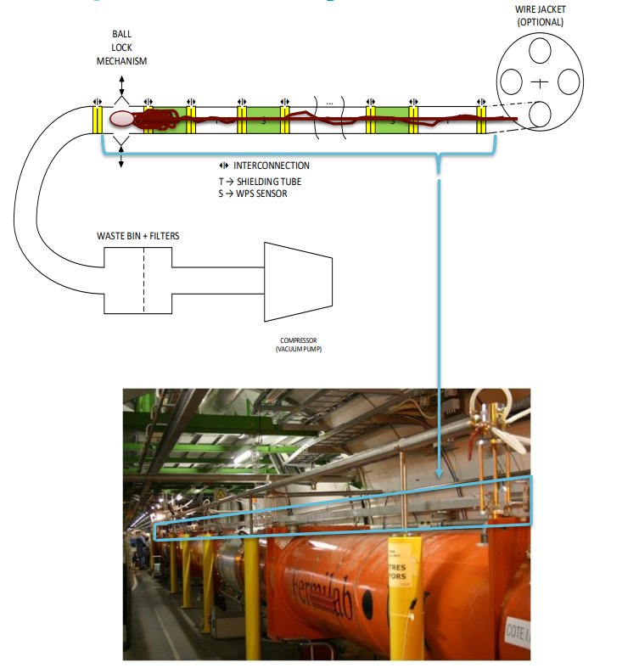
FRAS
FRAS
Environmental sensors
Motorized jacks
internal monitoring systems
Alignment sensors
Motorized universal alignment platforms (UAP)
Wire Replacement system, diagnostic systems
WPS Capacitive
HLS
FSI Inclinometers
FSI Distance measurement sensor (Long, short)
Load sensor
Notes:
11. Wire Replacement System diagnostic system(s) – for validation of WPS wire network and replacement of wire

Slide 12
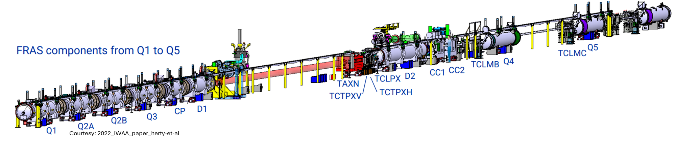
FRAS
Number of components to be remotely aligned per side (Q1 to Q5): 17
Total (ATLAS and CMS): 68
Notes:
12. For Hi-Lumi, FRAS will be responsible for remote alignment of about 17 components per IP side, that is a total of 68 components including ATLAS and CMS

Slide 13
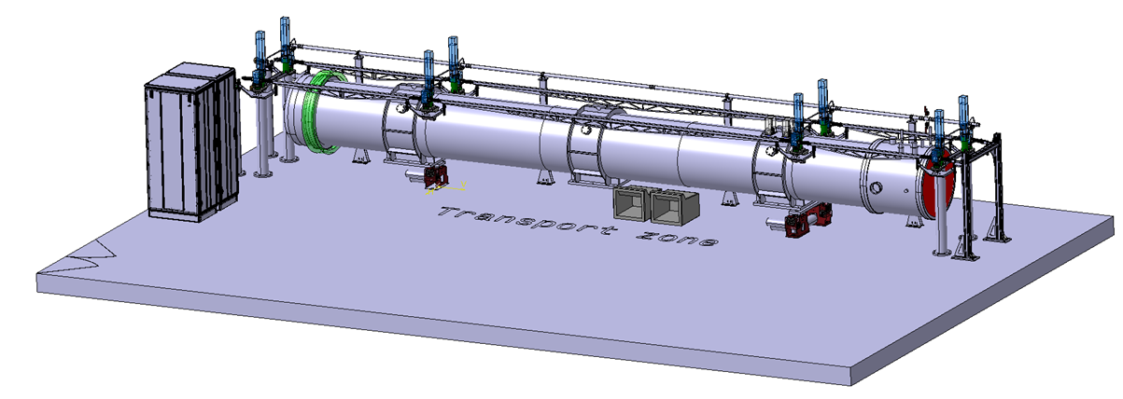
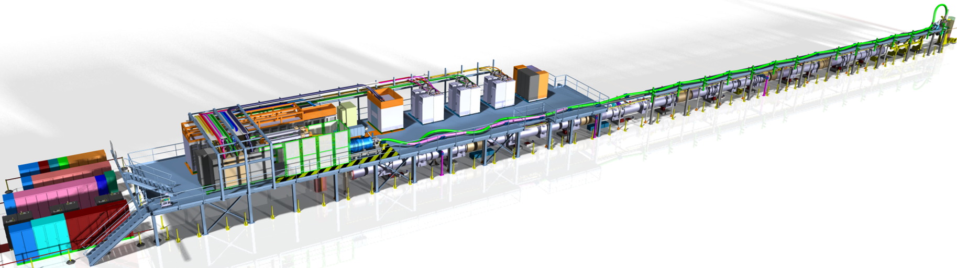
FRAS
Prior to implementation in HL-LHC, validation on two mock-ups:
  Single Component Test (SCT)
  SM18 Inner Triplet String (IT String)
    6 components
Single Component Test (SCT) in 947
Inner Triplet String (IT String) in SM18
Reference: https://string-sm18.web.cern.ch/#integration
Notes:
13. Prior to implementation in Hi-Lumi, it would be validated on 2 mock-ups. First on the Single Component Test (SCT) where it would be tested on 1 magnet/component and then on SM18 IT-String where it would be tested on 6 components
These mock-ups are very important as they would provide an insight into integration of systems in the FRAS and help to improve the final system implementation

Slide 14
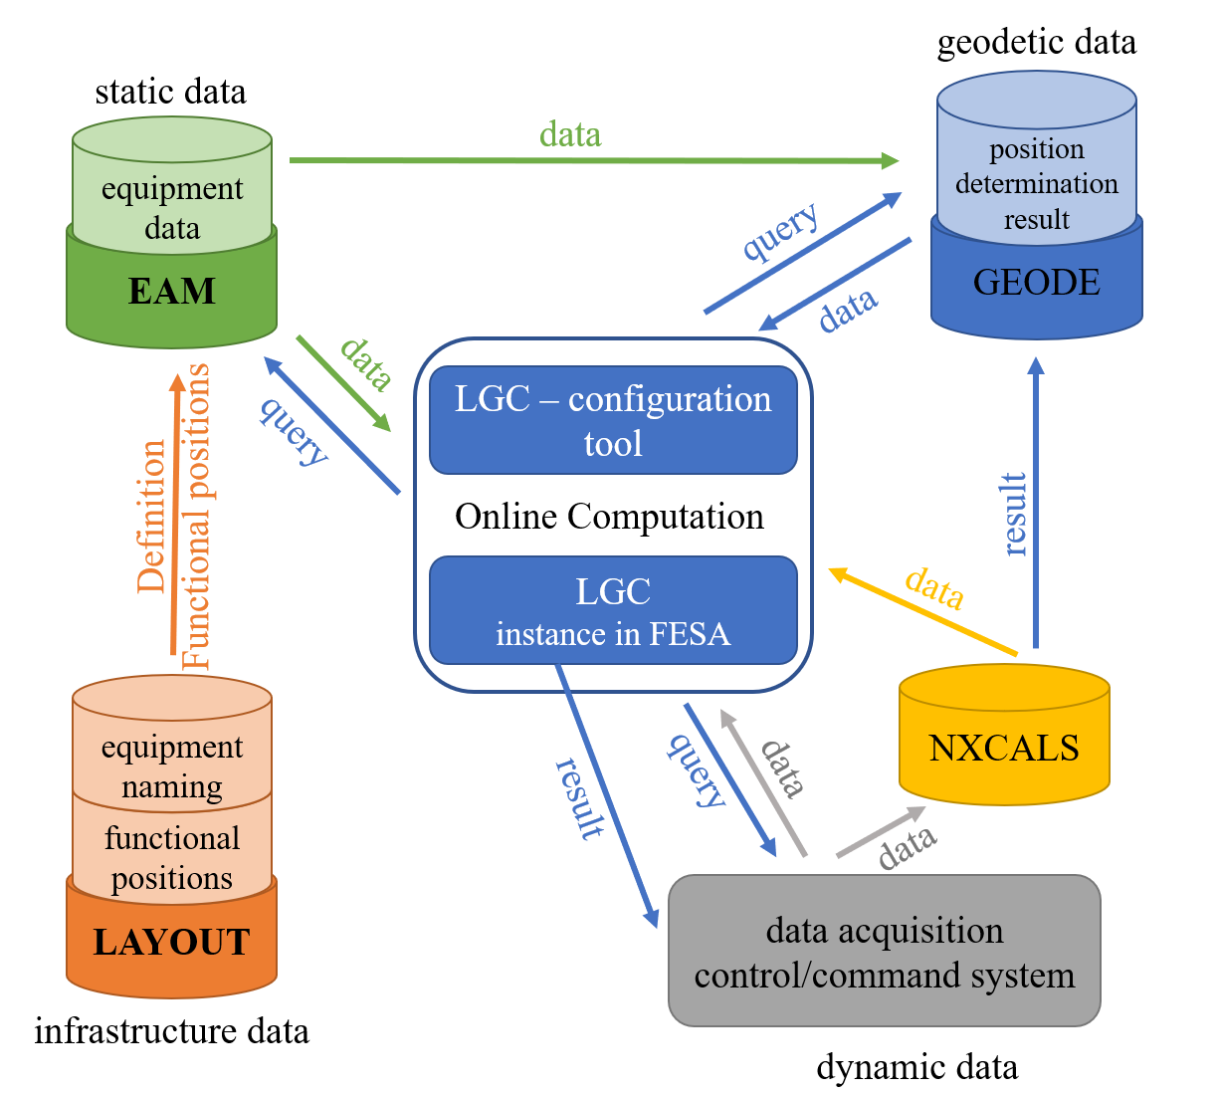
FRAS
The following CERN tools used to provide all information for position calculation and remote alignment of the FRAS components
Asset Management
EAM
Asset life. Static data from calibrations and fiducialisation.
Updated during maintenance.
SURVEY DB.
Naming reference and storage for geodetic points and magnets assemblies
LGC
CERN compensation software for 3D position network adjustment. Combines all measurements and parameters from the different databases.
NXCALS
Storage for sensor measurement and computation results
LAYOUT DB
Reference for infrastructure layout, including functional positions.
Data acquisition – control/command system. Stores data, provides live data to, and manage results from LGC.
Courtesy: 2022_IWAA_paper_herty-et-al
Notes:
14. There are many CERN tools that are used to provide information for FRAS, these tools provide and share data between them they are
Layout: The infrastructure layout including functional positions are generated in layout
EAM: Asset data including static data from calibrations, fiducialisation is stored
GEODE: Storage of Naming reference and geodetic points and magnets assemblies
NXCALS: Storage for sensor measurement and computational results
Data acquisition: Provides live data to and manages results from LGC, stores data
LGC: It is a compensation software for 3D position network adjustment. Combines all parameters from different databases
In this talk we would be focussing on the equipment data i.e. static data part for Asset Management

Slide 15
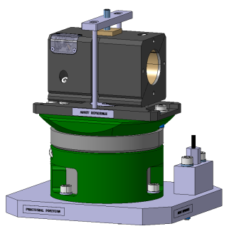
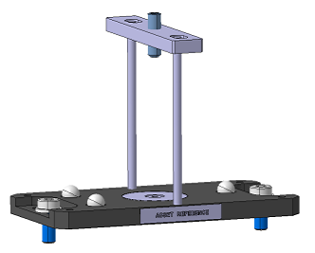
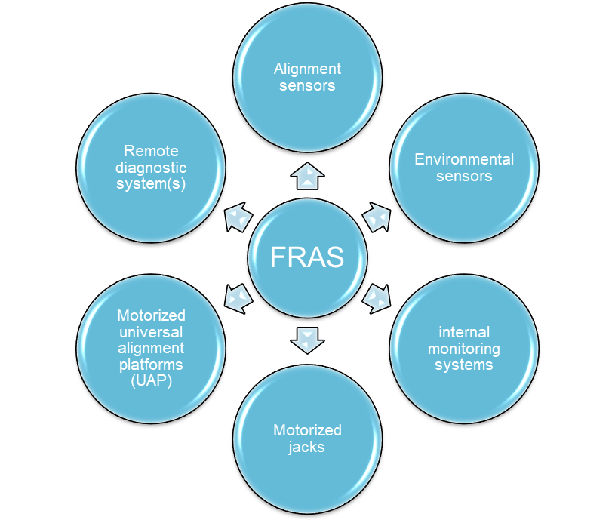
Asset Management for FRAS
Why Asset Management?
FRAS includes:
Around 1500 physical assets with substantial computation parameters
Example: WPS sensor.
  3 ball interface
  Sensor
  Cable
  Electronic
14 parameters
Electronic
→ 121 parameters per sensor position.
11 parameters
Cable
HL – LHC project: 72 WPS sensor per IP side
96 parameters
For 4 IP Sides → 288 sensors ≈ 35 000 parameters only for WPS sensors
Structured asset management is mandatory!
Remaining sensors, systems!
Notes:
15. Why asset management is required?
FRAS includes a significant quantity of physical assets i.e around 1500 physical assets with many computation parameters.
For reference, WPS sensor has the following associated: 3 ball interface, Sensor, Cable, Electronic where there are 11 parameters associated with the 3 ball interface, 96 with the sensor and 14 with the electronic which makes a total of 121 parameters associated with just 1 WPS position
And for Hi-Lumi, there are 72 WPS’s per IP side, taking into consideration ATLAS and CMS the total is 288 WPS’s which makes a total of almost 35000 parameters.
Other sensors and systems also present.
To streamline and To effectively manage data structured asset management is mandatory.

Slide 16






Asset Management
Physical assets have a lifecycle expected of 20+ years
Thorough documentation is essential
Asset
Asset
Asset
Asset
Asset
Asset
Asset
Asset
Asset
Asset
Notes:
16. Also, the physical assets are going to have long lifecycles around 20+ years.
Additionally, the changes in personnel over the asset lifecycle require good documentation to retain the knowledge.
To ensure smooth knowledge transfer, it is essential to store historical data associated with assets

Slide 17





Asset Management
The tool officially supported at CERN is EAM (Enterprise Asset Management)
Work-management
Storage → data from worktasks
Detailed version
On-the-go usage
Lighter version
Easy-to-use on site
Stores/ Inventory management
Efficient tracking of assets
Notes:
17. For generating the Asset Management Structure, EAM i.e. Enterprise Asset Management is being used.
It enables work management and storage of data obtained during various worktasks like inspection, installation etc.
It is also able to provide data to other interfaces.
Its lighter version EAMLight is easy to use on-site in tunnel, galleries etc.
It also has a Kiosk version which helps in efficient tracking of assets i.e location and quantity

Slide 18

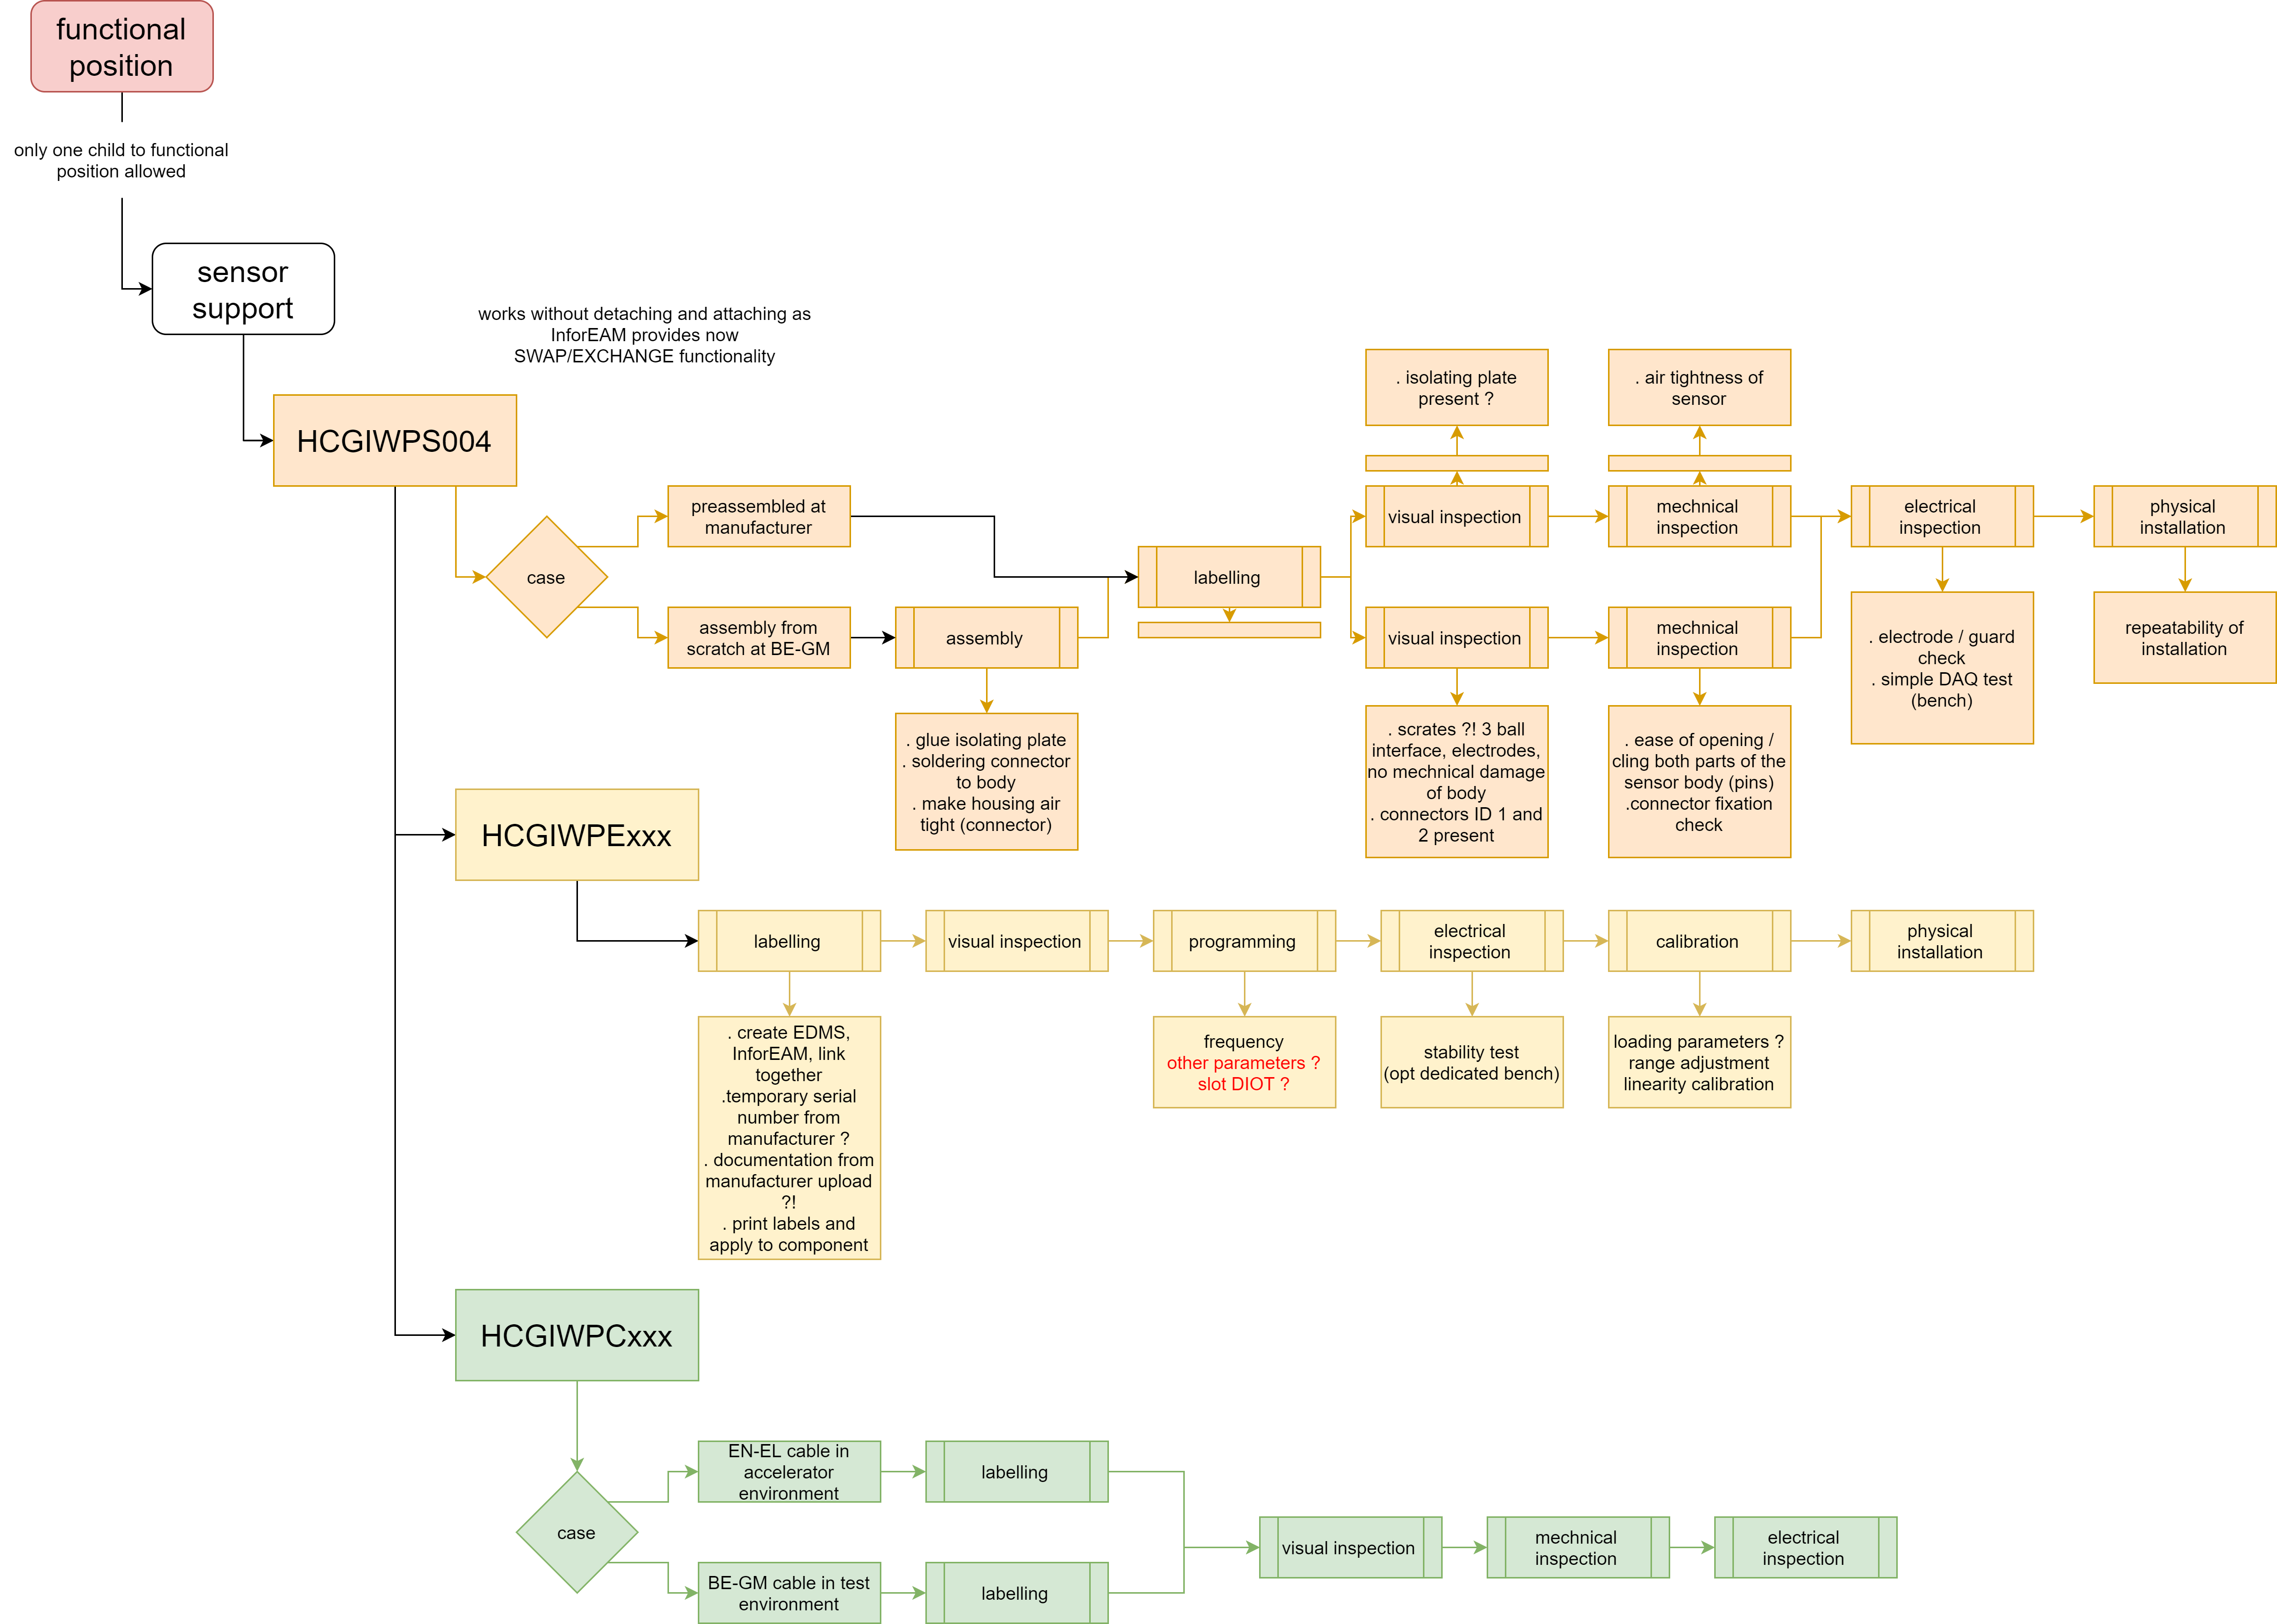
Process
Asset Hierarchy
Naming
Workflow
Sensor Parameter
Translating to EAM
Functional Position
H
C
G
I
W
P
S
*
*
*
-
Y
Y
M
M
*
*
*
*
Parent
Asset
Machine Code
Sensor Variant Code
001
002
003
004
.
.
YYMM of Batch Mfg or Assy
2101
2201
.
.
Code
Geodesy Instrumentation
Number
0001
0002
.
.
Child
Sensor Code
WPS
HLS
.
.
Asset
Child
Asset
Notes:
18. Now, for the Process that was followed to generate the asset management structure.
It is divided into 5 parts for simplicity.
First, we had to decide what would be the asset hierarchy.
It involved brainstorming on which equipment requires tracking and data to be attached with it to be registered as an asset.
Also, a few rules were already established such as a functional position is allowed to have only 1 asset child, but an asset may have multiple children.
We established hierarchies for all sensor systems.
Then, we moving on to Naming.
Some part of the naming i.e. HC which is the machine code, GI which is the department code are already established in the Hi-Lumi project rules.
We had to decide on the sensor codes and the prototype numbers.
Then for the 8 digits after we decided on having a YYMM for the first part of 8-digits and serial number for the remaining 4 digit for easy identification of manufacturing batches.
Then, we developed the initial workflow and listed the steps that would be involved starting from assembly to maintenance etc.

Slide 19
Process
Workflow
  Multiple Iterations prior to translating in EAM
Process flow
Iteration 1
Iteration 2
Iteration 3
Categorized Tasks
Notes:
19. It took us almost 3 iterations to arrive at the workflow that could be translated to EAM.
First iteration we developed a generalized process flow and categorized tasks into labelling, inspections (visual, mechanical..), assembly, calibration, installation etc.

Slide 20
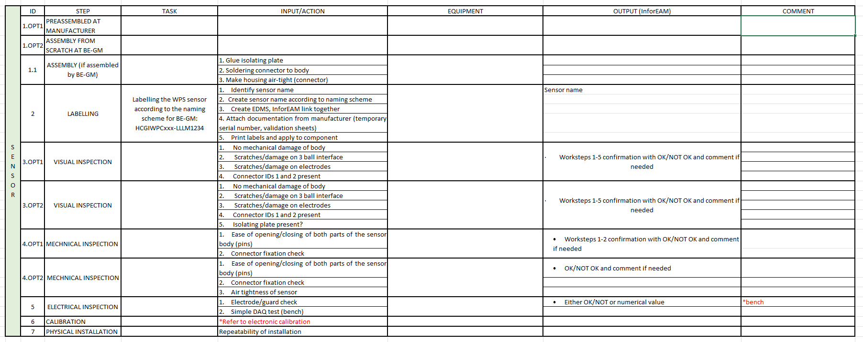
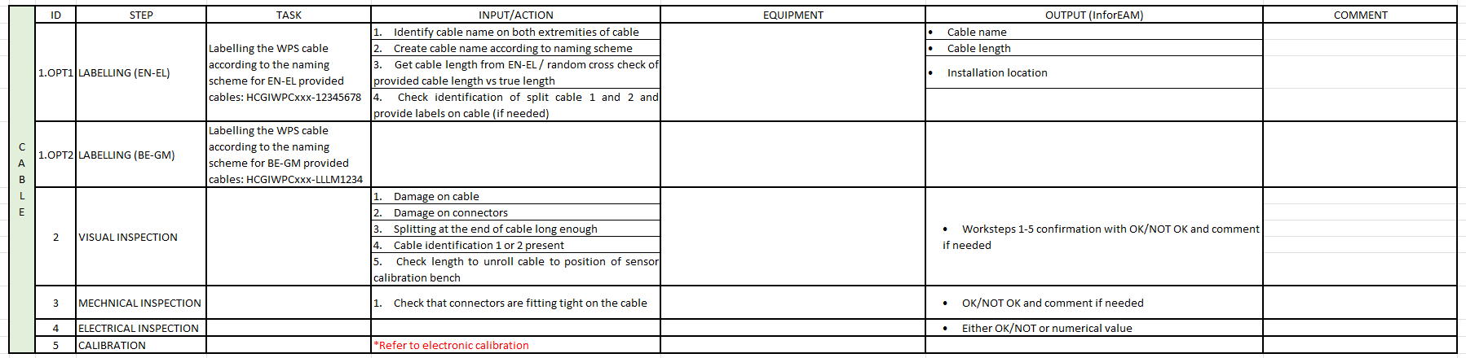
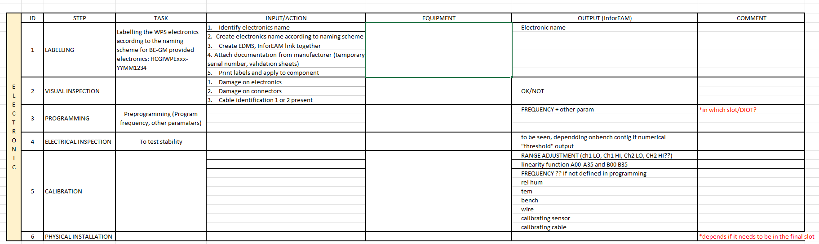
Process
Detailed Description of actions
Inputs
Workflow
  Multiple Iterations prior to translating in EAM
Outputs
Iteration 1
Iteration 2
Iteration 3
Notes:
20. In second iteration we documented detailed description of tasks and the Inputs required and the resulting outputs.

Slide 21
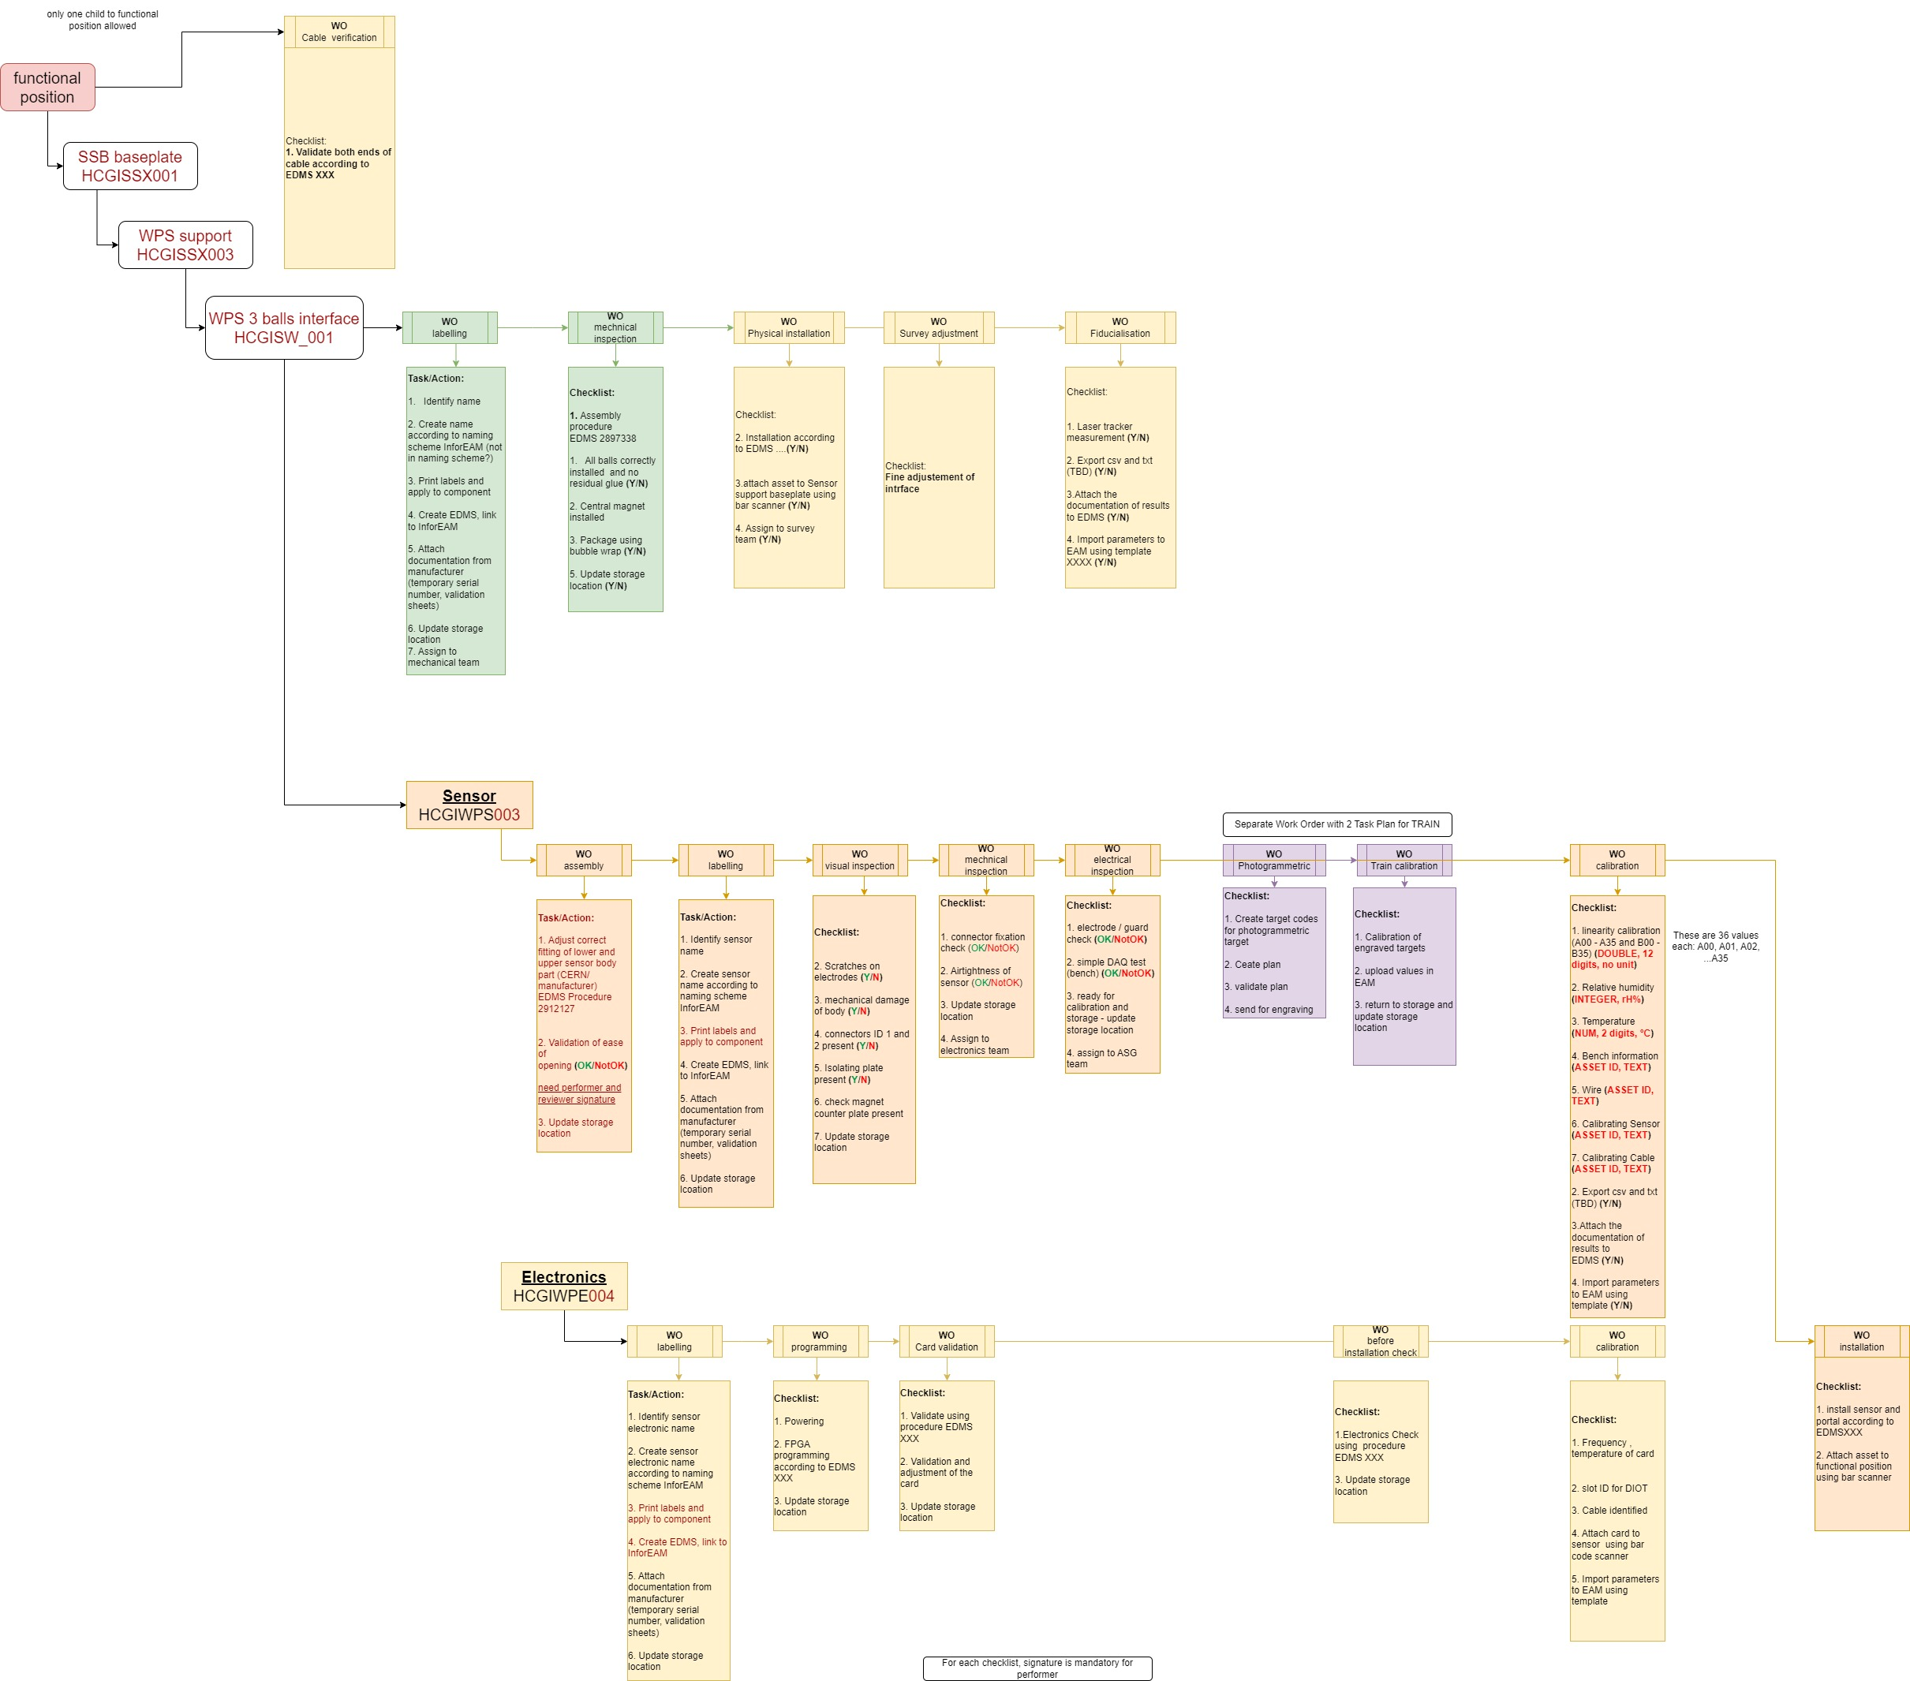
Process
Naming of assets finalized
Detailed hierarchy established
Divided actions into workorder taskgroups
Workflow
  Multiple Iterations prior to translating in EAM
Iteration 1
Iteration 2
Iteration 3
Notes:
21. By the third iteration, the Naming of assets was finalized and a detailed hierarchy established.
Also, we divided detailed actions and checklists into workorder task groups.

Slide 22
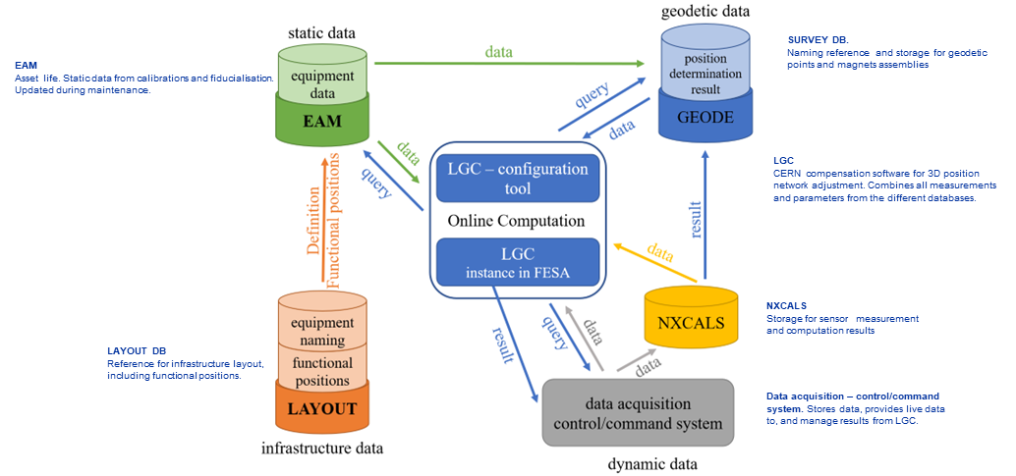
Process
Asset Hierarchy
Naming
Workflow
Sensor Parameter
Translating to EAM
Transformation data (Tx, Ty, Tz, Rx, Ry, Rz, Scaling, Temp_Fidu)
Origin data (Origin_x, Origin_y, Origin_z)
Fiducials data (1x, 1y, 1z, 2x, 2y, 2z,….)
Approximately 100,000 parameters
Assembly Accuracy data (Sigma_x, Sigma_y, Sigma_z)
Train Target data (Target_x, Target_y, Target_z)
Refractive Indices data
Data required by surveyors for performing calculations in LGC for applying remote adjustments
Network data (Wire, Water,..)
Relations data (Electronics, Network)
Functional Position data (Co-ordinates during installation etc.)
Calibration Function data (WPS 72….)
Co-ordinates data (x, y, z,..)
Others (sensor specific)
Notes:
22. For Sensor Parameters, we grouped data parameters that would be generated during worktasks to be attached to the required asset.
For eg. Transformation parameters, local co-ordinate systems, network data, calibration data.
There are about 100,000 parameters for Hi-Lumi.
This static data is required to calculate FRAS adjustments by surveyors in the geodetic compensation software.

Slide 23
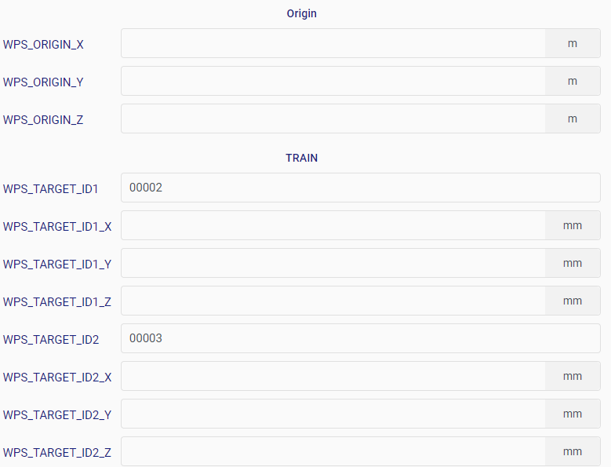
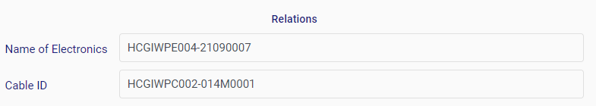
Process
Asset Hierarchy
Naming
Workflow
Translating to EAM
Sensor Parameter
Transformation data (Tx, Ty, Tz, Rx, Ry, Rz, Scaling, Temp_Fidu)
Origin data (Origin_x, Origin_y, Origin_z)
Fiducials data (1x, 1y, 1z, 2x, 2y, 2z,….)
Assembly Accuracy data (Sigma_x, Sigma_y, Sigma_z)
Train Target data (Target_x, Target_y, Target_z)
Refractive Indices data
Network data (Wire, Water,..)
Relations data (Electronics, Network)
Functional Position data (Co-ordinates during installation etc.)
Calibration Function data (WPS 72….)
Co-ordinates data (x, y, z,..)
Others (sensor specific)
Notes:
23. An example of how the sensor parameters look like as fields in EAM

Slide 24
Process
Asset Hierarchy
Naming
Workflow
Translating to EAM
Sensor Parameter
Asset
Parent Standard Workorder
Test Environment
Standard Workorder
1.
Task
Plan
Standard Workorder
2.
Task
Plan
Production Environment
.
.
Standard Workorder
X.
Task
Plan
Note: Initial Structure
Notes:
24. Now, translating all this dataflow into a structure in EAM.
First, we started with developing the structure in the EAM test environment to get used to the interface and solve workflow issues before jumping into the production environment.
The initial structure that was developed includes a taskplan or a checklist that is attached to a standard workorder.
Then, multiple children standard workorders are attached to a parent standard workorder which is then attached to an asset.

Slide 25
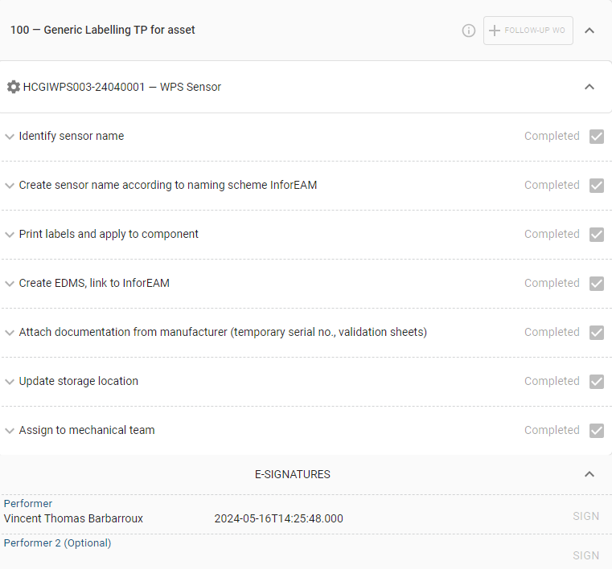
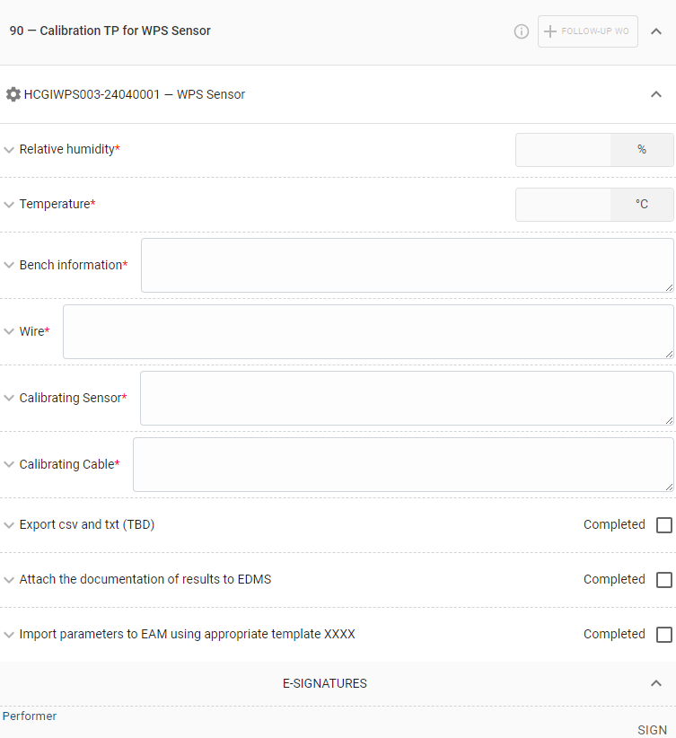
Process
Asset Hierarchy
Naming
Workflow
Translating to EAM
Sensor Parameter
Asset
Parent Standard Workorder
Standard Workorder
1.
Task
Plan
Standard Workorder
2.
Task
Plan
.
.
Standard Workorder
X.
Task
Plan
Note: Initial Structure
Name ID
Notes:
25. As an example, the labelling taskplan acts as a guide and checklist for the actions to be completed.
Also, for accountability we have added e-signatures for performer and the final reviewer. Another example is the calibration taskplan, which includes checklist for actions to be completed and also fields for data entry to store data generated during the worktasks.

Slide 26
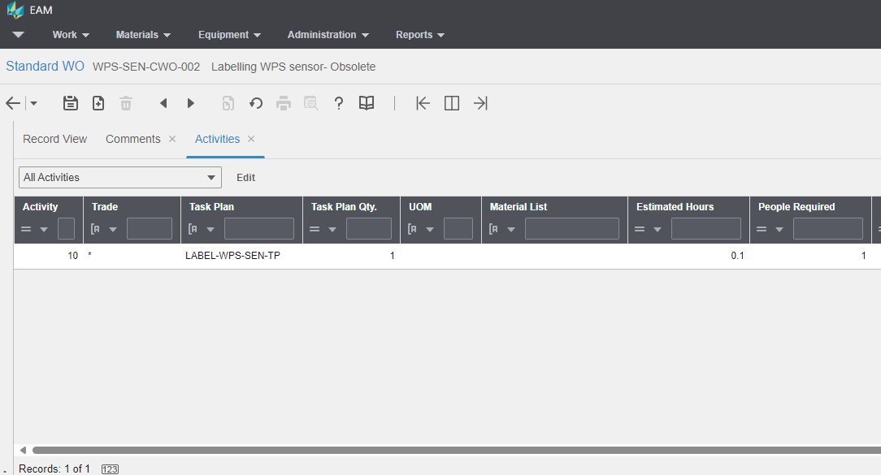
Process
Asset Hierarchy
Naming
Workflow
Translating to EAM
Sensor Parameter
Asset
Parent Standard Workorder
Standard Workorder
1.
Task
Plan
Standard Workorder
2.
Task
Plan
.
.
Standard Workorder
X.
Task
Plan
Note: Initial Structure
Notes:
26. This taskplan is then added as an activity to a Standard Workorder, similarly various taskplans could be attached individually to a specified standard workorder

Slide 27
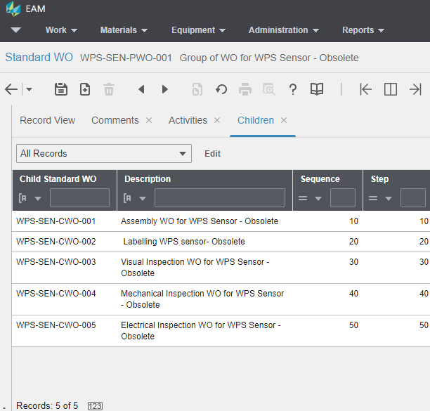
Process
Asset Hierarchy
Naming
Workflow
Translating to EAM
Sensor Parameter
Asset
Parent Standard Workorder
Standard Workorder
1.
Task
Plan
Standard Workorder
2.
Task
Plan
.
.
Standard Workorder
X.
Task
Plan
Note: Initial Structure
Notes:
27. Multiple standard workorders are attached to a Parent Standard workorder as child standard workorders

Slide 28
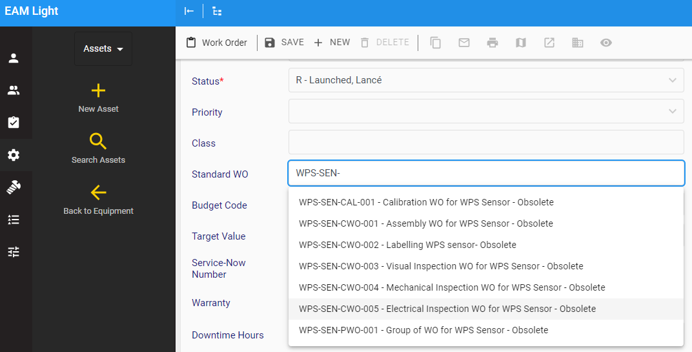
Process
Asset Hierarchy
Naming
Workflow
Translating to EAM
Sensor Parameter
Asset
Parent Standard Workorder
Standard Workorder
1.
Task
Plan
Standard Workorder
2.
Task
Plan
.
.
Standard Workorder
X.
Task
Plan
Note: Initial Structure
Notes:
28. Finally, when assigning workorders to an asset, individual standard workorders need not be attached
only the Parent Standard Workorder is needed to be attached to the asset and the child standard workorders are automatically then registered to the specific asset

Slide 29
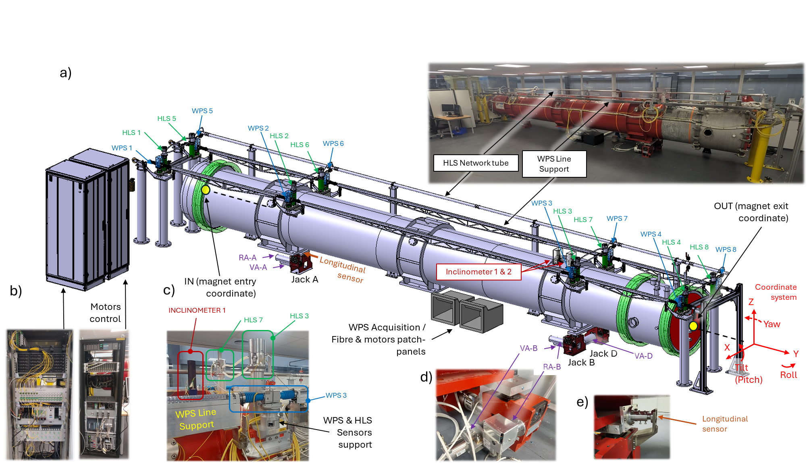
Process
Implemented in SCT
  Functional Positions and Assets defined → Completed
  Storage management → Completed
  Parameters retrieved automatically→ Completed
Notes:
29. We successfully implemented this structure for the SCT where we defined the functional positions and assets, alongwith storage management and tested the retrieval of sensor parameters.
Just a note, since SCT is mock-up we generated the functional positions but for Hi-Lumi the functional positions would be already generated in Layout and the pushed to EAM

Slide 30
Process
Feedback from SCT: Issues to Improvements
Pros | Limitations
Just 1 PSWO is to be attached per asset | If there are X workorders associated with an asset, using Parent SWO makes the total number of workorders to (X+1) *Additional documentation
One taskplan per workorder → Updates/additions are limited to only 1 taskplan and workorder | Not sequential
Easy assignment per task (no sharing)
Asset
Standard Workorder 1
Standard Workorder 2
Standard Workorder X
Iteration 1
Iteration 2
Iteration 3
Iteration 4
Task
Plan 01
Task
Plan 01
Task
Plan 01
Task
Plan 02
Task
Plan 02
Task
Plan 02
.
.
.
.
.
.
Task
Plan ..
Task
Plan ..
Task
Plan ..
Note: Updated Structure
Notes:
30. The SCT implementation provided us with feedback regarding workorder structure i.e. having a Parent Standard workorder increased documentation for the end-user. Also, the workorders are not visible in a sequence.
We improved the structure to make it more end-user friendly.
This is how the new updated structure looks, where multiple taskplans are grouped into a standard workorder and then attached to the asset.

Slide 31
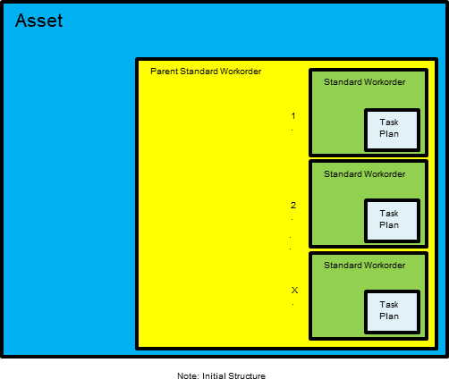
Process
Asset
Standard Workorder 1
Standard Workorder 2
Standard Workorder X
Task
Plan 01
Task
Plan 01
Task
Plan 01
Task
Plan 02
Task
Plan 02
Task
Plan 02
.
.
.
.
.
.
Task
Plan ..
Task
Plan ..
Task
Plan ..
Initial Structure:
Task A: 1 child SWO
Task B: 1 child SWO
Task C: 1 child SWO
Task D: 1 child SWO
Task E: 1 child SWO
Task F: 1 child SWO
Task G: 1 child SWO
Task H: 1 child SWO
Task I: 1 child SWO
PSWO: 9 child SWO’s
Therefore, total workorders to be completed = 1 PSWO + 9 child SWO = 10
Note: Updated Structure
Updated Structure:
Tasks A, B, C, D: 1 child SWO
Task E, F, G: 1 child SWO
Task H, I: 1 child SWO
Therefore, total workorders to be completed = 3 SWO
Notes:
31. When compared with the initial structure, there are multiple taskplans attached to a workorder.
But the overall number of workorders to be completed is less.
Sequential release of workorders possible if handled by dedicated resource.

Slide 32
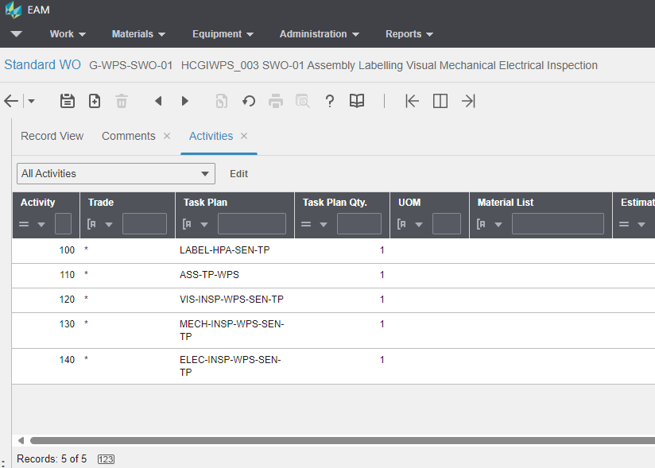
Process
Iteration 1
Iteration 2
Iteration 3
Iteration 4
Asset
Standard Workorder 1
Standard Workorder 2
Standard Workorder X
Task
Plan 01
Task
Plan 01
Task
Plan 01
Task
Plan 02
Task
Plan 02
Task
Plan 02
.
.
.
.
.
.
Task
Plan ..
Task
Plan ..
Task
Plan ..
Note: Updated Structure
Notes:
32. An example of how the new structure looks in EAM

Slide 33



Process
How to manage data? Data entry, storage of assets, reference documents
Data entry?
  Manual/ On-the-go data input
  Mass uploading
Template:
Asset
Workorder
Parameter
etc
Notes:
33. Then, moving on to how to manage data? Related to data entry, storage of assets and reference documents
For a few quick data entries it could be done by manual entry and for mass data entry it could be done semi-automatically by using standard excel templates uploaded through CERN upload utility for EAM.

Slide 34
Process
Storage of assets?
  Managing inventory
  Storage locations
904-S-409-Sx-Lyz
904-S-409-Sx-Lyz
904-S-409-Sx-Lyz
904-S-409-Sx-Lyz
904-S-409-Sx-Lyz
926-R-001-Pallet01
926-R-001-Box01
926-R-001-Box02
926-R-001-Box03
926-R-001-Box04
GM-HPA Store
(Virtual Store in Kiosk)
Locations
(Bins in Kiosk)
Notes:
34. To manage inventory and track asset locations we established a virtual GM-HPA store in EAM Kiosk. All the locations where the assets are stored/would be stored are generated as bins inside the GM-HPA virtual store

Slide 35
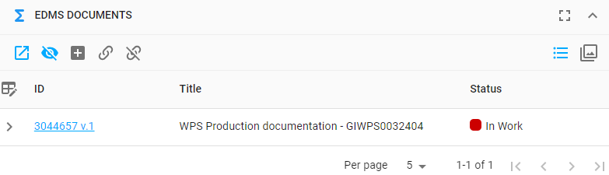
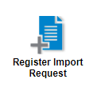
Process
Links to reference documents/EDMS?
  Individual link upload for specific technical documentation
  Mass uploading using EDMS upload
Notes:
35. To link edms documents related to manufacturers sheets, inspection data sheets etc individual links could be attached to an asset. If mass upload is required EDMS upload utility could be used to link individual link or multiple links to assets

Slide 36
Future Steps
Sensor improvements → Possibility of modifications of asset hierarchy, workflow
Implementation on IT String Test → first time several components integration
The final implementation of FRAS
User friendly interface approach for workorders/installation:
  E-Manufacturing inspection plan
  Automated and sequential release of workorders
  PM Schedules
    Repetitive
  Maintenance Patterns
Notes:
36. For future steps or improvements, for sensors if there are improvements there is a possibility of modifications in asset hierarchy and workflow.
Next, Implementation on IT-String which would involve first time integration of multiple components.
Then, final implementation of FRAS
Improvements in the user-interface during installation, we are looking into these options like E-Manufacturing inspection plan, automated and sequential release of workorders, PM schedules, Maintenance Patterns.

Slide 37
References
EDMS 2166298
Introduction - String (cern.ch) https://string-sm18.web.cern.ch/#integration
Full Remote Alignment System – Fesa And Scada Software by M.Sosin EDMS: 2776384
2022_IWAA_paper_herty-et-al
https://lhc-div-miwg.web.cern.ch/HL-LHC/Main_Pages_HL_LHC/new_frame_hl_lhc.htm
Equipment Naming for SCT by A. Herty, V. Barbarroux EDMS:2906090
HPA Newcomer Sessions (GM-HPA Alignment systems R&D 2021-12-09 by M. Sosin and V. Rude, LHC low beta quadrupoles associated CPDS, maintenance & consolidation by A. Herty)

Slide 38
Thank you
Thank you to EAM Support Team

