Slide 1



Tuning simulations Updates
1
Elaf Musa
Thanks to: R. Tomas for valuable inputs
FCC-ee tuning WG meeting
13th Sep 2024
FCCIS – The Future Circular Collider Innovation Study. This INFRADEV Research and Innovation Action project receives funding from the European Union’s H2020 Framework Programme under grant agreement no. 951754.

Slide 2
2
Table of content
Tuning simulations:
- BPMs attached to quadrupoles vs. sextupoles
- Girders misalignments
Used lattice:
- Tuning test has been done for V23 @ Z, DA calculation issue is being
discussed with AT developers.
- In this talk, V22 @ Z is used.
Notes:
Ttbar, 4IP lattice. These are the main results.
%$\epsilon_{x, \textrm{median}} = 1.509$ nm rad \\
%$\epsilon_{y, \textrm{median}} = 0.353$ pm rad \\
$\frac{\epsilon_{y}}{\epsilon_{x}} = 0.023$ $\%$ \\
\begin{table}[htb!]
\centering
\begin{tabular}{p{3cm}cccccc}
\hline
Type & $\Delta$X & $\Delta$Y & $\Delta$PSI & $\Delta$S & $\Delta$THETA & $\Delta$PHI \\
& ($\mu$m) & ($\mu$m) & ($\mu$rad) & ($\mu$m) & ($\mu$rad) & ($\mu$rad) \\
\vspace{.1cm} \\
\hline
Arc quadrupole* & 100 & 100 & 300 & 150 & 70 & 70 \\
Arc sextupoles* & 100 & 100 & 300 & 150 & 70 & 70 \\
\hline
Dipoles & 1000 & 1000 & 300 & 1000 & 0 & 0 \\
\hline
Girders & 200 & 200 & - & 1000 & 0 & 0 \\
\hline
IR quadrupole & 100 & 100 & 250 & 200 & 70 & 70 \\
IR sextupoles & 25 & 25 & 250 & 200 & 70 & 70 \\
%\hline
% BPM** & 40 & 40 & 100 & - \\
\hline
\end{tabular}
\end{table}

Slide 3
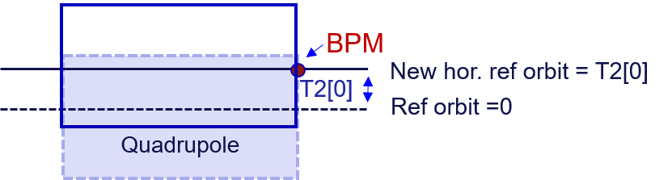
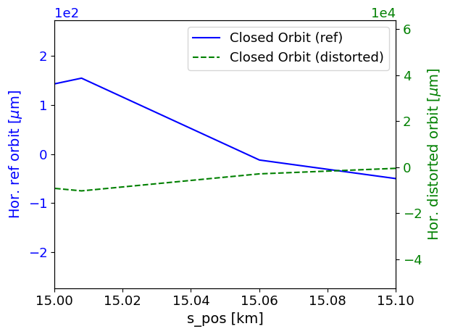
3
Adding BPMs alignments in PyAT
x
BPMs are attached to each quadrupole or to each sextupole.
The value of each BPM offset are equal to the assigned offset errors to the corresponding quadrupole or sextupole.
The hor. & ver. BPM offsets represent the new hor. & ver. reference orbit.
Orbit to be corrected = distorted orbit (AT get_optics function) – new reference orbit.
s
Notes:
Ttbar, 4IP lattice. These are the main results.
%$\epsilon_{x, \textrm{median}} = 1.509$ nm rad \\
%$\epsilon_{y, \textrm{median}} = 0.353$ pm rad \\
$\frac{\epsilon_{y}}{\epsilon_{x}} = 0.023$ $\%$ \\
\begin{table}[htb!]
\centering
\begin{tabular}{p{3cm}cccccc}
\hline
Type & $\Delta$X & $\Delta$Y & $\Delta$PSI & $\Delta$S & $\Delta$THETA & $\Delta$PHI \\
& ($\mu$m) & ($\mu$m) & ($\mu$rad) & ($\mu$m) & ($\mu$rad) & ($\mu$rad) \\
\vspace{.1cm} \\
\hline
Arc quadrupole* & 100 & 50 & 300 & 150 & 70 & 70 \\
Arc sextupoles* & 100 & 50 & 300 & 150 & 70 & 70 \\
\hline
Dipoles & 1000 & 1000 & 300 & 1000 & 0 & 0 \\
\hline
Girders & 200 & 200 & - & 1000 & 0 & 0 \\
\hline
IR quadrupole & 100 & 100 & 250 & 200 & 70 & 70 \\
IR sextupoles & 100 & 100 & 250 & 200 & 70 & 70 \\
%\hline
% BPM** & 40 & 40 & 100 & - \\
\hline
\end{tabular}
\end{table}

Slide 4
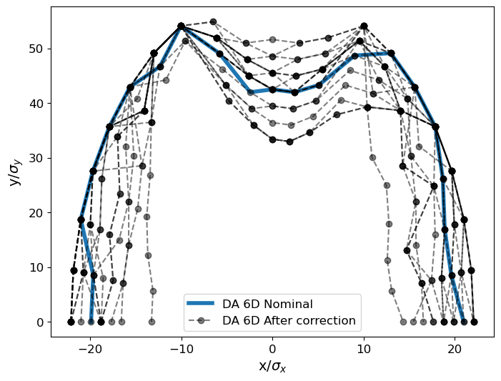
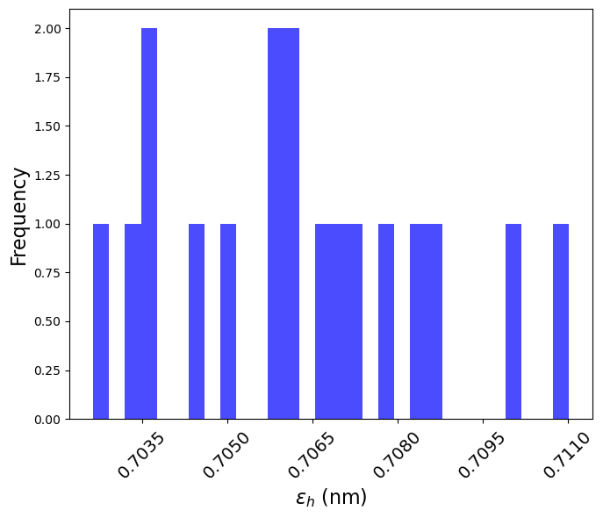
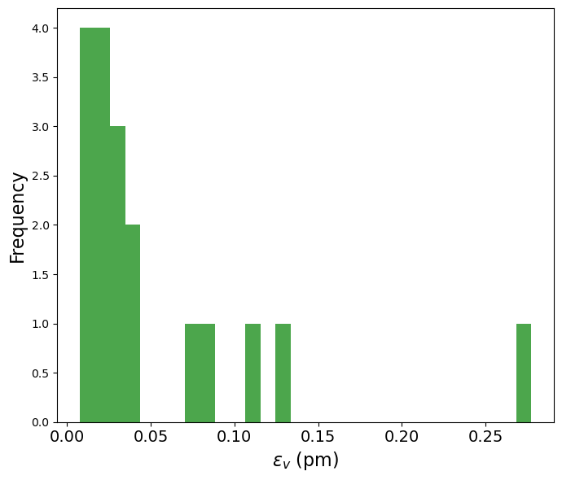
4
Elements | Hor. & Ver. displacement | Tilt θ
Arc quads and sext | 100 μm | 100 μrad
All dipoles | 150 μm | 150 μrad
BPMs | same as quads. | -
After correction of alignment errors
BPMs aligned to quadrupoles
20 seeds/ 1 failed seed + 1 removed large outlier
median εy = 0.03 pm
Notes:
Ttbar, 4IP lattice. These are the main results.
%$\epsilon_{x, \textrm{median}} = 1.509$ nm rad \\
%$\epsilon_{y, \textrm{median}} = 0.353$ pm rad \\
$\frac{\epsilon_{y}}{\epsilon_{x}} = 0.023$ $\%$ \\
\begin{table}[htb!]
\centering
\begin{tabular}{p{3cm}cccccc}
\hline
Type & $\Delta$X & $\Delta$Y & $\Delta$PSI & $\Delta$S & $\Delta$THETA & $\Delta$PHI \\
& ($\mu$m) & ($\mu$m) & ($\mu$rad) & ($\mu$m) & ($\mu$rad) & ($\mu$rad) \\
\vspace{.1cm} \\
\hline
Arc quadrupole* & 100 & 50 & 300 & 150 & 70 & 70 \\
Arc sextupoles* & 100 & 50 & 300 & 150 & 70 & 70 \\
\hline
Dipoles & 1000 & 1000 & 300 & 1000 & 0 & 0 \\
\hline
Girders & 200 & 200 & - & 1000 & 0 & 0 \\
\hline
IR quadrupole & 100 & 100 & 250 & 200 & 70 & 70 \\
IR sextupoles & 100 & 100 & 250 & 200 & 70 & 70 \\
%\hline
% BPM** & 40 & 40 & 100 & - \\
\hline
\end{tabular}
\end{table}

Slide 5
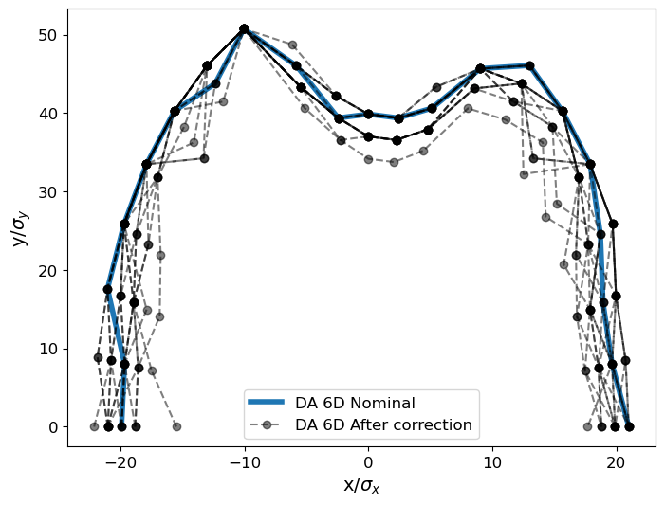
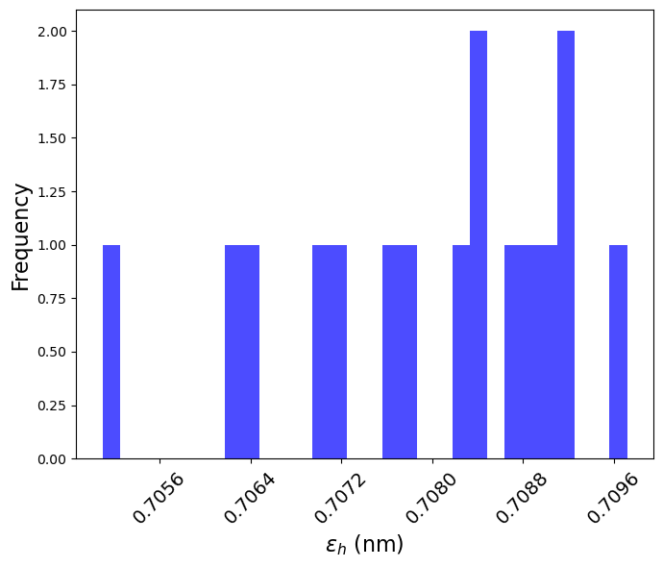
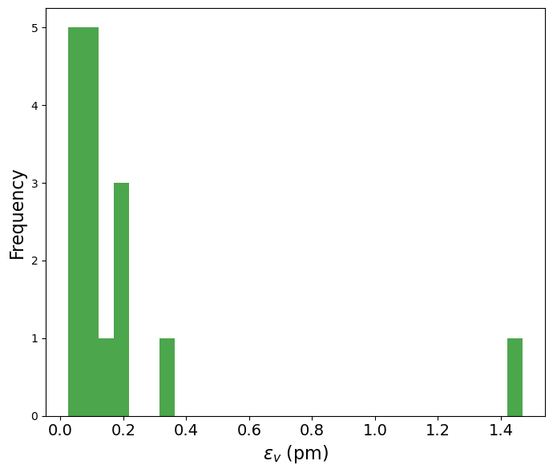
5
Elements | Hor. & Ver. displacement | Tilt θ
Arc quads and sext | 100 μm | 100 μrad
All dipoles | 150 μm | 150 μrad
BPMs | same as sext. | -
After correction of alignment errors
BPMs aligned to sextupoles
20 seeds/ 4 failed seeds
median εy =0.10 pm
Notes:
Ttbar, 4IP lattice. These are the main results.
%$\epsilon_{x, \textrm{median}} = 1.509$ nm rad \\
%$\epsilon_{y, \textrm{median}} = 0.353$ pm rad \\
$\frac{\epsilon_{y}}{\epsilon_{x}} = 0.023$ $\%$ \\
\begin{table}[htb!]
\centering
\begin{tabular}{p{3cm}cccccc}
\hline
Type & $\Delta$X & $\Delta$Y & $\Delta$PSI & $\Delta$S & $\Delta$THETA & $\Delta$PHI \\
& ($\mu$m) & ($\mu$m) & ($\mu$rad) & ($\mu$m) & ($\mu$rad) & ($\mu$rad) \\
\vspace{.1cm} \\
\hline
Arc quadrupole* & 100 & 50 & 300 & 150 & 70 & 70 \\
Arc sextupoles* & 100 & 50 & 300 & 150 & 70 & 70 \\
\hline
Dipoles & 1000 & 1000 & 300 & 1000 & 0 & 0 \\
\hline
Girders & 200 & 200 & - & 1000 & 0 & 0 \\
\hline
IR quadrupole & 100 & 100 & 250 & 200 & 70 & 70 \\
IR sextupoles & 100 & 100 & 250 & 200 & 70 & 70 \\
%\hline
% BPM** & 40 & 40 & 100 & - \\
\hline
\end{tabular}
\end{table}

Slide 6
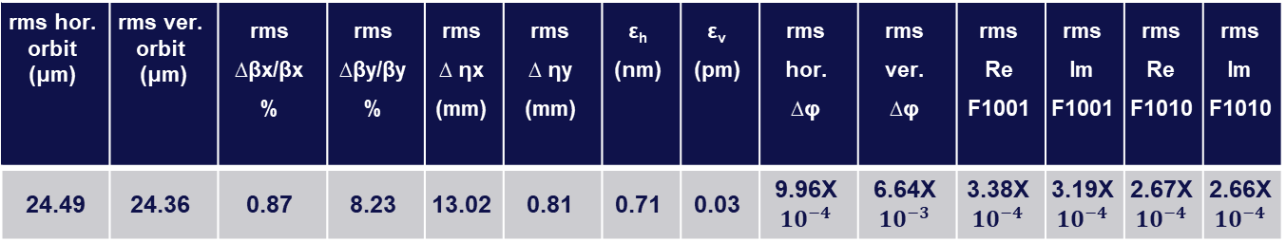
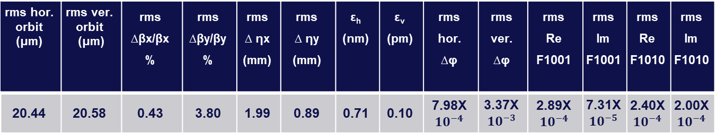
6
Optics parameters after correction (median values)
BPMs aligned to quadrupoles
rms hor. orbit (μm) | rms ver. orbit (μm) | rms ∆βx/βx % | rms ∆βy/βy% | rms ∆ ηx (mm) | rms ∆ ηy (mm) | ε_{h} (nm) | ε_{v} (pm) | rms hor. ∆φ | rms ver. ∆φ | rms Re F1001 | rms Im F1001 | rms Re F1010 | rms Im F1010
24.49 | 24.36 | 0.87 | 8.23 | 13.02 | 0.81 | 0.71 | 0.03 | 9.96X $${10}^{−4}$$ | 6.64X $${10}^{−3}$$ | 3.38X $${10}^{−4}$$ | 3.19X $${10}^{−4}$$ | 2.67X $${10}^{−4}$$ | 2.66X $${10}^{−4}$$
BPMs aligned to sextupoles
rms hor. orbit (μm) | rms ver. orbit (μm) | rms ∆βx/βx % | rms ∆βy/βy% | rms ∆ ηx (mm) | rms ∆ ηy (mm) | ε_{h} (nm) | ε_{v} (pm) | rms hor. ∆φ | rms ver. ∆φ | rms Re F1001 | rms Im F1001 | rms Re F1010 | rms Im F1010
20.44 | 20.58 | 0.43 | 3.80 | 1.99 | 0.89 | 0.71 | 0.10 | 7.98X $${10}^{−4}$$ | 3.37X $${10}^{−3}$$ | 2.89X $${10}^{−4}$$ | 7.31X $${10}^{−5}$$ | 2.40X $${10}^{−4}$$ | 2.00X $${10}^{−4}$$
Notes:
Ttbar, 4IP lattice. These are the main results.
%$\epsilon_{x, \textrm{median}} = 1.509$ nm rad \\
%$\epsilon_{y, \textrm{median}} = 0.353$ pm rad \\
$\frac{\epsilon_{y}}{\epsilon_{x}} = 0.023$ $\%$ \\
\begin{table}[htb!]
\centering
\begin{tabular}{p{3cm}cccccc}
\hline
Type & $\Delta$X & $\Delta$Y & $\Delta$PSI & $\Delta$S & $\Delta$THETA & $\Delta$PHI \\
& ($\mu$m) & ($\mu$m) & ($\mu$rad) & ($\mu$m) & ($\mu$rad) & ($\mu$rad) \\
\vspace{.1cm} \\
\hline
Arc quadrupole* & 100 & 50 & 300 & 150 & 70 & 70 \\
Arc sextupoles* & 100 & 50 & 300 & 150 & 70 & 70 \\
\hline
Dipoles & 1000 & 1000 & 300 & 1000 & 0 & 0 \\
\hline
Girders & 200 & 200 & - & 1000 & 0 & 0 \\
\hline
IR quadrupole & 100 & 100 & 250 & 200 & 70 & 70 \\
IR sextupoles & 100 & 100 & 250 & 200 & 70 & 70 \\
%\hline
% BPM** & 40 & 40 & 100 & - \\
\hline
\end{tabular}
\end{table}

Slide 7
7
For arc magnets
Adding Girders misalignments
Case 1
Orb. Cor.
Sext.
Quad
BPM
Elements | Hor. & Ver. displacement | Tilt θ
Arc quads and sext. | 50 μm | 50 μrad
All dipoles | 150 μm | 150 μrad
BPMs | same as quads/sext. | -
Girders | 150 μm | -
Dipole
Girder
Girder
Case 2
Dipole
Girder
Girder
Notes:
Ttbar, 4IP lattice. These are the main results.
%$\epsilon_{x, \textrm{median}} = 1.509$ nm rad \\
%$\epsilon_{y, \textrm{median}} = 0.353$ pm rad \\
$\frac{\epsilon_{y}}{\epsilon_{x}} = 0.023$ $\%$ \\
\begin{table}[htb!]
\centering
\begin{tabular}{p{3cm}cccccc}
\hline
Type & $\Delta$X & $\Delta$Y & $\Delta$PSI & $\Delta$S & $\Delta$THETA & $\Delta$PHI \\
& ($\mu$m) & ($\mu$m) & ($\mu$rad) & ($\mu$m) & ($\mu$rad) & ($\mu$rad) \\
\vspace{.1cm} \\
\hline
Arc quadrupole* & 100 & 50 & 300 & 150 & 70 & 70 \\
Arc sextupoles* & 100 & 50 & 300 & 150 & 70 & 70 \\
\hline
Dipoles & 1000 & 1000 & 300 & 1000 & 0 & 0 \\
\hline
Girders & 200 & 200 & - & 1000 & 0 & 0 \\
\hline
IR quadrupole & 100 & 100 & 250 & 200 & 70 & 70 \\
IR sextupoles & 100 & 100 & 250 & 200 & 70 & 70 \\
%\hline
% BPM** & 40 & 40 & 100 & - \\
\hline
\end{tabular}
\end{table}

Slide 8
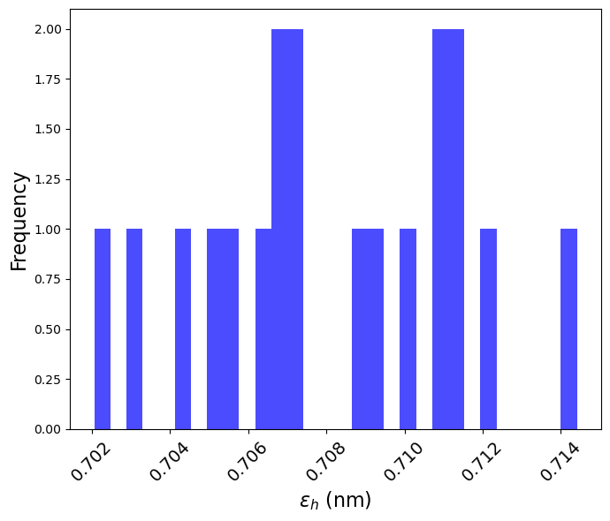
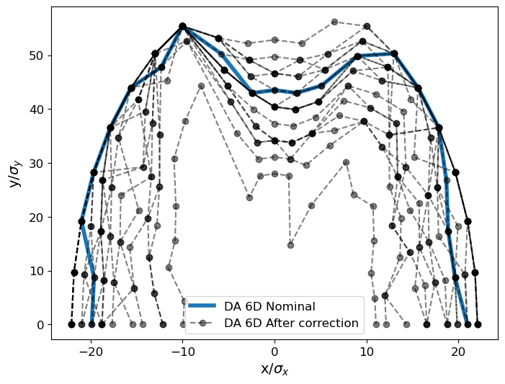
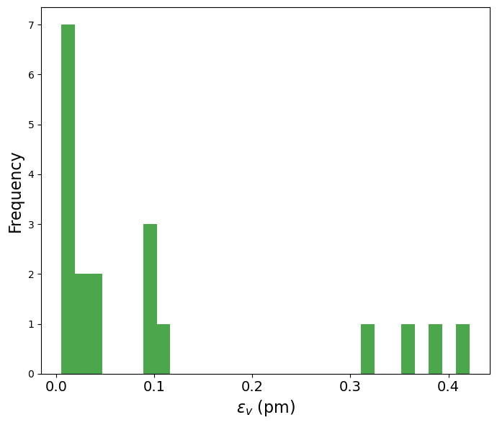
8
After correction of alignment errors
Case 1
BPMs aligned to quadrupoles
20 seeds
median εy = 0.04 pm
Notes:
Ttbar, 4IP lattice. These are the main results.
%$\epsilon_{x, \textrm{median}} = 1.509$ nm rad \\
%$\epsilon_{y, \textrm{median}} = 0.353$ pm rad \\
$\frac{\epsilon_{y}}{\epsilon_{x}} = 0.023$ $\%$ \\
\begin{table}[htb!]
\centering
\begin{tabular}{p{3cm}cccccc}
\hline
Type & $\Delta$X & $\Delta$Y & $\Delta$PSI & $\Delta$S & $\Delta$THETA & $\Delta$PHI \\
& ($\mu$m) & ($\mu$m) & ($\mu$rad) & ($\mu$m) & ($\mu$rad) & ($\mu$rad) \\
\vspace{.1cm} \\
\hline
Arc quadrupole* & 100 & 50 & 300 & 150 & 70 & 70 \\
Arc sextupoles* & 100 & 50 & 300 & 150 & 70 & 70 \\
\hline
Dipoles & 1000 & 1000 & 300 & 1000 & 0 & 0 \\
\hline
Girders & 200 & 200 & - & 1000 & 0 & 0 \\
\hline
IR quadrupole & 100 & 100 & 250 & 200 & 70 & 70 \\
IR sextupoles & 100 & 100 & 250 & 200 & 70 & 70 \\
%\hline
% BPM** & 40 & 40 & 100 & - \\
\hline
\end{tabular}
\end{table}

Slide 9
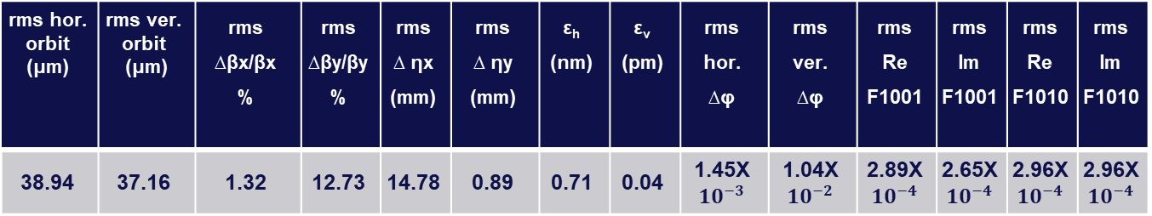
9
After correction of alignment errors
Case 1
BPMs aligned to quadrupoles
rms hor. orbit (μm) | rms ver. orbit (μm) | rms ∆βx/βx % | rms ∆βy/βy% | rms ∆ ηx (mm) | rms ∆ ηy (mm) | ε_{h} (nm) | ε_{v} (pm) | rms hor. ∆φ | rms ver. ∆φ | rms Re F1001 | rms Im F1001 | rms Re F1010 | rms Im F1010
38.94 | 37.16 | 1.32 | 12.73 | 14.78 | 0.89 | 0.71 | 0.04 | 1.45X $${10}^{−3}$$ | 1.04X $${10}^{−2}$$ | 2.89X $${10}^{−4}$$ | 2.65X $${10}^{−4}$$ | 2.96X $${10}^{−4}$$ | 2.96X $${10}^{−4}$$
Case 2
BPMs aligned to sextupoles
14 out of 20 seeds has failed when adding girders misalignment.
Notes:
Ttbar, 4IP lattice. These are the main results.
%$\epsilon_{x, \textrm{median}} = 1.509$ nm rad \\
%$\epsilon_{y, \textrm{median}} = 0.353$ pm rad \\
$\frac{\epsilon_{y}}{\epsilon_{x}} = 0.023$ $\%$ \\
\begin{table}[htb!]
\centering
\begin{tabular}{p{3cm}cccccc}
\hline
Type & $\Delta$X & $\Delta$Y & $\Delta$PSI & $\Delta$S & $\Delta$THETA & $\Delta$PHI \\
& ($\mu$m) & ($\mu$m) & ($\mu$rad) & ($\mu$m) & ($\mu$rad) & ($\mu$rad) \\
\vspace{.1cm} \\
\hline
Arc quadrupole* & 100 & 50 & 300 & 150 & 70 & 70 \\
Arc sextupoles* & 100 & 50 & 300 & 150 & 70 & 70 \\
\hline
Dipoles & 1000 & 1000 & 300 & 1000 & 0 & 0 \\
\hline
Girders & 200 & 200 & - & 1000 & 0 & 0 \\
\hline
IR quadrupole & 100 & 100 & 250 & 200 & 70 & 70 \\
IR sextupoles & 100 & 100 & 250 & 200 & 70 & 70 \\
%\hline
% BPM** & 40 & 40 & 100 & - \\
\hline
\end{tabular}
\end{table}

Slide 10
Thank you for your attention

Slide 11
Backups

