Slide 1




Ballistic Optics for FCC-ee
C. Garcia Jaimes, L. van Riesen-Haupt, T. Pieloni, R. Tomás
This work was performed under the auspices and with support from EPFL-GlobalLeaders under the Marie Skłodowska-Curie grant agreement No 945363.
September 2024

Slide 2
Overview
Ballistic optics aims at removing magnetic field gradients around the interaction point (IP) to use straight beam orbits for BPM alignment and calibration. In addition, this optics features very low chromaticity and no SR in the Final Doublet (ideal for first tuning).
Strategy:
Turn off certain IR quadrupoles and all IR sextupoles.
Match the optical functions (BETX, BETY, ALFX, ALFY, DX, DPX) at the start and end of the IR to the baseline values.
Aim to reduce the maximum beta functions in order to increase the Dynamic Aperture.
Notes:
To get the optical configuration you want → matching

Slide 3
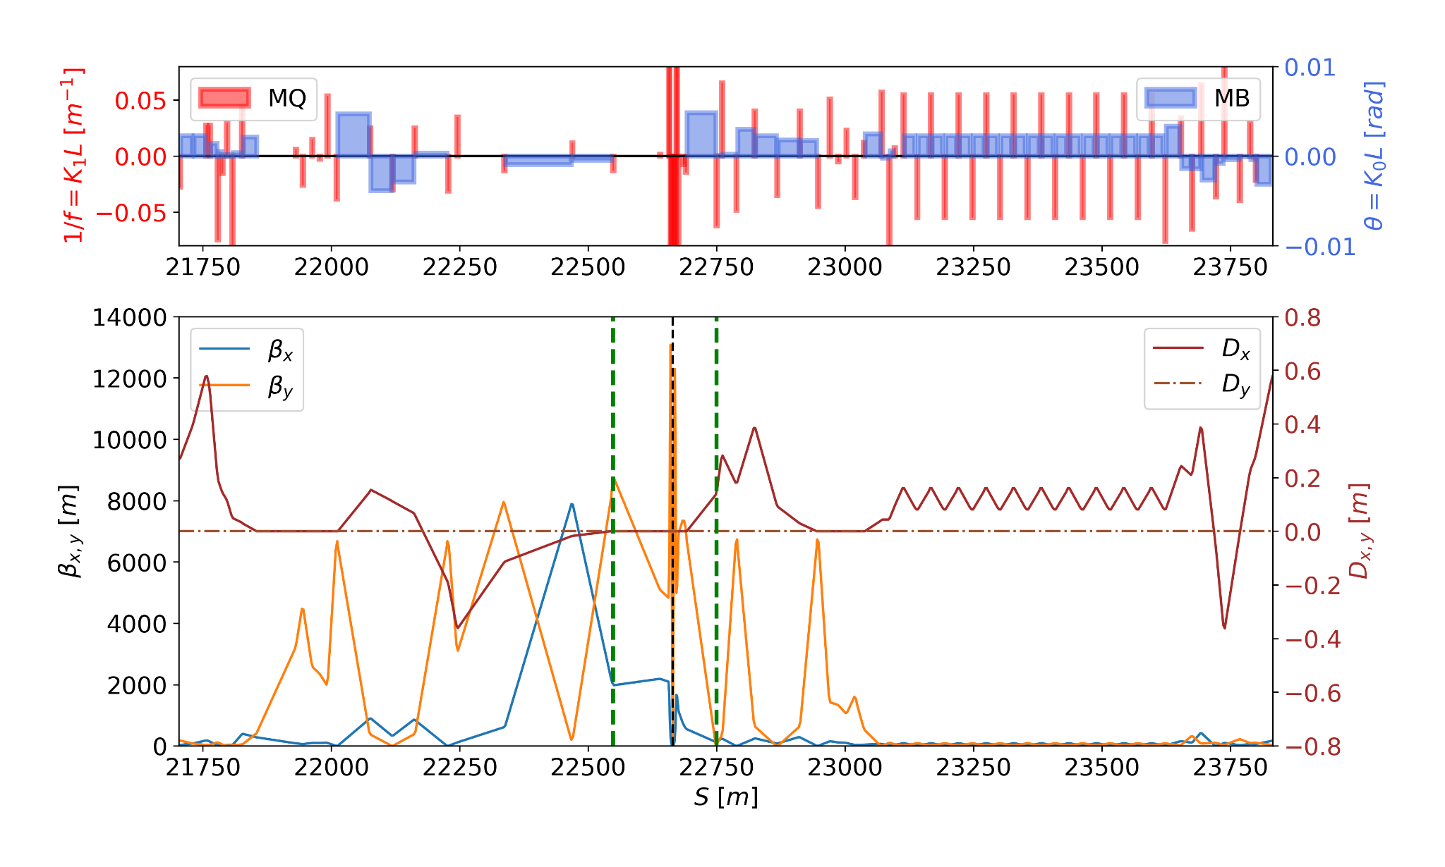
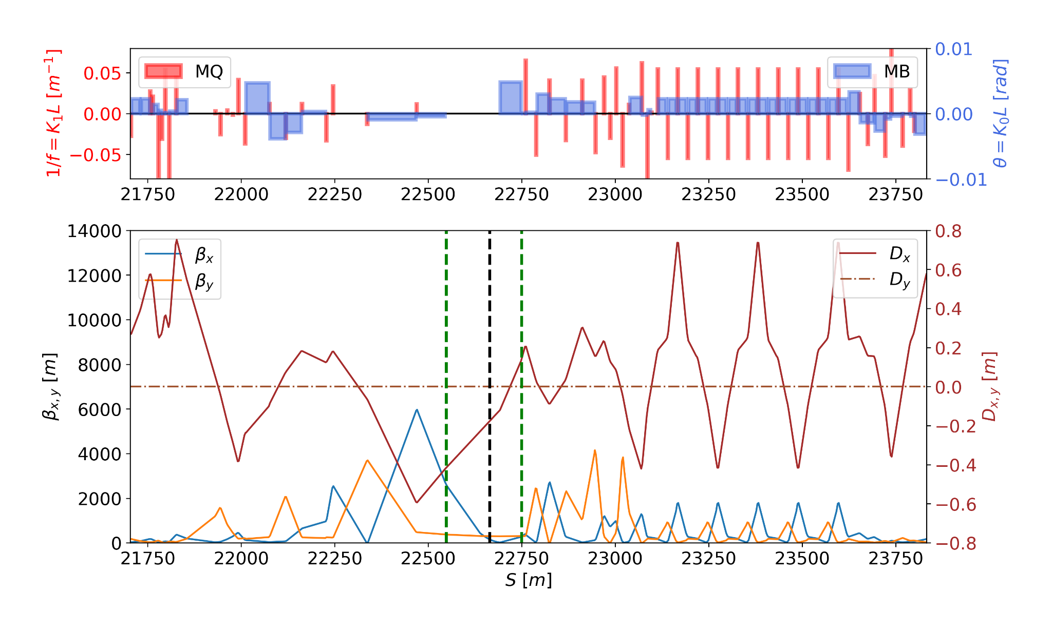
Definition of the Ballistic Region
Select a Ballistic Region (BR) in the Interaction Region (IR) and turn off the quadrupoles there.
Turn off all the sextupoles in the IR
Baseline lattice
Ballistic lattice
BR
BR
ARC2
IR
ARC3
ARC2
IR
ARC3
Notes:
To get the optical configuration you want → matching

Slide 4
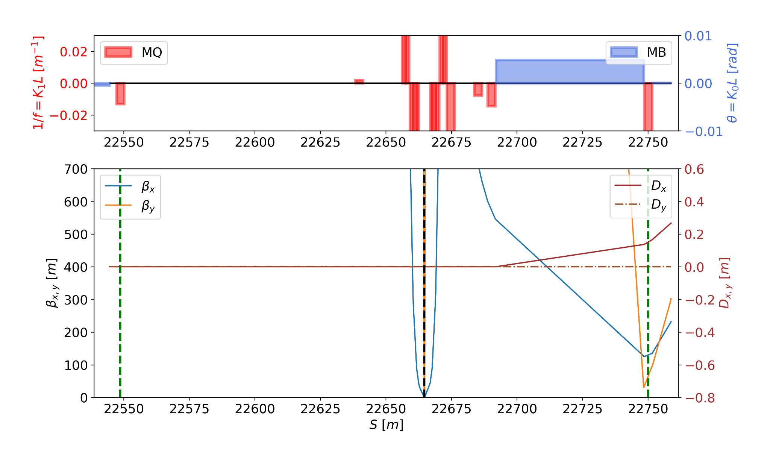
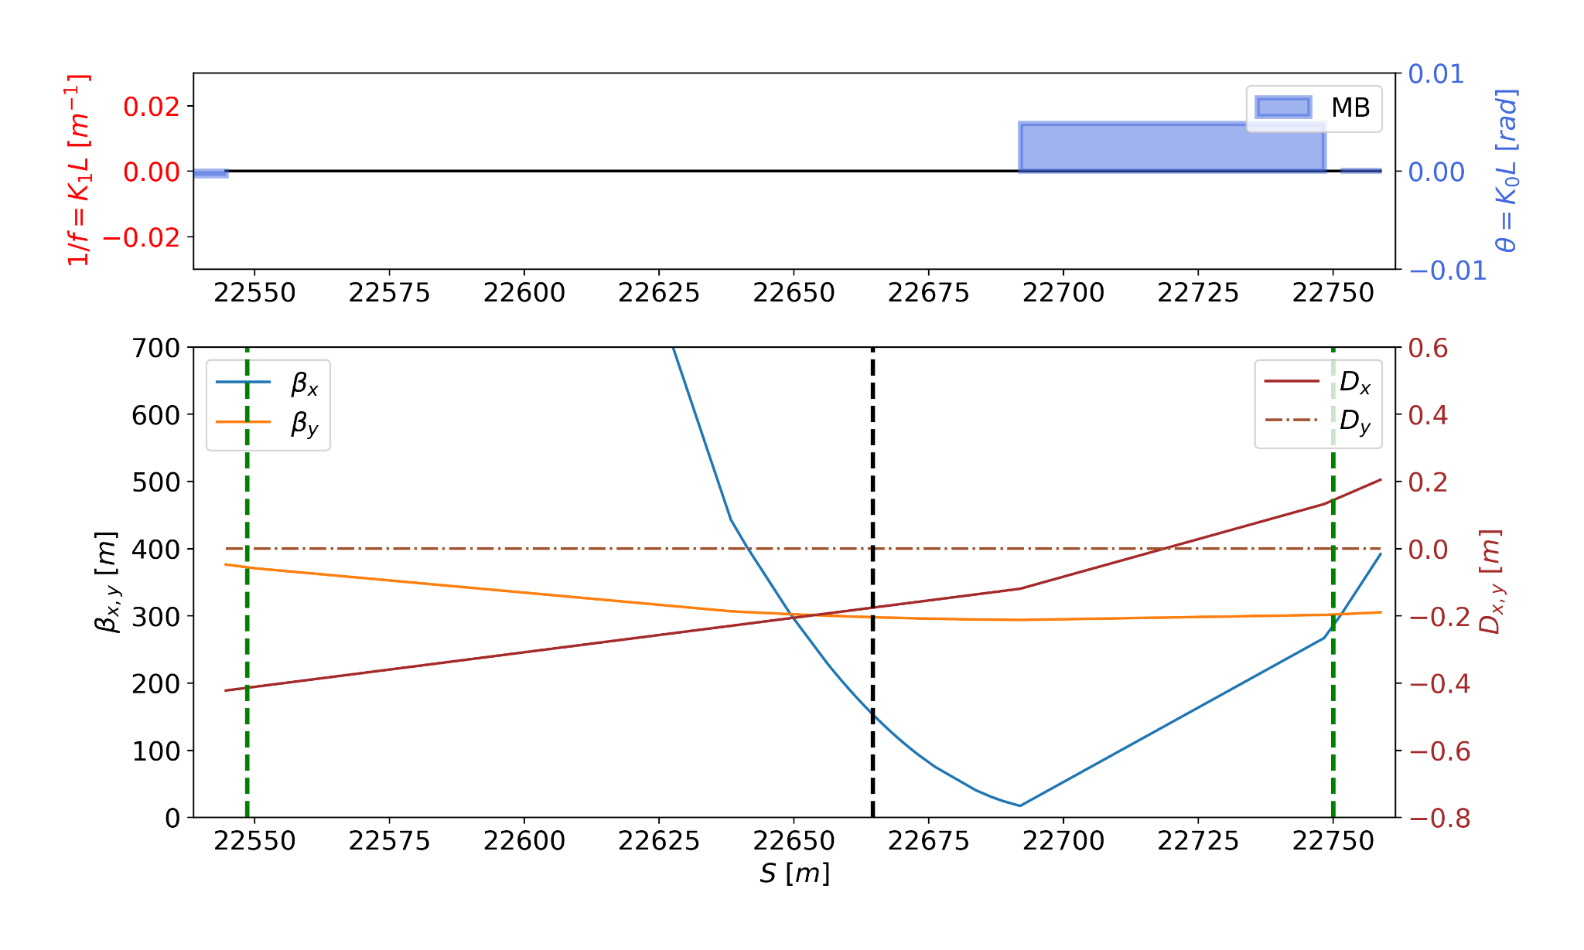
Definition of the Ballistic Region
Select a Ballistic Region (BR) in the Interaction Region (IR) and turn off the quadrupoles there.
Turn off all the sextupoles in the IR
Baseline lattice
Ballistic lattice
IP
IP
Ballistic Region
Ballistic Region
Notes:
To get the optical configuration you want → matching

Slide 5
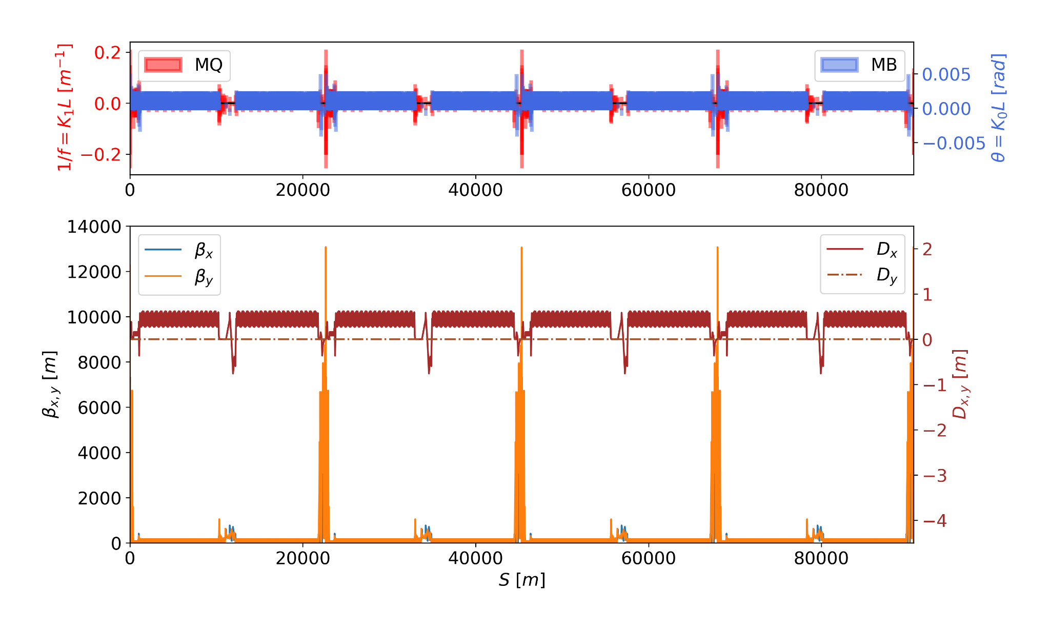
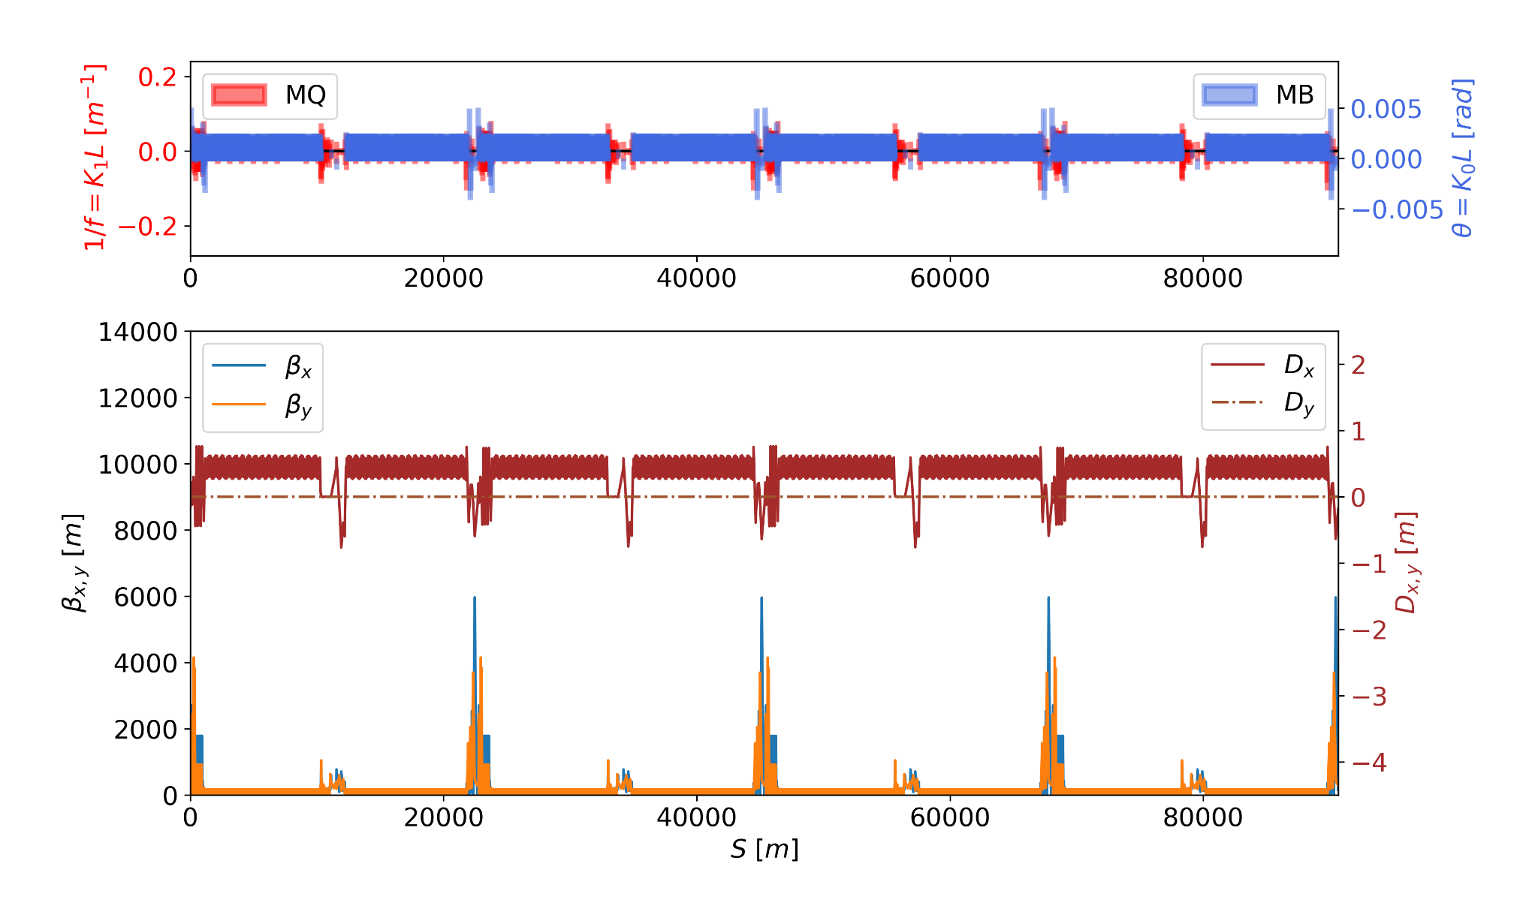
Maximum Beta Functions
With this optics, the maximum BETX and BETY functions are decreased by 30% and threefold, respectively.
Notes:
To get the optical configuration you want → matching

Slide 6
New parameters for the Ballistic Optics
FCC-ee_Z_v23 | Baseline | Ballistic
Betx Max [m] | 7884.28 | 5964.49
Bety Max [m] | 13076.04 | 4150.58
Dx max [m] | 0.75 | 0.75
Q1, Q2 | 218.15/222.19 | 217.77/220.37
dQ1, dQ2 | 0.29/4.28 | 0.00/-0.03
dQ1_nat dQ2_nat | -546.42 -3585.37 | -547.94 -586.93
Emittance [nm] | 0.70 | 0.85
Damping Partition Numbers | 1 1 2 | 1 1 2
Factors for sextupoles in arcs (scaling) | factork21f= 1.0 factork2ld= 1.0 | factork21f= 1.140 factork2ld= 1.760
Lower max beta functions.
The natural chromaticity in the lattice decreased and is corrected by the sextupoles in the arcs.
The emittance increases by 20%, but the DA is improved.

Slide 7
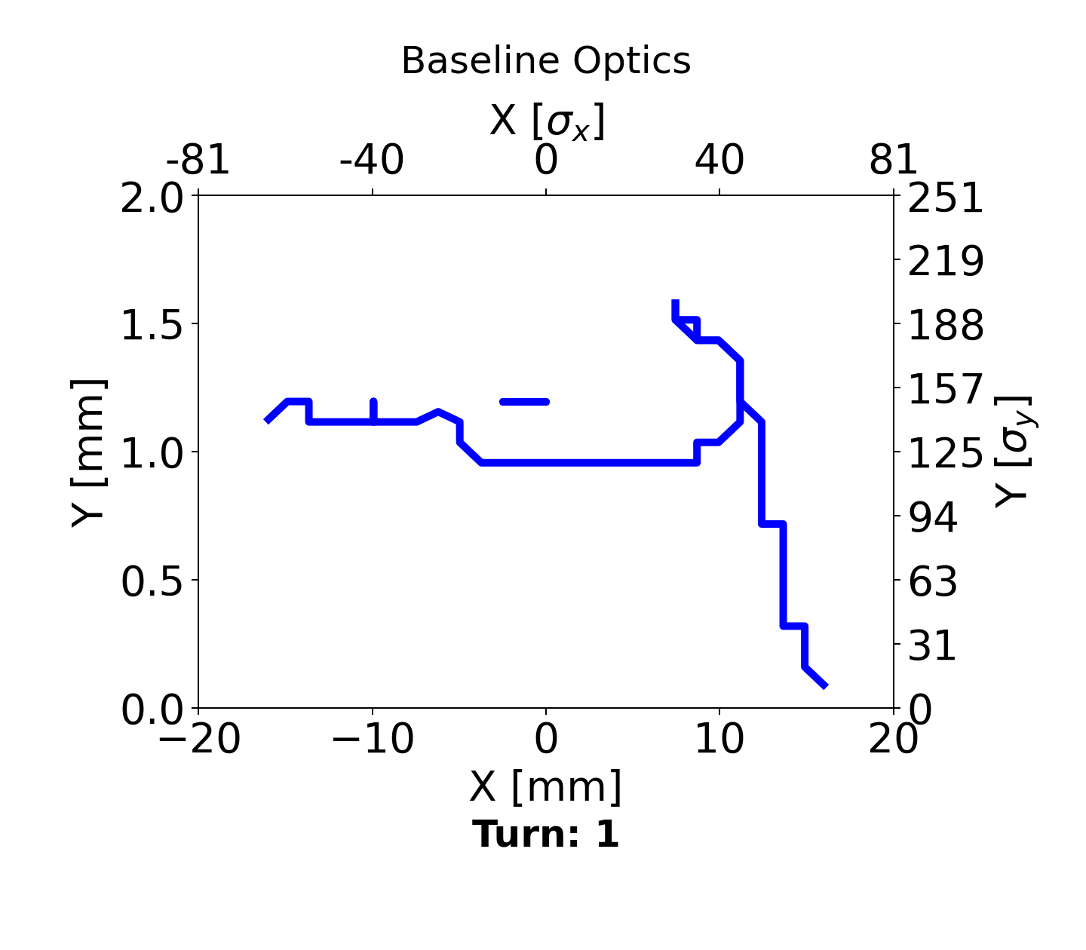
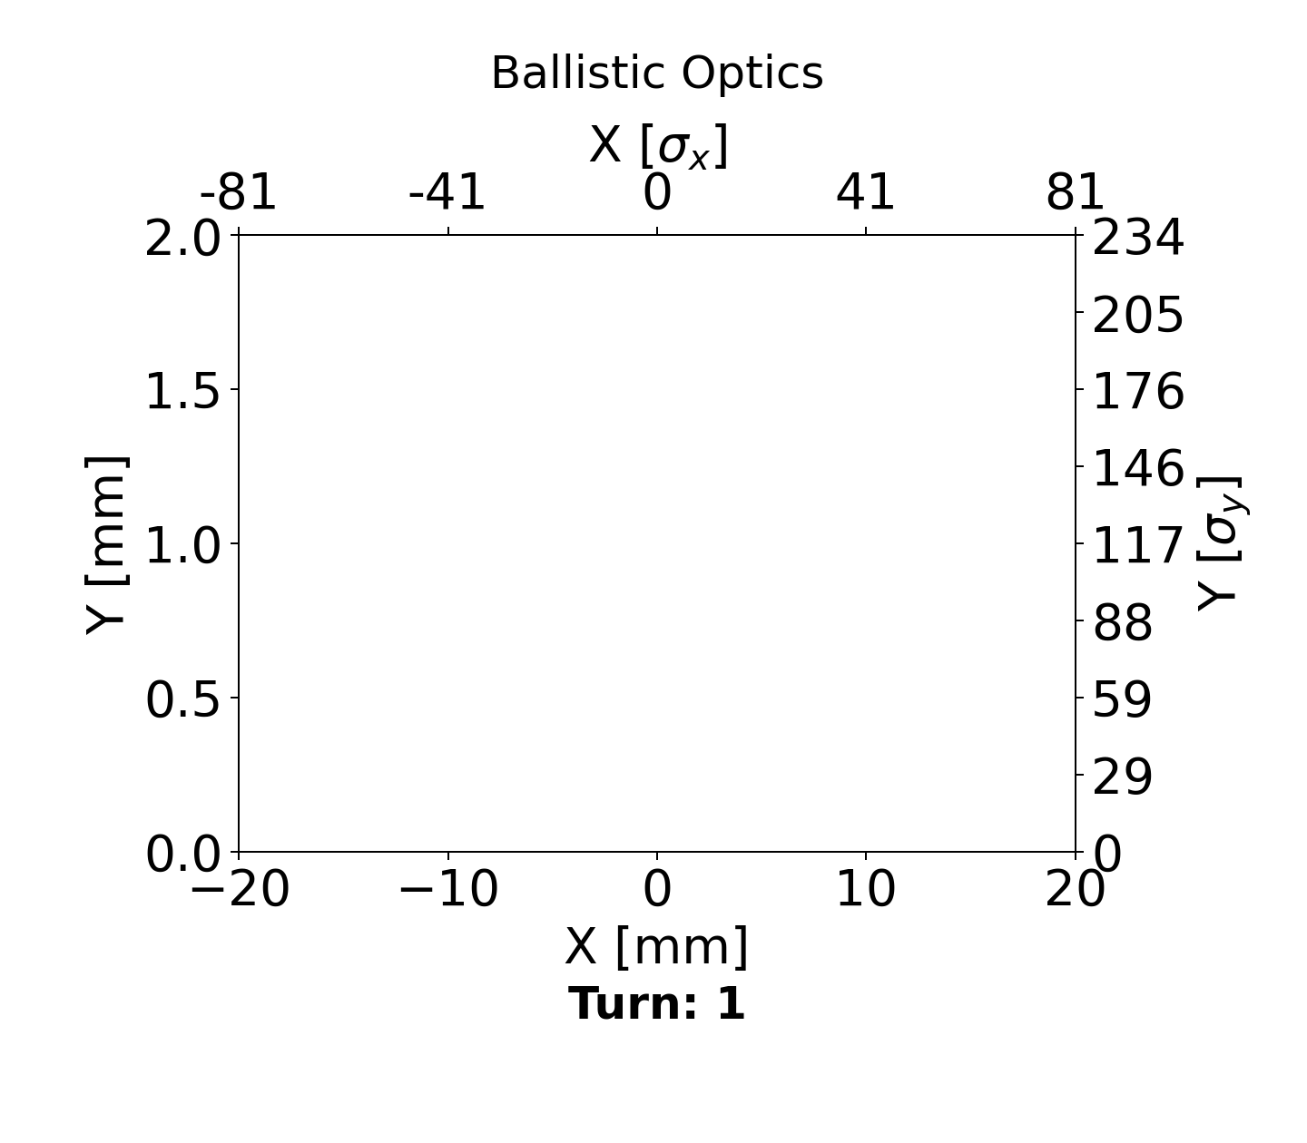
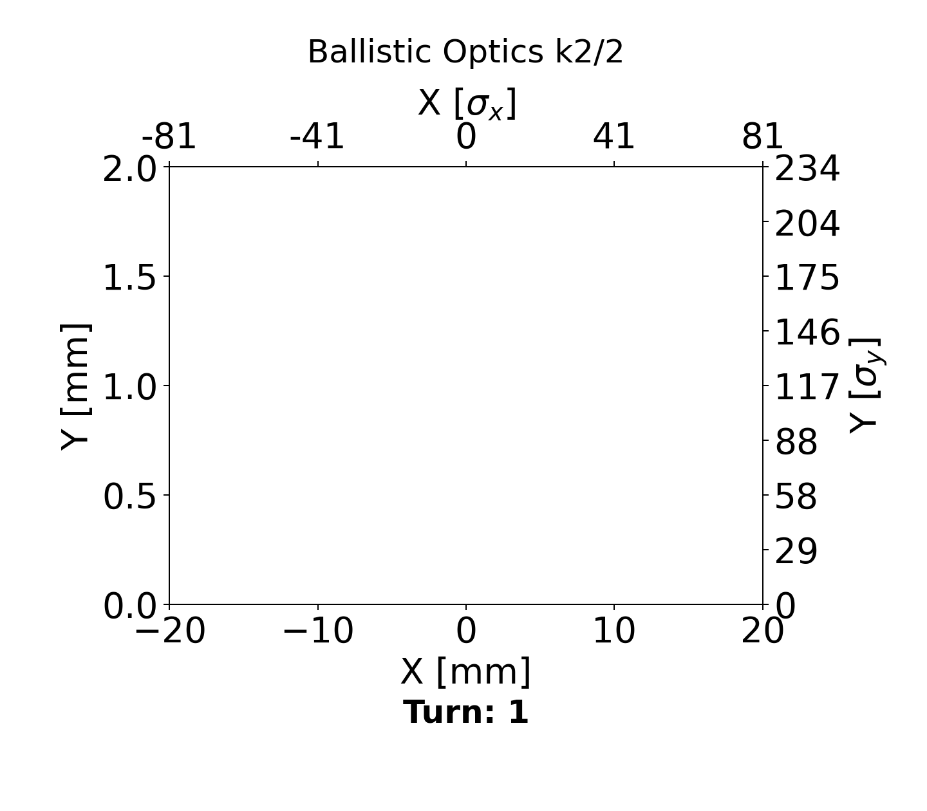
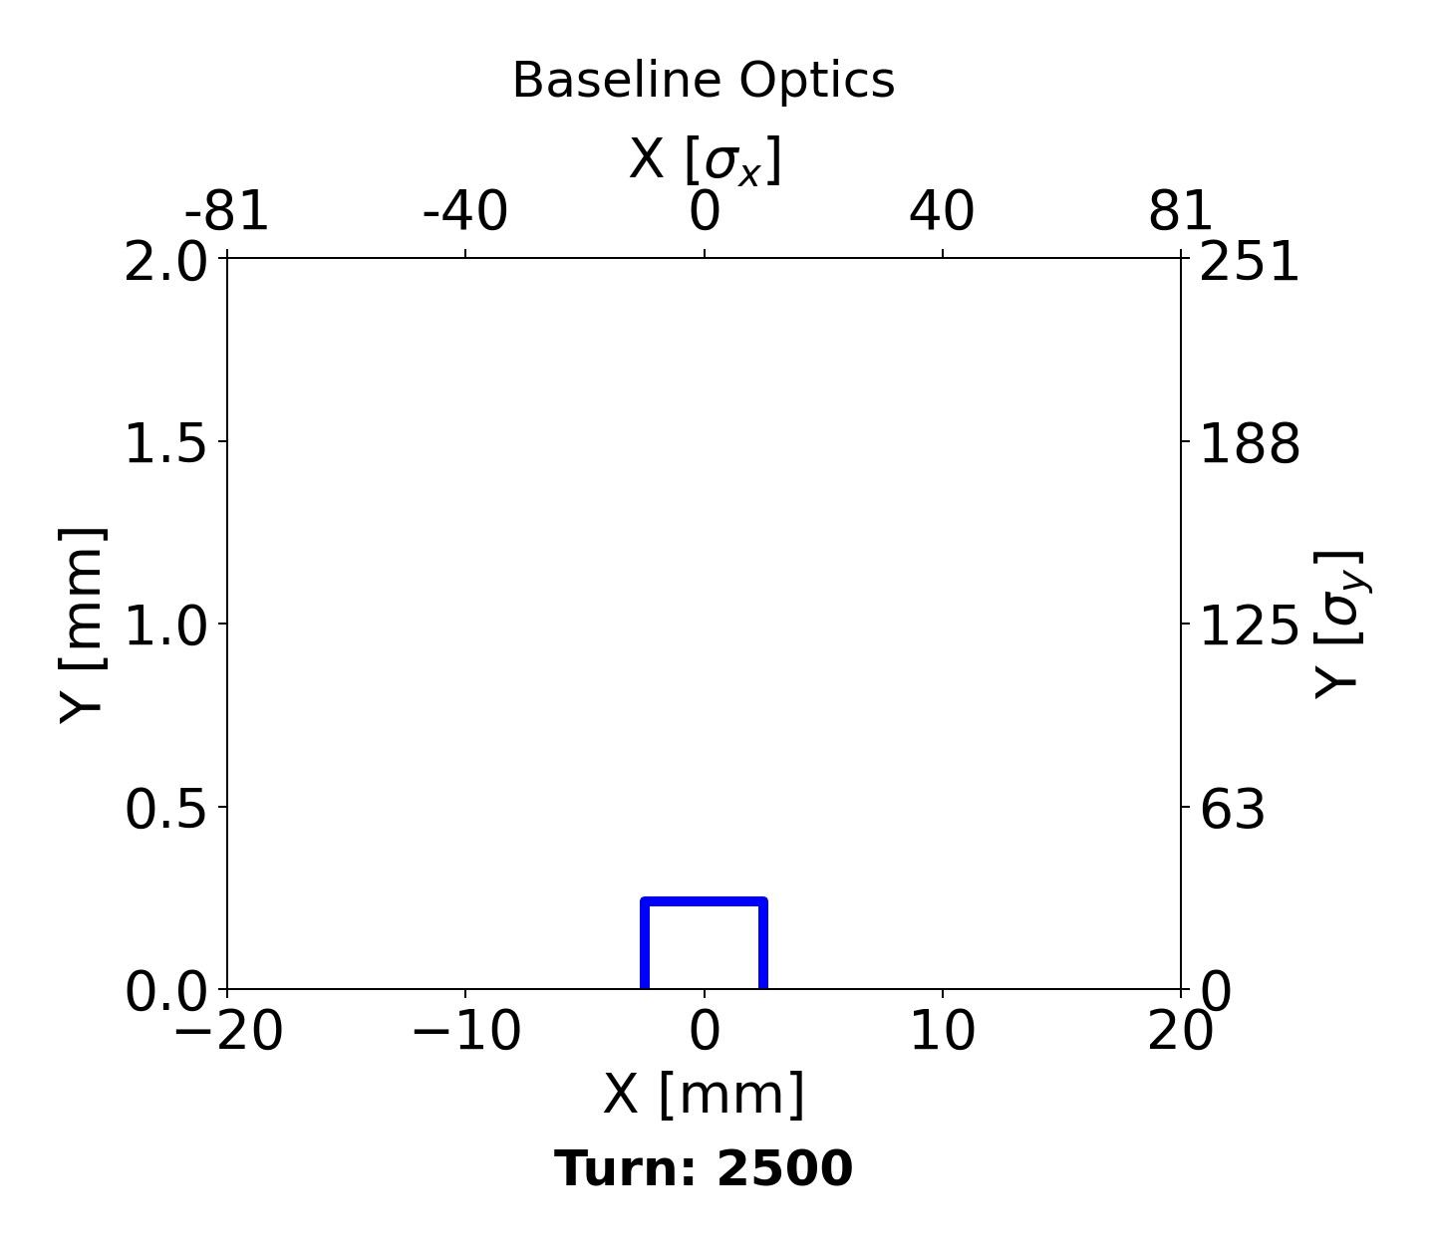
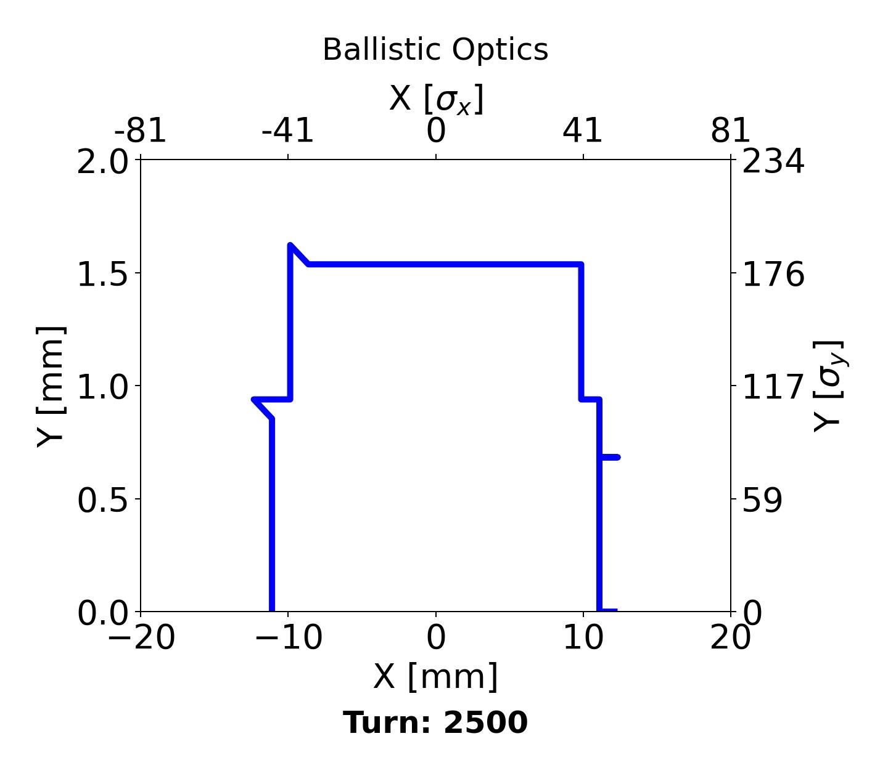
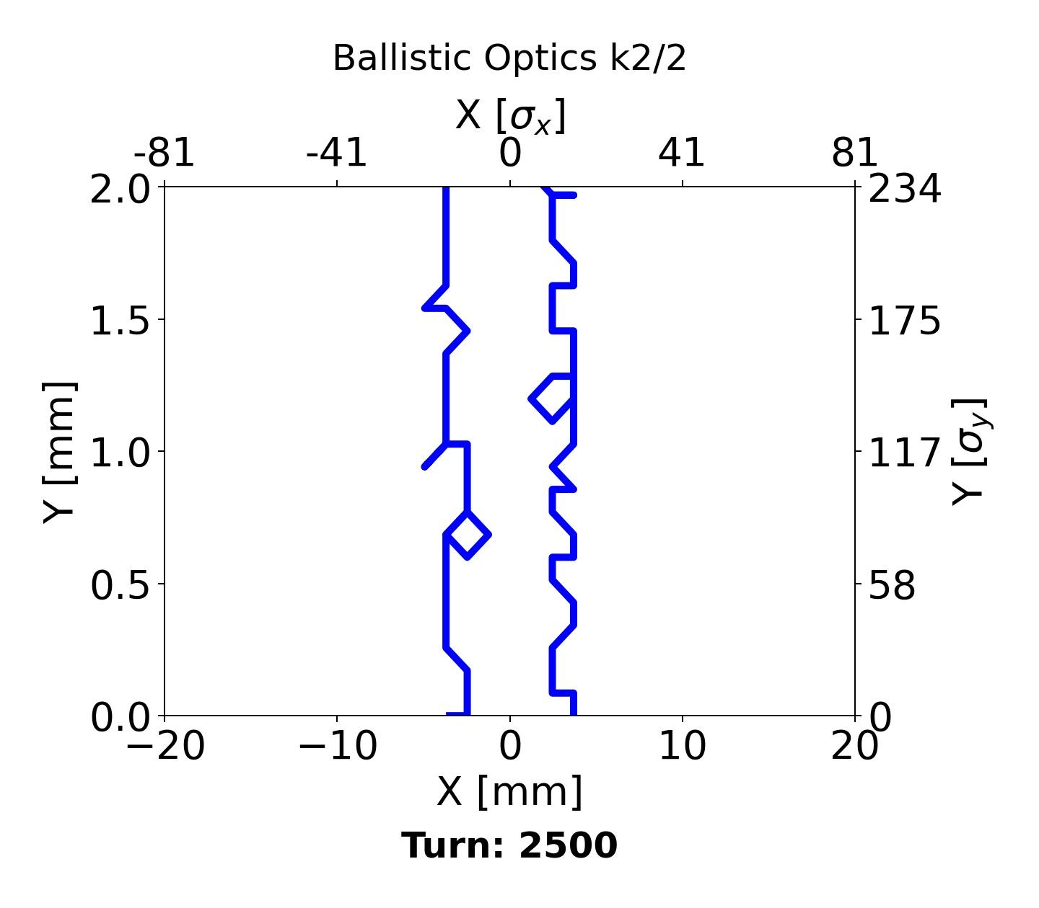
Dynamic Aperture for Ballistic Optics
An attempt with half of the K2 values for the sextupoles was made to observe the impact on this optics.
The longitudinal damping time is 1280 turns, and we are using 2500 turns.
DA computed with Rad & tapering in Xsuite.
Notes:
To get the optical configuration you want → matching

Slide 8
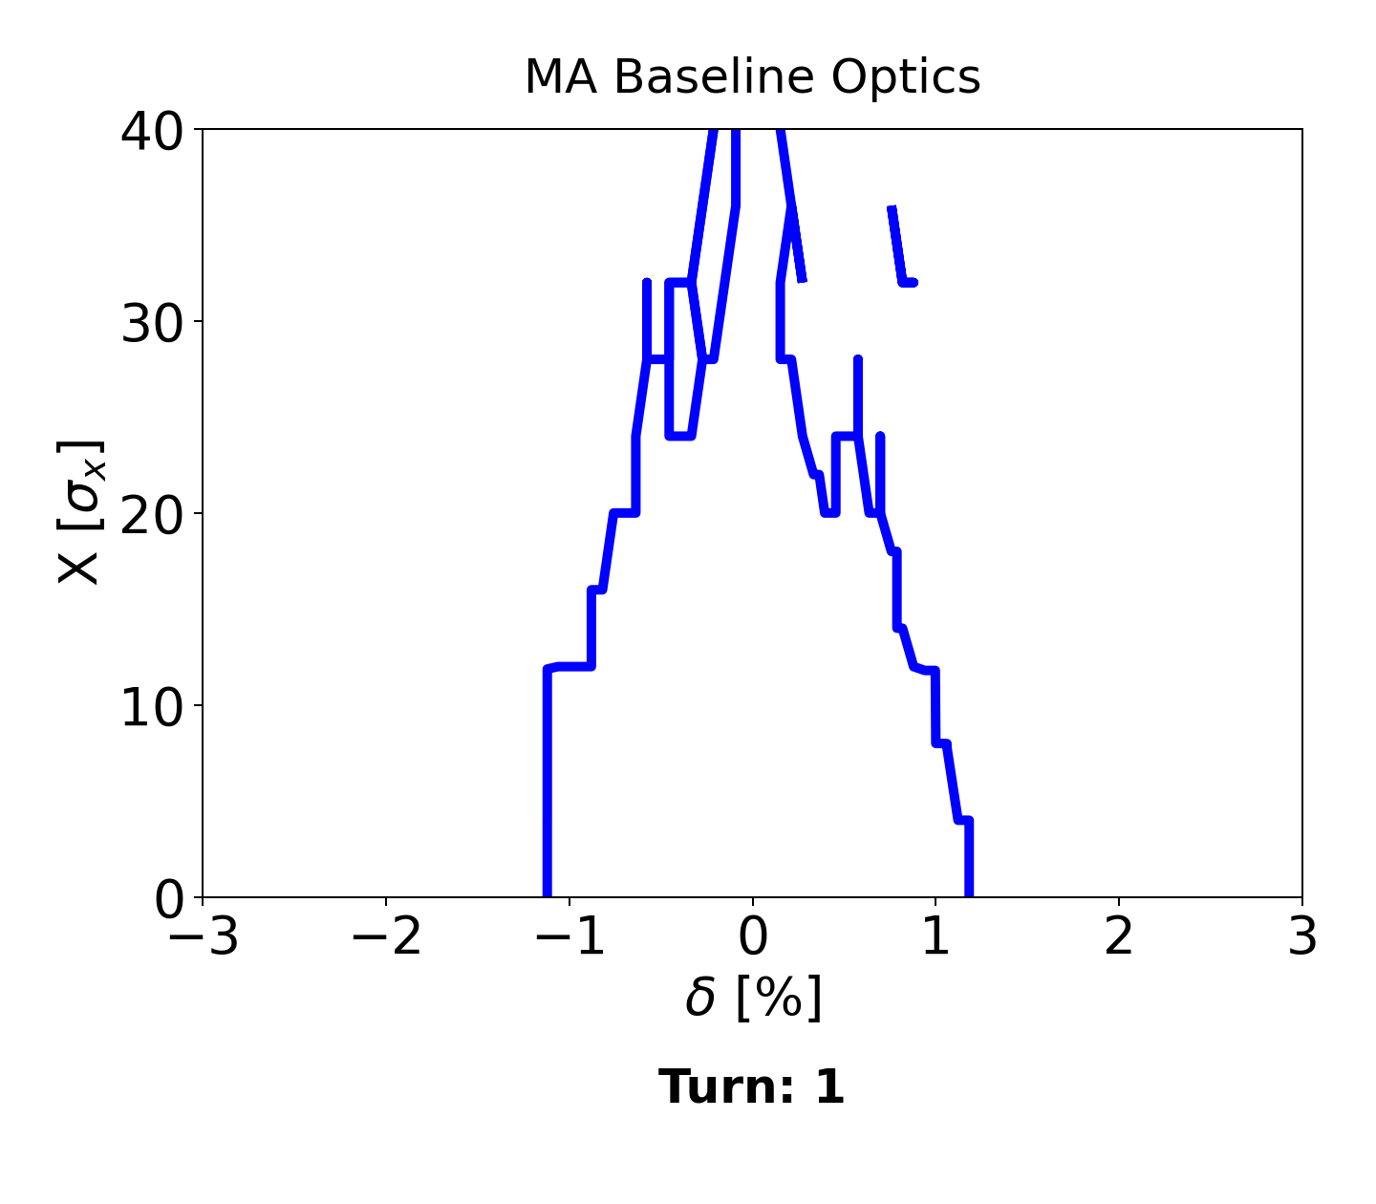
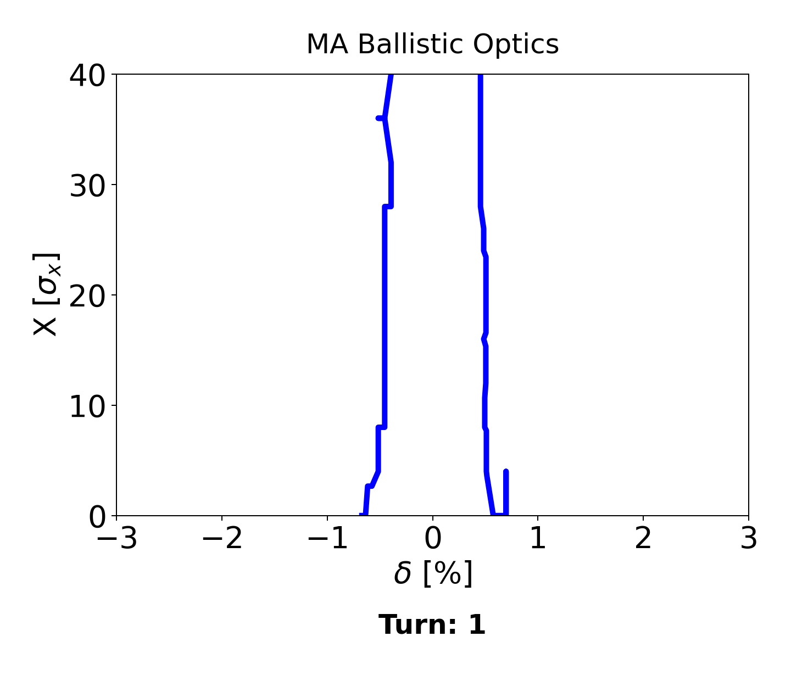
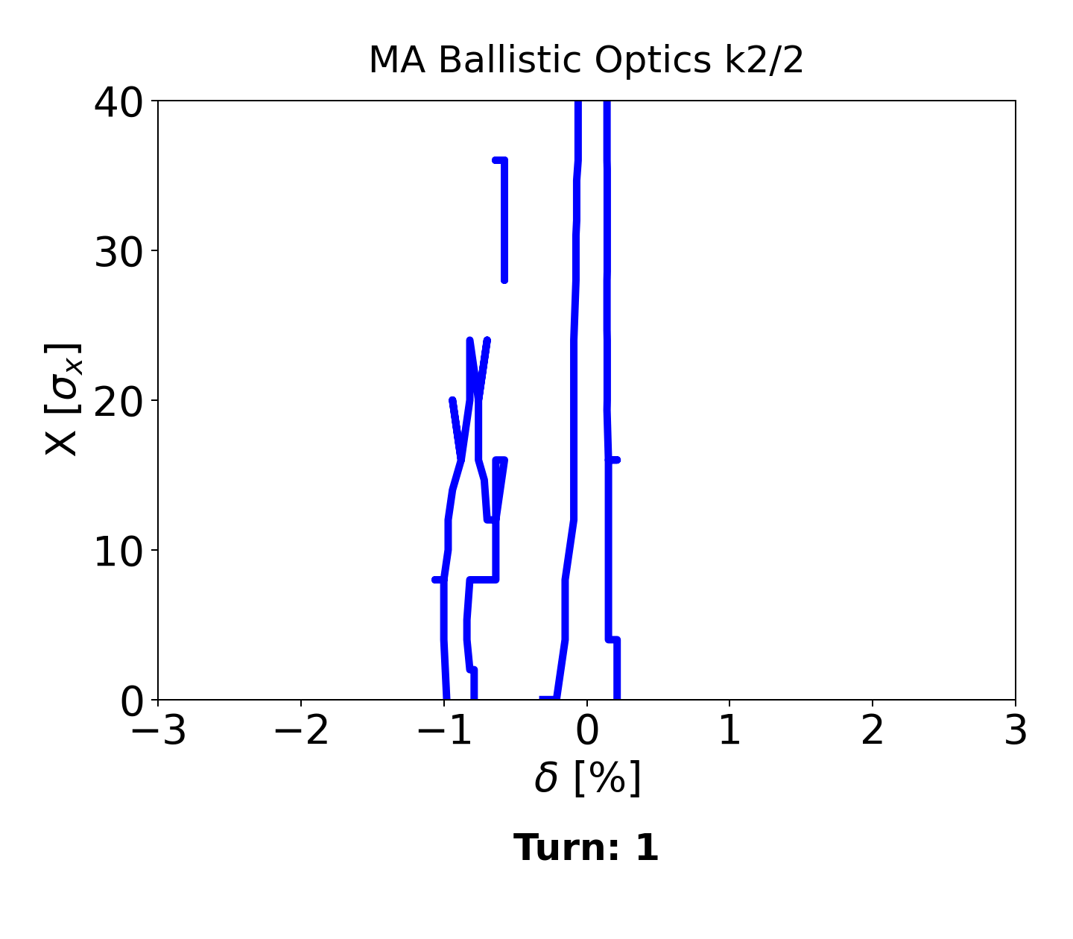
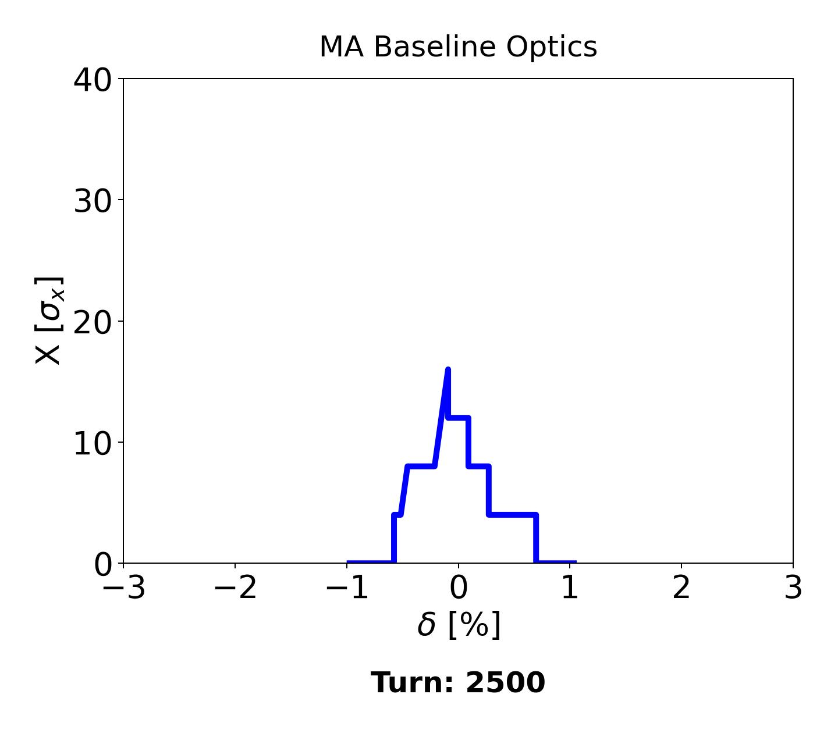
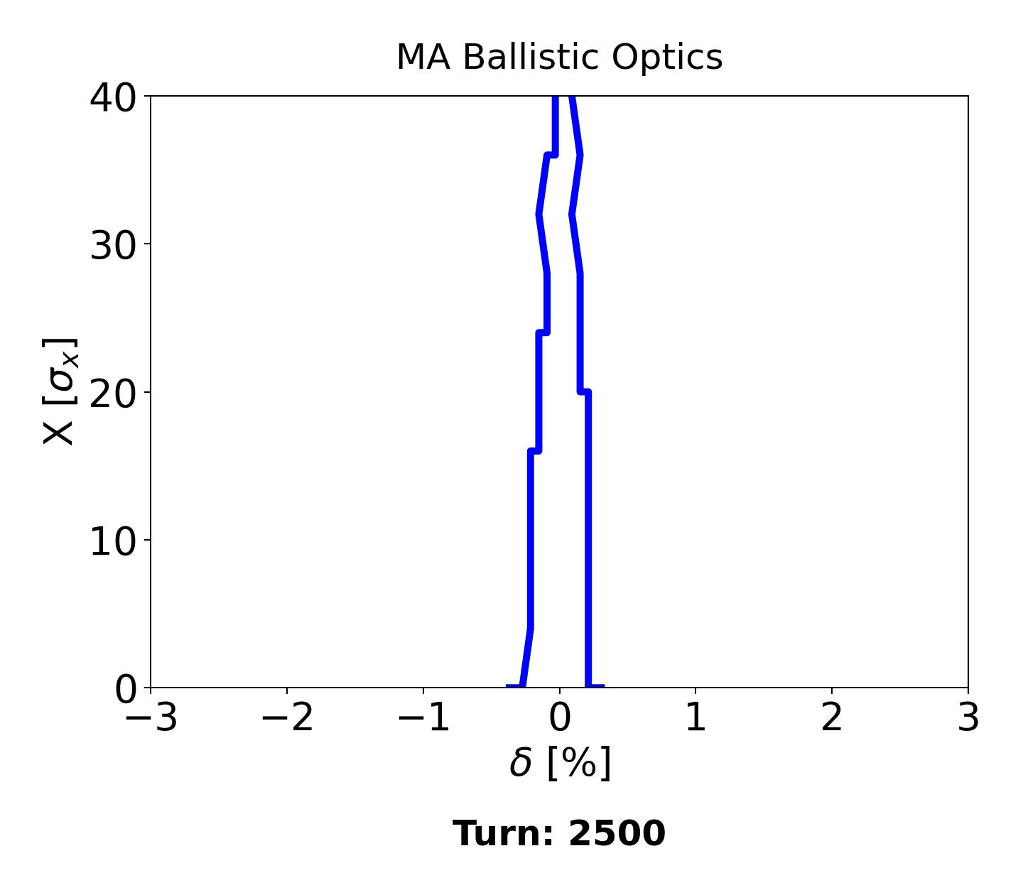
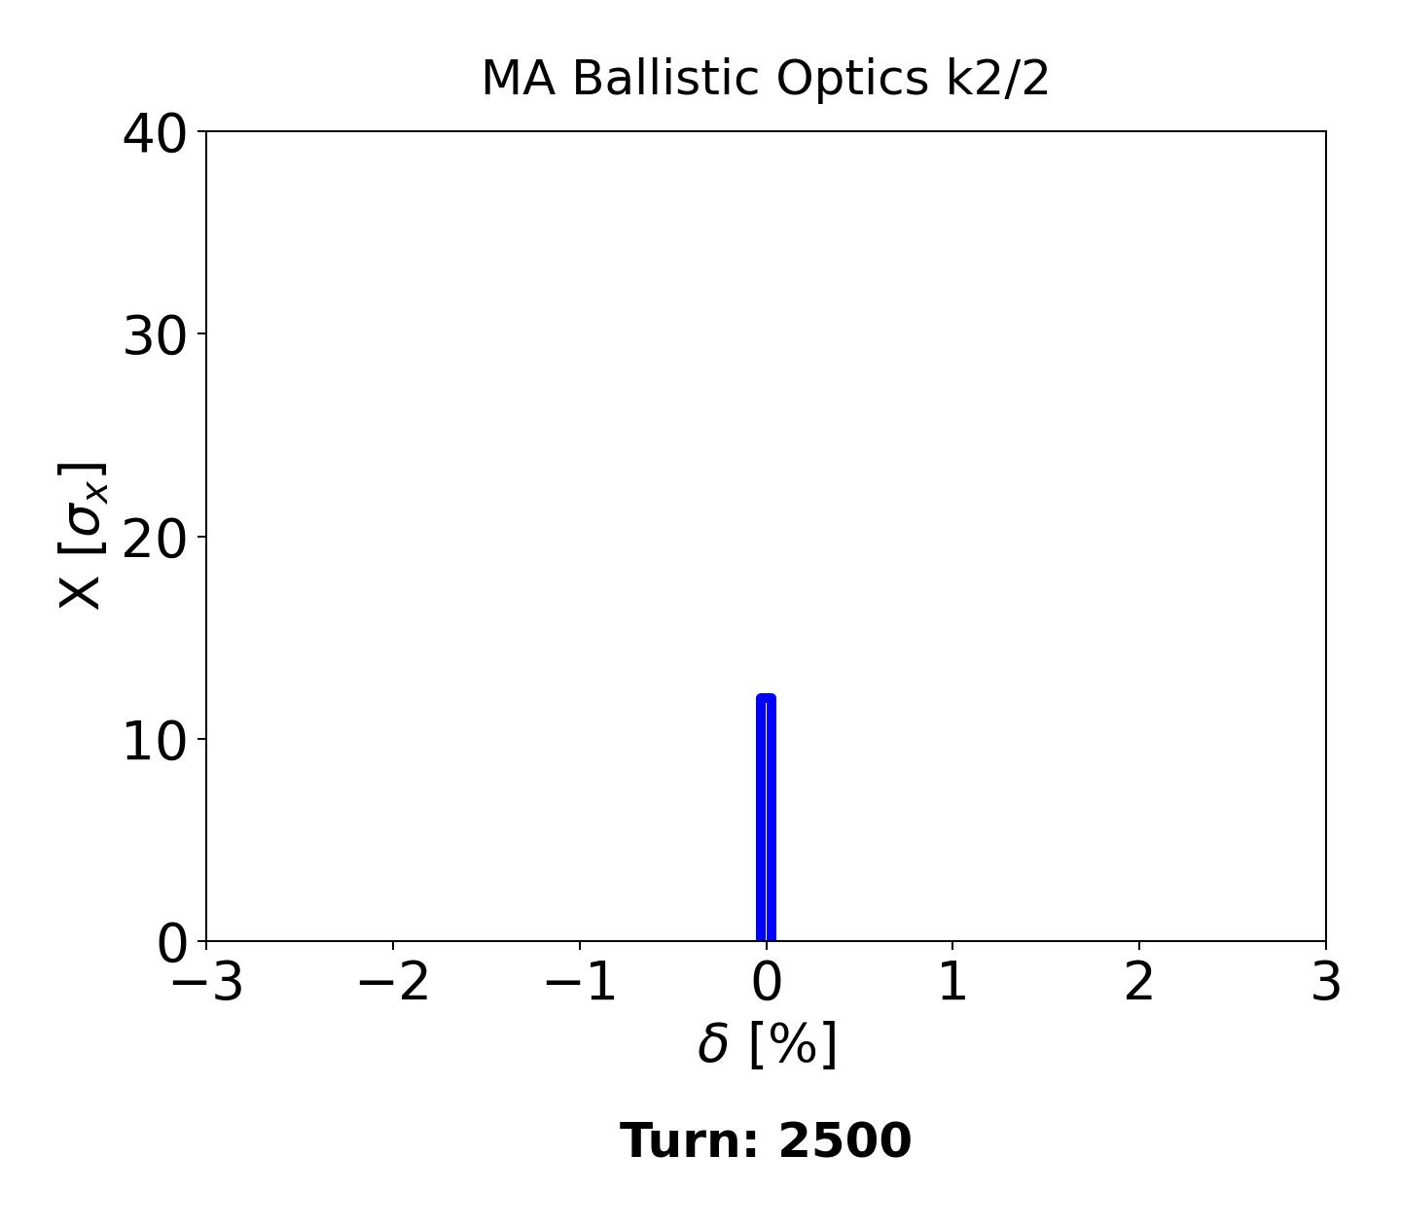
Momentum Acceptance for Ballistic Optics
The MA decreased compared to the baseline, which needs to be improved through an optimization of the sextupoles. There are 75 families of them.
Notes:
To get the optical configuration you want → matching

Slide 9
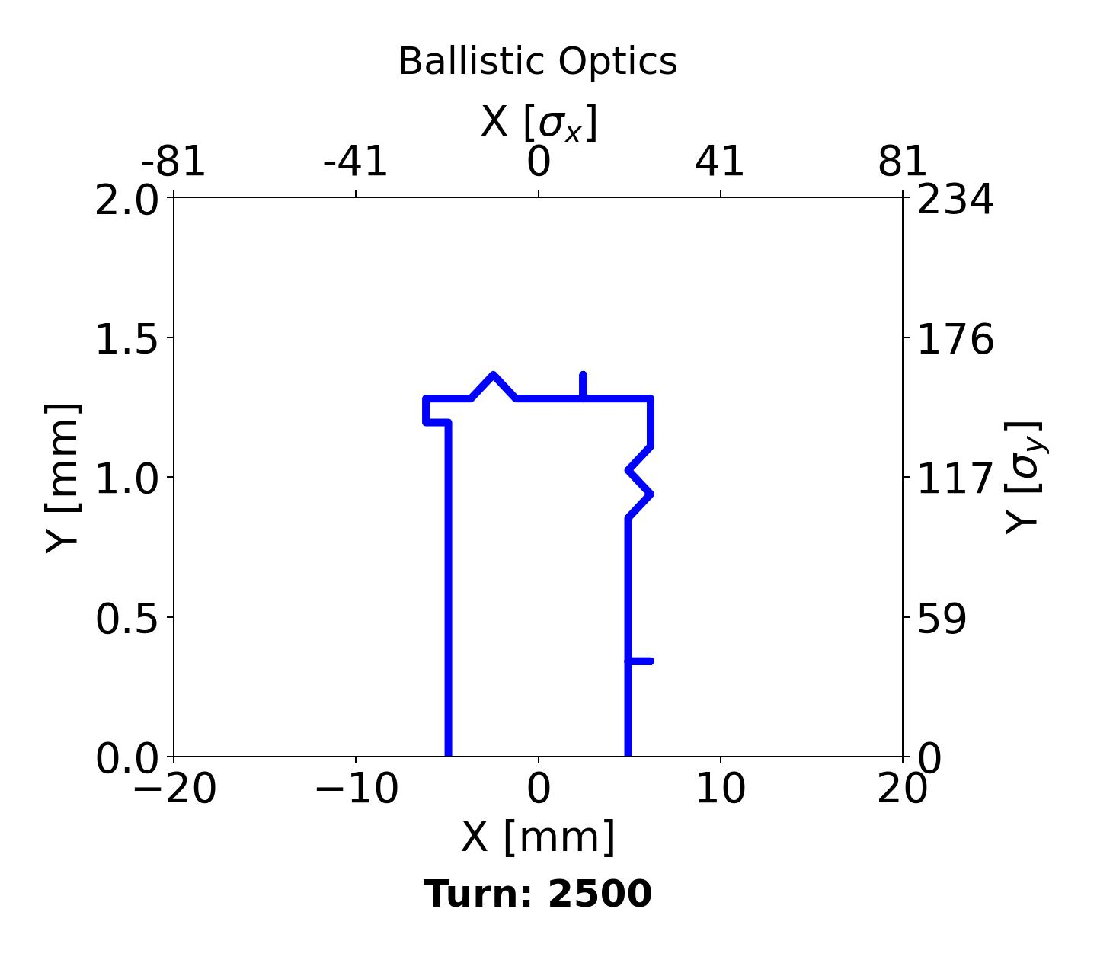
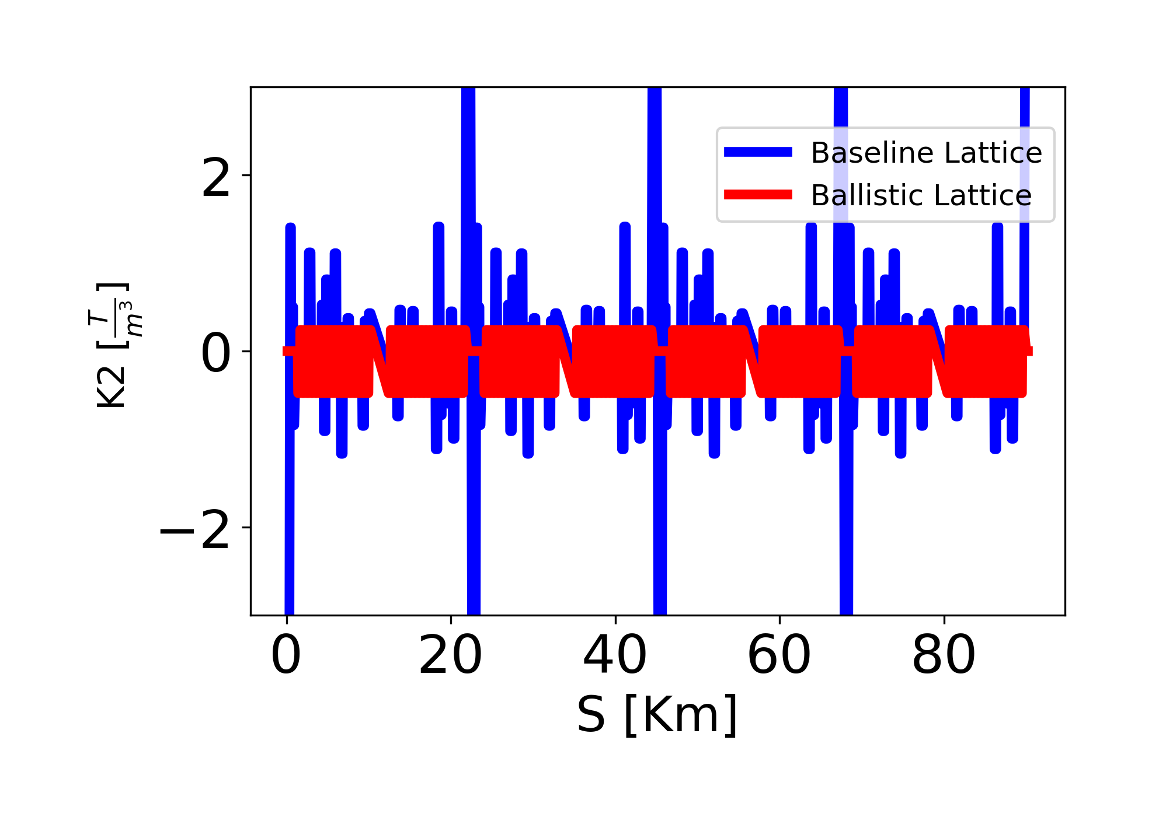
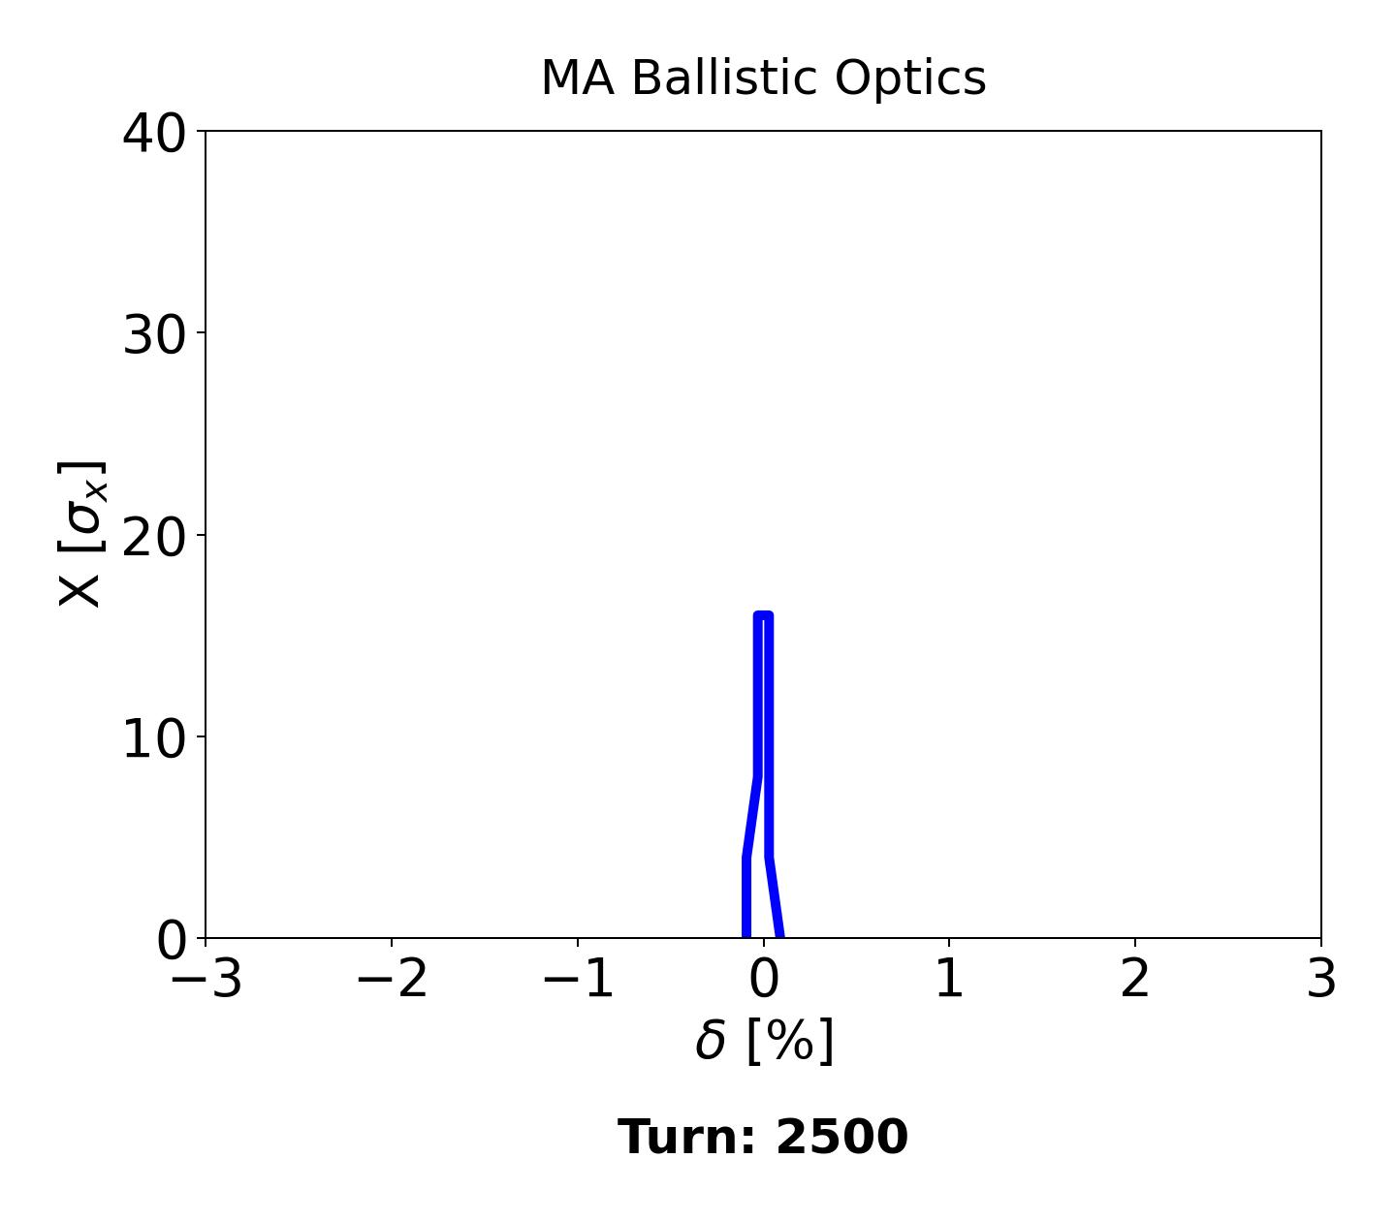
The case with homogeneous values in the Sextupoles
A case with homogeneous values for the sextupoles (k2sd = -0.477 & k2sf = 0.241) was carried out, and while the DA remains good, it is not better than the previous attempt.
MA further reduced

Slide 10
Summary
It is possible to achieve ballistic optics without quads in 200m around the IP and without sextupoles in all the IR. The DA increases, and the MA is acceptable.
In other cases, with homogeneous k2 values for the arc sextupoles, the chromaticity is corrected, but we lose in DA and MA.
Future studies should focus on optimizing MA with the arc sextupole families.
See further benefits in Kyriacos’ presentation

