Slide 1
ESREL 2024
Conference Report & Highlights
RAWG, 12 September 2024
Milosz Blaszkiewicz, Lukas Felsberger

Slide 2
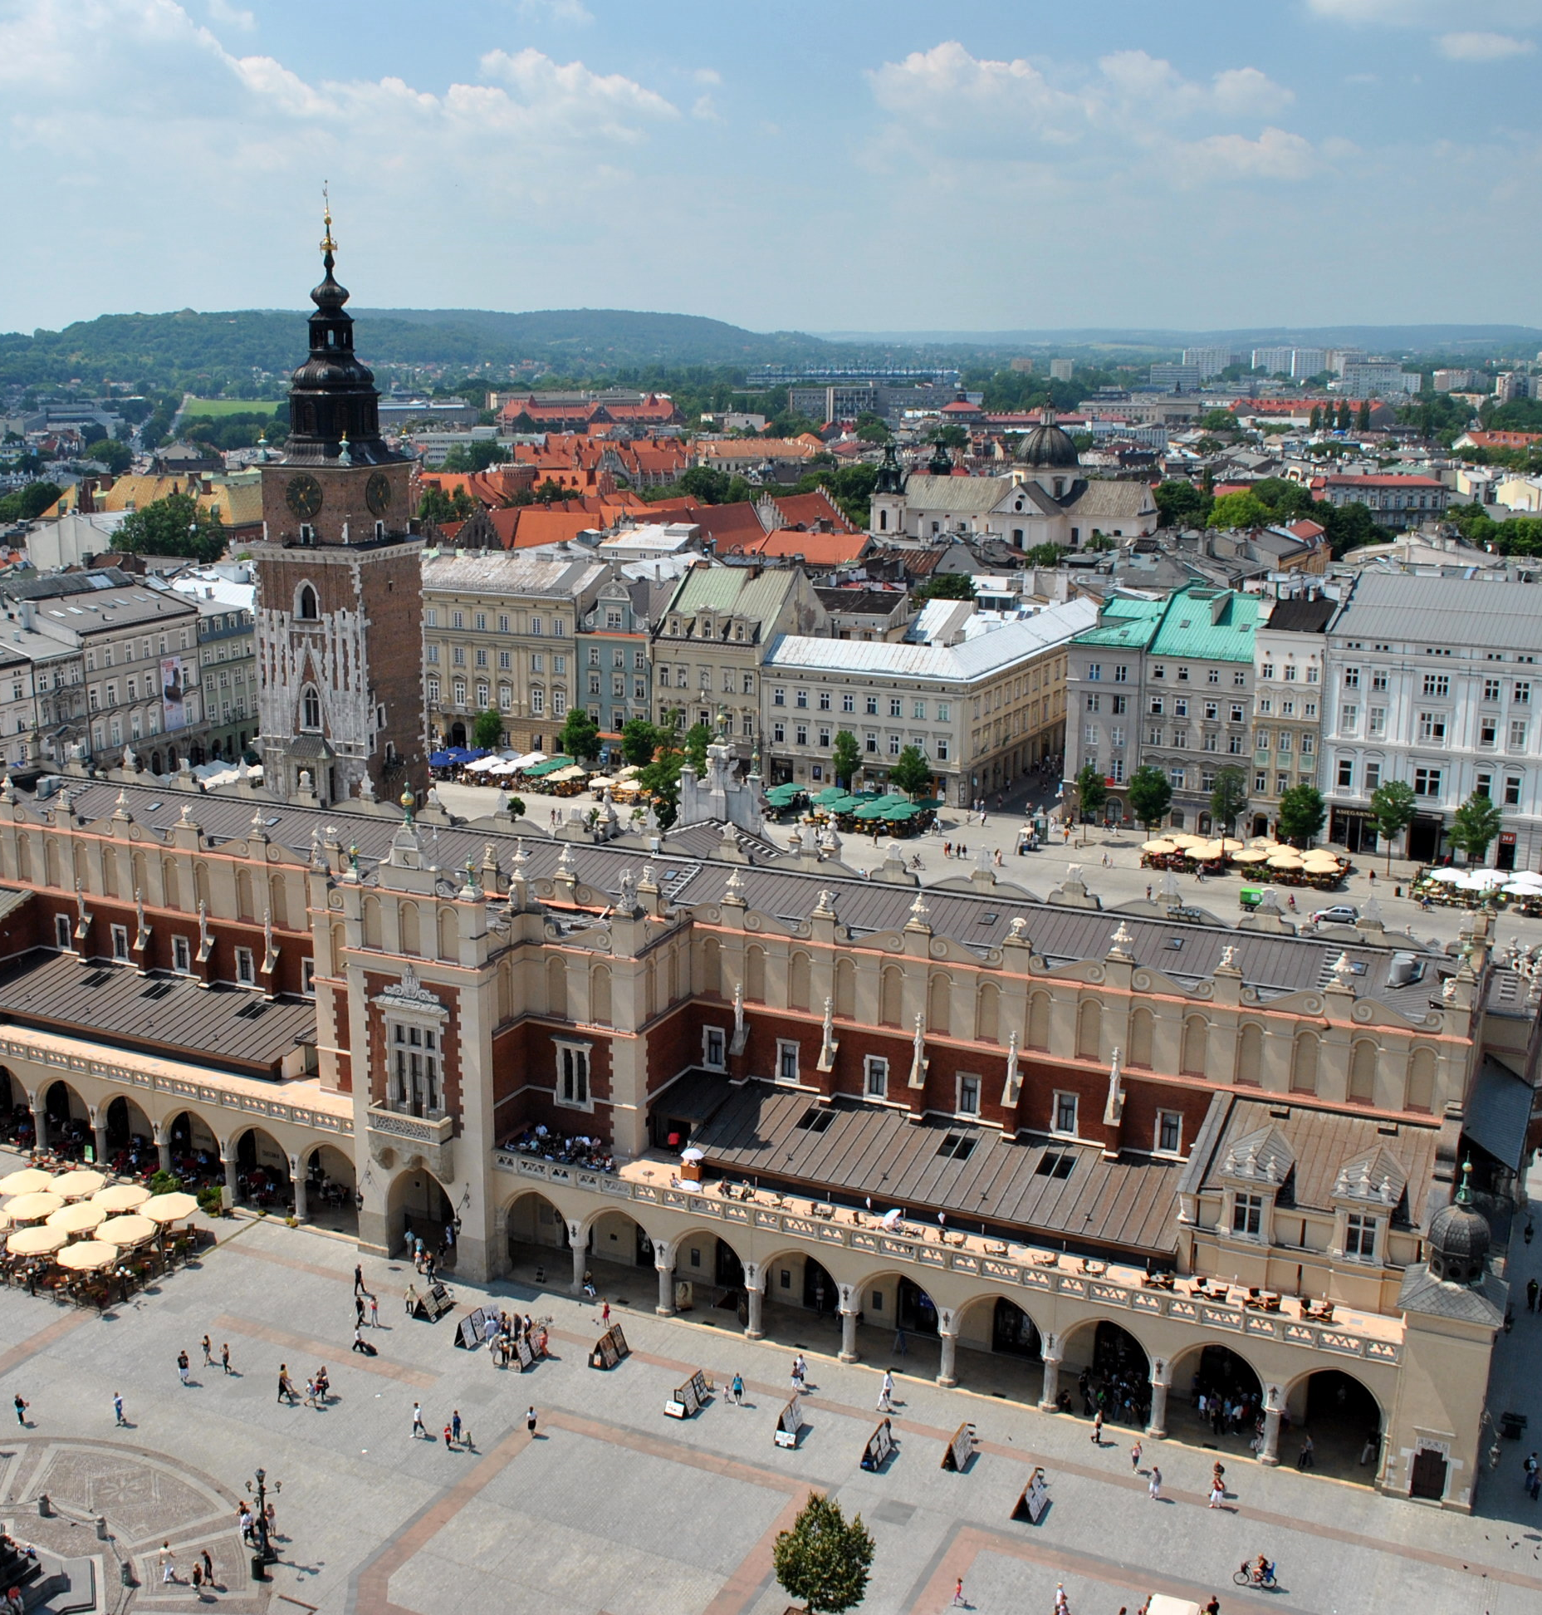
General information
34th European Safety and Reliability Conference
23 – 27 June
Cracow, Poland
https://esrel2024.com
Domain: reliability, safety, security.
7 concurrent parallel streams predeeded by 2-3 plenary talks for 4 days.
Size: 415 attendees (both academic and industry backgrounds).
Organized annually since 1992 by the European Safety and Reliability Association (ESRA).
This Photo by Unknown Author is licensed under CC BY-SA

Slide 3
Parallel sessions
Accident and Incident Modelling & Uncertainty Analysis
Reliability, Safety and Security of Components and Systems & Prognostics System Health Management
Mathematical and Statistical Methods
Simulation Based Methods
Human Factors
Complex Systems and Critical Infrastructures
Crisis Management, Disaster Preparedness, Mitigation and Response
Critical Infrastructures Business Continuity
Cybersecurity and functional safety
Special Sessions

Slide 4
Highlights of the contributions
Subjective view of the most interesting contributions

Slide 5
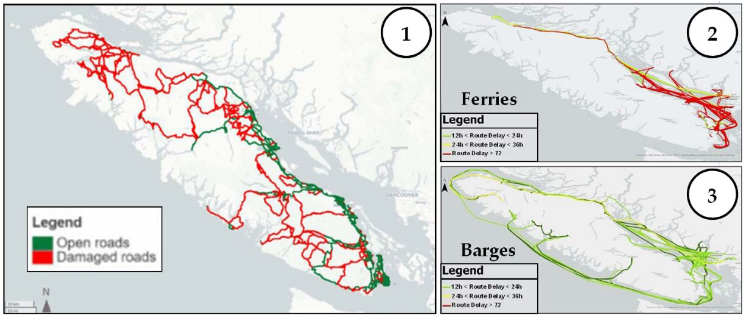
Modeling Multi Modal Supply Chain Vulnerability To Earthquakes: Case Study On Canada West Coast
Model-based approach to support planning of risk mitigation decision-making measures.
Possibility to simulate diasters in specific regions
Combining maintenance actions and multi-modal simulation of other logistics
Example of applying the method to a specifc aread in Canada’s West Coast
Article link
Figure from the article showing possible impact of an earthquake

Slide 6
Evaluating Code Generation Capabilities Of Large Language Models To Solve Risk, Reliability And Resilience Related Problems
Proposal of a dataset and early results of a comparison of various LLMs for code generation tasks in reliability domain.
Specific focus on code related to reliability, risk and resilience.
Introducing a novel benchmark evaluation dataset designed to evaluate code generation tasks for risk, reliability and resilience applications.
To be available in a GitHub repository.
Extended Abstract

Slide 7
Reliability Analyses With Extreme Gradient Boosting And Shapley Additive Explanations
Applying XGBoost and SHAP techinques to analyse failure data
GRTgaz maintains equipement and maintenance operation databases used as data sources for machine learning algorithms
The method allows for:
  Identification of the most impactful reliability factors.
  Support decision-making in the process of installations’ design.
  Informing preventive maintenance operations.
Extended Abstract

Slide 8
Our contributions
Simulation Based Availability Optimization Of Dynamic Fault Compensation For Particle Accelerator RF Systems Applied To The MYRRHA Accelerator Driven System
  Simulations MYRRHA linear accelerator availability based on an intricate model of radiofrequency systems with dynamic compensation scheme. The aim of the described research is to quantify availability gains obtained via optimizing power margins.
  Article link
AvailSim4: Open-Source Framework For Availability And Reliability Simulations
  Monte Carlo-based framework for simulating availability and reliability of complex systems. Developed at CERN since 2021. For more information, see a recent RAWG presentation.
  Article link

Slide 9
Networking
Other present organizations and companies
Airbus Protect
Siemens
ZHaW
EDF
DLR
ReliaSoft

Slide 10
ESREL 2025
Stavanger, Norway
1 October
Abstracts for presentation and papers
15 – 19 June 2025
Theme: “Advancing risk, safety and reliability sciences, with applications – from component, to system, to society”
https://esrel2025.com
15 January
Full paper submission
15 March
Final revised paper submission

