Slide 1
Security Operations Workshop

Slide 2
Security Operations Workshop
Agenda for today
90 minutes now, 180 minutes this afternoon in the “hackathon” session
Morning [0900-1030]
  impetus and drivers
  mini intros to some key tools
  status update from Chicago + discussion
Security Operations Workshop, HEPiX, Fall 2024

Slide 3
Security Operations Workshop
Afternoon [1330-1500 + 1530-1700]
Technical topics decided on by the group
  SNMP issues
  Zeek alerting deep dive
    Come out with *documented* code snippets!
  Advanced Zeek usage + incident response
Try to identify other topics before lunch to help prep
Security Operations Workshop, HEPiX, Fall 2024

Slide 4
What is the scope of our work?
We must work together to improve the cybersecurity posture of our organisations and infrastructures.
Before focusing on operational security tools, pause to consider the full scope of the work to be done in this area
Must have clear picture of this scope, and then make a plan to execute.
Security Operations Workshop, HEPiX, Fall 2024

Slide 5
Scope
Regional:
Gov
WLCG / OSG
SAFER
…
Facilities
Institutions/ Organisations
Security Operations Workshop, HEPiX, Fall 2024

Slide 6
Impetus
Why is this work important?
Cyber Threat Intelligence (strategic + operational) is fundamental to help us defend as one
  Strategic -> Landscapes, long term risk analysis
  Operational -> o(real time) support for incident response + protection
Both as part of Protection + Response, must use intelligence effectively
  How to do that might depend on the layer
Security Operations Workshop, HEPiX, Fall 2024

Slide 7
Roles
Important when working in this area to consider
  What is important?
  Who is best able to take on a role?
Security Operations Workshop, HEPiX, Fall 2024

Slide 8
Developing strategy and plans
Introduce two tools that could be of use in building a vision and strategic plan for an organization – or infrastructure
Trusted CI Framework
NIST Cybersecurity Framework
  (as example; other frameworks exist!)
Security Operations Workshop, HEPiX, Fall 2024

Slide 9
Trusted CI
Trusted CI is the NSF Cybersecurity Center of Excellence
Cybersecurity experts with experience working with US science and engineering communities
The team draws from best operational practices and includes leaders in the research and development of new methodologies and high-quality implementations.
Security Operations Workshop, HEPiX, Fall 2024

Slide 10
Trusted CI Framework
Trusted CI Framework
  An approach to support organisations building cybersecurity programmes and strategic plans. Specifically agnostic of other cybersecurity frameworks and technology, this could be of interest for the DRI
  Representation on Advisory Board by Dave Kelsey on behalf of the WISE Community
    International involvement
  4 pillars: Mission Alignment, Governance, Resources, and Controls
  16 “Musts”: Concrete requirements for establishing a cybersecurity program
Security Operations Workshop, HEPiX, Fall 2024

Slide 11
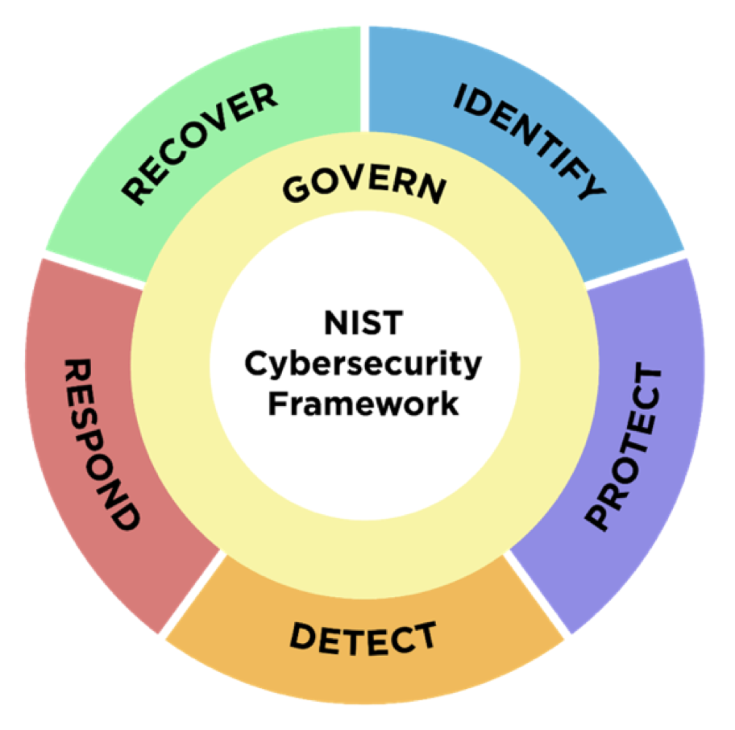
NIST Cybersecurity Framework
GOVERN
IDENTIFY
PROTECT
DETECT
RESPOND
RECOVER
Security Operations Workshop, HEPiX, Fall 2024

Slide 12
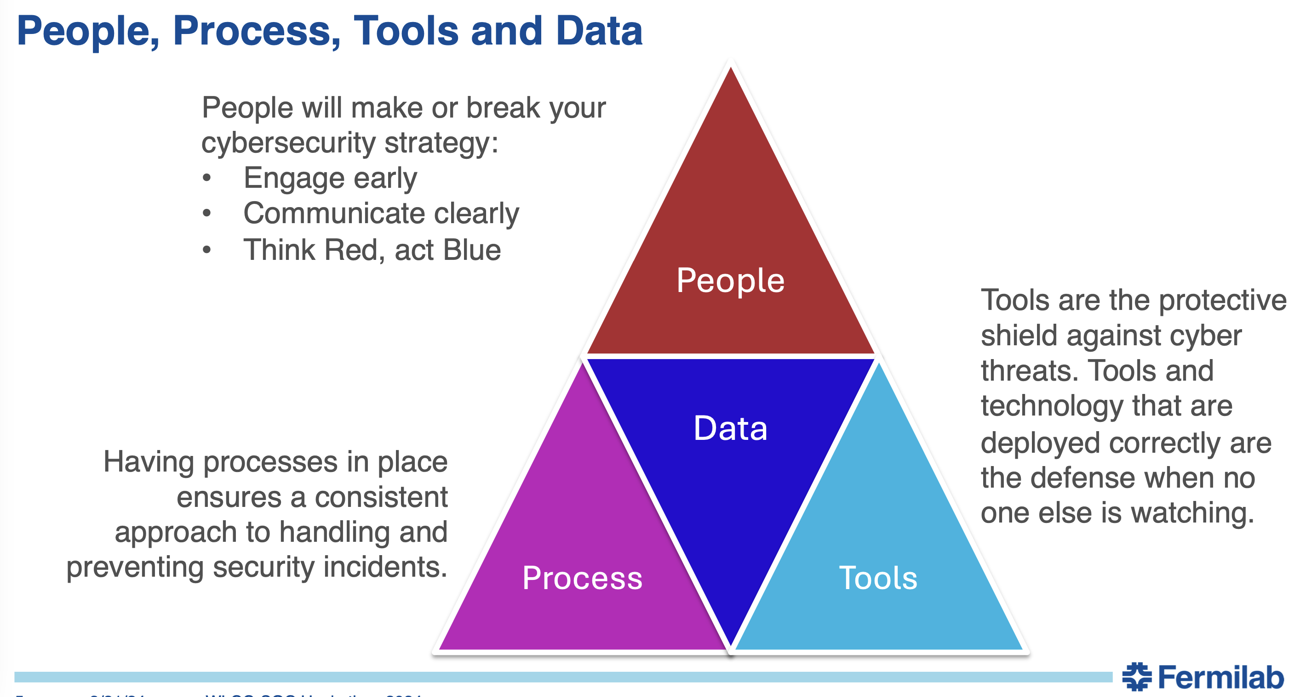
People, Process, Tools and Data
Let’s talk People and Process
Security Operations Workshop, HEPiX, Fall 2024

Slide 13
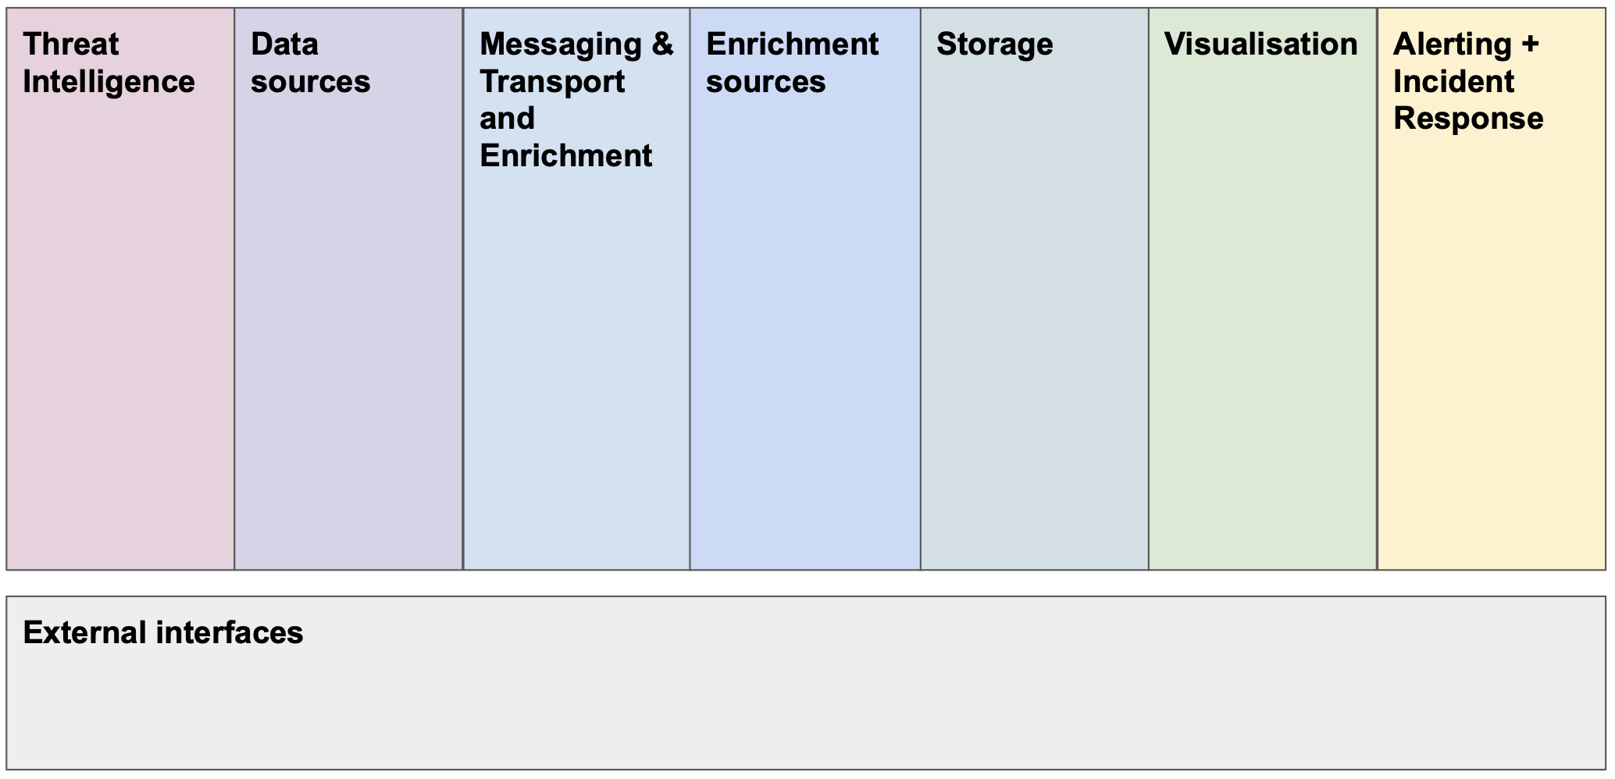
SOC Model
Collaborative Operational Security: The future of Cybersecurity for Research and Education
Security Operations Workshop, HEPiX, Fall 2024

Slide 14
Next: Software intros
Zeek
  Fine grained network monitoring using deep packet inspection
MISP
  Threat intelligence sharing platform
pDNSSOC
  Lightweight SOC capability using a sensor in DNS infra coupled to threat intel source -> alerting
Security Operations Workshop, HEPiX, Fall 2024

