Slide 1
WLCG Environmental Sustainability Workshop
Welcome & Introduction
David Britton (University of Glasgow (GB)), Markus Schulz (CERN), Simone Campana (CERN)
Thanks to: WLCG Environmental Sustainability Workshop Organising Group (David Britton, Simone Campana, Alessandro Di Girolamo, James Letts, Zach, Marshall, Cath Noble,, Markus, Schulz, and Mattias Wadenstein)

Slide 2
Workshop Purpose
Connect and disseminate the wide range of work that is going on in WLCG, HEP experiments, and the wider community.
Explore the active and practical steps that WLCG can take to encourage an increasingly sustainable global infrastructure.
Establish sustainability as a central concern in the evolution of WLCG, as described in the recent WLCG Strategy.

Slide 3
Workshop Structure
Wednesday
  Infrastructure
  Projects & Reports
Plan
What can WLCG do?
What can WLCG encourage others to do?
What can we measure?
How do we monitor?
What things are most important?
Where does funding to the most good?
What is our trajectory?
Etc…
Friday
Discussions
Thursday
Experiments
Workloads & Metrics
Hardware & Fabrics

Slide 4
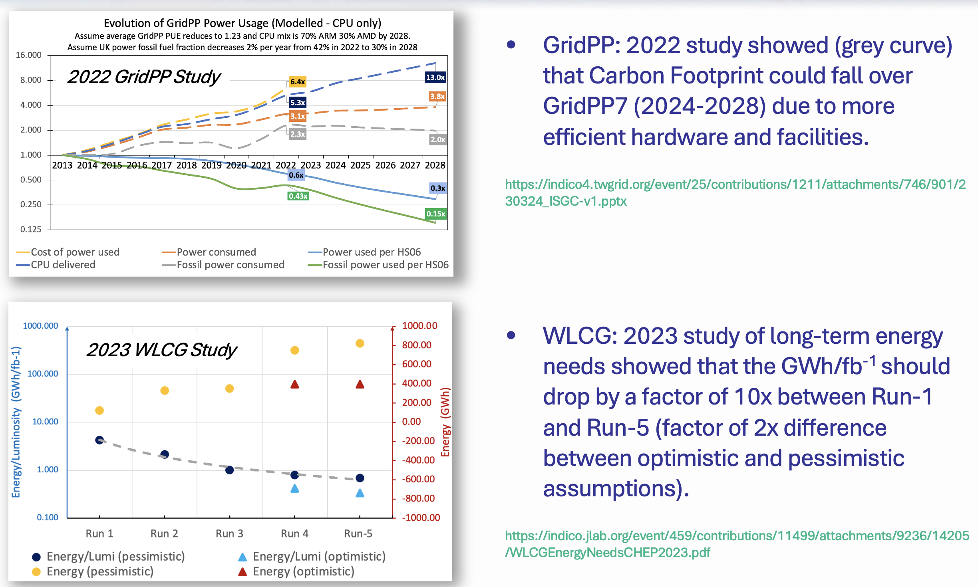
Background: Energy/Carbon Studies
These studies need to be updated but offered the hope that things wouldn’t get worse.
The challenge now, is how can we get significantly better?

Slide 5
Background: Taxonomy
Capture
NetZero
Offset
Scope-2: Indirect emission of CO₂ due to power used.
Reduce Scope-1
Scope-3: (Embodied) CO₂ emitted during the manufacture of hardware.
Reduce Scope-2
Reduce Scope-3
Reduce Volume
Constrain
Buy Lower Scope-3 HW
Reduce Power
Greener Power
Software
Hardware Lifetime
Newer Hardware
Supply Choice
Techniques
Hardware Choice
Usage Pattern
Computing Models
Many of these things are not under direct WLCG control.
Many of these things are costly.
Lower PUE
Benchmark Hardware
Measure Power Use
Life-Cycle Assessment
Carbon Inventory
Carbon Model
Carbon Allocation
Measure + Model + Monitor → Moderate

Slide 6
Background: WLCG Strategy/Actions
https://zenodo.org/records/12623280
‘Environmental sustainability is a strategic area of priority for many of the WLCG federations and funding agencies’
‘Providing information, opportunity, and incentive to help collaborators reduce the carbon footprint of computing needs should be a priority for WLCG as it is a priority of its funding agencies and a demonstration of social responsibility.’
‘WLCG should elaborate a plan that covers the areas of software, computing models, facilities, and hardware lifecycle.’
[ENV-1] WLCG to agree on metrics and provide a framework to collect information related to energy efficiency.
[ENV-2] WLCG to facilitate the use of more energy-efficient hardware where possible, depending on the readiness of the experiment software and the common libraries.
[ENV-3] WLCG to develop and promote a sustainability plan to improve energy efficiency and reduce carbon footprint, covering software, computing models, facilities, and hardware technology and lifecycle.

Slide 7
Organisation
Coffee Breaks are just outside auditorium.
Lunches not provided….
… but coffee + croissants available before meeting on Thursday and Friday.
Dinner (registration now closed) at 7pm Thursday at Luigia (https://www.luigia.ch/en/restaurant/Louise-Meyrin/)
Underground ATLAS tour at 1pm and 2pm on Friday – sign up TODAY before 3pm by emailing zach.marshall@cern.ch.

