Slide 1



Watt Counts: ARM Compute
& Energy Accounting in the WLCG
Emanuele Simili, Gordon Stewart, Samuel Skipsey Albert Borbely & David Britton (ScotGrid Glasgow)
WLCG Environmental Sustainability Workshop @ CERN - 12 December 2024
Notes:
Watt Counts: ARM Compute & Energy Accounting in the WLCG by Emanuele Simili (ScotGrid Glasgow), emanuele.simili@glasgow.ac.uk
In the push for sustainable solutions in High Energy Physics (HEP) computing, our WLCG Tier2 site at ScotGrid Glasgow has adopted ARM-based servers, achieving full production integration with increasingly positive results. Today we run significant workloads on ARM, including ATLAS production tasks, and our findings indicate a measurable reduction in energy consumption compared to traditional x86 servers. This talk will present the energy savings achieved so far and an outlook for the near future.
We will also outline recent efforts to standardize power-efficiency metrics across HEP centers by developing a unified HEP-Score/Watt output format in collaboration with the HEPiX Benchmark Working Group, to facilitate consistent data aggregation and reporting on energy efficiency.
Additionally, drawing inspiration from ATLAS PanDA CO2 reporting, we provide an example of power usage accounting at our site. Leveraging runtime data from Prometheus and power statistics, we calculate the energy consumption per Virtual Organization (VO), showing a potential approach to site-level CO2 accounting.

Slide 2


Outline
Performance per Watt (x86 vs ARM)
- motivations & methodology
- updated HS23/Watt and Frequency Scan results
- data processing improvements (thanks HEP-Score working group)
Heterogeneous Tier2 Cluster @ ScotGrid Glasgow
- configuration and dual queue management
- ARM energy savings
Toward a WLCG global CO₂ accounting …
- what is currently measured (ATLAS PanDA)
- what we can measure more precisely (kWh)
- accounting strategy and Proof of Concept
Notes:
outline

Slide 3

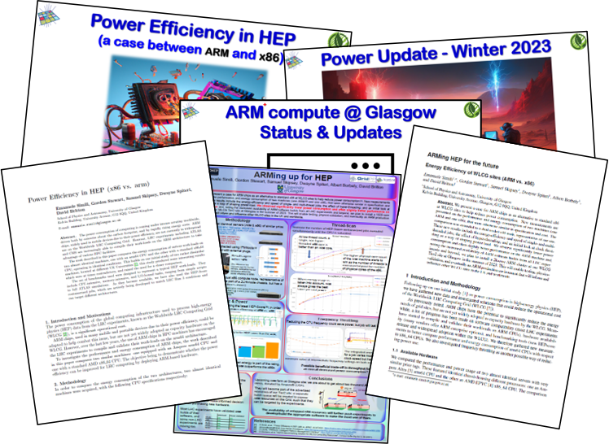
Motivations & Methodology
In 2021 we started investigating alternative architectures for Grid computing, starting with ARM chips …
Lot has happened since then:
most LHC experiments ported their software to ARM,
physics validations had been performed,
heterogeneous computing cluster set-up (x86 + ARM),
HEP-Score collaboration and improved methodology,
dissemination of results, …
Methodology:
As benchmark, we rely on the HEP-Score & the HEP-Benchmarking Suite:
HEP-Suite: https://gitlab.cern.ch/hep-benchmarks/hep-benchmark-suite
HEP-Score: https://gitlab.cern.ch/hep-benchmarks/hep-score
As for collecting metrics, so far I have been using my own script to exports CPU, RAM, Frequency and Power usage (via IPMI tools: https://github.com/ipmitool/ipmitool) into a CSV file … but now the HEP-Suite itself provides such metric exporters as plug-ins.
Results are then processed to generate plots, integrate the energy usage, and do some statistical calculations.
The final output (HS23/Watt) enable us to compare various machine based on performance per unit power.
Notes:
so far …

Slide 4
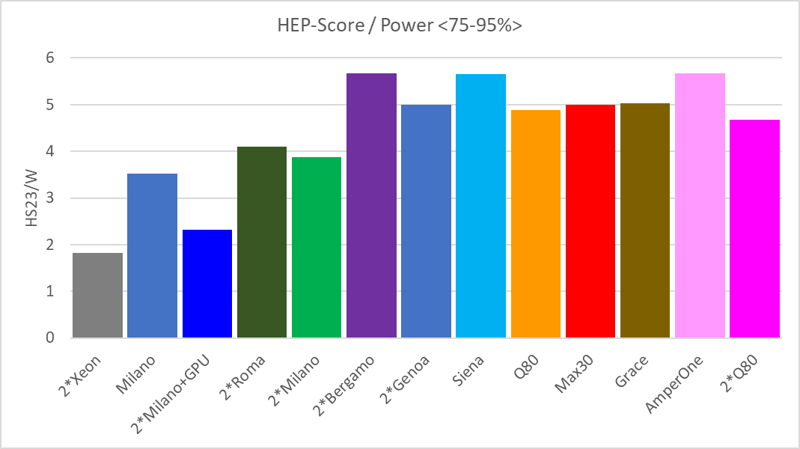
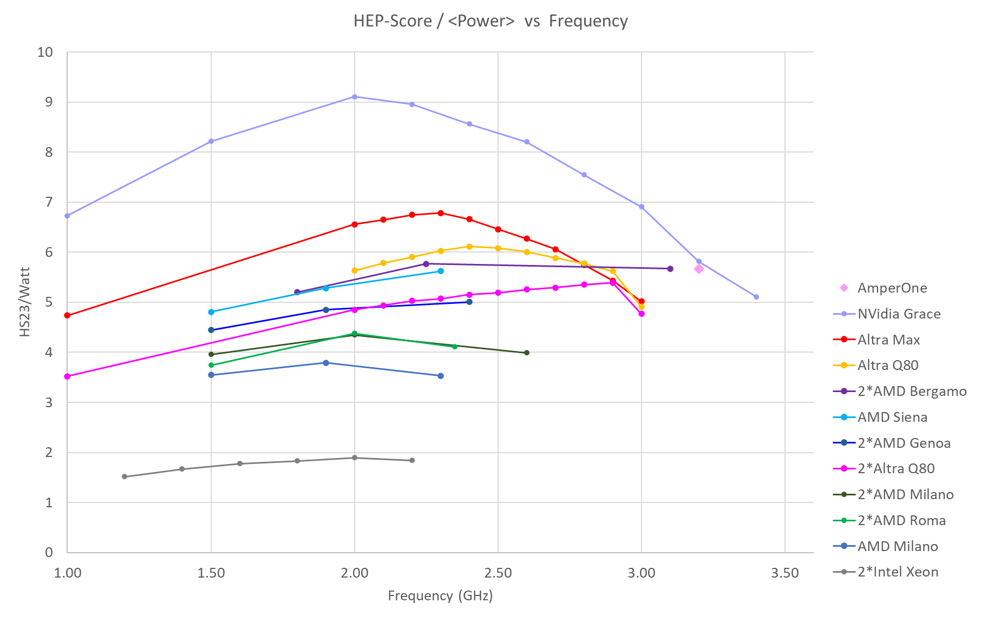
Performance/Watt (ARM vs. x86)
To account for the shape of HEP-Score workloads, we calculate the Figure of Merit (FoM) as: HS23/Power<75-95%>
And, finally, we can see how various machines compare against each other.
The trend of power optimization has sparked a healthy competition
between hardware manufacturers …
New generation x86 now match ARMs performance/watt!
x86
ARM
HEP-Score/Watt vs. CPU Frequency gives a more complete picture, and shows optimal performance per watt at mid frequency range. Also, ARM CPUs allow for a finer tuning of the clock speed to obtain a better HS23/Watt (for a slightly longer run-time).
Notes:
HS23/Watt & Frequency Scan

Slide 5

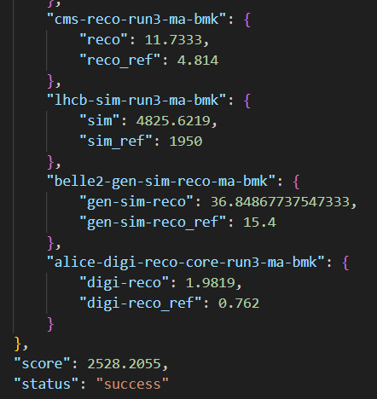

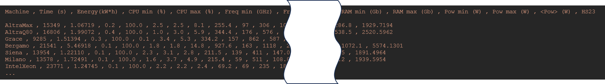

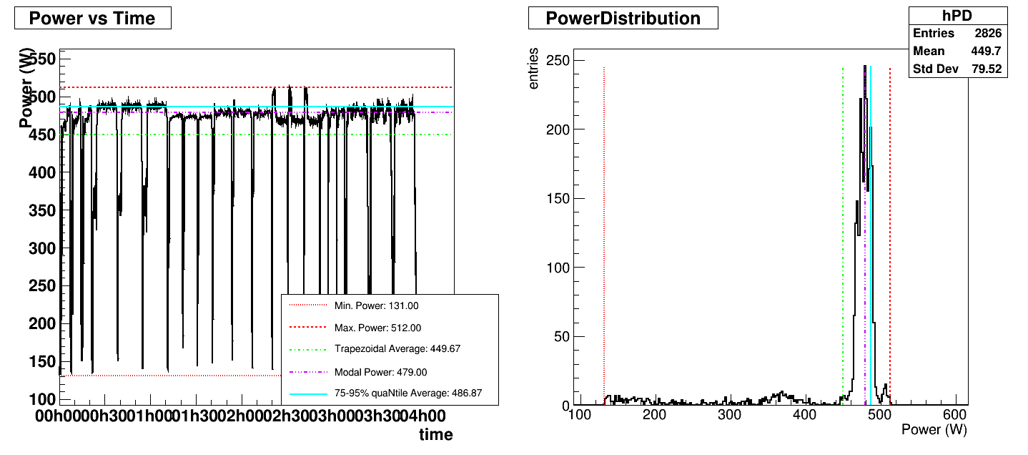
Data Processing (past)
This was the flow, from data collection to processing and visualization …
/tmp/ipmidump.json
ipmi_runtime.csv
jdump.sh
{
"date_yyyymmdd": "$DATE" ,
"time_hhmmss": "$TIME" ,
"cpu_usage_percent": "$CPUSE" ,
"memory_usage_gb": "$MEMUSE" ,
"cpu_frequency_ghz": "$FREQ" ,
"ipmi_power_watt": "$POWER"
}
jget.sh
persistent
(root’s script)
(user’s script)
volatile
bmkrun_report.json
run_HEPscore.sh
(user’s script)
persistent
Excel
ipmi2root.C
Notes:
TimeStamp: date +%F , %T
CPU: top -bn1 | grep Cpu(s) | sed s/.*, *([0-9.]*)%* id.*/1/ | awk '{print 100 - $1}'
RAM: free -t | awk 'FNR == 2 {printf(%.2f), $3/$2*100}’
FREQUENCY: cpupower frequency-info -f | grep "current CPU frequency:" | awk '{print $4 / 1000000}'
GPU: nvidia-smi --query-gpu=power.draw --format=csv,noheader,nounits | awk '{s+=$1} END {print s}’
Power (IPMI): ipmitool dcmi power reading | grep Instantaneous power reading:

Slide 6
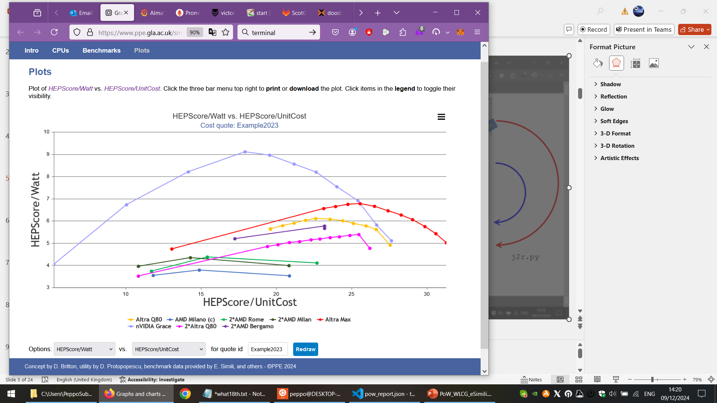

Data Processing (present)
In view of CHEP 2024 and to populate our web interface, I simplified the flow with a Python script …
/tmp/ipmidump.json
ipmi_runtime.csv
jdump.sh
{
"date_yyyymmdd": "$DATE" ,
"time_hhmmss": "$TIME" ,
"cpu_usage_percent": "$CPUSE" ,
"memory_usage_gb": "$MEMUSE" ,
"cpu_frequency_ghz": "$FREQ" ,
"ipmi_power_watt": "$POWER"
}
jget.sh
persistent
(root’s script)
(user’s script)
volatile
bmkrun_report.json
run_HEPscore.sh
(user’s script)
persistent
Excel
pow_report.json
j2r.py
Web-Import
SmartPro Web:
https://www.ppe.gla.ac.uk/smartpro/
Notes:
For the time being …

Slide 7
Data Processing (future)
With the new HEP-Score plugins, the flow will simplify even further …
/tmp/ipmidump.json
jdump.sh
{
"date_yyyymmdd": "$DATE" ,
"time_hhmmss": "$TIME" ,
"cpu_usage_percent": "$CPUSE" ,
"memory_usage_gb": "$MEMUSE" ,
"cpu_frequency_ghz": "$FREQ" ,
"ipmi_power_watt": "$POWER"
}
(root’s script)
volatile
bmkrun_report.json
persistent
run_HEPscore.sh
(user’s script)
In particular, the HEP-Score plugins produce a
power report within the standard JSON output (bmkrun_report.json) …
The only thing left to do is divide the score by a sensitive F.o.M. (<75-95%> ≈ q75 ≈ q85 ≈ K-Mean) See study by Kacper Kamil Kozik:
https://indico.cern.ch/event/1433496/
untitled_analyser.py
And … add the power metric (and the HS23/Watt) to the HEP-Score DB !
Notes:
Still ironing out the detail, e.g. Analyser !

Slide 8



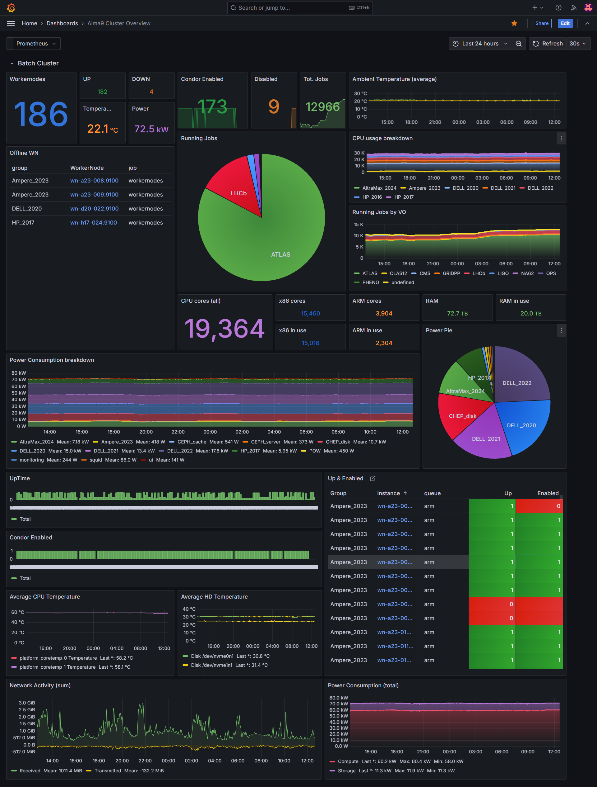
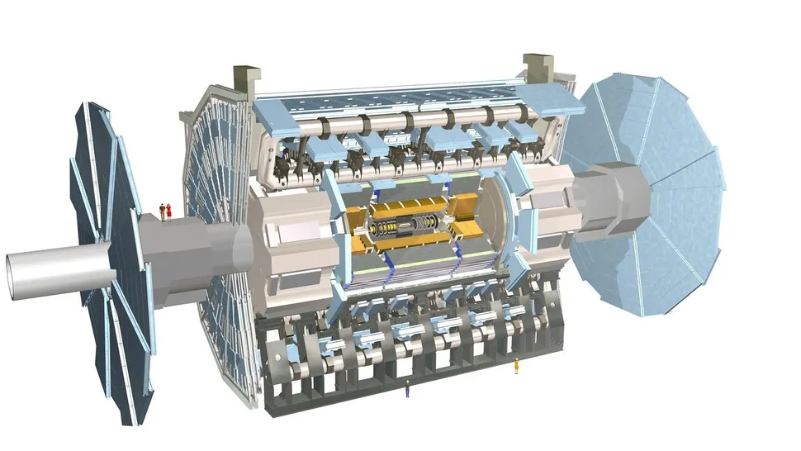
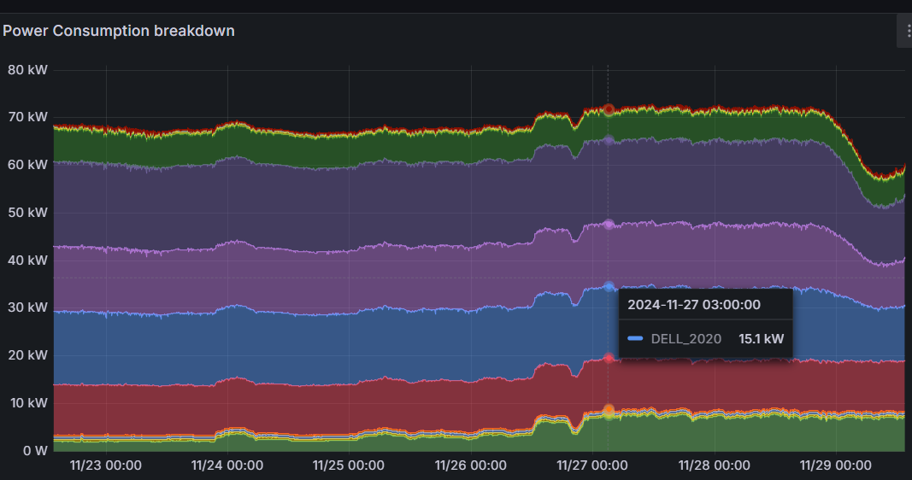
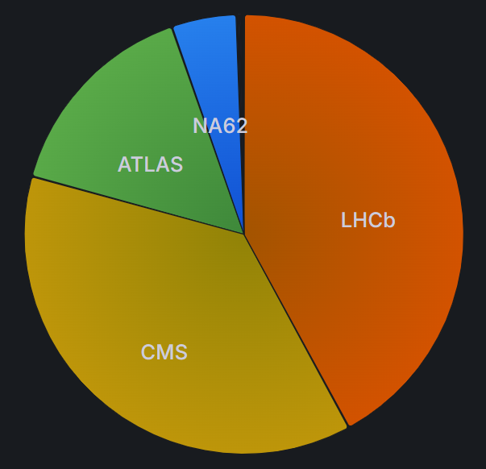
Heterogeneous Compute Cluster @ ScotGrid
The ScotGrid Glasgow Tier2 cluster provides ARM resources to the WLCG via standard job submission endpoints.
~15k cores (ht)
WLCG
UKI-SCOTGRID-GLASGOW_CEPH
wn_x86
wn_x86
x86 queue
wn_x86
wn_x86
wn_x86
ce01.gla.scotgrid.ac.uk
wn_x86
wn_x86
wn_x86
Job manager
wn_x86
ce02.gla.scotgrid.ac.uk
jobs
ce03.gla.scotgrid.ac.uk
~4k cores
ARM queue
wn_ARM
wn_ARM
ce04.gla.scotgrid.ac.uk
wn_ARM
wn_ARM
wn_ARM
wn_ARM
wn_ARM
Our monitoring system provides real-time view of the cluster via a Grafana dashboard.
At present, ARM resources are mainly used by the ATLAS collaboration, after they have successfully completed a physics validation campaign on our cluster.
We monitor power usage at machine level, and by combining it with job runtime information, we aim to set up a CO₂ accounting system for Virtual Organizations (VOs) within the WLCG ...
Notes:
ScotGrid Glasgow Heterogeneous Compute Cluster

Slide 9
ARM energy savings
Calculating energy savings at our site is a little tricky, because ARM resources are provided as an extra (overpledged): we are offering ARM computing resources to whoever can use them (especially, ATLAS).
But, if we compare the power usage of our latest ARMs machines (Ampere AltraMax) with the power that would have been used to run the same jobs on our older x86 infrastructure (AMD EPYC Milan), and scale by the number of jobs each VO has been running:
Power Saved = n_cores * (Power/core_{x86} – Power/core_{ARM}) ≈ Power_{ARM} * Δ_{HS23/W} (AltraMax – AMD Milan)
For example: ATLAS has been running a stable enough chunk of jobs on ARM last month, with an average usage 2k cores utilization …
VO ATLAS:
ARM: 3760.25 kWh
x86: 26086.83 kWh
VO LHCb:
ARM: 3720.07 kWh
x86: 25797.80 kWh
Savings_{ATLAS} = 3760 kWh * 0.2 = 752 kWh
Saving_{LHCb} = 3720 kWh * 0.2 = 744 kWh
preliminary
Note: all this was developed during the last week, using the existing monitoring infrastructure and a couple of hand-crafted scripts to export and process Prometheus data. Numbers may not be accurate!
Notes:
All these numbers are to be considered “preliminary”, as I am just playing with a new script and did not verify/validate any of these results yet!

Slide 10

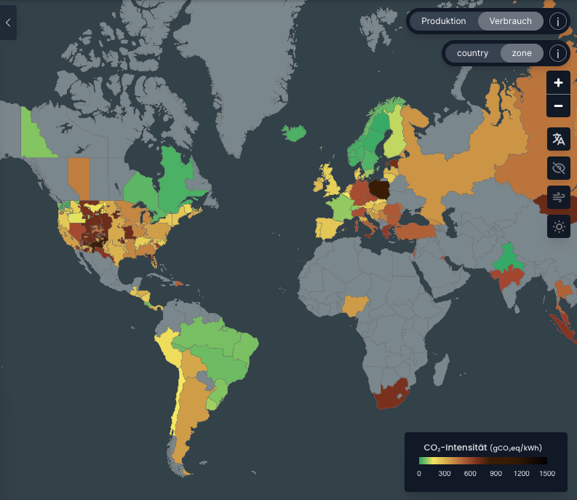
Toward a site-level CO₂ accounting?
Fernando Barreiro Megino has implemented a rough CO₂ calculator in ATLAS PanDA, based on the following formula: (https://panda-wms.readthedocs.io/en/latest/advanced/carbon_footprint.html)
How power hungry the CC/HW is
(currently hardcoded to 10W)
How CO2 intense the local power is
Easy number
Easy to estimate (site specific)
Very hard!
This number comes straight out of any monitoring system (local Prometheus, ATLAS PanDA, …)
ATLAS hardcoded this as 10W, but we can do better by looking at actual hardware at our site …
Image from https://app.electricitymaps.com/map
Estimating the CO₂/kWh is a complex issue, which depends on specific country, geographic area, electricity demand, time of the year, time of the day, … any power grid has a variable fraction of renewable vs. non-renewable power, and being able to track this in real time is complicated. But, we don’t have to do it ourself !
Notes:
CO2 accounting: hard!

Slide 11
Toward a site-level Power accounting
So … to avoid headaches and stick to hard data, we start from a straight power accounting.
This can be done quite precisely at any WLCG site. Here our strategy:
1) Gather Metrics from local Prometheus:
Resource utilization by VO: (count(node_condor_cpu{job="workernodes"}) by (vo))
Cluster-wide power consumption: (node_power_watts{job="workernodes"})
2) Perform some Calculations:
Total Power = Active power + Idle power
VO-specific power = %_usage × Total Power
Optional: adjust for machine types and specific job efficiencies (for now we only split between ARM & x86).
3) Generate Reports:
Produce tables or charts showing energy usage per VO.
4) From Power to CO₂ usage can be as simple as multiplying by the country average CO2/kWh, or as complicated as
integrating the convolution of Power Usage * instantaneous local CO₂/kWh during the sampled period:
Notes:
Power accounting: easy!

Slide 12
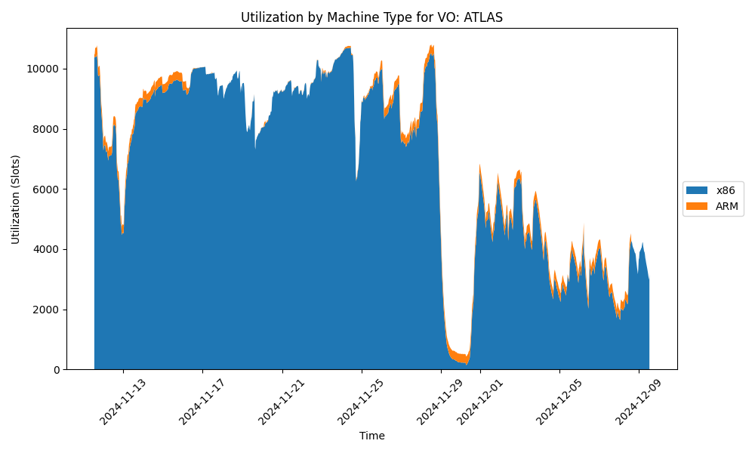
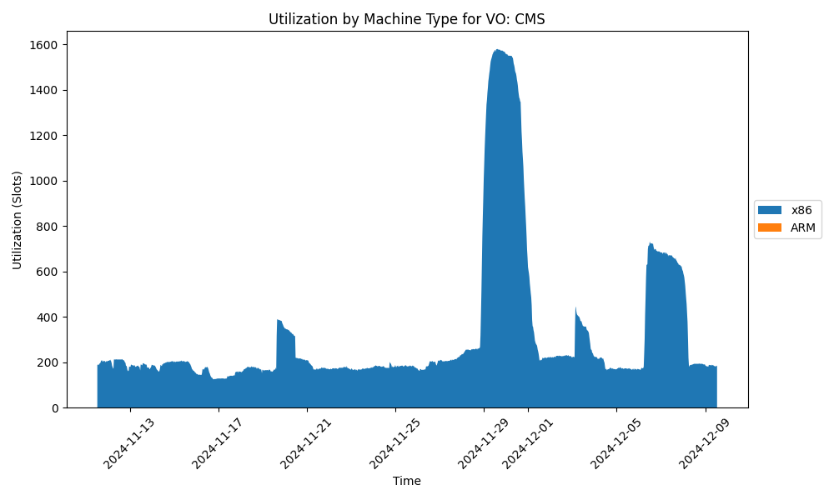
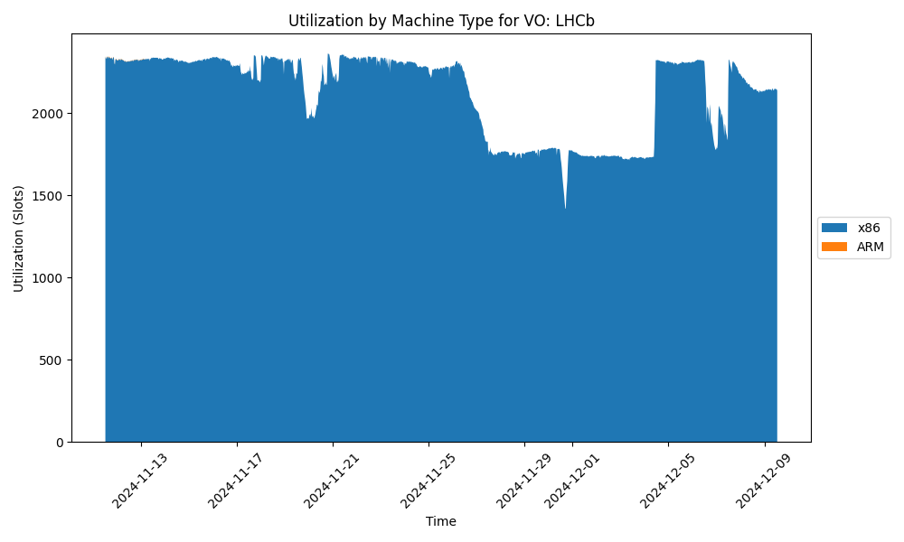
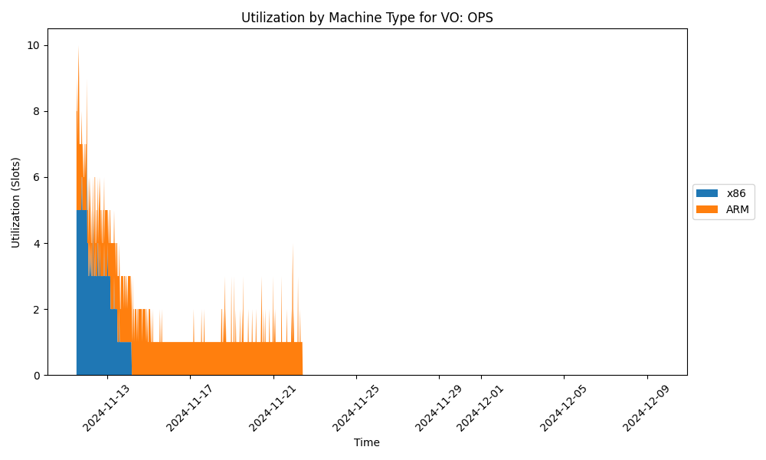
Proof of Concept
So far, I made a Python script that exports metrics from the Prometheus API and does some calculations.
The first step is extracting Job-Slots occupancy by VO (and Architecture). See examples in 1 month period:
preliminary
Notes:
PoC (job slots)

Slide 13
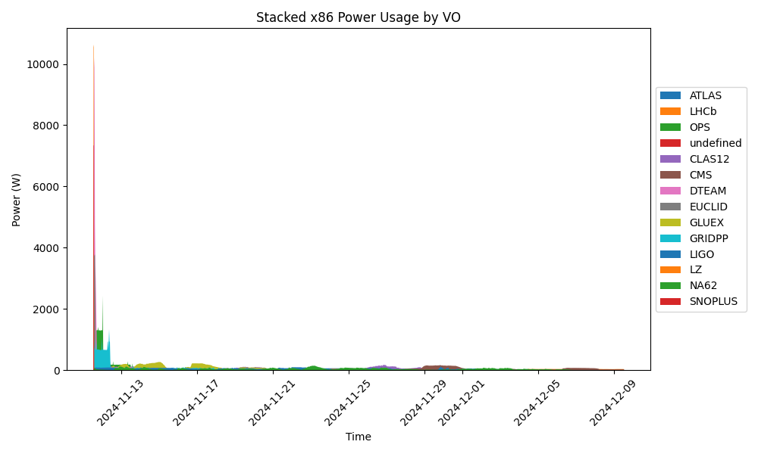
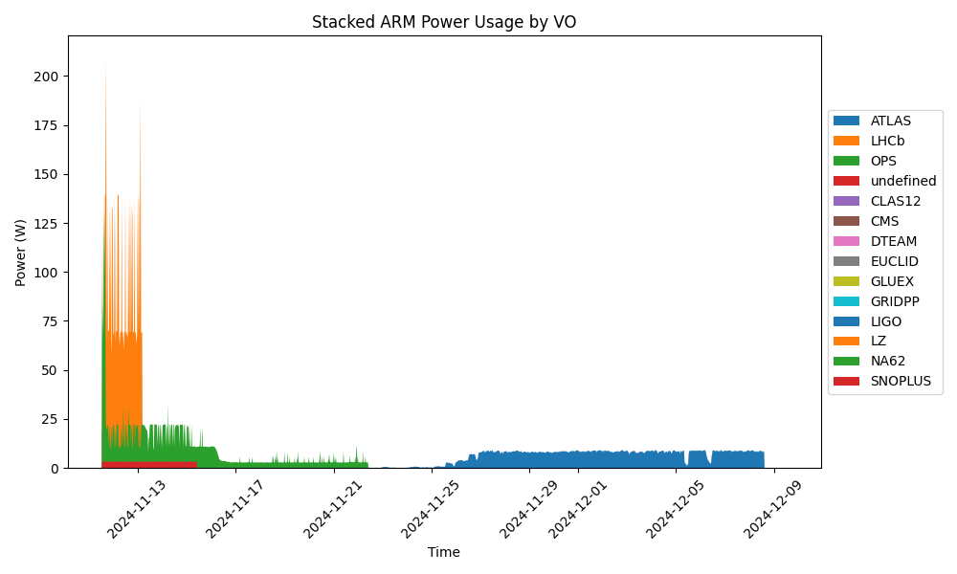
Proof of Concept (2)
With these numbers, we can then scale the power usage and assign it proportionally to VOs.
The 2 plots below show the proportional power usage by VO over 1 month period:
preliminary
And these are integrated power usages (kWh) for a few sampled VOs over the same period:
VO ATLAS:
ARM: 3760.25 kWh
x86: 26086.83 kWh
VO LHCb:
ARM: 3720.07 kWh
x86: 25797.80 kWh
VO OPS:
ARM: 2721.78 kWh
x86: 25950.92 kWh
VO CLAS12:
ARM: 0.00 kWh
x86: 25628.82 kWh
VO CMS:
ARM: 0.00 kWh
x86: 24582.94 kWh
VO DTEAM:
ARM: 0.00 kWh
x86: 25812.16 kWh
VO EUCLID:
ARM: 0.00 kWh
x86: 10602.08 kWh
VO GLUEX:
ARM: 0.00 kWh
x86: 26231.67 kWh
preliminary
Notes:
PoC (kWh)

Slide 14
Issue and possible solutions
The current strategy just calculates the proportional Power Distribution: use the % resource utilization by VO to allocate total power usage. For example: VO “ScotGrid” uses 30% of the cluster resources, so ScotGrid gets billed for 30% of the total power (active + idle). This is an executive choice, but I am ready to hear your suggestions and criticism … for instance:
1. Idle Power Allocation
Option A: Divide idle power among all VOs (including inactive ones)
Pros: Simple and reflects the cost of having infrastructure ready for all VOs.
Cons: Inactive VOs may complain about being "billed" for resources they didn’t use.
Option B: Divide idle power among active VOs only
Pros: Aligns cost with actual resource usage.
Cons: Few active VOs at any time may bear a disproportionate share of the idle power cost, which could seem unfair.
Suggestion: Option A is better for fairness as all VOs benefit from having the cluster online.
Rationale: if you rent a car and keep it parked in the drive-way, you may save on gas but you still pay for the rent!
2. Accounting for Machine Types
Option A: Track job distribution per machine type
Pros: Accurately reflects the true energy cost per VO.
Cons: Adds complexity; might lead to disputes if a VO is often assigned to less efficient machines.
Option B: Average out hardware efficiency
Pros: Simple and less controversial. Treat the cluster as a "black box" delivering aggregated services.
Cons: Loses granularity in reporting efficiency.
Suggestion: Option B for simplicity. But we consider expanding it to include machine-specific efficiencies and PUE
(“bill” the site, which should push site level optimization?).
Notes:
Issues & solutions

Slide 15

Conclusions & Outlook
Improving on the methodology and developing an automated Analysis framework:
- energy measurement now integrated in HEP-Score
- HS23/Watt metric soon to be included in the HEP-Score DB (one stop shop for hardware rating!)
- (maybe) add the frequency dependence in the DB for better characterization of hardware?
Implement a prototype for WLCG global CO₂ accounting - possibly, not in isolation
- work harder on developing a robust Power Accounting strategy!
- iron out the details in collaboration with VOs & WLCG sites (idle, PUE, hardware efficiency)
- talk to experts on Power grids to attach the CO₂ cost to power
Keep looking at more energy efficient hardware solutions (x86, ARM, RISC-V, GPUs)
Notes:
outlook

Slide 16
end
Emanuele Simili, Gordon Stewart, Samuel Skipsey Albert Borbely & David Britton (ScotGrid Glasgow)
WLCG Environmental Sustainability Workshop @ CERN - 12 December 2024
Notes:
end

Slide 17



in-House (production)
~ 1.5k cores
~ 2k cores
2xIntel40ht: Dual Socket Intel XEON E5-2630 v4 (HP)
CPU: 2 * x86 Intel(R) Xeon(R) E5-2630 v4, 10C/20HT @ 2.2GHz (TDP 85W)
RAM 160GB (4 x 32GB + 4 x 8GB) DDR4 2400 MHz → 4 GB/core
HDD: 2TB disk SATA @ ‎7200 RPM
2*ARM80c: Dual Socket Ampere Altra Q80-30 (Ampere)
CPU: 2 * ARM Ampere Q80-30, 80C @ 3GHz (TDP 210W)
RAM: 512GB (32 x 16GB or 16 x 32GB) DDR4 3200MT/s → 3.2 GB/core
HDD: 2 * 1TB NVMe
~ 5k cores
2xAMD64ht: Dual Socket AMD EPYC 7513 (DELL)
CPU: 2 * x86 AMD EPYC 7513 (Milano), 32C/64HT @ 2.6GHz (TDP 200W)
RAM: 512GB (16 x 32GB) DDR4 3200MT/s → 4 GB/core
HDD: 3.84TB SSD SATA Read Intensive
ARM128c: Single Socket Ampere Altra Max M128-30 (SuperMicro)
CPU: ARM Ampere M128-30, 128C @ 3GHz (TDP 250W)
RAM: 512GB (8 x 64 GB) DDR4 3200MHz → 4 GB/core
HDD: 8TB NVMe
~ 7.5k cores
~ 2k cores
2xAMD64ht: Dual Socket AMD EPYC 7452 (DELL)
CPU: 2 * x86 AMD EPYC 7452 (Roma), 32C/64HT @ 2.35GHz (TDP 200W)
RAM: 512GB (16 x 32GB) DDR4 3200MT/s → 4 GB/core
HDD: 3.84TB SSD SATA Read Intensive
in-House (testing)
AMD96ht: Single AMD EPYC 7003 (GIGABYTE)
CPU: x86 AMD EPYC 7643, 48C/96HT @ 2.3GHz (TDP 225W)
RAM: 256GB (16 x 16GB) DDR4 3200MHz → 2.7 GB/core
HDD: 3.84TB SSD SATA
ARM80c: Single socket Ampere Altra Q80-30 (GIGABYTE)
CPU: ARM Ampere Q80-30, 80C @ 3GHz (TDP 210W)
RAM: 256GB (16 x 16GB) DDR4 3200MHz → 3.2 GB/core
HDD: 3.84TB SSD SATA
2xAMD48ht+GPU: Dual Socket AMD EPYC 7443 (DELL)
CPU: 2* AMD EPYC 7443, 24C/48HT @ 2.3GHz (TDP 200W)
GPU: 2* NVIDIA A100 PCIe 80GB (TDP 300W)
RAM: 256GB (16 x 16GB) DDR4 3200MHz → 2.7 GB/core
HDD: 480GB SSD SATA + 5TB SSD SCSI
Grace144c: Dual Socket* NVidia Grace (SuperMicro)
CPU: NVidia Grace 144-Core 480GB DDR5 @ 3.4GHz (TDP 500W)
RAM: 480GB (on chip) DDR5 4237MHz → 3.3 GB/core
HDD: 1TB NVMe + 4TB NVMe
And, we also have a RISC-V test box …
Notes:
hardware currently available at Glasgow Tier2 (production & testing)

Slide 18
Remote Testing
2*AMD256ht: Dual Socket AMD EPYC 9754 (SuperMicro)
CPU: 2 * x86 AMD EPYC 9754 (Bergamo), 128C/256HT @ 3.1GHz (TDP 360W)
RAM: 1.536TB (24 x 64GB) DDR4 3200MHz → 3 GB/core
HDD: 512GB NVMe + 3.84TB SSD
ARM128c: Single Socket Ampere Altra Max M128-28 (XMA)
CPU: ARM Ampere M128-28, 128C @ 2.8GHz (TDP 250W)
RAM: 512GB (8 x 64GB) DDR4 3200MHz → 4 GB/core
HDD: 1TB NVMe Storage
SuperMicro
XMA
AMD128ht: Single Socket AMD EPYC 8534P (SuperMicro)
CPU: AMD EPYC 8534P (Siena), 64C/128HT @ 3.1GHz (TDP 200W)
RAM: 576GB (6 x 96GB) DDR5 3200MT/s → 4.5 GB/core
HDD: 1TB NVMe Storage
ARM192c: Single Socket AmpereOne A192-32x (SuperMicro)
CPU: ARM AmpereOne A192-32x, 192C @ 3.2GHz (TDP 350W)
RAM: 1Tb (…) → 5 GB/core
HDD: 1TB NVMe Storage
SuperMicro
2xAMD192ht: Dual Socket AMD EPYC 9654 96-Core (…)
CPU: AMD EPYC 9654 (Genoa), 96C/184HT @ 3.7GHz (TDP 340W)
RAM: 1TB (…) → 5GB/core
HDD: …
@ RAL
We have expressed our interest in testing new hardware to a few vendors, and from time to time we get remote access to new machines. We have also gathered data from other WLCG sites (RAL).
But, our machine sample is negligible compared to what is available in the HEP-Score DB …
Notes:
AmpereOne: https://amperecomputing.com/briefs/ampereone-family-product-brief

Slide 19
What Watt
We wish to extract an accurate Figure of Merit (FoM) of power usage for a standard HEP workload from smaller HEP-Score containerized jobs, which is easy to implement and consistent across hardware.
2*Milano
We could fit this peak, but … the distribution is not gaussian and varies across hardware.
<75-95%> Blue line sits nicely in the plateau !
By arranging the data in power order we can perform an upper quartile average, but discard the top 5% of data to remove isolated peaks. This we call 75-95% quantile average.
Notes:
Wordy explanation/motivation:
Neither the Max nor the Average power is the best way of characterizing the performance. The Max can be exaggerated by significant 'spikes' that can momentarily be higher than the plateau; the average is suppressed by the low-power start-up phase that can extend to 20% of the run-time for the short jobs in the HEP-Score suite. Thus, using Max power will underestimate HEP-Score/Watt and using Average power will overestimate HEP-Score/Watt. Instead, we propose to use the average power calculated from the 75-95% quaNtile. The upper quartile eliminates most of the start-up phase that would be over-emphasized by short benchmarking jobs, while the cut of the highest 5% prevents power spikes to have any significant effect.
The result is relatively insensitive to the shape of the distribution and well fits the upper plateau in the power drain plots, while giving less importance to the start-up phase and to isolated spikes in power. It can be noted that the modal power itself (the mode of the power distribution, corresponding to the most common power-draw) is a good estimate for single workloads, but not for the combination of different workloads in the HEP-Score suite that can have different power draws.

Slide 20
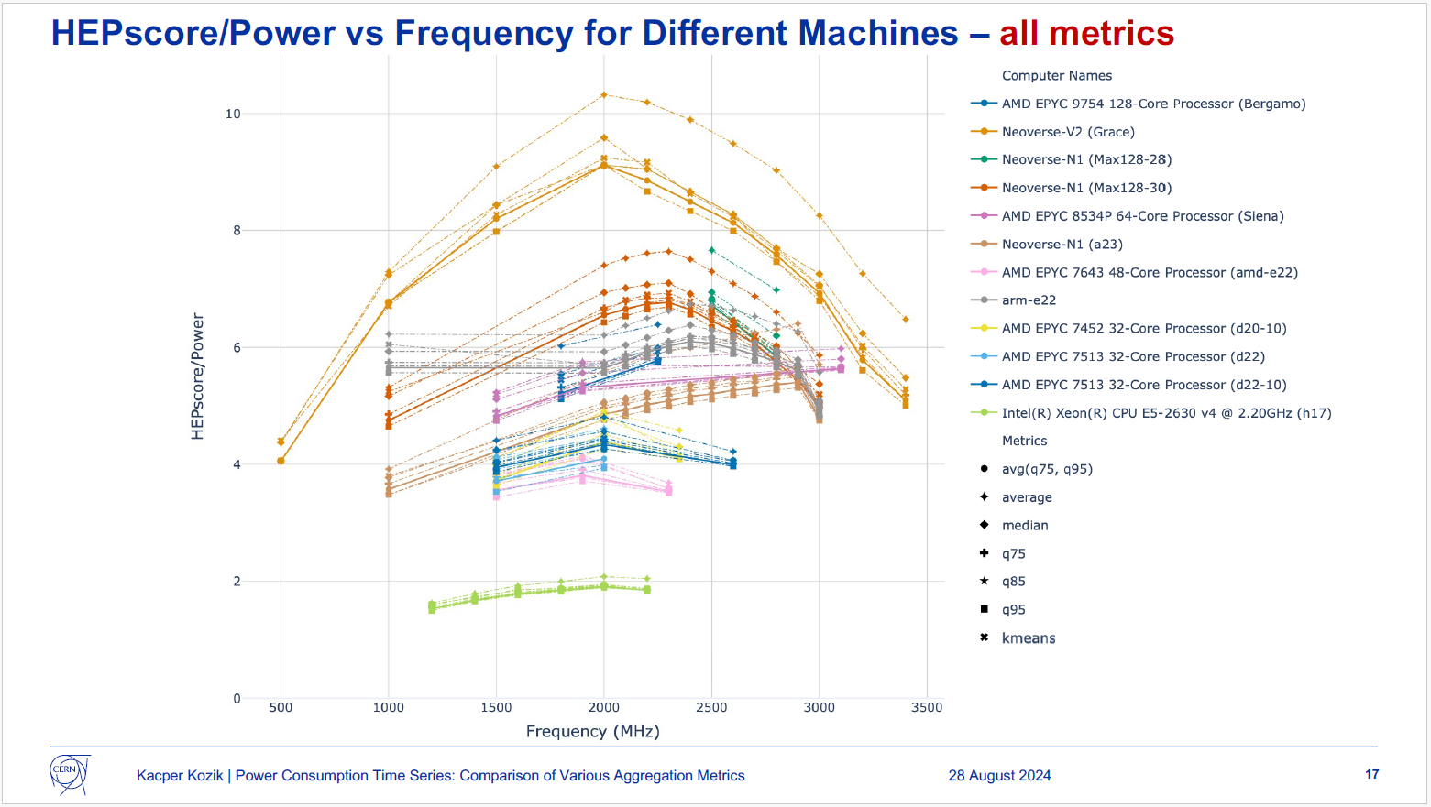
What Watt (reprise)
The HEPiX Benchmark Working Group has also studied various statistical proxies for power usage.
In particular, see the presentation by Kacper Kamil Kozik: https://indico.cern.ch/event/1433496/
The machines are the same from the previous slide, but labels are slightly different.
The “average power” is estimated by using different statistical proxies (metrics), see legend.
Notes:
Ref.
Kacper Kamil Kozik @ HEPiX Benchmarking Working Groups meeting on Wednesday Aug 28, 2024, 5:00 PM
https://indico.cern.ch/event/1433496/

Slide 21
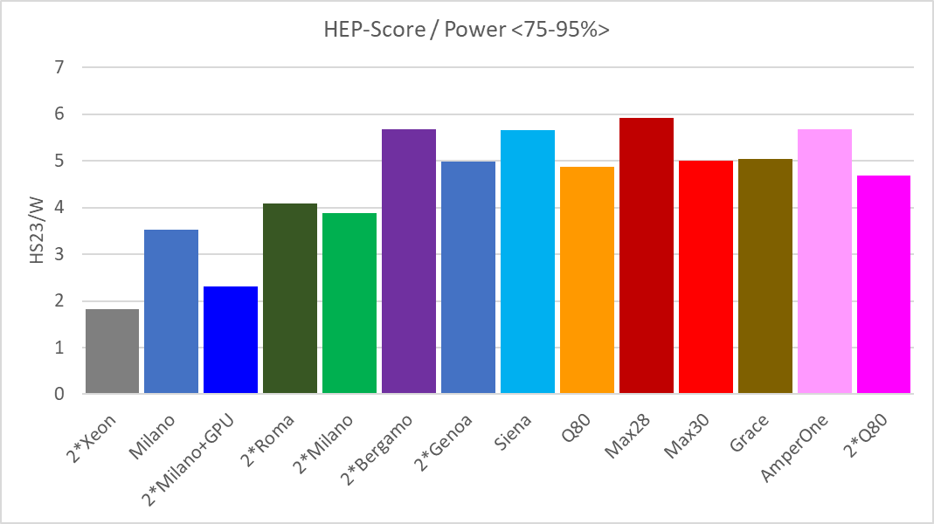
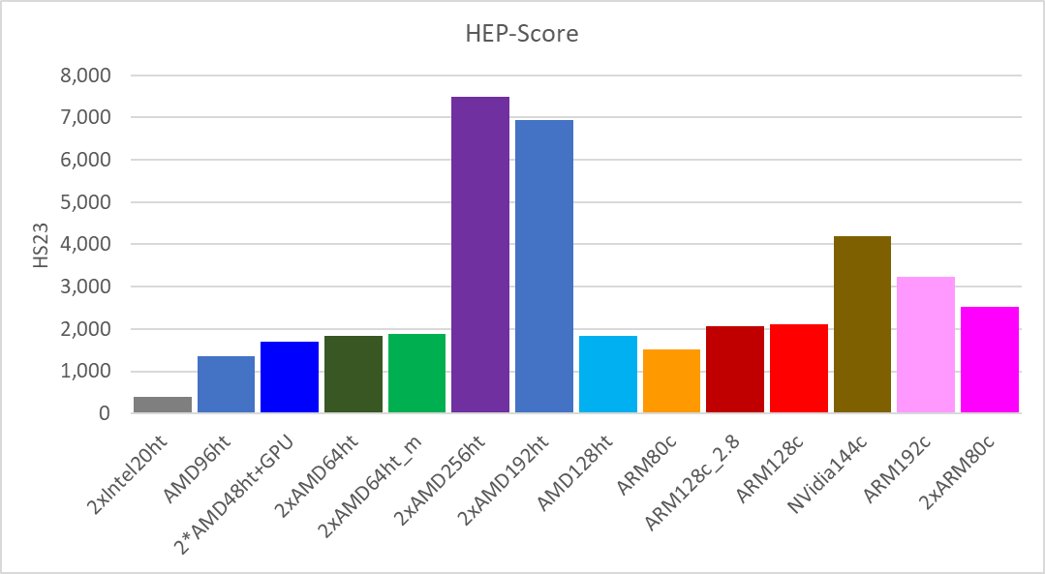
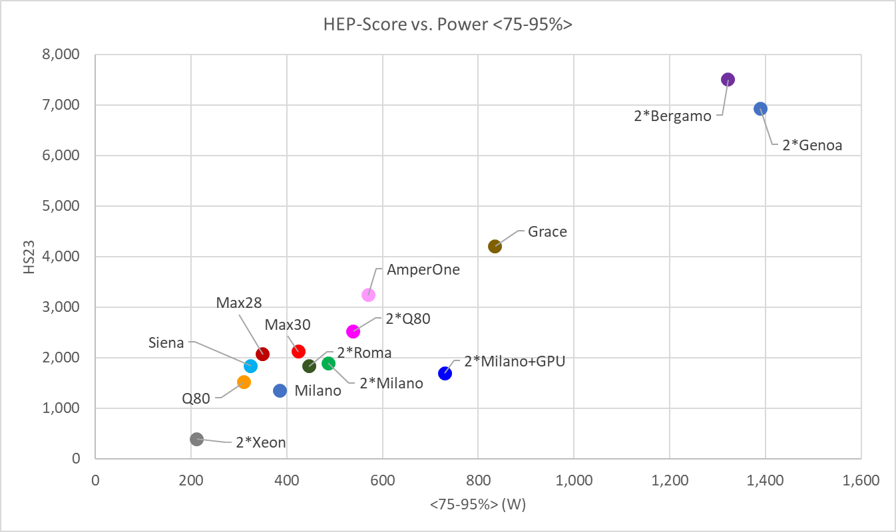
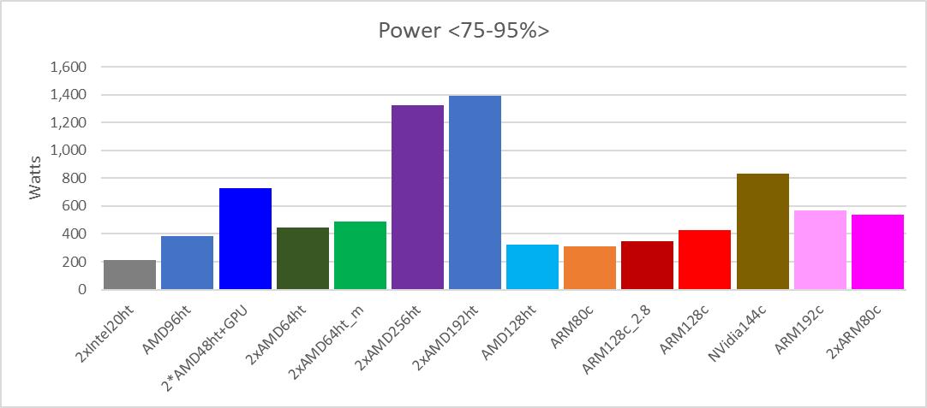
more HS23/Watt
GPU not used
Using our FoM, we measure performance per watt as: HS23 / Power<75-95%>
Notes:
Calculation of Watt/Job still in progress …

Slide 22




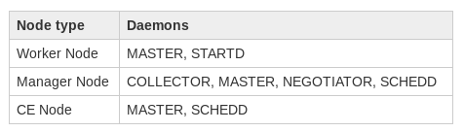
ScotGrid Tier2 Cluster Overview
VM-Hypervisor
Arc-ce04
AuthN / AuthZ
Arc-ce03
Arc-ce02
arc-ce
Arc-ce01
arc-ce
Job requests
schedd
arc-ce
Tokens, VOMS, ...
schedd
arc-ce
schedd
schedd
vpn
WAN
HTC-manager
Scot-Nat
collector
negotiator
nat
HTCondor
Scot-Squid
wn-x86-001
squid
Traffic
cvmfs
startd
storage
(ceph)
wn-ARM-001
cvmfs
startd
Notes:
ScotGrid Glasgow (compute)

Slide 23
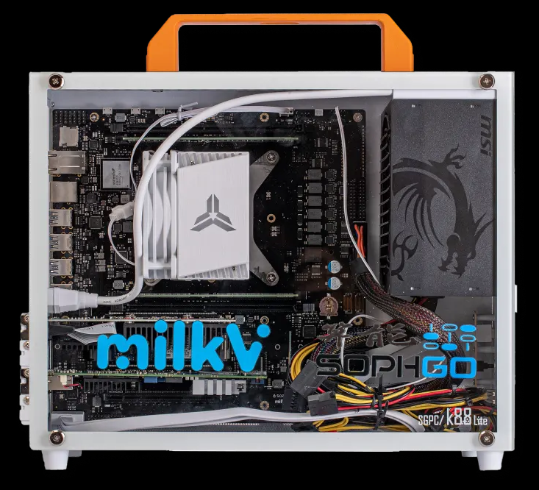
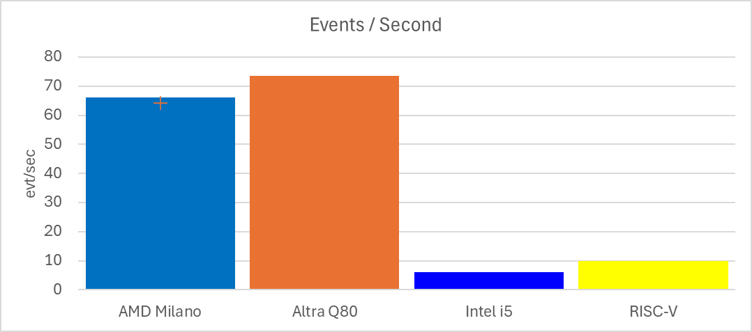
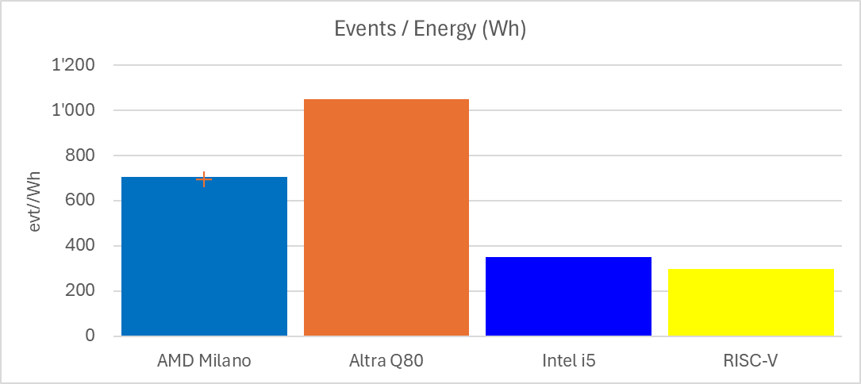
Preliminary look at RISC-V
RISC-V is an open standard Instruction Set Architecture (ISA) based on established Reduced Instruction Set Computing principles, and offered under royalty-free open-source license.
Support for RISC-V was added to the Linux kernel in 2022, the 64-bit variant (riscv64) in 2023.
We recently acquired a fully integrated RISC-V desktop PC running Fedora 38 (for ~2.5k £) …
Milk-V Pioneer
We ran a Geant4 full detector simulation as benchmark, and compared the RISC-V performance with 3 types of hardware (desktop i5 PC, AMD EPYC and ARM Ampere Q80 servers).
We evaluated the performance as Events/Second and Events/Sec/Watt. (≈ Events/Energy).
Our results show that, at present, the RISC-V PC performs slightly better than a 2017 desktop, but the hardware is not mature enough to compete with server grade x86 and ARM CPUs (and there are currently no RISC-V server solutions).
With growing interest for the RISC-V architecture (e.g., EPI https://www.european-processor-initiative.eu/), the landscape can rapidly evolve, and we want to be prepared!
Notes:
RISC-V will improve!
Already comparable to a mid-range x86 from 2017
Will soon become comparable with ARM
We wish to have a test-suite ready to follow the evolution …

