Slide 1
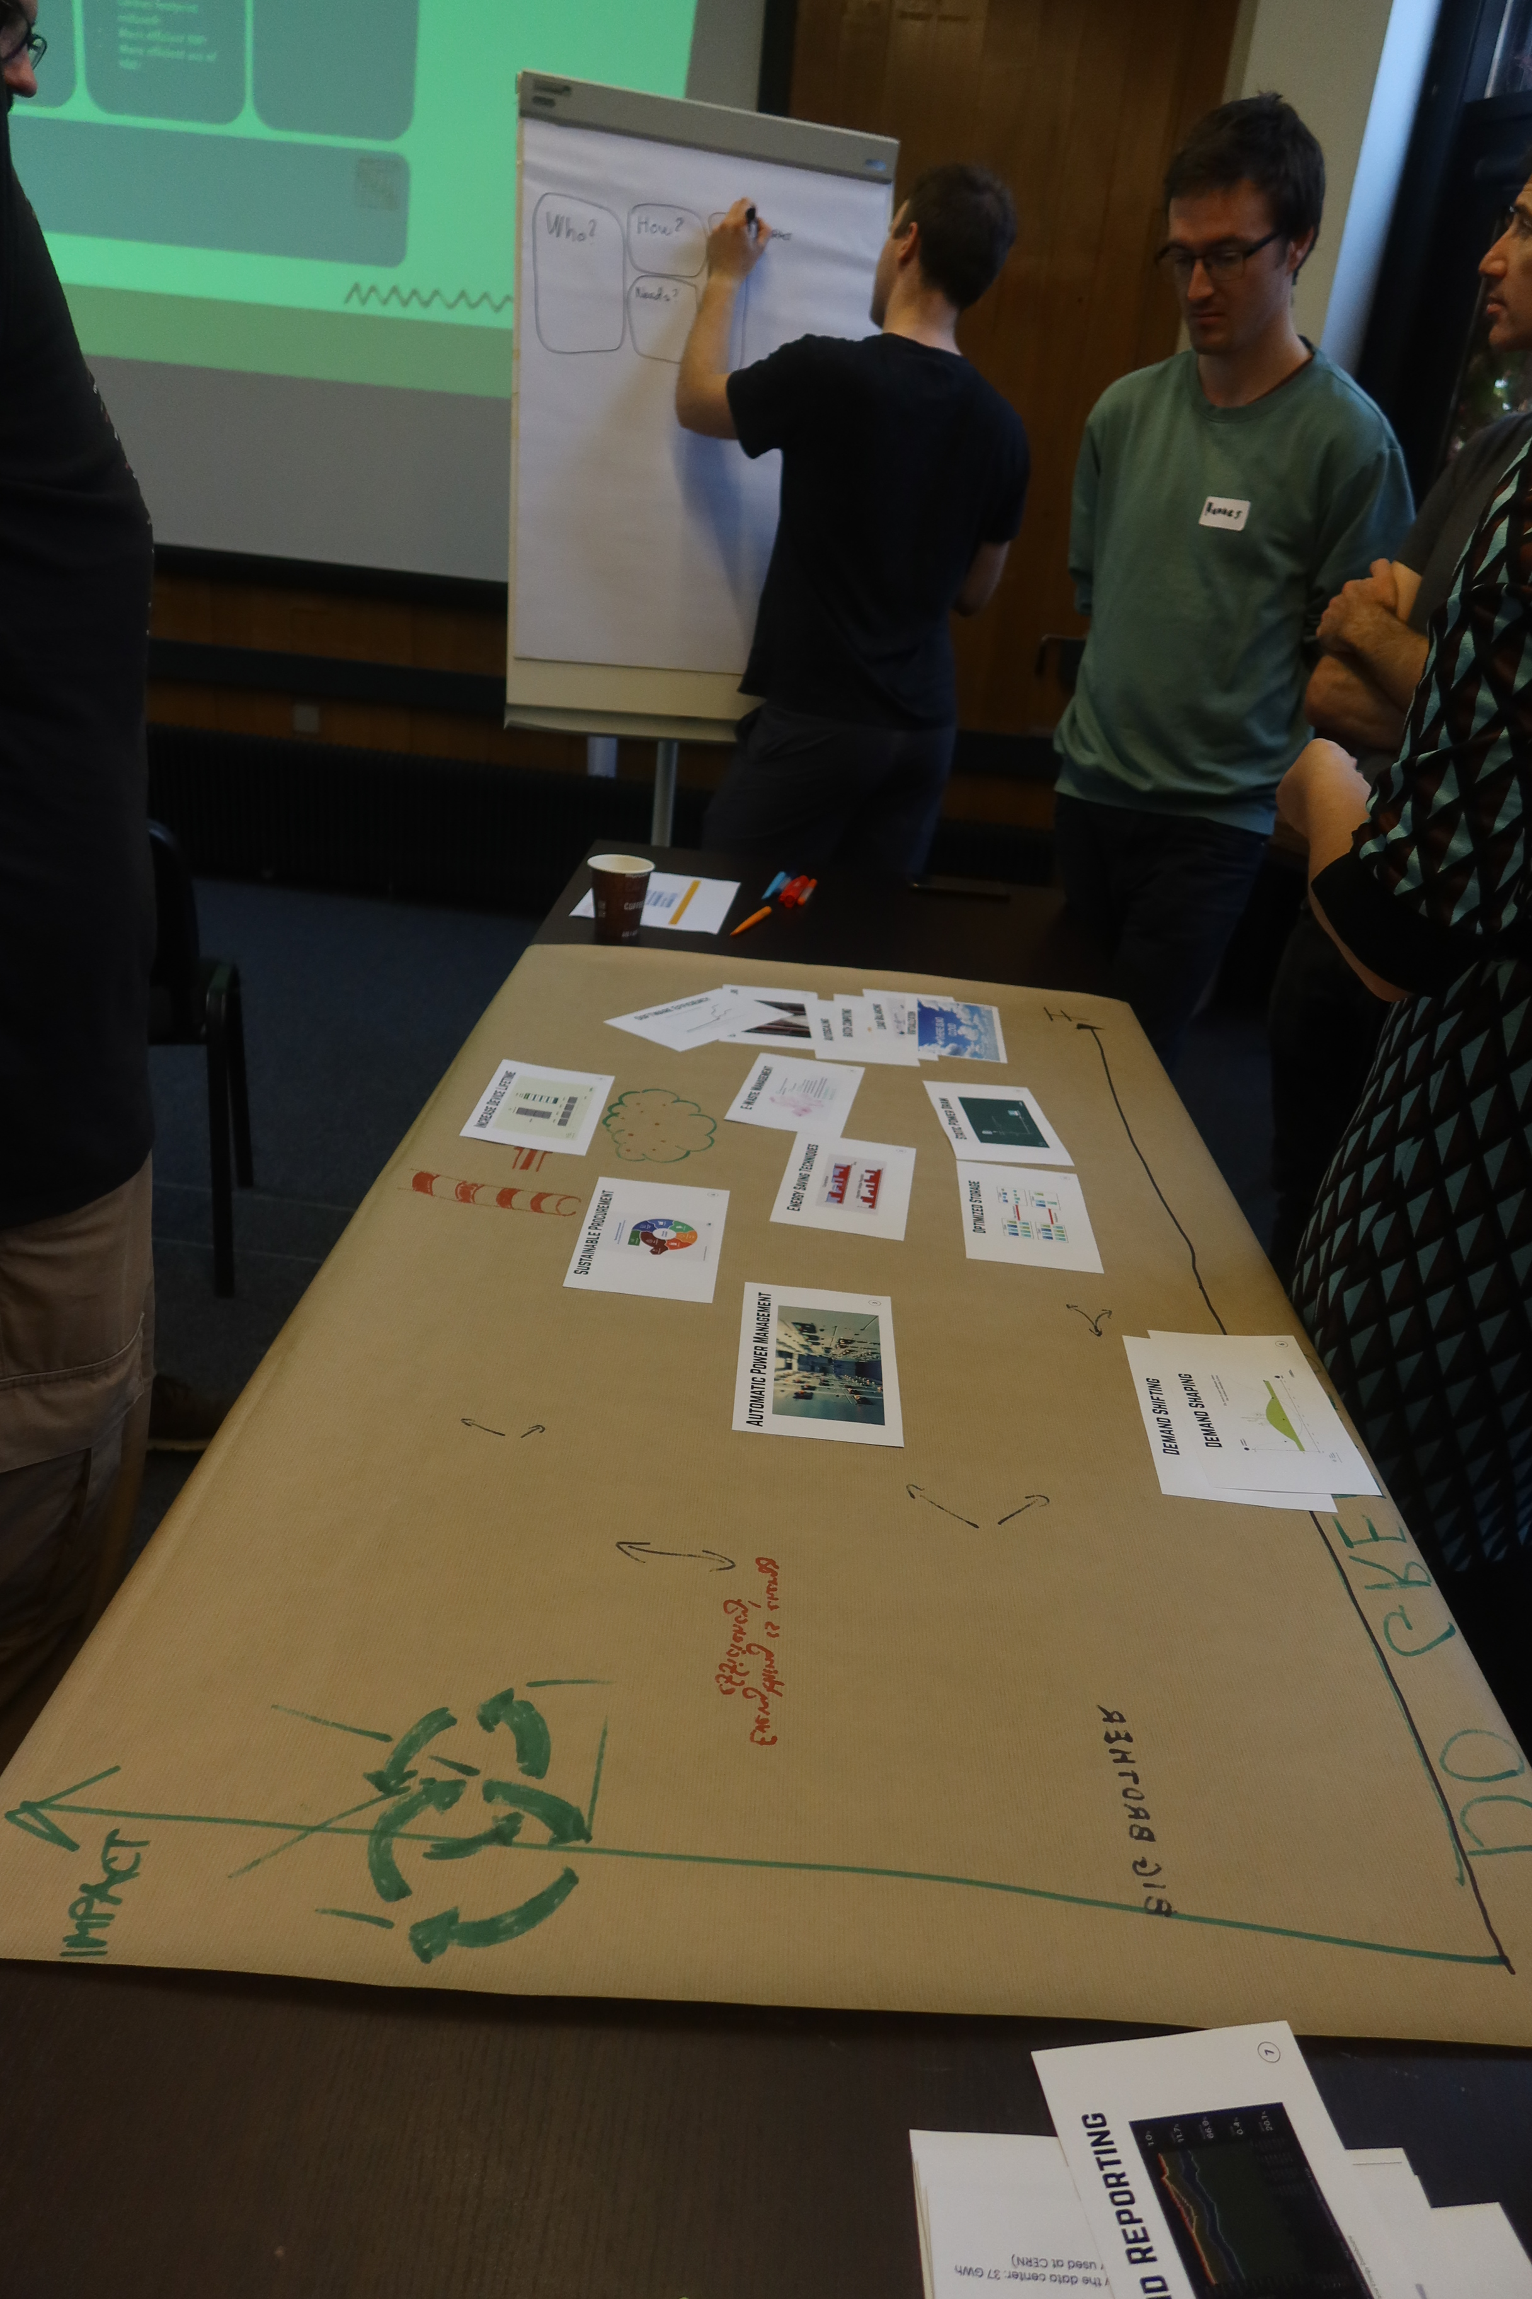
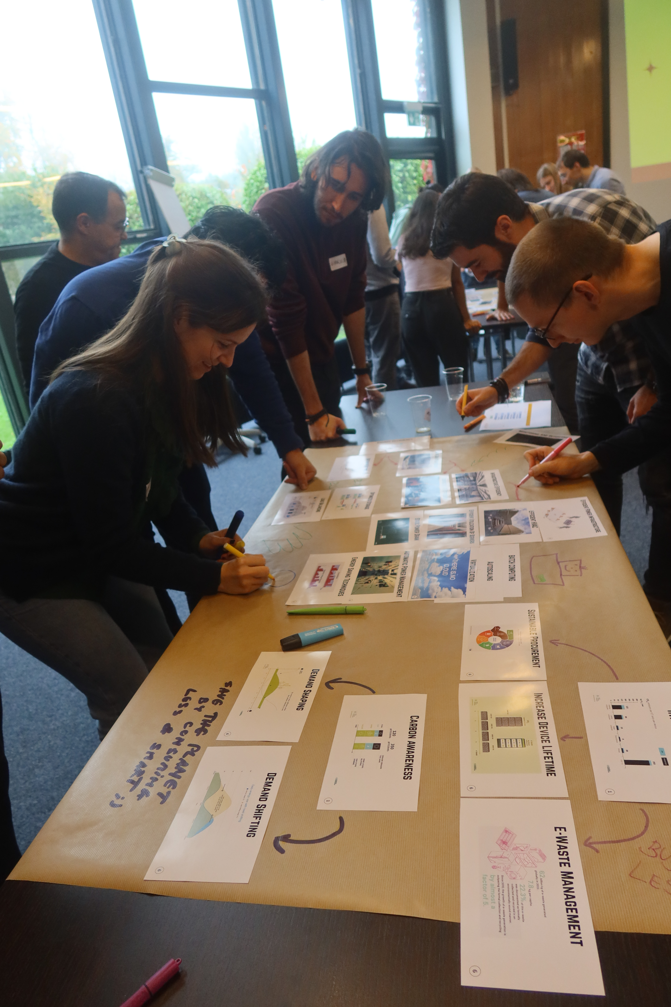
Raising awareness on IT’s Environmental Impact
Experiences from a Collaborative Workshop
Inspired from existing collaborative workshops like Climate Fresk
Focus on IT, in particular the IT services managed by the IT-CD group at CERN
  IT-CD operates, maintains and supports scientific computing services including the WLCG Tier-0
3h workshop with 36 IT-CD participants (October 2024)
  To learn climate change basics and impact of digital technologies
  Identify and develop mitigation strategies in a collaborative way

Slide 2
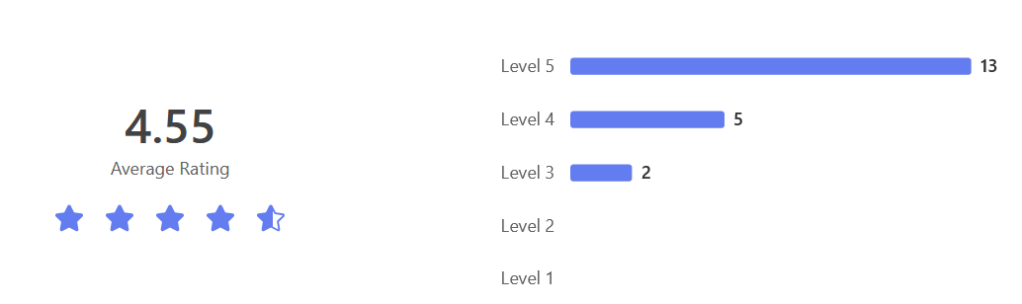
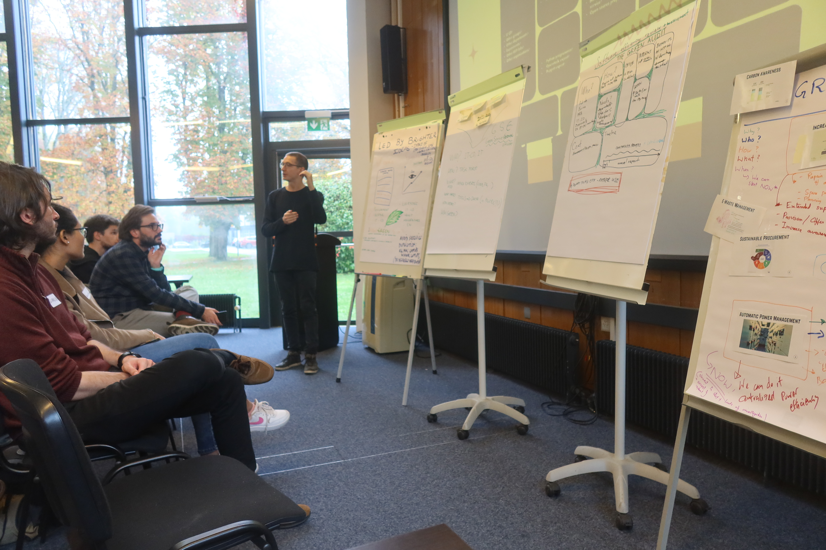
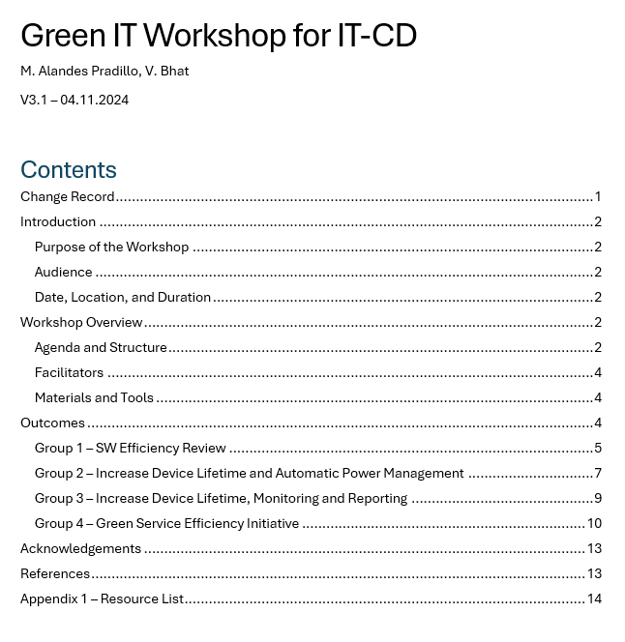
Raising awareness on IT’s Environmental Impact
Experiences from a Collaborative Workshop
24 cards describing IT strategies to reduce carbon footprint
Final report available with all the details
Overall positive experience
  Excellent teamwork and participation
  Identified some improvements on workshop material and structure after survey results
Interest from other groups in IT
In line with CERN and IT Sustainability strategy so it’s relevant and meaningful
Final report: https://cernbox.cern.ch/s/AVNErt0oGZNlDPJ

