Slide 1
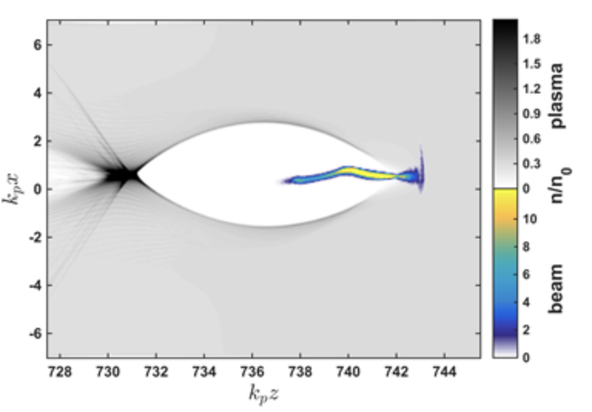
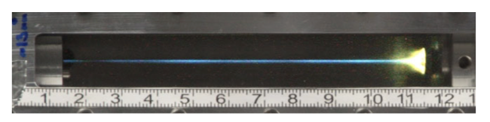
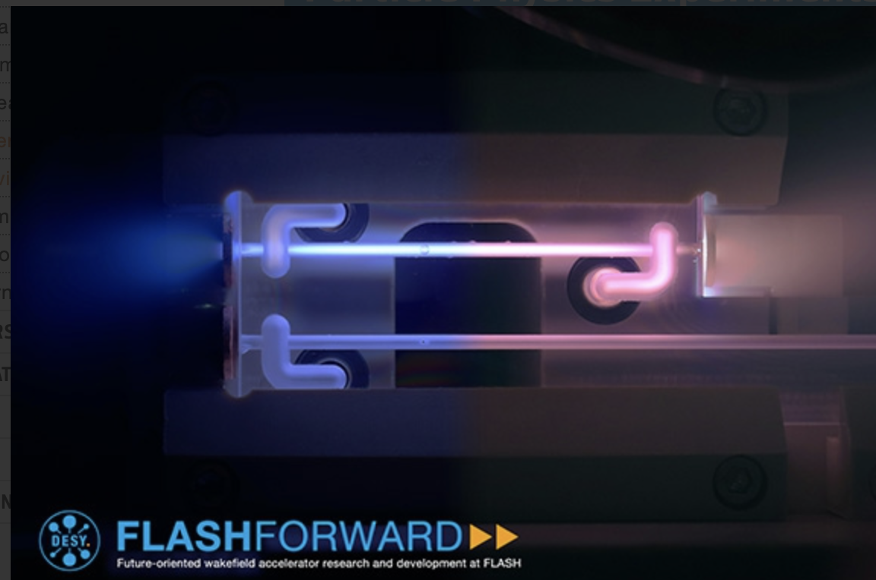
Introduction – work on plasma-based accelerators
Previously worked with Simon Hooker on laser driven wakefield accelerators
Now in the John Adams Institute with Richard D’Arcy using particle beams to drive plasma accelerators
Strong links with the FLASHForward group in DESY
Simulation of beam driven plasma wakefield (credit: Timon Mehrling)
A laser-produced plasma acting as a waveguide for PW lasers (above) vs a capillary discharge waveguide (right)

Slide 2
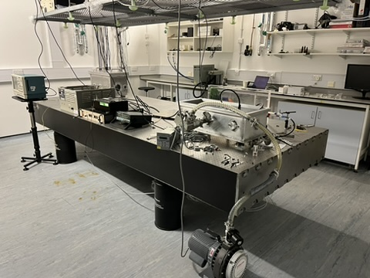
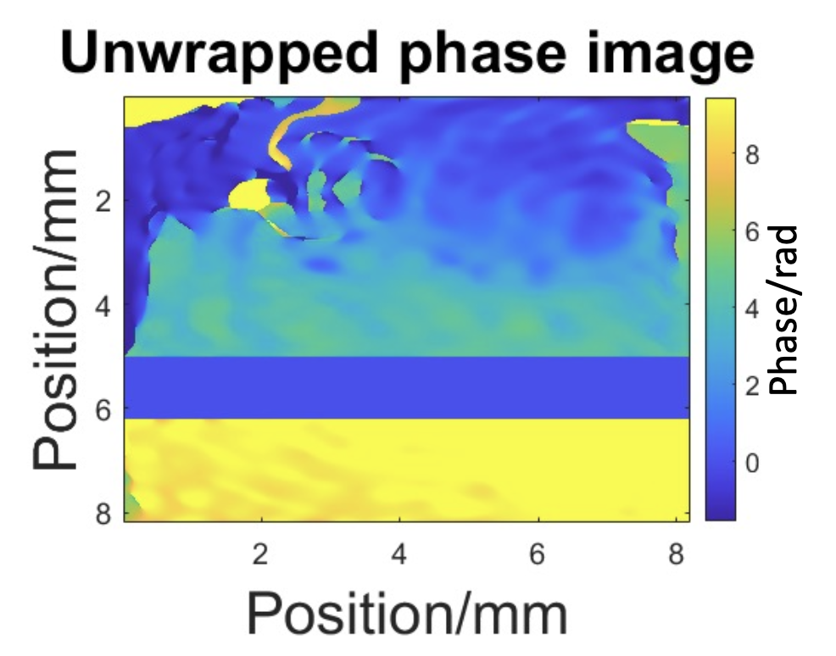
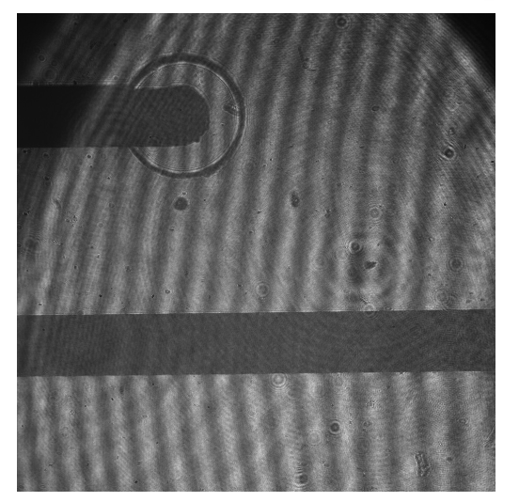
My current work
I am developing a laboratory in Oxford to be used as a testbed
To understand the accelerator at DESY I spent several weeks there
I also worked at DESY developing a non-invasive temperature diagnostic for the plasma source
Longer term goals are to develop further diagnostics here and DESY to study energy pathways in plasma accelerators
Raw data from temperature diagnostic and provisionally analysed data

Slide 3
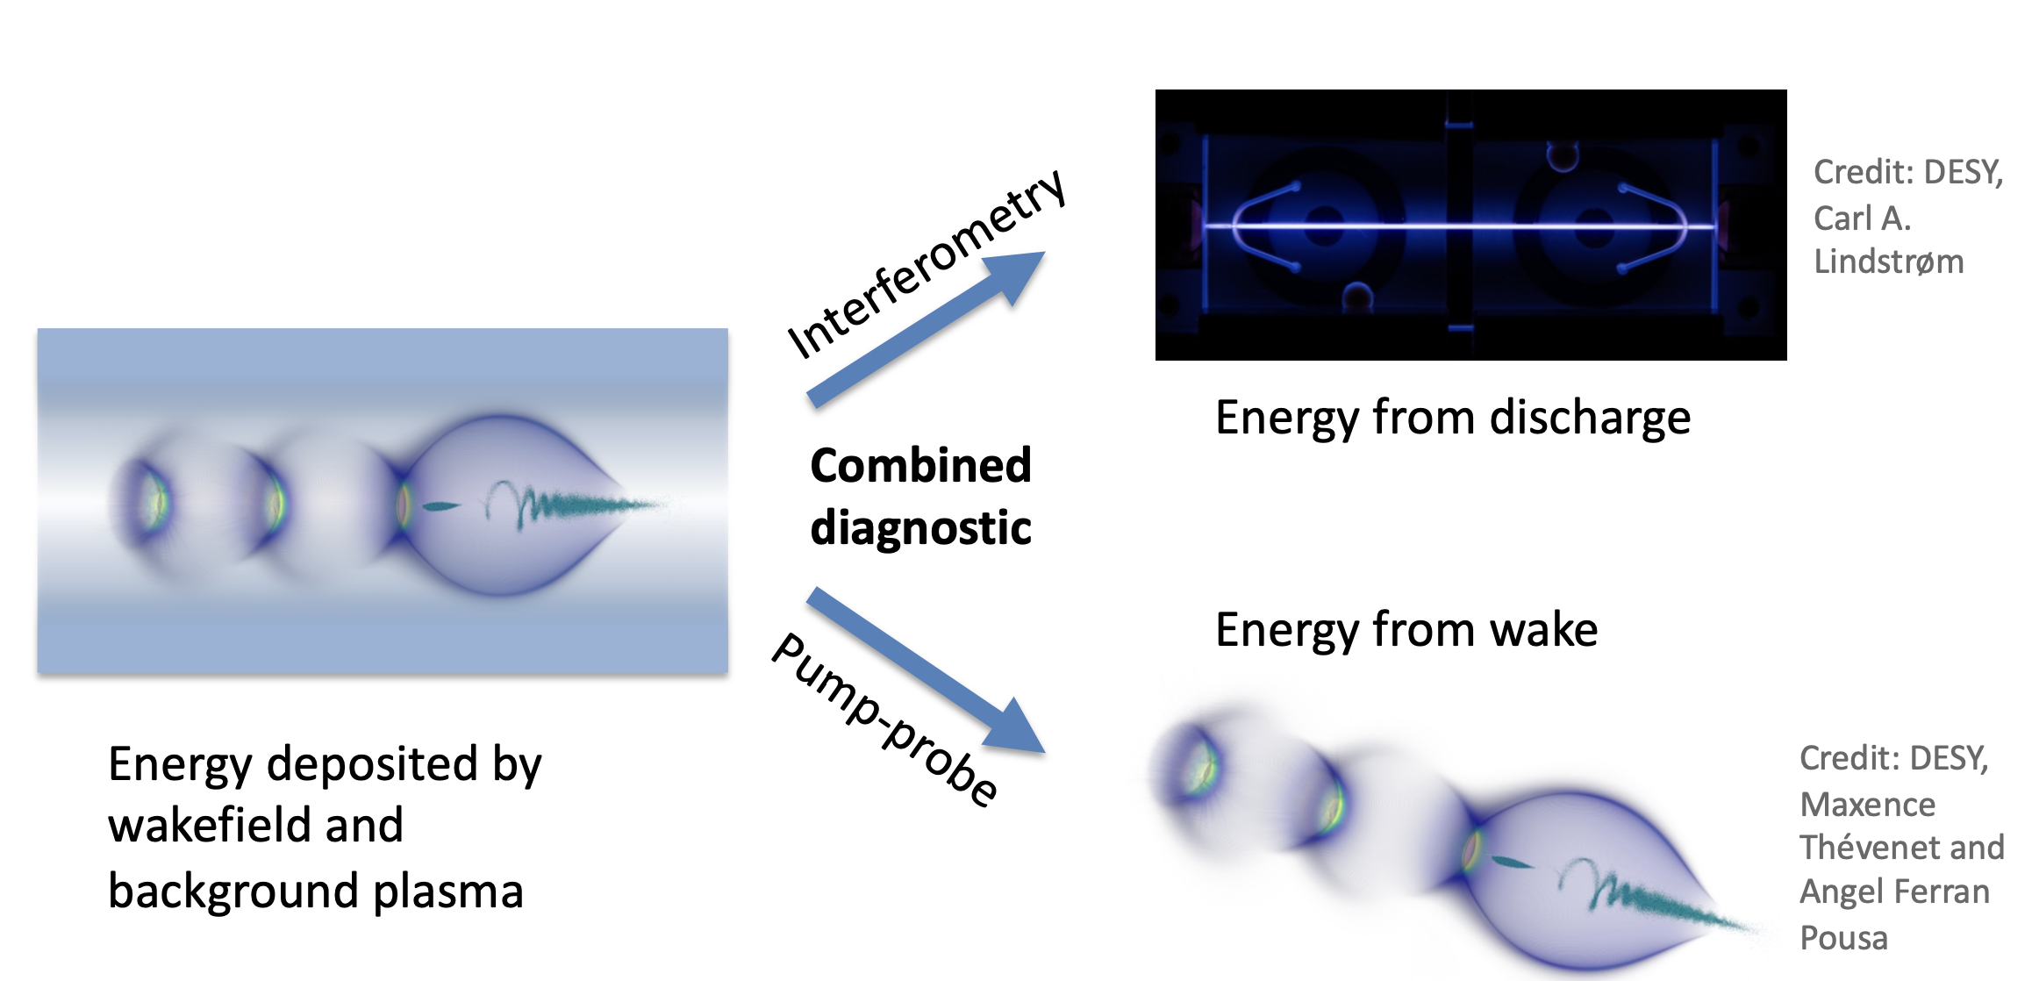
My current work

