Slide 1



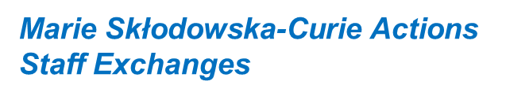
BACKGROUND
EDUCATION:
2017: Bachelor’s Degree in Physics Engineering @ Politecnico di Milano, Milan
  Bachelor’s Thesis: Realization and characterization of a Köhler Illuminator, aimed to realize a brightfield system used for SPIM (Single Plane Illumination Microscopy)
2020: Master’s Degree in Nuclear Engineering @ Politecnico di Milano, Milan
  Master’s Thesis: Numerical and computation analysis of the electromagnetic propagation through a magnetized cold plasma in a bi-dimensional configuration.
EXPERIENCE:
09/2015: Stage @ Boost4U, Milan. Data acquisition and data analysis
01/2021 – 12/2021: Application development analyst in Robotic Process Automation @ Accenture S.P.A., Milan
02/2022 – 05/2022, 02/2023 – 05/2023, 02/2024: Collaborator for tutoring activities for “Physics Laboratory with elements of statistic” @ Università degli Studi di Milano, Milan.
11/2023 – 01/2024: Collaborator for tutoring activities for “Measurement of nanoscale interactions in biological systems and data analysis”, @ Università degli Studi di Milano, Milan
01/2022 – now: Research Fellow in SRF group @ LASA, INFN, Milan
HOME INSTITUTION: Istituto Nazionale di Fisica Nucleare, Laboratorio di Acceleratori e Superconduttività Applicata (LASA), Milan, Italy
Elisa Del Core, INFN – LASA, Milan

Slide 2

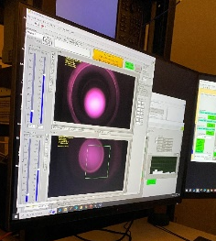
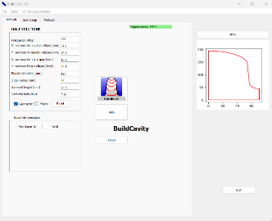
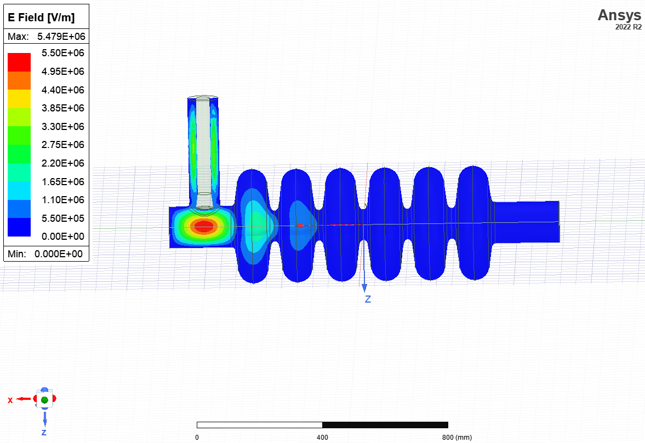
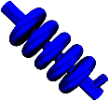
EAJADE Experience
Period:
07/04/2024 – 14/04/2024 @JLAB
15/04/2024 – 20/04/2024 @FERMILAB
TASKS: WP2, Tasks 2.1 and 2.3
Task 2.1: Plasma processing
@JLAB:
Bead pull apparatus and how it works → it is used for detecting e.m. mode patterns in the cavity
We ignited plasma in a C100 cavity (TESLA-style, 7 cells) that has HOM coupler ports and moved it from cell to cell, learning how to balance the input power for the chosen modes and how to avoid coupler ignition
How to read RGA to check hydrocarbon removal → diagnostics for plasma process efficiency
@FERMILAB:
Discussion about their plasma processing method/experience and mode simulation. Setting up a collaboration on this topic
Experience on the plasma processing apparatus for Single Spoke resonator
@LASA:
HFSS
simulations performed on ESS MB cavities and PIP-II LB cavities
First trial to ignite plasma in collaboration with FNAL in June 2024
Task 2.1: BuildCav @JLAB
Based on SUPERFISH (by Los Alamos National Laboratory), this code developed at LASA
is used for developing superconducting cavities of elliptical shape → geometric and electromagnetic design
In partnership with JLAB, we decided to implement new modules and functionalities to the code, to optimize parameters and design. This will leverage the capability of the tool in view of designing and optimizing new cavity shapes
As a first result of this collaboration, we worked with a JLAB summer student on the implementation of a new tuning method
Task 2.3: Diagnostics + magnetic hygiene @JLAB & @FERMILAB
Possible comparisons with our VT diagnostic system
We have seen the diagnostic systems used for vertical tests, especially Helmholtz coil, AMR sensors arrays and T sensors, but also low noise diagnostic systems for High Q0 applications. This technique will be implemented in our test stand at LASA
Elisa Del Core, INFN – LASA, Milan

