Slide 1
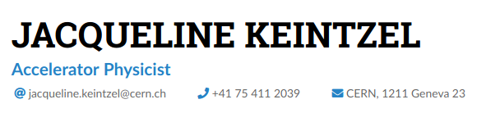
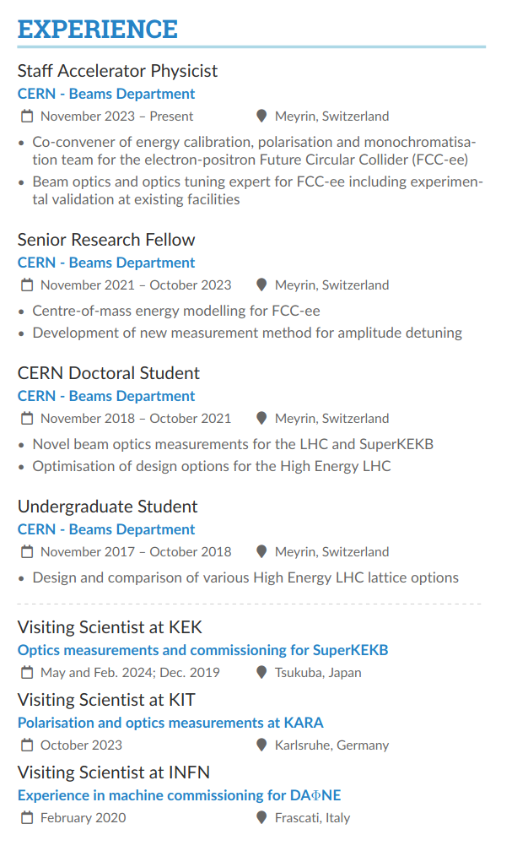
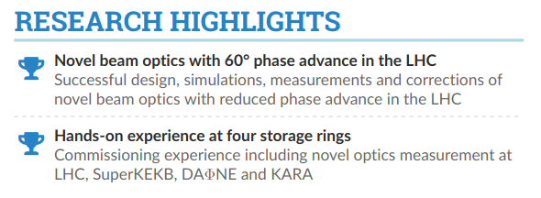
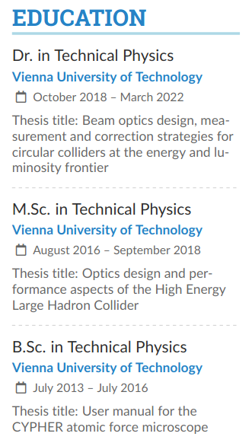
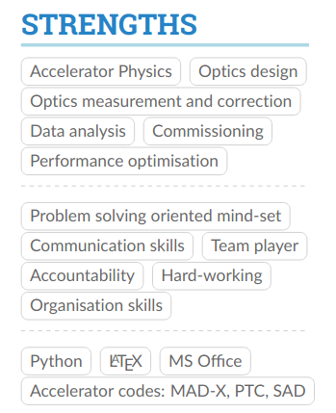

Slide 2
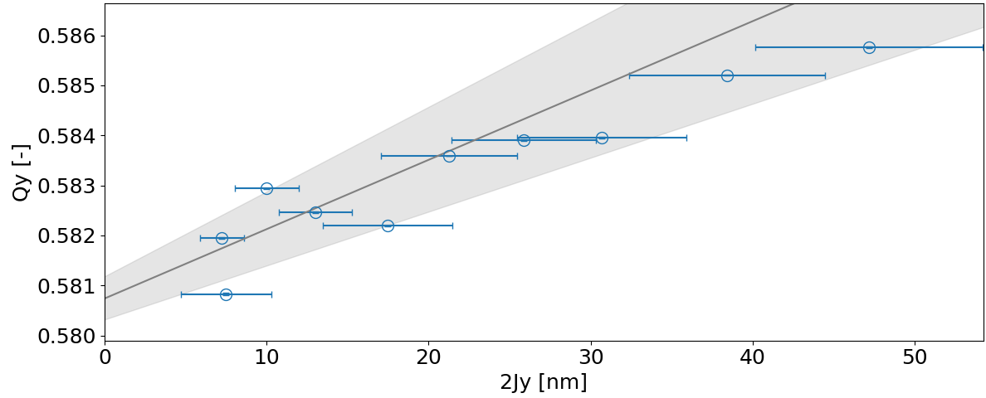
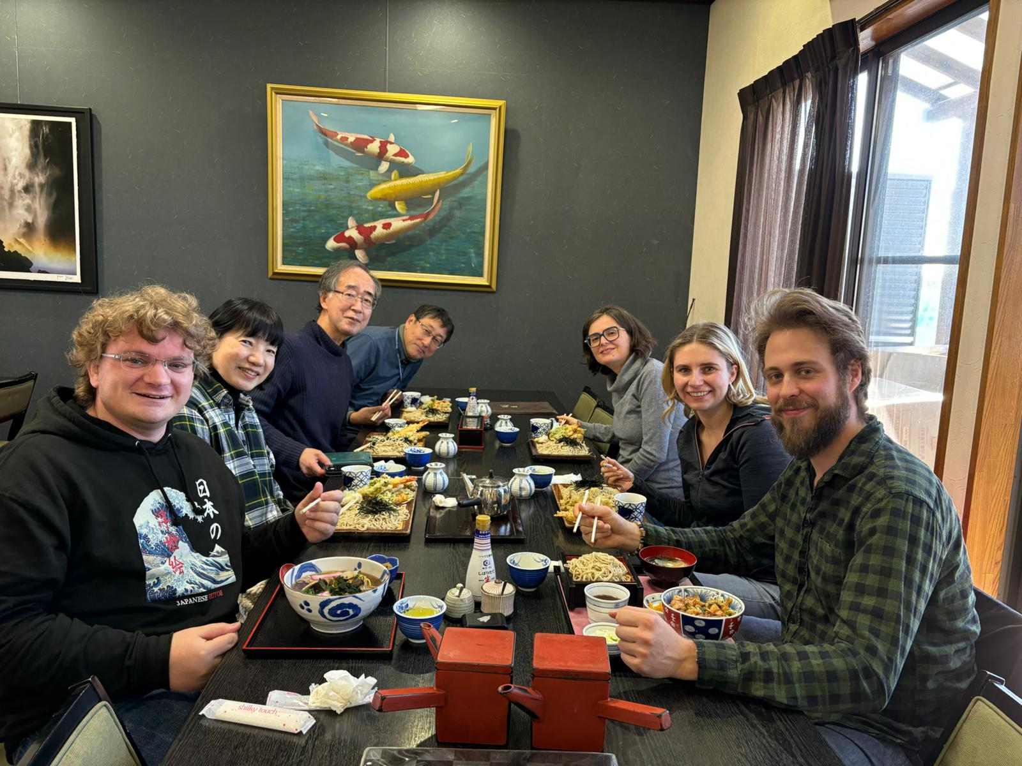
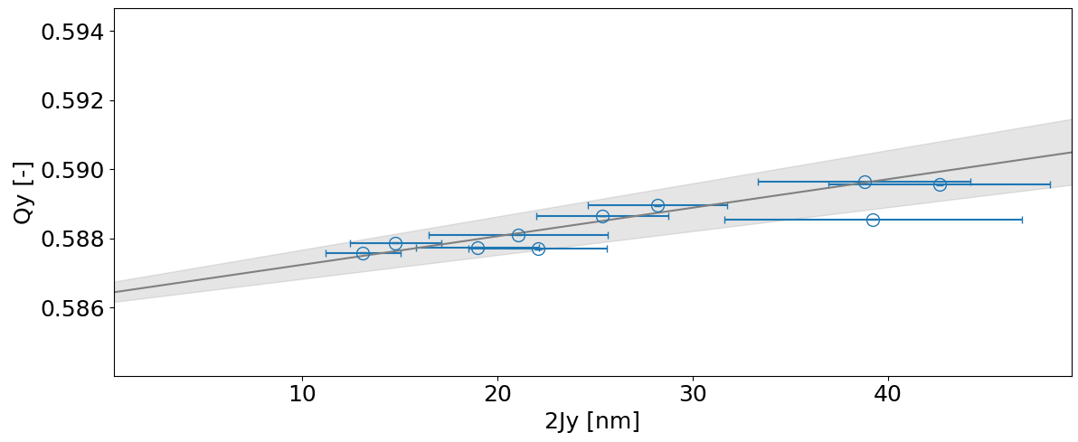
Experience
Secondment at SuperKEKB from 03/02/2024 - 17/02/2024 and 18/05/2024 - 01/06/2024 in WP1
Goal: Optics measurements at various machine conditions including with and without crab-waist transformation, commissioning experience, hands-on control room experience
Summary:
  Many optics measurements taken
  Ongoing analysis, many things to learn
  Excellent training from local experts
Amplitude detuning measurements
0% CW
dQy/d2Jy = (138±30) x 10³ m⁻¹
Preliminary
40% CW
dQy/d2Jy = (82±13) x 10³ m⁻¹
Preliminary

