Slide 1



Slide 1: background (education/experience and home institution)
Quentin Bruant:
Master in Physics, M2PSA (particle physics), Strasbourg University, 2021
Master in Physics, M2GI-PLATo (accelerator physics), Paris-Saclay University, 2023
PhD in progress in CEA/IRFU/DACM in Saclay, started in 2023

Slide 2
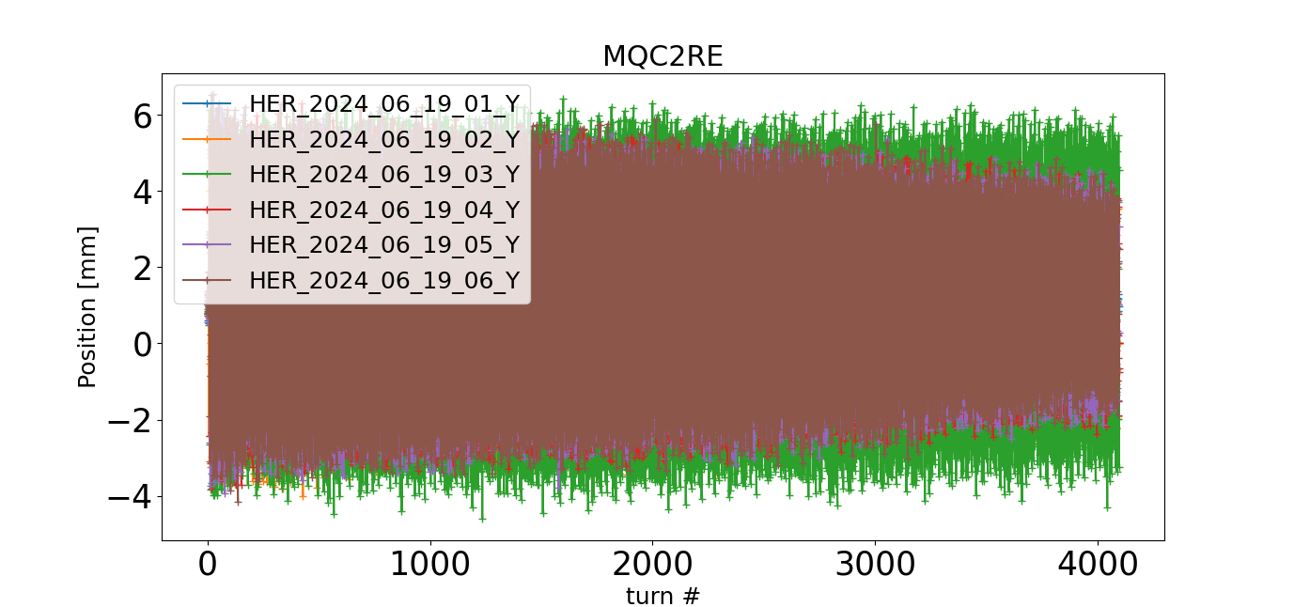
Slide 2: period, tasks, impact both on the overall project and on his/her own career
2 trips to KEK, Tsukuba, Japan:
6th to 19th of February 2024
16th to 29th of June 2024
Work done:
Understanding of the tuning of SuperKEKB
TbT BPM data gathering and harmonic analysis
Understanding of the denoising methods used in SOMA (J.Keintzel)
Start of the work on implementation of AI-based denoising on the TbTBPM datasets

