Slide 1
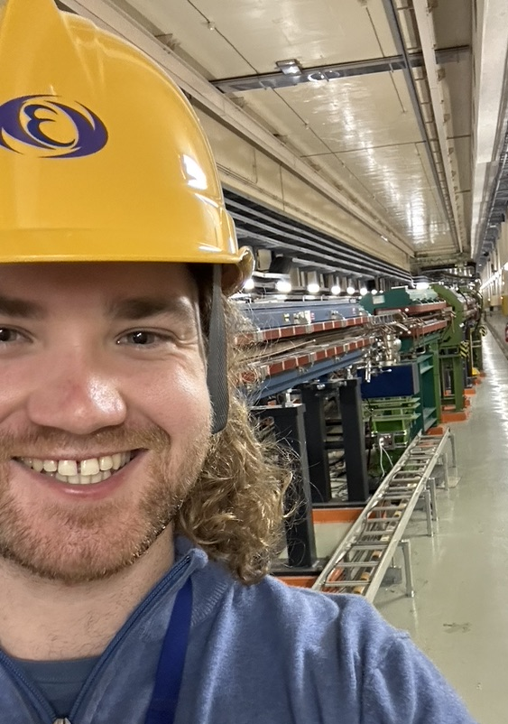
John Salvesen (Jack) [Irish/Scottish]
Thesis Aim:
Design of an Interaction Point Collision Feedback System for FCC-ee
Studies:
  FCC-ee IP feedback system requirements
  FCC-ee IP feedback input signals
  FCC-ee IP feedback hardware
  Analyze IP feedback performance of SuperKEKB
  Model IP feedback of SuperKEKB
Who Am I
Doctoral Student at CERN: BE-ABP-LAF
DPhil Candidate at University of Oxford
CERN Supervisor: Frank Zimmermann
University Supervisor: Phil Burrows
Project within FCCIS Task 2.3:
“Interaction region and machine detector interface design”
Under EAJADE Work package 3:
“Special technologies, devices and systems performance”
Thesis Goal
Develop a realistic, self-consistent, model of the FCC-ee IP collision feedback system
Based on input signals from BPMs, luminosity and other potential sources. Including realistic hardware considerations (correctors, processing). Using this model, study the luminosity performance in the presence of magnet vibrations.

Slide 2


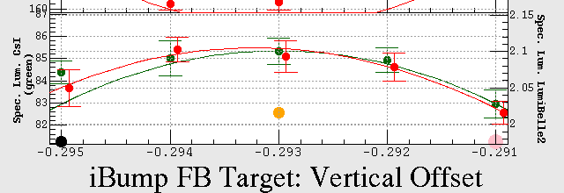
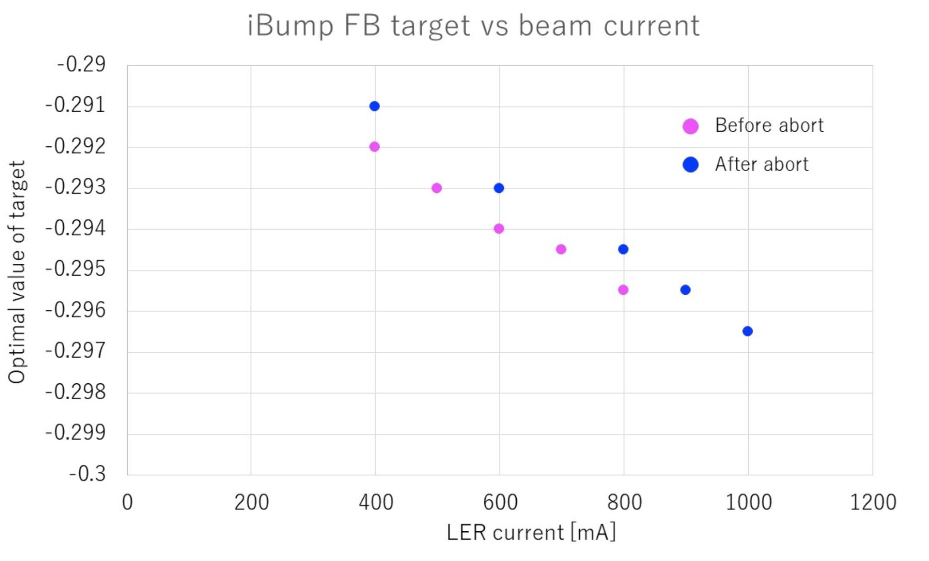
SuperKEKB Studies
(May-June 2024)
Machine Studies
  Dedicated MD: Investigating drift of ‘IP feedback target’ with beam current
  Follow up studies on historical data ongoing
Simulation
  SuperKEKB Optics Modelling with Xsuite
    Optics models for LER and HER in development
  Simulation Meetings
Operational Aspects
  Tour of interaction regions and IP Feedback system hardware
  Participation in IP feedback tuning
  Tour of Oxford FONT feedback system at ATF2

