Slide 1
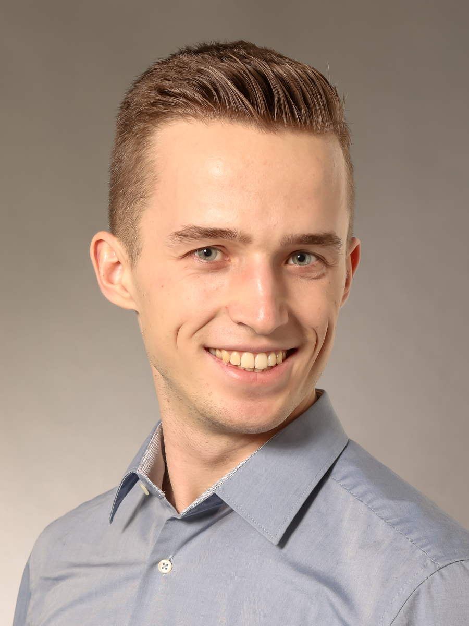
Victor Schwan (Secondee)
03/2024 - present: Doctoral Researcher at DESY & University of Hamburg, Germany
  Topic: Design of the Interaction Region for the ILD Detector Concept at the FCCee
10/2021 - 11/2023: M. Sc. Physics, RWTH Aachen University, Germany
  Thesis title: Deep Learning Driven Measurement of Single Top Quark and Top Quark Pair Associated Higgs Boson Production at the CMS Experiment
01/2020 - 09/2023: Certificate International of RWTH Aachen University
  Distinguishing exceptional dedication to intercultural competence
08/2021 - 06/2022: ERASMUS+ year abroad, Chalmers University of Technology, Gothenburg, Sweden
10/2017 - 10/2021: B. Sc. Physics, RWTH Aachen University, Germany
  Thesis title: Data Augmentation Strategies for Deep Learning based Di-Higgs Classification at the CMS Experiment

Slide 2
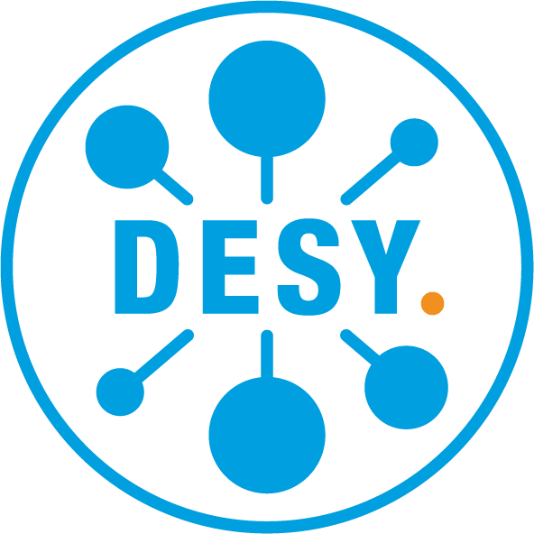

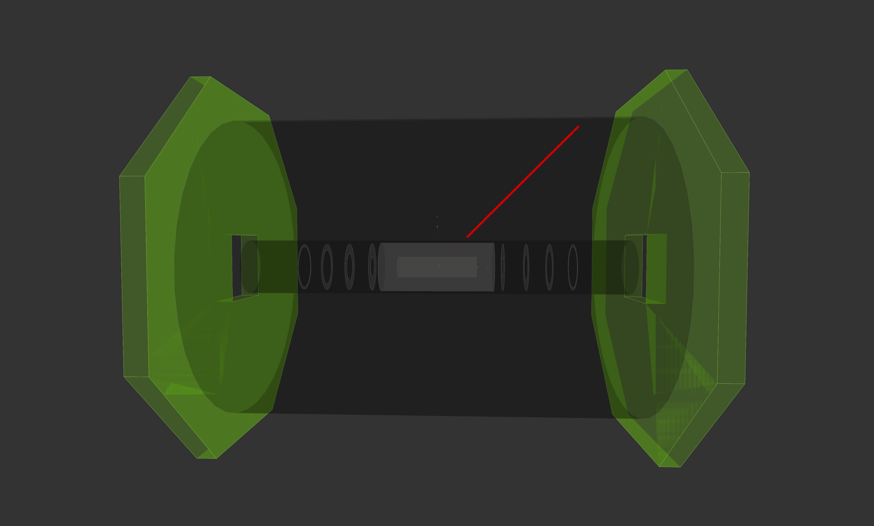
Secondment Overview
09/2024 -10/2024: Energy Frontier Group, Institute of Particle and Nuclear Studies, KEK, Japan
Local scientific contact: Daniel Jeans
Planned research program:
  Adaption of the machine-detector-interface of the International Large
  Detector concept for future circular colliders
  Interaction region design, studies of its impact on instrumentation and
  luminosity
  Studies on machine backgrounds caused by
  machine-detector-interface
Training objectives:
  Familiarization with tools for detector studies and accelerator
  background studies
  Seminar talk at KEK
  Practical experience in the international and intercultural research environment
Impact on overall project:
  Acceleration of efforts to design an ILD model for future circular colliders enabling comparison with deployment at future linear colliders
Impact on career:
  Continuation and deepening of intercultural competence and hands-on experience in an international research environment

