Slide 1
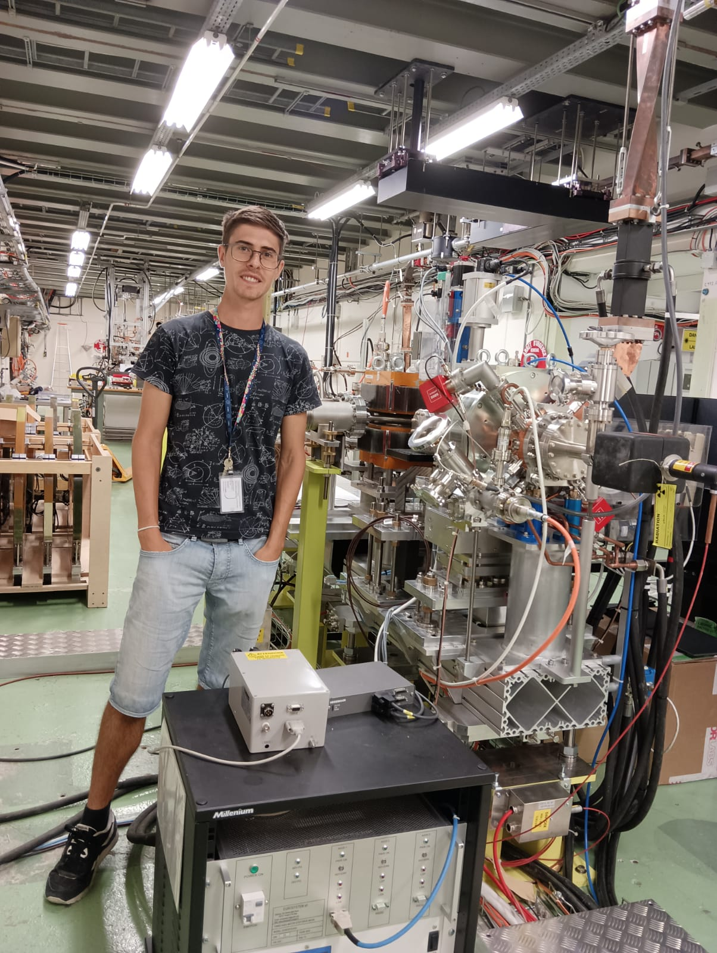
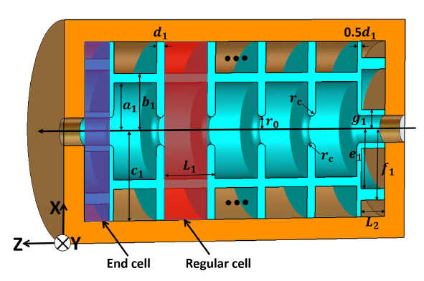
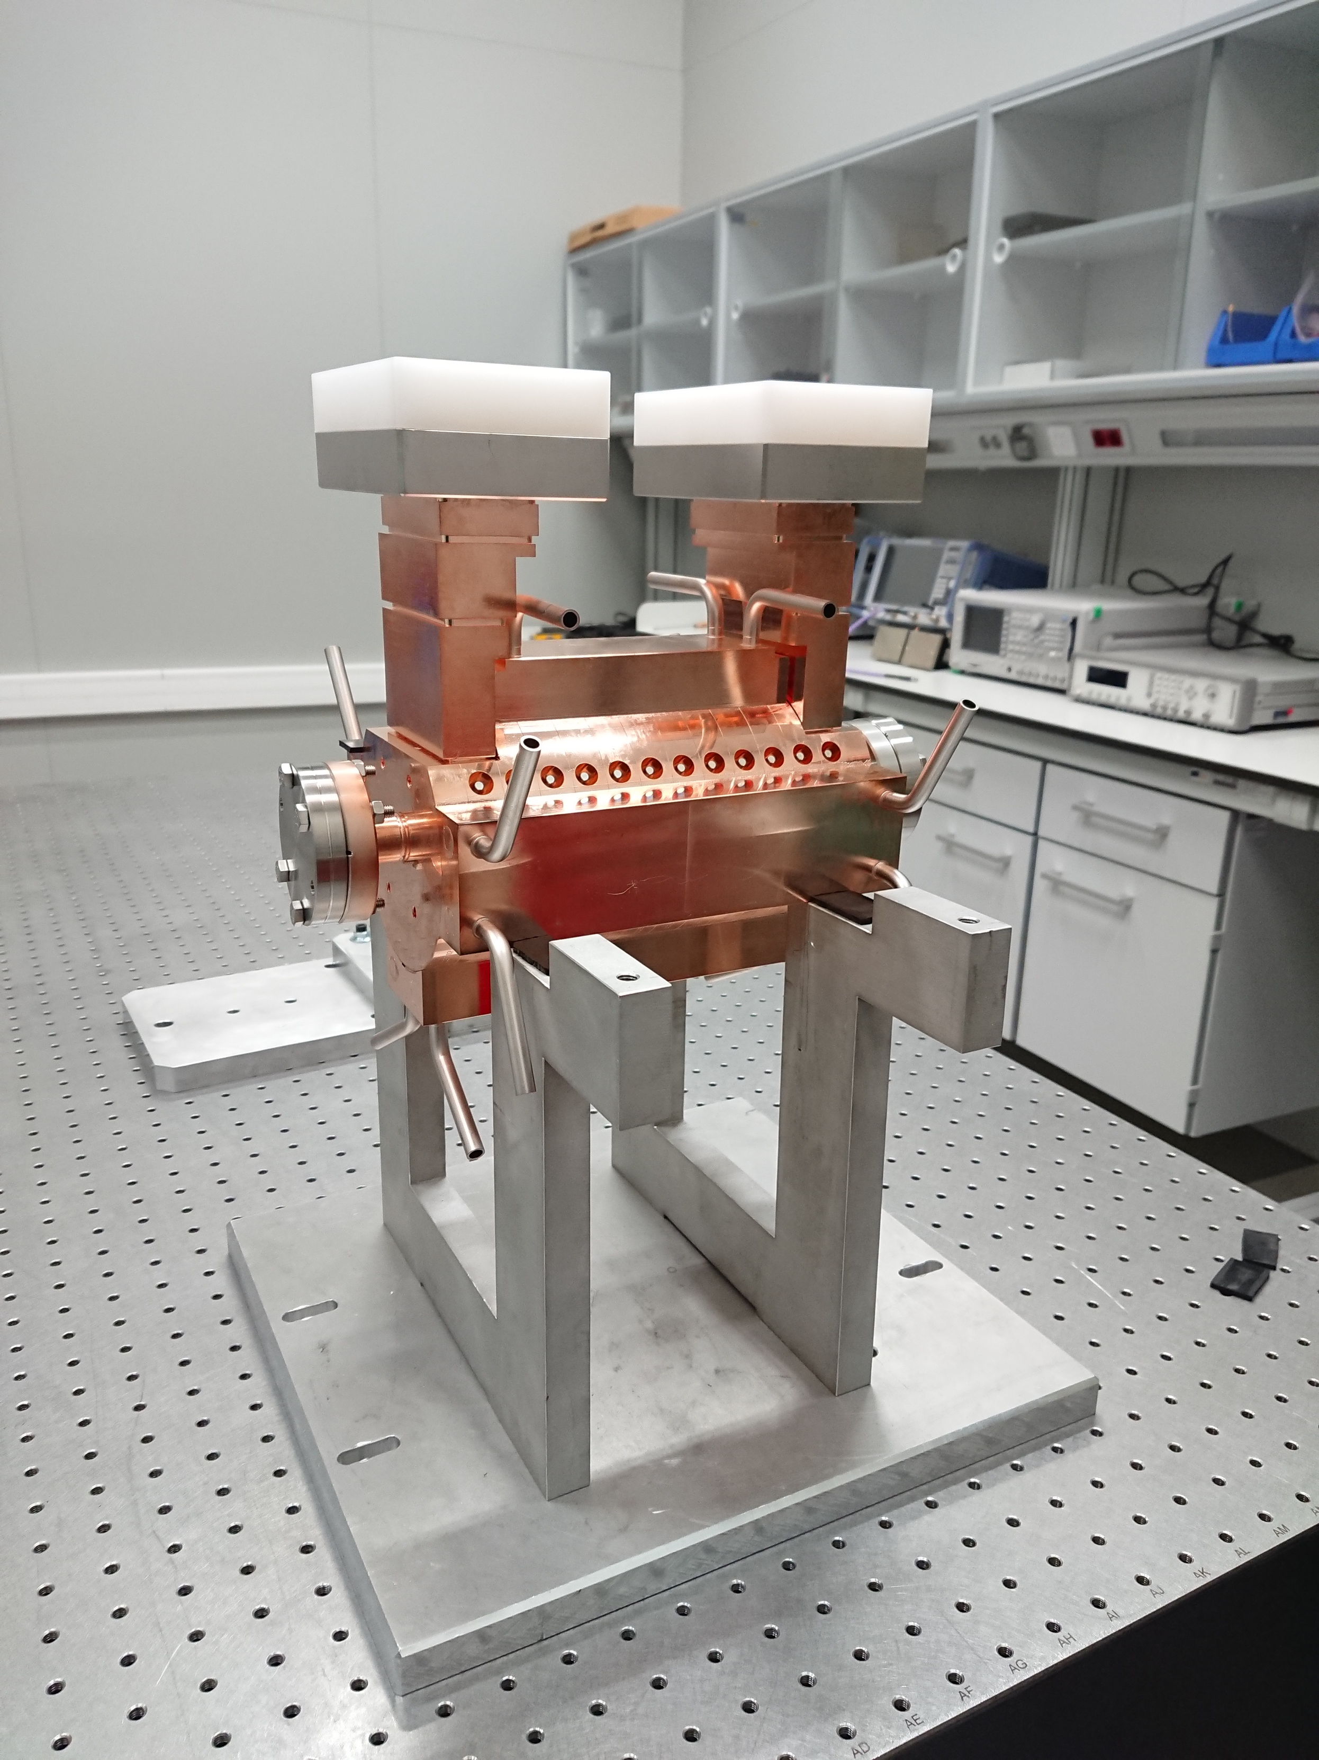
Pablo Martínez Reviriego
Spain
Bachelor in Physics at University of Sevilla
MSc in Nuclear and Particle Physics at University of Valencia
PhD in Accelerator Physics at University of Valencia in RF cavities for hadrontherapy linacs:
Currently: Postdoc as RF engineer at CLIC Project (CERN)
  Testing HG RF cavities
  Design of Dielectric Assist Accelerating Structures

Slide 2
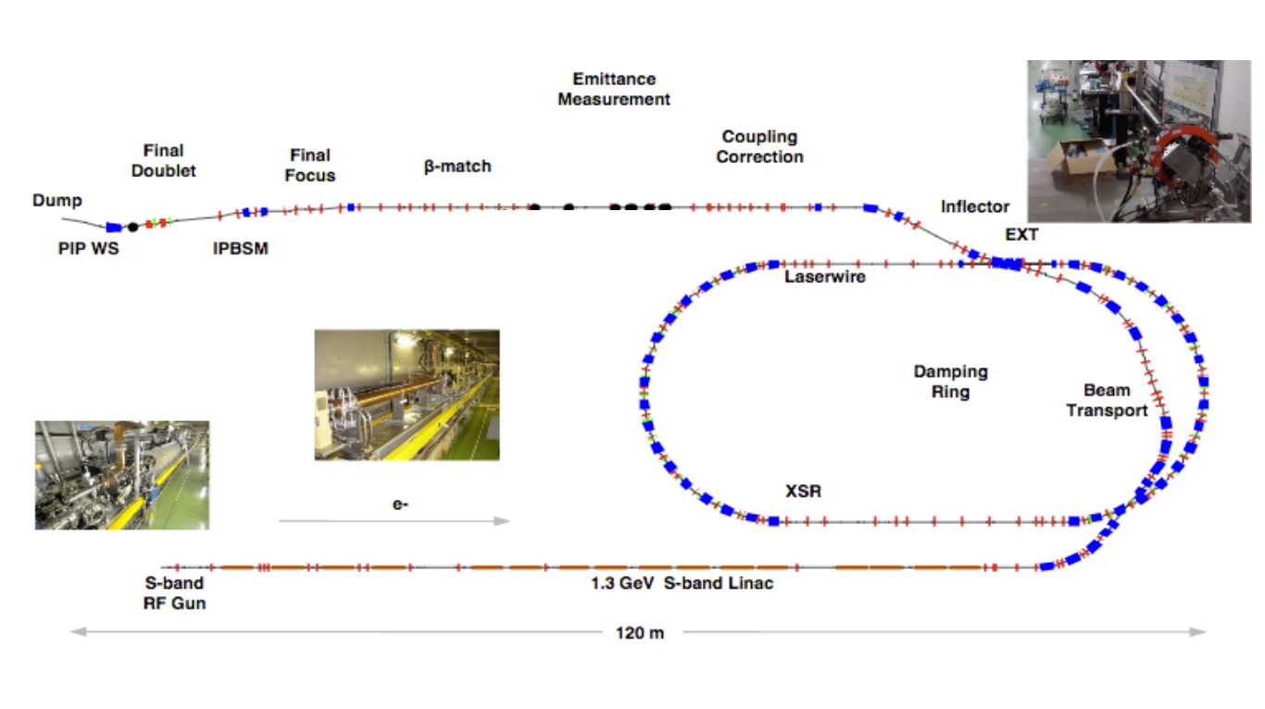
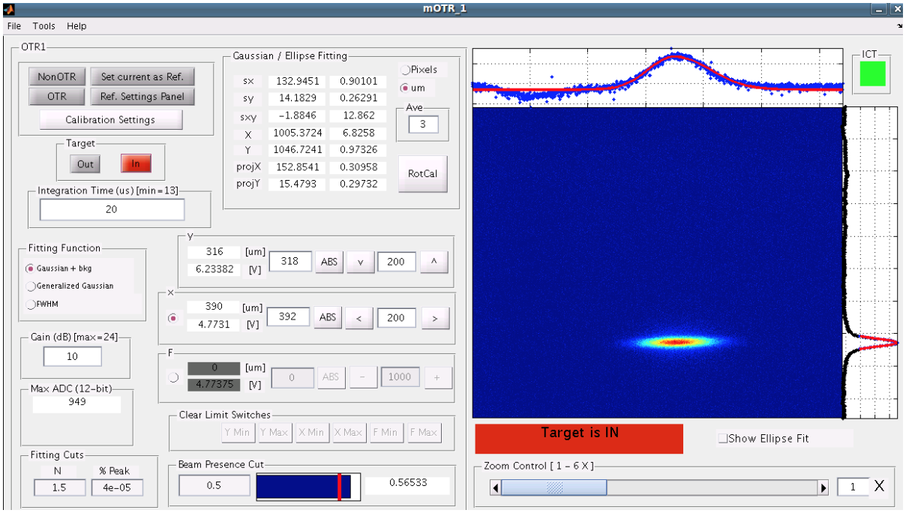
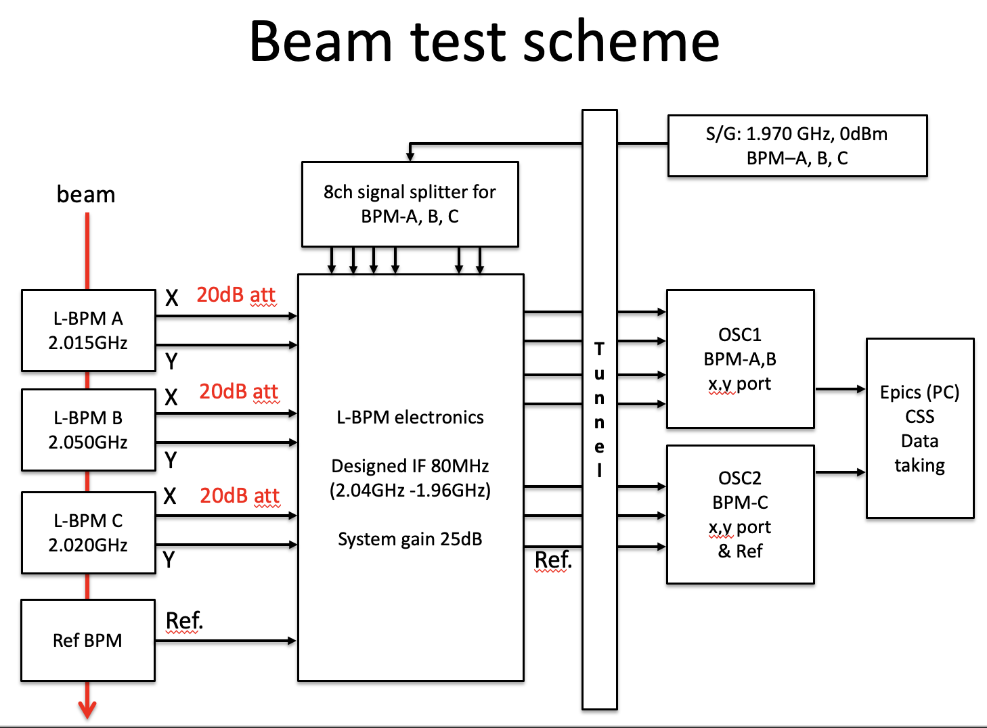
Period: 20/11/2023 to 20/12/2023
Lab: Accelerator Test Facility (ATF) at KEK, Japan.
Taks:
Learning on small beam size tuning procedure including:
  Beam orbit measurements with BPMs.
  Beam orbit correction with steering magnets.
  Dispersion correction with skew quadrupoles.
  Measurement of beam profile with OTRs.
  IP beam size measurements with carbon wire.
  Beam size reduction with focus quadrupoles.
  IP beam size measurement with Shintake Monitor.
Cavity BPMs studies:
  Calibration studies of the C-band BPMs with a pulse injection source.
  Calibration and spatial resolution of L-band BPMs.
Impact:
First experience of operation on a real accelerator in a state-of-the-art facility in an international environment.
Involvement in many interesting projects in parallel which contributed to enlarge my knowledge and experience in the accelerator science.
Opportunity to visit Japan landscapes and culture

