Slide 1


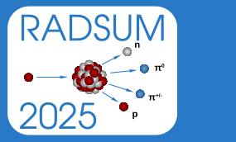
Explorative energy deposition studies in the superconducting dipole magnet of the carbon ion gantry for CNAO
G. Tosetti – A. Mereghetti – M. G. Pullia

Slide 2
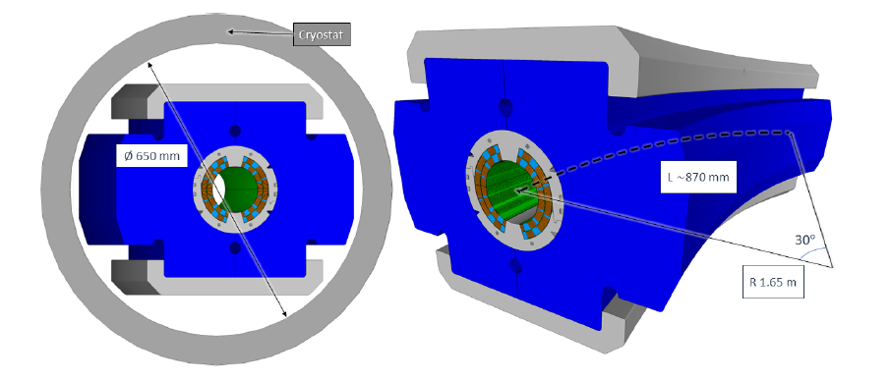
Introduction and overview of Gantry design
Energy deposition:
  in homogeneous material
  in straight and curved magnet geometry
Conclusions and Outlooks

Slide 3
Introduction and overview of Gantry design
Energy deposition:
  in homogeneous material
  in straight and curved magnet geometry
Conclusions and Outlooks

Slide 4

Introduction: CNAO
The National Center for Oncological Hadrontheray (CNAO) is a hadrontherapy center located in Pavia, Italy. In the center, proton and carbon-ion beams are used to treat radio-resistant tumors. Beams are accelerated by a synchrotron.
HITRIplus and EuroSIG projects: a Carbon–ion gantry is being designed for CNAO, based on superconducting magnet technology.
1/
15

Slide 5
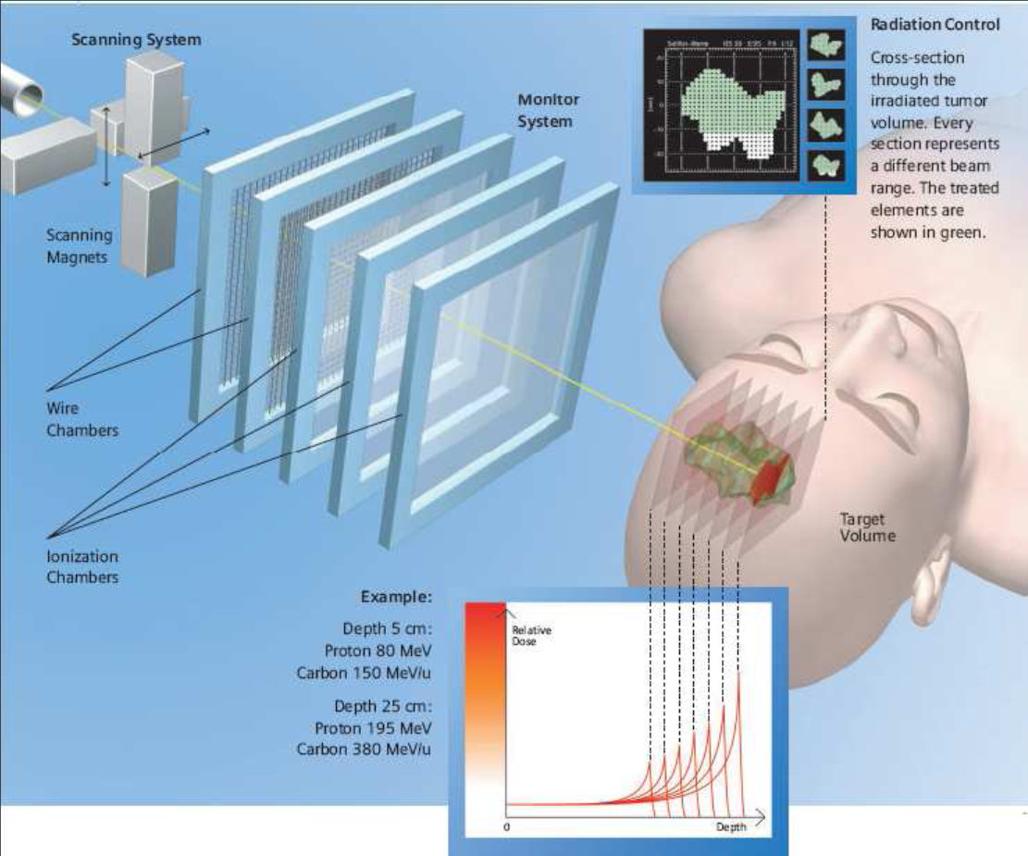
Introduction: hadrontherapy
Hadrontherapy is an advanced cancer treatment method.
It achieves precisely the targeting and killing of tumor cells while minimizing damage to surrounding healthy tissues, thanks to a range of particle energy.
C-ions |  | Protons
62 MeV | 228 MeV | 115 MeV/u | 400 MeV/u
30 mm | 320 mm | 30 mm | 270 mm
Range of particle in water (extreme beam energies treatment available at CNAO)
2/
15

Slide 6
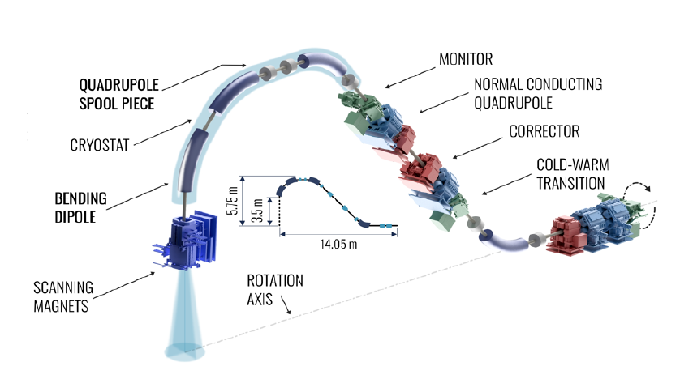
Introduction: overview of the gantry design
The conceptual design features scanning magnets positioned downstream of the final bending section, with superconducting dipole magnets generating a 4 T magnetic field.
Some technical aspects are still under study, as the optimal indirect cooling scheme and the configuration of the beam pipe.
3/
15

Slide 7
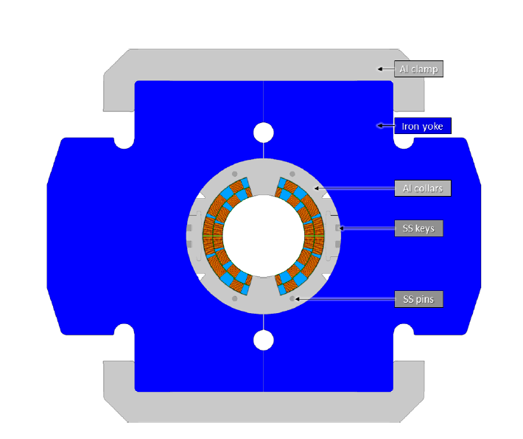

Introduction: overview of the SIG demonstrator design
The development of superconducting magnet technology is a significant challenge. Nowadays, INFN LASA is assembling a cos-theta dipole with:
4 T central field
80 mm aperture
curvature radius of 1.65 m
angular sector of 30°
Field ramp rate 0.15-0.4 T/s
Current [A] | 2770
Operetional temperature[K] | 5
Superconductor | Niobium-Titanium
Cable type | Rutherford
Twist pitch [mm] | 66
4/
15

Slide 8
Introduction and overview of Gantry design
Energy deposition:
  in homogeneous material
  in straight and curved magnet geometry
Conclusions and Outlooks

Slide 9
Energy deposition in homogeneous materials I
Full Beam impact on a cylindrical target made of an homogeneus material:
each material composing the dipole was considered.
with extreme beam energies treatment available at CNAO ( beams of C-ions at 400 and 115 MeV/u and proton at 230 and 62 MeV ).
Monochromatic Gaussian beam.
The energy deposition is estimated by means of Monte Carlo simulations, using the FLUKA code. The thermodinamic of the quench is not considered (adiabatic assumption).
Aim: very conservative assessment
Scoring mesh characteristics:
Cylindrical mesh;
Longitudinal step: 50 μm ;
Radial step: 300 μm;
Only one azimuthal angle.
5/
15

Slide 10
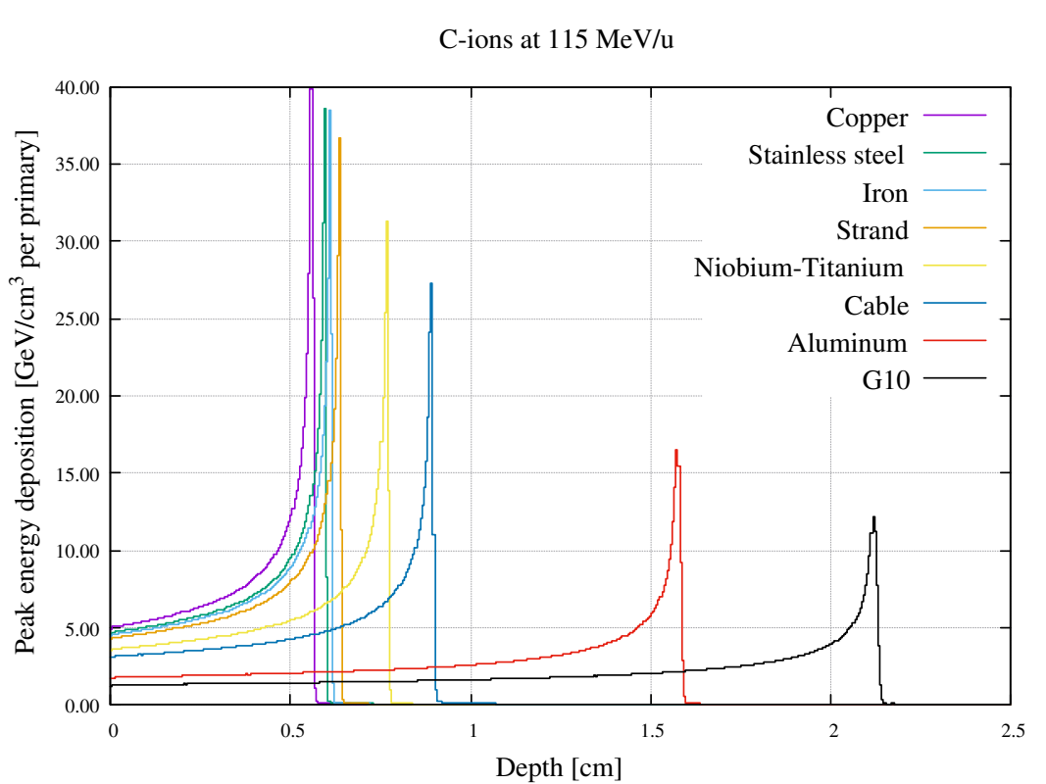
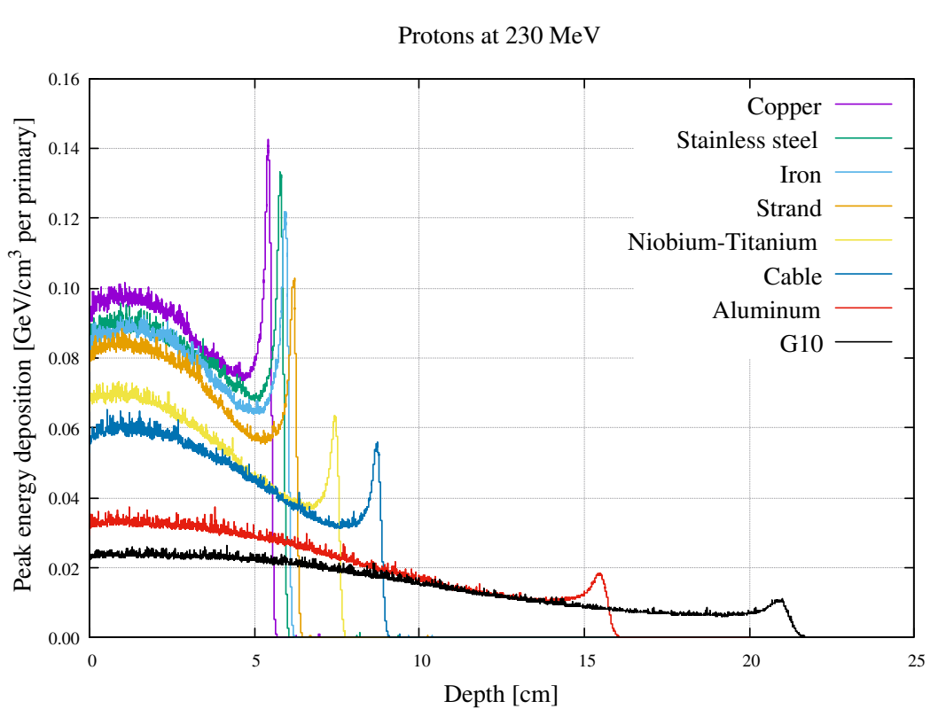
Energy deposition in homogeneous materials II
Longitudinal profiles of peak energy deposition in a thick target of homogeneous material for protons at maximum and C-ions at minimum energy.
6/
15

Slide 11
Energy deposition in homogeneous materials III
Assuming a nominal full beam extraction
4 E8 C-ions extracted in 1s;
1 E10 protons extracted in 1s;
Material | C-ions |  | Protons
 | 115 MeV/u | 400 MeV/u | 62 MeV | 230 MeV
Copper | 2560 | 685 | 1952 | 224
Strand | 2368 | 602 | 1632 | 166
Nb-Ti | 1984 | 480 | 1344 | 104
Cable | 1768 | 339 | 1184 | 91
Maximum values of energy deposition before quenching, given in mJ/cm³.
Considering a conservative quench limit of energy density (10 mJ/cm³ strand enthalpy at max current) is exceeded in all the simulated cases.
7/
15

Slide 12
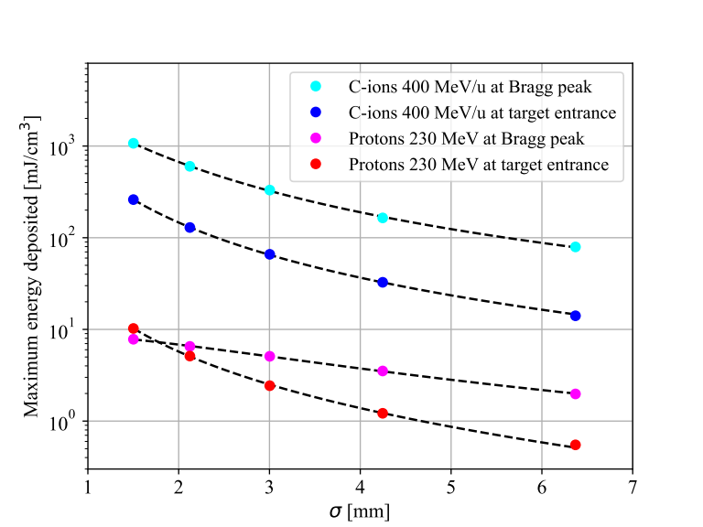
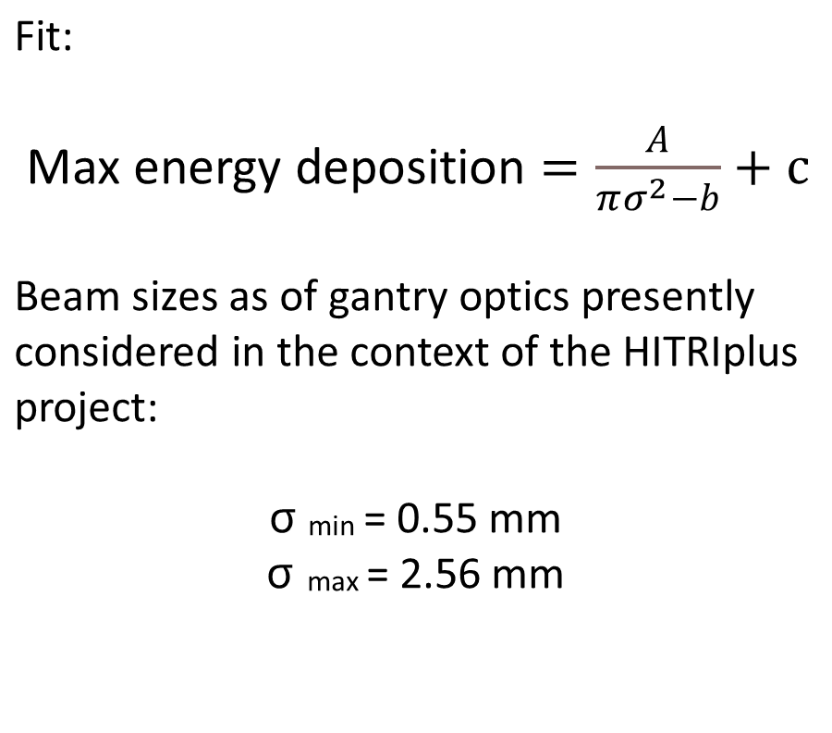
Energy deposition in homogeneous materials IV
8/
15

Slide 13
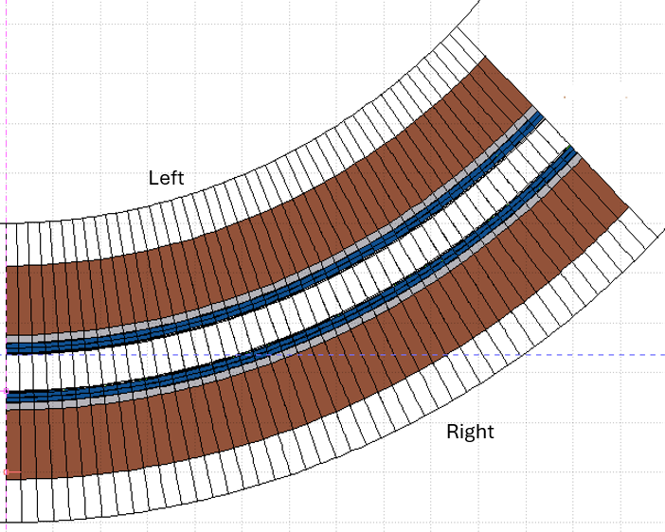
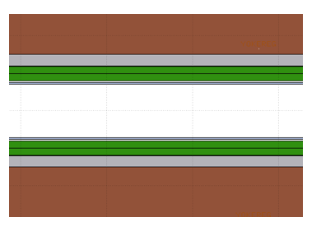
Energy deposition in magnet geometry I
The beam hits the dipole at different angles on the horizontal mid-plane.
Two geometries are implemented: straight and curved.
Simulation of C-ions beam at 115 MeV/u, carried without magnetic field.
Cases with the vacuum chamber (2 mm of Stainless Steel).
Aim: endep dependency on impact angle
x
z
Scoring mesh characteristics:
Longitudinal: 50 μm;
Radial: 230 μm;
Azimuthal: bear mid thick edge (480 μm).
9/
15

Slide 14

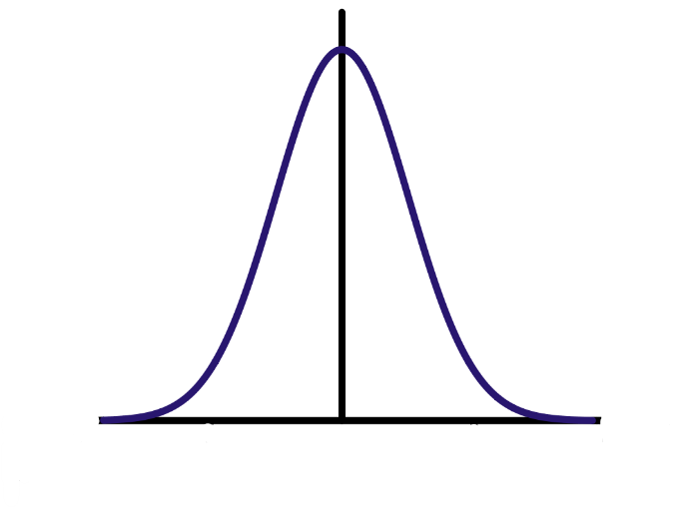
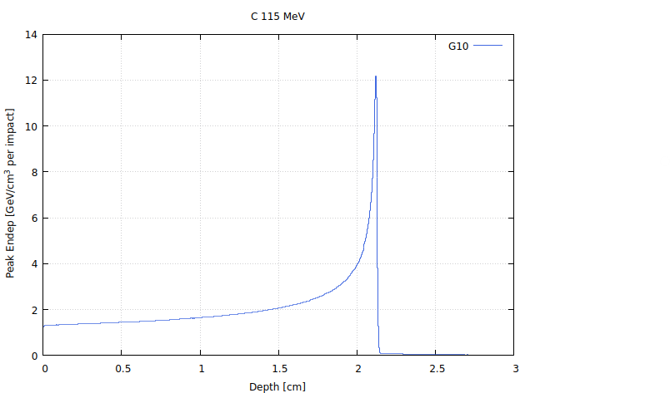
Energy deposition in magnet geometry II
Angle at which the primary particles are fully stopped inside a single layer of each composing magnet material with a given thickness.
Material | Thickness | C-ions |  | Protons
 | mm | 115 MeV/u | 400 MeV/u | 62 MeV | 230 MeV
Strand | 9.1 | - | 176 | - | 141
Stainless steel | 2 | 340 | 42 | 318 | 33
Angles are expressed in mrad.
10/
15

Slide 15
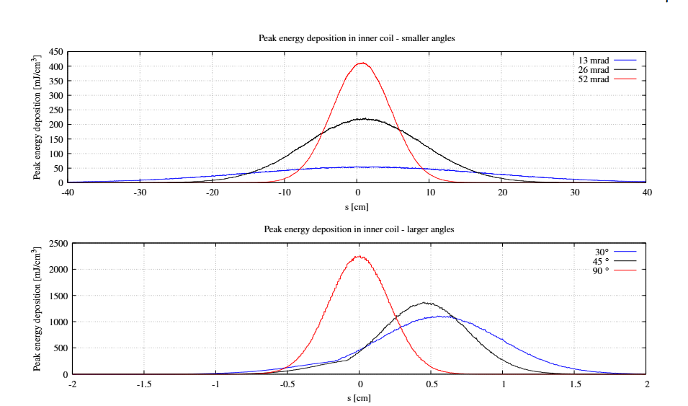
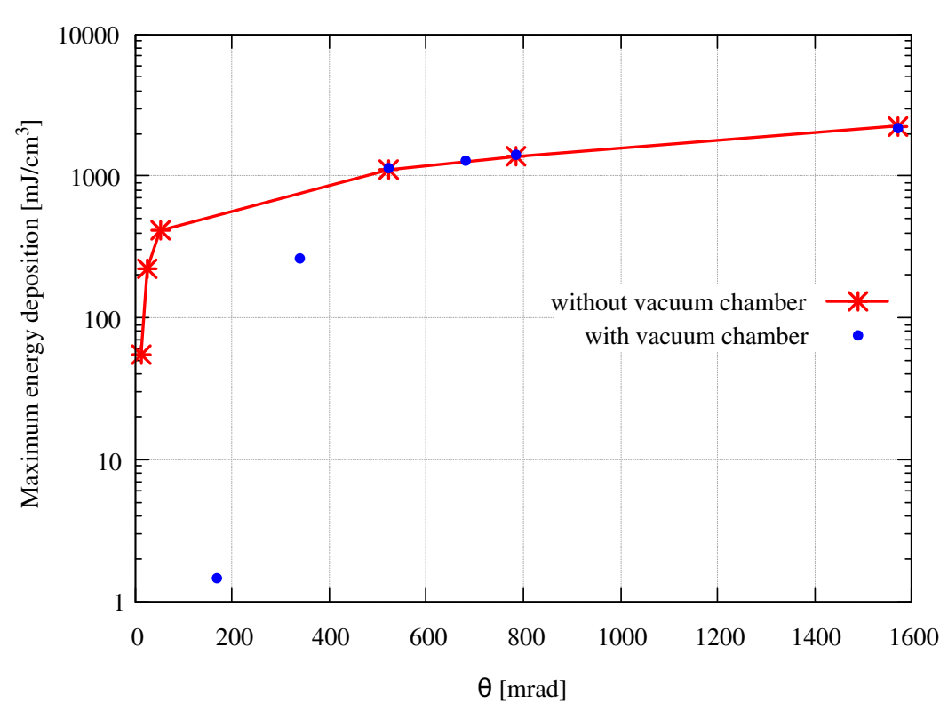
Energy deposition in magnet geometry: straight magnet
C-ions beam at 115 MeV/u
The quench occurs at higher impact angles or probably does not occur when the pipe is considered.
11/
15

Slide 16
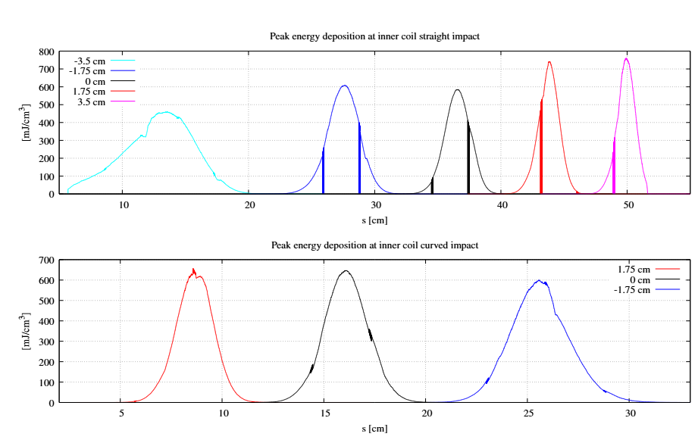
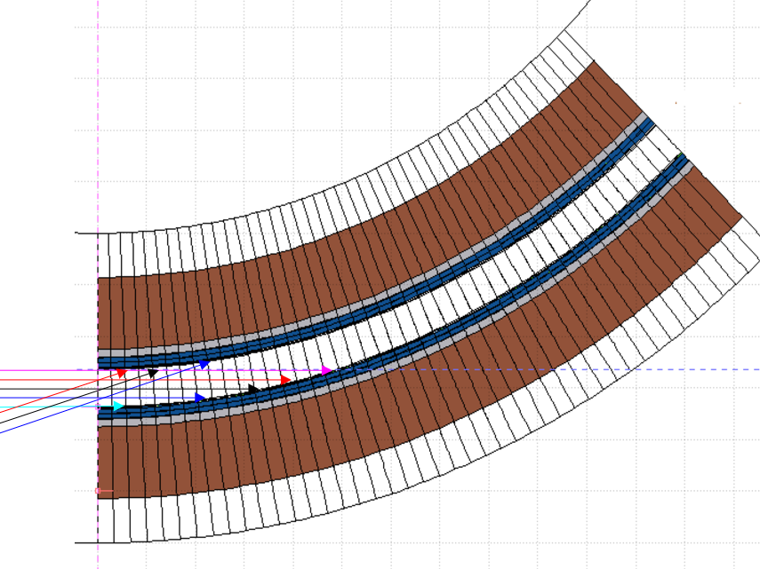
Energy deposition in magnet geometry: curved magnet
Left
Right
The beam impacts on the left and right side are separately evaluated (cases without the vacuum chamber).
12/
15

Slide 17
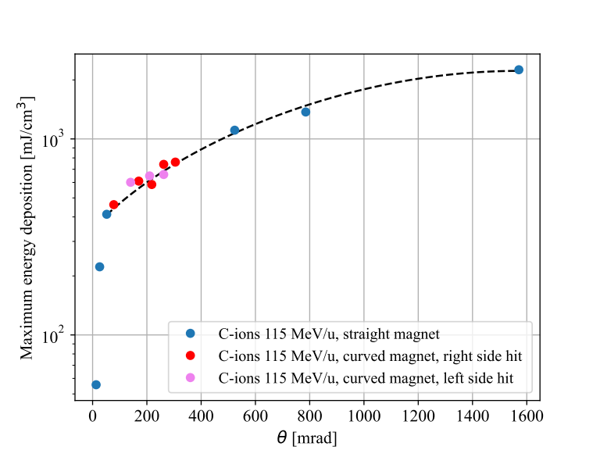
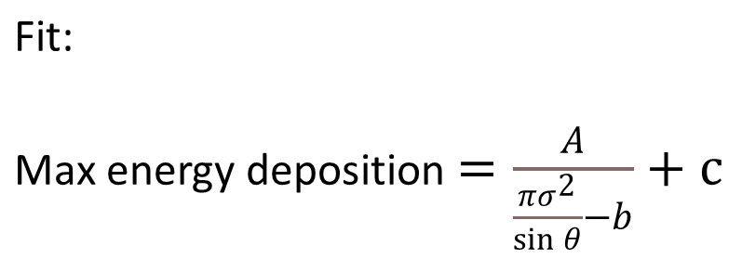
Energy deposition in magnet geometry: comparison
Simulation results for the
curved geometry are consistent with those obtained for the straight geometry.
13/
15

Slide 18
Introduction and overview of Gantry design
Energy deposition:
  in homogeneous material
  in straight and curved magnet geometry
Conclusions and Outlooks

Slide 19
Conclusions and Outlooks I
Motivations for the studies
  Can CNAO beams losses induce quenching?
  Should mitigation be considered (protection devices or reduce the beam intensity)?
Montecarlo simulation with FLUKA
  not based on operational beam losses at CNAO.
  Adiabatic assumption.
  no magnetic field.
Homogeneous material
  The particles at minimum energy present the most concerning results.
  Spot size is comparable to the beam sizes of the gantry optics studies.
  The spot size is a ruling factor.
14/
15

Slide 20
Conclusions and Outlooks II
Considering the SIG magnet cross section
  The inclusion of a vacuum chamber has led to a significant improvement in the results.
  Impact angle is a ruling factor.
Outlooks
  Studies on more realistic upstream line impact condition.
  Technical design of a vacuum chamber.
  Simulation of the entire gantry geometry.
14/
15
15/
15

Slide 21
Thanks for your attention!

Slide 22
Explorative energy deposition studies in the superconducting dipole magnet of the carbon ion gantry for CNAO BACKUP
G. Tosetti – A. Mereghetti – M. G. Pullia

Slide 23
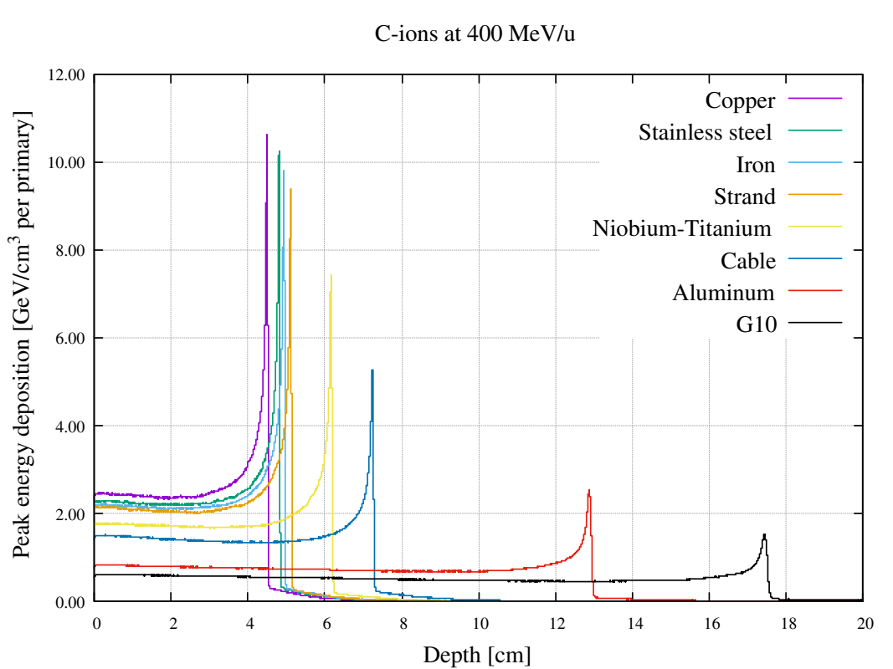
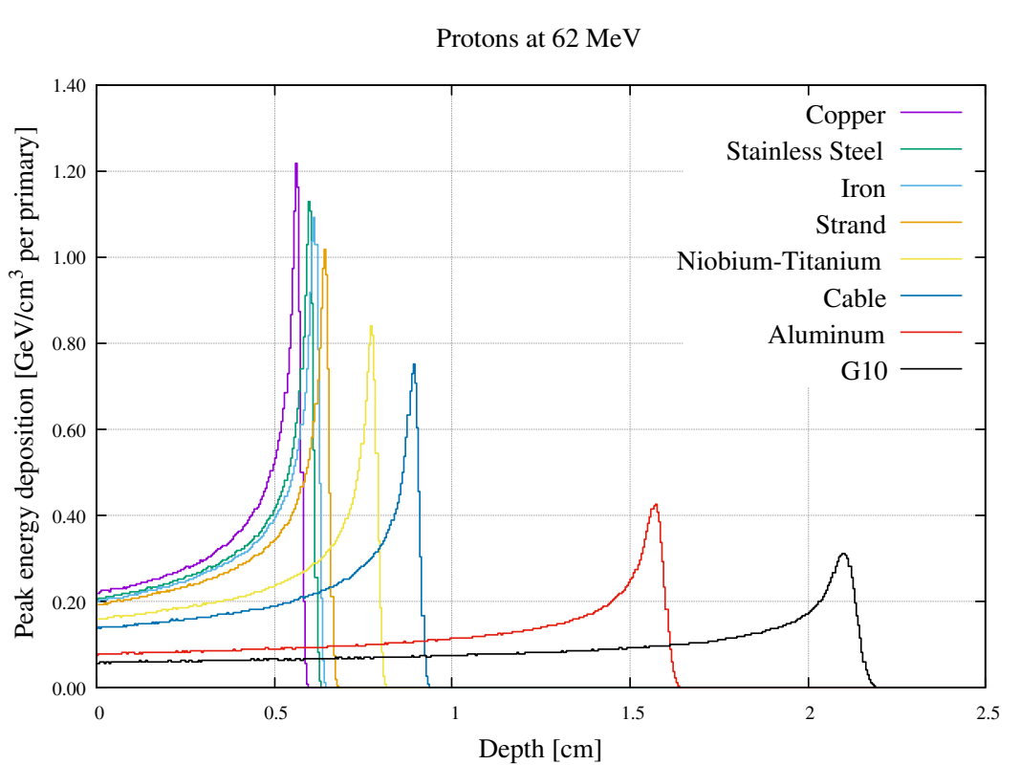
Energy deposition in magnet geometry : Backup
Longitudinal profiles of peak energy deposition in a thick target of homogeneous material for protons minimum and C-ions at maximum energy

Slide 24
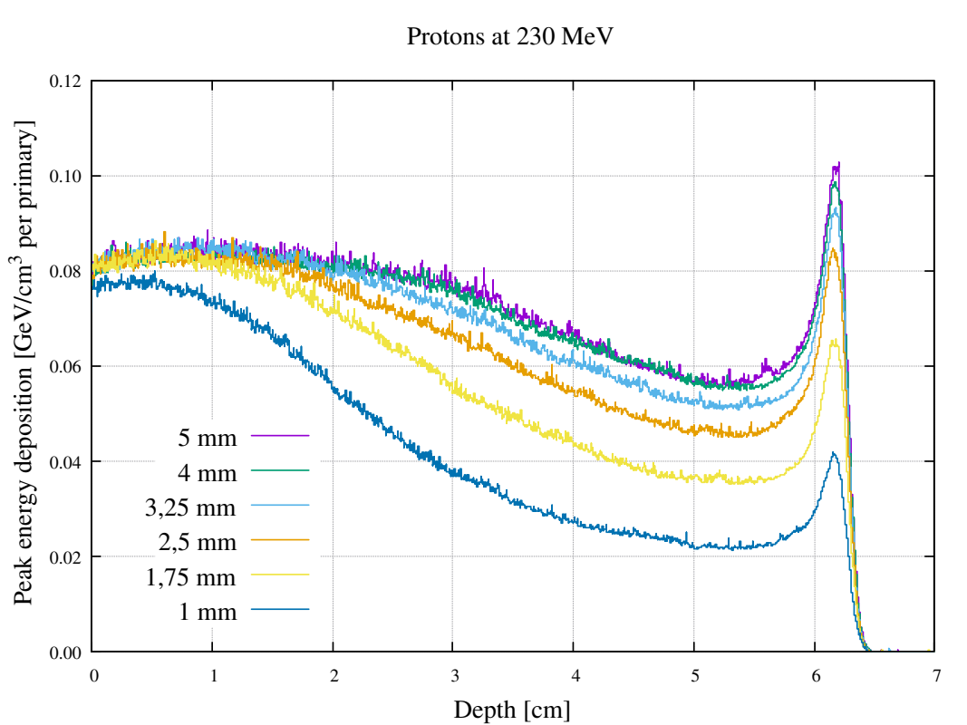
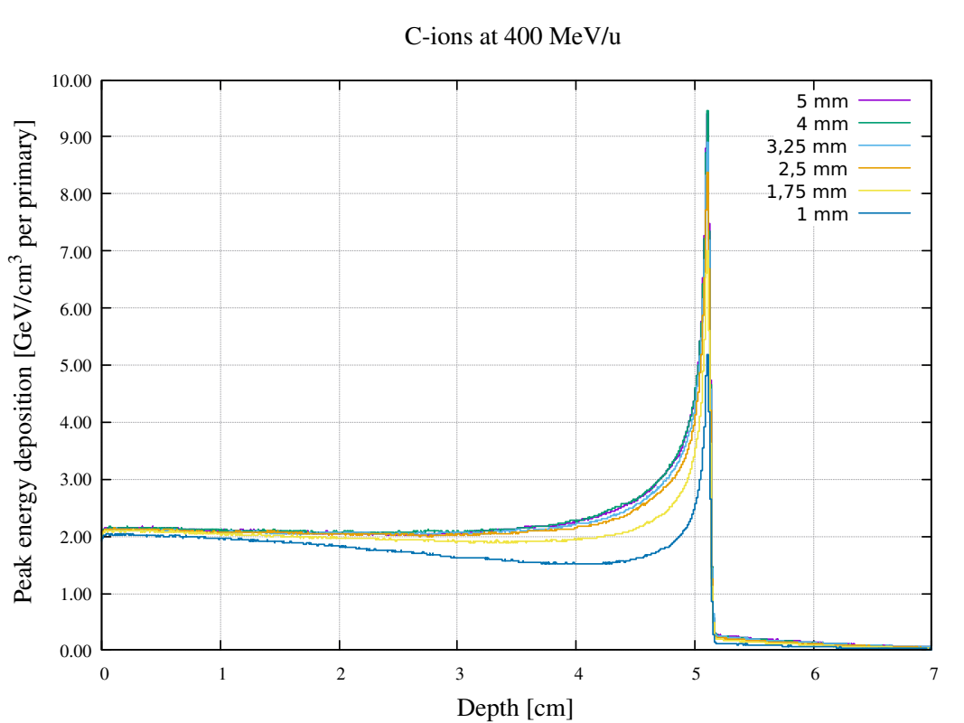
Energy deposition in magnet geometry : Backup
Longitudinal profiles of peak energy deposition in a thick target of homogeneous material for protons and C-ions at minimum energy, with different σ on the x and y axis but same area

Slide 25

Energy deposition in magnet geometry: Backup
Angle such that the entire
beam hits the magnet illuminating the entire length.
θ

