Slide 1
Cryogenic cooling options for radiation testing
Torsten Koettig, Aleksandra Onufrena, Maria Chioteli

Slide 2
Content
Cooling option comparison T ≥ 4.2 K
Cryocooler based solutions
Remote cooling loops
Summary

Slide 3
Cooling options/influence on cryostat design
LHe based options
Cryocooler based options
Bath cooling,
direct liquid contact
Phase separator as cooling source,
conduction cooling
Forced flow or natural circulation,
conduction cooling
Cryocooler,
conduction cooling
Cryocooler,
ZBO, Vapor condensation
Cryocooler,
remote cooling

Slide 4
Cooling options/influence on cryostat design
LHe based options
Cryocooler based options
Bath cooling,
direct liquid contact
Phase separator as cooling source,
conduction cooling
Forced flow or natural circulation,
conduction cooling
Cryocooler,
conduction cooling
Cryocooler,
ZBO, Vapor condensation
Cryocooler,
remote cooling
Liquid transfer lines, return gas active shield cooling
double vacuum insulated
LHe transfer lines in the zone for refill
Cryocooler stand-alone operation
He gas lines to the cryocooler, its materials are close to the irradiation region
Possible activation of all internal materials (rare earth alloys)
Radiation hardness of seals?
Reduced lifetime?
=> Pulse tube cryocoolers with He cooling remote circuits
Gas return
LHe supply

Slide 5
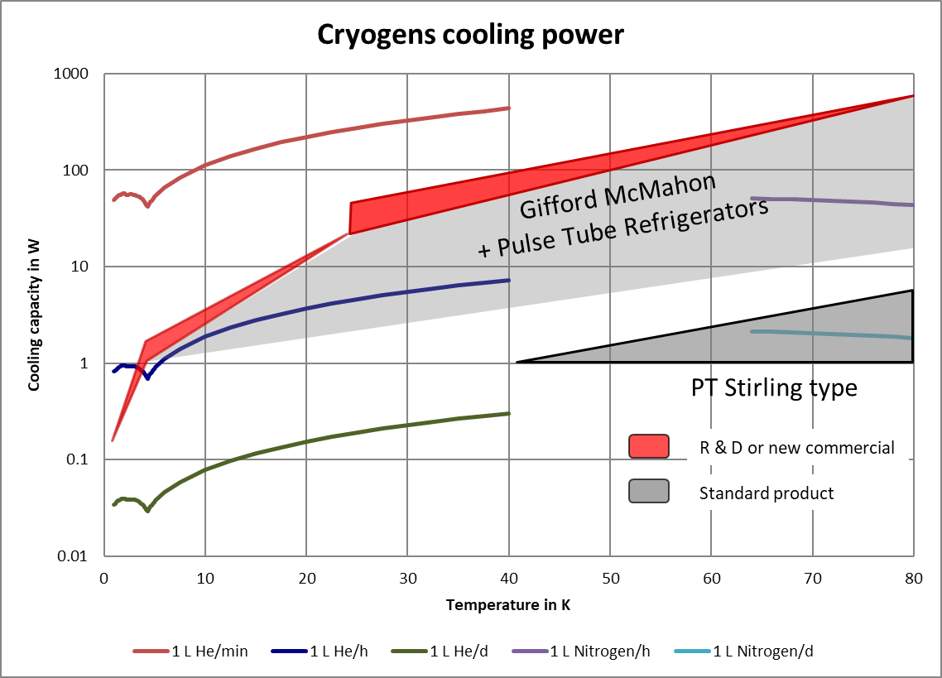
Cryocooler performance overview

Slide 6
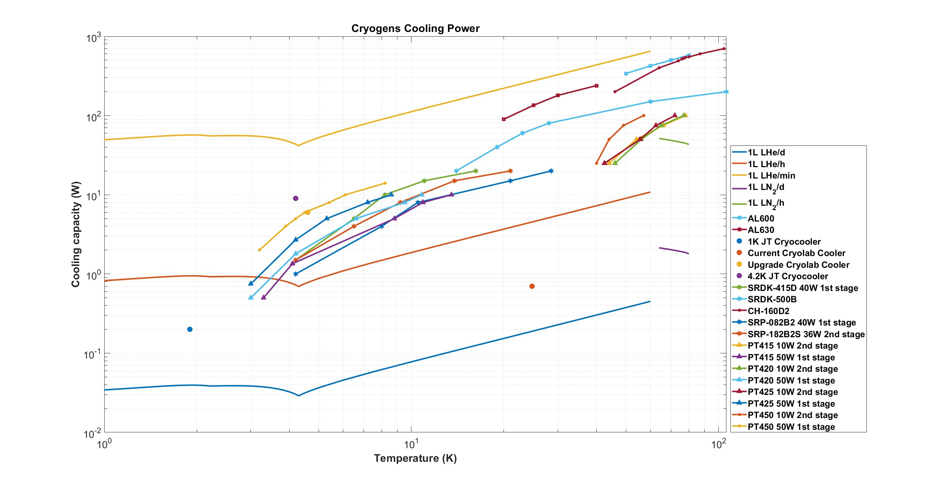
Cryocooler vs. liquid/vapour cooling
Status Aug. 2024

Slide 7
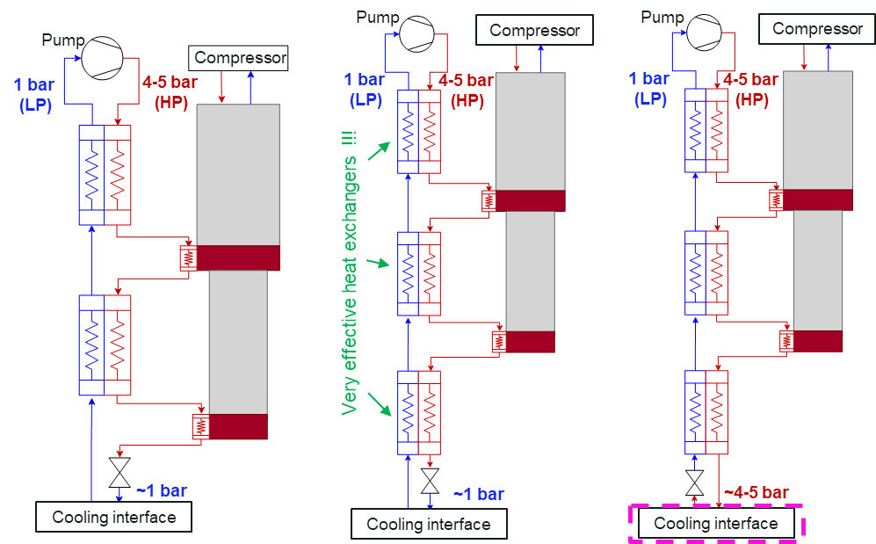
Remote cooling circuits => cryocooler based
Gain distance of 1-2 m

Slide 8
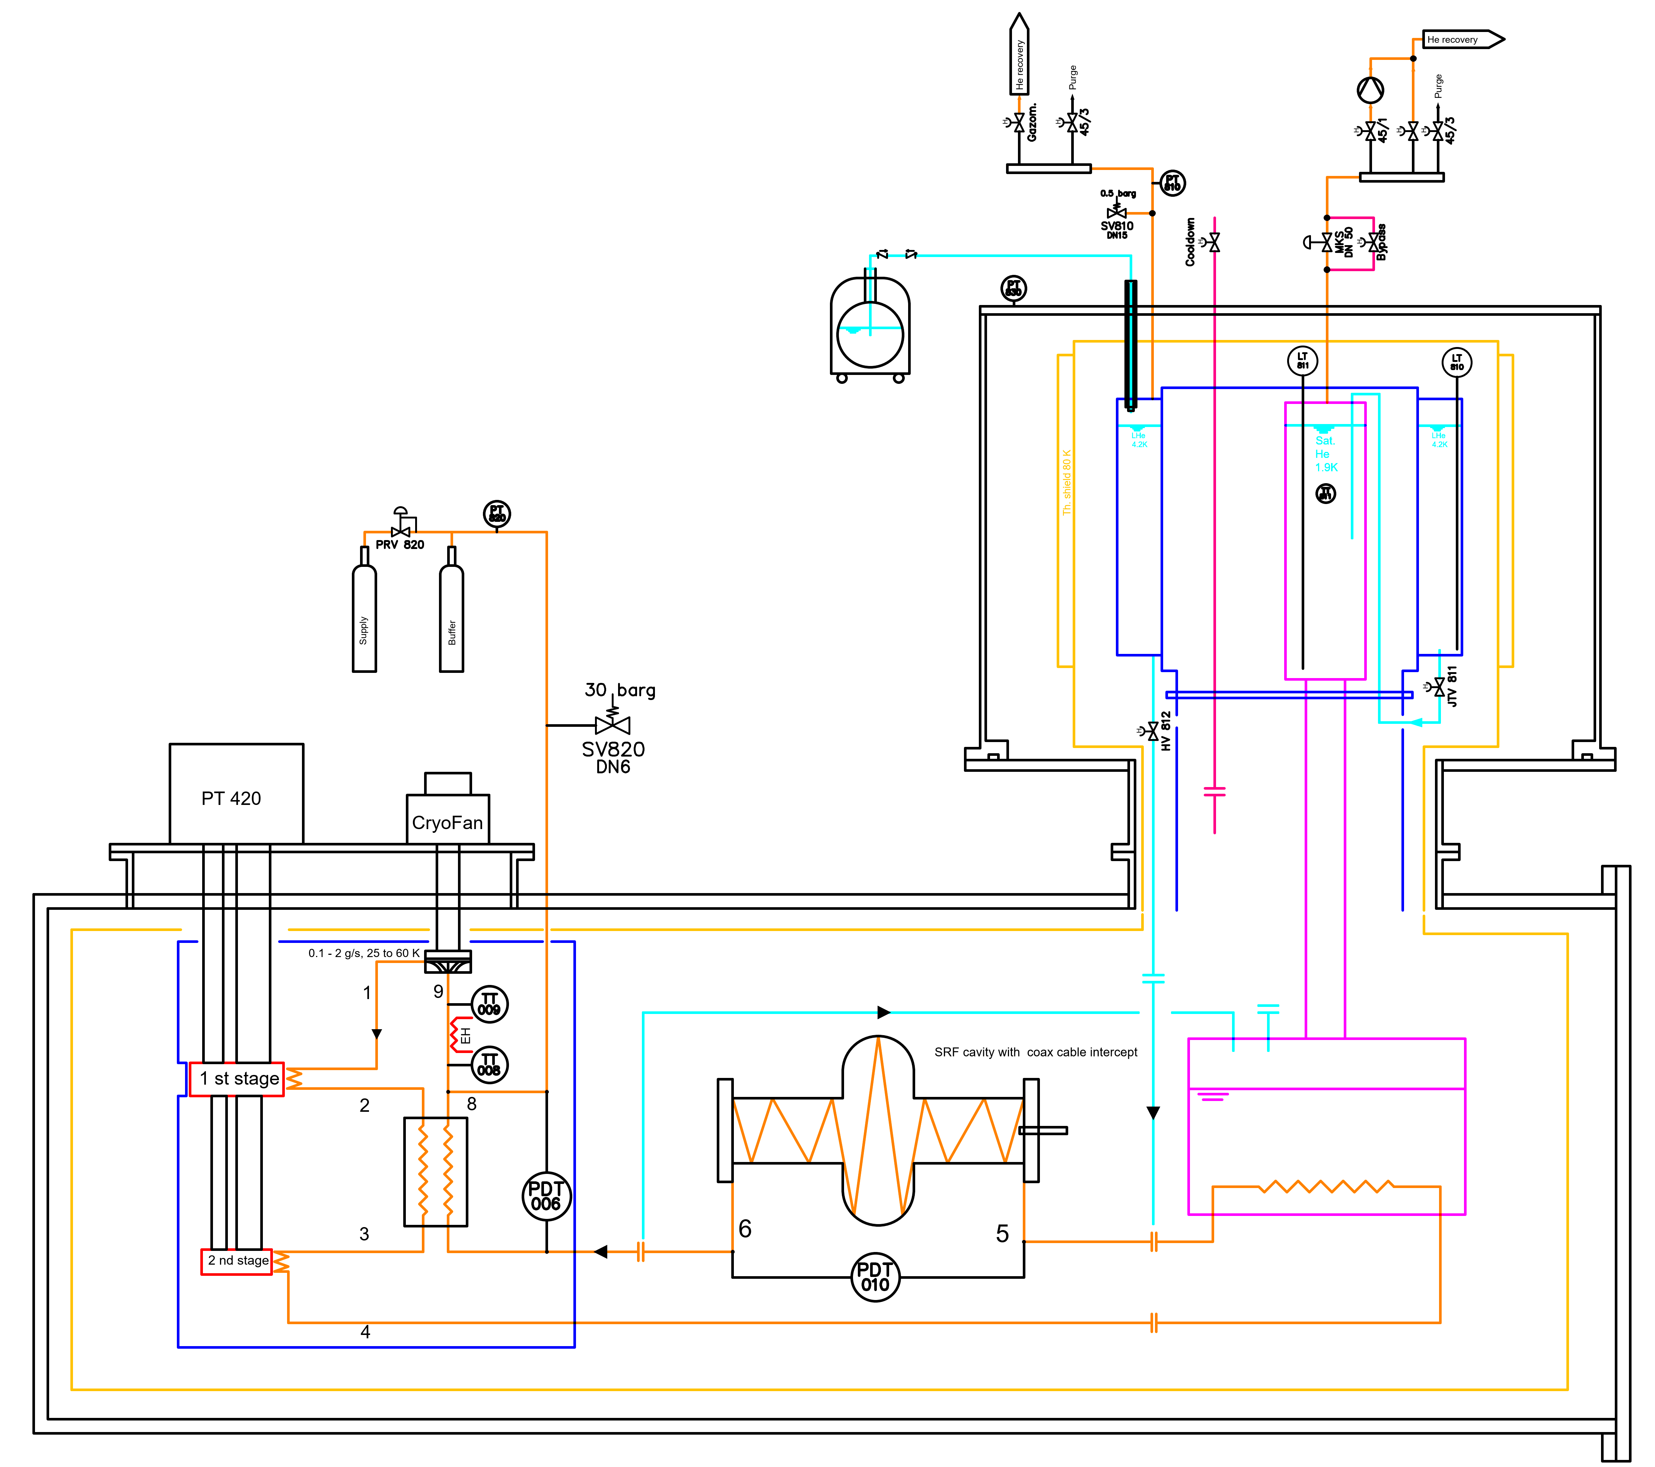
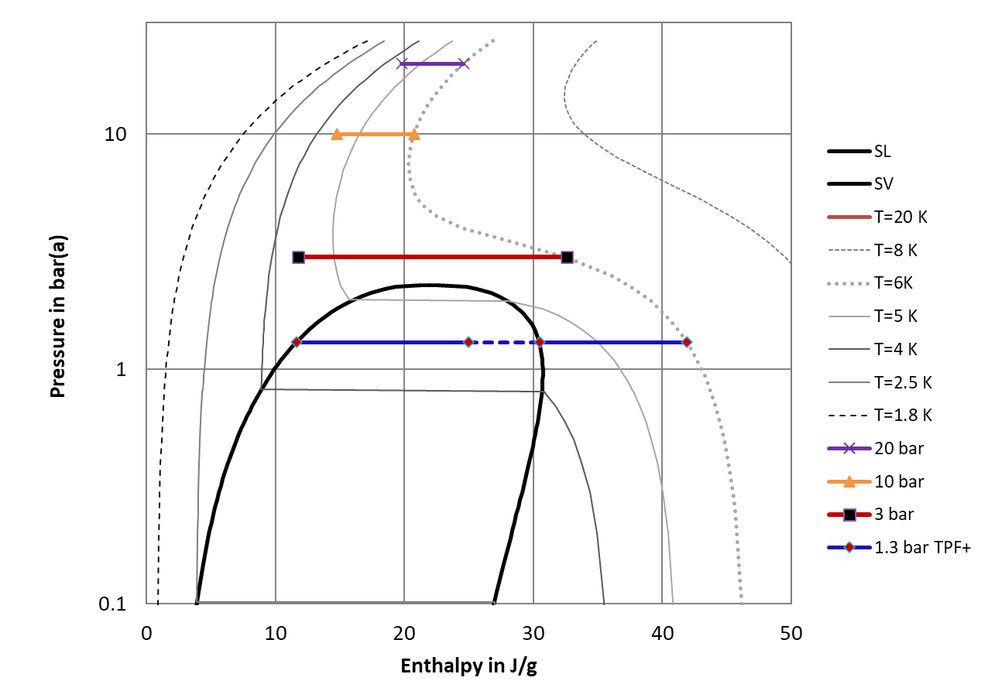
RF cavity cooling in a remote way
Possible fluid conditions
LHe two–phase flow to 6 K
SC He @ 3 bara, 4.5 - 6 K
GHe @ 10 bara, 4.5 - 6 K
GHe @ 20 bara, 4.5 - 6 K
1.8 2.5 4 5 6 8 K

Slide 9
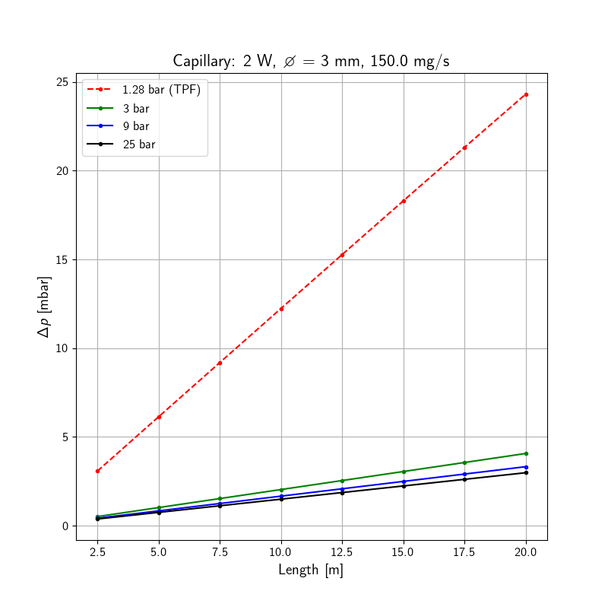
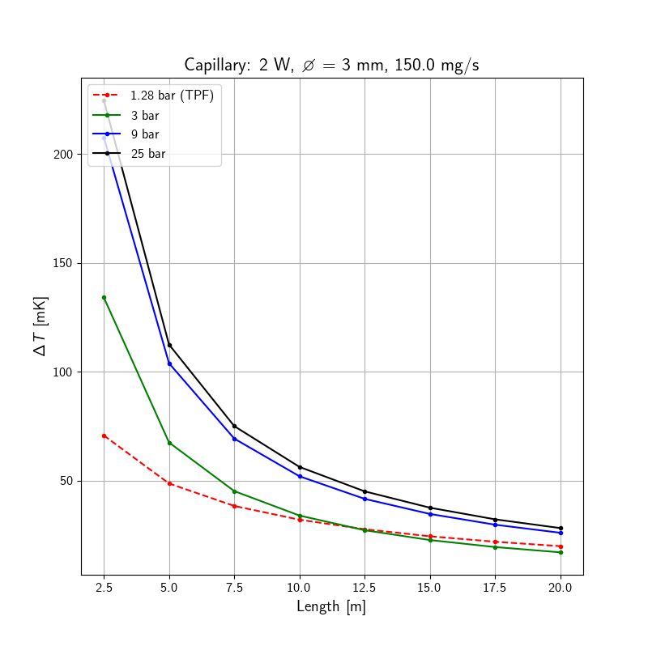
Remote cooling loop RF cavity cooling
Optimum capillary fluid conditions – numerical code
Similar heat transfer of TPF and Sup. crit. 3 bar
Quite higher pressure drop of TPF

Slide 10
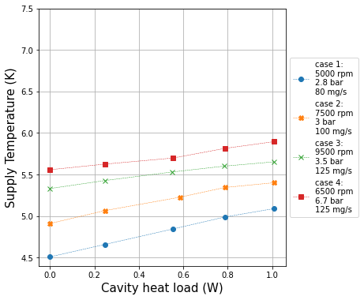
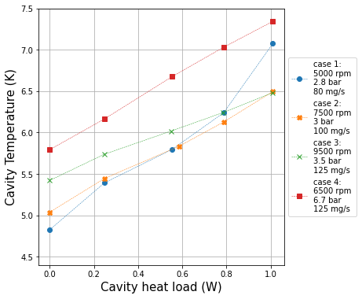
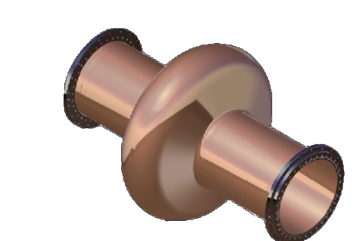

Heat load introduction to the cavity
Supply temperature
Cavity temperature
Additional halogen lamp to mimic uniform heating as expected from RF loads

Slide 11
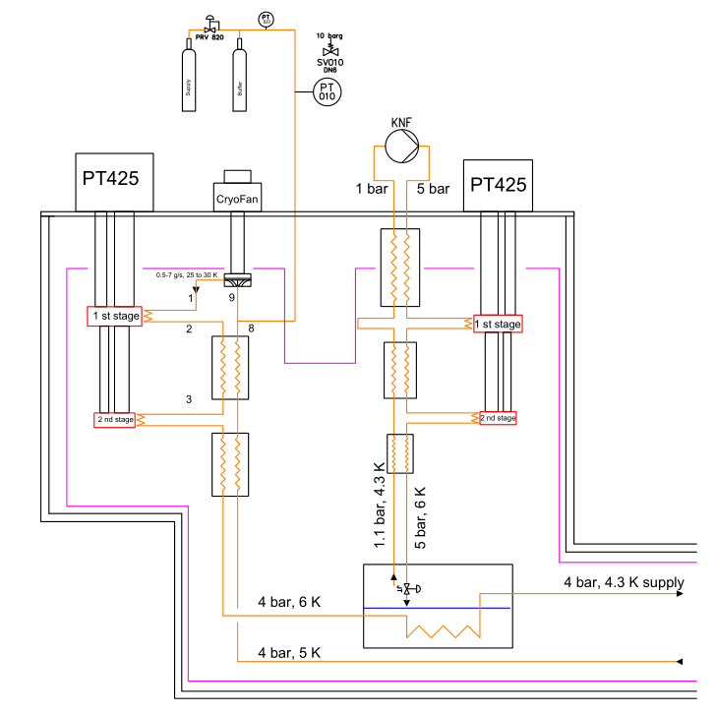
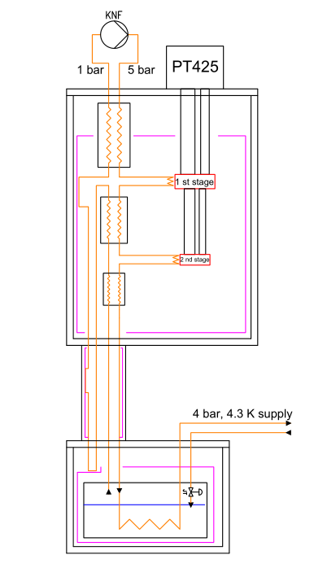
Remote cooling loops with boosted performance
Subcooled 4 bar cooling loop
Subcooled 4 bar cooling loop – high Q
2 stage
CC
Circulation pump and compressor outside radiation zone
2 stage
CC
2 stage
CC
3-4 x
Rad. zone
Rad. zone

Slide 12
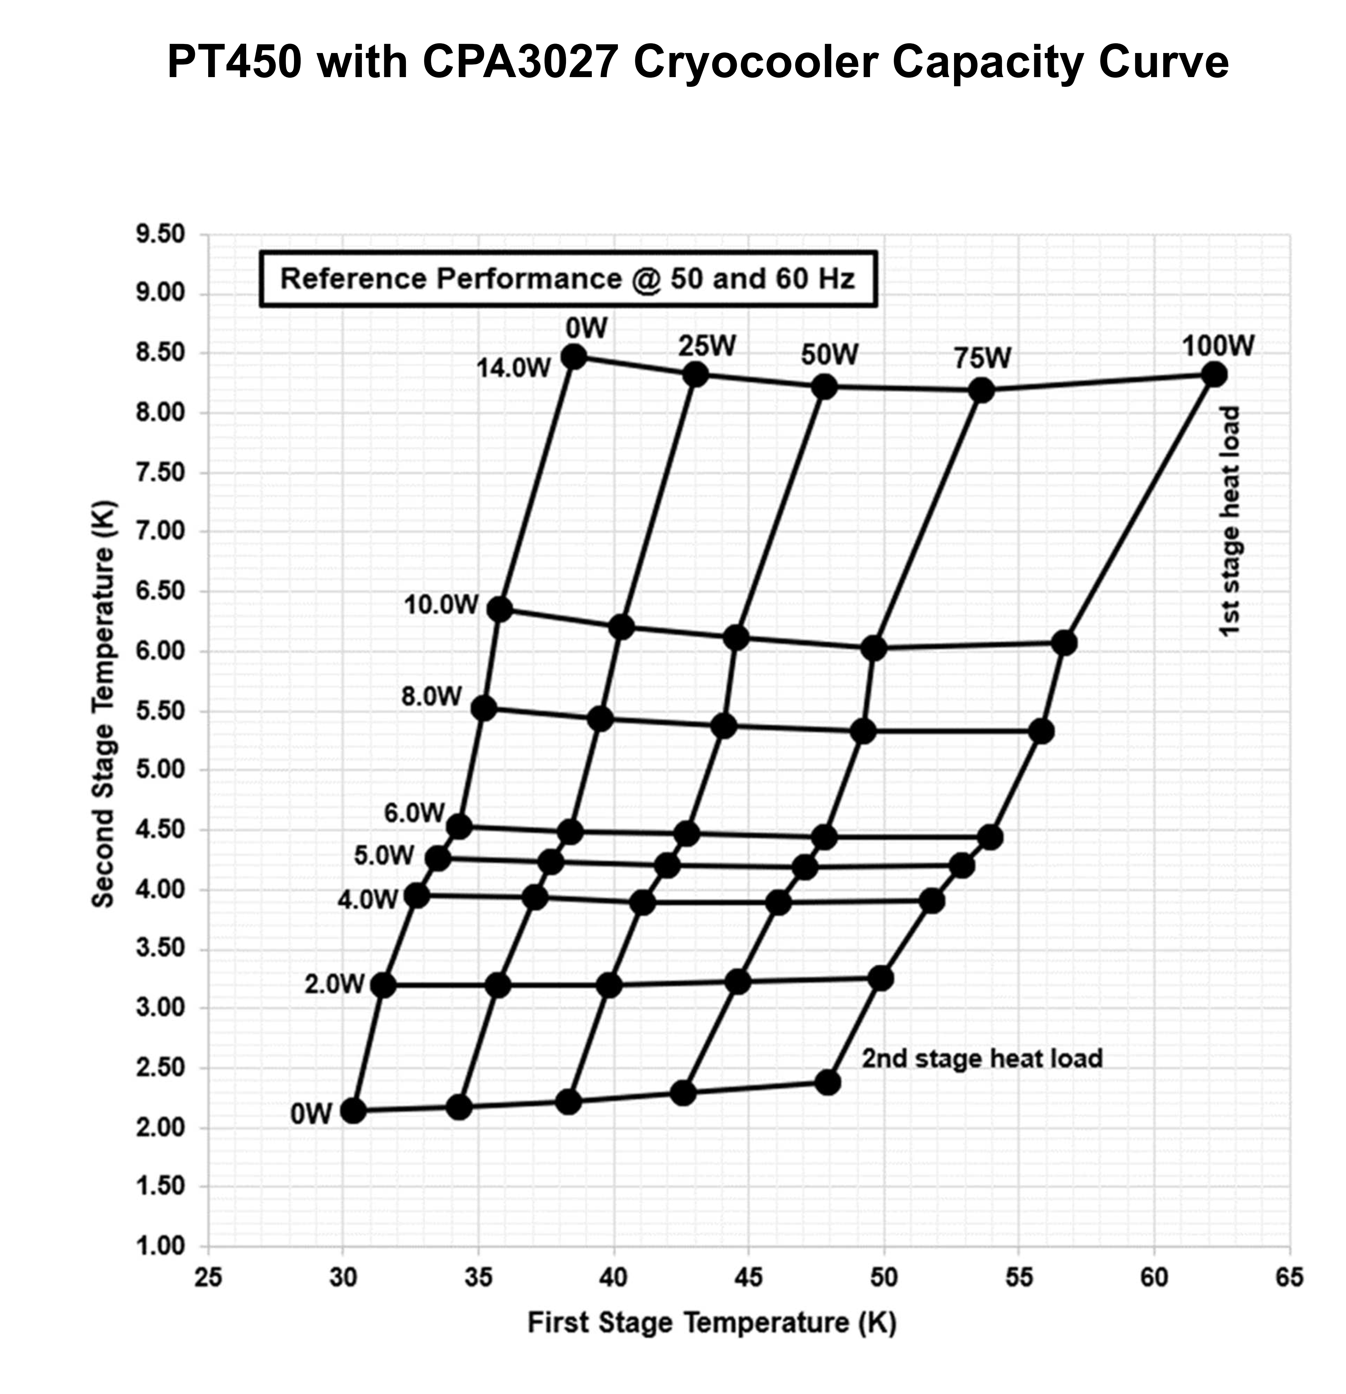
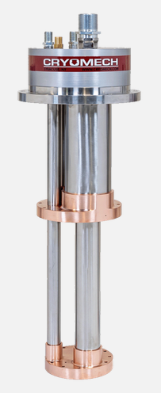
Latest developments (high cooling power at 4.2 K)
Source: Bluefors, Cryomech, Two-stage pulse tube refrigerator, P_{el}=25-27 kW (50 or 60 Hz)
https://bluefors.com/products/pulse-tube-cryocoolers/pt450/#downloads, photo courtesy Bluefors.

Slide 13
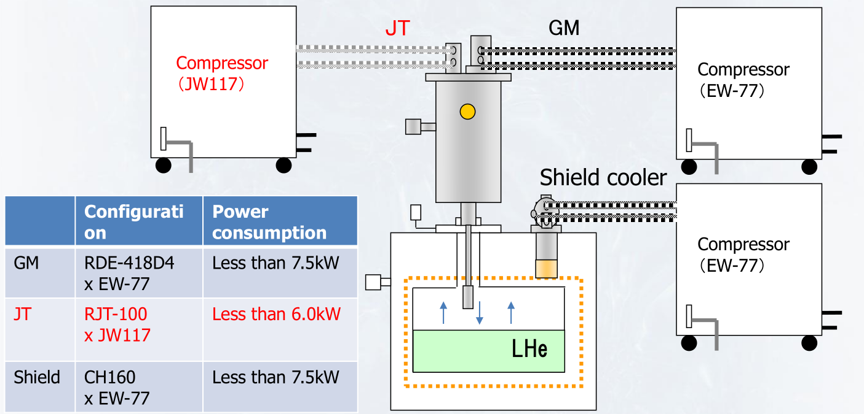
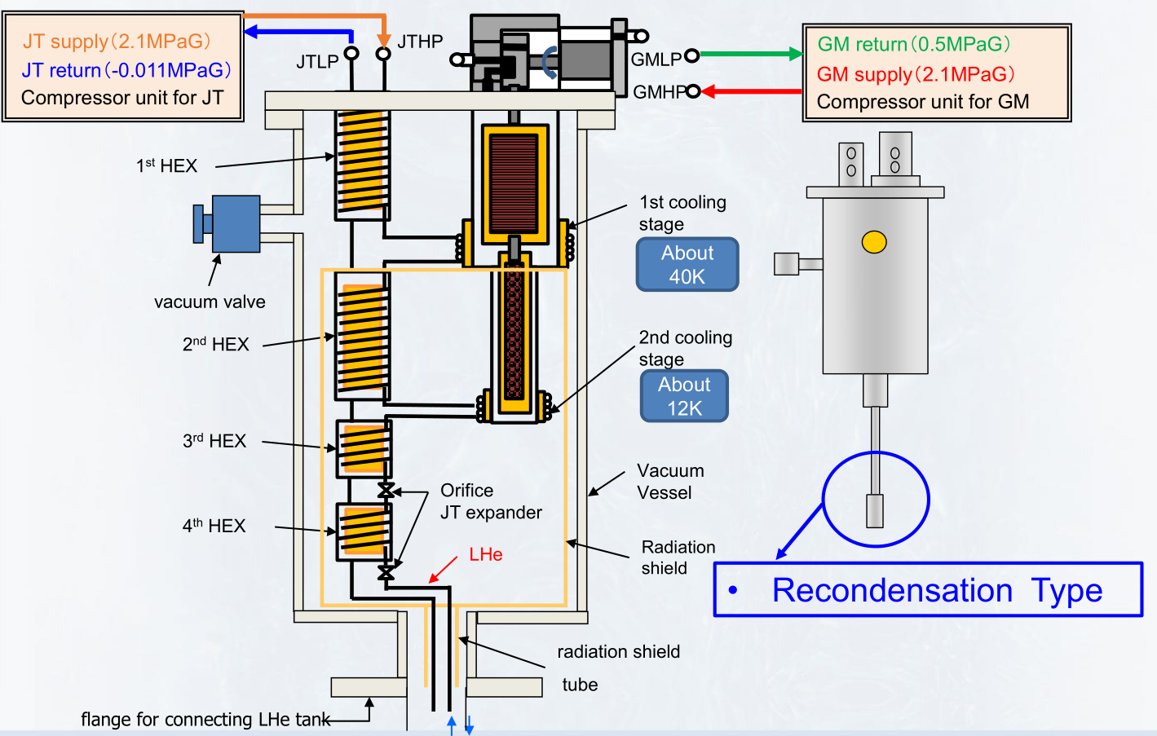
Latest developments (high cooling power at 4.2 K)
GM-JT cooler
Possible add. shield cooler
> 9 W @ 4.2 K cooling power at the CIF
Now also as open ”loop” system available!
Source: Introduction of GM – JT cooling system, A. Euler, Sumitomo

Slide 14
Conclusion
Testing radiation hardness of materials at low temperature
LHe cryostats vs. cryocoolers based options
Cooling performance
Pushing the frontier of cryocooler performance => add. J-T circuits
Remote cooling circuits to reduce the amount of materials exposed
New applications for R&D and stand-alone cryostats

Slide 15
Thank you for your attention

