Slide 1
EN-MME contribution to the ET project: the vacuum system
Anité Pérez – EN-MME-MM
2024-12-06

Slide 2
Outline
Einstein Telescope (ET)
ET Vacuum System
EN-MME contribution
Summary and perspectives

Slide 3
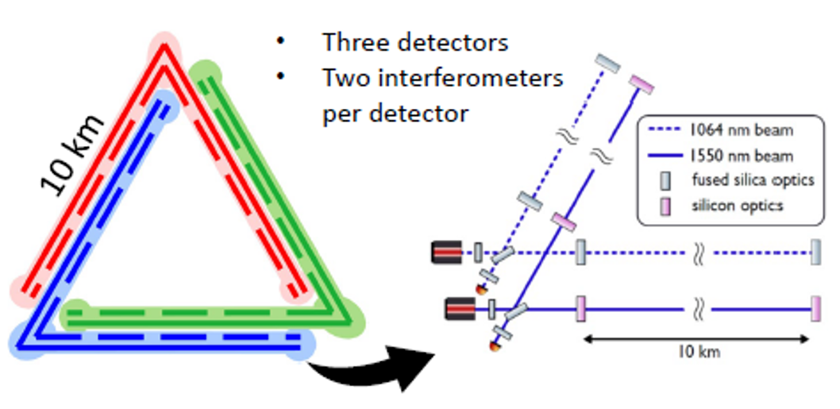
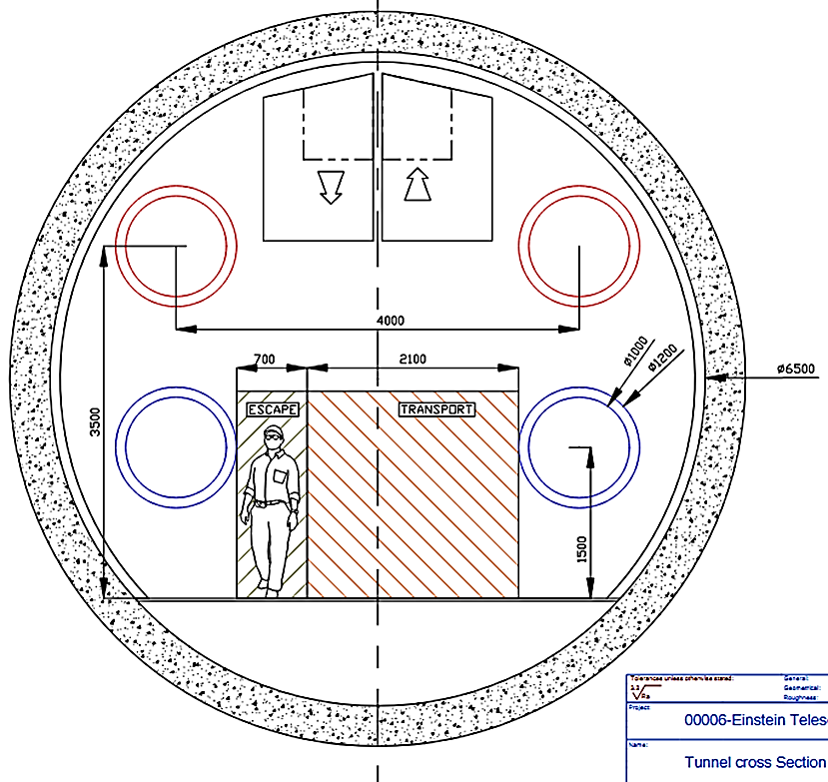
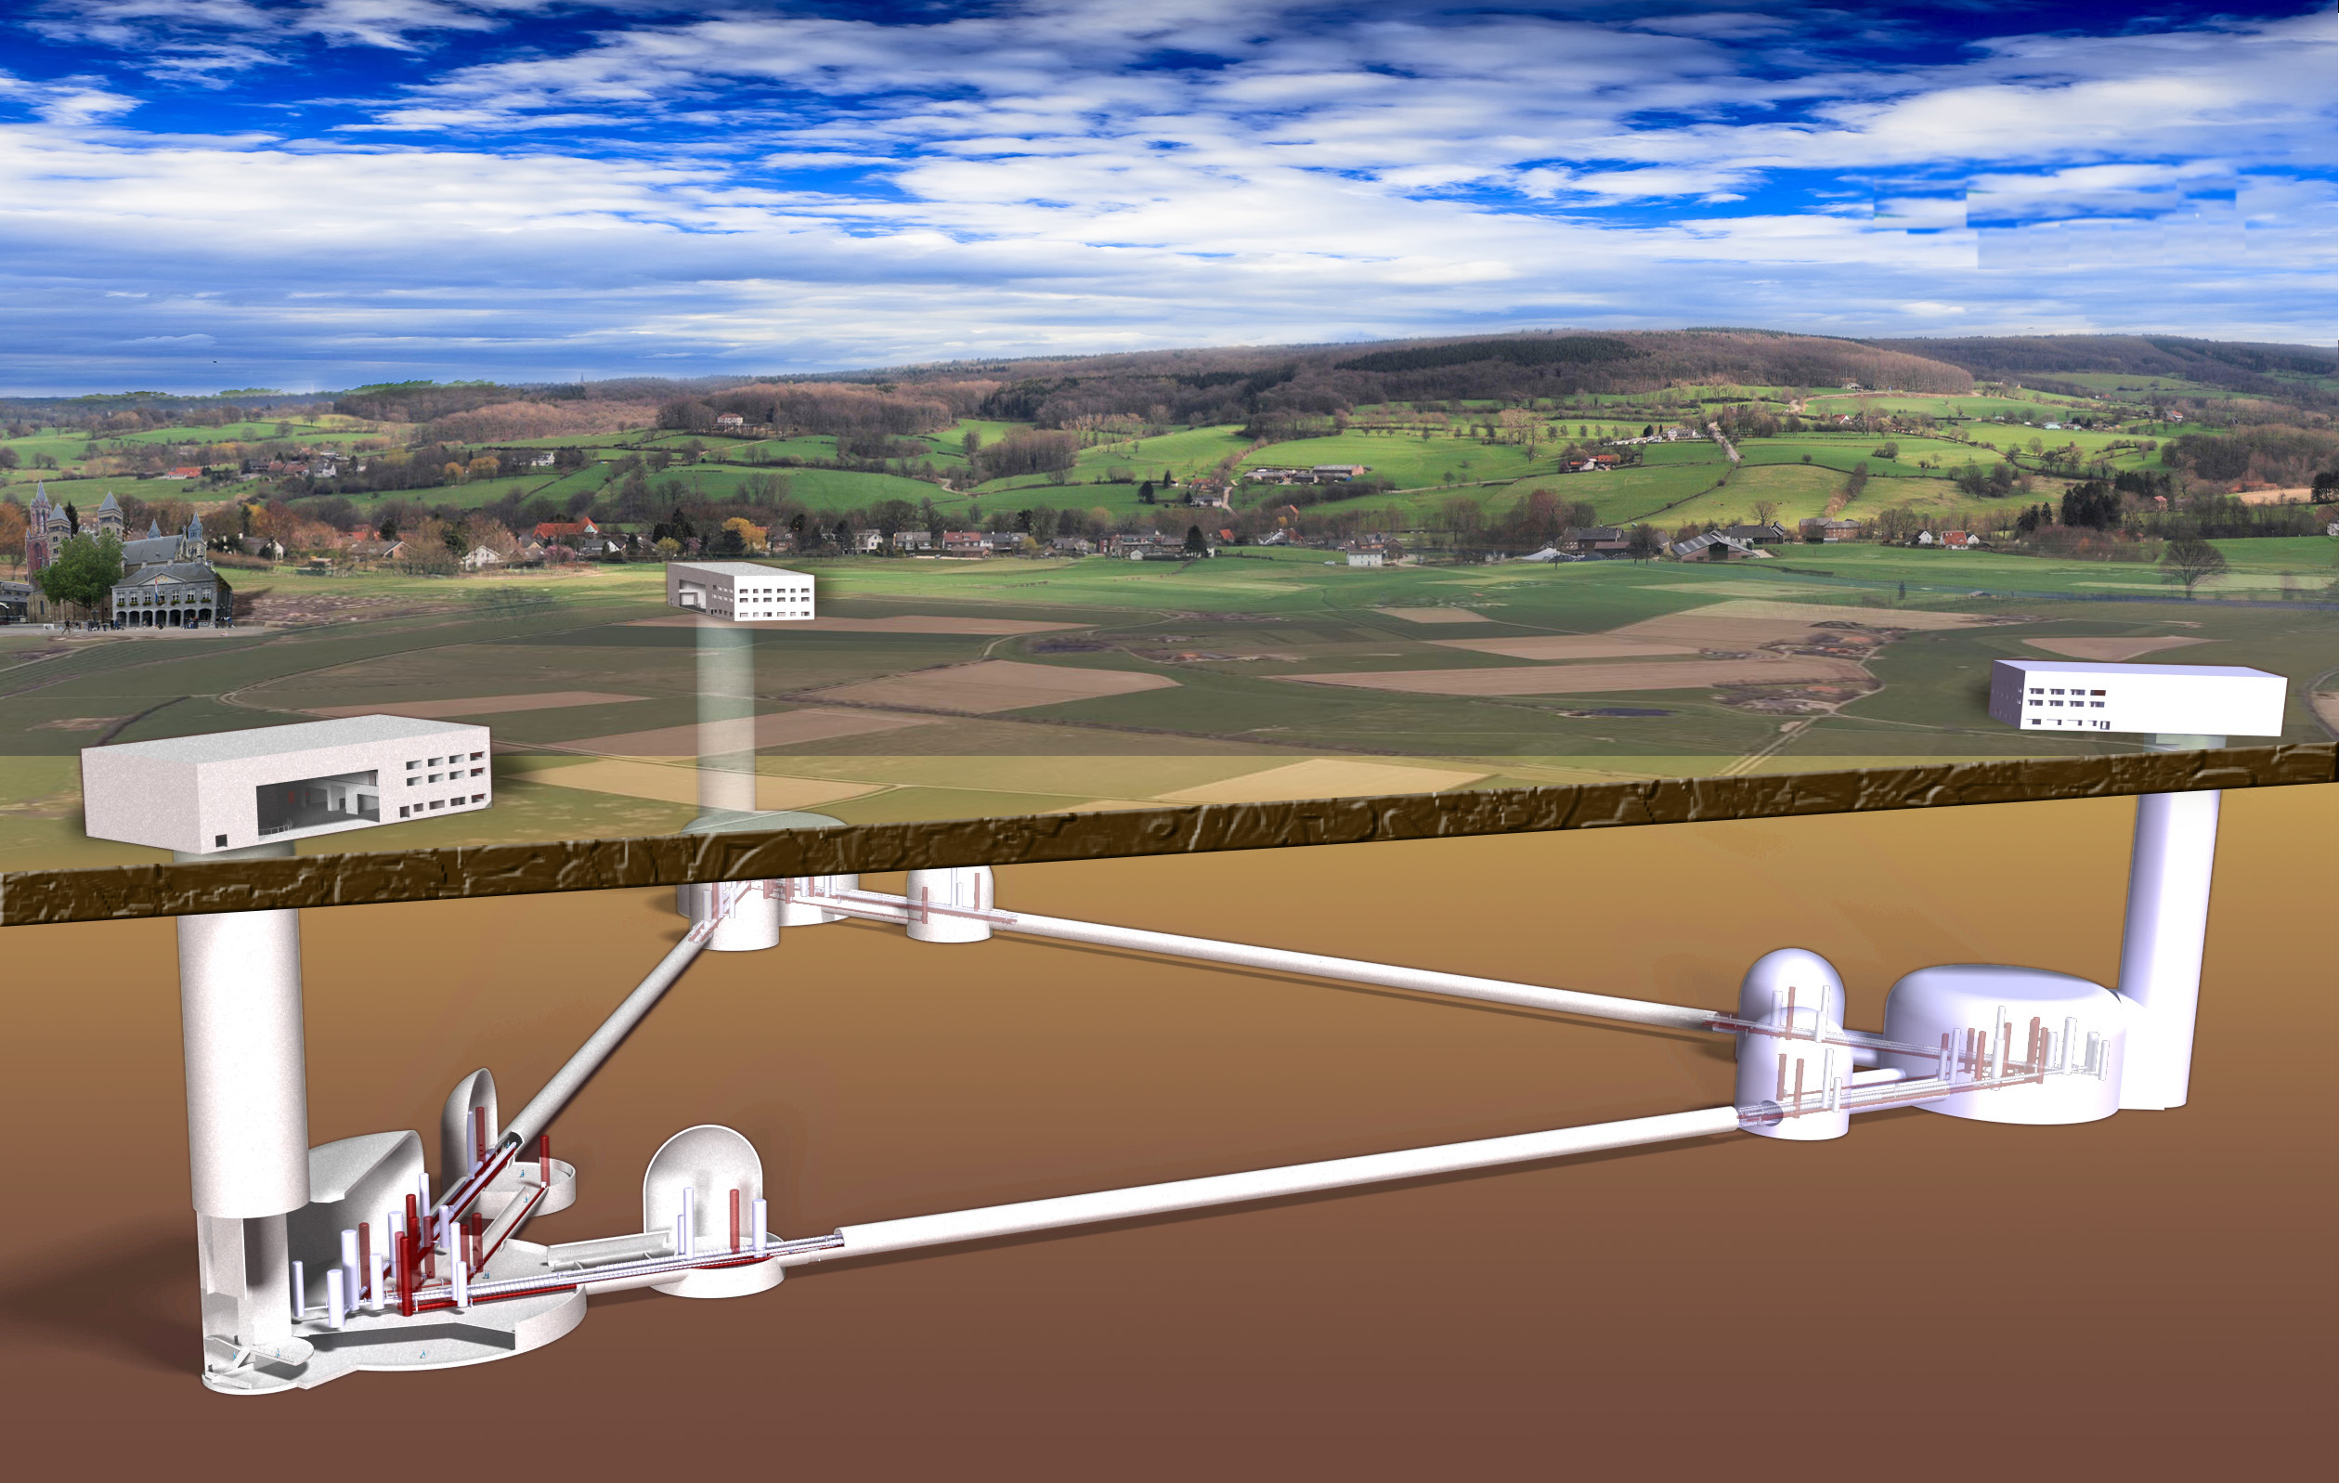

Einstein Telescope (ET)
ET concept
Next generation of GW detectors
Triangle
Underground Infrastructure: 200 – 300 meter
Probably largest UHV system ever built: 120 km!
≥ 10 km each arm
Triangular (or L-Shaped) Underground
Current detectors observe about one signal per week.
Next generation →100.000 to 1.000.000 binary black holes mergers per year! And many other new sources!

Slide 4
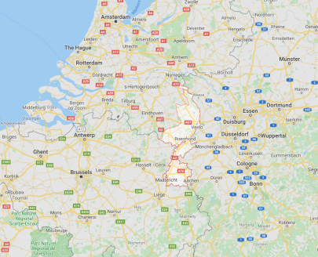
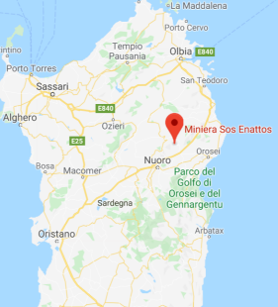
Einstein Telescope (ET)
ET concept
Next generation of GW detectors
15 km
Triangle
2L misaligned of 45°
Two locations presented their candidature (NL & IT)
Saxony (DE) is very present in ET and ETpathfinders
≥ 10 km each arm
Triangular (or L-Shaped) Underground
Limburg (NL)
Sardinia (IT)

Slide 5
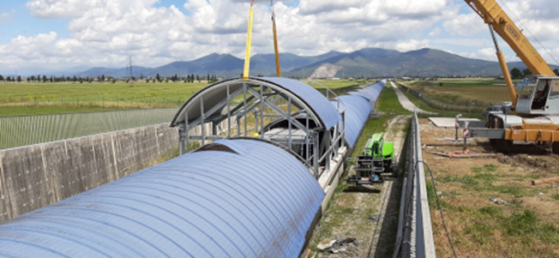
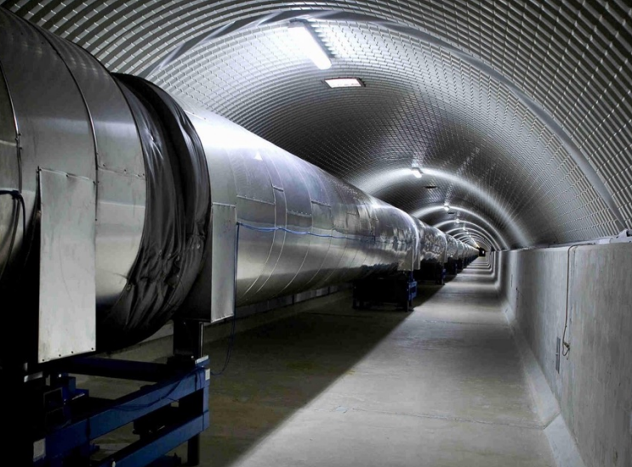

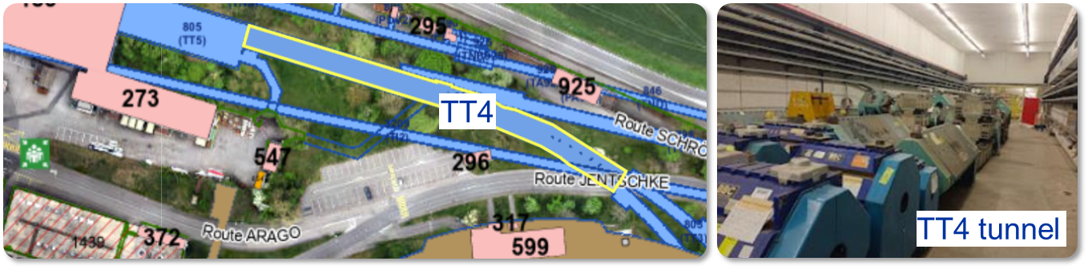
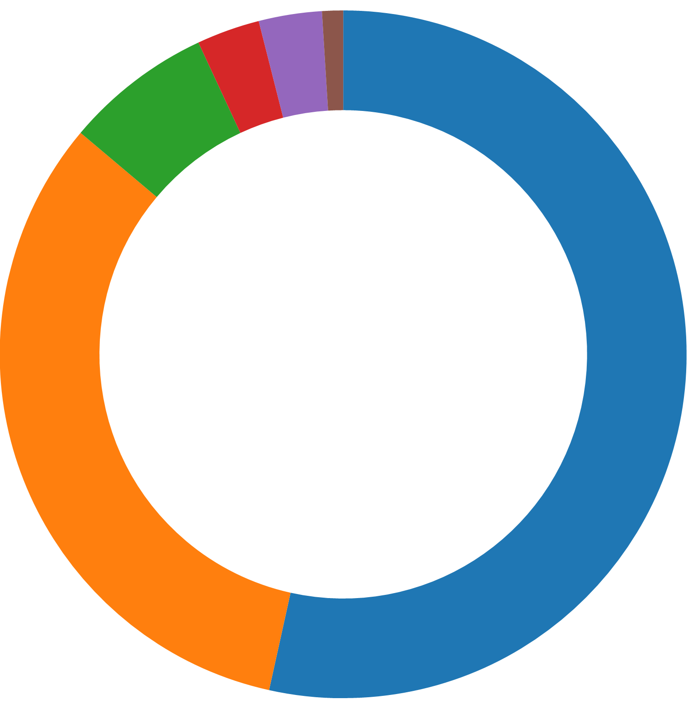
Objectives:
  To design and test technical solutions that fulfil the ET requirements and cost effective
  To manufacture, assemble and test a pilot sector (in TT4)
  To write the TDR, including cost estimations
MoU in 2022 between CERN, INFN, Nikhef and since 2023 also IFAE
ET vacuum system
Are there cost-effective alternatives (material, design, manufacturing, post-processing treatments) to achieve the needed vacuum performance?
Conceptual Design?
Cost estimation?
Pilot sector at CERN
If VIRGO vacuum system costs are scaled to ET dimensions
Civil engineering & services (54%)
Vacuum system* (33%)
ET total
budget
Optics and lasers (7%)
Suspension system (3%)
~ 440 M€
(estimated) [3, 4]
Cryogenics (3%)
Installation (1%)
*including towers
(~<10% of the vacuum system budget²)

Slide 6
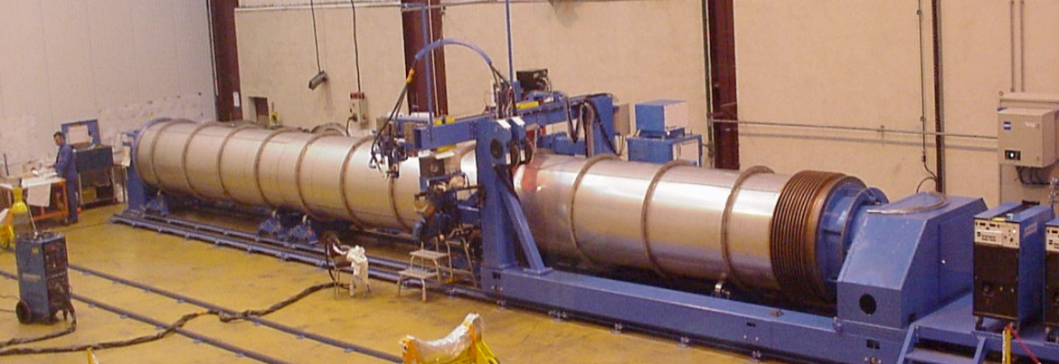
Objectives:
  To design and test technical solutions that fulfil the ET requirements and cost effective
  To manufacture, assemble and test a pilot sector (in TT4)
  To write the TDR, including cost estimations
ET vacuum system
Baseline based on VIRGO vacuum pipes [5]:
AISI-304L
4-mm-thick
Ø1.2 m x 15-meter-long
Pipes reinforced with stiffeners & air-fired

Slide 7
Objectives:
  To design and test technical solutions that fulfil the ET requirements and cost effective
  To manufacture, assemble and test a pilot sector (in TT4)
  To write the TDR, including cost estimations
Main requirements in ET:
  Beampipes of Ø1 m x 120 km
  UHV (H₂ partial pressure 10⁻¹⁰ mbar)
  Fast production and easy to handle in an underground facility
  Supports capable of holding, aligning and dumping the pipes
  Lifetime 50 years
ET vacuum system
Baseline based on VIRGO vacuum pipes [5]:
AISI-304L
4-mm-thick
Ø1.2 m x 15-meter-long
Pipes reinforced with stiffeners & air-fired

Slide 8
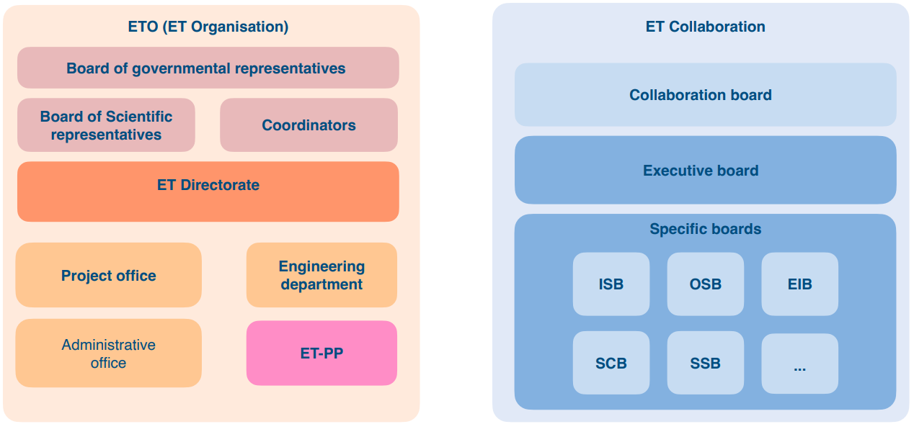
Objectives:
  To design and test technical solutions that fulfil the ET requirements and cost effective
  To manufacture, assemble and test a pilot sector (in TT4)
  To write the TDR, including cost estimations
Main requirements in ET:
  Beampipes of Ø1 m x 120 km
  UHV (H₂ partial pressure 10⁻¹⁰ mbar)
  Fast production and easy to handle in an underground facility
  Supports capable of holding, aligning and dumping the pipes
  Lifetime 50 years
ET vacuum system
ET vacuum team @ CERN
Interdepartmental collaboration
Monthly updates on activities:
ETC: Aniello Grado, Nick Van Remortel
ETO: Patrick Werneke, Fernando Ferroni (Giovanni Bisoffi), Andreas Freise, Mario Martinez
Project leader: Paolo Chiggiato (TE-VSC)
Deputy: Anité Pérez (EN-MME)

Slide 9
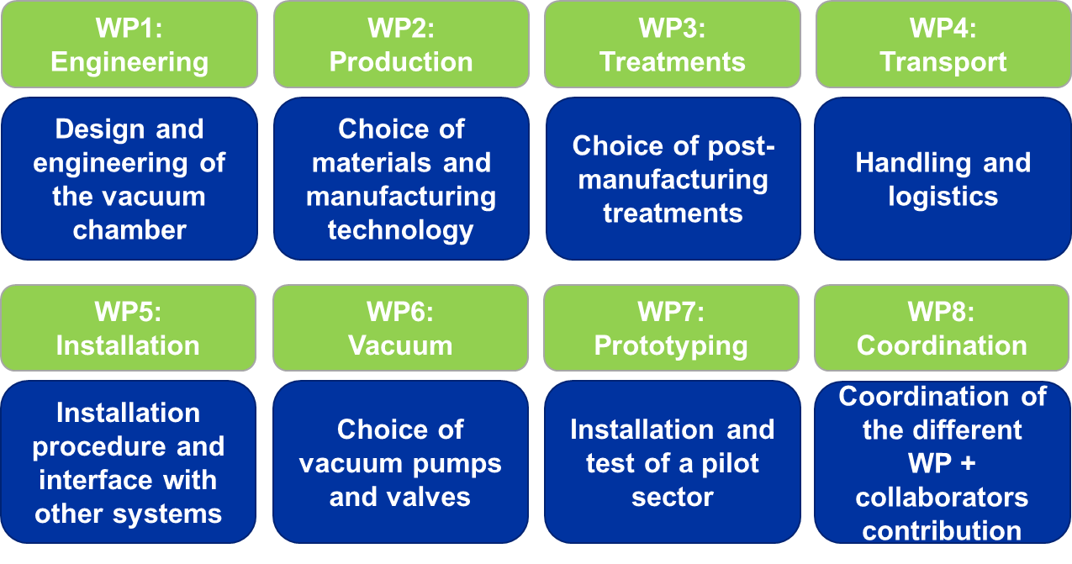
Objectives:
  To design and test technical solutions that fulfil the ET requirements and cost effective
  To manufacture, assemble and test a pilot sector (in TT4)
  To write the TDR, including cost estimations
EN-MME activity:
  Design office
  Materials, metrology and NDT
  Mechanical workshop
  Assembly and metal forming
  Technical subcontracting service
ET vacuum system

Slide 10
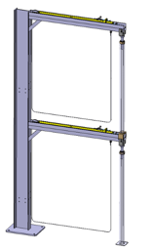
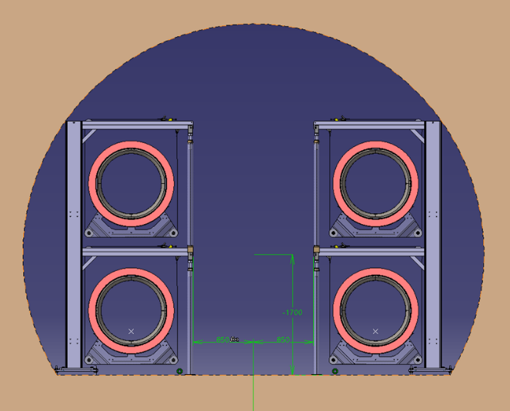
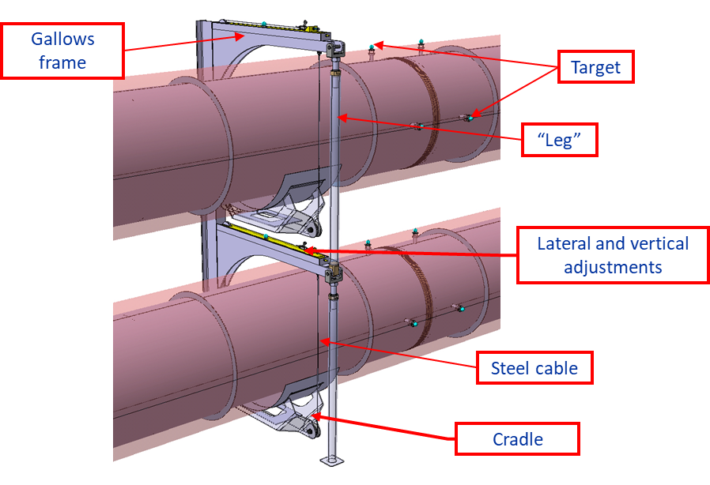
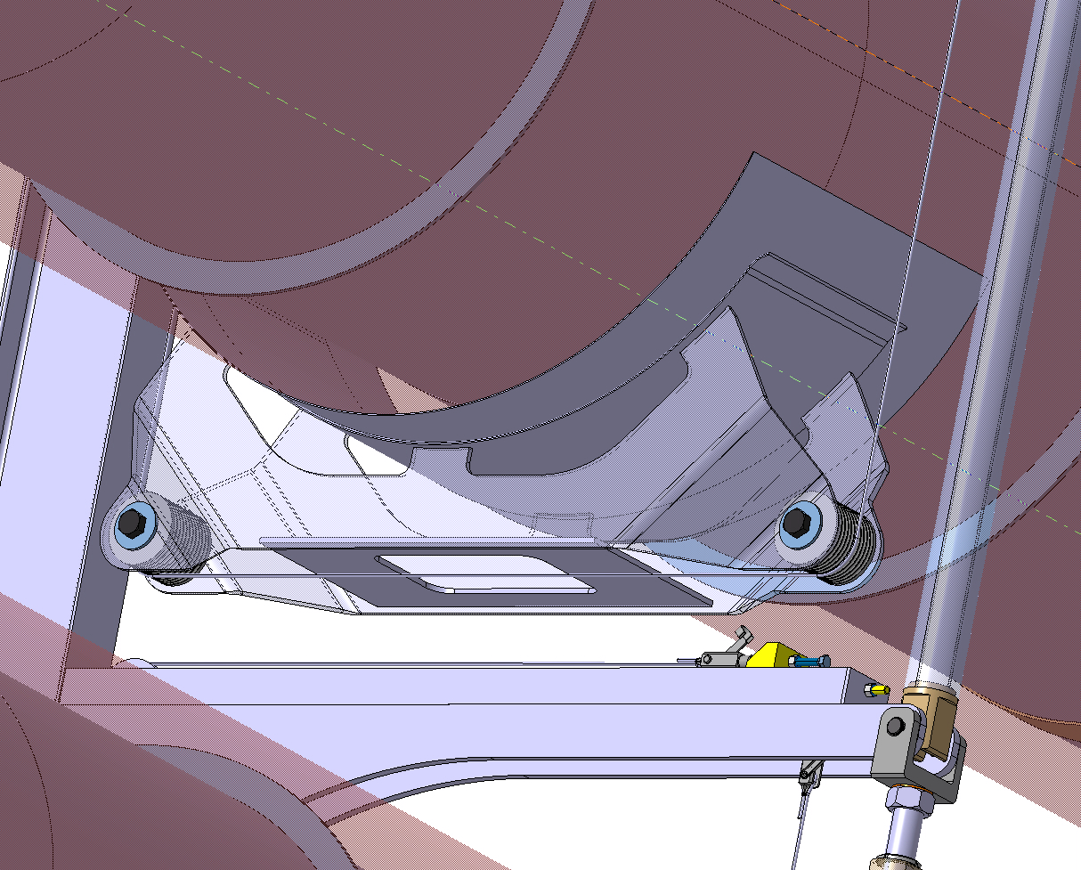
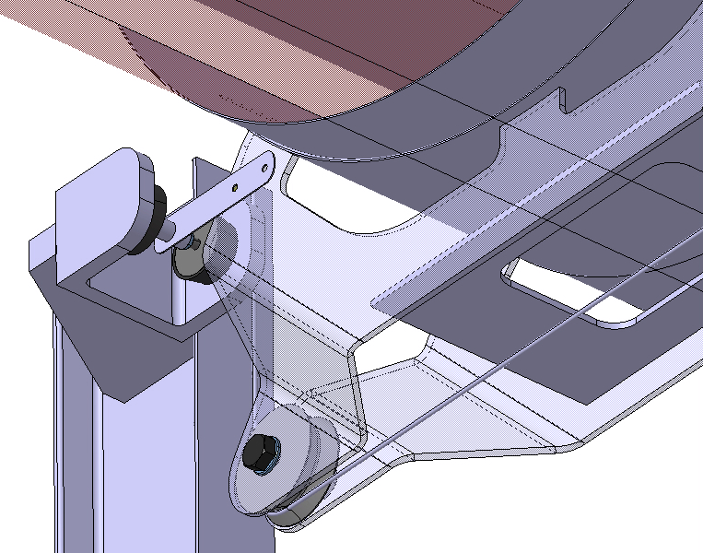
EN-MME contribution:
Design and manufacturing drawings for beampipes and supports of pilot sector → Applicable for ET
    In ET, the space required for the supporting structure shall be minimized allowing welding and future inspections
    Vacuum chamber position is adjustable within +/- 20 mm in both directions
1.7 m
Light supports based on standard beams with additional leg
Vacuum chambers suspended by cables (high strength synthetic ropes)
The insulated vacuum chambers lies on the cradle
Conceptual design of dampers

Slide 11
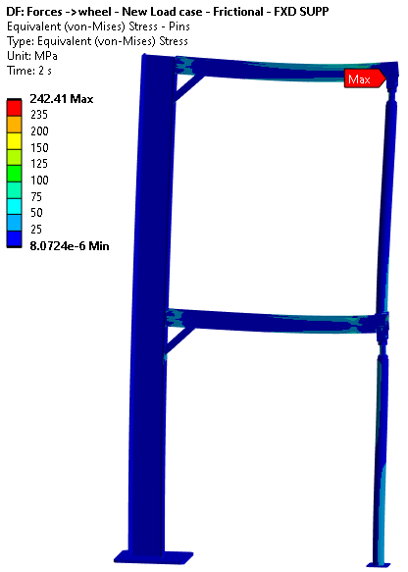
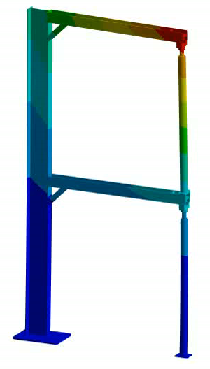
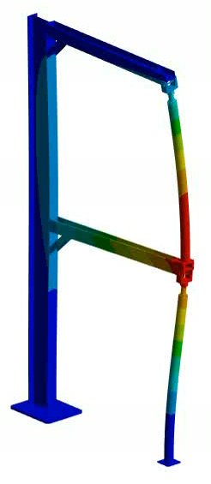
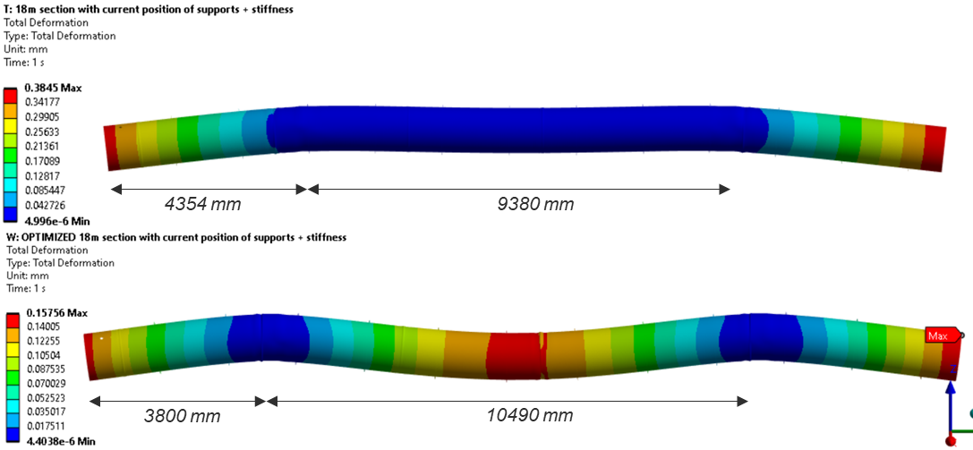
EN-MME contribution:
Finite element studies to optimize the supports dimensions and their positioning
Stresses
Eigenbuckling

Slide 12
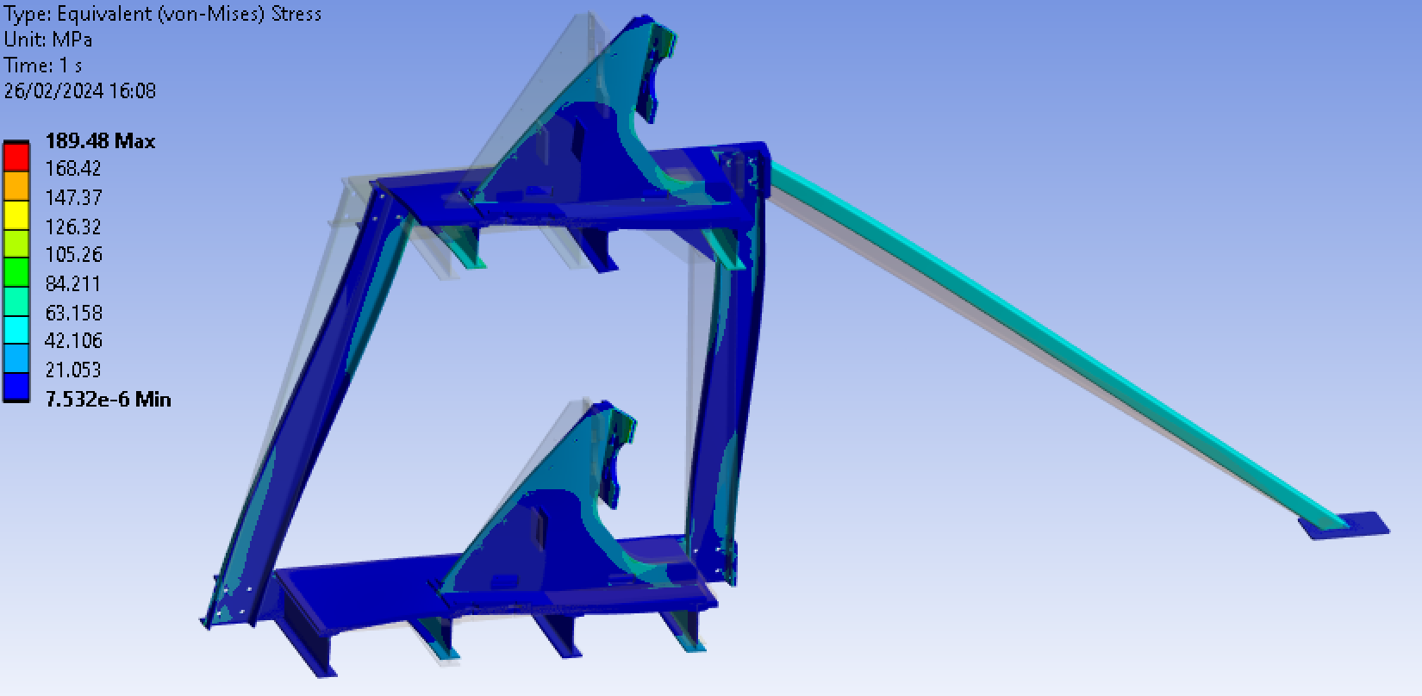
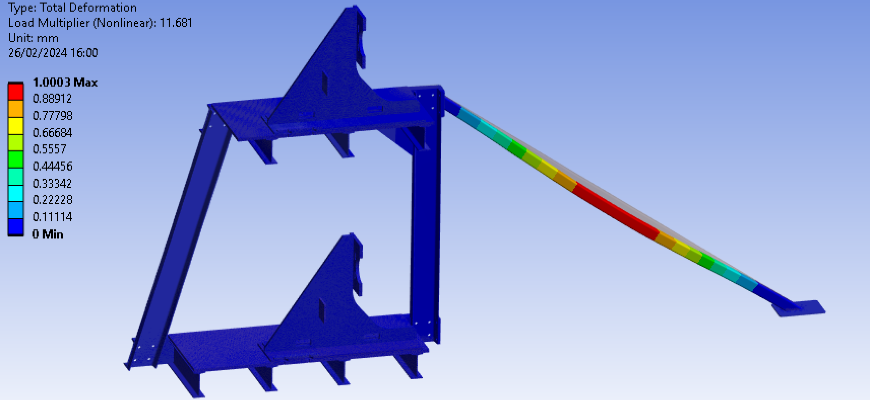
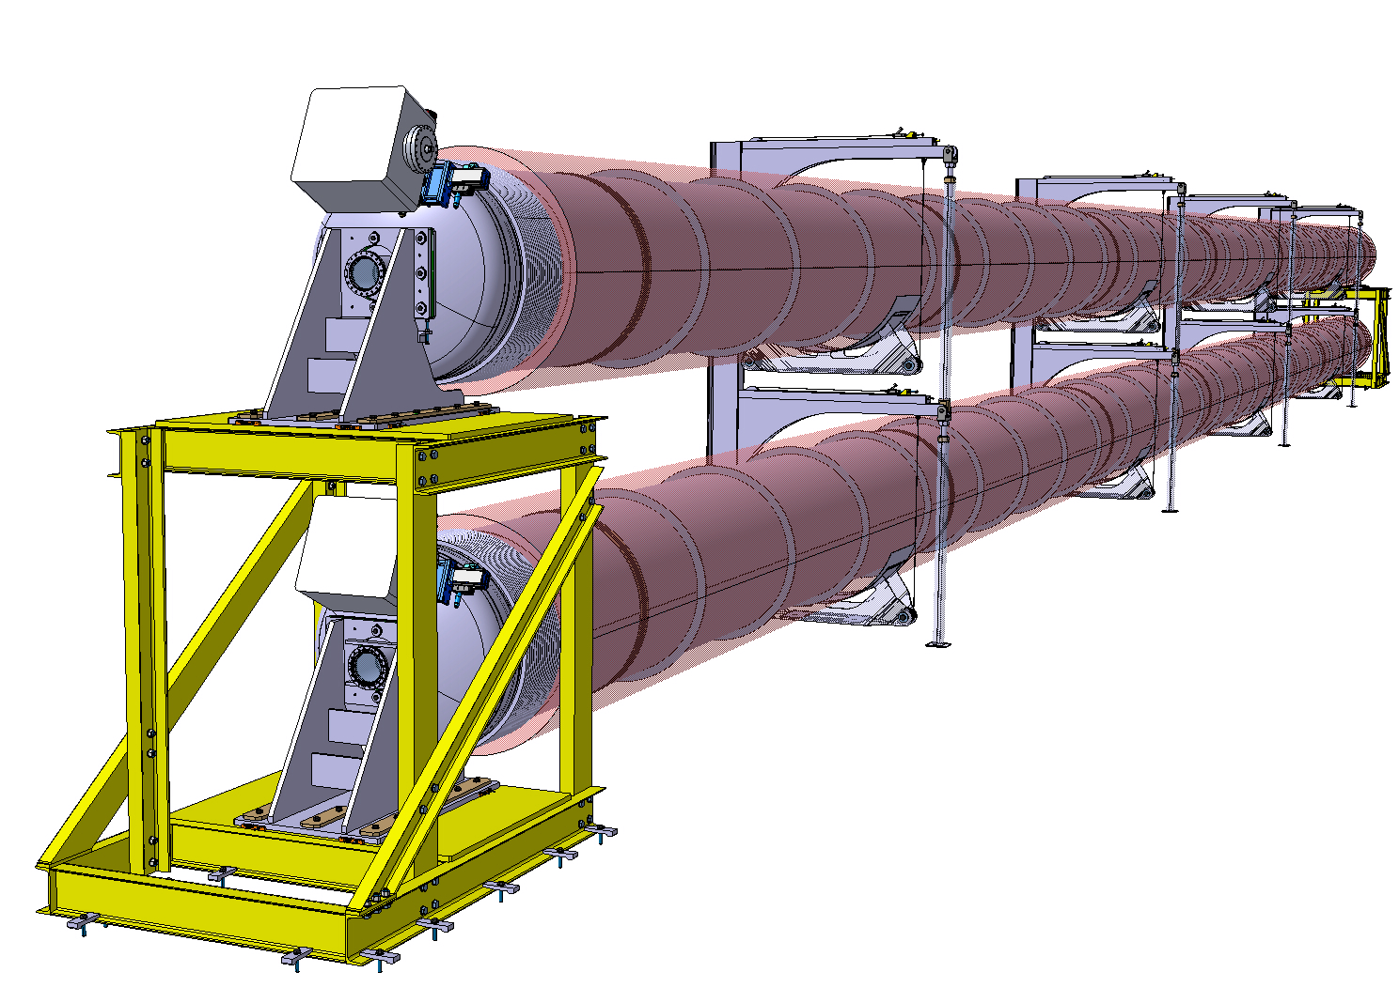
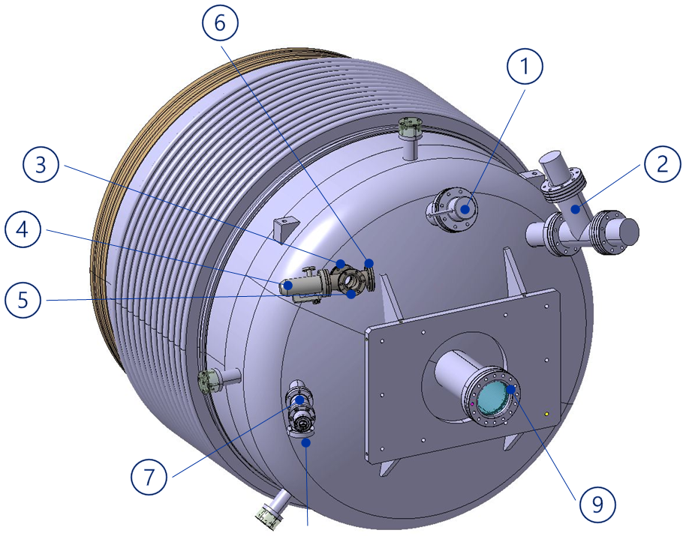
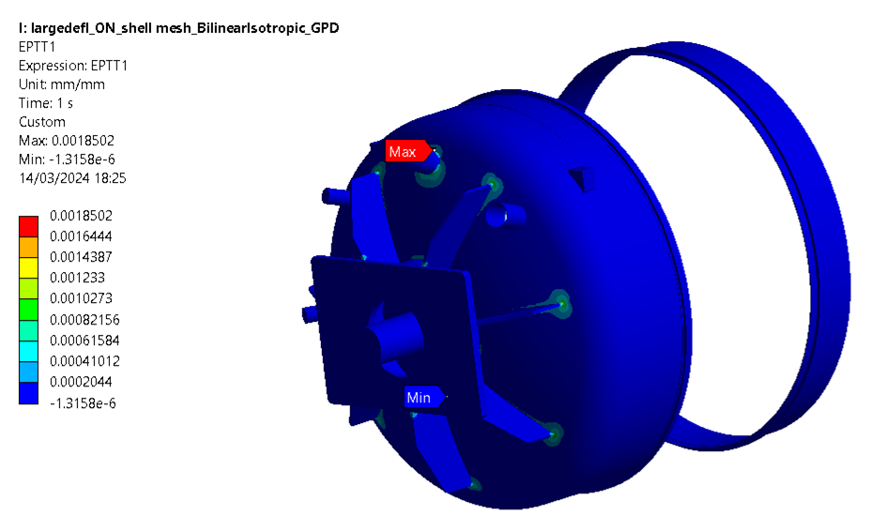
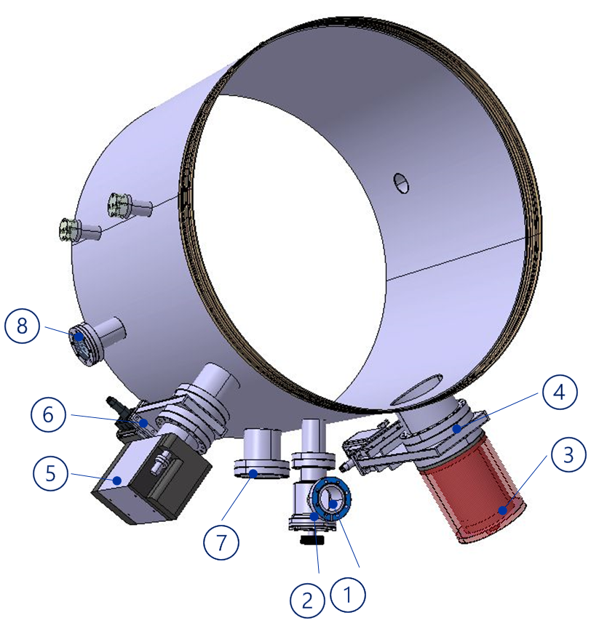
EN-MME contribution:
Finite element analysis for end caps end supports
Design of complementary parts, prototypes and supports
Von Mises stresses
Buckling mode
Plastic strain

Slide 13
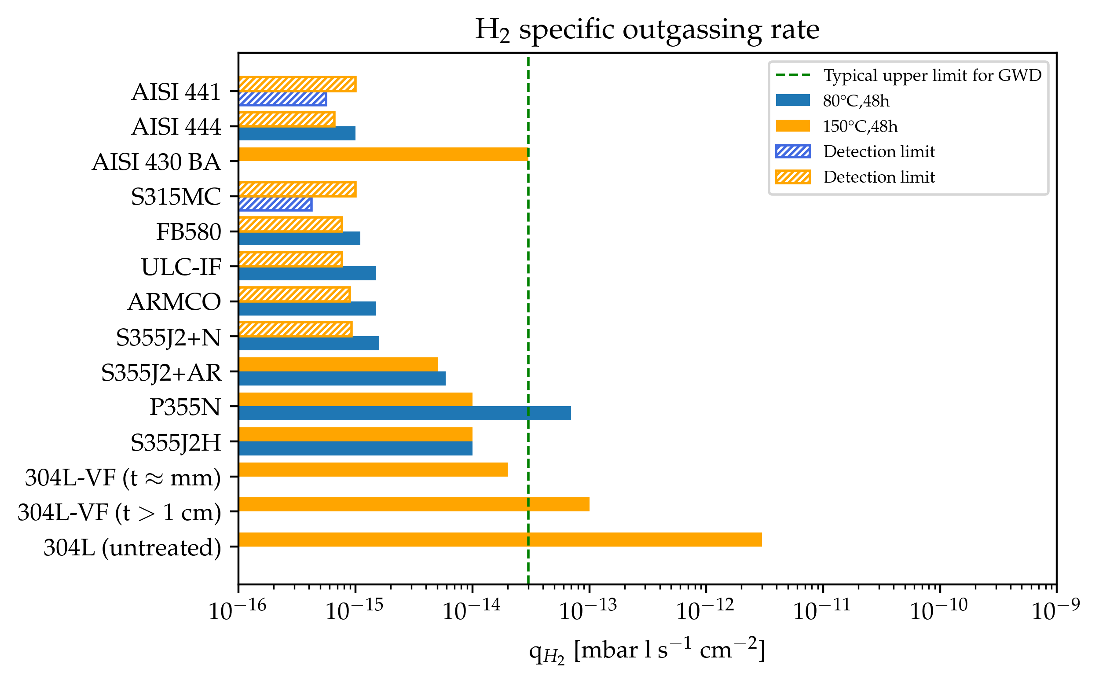
EN-MME contribution:
Select alternative materials with low H₂ content/outgassing rate
The native H₂ content of ferritic grades is comparable to that of vacuum-fired austenitic StSt​
Ferritic StSt
Vacuum properties
+
Availability and lower cost
+
Formability and weldability
+
Corrosion resistance
Mild steel
Austenitic StSt
Ferritic StSt AISI 441
Low C, iron-chromium alloy
With addition of Ti and Nb
Measurement error: ±40%; Detection limit: 50% of background
Courtesy of C. Scarcia

Slide 14
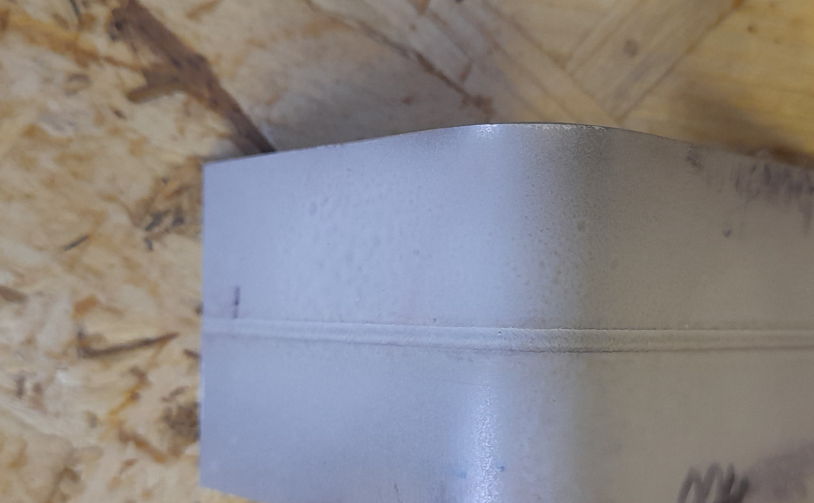
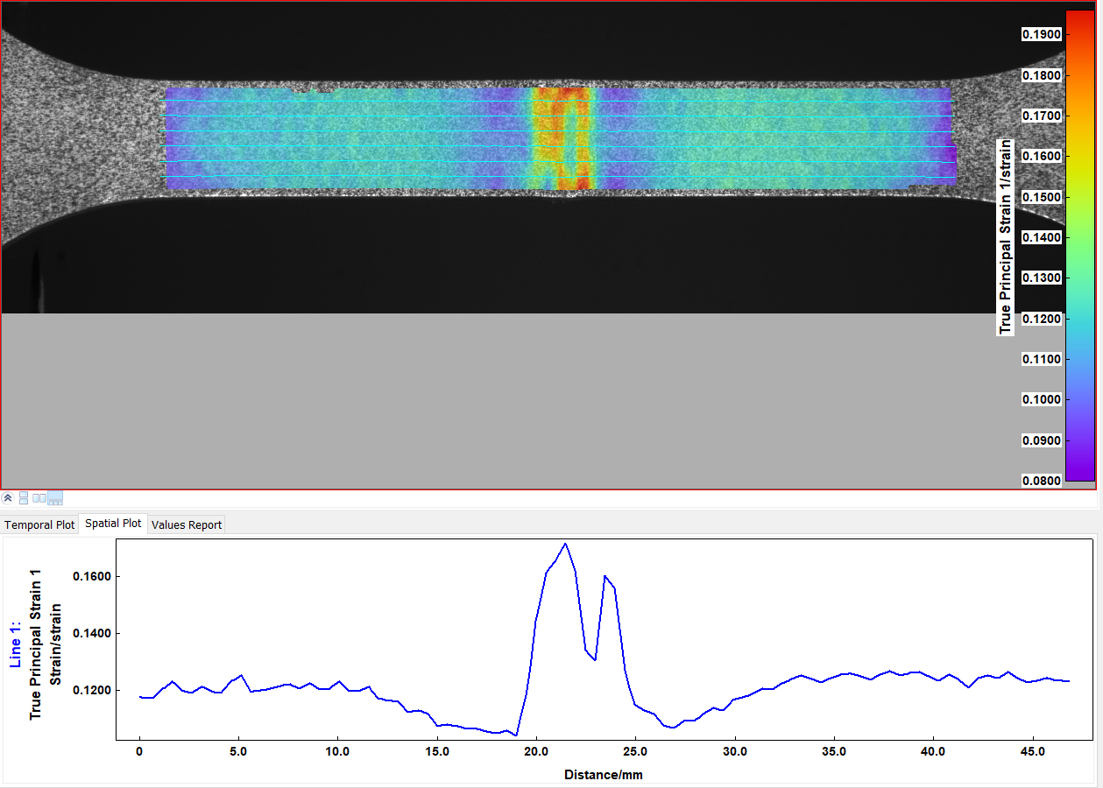
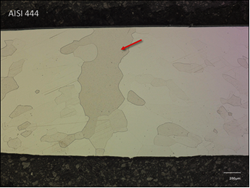
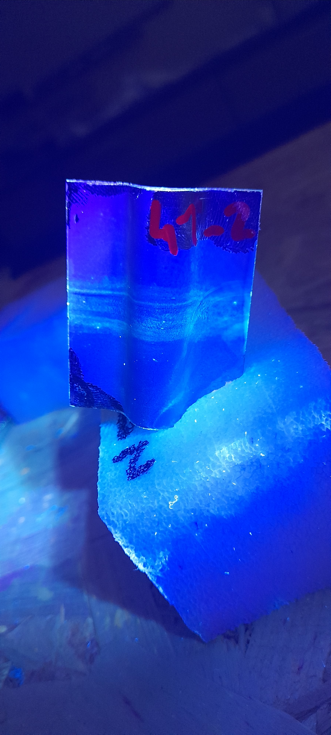
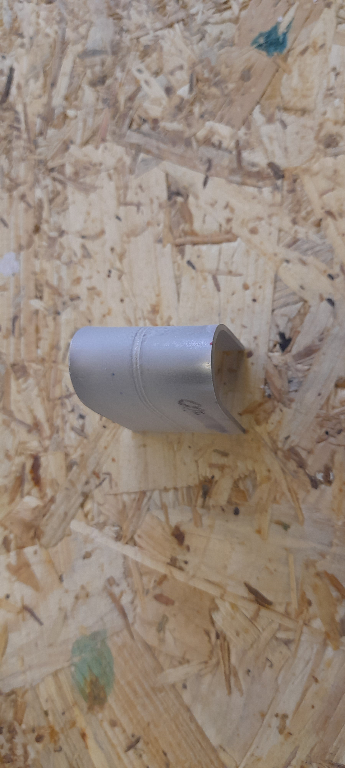
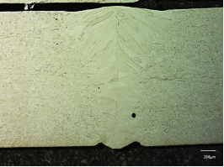
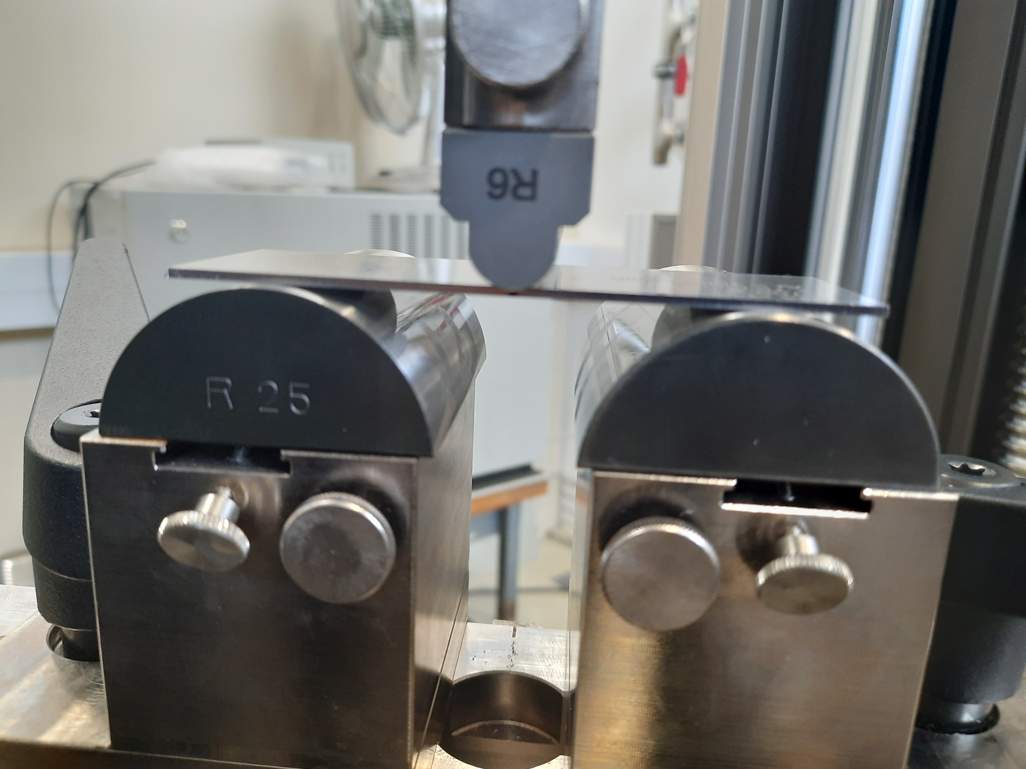
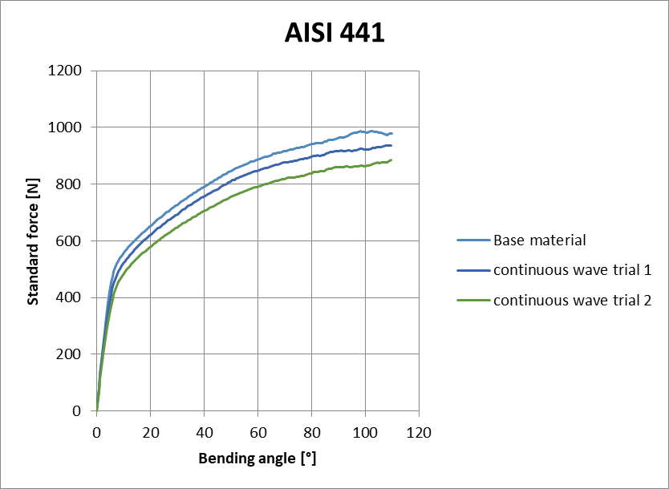
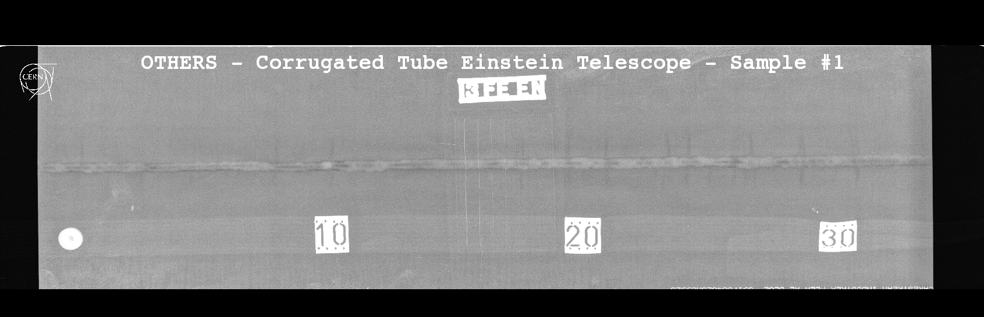
EN-MME contribution:
Welding testing and qualification for UHV applications
Non-destructive testing
Mechanical testing
Metallurgical analysis
110°
TIG welding
180°
Dye penetrant testing after flexural test
Tensile testing with DIC
Laser welding
Radiography testing
Flexural testing
Optical microscopy on weld’s cross sections

Slide 15
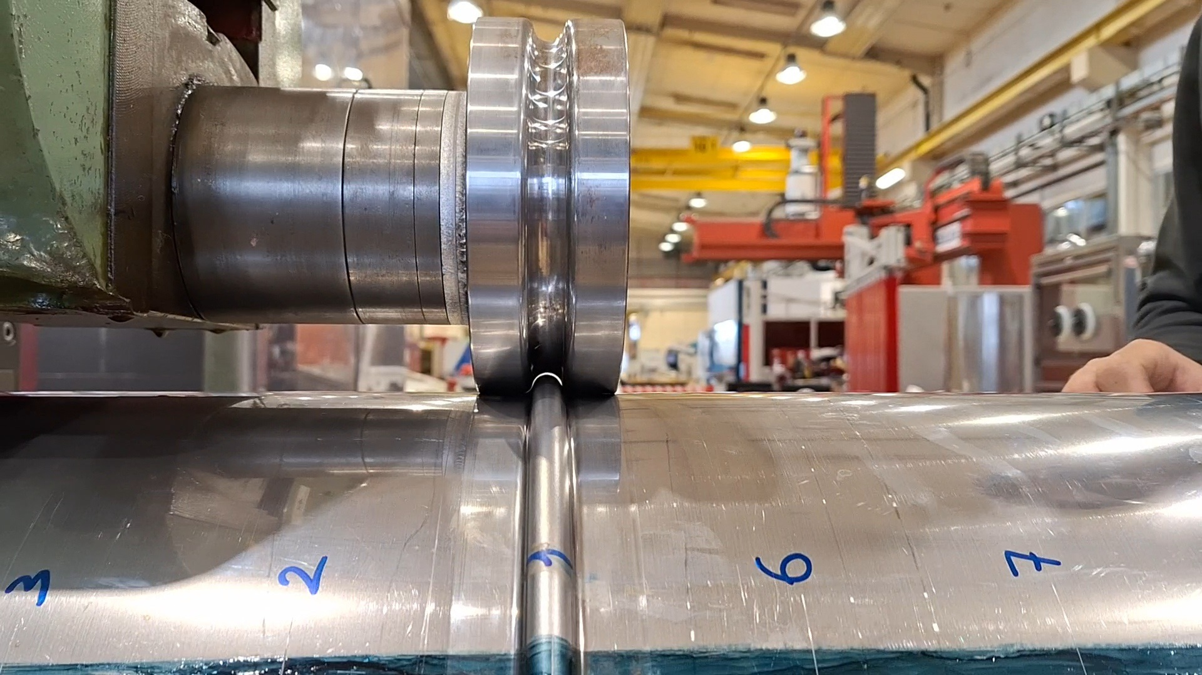
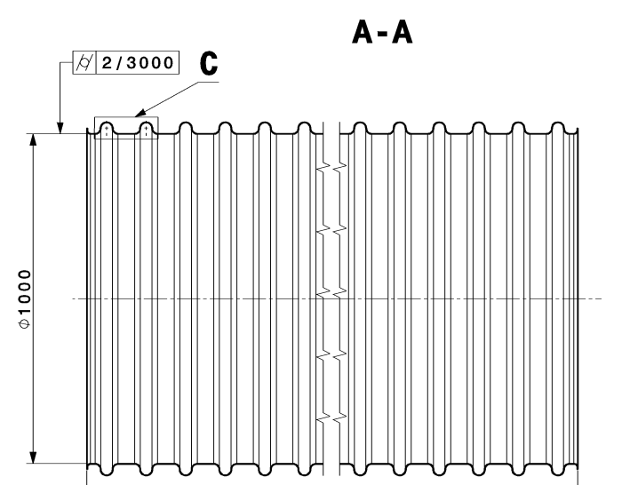
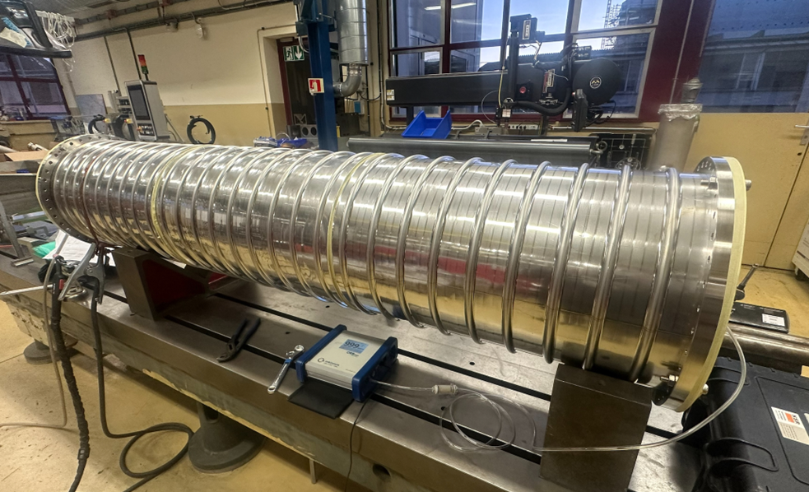
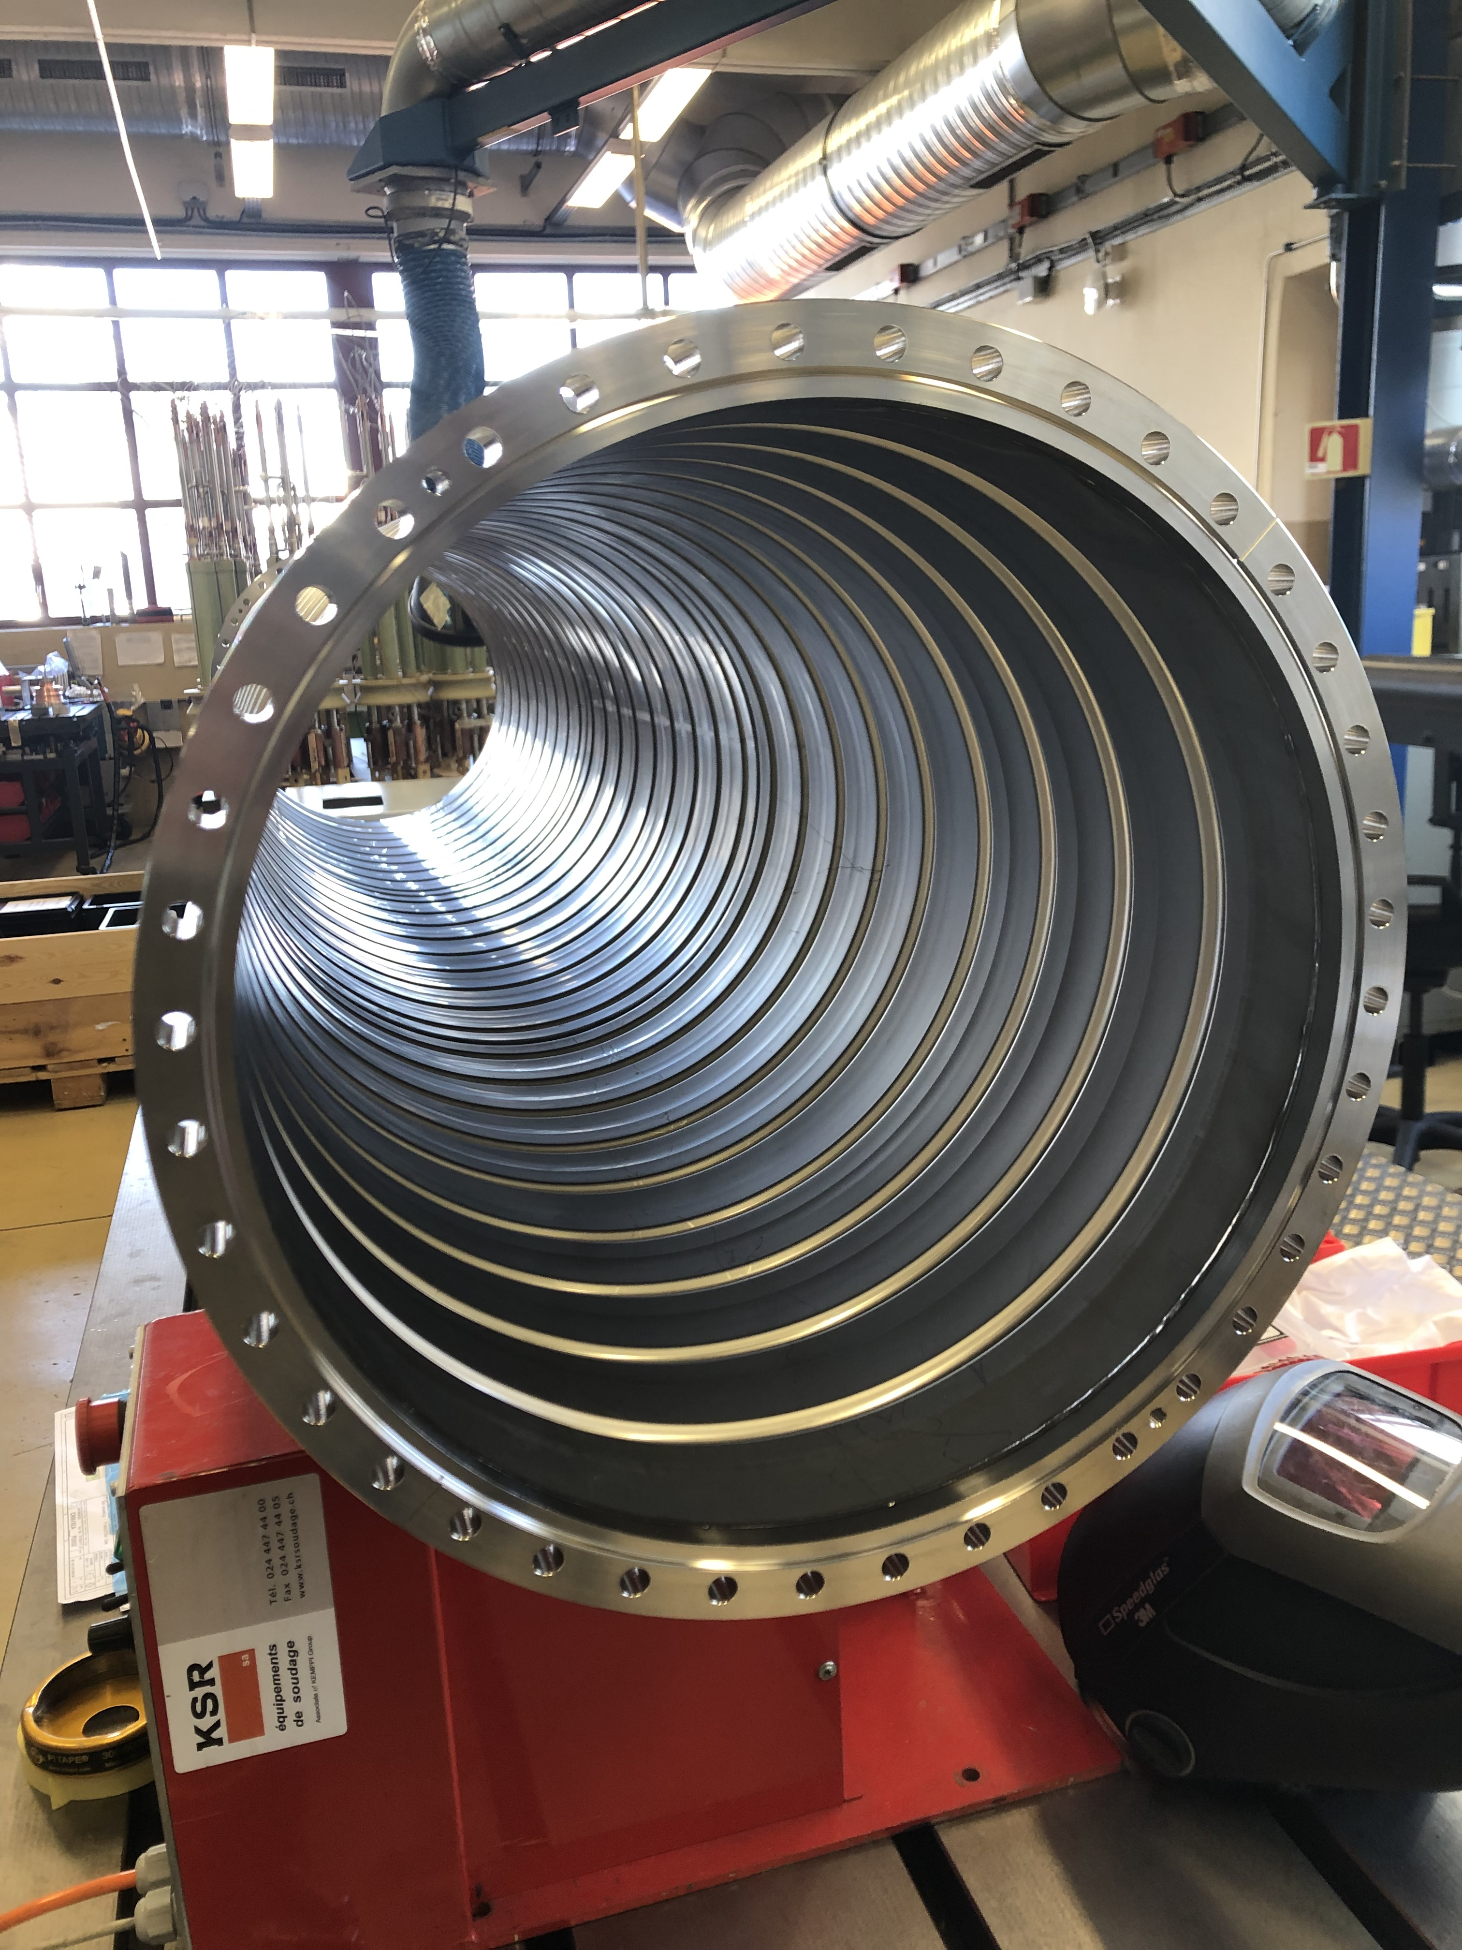
EN-MME contribution:
Annular corrugation performed at CERN
Define fabrication and welding procedures applicable to the pilot sector and ET beampipes
Two technical solutions:
Courtesy of C. Garion
Corrugated pipes
Thin walls (≤ 2 mm)
Longitudinal welding
Corrugation after welding
Prototypes
Smooth pipes
4 mm thick
Longitudinal welding
Reinforced by stiffeners
Pilot Sector

Slide 16
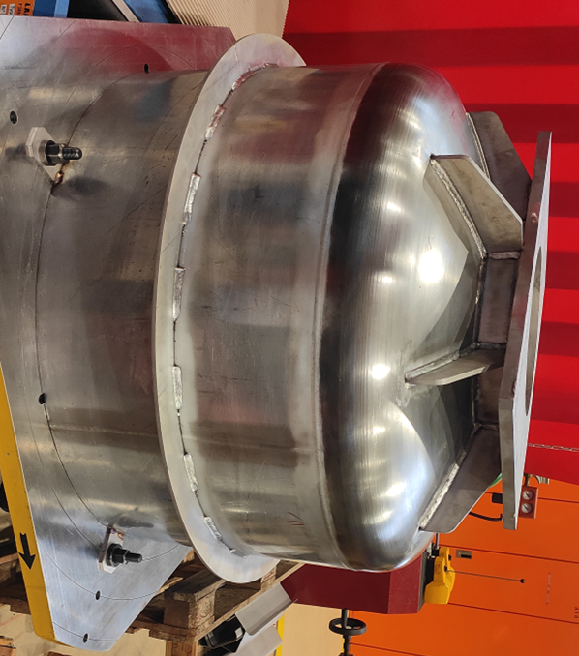
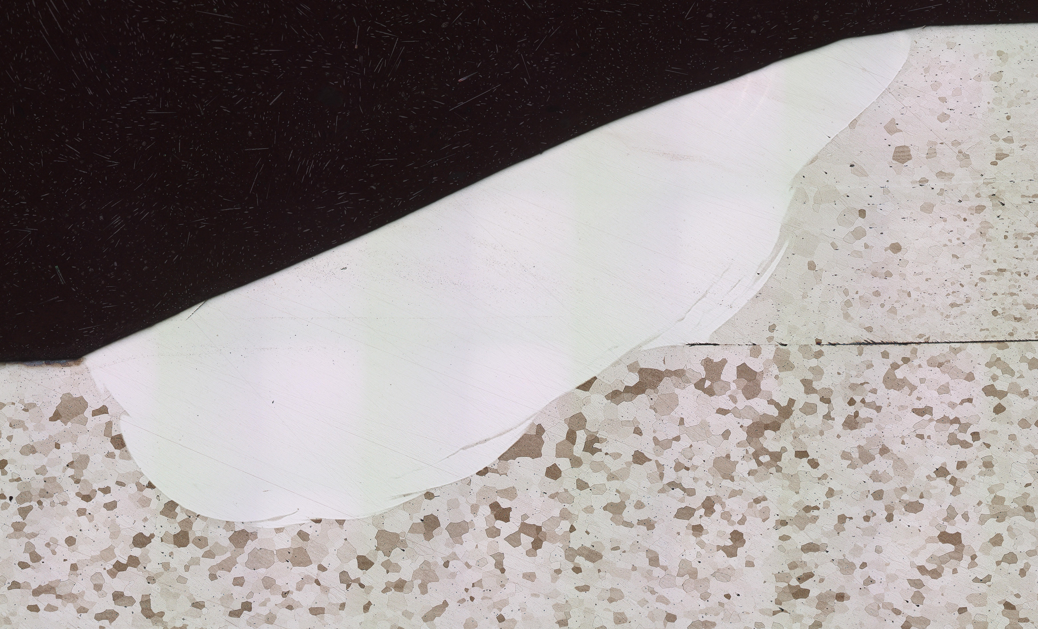
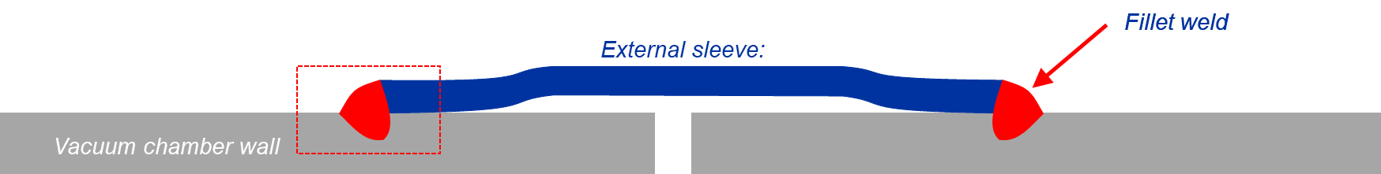
Propose and test innovative solutions for pipe’s connection (also applicable for ET)
EN-MME contribution:
Manufacture of prototypes, pilot sector components
Mock-up manufacturing
and assembly
End caps and pumping modules for pilot sector
Sleeves testing for pilot sector sections connection

Slide 17
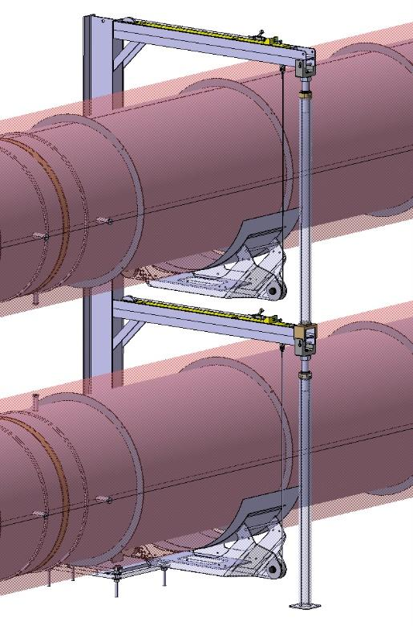
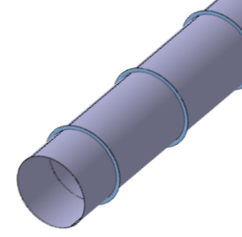
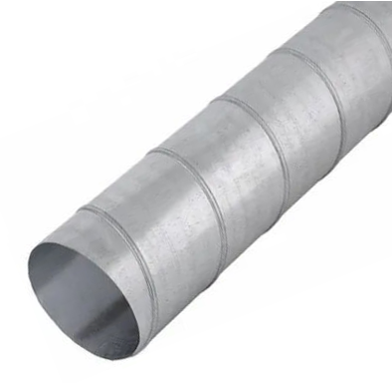
EN-MME contribution:
Sub-contracting the manufacturing of main support system, beampipes and complementary structures
Primary solution:
Innovative solution:
Smooth pipes
4 mm thick
Longitudinal welding
Reinforced by stiffeners
Pilot Sector
(externalized)
Corrugated pipes
Thin walls (≤ 2 mm)
Spiral welding + helicoidal corrugation simultaneously
Pilot Sector
(externalized)
Development needed!

Slide 18
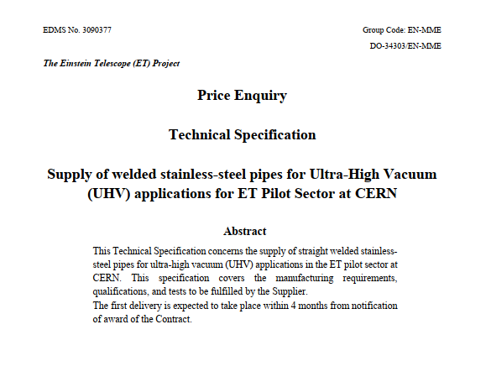
EN-MME contribution:
Sub-contracting the manufacturing of main support system, beampipes and complementary structures
Redaction of technical specifications for the price enquiries and market survey processes
Close follow-up of the production
Primary solution:
Innovative solution:
Smooth pipes
4 mm thick
Longitudinal welding
Reinforced by stiffeners
Pilot Sector
(externalized)
Corrugated pipes
Thin walls (≤ 2 mm)
Spiral welding + helicoidal corrugation simultaneously
Pilot Sector
(externalized)
Development needed!

Slide 19
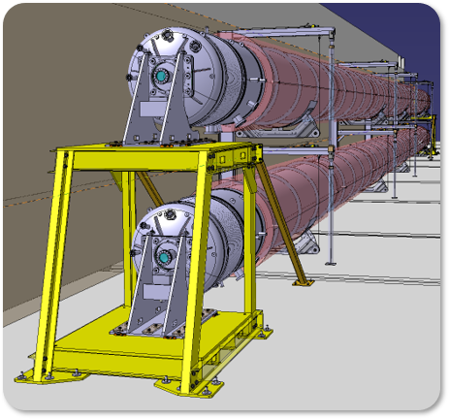
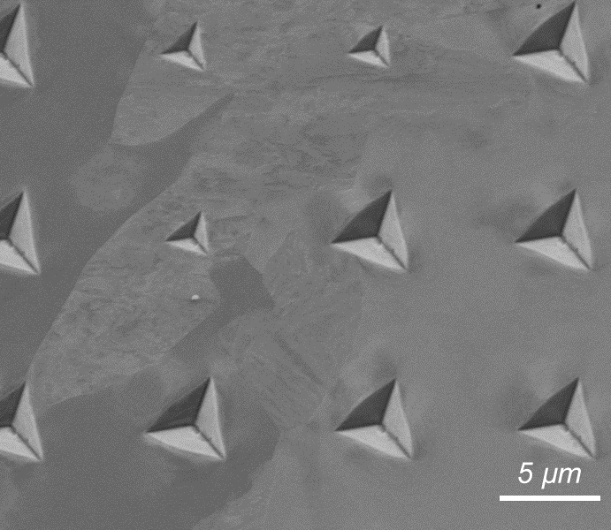




Summary and perspectives
Design, simulations and manufacturing drawings for supports and components
Selection and testing of alternative material (ferritic StSt AISI 441)
Manufacturing parts, welding procedures compatible with UHV
Sub-contracting pilot sector structural support and 1st beamline in ferritic StSt
Corrosion studies
Dust control studies
2nd beamline
2025:
Finalize the installation and testing of the pilot sector at CERN + TDR

Slide 20

Thanks for your attention!

Slide 21
References
[1] Video | Ripples in Spacetime Pond | LIGO Lab | Caltech
[2] What is an Interferometer? | LIGO Lab | Caltech
[3] ET collaboration, Einstein Telescope preliminary cost book, 2020
[4] ET Science Team, Einstein gravitational wave Telescope conceptual design study, 2011
[5] Ultra high vacuum beam pipe of the Einstein Telescope project: Challenges and perspectives. A. Grado et al. Journal of Vacuum Science & Technology (2023)
[6] Outgassing properties of vacuum materials for particle accelerators. P. Chiggiato
[7] Vacuum for Accelerators: Introduction to Materials and Properties. S. Sgobba
[8] Study of selected mild steels for application in vacuum systems of future gravitational wave detectors. C. Scarcia et al. Journal of Vacuum Science & Technology (2024)

Slide 22

EN-MME contribution:
Select alternative materials with low H₂ content/outgassing rate
Austenitic StSt, specifically AISI 304L, are a standard material for UHV applications in scientific equipment. To reduce H₂ outgassing at RT to acceptable levels high-temperature treatments (firing) are needed [6, 7]
The methods applied to reduce the H₂ outgassing in current GWD include ex-situ heating at high temperatures in a vacuum or air furnace (vacuum or air firing) and in-situ bakeout at medium temperatures [5]
(used in Virgo [5], LIGO and ET baseline)
Air bake-out 410°C
on finished tubes (15 m long)
5 days cycle in electrical furnace
Production Bottleneck!

Slide 23
EN-MME contribution:
Select alternative materials with low H₂ content/outgassing rate
Austenitic StSt, specifically AISI 304L, are a standard material for UHV applications in scientific equipment. To reduce H₂ outgassing at RT to acceptable levels high-temperature treatments (firing) are needed [6, 7]
The methods applied to reduce the H₂ outgassing in current GWD include ex-situ heating at high temperatures in a vacuum or air furnace (vacuum or air firing) and in-situ bakeout at medium temperatures [5]
Ferritic - bcc - structures present lower residual H₂ and higher diffusivity compared to the close-packed fcc resulting in a faster degassing at lower temperatures (≤ 150°C) [8]

Slide 24


Broader CERN involvement
Beampipes for Gravitational Wave Telescopes Workshop (CERN, March 2023)
Vacuum system: MoU in 2022 between CERN, INFN, Nikhef and IFAE → Dedicated activity ongoing and sharing the knowledge with Cosmic Explorer
Civil engineering: MoU in 2023. CERN will provide consultancy and technical support towards the creation of the TDR for the civil engineering and technical infrastructure for 2026
ET Civil Engineering Workshop
(CERN, April 2024)

Slide 25

Broader CERN involvement
Vacuum system: MoU in 2022 between CERN, INFN, Nikhef and IFAE → Dedicated activity ongoing and sharing the knowledge with Cosmic Explorer
Civil engineering: MoU in 2023. CERN will provide consultancy and technical support towards the creation of the TDR for the civil engineering and technical infrastructure for 2026
Document management: Project management required specific tools (i. e. EDMS) and CERN is providing support for a pilot study
Engineering support: Discussions are ongoing for a dedicated support for the design of the technical infrastructure
Other subjects related to occupational health and safety, integration, planning, support for costing, cryogenic infrastructure, survey…
Dimensions comparison

Slide 26


What’s the Einstein Telescope?
Next generation of GW detectors
≥ 10 km each arm
Triangular (or L-Shaped) Underground
L – 40km and 20 km
L-shaped surface observatory
Current detectors observe about one signal per week.
Next generation →100.000 to 1.000.000 binary black holes mergers per year! And many other new sources!

Slide 27

Let’s push the Universe exploration!
Current observatories
Einstein Telescope
Courtesy of P. Werneke

Slide 29





From current detectors to …
Virgo, Cascina, Italy
LIGO, Livingston, LA
LIGO, Hanford, WA

Slide 30

Virgo Pipes
Courtesy: A. Pasqualetti

