Slide 1
Modelling Activities in TE-MPE-PE:
FE Models, Transients in SC Magnets, and Quench Protection
Julien Dular, on behalf of the TE-MPE-PE section members
CERN, Switzerland
6th December 2024

Slide 2
Contents
Context and STEAM framework
New methods and models
Tools and selected results
Summary and perspectives

Slide 3
Contents
Context and STEAM framework
New methods and models
Tools and selected results
Summary and perspectives

Slide 4
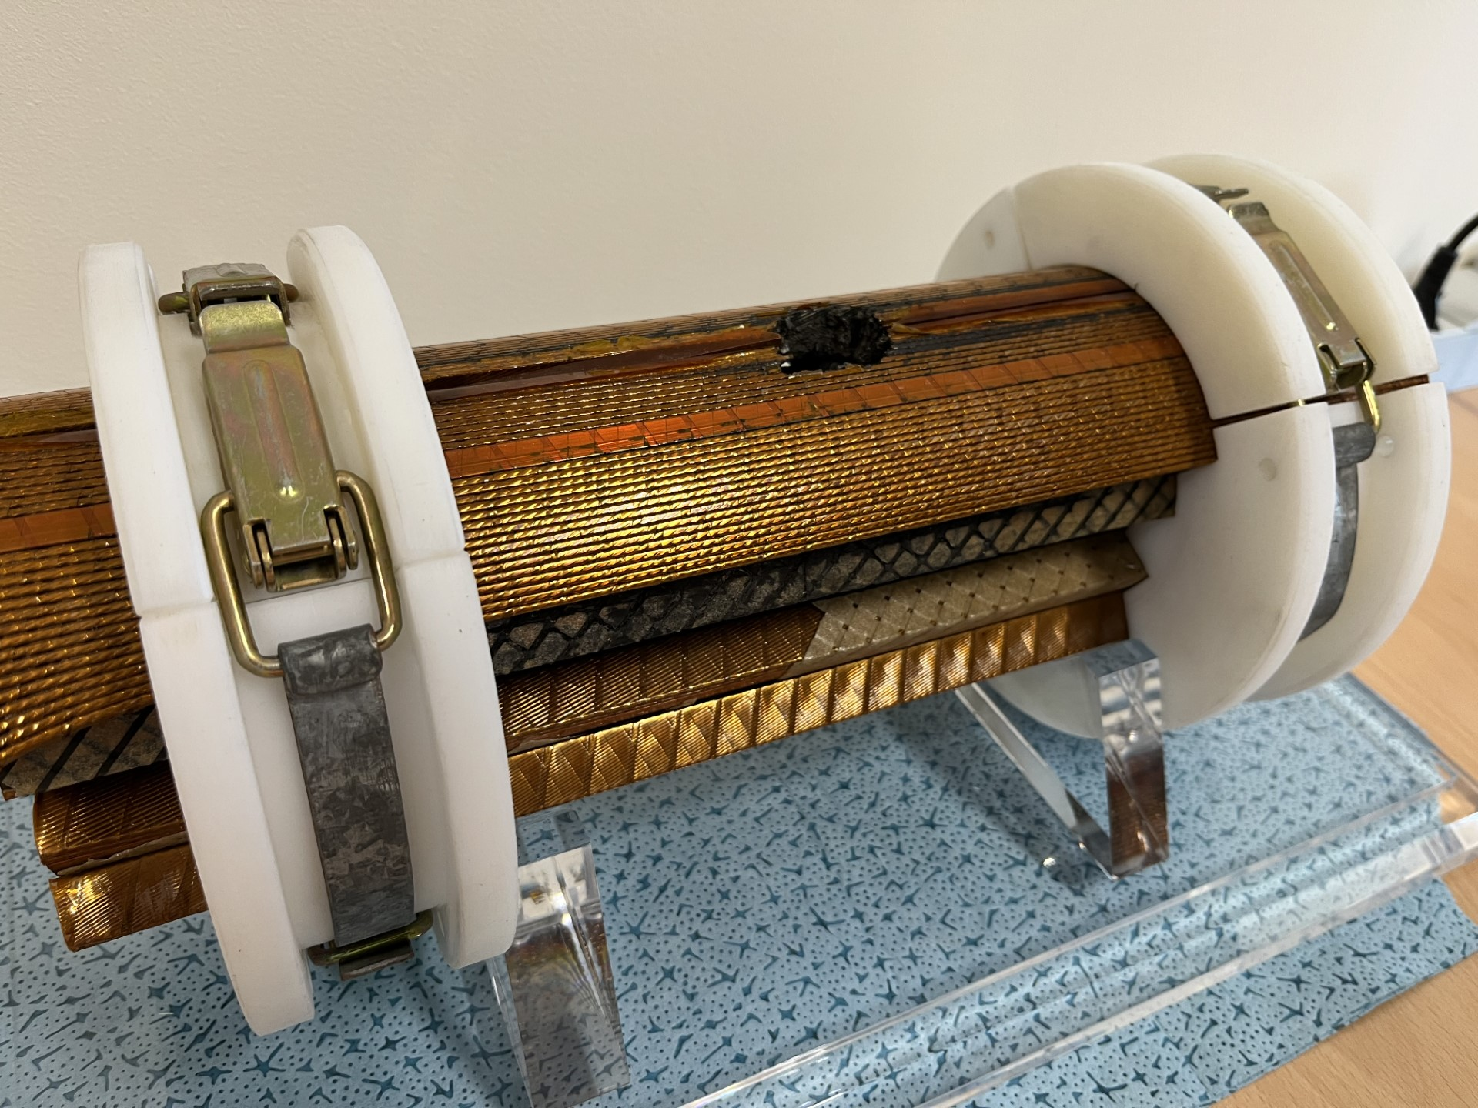
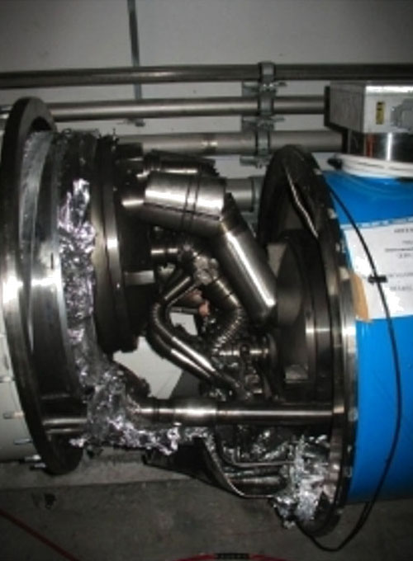
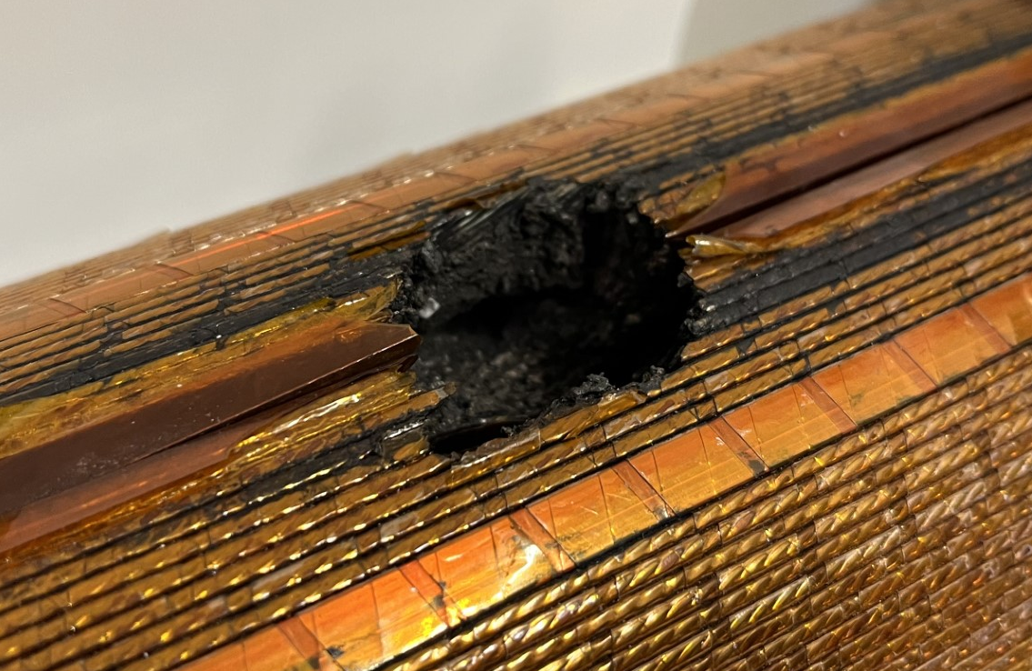
Quench of Superconducting Magnets
Quench: Loss of superconductivity leading to a thermal runaway.
  Violent process: high voltage, temperature, thermal and mechanical stress.
  Dissipation of stored magnetic energy in the coolant (rapid boil-off).
Complex phenomenon:
  Multi-physics, -rate, and -scale problem.
  Highly nonlinear process.
  Local phenomenon → need for 3D models or clever 2D reduced order models.
Accurate and robust modelling tools are essential for magnet protection.
  Stored energy in each main dipole circuit of the LHC:
  ~ 1 GJ = 250 kg of TNT.
Quench in coil due to interturn short
Ph. Lebrun, et al., “Report of the task force on the incident of 19th September 2008 at the LHC” . Technical report, CERN (2009), https://cds.cern.ch/record/1168025.

Slide 5
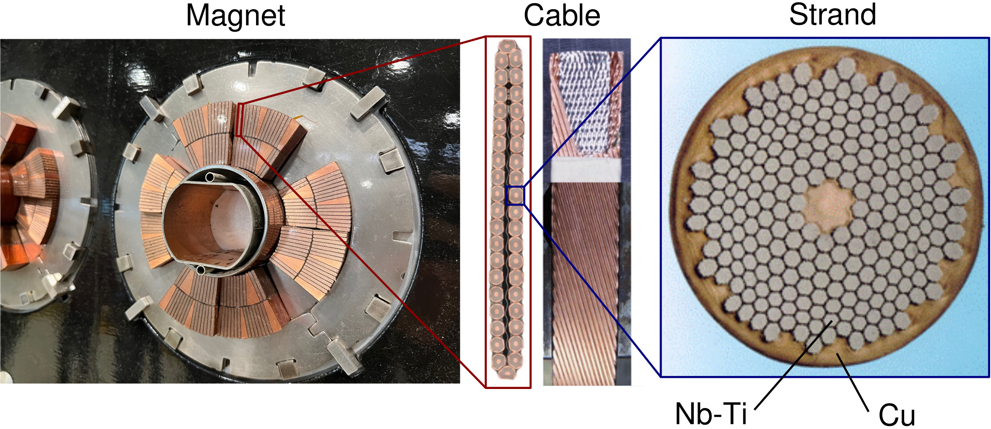
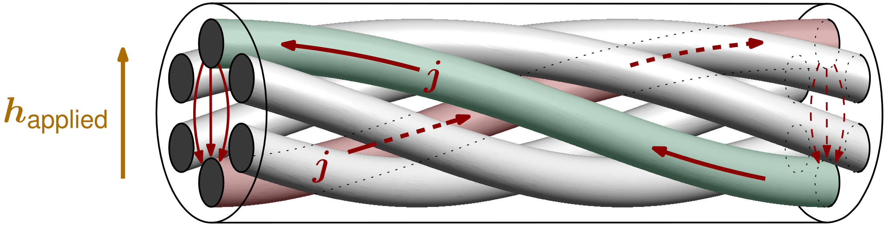
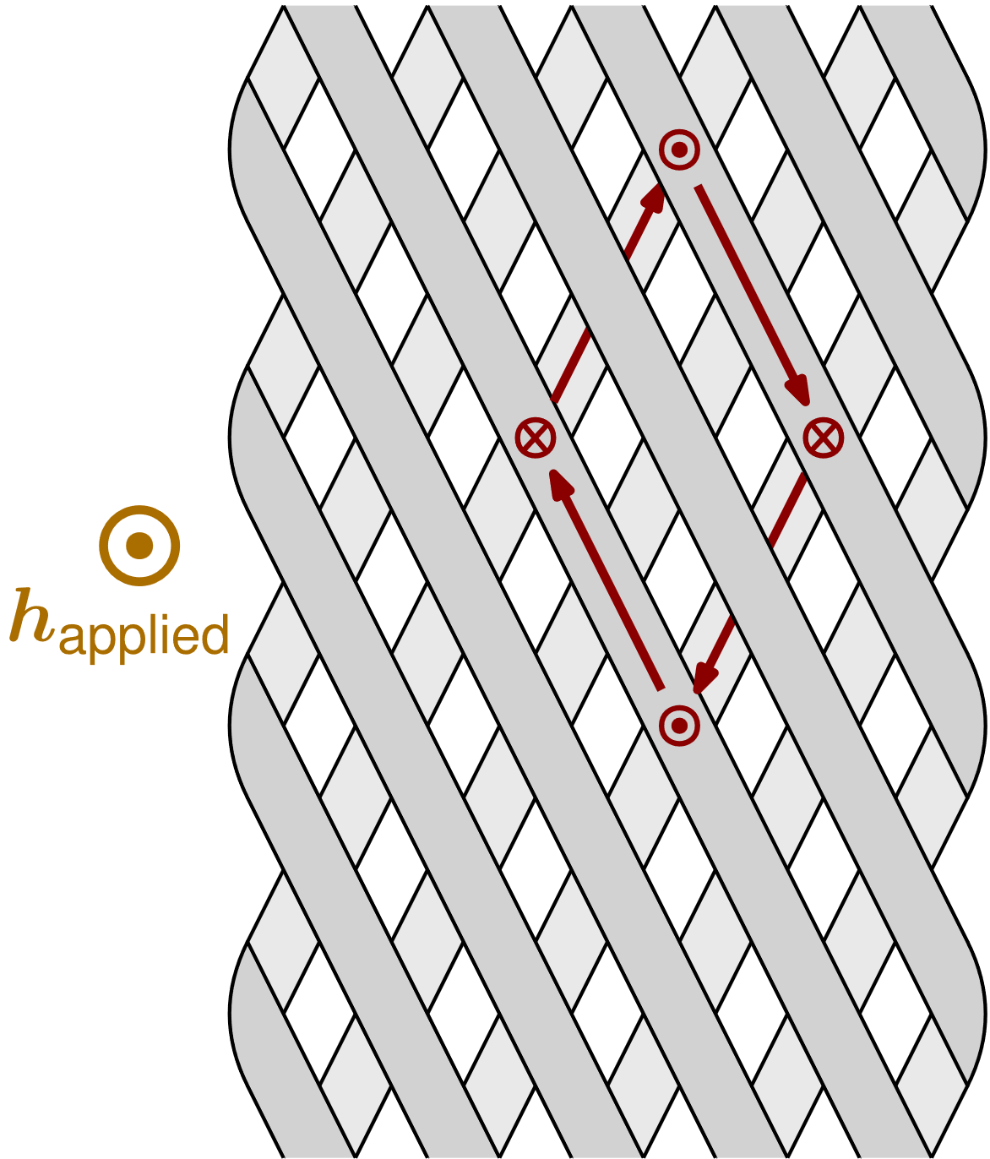
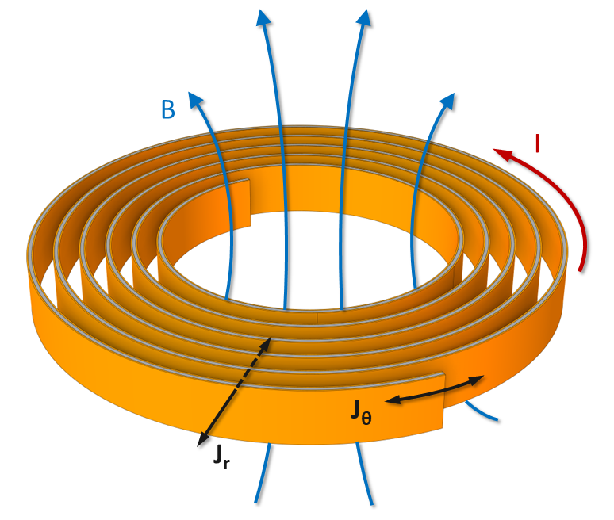
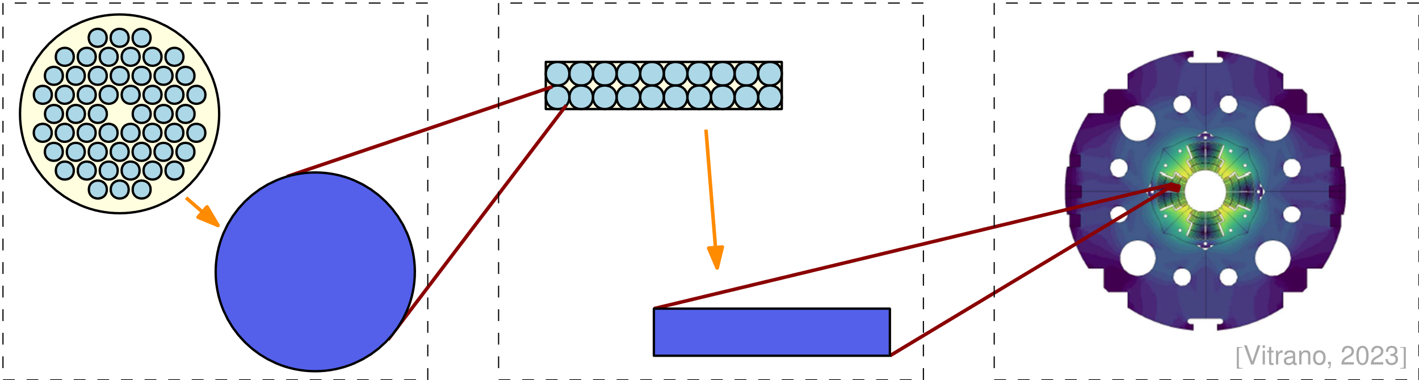
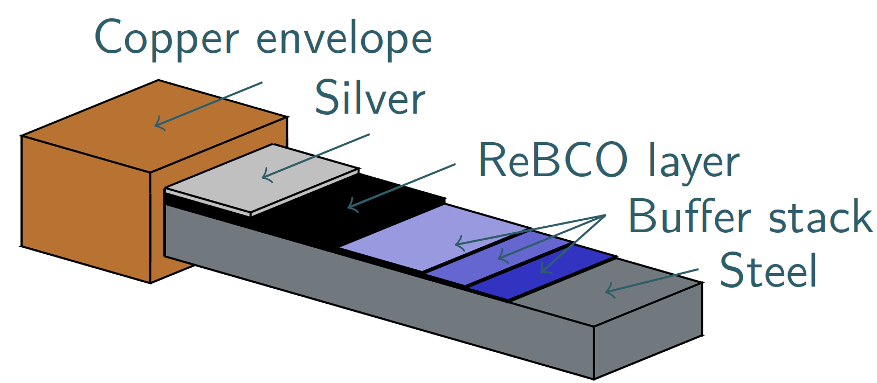
Modelling Challenges
Magnets are multi-scale structures.
The macroscopic response depends on currents at small scales, which must be resolved accurately:
  Interfilament coupling in LTS strands.
  Interstrand coupling in LTS cables.
  Current sharing in multilayer HTS tapes.
  Intertape coupling in HTS coils.
Detailed magnet models are too computationally expensive.
Need for efficient and reliable techniques:
  Homogenization, reduced order modelling, parallelization, thin-shell approximations…
Interfilament coupling currents
Intertape coupling currents [G. Vernassa]
Multilayer HTS tapes [E. Schnaubelt]
Interstrand coupling currents

Slide 6
Simulation of Transient Effects in Accelerator superconducting Magnet circuits - STEAM
TRANSIENTS
Energy extraction and quench-back
Quench heater induced quench
Fast current discharges (CLIQ)
Electro-Magneto-Thermal(-Mechanical)
Sensitivity studies
Fault analysis
Short circuit
Electrical arc
Frequency transfer measurement
CIRCUIT TYPES
Stand-alone magnets
Nested circuits
Series-connected magnets
… for LHC, HiLumi, and future projects
CONDUCTOR TYPES
Nb-Ti
Nb₃Sn
Bi-2212
YBCO
MAGNET TYPES
Cos-theta, Block-coil, Common coil
Canted Cos-Theta (CCT), Curved CCT
Solenoid, Pancake coils (Insulated, No-, Metallic-)
LEVEL OF DETAIL
Circuit → Magnet → Cable → Wire → Filament
No single tool can do it all. Therefore, we have many tools connected by the framework.
Courtesy of Mariusz Wozniak, Emmanuele Ravaioli

Slide 7
Contents
Context and STEAM framework
New methods and models
  LTS magnets
  HTS magnets
Tools and selected results
Summary and perspectives

Slide 8

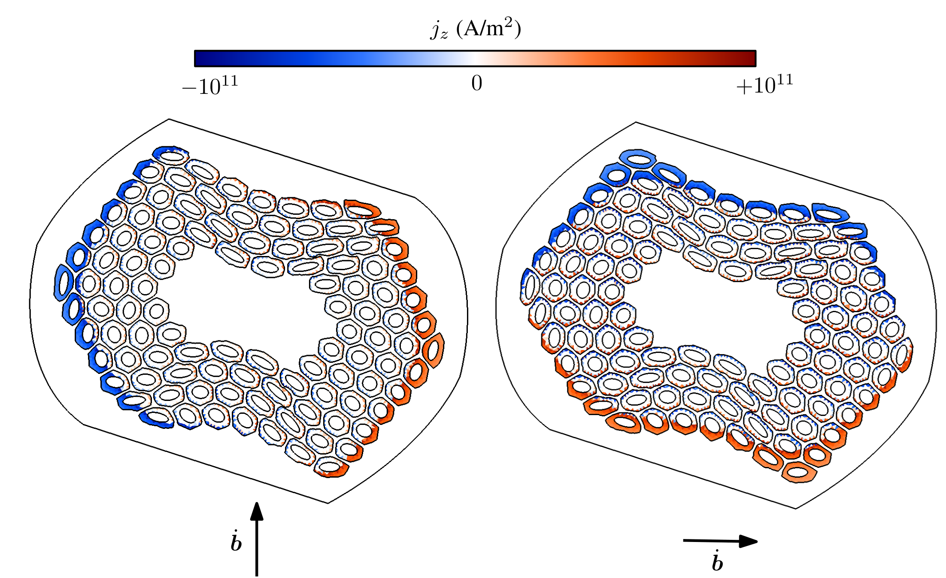
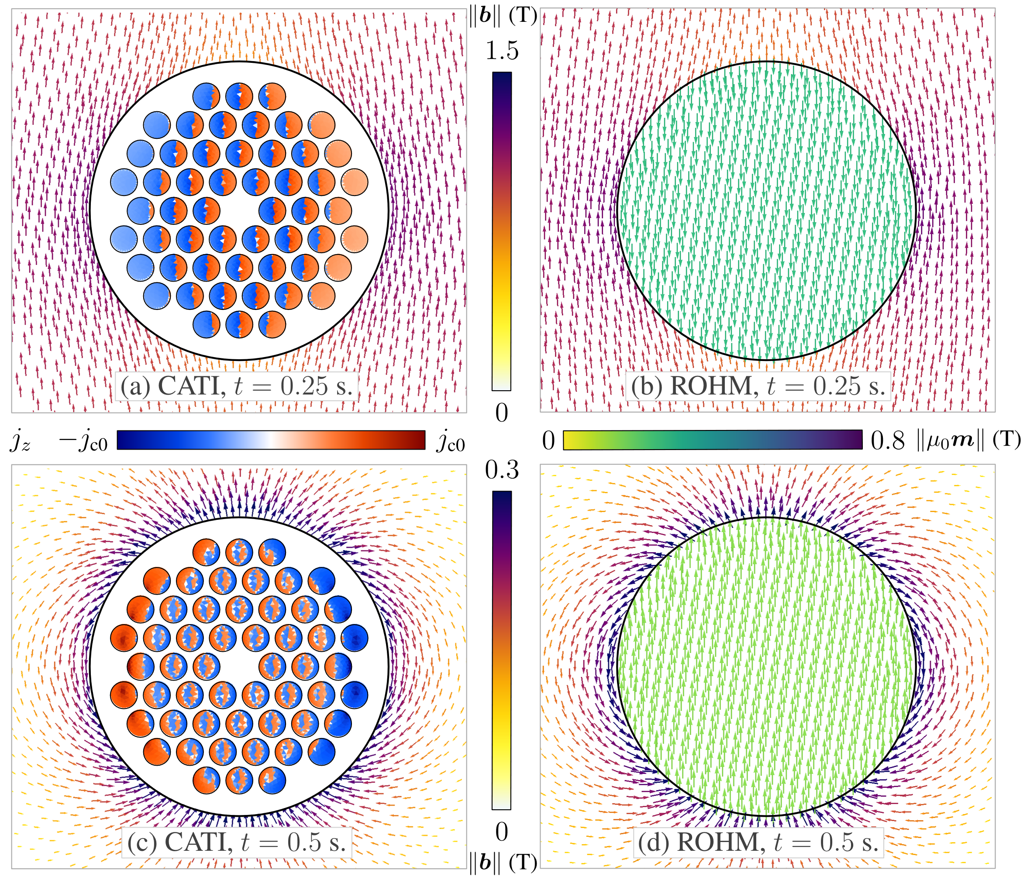
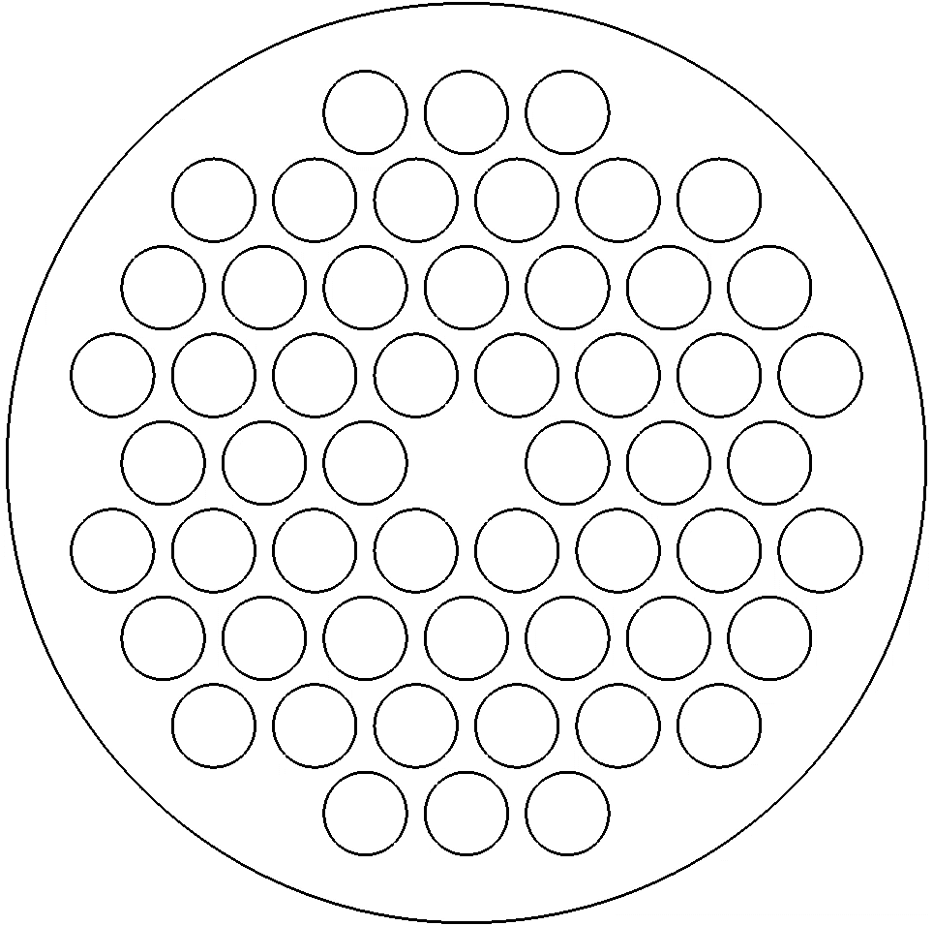
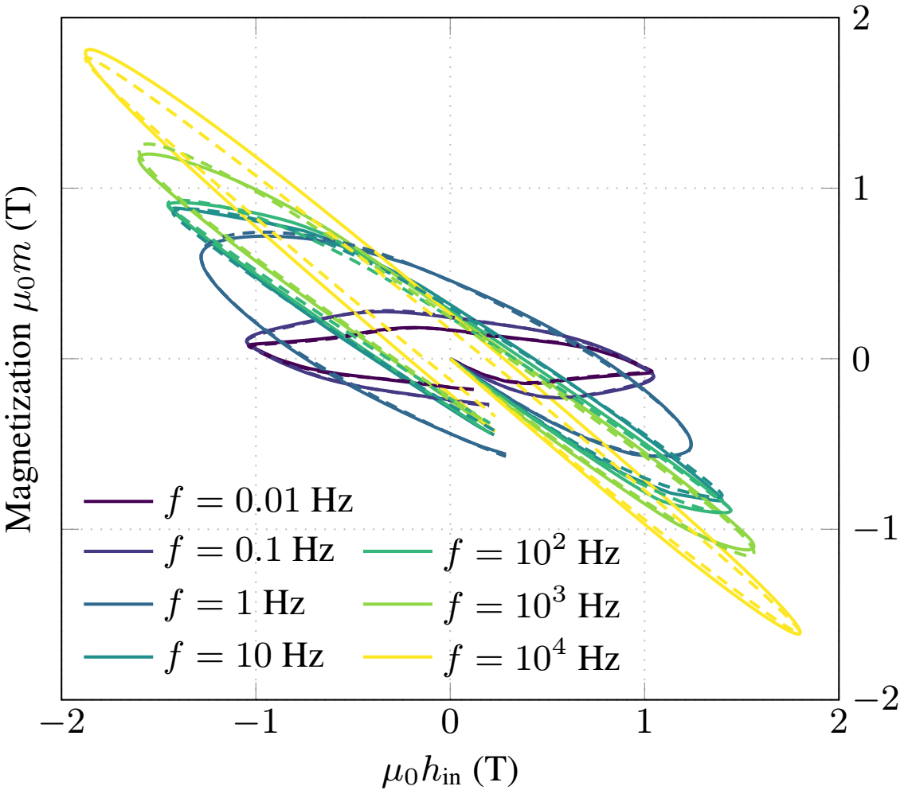
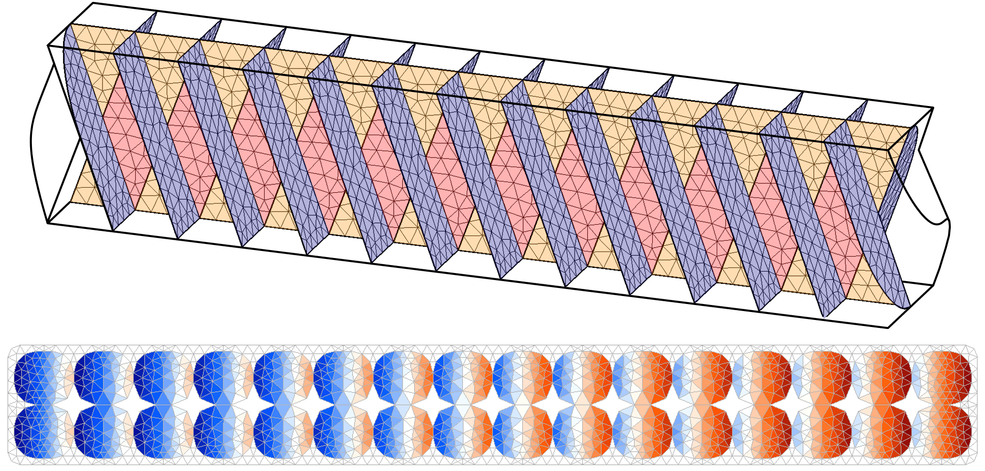
LTS Conductors – 2D FE Models
Phase 1 – Detailed 2D-based models:
  Transients in superconducting strands and Rutherford cables.
  Coupled Axial and Transverse currents (CATI) method, 2D Finite Element (FE)
Phase 2 – Homogenized model:
  Reduced Order Hysteretic Magnetization (ROHM) model:
    Describes AC loss and magnetization.
    Includes rate-dependent effects.
J. Dular et al. 2024 https://arxiv.org/abs/2409.13653
Geometry from TE-MSC
Multifilamentary strand
J. Dular et al. 2024 DOI: 10.1088/1361-6668/ad650d
Rutherford cable model
Next steps:
Transport current effect, HTS Conductors.
J. Dular et al. 2024 https://arxiv.org/abs/2411.13347
Courtesy of Fredrik Magnus, Alexander Glock and Mariusz Wozniak

Slide 9
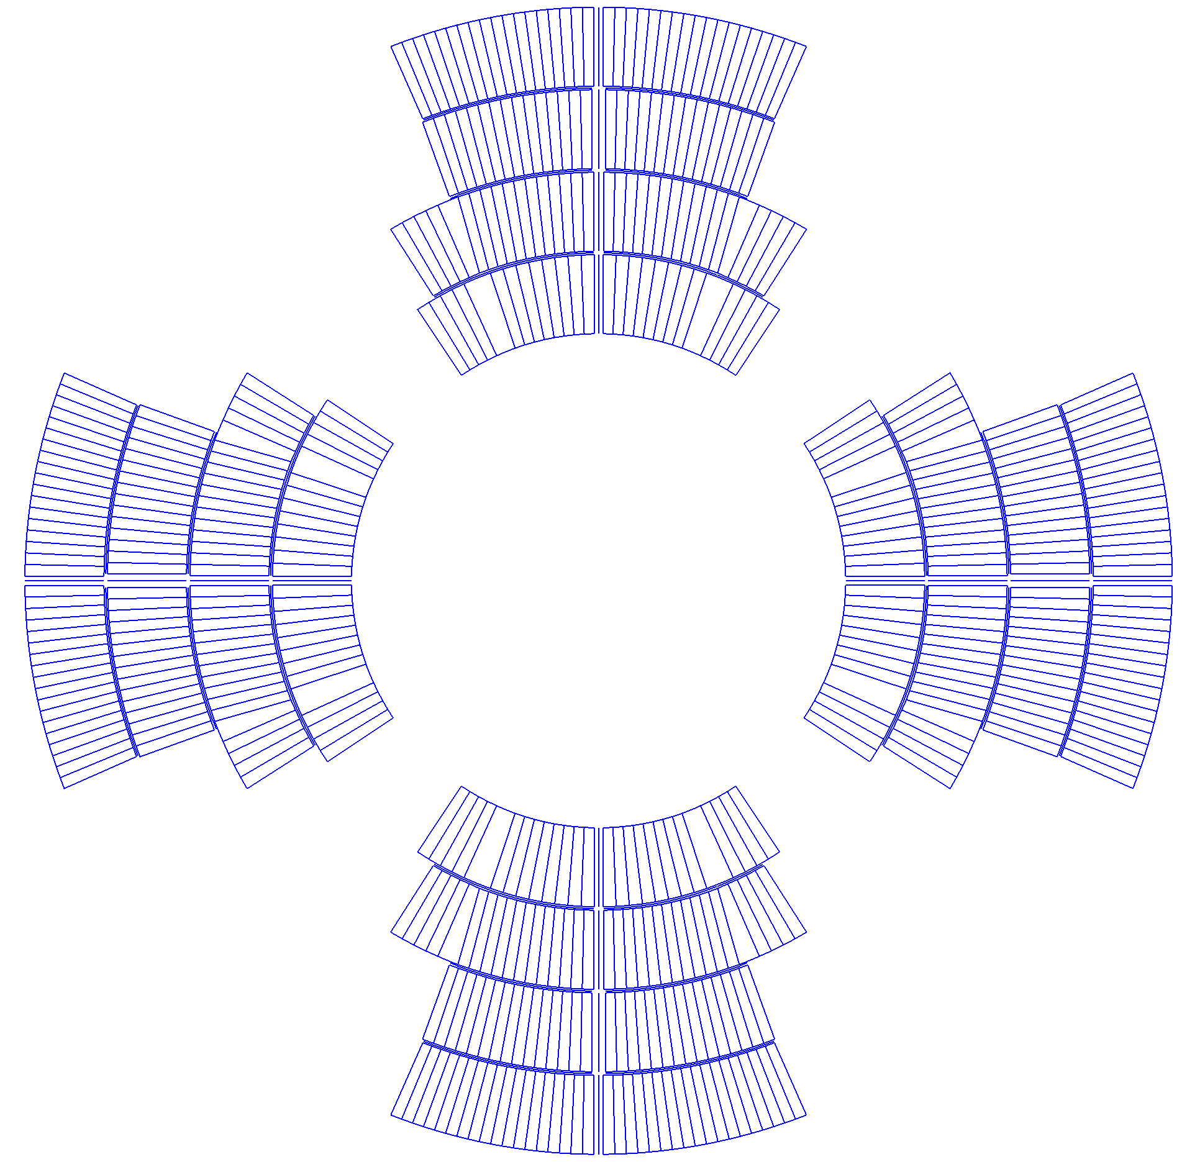
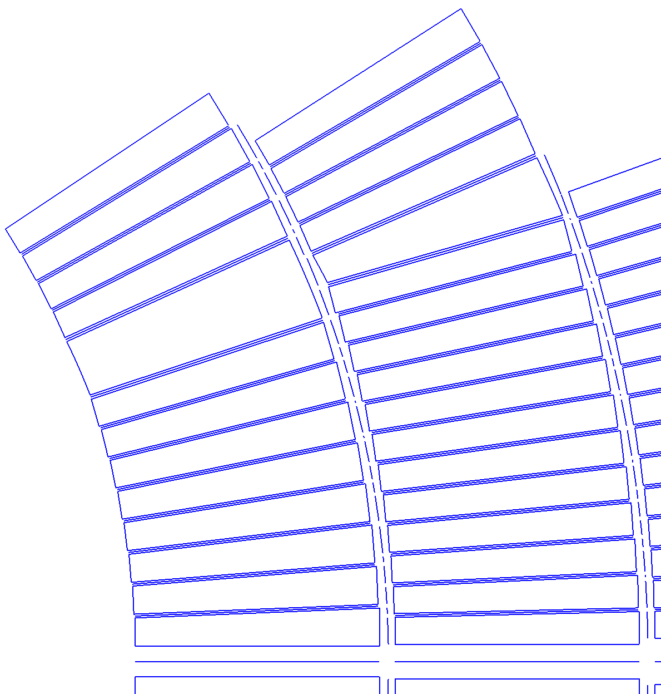
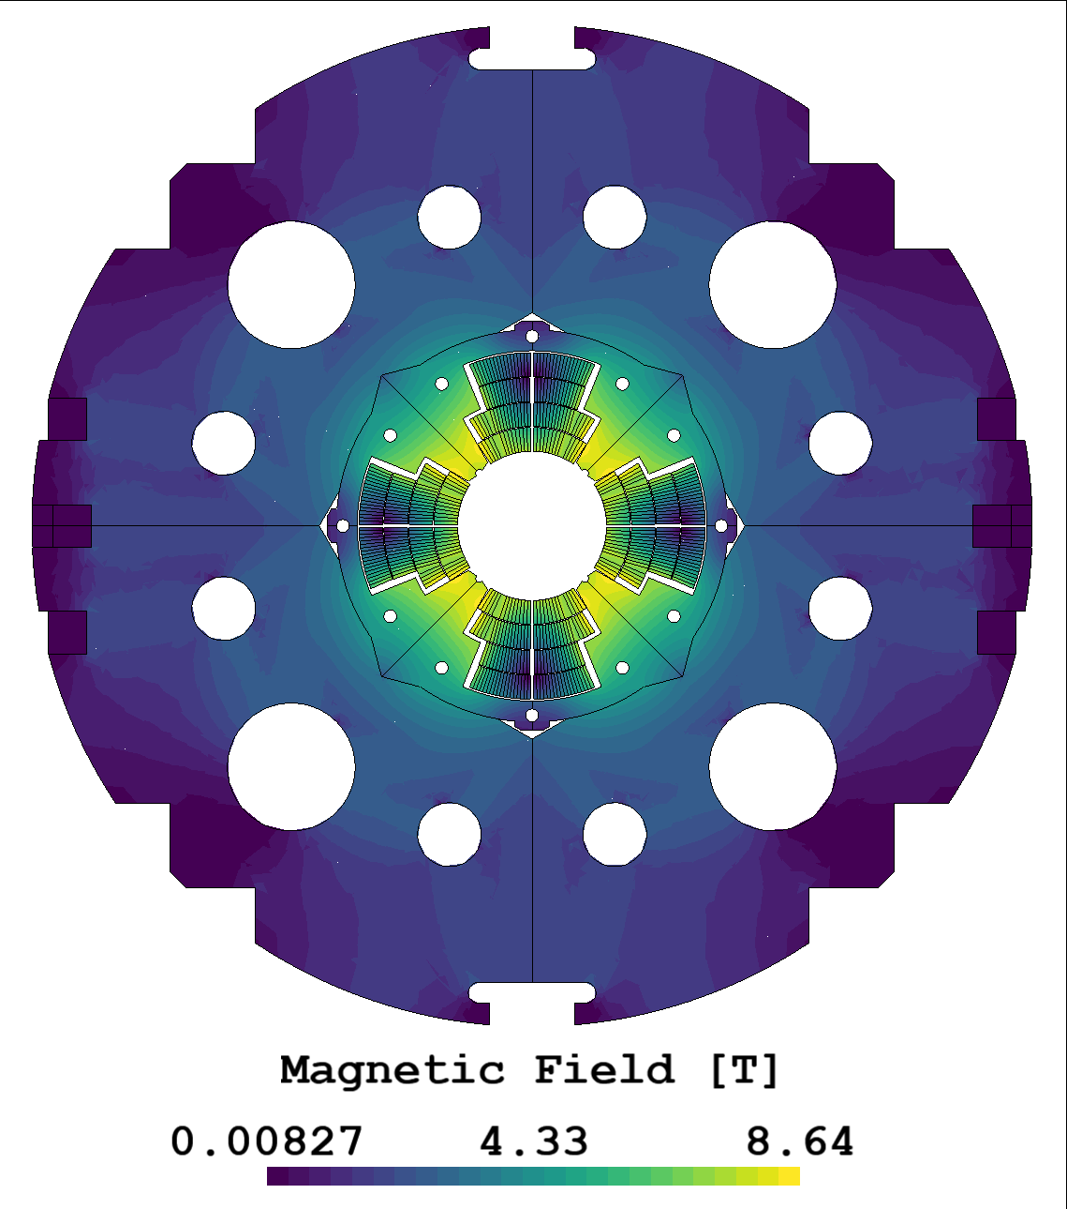
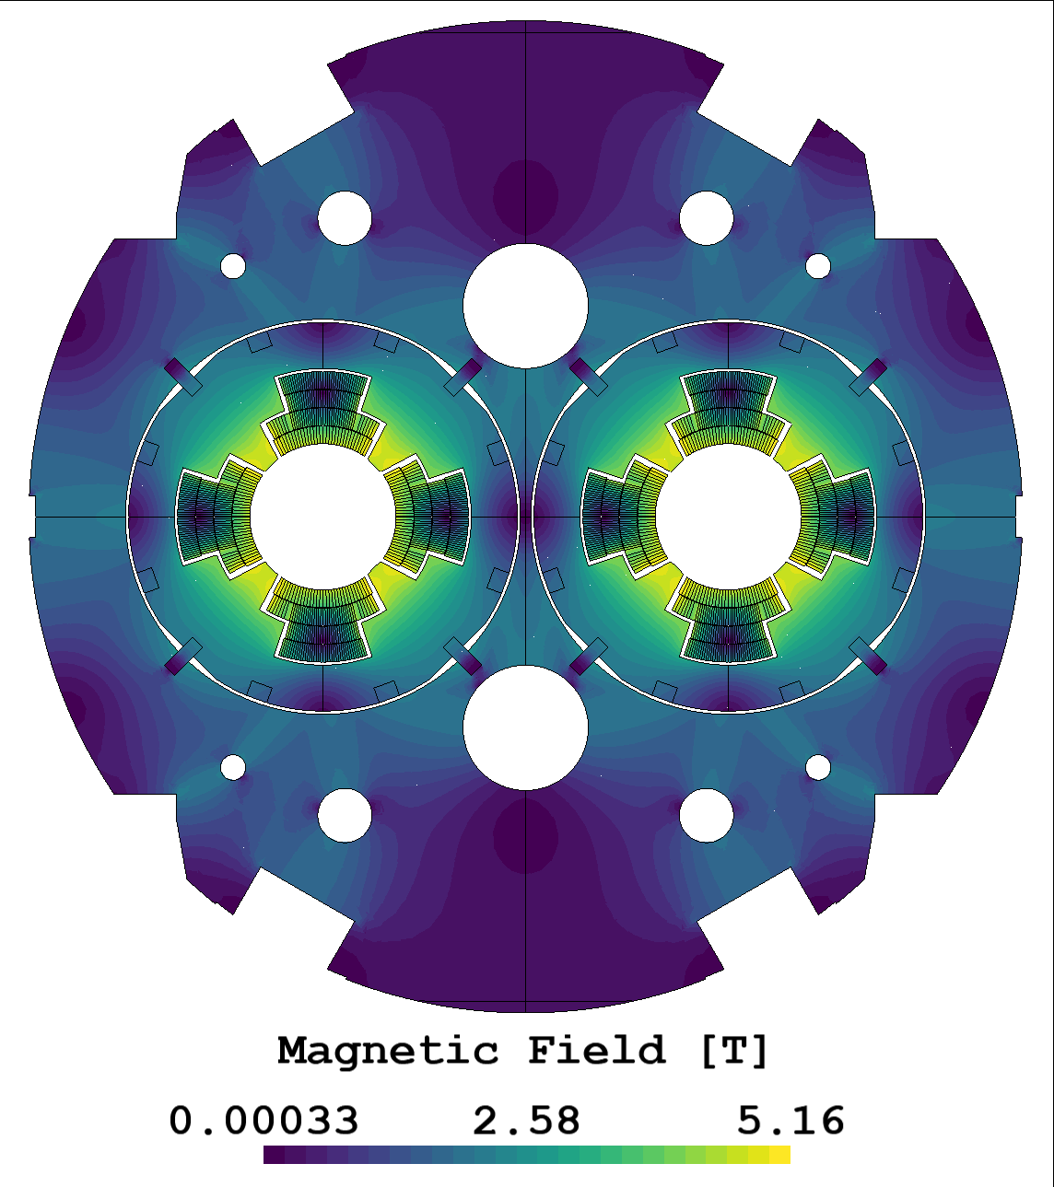
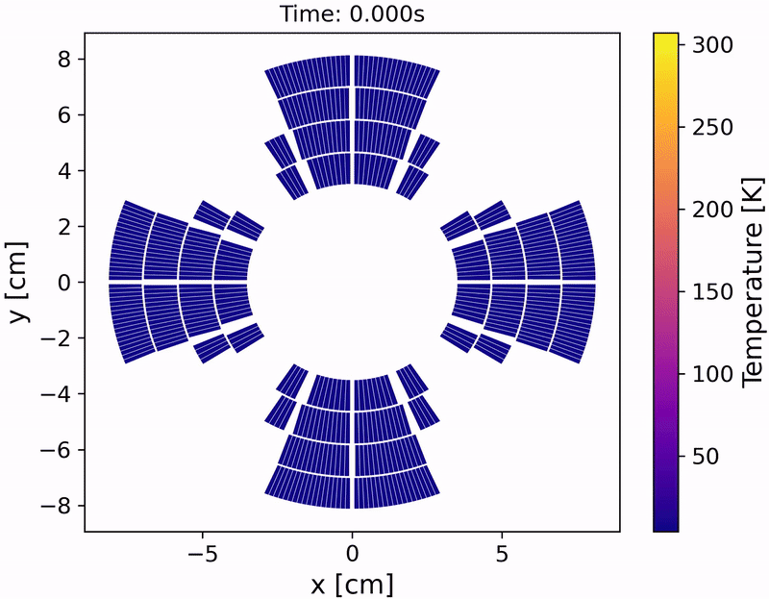
LTS Magnet – 2D FE Model
Coupled 2D FE magnetostatic and transient thermal models of LTS multipole magnets:
Automated computation of geometry, mesh, and solution from ROXIE and text-based versioned files.
Thin shell approximations (TSA) to model thermal gradients across insulation layers:
Enables correct modelling of Quench Heaters (computationally prohibitive for classical FE).
E. Schnaubelt et al., SUST 2023, DOI 10.1088/1361-6668/acbeea
MQXA
TSA
Next steps:
Incorporate ROHM method for accurate AC loss modelling.
Implement active quench detection and protection circuits for QH, EE, CLIQ, and ESC.
Validate this model against experimental data.
Courtesy of Erik Schnaubelt, Andrea Vitrano and Mariusz Wozniak

Slide 10
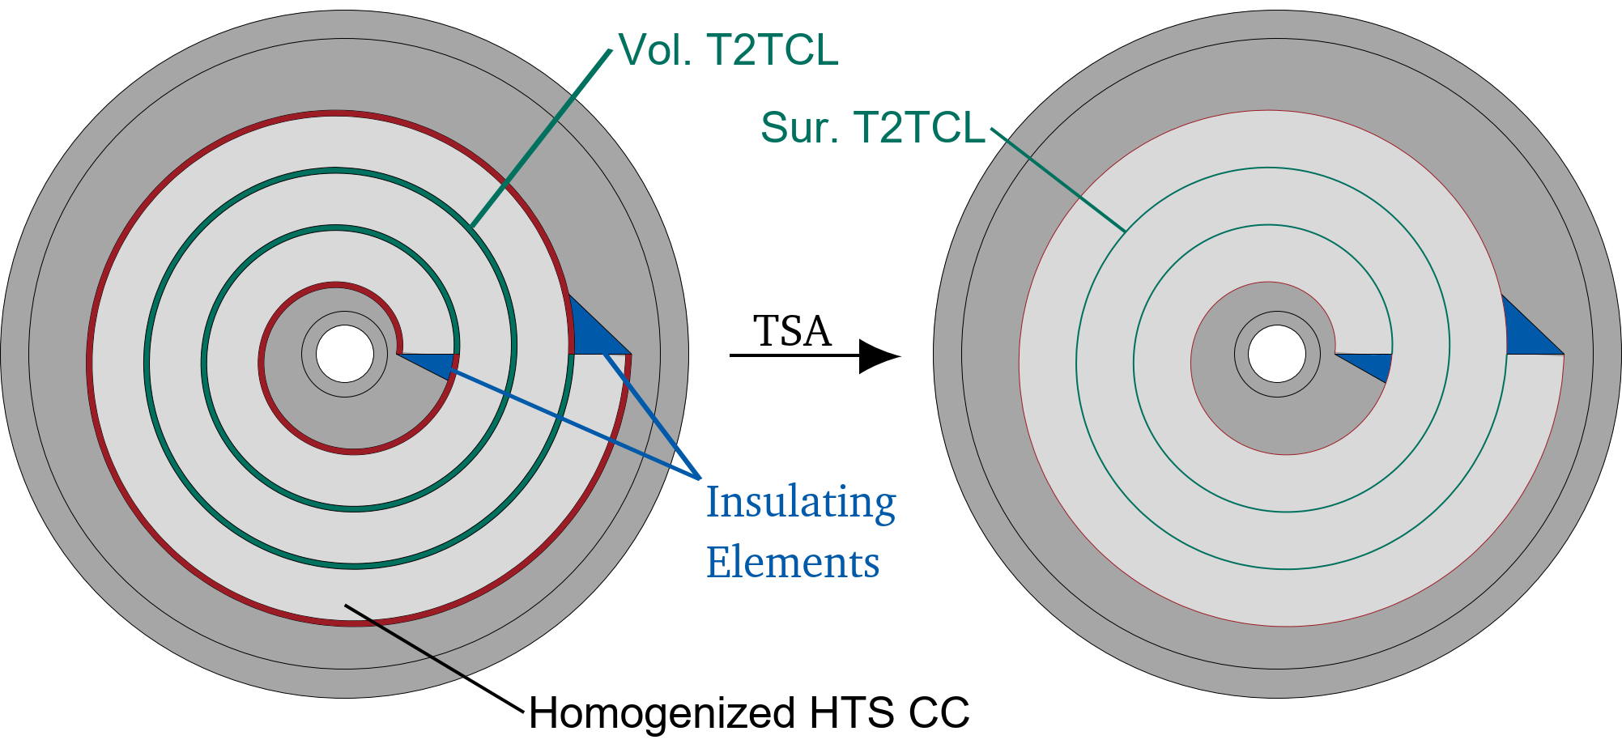
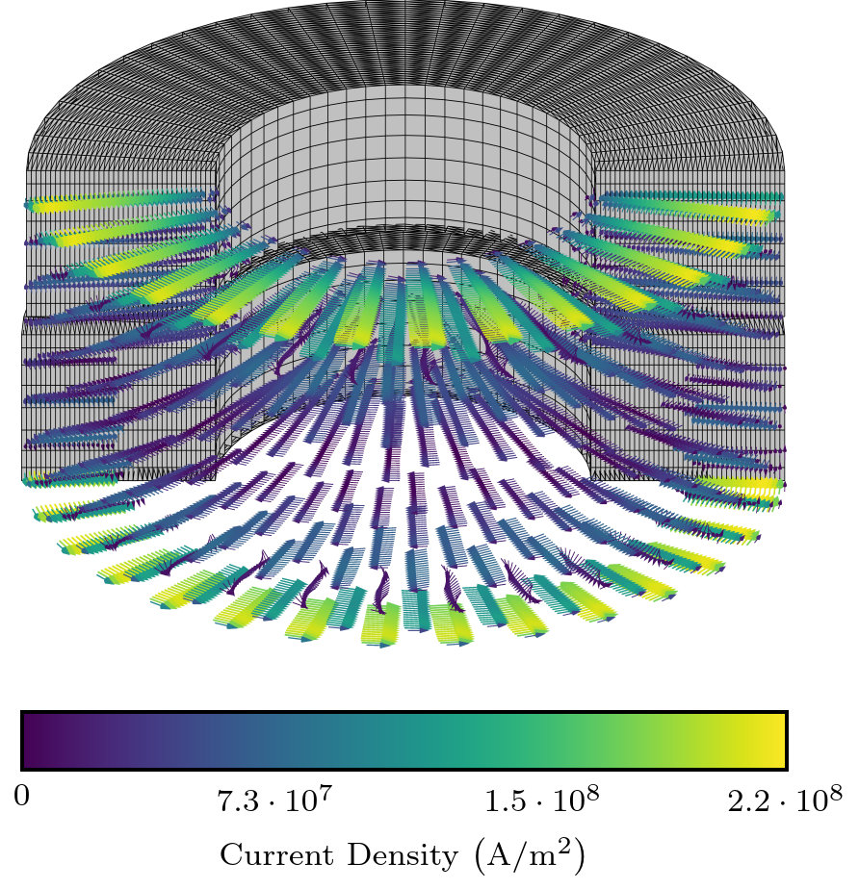
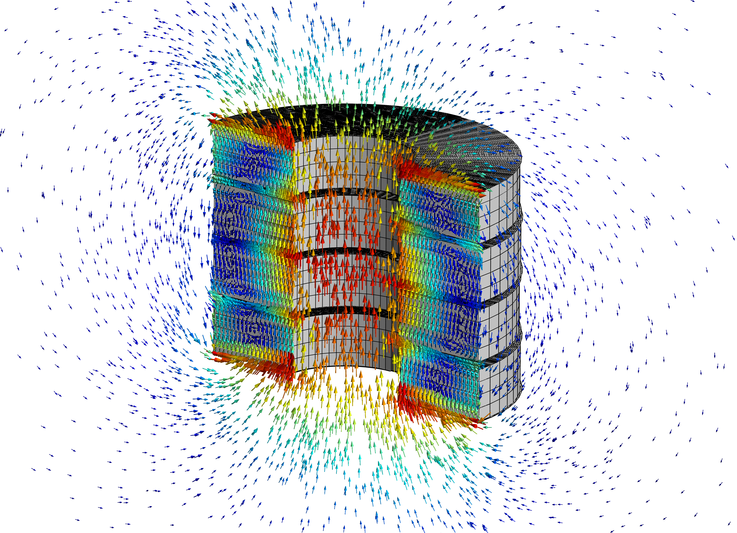
No Insulation HTS Coil – 3D FE Model
3D magneto-thermal model in FiQuS/GetDP.
Homogenization of the HTS coated conductor (CC):
  Power law with angle dependency for HTS.
  Anisotropic homogenization.
Thin-Shell Approximation (TSA) for the turn-to-turn contact layer (T2TCL): both thermal and magnetic.
HPC and parallelization efforts with benefits for all FiQuS models (parallelization in time, MPI with PETSc).
E. Schnaubelt et al., "Magneto-Thermal Thin Shell Approximation for 3D Finite Element Analysis of No-Insulation Coils," IEEE TAS (2024)
E. Schnaubelt et al., “Parallel-in-Time Integration of Transient Phenomena in No-Insulation Superconducting Coils Using Parareal”, SCEE’24 proceedings
Courtesy of Erik Schnaubelt, Sina Atalay and Mariusz Wozniak

Slide 11
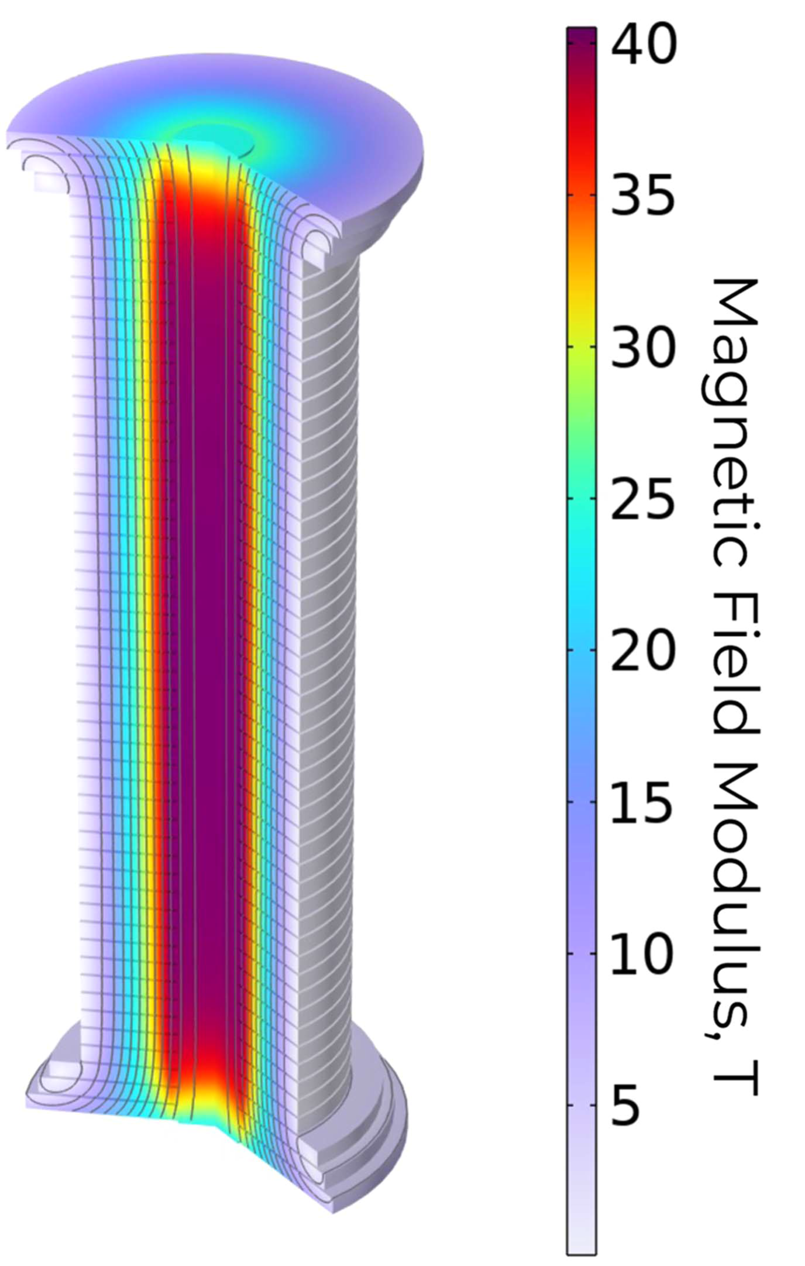
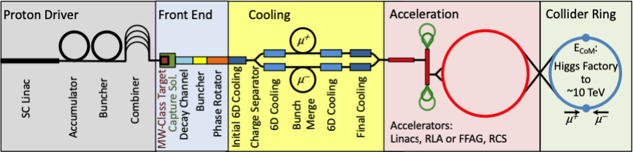
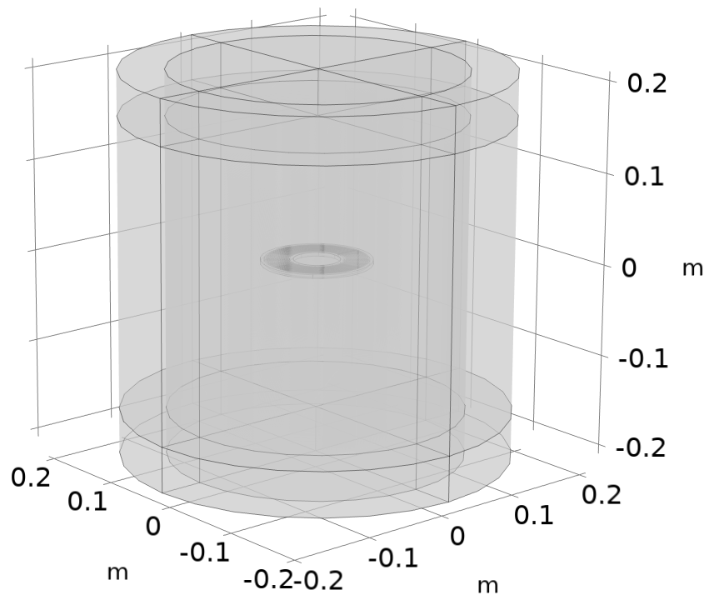
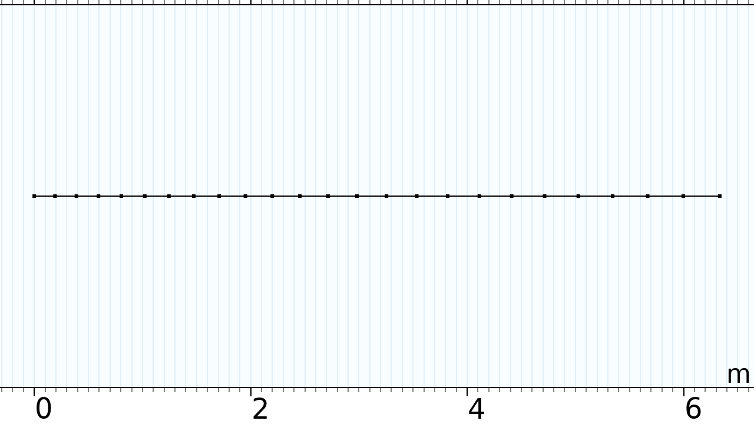
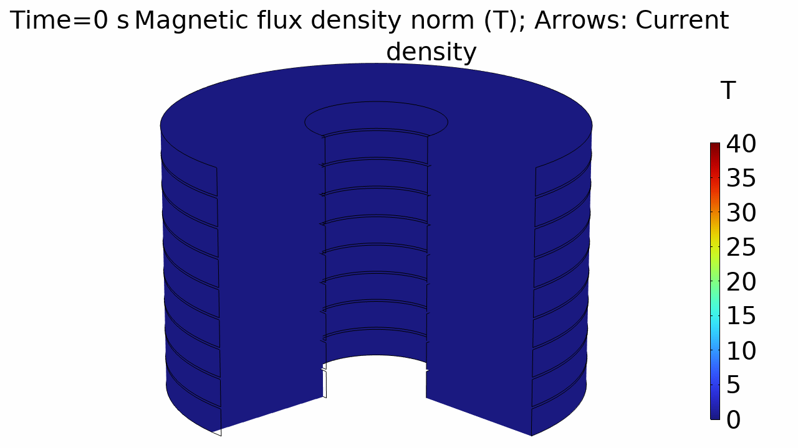
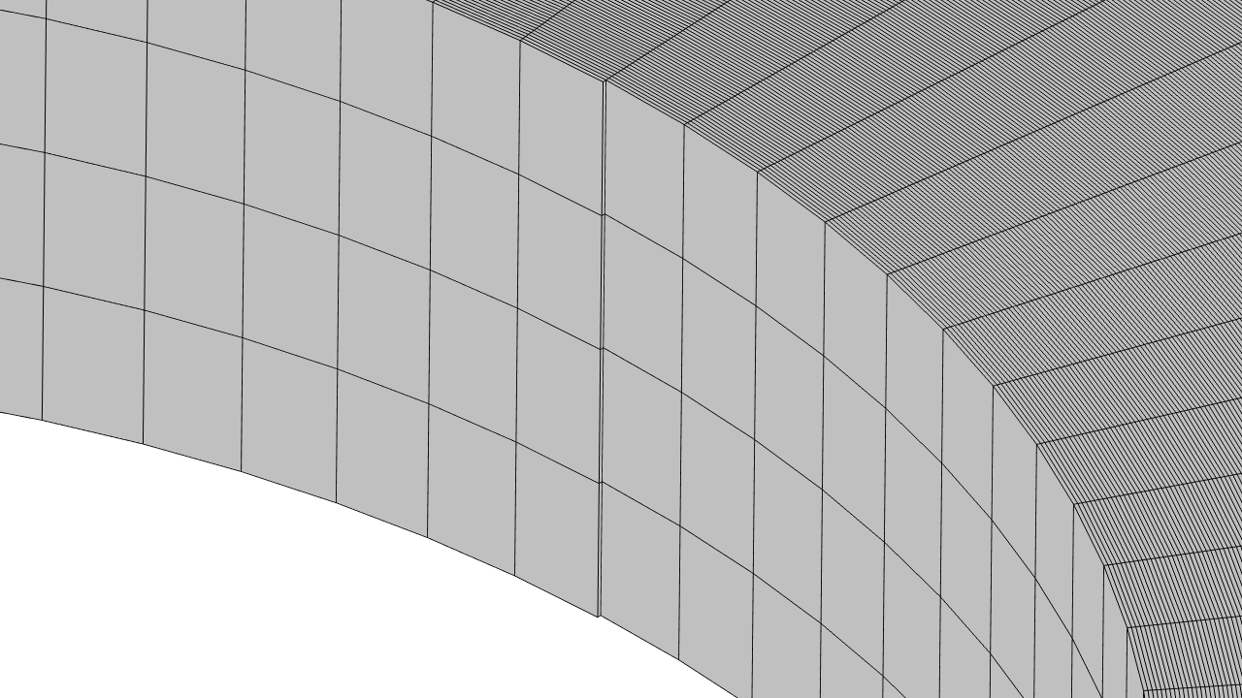
No Insulation HTS Coil – 3D+2D FE Model
Modelling of the 40 T Final Cooling Solenoid of the Muon Collider.
Iterative scheme: 3D FE magnetic
coupled with 1D+2D FD electric.
US Muon Accelerator Program
Bordini et al. (2024)
3D: Computes m.v.p. based on current density
1D/2D: Longitudinal, turn-to-turn and screening currents
J_{z34}
J₄
Model in Comsol Multiphysics.
Work in progress with the T-A homogeneous formulation.
J_{z23}
J₃
J_{z12}
J₂
J₁
Courtesy of Davide Rinaldoni and Bernardo Bordini

Slide 12

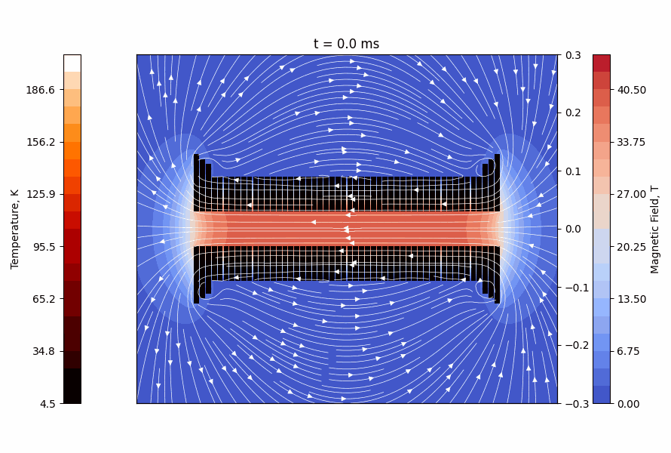
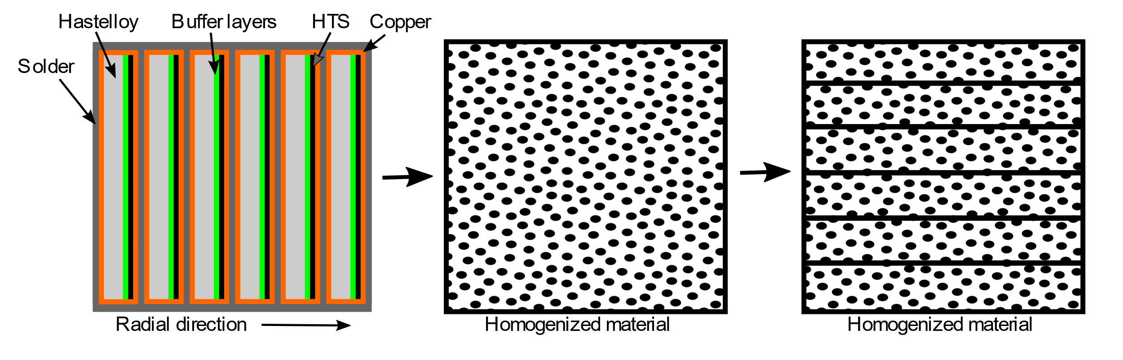
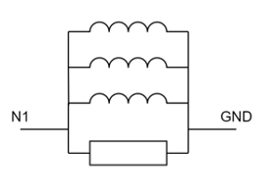
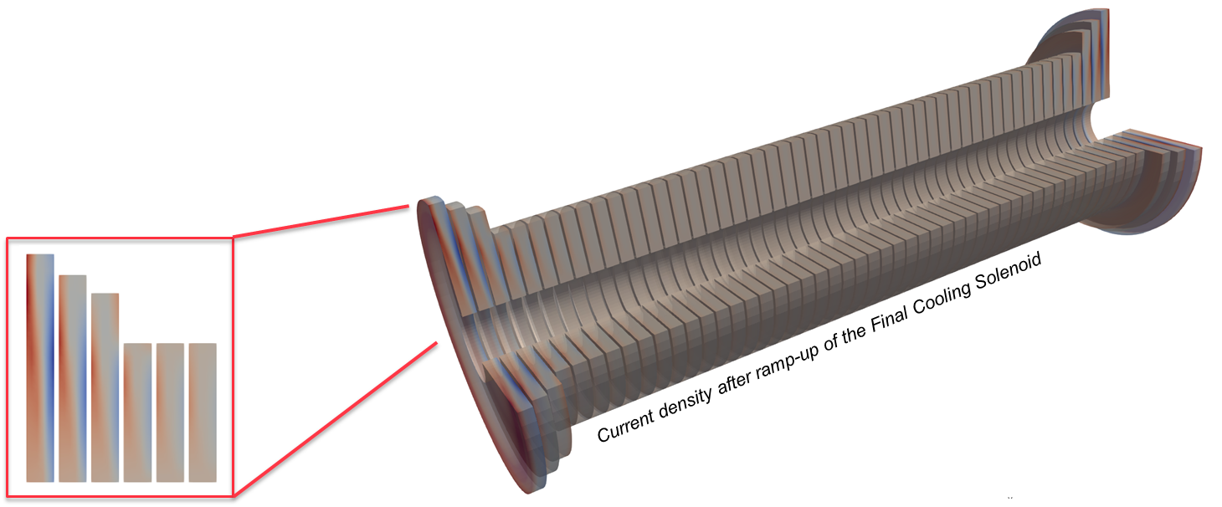
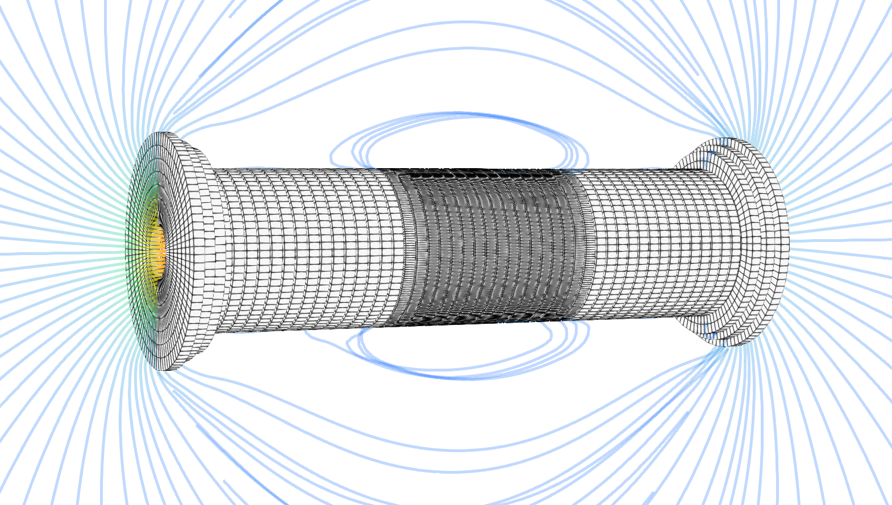
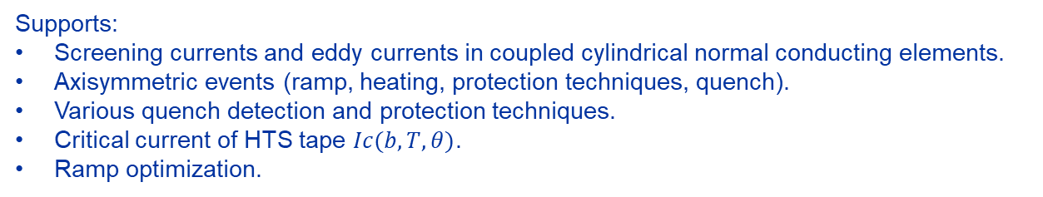
No Insulation HTS Coil – 2D/3D Network Model
NICQS: No Insulation Coil Quench Simulator
  Network model (PEEC): finite difference solved with ODE solver.
  Smart homogenization → ideal for solenoids with many turns.
Supports:
Screening currents and eddy currents in coupled cylindrical normal conducting elements.
Axisymmetric events (ramp, heating, protection techniques, quench).
Various quench detection and protection techniques.
Critical current of HTS tape $Ic(b, T, θ)$.
Ramp optimization.
NICQS is being used as one of the design tools for a 40 T final cooling solenoid for a muon collider
3D version is under development
Courtesy of Tim Mulder and Leon Teichrob

Slide 13
Contents
Context and STEAM framework
New methods and models
Tools and selected results
Summary and perspectives

Slide 14

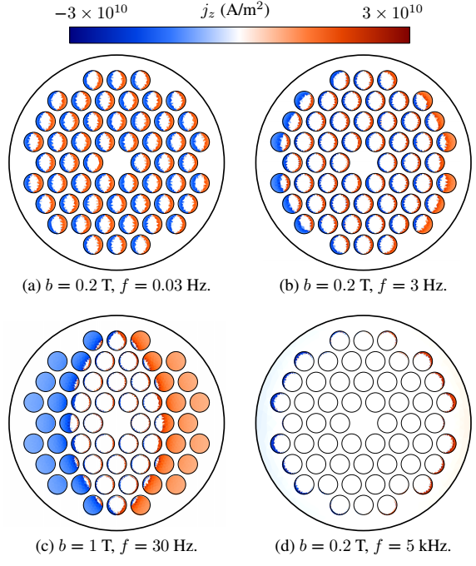
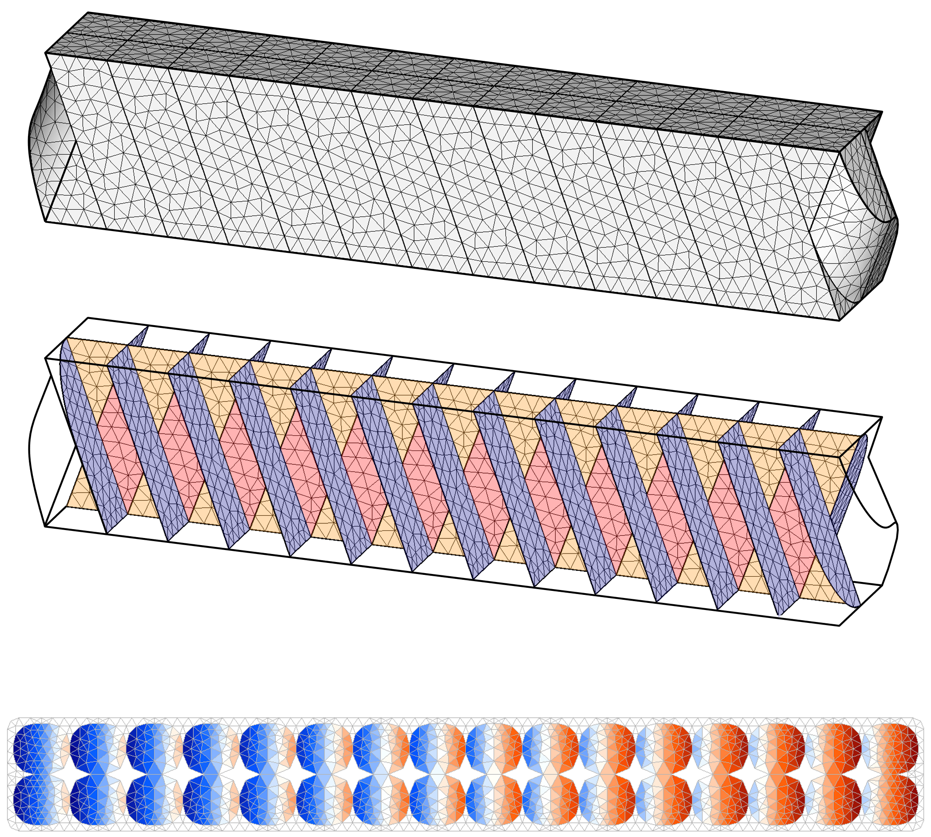
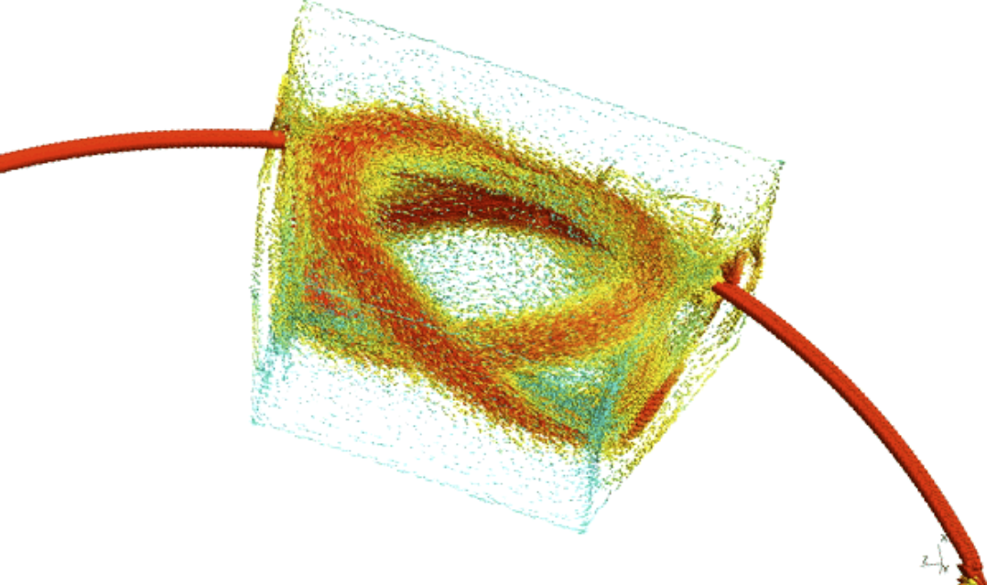


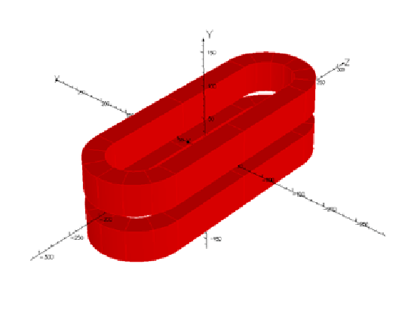


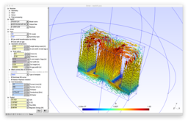
Finite element Quench Simulator
CATI method on strands and cables (2D)
Curved CCT magnet (3D)
Developed in TE-MPE-PE
In STEAM framework
Coded in Python
Based on Gmsh and GetDP
Multipole models (2D)
No-insulation HTS coil (3D)
HTS and LTS Racetrack coils (3D)

Slide 15

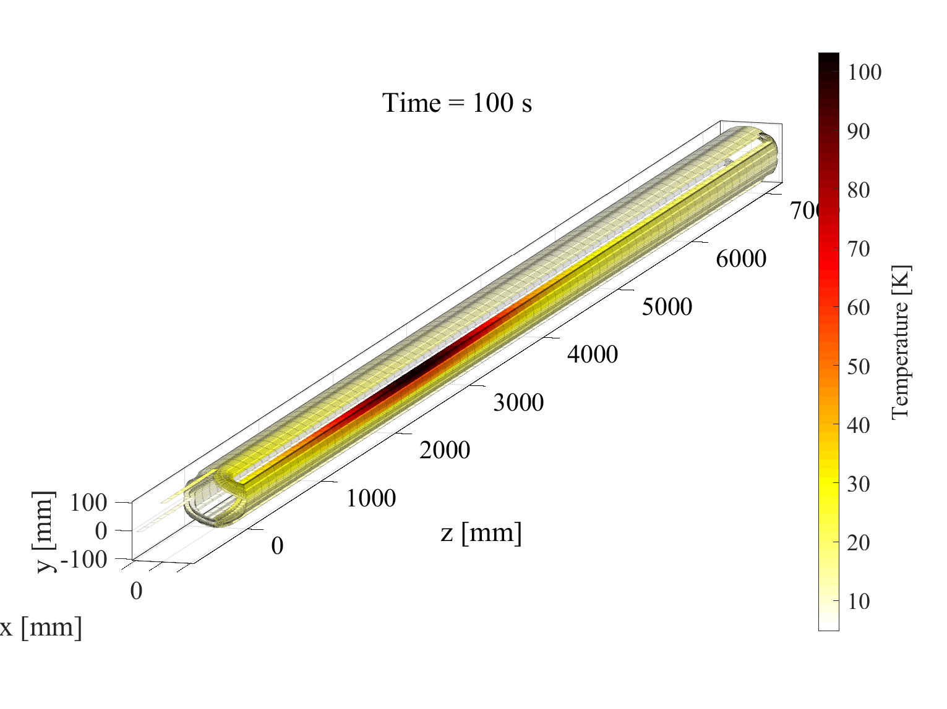
Lumped-Element Dynamic Electro-Thermal - LEDET
Simulate electro-magnetic and thermal transients in superconducting magnets in 2D and 3D geometry using the Finite Difference (FD) method.
Courtesy of Emmanuele Ravaioli

Slide 16
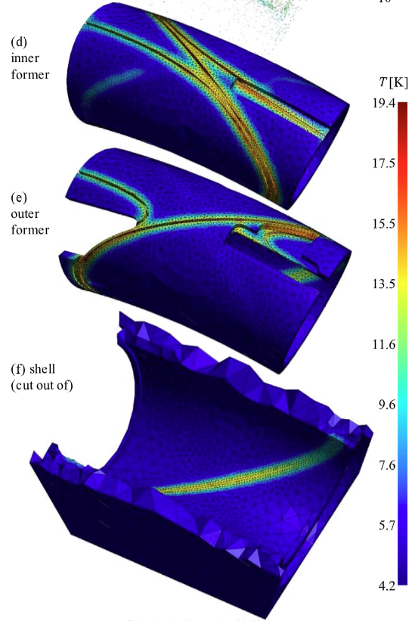
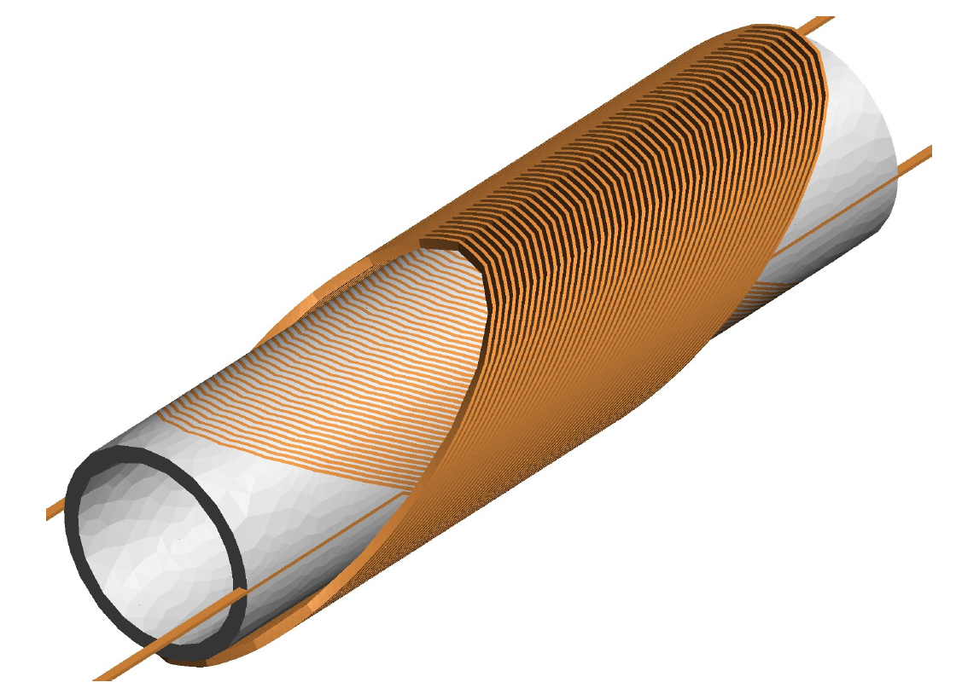
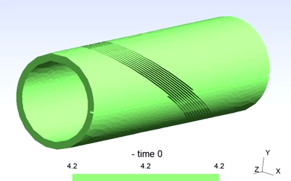
FiQuS – LEDET Co-Simulation
Co-simulation for Canted-Cos-Theta (CCT) magnets:
  FiQuS: 3D FE magneto-thermal model with homogenized conductors, for eddy currents in formers and shell.
    Thin-shell insulations between windings, formers and shell for efficient simulations and simplified meshing.
  LEDET: finite difference for currents, loss, and temperature in windings.
More details:
https://doi.org/10.1109/TASC.2023.3338142
https://doi.org/10.1109/TASC.2024.3355358
Temperature of former
Magnet designs by A. Haziot and the Fusillo team
M. Wozniak et al., "Quench Co-Simulation of Canted Cos-Theta Magnets," IEEE TAS (2023)
Courtesy of Mariusz Wozniak, Emmanuele Ravaioli and Erik Schnaubelt
16

Slide 17
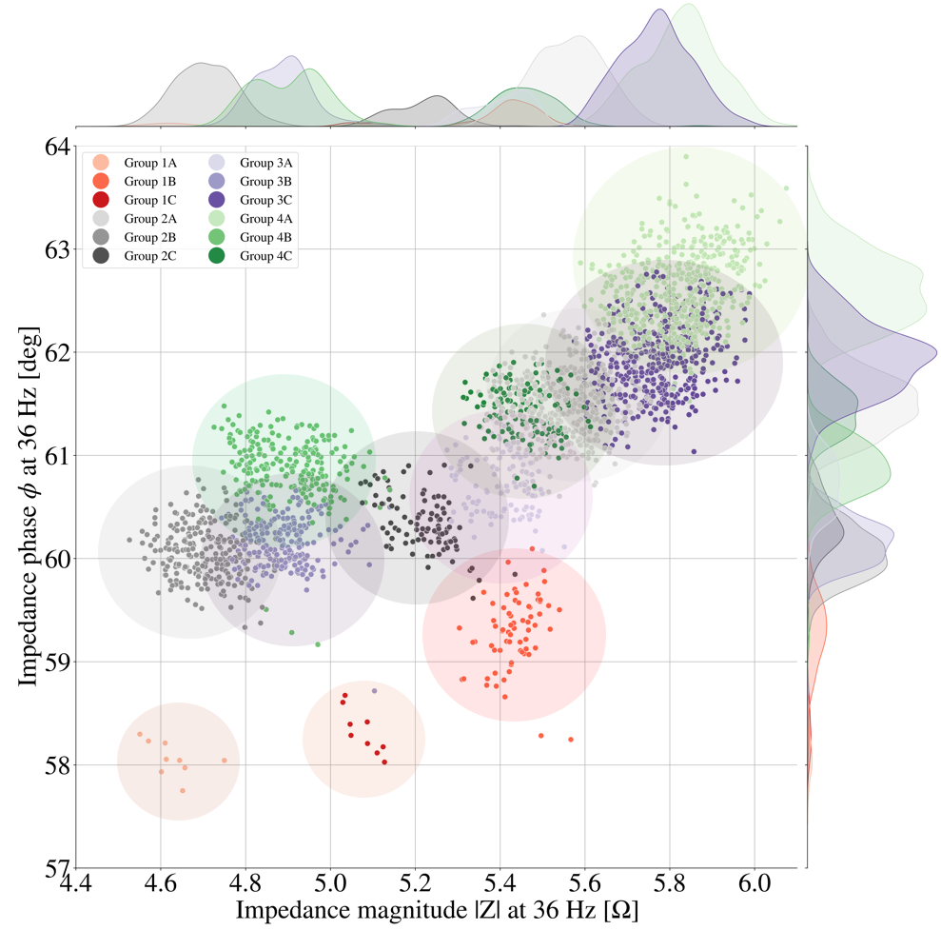
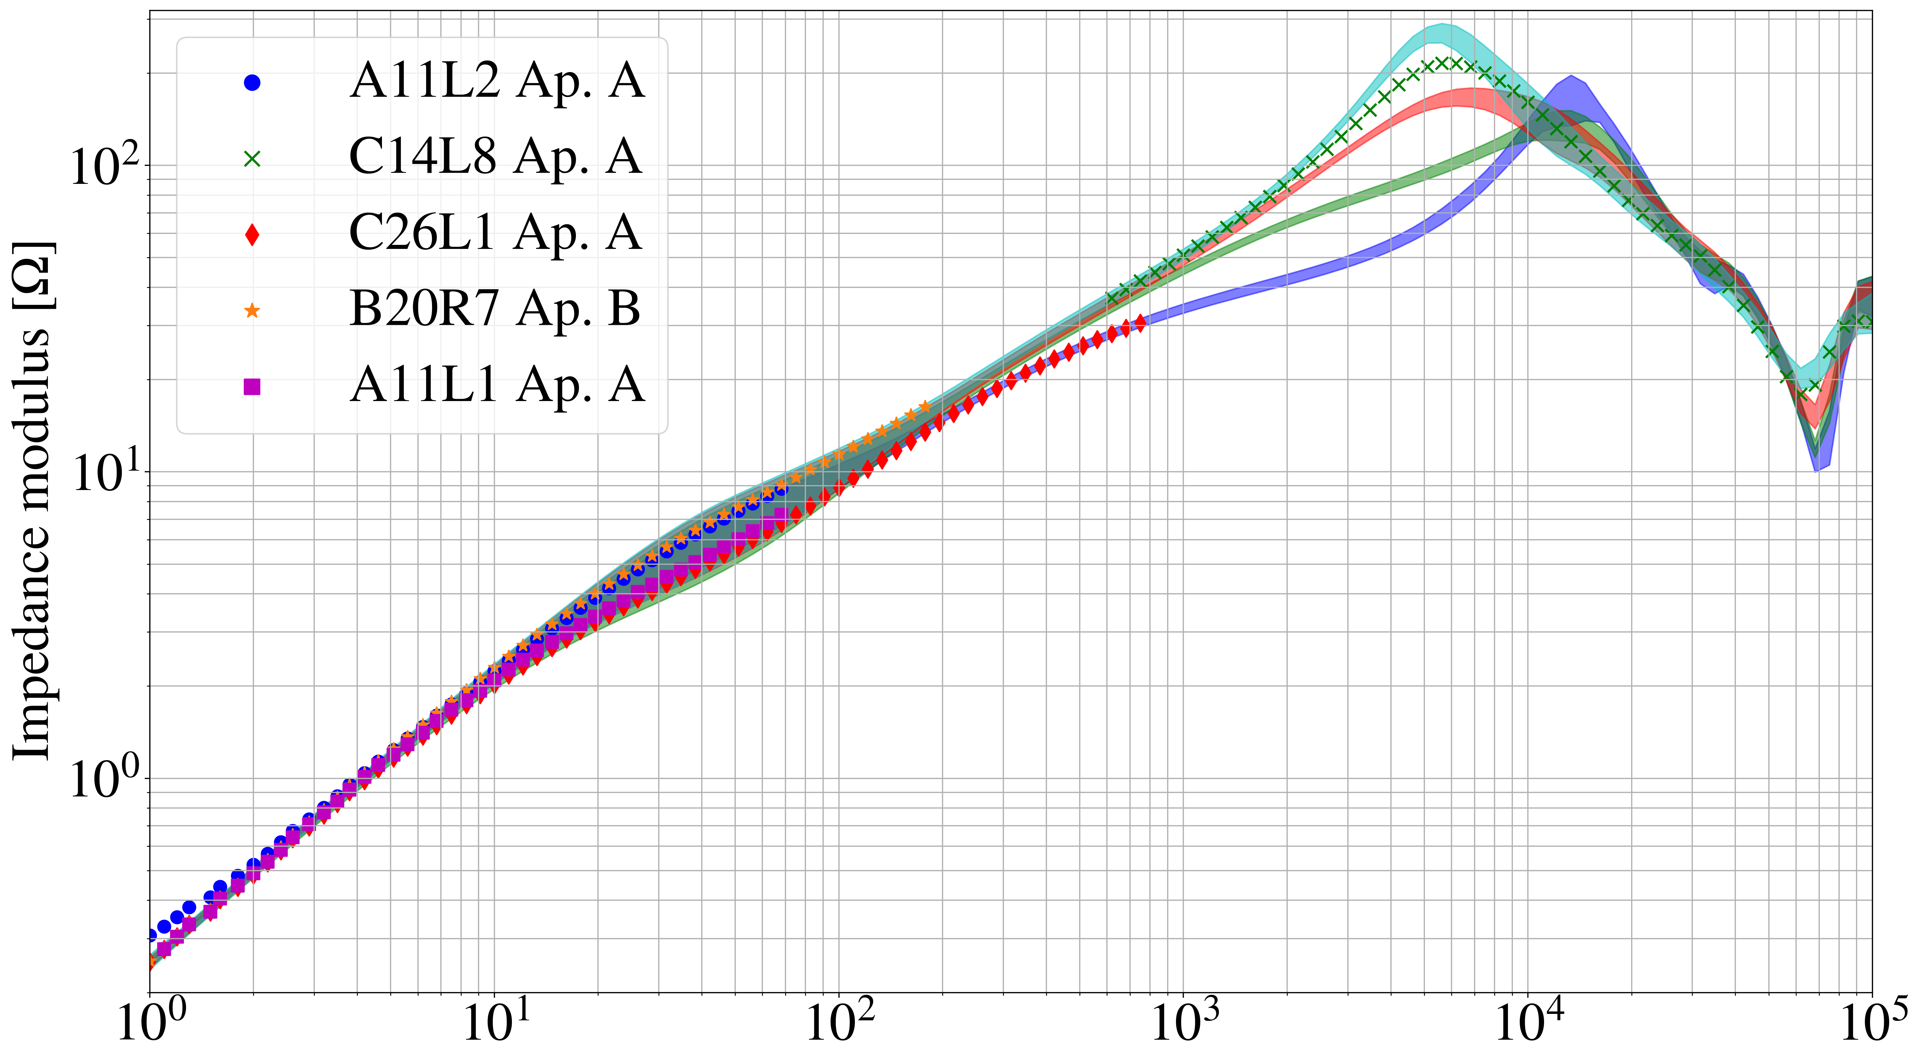
Dipole Magnets Impedance Model
Transfer Function Measurements (TFM) on all 1232 dipole magnets of the LHC.
Model to reproduce impedances based on FE, analytical models, and circuit equations.
Average error below 5 % up to 10 kHz.
Identification of outlier magnets.
Frequency (Hz)
Courtesy of Marvin Janitschke, Emmanuele Ravaioli and Valentina Reynaud

Slide 18
The framework
Input files
Input files
Conductor
Conductor
Magnet
Magnet
Circuit
Circuit
Consecutive analysis
Consecutive analysis
Parametric analysis
Parametric analysis
Comparison to
measurements
Comparison to
measurements
Conductor
Conductor
FiQuS
FiQuS
STEAM SDK
STEAM SDK
STEAM SDK
STEAM SDK
STEAM SDK
LEDET
STEAM SDK
LEDET
XYCE
XYCE***
PyBBQ
PyBBQ
LEDET
LEDET
Dakota
Magnet
Dakota***
Magnet
ProteCCT
Circuit
FiQuS
ProteCCT
Circuit
PSPICE
CHALLENGES
Commercial software is not easily available to all users and expensive
BBQ
PSPICE**
BBQ*
SIGMA
Co-sim.
NICQS
Co-sim.
Analysis
Materials properties
SIGMA*
Component library
Analysis
Parametric
Materials properties
Component library
Parametric
Co-operative simulation
Meas. config
Meas. config
Co-operative simulation
COSIM
STEAM SDK
Software in green boxes is free to use
Meas. data
Meas. data
COSIM
STEAM SDK
STEAM SDK
STEAM SDK
*COMSOL license needed. **Commercial circuit solver from Cadence Design Systems. ***Free tools from Sandia Labs.
Courtesy of Mariusz Wozniak, Emmanuele Ravaioli

Slide 19
Contents
Context and STEAM framework
New methods and models
Tools and selected results
Summary and perspectives

Slide 20
Summary and Perspectives
Superconducting Conductors and Magnets Modelling.
  For LTS: efforts for development of FE and FD models.
  For HTS: efforts for development in four directions (FiQuS, NICQS, LEDET, and Comsol).
  Homogenization and reduced order modelling are necessary to obtain affordable computing time.
  HPC, parallelization in space/time are a must-have for 3D modelling.
  → Need for novel methods and cutting-edge modelling tools.
Perspectives for collaborations with modelling experts at the University of Liège.
  Research on formulations, homogenization techniques, coupling between machine learning techniques and reduced order modelling approaches.
  Synergies for the use and development of open-source software and modelling tools.
  Co-simulation with mechanical and/or cryogenic models.

