Slide 1
Normal conducting magnet activities at CERN
(incl. FCC-ee magnet development)
J. Bauche, D. Schoerling

Slide 2
Outline
Normal Conducting (NC) magnets in the CERN accelerator complex
The NCM section
  Our facilities
  Maintenance and consolidation
  Production and procurement
  Quality assurance
Project examples
  Medical application: DEFT
  FCC-ee

Slide 3
NC magnets in the CERN accelerator complex

Slide 4
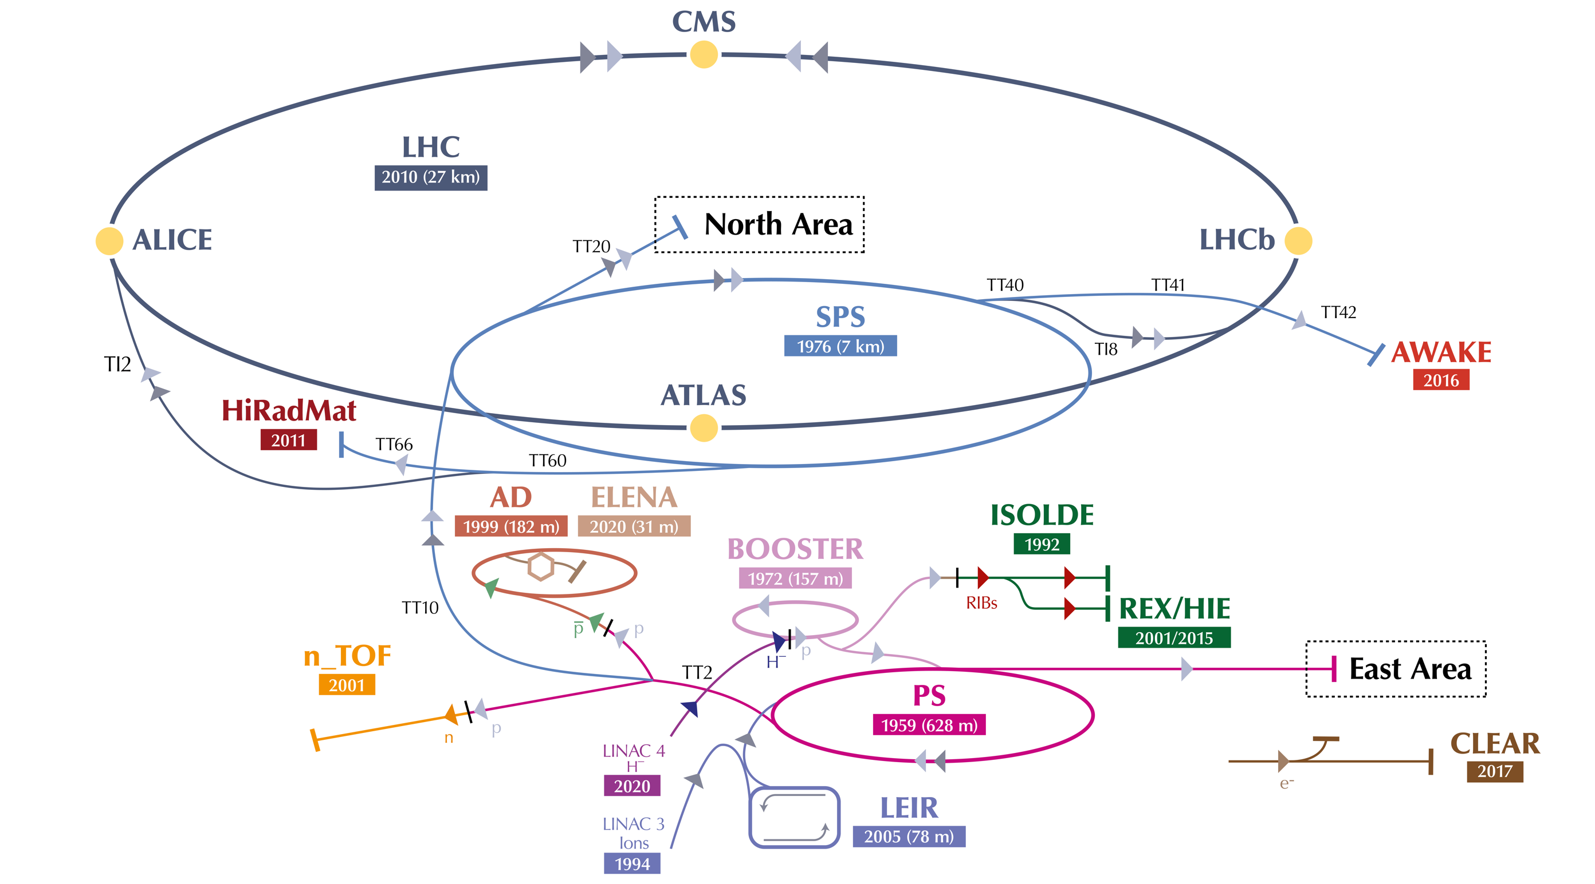
The CERN accelerator complex
LHC
Almost exclusively NC magnets (except LHC)
SPS complex
LINACs and PSB
PS complex

Slide 6
The Normal Conducting Magnet section
(TE-MSC-NCM)

Slide 7
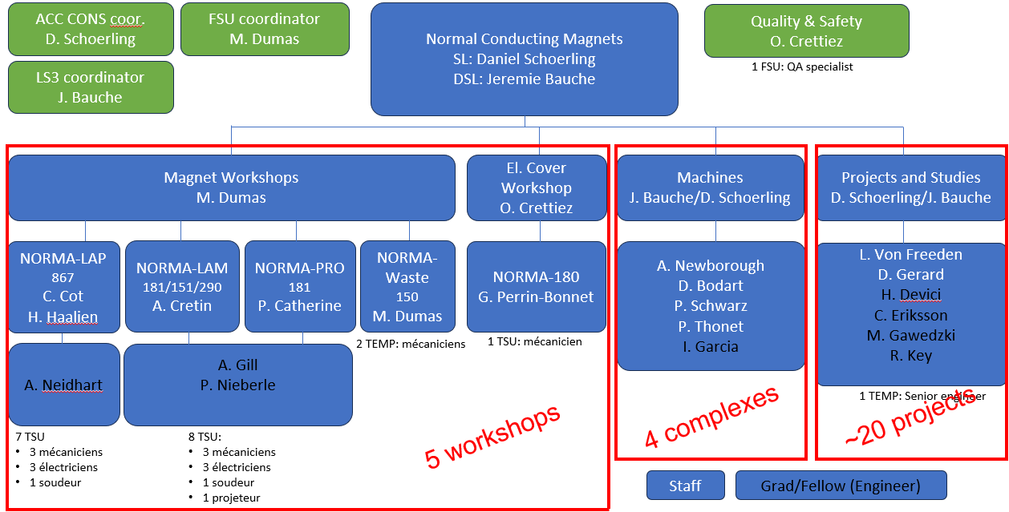
The NCM Team
~40 persons
(MPE + MPA)

Slide 8
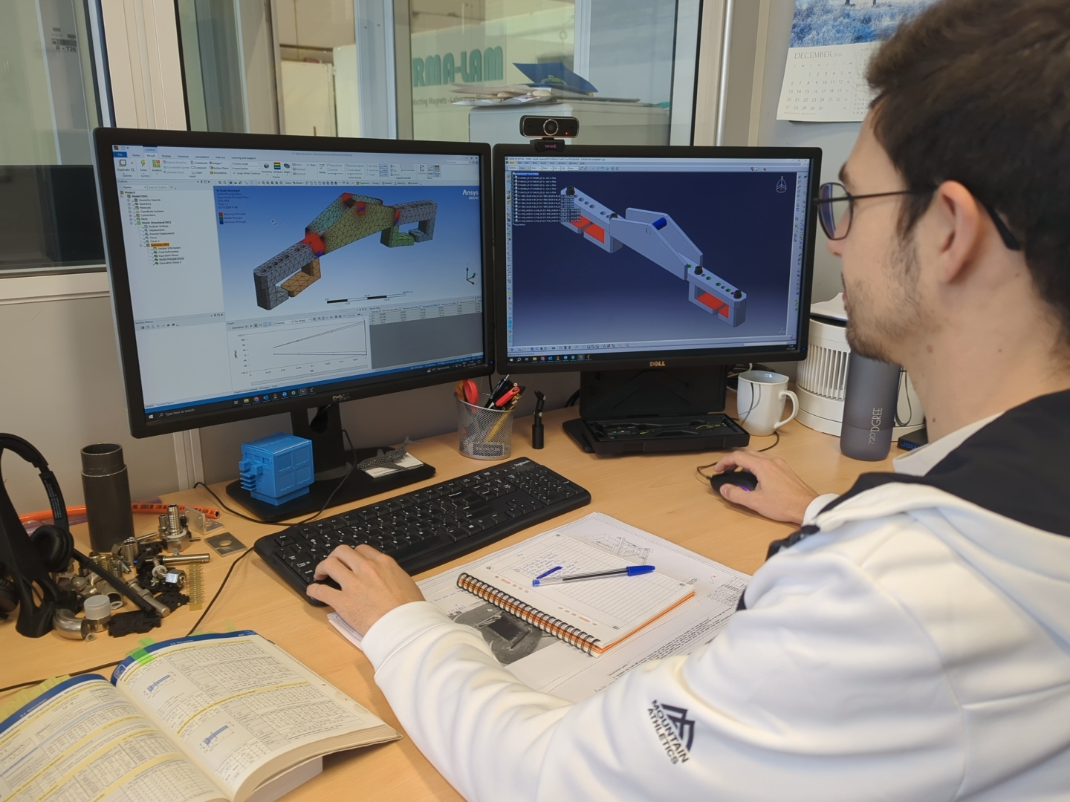
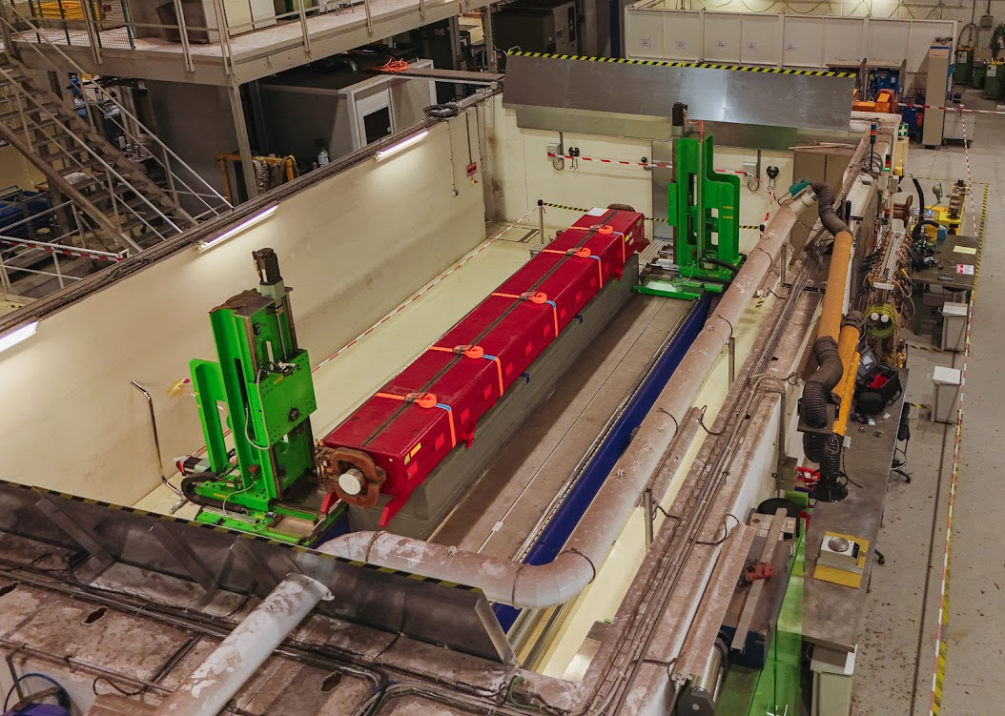
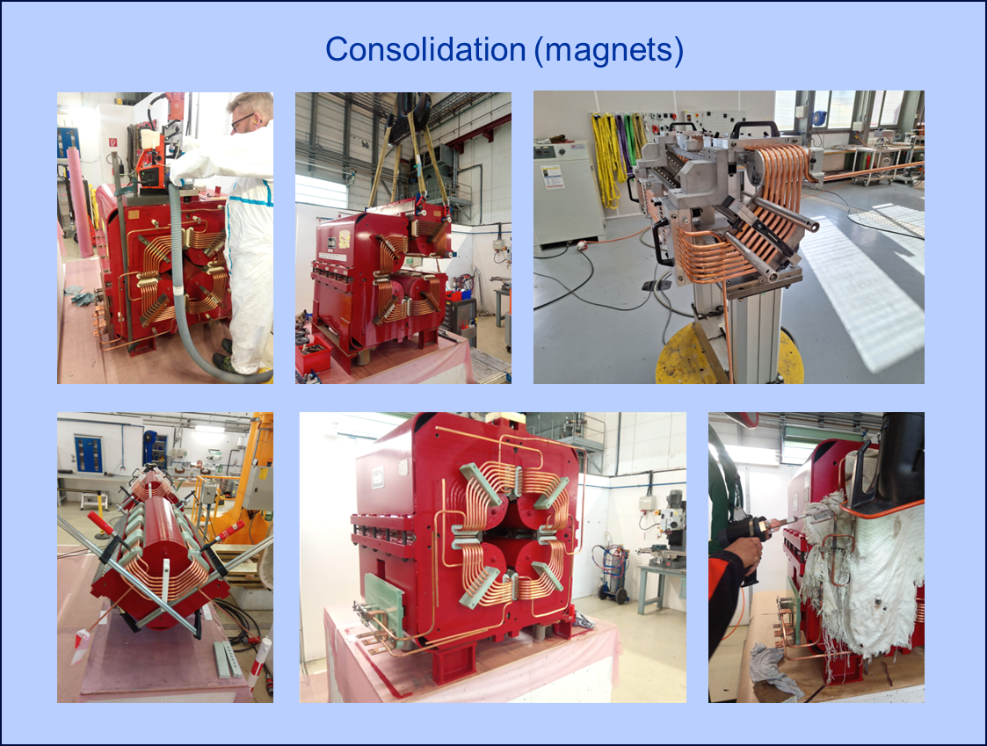
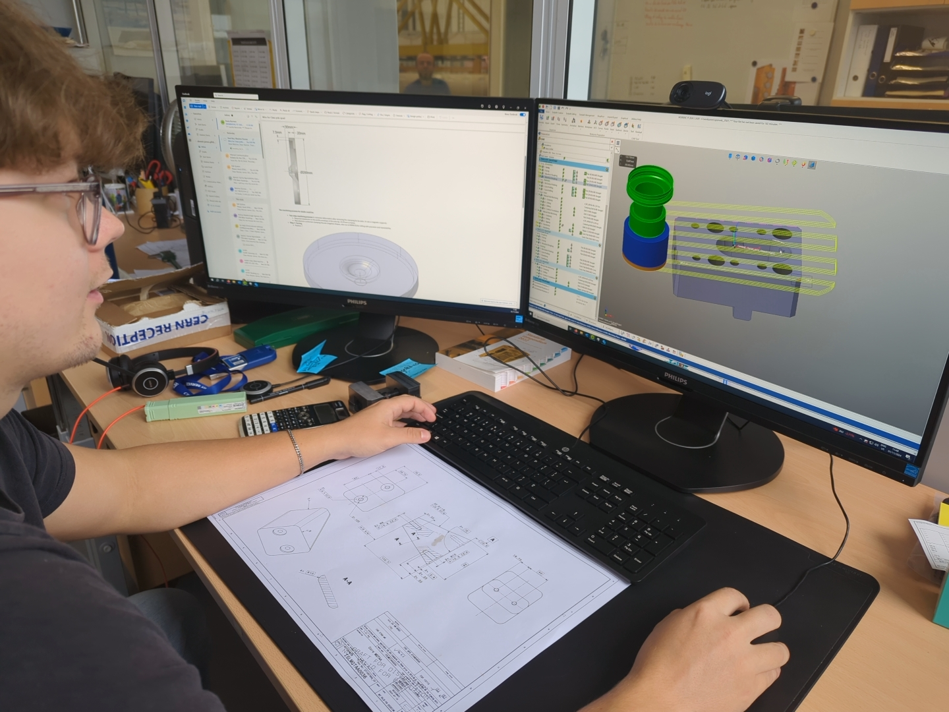
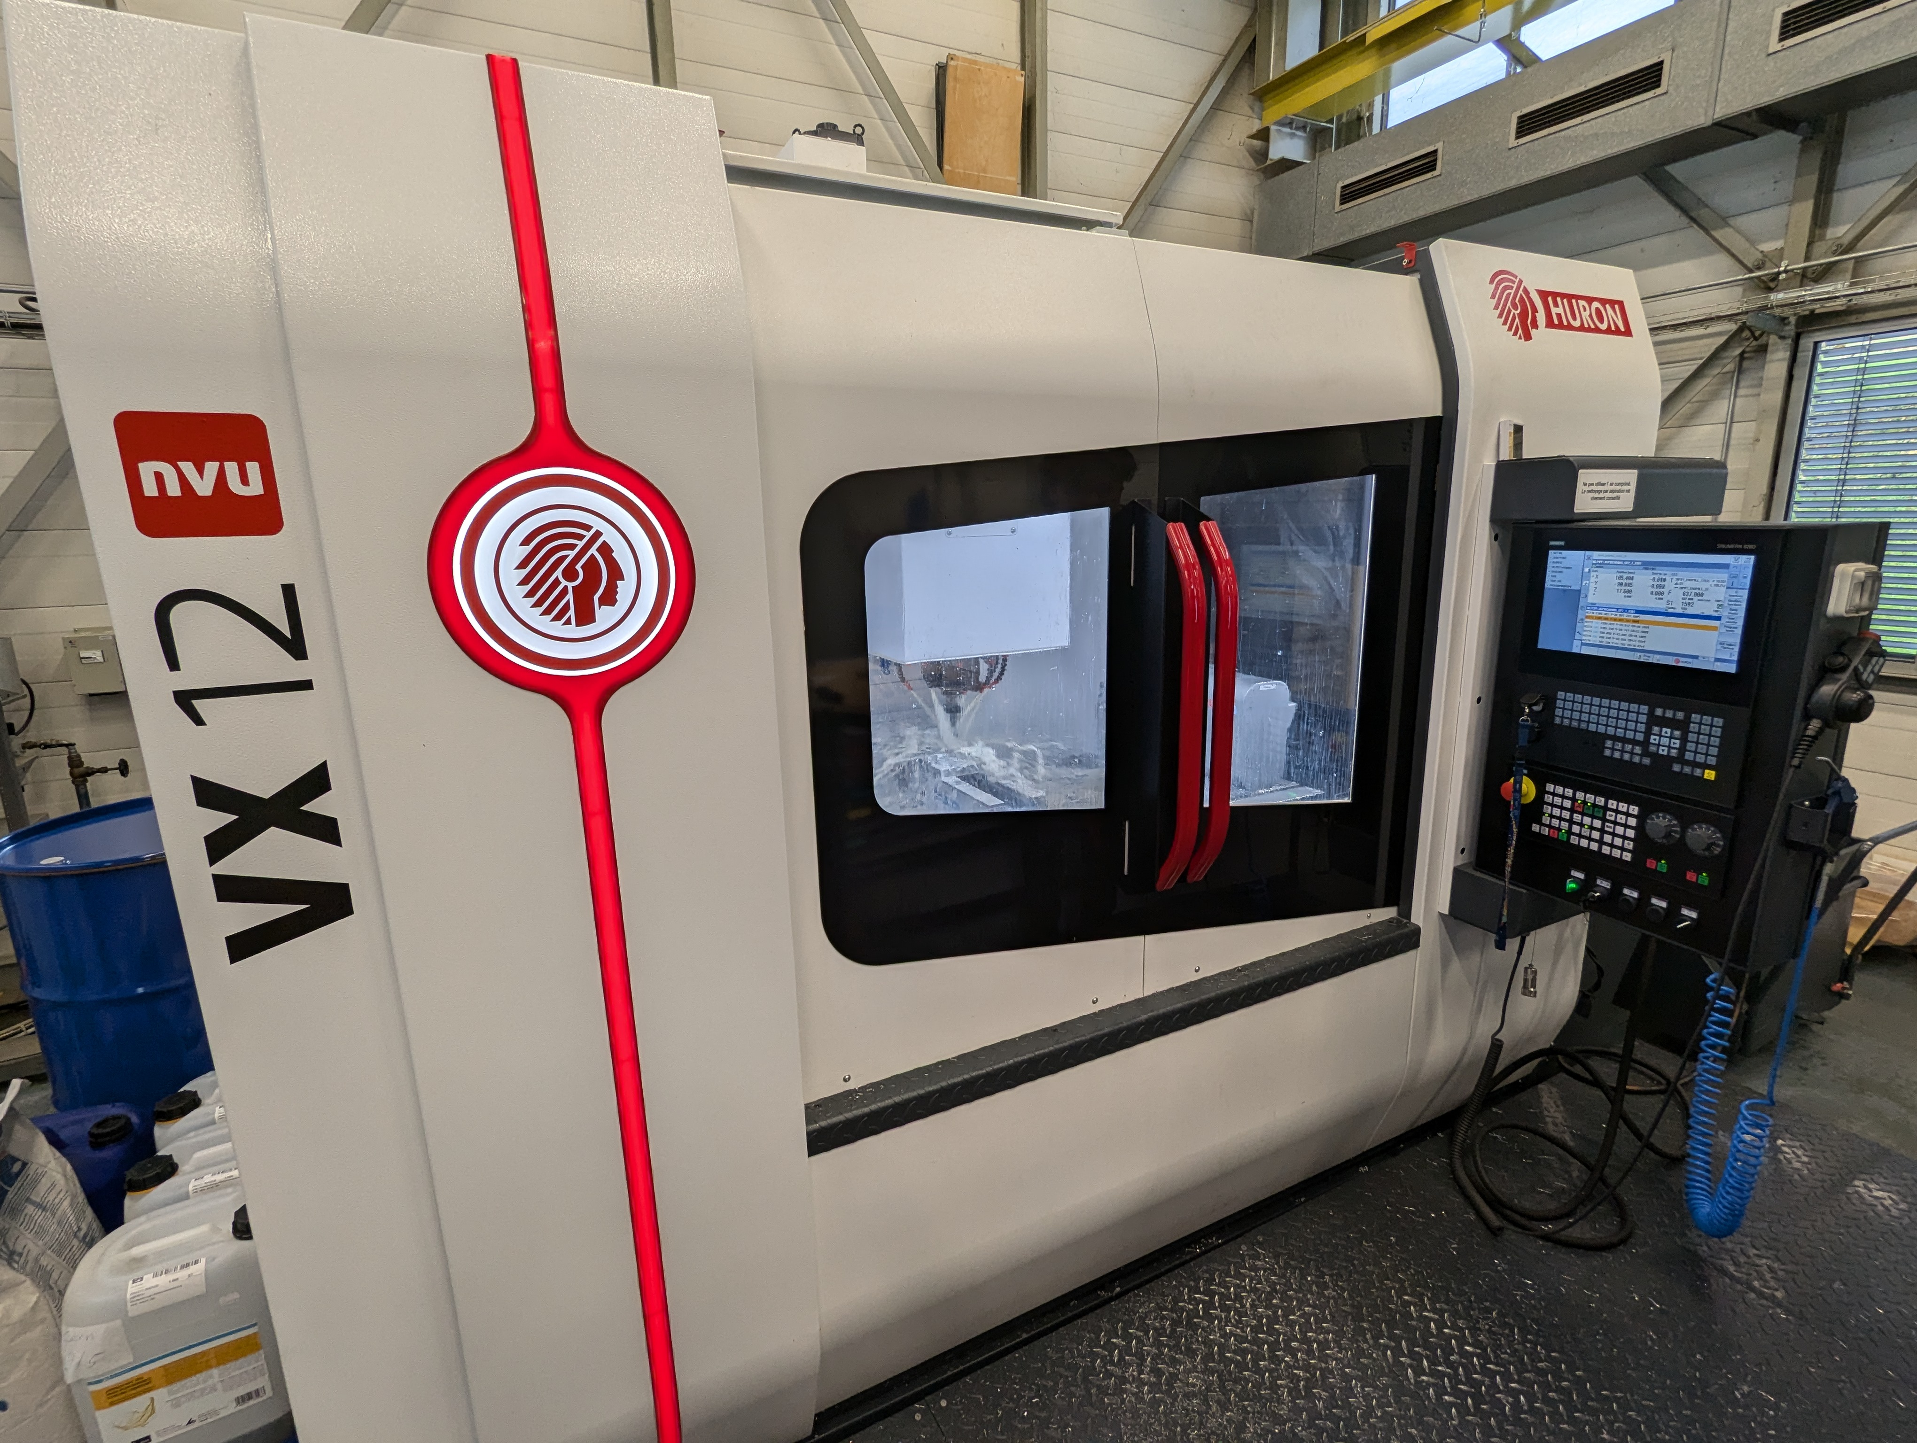

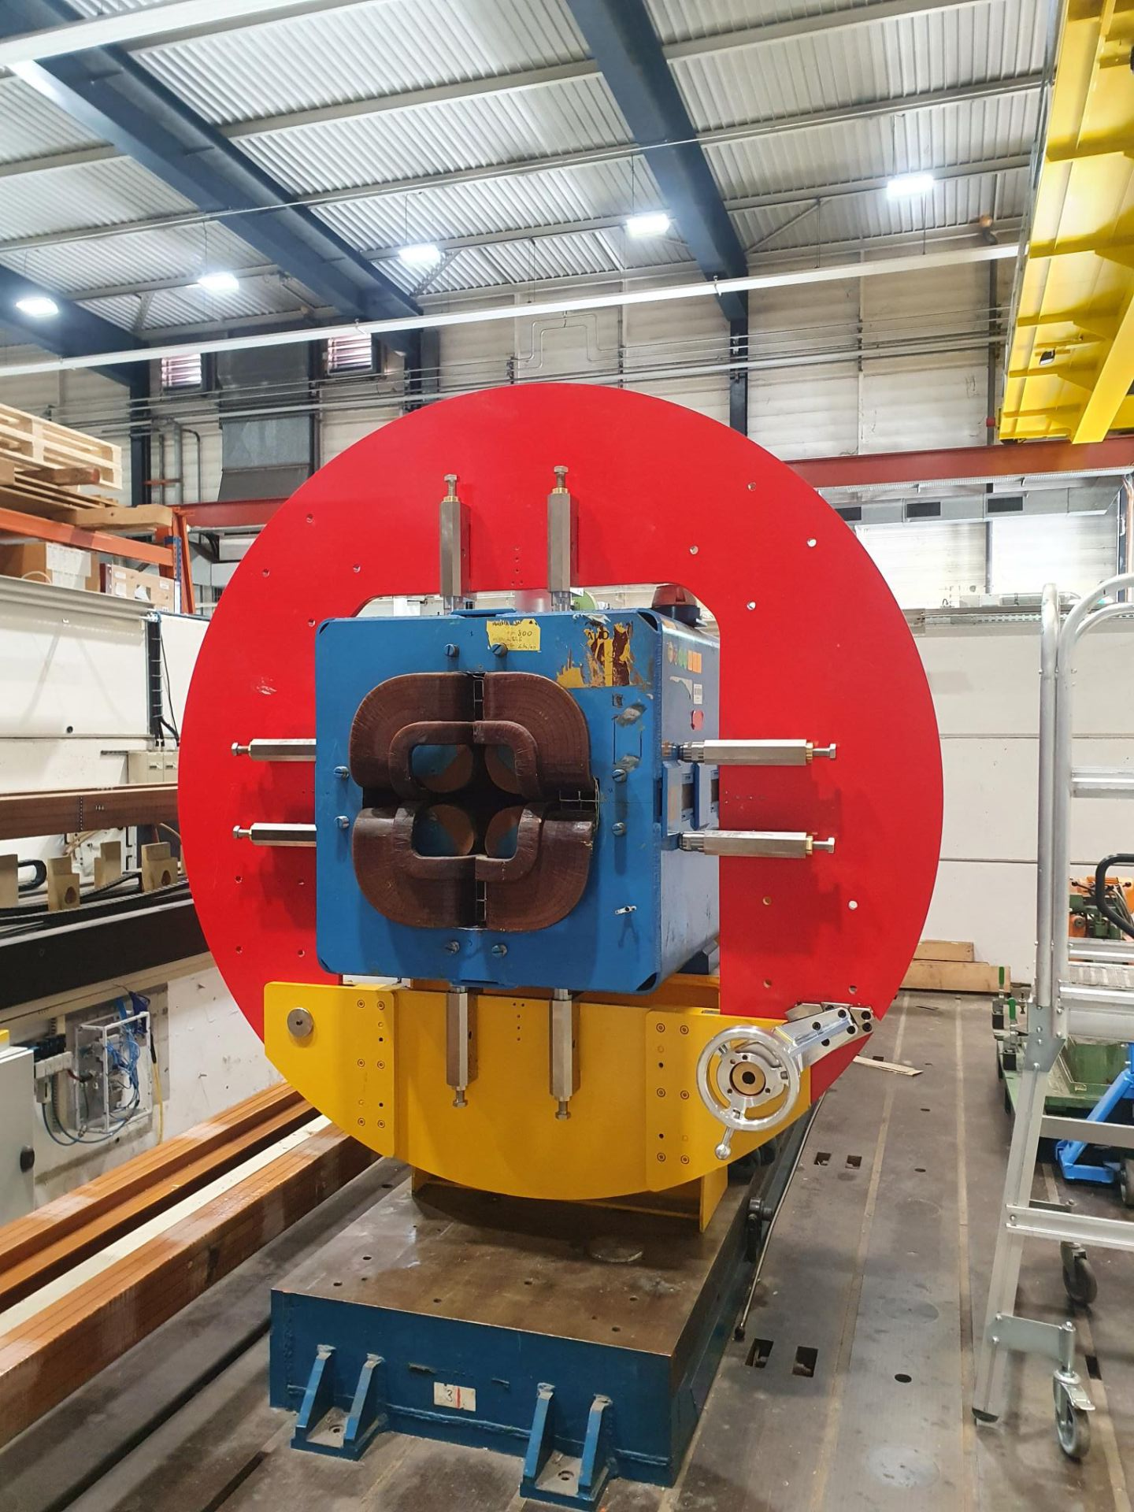
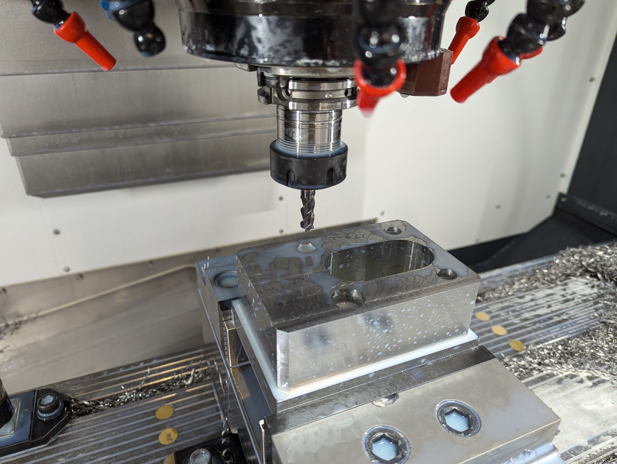
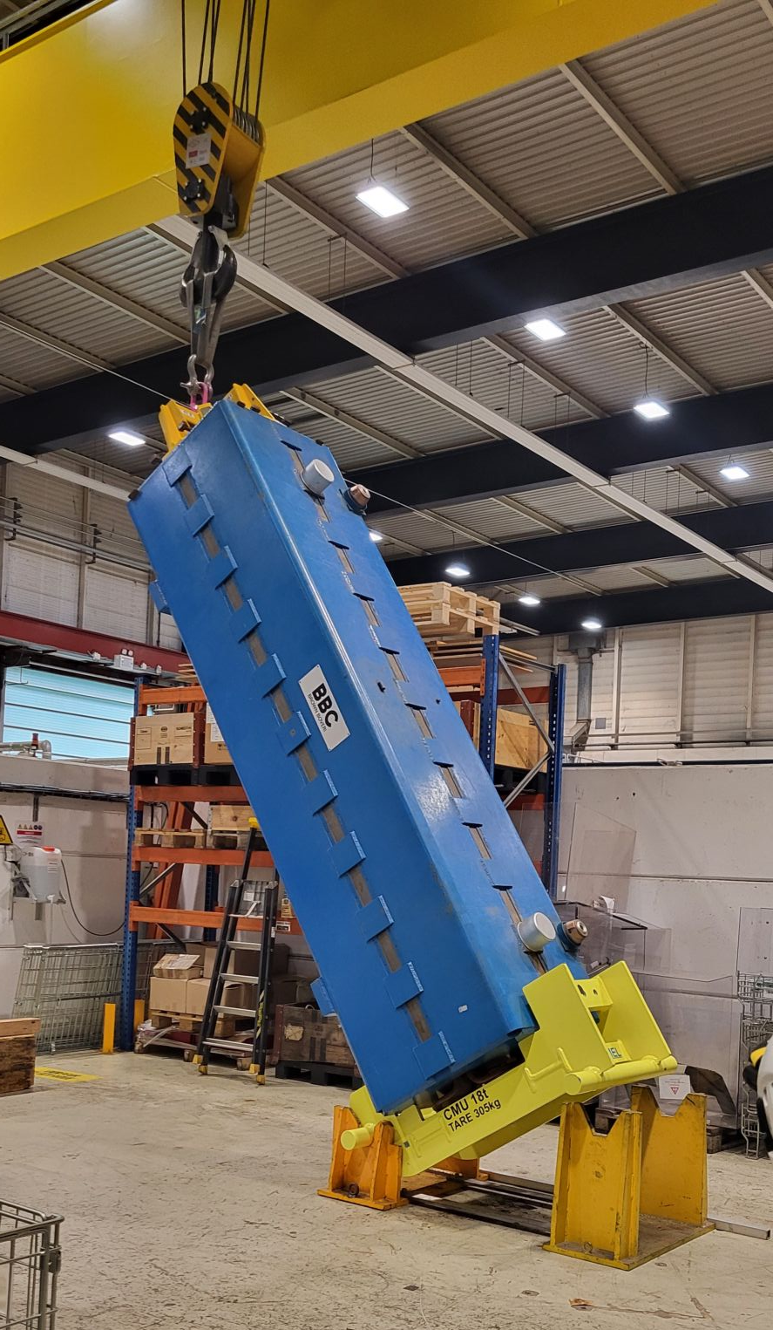
Our radioactive magnet workshops
We certify for use ~70 magnets/year for spare use or installation. The majority is used for preventive maintenance and new installations.
Catia 3D Design and Ansys engineering simulations
CAM programming
NCM Workshop 290 3 and 3+1 axis CNC Machine
We maintain and improve our magnets

Slide 9
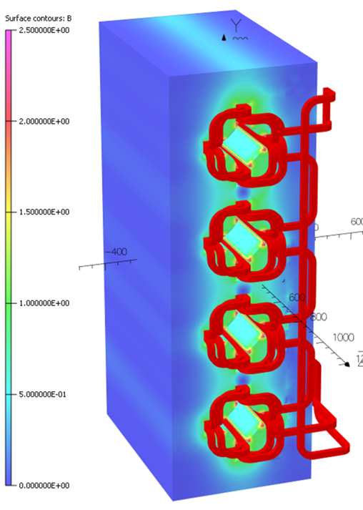
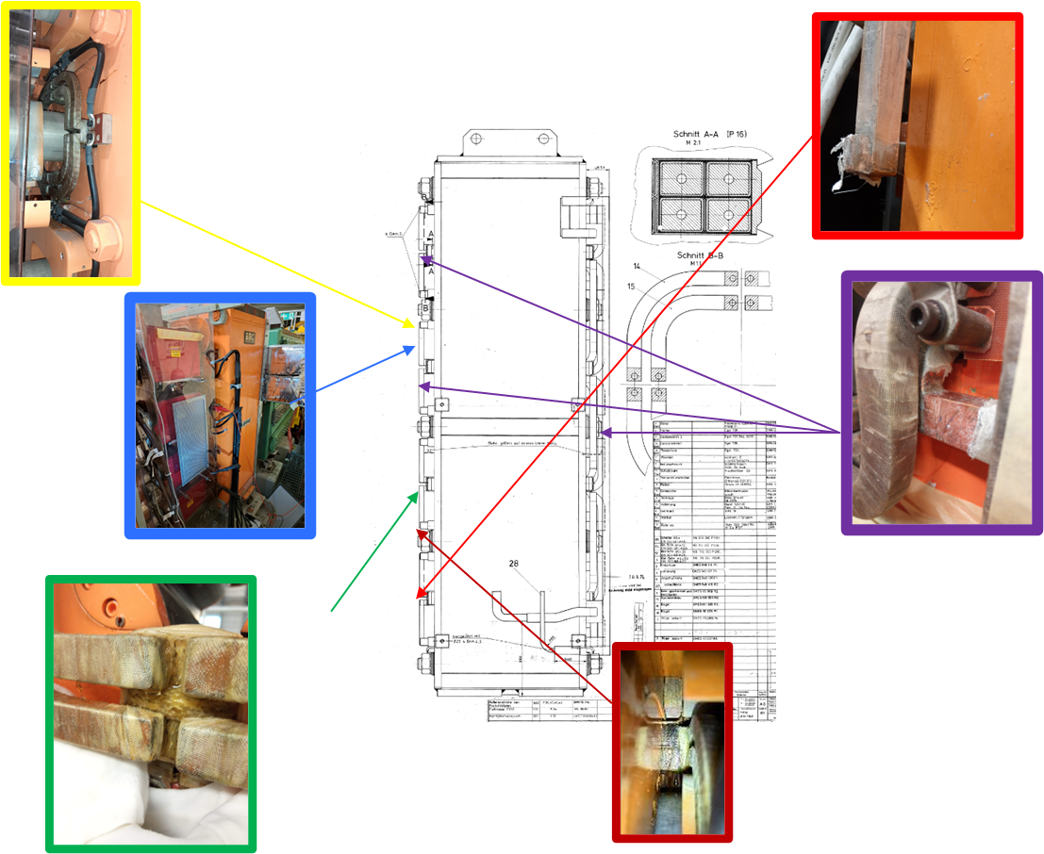
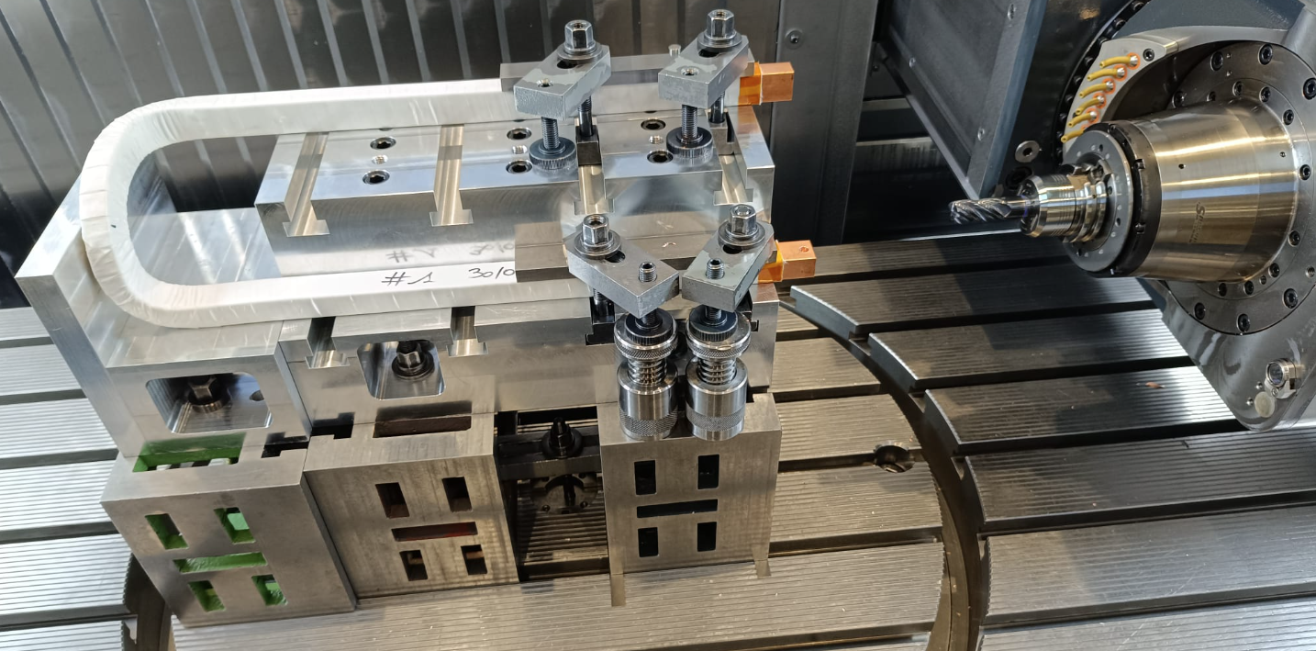
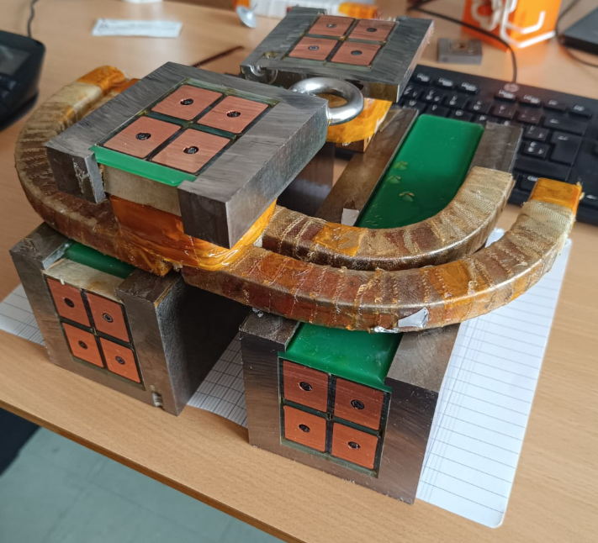
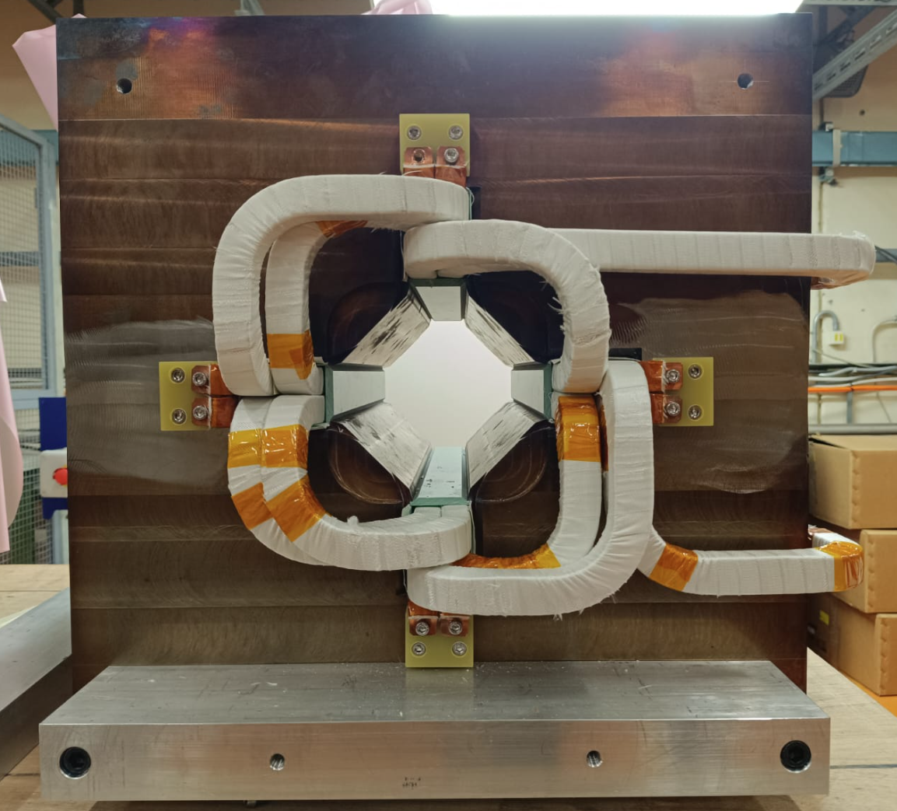
Example of consolidation: PSB quadrupoles
Reverse engineering to build 12 new identical spare magnets, including:
  Lamination procurement
  Yoke manufacturing
  Magnet assembly and qualification
Refurbishment of the original (radioactive) magnets, including:
  Dismantling of bonded assemblies
  Coil forming and machining
  Assembly, impregnation and qualification
Year / # Leaks
2021 / # 2
2022 / # 3
2023 / # 1
2024 / # 3
Electro-magnetic analysis
CNC machining of bent and wrapped coil parts
Mechanical and electrical test samples
Single aperture mock-up

Slide 10
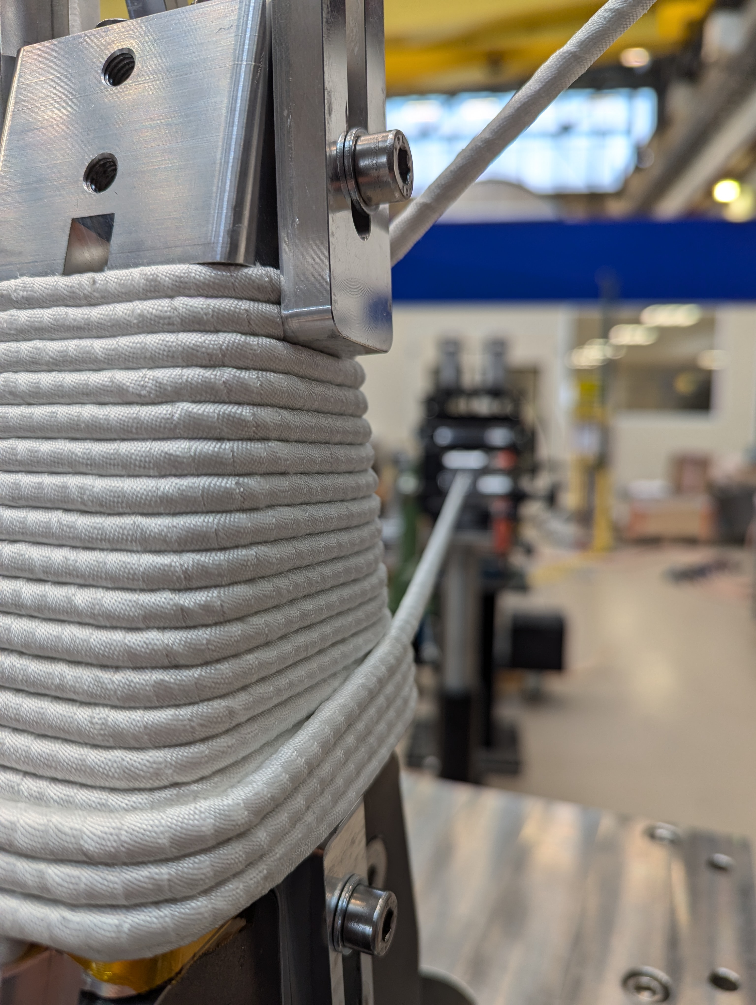
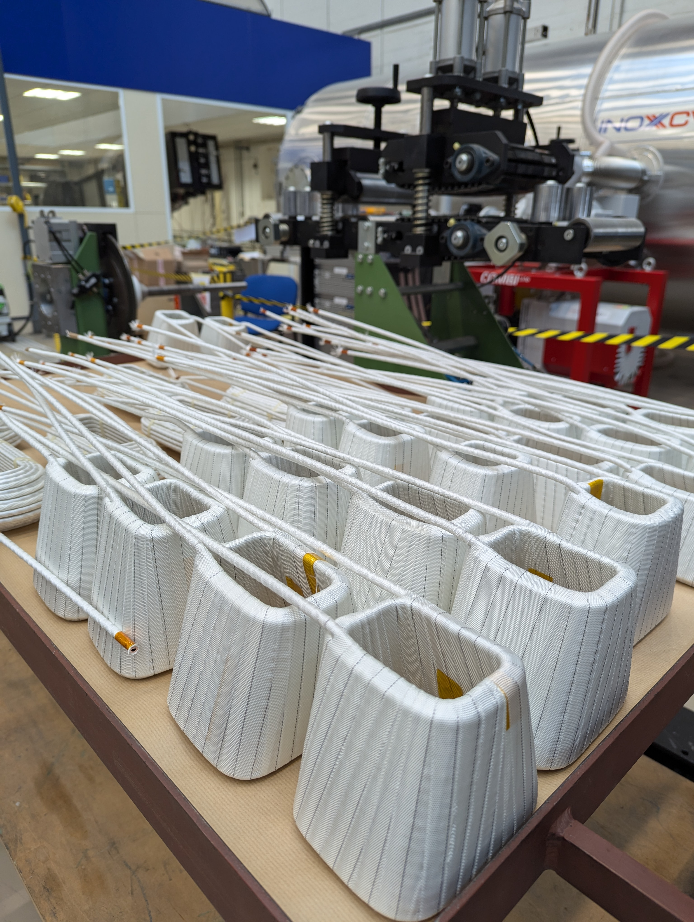
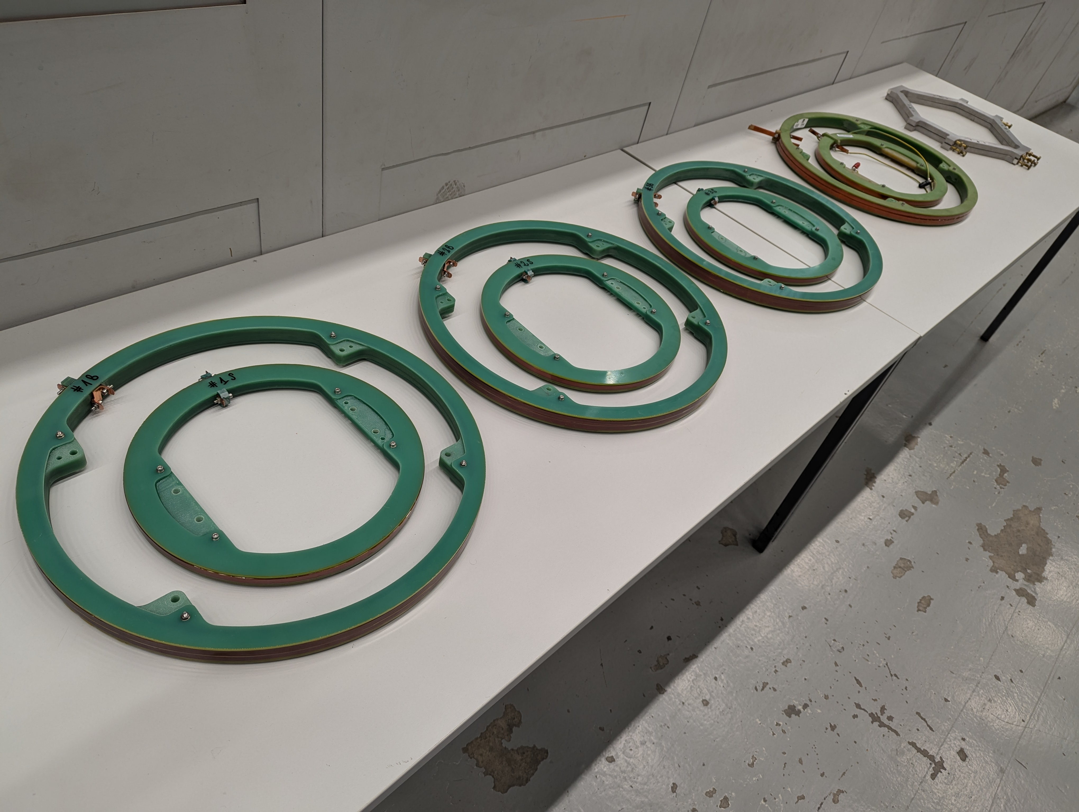
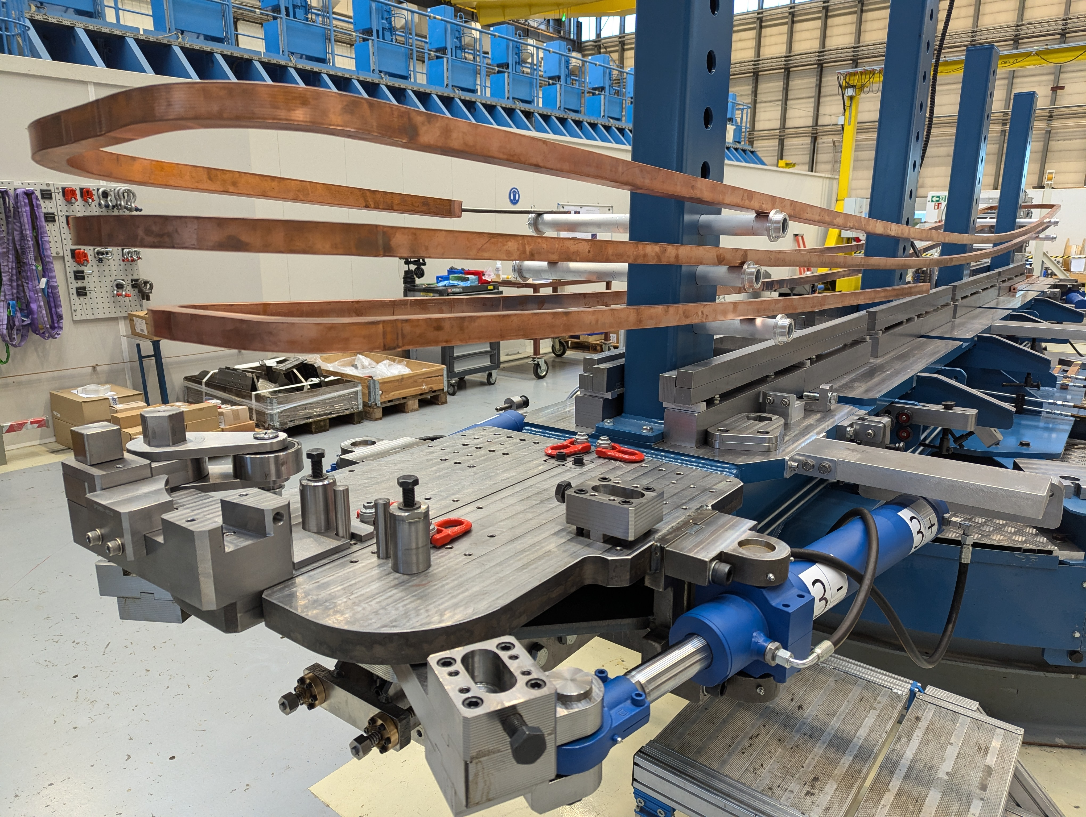
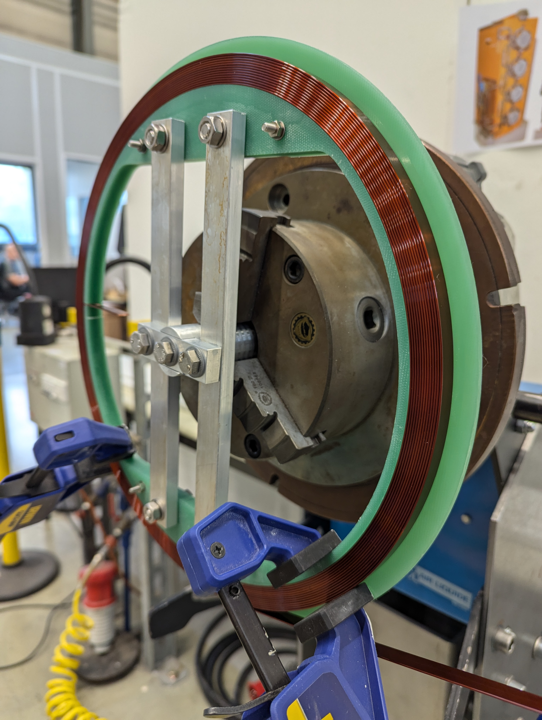
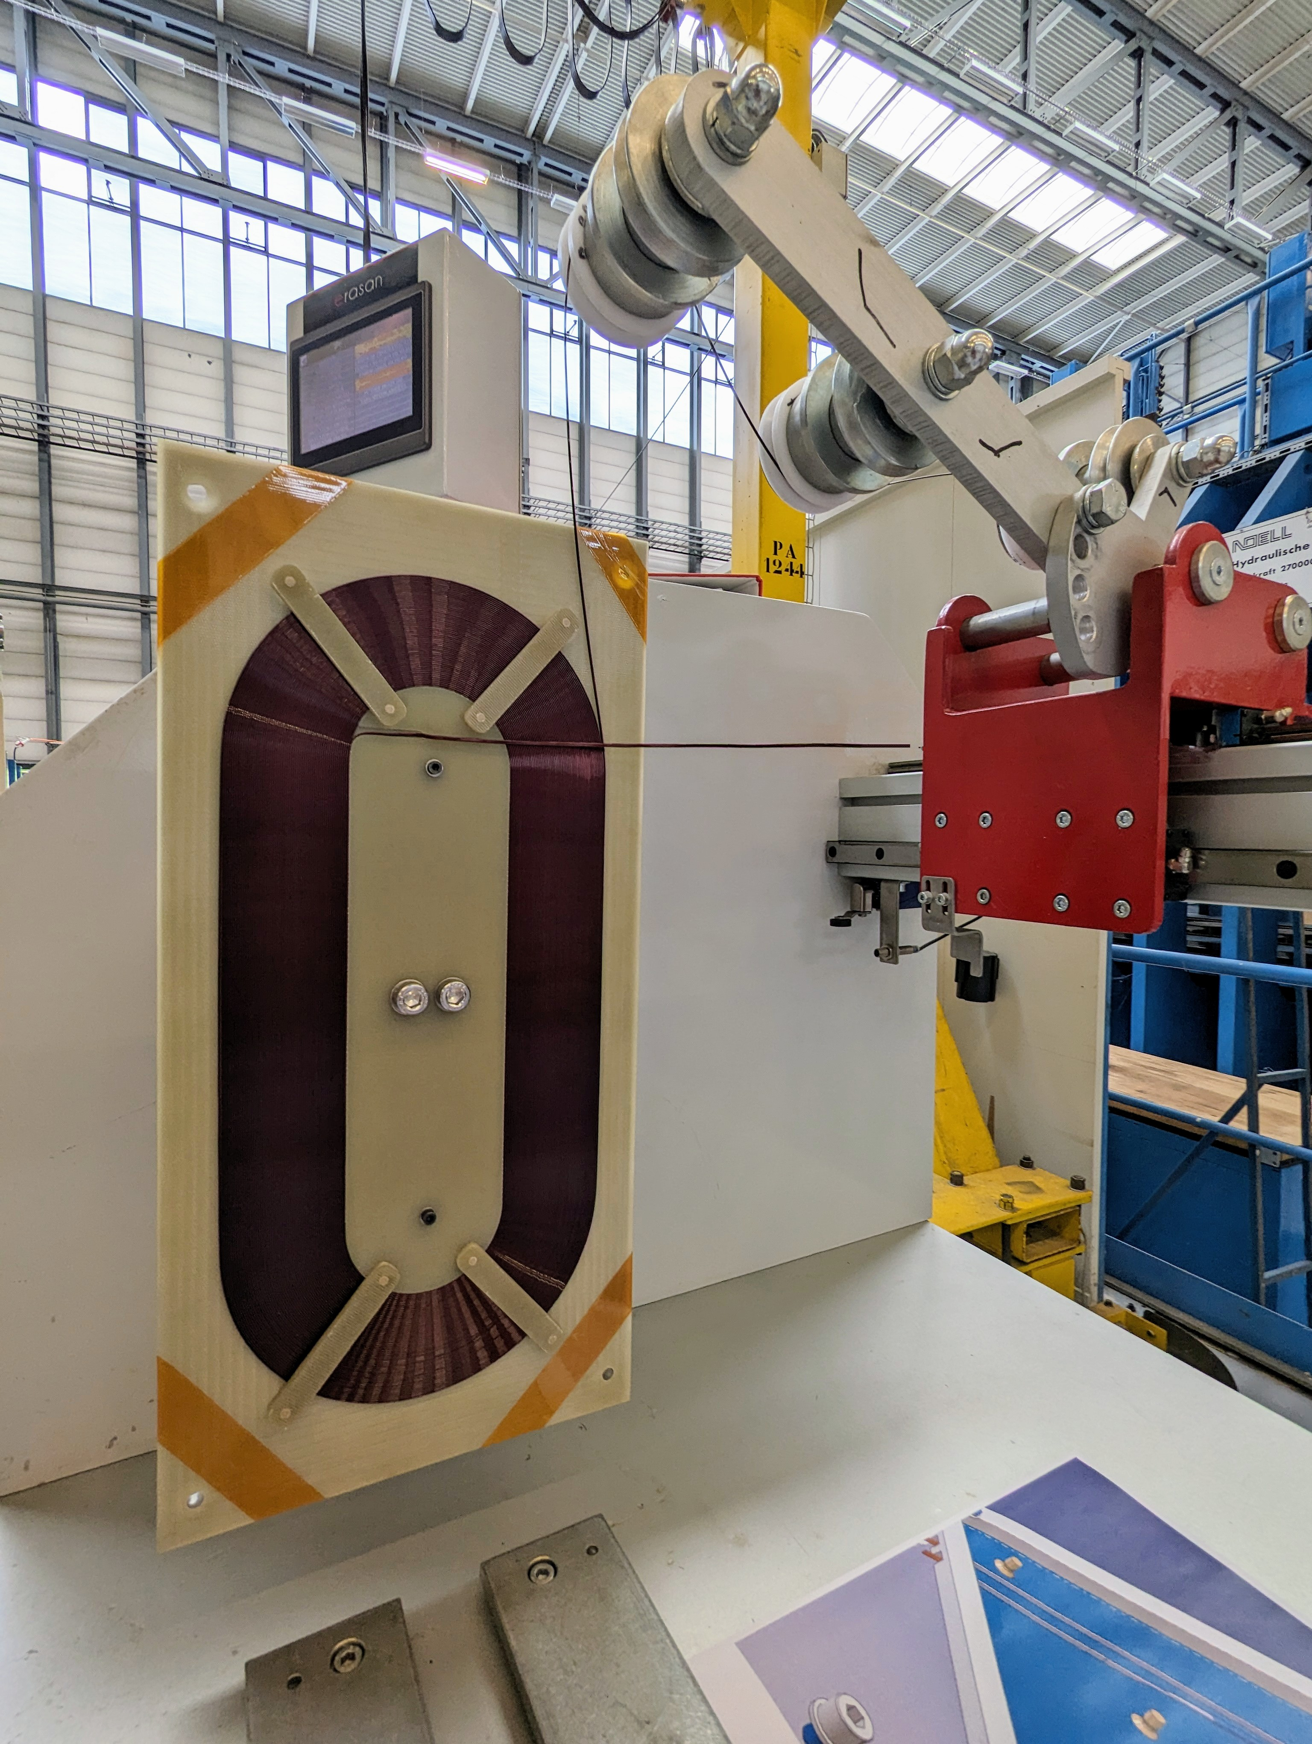
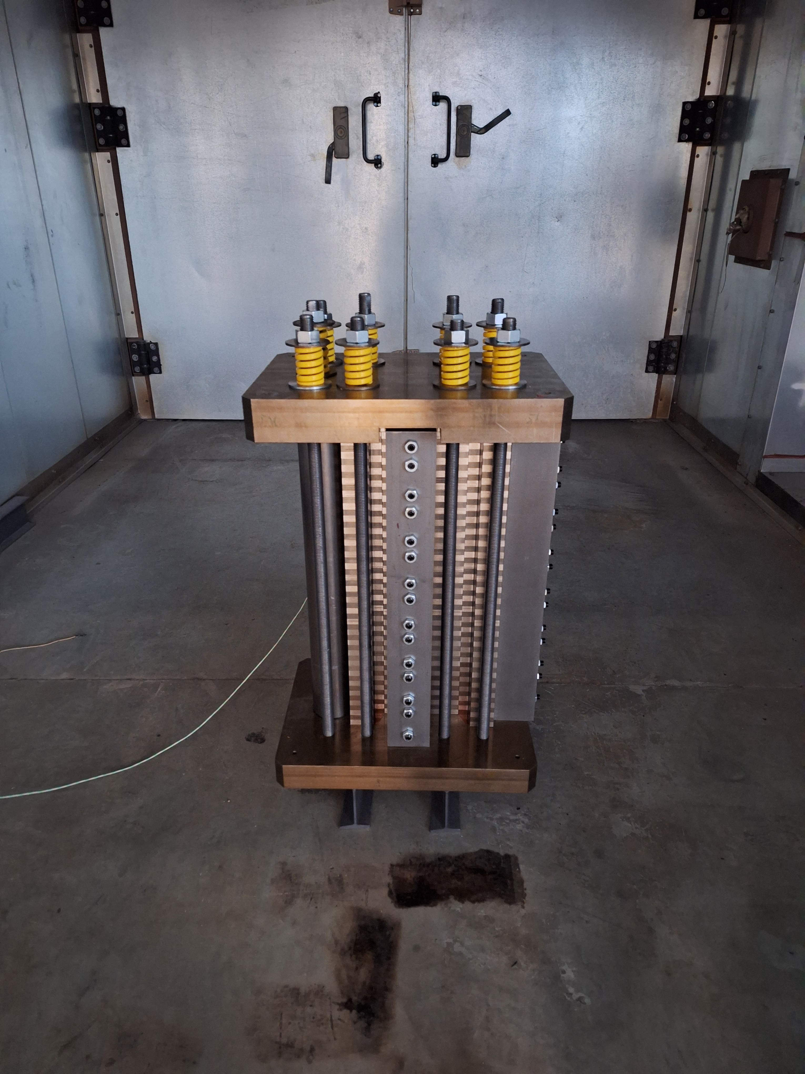
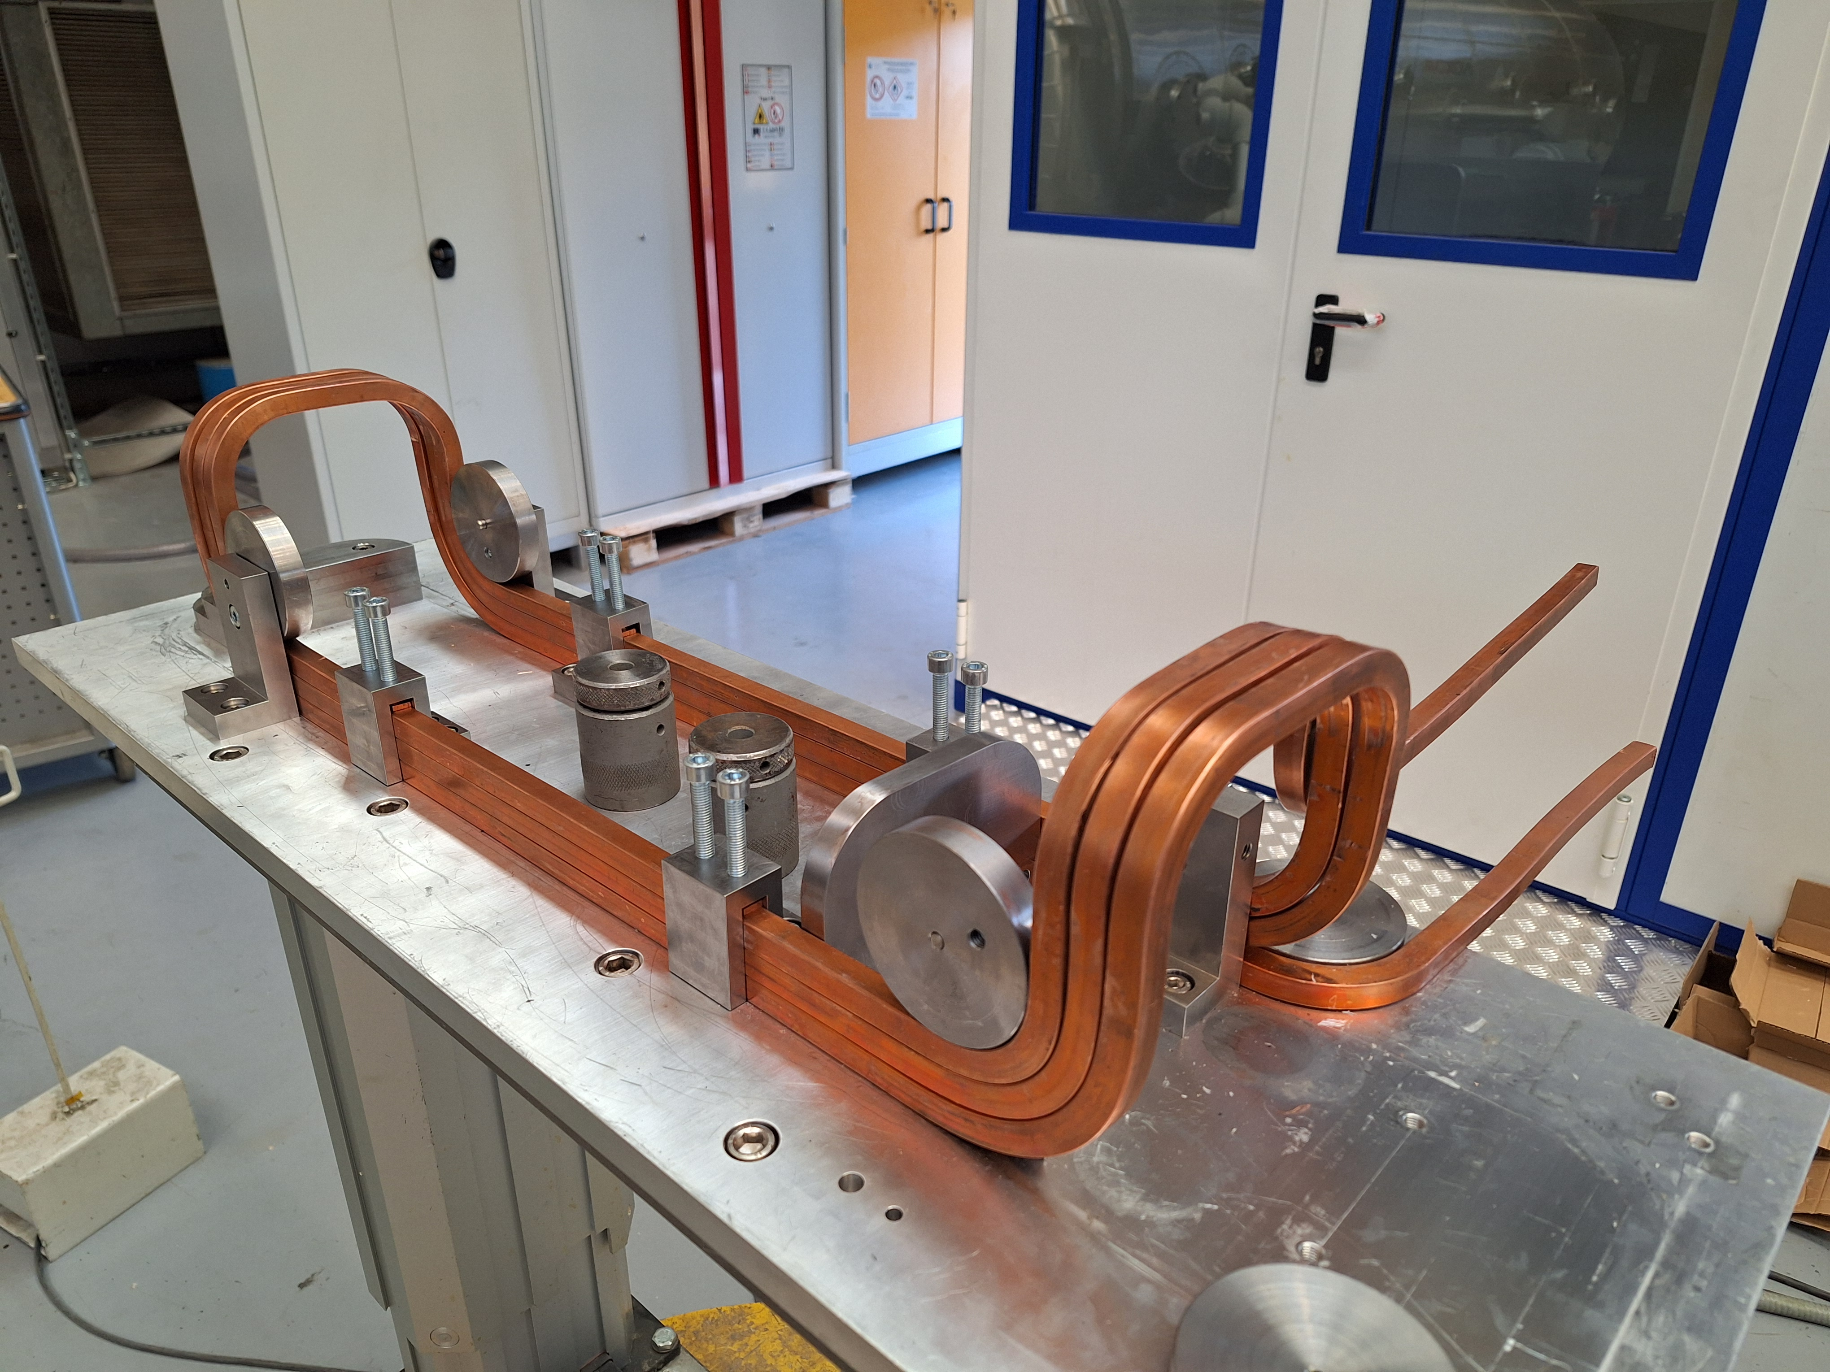
Magnet production in our proto lab
Helmholtz Coils (ASACUSA)
Isolde triplet/doublet Spare coils
SPS MBB Coil winding line
ESC Coil (Quench induction coil for SMC Magnet)
We build magnets
FCC-ee Booster Dipole Prototype Construction

Slide 11

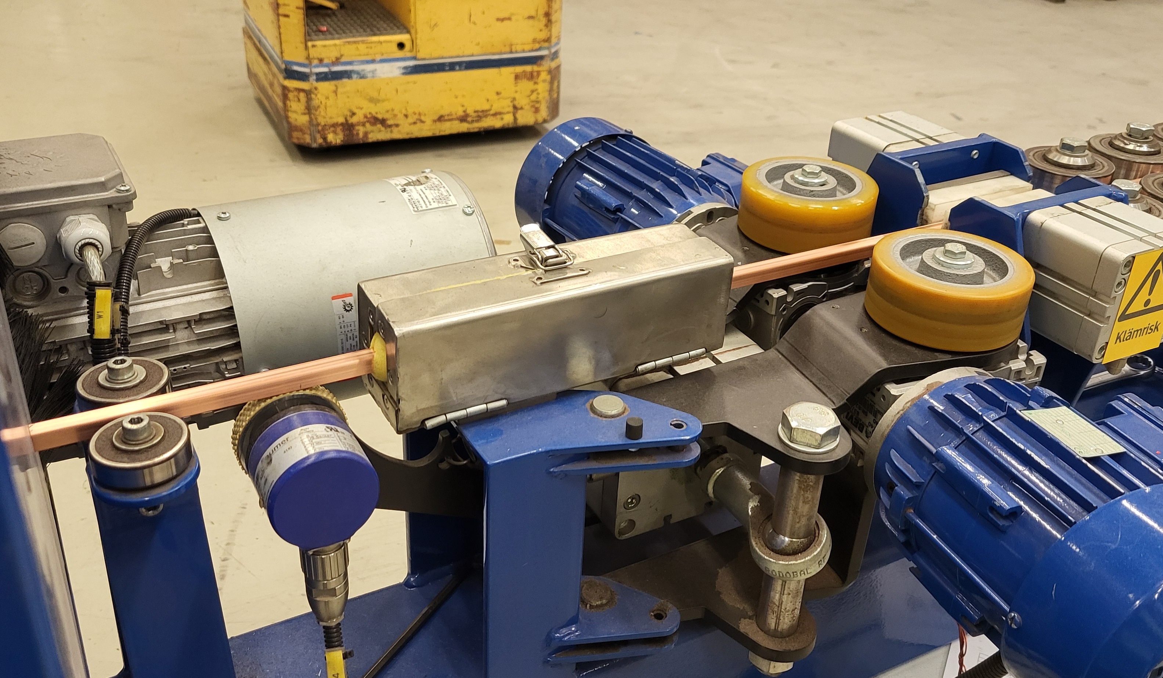
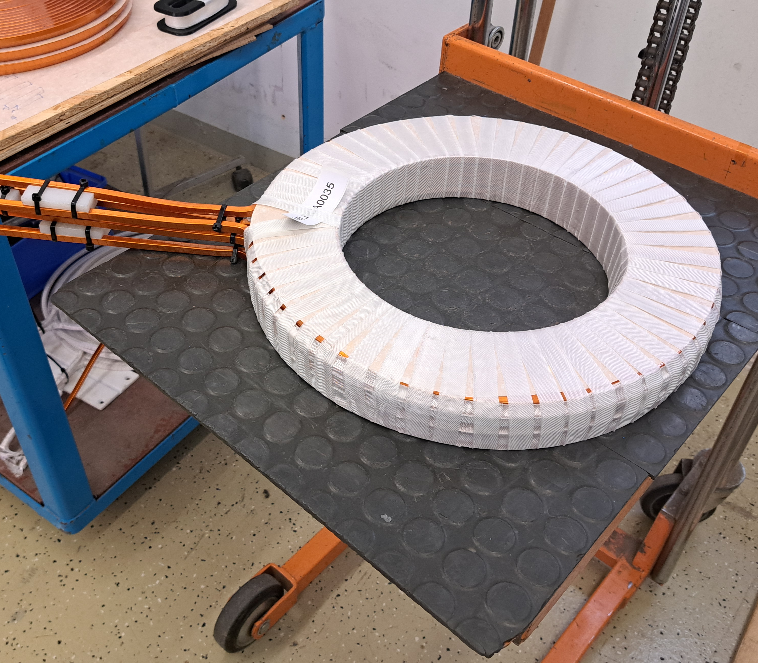
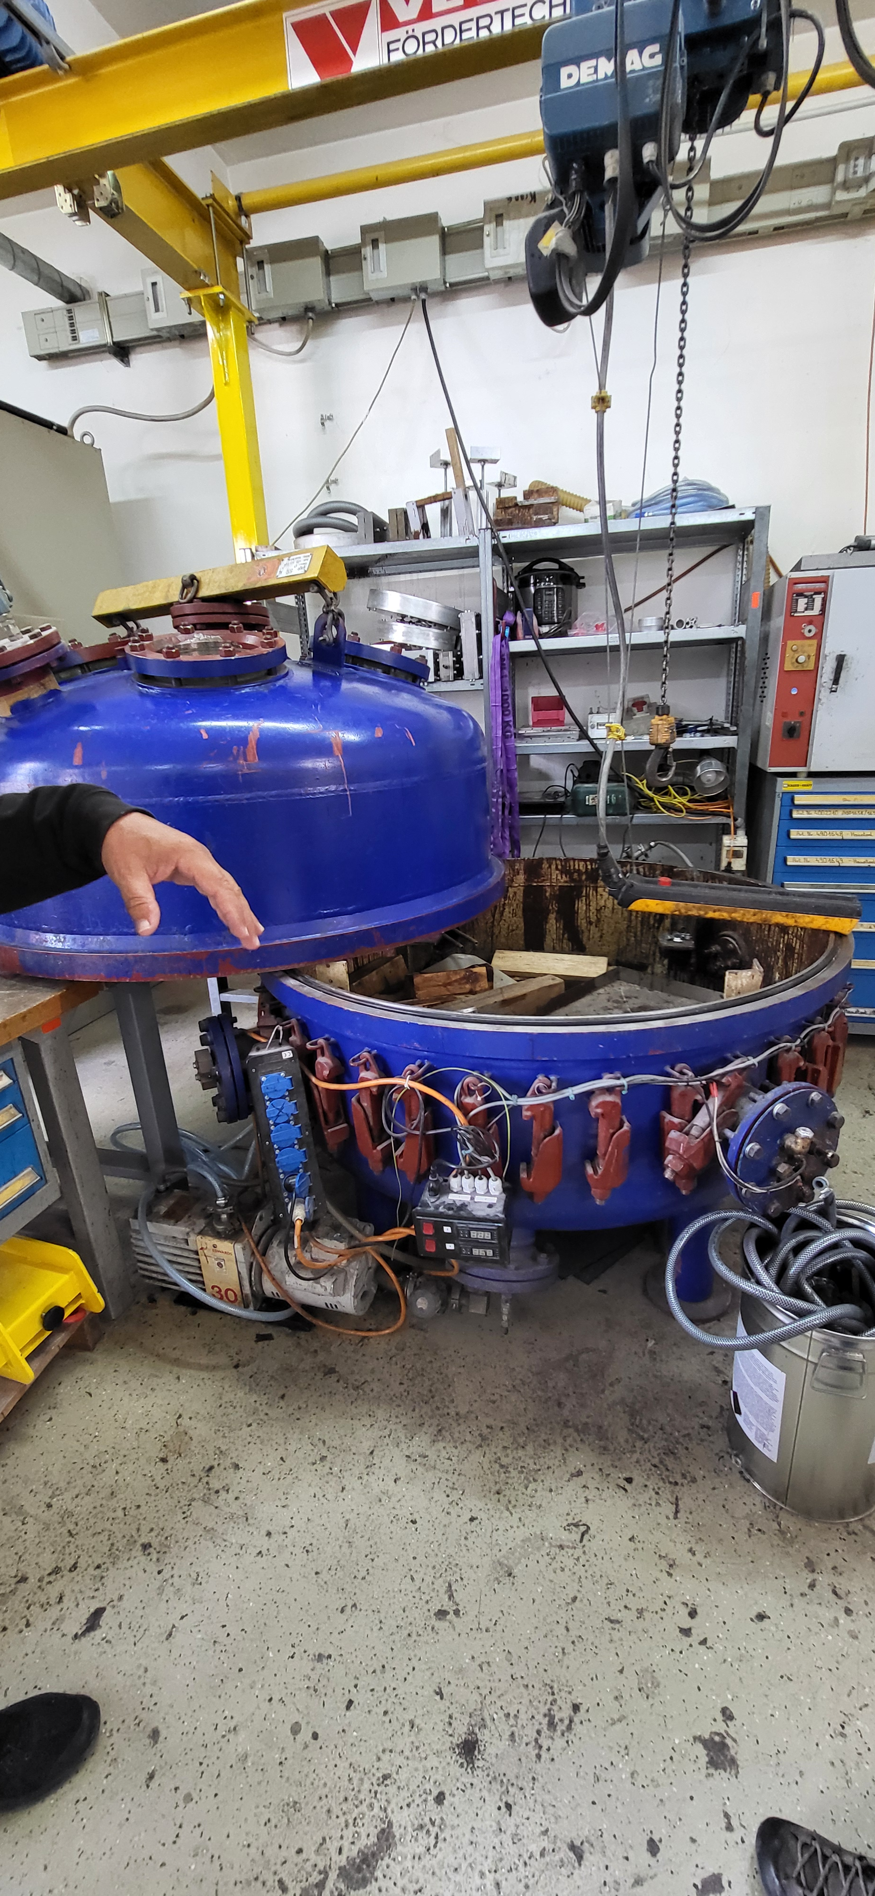
Magnet procurement
We have to procure 50 different magnet/coils for the consolidation of the accelerator complex
This year, we have launched 10+ Invitation to Tenders and Price Enquiries
Almost 30 travel.persons during the year for follow-up of contracts
We work with industry

Slide 12
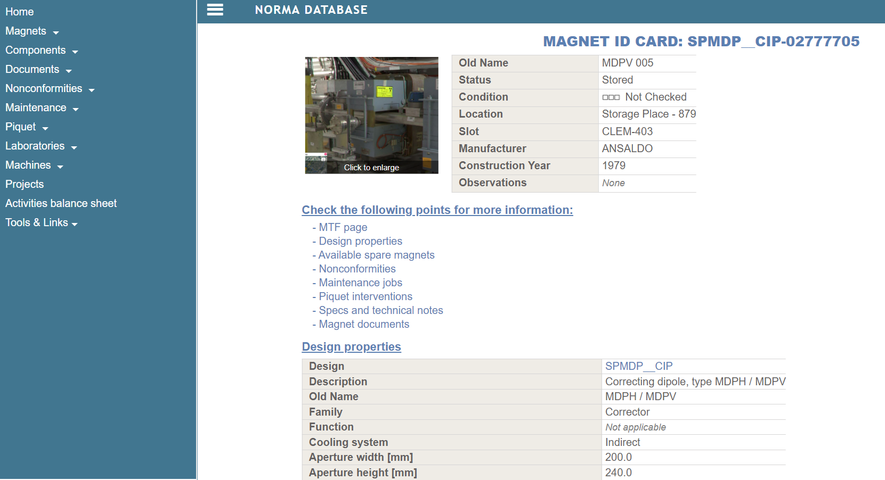
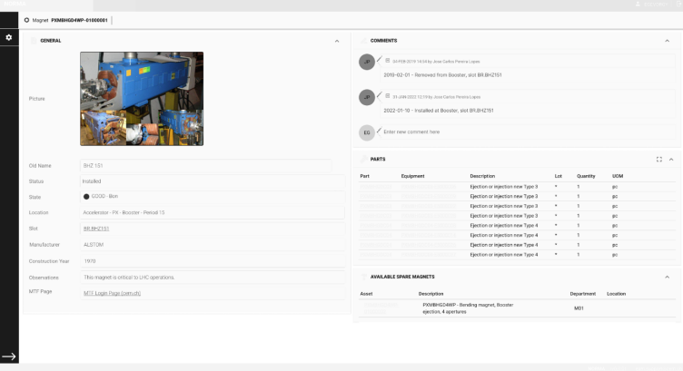
NCM Quality Assurance
NORMA DB
NORMA Database
We have developed our own database and maintenance support tool
  To secure all the magnet data
  To coordinate our maintenance plan
New version under development with EAM
Risk assessment
Risk analysis of installed magnets mutually reviewed in the section establishing mitigation measures
NORMA DB mock-up
We keep track of the magnet life to establish
targeted maintenance and consolidation plans

Slide 13
NCM projects

Slide 14
List of present projects
Studies for Magnet Systems for future CERN accelerators
FCC-ee collider magnets (J. Bauche, C. Eriksson)
FCC-ee booster magnets (L. von Freeden, H. Deveci)
FCC-ee transfer line magnets (P. Thonet)
CLIC (J. Bauche)
New magnets for CERN accelerators & approved experiments
AWAKE2c magnet system (P. Schwarz)
AWAKE, CLEAR and DEFT solenoids (R. Key)
LHC BGI magnet system (D. Bodart)
McKeehan coils for ASACUSA (M. Dumas)
ALPHA solenoid (L. von Freeden, R. Key)
SHiP/BDF hadron shielding (P. Schwarz)
Consolidation activities
SPS MBB spare coils (P. Schwarz)
PSB quadrupoles (A. Newborough, I. Garcia)
ISOLDE triplets (C. Eriksson, M. Dumas)
AD quad and dipole target magnets (P. Thonet)
AD electron cooler (L. von Freeden, D. Gerard)
TCC2 magnets (MSN, MTN, QSL) (P. Schwarz)
Refurbishing of existing magnets (production plan)
Spare coils for existing magnets (production plan)
Electrical cover project (O. Crettiez)
Collaborations
EuroSIG scanning magnet (P. Schwarz)
DEFT (FLASH) magnet system (J. Bauche, R. Key)
ESC coil for SMC quench induction (I. Garcia)
LHCb magnet consolidation (P. Thonet)
EP experimental magnets (P. Schwarz)
20++ projects

Slide 15
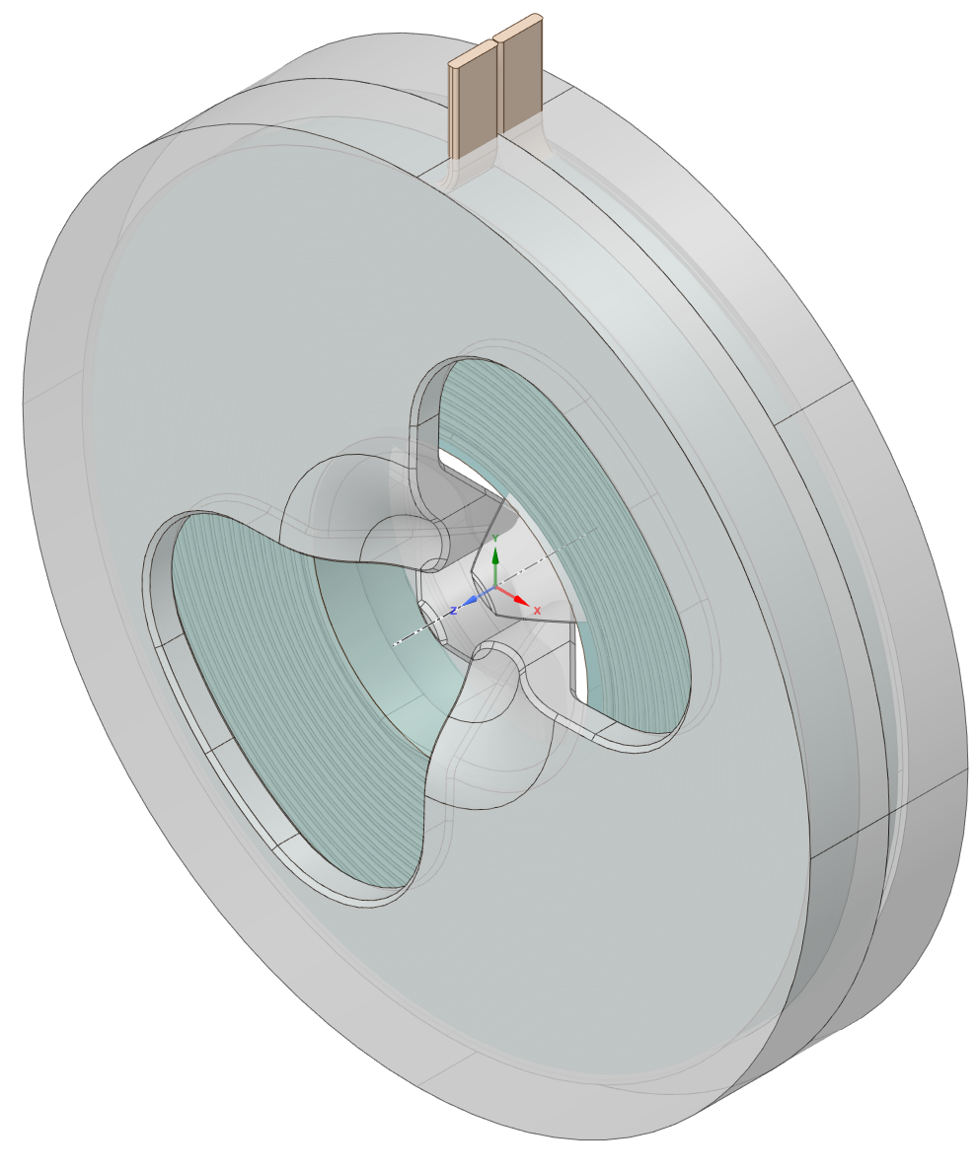
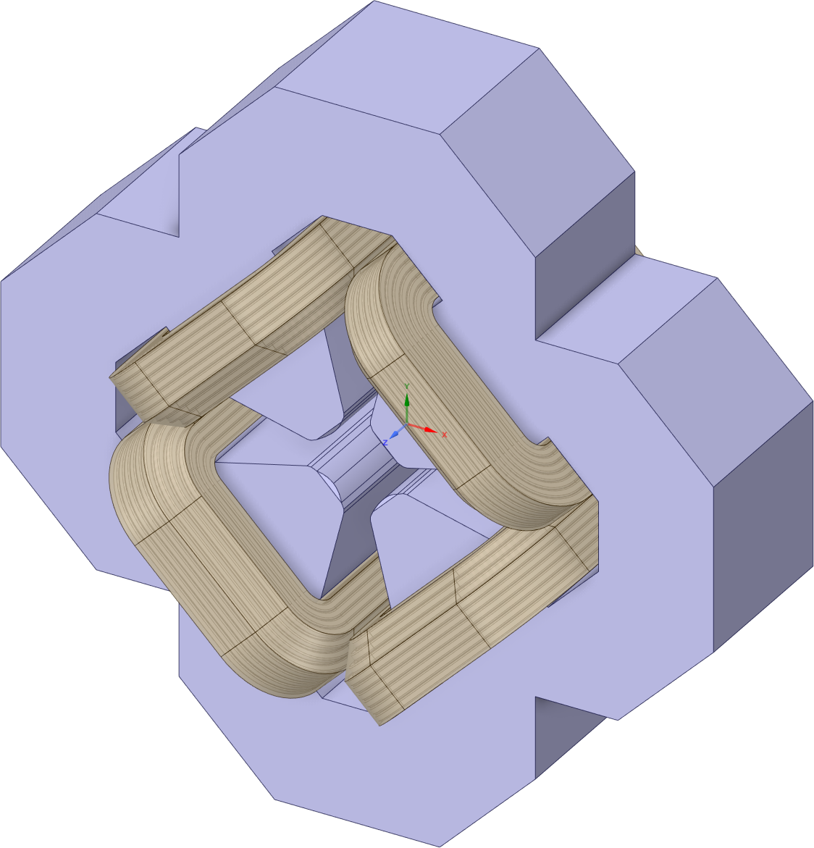
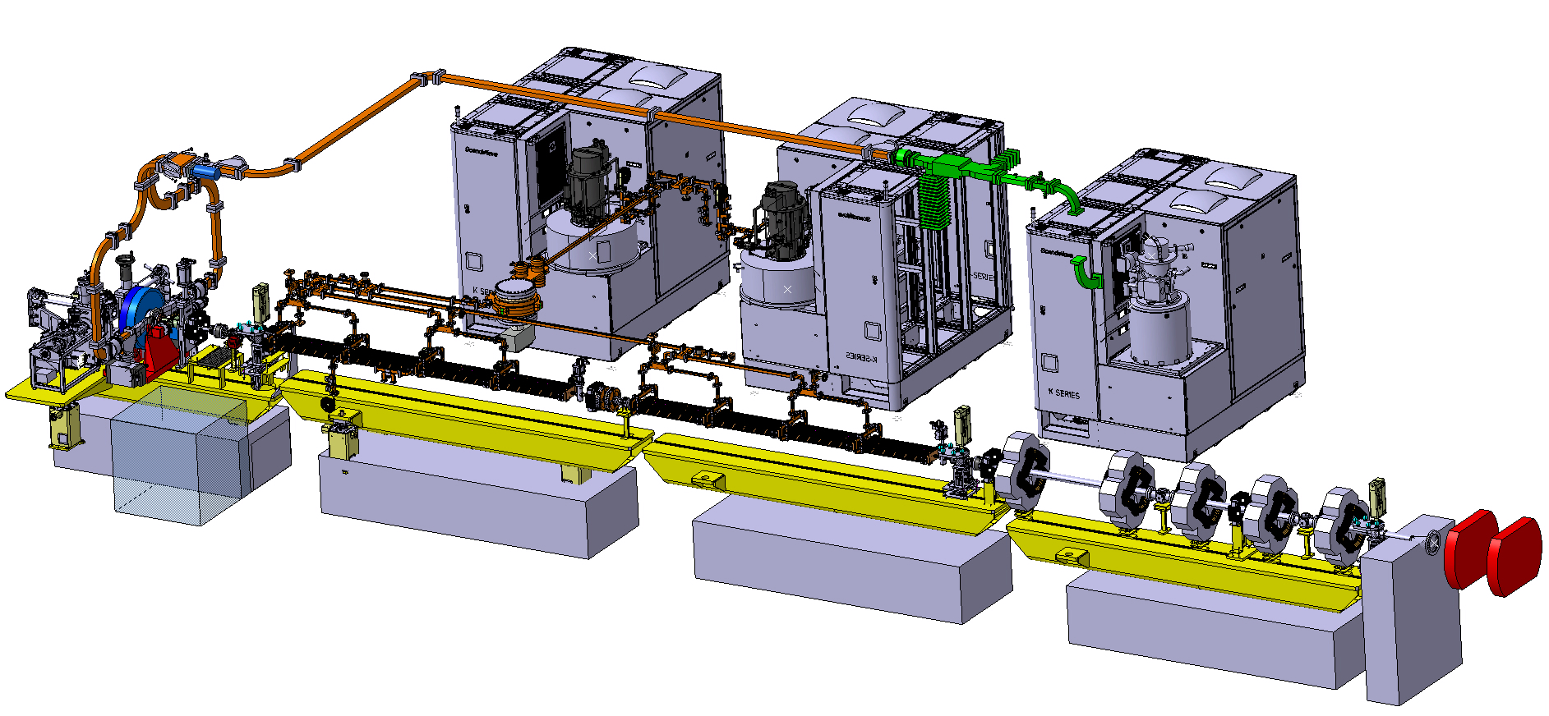
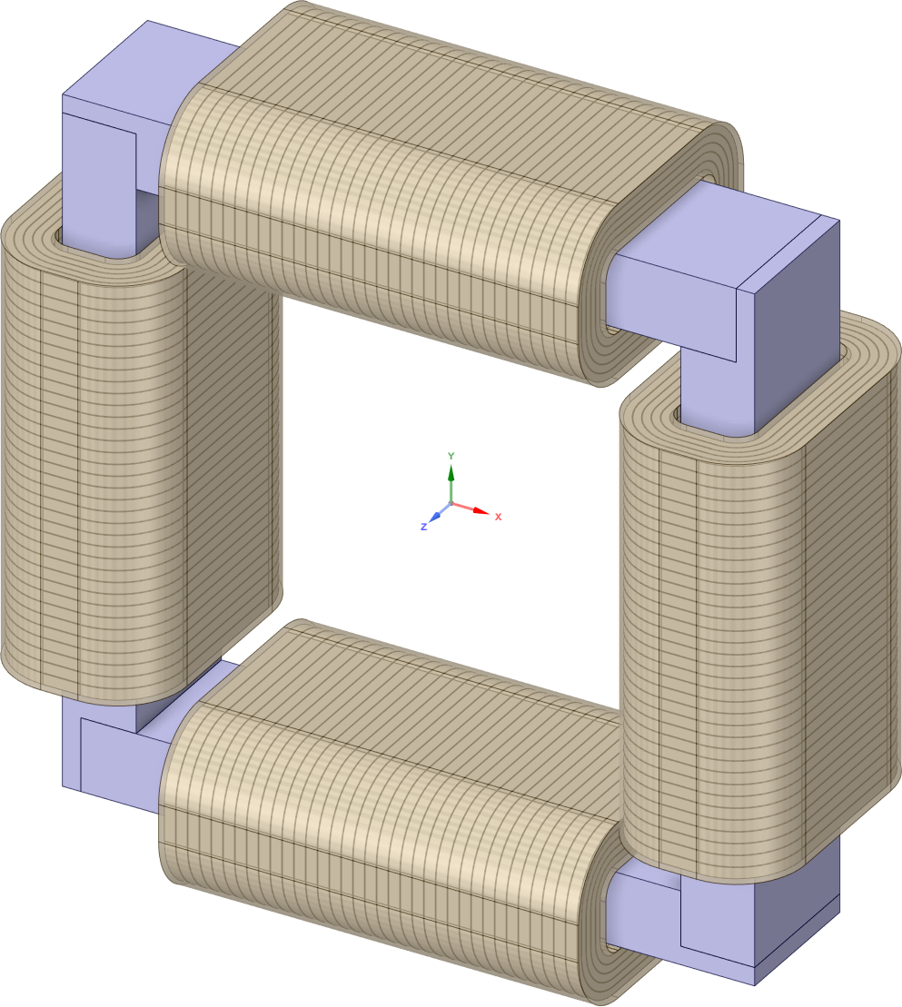
Diversity program: DEFT, a radiation therapy accelerator
Source solenoids
Claw-pole quadrupole (x2)
BDS quadrupole (x5)
Prototype to be built in 2025
TDR V3 completed
H/V steerer (x5)
*
*
*
*
FLASH electron radiotherapy
*
*

Slide 16
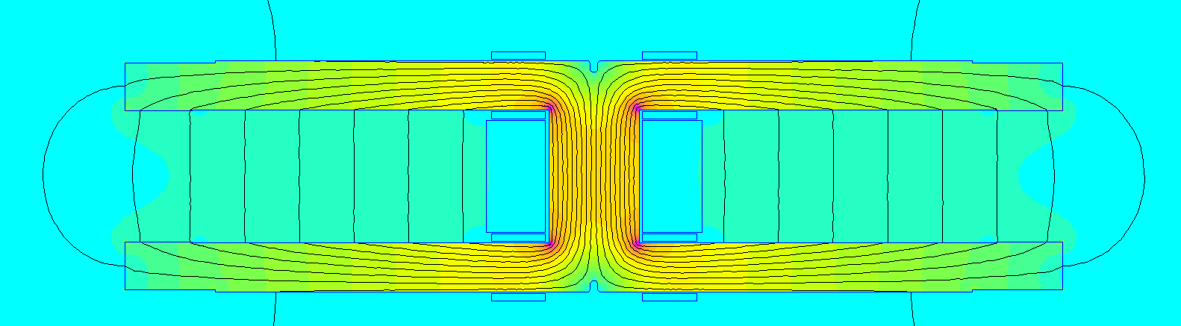
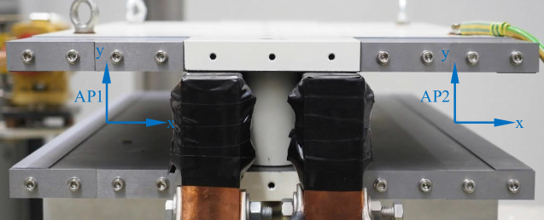
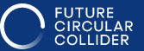
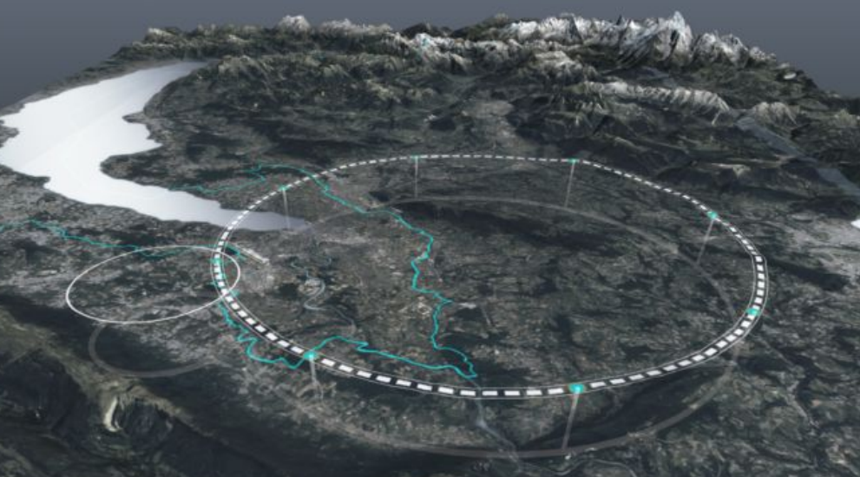
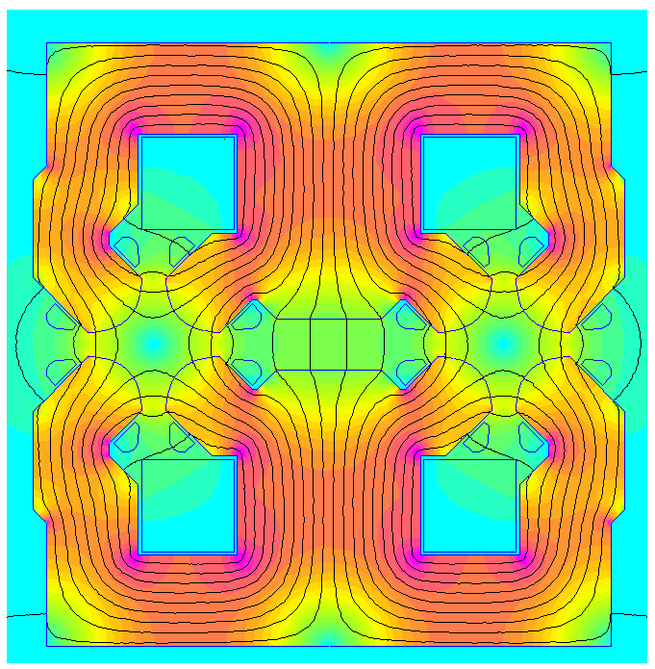
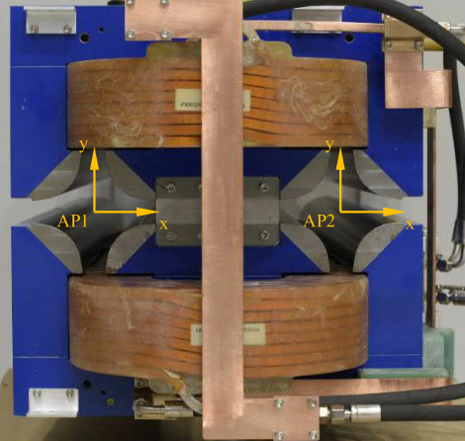
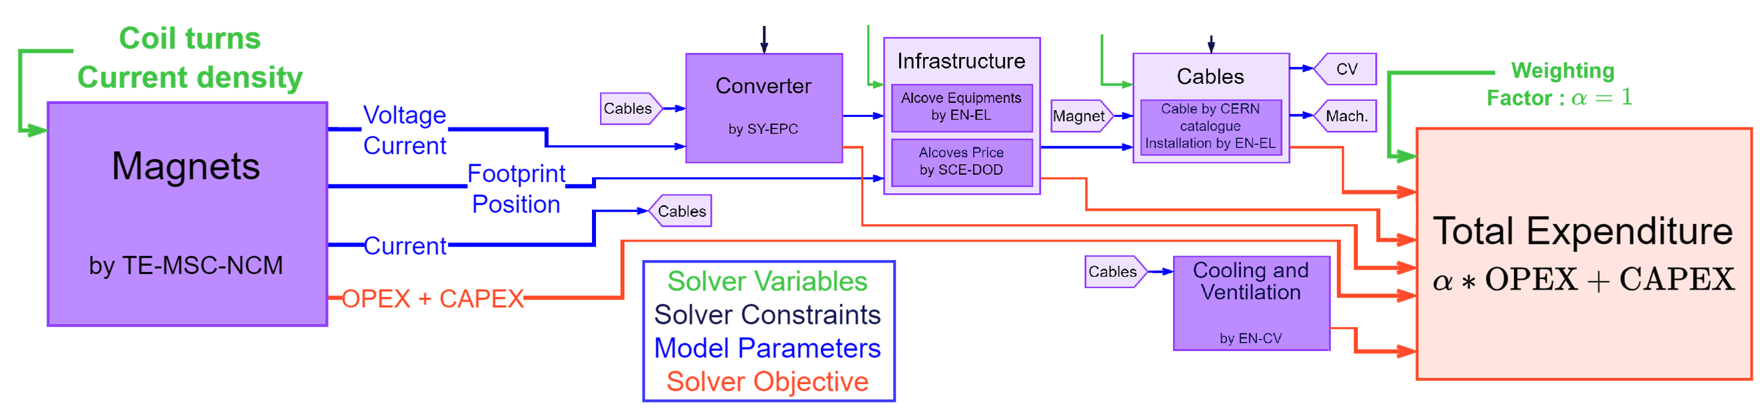
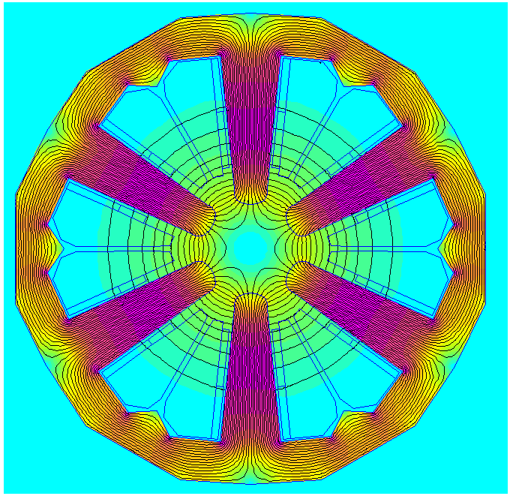
Magnets for FCC-ee: Collider
5680 units x 10.5 m ≈ 60 km
FCC-ee: 90 km ring, 75 km of magnets!
Magnet prototypes
2840 units x 2.9 m ≈ 8 km
Feasibility report in preparation
Magnet optimization
Lifetime cost optimization of magnet circuits
4672 units x 1.3 m ≈ 6 km

Slide 17
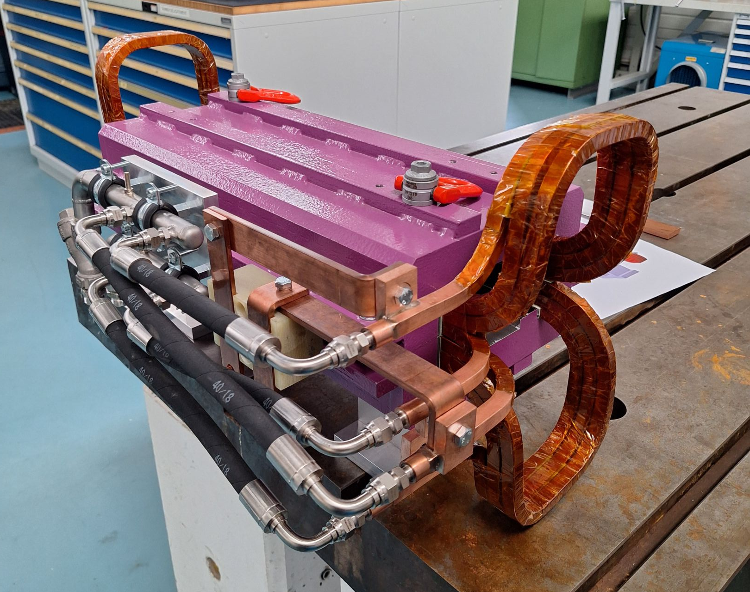
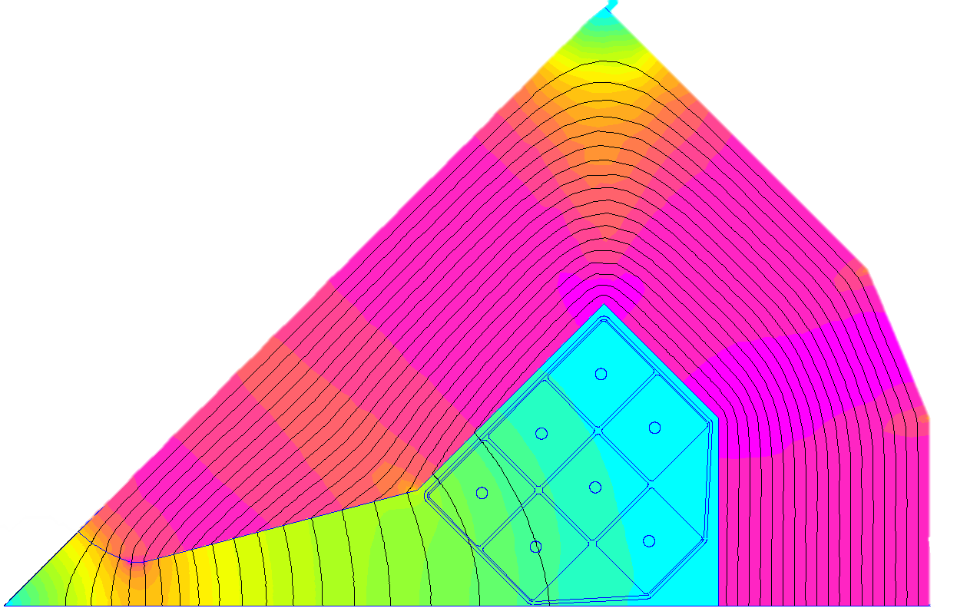
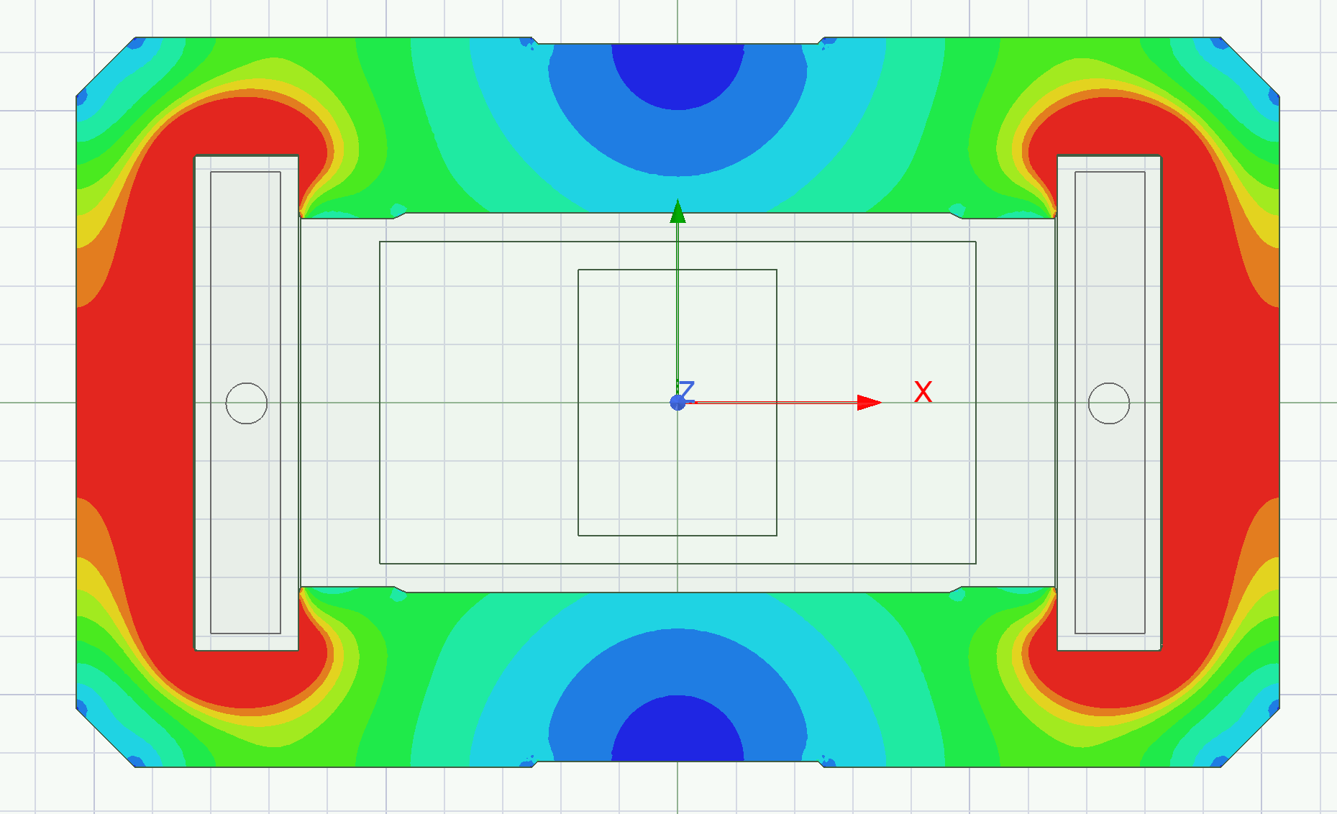
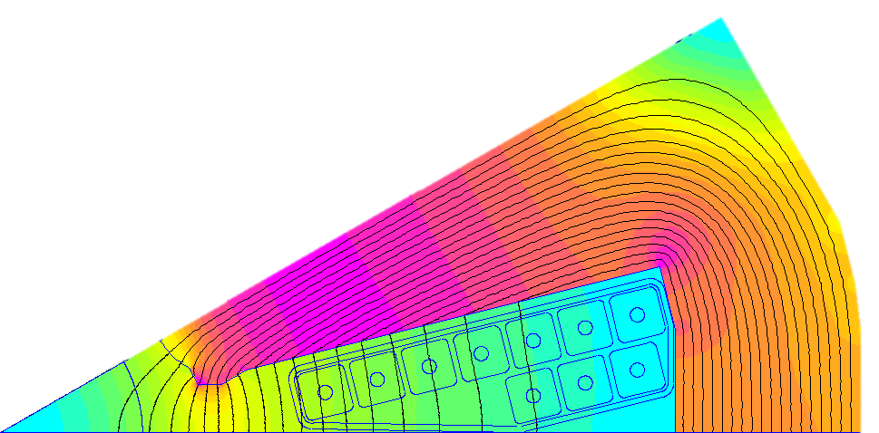
Magnets for FCC-ee: Booster
Completed main magnet design fulfilling the v. 24 optics requirements
R 32.5
Outer Ø 584
R 32.5
Outer Ø 304
Validated >99% predictive accuracy of hysteresis modeling
We showed that 20 GeV injection field seems feasible!

Slide 18
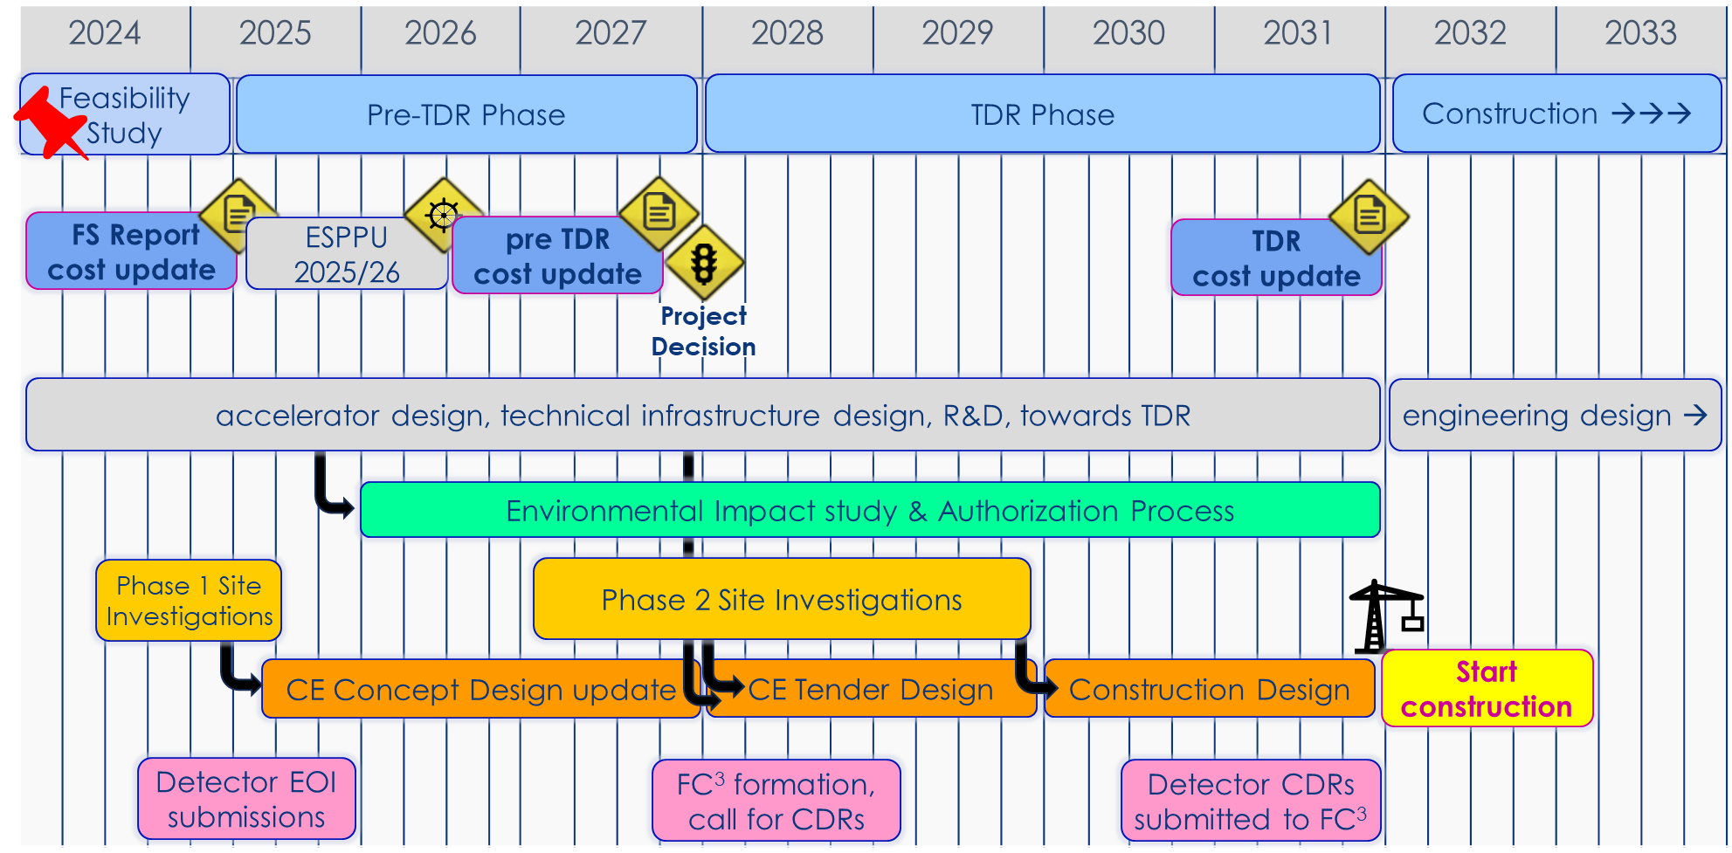
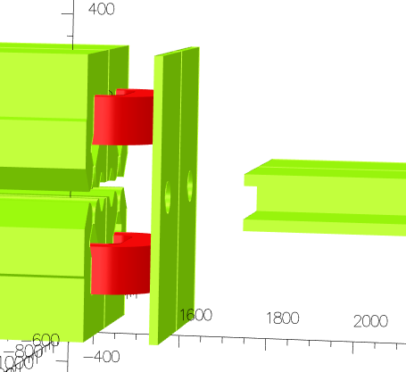
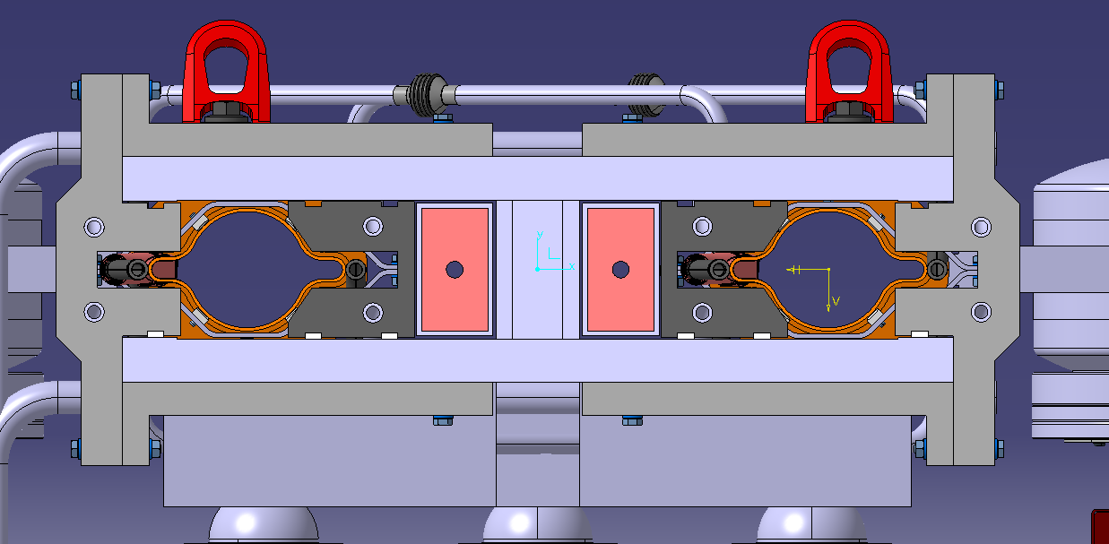
Magnet development for FCC-ee: next steps
EMC mitigation studies
FCC timeline (M. Benedikt, FCC Week 2024)
Magnet development during pre-TDR phase
Magnet design and optimization for collider, booster and injector
  Study for alternative collider optics (LCC vs. GHC, or else)
  EM vs. PM magnets for injector – booster transfer line
  Orbit correctors
Prototype construction and measurements
  1 of each main magnets
Study of industrialization strategy and manufacturing methods
  Manufacture
  Measurements and qualification
Opportunities for collaborations!
SR shielding integration

Slide 19
Thank you for your attention.

