Slide 1

Cryogenic radiative cooling of a large mirror suspended from an inverted pendulum and active platform for gravitational wave detector
Christophe Collette & Lionel Jacques

Slide 2
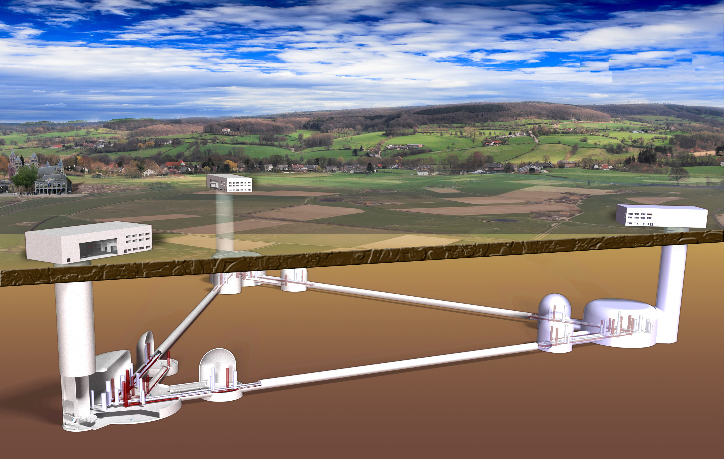
The Einstein Telescope
200m
10 Km

Slide 3
Challenges
Instrumental
Technologies
Construction Technologies
Sustainability
Cryogenics
Vacuum
Precision instruments
3D models & Simulations
Geografic imaging
Sustainable constructions
Sustainable waste ground removal
High grade mirrors
Mirror coatings
Sensors
Tunneling techniques
Ground water techniques
Climate neutral and sustainable energy
Sustainable logistics
Lasers
Advanced algorithms
Sustainable maintenance
Sustainable decommissioning

Slide 4
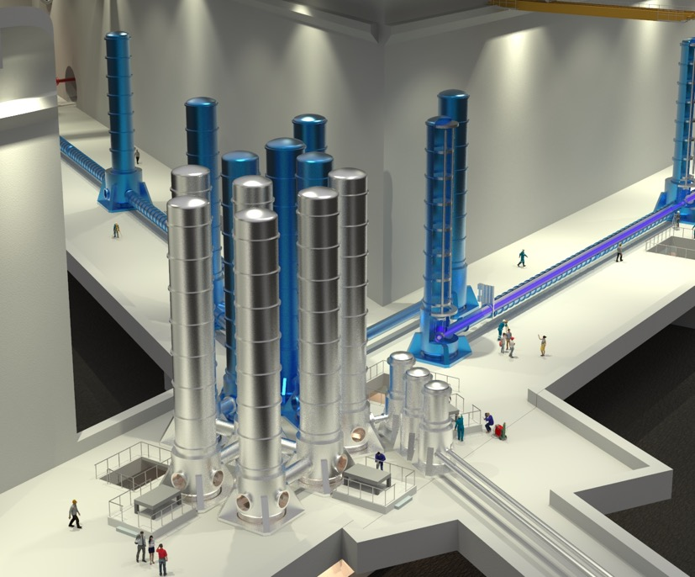
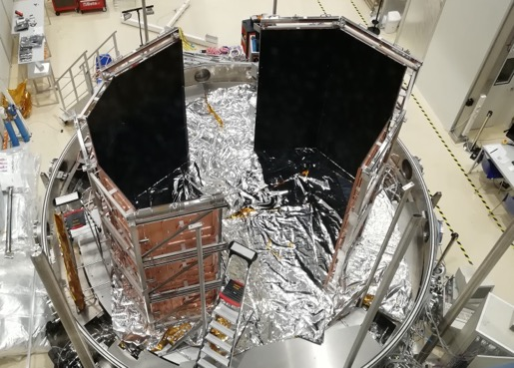
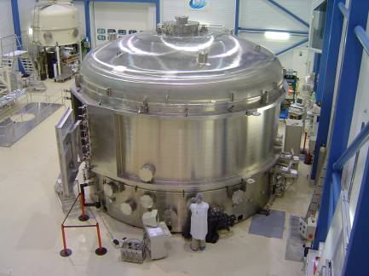





Objectives
Large mirror (100 Kg)
Cryogenic temperature (20 K)
Radiative cooling
Isolated at low frequency (0.1-10 Hz)
Compact suspension (4.5 meters)
Partners
Liège Space Center

Slide 5
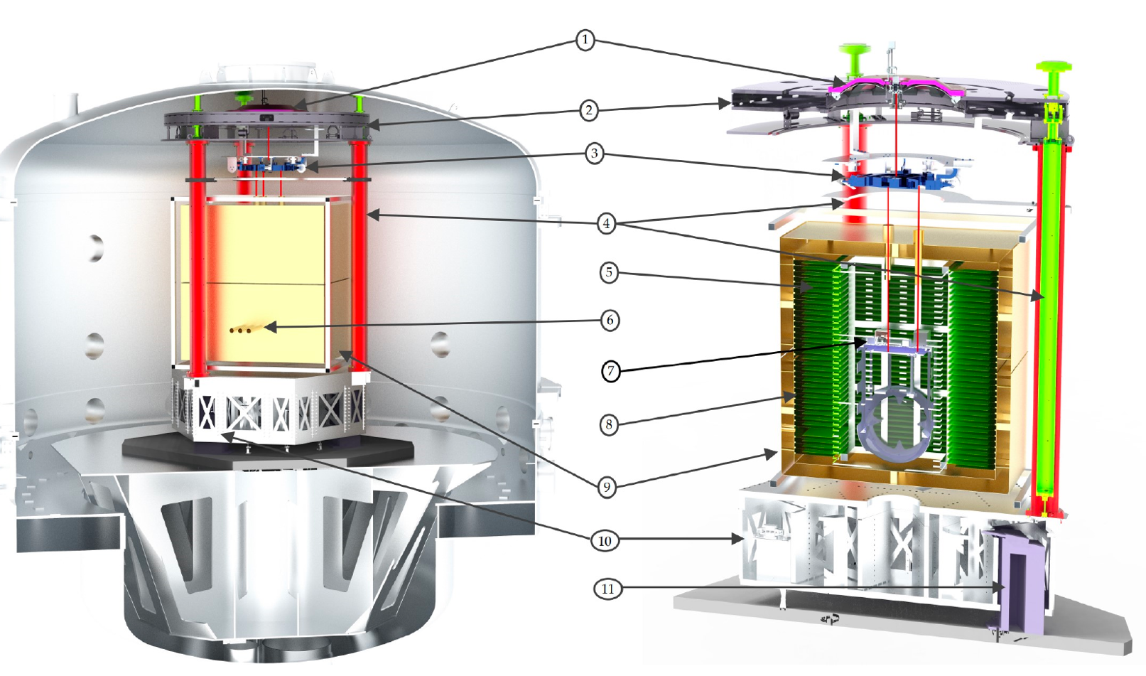
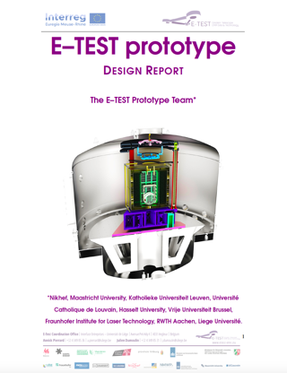
Conceptual design
Marionette
Inverted pendulum
Inertial sensors
Radiative cooling
Submitted: 12/2021
Revised: 03/2022
Active platform
https://arxiv.org/abs/2212.10083

Slide 6
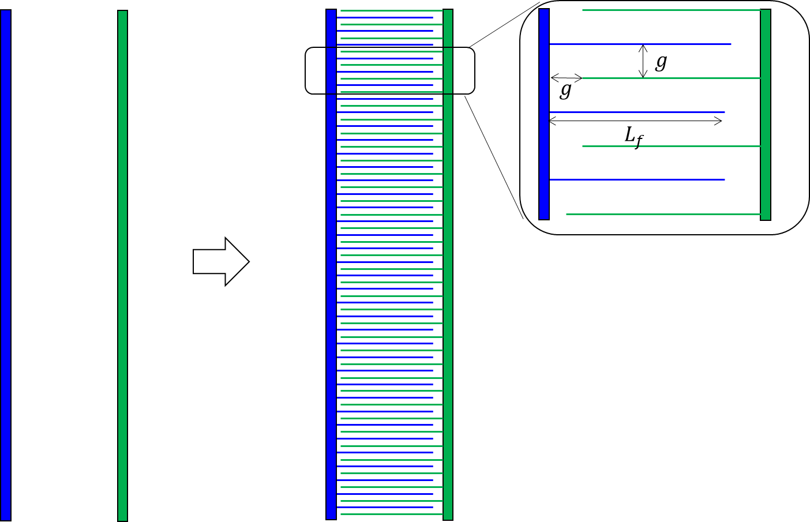
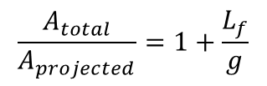
How to fit ~100m² around the payload?
Compress the radiative heat exchanger area: interleaved fins!
Trade-offs:
  Fin length & thickness ↔ stiffness
  mass (cooling time)
  Gap ↔ no-contact
  deformation
  relative motion
300mm long fins, 20mm gap
Amplification factor = 16
75m² → 5m² around the cold platform, 1m² footprint
$$\frac{A_{total}}{A_{projected}}=1+\frac{L_{f}}{g}$$

Slide 7
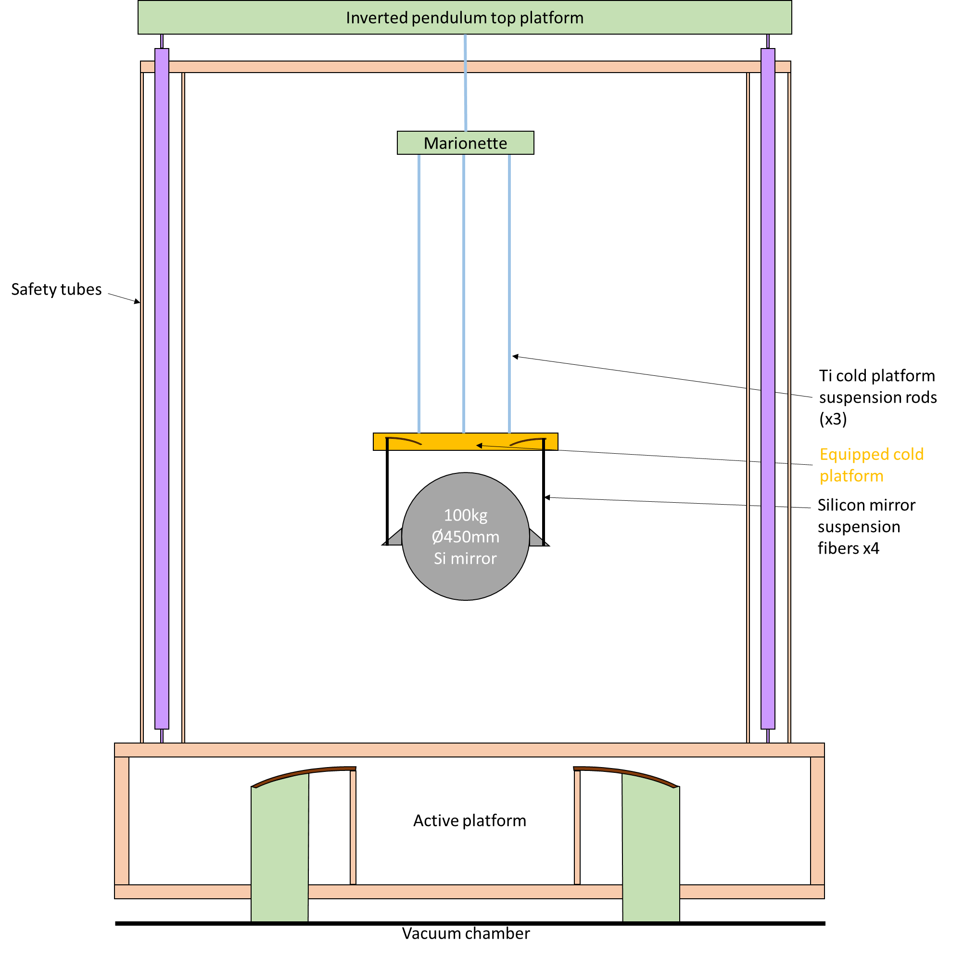
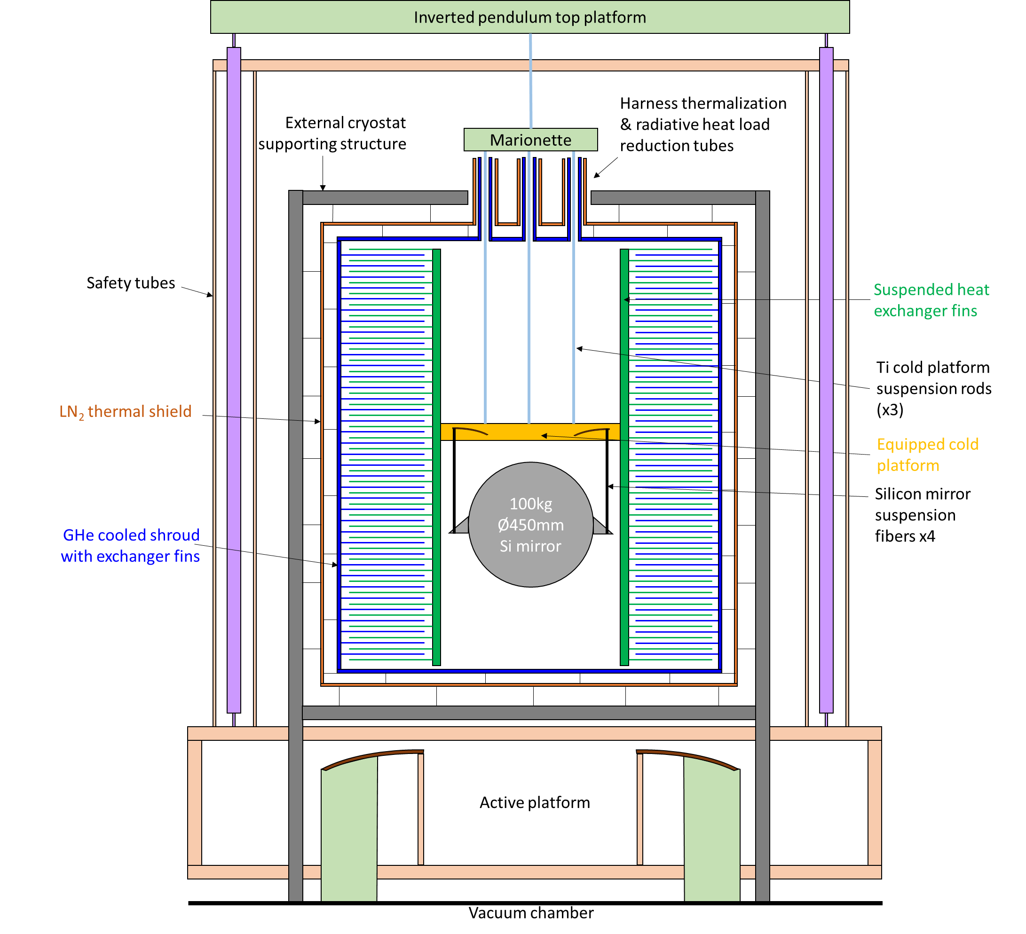
Fitting the heat exchanger around the payload

Slide 8
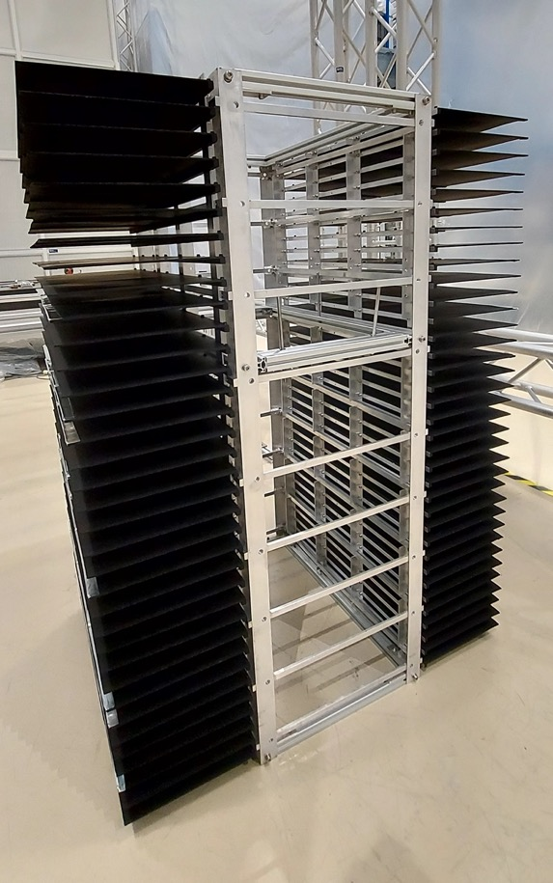
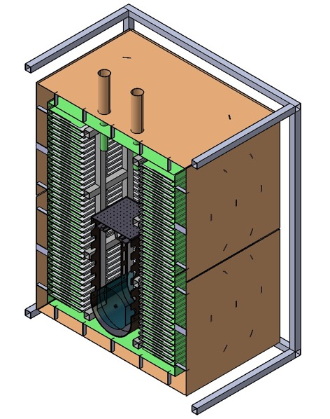

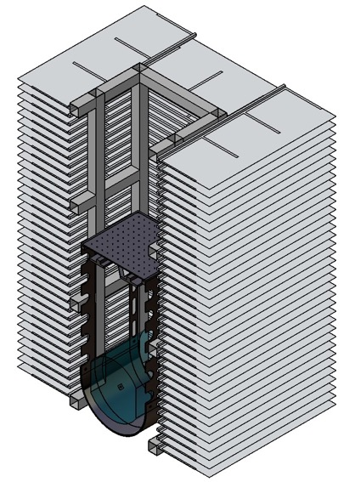
Cryostat development
overall dimensions: 1.8 x 1.6 x 2 m³
conventional radiator design with horizontal fins (25K)
three 30-mm diameter optical feedthroughs towards the mirror
Outer cryostat:
80K LN2 shield (brown)
25K GHe panels (green)
Inner cryostat suspended and conductively linked to the silicon mirror
Contact: Cedric Lenaerts (CSL)
Cedric.Lenaerts@uliege.be

Slide 9

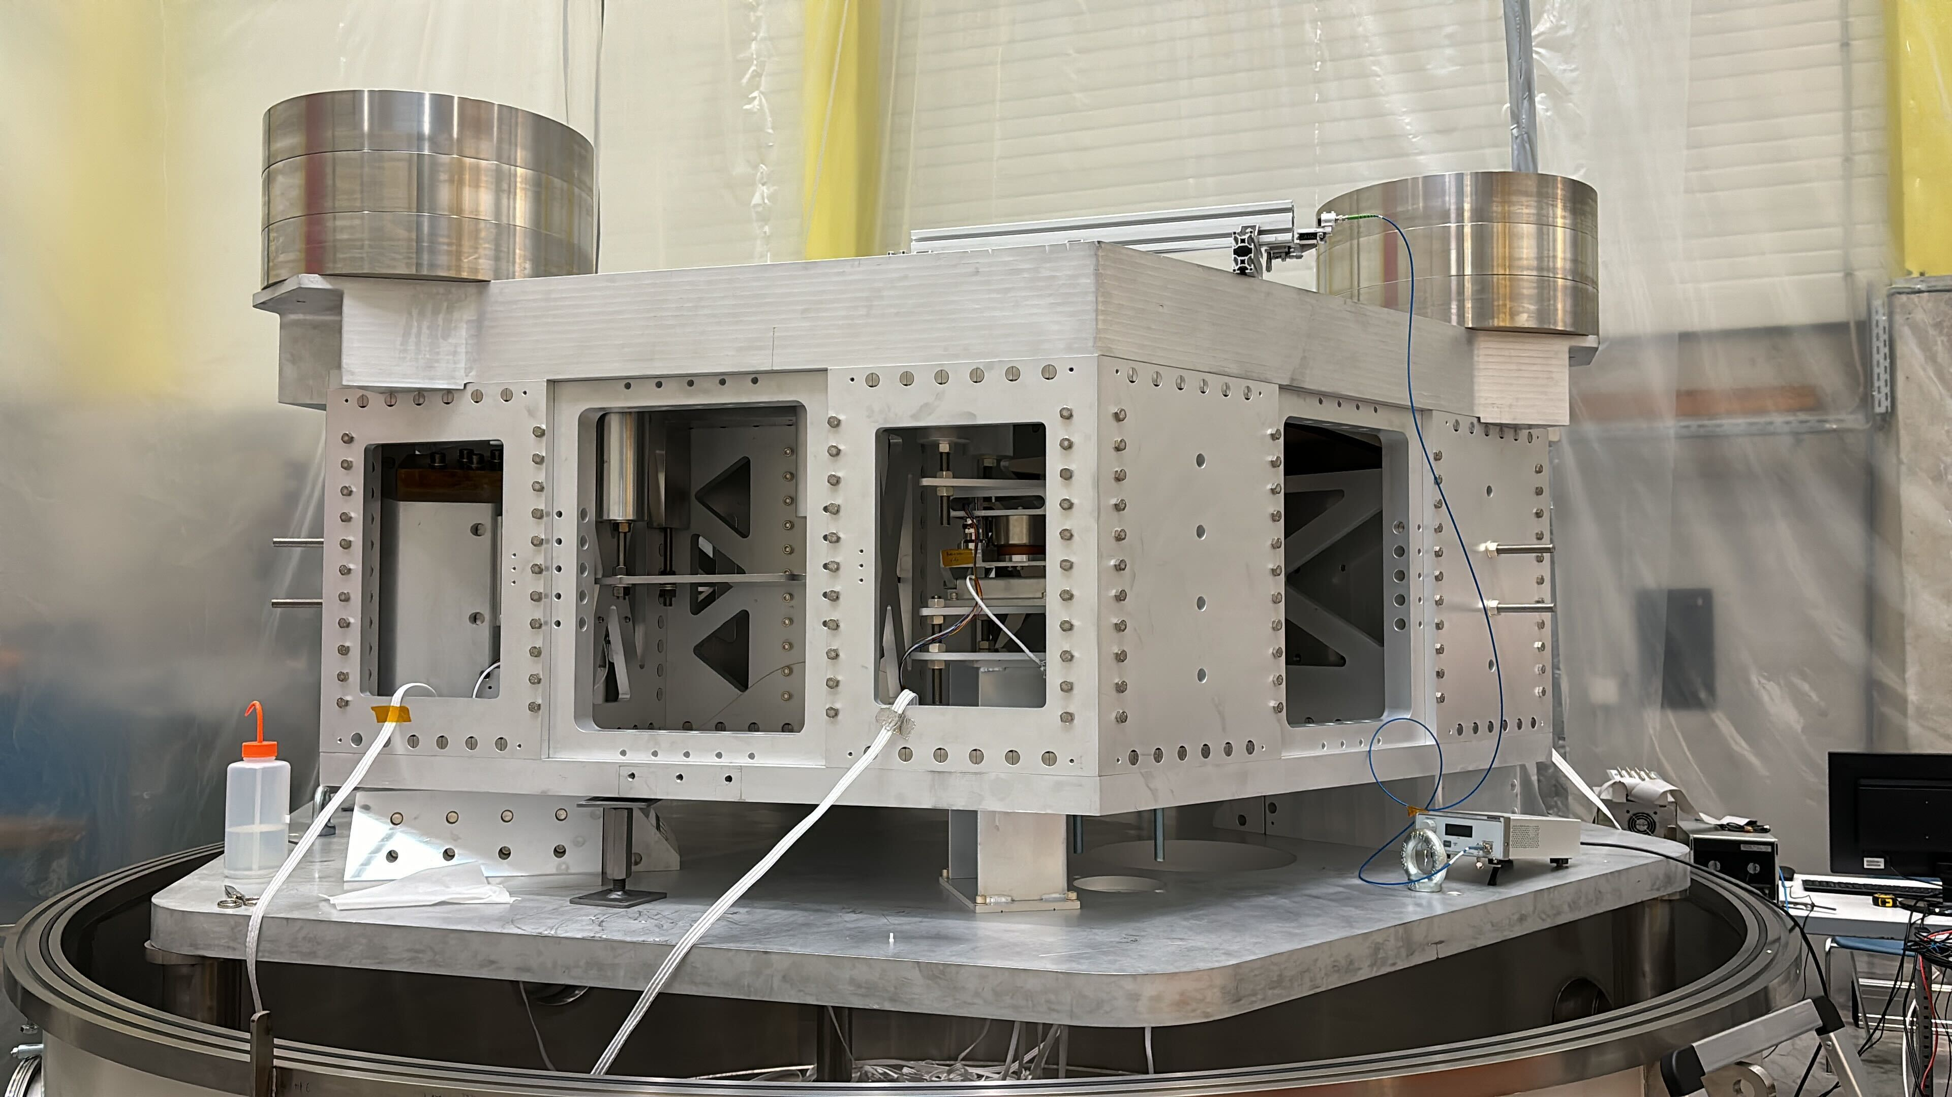
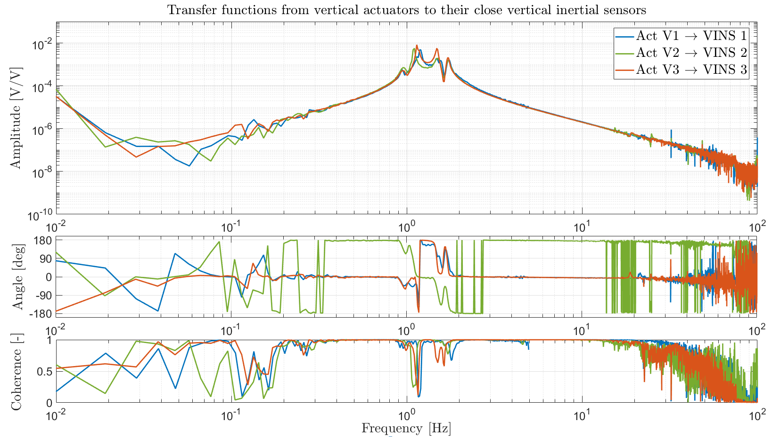
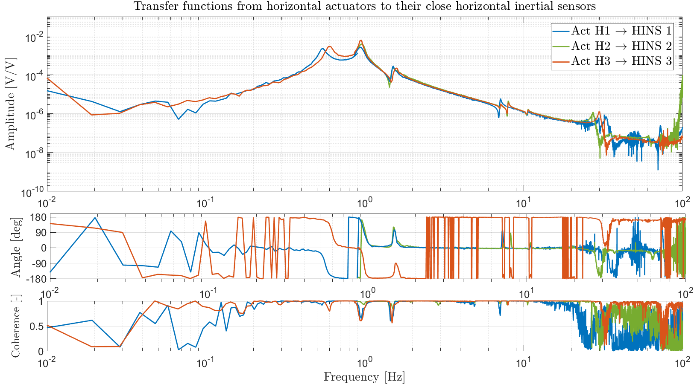
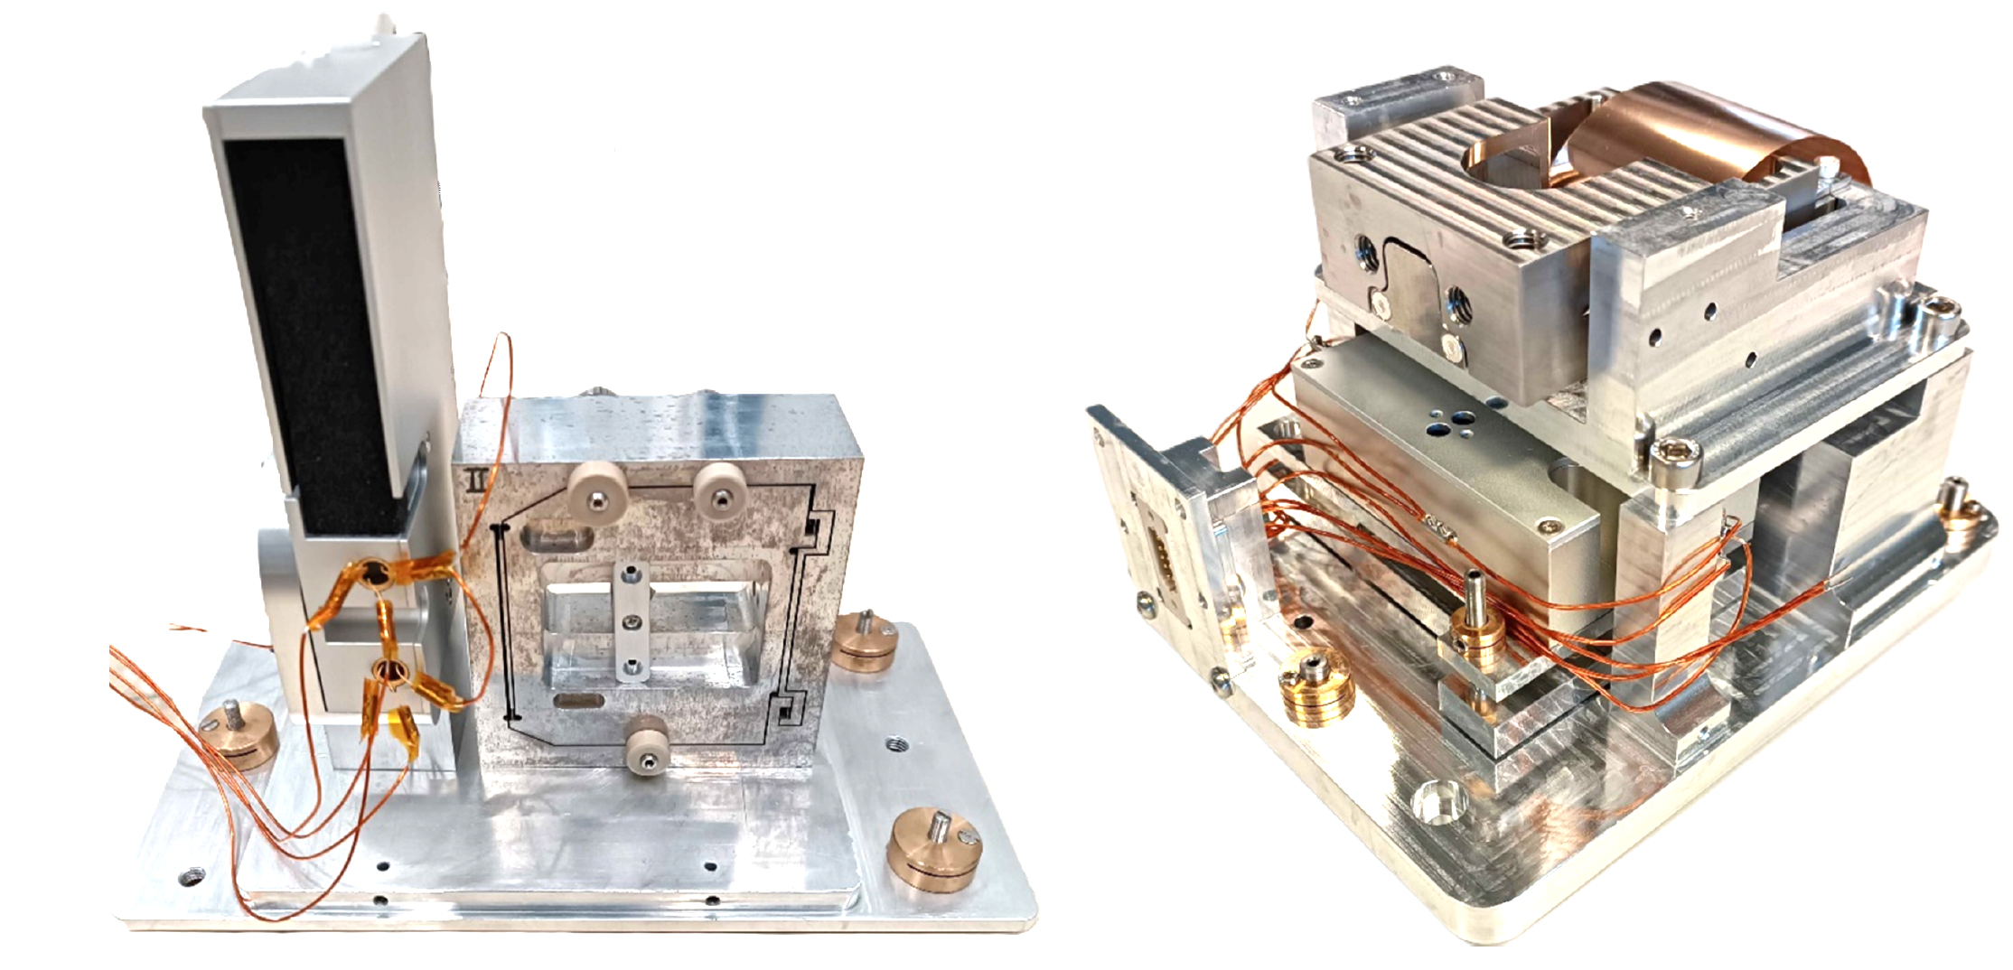
Active platform
Contact : Haidar Lakkis (ULiege)
mhlakkis@uliege.be

Slide 10
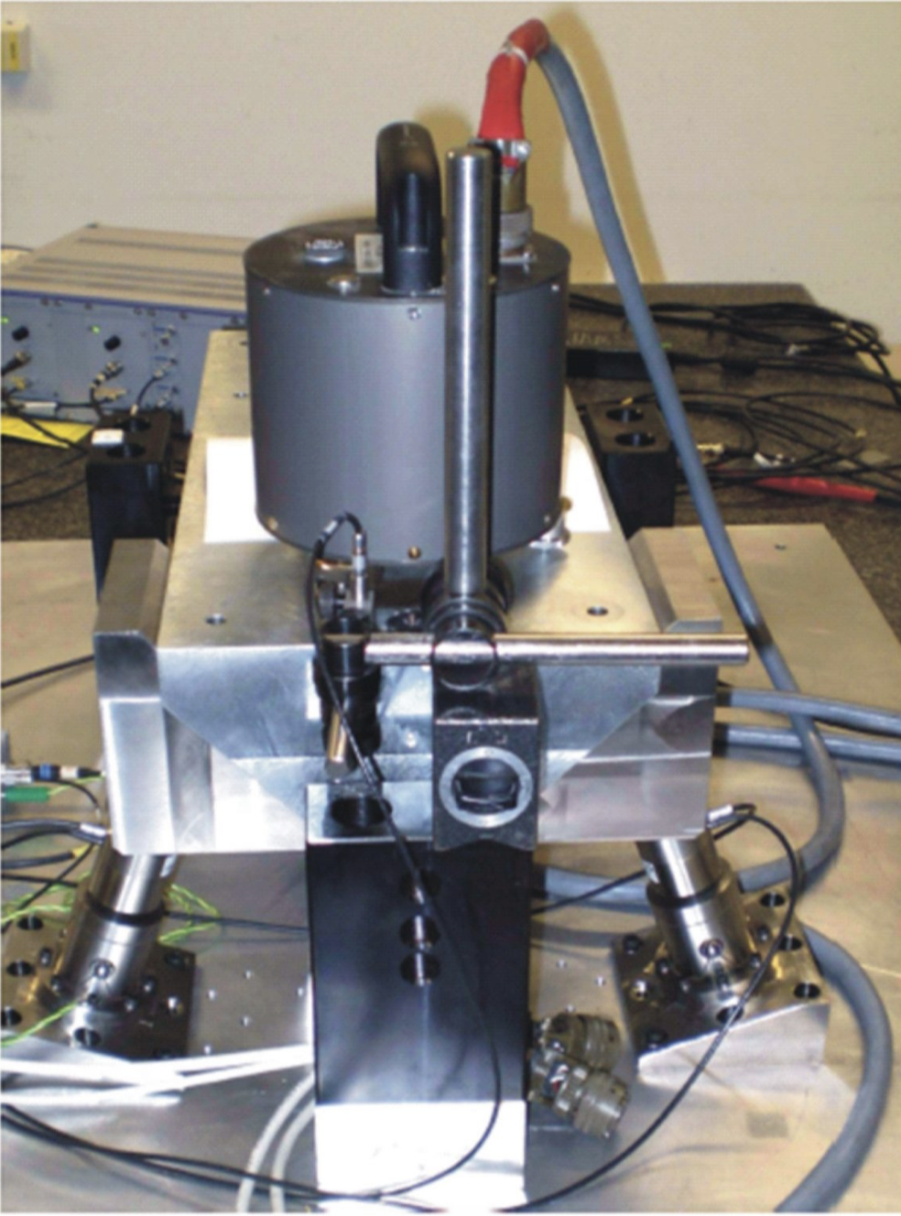
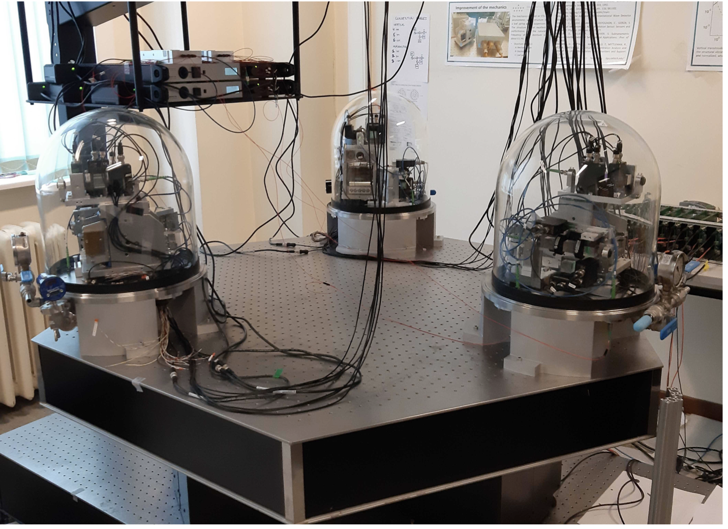
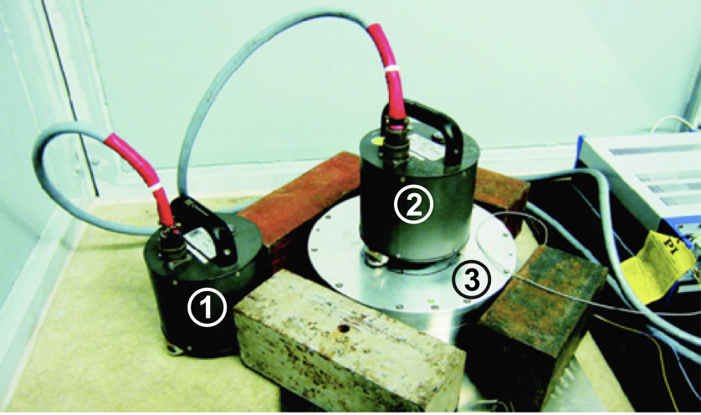
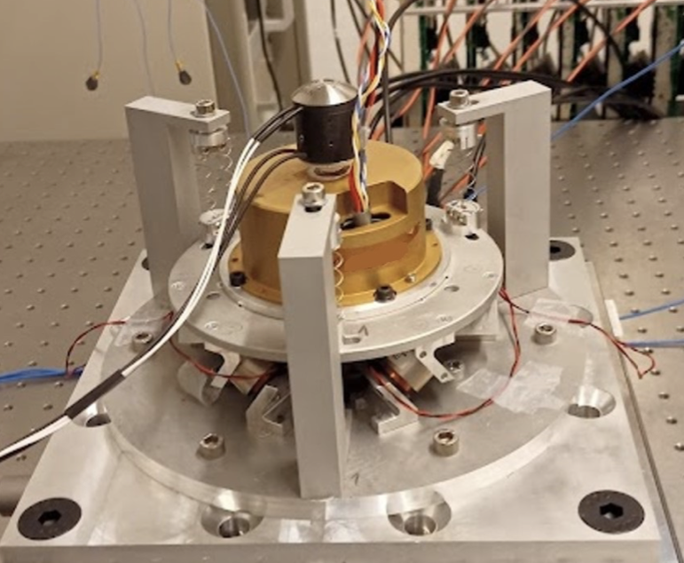
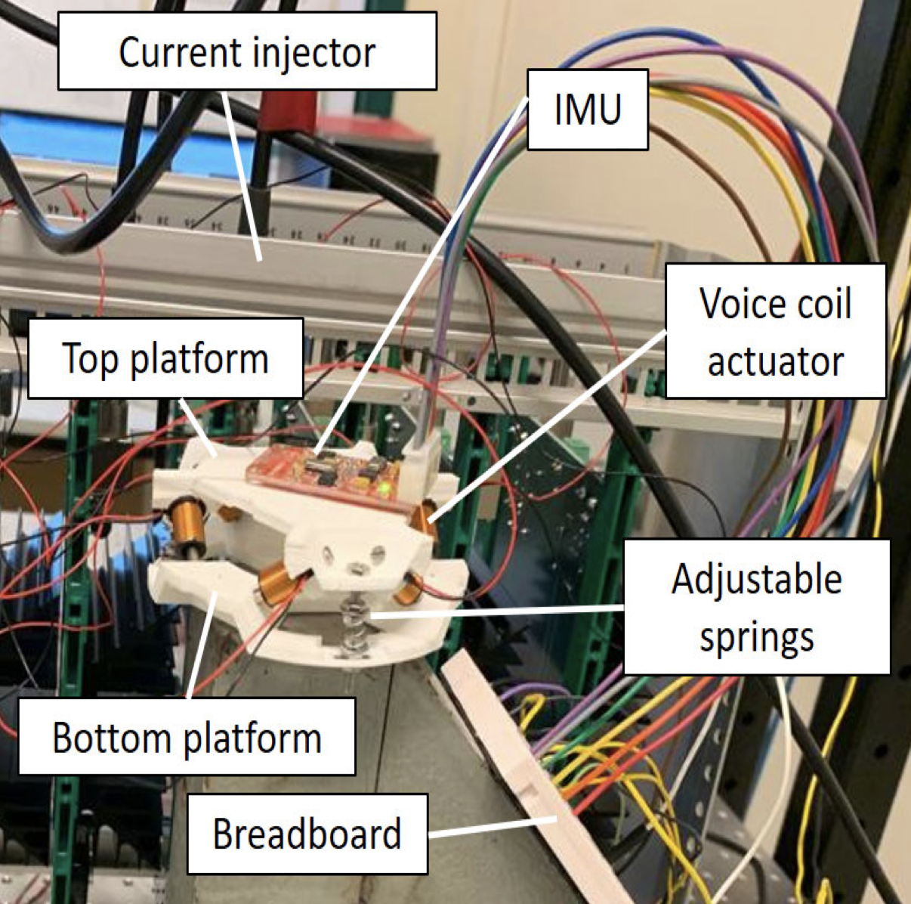
Active vibration isolation
2010
2009
2018
2014
2021
2020

Slide 11
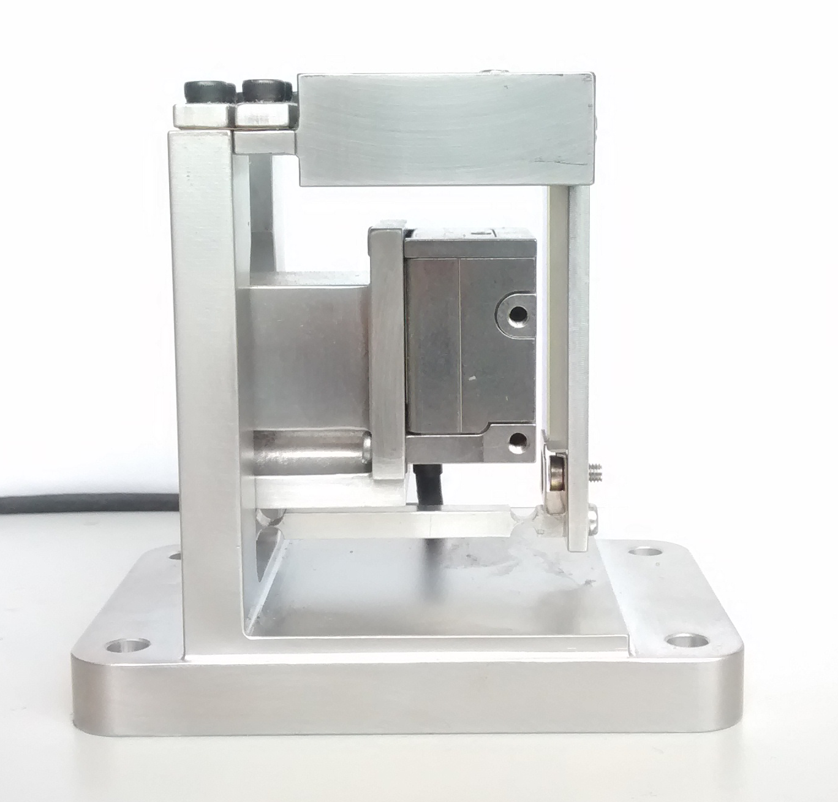
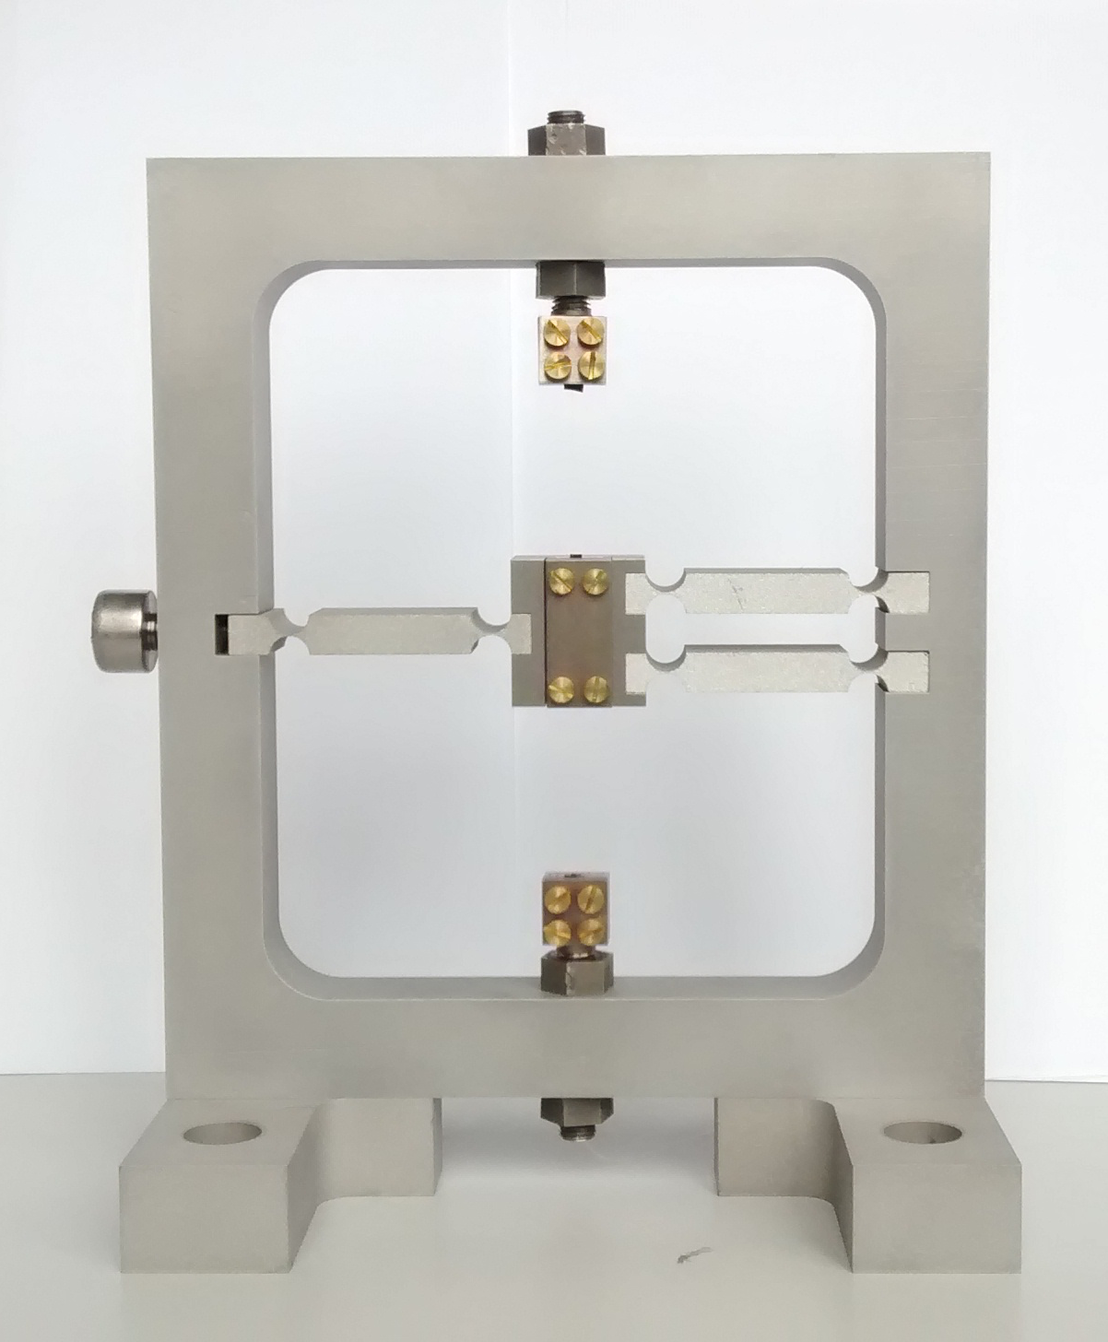
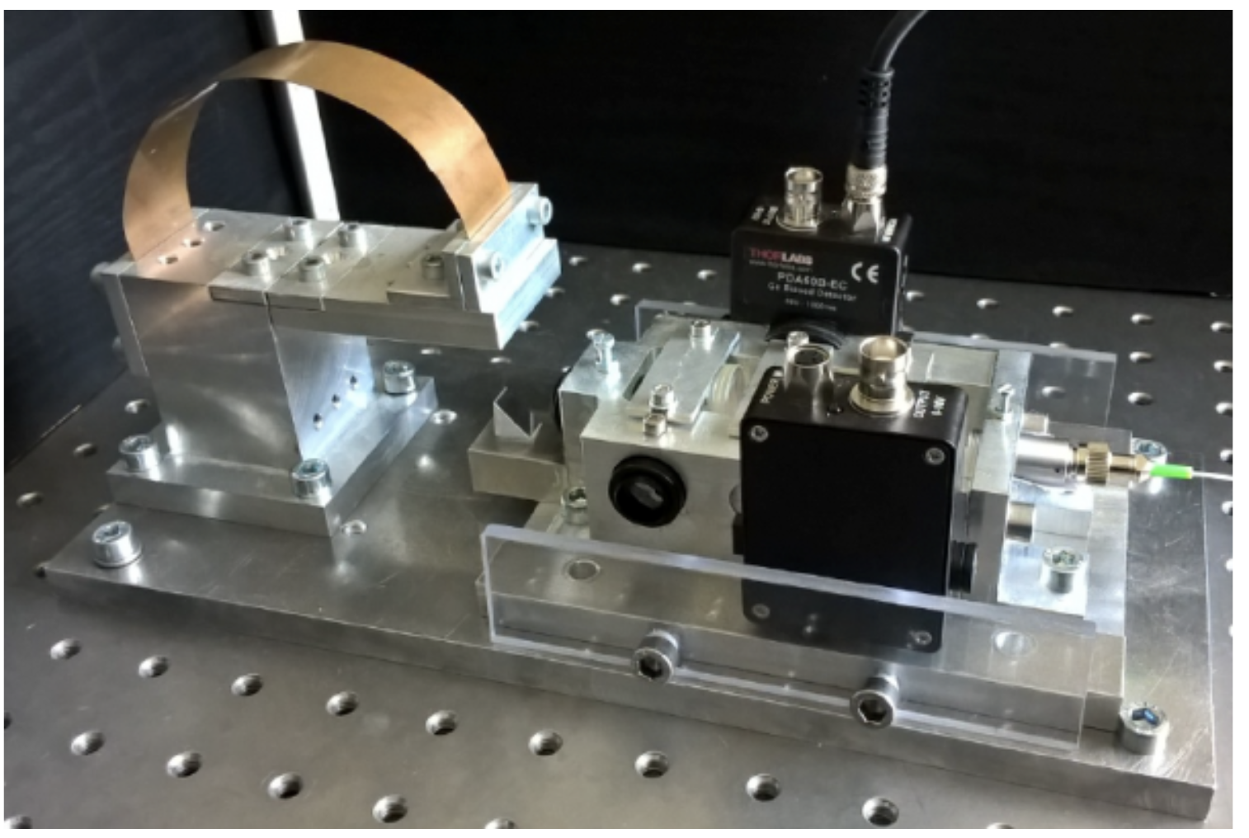

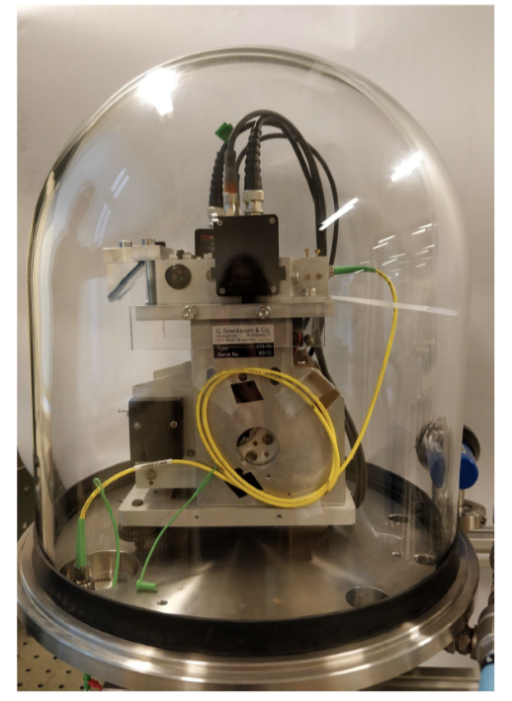
Optical inertial sensors at PML started at CERN
2012
2021
2016
2015
2020
2024
Notes:
Mecasoft and Polmans

Slide 12
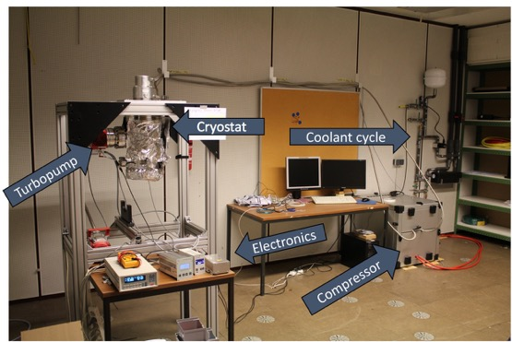
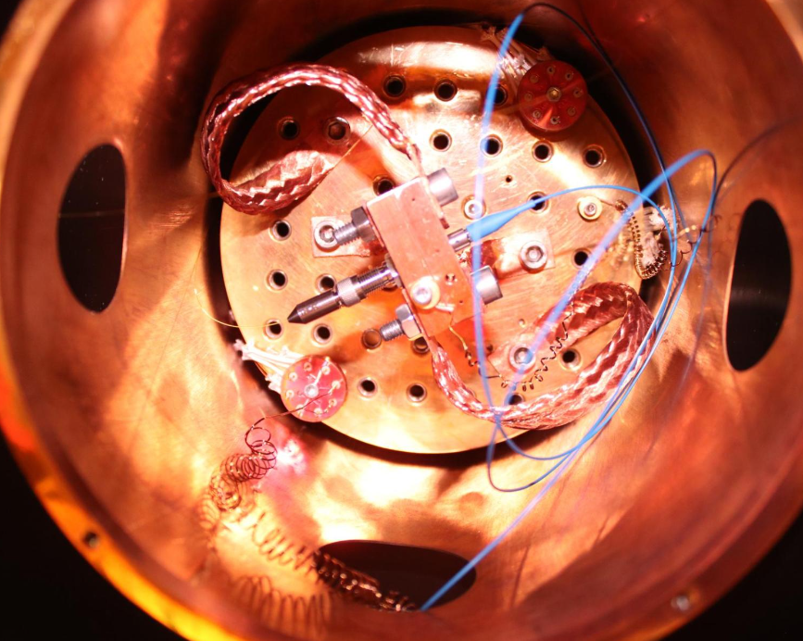
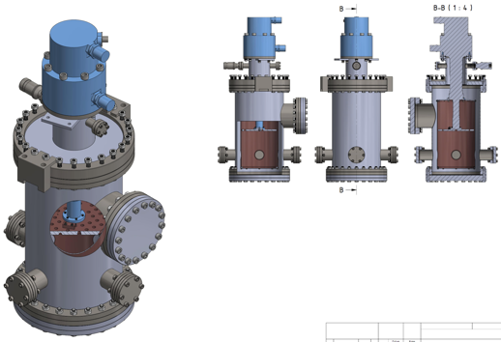
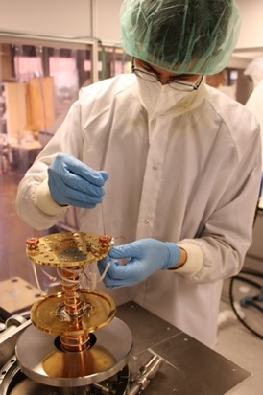
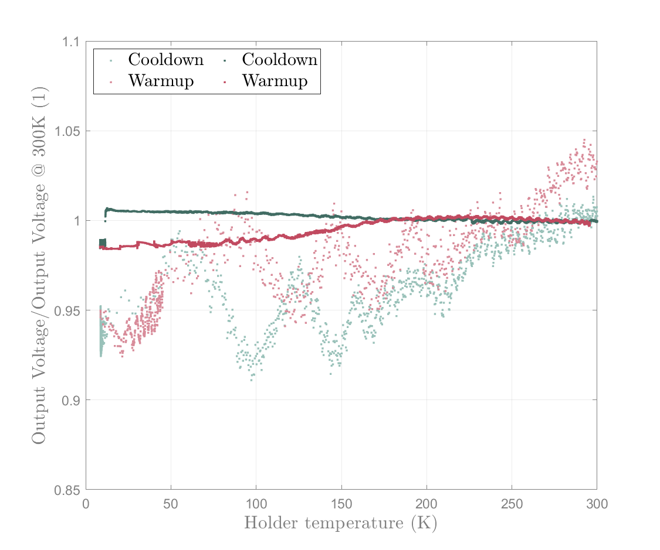
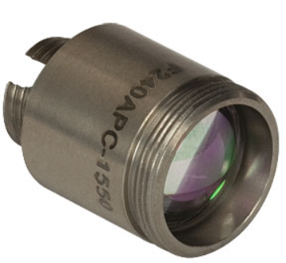
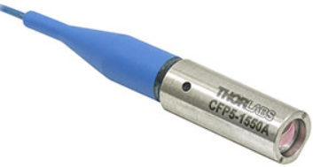
Cryogenic test bench
Collimators
F230APC
Closed-cycle cryostat with up to 1W cooling power at 10K
Vacuum level: better than 10⁻⁹ mbar
Usable volume: cylindrical 15x15cm
Fast turnaround and low running costs
Useful for testing materials, components and assemblies
CFP5
More sensitive to temperature fluctuations
Contacts: Robert Joppe
joppe@physik.rwth-aachen.de
Tim Kuhlbusch
tim.kuhlbusch@rwth-aachen.de

Slide 13

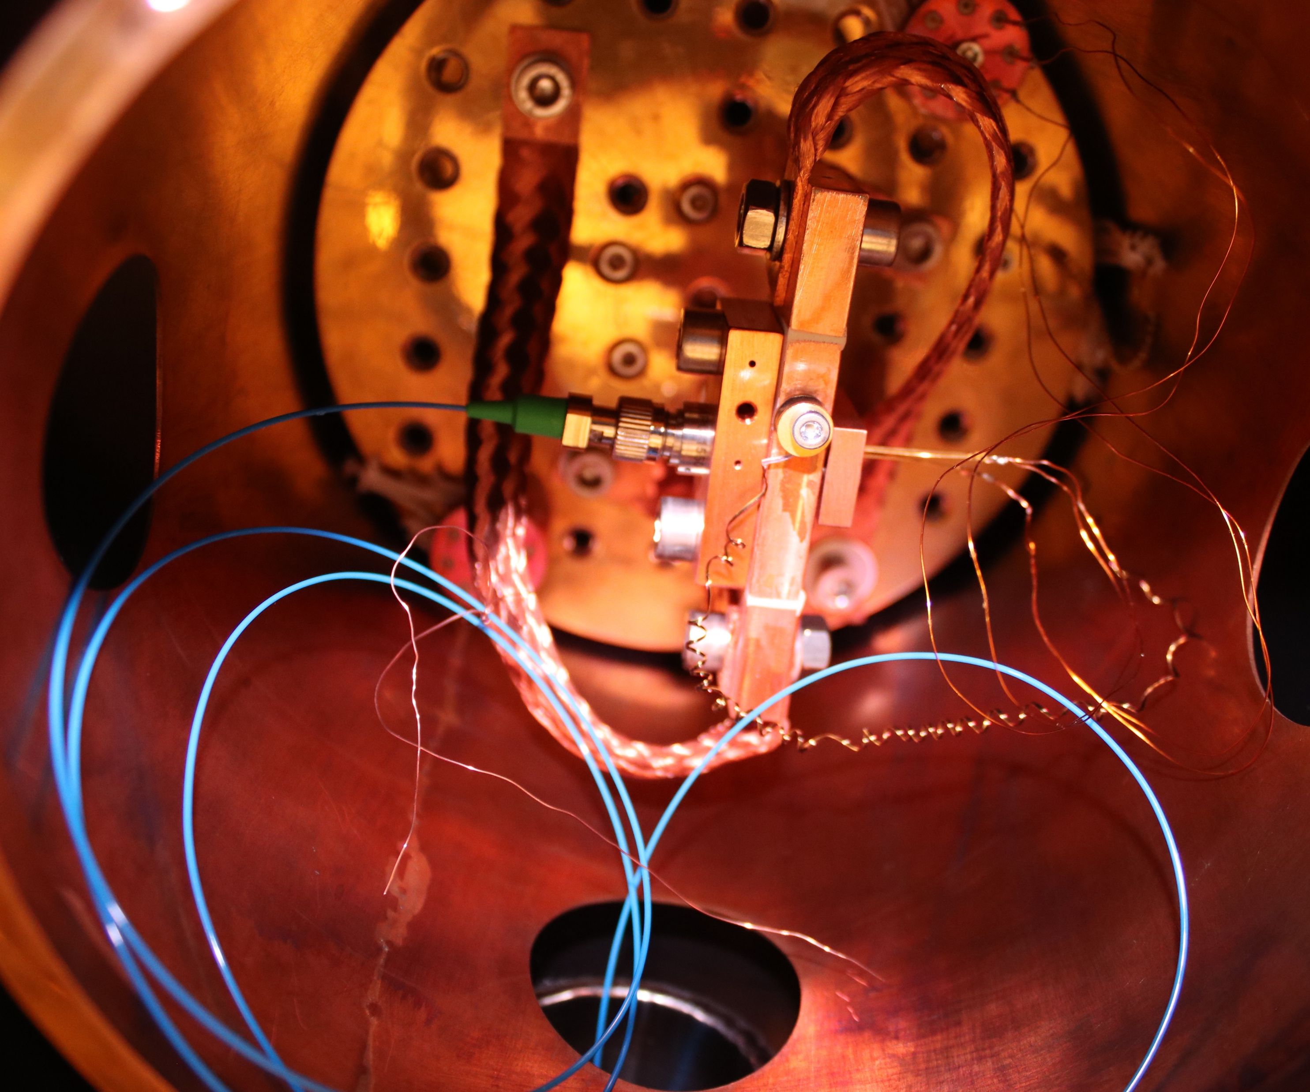
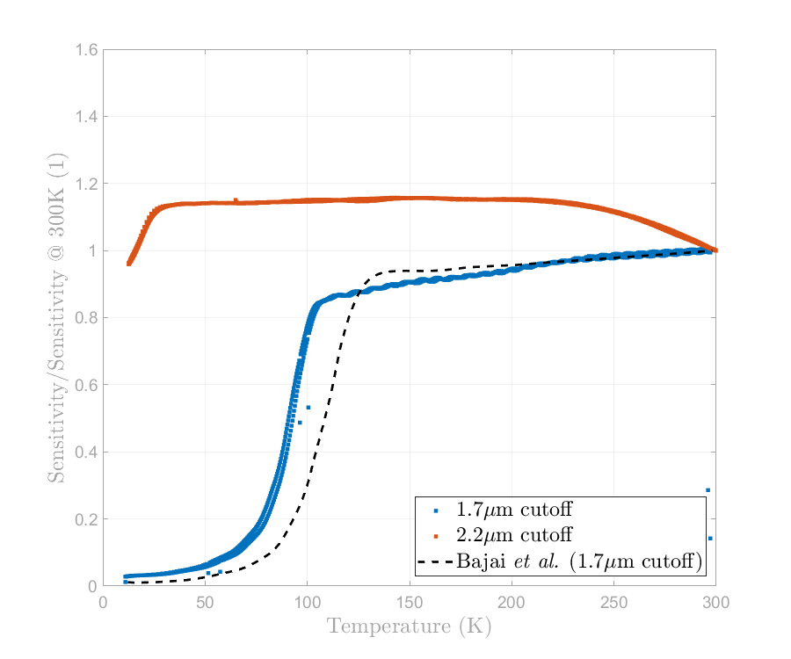
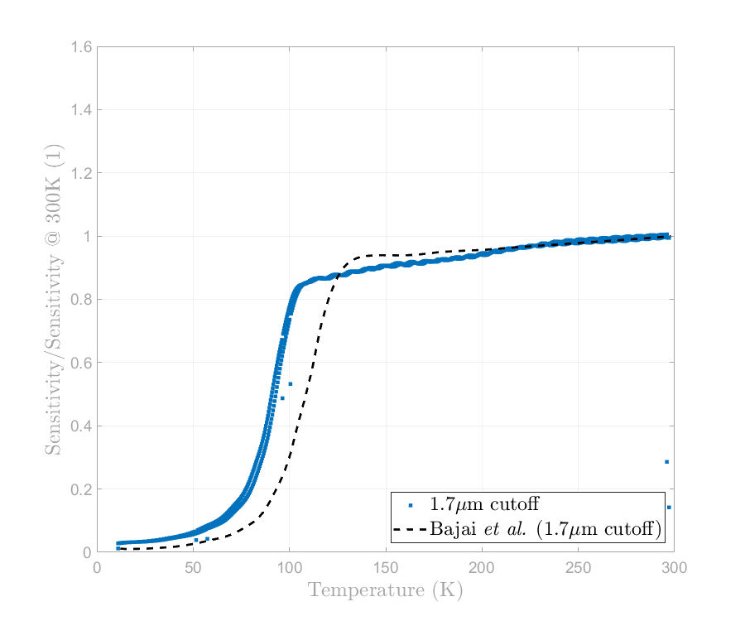
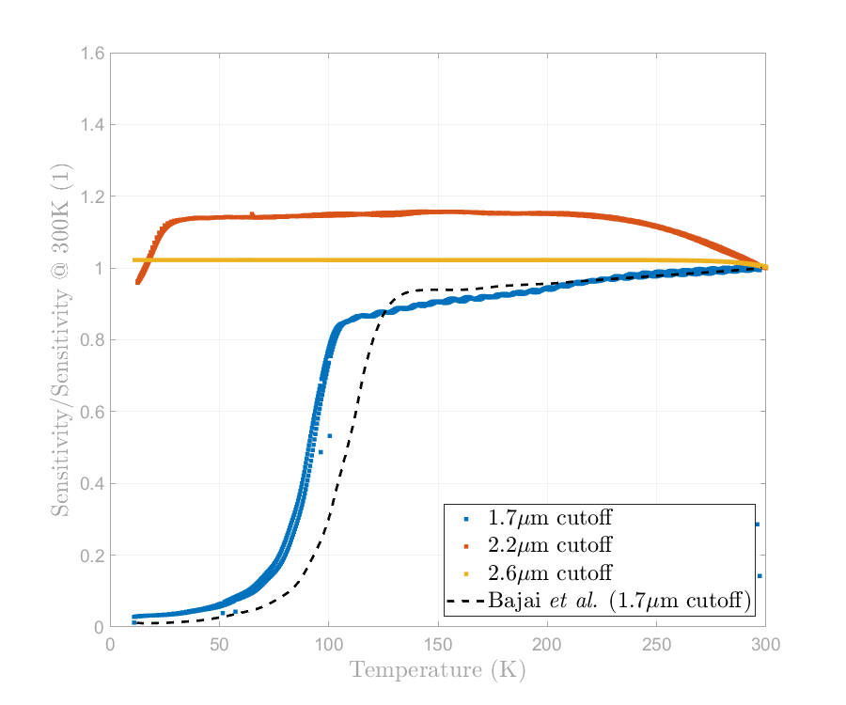
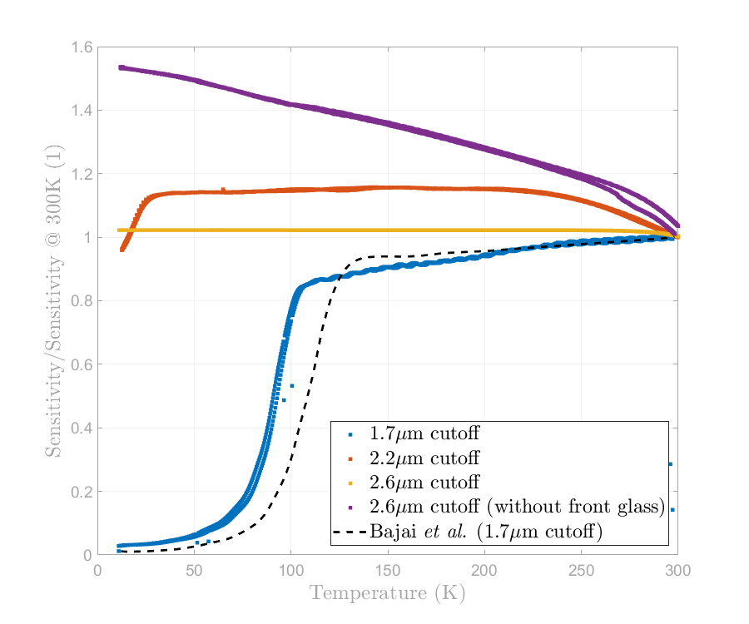
Validation of 1550 nm optical elements in cryogenic conditions
https://doi.org/10.1016/j.cryogenics.2024.103895
Photodiodes
Cutoff before 1550 nm: responsivity drop below 100 K
[2] Bajpai et al, 2022 arxiv 2203.10427v1]
Constant improvement of the responsivity
Better but still a: responsivity drop below 30 K
Very stable response over all temperatures tested!
InGaAs ++ without front glass
InGaAs +
InGaAs ++
InGaAs

Slide 14
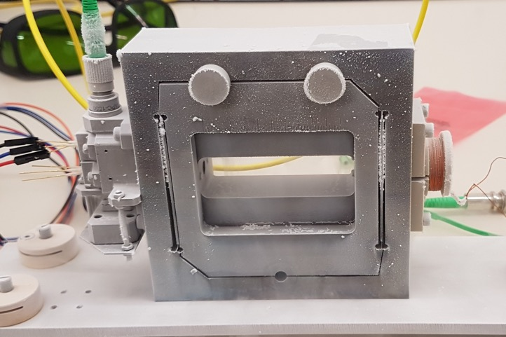
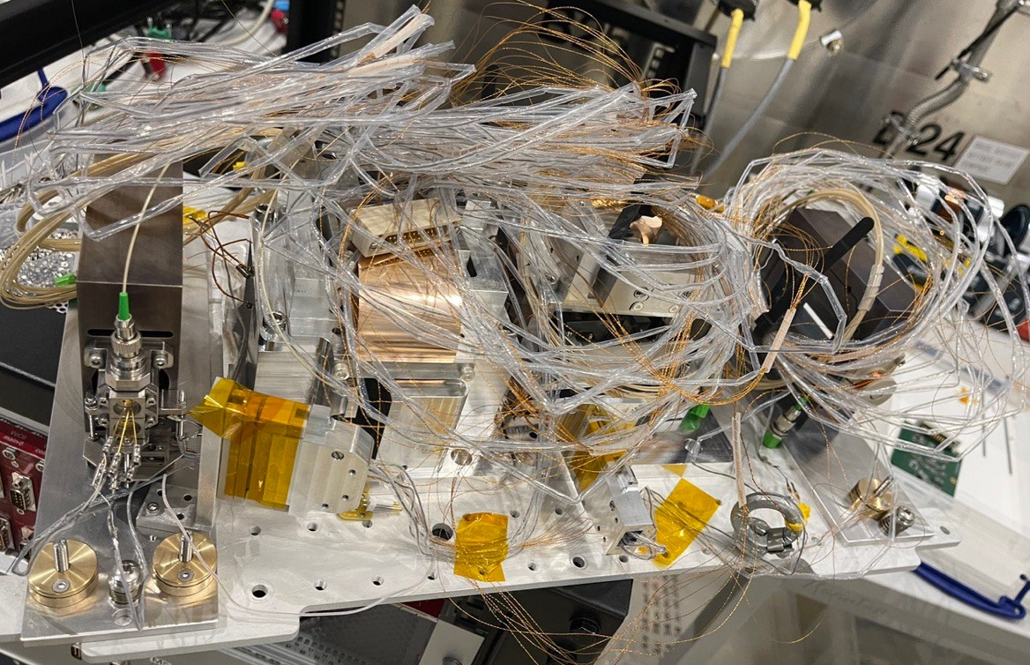
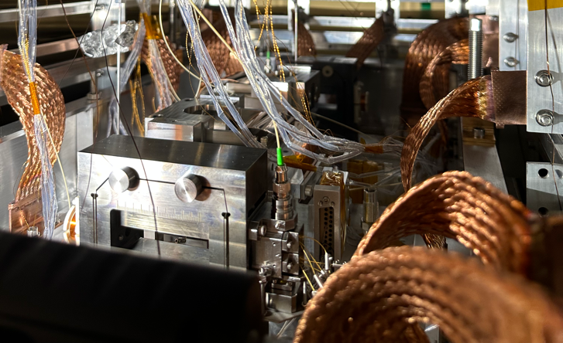

Cryogenic inertial sensors

Slide 15
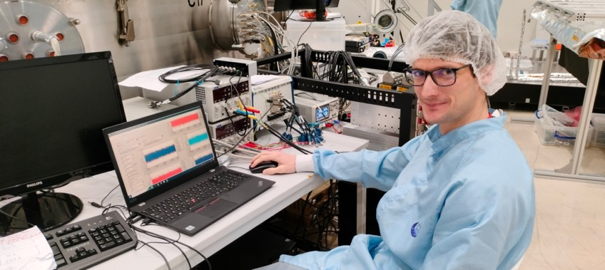
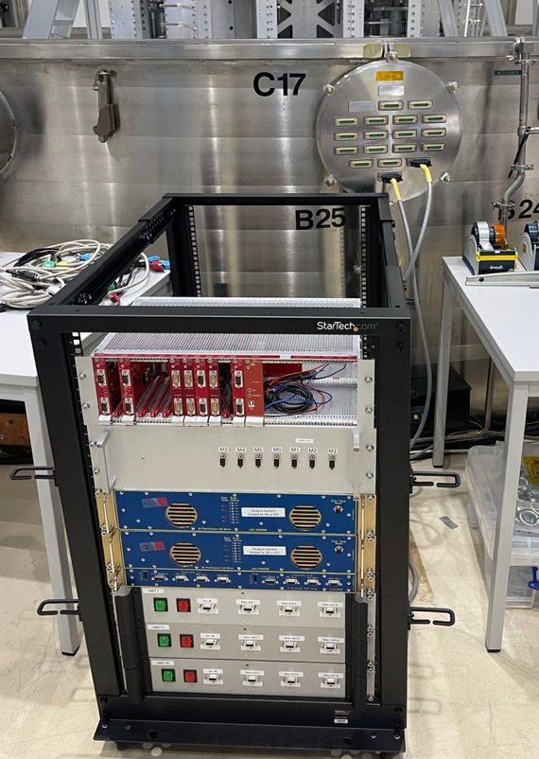
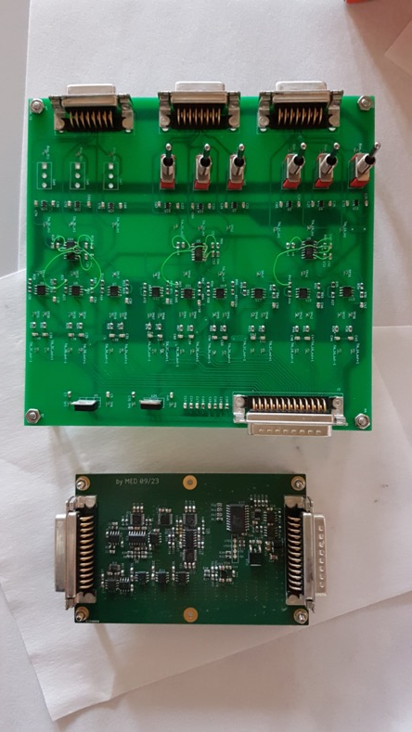
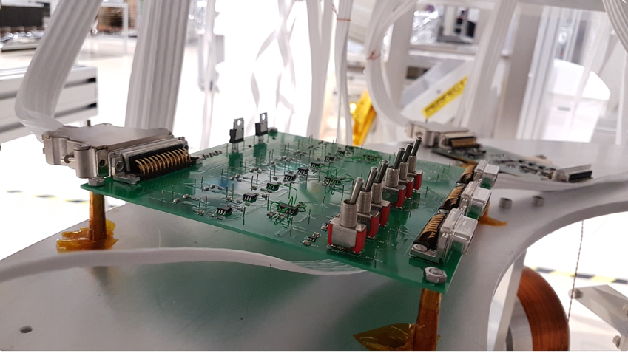
Electronics and control

Slide 16
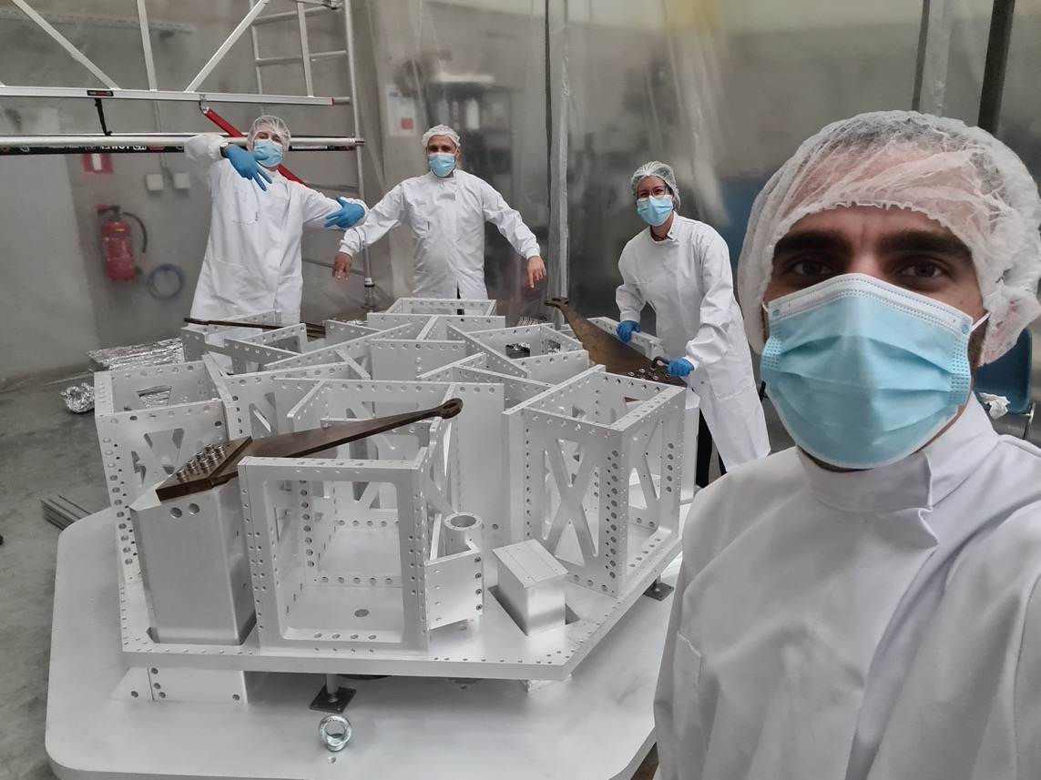

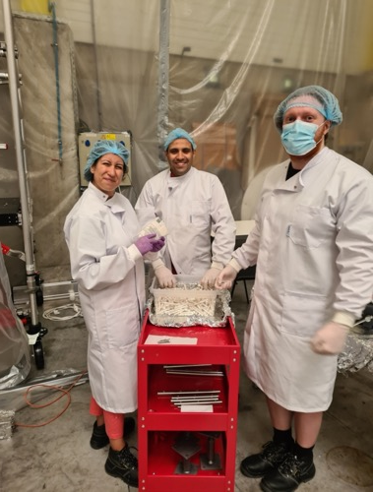
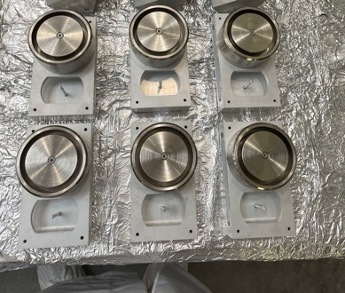
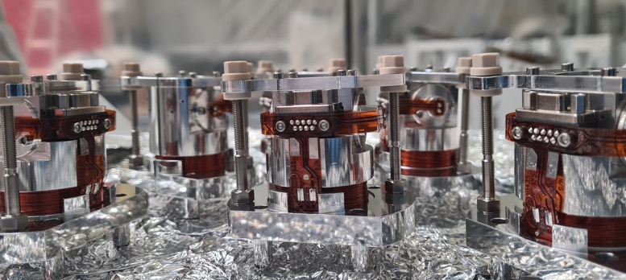


Assembly of the prototype

Slide 17
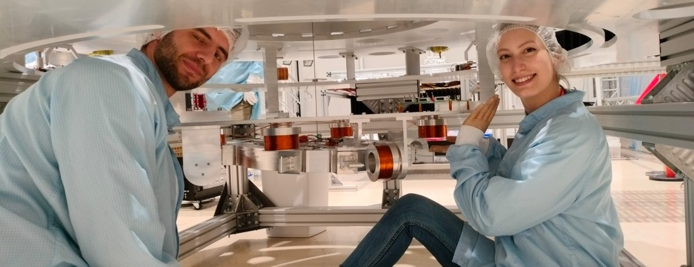


Final installation at CSL

Slide 18



Contact :Cédric Lenaerts (CLS)
cedric.lenaerts@uliege.be
Lionel Jacques (CSL)
ljacques@uliege.be
22K achieved in 18days
After integration of outer cryostat including LN₂ shield and GHe panels
Sink @16K (recirculating GHe)
Black-paint emissivity >60% @ 22K
dotted line
= correlated model

Slide 19


Summary @ plan
E-TEST becomes CRISTAL
2023: 1st run: Fully assembled prototype
  100 kg test mass
  Low frequency seismic isolation
  Radiative cooling strategy
2024:
  100kg Si mirror being polished
  Improvement of sensor
  Control strategies

Slide 20
2025-
High-emissivity @ cryogenic T° → coating + surface structuring
Thermal noise of suspended heat exchanger structure
Silicon mirror suspension
Improved architecture → integration sequence & scale-up to ET
Electronics:
  Current injector noise < 1 µA/rt(Hz)
  Amplifier noise < 10 µV/rt(Hz)
  Cryogenic electronics

