Slide 1
Scheduling Tools development for the next programmed stops
ACE Seminar #29 – Afonso Caiado de Sousa – EN-ACE-OSS
2024-12-06 INDICO 1451248

Slide 2






Table of Contents
Background
Scheduling Tools Project
Linear Planning Web Interface
Scheduling tools across CERN
Conclusions
Next steps

Slide 3
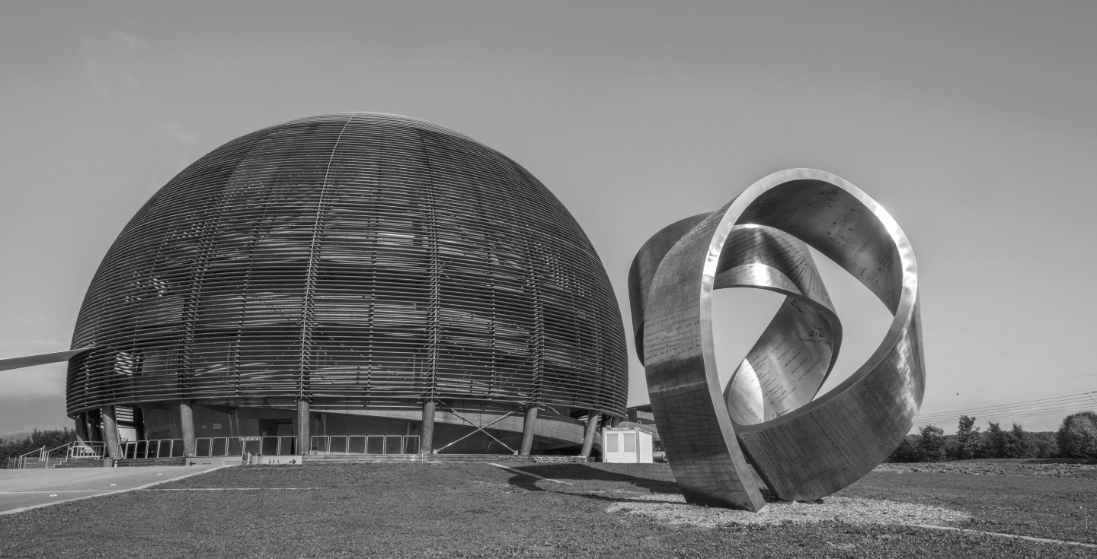
Background

Slide 4


About me - ACE Seminar #17
Graduated - Degree in Engineering Sciences – Informatics and Computer Engineering @ FEUP
Current - Master’s in Informatics and Computer Engineering Student @ FEUP (2nd year)
Master’s thesis work @ CERN
FEUP thesis supervisors: João Faria, João Moreira
CERN supervisors: Fernando Pedrosa

Slide 5
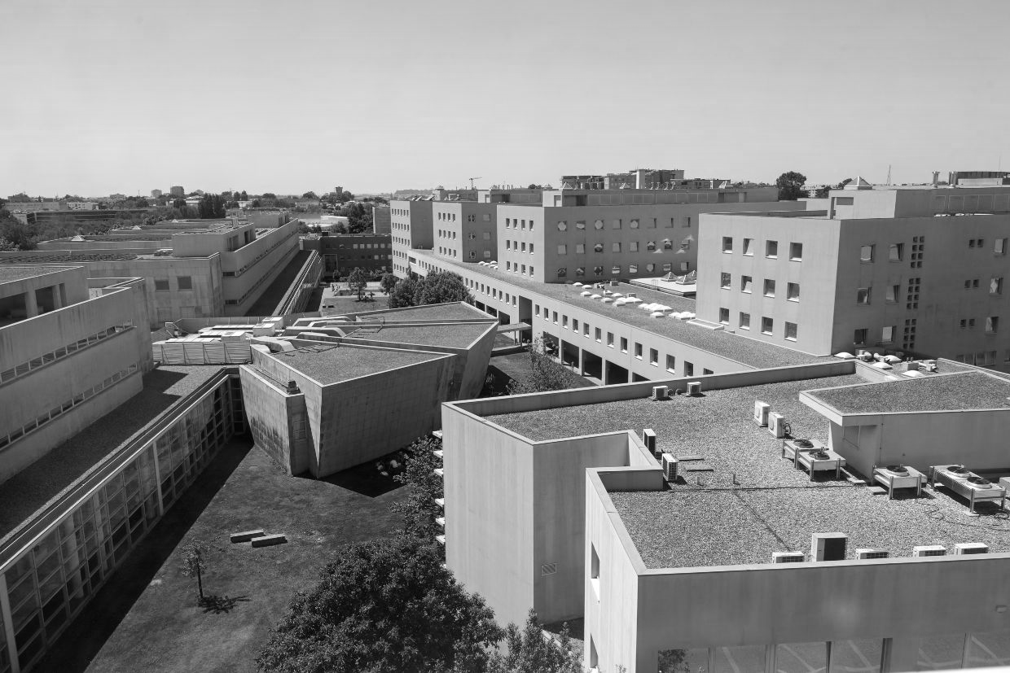

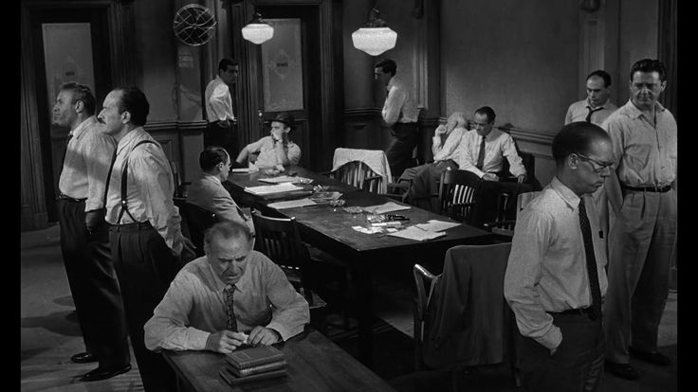
About me - Today
Master’s in Informatics and Computer Engineering @ FEUP
Master’s thesis work about predicting and using Machine Learning in small datasets
Working for the past ~ 1 year as the lead Scheduling Tools Project Developer
Supervisor: Estrella Vergara
Obsessed with movies, gym, and traveling
Notes:
Beard

Slide 6
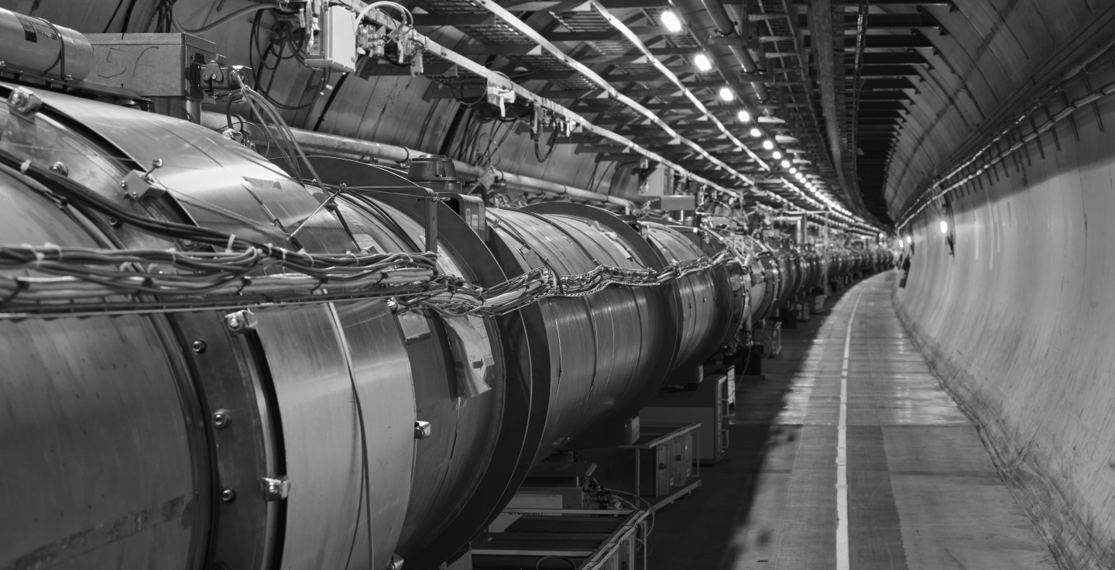
Scheduling Tools Project

Slide 7

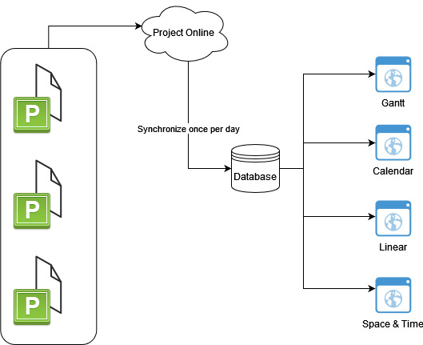
What is Scheduling Tools
Screens
Initially developed by EN-IM during the LS2
Main goals:
  Gather all coordination related data in a unique repository
  Allow the visualization of plannings without and MS Project License

Slide 8
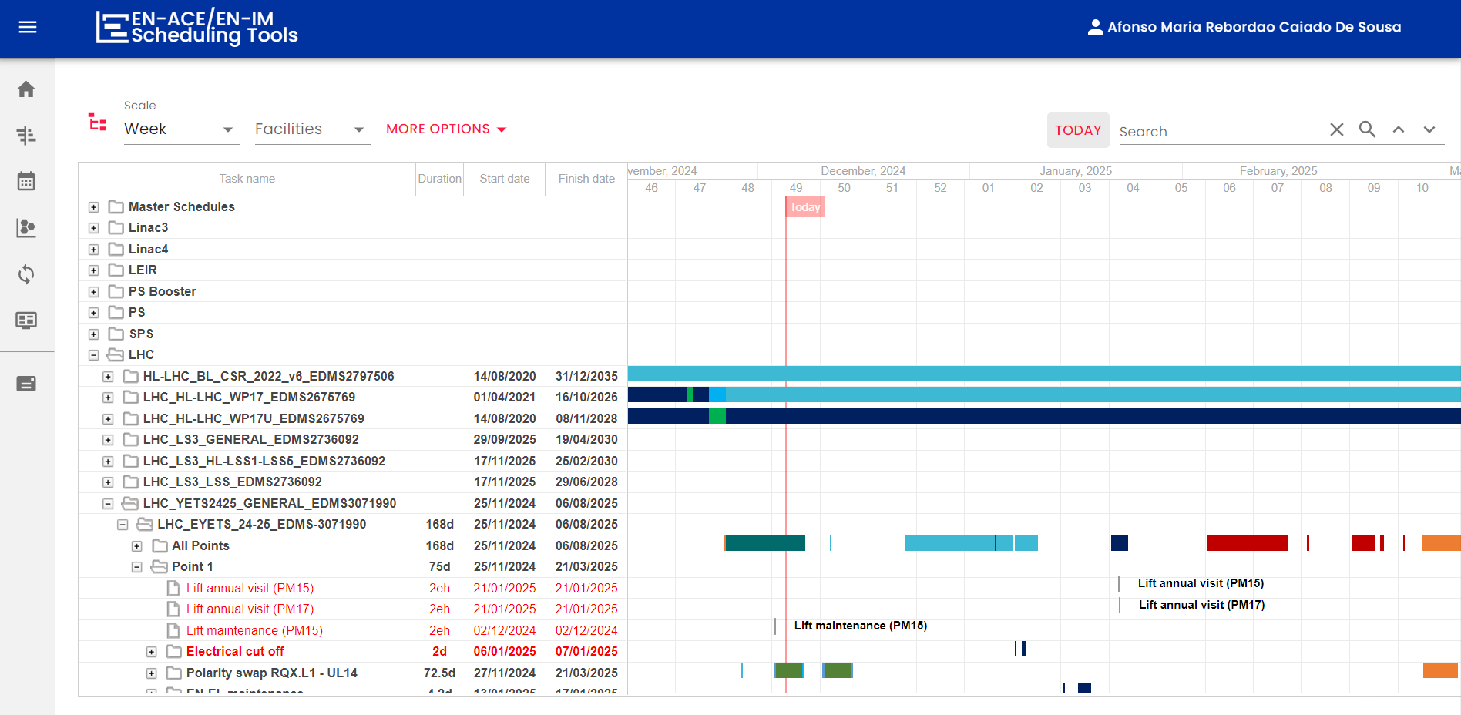
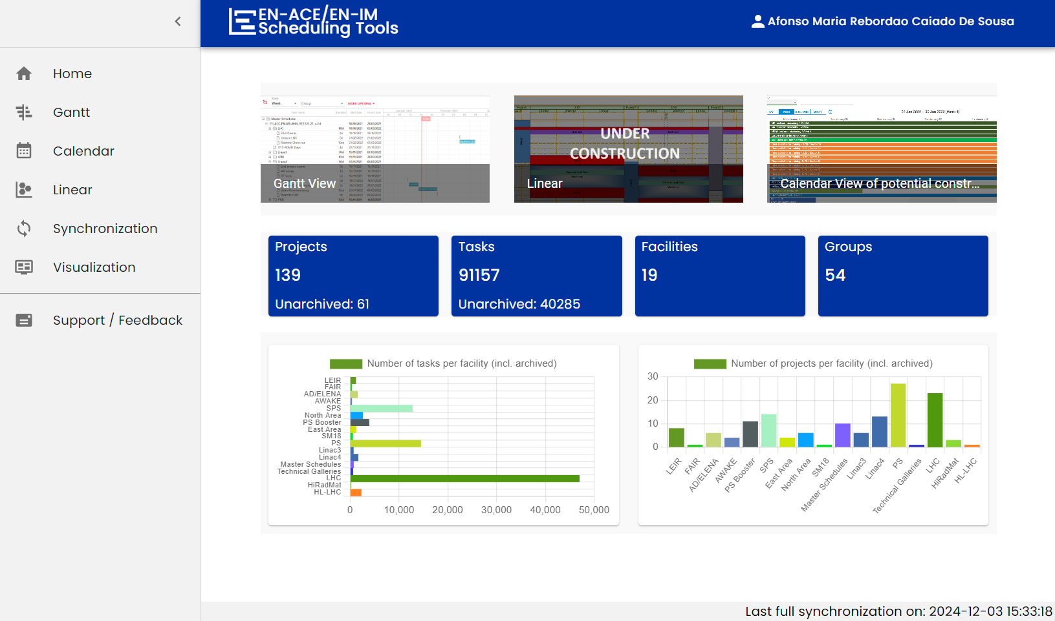
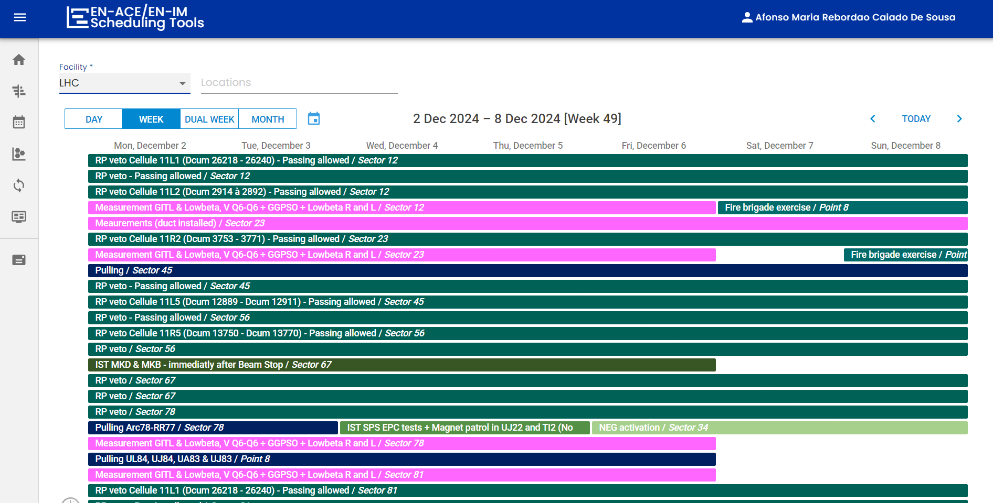
What is Scheduling Tools

Slide 9
Who uses Scheduling Tools
WHO?
EN-ACE Members: Core contributors and stakeholders in planning activities.
End Users: Individuals who rely on the tool to consult plannings and track ongoing.
WHY?
Streamlining Processes: Automates routine tasks to improve efficiency and reduce manual effort.
Time-Saving: Makes viewing, creating and managing Linear Plannings faster and easier for CERN personnel.

Slide 10
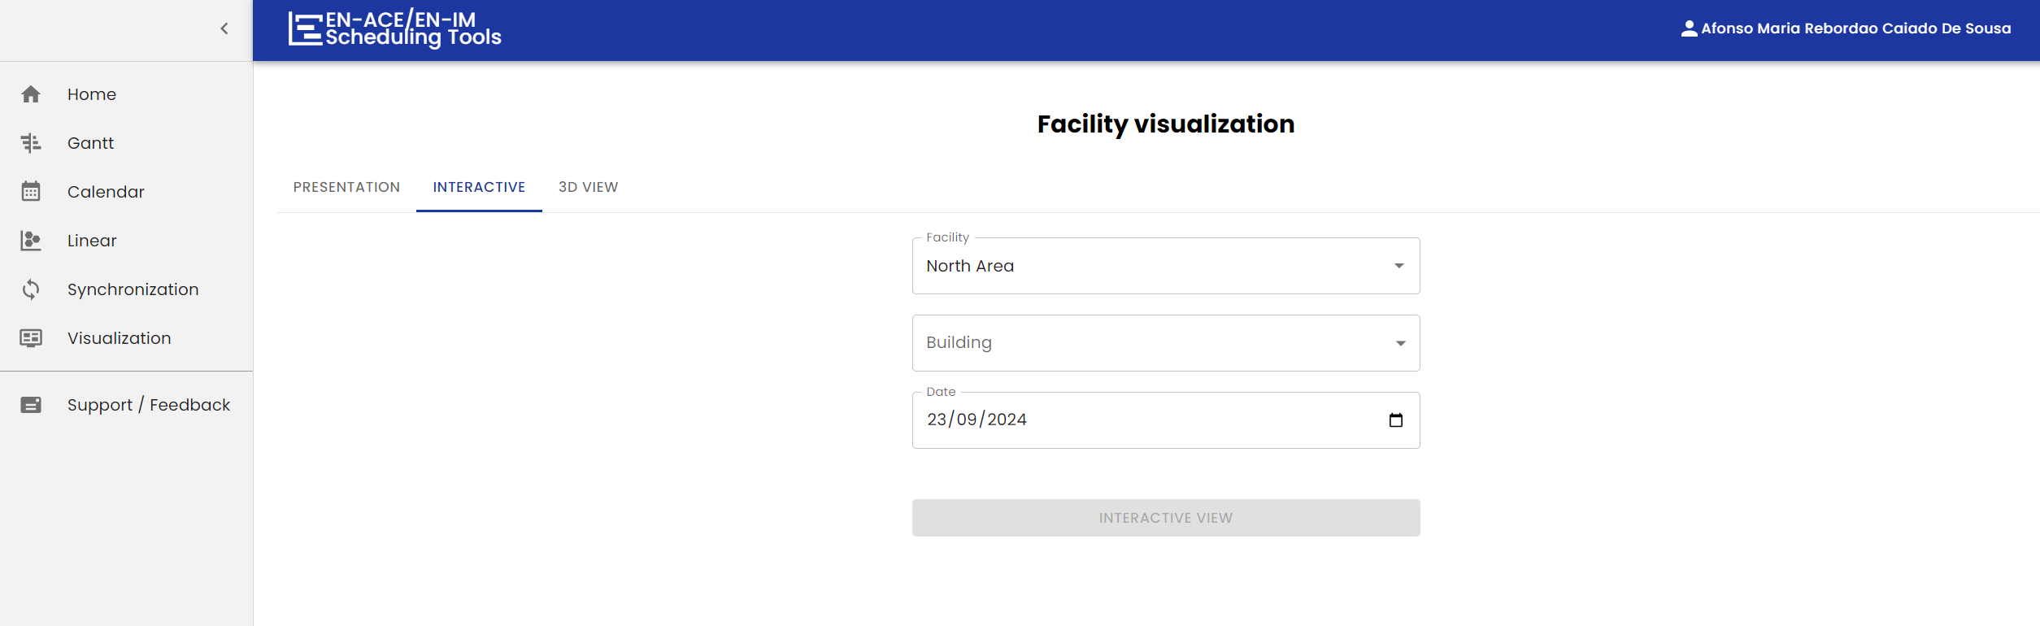
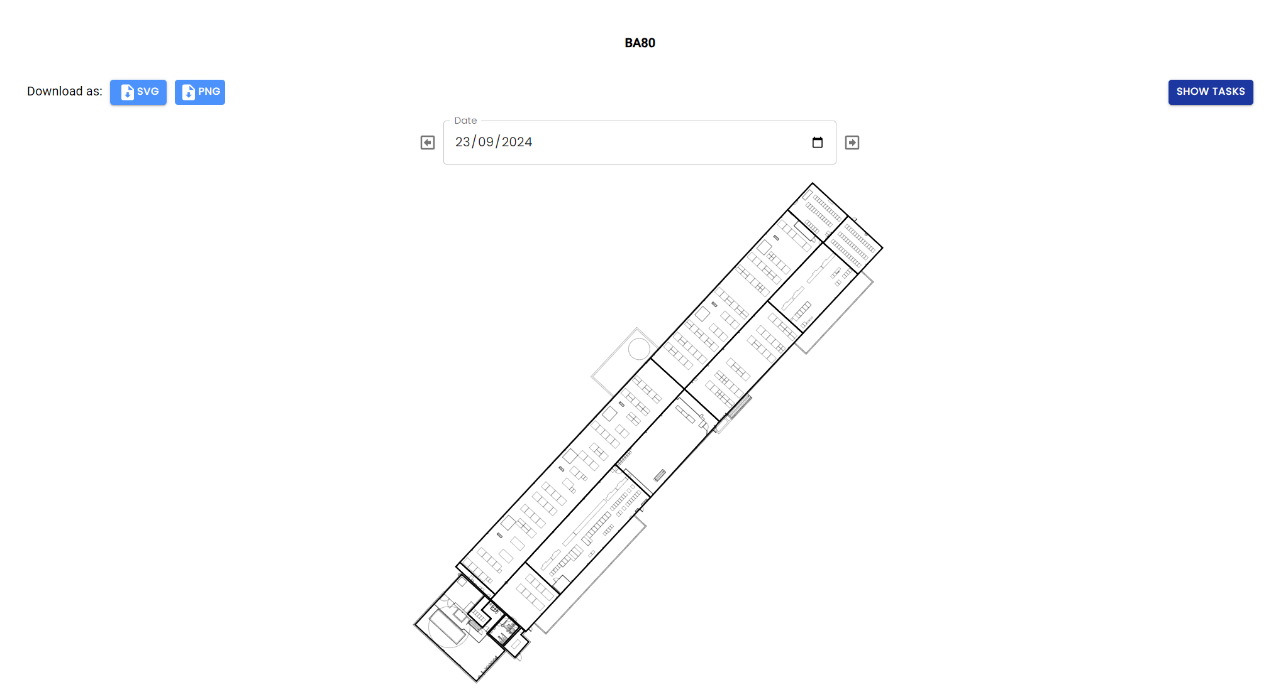

Space & Time

Slide 11
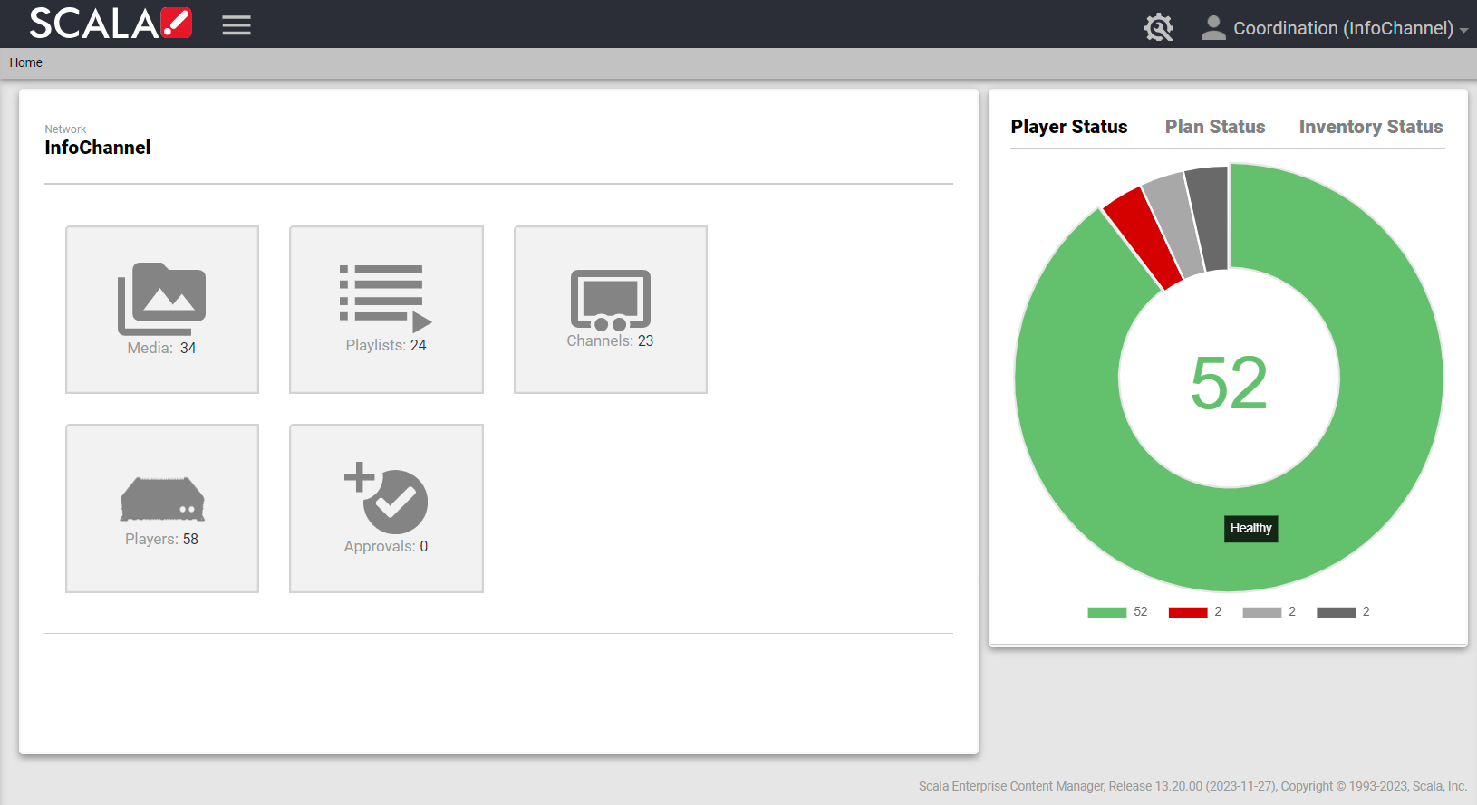
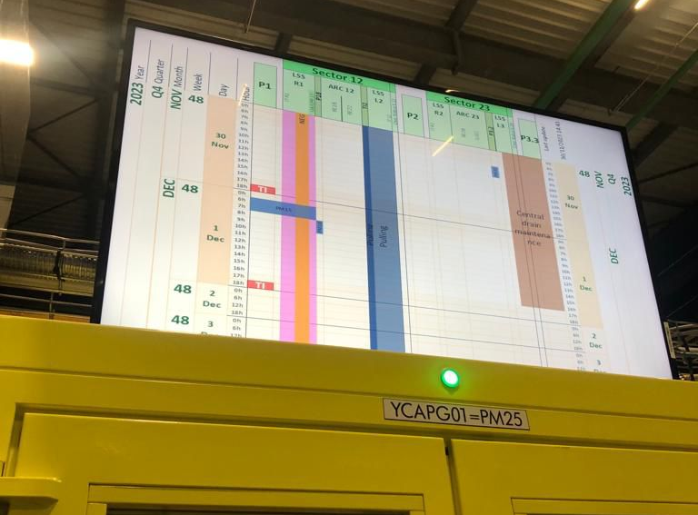
Access screens
24 LHC screens
Recent Injectors transition:
  9 SPS screens
  7 PS screens
  1 Booster screen
  1 Linac4 screen

Slide 12
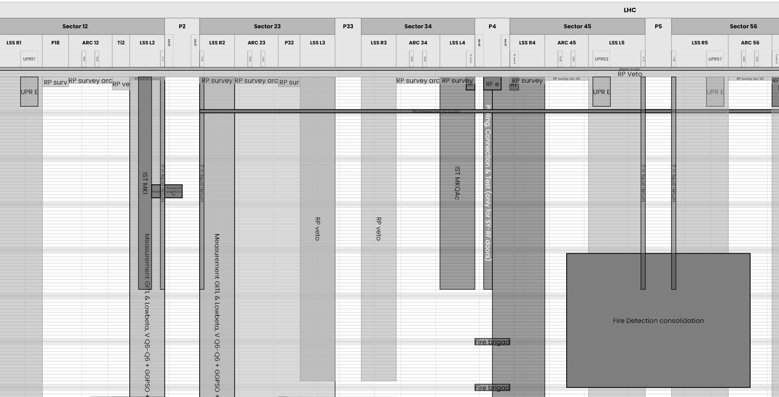
Linear Planning Web Interface

Slide 13
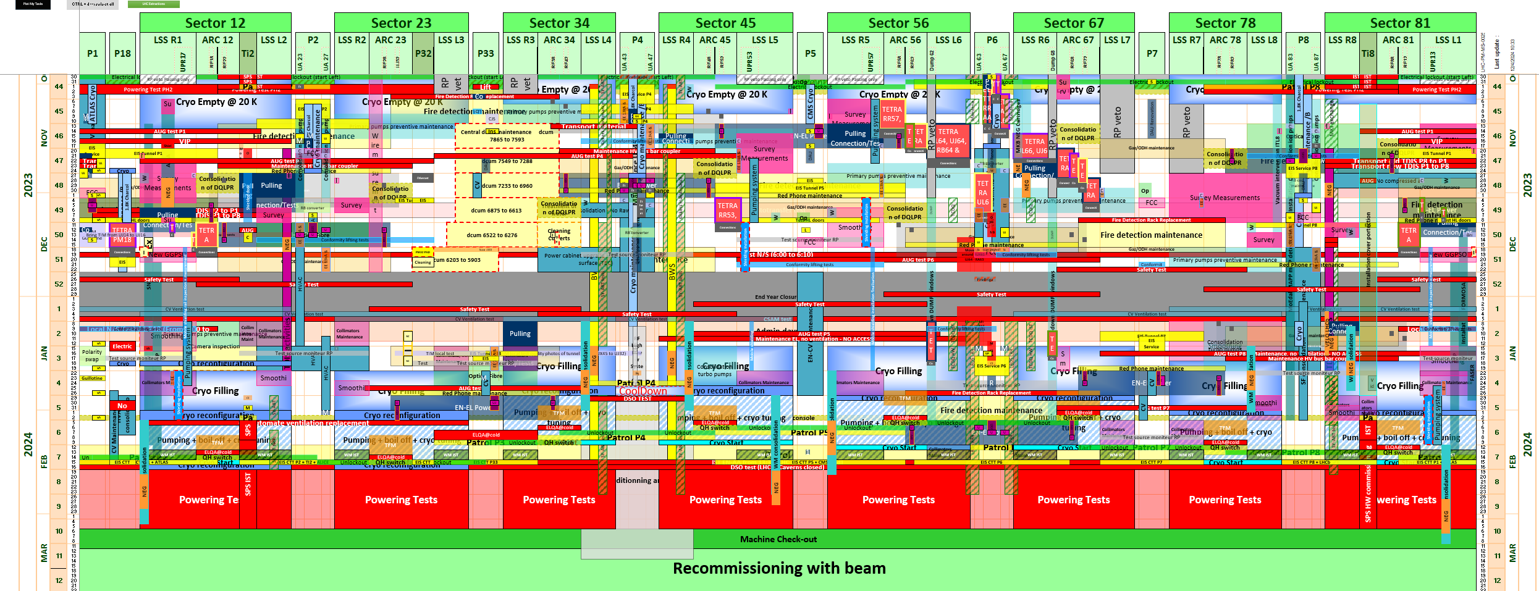
Excel VBA Linear Planning

Slide 14
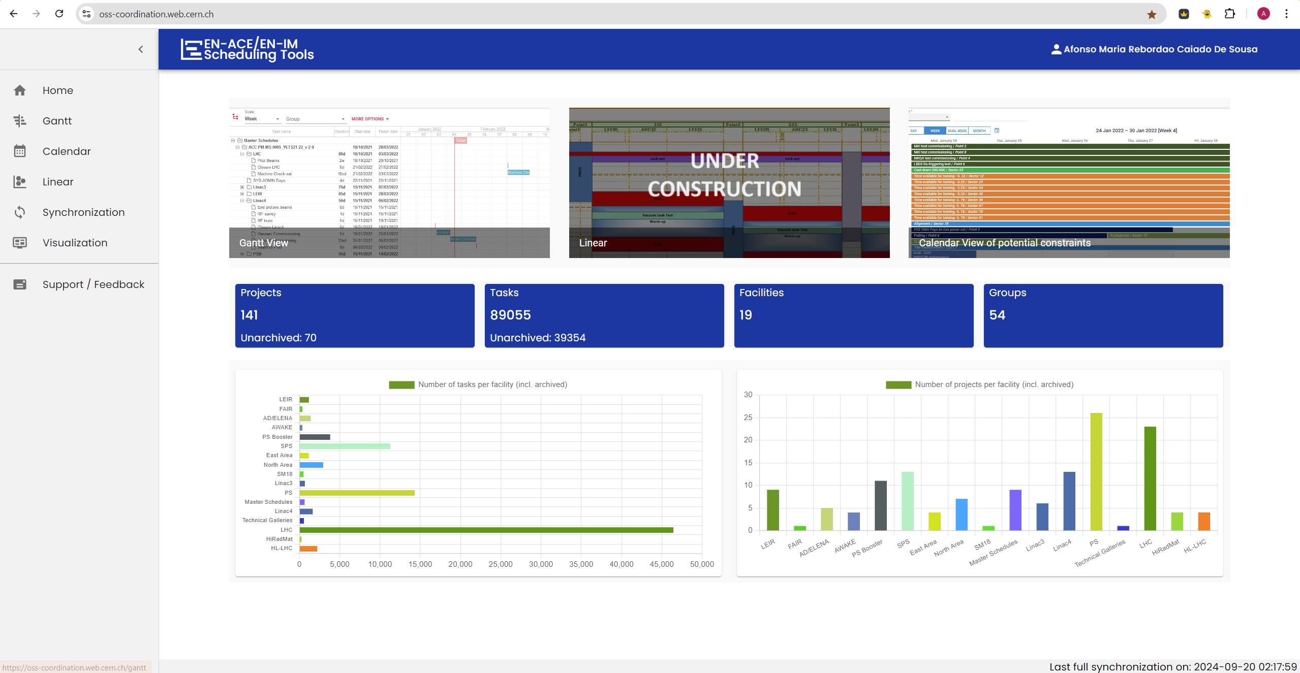
Scheduling Tools Home Page
https://oss-coordination.web.cern.ch/

Slide 15
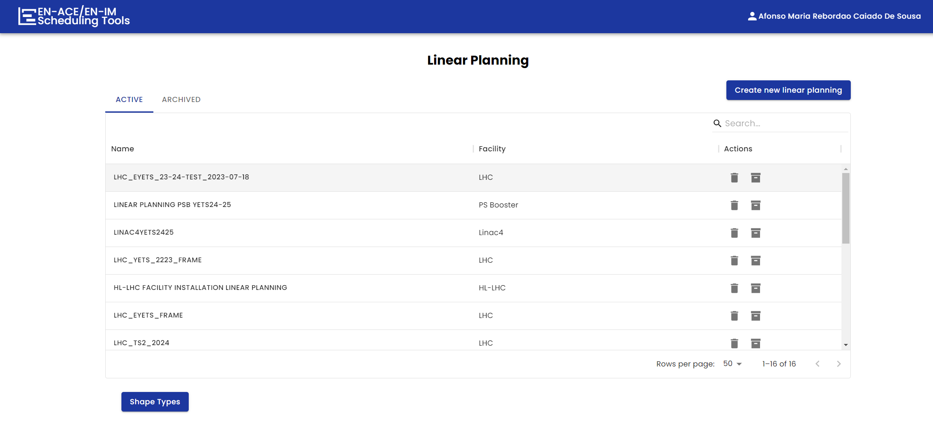
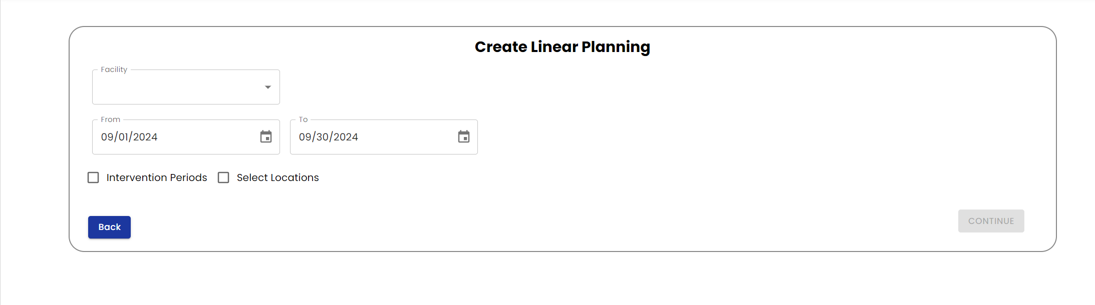

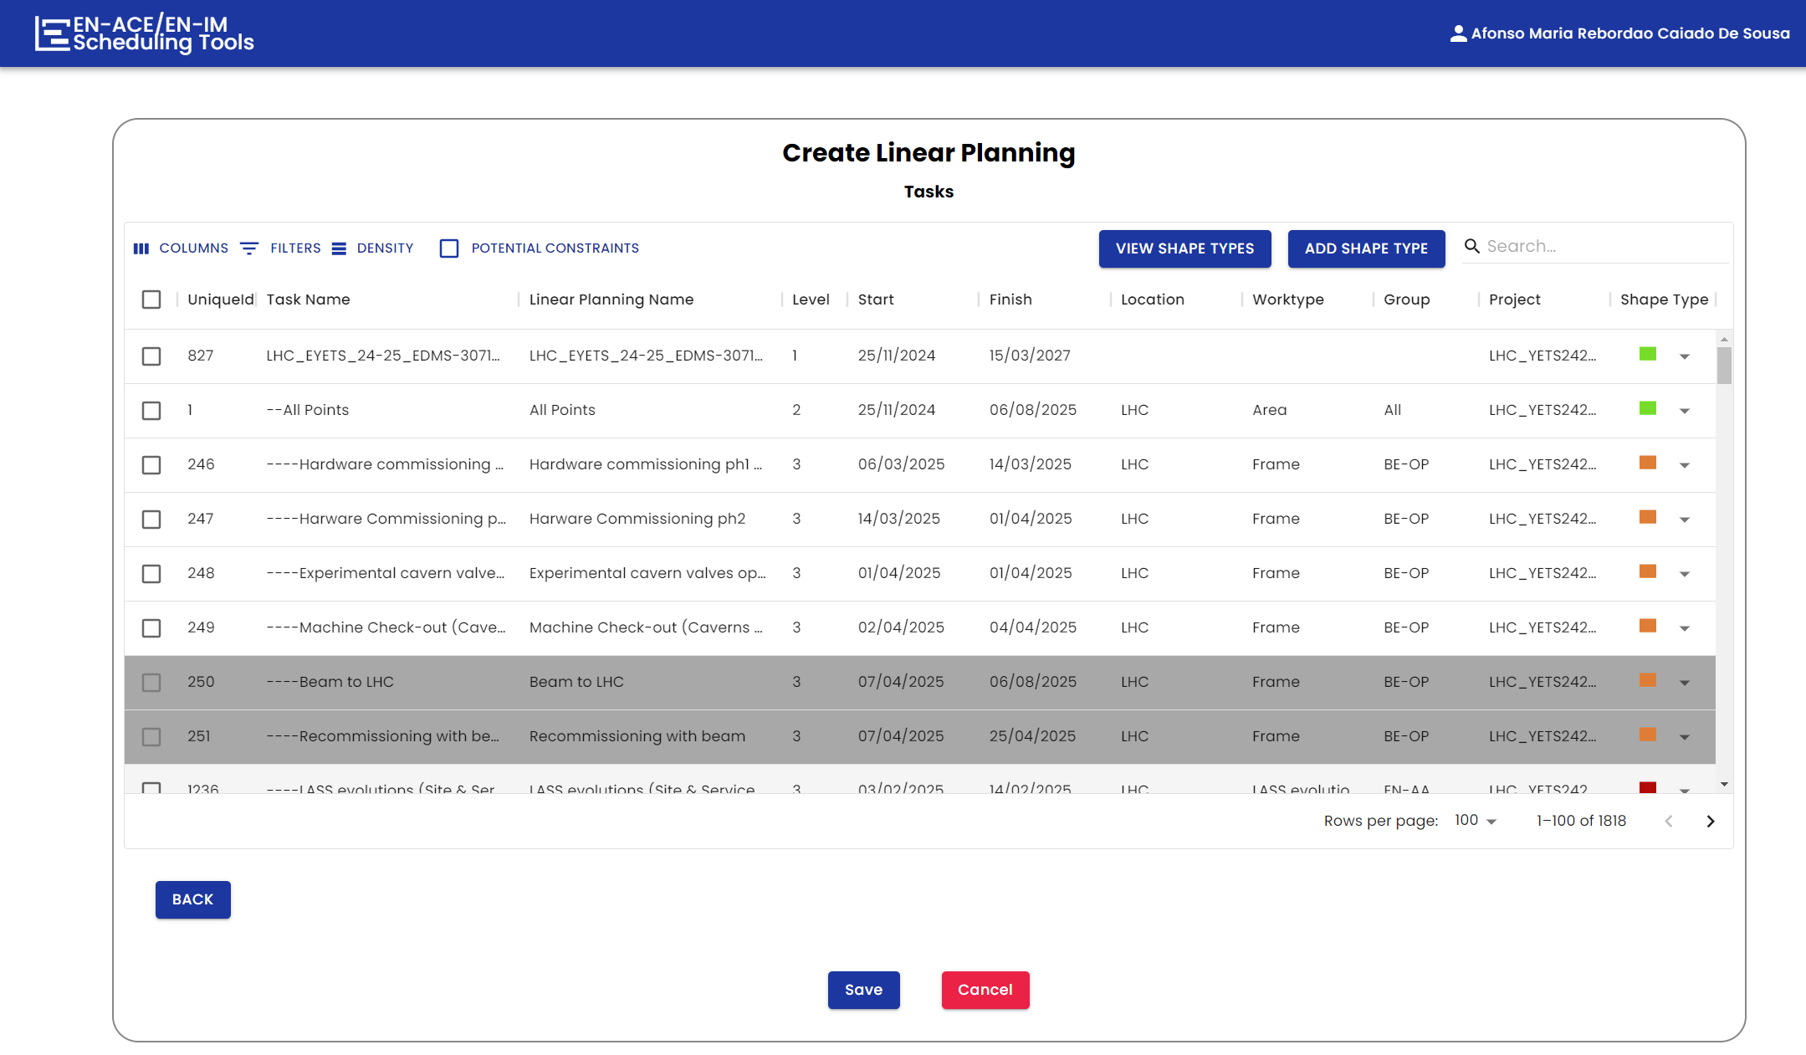
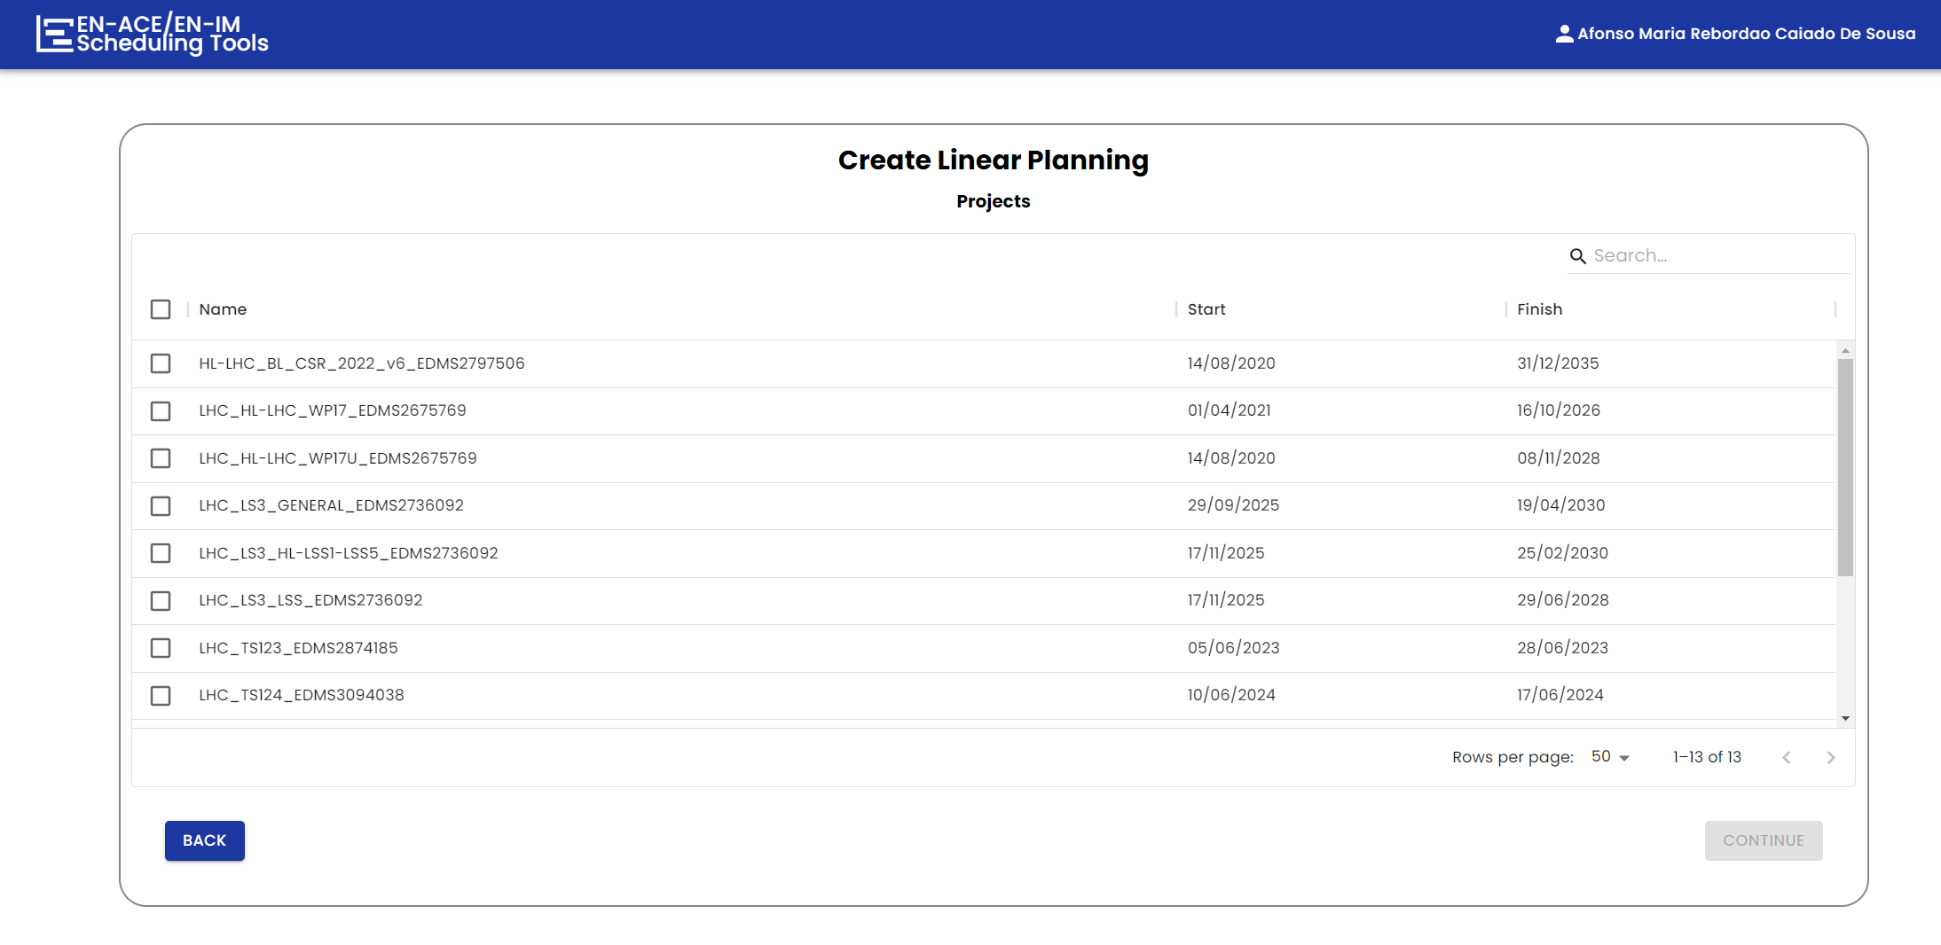
Linear Planning Creation

Slide 16
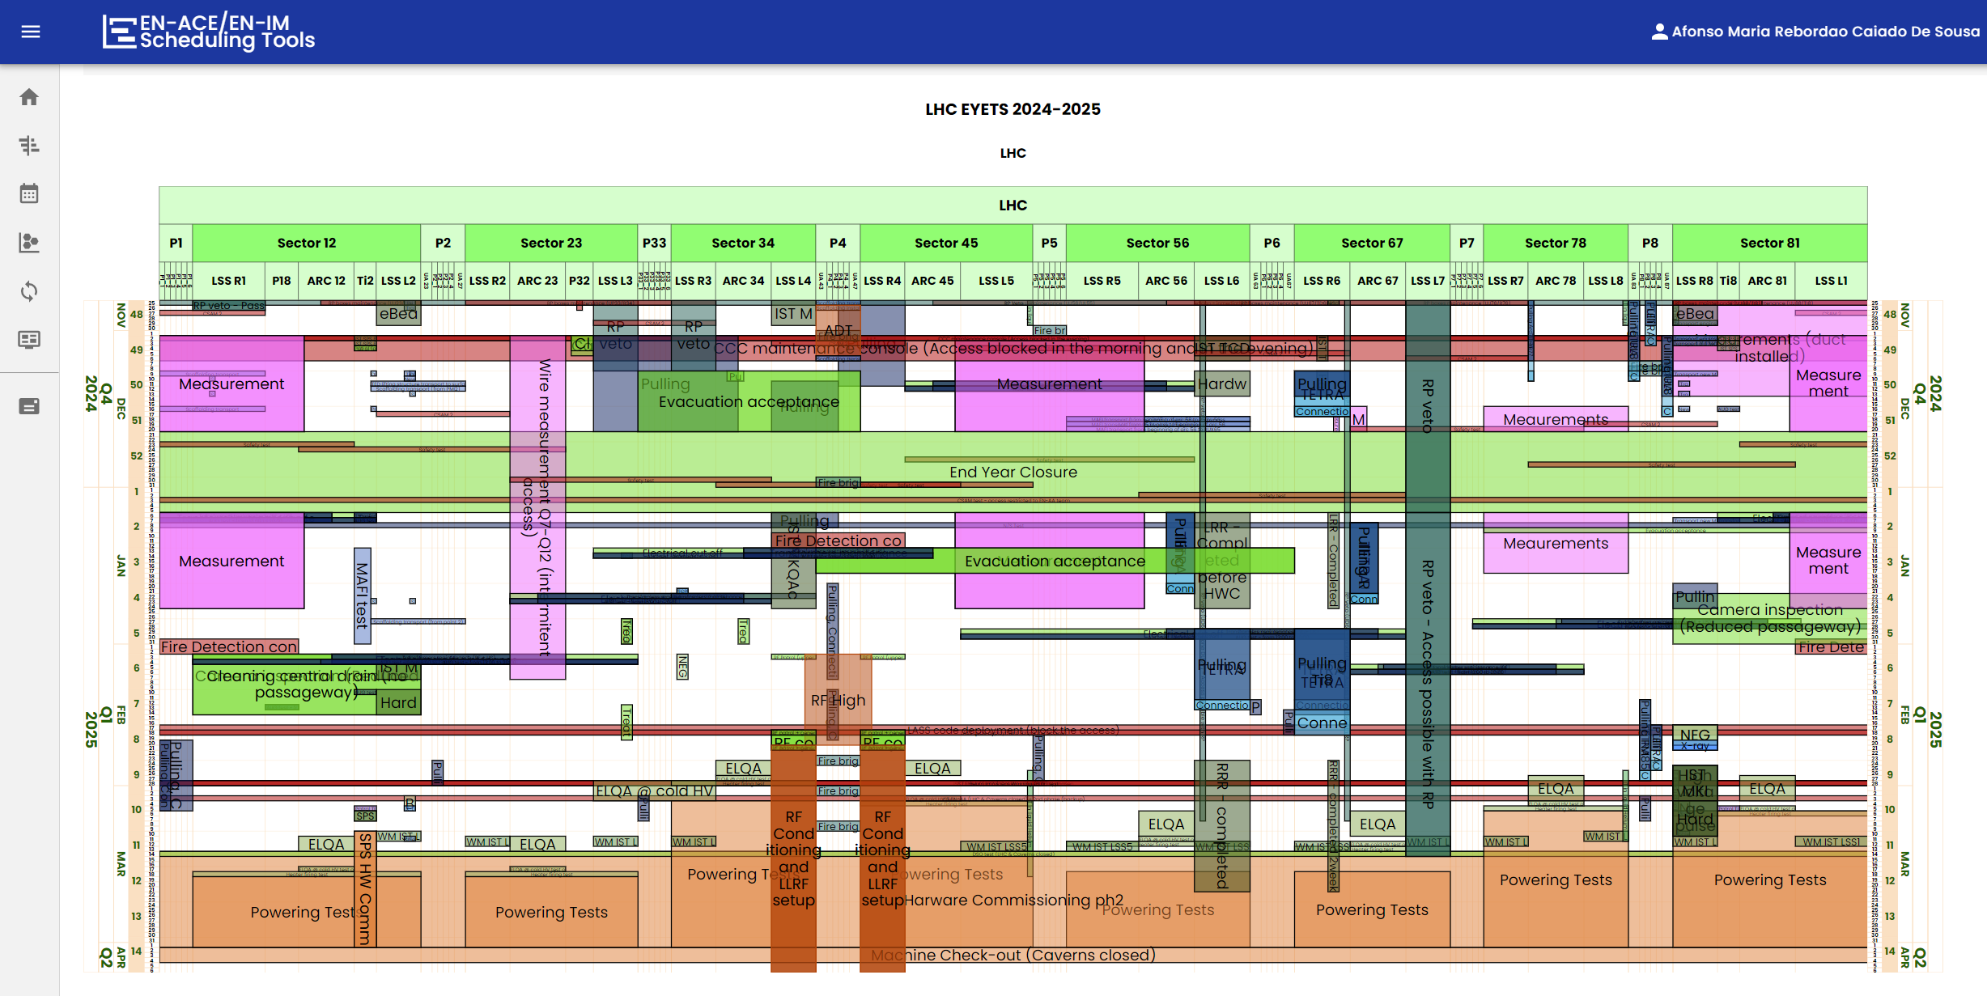
Web Interface Linear Planning

Slide 17
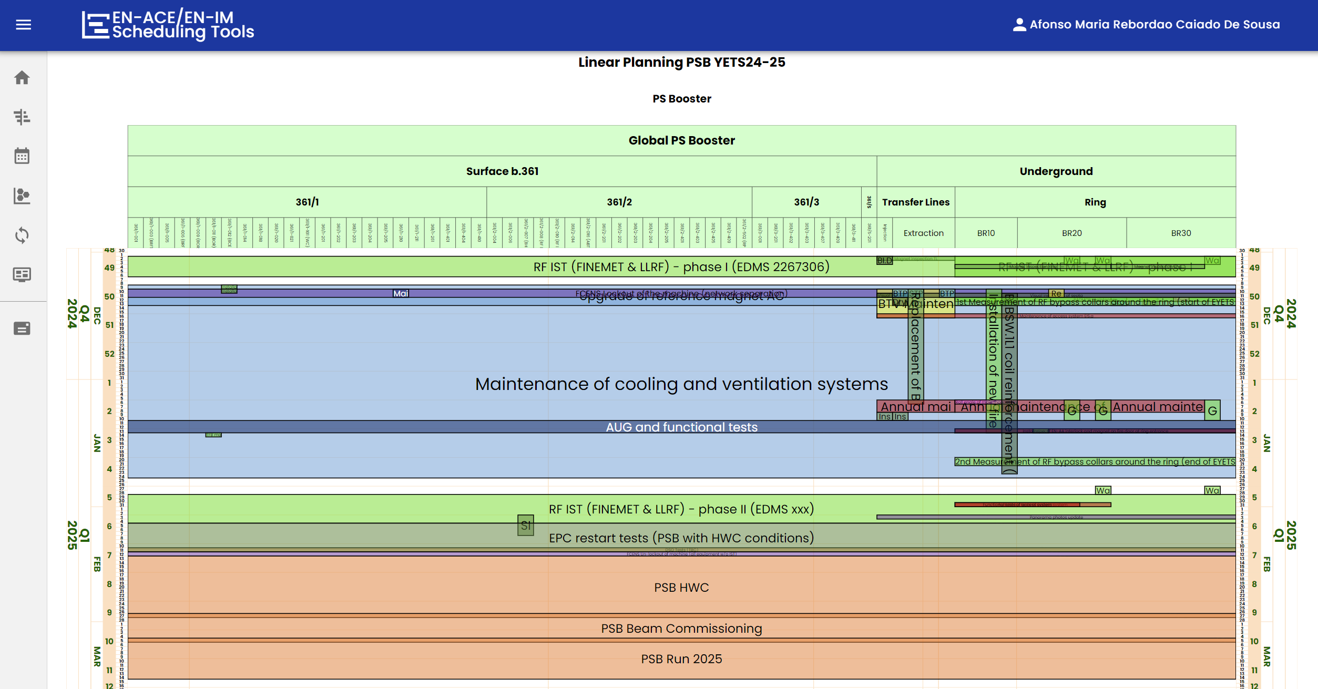
Web Interface Linear Planning

Slide 18
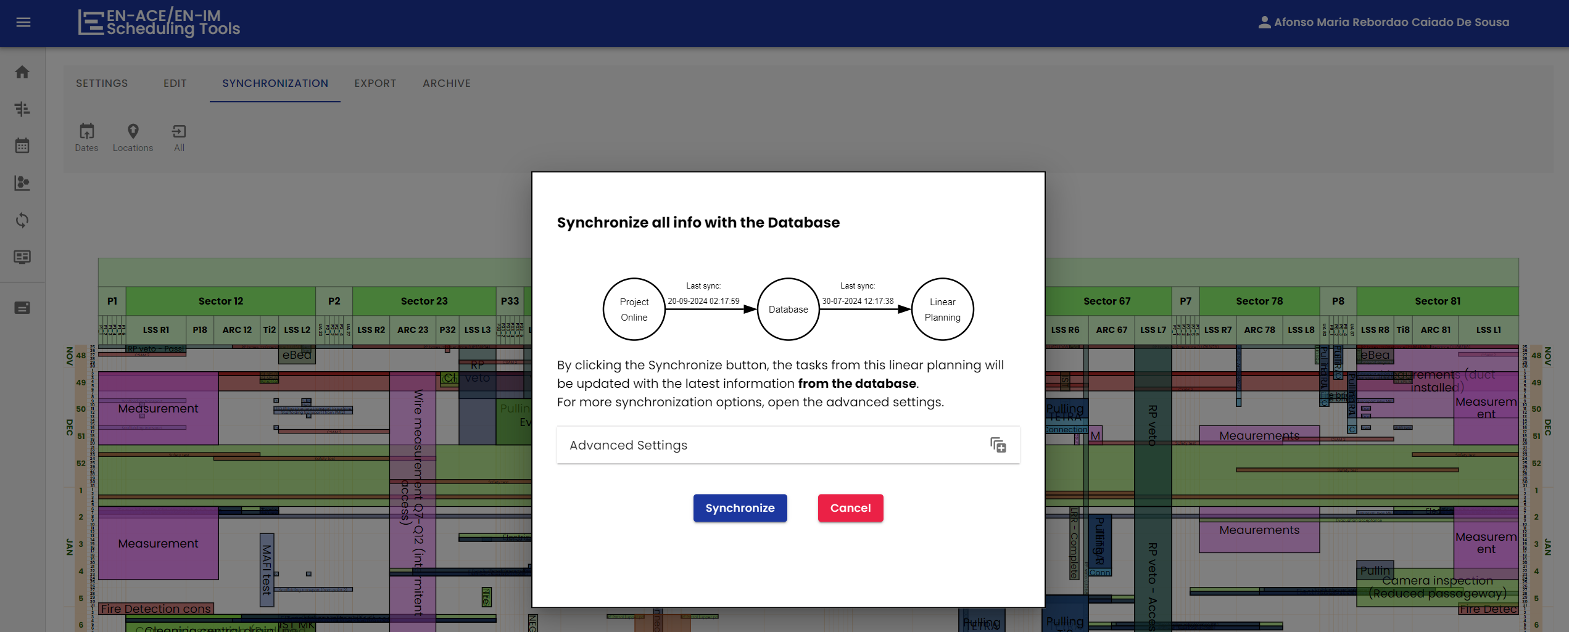
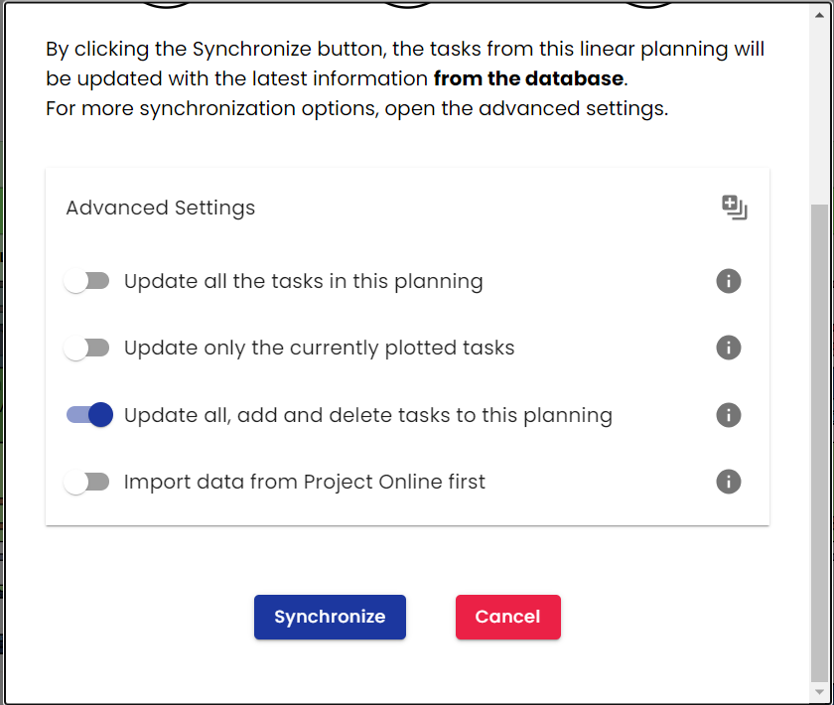
Synchronization

Slide 19
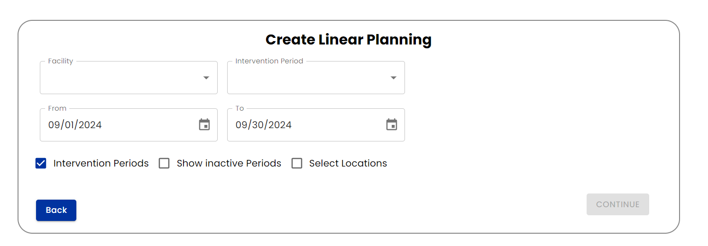
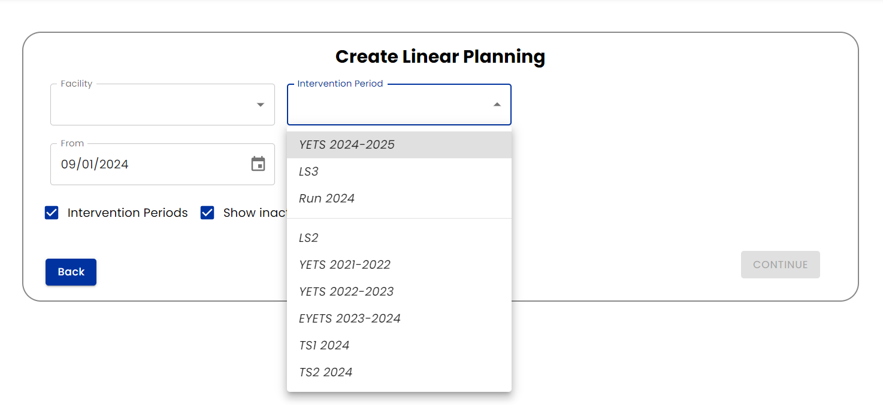
Intervention Periods
Up-to-date period information
Possibility to show inactive periods

Slide 20
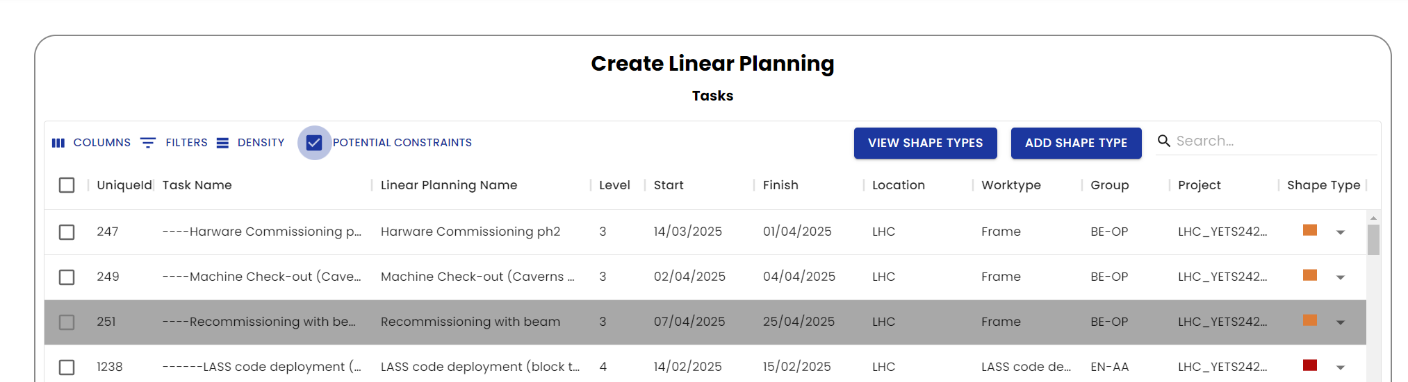
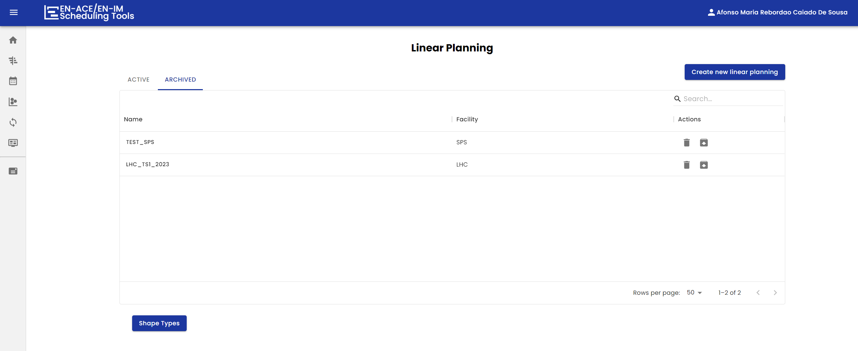
Filtering
Possibility to view only constraints activities
Multi-filters
Ability to archive linear plannings

Slide 21
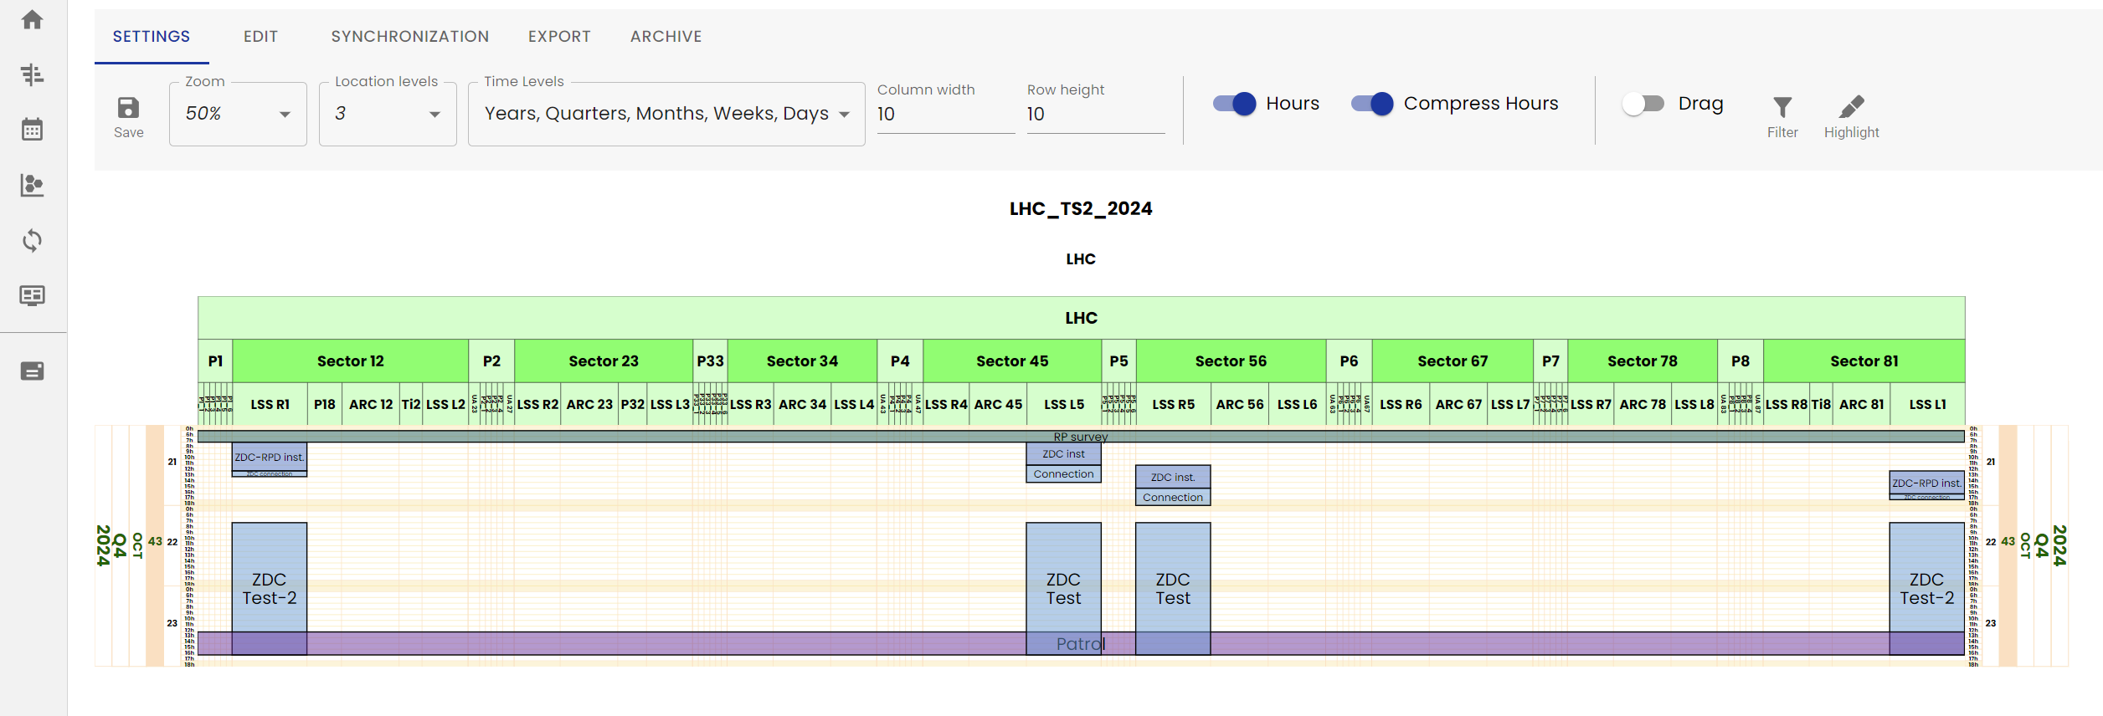
Design
New text font
Compress hours
Location and time colors
Visible text
Vertical lines

Slide 22
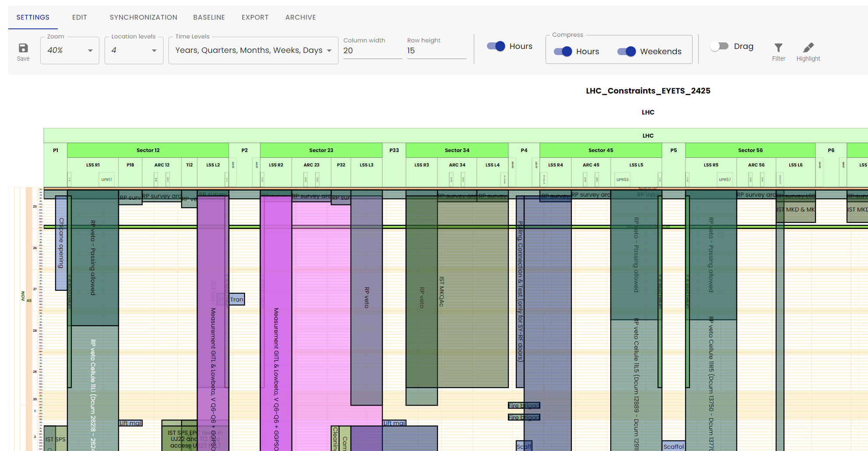
Design
Compress weekend days
Ability to hide parts of the planning

Slide 23
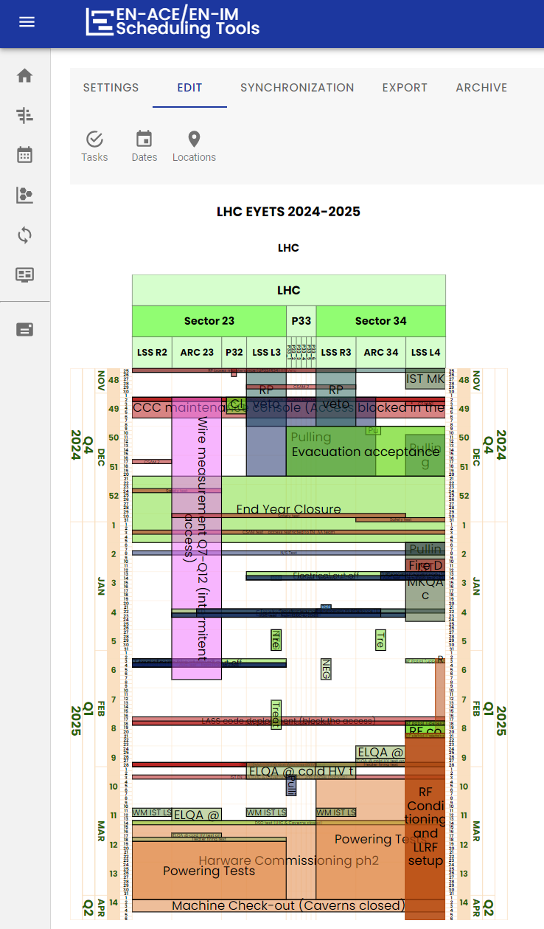
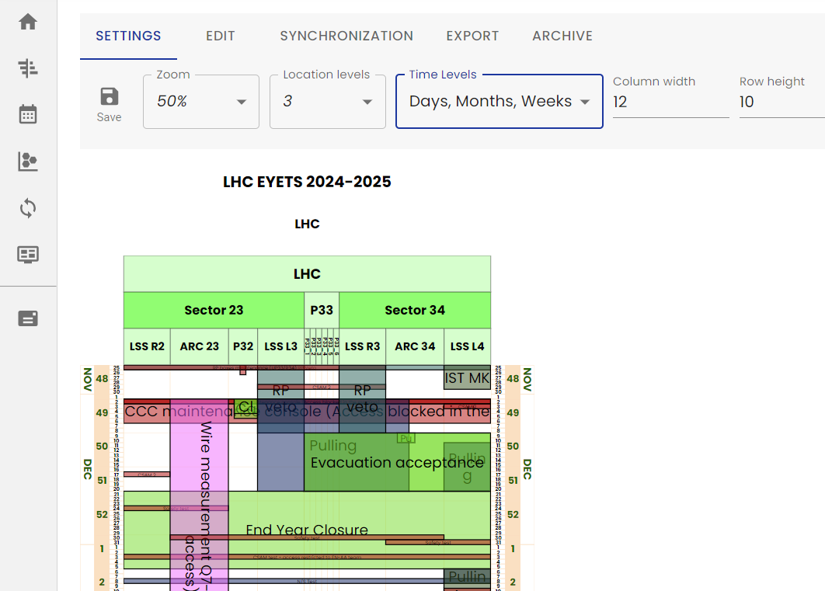
Planning Customization
Select which are the locations to be seen / exported
Modify the time levels to be seen

Slide 24
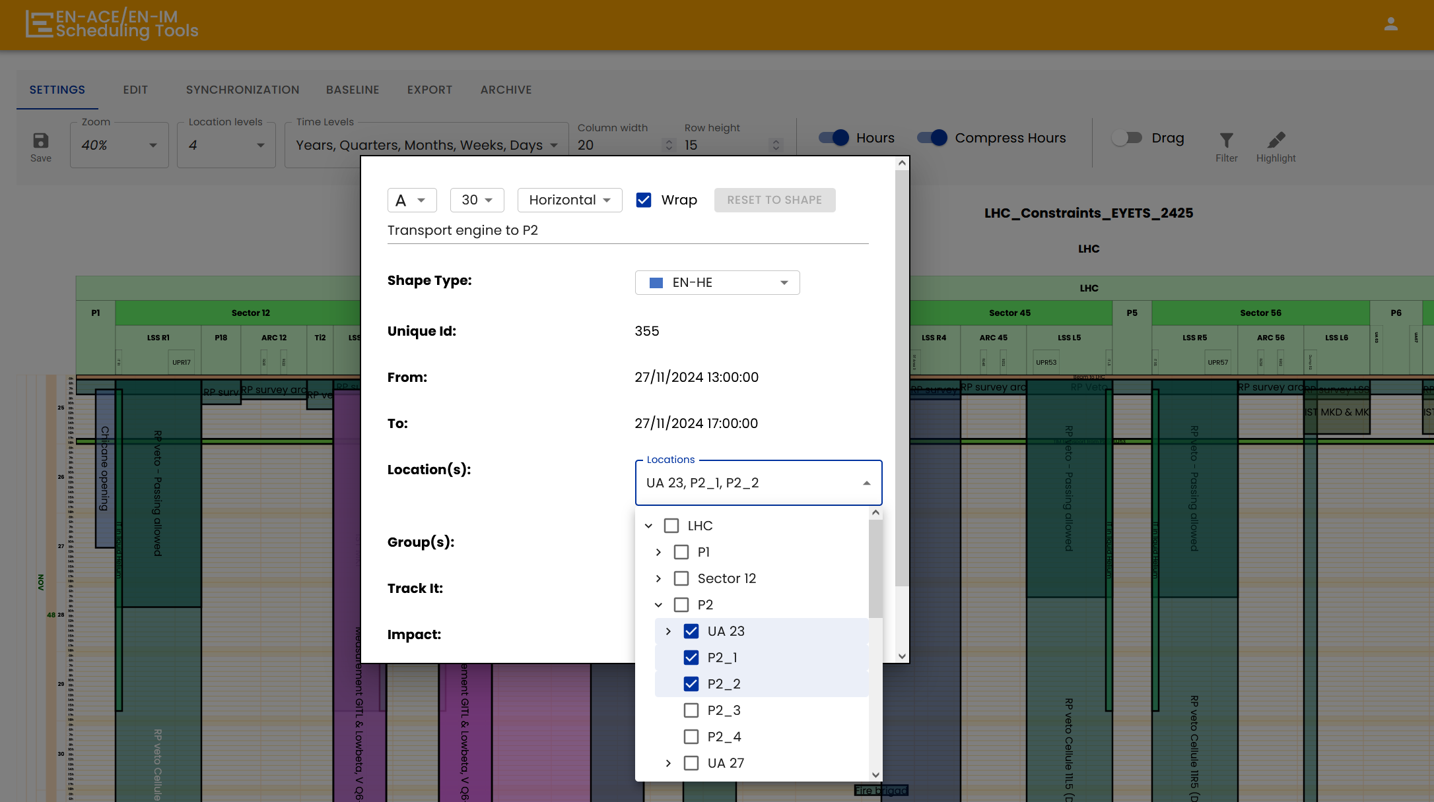
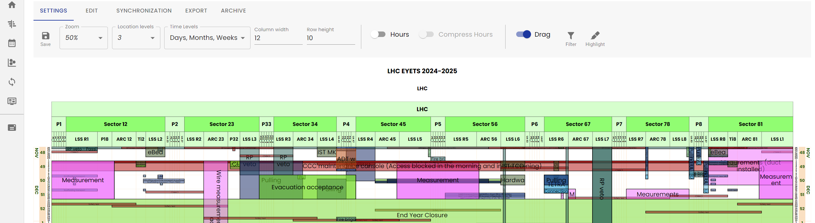
Planning Customization
Modify a task’s location directly in the planning
Ability to save the drag and dropped tasks
Save the linear planning settings

Slide 25
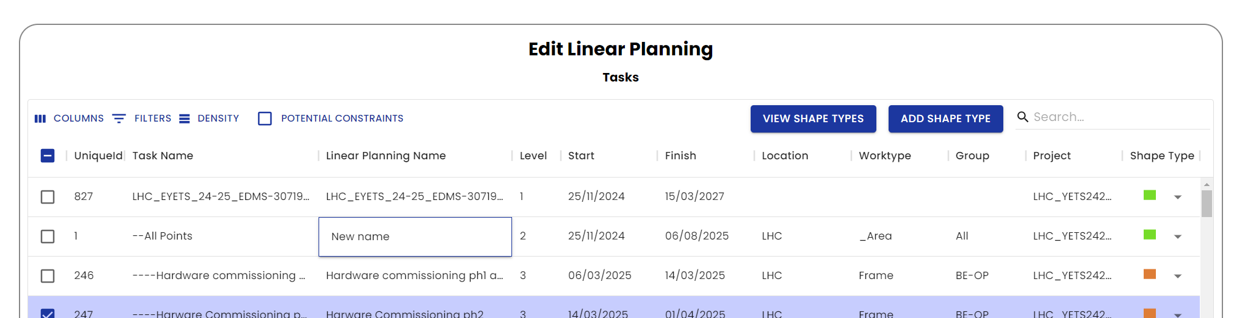
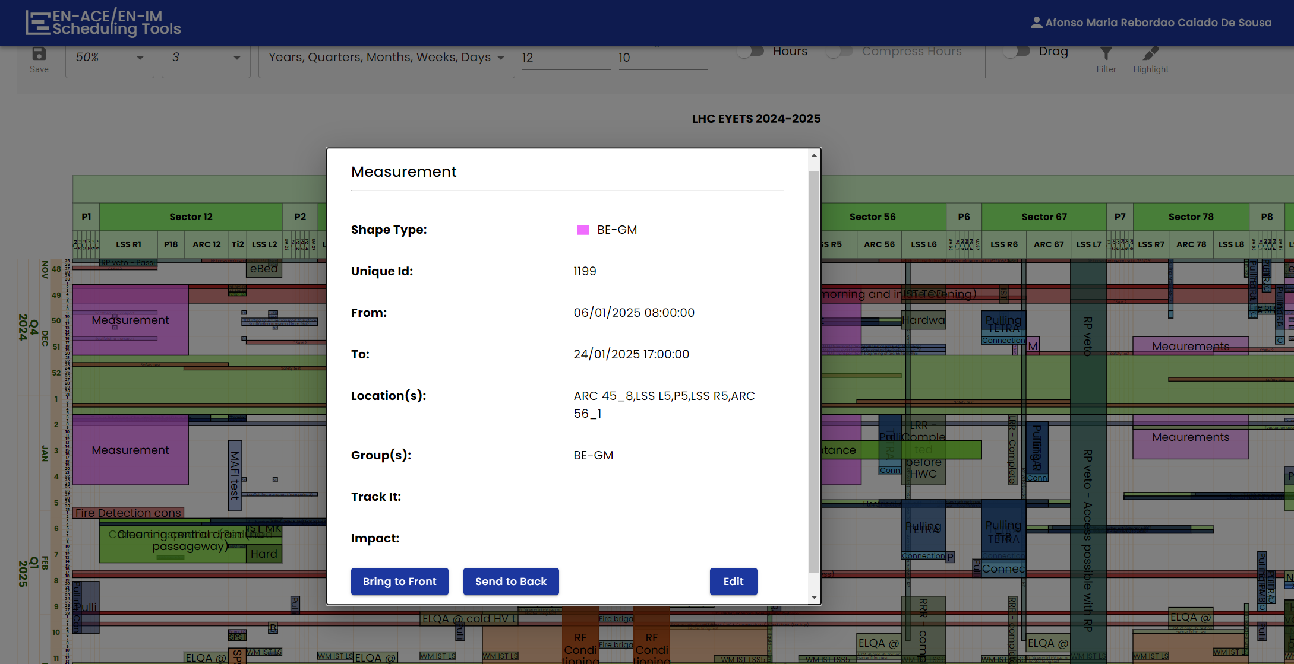
Planning Customization
Send a task to the front / back
Change a task name

Slide 26
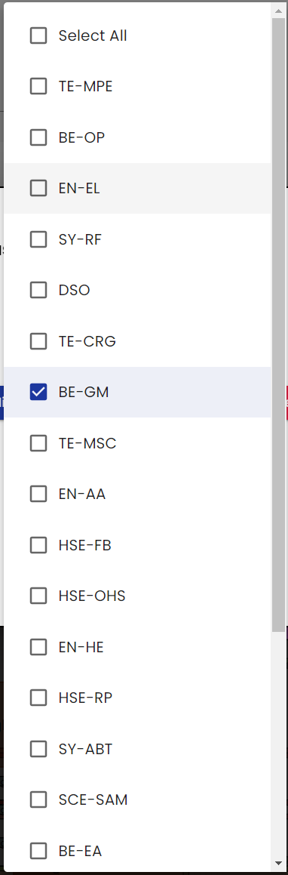
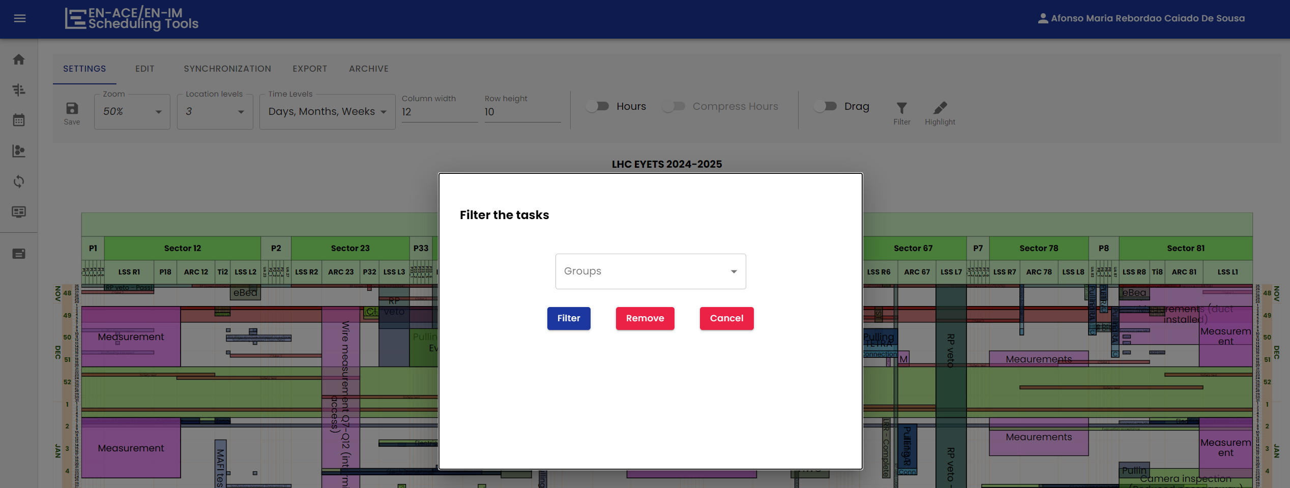
Planning Customization

Slide 27
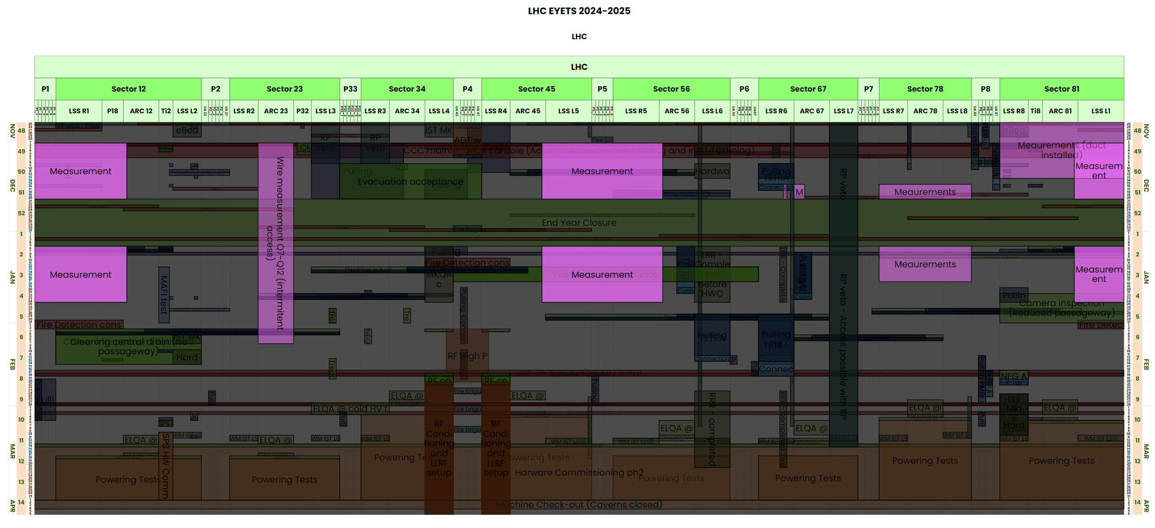
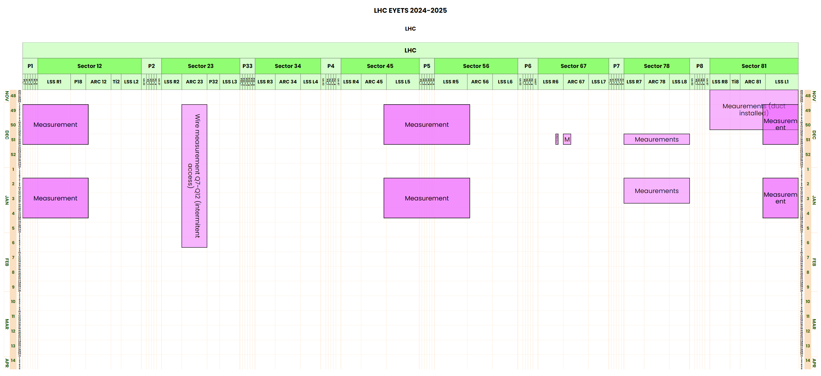
Planning Customization
Highlight
Filter

Slide 28
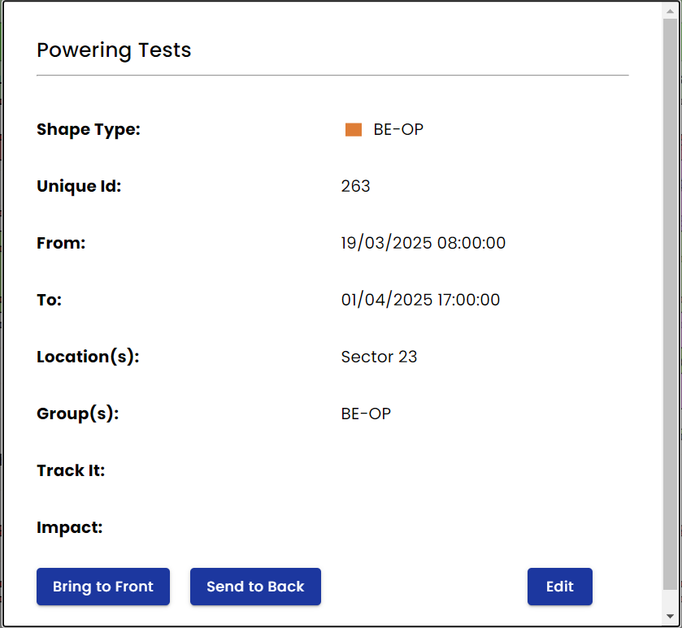
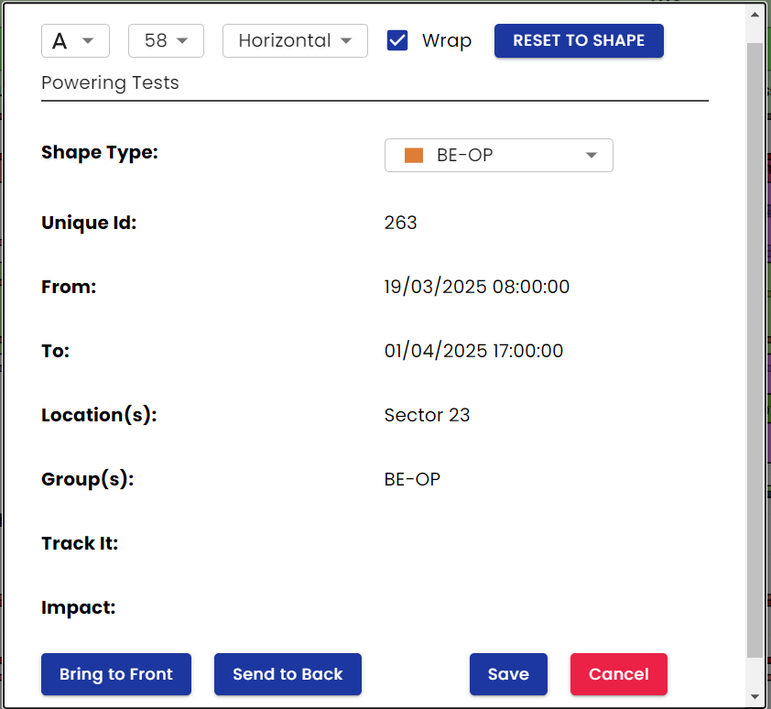


Planning Customization

Slide 29
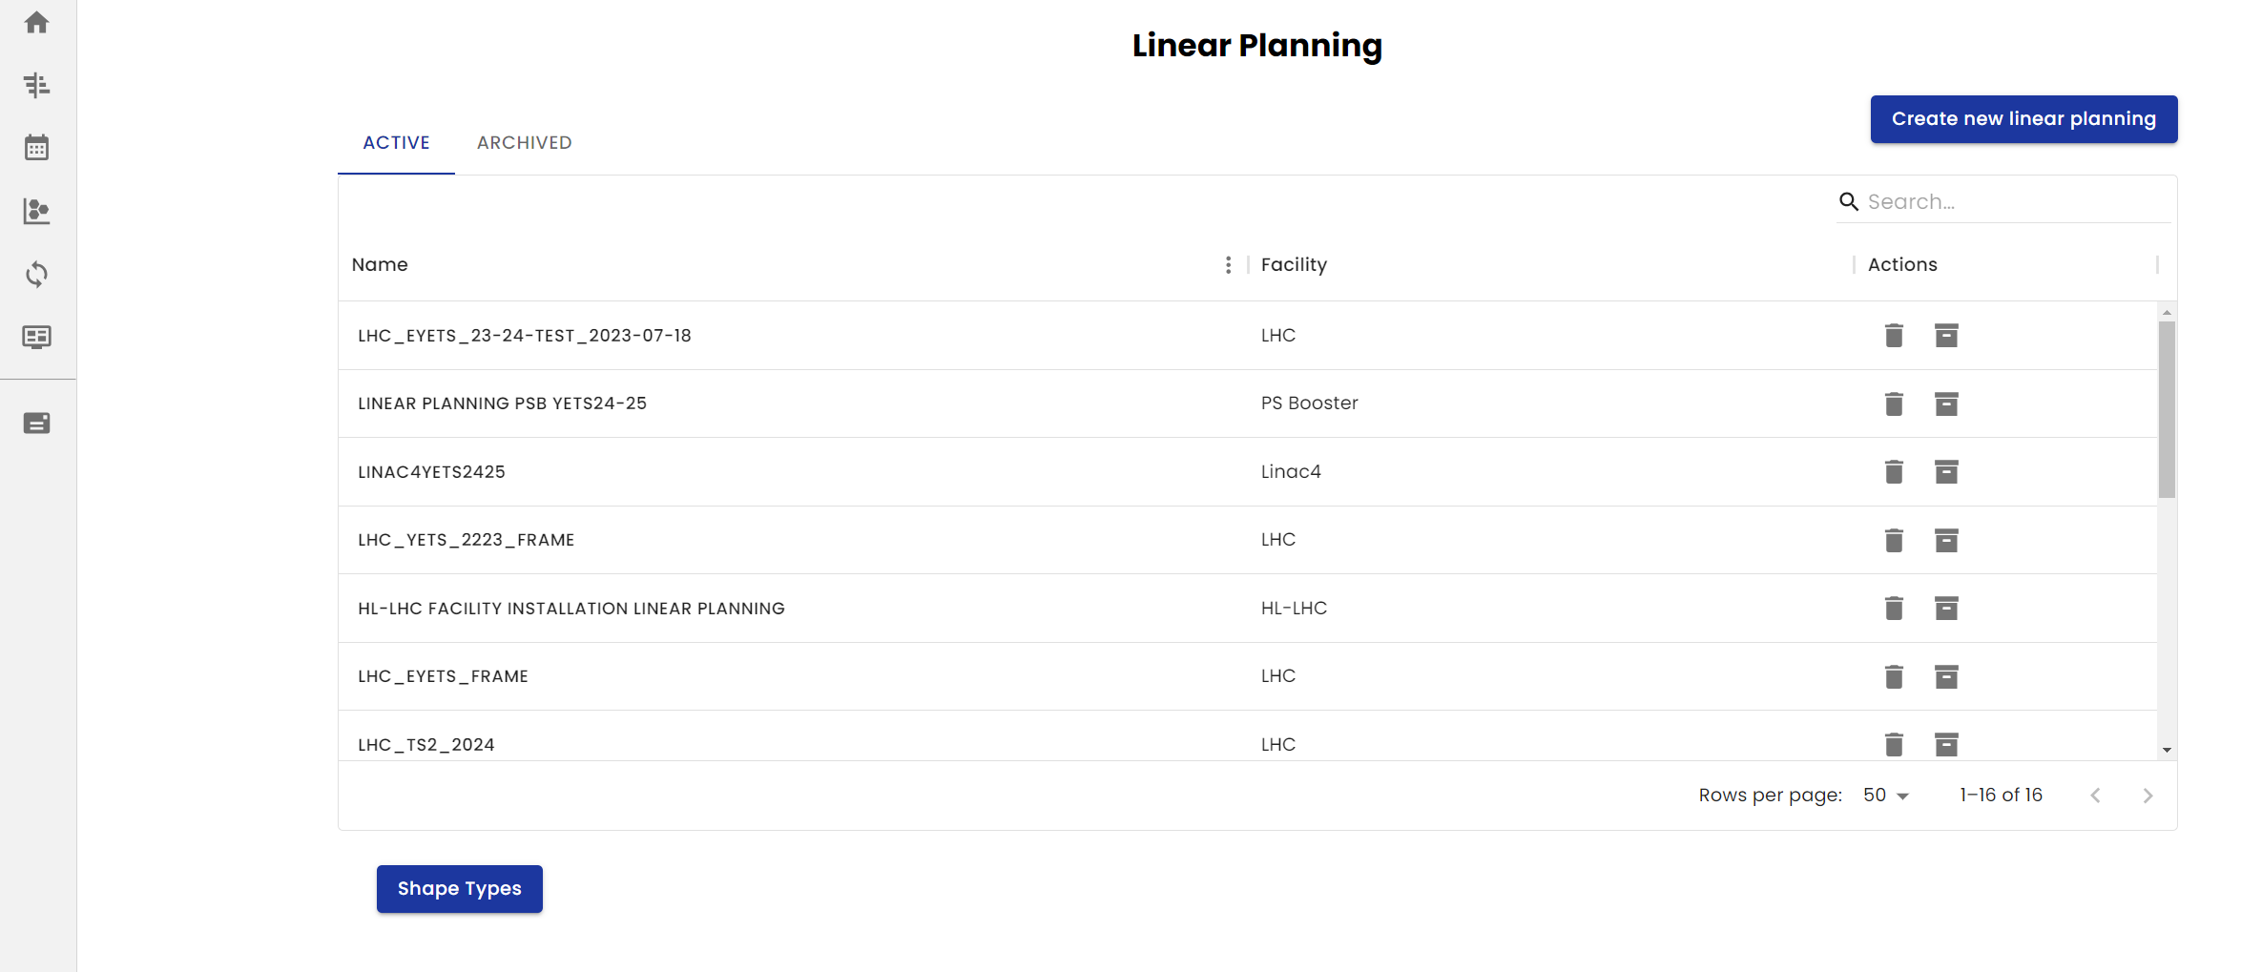
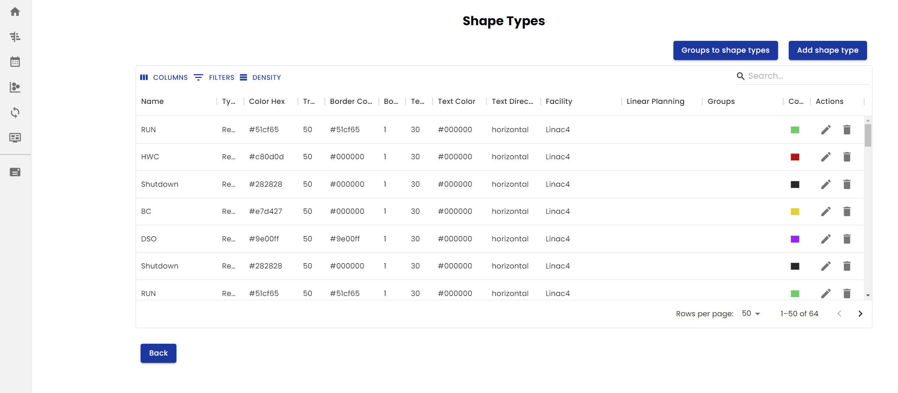
Planning Customization

Slide 30
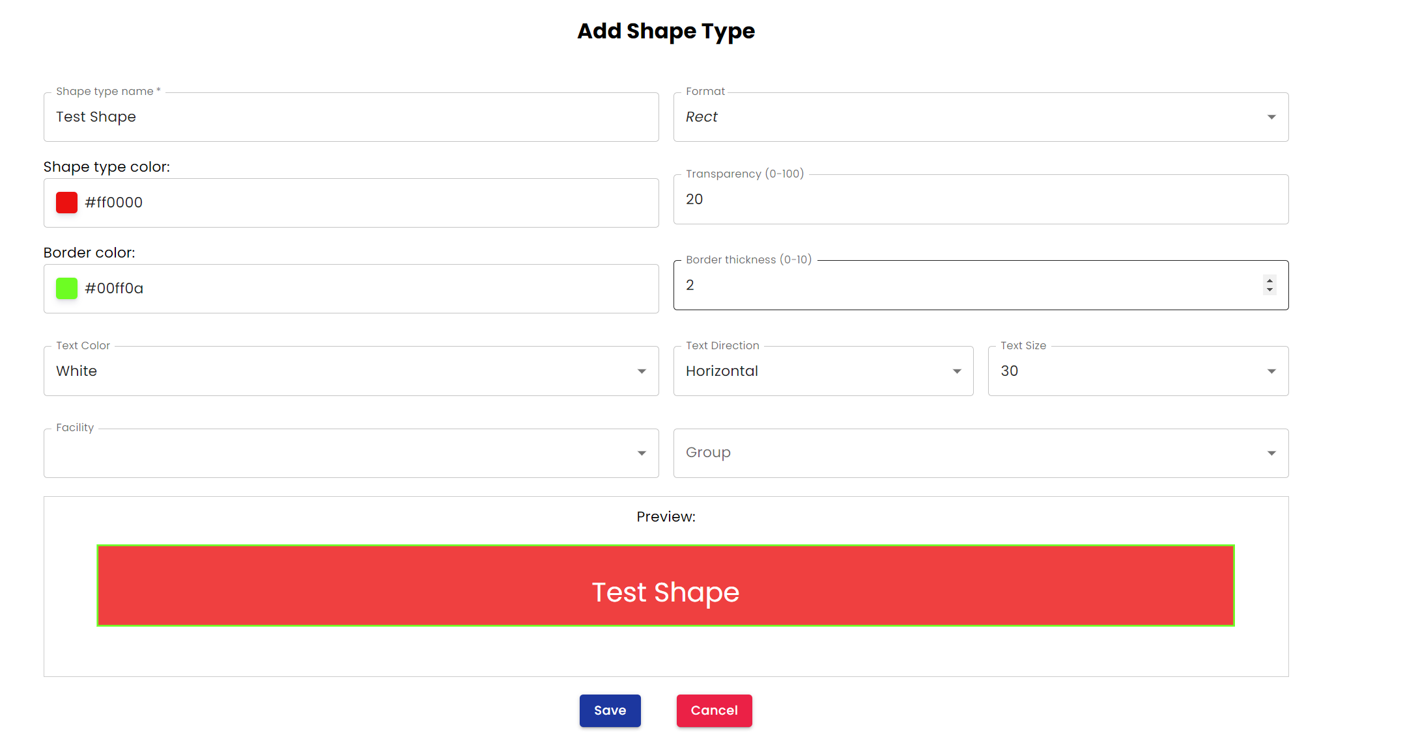
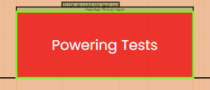
Planning Customization

Slide 31
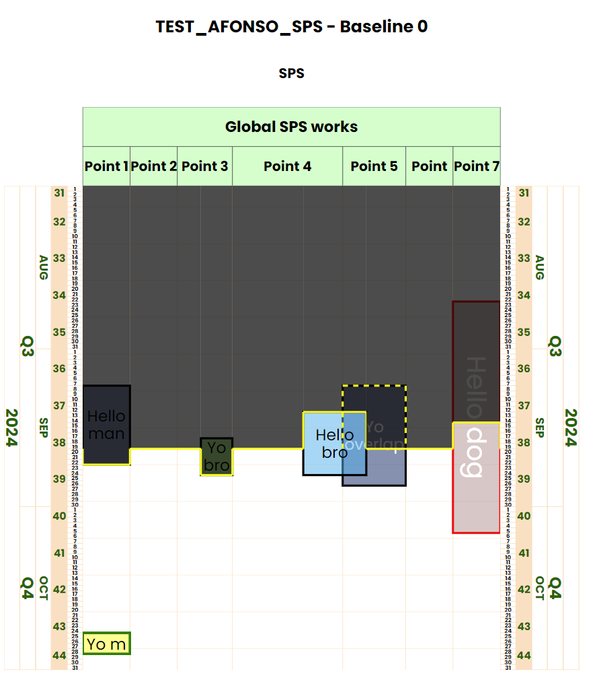
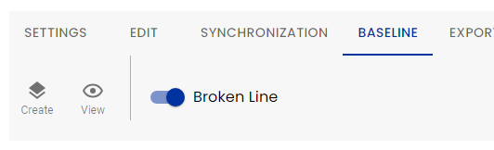
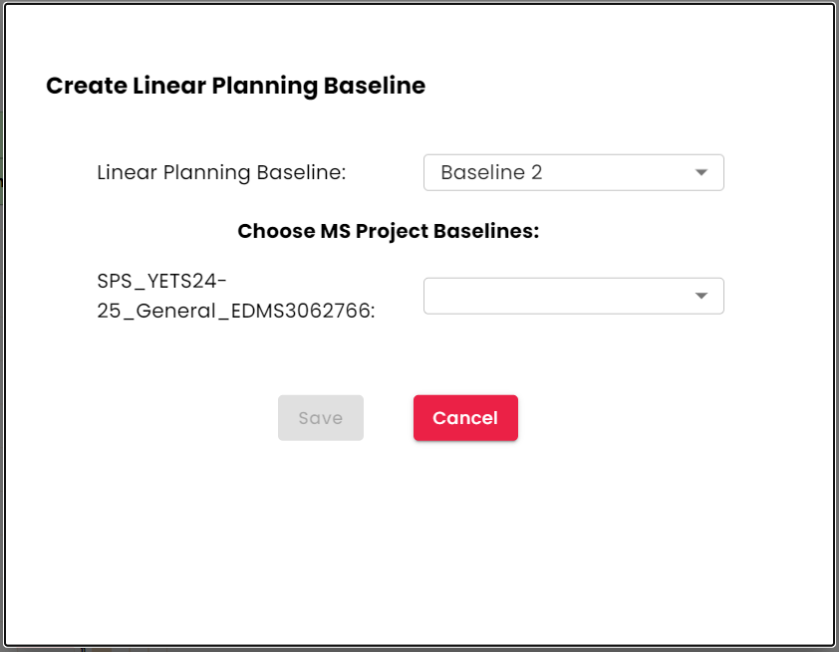
Baseline & Brokenline

Slide 32
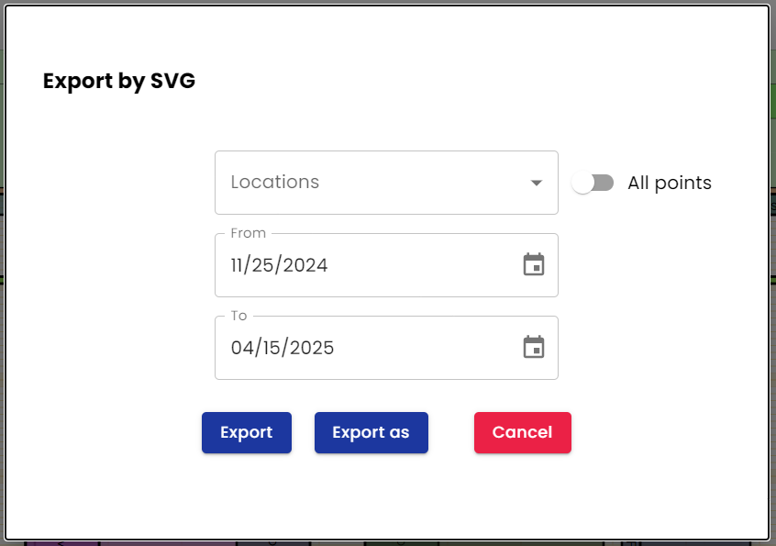
Export images
Possibility to export all 8 LHC points with one click
Export images with a custom name and location
Export the linear planning to SVG or PNG

Slide 33
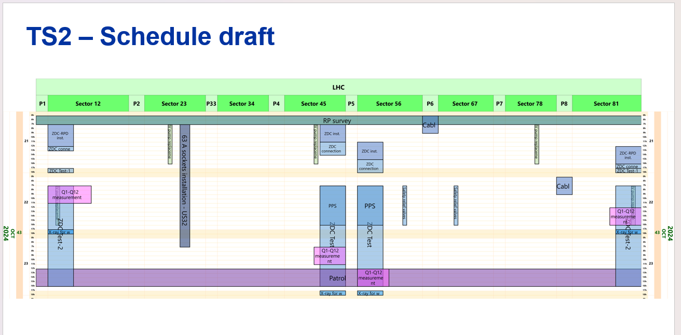
LHC – TS2
Preparation was done with the Linear Planning Web Interface
Notes:
Needs review

Slide 34

LHC – (E)YETS 24-25
LHC Constraints planning is being done with the web interface
Hourly planning for the whole (E)YETS duration
Exported images that are sent to the LHC access screens
Image shown in LHC Point 2. Images available at: https://accelerator-dashboard.web.cern.ch/Dashboard-Access-Screens

Slide 35

Scheduling Tools across CERN

Slide 36
All collaborations
Scheduling Tools Project
Technical Galleries
NA Cons
Exp. Areas
ATLAS
IMPACT
Track-it
EN-Projects

Slide 37

ATLAS Collaboration
ATLAS coordination team needed a visible Gantt viewer without an MS Project license
Solution:
Two-way collaboration that provides a similar Gantt viewer for ATLAS
ATLAS provides a software developer to reproduce Gantt Viewer for ATLAS
Scheduling Tools follows the development and remains the owner of the tool
Results:
Successful export of Gantt Viewer into ATLAS coordination needs, benefiting from ATLAS’s resources to implement new functionalities in the tool
Demonstration of the benefits of Groups cooperation at CERN: A unified methodology facilitating seamless data sharing
Notes:
August 2023

Slide 38

ATLAS Collaboration
Replicated the Scheduling Tools websites
Removed unused Linear and Visualization pages

Slide 39

ATLAS Collaboration
Organization of the Gantt chart by Period
New features:
Support / Feedback, Sorting

Slide 40


Intervention periods - IMPACT
Intervention Periods Centralization between Scheduling Tools Project and IMPACT Databases EDMS 3064968
Data model for inserting intervention periods information in the STP database

Slide 41

Next steps

Slide 42
Project Management Plan – Roadmap
EYETS 2023-2024
EYETS 2024-20245
YETS 2025-20246
2023
2024
2025
2026
LS3
LPWI specification review
Test of linear planning web interface for EYETS 2023-24
LPWI Phase 1 post mortem
September: Origin arrival
LPWI Phase 2 development
LPWI Final development
Test of linear planning web interface for EYETS 2024-25
Test for LHC TS2
LPWI Phase 2 post mortem
STP Usage
Maintenance of the tools
Long term maintainability ?

Slide 43
What’s next
The main objective
Deliver a robust and user-friendly Linear Planning Web Interface for the LS3, ensuring compatibility across all accelerators.
How?
Performance Optimization
  Enhance app performance by refining backend processes, reducing loading times, and improving overall responsiveness.
Feature Refinement and Expansion
  Continuously improve existing features based on user feedback and introduce new functionalities to meet evolving needs.
Master Schedule Integration
  Implement the ability to create and view Master Schedule directly into the web interface.
Notes:
Needs review

Slide 44

Conclusions

Slide 45
My Conclusions
The project is progressing well and remains on track to meet its goals.
Despite challenges and constant adjustments, working closely with end users has proven invaluable. This collaboration enables rapid feedback and continuous improvements.
This project helps me grow by managing development, handling user requests, and setting priorities.
I’m grateful for the collaboration among ACE developers that we were able to establish with Victor and Georg. It advances the project, applies industry standards, balances fast development, and fosters creativity.
Notes:
Next year I will be here saying it is being used

Slide 46
Acknowledgements
Estrella: for your unwavering positivity and help in tackling the challenges we face together.
Georg and Victor: for your great contributions in advancing this project and in creating a better EN-ACE developer team.
The Scheduling Tools Community: To everyone who has supported this project through feedback, ideas, contributions, and more — your input has been invaluable.

Slide 47
Any questions?

