Slide 1
ULiège @ CERN
Introduction
J.-Ph. Tock EN-ACE GL
2024-12-05/06

Slide 2
EN-ACE (05.12.204)
Collaboration agreement (06.12.204)

Slide 3


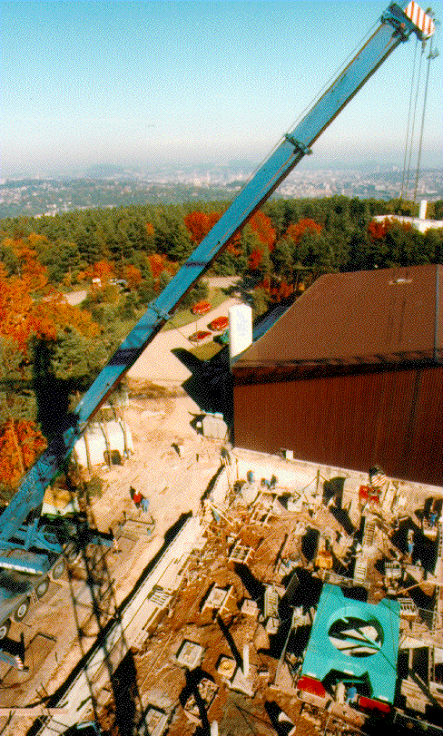
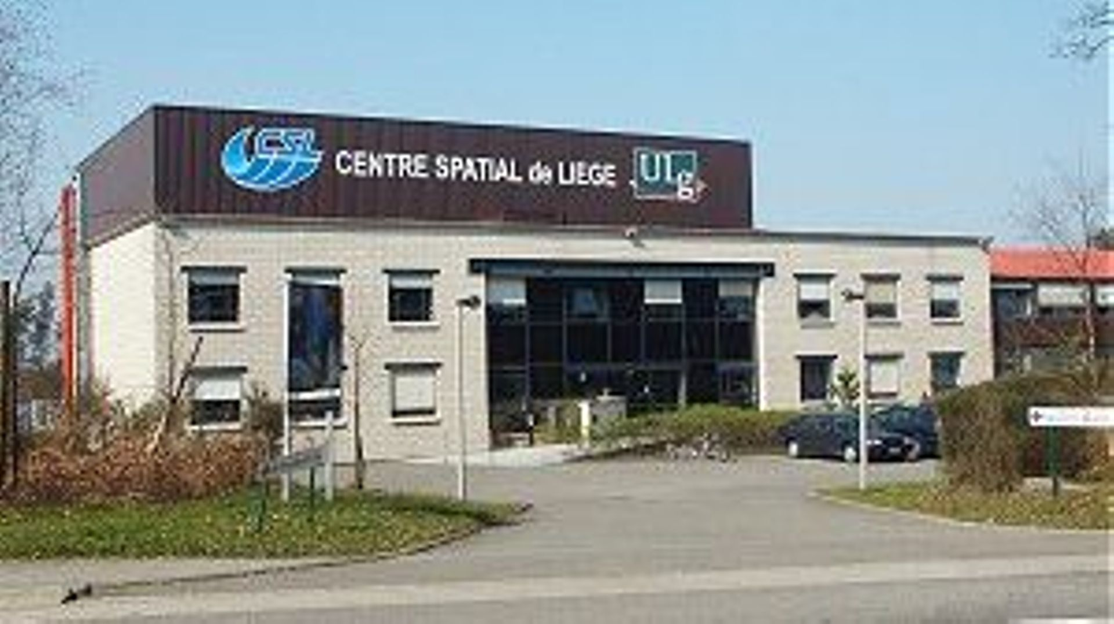
Master degree in Aerospace Electromechanical Engineering
Ingénieur Civil en Gestion Industrielle
Ion beam figuring Facility Project Engineer
XMM optical test facility (FOCAL X) system engineer
XMM optical modules ground test director

Slide 4
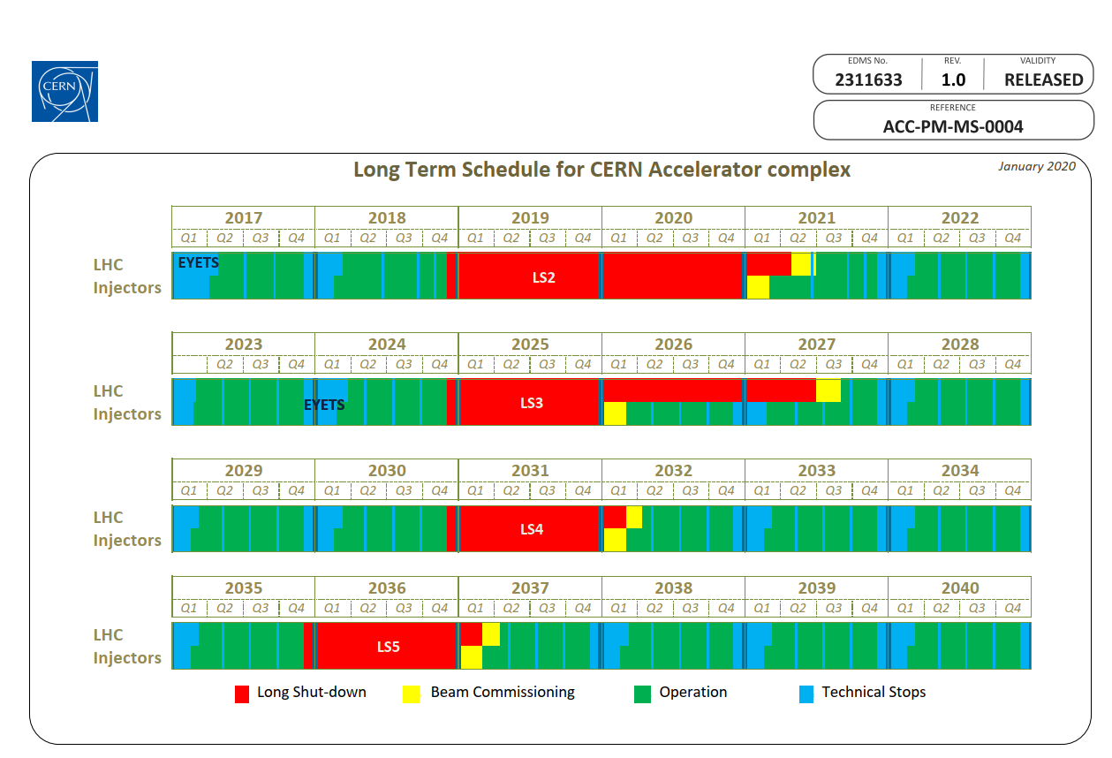
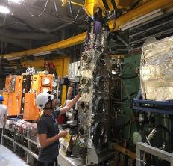

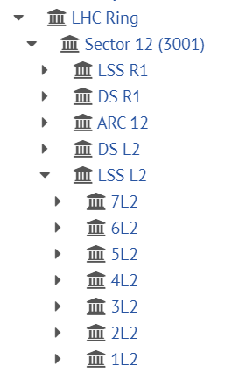
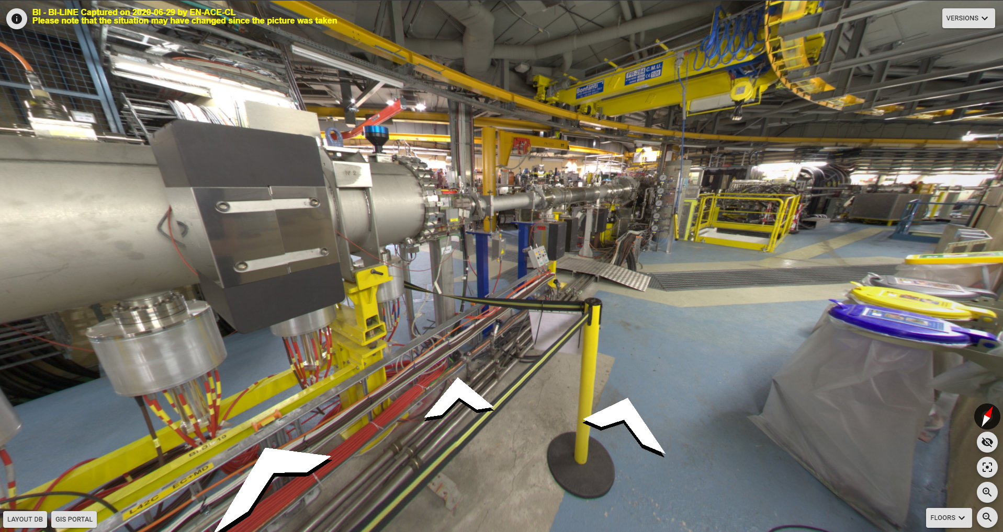
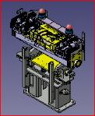
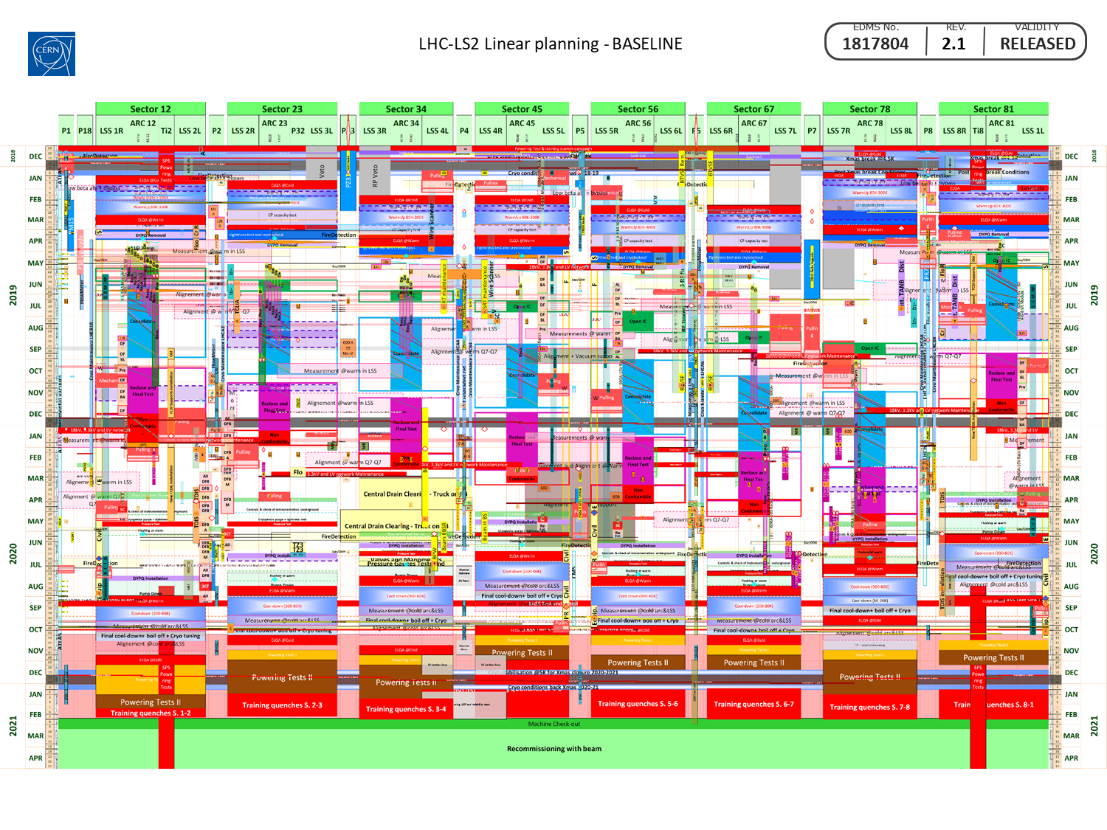
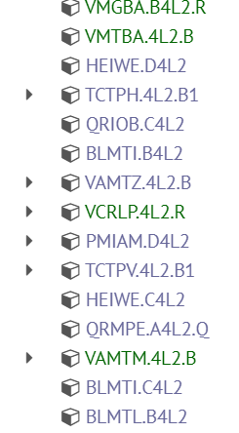
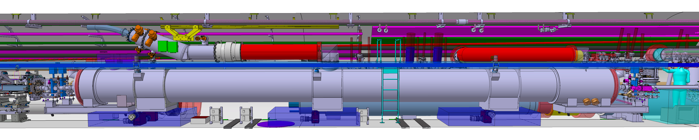
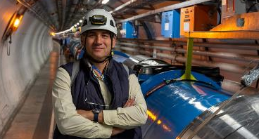

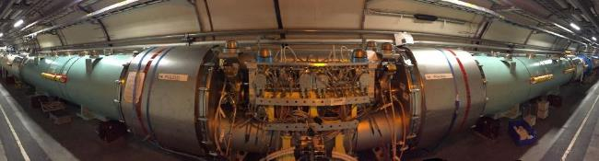
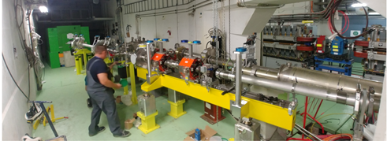
EN-ACE
ACE : Accelerator Coordination & Engineering Group
https://en.web.cern.ch/group/ace
The group coordinates the activities for the interventions and changes to the LHC and its injectors. This includes configuration & layout management, integration studies and maintenance of the related 3D-CAD representations, organization and scheduling of programmed stops, management of the mid- and long-term schedule, worksites follow-up and management of the LHC sites, management of electrical lock-out in LHC and operational safety coordination.
The group is responsible for the ATS Quality Service, giving support to the stakeholders of the ATS.
The group also provides support and/or advices in its key competencies.
Accelertor Quality Service
Group Leader
Jean-Philippe Tock

Slide 5
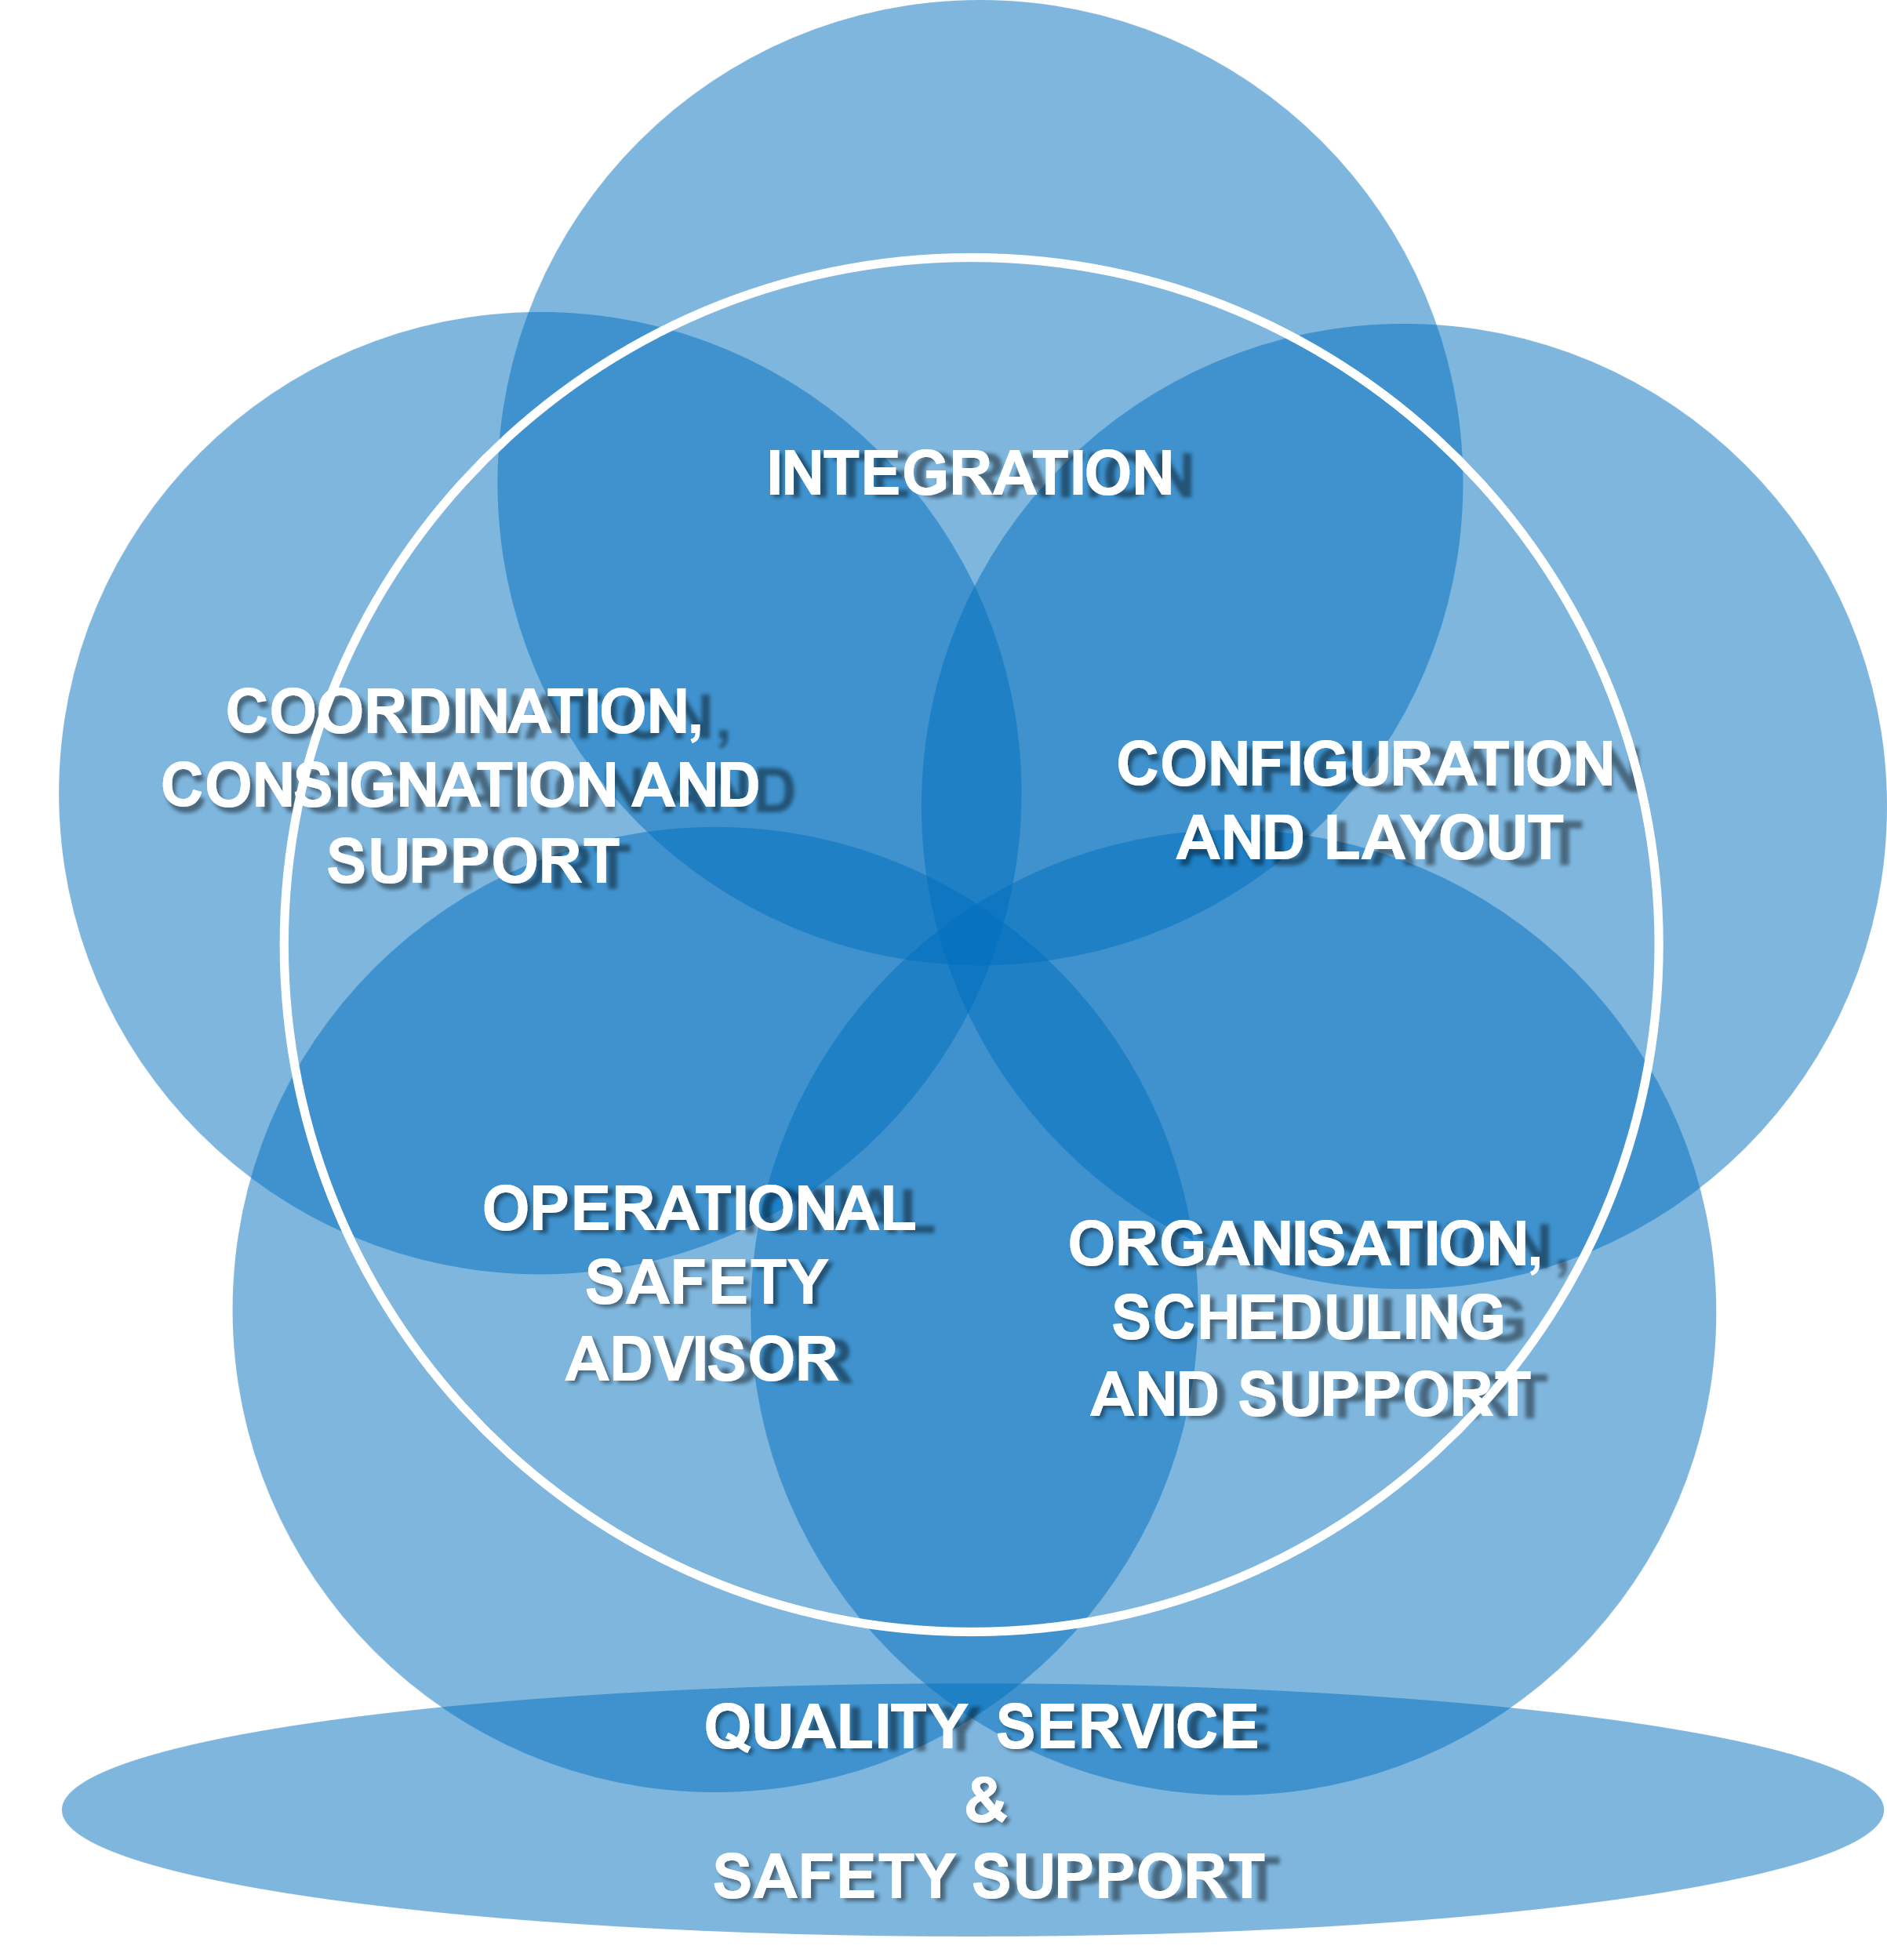
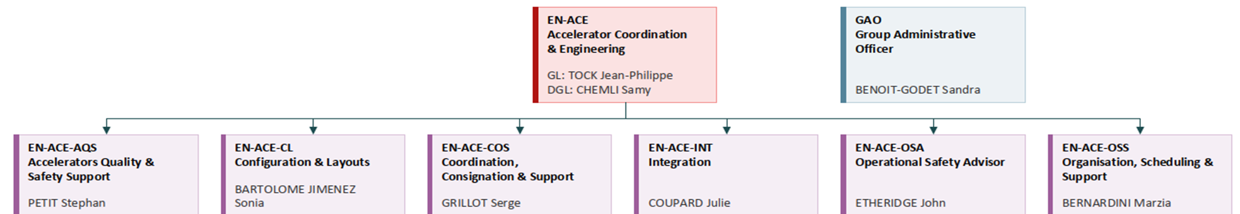
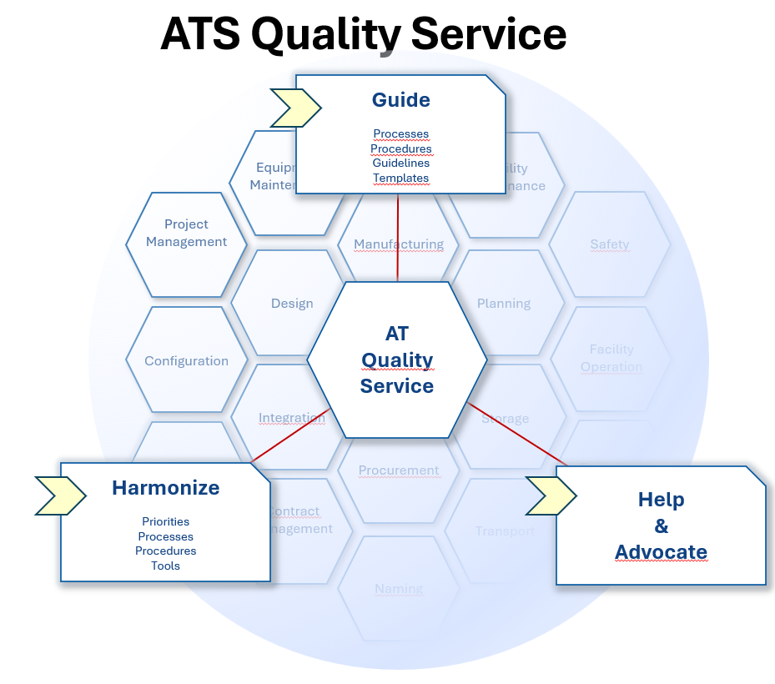
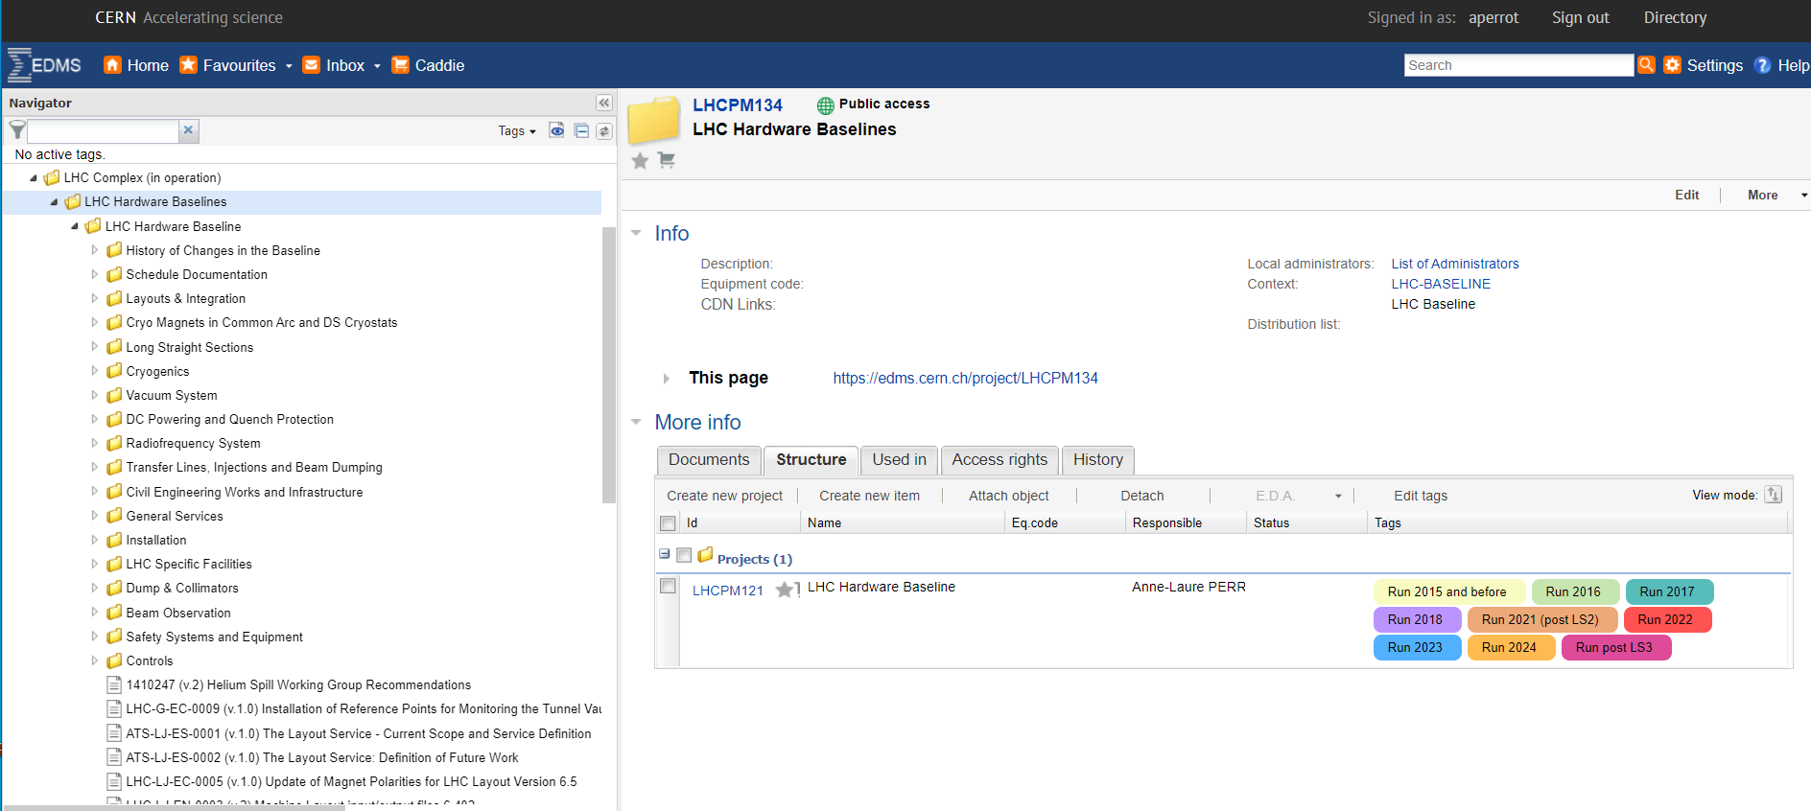
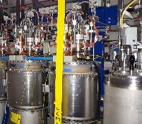
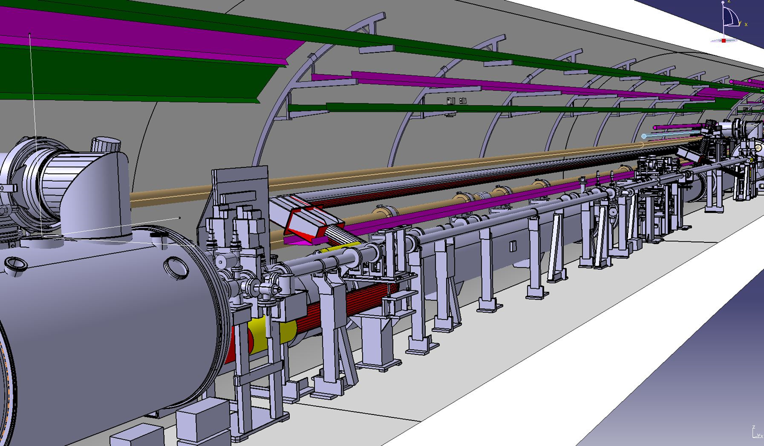
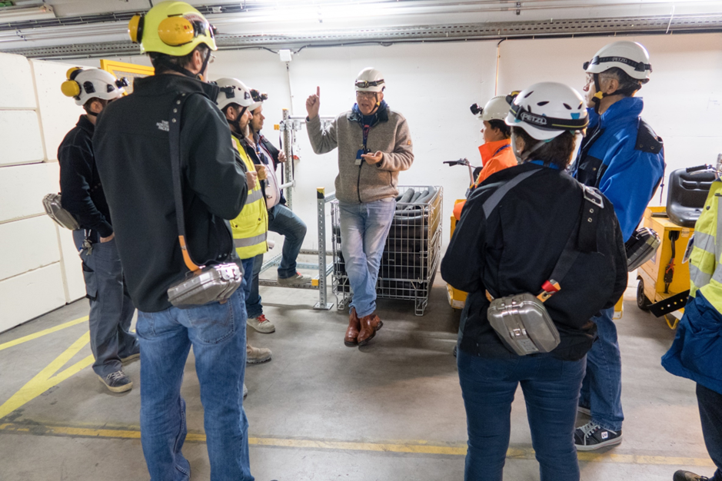
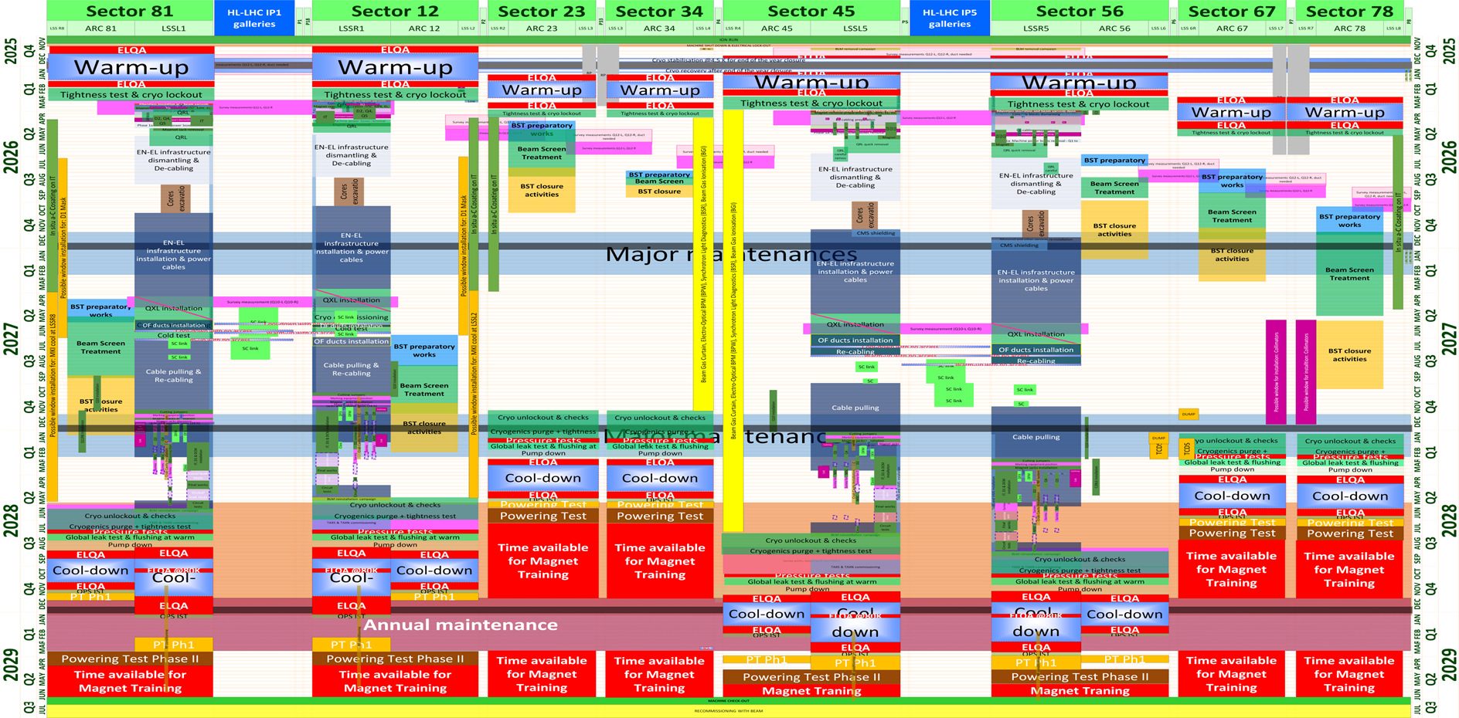
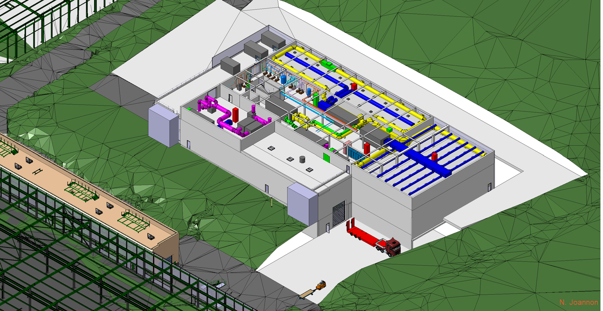
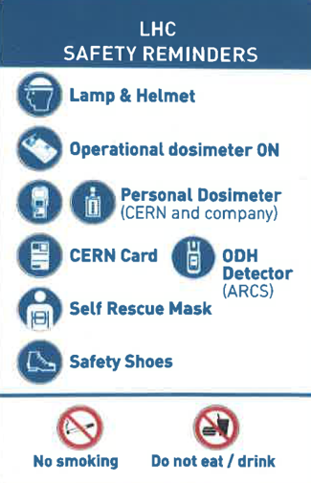



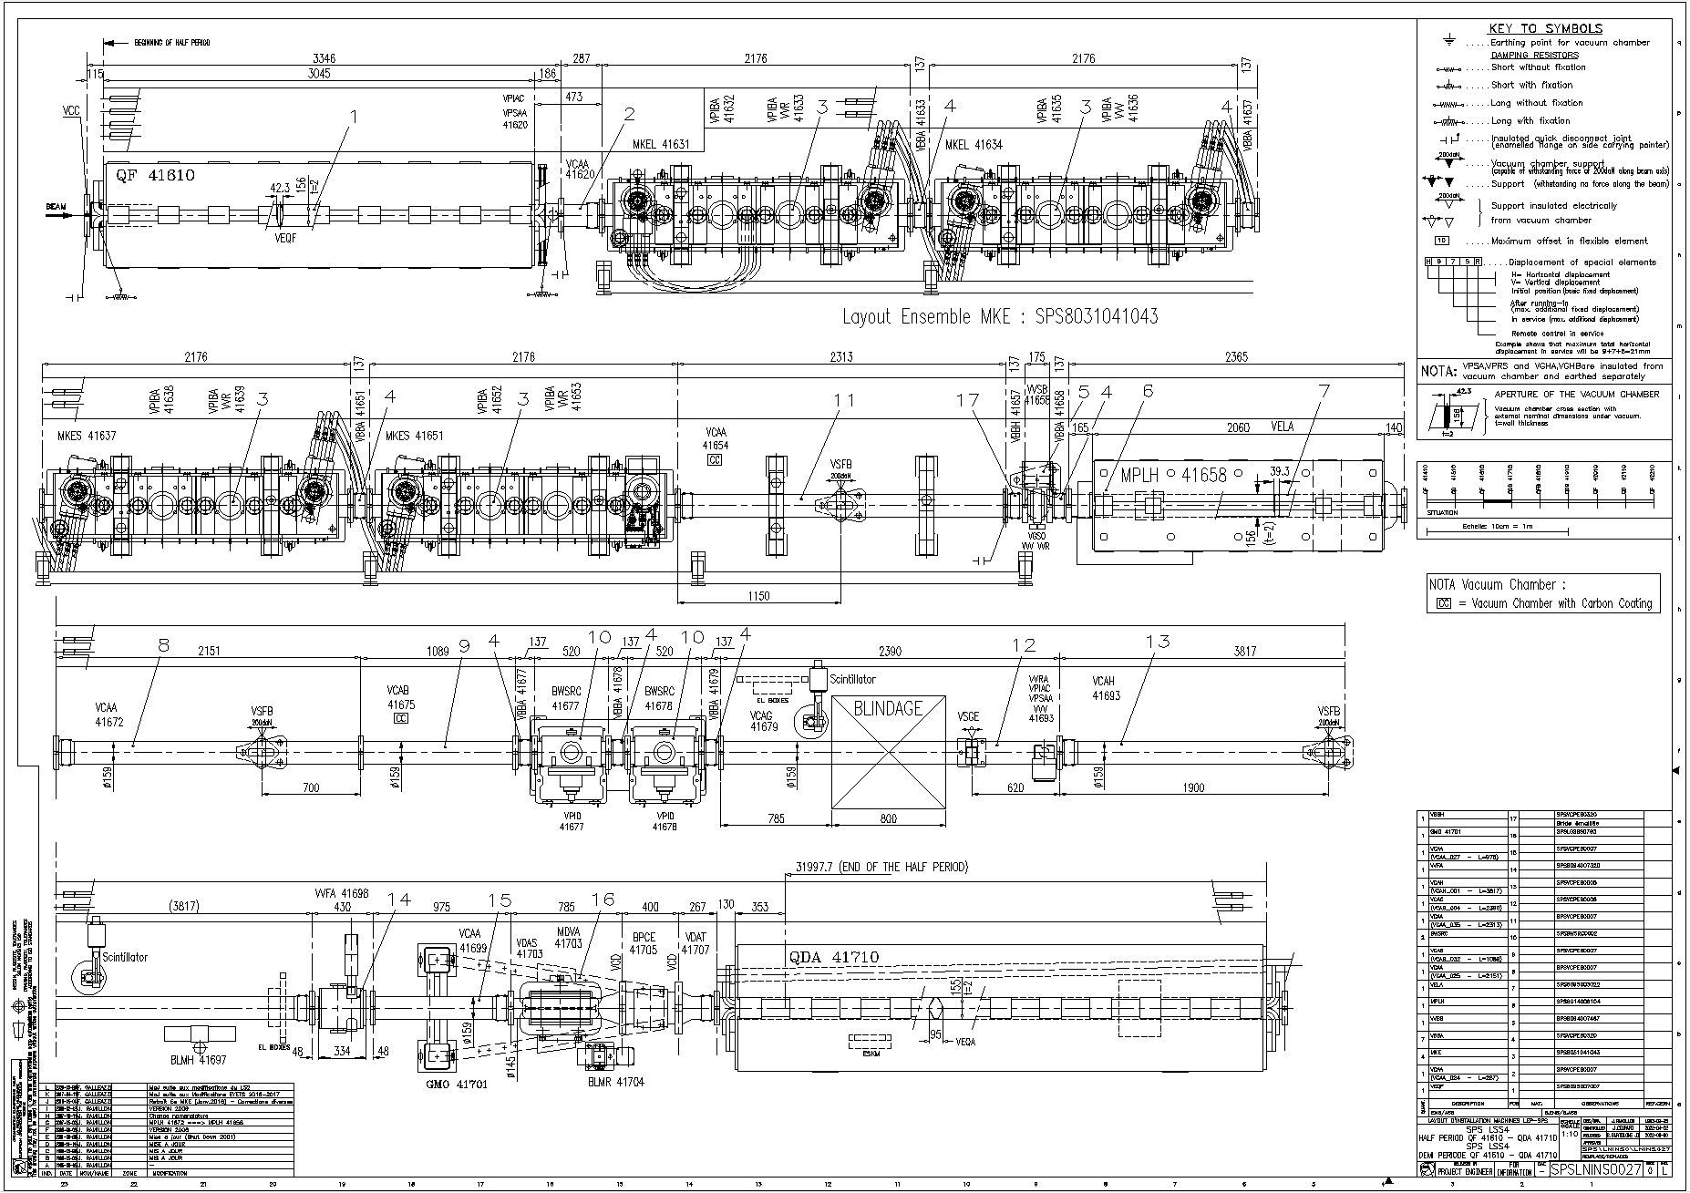

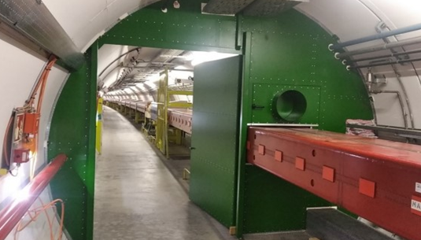
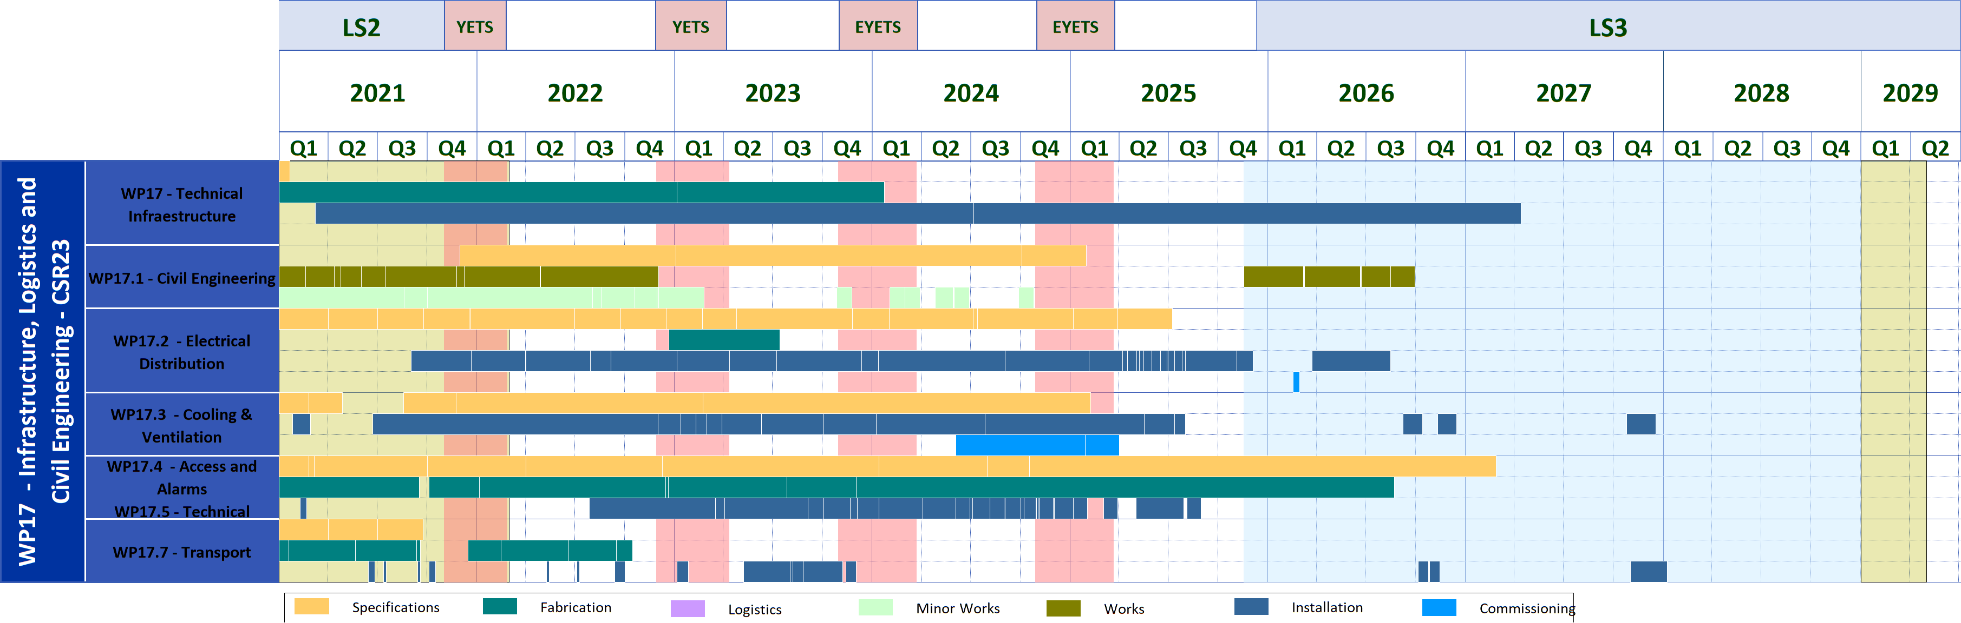
Accelerators Coordination & Engineering Group (EN-ACE)
Mandate :
Coordinate the activities for the interventions and changes to the LHC and its injectors.
Is responsible for the Accelerators & Technology Sector Quality Service.
Provides support and/or advices in its key competences to projects and groups.

Slide 6
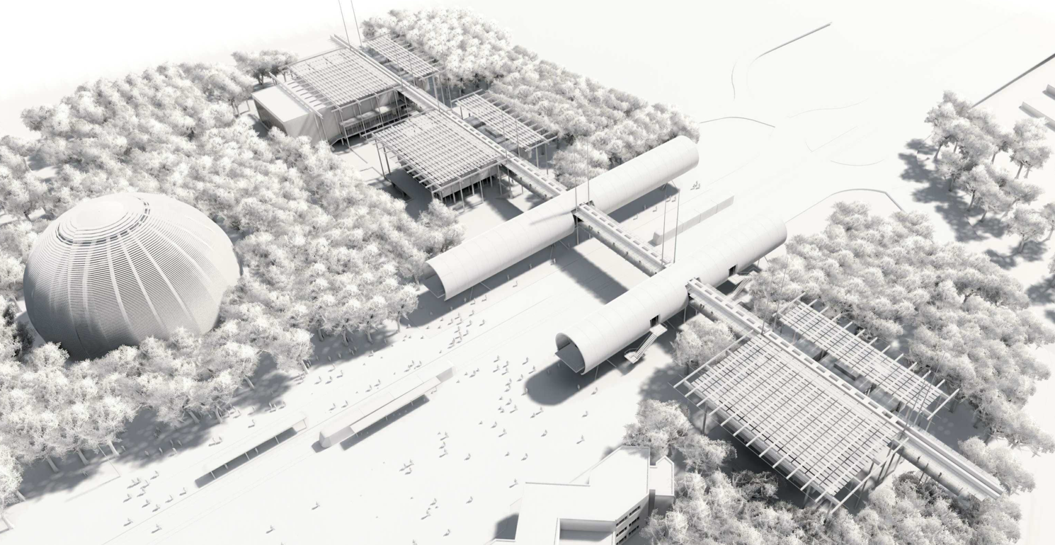
Les opportunités
https://careers.cern/
PROFESSIONNEL.LE.S &
JEUNES DIPLÔMÉ.E.S
ÉTUDIANT.E.S
STAFF MEMBERS
ORIGIN
Récemment diplômé.e.s
TECHNICAL & ADMINISTRATIVE STUDENTS
DOCTORAL STUDENTS
QUEST
Jeunes dîplômé.e.s avec
une expérience
SUMMER STUDENTS
SHORT-TERM INTERNS
RESEARCH FELLOWS
Post-docs

Slide 7
ULiège @ CERN
Introduction
J.-Ph. Tock EN-ACE GL
2024-12-05/06

Slide 8
EN-ACE (05.12.204)
Collaboration agreement (06.12.204)

Slide 9
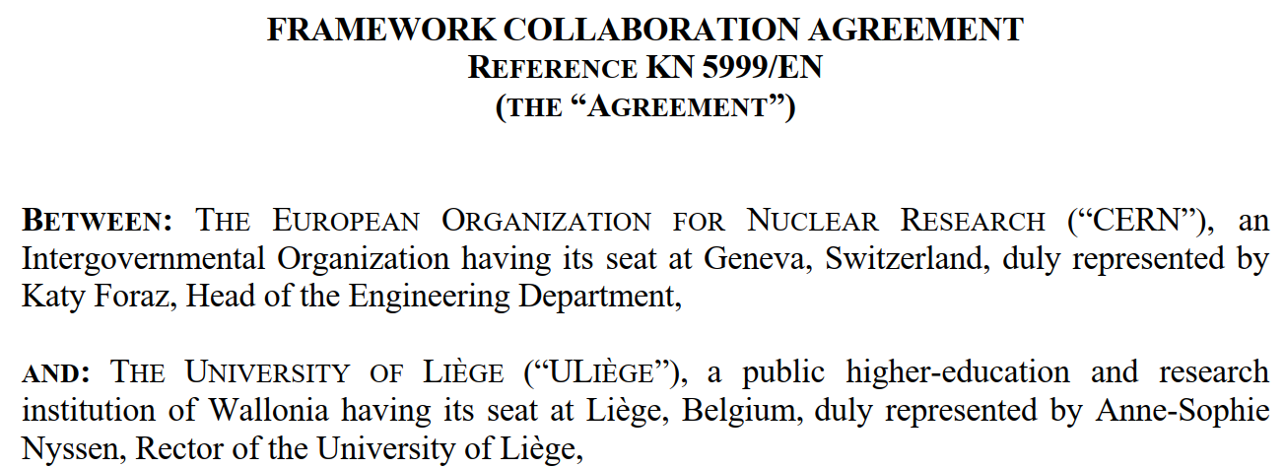
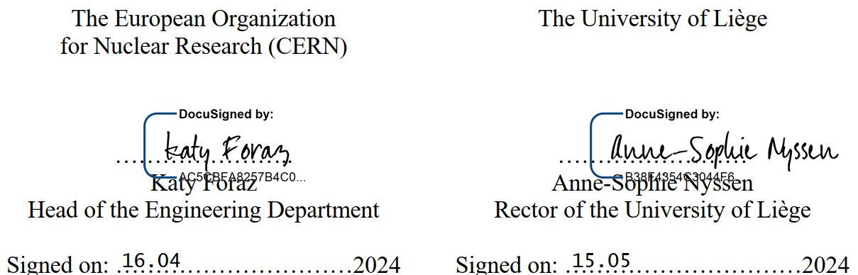
Collaboration agreement : KN 5999/EN

Slide 10
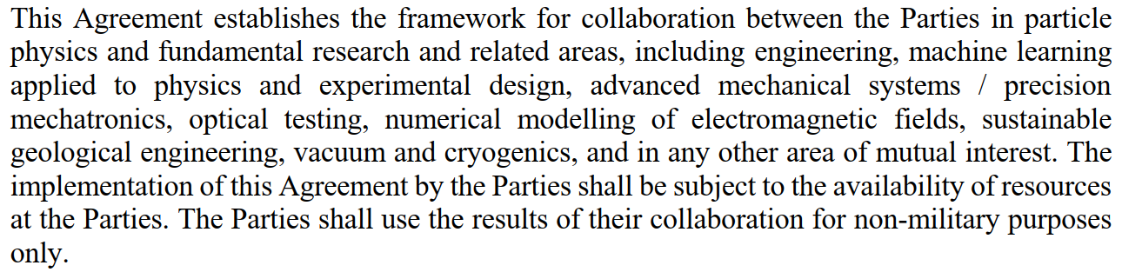
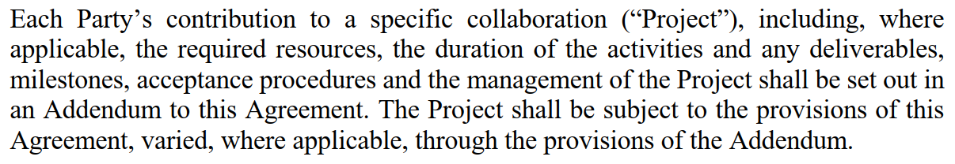
Collaboration agreement : KN 5999/EN

Slide 11
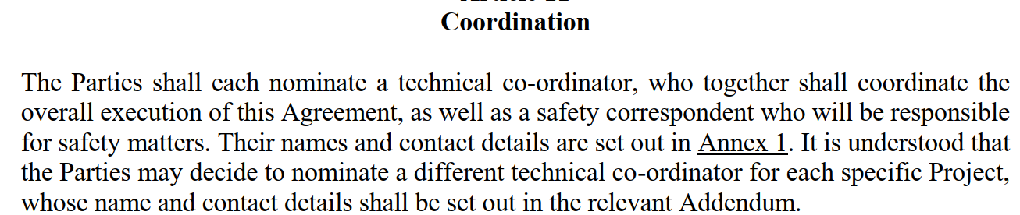
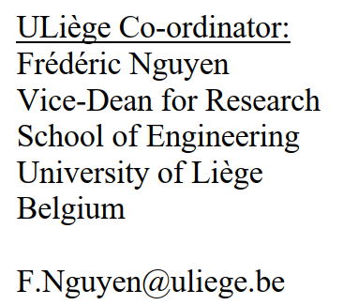
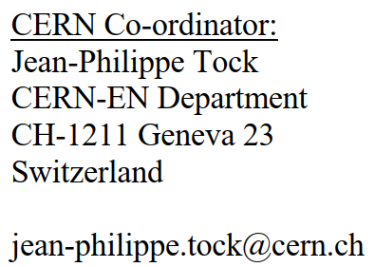
Collaboration agreement : KN 5999/EN

Slide 12
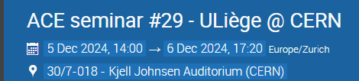
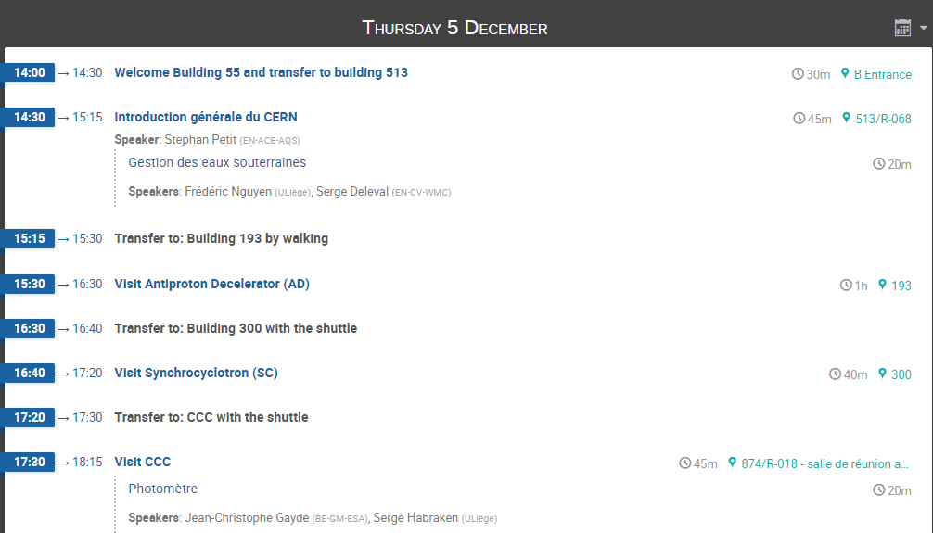
ACE seminar #29 - ULiège @ CERN (5-6 December 2024) · Indico\
https://indico.cern.ch/event/1451248/

Slide 13

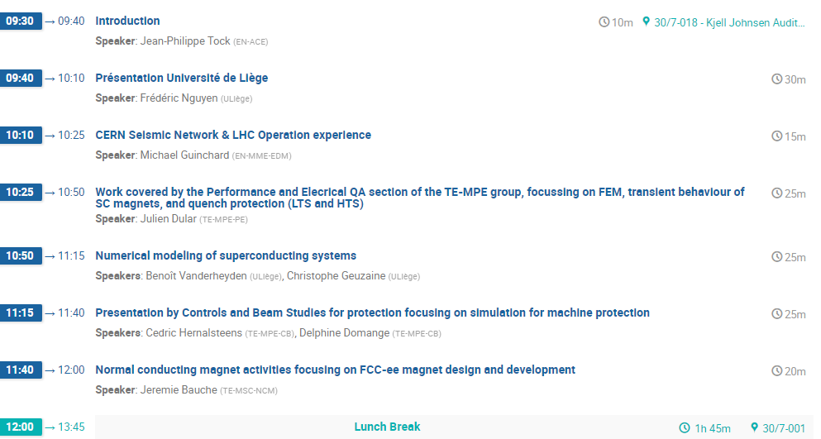
ACE seminar #29 - ULiège @ CERN (5-6 December 2024) · Indico\
https://indico.cern.ch/event/1451248/

Slide 14
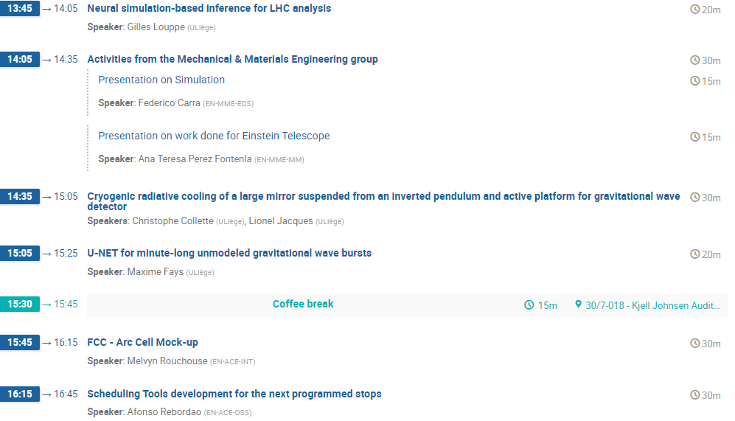
ACE seminar #29 - ULiège @ CERN (5-6 December 2024) · Indico\
https://indico.cern.ch/event/1451248/

Slide 15

Collaboration agreement : KN 5999/EN

Slide 16


