Slide 1
Smoke detection & Evacuation systems in ECN3 & TCC8
Meeting 12-09-2024 | Pierre Durand | EN-AA-AS
EDMS 3158211

Slide 2
ECN3/TDC85/TCC8 – smoke detection upgrade
Current state of smoke detection & Evacuation system
Upgrade in progress (equipment renewal)

Slide 3
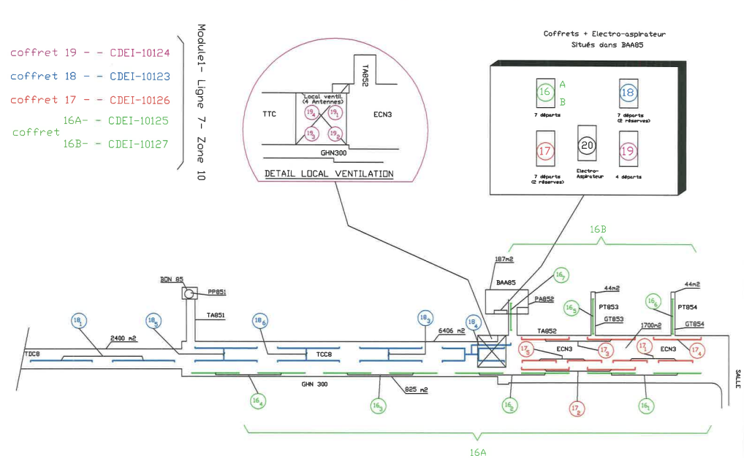
ECN3/TDC85/TCC8 – smoke detection upgrade
Current state of smoke detection & Evacuation system
  Smoke detection is performed with 6 detectors located in the building 911 (surface)
  Suction pipes are made of PVC
  All smoke detection is performed with the same vacuum unit
  End of upgrade sept. 2024, 11th

Slide 4
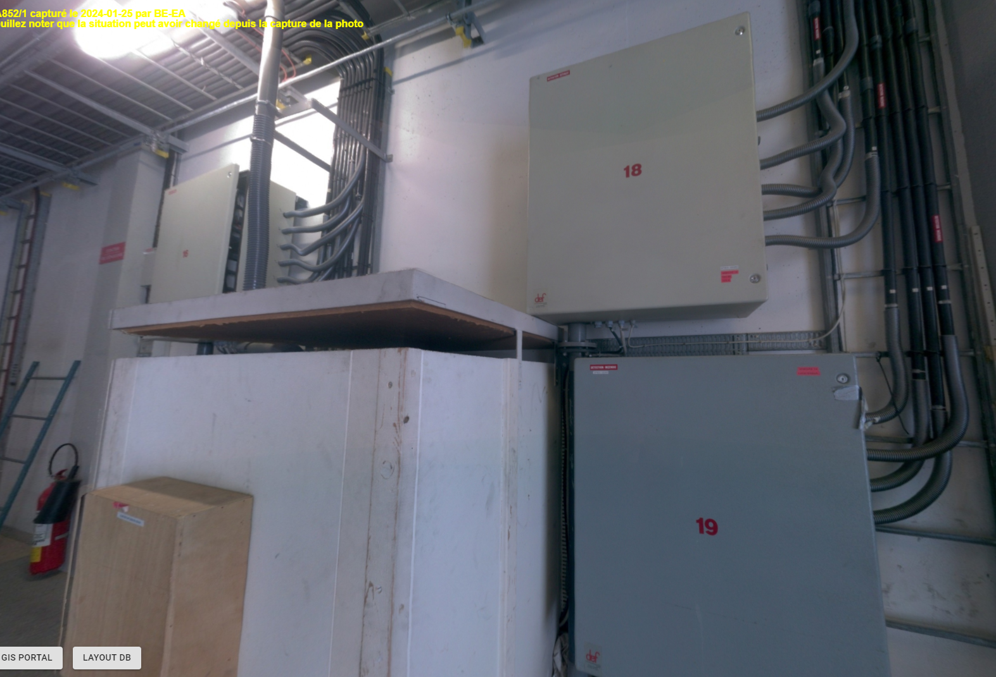
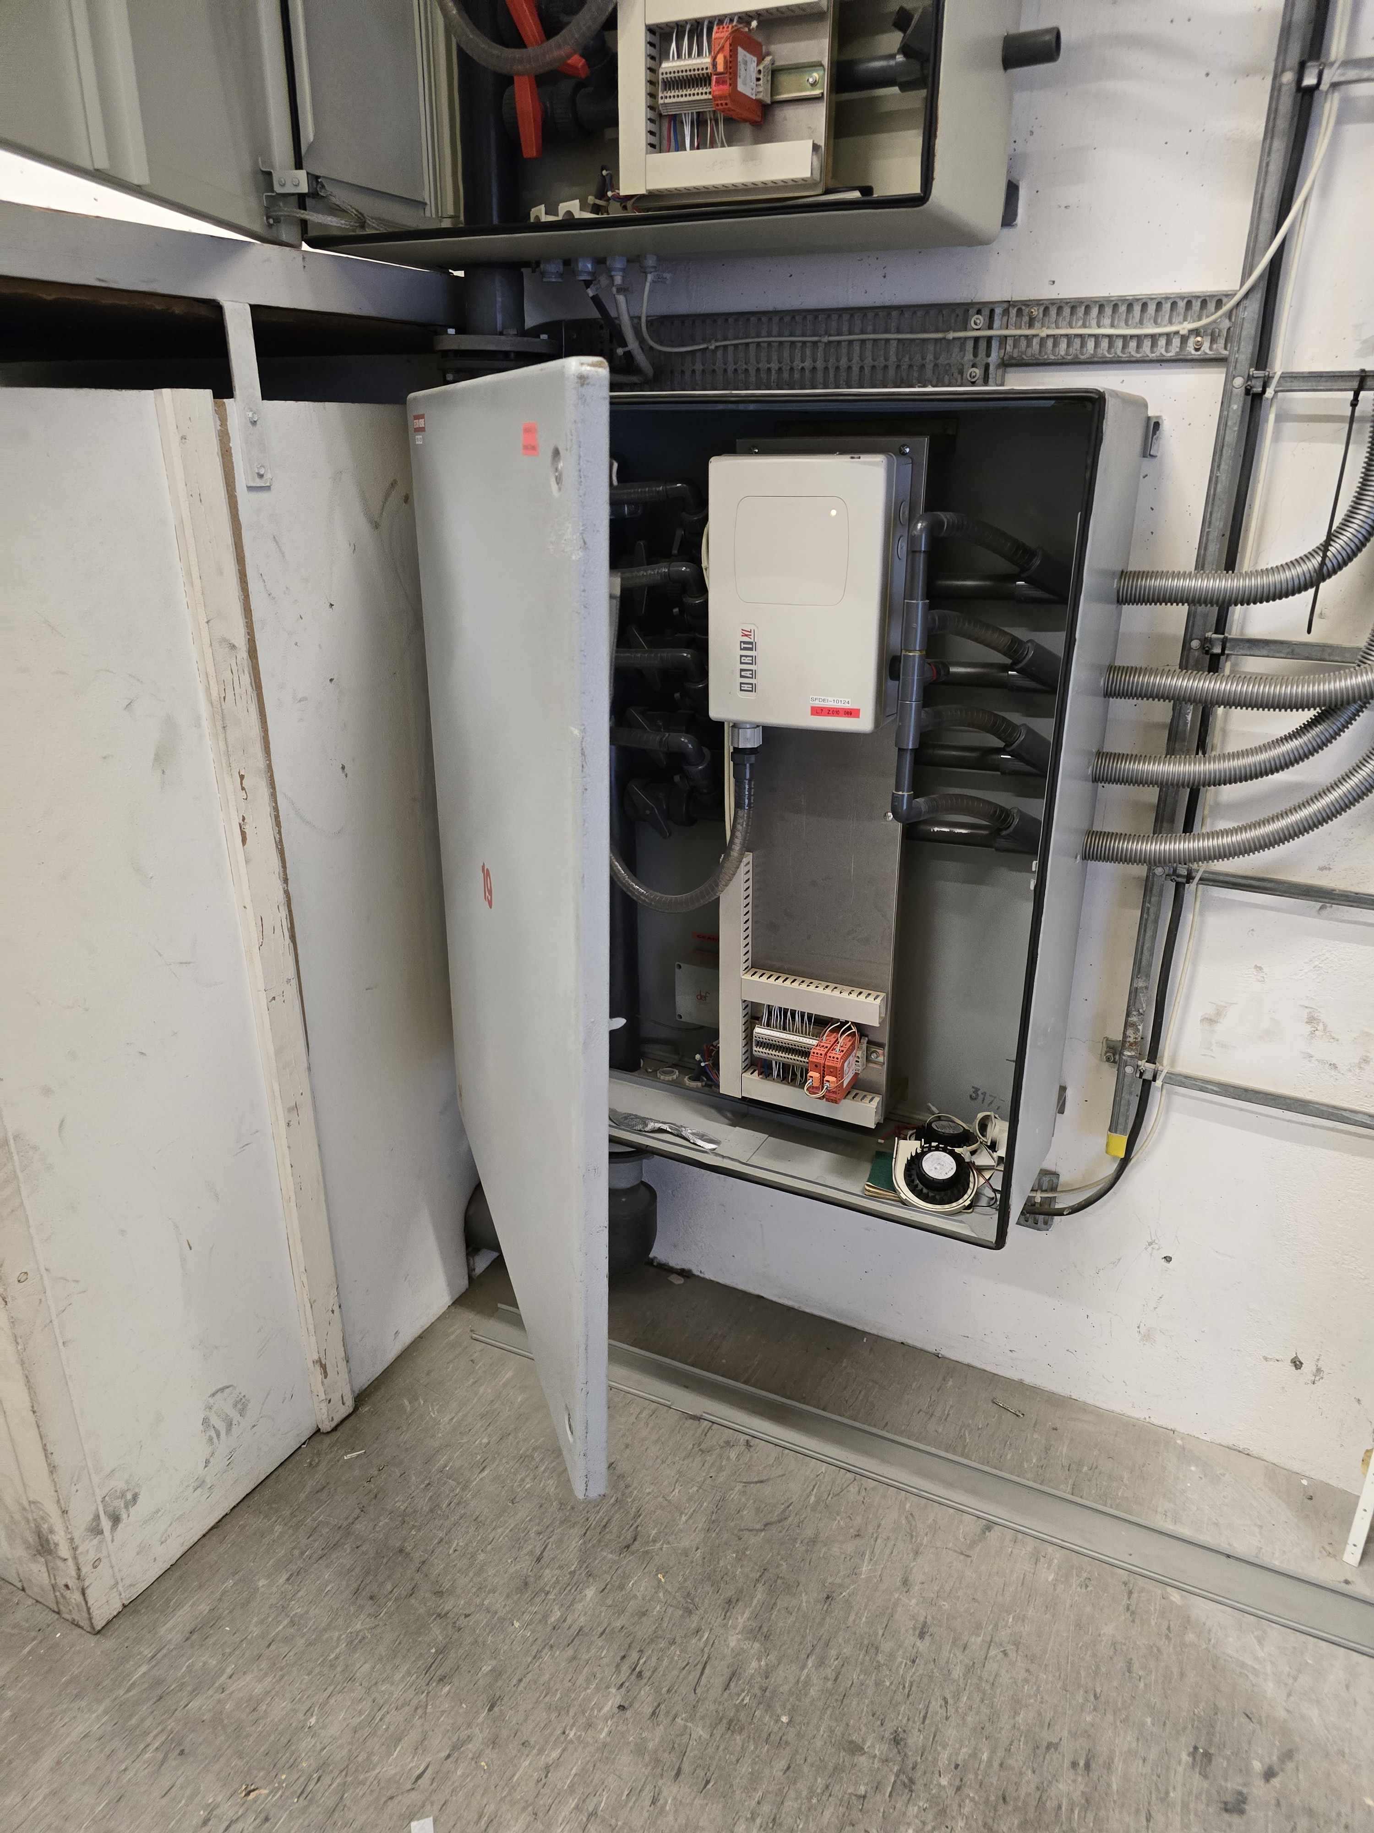
ECN3/TDC85/TCC8 – smoke detection upgrade
Current state of smoke detection & Evacuation system
View from the mezzanine of building 911
1 Common Vacuum unit
4 Boxes with 5 smoke detectors

Slide 5
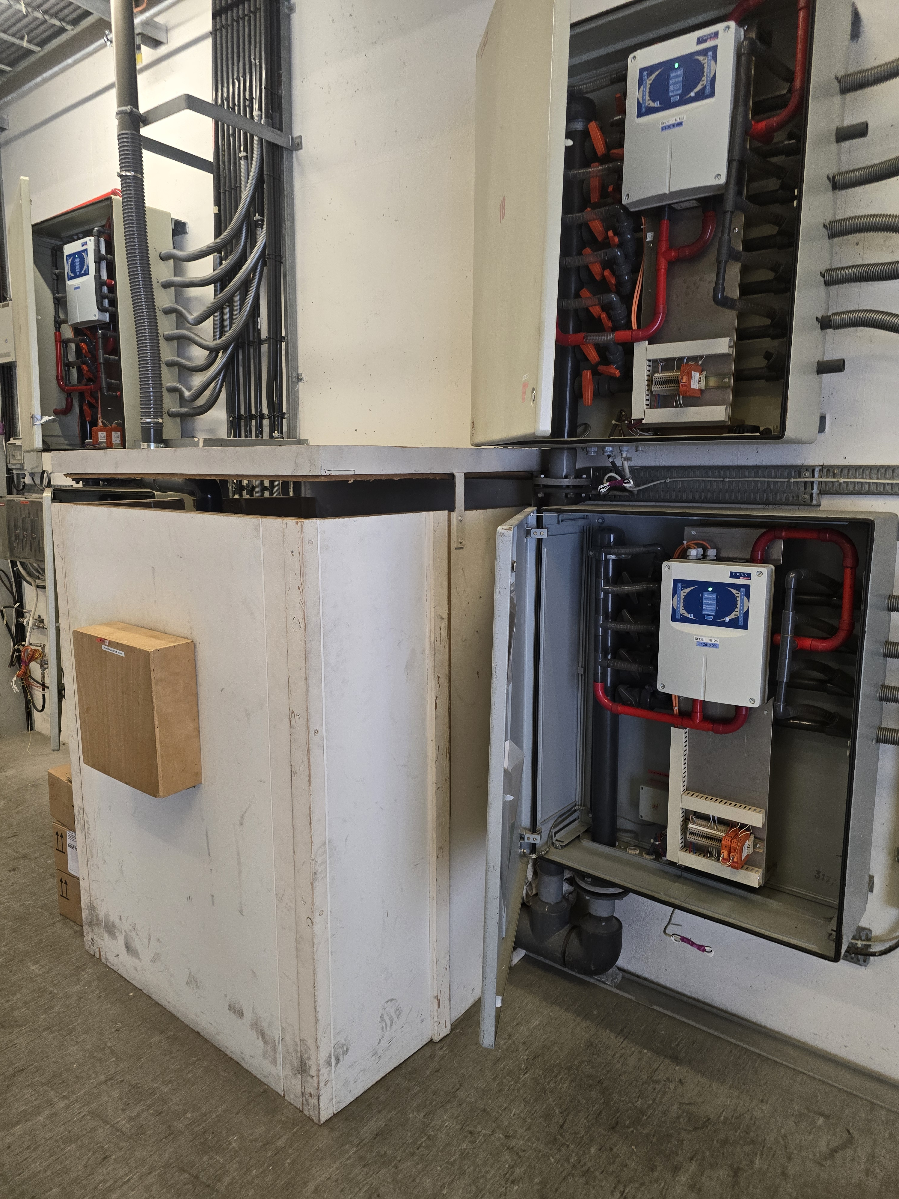
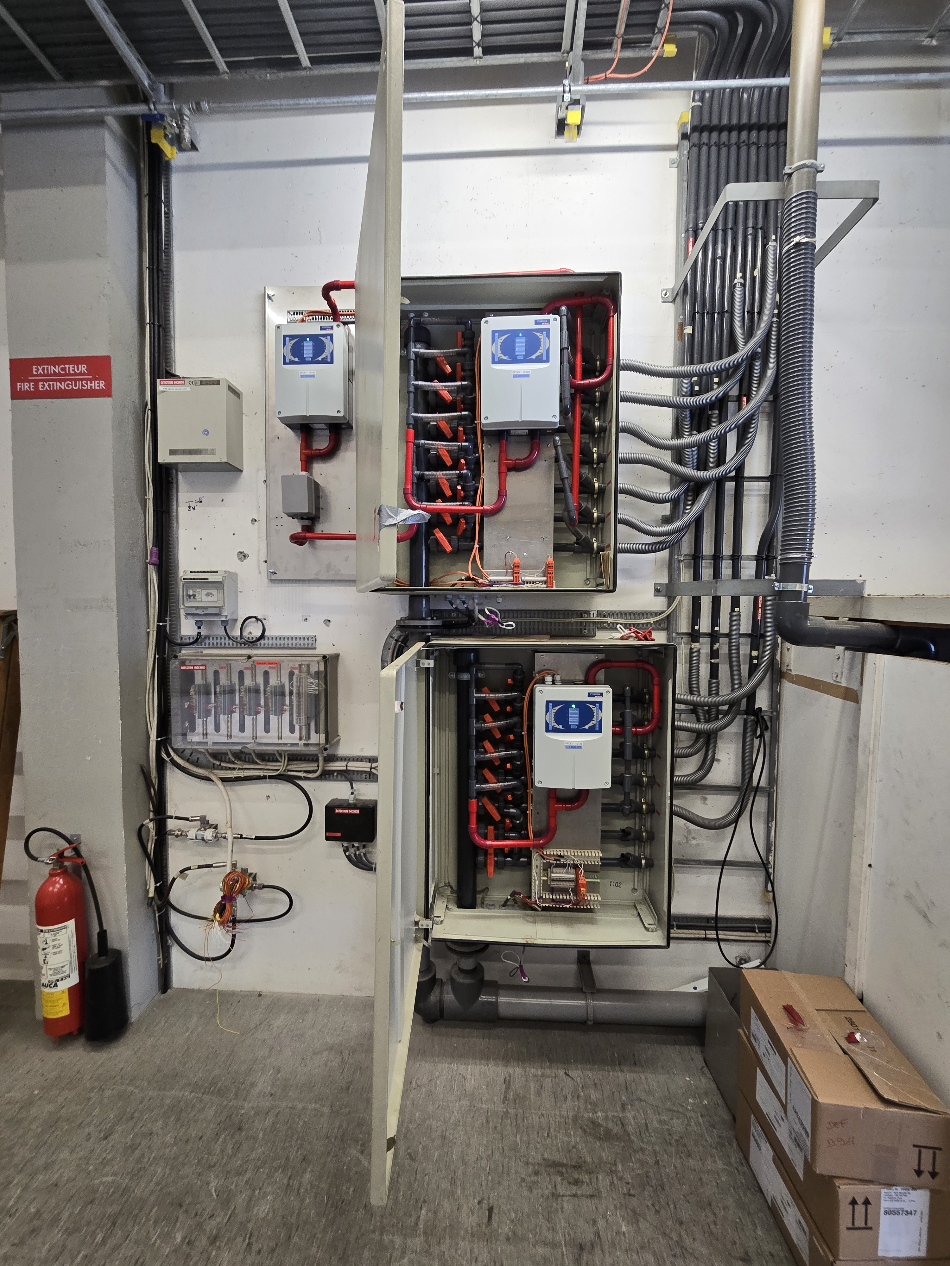
ECN3/TDC85/TCC8 – smoke detection upgrade

Slide 6
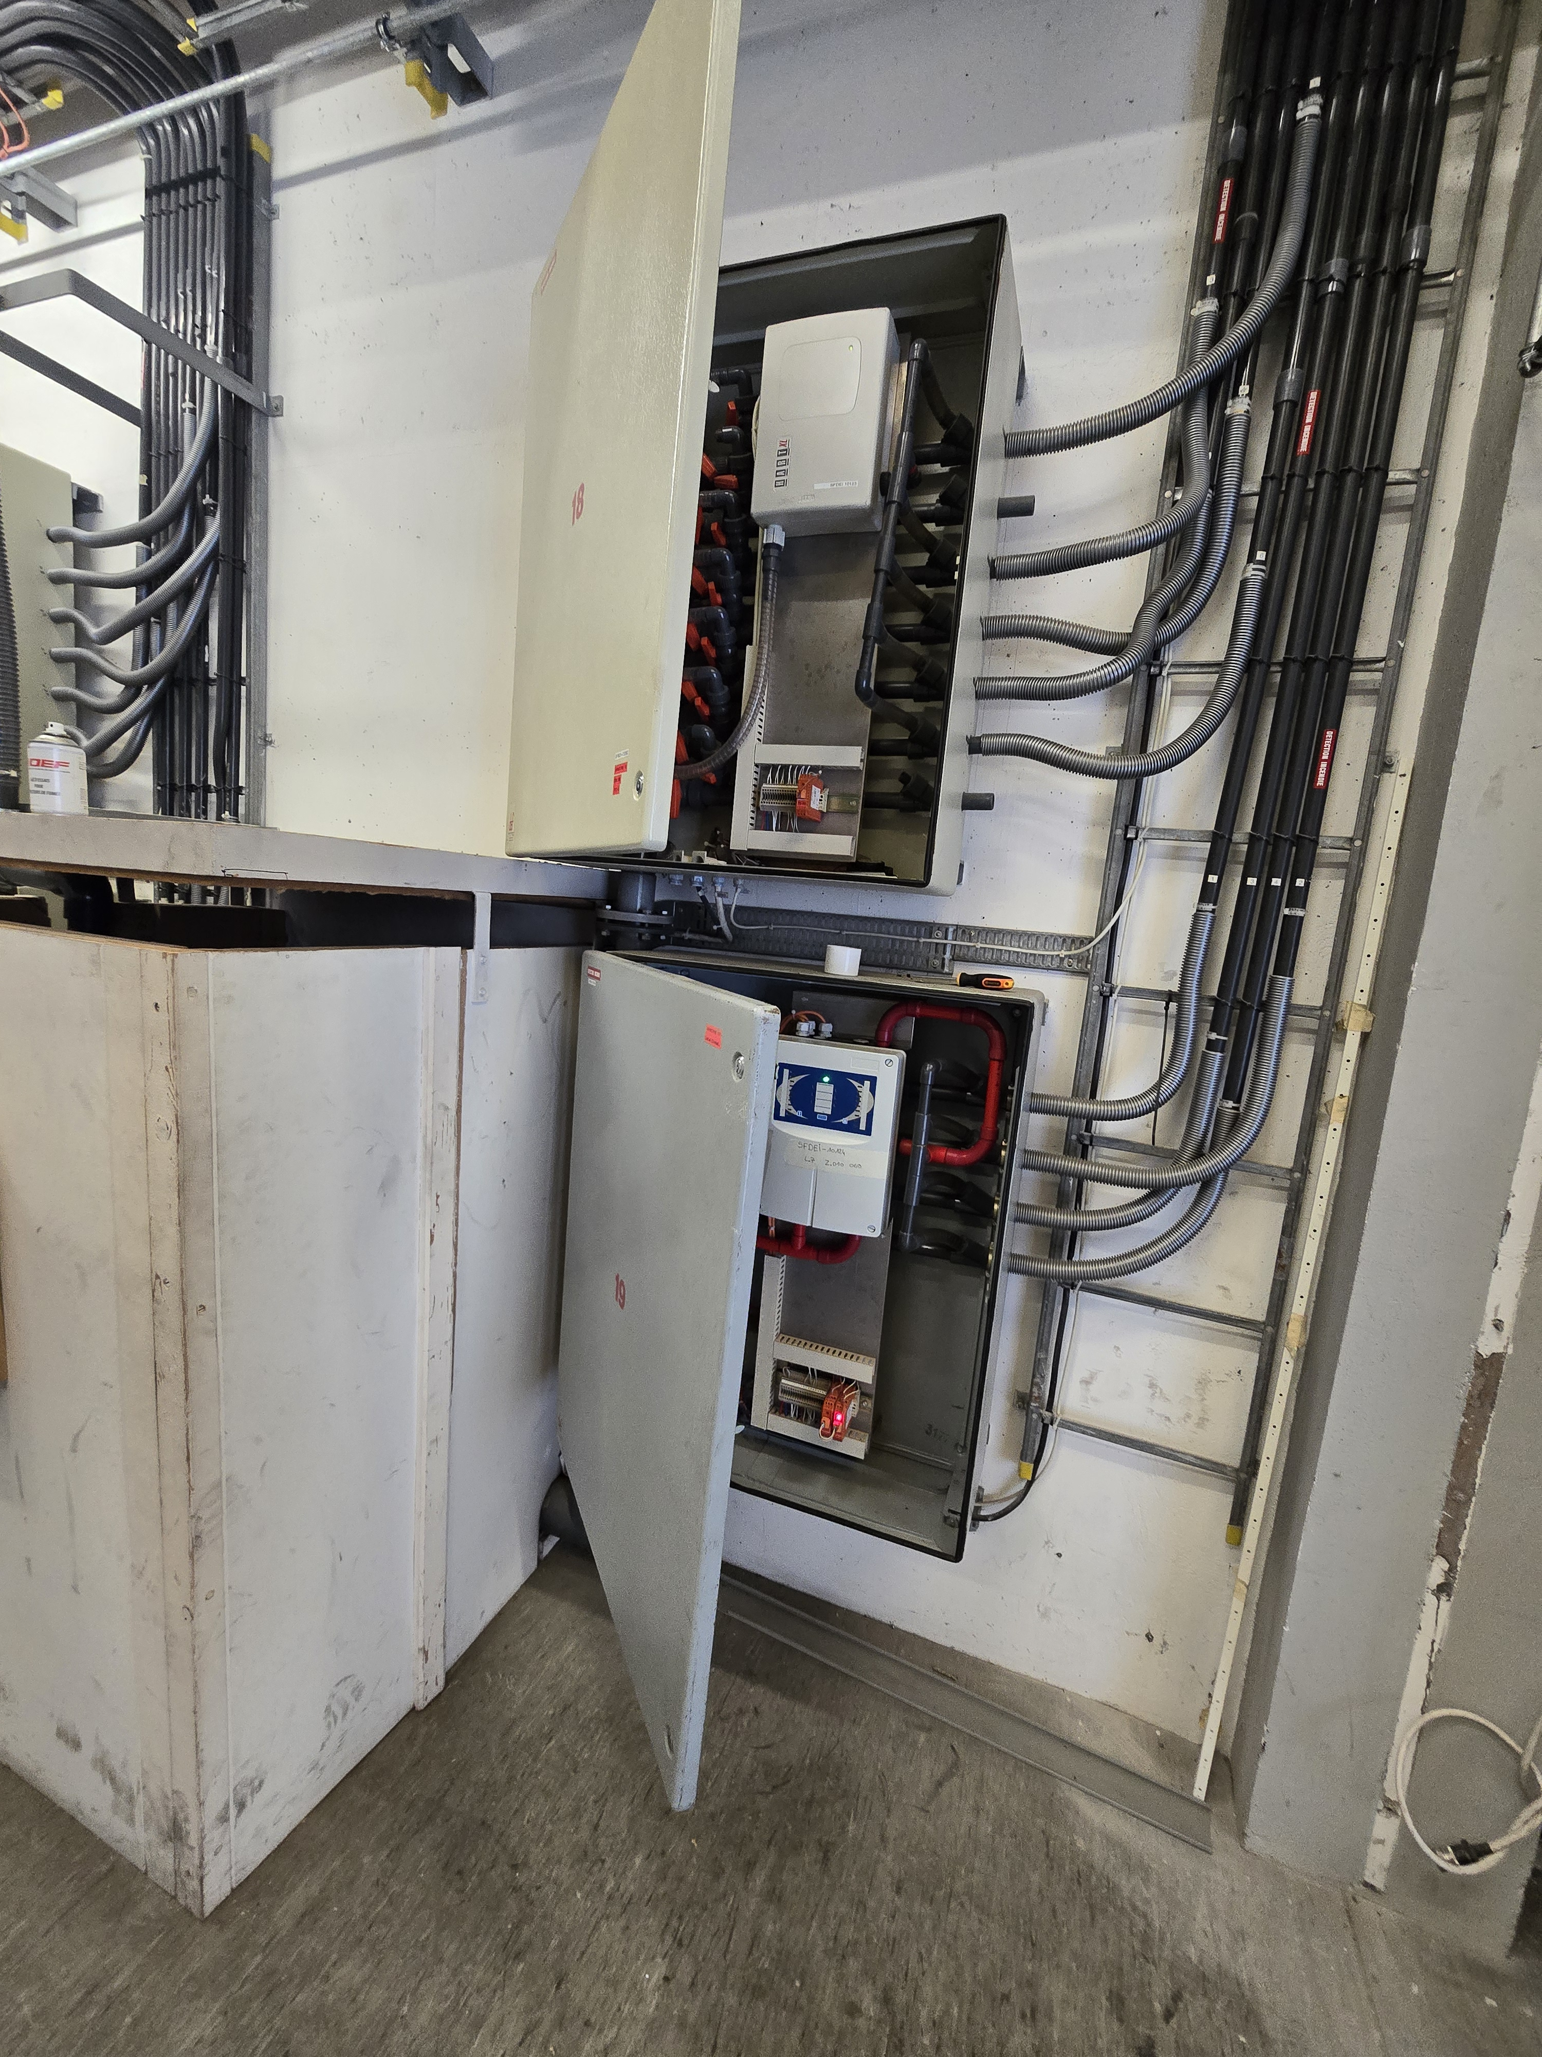
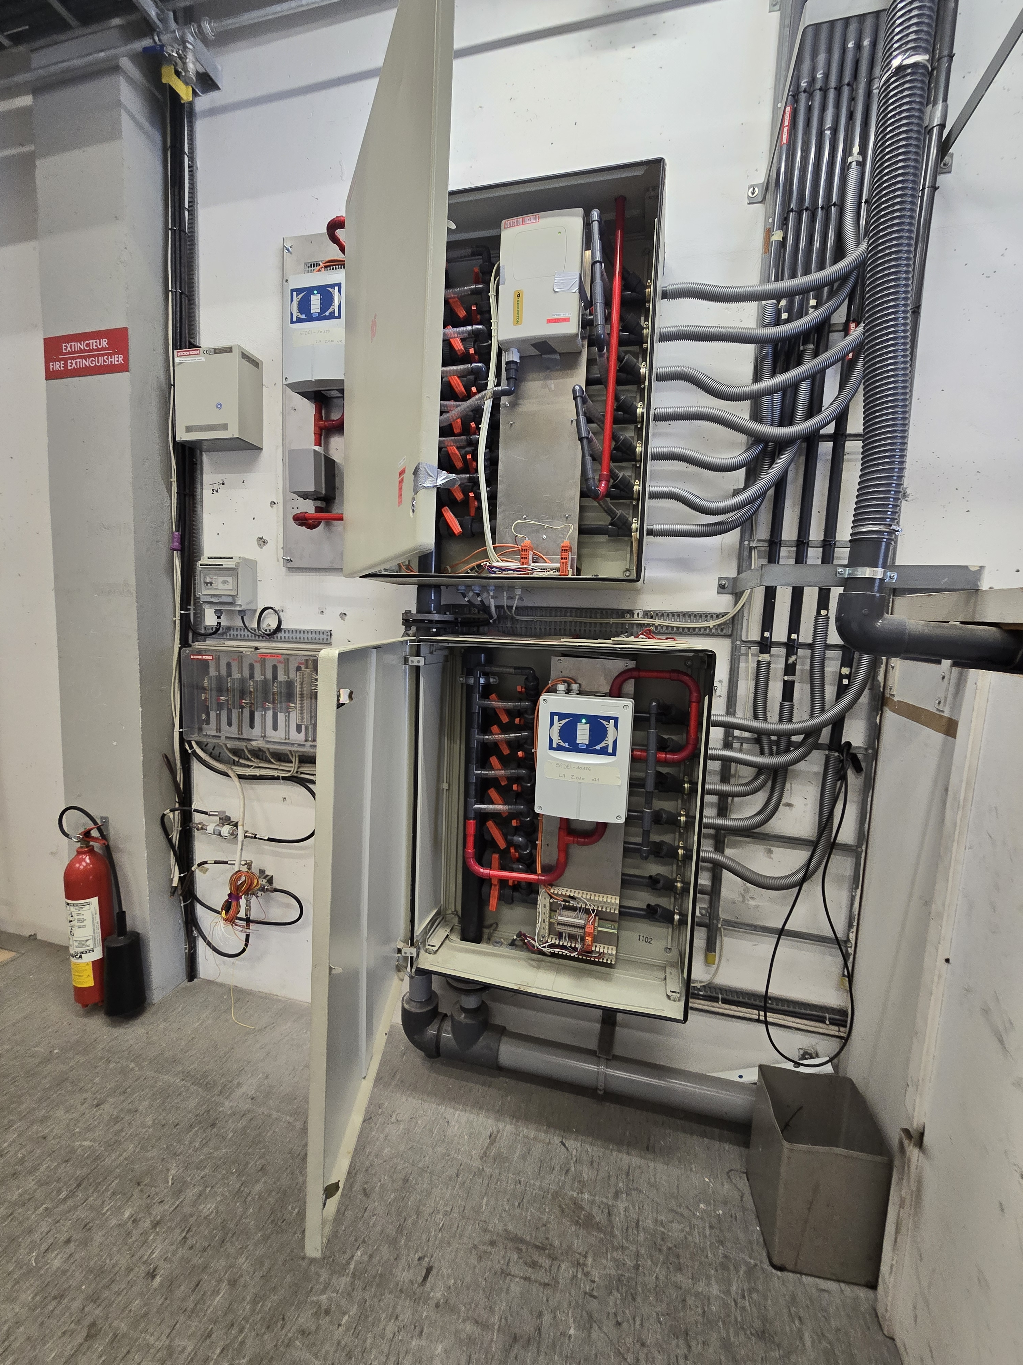
SPS-Fire detection & extinguishing system – Power failure
Upgrade in progress
  All sensors are now replaced with a new version available for the next 15 years at least
  Vacuum unit remain common for all smoke detectors
  Pipes are not upgraded
  100% of smoke detection is working now and
  Is more sensitive
  Ventilation is interlocked with smoke detection
  no guarantee on the mechanical strength
  of the suction pipes to last up to LS3 or more

