Slide 1
Replication solutions for Oracle database 11g
Zbigniew Baranowski

Slide 2
Agenda
Testing of replication solutions with real production workload
  Preparing the environment
  Comparison of results
  Conclusions
11g replication deployment for experiments databases
  Proposals of changes for 2012
  Deployment strategy

Slide 3
Motivation
Validation of technologies with real production data
  Generic tests rarely uncover bugs and problems
  Confidence when moving to production
  Tests have no impact on production environment!
Measurable and valuable comparison of available replication solutions
  Exactly the same workload
  HW&SW configuration equal to production
  Isolated test environment

Slide 4

Setting up the environment
Source
Host
Target
Host
TEST11G standby
TEST11G
DATAGUARD
GOLDEN GATE
STRM11G
STREAMS

Slide 5
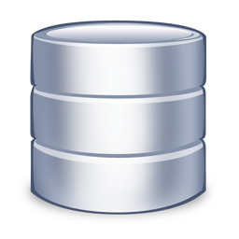
Setting up the environment
Source
Host
Target
Host
TEST11G standby
TEST11G
DATAGUARD
GOLDEN GATE
STRM11G
STREAMS
11.2.0.2
11.2.0.2
STREAMS
T1 databaseSES
Online database
OFFLINE database
Downstream database
STREAMS
Redo log transport
STREAMS
10.2.0.5
10.2.0.5
10.2.0.5
10.2.0.5

Slide 6
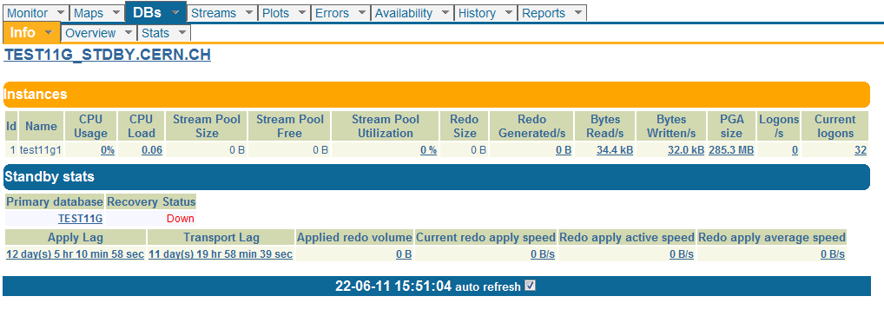
Performance Monitoring
Streams 11g
  STRMMON – compatible with 11g
GoldenGate
  Current out of the box monitoring does not offer much
  Custom scripts has been written
DataGuard 11g
  STRMMON has been extended to offer performance history of standby database

Slide 7
Workload description
Replication software configuration
  Default SW configuration
Workload set #1
  LHC file catalogue (LHCb)
  Data window of 13 days (28/05 – 10/06)
  15GB of redo logs generated on source
  ~4M of operations (statements)
    1,5M of inserts
    1,5M of updates
    1M of deletes
  7M of row changes

Slide 8
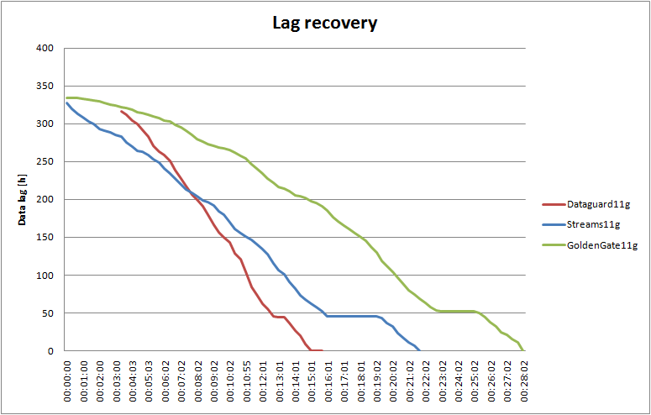
Results for workload #1
Dataguard: Shipping database redo log files over the network to the target db

Slide 9
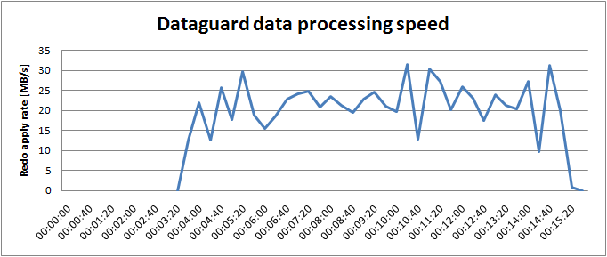
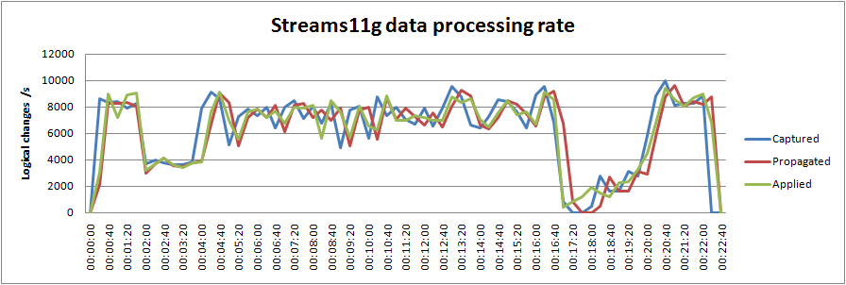
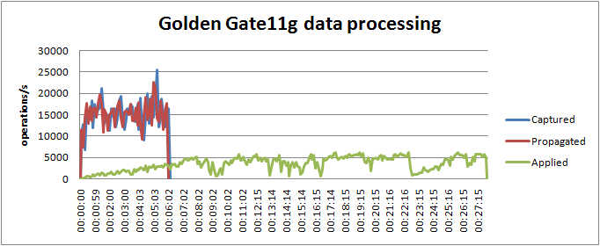
Performance results with workload #1
Shipping database redo log files over the network to the target db
Database writer (DBW) process was a bottleneck due to CPU
(100% on one core)
Slow down due to big transaction processing
Random access to database data files was a bottleneck
Log mining of redo logs is very efficient
Random access to data files was a bottleneck

Slide 10
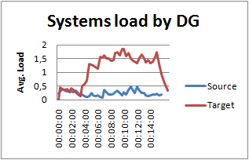
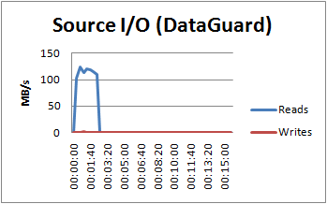
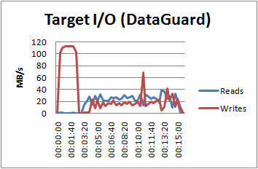
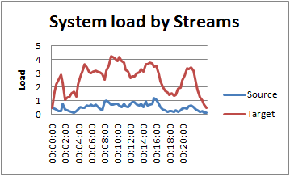
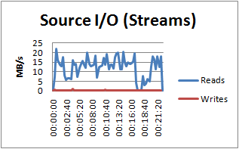
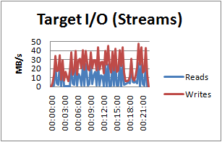
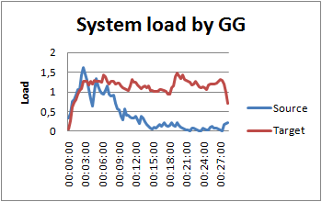
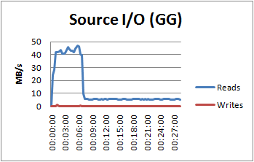
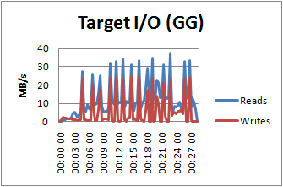
Resource utilization by workload#1
Besides redo download quite significant load of I/O system (reads and writes)
I/O (reads) only for shipping redo logs over the network
No writes on the source
Almost no load on source
Insignificant load on target
Almost no load on source
Some load on target (apply paralellism)
No writes on source.
Quite a lot of reads (logmining)
Small amount of reads.
High writes rato (~20MB/s)
Insignificant load on source and target
High reads rates during logmining
Modrate I/O reates

Slide 11
Workload description
Replication software configuration
  DataGuard: 2x database writers
  GoldenGate: SQLBatch optimization enabled
Workload set #2
  LHC file catalogue (LHCb)
  Data window of 13 days (10/06 – 23/06)
  17GB of redo logs generated on source
  ~6M of operations (statements)
    2,5M of inserts
    2M of updates
    1,5M of deletes
  3229273 transactions in total (~ 10M of row changes)

Slide 12
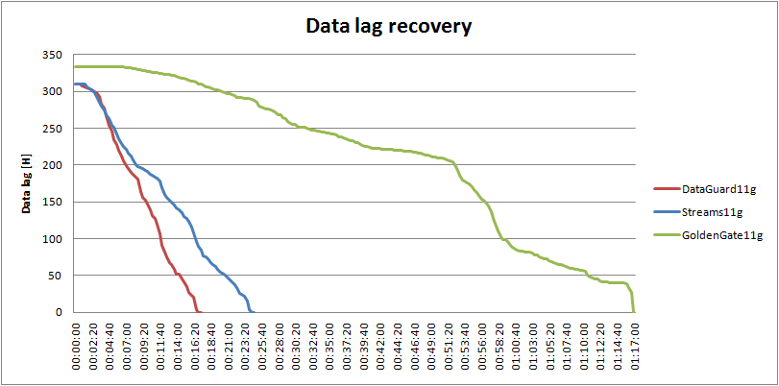
Results for workload #2
BatchSQL disabled

Slide 13
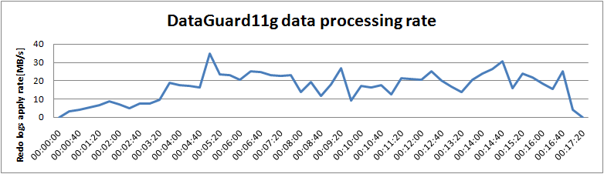
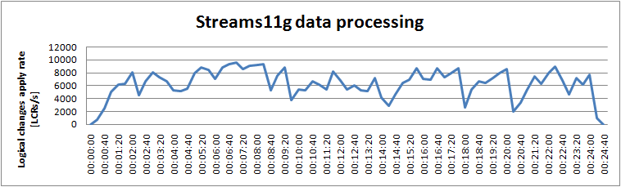
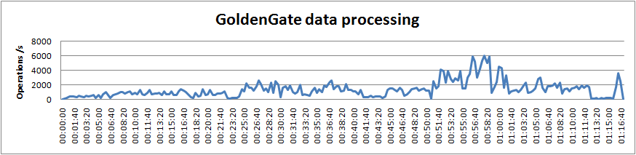
Performance results with workload #2
Database writers (DBW) process were still a bottleneck due to CPU
(100% on one core)
Random access to database data files was a bottleneck
Random access to database data files
BatchSQL disabled

Slide 14
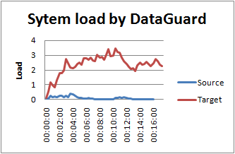
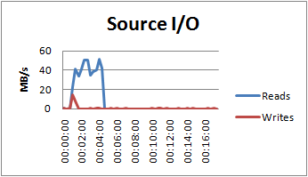
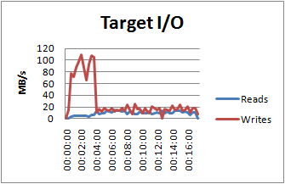
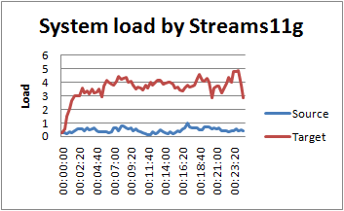
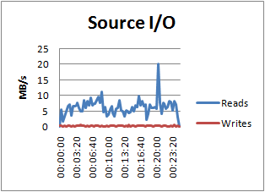
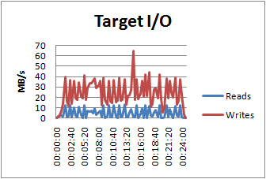
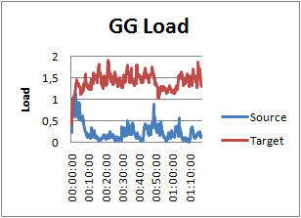
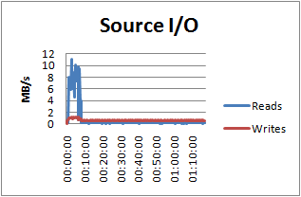
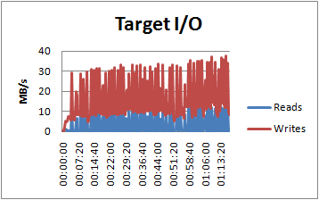
Resource utilization by workload#2
Target load increased by 1 but performance did not improve
Without BatchSQL load is lower and performance better

Slide 15
Conclusions
DataGuard was the fastest technology
  Streams were slower by 1.5
  GoldenGate was slower by 2
Optimization of DG did not bring significant effects
BatchSQL optimization brought down GG performance by 3 introducing overhead additionally
No more SW optimization from Streams and Goldengate

Slide 16
Conclusions
Resource utilization
  Insignificant load on source system (all)
  DataGuard while using log buffers does not need to read anything from disks on source db
  DataGuard writes data to replica most efficient (lowest write rates)
  Streams introduce highest load on target system (parallel composition of data changes)
  Streams required a lot of reads on source (~15MB/s) system but less on target (use of buffered queues)

Slide 17
Bug discoverd
Streams DDL replication incomatibiities between RDBMS 10.2.0.5 and 11.2.0.2
DDL
DDL
X
DDL
DDL
Online database
OFFLINE database
T1 database
X
STREAMS
STREAMS
10.2.0.5
10.2.0.5
11.2.0.2

Slide 18
Replication plans for 2012
No changes (Streams11g)
  ATLAS (foreseen in 2013)
  LHCb
  COMPASS
Streams replacement with ADG
  CMS
  ALICE

Slide 19

CMS overview
Databases
  Online (CMSONR)
    Size 3486 GB
    588 schemas
  Offline (CMSR)
    Size 3459GB
Replications
  3 streamings (conditions, pvss and misc)
  60% of CMSONR database size is replicated
    92 schemas, 2078 GB
  many DDL updates
  many cross schema dependencies
  high workload - around 500 LCR/s (periodical data delivery latency on PVSS replication)

Slide 20

Safe streams replacement with ADG for CMS
ACTIVE ONLINE STANDBY
PVSS, COND replica schemas can be dropped.
CMSR RAC can be reduced
some storage space can be reclaim (also from STANDBY)
Redo Transport
Everybody is happy with ADG – we can drop streams
Online database
OFFLINE database
PVSS, COND, MISC readers sessions
STREAMS COND
STREAMS PVSS
Other OFFLINE readers sessions
STREAMS MISC
Redo Transport
Redo Transport
ONLINE STANDBY
OFFLINE Standby

Slide 21

ALICE overview
Databases
  Online (ALIONR)
    size: 2788GB
    97 schemas
  Offline (PDBR)
    Size 1174GB
Replications
  PVSS
    2 schemas ,431 GB (15% of ALIONR), avg workload 50 LCRs/s
    Replica size on PDBR: 349 GB (30% of db size)

Slide 22
Safe streams replacement with ADG for ALICE
PVSS replica schemas can be dropped.
some storage space can be reclaim on PDBR
Online database
PDBR
database
PVSS readers sessions
STREAMS PVSS
Everybody is happy with ADG – we can drop streams
Redo Transport
Active onlin STANDBY
ONLINE STANDBY

Slide 23
Future plans
Switchover and failover tests in double standby database environment
Validation of active standby with CMS applications
GodenGate 11.2 beta testing?

