Slide 1
Run 2024 & DAQ (future)
M. Bacak
with input from M. Farkas

Slide 2
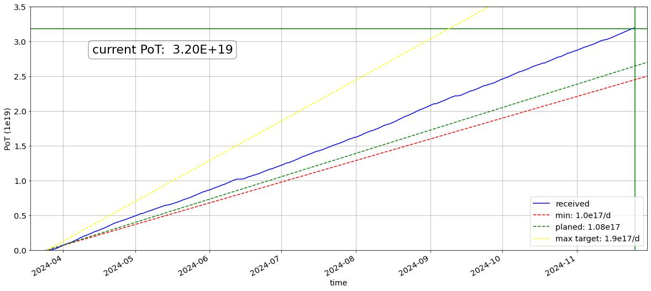
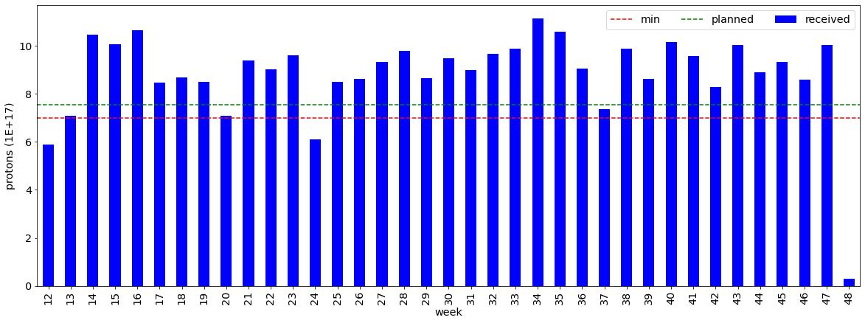
2024 Run summary
Protons from 18.03.2024 – 25.11.2024
  7 days of beam commissioning
  245 days of physics (start 25.03.) +- stops
  Physics: 3.2e19 Protons on Target (PoT)
  (2.45e19 expected!)
  → 1.31e17 p/d – how? … later!
  5082214 bunches in 252 days
  (20168/day, 840/hour, cycle share 28%)
Experiments in short:
  PoT Requested/Delivered>1 for all
  experiments
  (tiny exception: 40K depending on
  counting, Sorry & Thanks to Claudia & EDI
  team who endured 1, 2, 3, 4, … numerous
  changes to the 40K schedule)

Slide 3
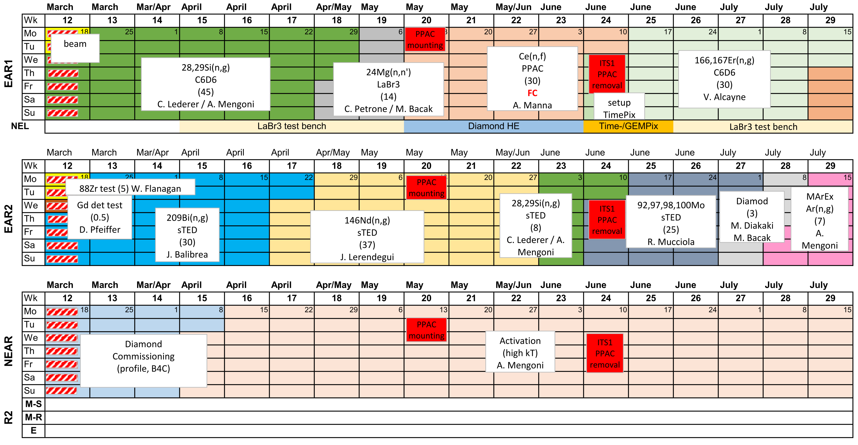
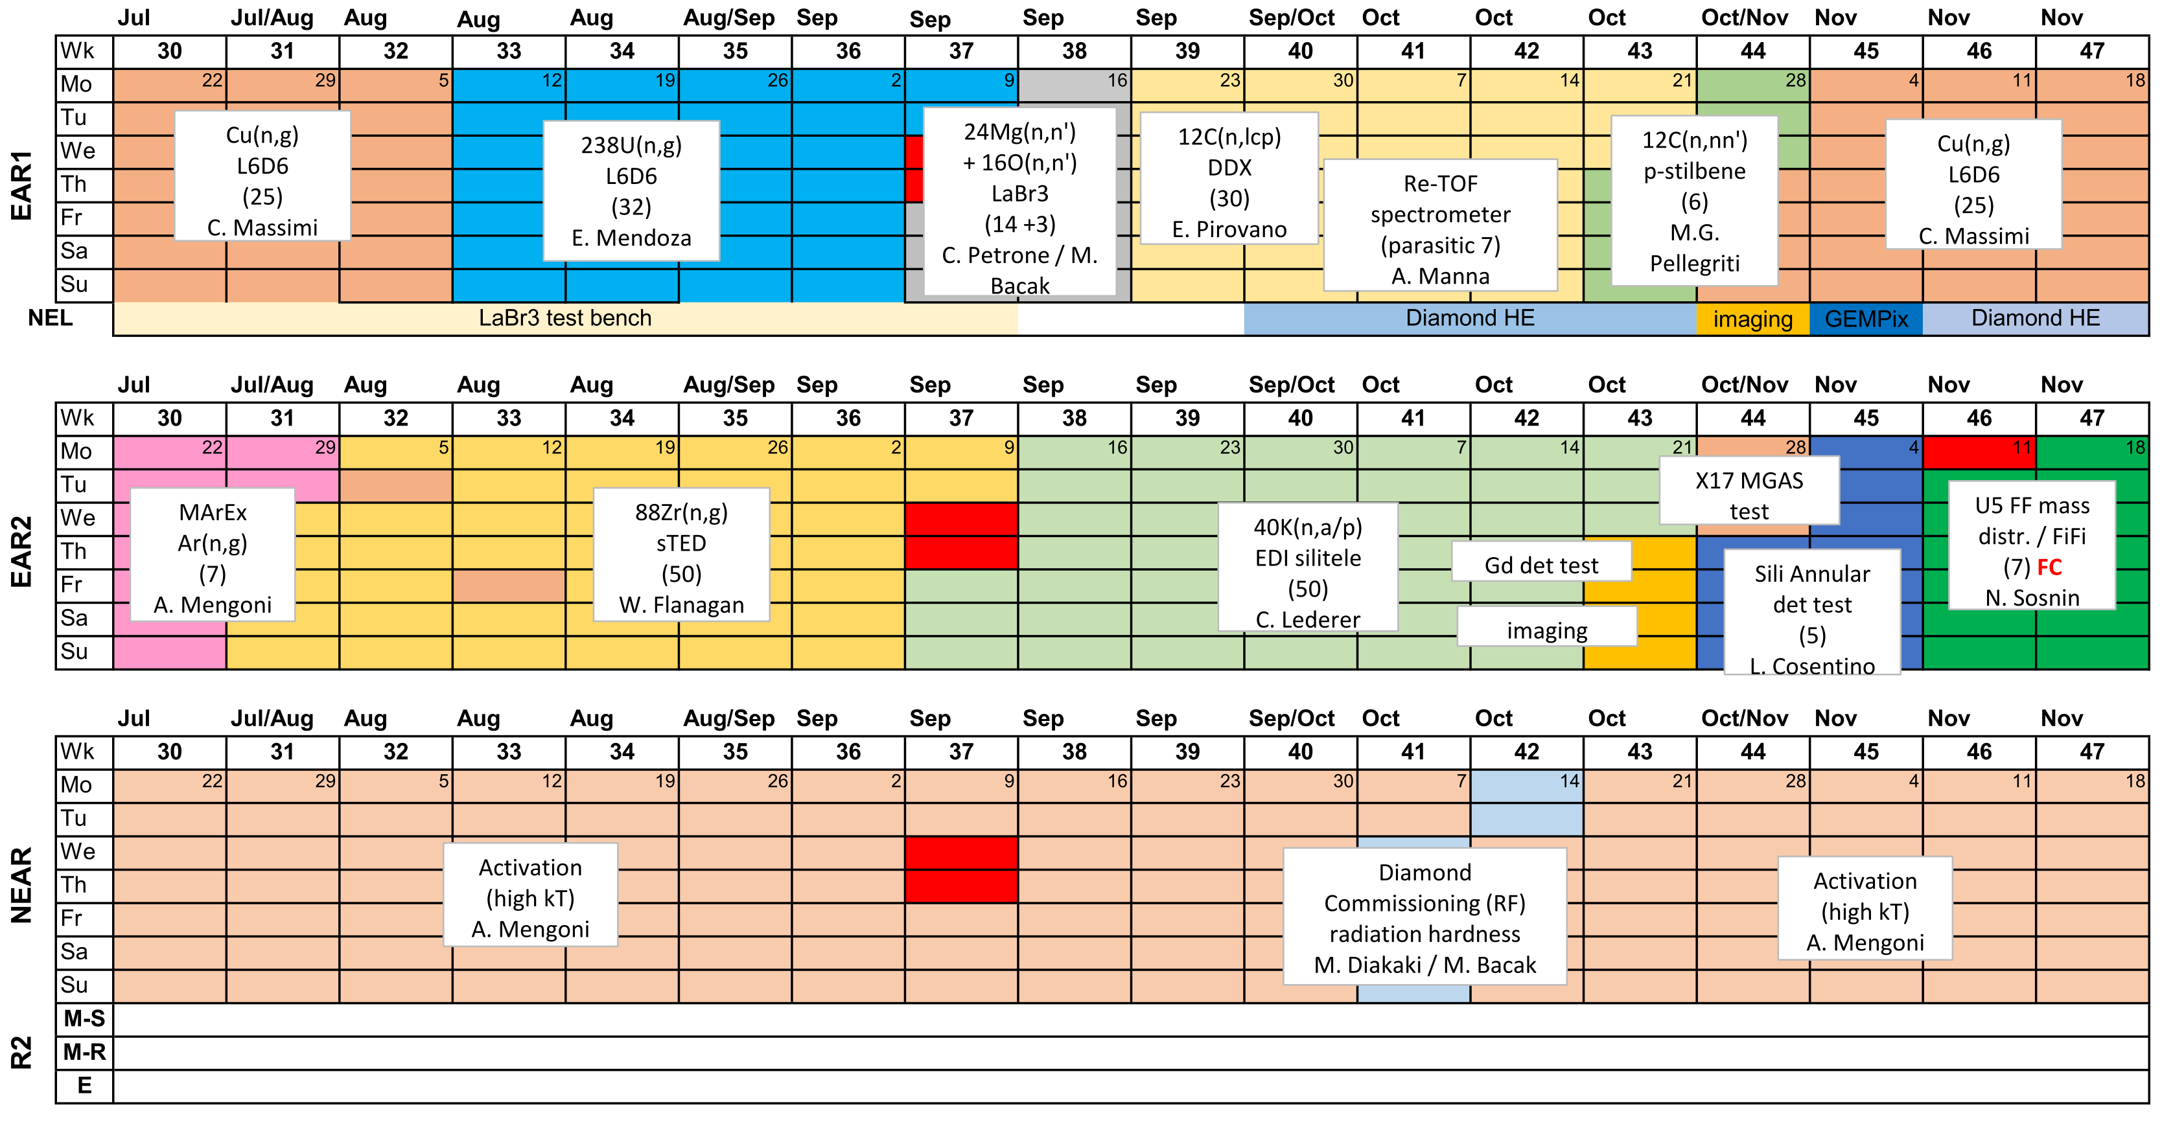
Feedback / lesson’s learned (EAR1)
Convenient long (n,g) campaigns.
Special thanks to Italian teams
PPAC installation „relearned“:
Smooth mechanical installation
→ open question about the necessity of the concrete blocks rack-bunker
Plenty of person power available from incoming teams – no slacking off in 2025!
Always with plenty of support from the local team (specifically for (n,g) setups)
Good compromises and synergies reached for parasitic and additional experiments:
  MGAS for parallel (n,tot) with some (n,g) measurements
  ReTOF parasitic to DDX (see R. Zarella‘s talk)
Some detectors show improved performance wrt the „ringing“ when bypassing the „patch panel“
Plenty of activity at the NEL
# | EAR | Experiment | TOTAL | approved (1e17) | approved-received (1e17) | received/approved
1 | 1 | 28,29Si(n,g) | 5.6E+18 | 45 | 11 | 1.24
2 | 1 | 24Mg + 16O (n,n'g) | 2.7E+18 | 17 | 10 | 1.56
3 | 1 | Ce(n,f) | 3.8E+18 | 30 | 8 | 1.26
4 | 1 | 167Er(n,g) | 4.1E+18 | 30 | 11 | 1.35
5 | 1 | 63Cu(n,g) | 3.7E+18 | 25 | 12 | 1.47
6 | 1 | 238U(n,g) | 4.1E+18 | 32 | 9 | 1.29
7 | 1 | 12C(n,cp) DDX | 4.1E+18 | 30 | 11 | 1.35
8 | 1 | ReTOF (parasitic) | 2.1E+18 | 7 | 14 | 2.99
9 | 1 | 12C(n,n') p-stil | 9.1E+17 | 6 | 3 | 1.52
10 | 1 | 65Cu(n,g) | 3.3E+18 | 25 | 8 | 1.32

Slide 4





Feedback / lesson’s learned (EAR2)
Convenient long (n,g) campaigns.
Special thanks to Spanish teams
Ar(n,g) – physics & safety highlight
(see Pino & Emilio‘s talks)
88Zr(n,g): p-beam improvements & uniqueness of n_TOF
(see Genevieve‘s talk)
40K(n,lcp) some sample troubles
(see Selin‘s talk)
PSI-CERN distance is really practical for… sample transports ;)
Some last minute improvised stressor experiments:
  X17 MGAS test,
  ESS Gd det test
  imaging, …
Bit stressful end due to novelty „FiFi“ (see Nick‘s talk & big thanks to Zina)
# | EAR | Experiment | TOTAL | approved (1e17) | approved-received (1e17) | received/approved
1 | 2 | 209Bi(n,g) | 4.0E+18 | 30 | 10 | 1.33
2 | 2 | 146Nd(n,g) | 5.1E+18 | 37 | 14 | 1.37
3 | 2 | 28,29Si(n,g) | 1.1E+18 | 8 | 3 | 1.36
4 | 2 | Mo (2 isotopes) | 2.5E+18 | 25 | 0 | 1.02
5 | 2 | Ar(n,g) | 2.6E+18 | 7 | 19 | 3.77
6 | 2 | 88Zr(n,g) | 5.7E+18 | 50 | 7 | 1.15
7 | 2 | 40K(n,cp) | 5.6E+18 | 50 | 6 | 1.12
8 | 2 | 12C(n,cp) SADR | 1.5E+18 | 5 | 10 | 2.92
9 | 2 | 235U(n,f) FiFi | 1.8E+18 | 7 | 11 | 2.63
FiFi
(the new miniSTEFF)

Slide 5
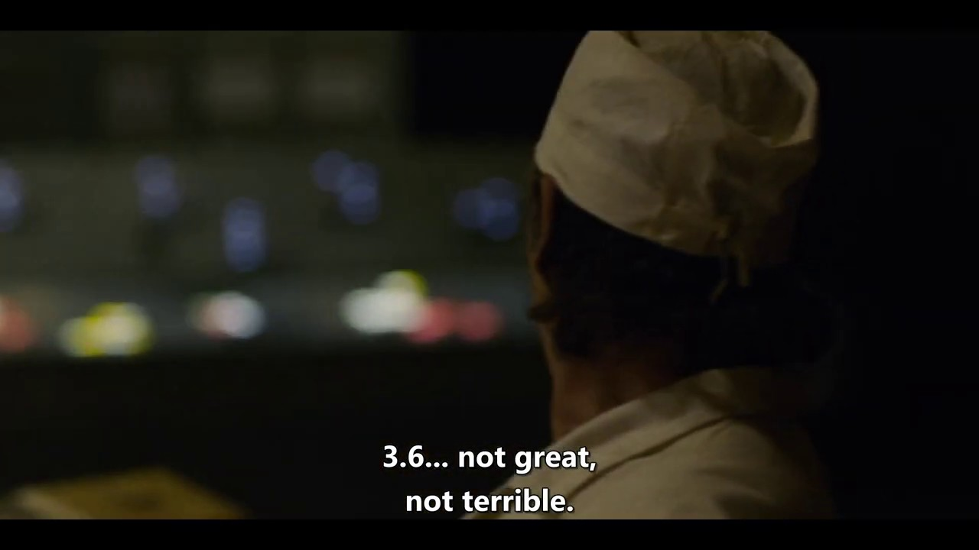
Feedback / lesson’s learned (EAR3)
Handovers for Activation at NEAR could have been better
Activation business taken care of by Francisco in 2024
Diamond campaigns (see Kalli‘s talk)
HBO series "Chernobyl"

Slide 6
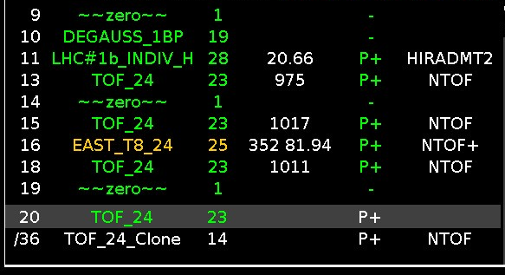
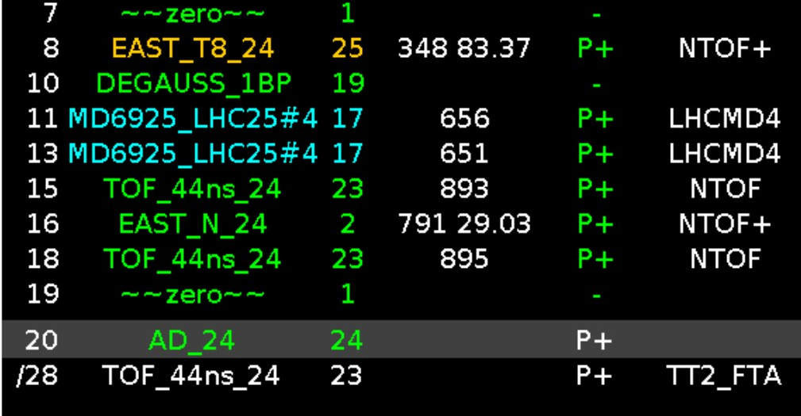
Proton beam developments
Protons - excellent throughout 2024
  First weeks „too good“ → IEFC approved 1.08e17 p/d (May)
Bunch Intensity increase (firstly for 88Zr):
  TOF from 800 to 900e10 ppp (@ 44ns) (up to 1000e10)
  Parasitics from 350 to 800e10 ppp (@ 44 ns)
  After September RP FTN survey IEFC approved until end 2024
Bunch Length:
  From 28 ns to 44 ns (mid 2024) → relevant >500 MeV EAR1
  Possible to go back to 28 ns with slight penalty on bunch
  intensities (800/700 dedi/para – confirmed last Sunday)
Bunch quality identical on all bunch types
DoubleTOF → see next slide
… that‘s how!

Slide 7
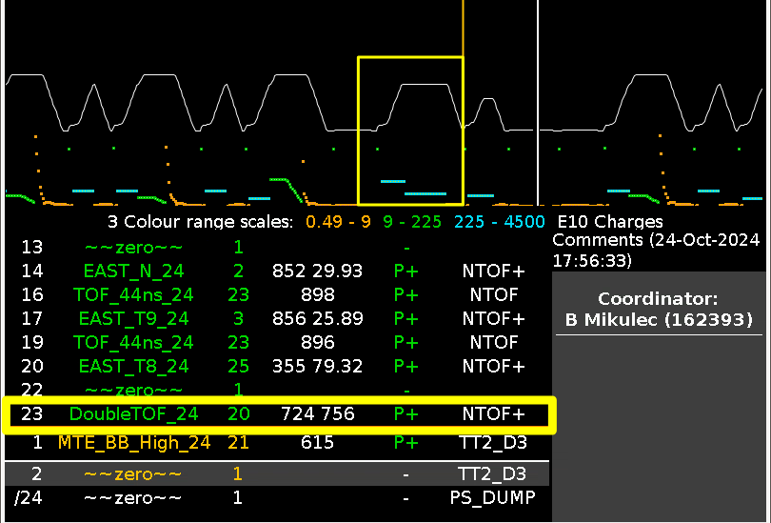
Proton beam developments – DoubleTOF
„Double Bunch“ or DoubleTOF
  Single cycle but 2 ejections NOT 2x intensity (target)
    1.2 second spacing between bunches = no overlap
  More effective/efficient for machines (1 cycle gain in PSB)
  Single bunch intensity up to 750e10 ppp (more protons!)
DAQ modification (Martin Farkas):
  Heavy intervention in the timing logic
    „Same cycleStamp but different AcqStamps“
  Successful and smooth implementation mid operation
  (tested in EAR3 before)
Status/Issue: PS identified unlikely but catastrophic failure scenarios (extraction of both bunches at once) related to synchronization between PSB-PS
  Planned to be fixed during the YETS & run DoubleTOF normally in 2025
*details: Martin Farkas & soon in the DAQ documentation

Slide 8
DAQ
Statis is ok
  Few broken things in 2024 (power supply for the FAN in/outs of the timings)
  Purchases: Spare machine (CERN ~20k), 3x 14 bit digitizers (SANDA ~33k), SSDs & misc (CERN ~15k)
Intense upgrade programme during YETS (aka “Martin is busy”):
  OS change to Al9 (IT security)
  Network domain for n_TOF (IT security)
  Work flow change for data storage CTA/CASTOR + changes in data processing (IT complaint)
  No DAQ from yesterday to 3rd March 2025 (exceptions not impossible but unwelcome)
DAQ Day:
  What: 1 day remote workshop
  Purpose: collect and tackle requests and ideas from the collaboration+ (new technologies, …)
  When: towards end of January 2025 – precise date to be announced in the next two weeks

Slide 9
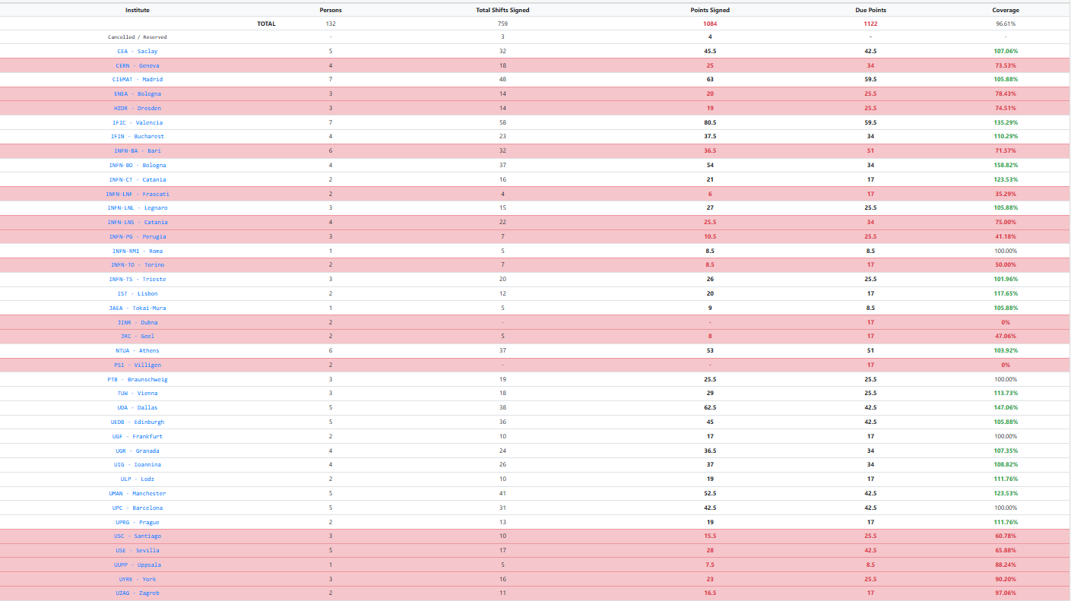
Shifts & shift leading
Only 1 “come for shifts” email needed in 2024
  Shifts and experiments in summer are always an issue – so special thanks to those
Local team has seen worse (2021-2023)
  local team members still do ~2x the shift load of a single n_TOF member
  In addition to shift leading for 5-6 weeks per year (= on-call & not going out of the region)
Still room for improvement in 2025 & 2026 ;-)

Slide 10
Summary
Successful year with plenty of physics (see Paolo‘s talk)
  Everybody got what they wanted (in terms of protons/statistics & more)
  No im-/explosions or incident-report-worthy accidents (see Pino‘s talk)
Improved PoT rate from 1.0e17 to 1.3e17 p/d
  Higher bunch intensities due to an intense work programme in PS
  DoubleTOF for 2025 operational
„DAQ Day“ - late January 2025
3D priting is cool but some last-minute requests are very very last-minute even when turning two blind eyes
  Relations and proximity to STI was crucial this year - thanks to: Kristian for doing the work, Oliver for organizing/filtering Kristian‘s work and Marco for only saying no soft-heartedly ;-)
  I assume a few minutes ago Oliver said already that this must/will change in 2025
  (Same can be said for PSI wrt sample production (Emilio & Eliza) )

