Slide 1


Status and first results of the High precision
²⁰⁹Bi(n,ɣ) cross section at n_TOF EAR2
G. de la Fuente Rosales¹, J. Balibrea-Correa¹, C. Domingo-Pardo¹,
B. Gameiro¹, J. Lerendegui-Marco¹, V. Babiano-Suárez², I. Ladarescu¹, A. Casanovas³, F. García^{4,5}, M. Bacak⁵ and n_TOF collaboration.
¹ Instituto de Física Corpuscular (IFIC), CSIC
² Universidad de Valencia
³ Universitat Politècnica de Catalunya, Spain
⁴ University of Granada, Spain
⁵ European Organization for Nuclear Research (CERN), Switzerland

Slide 2


Outline
Motivation
Brief summary of prev. analysis status reported
²⁰⁹Bi(n,ɣ) cross section measurement @ EAR2:
  Background estimation
  Preliminary ²⁰⁹Bi(n,ɣ) reaction yield (up to 10 keV)
Summary and conclusions
n_TOF Collaboration meeting, November 27-29, 2024

Slide 3
Outline
Motivation
Brief summary of prev. analysis status reported
²⁰⁹Bi(n,ɣ) cross section measurement @ EAR2:
  Background estimation
  Preliminary ²⁰⁹Bi(n,ɣ) reaction yield (up to 10 keV)
Summary and conclusions
n_TOF Collaboration meeting, November 27-29, 2024

Slide 4



Motivation
²⁰⁹Bi(n,ɣ) is important for understanding the chemical evolution of the Universe via s-process.
Th/U ratios, used as cosmic clocks for stars, needs accurate data on ²⁰⁹Bi(n,ɣ) to disentangle radiogenic contributions from Th and U ⍺-chain decays.
Development on nuclear technology requires improvement on nuclear data accuracy:
  Delayed neutron emission probabilities.
  Neutron induced cross sections.
https://ecoinventos.com/myrrha/
n_TOF Collaboration meeting, November 27-29, 2024

Slide 5
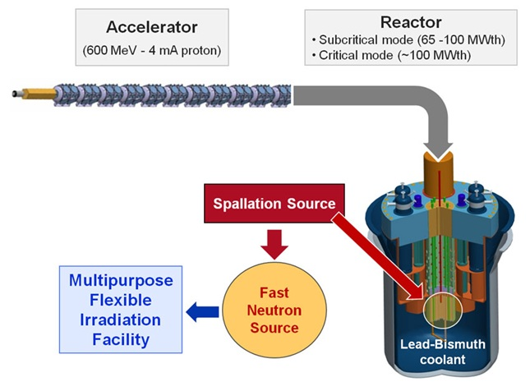
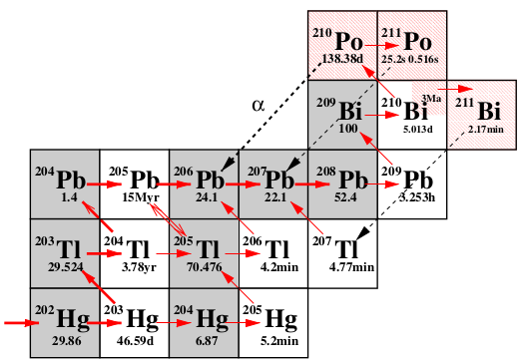
MYRRHA and ²¹⁰Po production
Figure adapted from https://www.sckcen.be/en/expertises-0
MYRRHA is a multipurpose Accelerator Driven System (ADS) nuclear reactor able to operate in subcritical and critical mode. It is made of:
600 MeV Proton accelerator.
Spallation target.
A core with MOX fuel cooled by liquid lead-bismuth (Pb-Bi).
Radiological Burden associated with the use of Pb-Bi coolant is because of ²⁰⁹Bi(n,ɣ) populating ²¹⁰Bi and ^{210m}Bi:
²¹⁰Po (t_{1/2}~5 days)/²⁰⁶Tl (t_{1/2}~3My)
Calculations for ²¹⁰Po concentration for MYHRRA in one irradiation ranges from 5 to 20% depending on the evaluation.
n_TOF Collaboration meeting, November 27-29, 2024

Slide 6
Outline
Motivation
Brief summary of prev. analysis status reported
²⁰⁹Bi(n,ɣ) cross section measurement @ EAR2:
  Background estimation
  Preliminary ²⁰⁹Bi(n,ɣ) reaction yield (up to 10keV)
Summary and conclusions
n_TOF Collaboration meeting, November 27-29, 2024

Slide 7
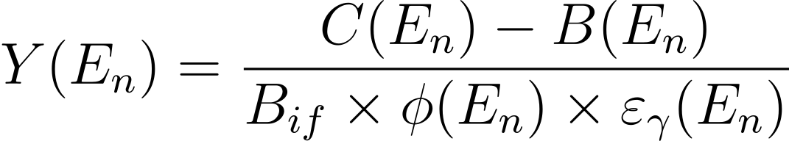
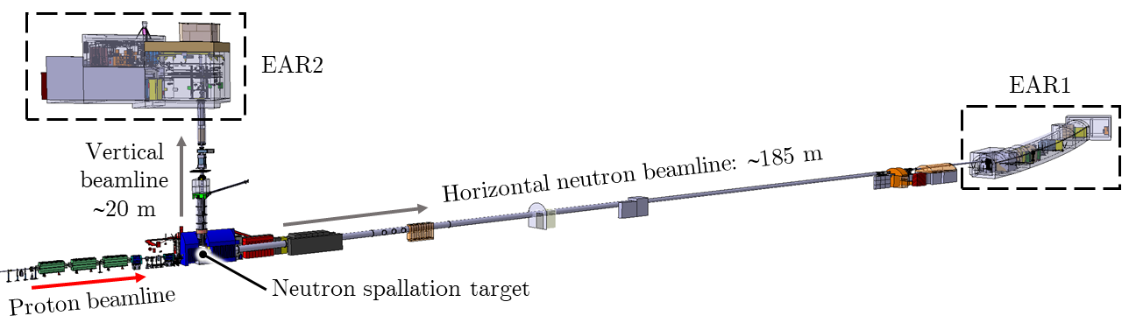
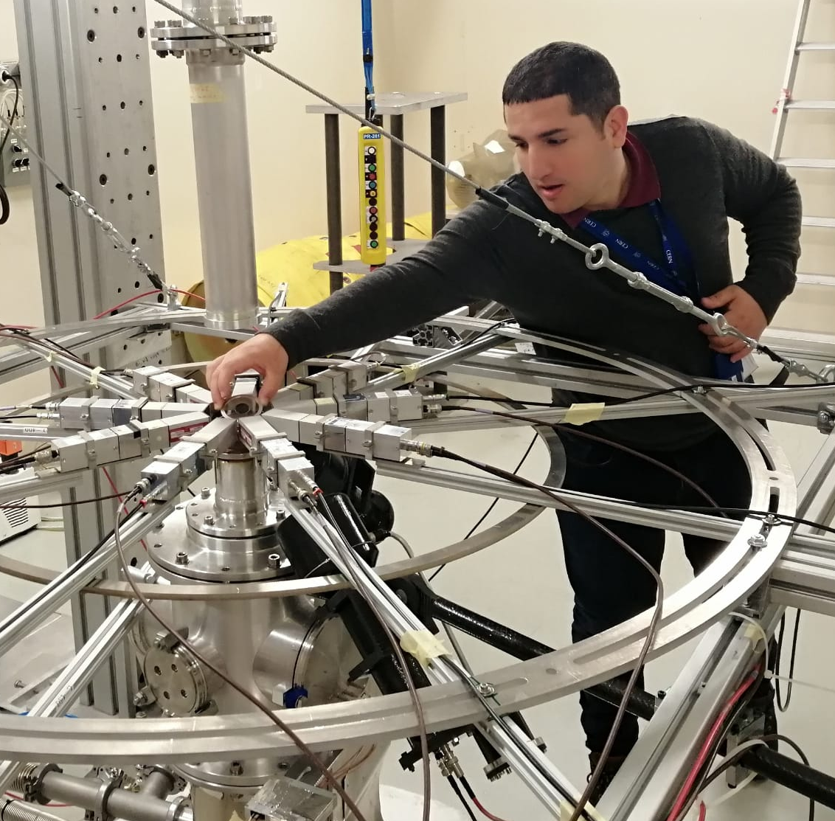
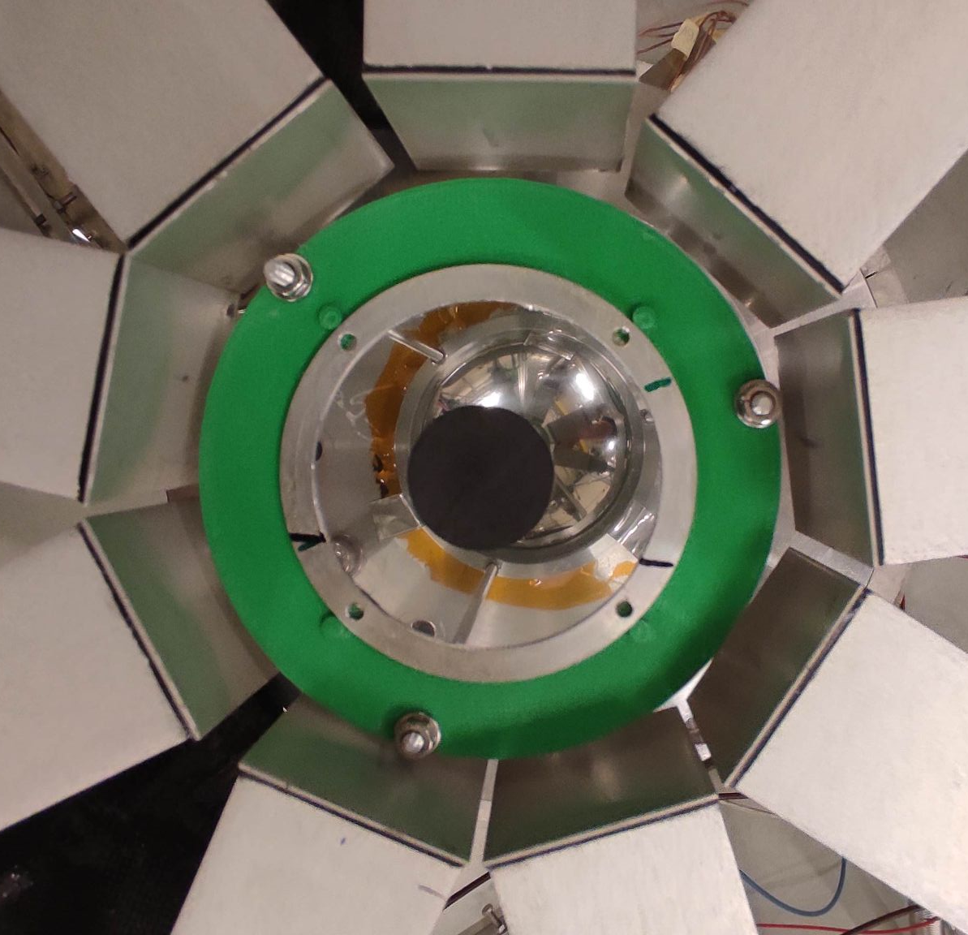
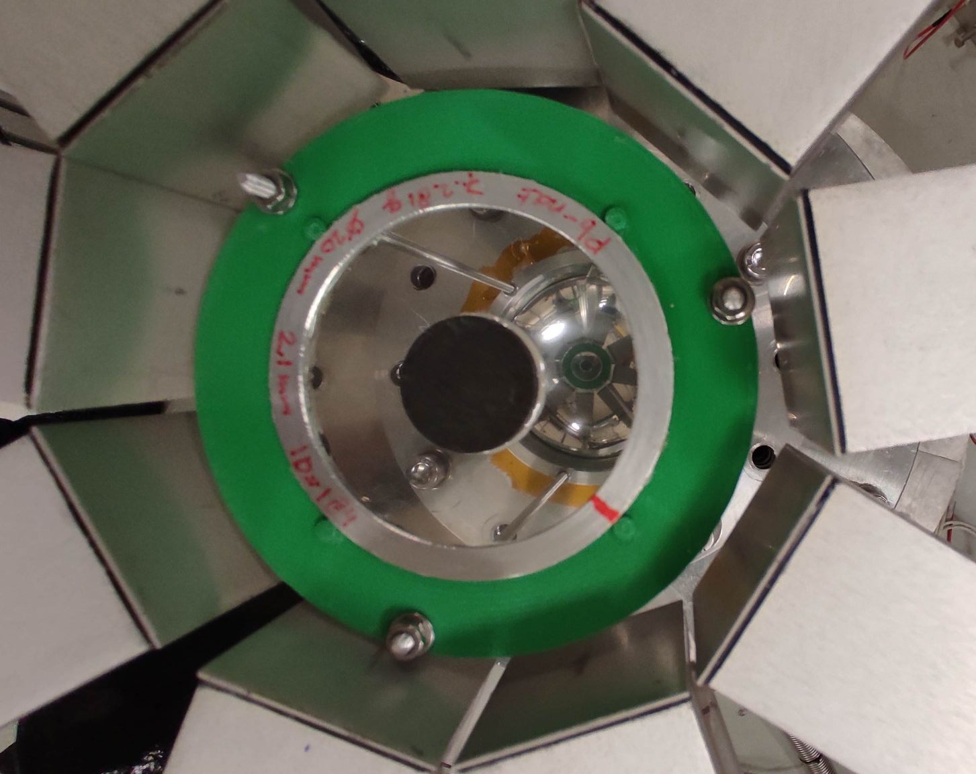
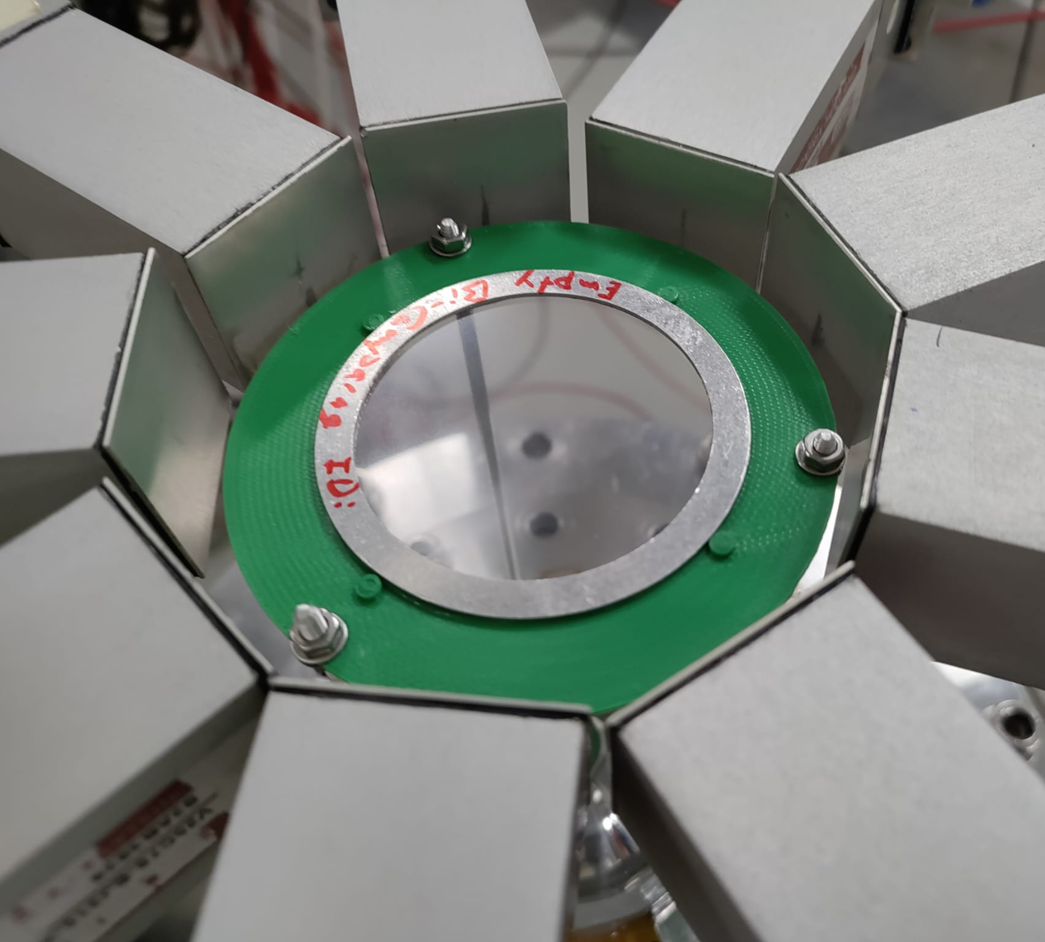
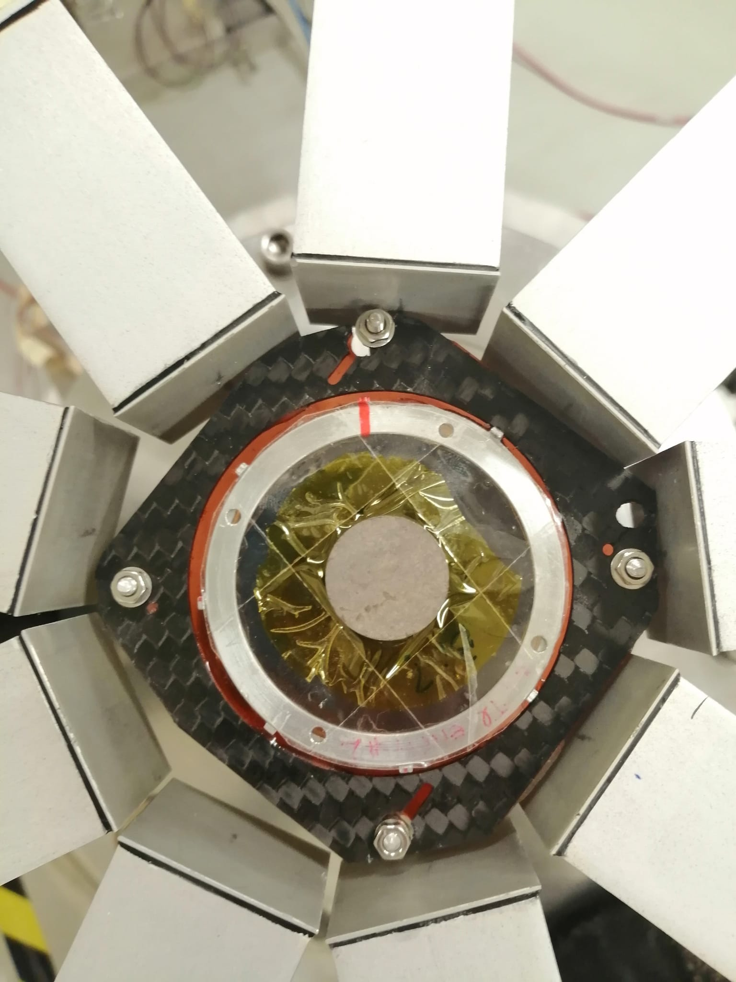
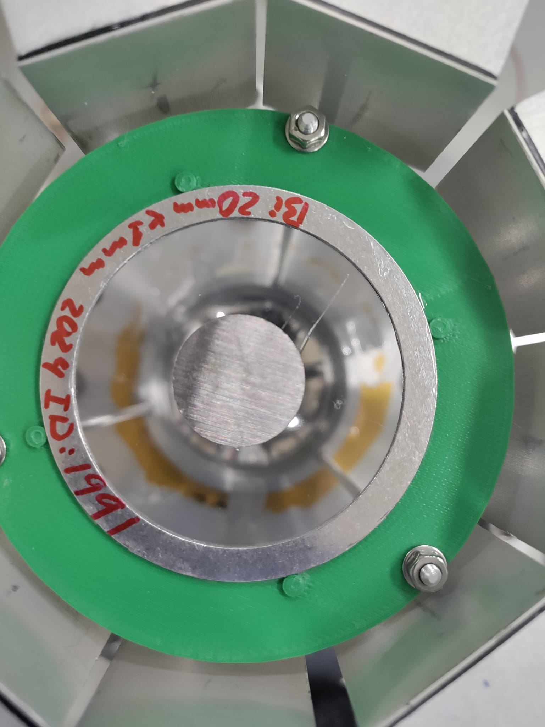
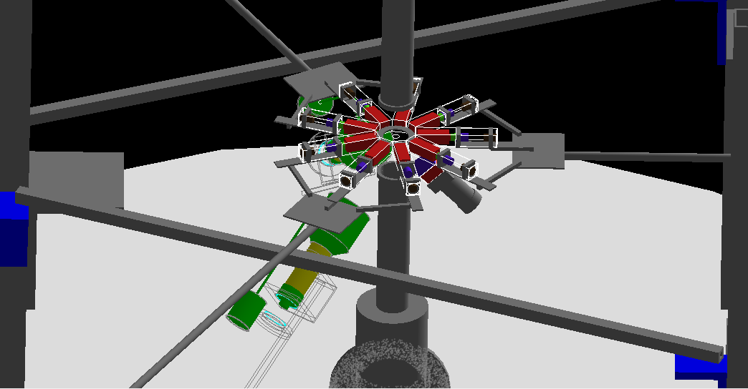
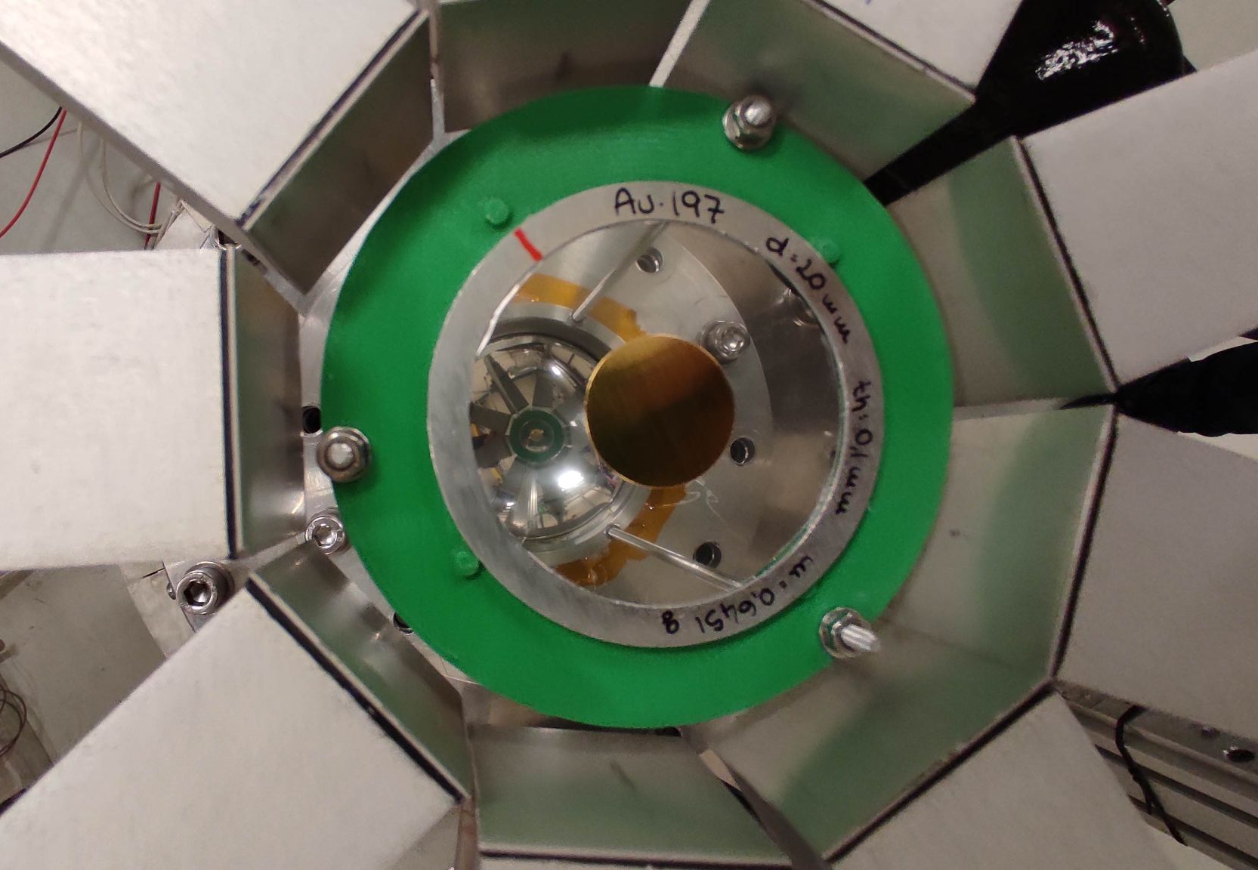
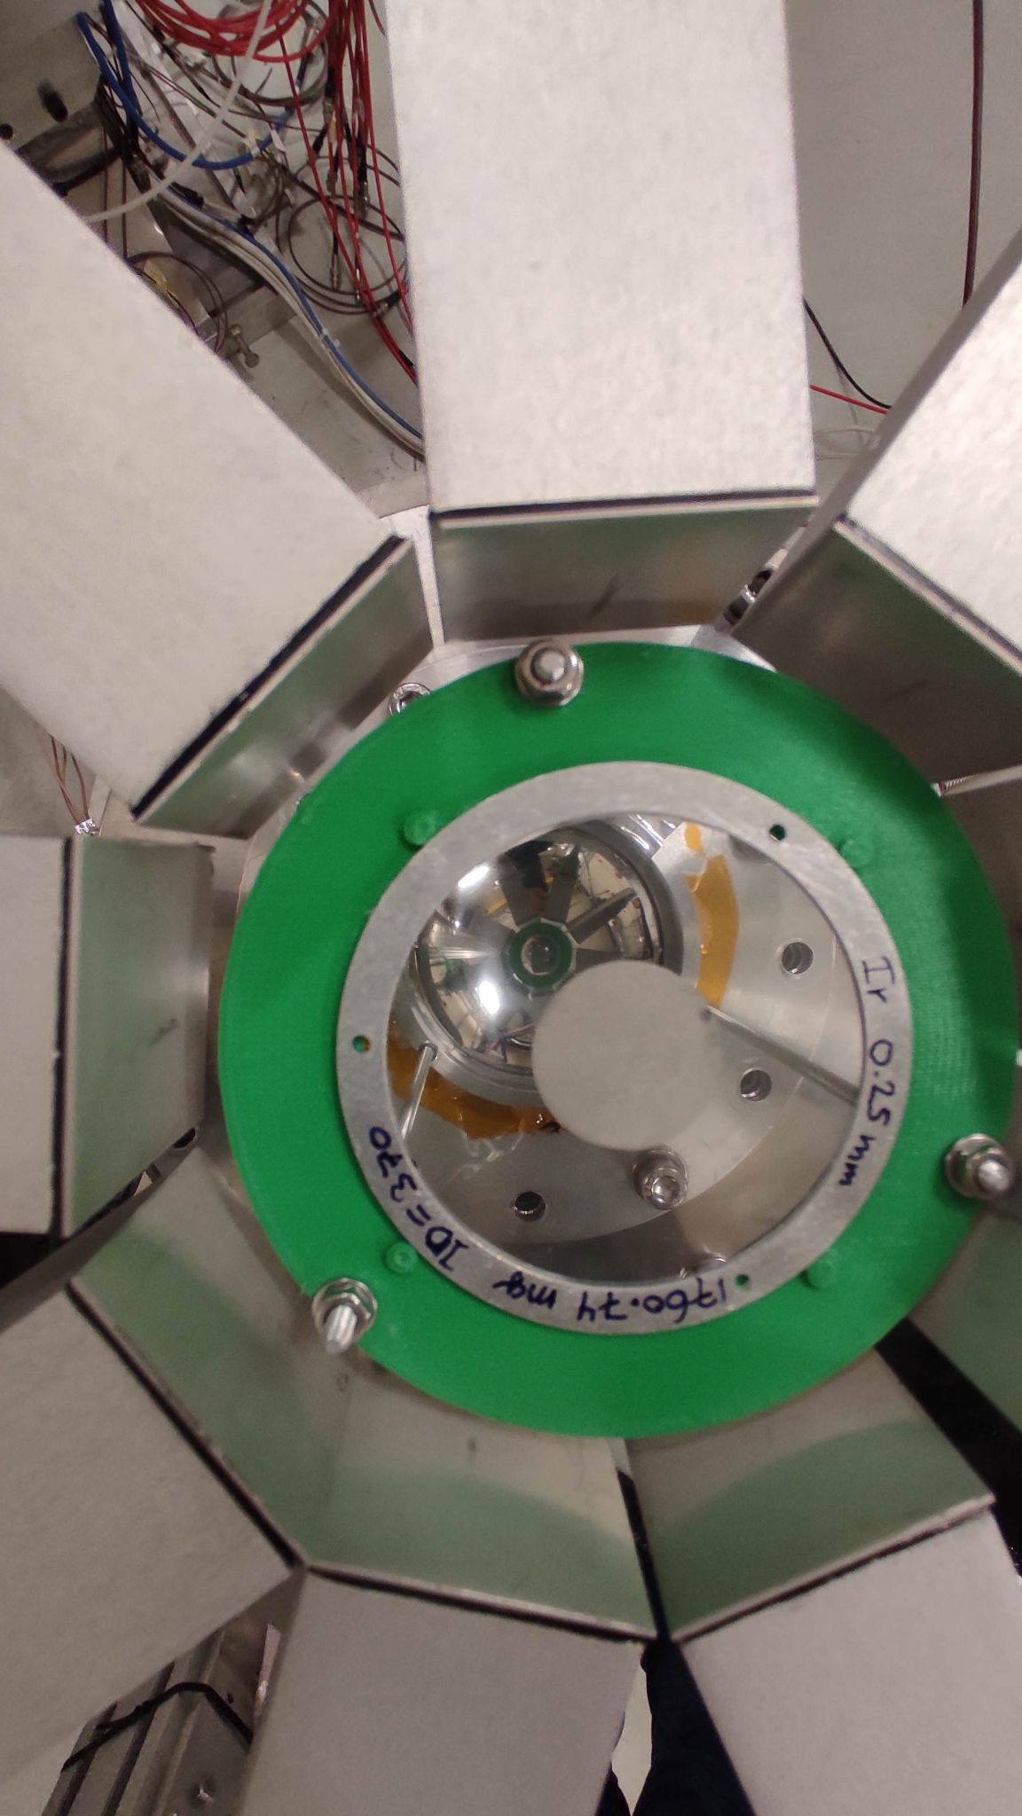
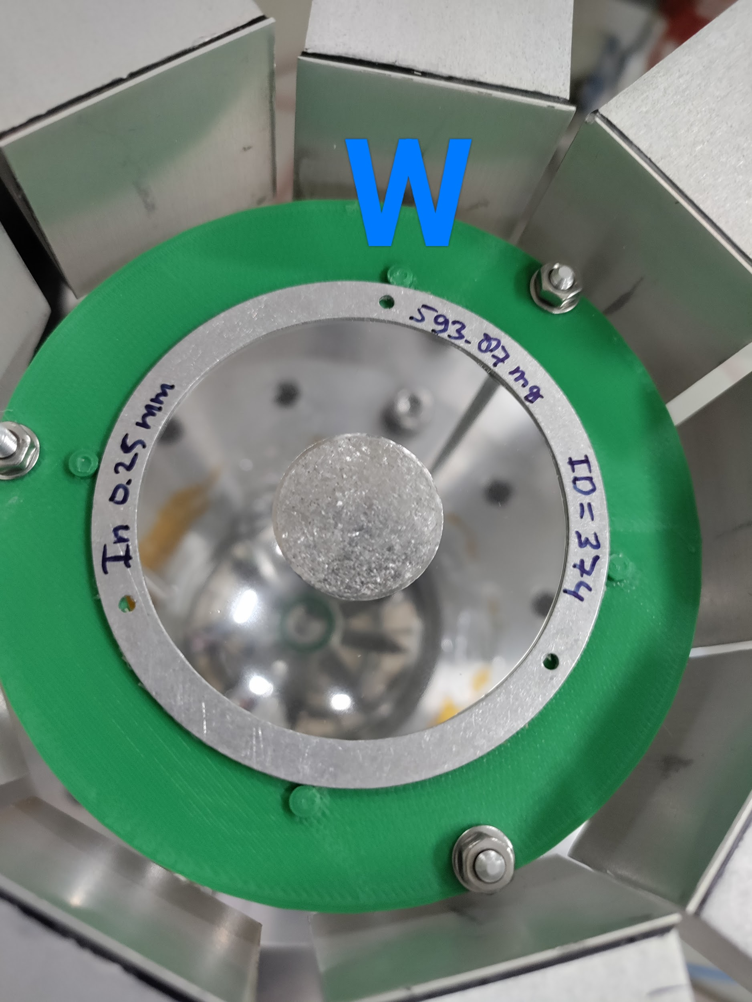
Brief summary: High Precision Measurement
The reaction yield is calculated experimentally as:
Improve ²⁰⁹Bi(n,ɣ) signal
Dedicated bkg. measurements
Well controlled geometry,
high purity, targets with different thicknesses
Carbon
Pb
Empty
Several normalizations
Bi209 Thick
Bi209 Thin
Need
Update
Thick
Gold
Ir
In
Thin
6 mm
1 mm
White neutron fluence
@ nTOF-EAR2
2022 setup
n_TOF Collaboration meeting, November 27-29, 2024

Slide 8
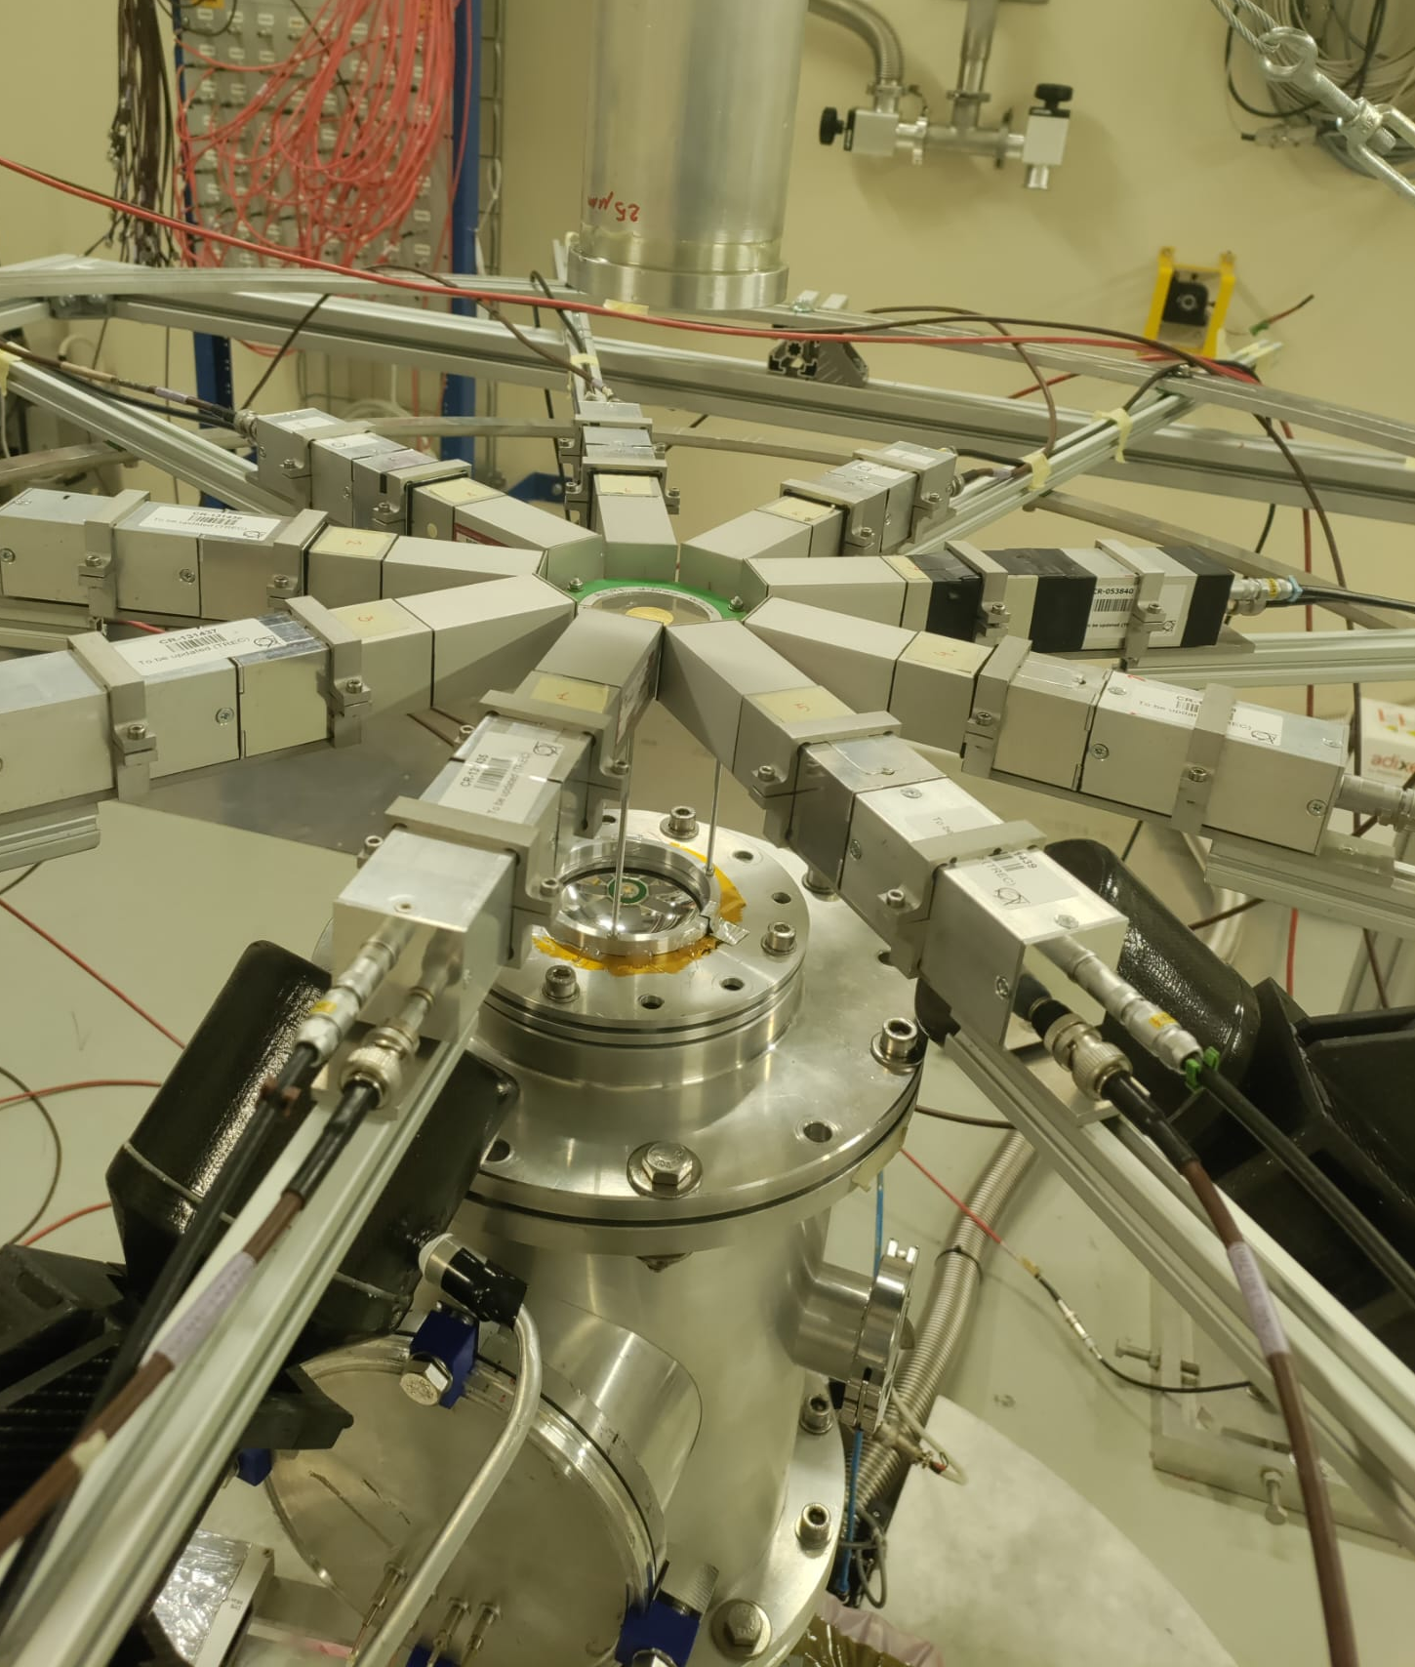
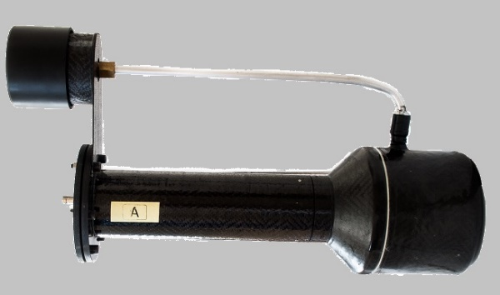
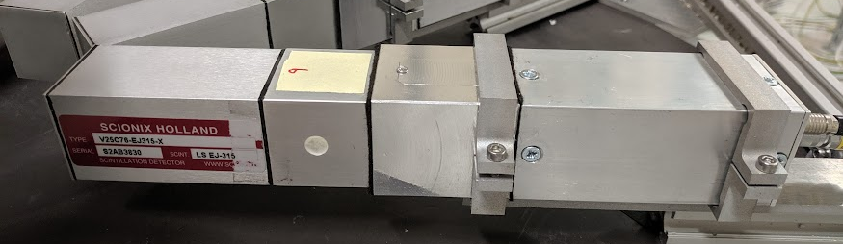


Brief summary: Experimental Setup
The experiment took place in April 2024 at the nTOF EAR2 using the state-of-the-art (n,ɣ) experimental setup:
High sensitivity sTED array (9) in compact configuration @90º and 4.5-4.75 cm from target: High sensitivity detection system.
2 C₆D₆ detectors @135º and 17 cm and 20 cm respectively from target: Angular anisotropies + other possible systematics.
SiMOn2 : Beam monitoring/normalization/neutron flux shape.
sTEDs
State-of-the art for (n,𝛾):
C₆D₆ TED detectors
sTED detectors (~1/9 L C₆D₆) + New PMTs
Minimized G-flash effects:
→Max En in A. range
Low C. rates
→Low dead-time
Geom. optimization for (n,𝛾)
→Large sensitivity
V. Alcayne et al., Rad. Phys. and Chem. (2024) 217, 111525
C₆D₆
Limitations @ EAR2:
High C. rates + effect of the G-flash in the PMT
Limitations in max En
Large dead-time corrections.
SIMOn2
n_TOF Collaboration meeting, November 27-29, 2024
Notes:
Vacuum configuration:
Above: Vacuum from 15 cm of the sample.
Below: Air up to the big flange. New lighter holder directly connected to the SiMon in air.
In order to reach the goals of the current work we used EAR2 together with the experimental setup used for 94Nb(n,ɣ) and 79Se(n,ɣ) campaigns (with successfully results in 2022), it is made of:
-High sensitivity sTED array (9) in compact configuration @90º and 4.5-4.75 cm from target: High sensitivity detection system.
-2 C6D6 detectors @135º and 17 and 20 cm from target: Identify possible systematics associated to angular distributions, efficiency…etc.
-SiMOn2 : Beam monitoring/normalization/neutron flux shape.

Slide 9

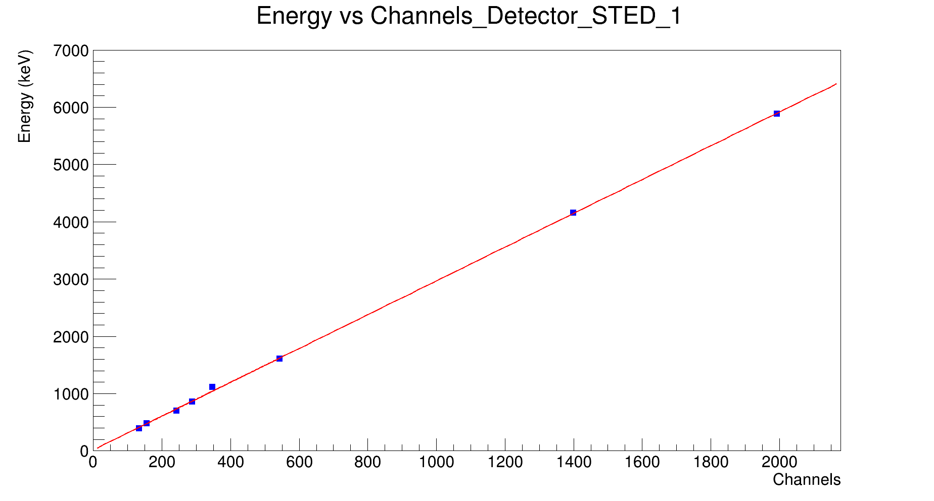
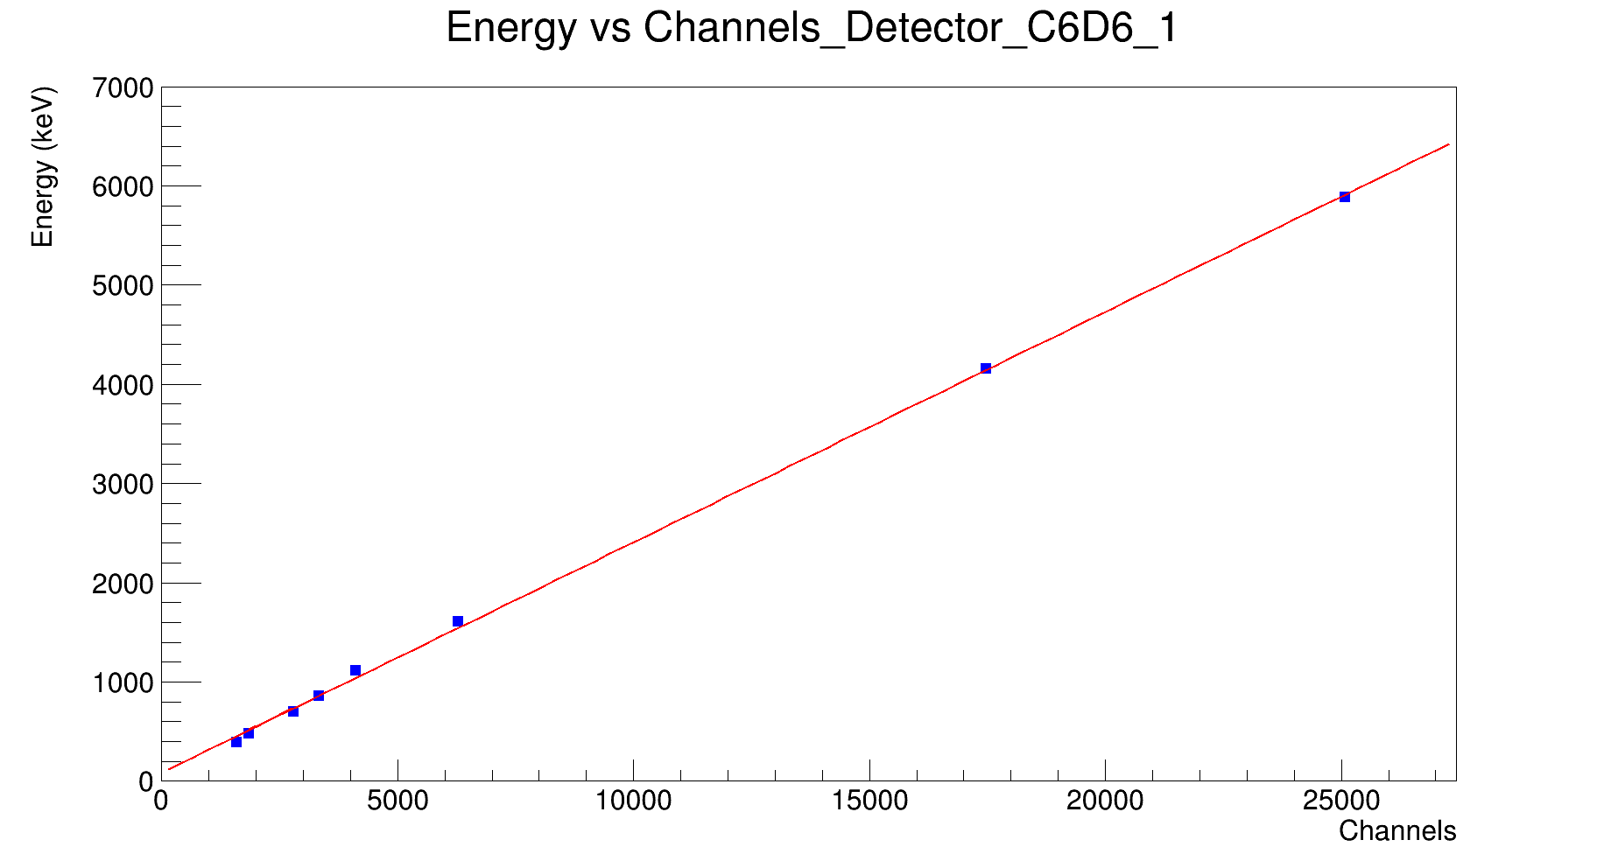
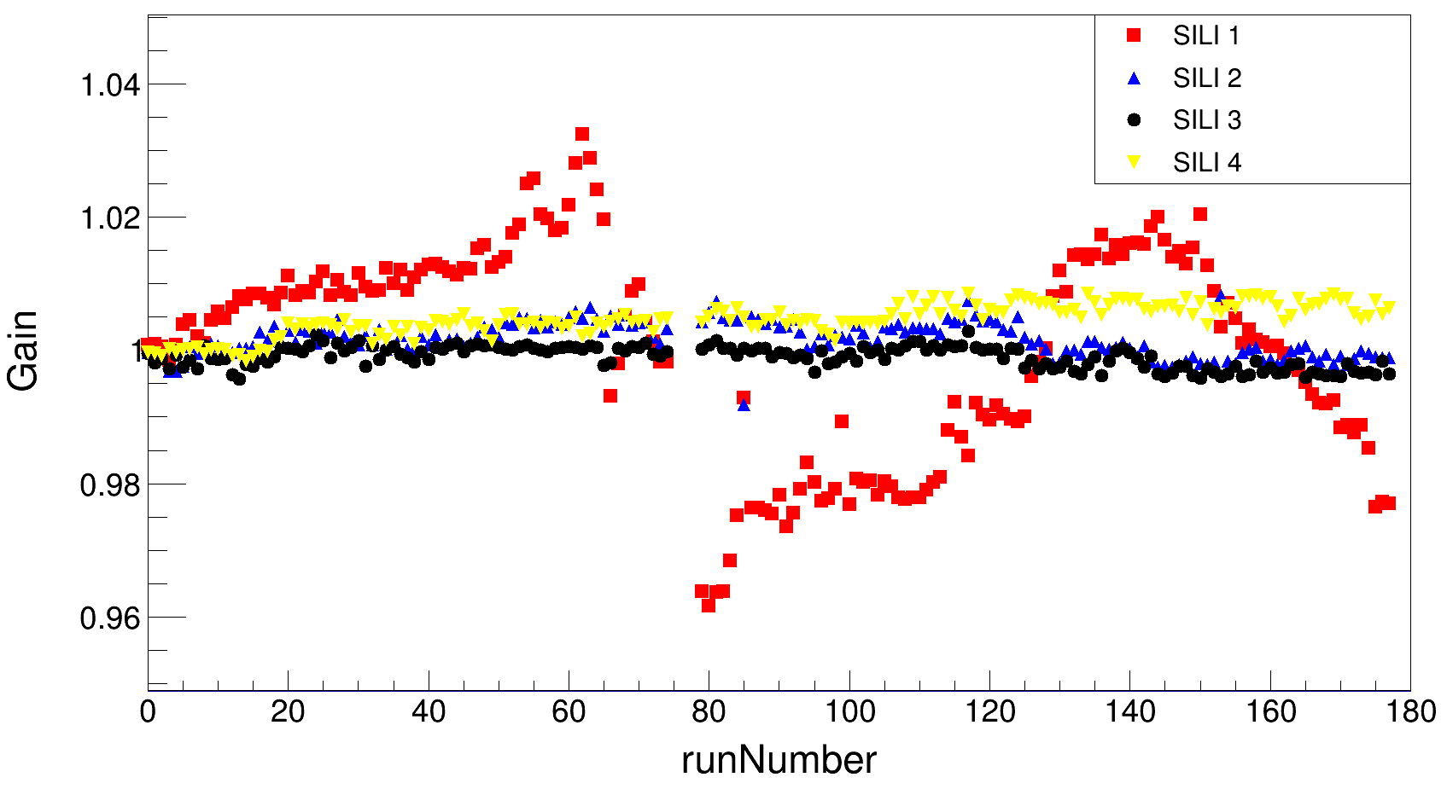
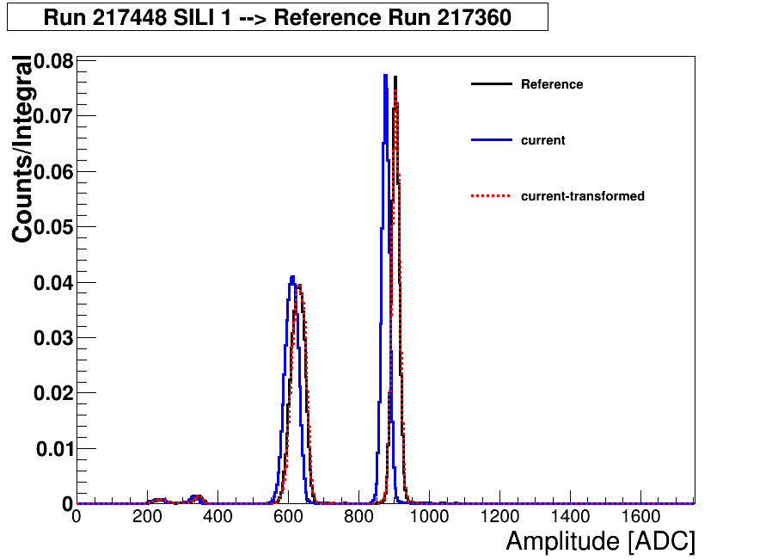
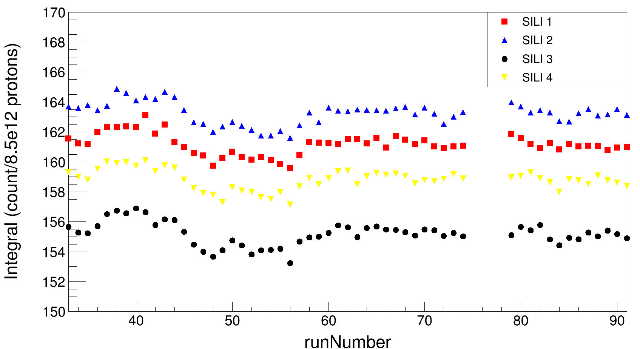
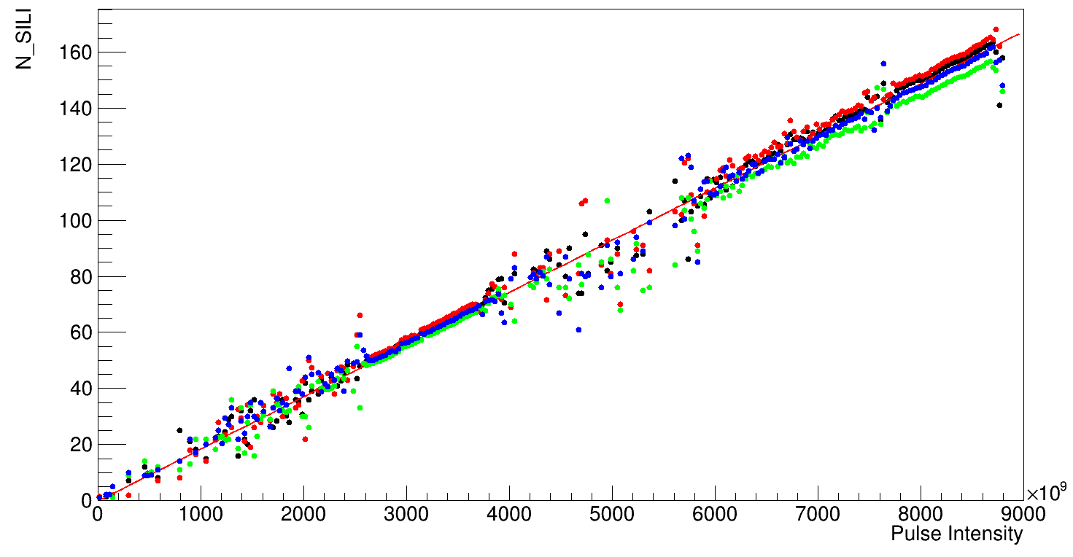
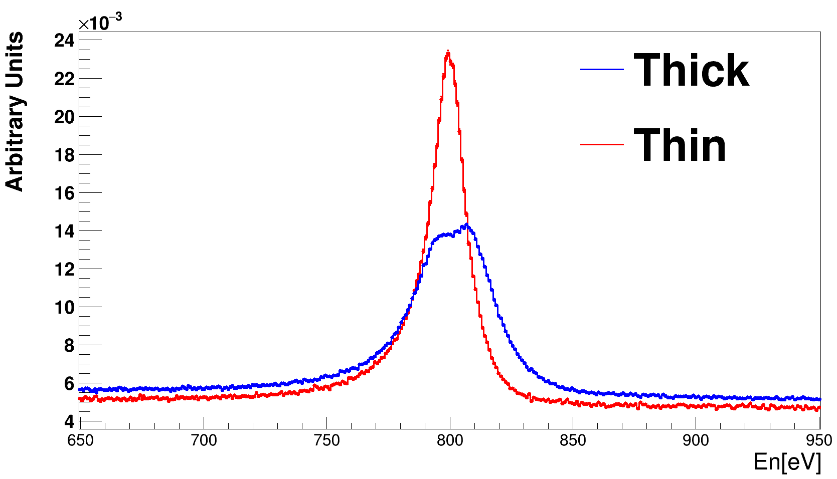
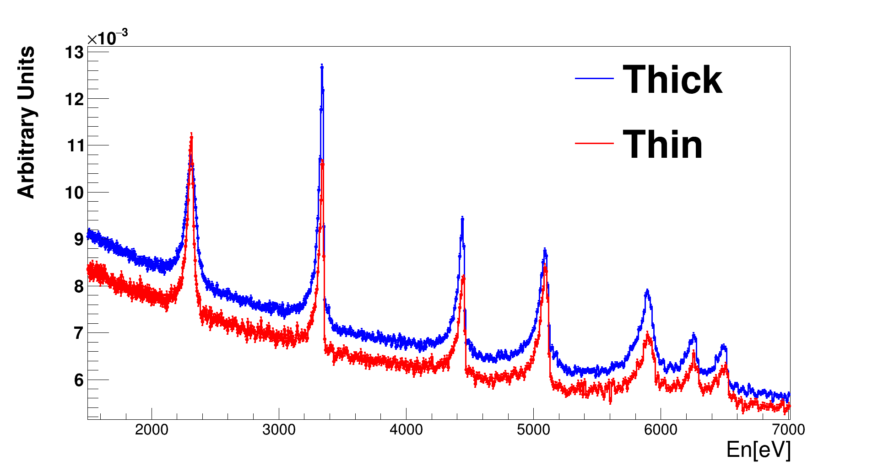
Outline
Brief summary: Prev. analysis status reported
In the last meeting:
Detector individual energy calibration ✔
Gain drift for all detectors along the measurement ✔
Count rate stability ✔
“Very Preliminary” ²⁰⁹Bi(n,ɣ) data. ✔
n_TOF Collaboration meeting, November 27-29, 2024

Slide 10
Outline
Brief summary: Prev. analysis status reported
In the last meeting:
Detector individual energy calibration ✔
Gain drift for all detectors along the measurement ✔
Count rate stability ✔
“Very Preliminary” ²⁰⁹Bi(n,ɣ) data. ✔
So, what is new since June?
n_TOF Collaboration meeting, November 27-29, 2024

Slide 11
Outline
Motivation
Brief summary of prev. analysis status reported
²⁰⁹Bi(n,ɣ) cross section measurement @ EAR2:
  Background estimation
  Preliminary ²⁰⁹Bi(n,ɣ) reaction yield (up to 10 keV)
Summary and conclusions
n_TOF Collaboration meeting, November 27-29, 2024

Slide 12
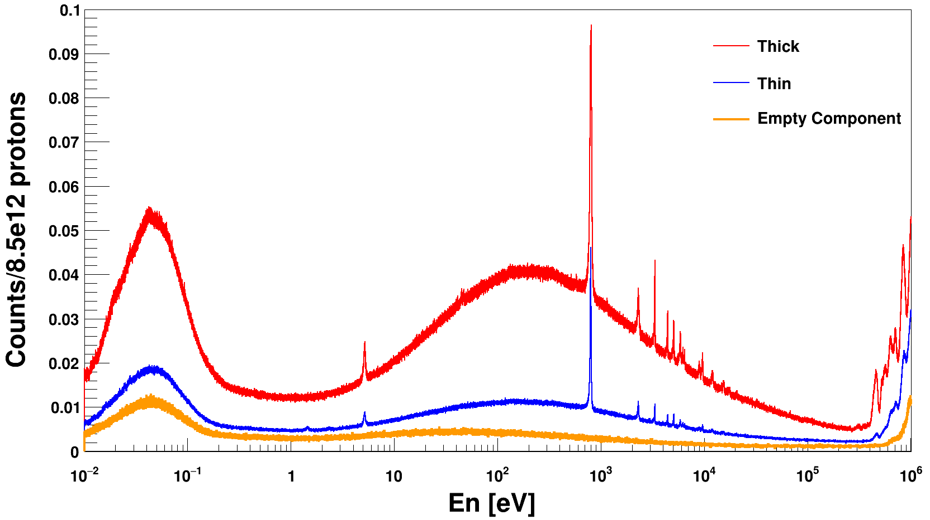
Preliminary ²⁰⁹Bi(n,ɣ) data
Preliminary
The thin and thick targets are of capital importance for MS estimation, cover the goal neutron energy range and control other systematics
“Very Good” Background subtraction needed
n
scattering
In beam
gamma
n
scattering
n_TOF Collaboration meeting, November 27-29, 2024

Slide 13
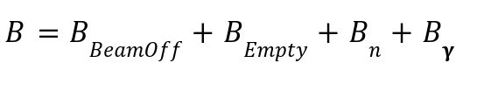
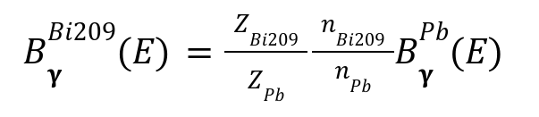
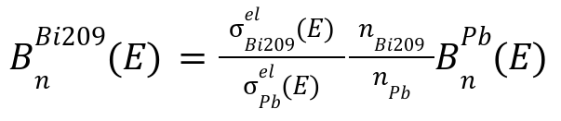
Ongoing analysis: Background
Different components added together to estimate total background for each sample:
Neutron and in-beam gamma scattering background component scaled to reproduce the observed background shape in both ²⁰⁹Bi targets. Estimation based on C (“perfect n scattering”) and Pb (“perfect gamma scattering”)
Beam-off configuration.
Beam-on configuration using an empty sample.
Janis
Sample
n_TOF Collaboration meeting, November 27-29, 2024

Slide 14
Ongoing analysis: Background
Different components added together to estimate total background for each sample:
Neutron and in-beam gamma scattering background component scaled to reproduce the observed background shape in both ²⁰⁹Bi targets. Estimation based on C (“perfect n scattering”) and Pb (“perfect gamma scattering”)
Beam-off configuration.
Beam-on configuration using an empty sample.
?
Janis
Sample
n_TOF Collaboration meeting, November 27-29, 2024

Slide 15
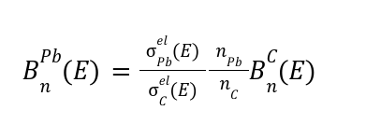
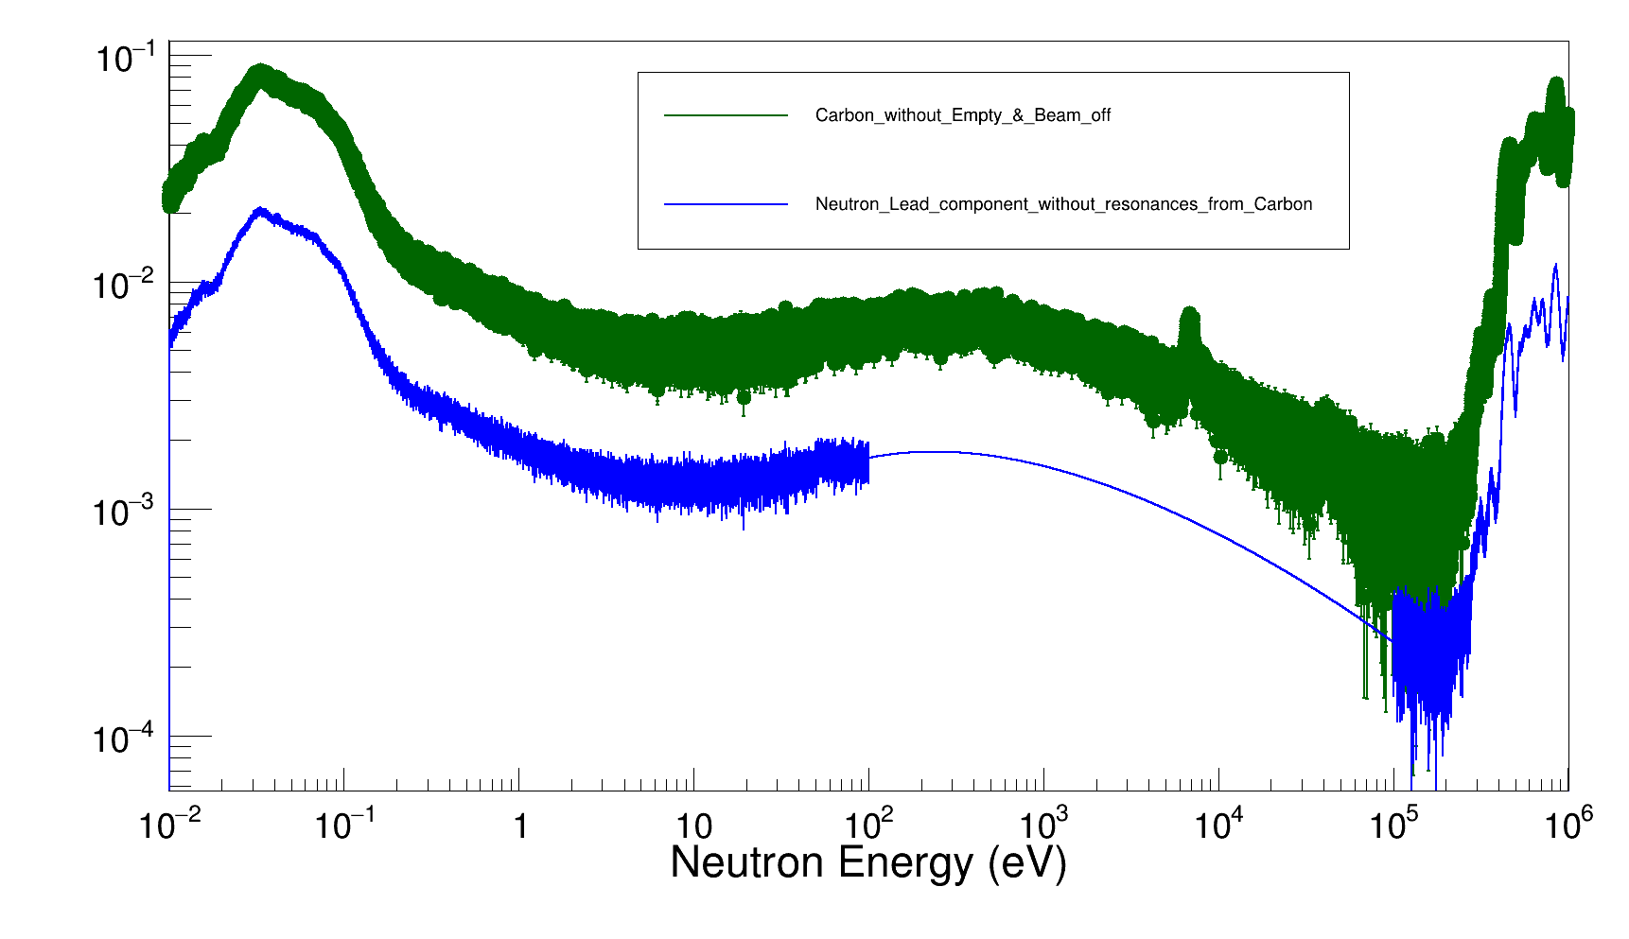
Ongoing analysis: Background
STEP 1
Janis
Sample
Remove Neutron Lead component resonance peaks in the range En [100-10⁵] eV using a fit function (Thanks Bernardo)
n_TOF Collaboration meeting, November 27-29, 2024

Slide 16

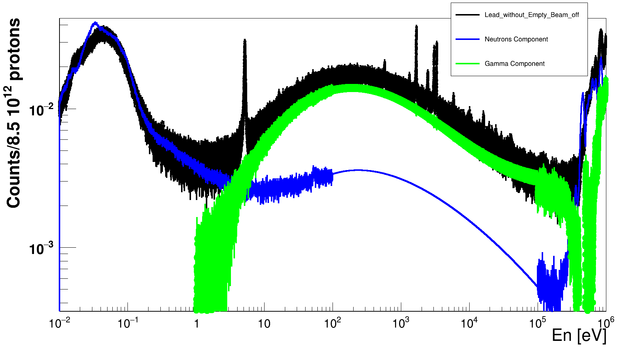
Ongoing analysis: Background
STEP 1
Janis
Sample
Remove Neutron Lead component resonance peaks in the range En [100-10⁵] eV using a fit function (Thanks Bernardo)
STEP 2
Remove Lead resonance peaks in the range En [1-10⁵] eV using a fit function
Neutron Lead Component scaled to Lead spectra below ~1 eV.
Gamma Lead Component set force to 0 below 1 eV.
n_TOF Collaboration meeting, November 27-29, 2024

Slide 17
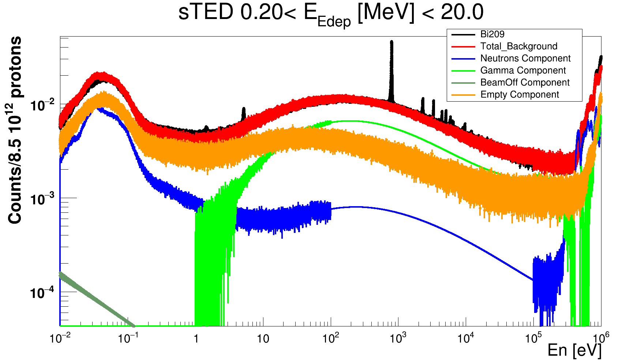
Ongoing analysis: Background
Neutron scattering and in-beam gamma component scaled to reproduce the total background in ²⁰⁹Bi thin sample:
The total background is represented by the red line.
Bi209 Thin Target
n_TOF Collaboration meeting, November 27-29, 2024

Slide 18
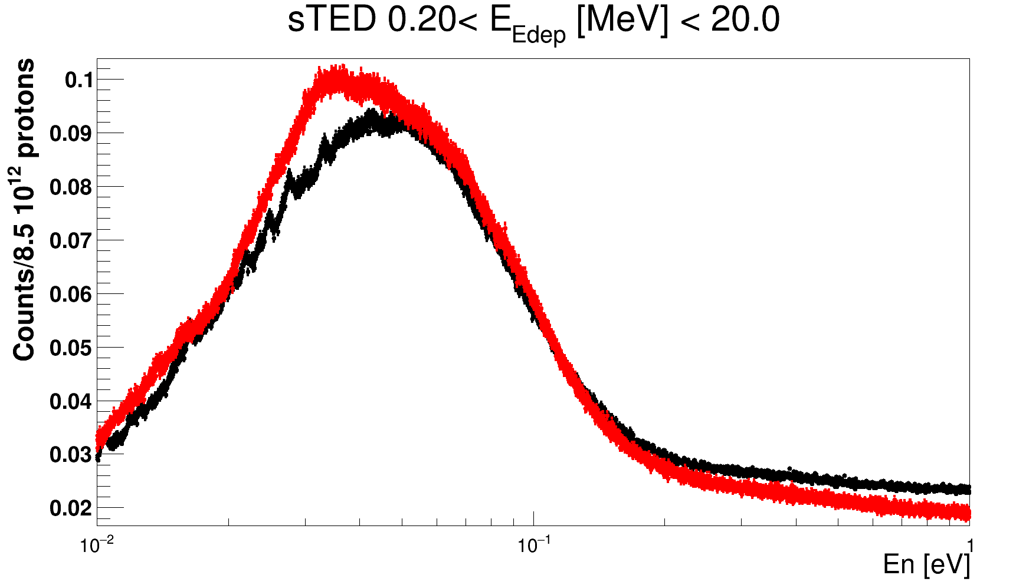
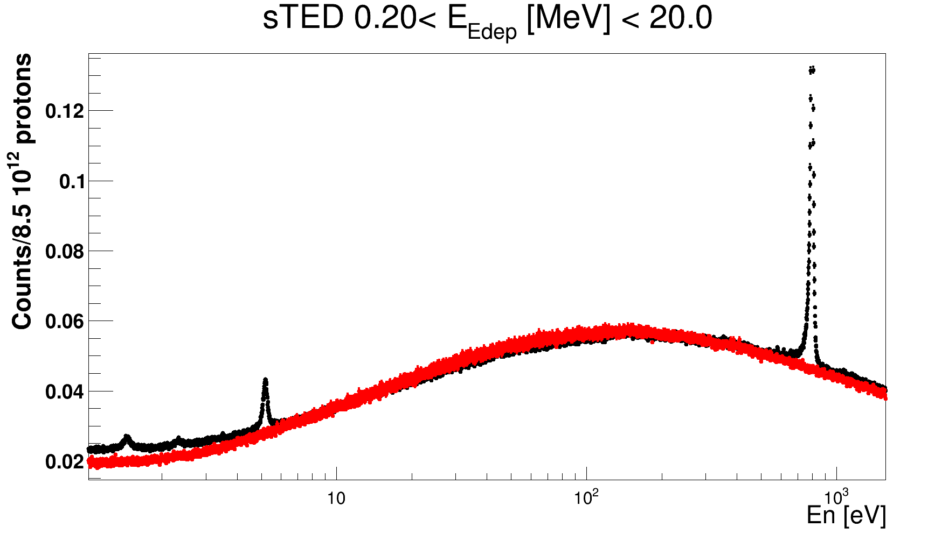
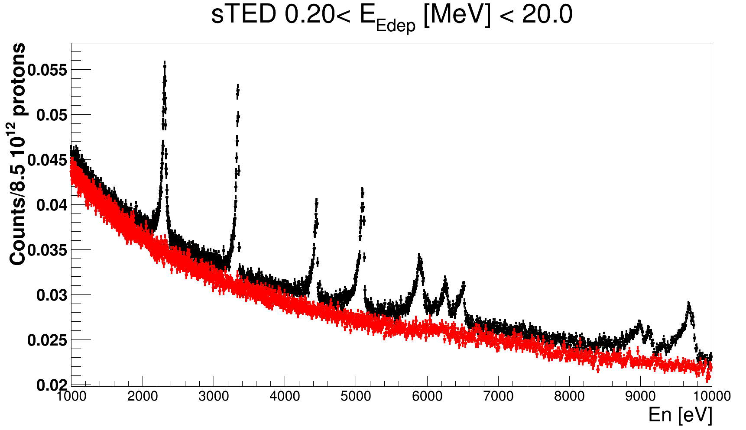
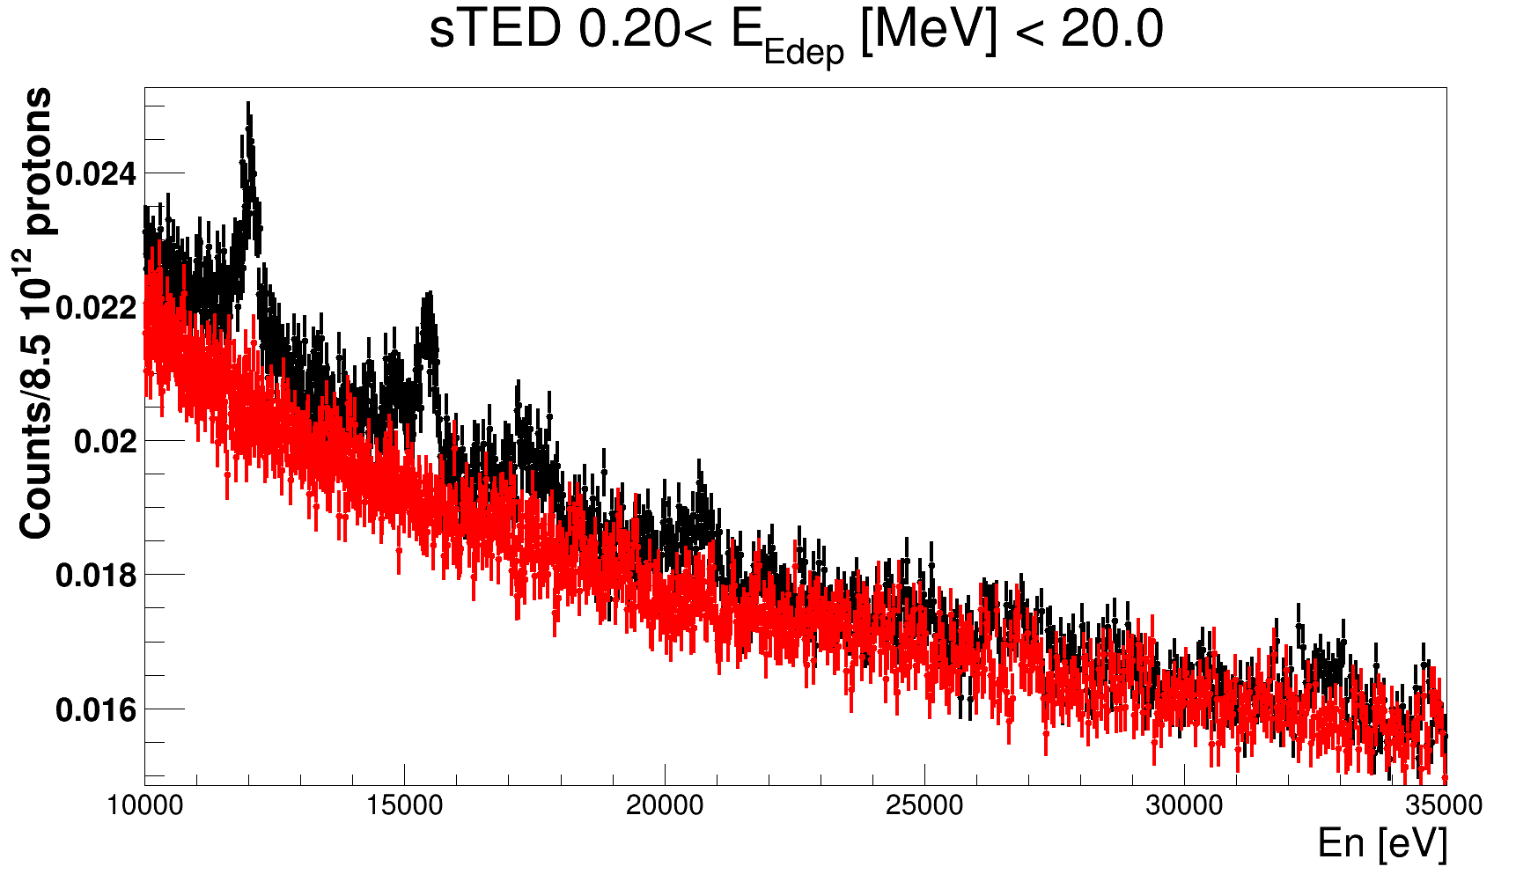
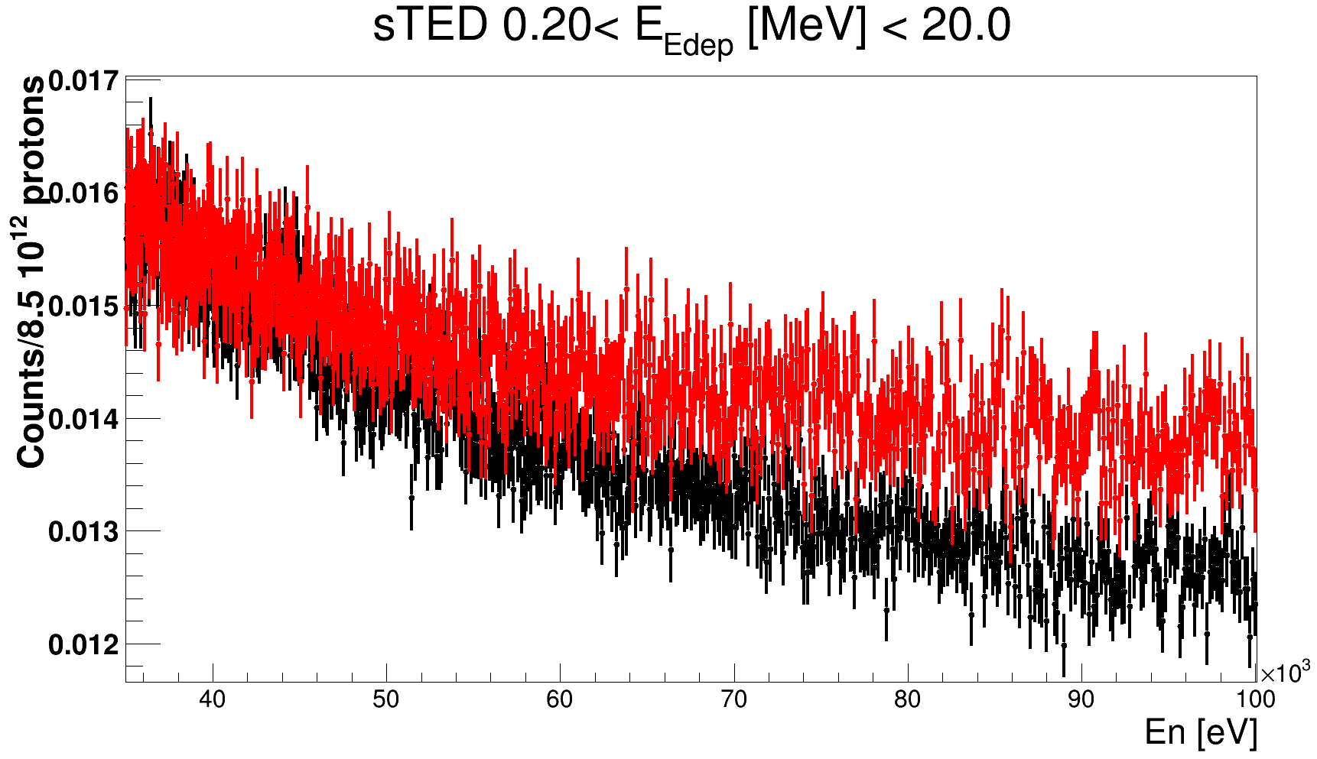
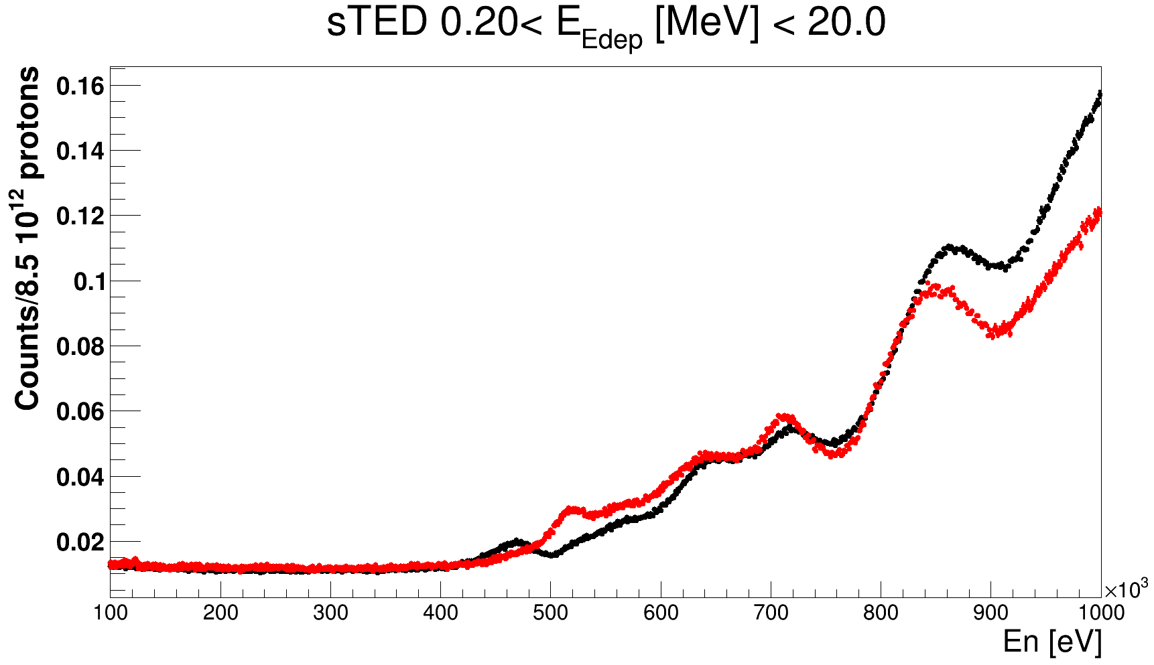
Ongoing analysis: Background
Bi209 Thin Target
n_TOF Collaboration meeting, November 27-29, 2024

Slide 19
Ongoing analysis: Background
Conclusions:
Background estimations work relatively good for the neutron energy range between 1 eV and 35 keV, region of interest for RRR.
Improve background estimation calculations will require more work:
Possible solution: MC simulations as P. Žugec
Bi209 Thin Target
n_TOF Collaboration meeting, November 27-29, 2024

Slide 20
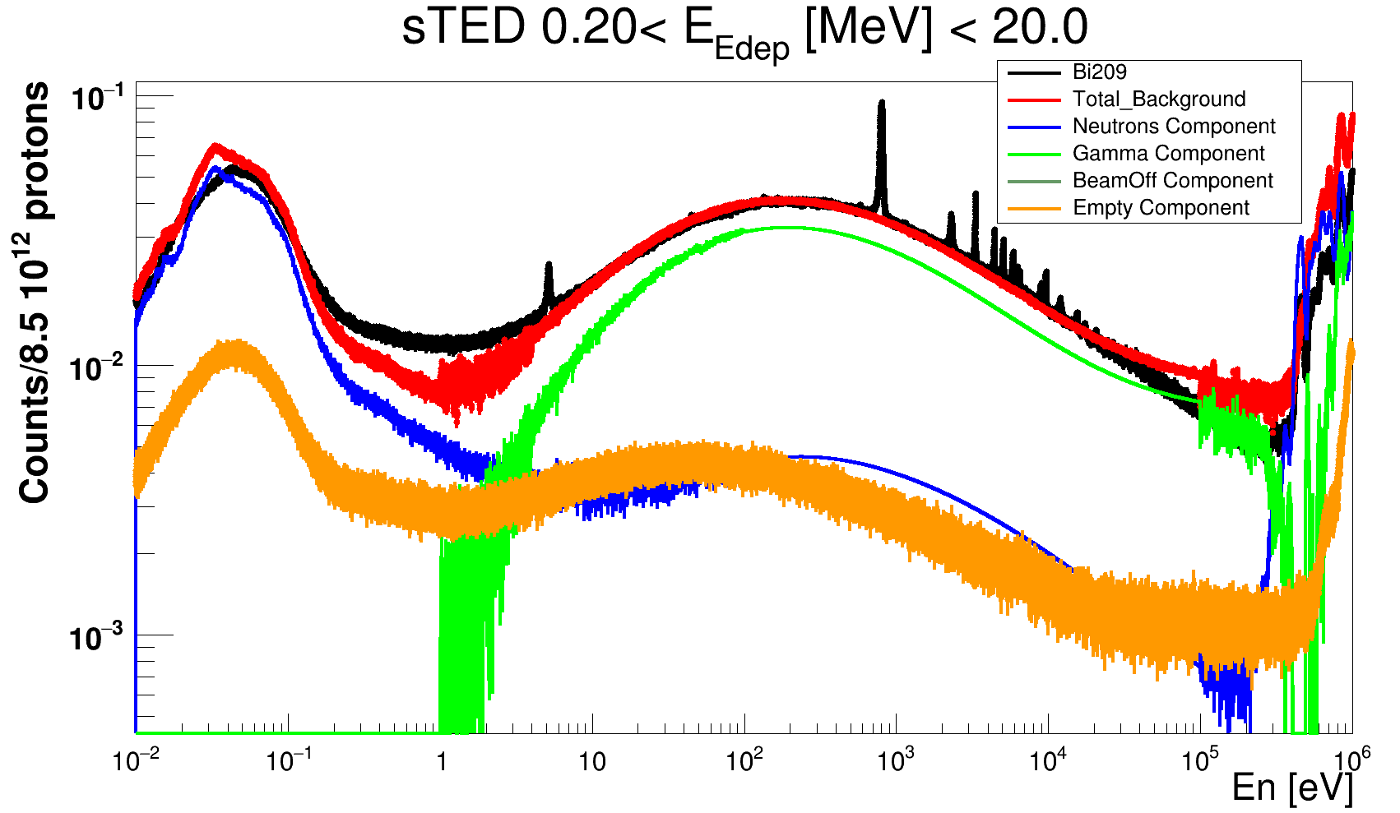
Ongoing analysis: Background
Neutron scattering and in-beam gamma component scaled to reproduce the total background in ²⁰⁹Bi thick sample:
The total background is represented by the red line.
Bi209 Thick Target
n_TOF Collaboration meeting, November 27-29, 2024

Slide 21
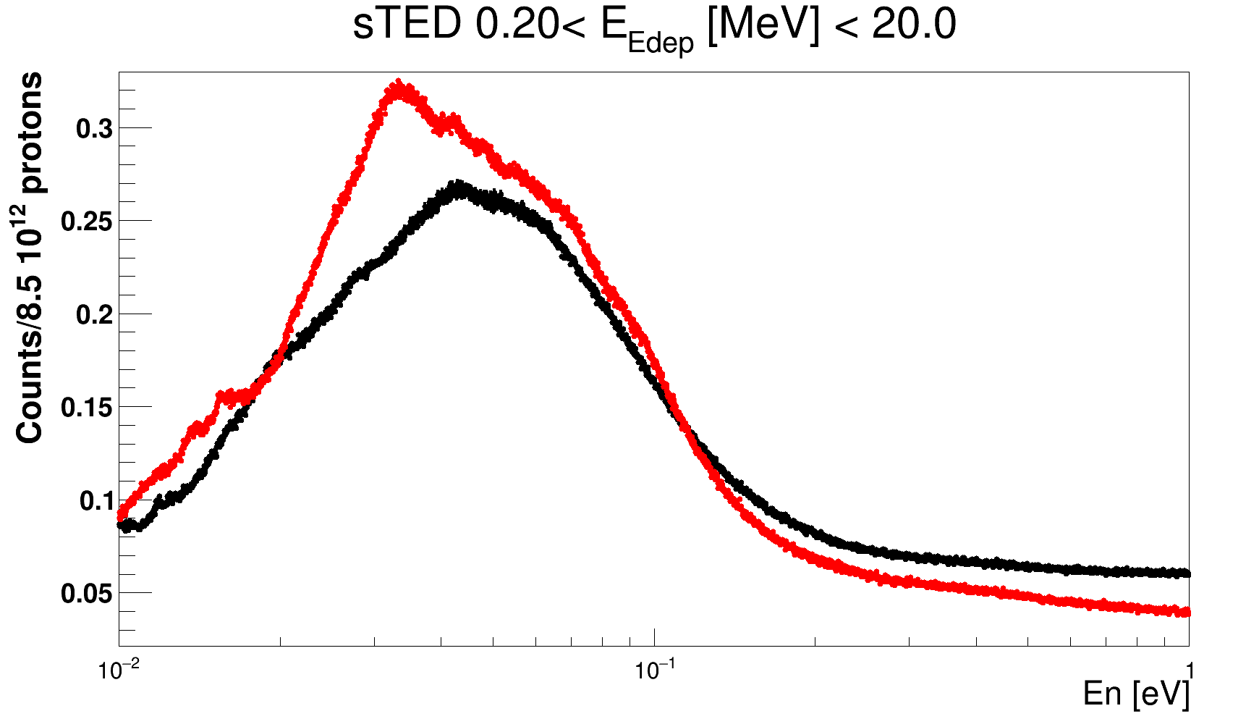
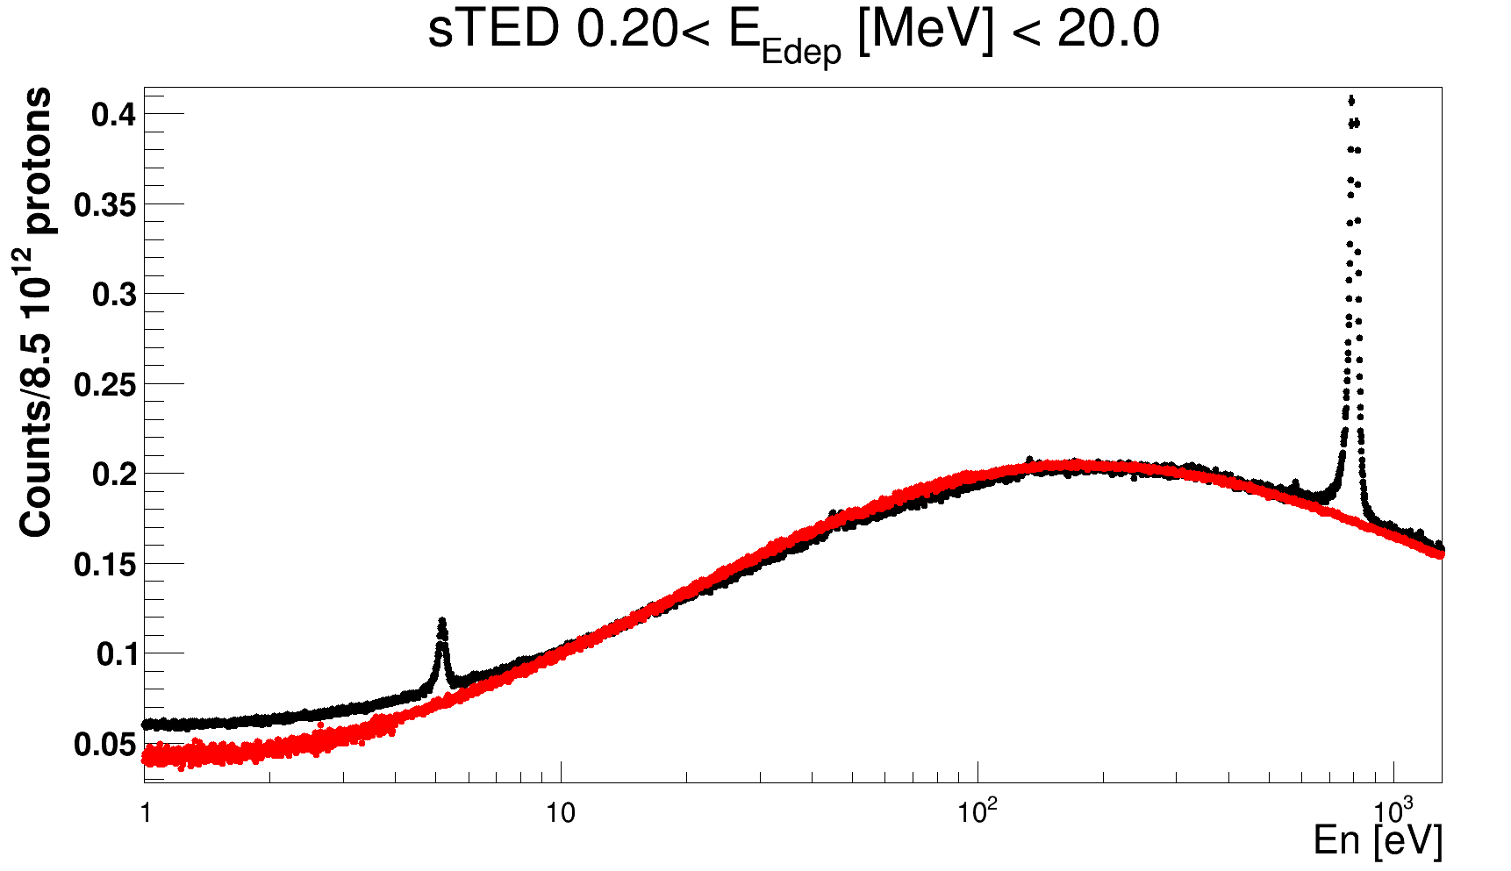
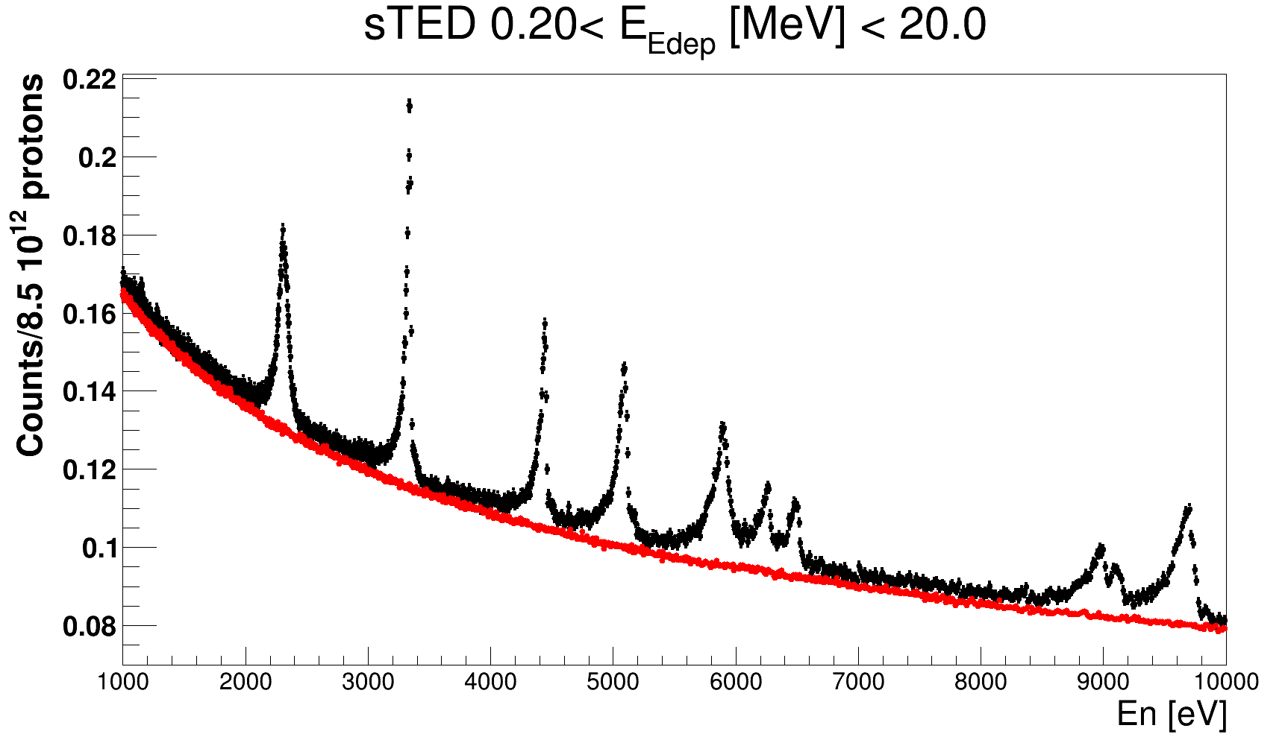
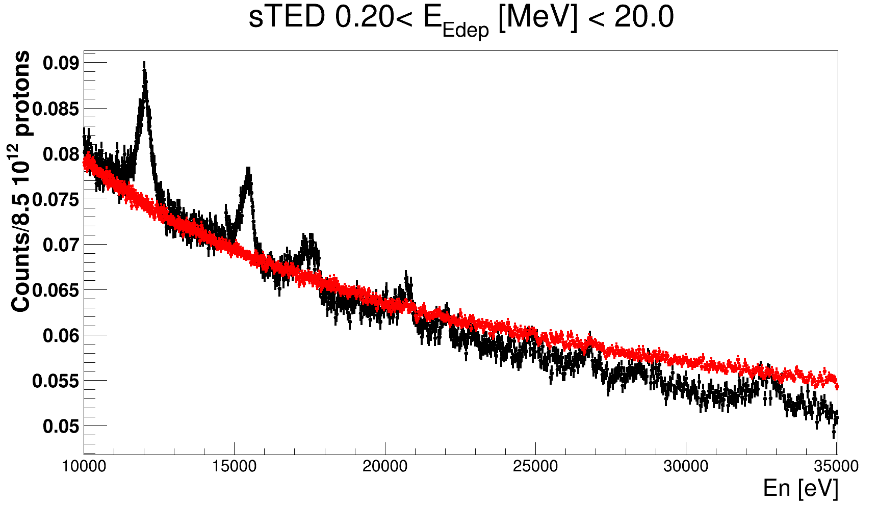
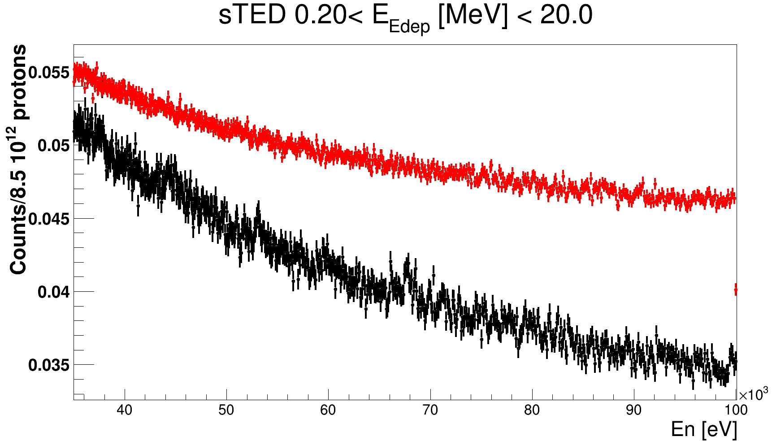
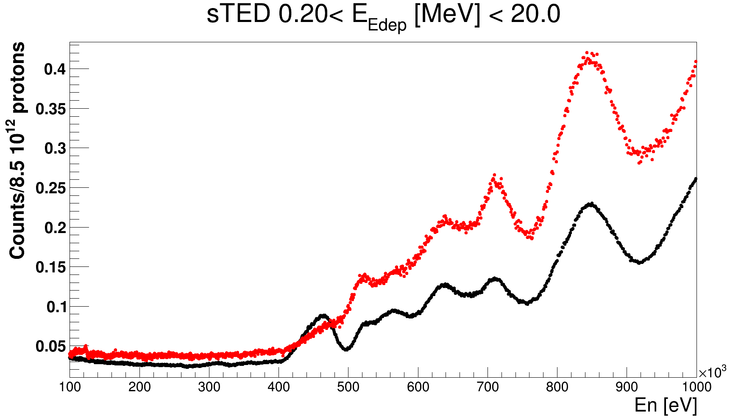
Ongoing analysis: Background
Bi209 Thick Target
n_TOF Collaboration meeting, November 27-29, 2024

Slide 22
Ongoing analysis: Background
Conclusions:
Background estimations work relatively good in the region between En[1 eV, 10 keV].
Limitations might be due different thicknesses used for background estimation and the actual target.
Still needed more work on other neutron energies range:
Possible solution: MC simulations as P. Žugec
Bi209 Thick Target
n_TOF Collaboration meeting, November 27-29, 2024

Slide 23
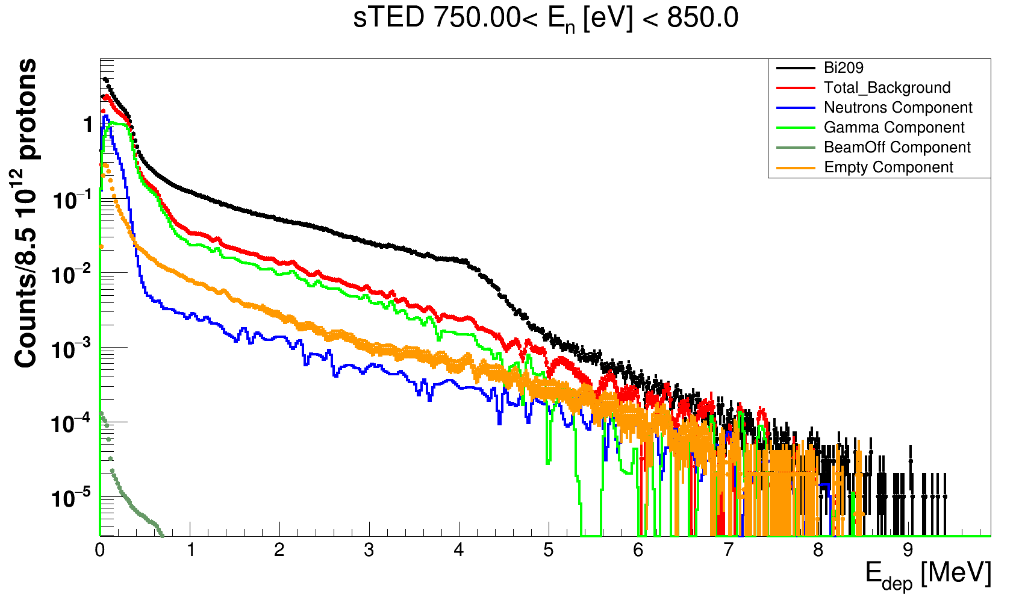
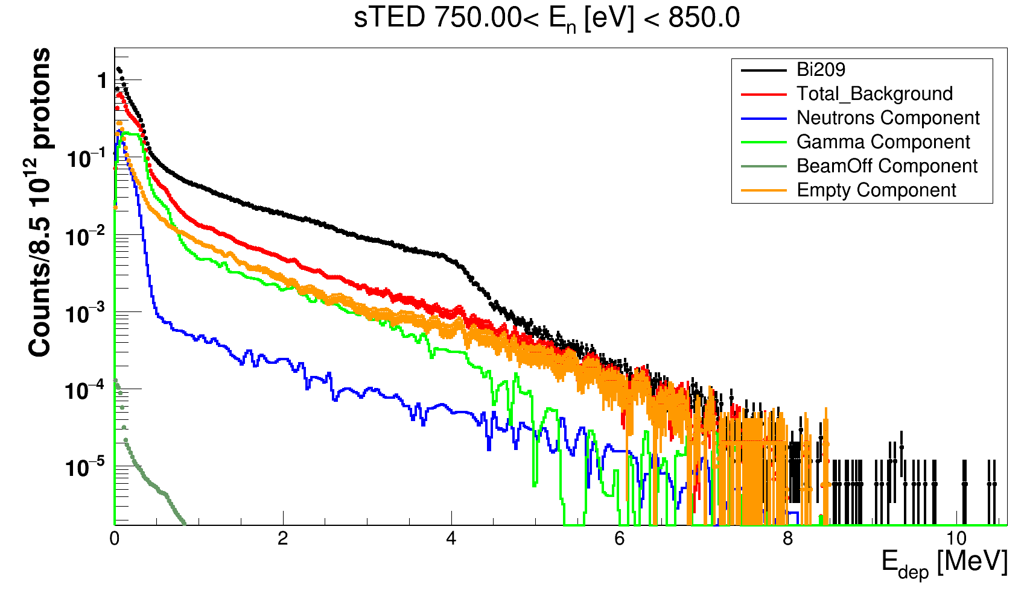
Ongoing analysis: Background
Bi209 Thick Target
Bi209 Thin Target
Deposited Energy Spectrum at the First Resonance of Bi209.
Background Components
n_TOF Collaboration meeting, November 27-29, 2024

Slide 24
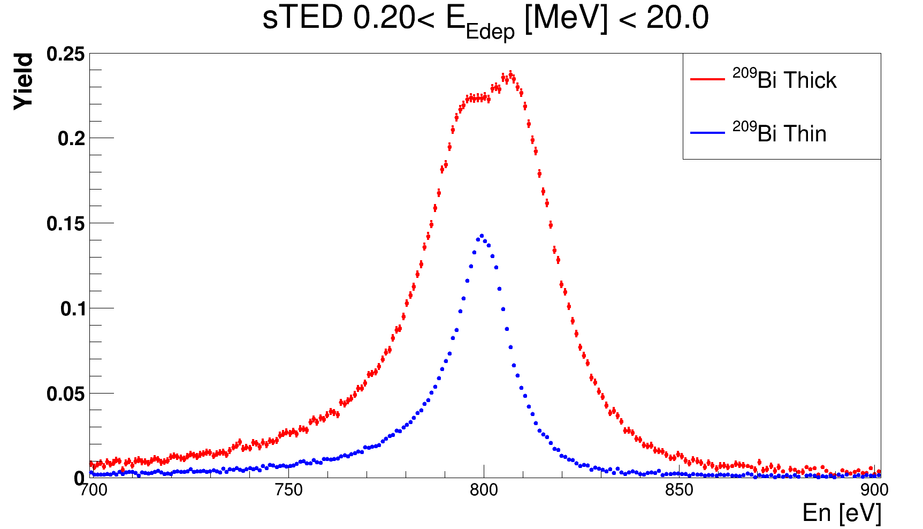
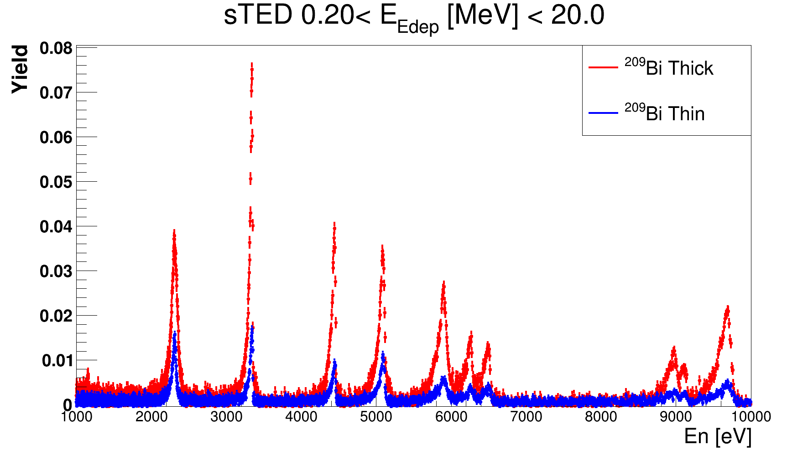
Preliminary (n,ɣ) reaction yield
MS effects!
After a preliminary background subtraction up to 10 keV:
Different neutron resonance shape between thin and thick target data
  We can account for MS and other systematics thanks to both datasets!
Expected useful thin and thick datasets up to E_{n}~30 keV
For E_{n}>30 keV, only the thick target will be of use.
n_TOF Collaboration meeting, November 27-29, 2024

Slide 25
Outline
Motivation
Brief summary of prev. analysis status reported
²⁰⁹Bi(n,ɣ) cross section measurement @ EAR2:
  Background estimation
  Preliminary ²⁰⁹Bi(n,ɣ) reaction yield (up to 10 keV)
Summary and conclusions
n_TOF Collaboration meeting, November 27-29, 2024

Slide 26
Summary and conclusions
²⁰⁹Bi(n,ɣ) is an important cross section:
  Critical to assess the radiological burden associated to ²¹⁰Po for GenIV and ADS systems cooled by Bi/Pb mixtures.
  Understanding the chemical evolution of the Universe via s-process and for U/Th cosmic clocks.
The campaign took place in April 2024 at the high luminosity n_TOF EAR2:
  Experimental setup design to enhance sensitivity:
    sTED array (Large sensitivity)+ 2 C6D6 (Systematics)
    Two ²⁰⁹Bi targets with different thicknesses 6/1mm (Multiple Scattering corrections)
    Full set of Background estimation: (Carbon, Lead and Empty)
  Normalization: ¹⁹⁷Au, Ir, In (High precision normalization).
  Preliminar background subtraction for different targets is ongoing.
  Preliminar capture Yield is ongoing in the RRR.
n_TOF Collaboration meeting, November 27-29, 2024

Slide 27



Summary and conclusions
Next steps:
  Improve background estimation for both Bi209 targets.
  Monte Carlo Simulations of the Experimental Setup 2024. Using previous Geant4 2022 geometry available.
Analysis just started!
“Work in progress”
TFlash per run
ΔTFlash per run
TFlash
Possibles differences using one or another in the spectrum???
n_TOF Collaboration meeting, November 27-29, 2024

Slide 28

Thanks for your attention

Slide 29
Backup
n_TOF Collaboration meeting, November 27-29, 2024

Slide 30


s-process & Th/U cosmic clocks
Figure adapted from U. Ratzel et al Phys. Rev. C 70 065803 (2004)
From the astrophysical point of view, ²⁰⁹Bi(n,ɣ) is important for understanding the chemical evolution of the Universe via s-process and for U/Th cosmic clocks:
²⁰⁹Bi is the last stable s-process nucleus before the ⍺-unstable region feeding to the region above ²⁰⁶Pb recycling heavy material.
²⁰⁹Bi(n,ɣ) also contribute to ²⁰⁷Tl branching point towards production of ²⁰⁷Pb.
Th/U ratios, used as cosmic clocks for stars, needs accurate data on ²⁰⁹Bi(n,ɣ) to disentangle radiogenic contributions from Th and U ⍺-chain decays.
211
207
n_TOF Collaboration meeting, November 27-29, 2024

Slide 31





Gen-IV & ADS nuclear systems
Figure adapted from https://www.psi.ch/en/fast
Gen IV
Gen III+
Gen III
Gen II
Gen I
1950 1960 1970 1980 1990 2000 2010 2020 2030
Early prototypes
Commercial power reactors
Advanced LWRs
Evolutionary designs
Revolutionary designs
New generation of advanced nuclear power plants (GenIV) and ADS is under design and development aiming to:
Excel safety and reliability during operation.
Sustainability energy generation and minimization of nuclear waste in long-term.
Comply with Non proliferation agreements.
Development on nuclear technology requires improvement on nuclear data accuracy:
Delayed neutron emission probabilities.
Neutron induced cross sections.
n_TOF Collaboration meeting, November 27-29, 2024

Slide 32
MYRRHA and ²¹⁰Po production
Figure adapted from https://www.sckcen.be/en/expertises-0
MYRRHA is a multipurpose Accelerator Driven System (ADS) nuclear reactor able to operate in subcritical and critical mode. It is made of:
600 MeV Proton accelerator.
Spallation target.
A core with MOX fuel cooled by liquid lead-bismuth (Pb-Bi).
Radiological Burden associated with the use of Pb-Bi coolant is because of ²⁰⁹Bi(n,ɣ) populating ²¹⁰Bi and ^{210m}Bi:
²¹⁰Po (t_{1/2}~5 days)/²⁰⁶Tl (t_{1/2}~3My)
Calculations for ²¹⁰Po concentration for MYHRRA in one irradiation ranges from 5 to 20% depending on the evaluation.
n_TOF Collaboration meeting, November 27-29, 2024

Slide 33


²⁰⁹Bi(n,ɣ) XS and challenges
Figure adapted from L. Fiorito et al. EPJ Nuclear Sci. Technol. (2018) 4, 48
Relative ²⁰⁹Bi(n,ɣ) uncertainty for different evaluated libraries are in between 20% and 40% for neutron resonances.
Measurement of ²⁰⁹Bi(n,ɣ) cross section is very challenging because of:
Small (n,ɣ) cross section.
Large (n,el)/(n,ɣ).
Need for new accurate ²⁰⁹Bi(n,ɣ) and ^{209m}Bi(n,ɣ)/²⁰⁹Bi(n,ɣ) data as requested in
the High Priority request list.
n_TOF Collaboration meeting, November 27-29, 2024

Slide 34




Goals and Time-of-Flight technique
Goals of the current ²⁰⁹Bi(n,ɣ) cross section measurement at the CERN nTOF-EAR2:
5-10% accuracy in RRR covering neutron energies range from thermal up to 35 keV.
<15% accuracy in the neutron energy range from 35-100 keV.
Time-of-flight technique
Start: p-beam time impact
Stop: (n,ɣ) time detection
Stop
Flightpath L
Stop
Measure arrival time t
Start
n_TOF Collaboration meeting, November 27-29, 2024
Notes:
High luminosity EAR2 and refined spallation source design
In the ToF technique, the time tToF spent by neutrons travelling a distance L from their production site to the sample location is measured with high precision. The energy En of a neutron with mass mn is then calculated by using the non-relativistic kinetic energy equation

