Slide 1
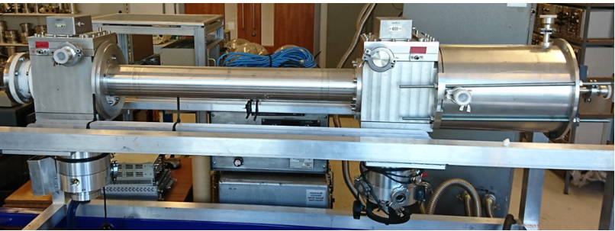






Fission fragment identification
test with 235U at EAR2
N.V. Sosnin^{1,2*}, Z. Eleme³, A. G. Smith², T. Wright², A. Sekhar², A. D’Ottavi², C. Lederer-Woods¹, M. Diakaki⁴, V. Michalopoulou⁴, N. Patronis^{3,5}, M. Bacak^{2,5}
1 - University of Edinburgh, UK
2 - University of Manchester, UK
3 - University of Ioannina, Greece
4 - National Technical University of Athens, Greece
5 - CERN
*nikolay.sosnin@manchester.ac.uk

Slide 2
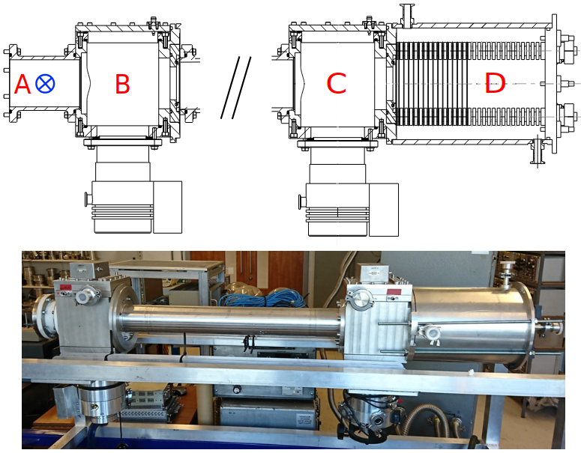
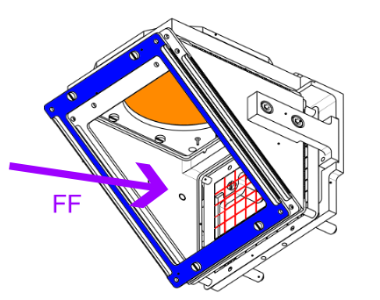
Fission Fragment Identification arm
2 timing detectors with MCPs for FF velocity measurement
Ionization chamber with a Frisch grid and anode for total energy measurement
^{Target}
^{START}
^{STOP}
^{MCP}
^{FF direction}
Bragg detector with anode and Frisch grid
^{Vacuum pumps}
^{Neutrons}
^{Electrostatic mirror}
^{Foil}
Ø8cm

Slide 3
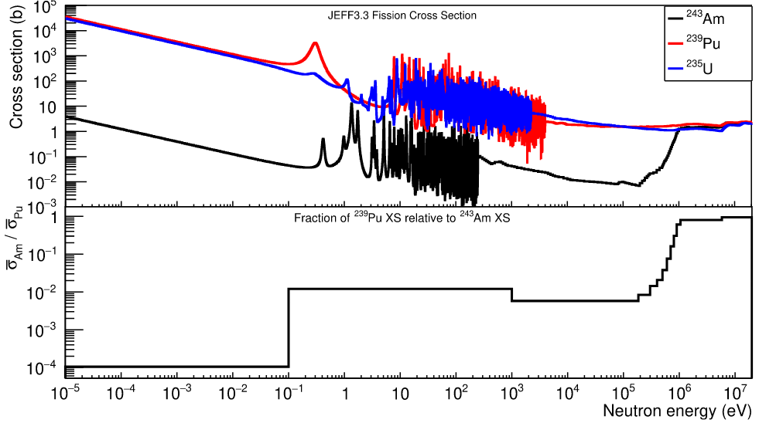
Detector test
Used 235U target at EAR2 with fission collimator
Hoping for 243Am measurement in the future with thick-backing targets
Examine gamma flash and 1-10 MeV region
Calculate thermal mass yield
Establish RP procedure, gas handling, codebase for analysis
Requested 7e17 POT, received 1.3e18 😄

Slide 4
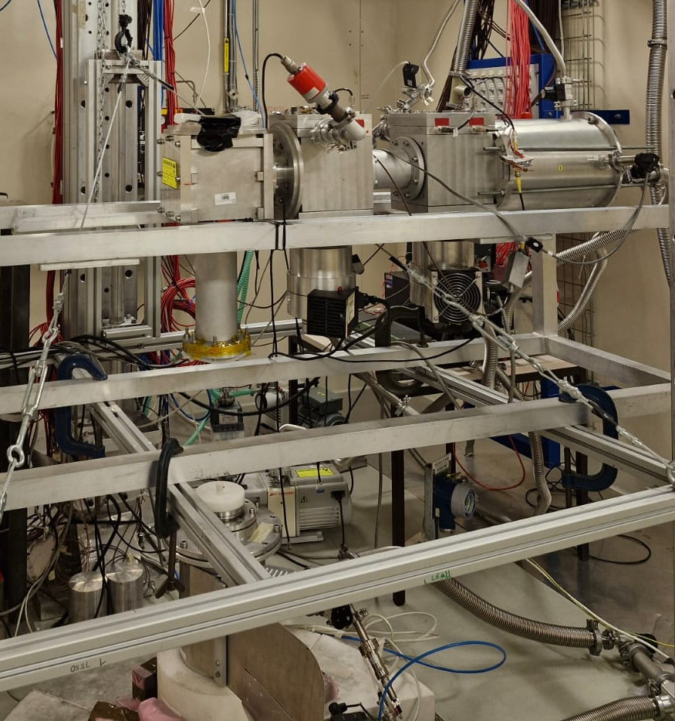
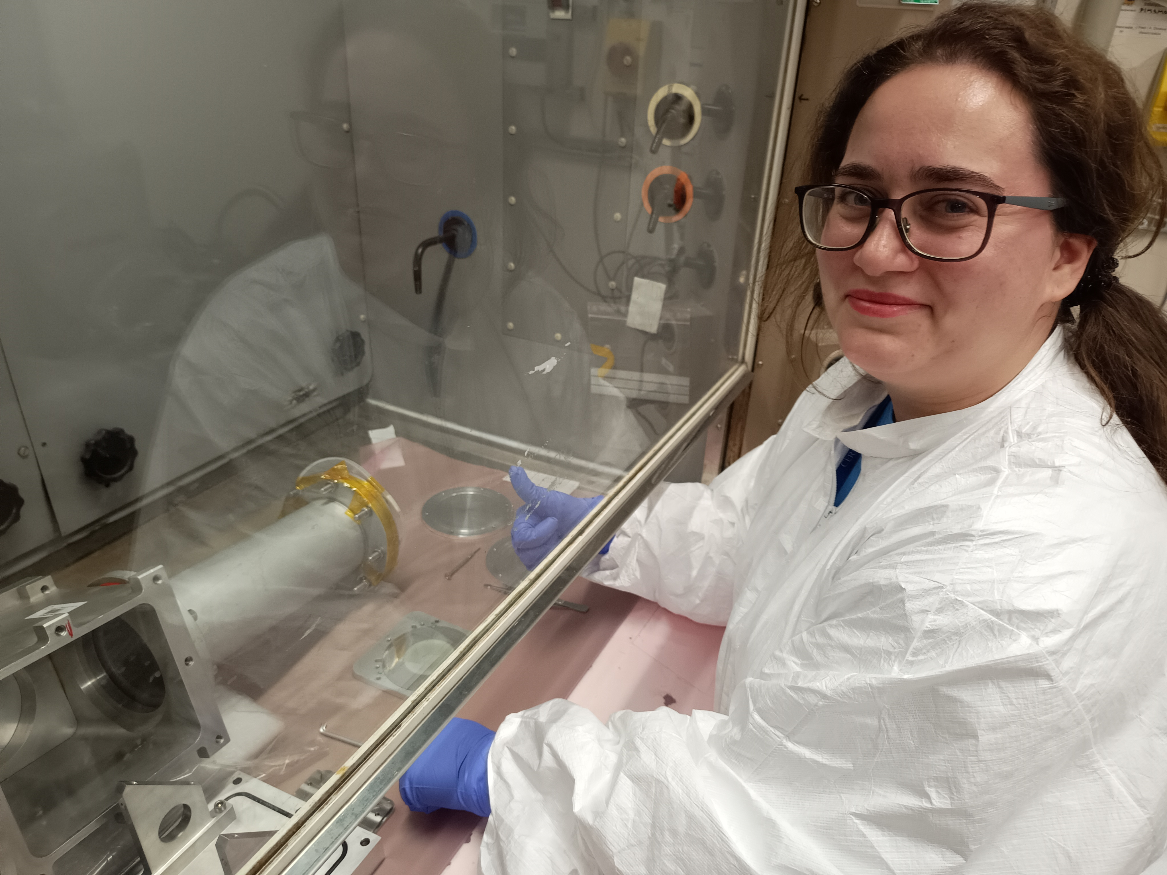
Setting up
1 day to change to fission collimator
4 days of mounting (including 1 day delay in target transport)
9 days data collection
Thanks to Pino for pressure management systems and overall supervision of the whole setup!
Had to get power from a building near gas bottles (would be good to power the sockets there)
No isobutane freezing!
^{235U in ISOLDE (Thanks, Zina!)}

Slide 5
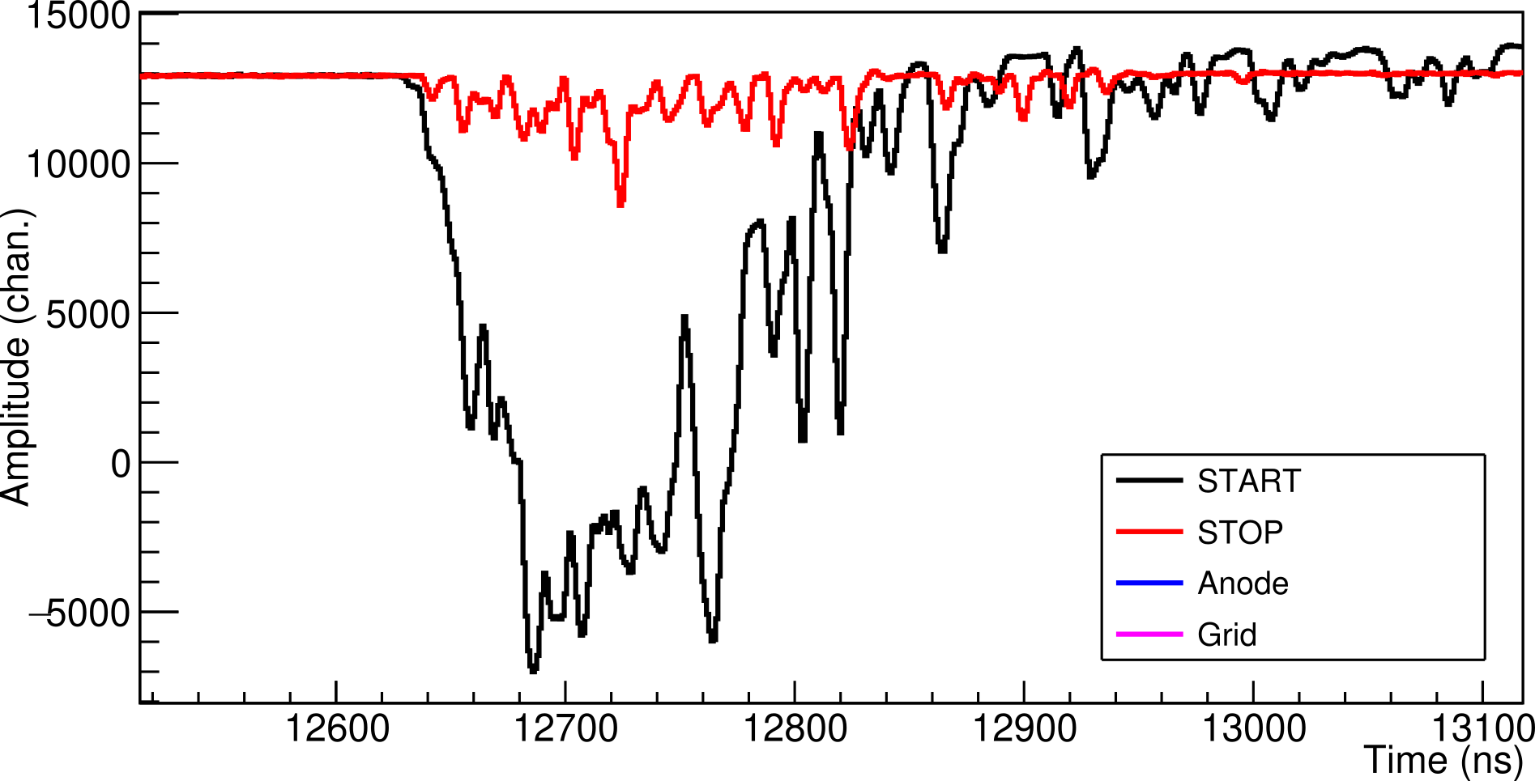
Early results
Long TOF arm: high rates in START, low rates in ionization chamber
Timing signals
START needs to move further away to reduce rate/flash
Fission signals similar size to gflash
^{600 keV}

Slide 6
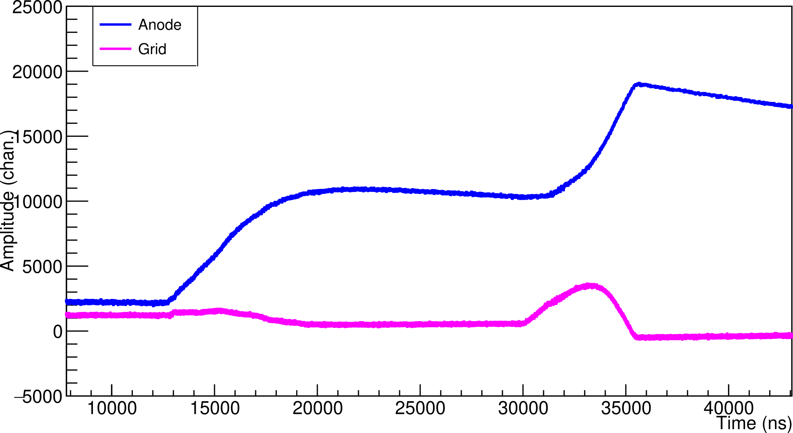
Early results
Long TOF arm: high rates in START, low rates in ionization chamber
Ionization chamber signals
Fission collimator → large gamma flash despite ~60 cm distance from the beam
Very small gflash in grid (can identify fission events, but likely poor energy resolution)
^{Fission}
^{Gamma flash}
^{~1 keV}
}
^{Easy event ID}

Slide 7
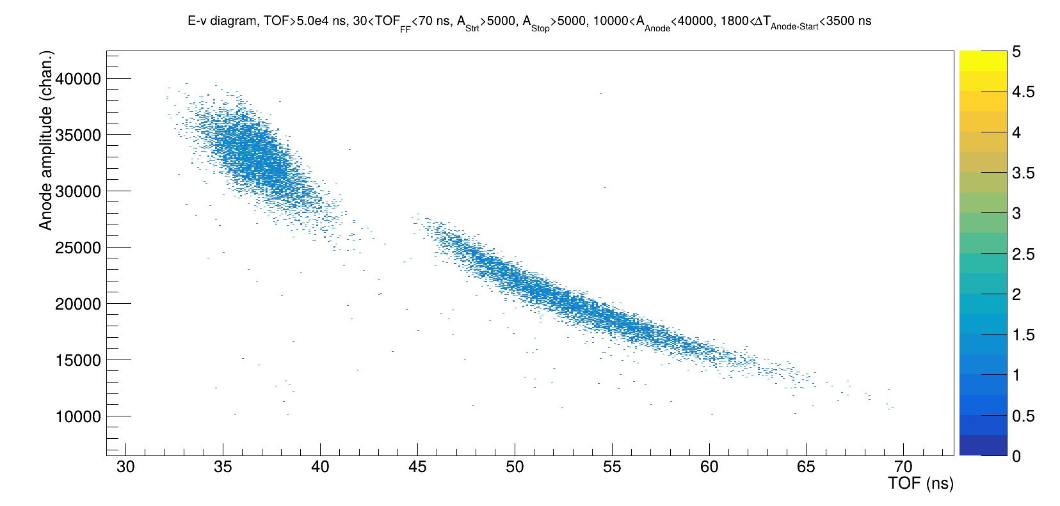
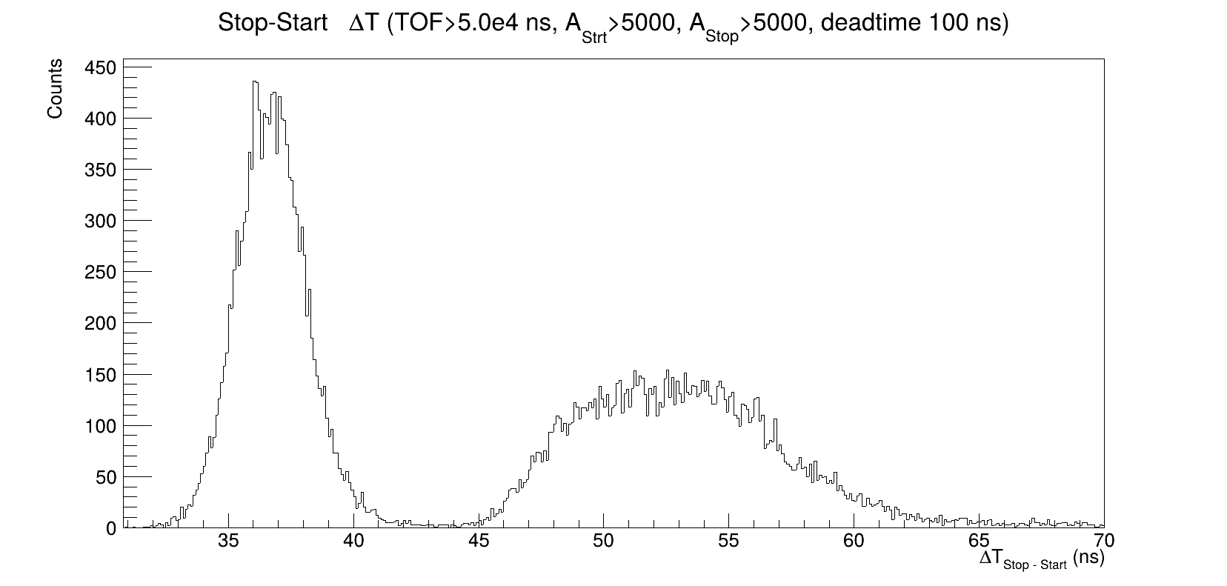
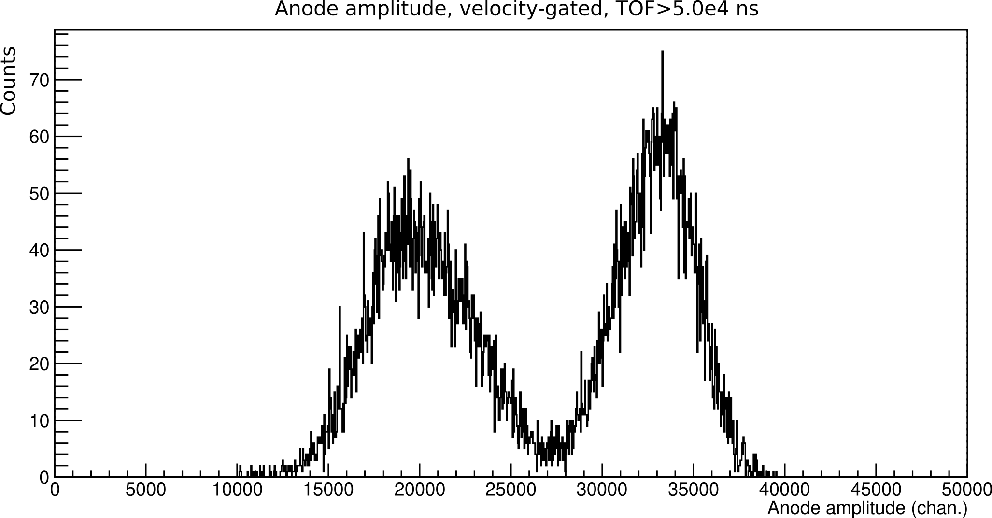
Early results

Slide 8
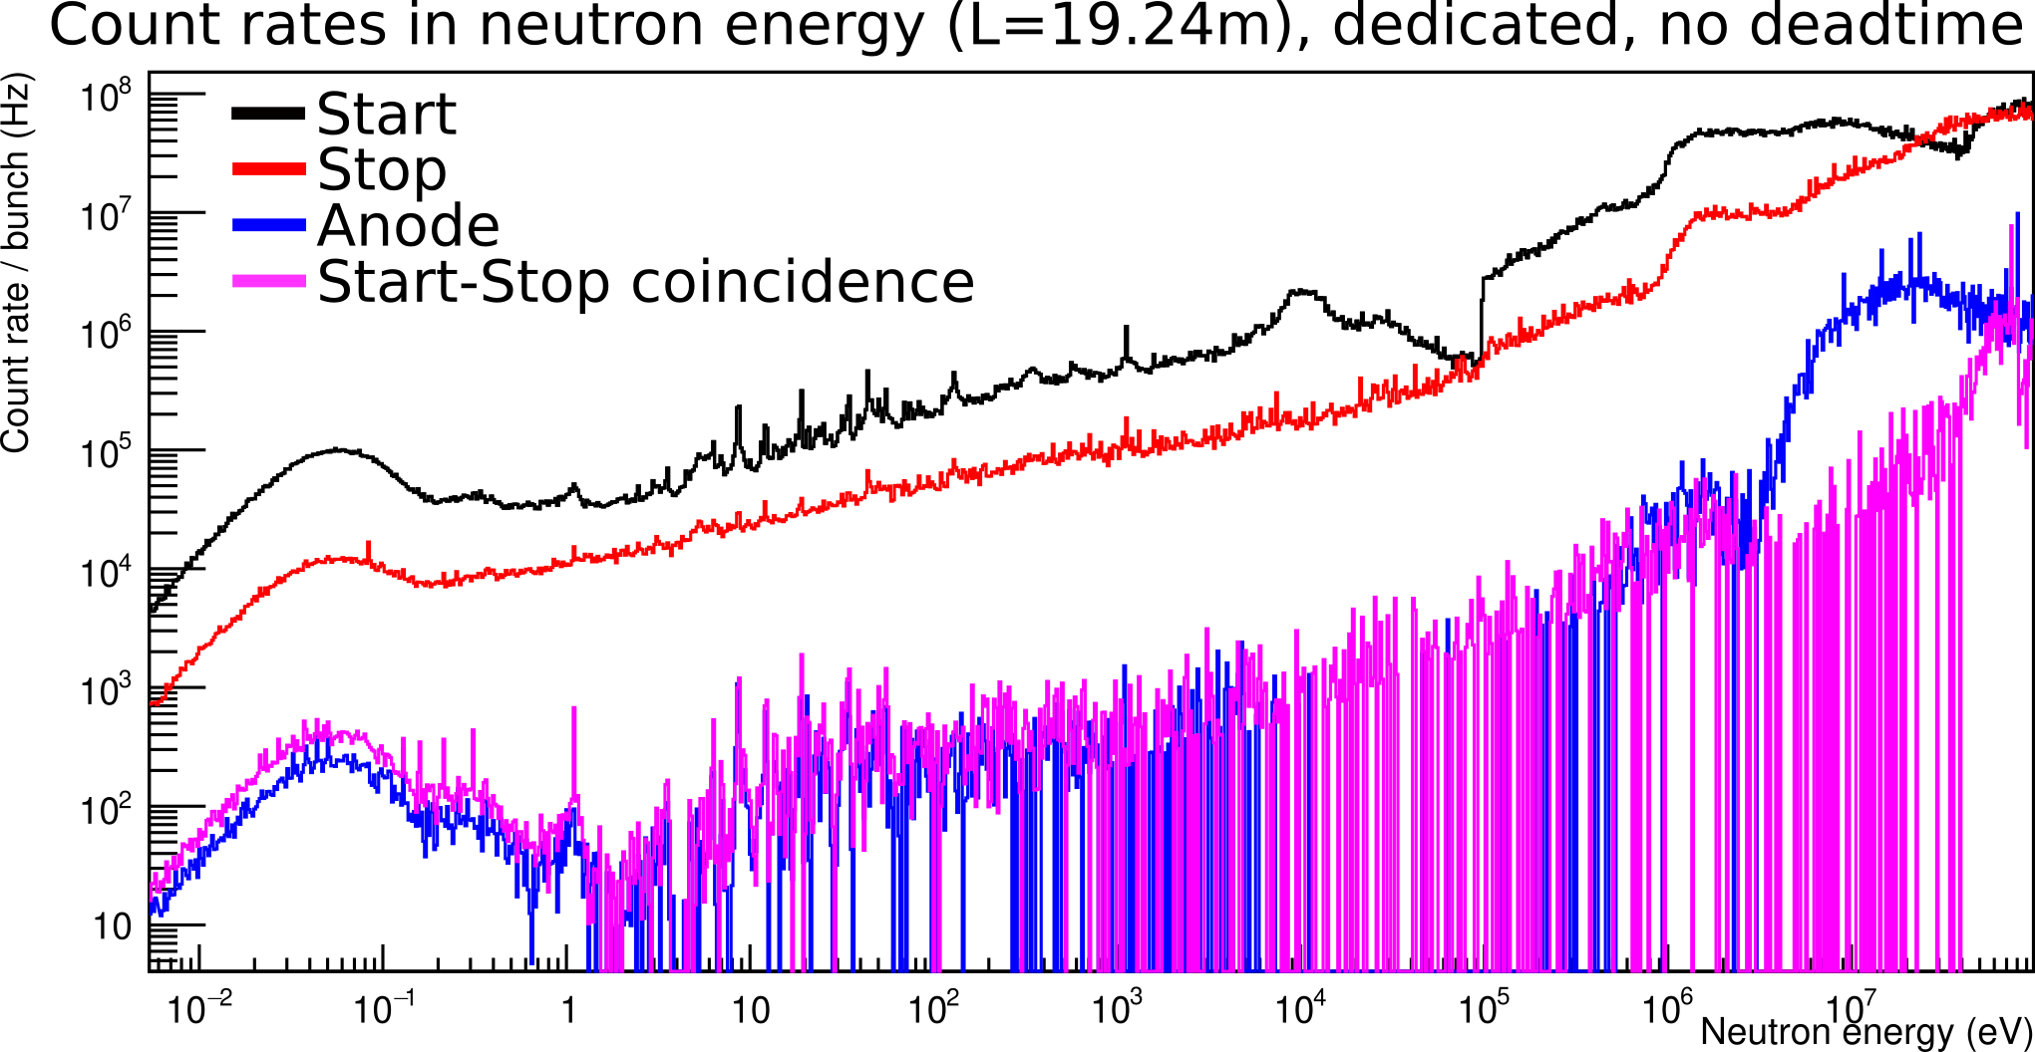
Early results
FF TOF up to 70 ns, need rates around or below 10 MHz
^{PSA?}

Slide 9
How to proceed
Instead of americium, a test with uranium at EAR2 with capture collimator to improve upper energy
Can move Start closer to Stop to reduce rate, TOF resolution can be reduced too
Longer target-Start distance moves ionization chamber away from beam
STEFF sees less gamma flash at 75 cm distance, but also has larger target chamber with less material, which already can be attached to FiFI
Try faster gas like CF4 (bonus: non-flammable!), although reduced energy resolution
Maybe a short test at EAR1 to see flash (more gammas than neutrons in EAR1 flash?), CF4
Check available targets for interest in lower energy data
MiniSTEFF: gamma detectors? Resonance gamma spectra?

