Slide 1





Chemical and Structural Evolution of Rb_{2–2x}K_{2x}Ti₂O₅ Layered Titanates When Exposed to Ambient Air
Narimane Meziani, David Bérardan , Méline Parent, Brigitte Leridon, Gwenaelle Rousse and Paola Giura
Journée UFR de Chimie / UFR de Physique - 2ème édition
15/11/2024

Slide 2
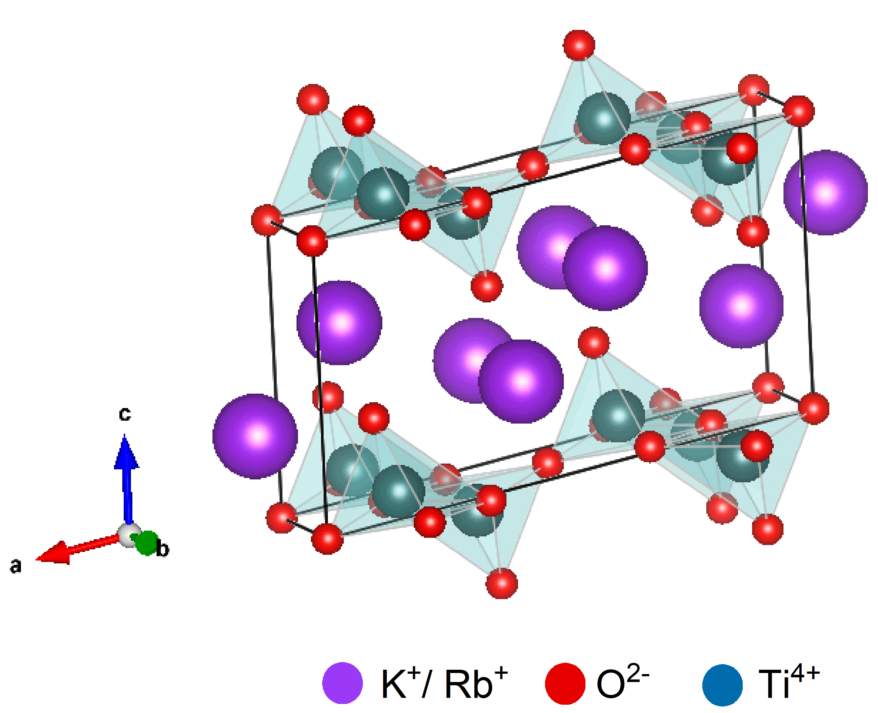
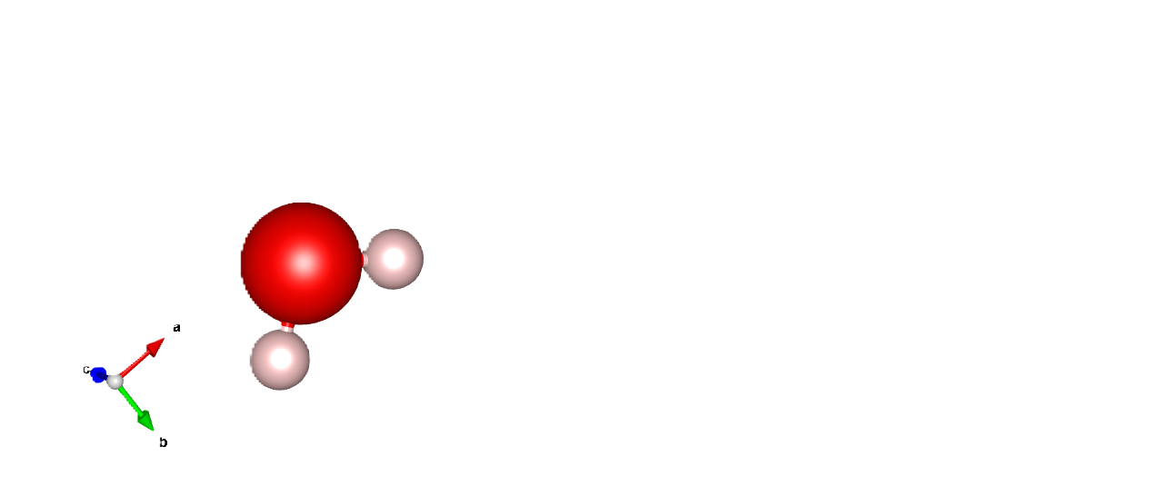
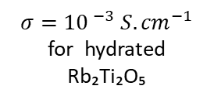

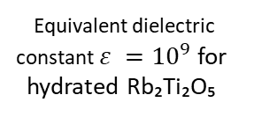
Chemical and Structural Evolution of Layered Rb₂₋₂ₓK₂ₓTi₂O₅ Titanates
Crystal Structure and Properties of M₂Ti₂O₅
General Formula: M₂Ti₂O₅, where M = {alkali element} (e.g., Rb₂Ti₂O₅ or RTO)
Layered Structure
Key Property: Large water absorption capacity
Equivalent dielectric constant $ε ={10}^{9}$ for hydrated Rb₂Ti₂O₅
$σ=$ ${10}^{ −3} S.{cm}^{−1}$ for hydrated Rb₂Ti₂O₅
ɛ_{r}
High capacitance
d
Promising Electrolyte for Supercapacitors
C_{(Farad)}= $ε$ $ε$₀A/d
SDS. Coutinho, D. Berardan, G. Lang , and al. Solid State Ion. 2021; 364:115630

Slide 3


Chemical and Structural Evolution of Layered Rb₂₋₂ₓK₂ₓTi₂O₅ Titanates
How does this material evolve when exposed to ambient air and humidity ?

Slide 4

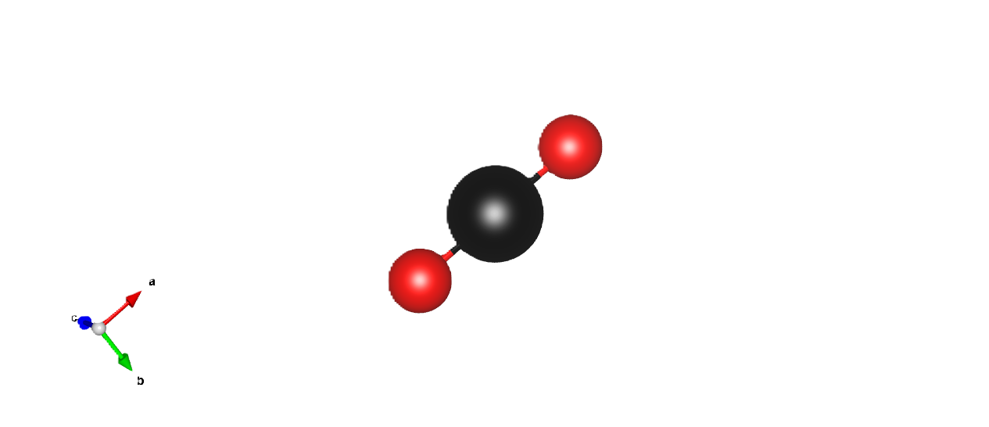
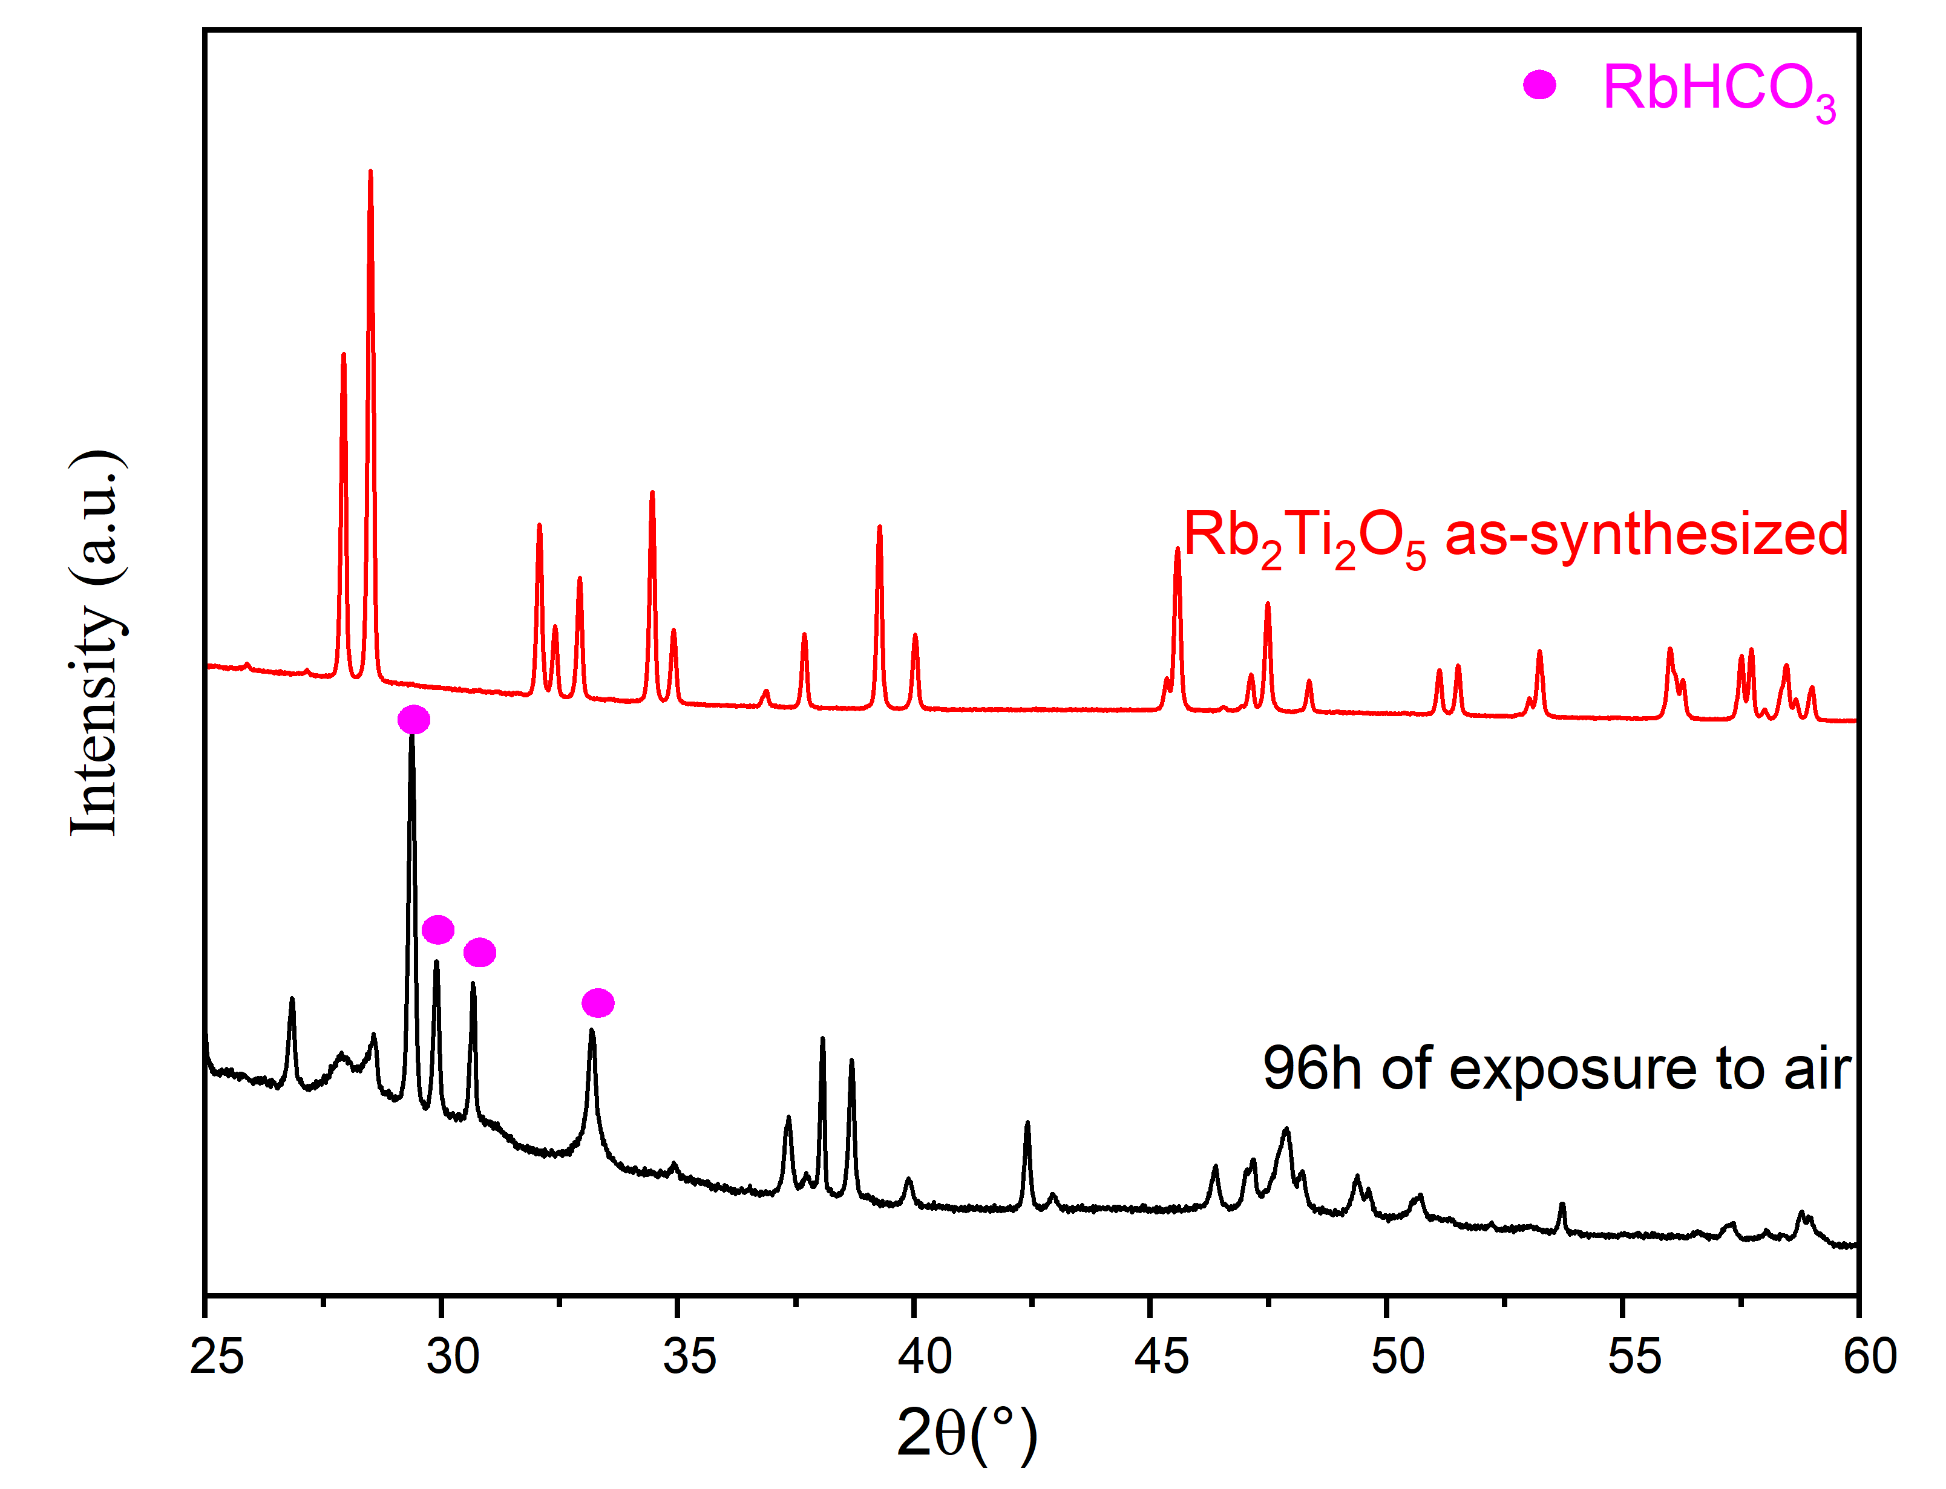
Chemical and Structural Evolution of Layered Rb₂₋₂ₓK₂ₓTi₂O₅ Titanates
Evolution Cycle of Rb₂Ti₂O₅
Hydration in ambiant air
Reaction with CO₂ from air leading to degradation of crystalline compounds, and formation of MHCO₃ (RbHCO₃)

Slide 5
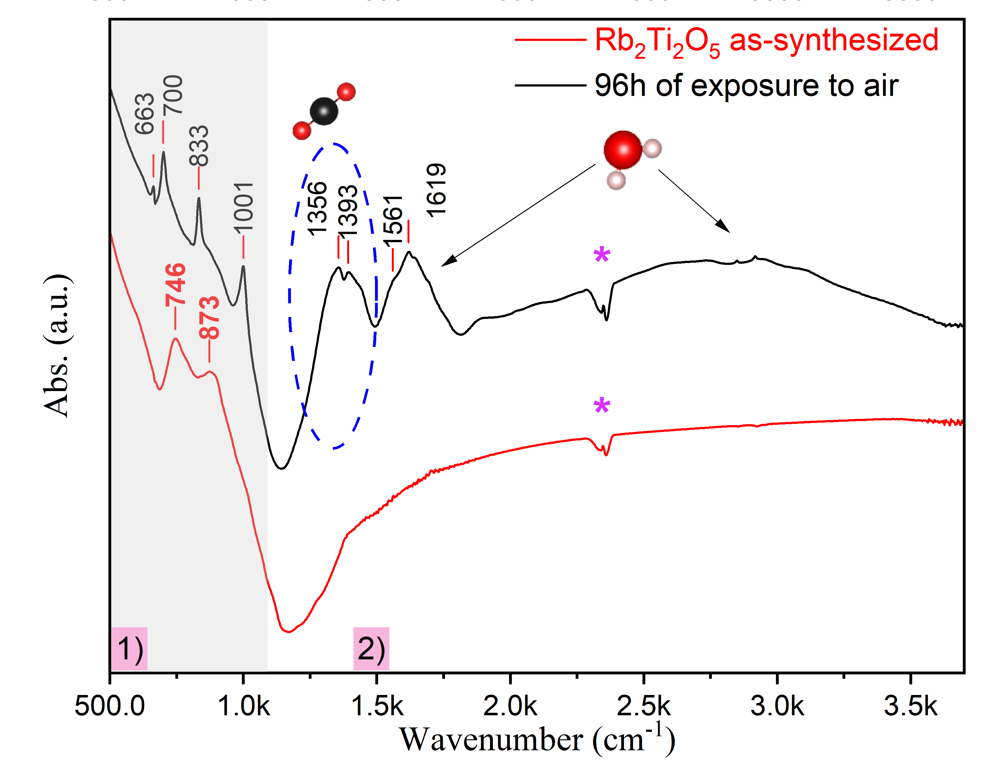

Chemical and Structural Evolution of Layered Rb₂₋₂ₓK₂ₓTi₂O₅ Titanates
Evolution Cycle of Rb₂Ti₂O₅
Hydration in ambiant air
Reaction with CO₂ from air leading to degradation of crystalline compounds, and formation of MHCO₃ (RbHCO₃)
380°C

Slide 6
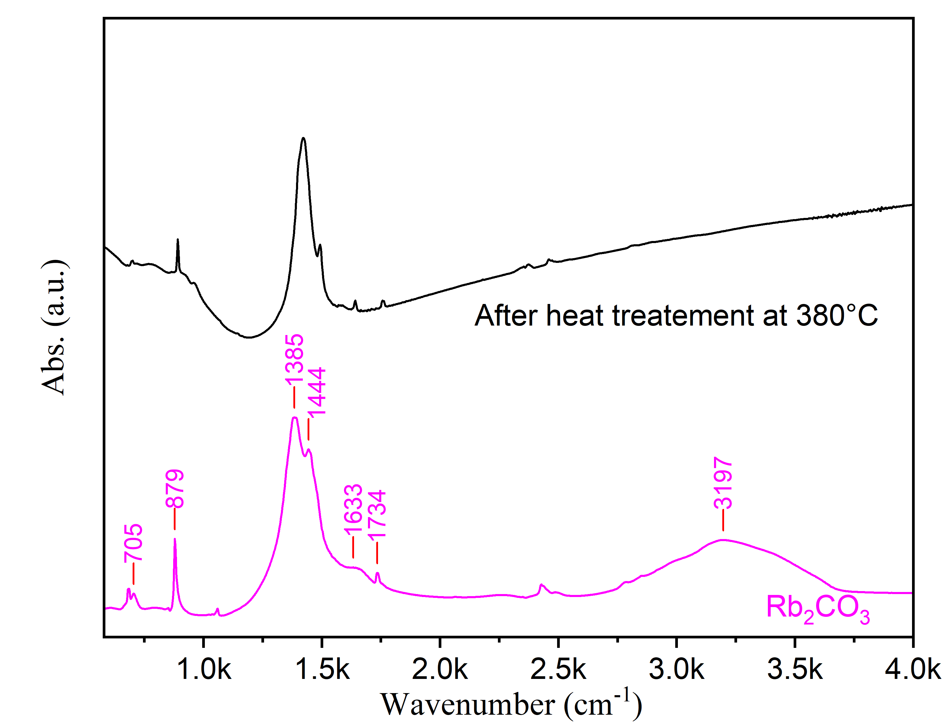
Chemical and Structural Evolution of Layered Rb₂₋₂ₓK₂ₓTi₂O₅ Titanates
Evolution Cycle of Rb₂Ti₂O₅
Hydration in ambiant air
Reaction with CO₂ from air leading to degradation of crystalline compounds, and formation of MHCO₃ (RbHCO₃)
Thermal treatment at 380°C of the compound exposed to air for 96 hours formation of Rb₂CO₃
2RbHCO₃ = Rb₂CO₃ + H₂O + CO₂
380°C

Slide 7

Chemical and Structural Evolution of Layered Rb₂₋₂ₓK₂ₓTi₂O₅ Titanates
Evolution Cycle of Rb₂Ti₂O₅
Hydration in ambiant air
Reaction with CO₂ from air leading to degradation of crystalline compounds, and formation of MHCO₃ (RbHCO₃)
Thermal treatment at 380°C of the compound exposed to air for 96 hours formation of Rb₂CO₃
Thermal treatment at 900°C formation of Rb₂Ti₂O₅ (M₂Ti₂O₅).
1st Reaction
2nd Reaction
380°C
900°C
2RbHCO₃ = Rb₂CO₃ + H₂O + CO₂
Formation of Rb₂Ti₂O₅

Slide 8
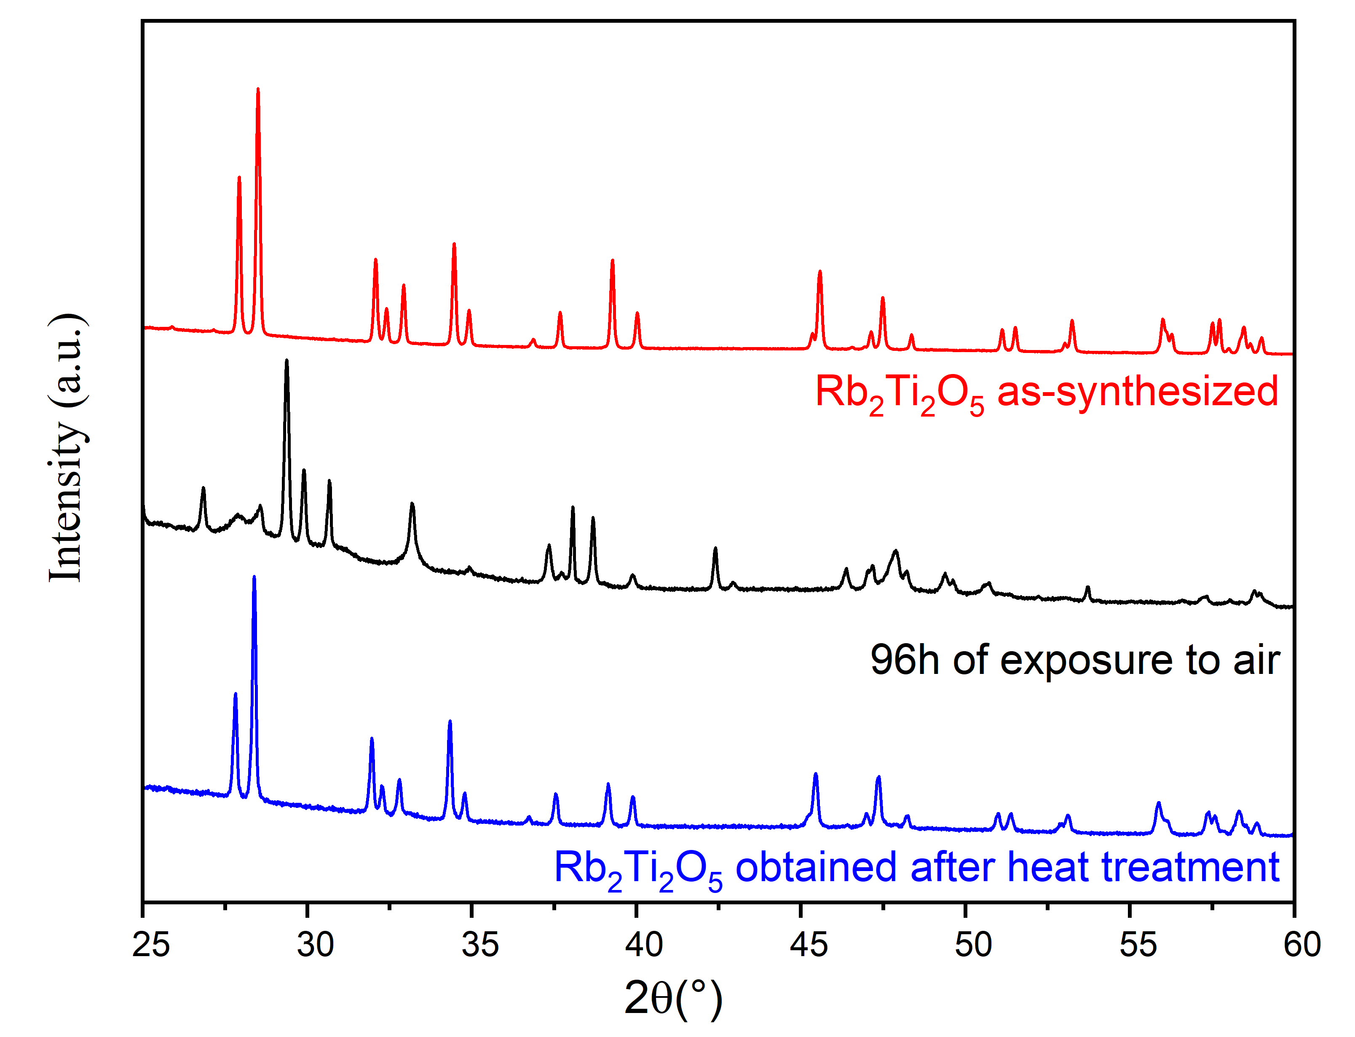
Chemical and Structural Evolution of Layered Rb₂₋₂ₓK₂ₓTi₂O₅ Titanates
Evolution Cycle of Rb₂Ti₂O₅
Hydration in ambiant air
Reaction with CO₂ from air leading to degradation of crystalline compounds, and formation of MHCO₃ (RbHCO₃)
Thermal treatment at 380°C of the compound exposed to air for 96 hours formation of Rb₂CO₃
Thermal treatment at 900°C formation of Rb₂Ti₂O₅ (M₂Ti₂O₅).
1st Reaction
2nd Reaction
380°C
900°C
2RbHCO₃ = Rb₂CO₃ + H₂O + CO₂
Formation of Rb₂Ti₂O₅

Slide 9
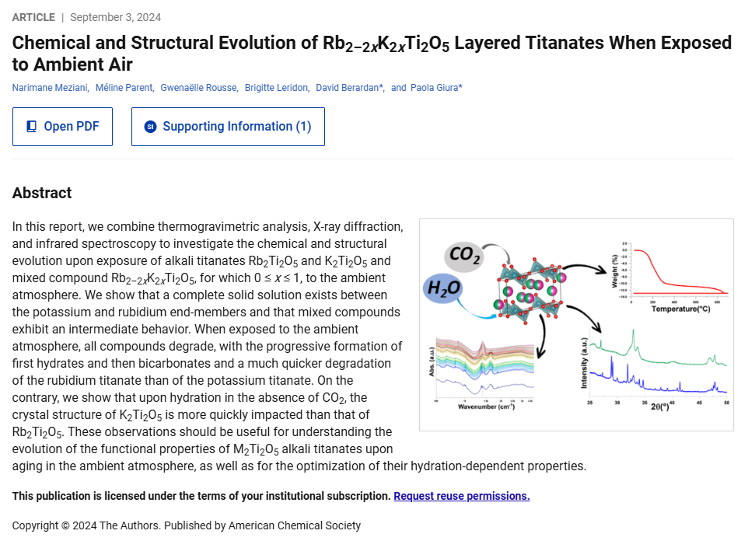
Chemical and Structural Evolution of Layered Rb₂₋₂ₓK₂ₓTi₂O₅ Titanates
Evolution Cycle of Layered Rb₂₋₂ₓK₂ₓTi₂O₅ Titanates
Inorg. Chem. 2024, 63, 38, 17513
What if we conduct hydration experiments without CO₂ ?

Slide 10
Chemical and Structural Evolution of Layered Rb₂₋₂ₓK₂ₓTi₂O₅ Titanates
Evolution Cycle of Layered Rb₂₋₂ₓK₂ₓTi₂O₅ Titanates
Inorg. Chem. 2024, 63, 38, 17513
What if we conduct hydration experiments without CO₂ ?
Thank you for your attention !

