Slide 1


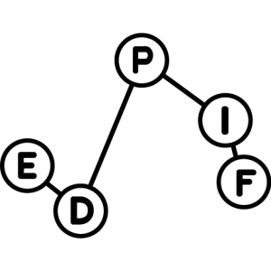




Photon-avalanche manipulation of Tm³⁺ doped nanoparticles using a Scanning Near-Field Optical Microscope
Journée UFR de Chimie / UFR de Physique - 2ème édition
Benoît Reynier
Institut des NanoSciences de Paris
Mathieu Mivelle

Slide 2
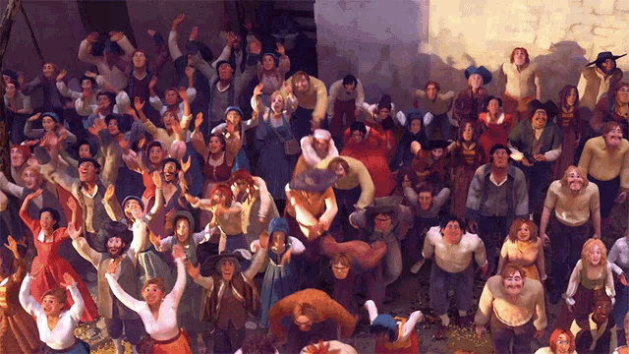
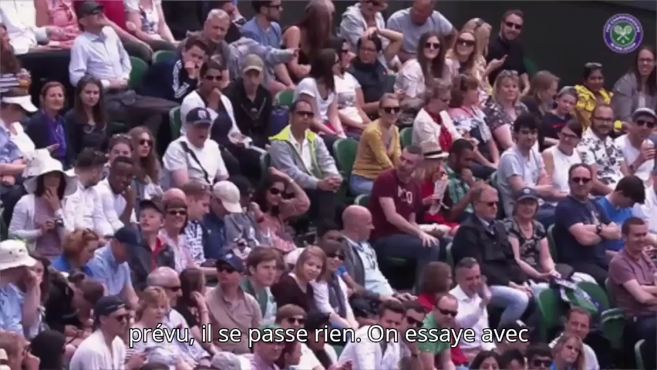
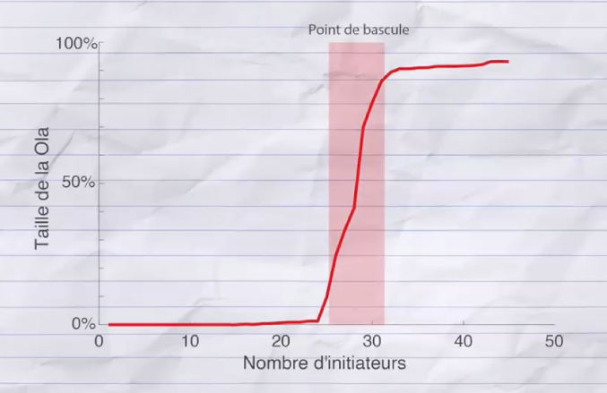

Mexican wave : a not so simple physical system
Simple conditions for each fan
A Mexican wave
How many people are needed to launch a Mexican wave?
Area of interaction
Stand-up condition
$$⟹$$
Complex collective behaviour
Mehdi Moussaïd - Fouloscopie - Combien faut-il de personnes pour lancer UNE RÉVOLUTION ? ✊✊✊

Slide 3







$$λ_{emi}^{PA}$$
$$λ_{exc}^{IR}$$
photon-avalanche emission
excitation
${Tm}^{3+}$ doped $NaYF_{4}$ nanoparticle
cross-relaxation
$$λ_{emi}^{PA}$$
$$λ_{exc}^{IR}$$
$${Tm}^{3+}$$
Tipping point
Intensity (a.u)
Luminescence
${Tm}^{3+}$ doped $NaYF_{4}$ nanoparticle
600
700
800
Incident Power
Wavelength (nm)
Giant nonlinear optical responses from photon-avalanching nanoparticles, Nature, Lee et al. (2021)

Slide 4
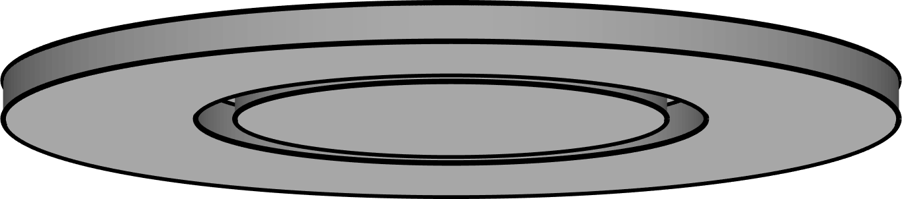

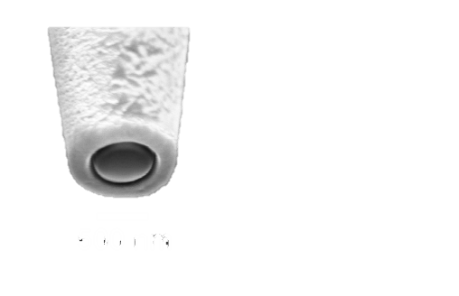


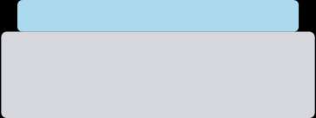






Photon-avalanche manipulation
Chemical approach
Physical approach
Tune the doping
Tune the Local Density Of States (LDOS)
Investigate the electric or magnetic dipole nature
Influence the internal cross-relaxation process
SNOM
clamp
PMMA
Glass
Tune the core-shell design
$$λ_{exc}^{IR}$$
$$λ_{emi}^{PA}$$
$$λ_{2}^{ED}$$
Tuning-fork
$$λ_{1}^{ED}$$
Intensity (a.u)
Luminescence
$$λ_{2}^{MD}$$
$$λ_{1}^{MD}$$
XY scanning stage
600
700
800
Wavelength (nm)
Incident Power
Giant nonlinear optical responses from photon-avalanching nanoparticles, Nature, Lee et al. (2021)

