Slide 1



A mechanism for VUV photodesorption : CO ices
Journée inter-UFR-CHIMIE PHYSIQUE
Antoine Hacquard
J.-H. Fillion, M. Bertin, G. Féraud, X. Michaut
15/11/2024

Slide 2
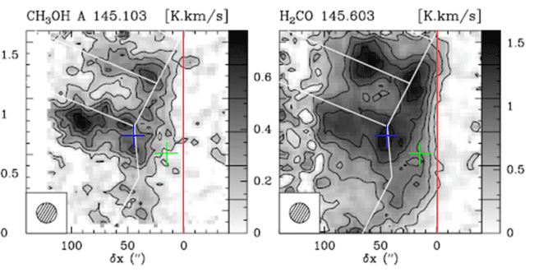


Context
Molecules in the Interstellar Medium
In cold regions ~ 10K : protoplanetary disks dense cores, PDRs
Gaz phase
H O, CO and complex molecules
Guzman+2011, 2013
2
Walsh+2016, Vastel+2014, Favre+2018
Willacy&Langer2000, Hogerheidje+2011
01

Slide 3
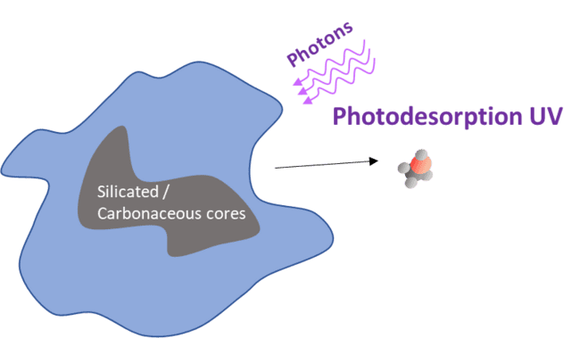

Context
Molecules in the Interstellar Medium
In cold regions ~ 10K : protoplanetary disks dense cores, PDRs
Gaz phase
H O, CO and complex molecules
Guzman+2011, 2013
2
Walsh+2016, Vastel+2014, Favre+2018
Willacy&Langer2000, Hogerheidje+2011
Non thermal desorption at play to explain gas phase abundances
Photo-induced desorption
Need to understand desorption mechanism on a microscopic scale
01

Slide 4

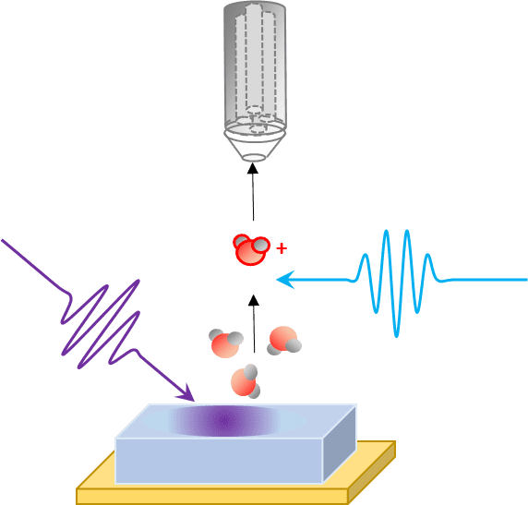
Experimental Study
Detection of positive ions
At MONARIS
VUV pulsed laser
8-10 eV
Delayed UV Probe laser
Δt / E
SPICES UHV
Chamber P=10 mbar
-10
Acces to internal and kinetics energy
Mechanisms
Molecular ice
50 ML CO
Au substrate
15K
02

Slide 5

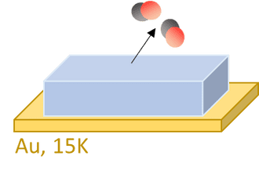
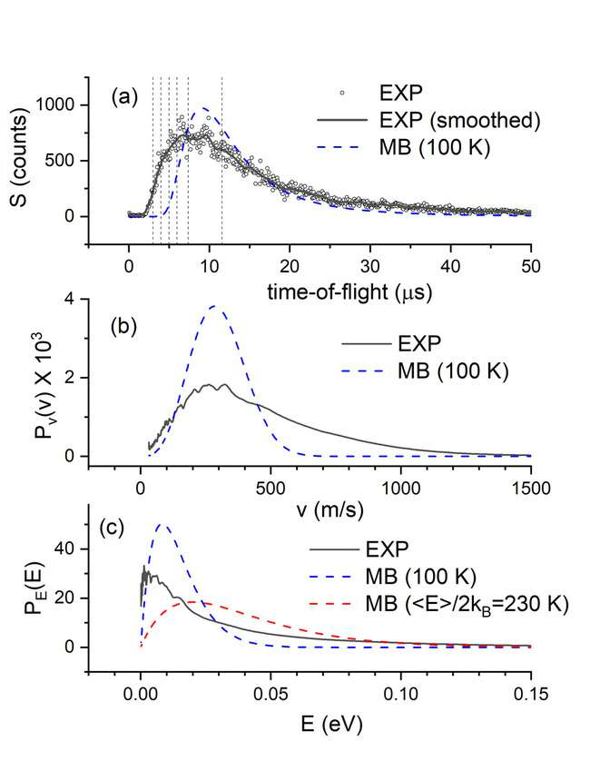

Results
Translational Energy
J=0-2
E < 2 meV
rot
03
Hacquard+2024b

Slide 6
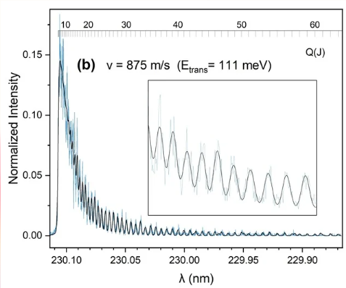
Results
Translational Energy
& Rotational Energy
J=0-2
E < 2 meV
rot
Hacquard+2024b
03
Hacquard+2024b
Experimental and simulated

Slide 7

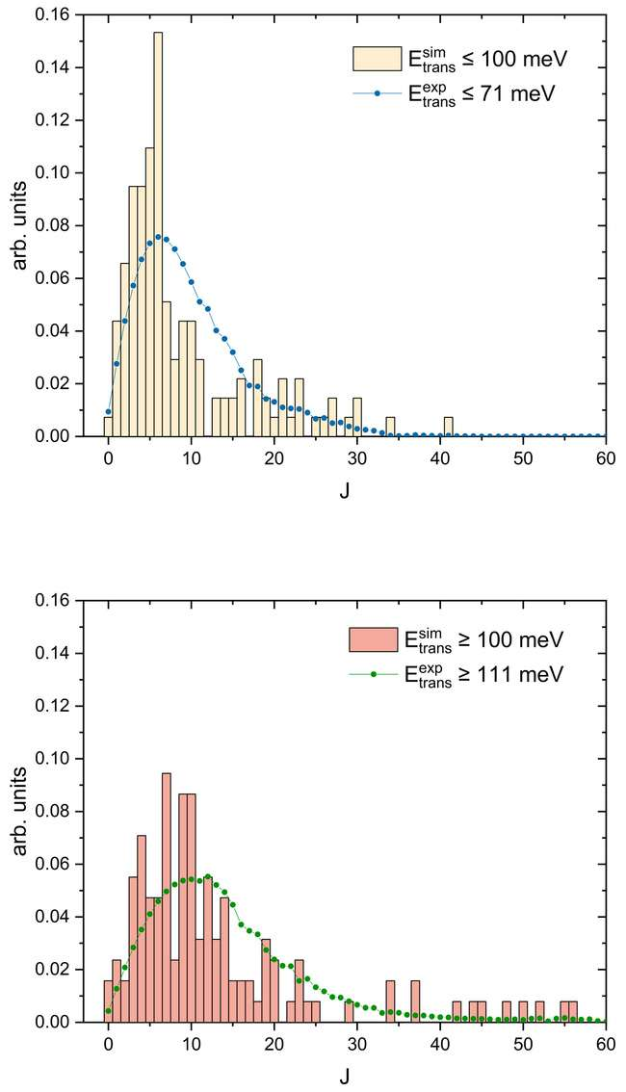
Results
Theory Comparison
Ab Initio Molecular Dynamics
University of Lille
ANR PIXyES
Hacquard+2024b
04

Slide 8

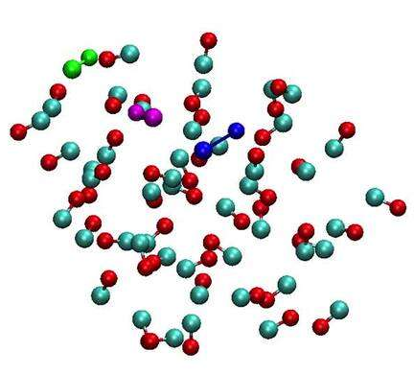
Conclusion
ANR PIXyES
Experimental method able to distinguish desorption mechanism
Indirect Desorption Induced by an Electronic Transition
Hacquard et al, JCP, 2024
Only desorption mechanism understood in detail
Energy balance in all freedom degrees
Great correlation with theory
See J.-H. Fillion Poster for more details!
Del Fré et al, PRL, 2023
05

Slide 9





THANK
YOU

Slide 10
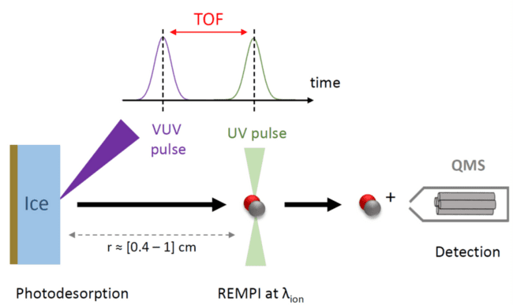
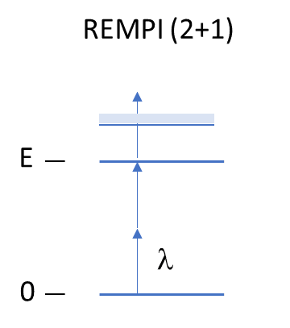
Experimental Study
Time-of-flight (TOF) spectra S(t) obtained by recording ion signal as a function of the TOF t at a fixed λ ion.
00

Slide 11
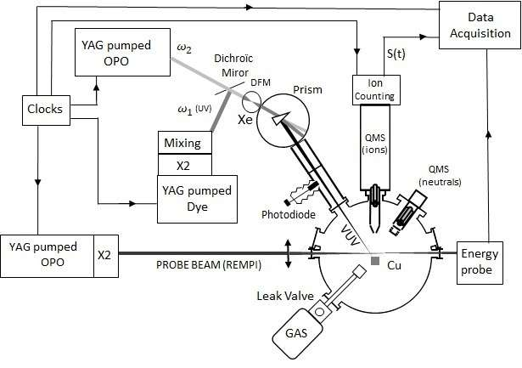
Experimental Study
00

Slide 12
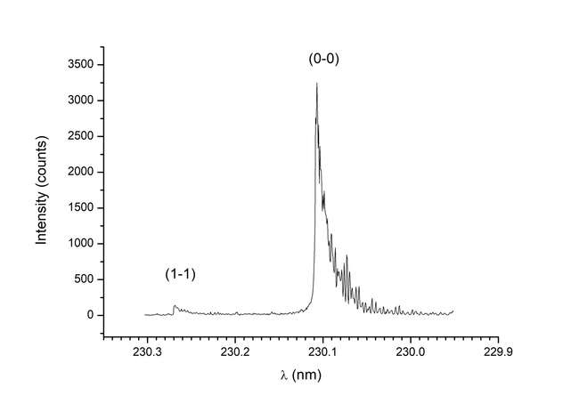
Results
Vibrational Energy
CO B-X (2+1) REMPI spectrum
v = 755 m/s E = 83 meV
96% of vibrationnaly cold molecules
Hacquard+2024b
00

Slide 13
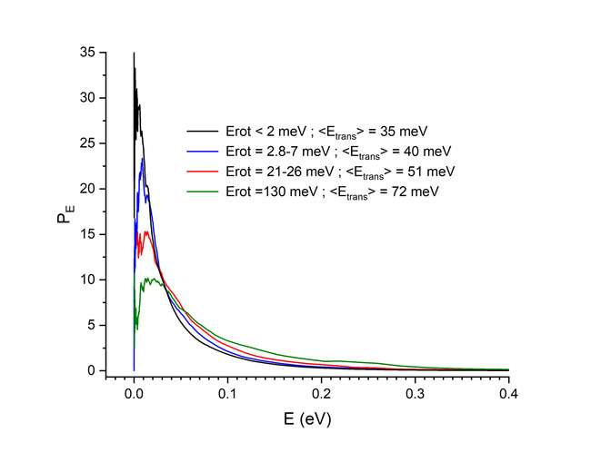
Results
Translational Energy
J=0-2
E < 2 meV
E distribution
rot
trans
00
Hacquard+2024b
Hacquard+2024b

Slide 14
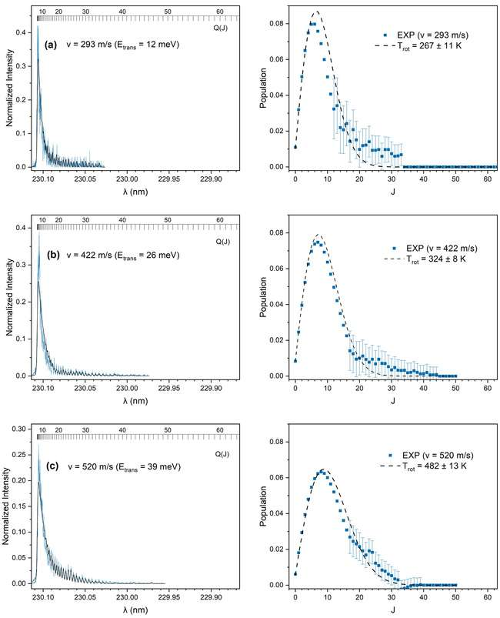
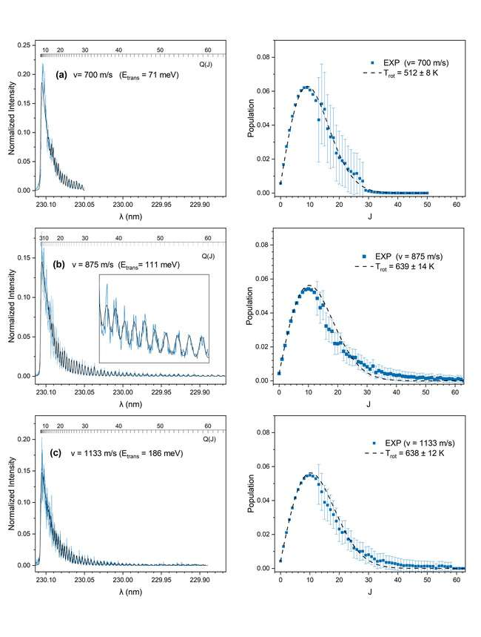
Results
Rotational Energy
Correlation E / E
trans
rot
00
Hacquard+2024b

