Slide 1
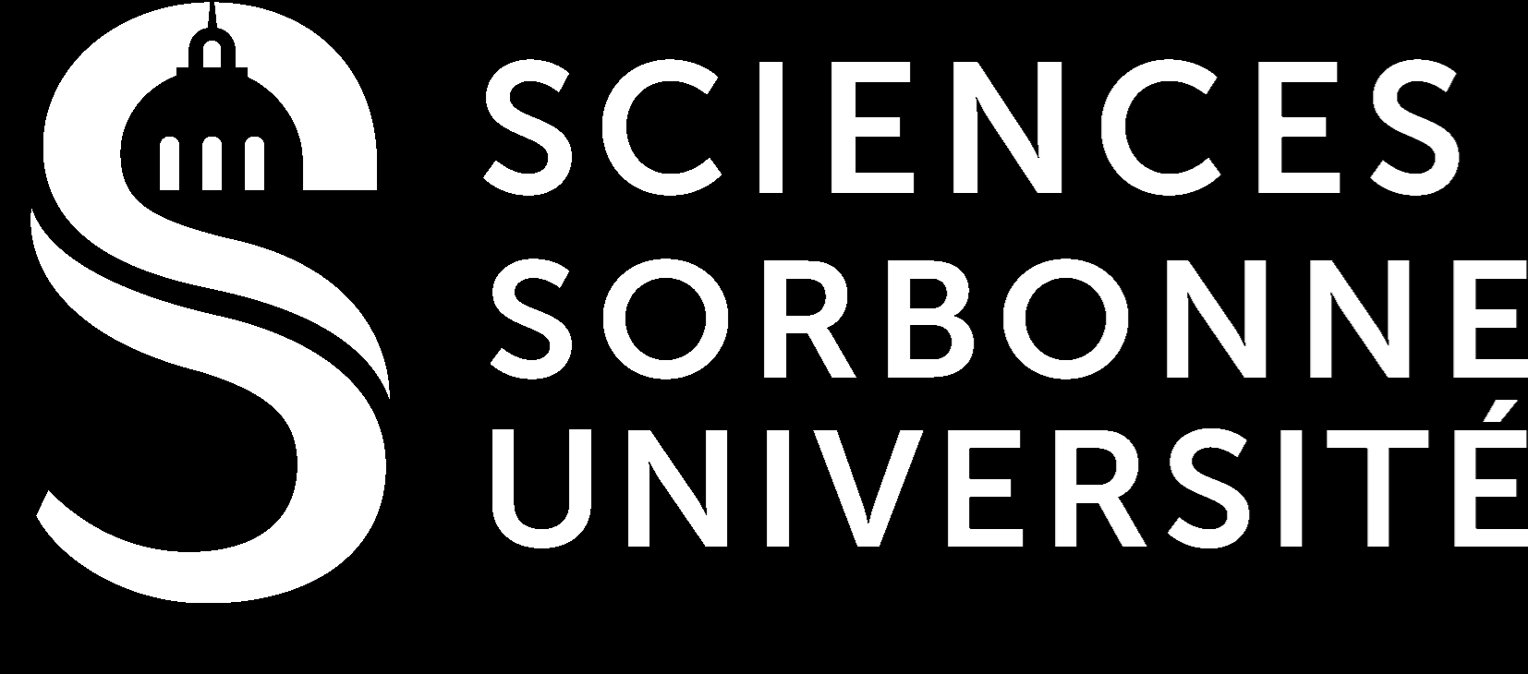
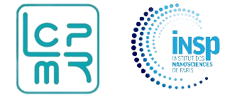
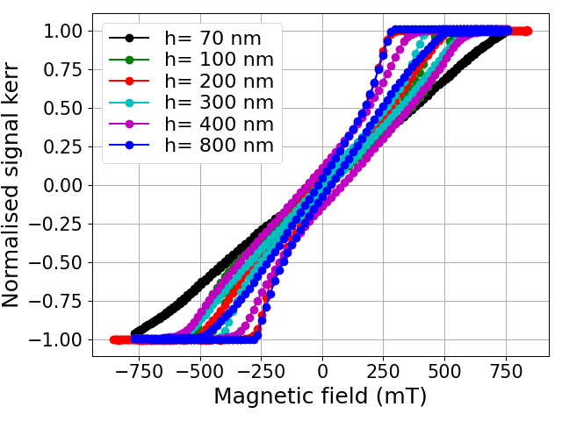
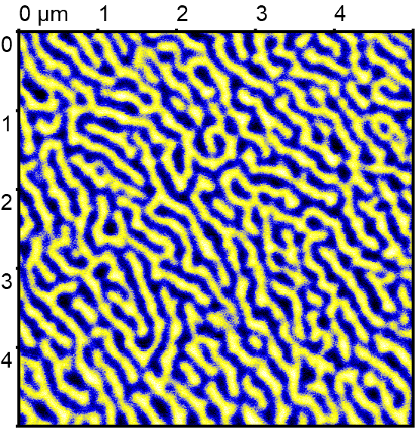
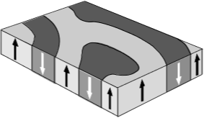
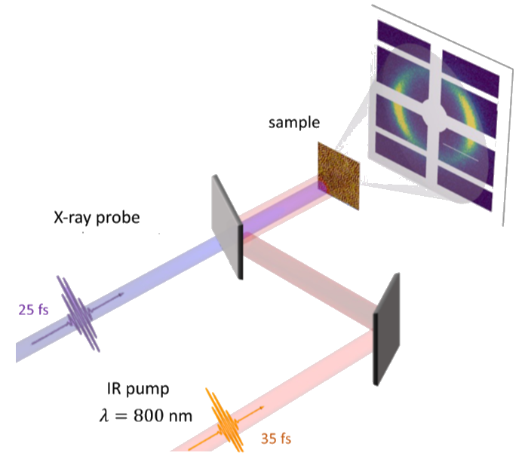
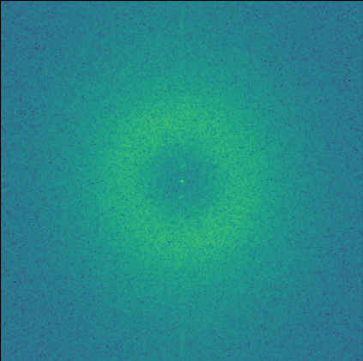






Growth of ferrimagnetic CoTb alloy thin films with out-of-plane magnetic domains
${Moundji Hemili}^{1,2}$, ${\text{Anju} \text{Ahlawat}}^{1}$ , ${\text{Car}los Rodriguez}^{2}$, ${Franck Vidal}^{2}$ , ${Dominique Demaille}^{2},$
${Renaud Delaunay}^{1}$, ${Boris Vodungbo}^{1}$, ${Emmanuelle Jal}^{1}$ , ${Marcel Hennes}^{2}$.
$${}^{1}$$
Sorbonne Université, CNRS, Laboratoire de Chimie Physique- Matière et Rayonnement, LCPMR, Paris, France.
$${}^{2}$$
Sorbonne Universié, CNRS, Institut des NanoSciences de Paris, INSP, Paris, France.
Introduction
Results
Conclusions and outlook
Co-Tb thin films are structurally amorphous and exhibit a large perpendicular magnetic anisotropy (PMA).
Experiments
Good understanding of the system.
Characterisation of magnetic properties:
MOKE, MFM, VSM.
The reproducibility of the samples will allow us to select appropriate thin films to use them in X-ray Resonant Magnetic
Scattering experiments.
$$\vec{M_{tot}}$$
$$\vec{M_{Co}}$$
2 magnetic sublattices
antiferromagnetically
coupled.
$$\vec{M_{Tb}}$$
$$\vec{M_{tot}}$$
Tuning of magnetic properties by varying temperature or composition.
Model
Numerical, analytical modeling and micromagnetic simulations.
Model system for ultrafast studies.

