Slide 1


Efficient simulation techniques for solution dynamics
and precipitation processes
David Girardier
Supervisors : Fabio Pietrucci & Sara Bonella
2éme journée inter-UFR Chimie-Physique, November 15th 2024

Slide 2
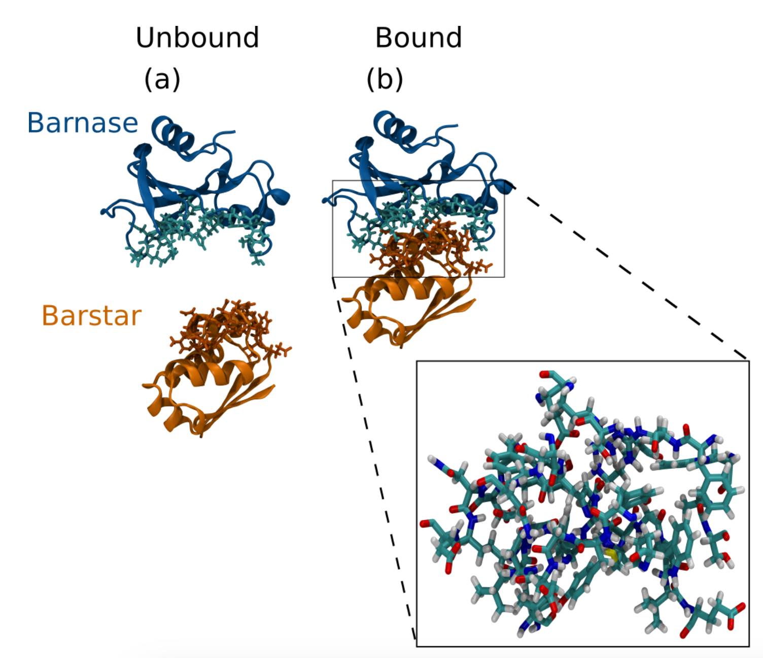
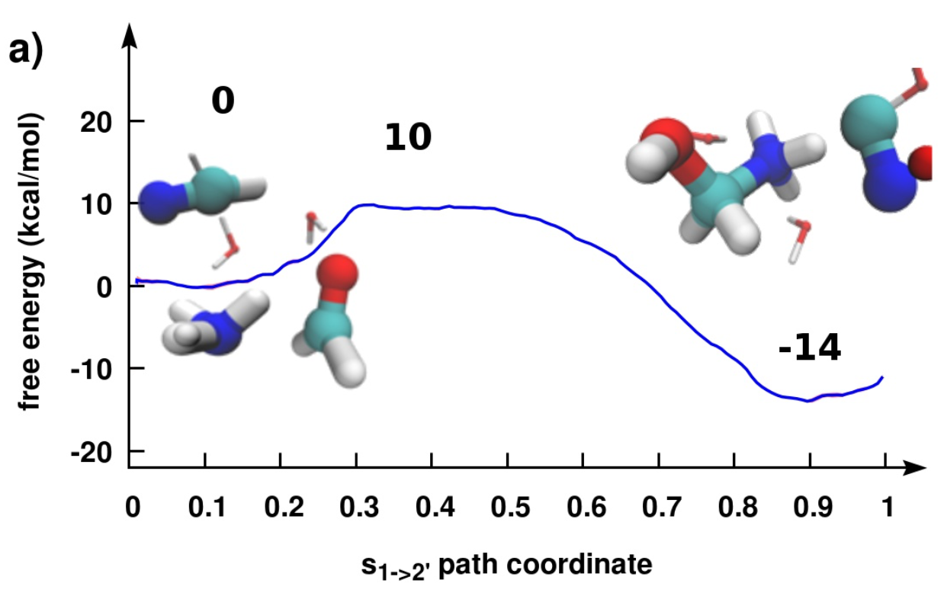
Context
Rare events
Many interesting chemical/physical processes have free energy barriers
→ straightforward simulation impossible
State-of-the-art / widespread methods
Bias along a chosen reaction coordinates (RC) : metadynamics, umbrella sampling, …
Non-trivial to use, new simulation needed for a change of RC
Our goal
Using only short unbiased trajectories (Transition Path Sampling)
Obtain free-energy barrier and kinetics from reduced model
many RCs can be compared without additional cost
Protein-protein association
Chemical reaction

Slide 3
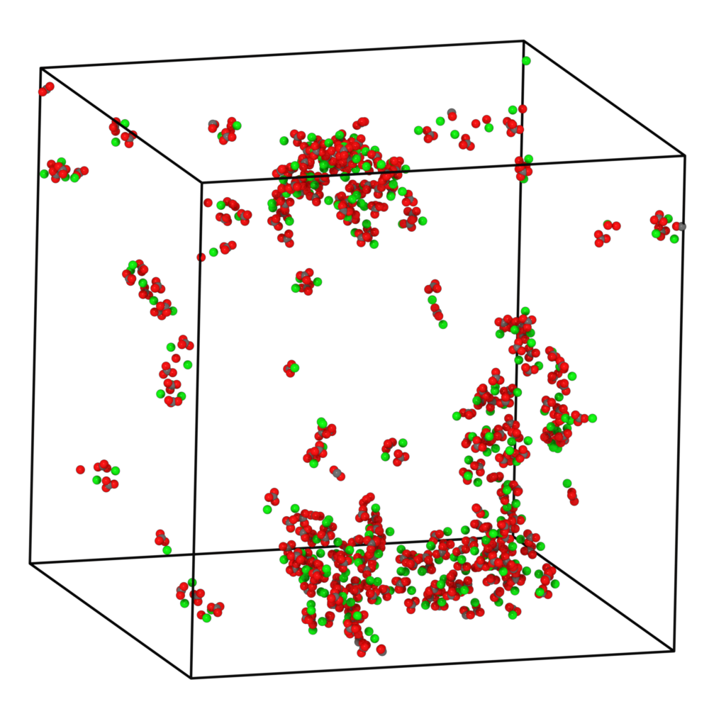
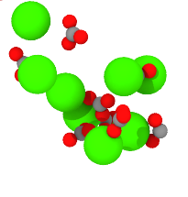
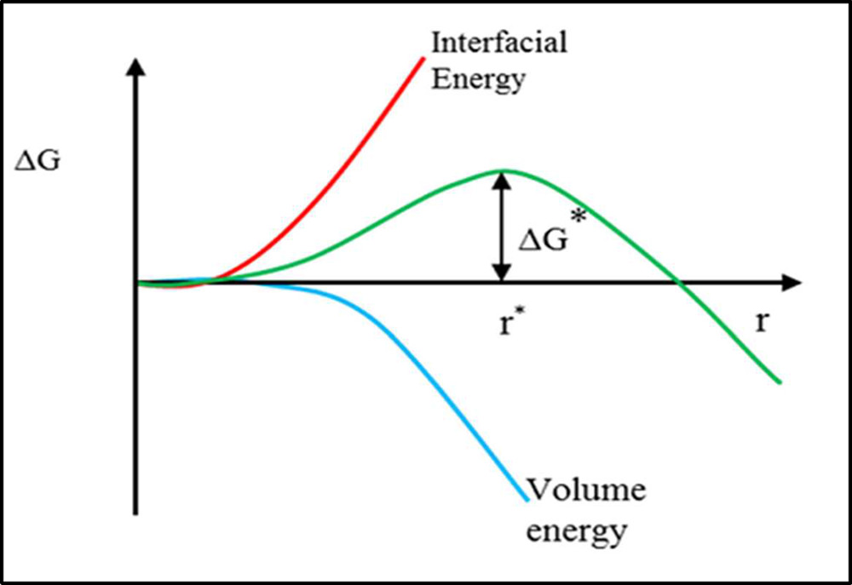
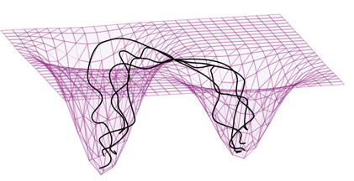
Introduction
Motivation
precipitation processes central in many domains:
  CaCO₃, batteries, bone formation, …
unclear mechanism (beyond classical nucleation th.)
need of quantitative predictions (kinetic rates)
Challenges
MD simulations include huge number of particles
rare events: system trapped in free-energy minima
Goal reduced model from short relaxation trajectories (free-energy profile, kinetics)

Slide 4
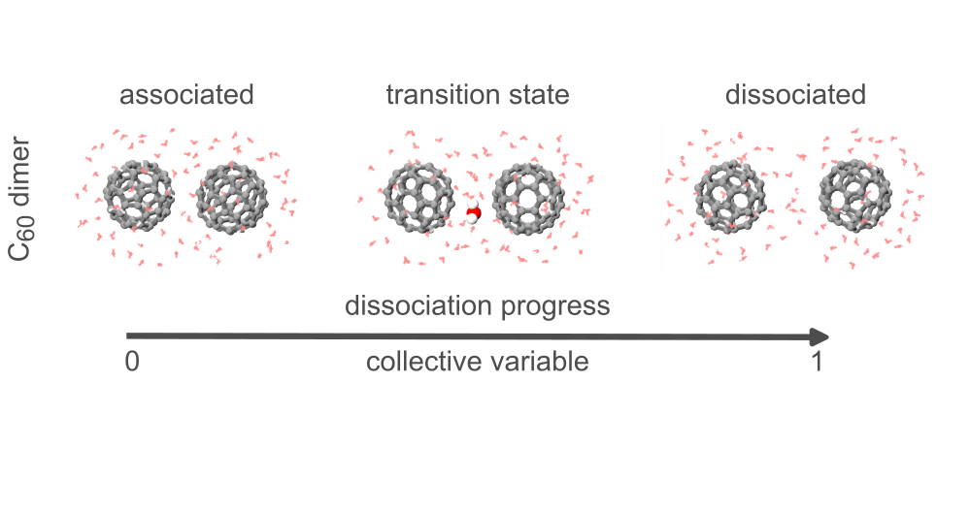
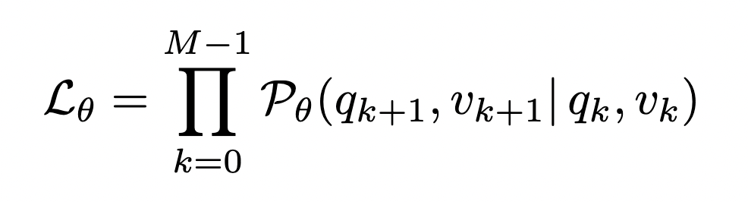
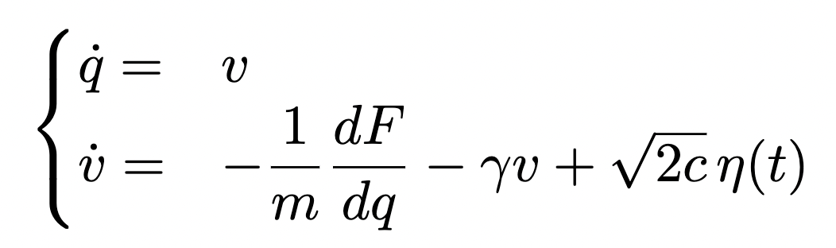
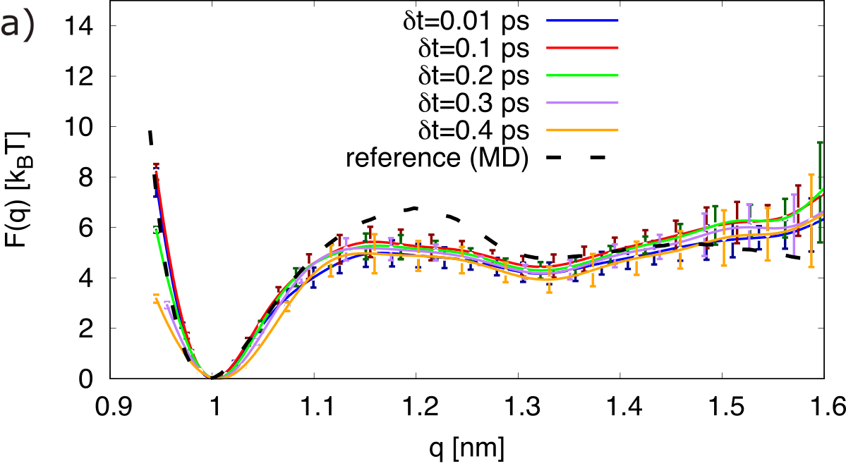
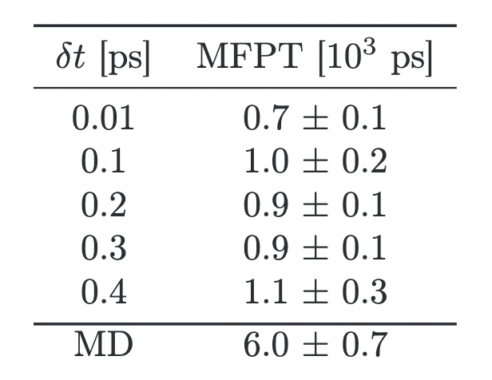
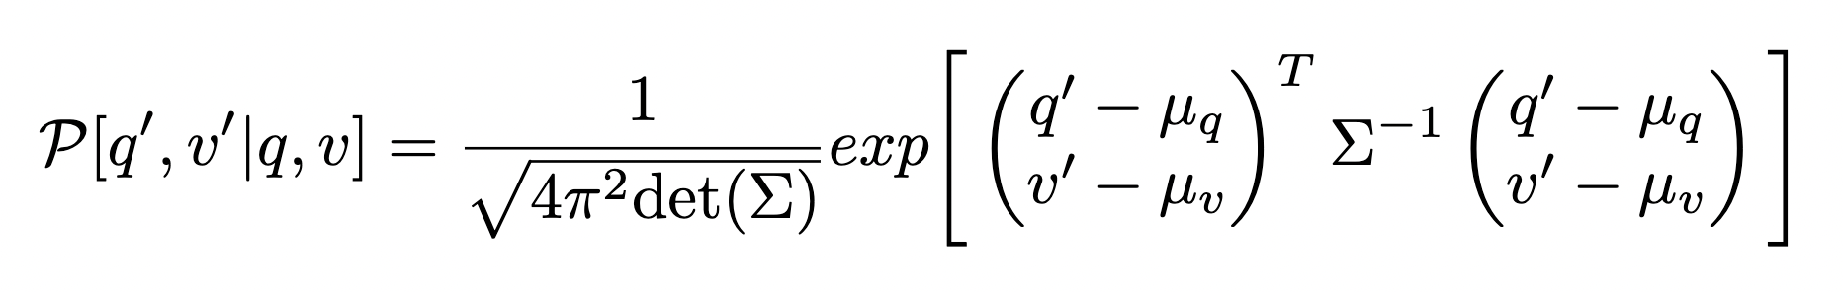
Langevin equations and inference
Langevin dynamics
Results by projecting the full dynamics onto one reaction coordinate
Method
reactive trajectories
Ignored coordinates being recovered by a friction and a random force
Maximize model probability to mimic trajectories
Probability to jump : ( q , v ) to ( q’ , v’ )

