Slide 1






Nanocatalyseurs ultra-modèles à base de ZrO₂ pour la réaction d'hydrogénation catalytique du CO₂: structure cristalline et réaction en mode operando
UFR de Chimie: Guilhem SIMON, Ahmed NAÏTABDI, Axel Wilson
UFR de Physique: Romain BERNARD, Geoffroy PRÉVOT

Slide 2
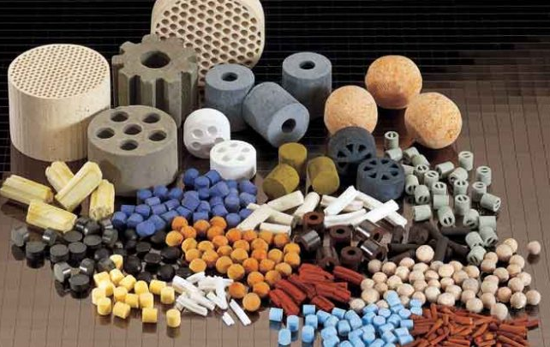
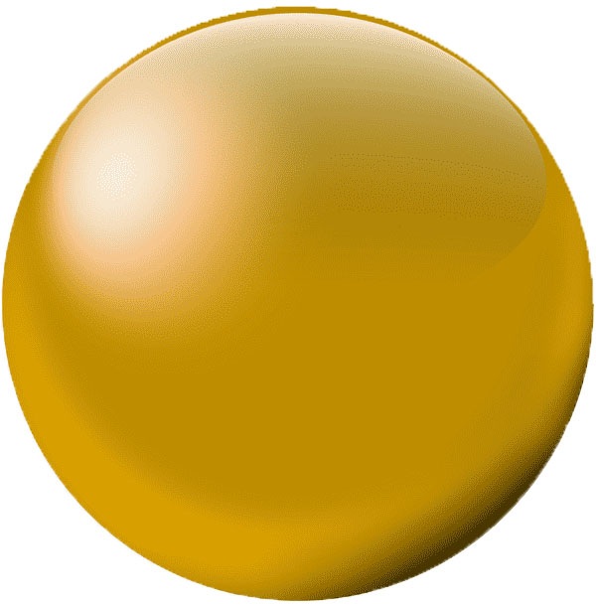
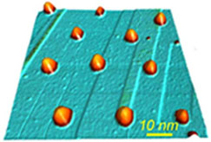
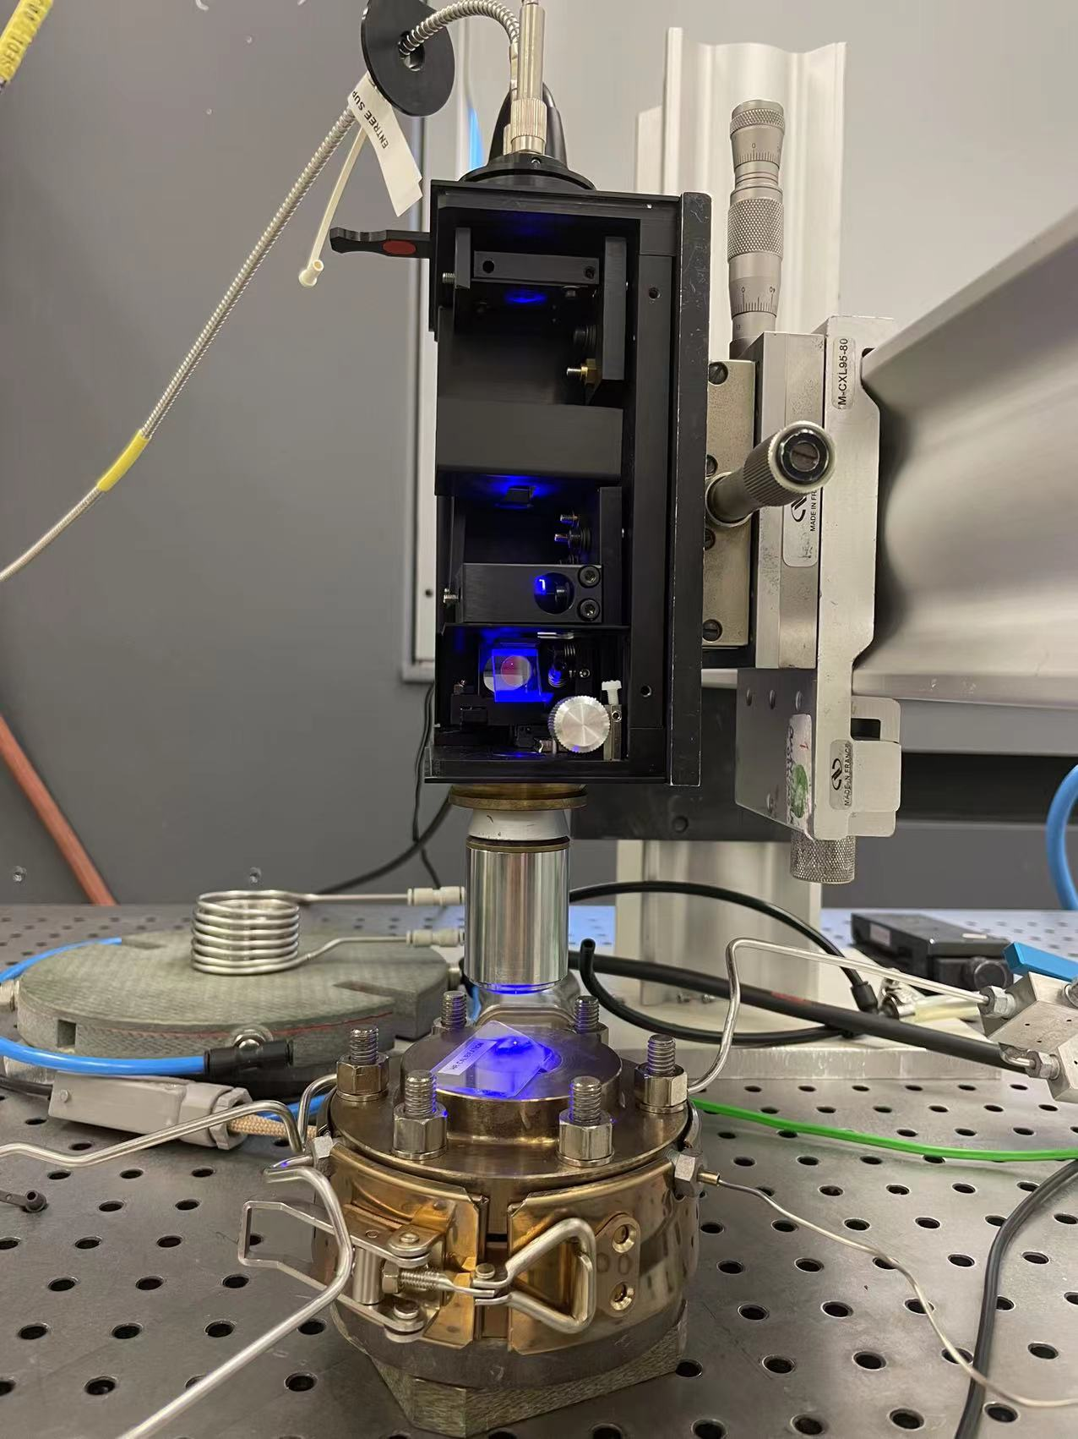
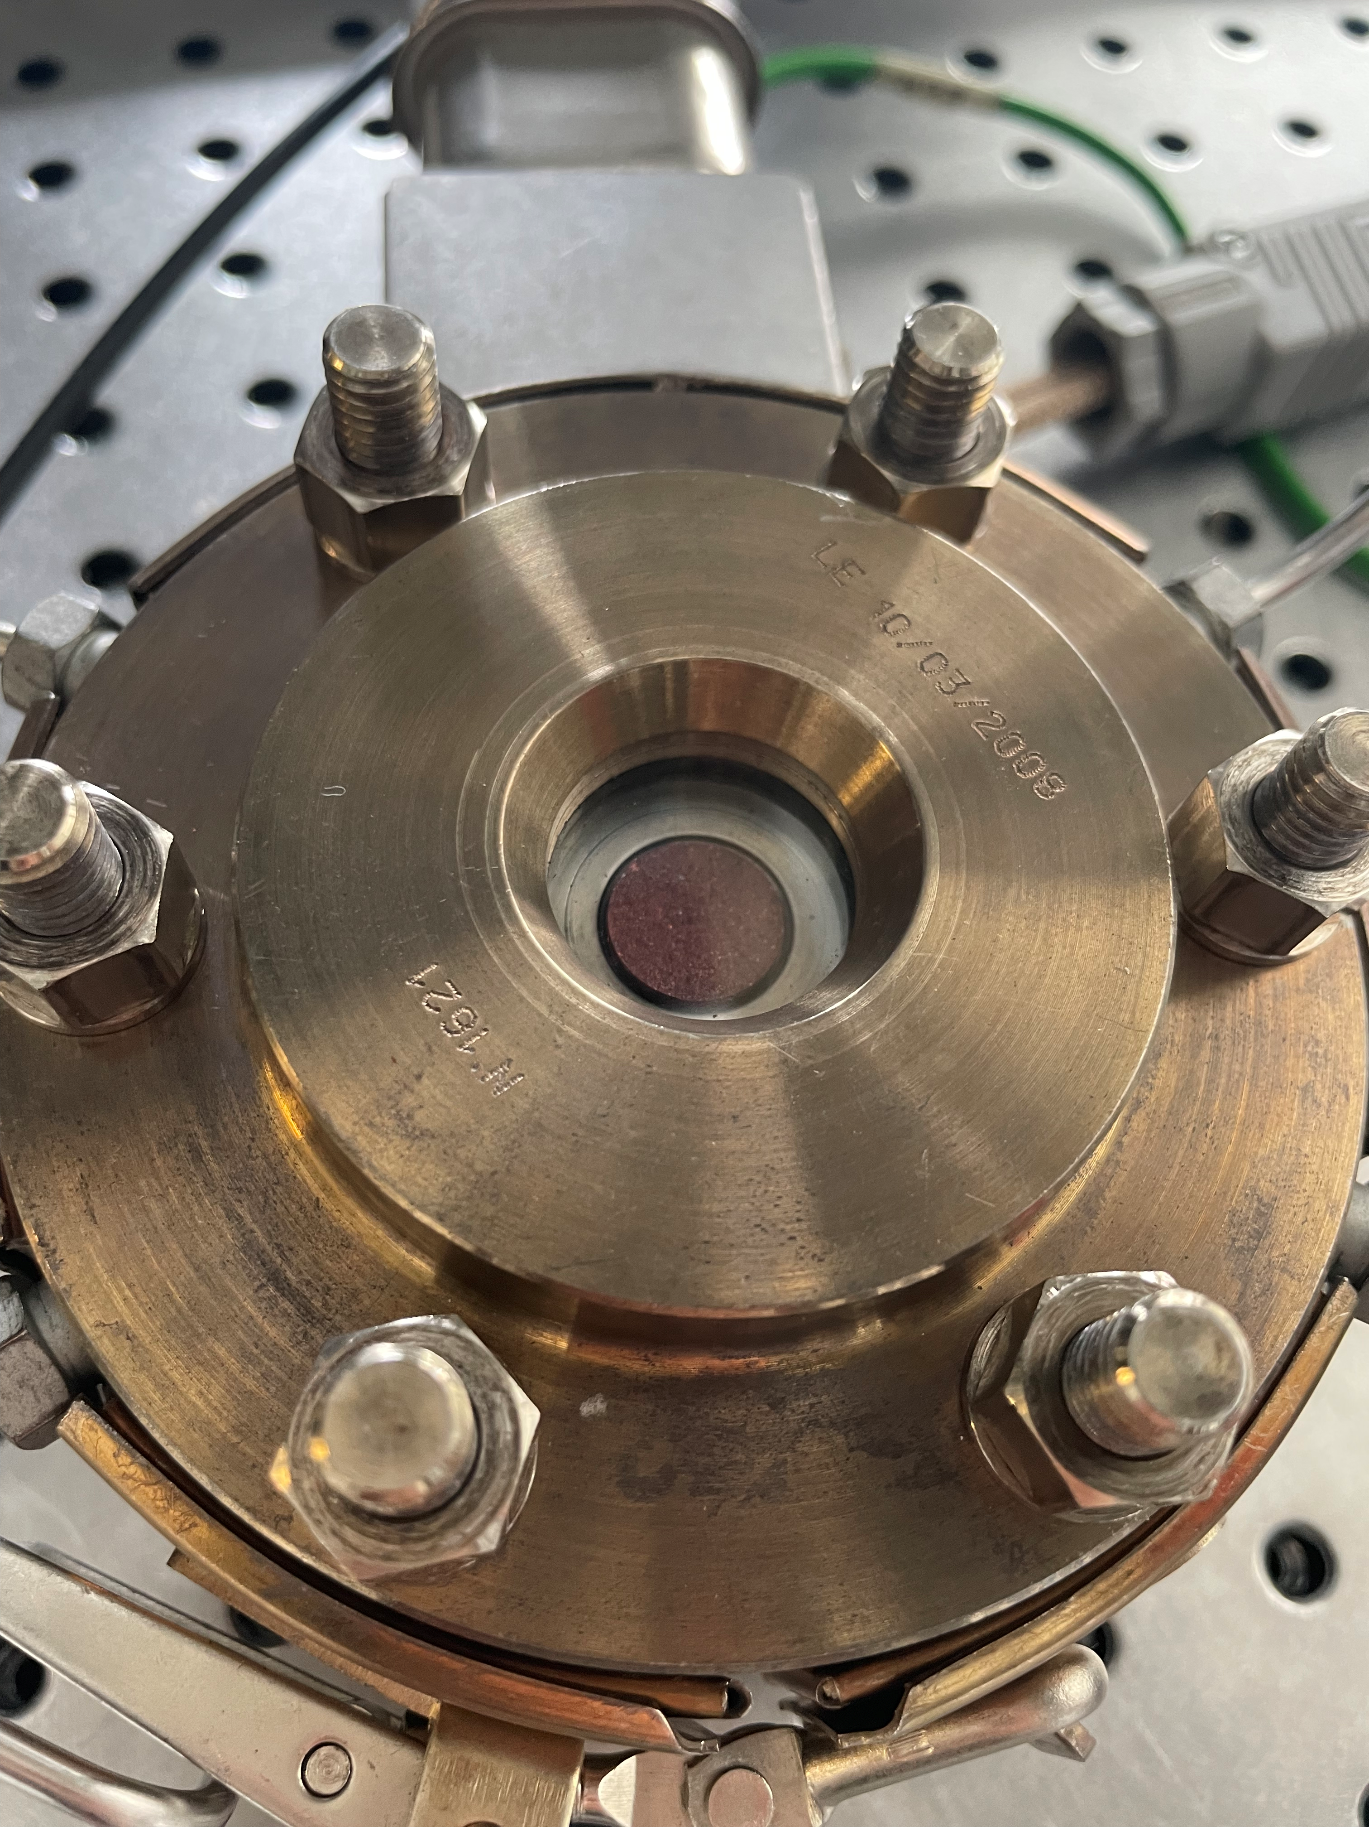
Analyse du projet : diapositive 3
Project plan
Putting CO₂ to use. Creating value from emission
$$CO_{2}+H_{2}⟷CH_{3}OH+H_{2}O ∆H_{298}=−49,5 kJ.{mol}^{−1}$$
$$CO_{2}+H_{2}⟷CO+H_{2}O ∆H_{298}=41. 2kJ.{mol}^{−1}$$
Ultra-model Nanocatalysts
Model Nanocatalysts
Practical Nanocatalysts
ZrO₂ ultrathin films grown on Cu₂O/Cu(111)
Supported Nanoparticles
Benchmark and industrial catalysts
Electronic properties and morphology are thickness dependent
ZrO₂
O₂ plasma
treatment
Cu(111)
Nanopowders
Cu₂O/Cu(111)
Design method: Physical
Design method: Chemical
ZrO₂
ZrO₂
Operando Raman spectroscopy, XPS
CO₂ hydrogenation under realistic reaction conditions
Reaction as a function of the thickness
Electronic properties
ZrO₂
Up to 50 bar @350 °C:
Size-selected nanoparticles
XRD (Grazing Incidence @Synchrotron
STM image: (100×100 nm²)
Gap 1
Gap 2
ZrO₂ strengths:
Structures as a function of
the thickness
Dual sites:
strong Lewis acidity (Zr⁺⁴)
and strong Lewis basicity
(Ovac: Zr³⁺)
Size control
Thermodynamic
Composition
Stability
Raman setup

Slide 3
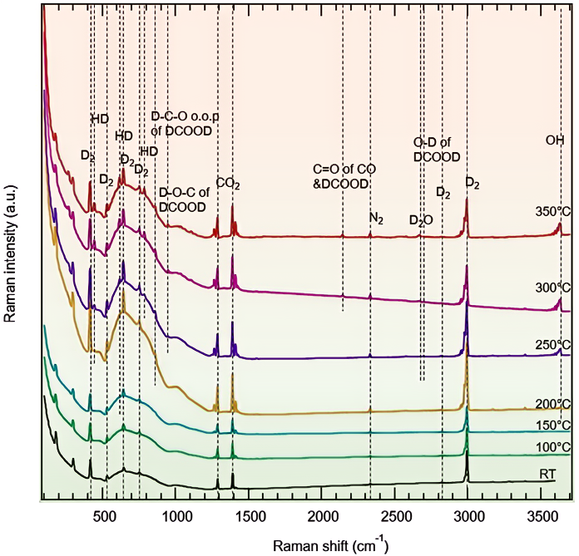
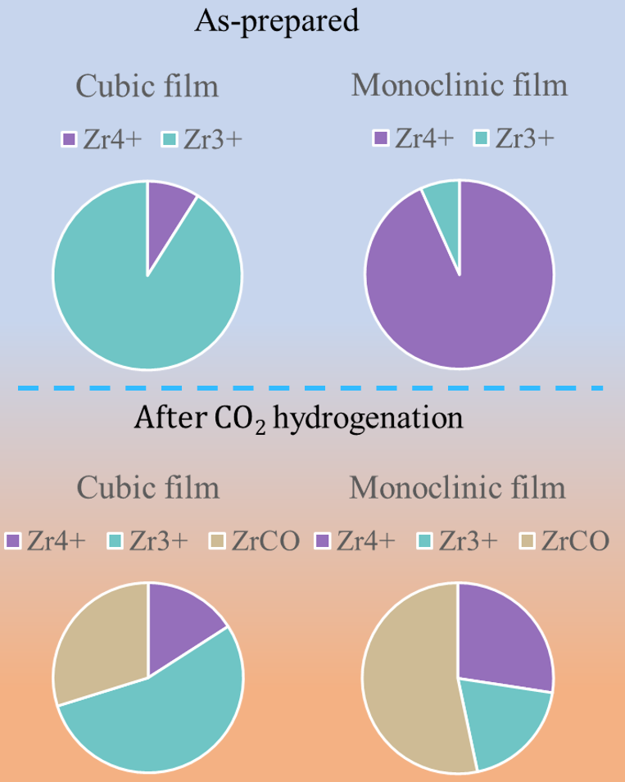
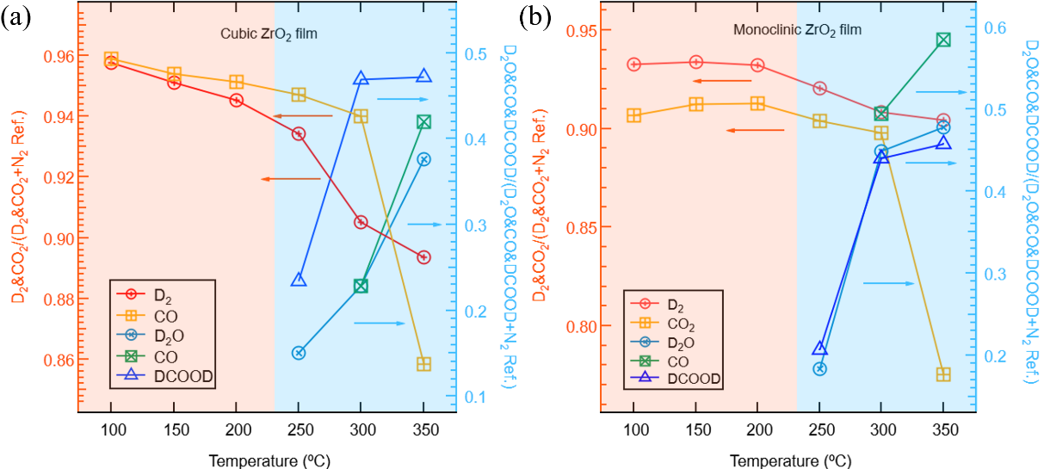
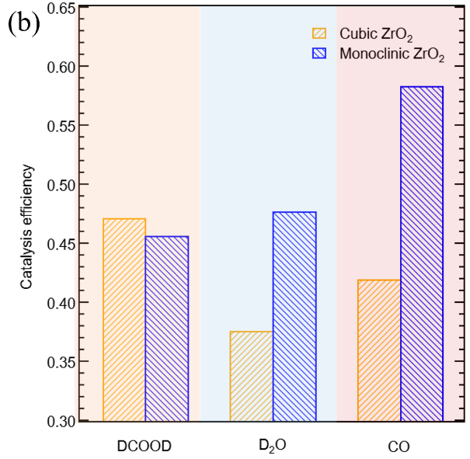
Analyse du projet : diapositive 2
Electronic properties and in situ investigations
XPS
Cubic
Tetragonal
Monoclinic
In situ Raman spectroscopy
Catalytic efficiency
2 ML (Thin)
6 ML(Thick)
Cubic
Cubic
After reaction
Monoclinic
Before reaction
Reaction conditions: (D₂ + CO₂)
Electronic properties are thickness dependent
30 bar @ 300°C
Real time monitoring of the gas phase:
High concentration of Zr³⁺ in thin films
Large accumulation of CO (ZrCO) on thick films
-Reactants
-Reaction products @ 250°C
Both Cubic and Monoclinic are active for CO₂ HR
Cubic: via formates
Monoclinic: via rWGS

Slide 4



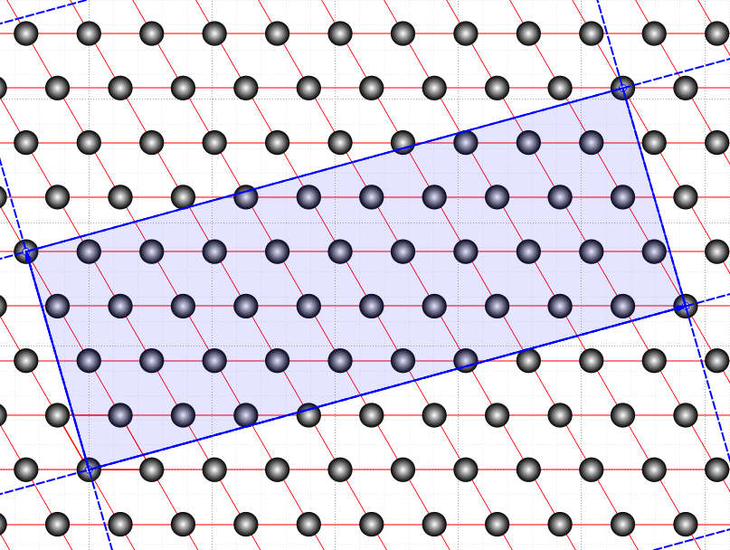
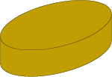
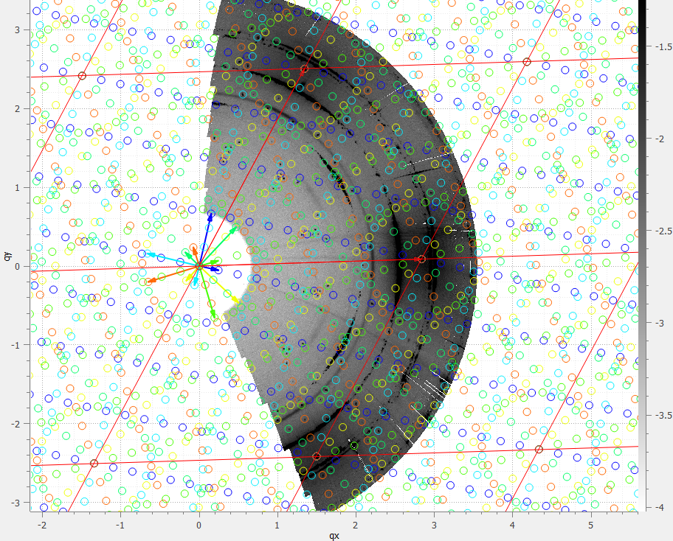
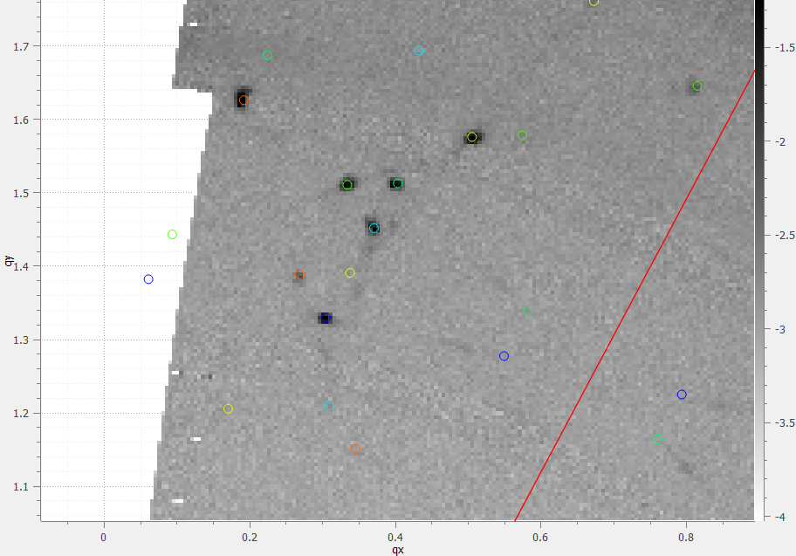
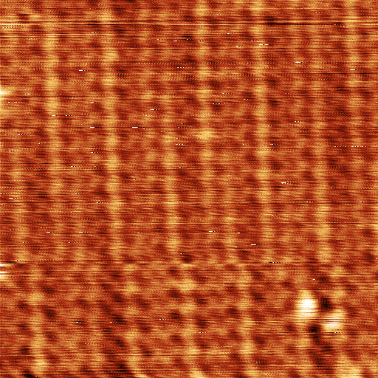

Analyse du projet : diapositive 2
Surface structure: ZrO₂/Cu₂O/Cu(111)
Surface X-ray diffraction experiments
z
y
α
x
$\left[\begin{matrix}11 & 1 \\ 3 & 4\end{matrix}\right]$ reconstruction (25.1 Å x 9.2 Å)
Scanning tunneling microscopy

