Slide 1
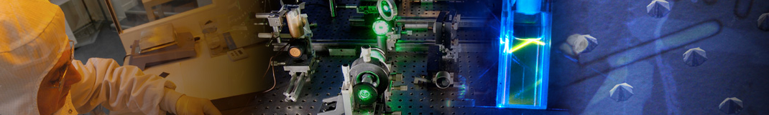
Novel strategies for the synthesis of efficient ZnO supported Pd-based nanocatalysts
Journée UFR de Chimie / UFR de Physique - 2ème édition
15.11.2024.
Institut des NanoSciences de Paris
Andrija Kokanović
Thesis supervisors: dr Slavica Stankic, dr Igor M. Opsenica

Slide 2
Introduction – context and motivation
Heterogeneous catalysis – ZnO supported Pd/PdZn nanoparticles.
Gas-phase centered synthesis methodologies.
Novel materials.
Potential environmental remediation and industrial application.

Slide 3
Strategy and approach
Gas-phase synthesis
Material
Characterization
Application
XRD
Electron microscopy
XPS
FTIR-CO
ICP-QMS
S_{BET}
Gas-phase synthesis of the support + chemical deposition
Conversion of organic pollutants
or
industrially important reactions
or
Catalyst
One step gas-phase synthesis
Thermal annealing

Slide 4
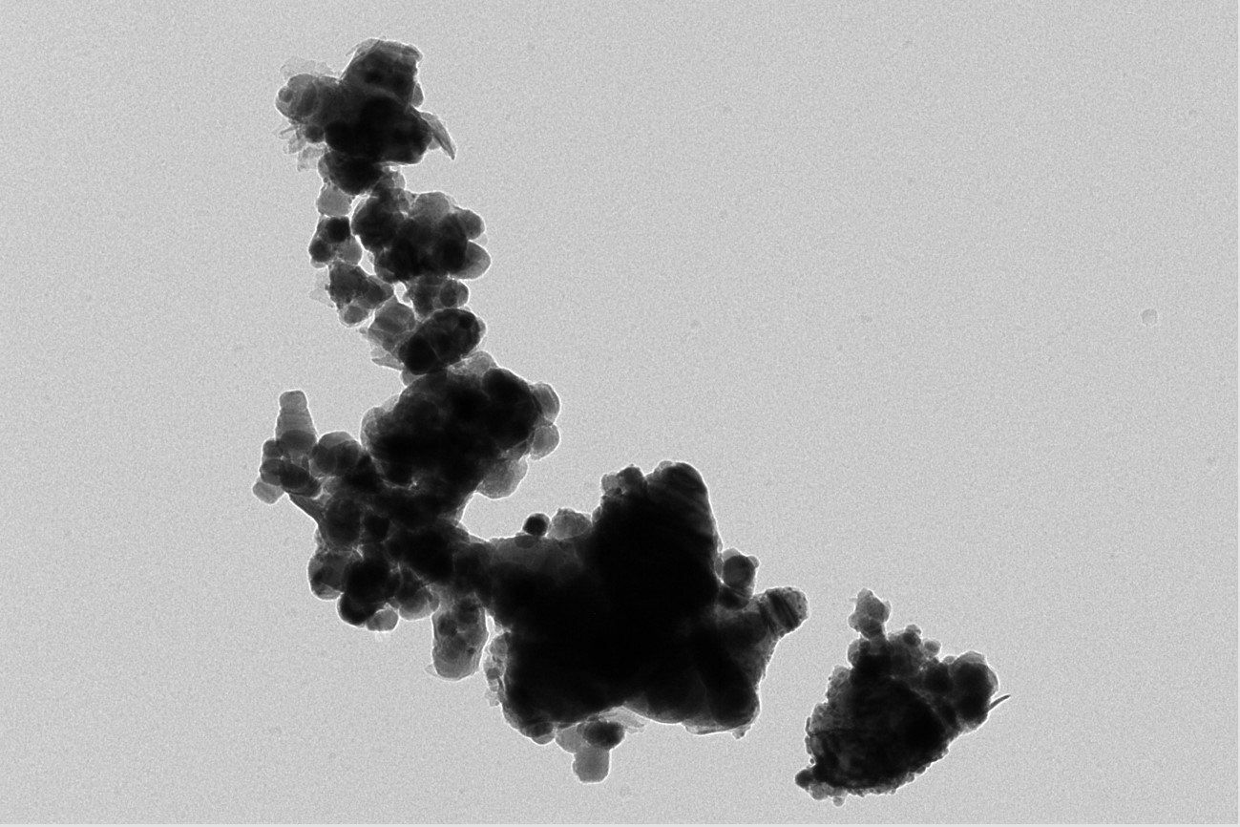
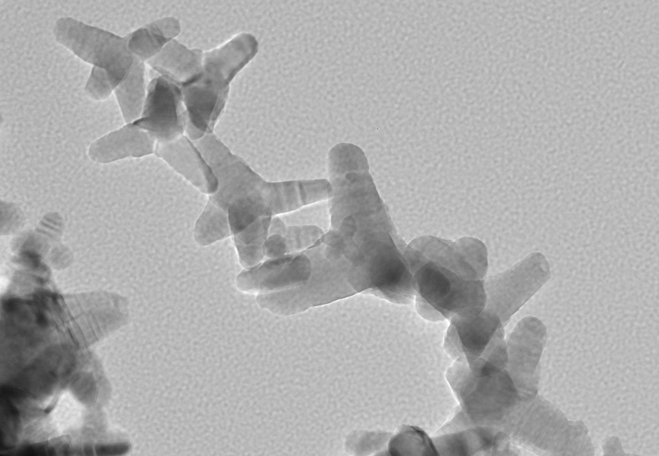
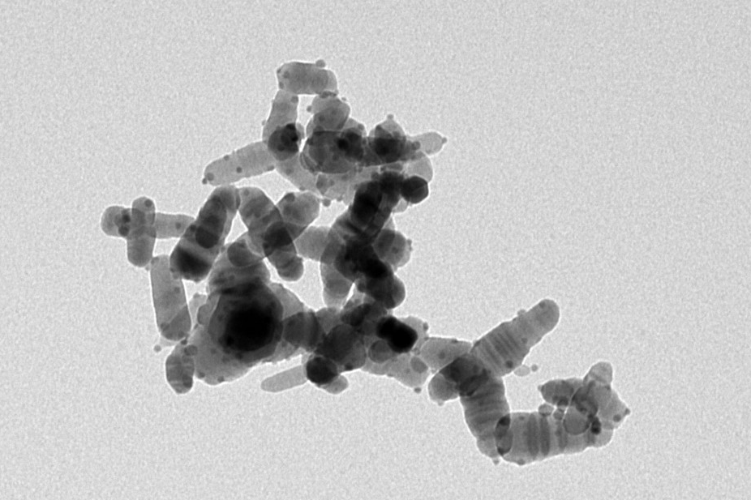
Strategy and approach
Pd/CVS-ZnO
Innovative vs conventional synthesis
PdCl₂, NaBH₄, H₂O
400 nm
T
T
oxidation
zone
collection zone (r.t.)
CSV-ZnO
O₂
Ar
Zn pieces
O₂
Zn_{(g)}
Zn_{(g)}
O₂
CVS-ZnO
100 nm
PdZn/ZnO
1) Pd(acac)₂, acetone
2) O₂, 400 °C
3) H₂, 400 °C
100 nm

Slide 5
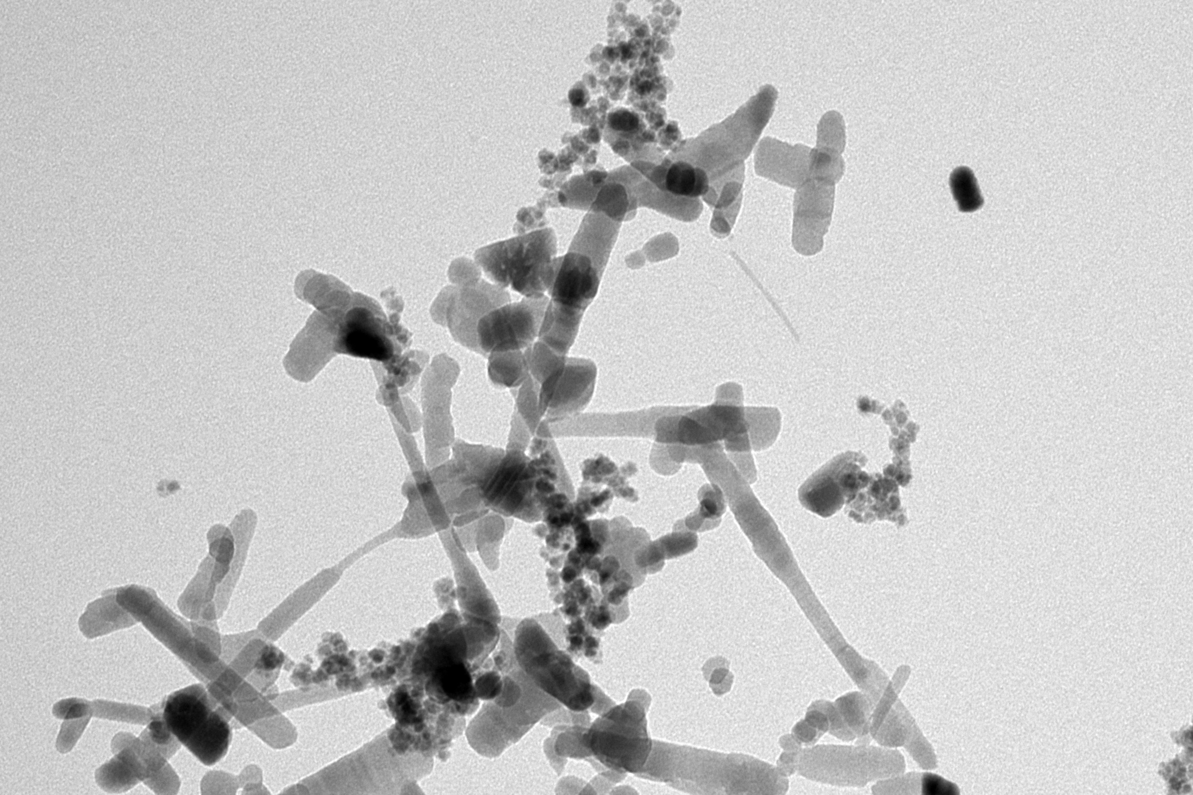
Strategy and approach
MOCVS-PdZn-ZnO
T1
T2
oxidation
zone
collection zone (r.t.)
One step procedure.
No post synthesis workup.
Induction of morphological changes by thermal annealing.
O₂
Ar
Pd(acac)₂
Zn pieces
O₂
Zn_{(g)}
PdZn-ZnO
Pd(X)_{(g)}
100 nm

Slide 6
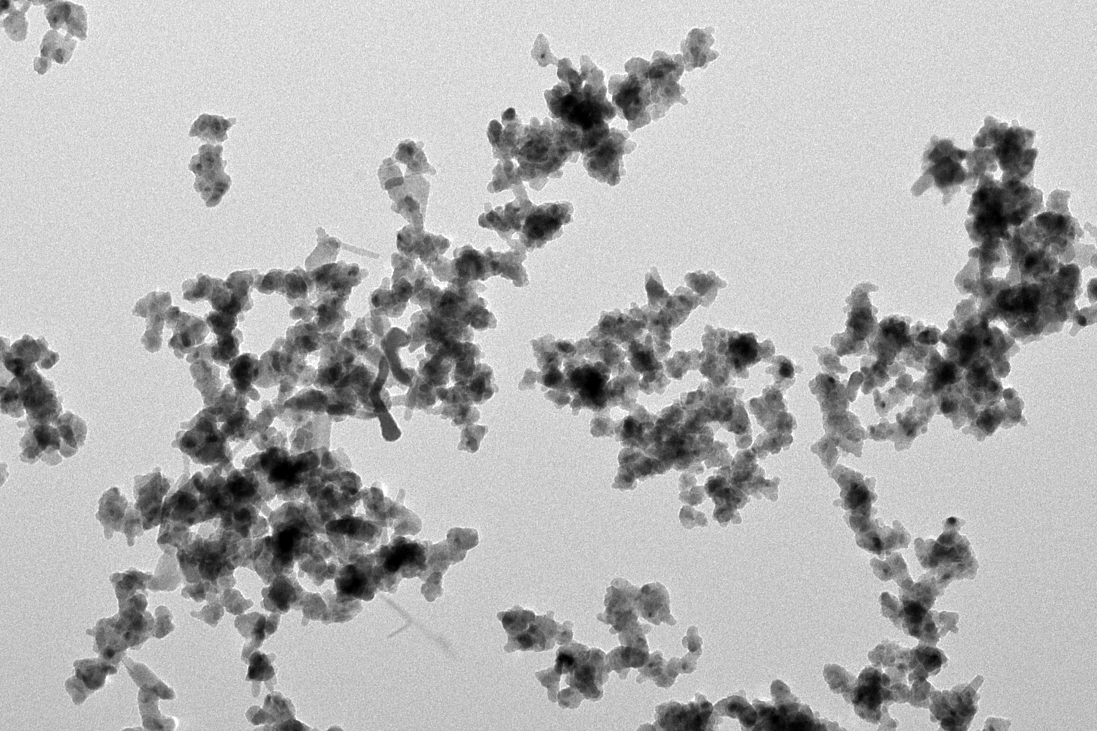
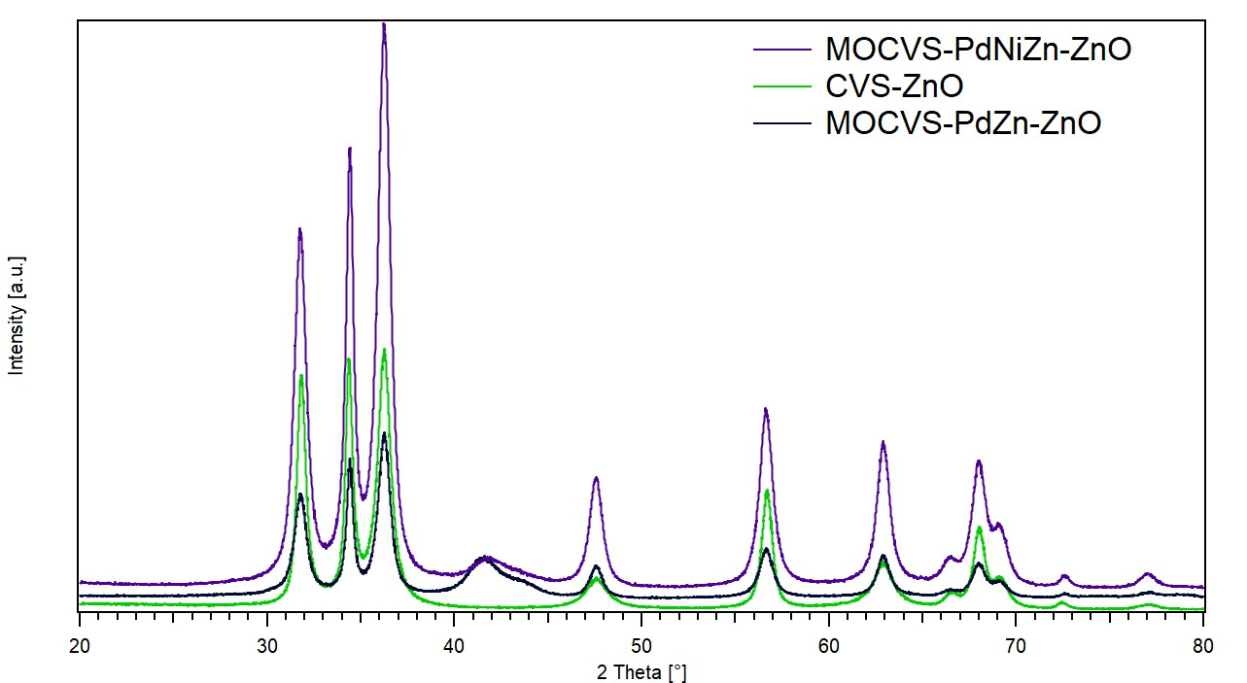
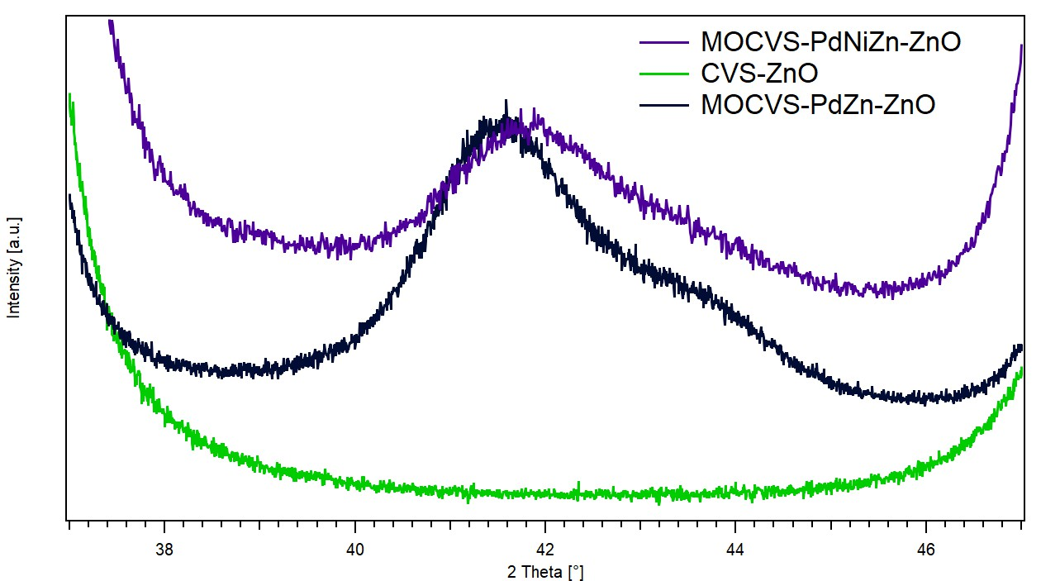
Strategy and approach
MOCVS-PdNiZn-ZnO
T1
T2
oxidation
zone
collection zone (r.t.)
O₂
Ar
Ni(TMHD)₂
Pd(acac)₂
Zn pieces
O₂
Ni(X)_{(g)}
Zn_{(g)}
PdNiZn-ZnO
Pd(X)_{(g)}
PdZn – 41.5 ° and 43.6 °
NiZn – ~43.5 °

Slide 7
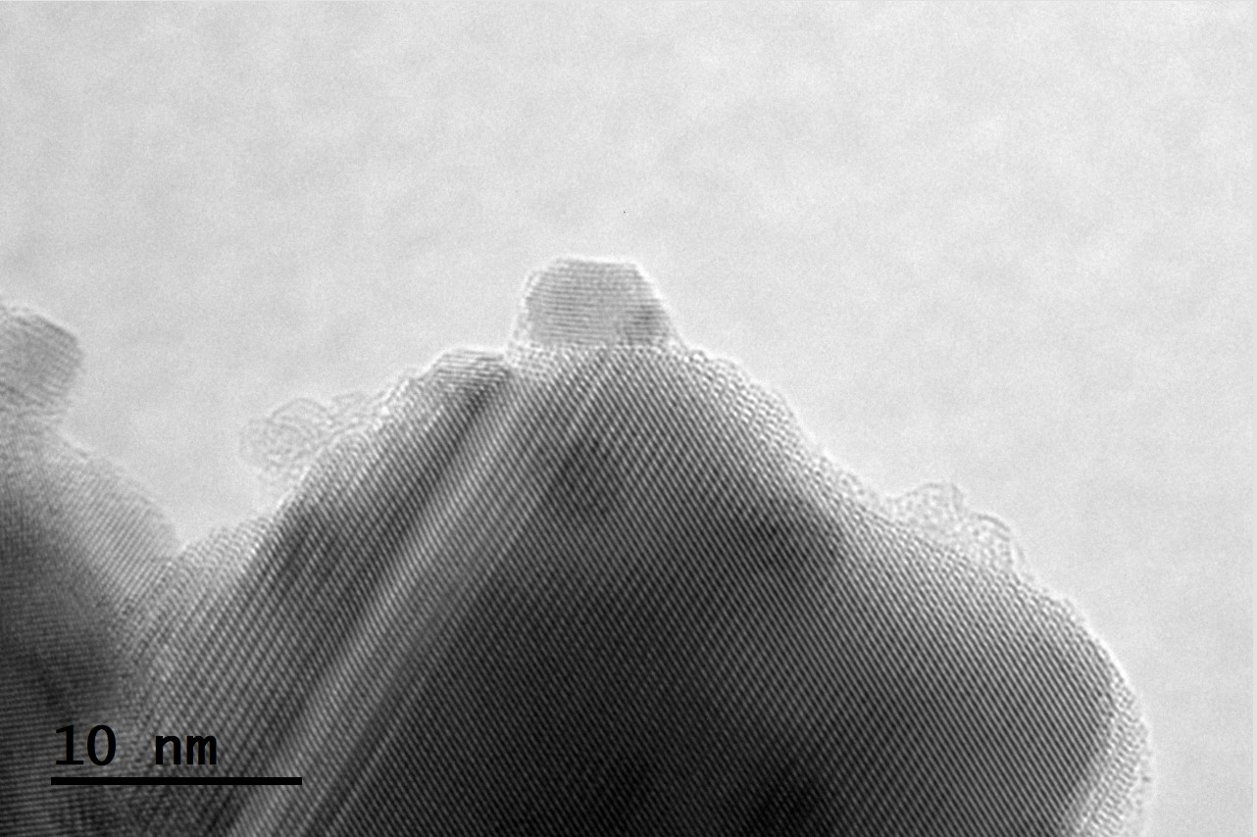
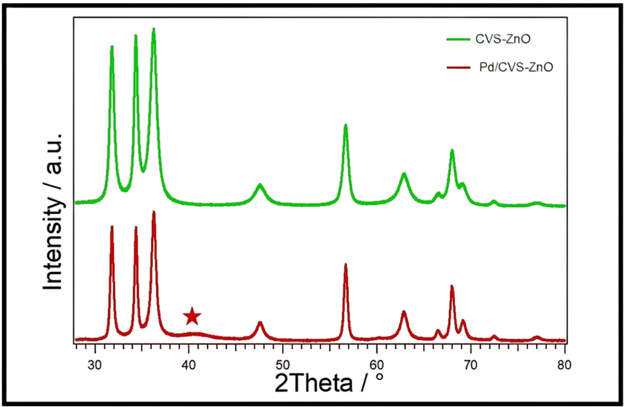
My results - Pd/CVS-ZnO
CVS-ZnO
Pd/CVS-ZnO
HRTEM
Pd
0,219 nm
(111)
ZnO
100 nm
400 nm
5 nm
XRD
1. A. Kokanović, V. Ajdačić, N. T. Jovanović, S. Stankic, I. M. Opsenica, ACS Appl. Nano Mater. 2023, 6, 15820–15828.

Slide 8
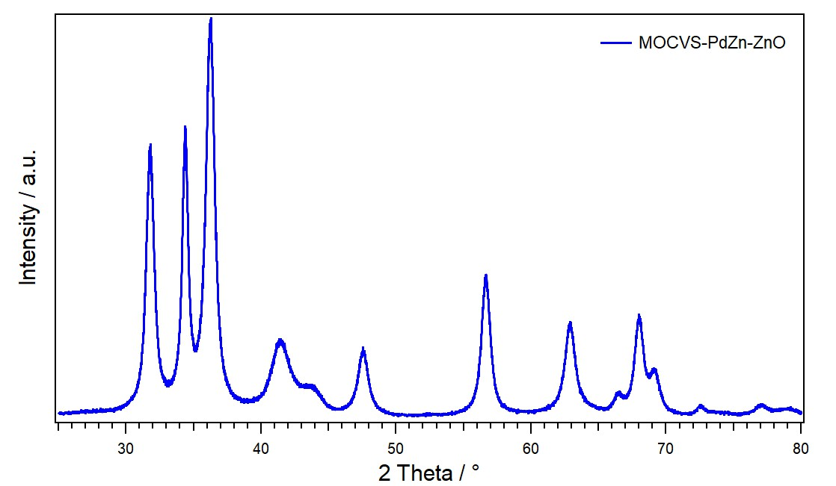
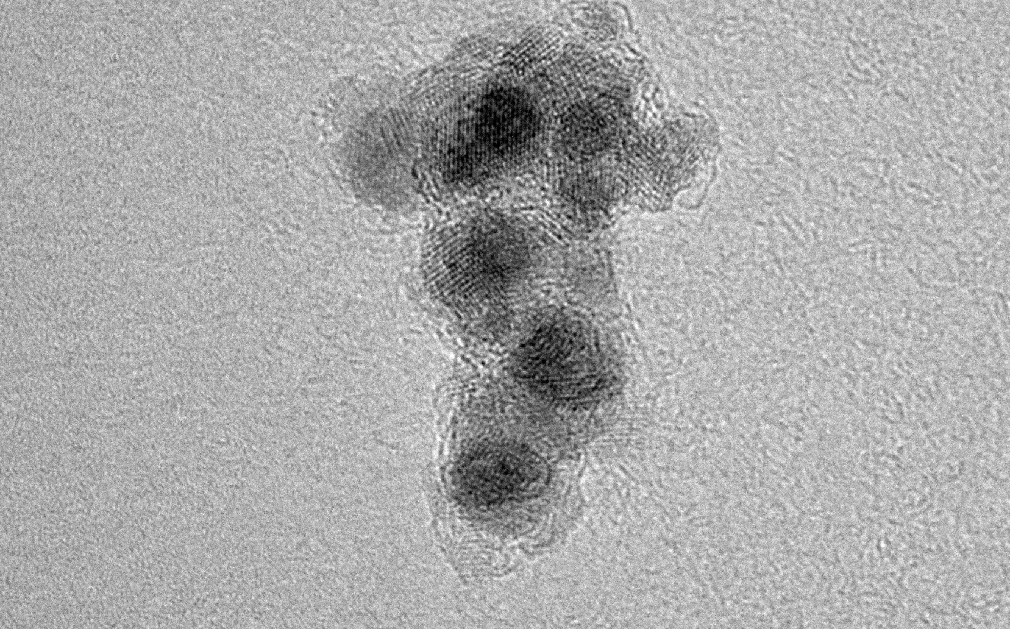
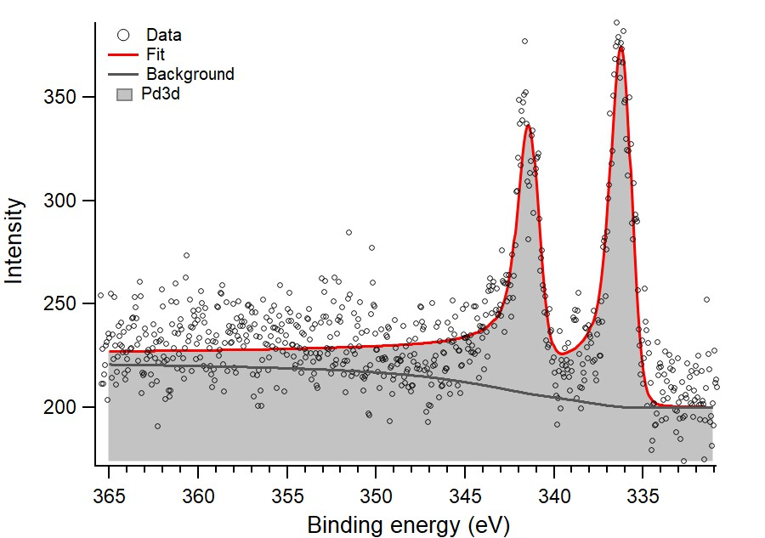
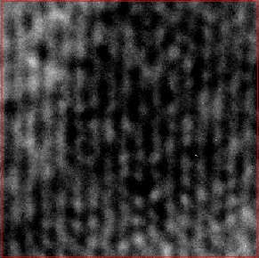
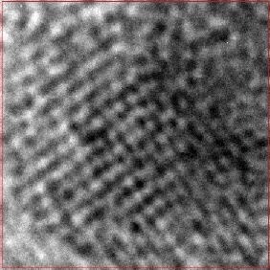
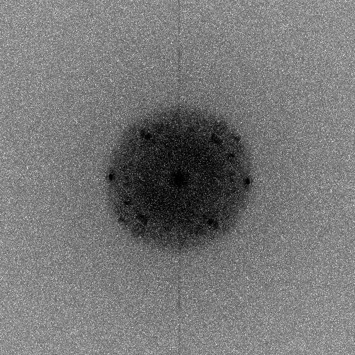
My results - MOCVS-PdZn-ZnO
MOCVS-PdZn-ZnO
250 °C
650 °C
30 mbar, Ar:O₂/10:9, 1 h
Pd(acac)_{2(s)}
Zn_{(s)}
100 nm
XRD
HRTEM
XPS
Pd 3d_{5/2}
335.0 eV Pd(0)
336.2 eV Pd in PdZn
PdZn (111)
2.19 Å
PdZn (200)
ZnO (100)
2.81 Å
PdZn (111)
10 nm
2. A. Kokanović, D. Pupavac, S. Chenot, S. Guilet, I. M. Opsenica, S. Stankic, Catal. Sci. Technol. 2024, Advance Article.

Slide 9
Conclusion
Innovative approach to heterogeneous catalysts synthesis.
Possibility of increasing catalytic system complexity.
Materials applicable in environmentally friendly and industrially important chemical reactions.

Slide 10
Thank you for your attention!
I would like to express my gratitude toward my colleagues: Stephane Chenot, Stephane Guilet, Dunja Pupavac, Vladimir Ajdačić, Nataša T. Jovanović;
supervisors: S. Stankic, Igor M. Opsenica;
research groups: Low-dimensional Oxydes (Institut des NanoSciences de Paris, CNRS/Sorbonne Université) and OpsenicaLab (Faculty of Chemistry – University of Belgrade).

