Slide 1
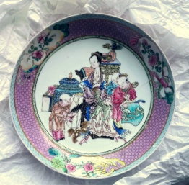
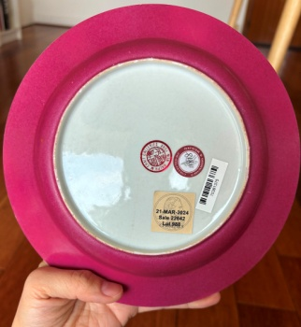
Famille rose Porcelaine
colored with gold nanoparticules (Au°)
Search for classification tools (workshops, provenance)
for non-invasive on-site analysis with mobile instrument
Ph. Colomban
(& membres du LIA CNRS-Palace Museum Beijing, Chine
de l'ANR EnamelFC project 19-CE27-0019-02,
de National Taiwan University,
des musées de France
(Cité de la céramique, Arts décoratifs, Louvre, Arts Asiatiques-Guimet, Fontainebleau)
et de Suisse (Ariana et Fondation Baur, Genève)
De la Molécule au Nano-objet : Réactivité, Interactions & Spectroscopies (MONARIS)
UMR8233 (CNRS/Sorbonne Université), 75005 Paris
Item value
20 K€ to >2 M€
No contact
Pink glaze
~0.1 wt% Au° NPs
in glassy silicate
1/3

Slide 2
Historical context: When Europe taught porcelain enameling to Japan
and China !
1543 Jesuits missionaries arrived in Kyushu Island, Japan (St François Xavier, Nagasaki)
1583 Creation of a school and a workshops in Nagasaki (painting, glass, clocks…)
~1600 : 300 churches
>1640 : First porcelains with polychrome decoration (Arita, Yanbeta kiln) with ingredients imported from Europe
1650: Martyrdom and expulsion of Christians. Closure of Japan. Withdrawal to Macau.
1685: Louis XIV Jesuits mission to Manchu Court (Cassini project to map the whole earth)
(French enameled artifacts as official gifts)
1687: Request for local production by Emperor Kangxi
1693: Establishment of a workshop near the French church (Beitang) in the Forbidden City
1698: Ship "l'Amphitrite": arrival of 3 enamellers and 8 French glassmakers in Beijing
1715: Arrival of Giuseppe Castiglione (painter)
1719: Arrival of Jean-Baptiste Gravereau (painter & enameller) etc.
Compagnie des Indes Orientales
Objectives : identify objects produced with European recipes & ingredients
to characterize the enamels, non-invasively on-site
to differentiate originals and copies
to characterize the technological evolutions (⬄ dating)
2/3

Slide 3
Two tools are identified
Mobile, on-site Raman Microspectroscopy: Au° NPs plasmon luminescence
Raman Microscoscopy at the lab: luminescence & NPs Lamb's modes (~10-100 cm⁻¹)
Brillouin Spectroscopy at the lab : Lamb's mode (~1-50 cm⁻¹)
X-ray Mobile Fluorescence (pXRF) : close to the limit of detection
<0.5 % wt in 30 to 300 µm thick glassy silicate layer
Mobile & Lab
Laboratory only
Low wavenumber modes :
2 types of Lamb's modes ?
& Boson contribution ?
Luminescence : 2 types
Size, aggregate, alloying ?
⬄ Correlation with workshops, fakes, etc ?
3/3

