Slide 1





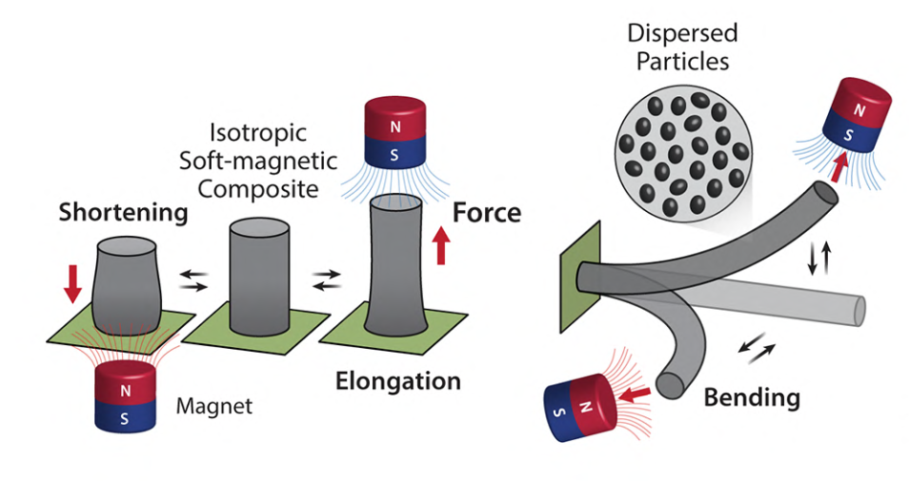
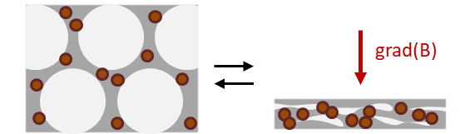
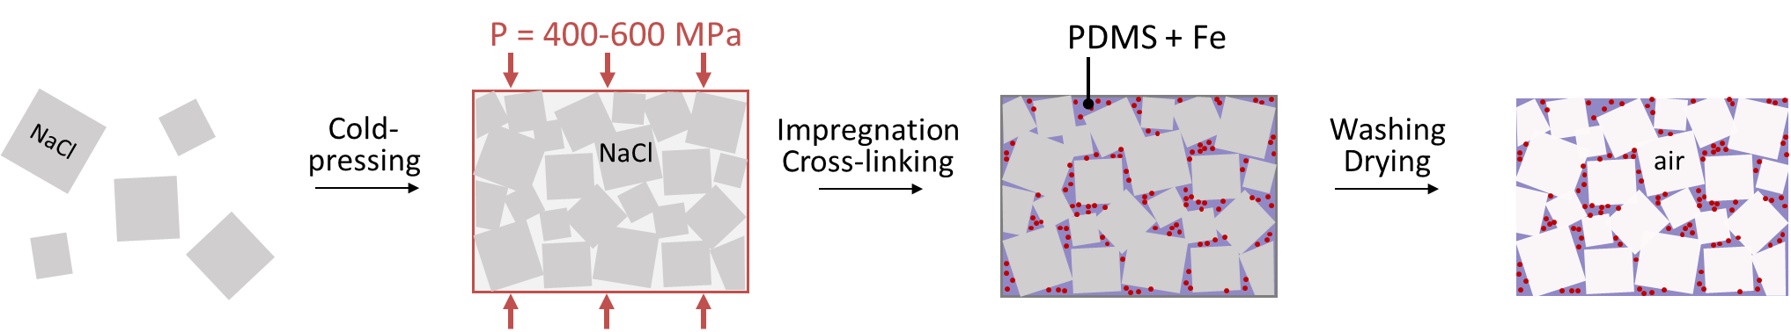
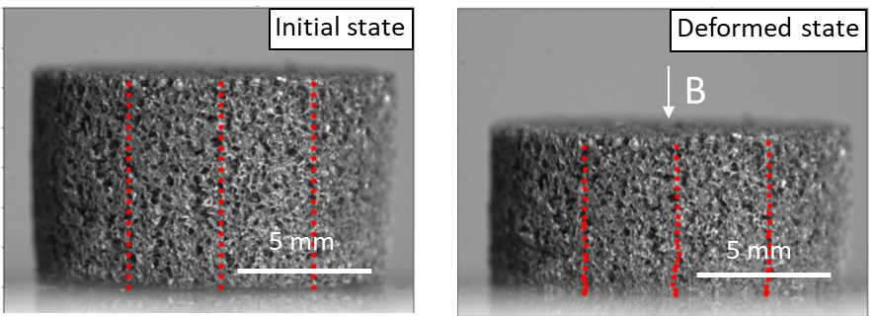
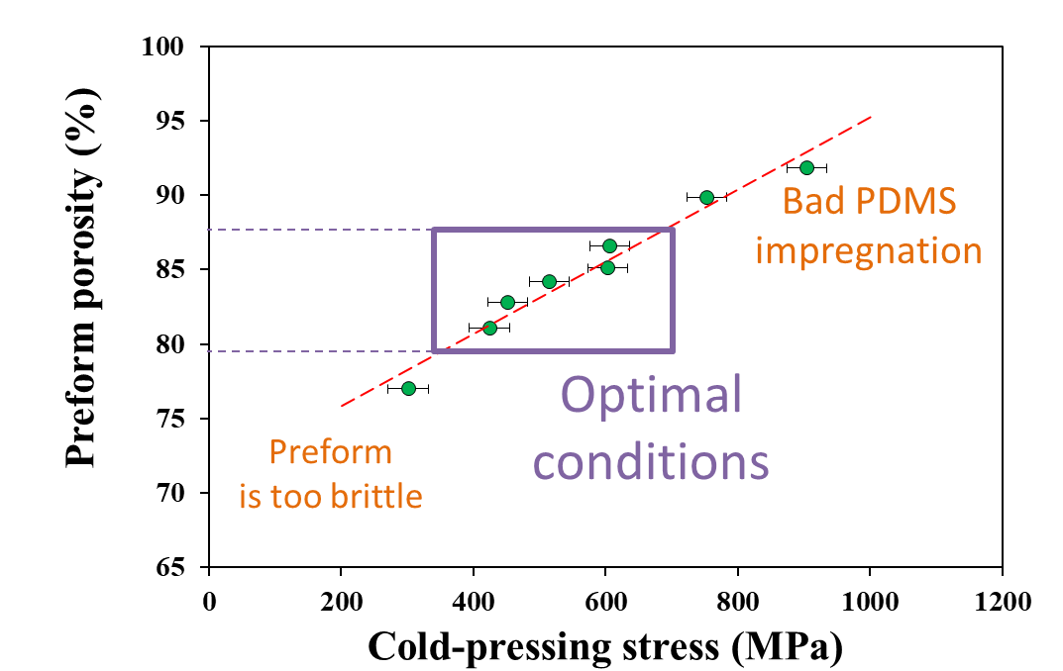
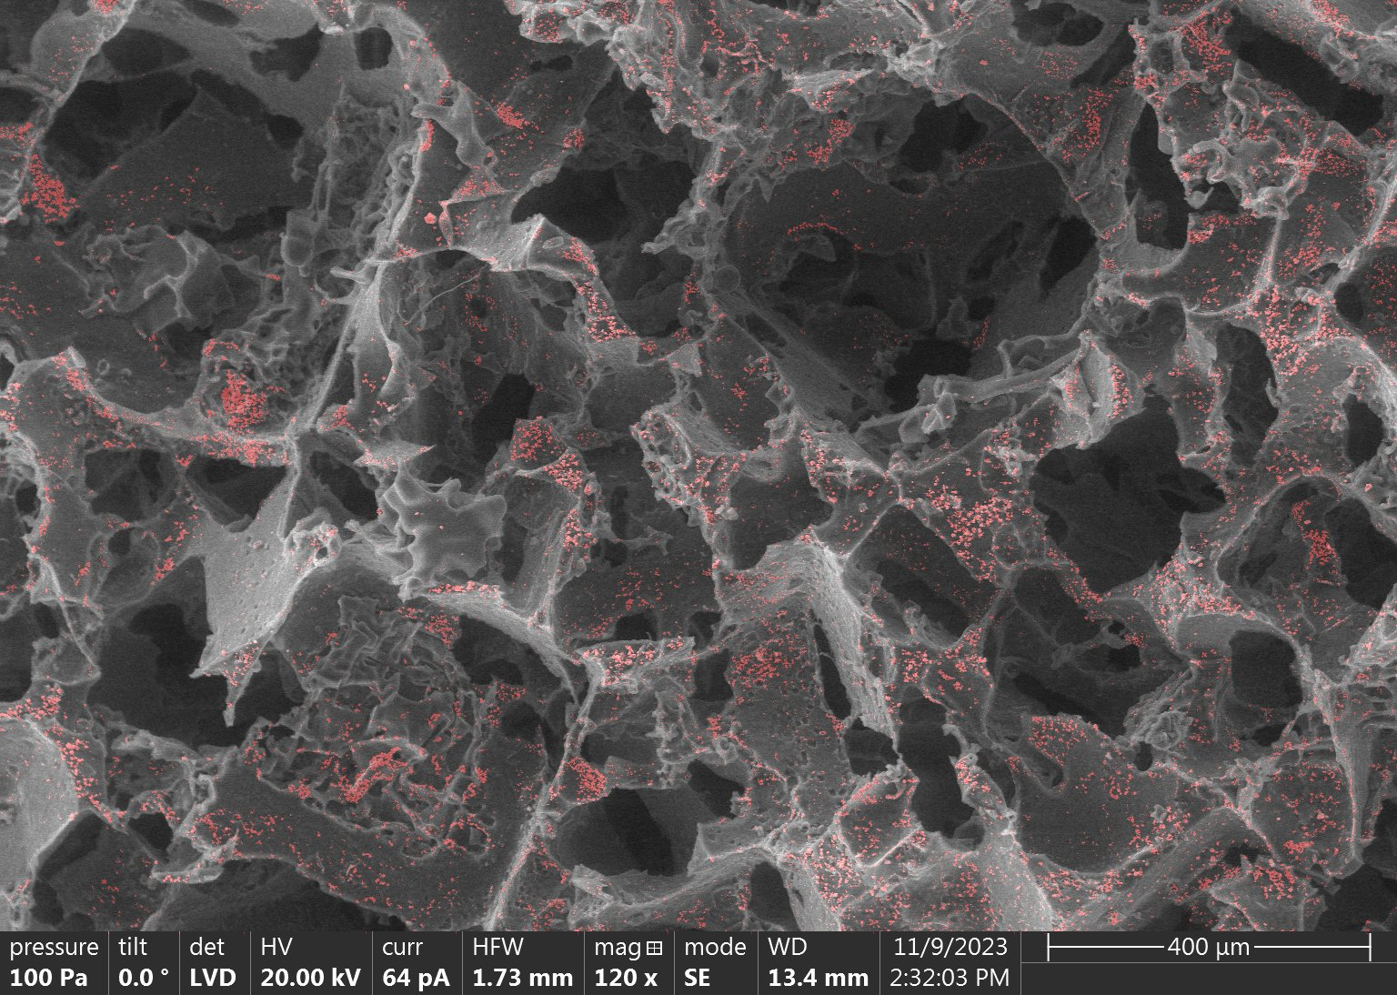
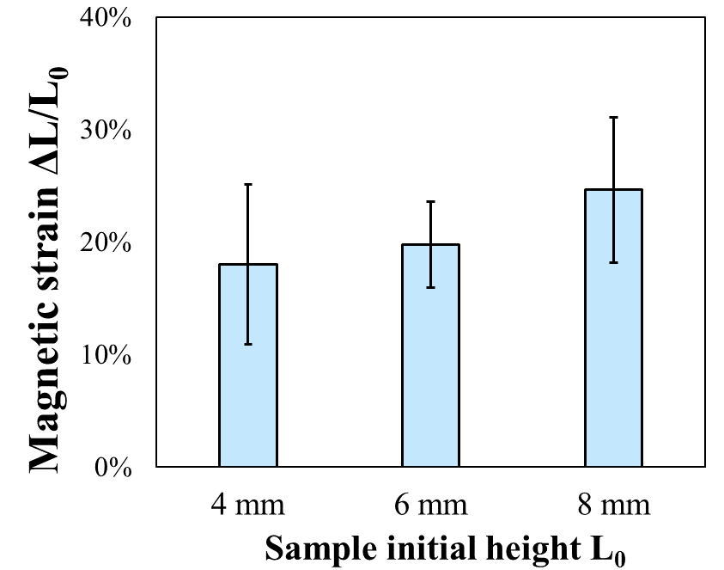
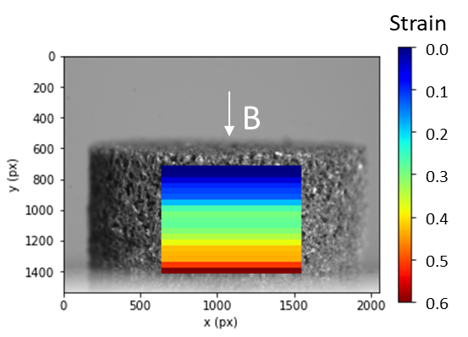
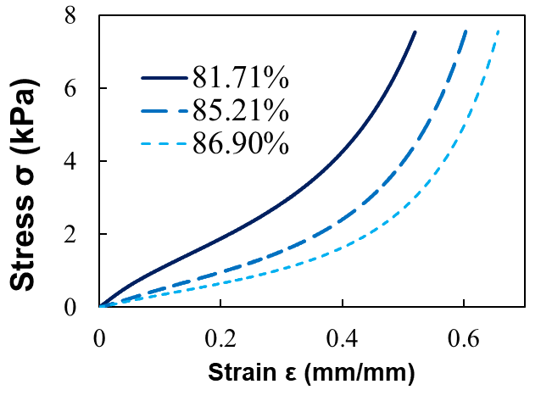

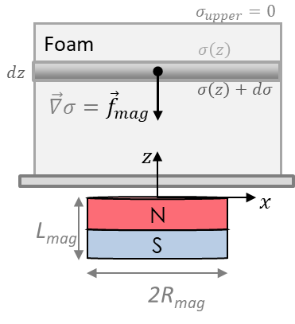

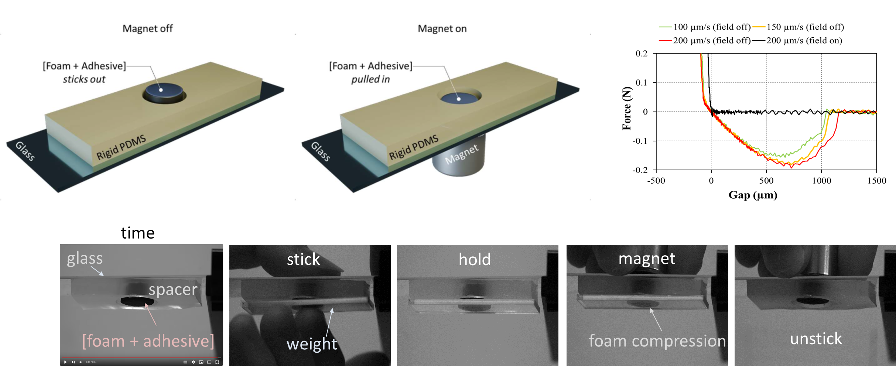

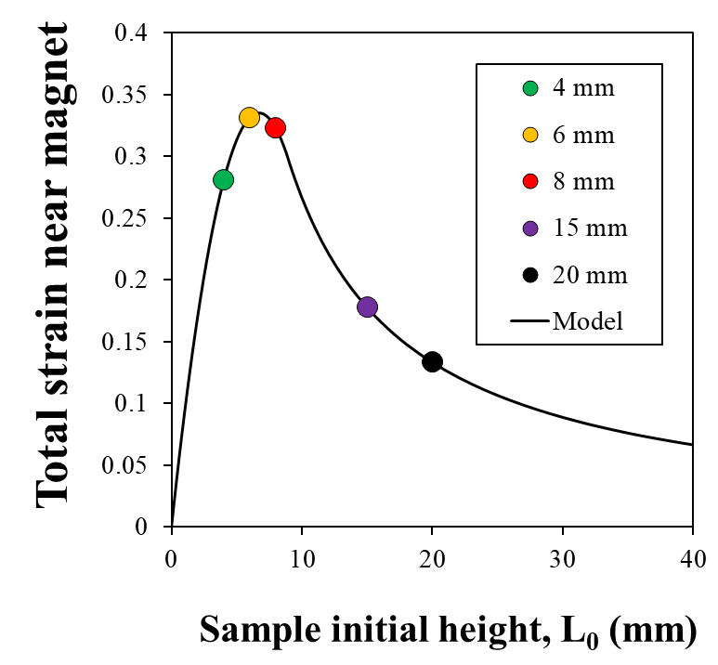








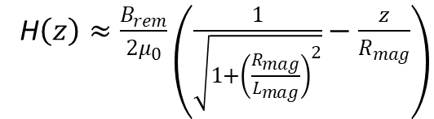



Magnetic elastomer foams as low Poisson’s ratio actuators
for switchable adhesion
Maxime Bès¹, Samuel Lamont², Jean-Claude Mancer¹, Ludovic Olanier¹, Franck Vernerey², Artem Kovalenko¹
¹ Laboratoire Sciences et Ingénierie de la Matière Molle, ESPCI Paris, PSL University, Sorbonne Université, UMR7615-CNRS, F-75005 Paris, France
² Department of Mechanical Engineering and Material Science & Engineering Program, University of Colorado at Boulder, Boulder, Colorado, USA.
artem.kovalenko@espci.fr
Introduction
Soft magnetic composites exhibit fast and programmable macroscopic deformations in magnetic fields and are promising for applications in soft untethered robotics or for design of surfaces with switchable adhesion or wetting. In practice, because of incompressible nature of the soft non-porous actuators their compression or elongation are limited, and bending and folding remain preferred actuation modes. Here, we explore the potential of magnetic foams as compressible actuators with low Poisson’s ratio.
Non-porous magnetic actuators
Magnetic foam actuators
easy
☹difficult
easy, with no lateral expansion
pore
Kim, Y.; Zhao, X. Chem. Rev. 2022, 122 (5), 5317–5364
What determines the strain?
How can we use these actuators?
Fabrication of model magnetic foams
Magnetic compression
L₀
Δ$l$
a
d
$$a_{NaCl}=400÷600 µm$$
$$Φ_{preform}=f(P)$$
$$d_{pores}=a_{NaCl}$$
$$Φ_{foam}≈Φ_{preform}$$
Magnet
Control of porosity
Microstructure characterization
Total strain
Strain field (DIC)
Fe microparticles
open
pores
Increase
ε≈0
200 µm
ε≈0.6
Mechanical properties
Observations:
Compression curves
Poisson’s ratio
Macroscopic deformation in a field of a permanent magnet;
The total strain increases with the sample height;
High strain gradient from the top to the bottom of the sample
$$Φ_{foam}$$
Cause: gravity-like action of magnetic force (= body force)
$$ν=0,16$$
See the modeling part for more details…
$${(ν}_{PDMS}≈0,5)$$
Flash for a video on foam-magnet interaction
Magnetic compression modeling
Switchable adhesion
Magnetic force
Mechanical equilibrium
Working principle
Adhesion tests (Tack)
$$f_{mag}=μ_{0}M∙gradH$$
field on
Approximations
field off
$M=χH, χ$_{sample} ≈ const (H)
H$\left(z\right)≈\frac{B_{rem}}{2μ_{0}}\left(\frac{1}{\sqrt{1+{\left(\frac{R_{mag}}{L_{mag}}\right)}^{2}}}−\frac{z}{R_{mag}}\right)$
Video
Strain gradient
Effect of L₀
Conclusions
Acknowledgments
optimum
sample height
We fabricated model soft magnetic PDMS foams with open porosity and low Poisson’s ratio.
Magnetically-induced compression is stronger for thicker foams.
We showed a proof-of-concept of a magnetically-triggered adhesive detachment.
Funding:
ANR MAGELAn
Jérôme Robert (IPCMS), Jérôme Fresnais (Phenix), Etienne Barthel (SIMM), Bruno Bresson (SIMM)

