Slide 1

Workshop with Lithuanian stakeholders: "Advanced Particle Therapy center for the Baltic States: Feasibility study“
September 23, 2024 @ KTU “Santaka” Valley
K. Baršausko str. 59, Room 225, Kaunas

Slide 2
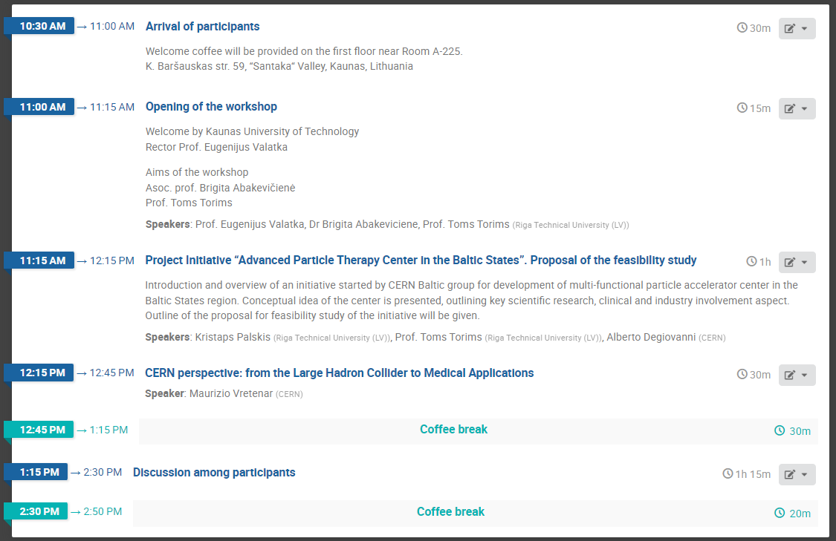
Agenda of event
https://indico.cern.ch/event/1451972/

Slide 3
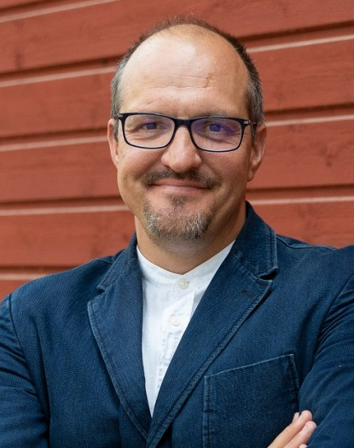
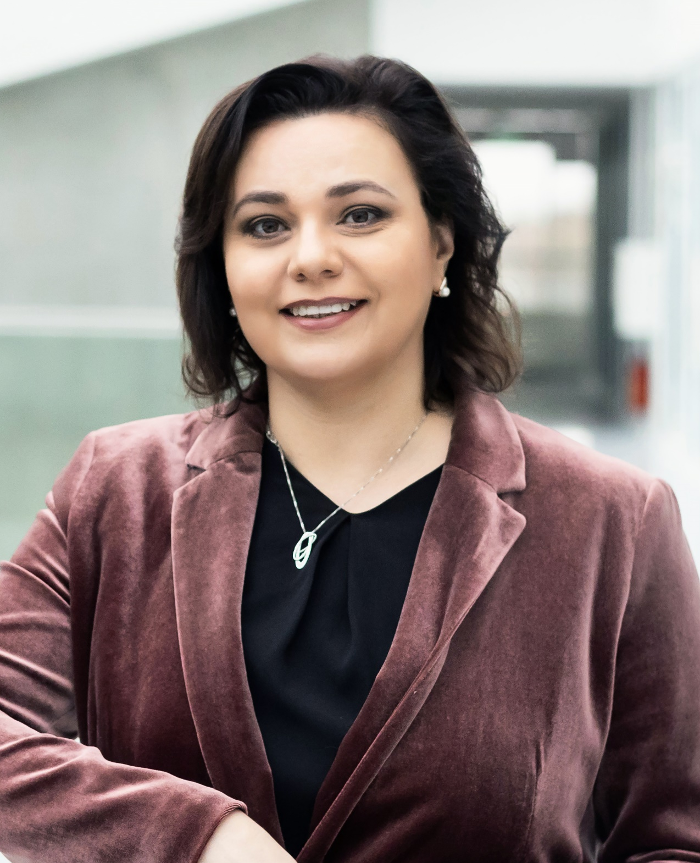
Workshop with Lithuanian stakeholders: "Advanced Particle Therapy center for the Baltic States: Feasibility study“
September 23, 2024 @ KTU
Prof. Toms Torims
t.torims@cern.ch
(CERN Baltic Group |
Riga Technical University, LV)
Dr. Brigita Abakevičienė
brigita.abakeviciene@ktu.lt
(CERN Baltic Group |
Kaunas University of Technology, LT)

