Slide 1
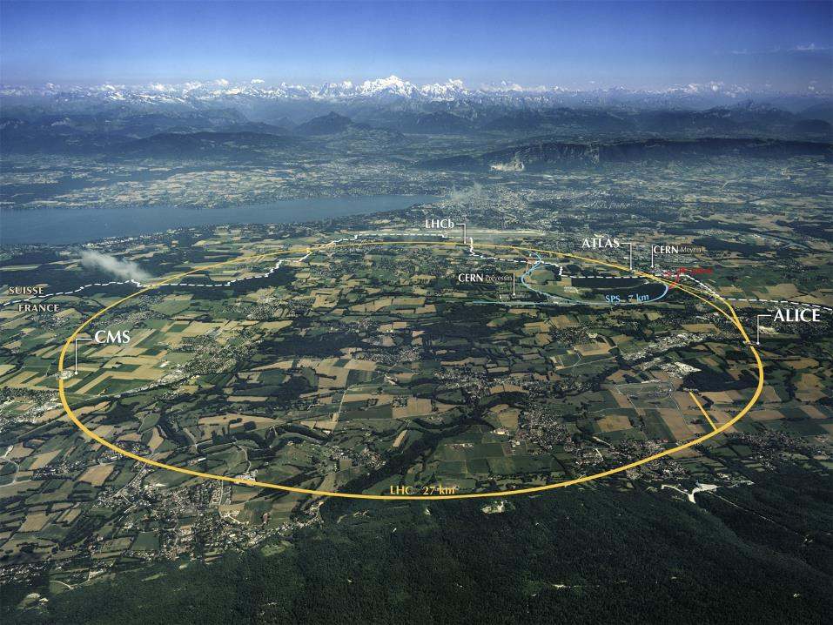
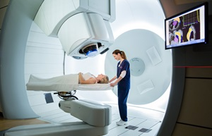

From the Large Hadron Collider to Medical Applications
Maurizio Vretenar
CERN, ATS/DO Accelerator and Technology Projects and Studies
Workshop with Lithuania stakeholders, 23.09.2024

Slide 2
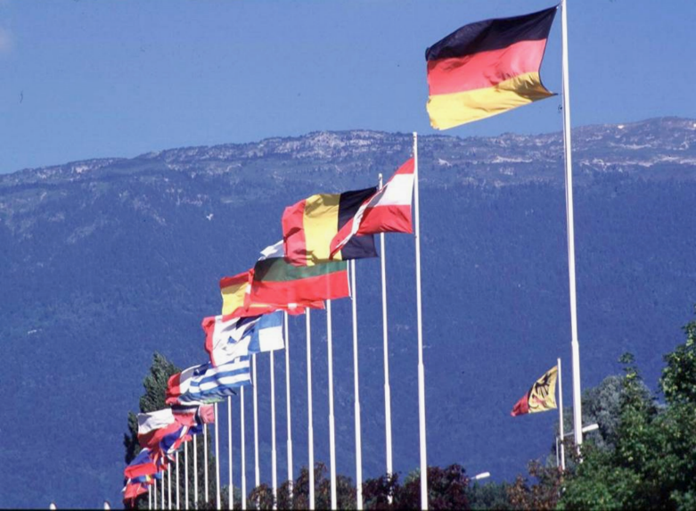
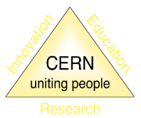
About CERN
CERN (“Conseil Européen pour la Recherche Nucléaire”) was founded in 1954 to promote “science for peace”.
Today an International Organisation with 23 member states, is the largest particle physics laboratory in the world.
~ 2600 staff
~ 1800 other paid personnel
~ 14000 scientific users
Budget (annual) ~ 1300 MCHF
24 Member States: Austria, Belgium, Bulgaria, Czech Republic, Denmark, Estonia, Finland, France, Germany, Greece, Hungary, Israel, Italy, Netherlands, Norway, Poland, Portugal, Romania, Serbia, Slovak Republic, Spain, Sweden, Switzerland, United Kingdom.
10 Associate Members: Cyprus, Slovenia, Brazil, Croatia, India, Latvia, Lithuania, Pakistan, Türkiye, Ukraine

Slide 3
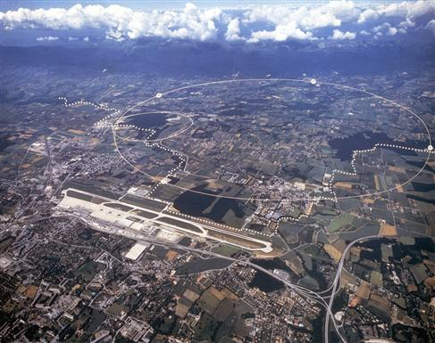

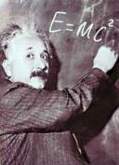


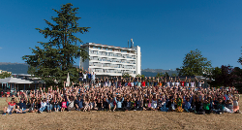
The mission of CERN
Push back the frontiers of knowledge
the secrets of the Big Bang …what was the matter like within the first moments of the Universe’s existence?
Develop new technologies for accelerators and detectors
Train scientists and engineers of tomorrow
Unite people from different countries
and cultures
The 27-km Large Hadron Collider (LHC), built and operated at CERN, is the largest particle accelerator in the world

Slide 4
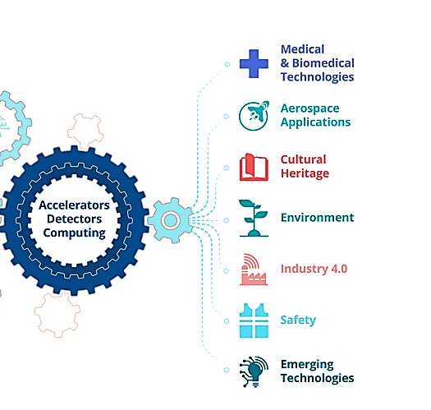
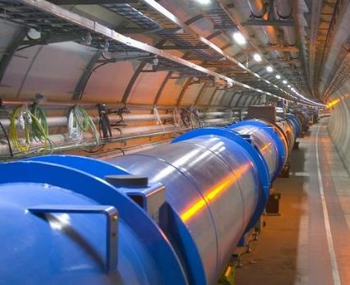
From the Large Hadron Collider to medicine
CERN and Society
Huge experience in the three technology pillars of CERN: Accelerators, Detectors, Computing.
Engaged to maximise the return to society and to demonstrate the impact of major investments as the Large Hadron Collider.
Medical Technologies are the main field of application of CERN technologies for the benefit of society.
The subatomic world made accessible using particle accelerators can lead to substantial advances in many fields of medicine: treatments with particles, isotopes, advanced diagnostics,…
Developing these technologies requires a strong collaboration across physics, biology, medicine - CERN can provide a fertile collaborative ground for them to grow.
CERN has a limited budget to support selected medical applications developed in a collaborative environment

Slide 5
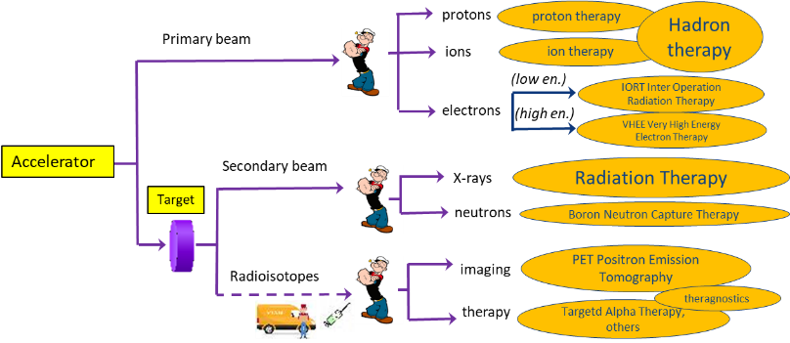
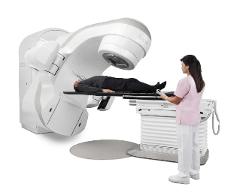
Particle accelerators, a formidable tool for medicine
Accelerators produce particles (photons, protons, ions) that can penetrate into the body to treat diseases and to observe internal organs without using surgical tools.
> 150
12
>300
0
≈ 14’000
15
≈ 1’500
0
Cancer treatment
Imaging
New cancer treatments
14,000 electron linear accelerators worldwide for X-ray therapy of cancer
Reference domains for the Baltic Advanced Particle Therapy Centre
5

Slide 6
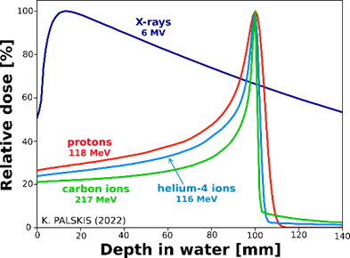
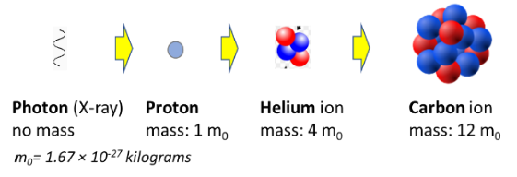
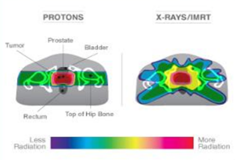
Treating cancer with particle beams
Comparison of dose for prostate cancer (protons vs. X-rays)
tumour position
Bragg peak:
Different from X-rays, protons and heavier ions deposit their energy at a defined (energy dependent) depth inside the tissues, minimising the dose to the organs close to the tumour.
Today only protons and carbon ions are licensed for treatment. Trials with helium ions (intermediate between the two) are starting at HIT Heidelberg.
Particle therapy recommended for cancers close to critical organs and paediatric. Many ongoing clinical trials to assess benefits for different types of cancer in terms of side effects and recurrencies.
Notes:
X-rays: atomic and molecular level – particles: atomic and subatomic level

Slide 7


The CERN Next Ion Medical Machine Study
Proton therapy is now commercial, and CERN, as an international organisation, cannot interfere with a mature commercial market.
Ion therapy is still in an early phase despite its advantages, limited by:
  Size and cost of the accelerator;
  Lack of experimental data.
New demands from the medical community and new opportunities from accelerator technologies can be integrated in newly designed ion therapy facilities.
Start in 2020 of the Next Ion Medical Machine Study (NIMMS).
In line with CERN mission, the goal of NIMMS is to build on CERN expertise to develop a portfolio of technologies that can be used in next generation facilities for ion therapy, more than developing a single design (NIMMS as a «toolbox»).
For its 5th year of activity, in 2025 NIMMS will be structured in an International Collaboration based on a (light) collaboration agreement, with a Collaboration Board, a Chair, and a Coordinator. Interested partners will be welcome to participate.

Slide 8


NIMMS as an international collaboration
NIMMS is an international collaboration based at CERN to develop new technologies for the future generation of accelerators for cancer therapy with ions.
Building on the CERN experience in small accelerators and in accelerators for medicine;
Federating partners to develop innovative designs and technologies;
Partners can use the NIMMS technologies to assemble their own optimized facility.
NIMMS collaborators in 2024 (19 partners)
SEEIIST (South-East European International Institute for Sustainable Technologies)
TERA/TERA-CARE Foundation (Italy/CH)
Riga Technical University (Latvia)
GSI (Germany)
CIEMAT (Spain)
INFN (Italy)
Cockcroft Institute (UK)
University of Manchester (UK)
CNAO (Italy)
Imperial College (UK)
MedAustron (Austria)
U. Melbourne (Australia)
ESS-Bilbao (Spain)
Sarajevo University (Bosnia &H.)
University of Thessaloniki (Greece)
PARTREC (Netherlands)
TENMAK (Türkiye)
ITRE (Slovenia)
University of Malta
In 2022/23 NIMMS has supported:
8 PhD Students
3 Post-Docs
2 Master students
NIMMS Funding:
CERN Accelerator and Technology Sector
SEEIST, RTU and TERA (personnel at CERN)
European projects HITRIplus and I.FAST
Donations

Slide 9
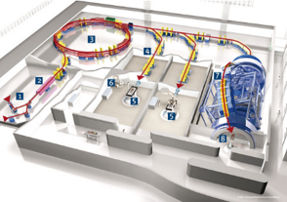
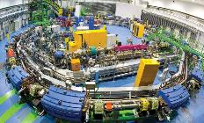
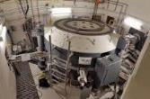
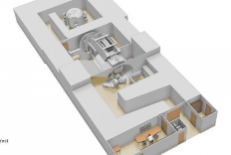
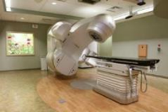

Accelerator designs for particle therapy
Heavier ions are more effective because they deliver more energy to the tissues, but need more energy to enter the body → factor 2.8 in accelerator diameter from protons to carbon
Synchrotron, carbon ions
~5,000 m²
~250 M€
courtesy IBA
Cyclotron or synchrotron, protons
~500 m²
~40 M€
Commercially available Specially designed and built
Linac, X-rays
~50 m²
~few M€
New range to explore: compact synchrotron for light ions

Slide 10
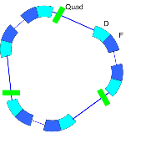
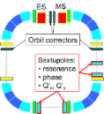
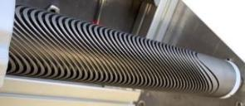
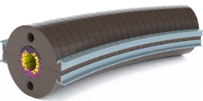
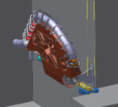
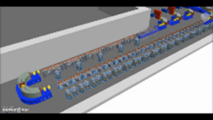
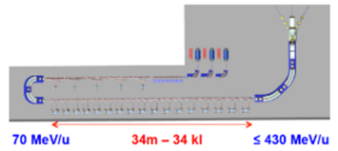
NIMMS Accelerator Technologies
Small synchrotrons
for particle therapy
Reduced dimensions with improved performance (injection, extraction)
2. Curved superconducting magnets
for synchrotrons and gantries
Canted Cosine Theta, NbTi or HTS
IFAST EU project
HITRIplus EU project
3. Superconducting gantries
Precise beam delivery on multiple angles
4. High-frequency ion linacs
EU supporting initiatives
Compact bent layout

Slide 11
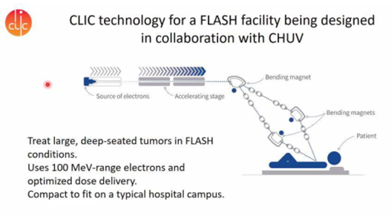
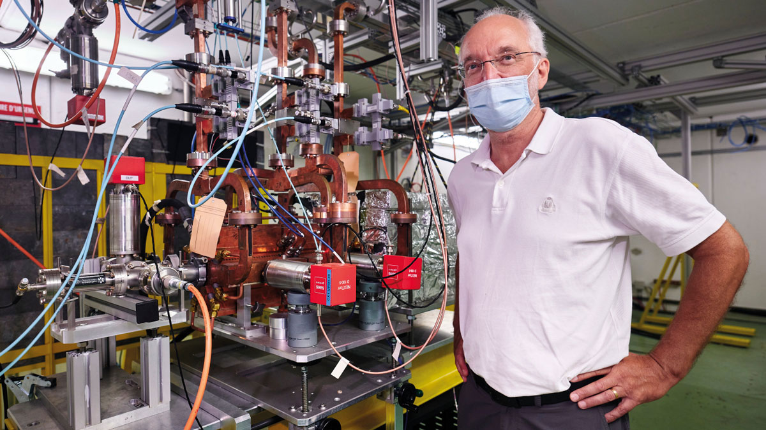
Other CERN initiatives: the electron FLASH project
Cancer treatment with Very High Energy Electrons (VHEE) combined with the FLASH effect
Treating tumours delivering radiation in short pulses at ultra-high dose rates appears to reduce toxicity to healthy tissue while maintaining tumour control.
Dose delivered in fractions of a second instead of several minutes.
First observed in the 70’s, rediscovered in 2014 (Favaudon and Vozenin), 1st treatments 2014-18, 1st clinical trial in 2020.
A collaboration CERN – CHUV Lausanne- TERIQ company is building a 100 MeV linac based on CERN Linear Collider technology, intended to become commercial and pave the way for new treatments based on the FLASH effect.
Courtesy W. Wuensch, CERN
Courtesy W. Wuensch, CERN

Slide 12

NIMMS-supported designs

Slide 13
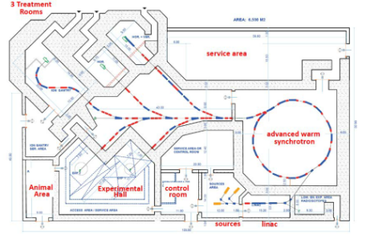
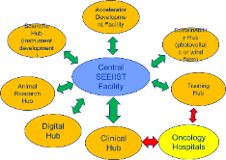
1. SEEIIST carbon ion therapy and research facility
Intensive design work in 2019/20 in collaboration between CERN and SEEIIST, with the contribution of TERA and other NIMMS partners, and of the European ion therapy centres: complete modern facility for research and therapy with ions up to Oxygen
A. Innovative SEEIIST features:
Optimised for 50% research and 50% patient treatment (~400 patients/year);
Providing 20 times higher beam intensity for carbon ions than present facilities;
Equipped with flexible extraction for operation in FLASH mode;
Equipped with dual mode linear injector capable of producing radioisotopes for cancer imaging and therapy.
C. Conservative SEEIIST feature:
  The synchrotron adopts the well-established PIMMS design (known and available components, flexible layout for research);
D. Specific SEEIIST features:
Environmental strategy: minimise energy consumption, strategy for energy generation;
Conceived as a multiple-hub facility, to federate partners in different countries.
B. Advanced SEEIIST features (common to other advanced facilities):
Operation with multiple ions: protons, Helium, Carbon, Oxygen, Argon;
Multiple energy extraction (multiple flat-tops) for faster treatment;
Equipped with a compact superconducting gantry of novel design.

Slide 14
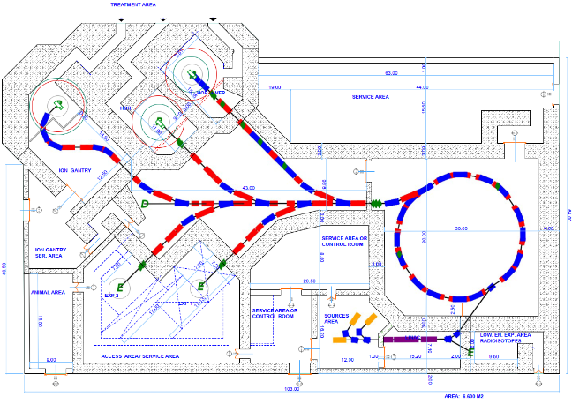
Layout of the complete SEEIIST-type facility
Access for therapy
Total 5,400 m² (including shielding)
Estimated cost (2019):
240 M€ (including personnel for construction)
Design to be presented in a CERN Yellow Report in preparation
Equipment room and access to synchrotron
Area for future expansion
Target for isotope production
Access for animal testing
Reconfigurable experimental room
Access to experimental room and linac

Slide 15
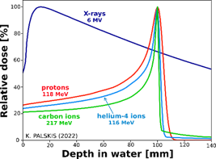

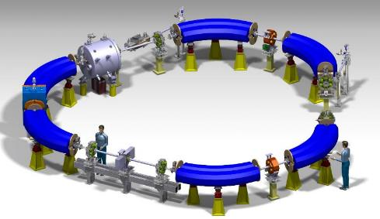
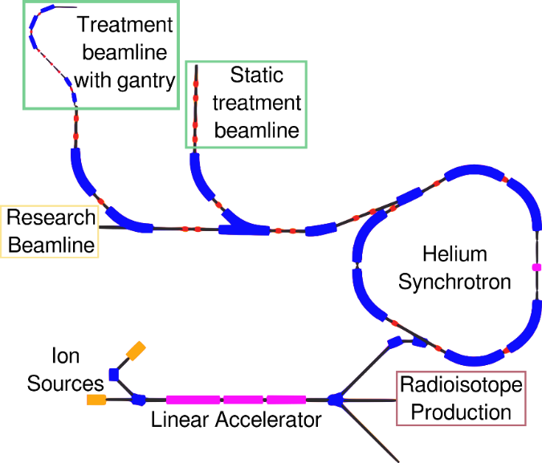
2. Helium & proton therapy and research facility
A facility centred on a compact helium synchrotron based on CERN technology
A facility for cancer research and therapy with helium ions
2 beamlines for treatment, 1 for research.
Slow and FLASH-type extraction.
On-line proton radiography.
Rotating superconducting gantry.
Linac for parallel radioisotope production (211At)
Synchrotron circumference 33m
Surface ~1,600 m2
Presently, only protons or carbon ions are used for treatment.
Therapy with helium ions, under development at Heidelberg, will provide at an affordable accelerator cost maximum conformality with excellent effectiveness.
Ideal in particular for paediatric patients.
11 m

Slide 16

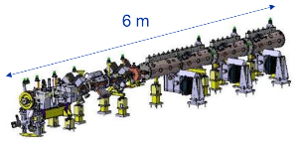
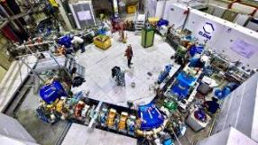
The accelerator elements of the facility
11 m
Ion linear accelerator for synchrotron injection and production of medical radioisotopes
Compact triangle-shaped synchrotron
The design of the accelerator is progressing fast.
Mechanical layout and main components are based on a synchrotron recently built at CERN for deceleration of antiprotons (ELENA – image to the right)

Slide 17
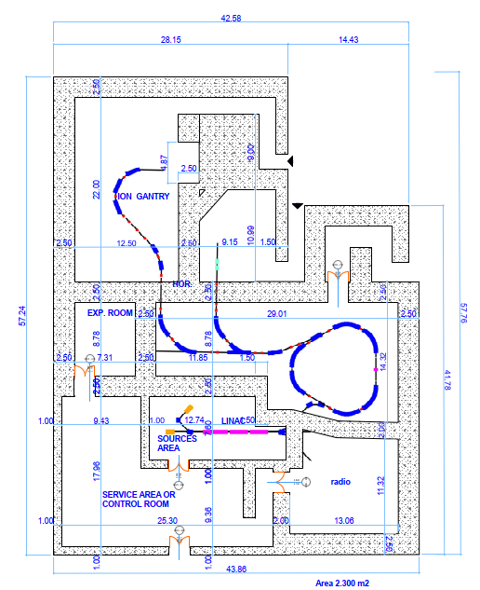
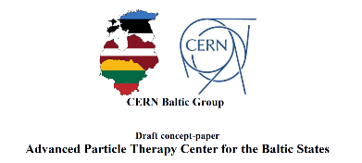
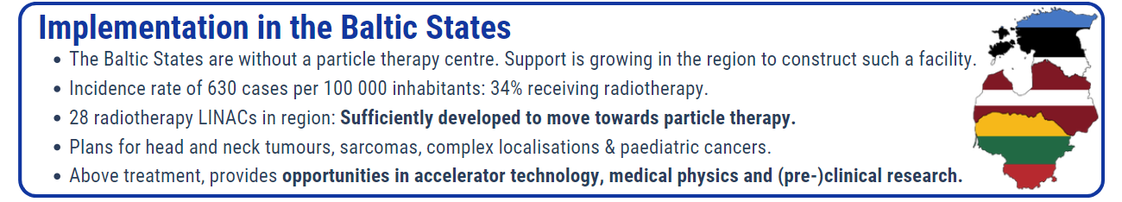
Advanced Particle Therapy Center for the Baltics (APTCB)
CERN Baltic Group (CBG)
14 Latvian, Estonian, and Lithuanian research institutions involved in CERN activities (LUHS is a partner, together with other 5 Lithuanian institutions).
The CBG has compared 5 options for a new Research Infrastructure for cancer therapy and research with particle beams in the region. The Helium synchrotron has been selected as the one giving the best combination of cost, innovation, scientific reach, treatment opportunities.
Concept developed in collaboration between NIMMS and CBG, regional project with EC support
Strategy: the NIMMS Collaboration will complete in 2025 a Technical Design Report available to all NIMMS collaborators. CBG will prepare a Feasibility Study covering medical, infrastructural, and economical aspects (business plan).

Slide 18
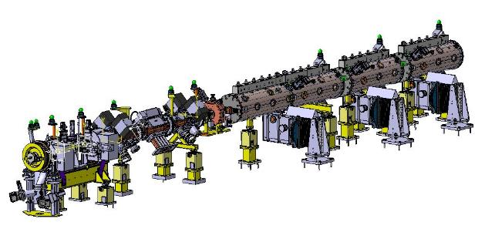
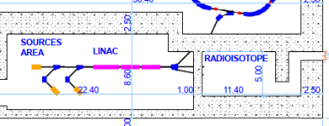
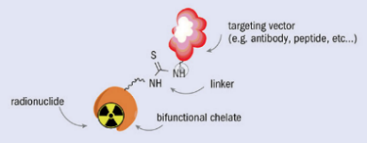
3. Linear accelerator for radioisotope production
Coupling particle therapy with nuclear medicine
The linear injector of a helium therapy synchrotron can be used to produce radioisotopes for imaging and therapy, in parallel to operation for therapy.
Linear accelerators are more efficient and less demanding than conventional cyclotrons for operation with helium ions.
Radioisotope | Usage
Scandium-43, 44 | Diagnostic – PET
Cobalt-57 | Diagnostic – SPECT
Copper-64 | Theranostic (β⁻)
Copper-67 | Theranostic (β⁻)
Indium-111 | Diagnostic – SPECT
Tin-117m | Theranostic (β⁻)
Samarium-153 | Theranostic (β⁻)
Rhenium-186 | Theranostic (β⁻)
Astatine-211 | Therapeutic (α)
synchrotron
radioisotope production target
Courtesy K. Palskis, RTU/CERN
Example: Targeted Alpha Therapy with Astatine 211
Alpha particles = Helium ions (2 protons, 2 neutrons) are the most dangerous radiation, short range and high toxicity!
The linear injector produces alpha-emitting therapeutic isotopes like 211At that are attached to antibodies and injected to the patient. The targeting vector accumulates the isotopes in the cancerous tissues where they selectively deliver their dose.
Advanced experimentation, promising for solid or diffused cancers (leukaemia).
Image credit: Caterina F Ramogida, CERN Courier

Slide 19
NIMMS dissemination strategy
CERN with the help of collaborating institutes providing resources (personnel) will deliver in June 2025 a Technical Design Report (TDR) for the helium therapy and research facility with an annex on isotope production. This design will be available to all NIMMS collaborators and other interested partners in CERN Member and Associate Member States.
Partners willing to use the technologies described in the TDR can integrate this design into a proposal to their funding agencies (an implementation plan, as the Feasibility Study for the APTCB).
If and when their proposal is approved, the Partners can negotiate with CERN an agreement to transfer the technology (drawings, fabrication procedures, expertise) for the components that are available at CERN. This transfer can be done at different levels of engagement, subject to negotiations at political level.

Slide 20
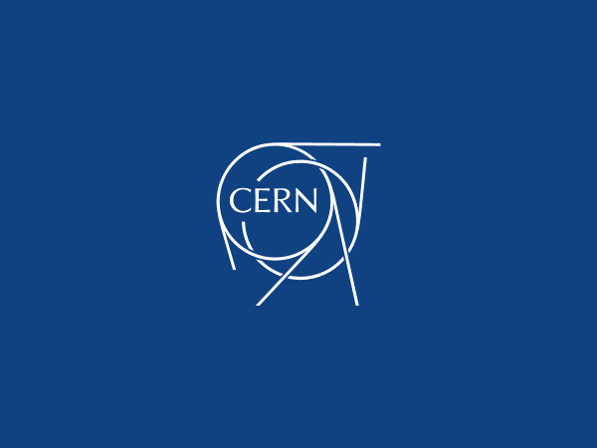
Thank you for your attention

Slide 21

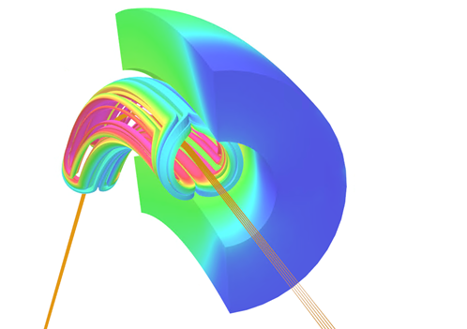
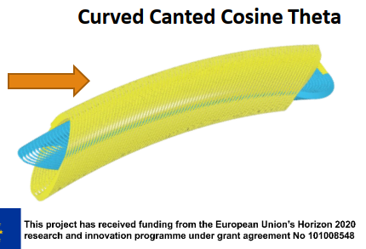
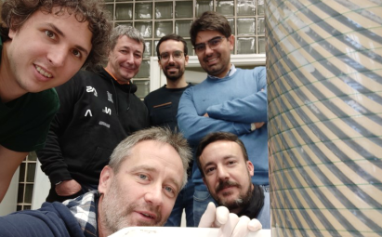
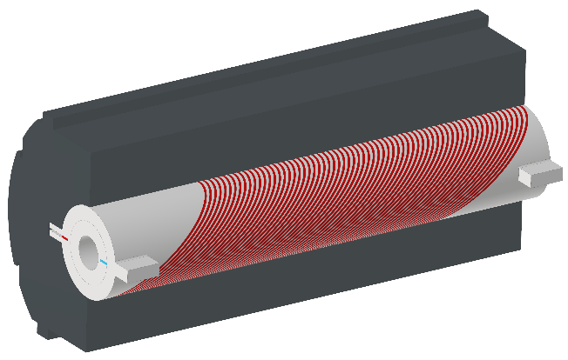
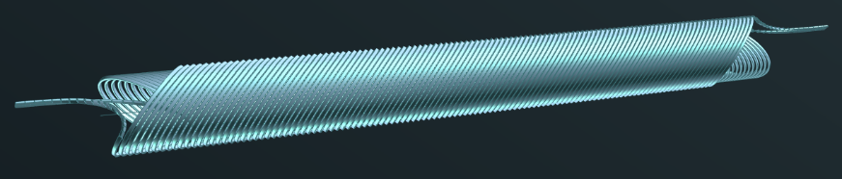
Superconducting magnets for synchrotrons and gantries
The main avenue to reducing the dimensions of a magnetic system is superconductivity.
But medical accelerator magnets have specific challenges: ramped field, curved shape, integrated focusing
4 projects launched for the construction of 5 demonstrator magnets (short length, pre-prototypes) supported by 3 collaborations:
1. Cos-theta (2 demonstrators, thermal and curved) for gantry
4 T, 0.4 T/s, 80 mm ø, r=1.65 m (430 MeV/u)
collaboration INFN-CERN-CNAO-MedAustron
CERN (courtesy M. Karppinen)
2. Canted Cosine Theta (CCT) curved demonstrator
4 T, 0.4 T/s, 80 mm ø, r=1.65 m (430 MeV/u), 30⁰
EU Project HITRIplus (2021-25)
3. Combined-functions LTS CCT straight demonstrator
4 T + 5 T/m quadrupole, 80 mm ø, L=0.73 m
4. Combined-functions HTS CCT straight demonstrator
4 T @ 10 K, ReBCO tapes, 80 mm ø, L=1 m
EU Project I.FAST (2021-25)
INFN (courtesy E. De Matteis
Only 1 out of 5 demonstrators will be built at CERN!

Slide 22
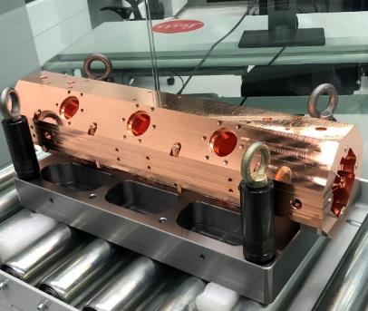
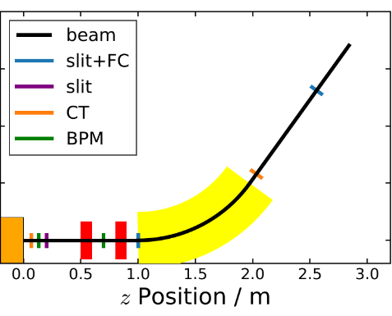


Low-energy beam and He/C-linac test stand
CERN is acquiring a “Supernanogan” ion source funded by a donor: after the end of tests at CERN the source will be the core of an ion beam laboratory at the University of Sarajevo.
The source will be completed with a small accelerator (RFQ) provided by CIEMAT (Spain) and used to test different beam configurations with e/m= ½ (helium, fully stripped carbon).
A test stand area for low-energy medical beams will be equipped at CERN and operated in the period 2024-25.
Practical experience on optimisation and operation of the critical injector (current, emittance), valid for both the HF linac and the synchrotron
“Long-term” objective: a folded Carbon therapy high repetition frequency linac
He ion source
RFQ, 2.35 m
Beam measurement line (2.5 m)
Ordered (9/23)
In construction
Being assembled

Slide 23




Gantries: superconducting ion gantry, Gatoroid
Development of a rotating SC gantry for Carbon ions:
CERN-INFN-CNAO-MedAustron: magnets, dose delivery, range verification, scanning system.
HITRIplus EU project (CNAO, RTU, SEEIIST, CERN: optics and mechanics design.
Courtesy L. Piacentini (CERN, RTU), E. Felcini, M. Pullia (CNAO)
4 magnets 45⁰, 360⁰ rotation
Development of a toroidal gantry (Gatoroid) at CERN.
Explored proton and carbon versions, now concentrates on a non-superconducting version for electrons, to be tested with low-energy protons.
VHEE version of the Gatoroid gantry, based on normal conducting magnets.
Inherent FLASH capability with multidirectional treatment.
Being designed at CERN.
(image courtesy T. Lehtinen, L. Bottura)

