Slide 1
Advanced Particle Therapy center for the Baltic States
Overview, status and outlook of Feasibility Study
On behalf of CERN Baltic Group’s “Advanced Particle Therapy center for the Baltic States” working group
Prof. Toms TORIMS (CERN Baltic Group, RTU)
Kristaps PALSKIS (RTU)

Slide 2
Mandate
On April 12th 2022 within CERN Baltic Group 9th general meeting at CERN the Advanced Particle Therapy Center in Baltic States Working Group has been established
Mandate: Develop and induce CBG flagship project - construction of a large scale scientific research and clinical particle therapy facility in the Baltic States
To achieve this initial goal:
establish Expert Team composed by medical professionals nominated by professional associations in the fields of radiology, therapeutic radiology, nuclear medicine, medical physics and others, researchers from CBG institutional members and experts of the NIMMS collaboration;
facilitate the work of the Expert Team in order to evaluate the feasibility of the proposed project initiative
establish Stakeholder Advisory Panel comprised by the relevant stakeholders in political, economical, social and other involved fields, as well as industry partners;
regularly inform Stakeholder Advisory Panel from Expert Team side, with the inclusion in the decision making process and overall development of the project.
Today – report on the idea of initiative, work done so far and foreseen future Feasibility Study

Slide 3
Outline
Recap: particle therapy initiative in the Baltic States
Recap: stakeholder engagement activities
The workshop “Particle therapy - future for the Baltic States? State-of-play, synergies and challenges”
Political support of the initiative
Future outlook on the Feasibility Study

Slide 4
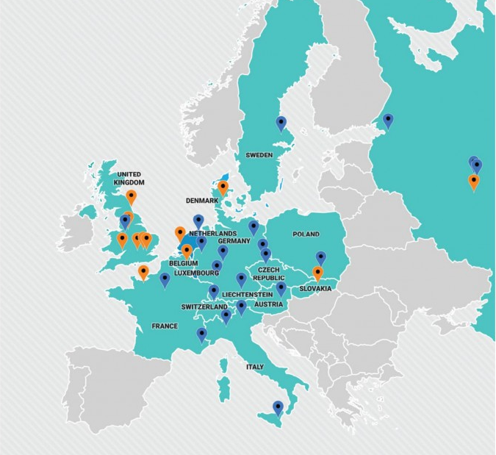
The “why” of the initiative idea: clinical perspective
In 2018 – 4.23 million new registered cancer cases in Europe
By 2040 – estimated 5.2 million new registered cases
More than 50% of cancer patients require radiation therapy BUT
1 in 4 patients do not receive the treatment
One of the main causes – lack of technology
For specific cancer types – particle therapy is the ONLY optimal treatment modality
Particle therapy centre geography in Europe, ENLIGHT 2018

Slide 5
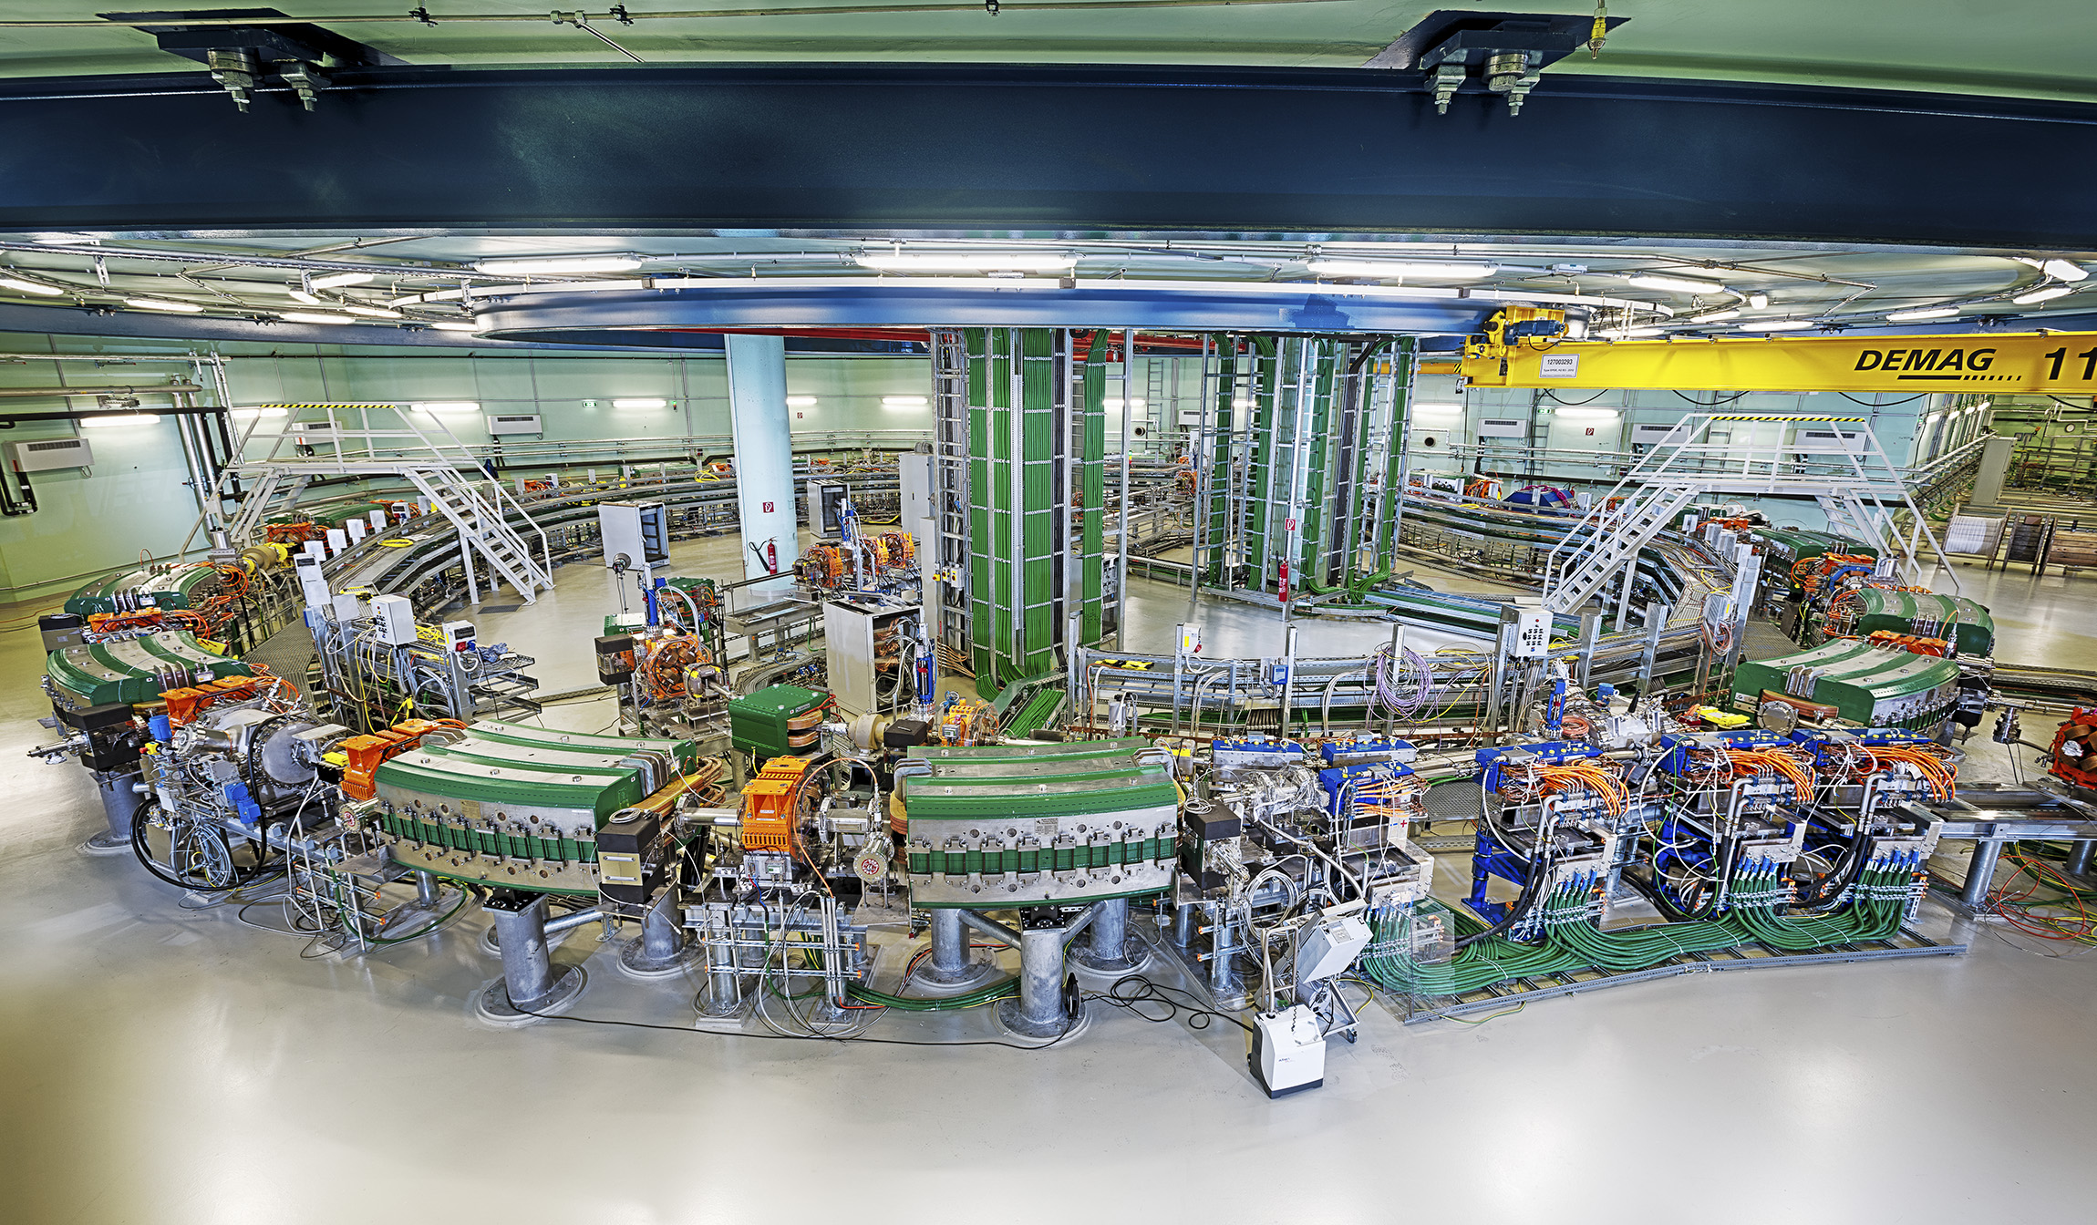
The “why” of the initiative idea: scientific research perspective
The Baltic States are lacking a joint, large-scale multi-disciplinary scientific research infrastructure
Opportunities to develop broad programme in various new research areas for the region
Joint particle accelerator based research infrastructure would foster even more fruitful collaboration with
the European Organization for Nuclear Research

Slide 6
Recap: Road to the initiative
October 8th, 2021
CBG discussion with NIMMS collaboration on facility options

Slide 7

Recap: NIMMS collaboration
Next Ion Medical Machine Study
CERN-based scientific collaboration (under KT) for development of next generation particle accelerators for cancer treatment with ion therapy
  Building on experience of PIMMS
  Federating large number of partners for key technology development
  Partners can use the NIMMS technologies to assemle their own optimized facility

Slide 8
Recap: Road to the initiative
State-of-art technology
Novel pathways for scientific research
Financially viable option for the region
If possible – limited R&D risk
HELIUM SYNCHROTRON
Development of a novel ion therapy system
Novel treatment techniques
Vast possibilities of scientific research
Local industries for construction of the facility
Attractive to patients and research from the whole Europe
A circular particle accelerator in development by NIMMS collaboration
Acceleration of protons and helium ions to treatment energies
Higher energy protons for ion radiography purposes
Possibility for heavy ion acceleration (carbon, oxygen) for biophysics research
Possibility of ultra-fast dose rate delivery (FLASH)
Possibility of parallel production of therapeutic and diagnostic radioisotopes
On initial design: M. Vretenar, E. Benedetto, M. Sapinski, M. E. Angoletta, G. Bisoffi, J. Borburgh, L. Bottura, K. Paļskis, R. Taylor, G. Tranquille: A Compact Synchrotron for Advanced Cancer Therapy with Helium and Proton Beams
Commercially available proton therapy system
5 options from NIMMS toolbox
CYCLINAC
CARBON LINAC
HELIUM SYNCHROTRON
NC CARBON SYNCHROTRON
SC CARBON SYNCHROTRON

Slide 9
Recap: Road to the initiative
April 12th, 2022
“Advanced Particle Therapy center for the Baltic States” working group established within the CERN Baltic group (CBG)
Convener: Prof. Toms Torims (RTU)
Vice-convener: Prof. Diana Adliene (KTU)
Spring 2022
Development of a dedicated conceptual design report
February 2022
NIMMS Helium synchrotron working group establishment with involvement of researchers from the CBG

Slide 10
Recap: The overall concept
Integration of helium synchrotron technology and all the capabilities into a modern clinical treatment center and large scale scientific research infrastructure
Clinical cancer treatment facility
Particle therapy and nuclear medicine
Industry involvement infrastructure
Research institution
For more details on conceptual idea, refer to: Conceptual design idea report and Presentations from last bi-lateral meeting

Slide 11
Recap: The overall concept
Clinical treatment with proton therapy
Clinical research and future treatment with helium ion beams
Novel delivery methods – FLASH, mini-beams. Possibilities of proton radiography
Possibility of parallel radioisotope production – diagnostics for radiotherapy treatment planning, theranostics approaches and targeted alpha therapy
Pre-clinical and clinical research work necessary for novel therapy integration
Particle therapy research fields – medical physics, radiobiology, dosimetry, accelerator physics and technologies
Complementary research fields – material science, radiation chemistry, particle physics aspects . . .
Possibility of heavier ion research (carbon, oxygen)
Involvement of relevant industry sectors in delivery of center – capacity and “know-how” in accelerator technologies
Infrastructure provides possibilities of future R&D activities in particle therapy technology developments, addressing the global needs of the community
For more details on conceptual idea, refer to: Conceptual design idea report and Presentations from last bi-lateral meeting

Slide 12
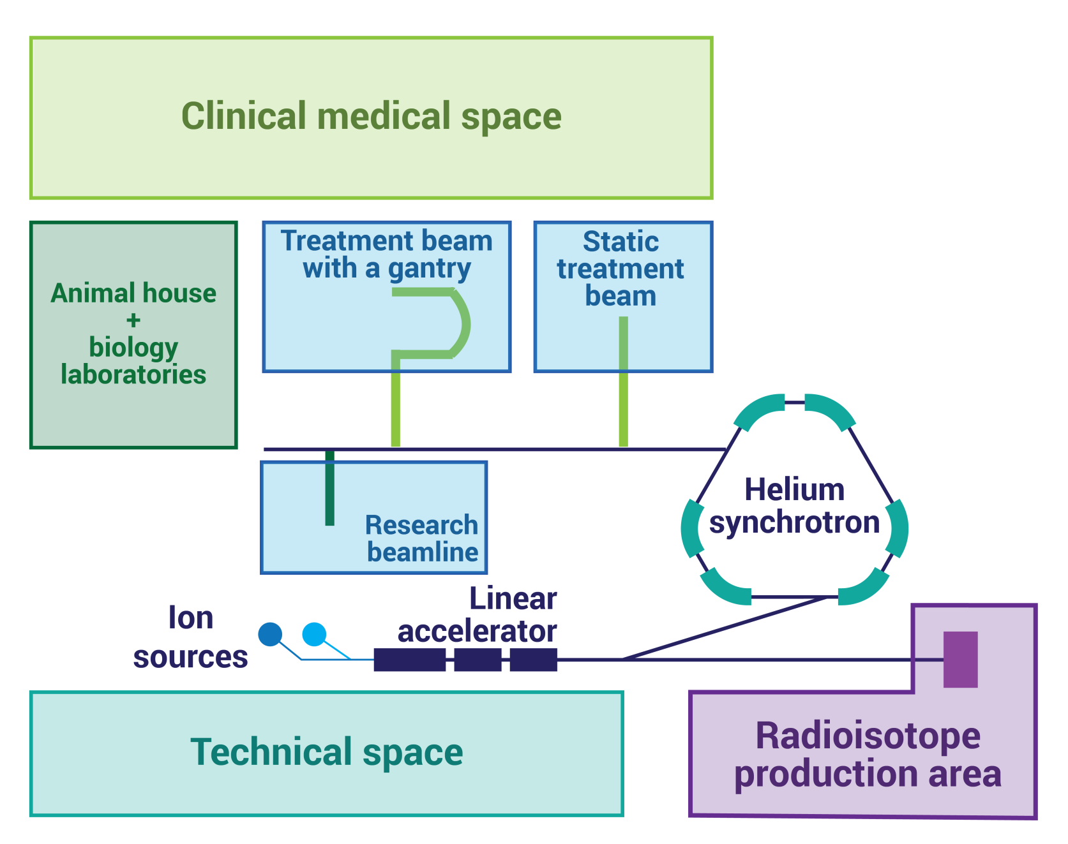
Recap: The overall concept

Slide 13
In unison with medical community: professional societies
Oct 2022 Presentation at the 8th Baltic Radiology congress
Jan 2023 Presentation at Lithuanian Society of Radiation Therapy conference
Mar 2023 Presentation for Latvian Therapeutical Radiology Association
Spring 2023 Discussions on conceptual idea with Baltic Nuclear Medicine Association
Jun 2023 Presentation at 19th Nordic-Baltic Conference on Biomedical Engineering and Medical Physics
Jun 2023 Presentation at Educational course of International Stereotactic Radiotherapy Society held in Latvia

Slide 14
Milestones achieved
End of 2021
Idea and
first discussions
Aug 2022
Baltic Assembly support – letter to 3 prime ministers
May 2023
Baltic implementation – part of IPAC paper by NIMMS
Oct 2023
Report on the workshop findings approved by CERN Baltic Group
Oct 2022
Resolution of Baltic Assembly
Presentations and discussions with relevant professional societies,
scientific universities and political stakeholders
Apr 2022
Conceptual design paper and working group establishment
Oct-Nov 2022
Bi-lateral discussions with stakeholders in all 3 Baltic States
25th of May 2023
Workshop at CERN
Particle therapy - future for the Baltic States? State-of-play, synergies and challenges

Slide 15
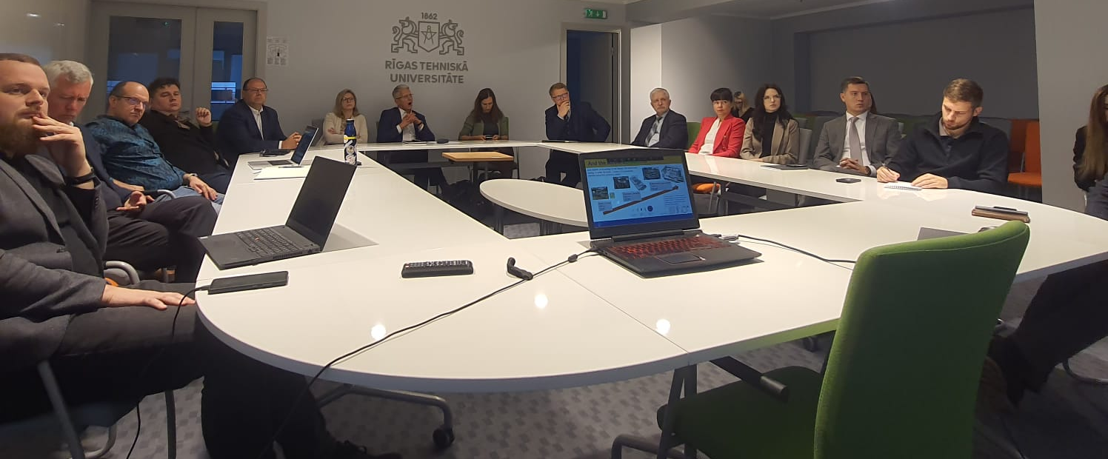
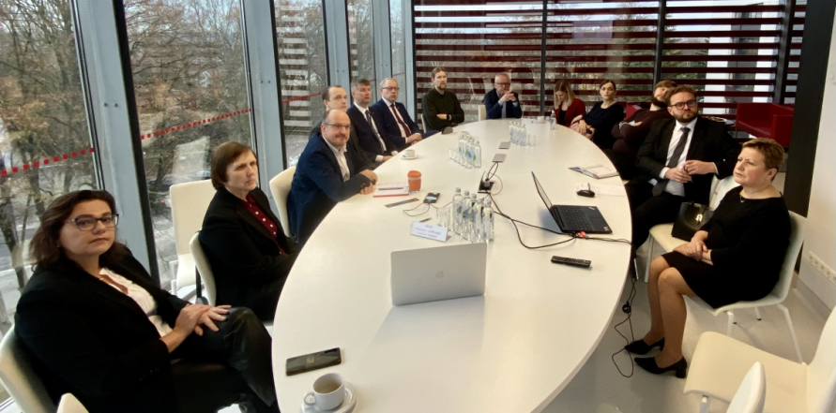
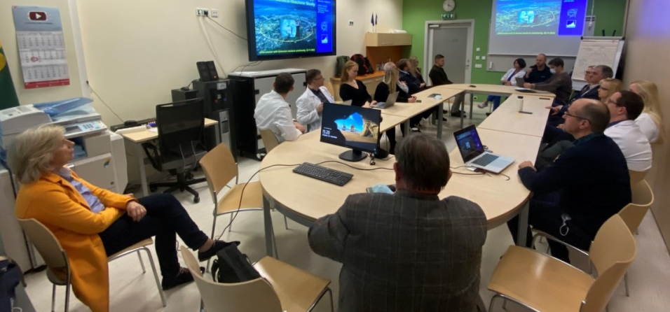



The bi-lateral meetings with medical and other stakeholders
Set-up of the events
Meeting relevant stakeholders in all 3 of the Baltic countries
Invitations to professional associations and societies of radiologists, nuclear medicine specialists, radiation oncologists and medical physicists as well as representatives of involved universities, research institutions and political bodies
Meetings were aimed to be in-person for maximum engagement
18th of October – Latvian stakeholders, Riga
16th of November – Lithuanian stakeholders, Kaunas
22nd of November – Estonian stakeholders, Tallinn
20 – 30 participants in each of the meetings

Slide 16
The bi-lateral meetings with medical and other stakeholders
Grateful for NIMMS collaboration representation in these meetings
Set-up of the events
Agenda of the events:
  Overview of CERN and NIMMS activities in medical technology development
  Overview of CERN Baltic Group and current status of initiative related activities
  Presentation of the conceptual design idea for the proposed facility
  Discussion session
A summary report was developed after each of the meetings, outlining key discussion topics and concerns
General support and interest in the conceptual idea and initiative
BUT, of course, there are various aspects that should be looked into in greater detail before going forward
How should we proceed?

Slide 17

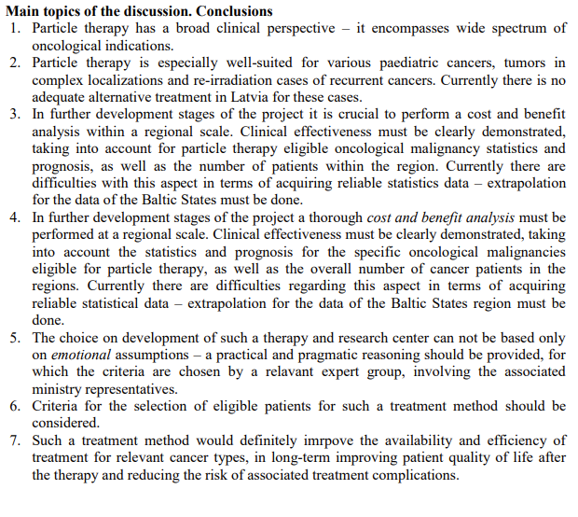
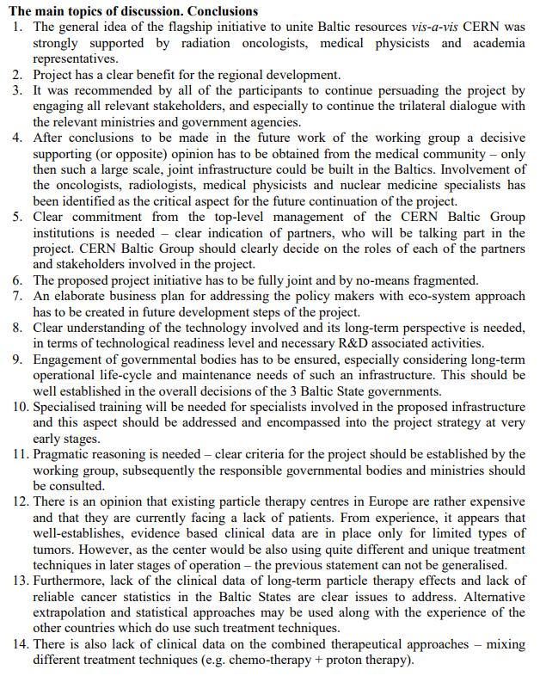
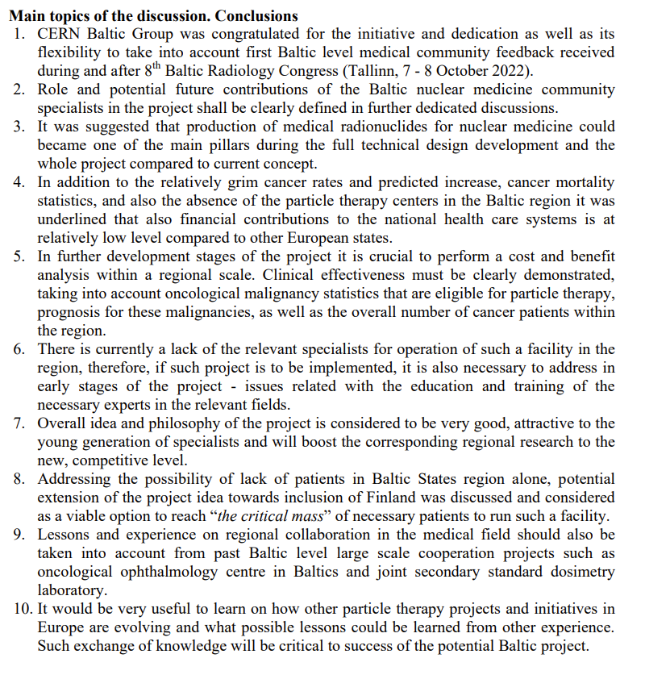
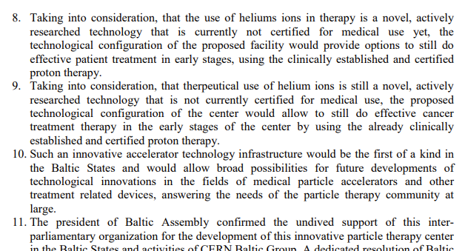
Lessons learned from the bi-lateral meetings
Baltic cancer statistics
Cancer types eligible
Clinical evidence of proton therapy
Do we have enough patients?
?
Lack of specialists
Training and experience from other centers
How developed is the technology?
Radioisotope production
Involvement of nuclear medicine
TRL of helium synchrotron
For more details, all 3 reports can be found: Meeting summaries

Slide 18
“Particle therapy - future for the Baltic States?”
A joint, dedicated workshop
“Particle therapy - future for the Baltic States? State-of-play, synergies and challenges”
Set-up of the event
Conceptually – workshop and discussion with professionals and experts representing professional societies from all 3 Baltic States
Invitations to professional associations and societies of radiologists, nuclear medicine specialists, radiation oncologists and medical physicists for nominated representatives
25th of May, 2023 at CERN
Main goals of the event:
  To bring together high-level professionals, experts and stakeholders from the Baltic States, nominated by the corresponding professional associations to discuss and work on ideas for development of key aspects of the initiative.
  To provide fact-based and scientifically driven reasoning for each of the key aspects of the initiative based on the afore mentioned stakeholder opinion.
  To build multi-disciplinary synergies between the different fields and specialties involved in cancer treatment and three Baltic States at large.
  To reach a joint consensus and vision of future development of the “Advanced Particle Therapy Center in the Baltic States” initiative based on the conclusions reached within the workshop.
[ 18 ]

Slide 19
“Particle therapy - future for the Baltic States?”
A joint, dedicated workshop
“Particle therapy - future for the Baltic States? State-of-play, synergies and challenges”
Set-up of the event
37 participants (mainly on site participants) – Baltic medical community representatives, CNAO radiation oncologist, CERN and NIMMS experts, members of political bodies – Baltic Assembly
5 sessions dedicated to each of the core discussion areas identified with reporters on subject matter and moderators of the session
Cancer statistics and indication profile in the Baltic States. Status of radiotherapy technologies in the Baltic States. | Cancer statistics in the Baltic States – number of patients diagnosed and treated with RT yearly Most common malignancies, with a correspondence to eligibility for particle therapy Technological level of currently used radiation therapy techniques, statistics of RT equipment
Clinical indications for proton and particle therapy. Existing clinical evidence and on-going clinical trials. | Main cancer types and oncological indications eligible On-going clinical trials for evidence-based medicine are to be discussed Existing consensus statements and alternative approaches for patient selection
The technology of helium synchrotron: technology readiness level and research needed. | Current status of the technology and technology readiness level Potential challenges in the development and construction stages Scientific research inputs necessary
Current status of nuclear medicine in the Baltic States. Trends and research pathways going into the future. | Current status of the nuclear medicine field within the Baltic States Insights gained from PRISMAP project - focus on novel radioisotopes Technical aspects and scientific research needed to develop production of such isotopes
Educational necessities and possible solution pathways for clinical and technical personnel training. | Key educational necessity areas International educational opportunities and collaborations Educational aspect implementation paths early-on within the project initiative

Slide 20
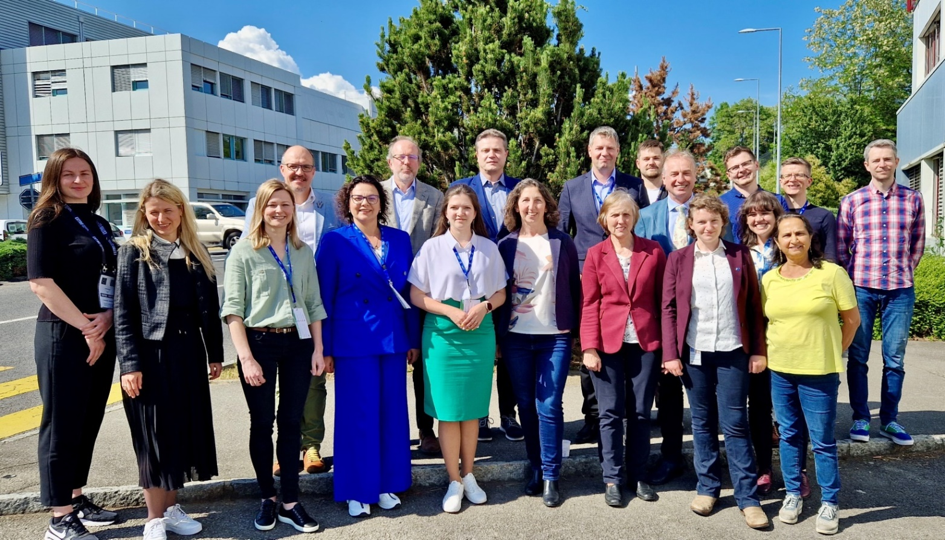
“Particle therapy - future for the Baltic States?”
A joint, dedicated workshop
“Particle therapy - future for the Baltic States? State-of-play, synergies and challenges”
Set-up of the event
There would be no workshop without the reporters and moderators
Erika Korobeinikova (Lithuanian Society of Radiation Oncology, LSMU, Clinic of Kaunas)
Anna Maria Camarda (CNAO)
Dace Bogorada-Saukuma (Latvian Association of Therapeutic Radiology)
Maija Radziņa (Latvian Radiology Association, University of Latvia)
Andrejs Ērglis (University of Latvia)
Manjit Dosanjh (University of Oxford, CERN)
Maurizio Vretenar (CERN)
Elena Benedetto (SEEIIST Association, CERN)
Taylor Rebecca (Imperial College, CERN)
Edgars Mamis (University of Latvia, CERN)
Diana Adlienė (KTU, CERN Baltic Group)
Toms Torims (RTU, CERN Baltic Group)
Kristaps Palskis (RTU, CERN)

Slide 21
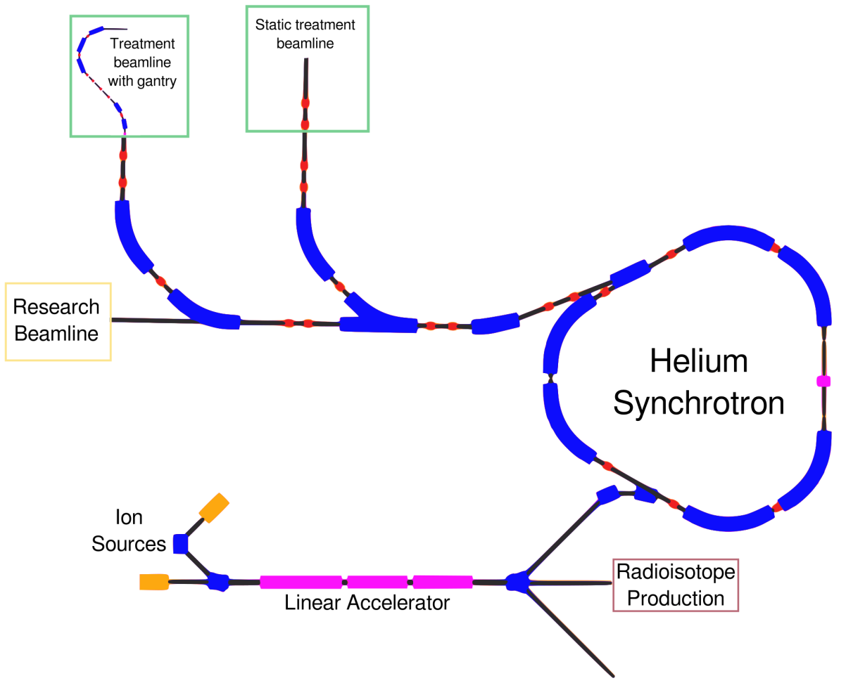
Outcomes of “Particle therapy - future for the Baltic States?”
Key outcomes
What does the technology offer?
  protons and helium ions at treatment energies;
  heavier ions at research-suitable energies;
  protons energies for radiography purposes;
  novel, biology-driven deliveries – FLASH, mini-beams;
  parallel radioisotope production capabilities.
Helium synchrotron
technology
Indications for particle therapy
Nuclear medicine
Educational pathways
“An evolution of proton therapy not a revolution in particle therapy”
Cancer statistics in the Baltics
Reporter slides: Maurizio Vretenar, Elena Benedetto
Moderator notes: Taylor Rebecca

Slide 22
Outcomes of “Particle therapy - future for the Baltic States?”
Key outcomes
How ready is the technology?
Most of the technologies necessary - proven and existing, with vast knowledge and expertise at CERN
Most of the components – quite standard
Part of components – available in industry, part – manufacturing needed – involvement of Baltic industries
Additional R&D and new hardware – necessary for FLASH delivery, currently TRL5
NIMMS Technical Design Report (TDR) could be done by the end of 2025
Final design and construction initiative goes into responsibility of the respective institution
Helium synchrotron
technology
Indications for particle therapy
Nuclear medicine
Educational pathways
Compared to commercial proton cyclotrons:
Improved performance and increased flexibility
Compared to carbon synchrotron facilities:
Reduced cost and footprint of the facility
Cancer statistics in the Baltics
Reporter slides: Maurizio Vretenar, Elena Benedetto
Moderator notes: Taylor Rebecca

Slide 23
Outcomes of “Particle therapy - future for the Baltic States?”
Key outcomes
What should be considered?
Medical licensing – crucial and considerations should be implemented in initial design stages already
To allow activities at earlier stages – stages commissioning approach
For final design – MedAustron approach with PIMMS could be followed
Helium ion therapy itself - appealing from physics, but the biggest challenge - synergy between the cutting-edge technology and the end users – radiation oncologists. Therefore - clinically established proton therapy after certification and commissioning
Helium synchrotron
technology
Beams for radioisotope production
Beams for experimental area
Medical certification for fixed protons
Medical certification for fixed helium ions
Gantry room commissioning
Indications for particle therapy
Nuclear medicine
Educational pathways
NIMMS helium synchrotron design provides vastly larger customizability and adaptability compared to a commercially available systems
Cancer statistics in the Baltics
Design gains translate to larger opportunities in scientific research, personnel training, capacity building and brain-drain prevention
Scientific research programme – crucial in the plan of machine usage
Reporter slides: Maurizio Vretenar, Elena Benedetto
Moderator notes: Taylor Rebecca

Slide 24
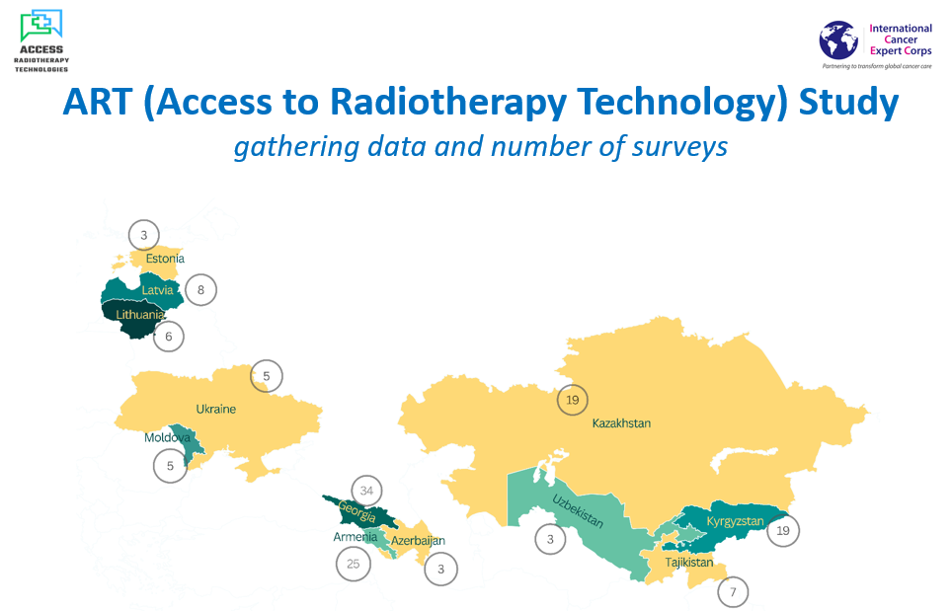
Outcomes of “Particle therapy - future for the Baltic States?”
Side note: The ART study
Helium synchrotron
technology
A study started in 2022 to assess the basic cancer statistics, RT equipment availability and personnel capacity
Indications for particle therapy
Huge “thank you” to Manjit Dosanjh for asking for Baltic States participation – this is our first up-to date data set for further investigations
Nuclear medicine
Educational pathways
Coordination of data collecting:
Erika Korobeinikova (Lithuania)
Eduard Gershkevitsh (Estonia)
Kristaps Palskis (Latvia)
Cancer statistics in the Baltics
Reporter slides: jointly Manjit Dosanjh, Erika Korobeinikova, Kristaps Palskis
Moderator notes: Dace Bogorada-Saukuma

Slide 25
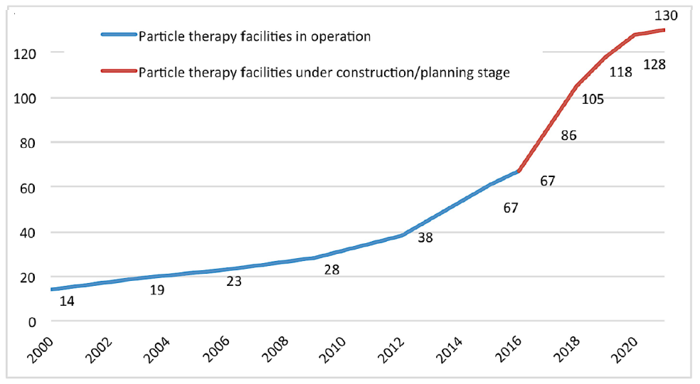
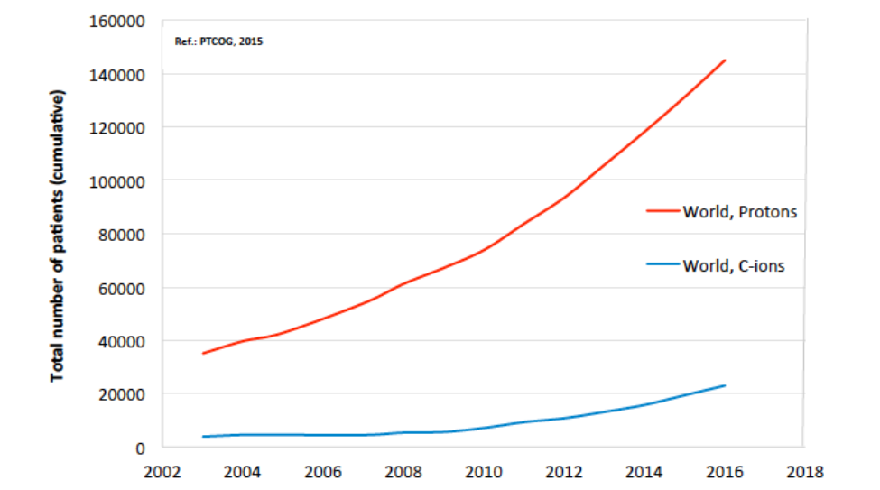
Outcomes of “Particle therapy - future for the Baltic States?”
Key outcomes
What is the global perspective?
2020 - 19.3 million new cases diagnosed with 9.96 million deaths
Predictions by 2040 - 27.5 million new cases diagnosed and 16.3 million deaths
Focusing on radiotherapy and particle therapy, in early 2000’s by efforts of ENLIGHT, data were studied in Austria, France, Germany and Italy:
  20 000 patients per 10 million inhabitants would receive conventional radiation therapy;
  12 % of these patients would largely benefit and be eligible for proton therapy - around 2400 patients per 10 million inhabitants
Helium synchrotron
technology
Indications for particle therapy
Nuclear medicine
p:280,000
Educational pathways
Cancer statistics in the Baltics
C: 40,000
Reporter slides: jointly Manjit Dosanjh, Erika Korobeinikova, Kristaps Palskis
Moderator notes: Dace Bogorada-Saukuma
Graphs – courtesy of Manjit Dosanjh

Slide 26
Outcomes of “Particle therapy - future for the Baltic States?”
Key outcomes
  What is the cancer incidence and mortality in the Baltic States ?
 | Lithuania | Latvia | Estonia | TOTAL
Registered cancer cases | 17 073 | 12 051 | 8 907 | 38 031
Registered cancer deaths | 8 168 | 5 892 | 3 840 | 17 900
Cancer incidence rate (per 100 000 inhabitants) | 611 | 637 | 669 | 632
Cancer mortality (per 100 000 inhabitants) | 292 | 311 | 288 | 297
Patients receiving RT | 6343 (37.2 %) | 4146 (34.4 %) | 2556 (28.7 %) | 13045 (34.3 %)
Helium synchrotron
technology
Indications for particle therapy
Nuclear medicine
Educational pathways
Data as of 2020/2021
  Total population in the Baltic States - 6.02 million
  Crude, non age-specific corrected cancer incidence and mortality rates are 632 and 297 per 100 000 inhabitants, respectively
  in 2020 a total of about 13045 patients received conventional radiotherapy as cancer treatment procedure
Cancer statistics in the Baltics
What about specific data for particle therapy ?
Reporter slides: jointly Manjit Dosanjh, Erika Korobeinikova, Kristaps Palskis
Moderator notes: Dace Bogorada-Saukuma

Slide 27
Outcomes of “Particle therapy - future for the Baltic States?”
Preliminary data are promising for further investigations . . .
Key information reported
How many PT eligible patients could we have in the Baltic States ?
  A literature review done by dr. Erika Korobeinikova:
Helium synchrotron
technology
Data of United States, 2021 | 2.2 % of all RT patients – eligible and treated
Data of United Kingdom, 2018 | 1.5 % of all RT patients – eligible and treated
Swedish study, 2005 | 14 – 15 % of all RT patients - therapeutic benefit to justify
United Kingdom study, 2022 | 4.3 % of all RT patients - therapeutic benefit to justify
Korean study, 2018 | 10 % of all RT patients – eligible and treated
Indications for particle therapy
Nuclear medicine
196 PT patients
13045 RT patients
in 2020
1.5 %
Educational pathways
1950 PT patients
Cancer statistics in the Baltics
15 %
European proton therapy center statistics show on average 223 adult and 150 pediatric patients receive proton therapy yearly per center ( data of 2020 )
Reporter slides: jointly Manjit Dosanjh, Erika Korobeinikova, Kristaps Palskis
Moderator notes: Dace Bogorada-Saukuma

Slide 28
Main conclusions of the workshop
  I Medical case in the Baltic States and outlook of particle therapy
  Baltic region – state-of art conventional radiotherapy practices.
  Total of 6.02 million inhabitants, the crude cancer incidence and mortality rate is 632 and 297 per 100 000 inhabitants.
  In 2020, out of all cancer patients 13045 had received radiation therapy treatment.
  Different studies generally indicate between 1.5 to 15 % patients receiving conventional radiation therapy would be eligible for particle therapy. In the Baltic States – corresponds to about 500 to 2000 patients annually.
  There exists a clinical evidence base for various cancer types for treatment with particle therapy, with a number of clinical trials on-going. In the situation of lacking clinical evidence, different approaches can be used for patient selection (NTCP-model based).
Baltic medical community representatives - general support for further developments and investigations of the initiative

Slide 29
Main conclusions of the workshop
  II Technology of helium synchrotron
  NIMMS helium synchrotron design would provide larger flexibility of the design, as well as training of personnel and vast scientific research programme. Helium synchrotron would allow proton therapy before commissioning and clinical trials of helium ion therapy.
  Most of technologies and components used in the helium synchrotron design are standard, so R&D risk is limited.
  NIMMS collaboration - a Technical Design Report by the end of 2025 -> Final design by institution -> Developed facility
  III Perspective of parallel isotope production
  New pathways in radioisotope production for nuclear medicine and associated research, though coordination with existing cyclotron facilities and research activities with current infrastructure should be considered.

Slide 30
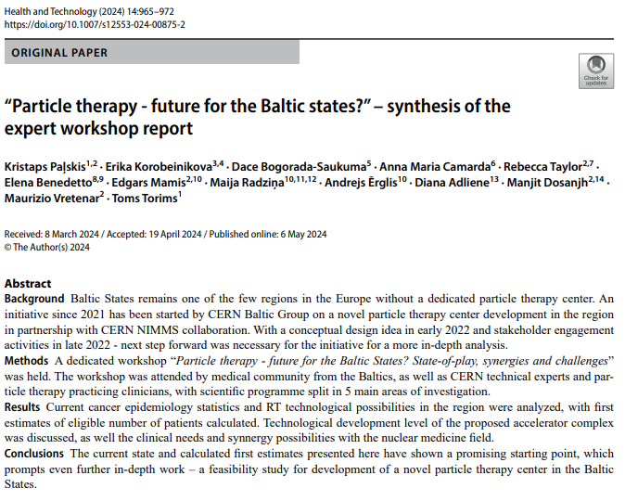
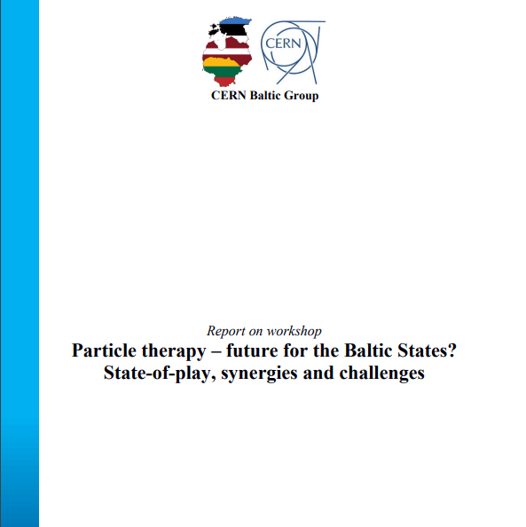
Main conclusions of the workshop
Workshop report
https://link.springer.com/article/10.1007/s12553-024-00875-2
Publication «Health and Technology» «Hadrontherapy and BNCT: Current Status and Future Trends»
https://indico.cern.ch/category/16259/attachments/2838075/4960020/REPORT_25_05_2023.pdf

Slide 31
Political support
From the very beginning of the initiative policy makers were informed, consulted and engaged:
  relevant national research and health authorities
  ministries
  research institutions
  selected government ministers and legislators in all three Baltic States
Furthermore, experts from permanent Representation in Brussels and COREPER I Ambassadors were kept in the loop and advised CERN Baltic Group on the EU policies and priorities.

Slide 32
Political support
At inter-parliamentary-level, initiative has been presented to Baltic Assembly
Baltic Assembly has made several resolutions of great relevance for the initiative, addressed to the parliaments and governments of Estonia, Lithuania and Latvia, as well as the Baltic Council of Ministers:
  to enable potential for the cooperation with the CERN for the development of science, research and technology in the Baltic States and allocate corresponding financial support within the State budgets;
  to engage the corresponding ministries, national agencies and relevant stakeholders and to jointly apply for co-financing from the European Union for implementing the joint initiative of Advanced Particle Therapy Center for the Baltic States;
  the Baltic Assembly also emphasizes the importance of the initiative as an integrated flagship project for the Baltic States, falling entirely within the scope of the national policies of the Baltic States, Europe's Beating Cancer Plan and the Mission on Cancer of the European Union, especially in the pillars of diagnostics, treatment and quality of life improvement for cancer patients and their families;
  to implement a full-scale feasibility study of the joint initiative of the CERN Baltic Group and CERN on the Advanced Particle Therapy Center for the Baltic States.
https://indico.cern.ch/category/16259/attachments/2838068/4960374/RESOLUTION%20of%20the%20digital%2039th%20Session%20of%20the%20Baltic%20Assembly.pdf
https://indico.cern.ch/category/16259/attachments/2838068/4960369/RESOLUTION%20of%20the%2040th%20Session%20of%20the%20Baltic%20Assembly.pdf
https://indico.cern.ch/category/16259/attachments/2838068/4960375/RESOLUTION%20of%20the%2041st%20Session%20of%20the%20Baltic%20Assembly.pdf
https://indico.cern.ch/category/16259/attachments/2838068/4960376/RESOLUTION%20of%20the%2042nd%20Session%20of%20the%20Baltic%20Assembly.pdf

Slide 33
Going into the future . . .
End of 2021
Idea and
first discussions
Aug 2022
Baltic Assembly support – letter to 3 prime ministers
May 2023
Baltic implementation – part of IPAC paper by NIMMS
Oct 2023
Report on the workshop findings approved by CERN Baltic Group
Oct 2022
Resolution of Baltic Assembly
Future of the initiative
FEASIBILITY STUDY
Presentations and discussions with relevant professional societies,
scientific universities and political stakeholders
Apr 2022
Conceptual design paper and working group establishment
Oct-Nov 2022
Bi-lateral discussions with stakeholders in all 3 Baltic States
25th of May 2023
Workshop at CERN
Particle therapy - future for the Baltic States? State-of-play, synergies and challenges

Slide 34
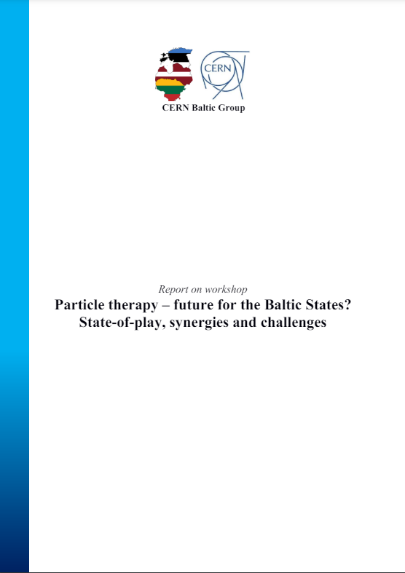
Feasibility Study overview
Workshop
«Particle therapy - future for the Baltic States? State-of-play, synergies and challenges»
« . . . In order to proceed with this promising idea, a full-scale feasibility study of the project is needed. It shall assess feasibility of the facility of this research infrastructure from financial (business case), clinical (medical case), technological (technical outline, availability and R&D required) and multi-disciplinary scientific research perspective. In each of these segments, feasibility study would need to have involvement of experts from every Baltic State and CERN researchers, as well as representatives of European particle therapy centers. The best existing platform for such feasibility study is CERN based NIMMS collaboration . . . »

Slide 35
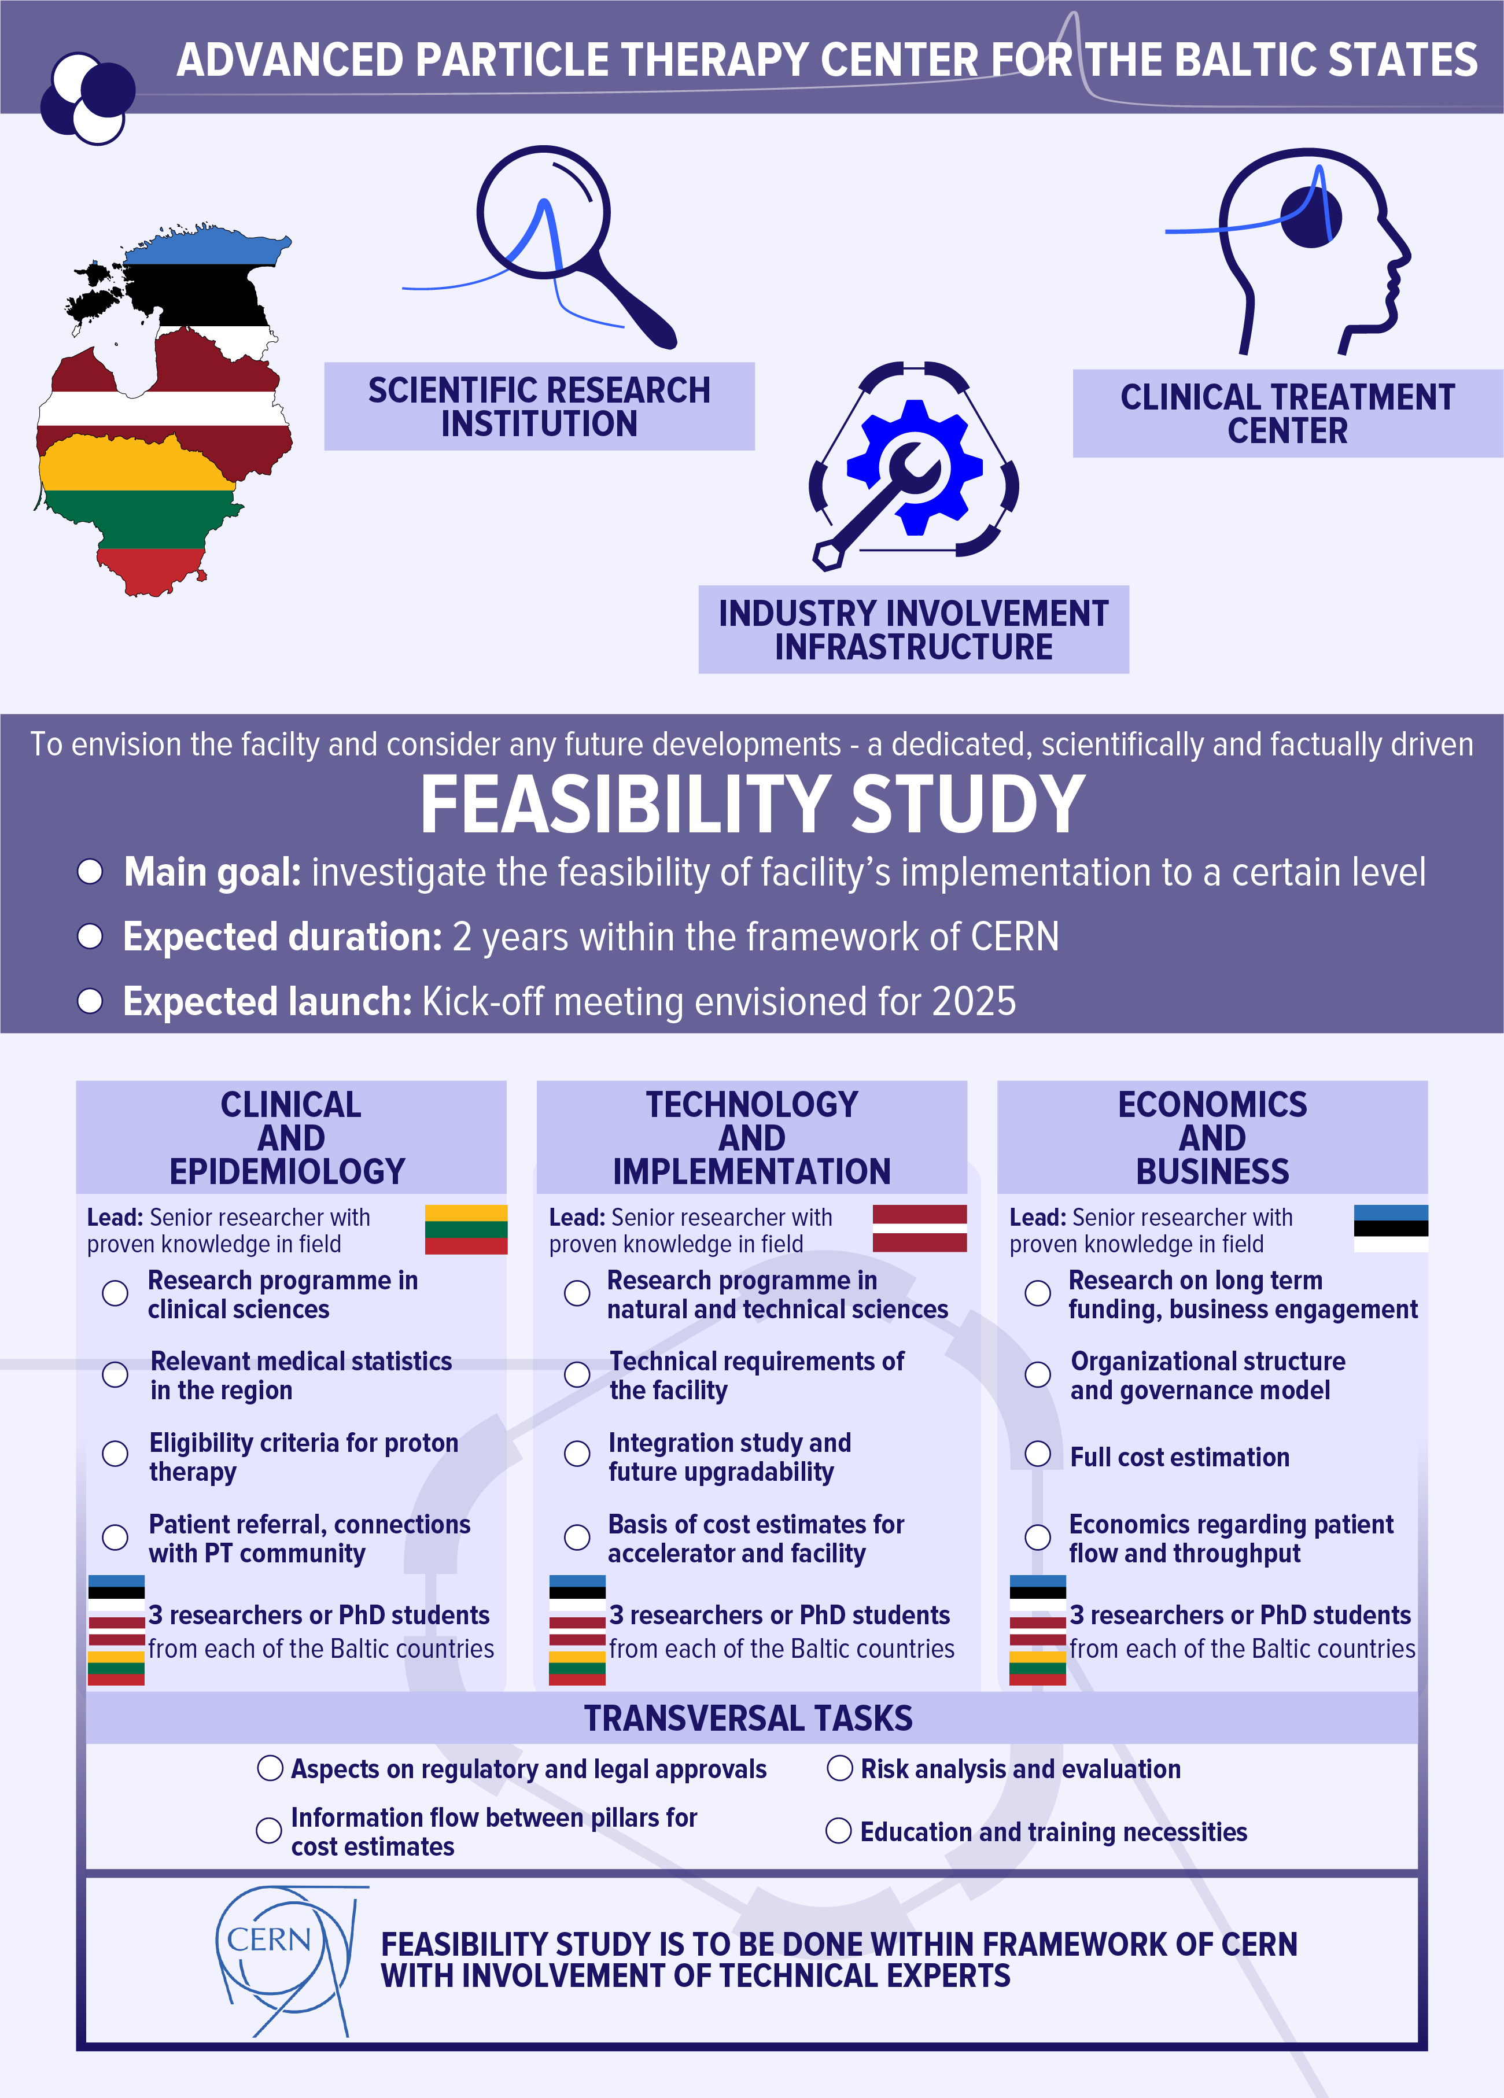
Feasibility Study overview

Slide 36
Aims of the Feasibility study
Main aims of the Feasibility Study:
  to investigate the feasibility and various scenarios of the implementation of the APTCB facility;
  to provide a factual based Feasibility Study Report to be used as tool for the decision making in the APTCB project continuation;
  through the Feasibility Study Report and associated documents – to provide multiple possible scenarios for implementation at various levels: full, partial or no implementation, with possible alternatives.

Slide 37
Proposal of FS Implementation Plan
Throughout 2024, working group has been working on proposal of Feasibility Study Implementation plan
  Working group:
    Convener of the WG: Prof. Toms Torims (Riga Technical University, LV)
    Deputy Convener of the WG: Prof. Diana Adlienė (Kaunas University of Technology, LT)
    Kristaps Palskis (Riga Technical University, LV)
    Dr. Erika Korobeinikova (Lithuanian University of Health Sciences, LT)
    Dr. Alberto Degiovanni (Riga Technical University, LV)
    Dr. Maurizio Vretenar (CERN, CH)
    Dr. Andris Ratkus (Riga Technical University, LV)
    Prof. Saulė Mačiukaitė-Žvinienė (Vilnius University, LT)
    Dr. Eduard Gershkevitsh (North Estonia Medical Centre, EE)
Proposal of implementation plan in finalization stages.
To be sent out to CBG member this week for submission and discussion in 14th CBG General meeting

Slide 38
Overall structure of the Feasibility Study
COLLABORATION BOARD
SCIENTIFIC ADVISORY BOARD
STAKEHOLDER ADVISORY BOARD
STEERING COMMITTEE
(4 + 1 CERN + 1 CBG)
FEASIBILITY STUDY LEADER
+
3 PILLAR LEADERS
Three working groups – “pillars”:
  CLINICAL and EPIDEMIOLOGY
  TECHNOLOGY and IMPLEMENTATION
  ECONOMICS and BUSINESS
Transversal tasks covering aspects of the 3 “pillars”

Slide 39
Overall structure of the Feasibility Study

Slide 40






Preliminary budget of the Feasibility Study
Feasibility study leader: ~ 70 000
Clinical and epidemiology
Technical
aspects
Economic
assessment
61 000
61 000
61 000
Pillar Leader
Pillar Leader
Pillar Leader
56 000
56 000
56 000
56 000
56 000
56 000
56 000
56 000
56 000
+ administrative costs: 40 550
+ travel: 9 500

Slide 41

Preliminary budget of the Feasibility Study
 | Year 1 | Year 2 | Total contribution
 | 287 016 | 287 016 | 574 033
 | 287 016 | 287 016 | 574 033
 | 287 016 | 287 016 | 574 033
Total | 861 050 | 861 050 | 1 722 100

Slide 42
Preliminary team composition of Feasibility Study
FS Leader (@CERN) + Project. Admin.+ Comm
Clinical and epidemiology
Technical
aspects
Economic
assessment
Pillar Leader - Senior Researcher with proven knowledge in the field
LUHS
Pillar Leader - Senior Researcher with proven knowledge in the field
Pillar Leader - Senior Researcher with proven knowledge in the field
RTU
TalTech
PhD student or researcher
PhD student or researcher
PhD student or researcher
NCI
KTU+LEI
VU
PhD student or researcher
RSU
PhD student or researcher
LU
PhD student or researcher
LU
PhD student or researcher
PhD student or researcher
PhD student or researcher
North Estonia Medical Centre
TalTech
TU
Criteria: commitment, competence, collaboration
+ associated partners of CBG member institutions

Slide 43
Expected outcomes of the Feasibility Study
Feasibility Study report → Decision making tool for future of the initiative
The main tangible outcome for the Feasibility Study is the Feasibility Study Report. The information collected within the Feasibility Study Rreport is to be used as decision making tool for the future of the APTCB project: facility construction and full implementation of the proposal.
Other documents will be created along with the Feasibility Study report:
  risk analysis associated with APTCB proposal and overall risk management strategy;
  finalized and factual-based proposal for layout of the APTCB facility;
  finalized and factual-based beam-time separation usage proposal for the APTCB facility;
  finalized and factual-based list of selection criteria for the choice of most suitable APTCB facility construction site.
  initial proposal for the expected staging for full-scale development of APTCB facility;
  initial basis for a business plan for the APTCB facility.

Slide 44
Expected outcomes of the Feasibility Study
Feasibility Study report → Decision making tool for future of the initiative
Importantly, the Feasibility Study report and other accompanying documents are to provide the basis for multiple possible scenarios, not a definitive solution, for the decision making stakeholders, while also providing factual basis for comparison of the different options. Exact different scenarios are to be decided within the Feasibility Study, but should at least include:
  full-scale implementation scenario, with varying weights of scientific research and clinical treatment functions;
  partial implementation scenario, limiting certain technical functionalities of the proposed facility;
  scenario of not implementing the facility, while identifying possible alternatives.

Slide 45
An exciting and unifying opportunity not to be missed!

Slide 46
Thank you for your attention !

