Slide 1
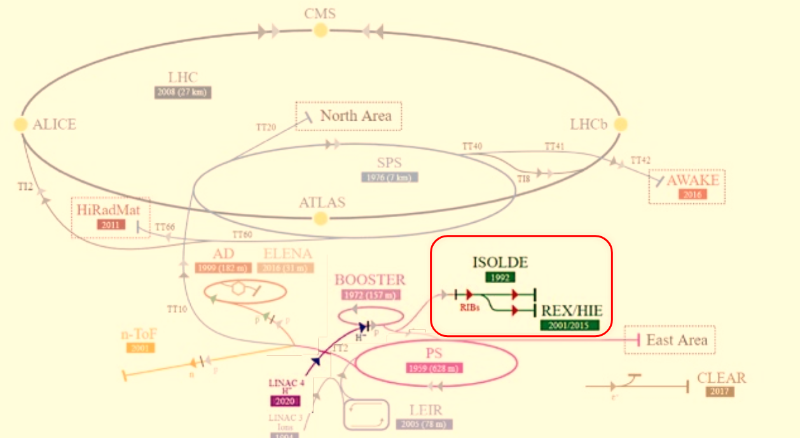





Ion test bench : linear spectrometer design for
low-medium mass
Fazel Taft
Jorge Giner Navarro,
Yanis Fontenla Barba
Javier Resta-López

Slide 2
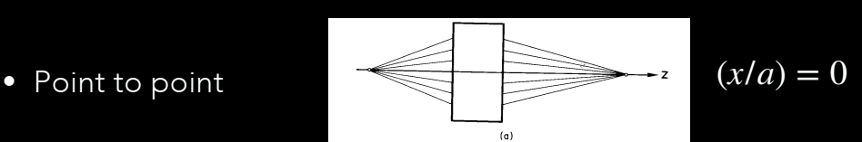
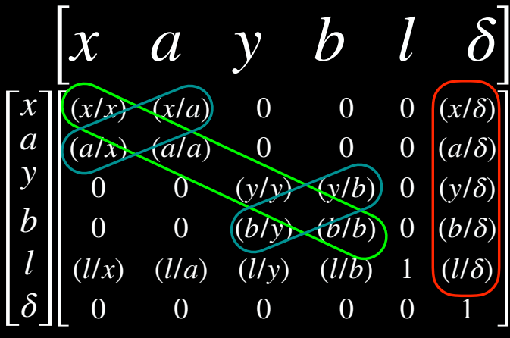
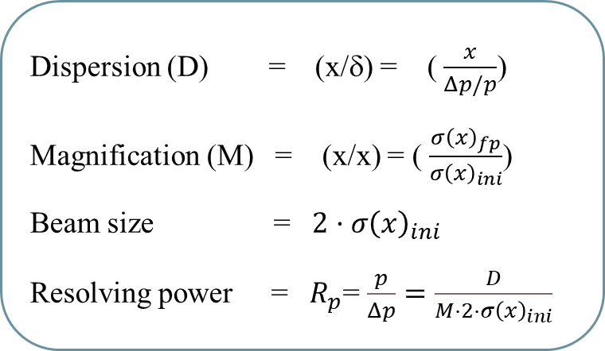
Basic optics of A separator
creates an image size in x that is independent of the incident angular distributions
Transfer matrix
Dispersion (D) = (x/δ) = ( $\frac{x}{Δp/p}$)
Magnification (M) = (x/x) = ( $\frac{σ{\left(x\right)}_{fp}}{σ{\left(x\right)}_{ini}}$)
Beam size = $2·σ{\left(x\right)}_{ini}$
Resolving power = $R_{p}$= $\frac{p}{Δp}=\frac{D}{M·2·σ{\left(x\right)}_{ini}}$

Slide 3
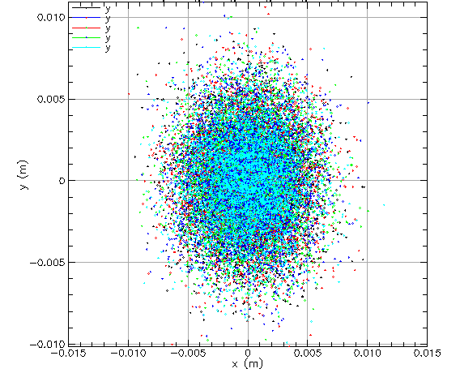

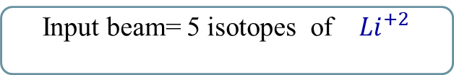
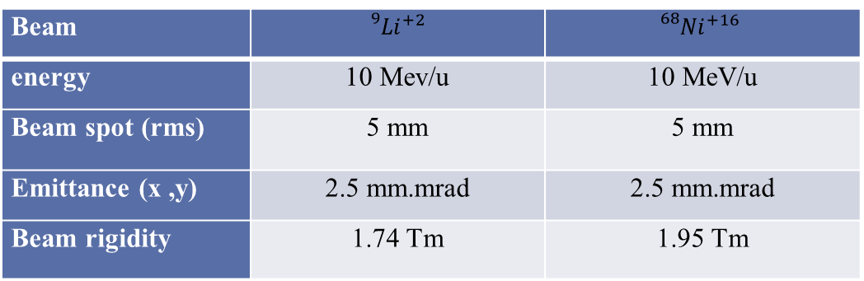
Details of Input Beam parameters
Input beam= 5 isotopes of ${}_{}^{}{{Li}^{+2}}$
Beam | $${}_{}^{9}{{Li}^{+2}}$$ | $${}_{}^{68}{{Ni}^{+16}}$$
energy | 10 Mev/u | 10 MeV/u
Beam spot (rms) | 5 mm | 5 mm
Emittance (x ,y) | 2.5 mm.mrad | 2.5 mm.mrad
Beam rigidity | 1.74 Tm | 1.95 Tm
Simulation code: Bmad
Open-source toolkits( software libraries)
Cornell University

Slide 4
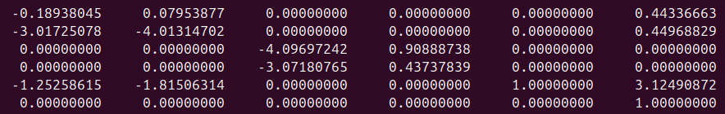
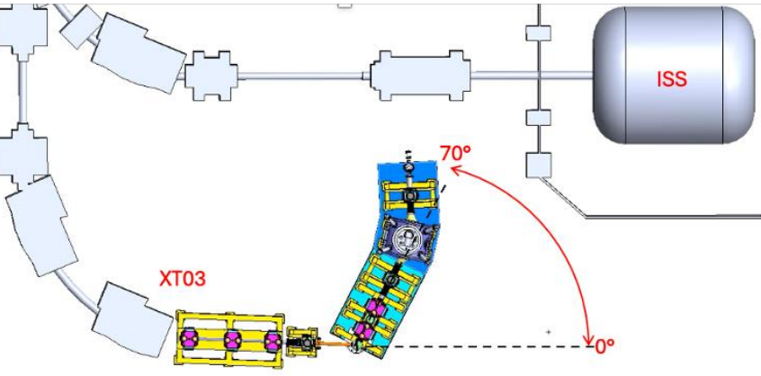
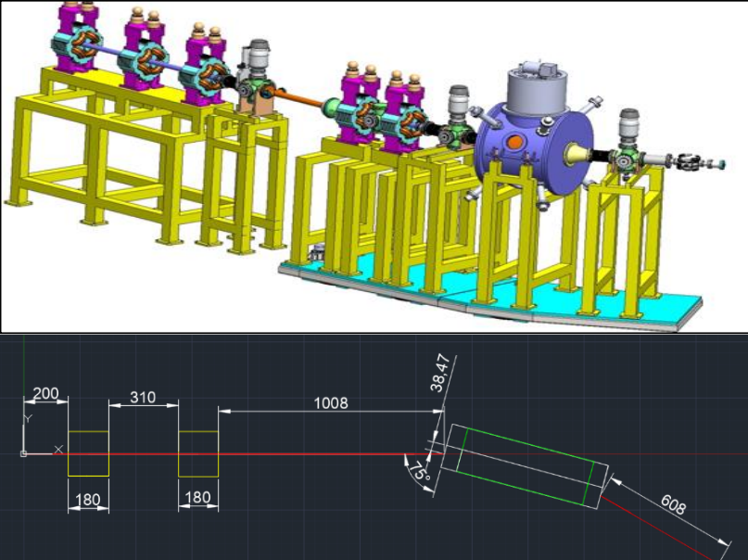
Lattice deTails and layout
Magnification (M)
Point to point
Dispersion(D)
 | Effective length | Gradient strength | B-field | Bend
Quadrupole 1 | 180 mm | 2.7944 T/m | - | -
Quadrupole 2 | 180 mm | -18.5603 T/m | - | -
CCT | 580 mm | 5.9874 T/m | 1.7812 T | 30 deg
Quadrupole 1
Quadrupole 2
CCT
Courtesy Univ. Huelva

Slide 5
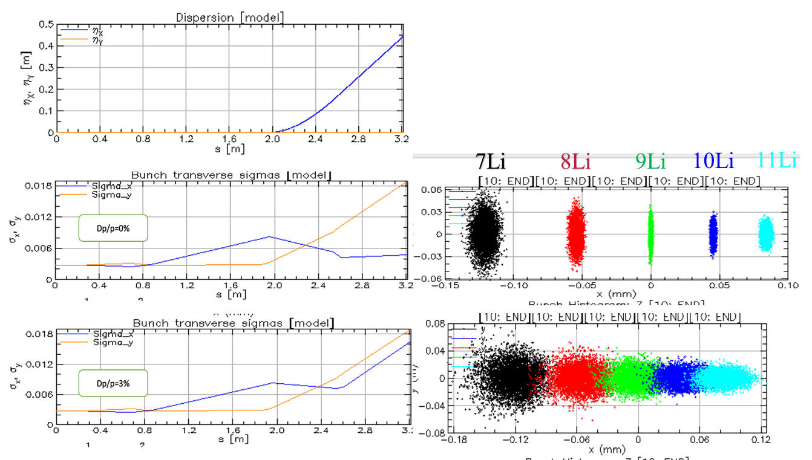
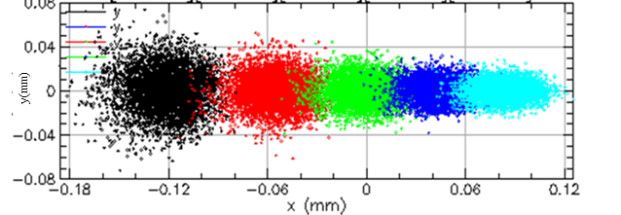
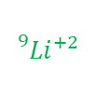
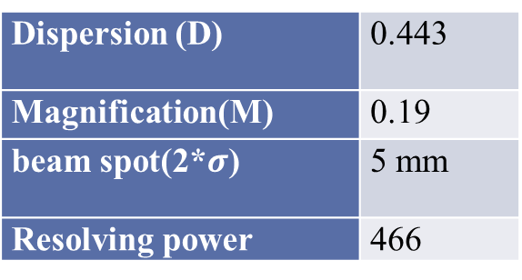
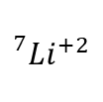

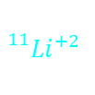
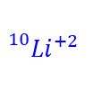
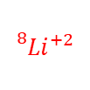
Transport beam at different momentum SPREADS for ${}_{}^{9}{{Li}^{+2}}$
Dispersion (D) | 0.443
Magnification(M) | 0.19
beam spot(2*$σ$) | 5 mm
Resolving power | 466
$${}_{}^{7}{{Li}^{+2}}$$
$${}_{}^{8}{{Li}^{+2}}$$
$${}_{}^{9}{{Li}^{+2}}$$
$${}_{}^{10}{{Li}^{+2}}$$
$${}_{}^{11}{{Li}^{+2}}$$
y(mm)
Δp/p = 0%
y(mm)
Δp/p = 3%
y(mm)

Slide 6
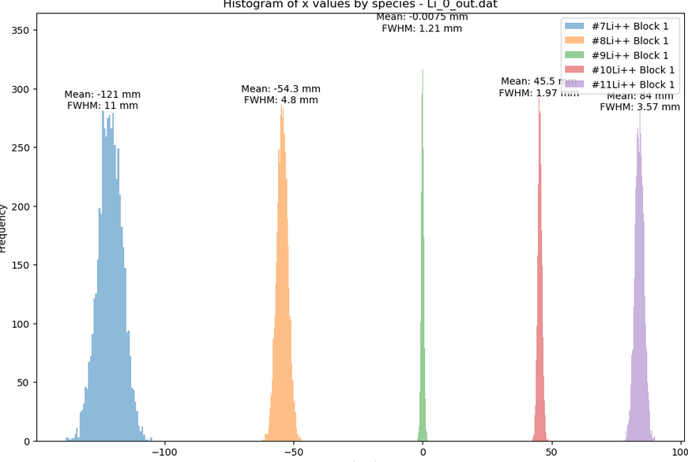
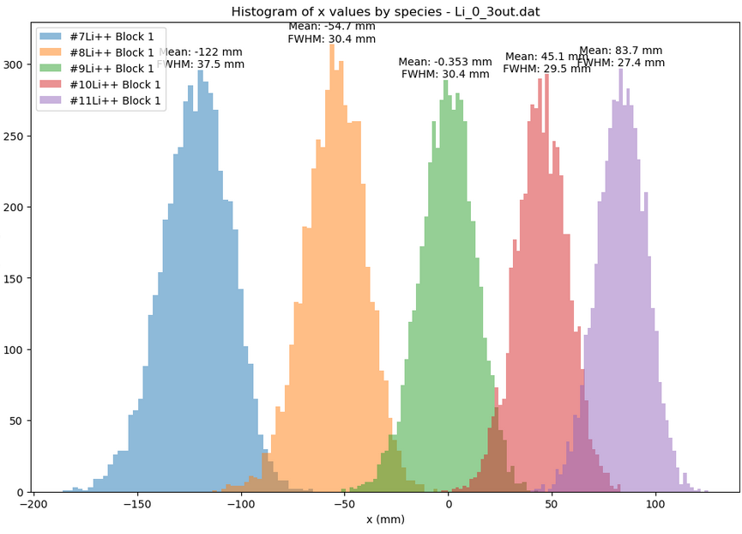


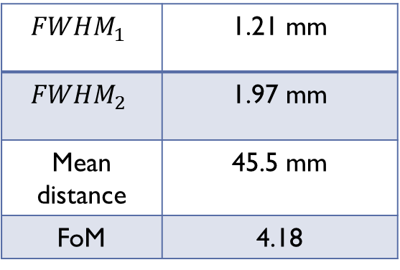
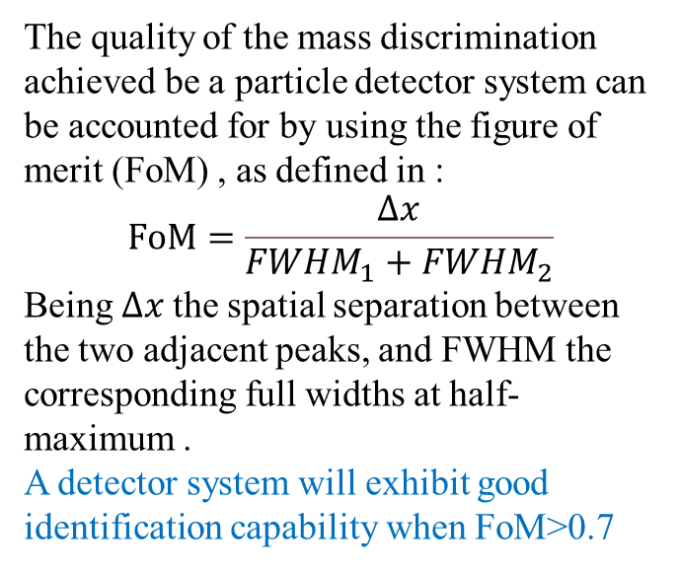

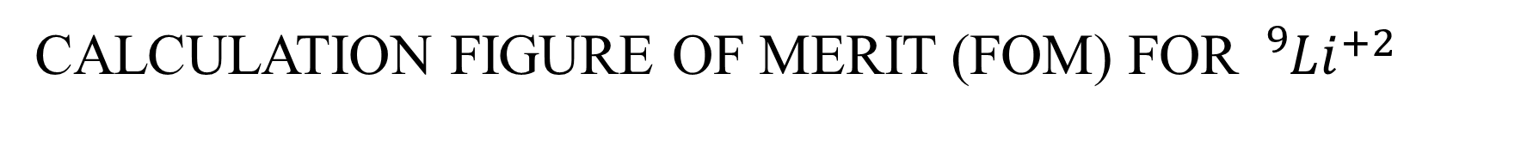




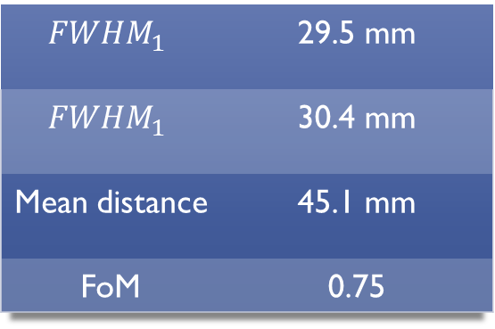


Calculation figure of merit (FOM) for ${}_{}^{9}{{Li}^{+2}}$
Δp/p=0.0%
$$FWHM_{1}$$ | 1.21 mm
$$FWHM_{2}$$ | 1.97 mm
Mean distance | 45.5 mm
FoM | 4.18
The quality of the mass discrimination achieved be a particle detector system can be accounted for by using the figure of merit (FoM) , as defined in :
$$FoM=\frac{Δx}{FWHM_{1}+FWHM_{2}}$$
Being $Δx$the spatial separation between the two adjacent peaks, and FWHM the corresponding full widths at half-maximum .
A detector system will exhibit good identification capability when FoM>0.7
$${}_{}^{7}{{Li}^{+2}}$$
$${}_{}^{8}{{Li}^{+2}}$$
$${}_{}^{9}{{Li}^{+2}}$$
$${}_{}^{10}{{Li}^{+2}}$$
$${}_{}^{11}{{Li}^{+2}}$$
Δp/p=3.%
$$FWHM_{1}$$ | 29.5 mm
$$FWHM_{1}$$ | 30.4 mm
Mean distance | 45.1 mm
FoM | 0.75
$${}_{}^{8}{{Li}^{+2}}$$
$${}_{}^{10}{{Li}^{+2}}$$
$${}_{}^{7}{{Li}^{+2}}$$
$${}_{}^{9}{{Li}^{+2}}$$
$${}_{}^{11}{{Li}^{+2}}$$

Slide 7
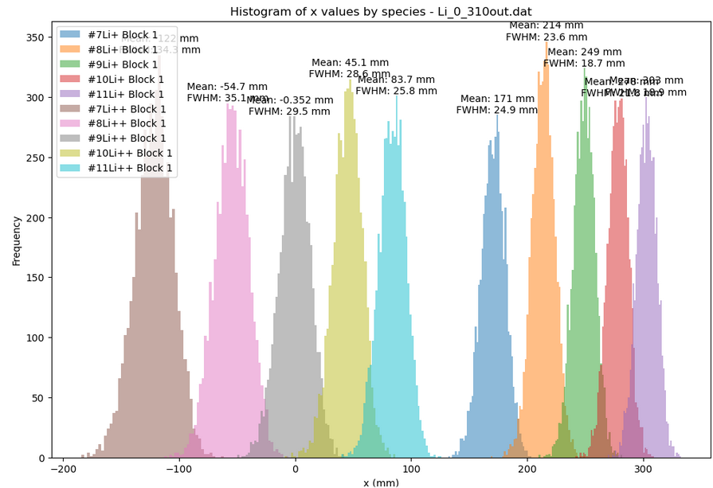
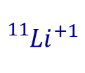

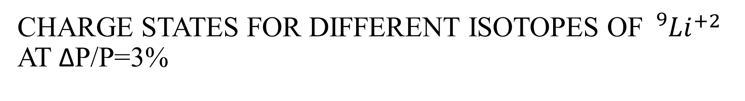


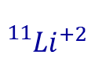

Charge stateS for differENT isotopes of ${}_{}^{9}{{Li}^{+2}}$ AT Δp/p=3%
$${}_{}^{7}{{Li}^{+2}}$$
$${}_{}^{9}{{Li}^{+2}}$$
$${}_{}^{11}{{Li}^{+2}}$$
$${}_{}^{7}{{Li}^{+1}}$$
$${}_{}^{9}{{Li}^{+1}}$$
$${}_{}^{11}{{Li}^{+1}}$$
Li+2
Li+

Slide 8
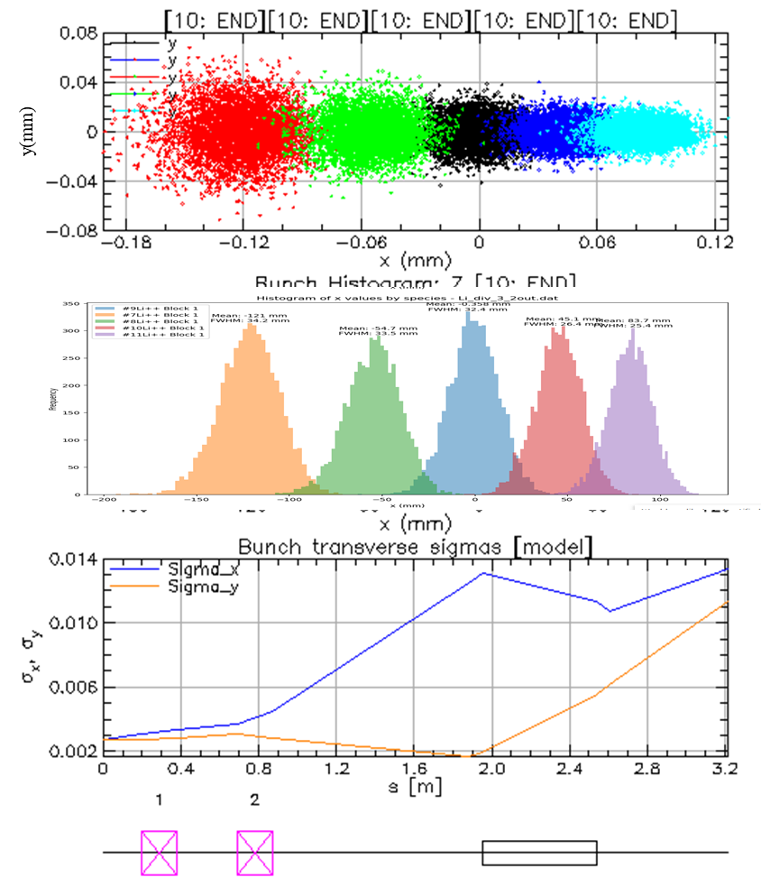
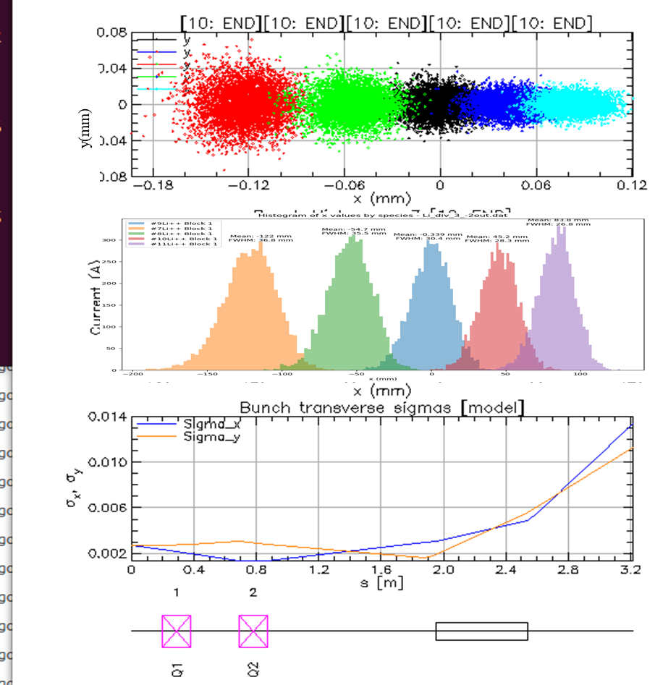
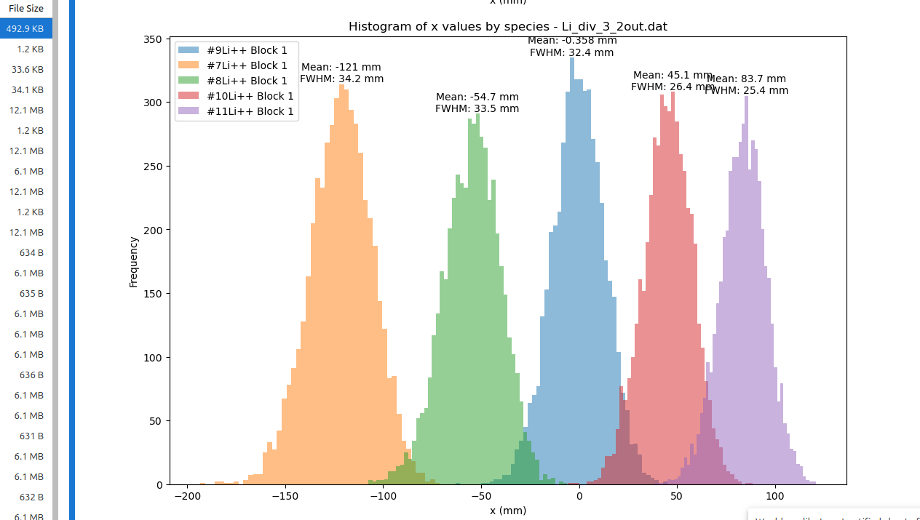
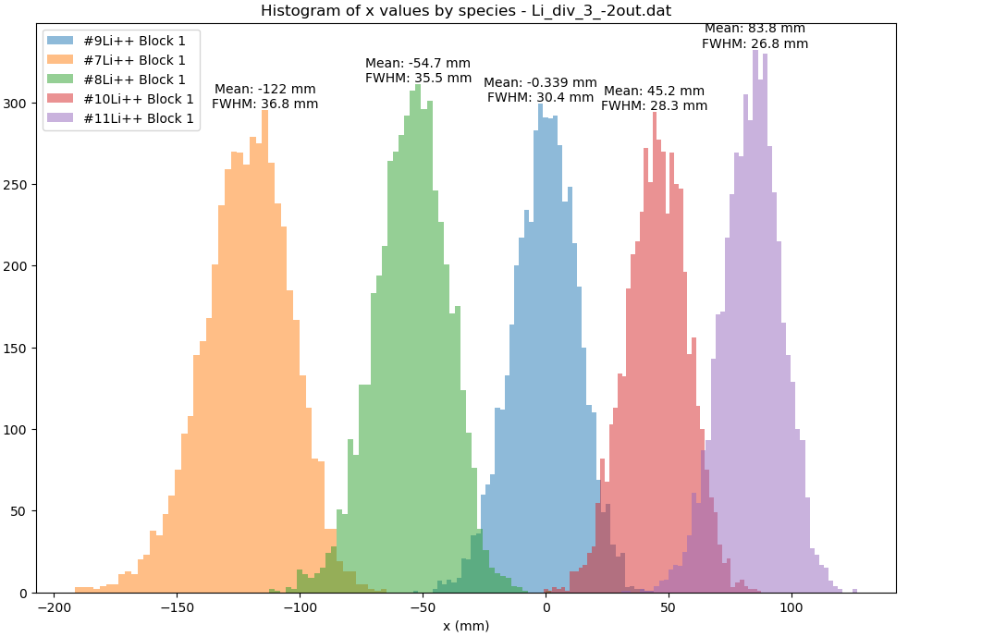











Impact of Beam Convergence and Divergence of ${}_{}^{9}{{Li}^{+2}}$ isotopEs AT Δp/p=3%
Divergent beam(Alpha=-2)
Convergent beam(Alpha=2)
$${}_{}^{10}{{Li}^{+2}}$$
$${}_{}^{10}{{Li}^{+2}}$$
$${}_{}^{11}{{Li}^{+2}}$$
$${}_{}^{7}{{Li}^{+2}}$$
$${}_{}^{8}{{Li}^{+2}}$$
$${}_{}^{11}{{Li}^{+2}}$$
$${}_{}^{7}{{Li}^{+2}}$$
$${}_{}^{8}{{Li}^{+2}}$$
$${}_{}^{9}{{Li}^{+2}}$$
$${}_{}^{9}{{Li}^{+2}}$$

Slide 9



























${}_{}^{68}{{Ni}^{+16}}$AT different Δp/p
Dp/p=0.3%
$FWHM_{1}$ | 3.13 mm
$FWHM_{2}$ | 2.97 mm
Mean distance | 6.47 mm
FoM | 1.02
Charge state ${}_{}^{69}{{Ni}^{+16}}$ for Δp/p=0 %
$${}_{}^{67}{{Ni}^{+16}}$$
$${}_{}^{69}{{Ni}^{+16}}$$
$${}_{}^{65}{{Ni}^{+16}}$$
$${}_{}^{66}{{Ni}^{+16}}$$
$${}_{}^{68}{{Ni}^{+16}}$$
$${}_{}^{68}{{Ni}^{+15}}$$
$$FWHM_{1}$$ | 5.29 mm
$$FWHM_{2}$$ | 4.58 mm
Mean distance | 6.62 mm
FoM | 0.68
$${}_{}^{69}{{Ni}^{+16}}$$
$${}_{}^{65}{{Ni}^{+15}}$$
$${}_{}^{67}{{Ni}^{+15}}$$
$${}_{}^{69}{{Ni}^{+15}}$$
$${}_{}^{67}{{Ni}^{+16}}$$
$${}_{}^{67}{{Ni}^{+15}}$$
$${}_{}^{65}{{Ni}^{+16}}$$
$${}_{}^{66}{{Ni}^{+16}}$$
$${}_{}^{66}{{Ni}^{+15}}$$
Dp/p=0.5%
$${}_{}^{68}{{Ni}^{+16}}$$
$${}_{}^{67}{{Ni}^{+16}}$$
$${}_{}^{69}{{Ni}^{+16}}$$
$${}_{}^{65}{{Ni}^{+16}}$$
$${}_{}^{68}{{Ni}^{+16}}$$
Ni+16
Ni+15
$${}_{}^{66}{{Ni}^{+16}}$$

Slide 10
Thanks for your attention
Thanks to all contributors:
Rafael Berjillos, Carlos Garcia-Ramos, Domingo Gomez , Ismael Martel
(university of Huelva, Spain)
Teresa Kutukian-Nieto
(Instituto de Estructurra de la Materia , CSIC , Madrid , Spain)

