Slide 1

Status and perspectives in high field superconducting magnets for particle accelerators
E. Todesco, CERN
Applied Superconductivity Conference, September 4th 2024

Slide 2
Acknowledgments
I wish to acknowledge numerous teams working in different labs (from West to East)
  LBNL, FNAL, NHFML, BNL in the US
  CIEMAT, CEA, PSI, CERN, INFN, UTwente in EU
  IHEP, IMP in China
  KEK in Japan
Special thanks in the preparation of this talk to (from East to West): A. Yamamoto, Q. Xu, T. Salmi, L. Rossi, B. Auchmann, A. Milanese, S. Izquierdo Bermudez, A. Ballarino, L. Bottura, H. Felice, H. ten Kate, L. Chiesa, B. Strauss, S. Prestemon, P. Ferracin

Slide 3
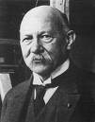
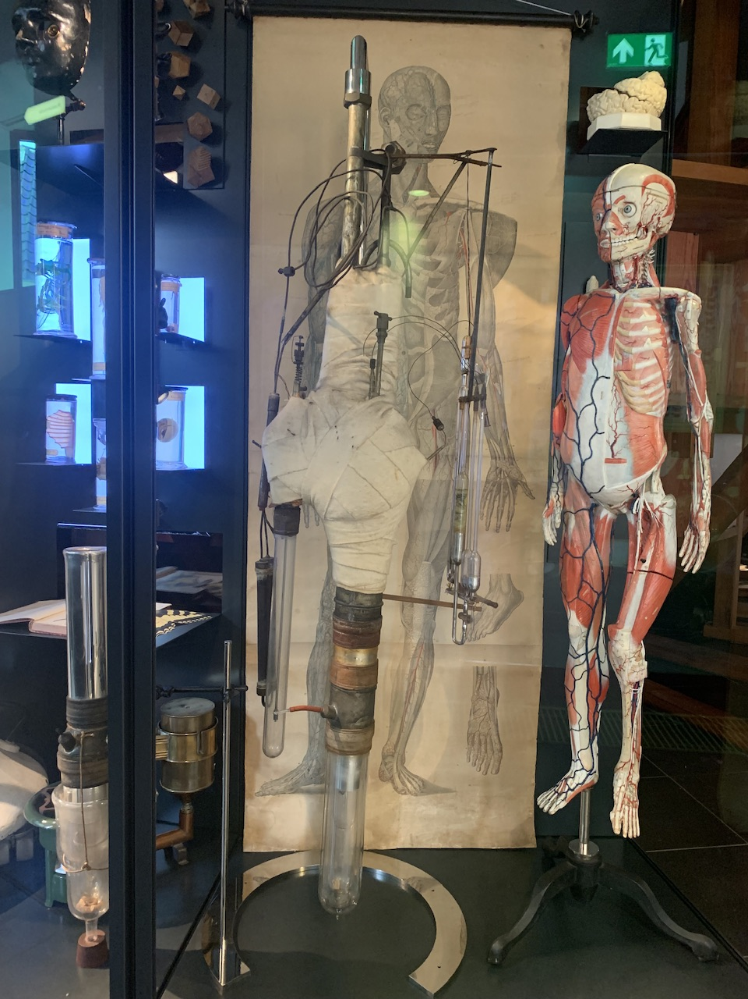
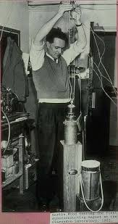
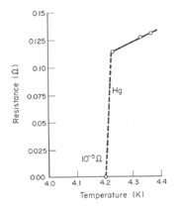
Foreword
The history of superconductivity applied to magnets is a very interesting paradigm
  Theory lags behind experimental results, arriving several decades later
  Applications of superconductivity to build magnets above 1 T arrive 50 years after the Onnes discovery
  The discovery is made possible by a technological achievement (making liquid He), explicitly mentioned in the attribution of the Nobel prize (whereas superconductivity itself is not mentioned)
  ”For his investigations on the properties of matter at low temperatures which led, inter alia, to the production of liquid helium”
Heinke Kamerlingh Onnes
(18 July 1853 – 4 February 1928)
Nobel prize 1913
Onnes He liquefactor,
Boerhaave museum, Leiden
First superconducting magnets, 60’s

Slide 4
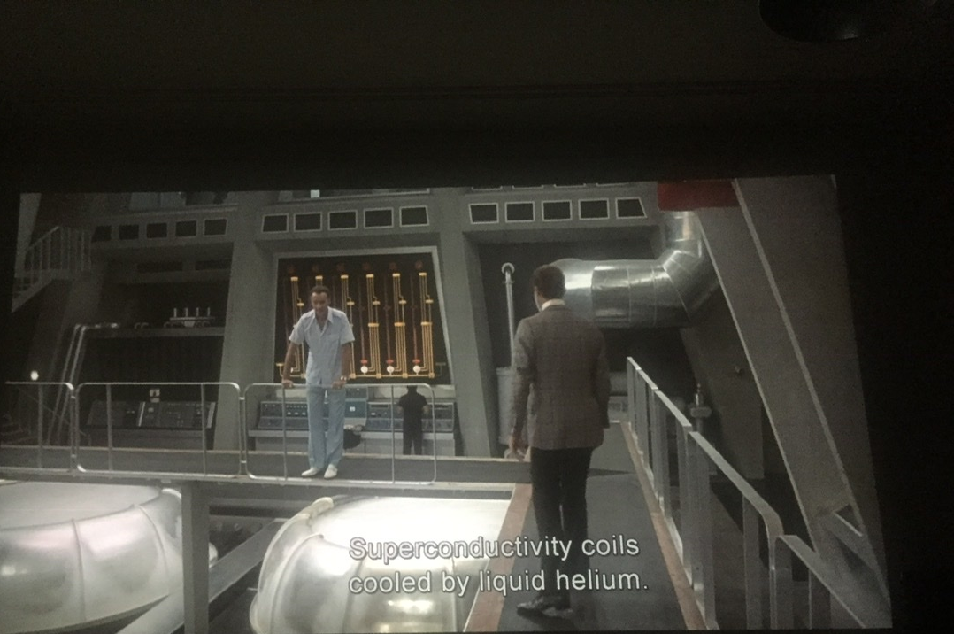
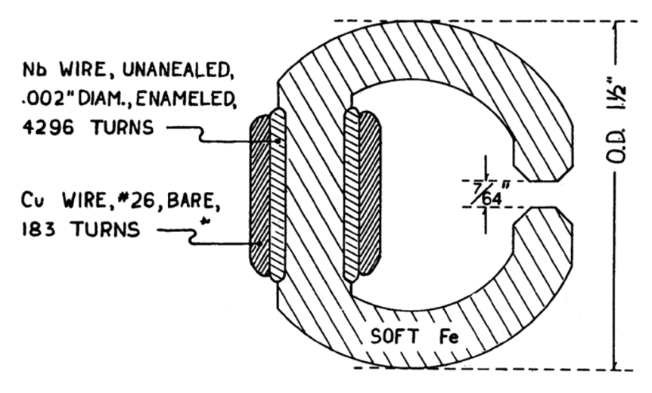
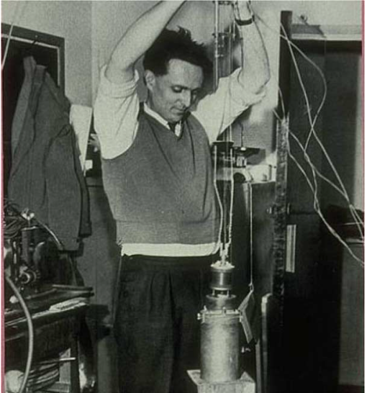
My name is Bond …
50 years after Nobel prize, the first superconducting solenoids well above 1 T
  1956: a Nb superconducting magnet reaching 0.7 T
  1962: a 4 T magnet (M. Wood, et al)
  1964: a 10 T Nb-Ti solenoid (H. T. Coffey and J. K. Hulm et al., J. Appl. Phys. 36 (1965) 128
    See M. Wilson, IEEE TAS 22 (2012) 3800212 for an historical review
Superconductivity rapidly enters the collective imagination !
The bad guy
(C. Lee)
James Bond
(R. Moore)
G. Yntema, IEEE Trans.
MAG-23, no. 2, p. 390, 1987
M. Wood with the first Oxford instruments magnet
G. Hamilton, “A007 – The man with the golden gun” EON production (1974)

Slide 5
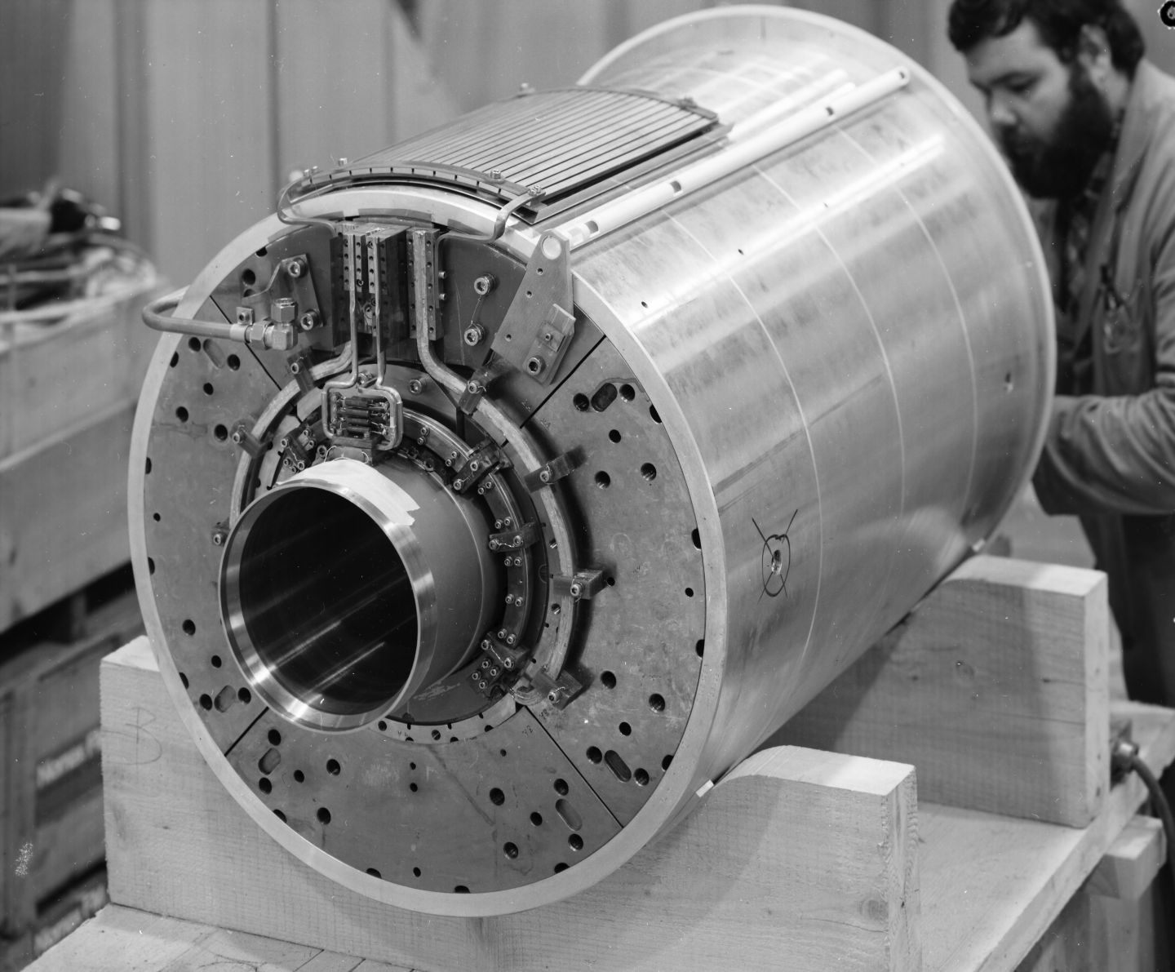
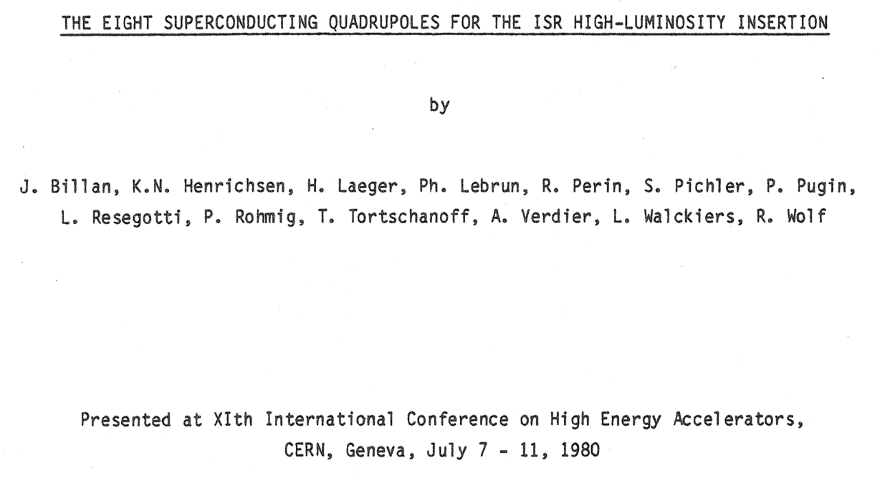
… a few years later, between France and Switzerland
First superconducting quadrupole magnets installed in a collider based on Nb-Ti
  Eight quadrupoles for the ISR insertion region, 43 T/m in 173 mm bore –
  Pole field 3.8 T, but peak field in the superconductor 5.8 T
  Rectangular Nb-Ti wire with twisted filaments (no need of field quality along the ramp)
Even though this design did not further evolve, we can start our history from here …

Slide 6
Contents
Features of superconducting magnets for accelerators
35 years of Nb-Ti in accelerators: from the the ISR (1975) to the LHC (2009)
35 years of Nb₃Sn short models: from the 80s to 2015
The LARP / HL-LHC MQXF age: towards mini series and long lenghts (2004-2030)
Towards Nb₃Sn dipoles for 100 TeV colliders (2015-2050)
HTS: opportunities and challenges

Slide 7
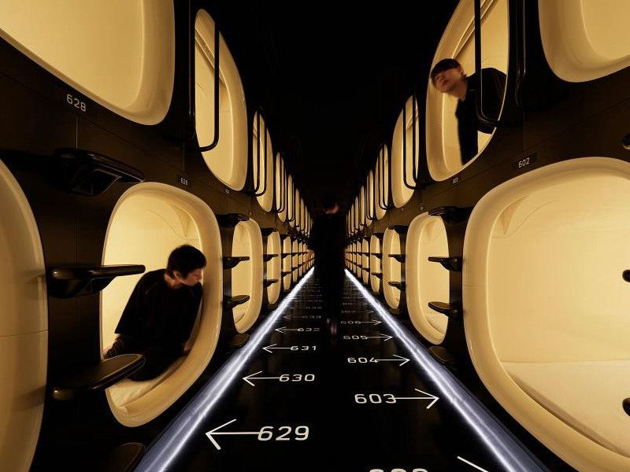
Features of superconducting magnets for accelerators
Compact, highly optimizied, and cost-effective: the capsule hotels of applications of superconductivity ?
Nine Hours Narita Airport capsule hotel

Slide 8
Features of superconducting magnets for accelerators
Overall current densities of ∼500 A/mm² are a peculiar feature/challenge for accelerator magnets (overall current density = current density over insulated coil)
  One order of magnitude above applications as HEP detector magnets or fusion magnets
This large current density is needed for compactness required in the transverse size:
  ∼10 cm for the active part (coil around the bore), ∼1 m for the total size of the cryostat
Other applications have other types of challenges as
  Total size for HEP detector magnets, total size and pulsed field for ITER magnets
  Coupling between circuits and different temperatures in the SC link
 | Overall current density (A/mm²) | Superconductor current density (A/mm²) | Ramp | Field in conductor (T)
Tevatron dipole | 360 | 1550 | slow | 4.7
LHC dipole | 360/440 | 1260/1820 | slow | 8.6
ATLAS BCT | 30 | 950 | very slow | 3.9
ITER (TF & CS) | 20 to 40 | 150 | very fast | 5 to 13
HL-LHC SC link | 17 | 1450 | slow | Self field (<1 T)

Slide 9
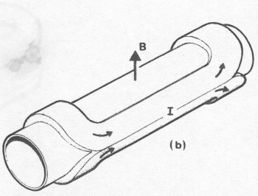
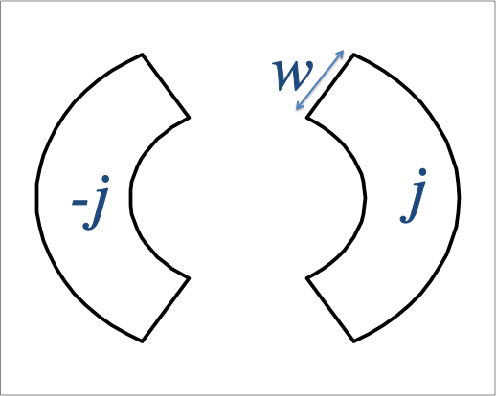
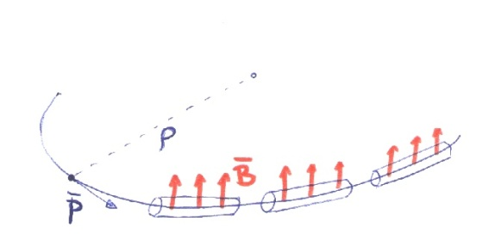
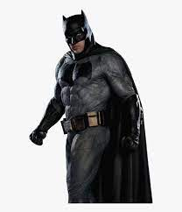

Field, collider size, and energy
Energy of a particle accelerator is given by magnetic field and accelerator size
Long accelerators ?
High fields ?
Field of a magnet is given by current density and coil width
μ₀/2
Speed of light

Slide 10
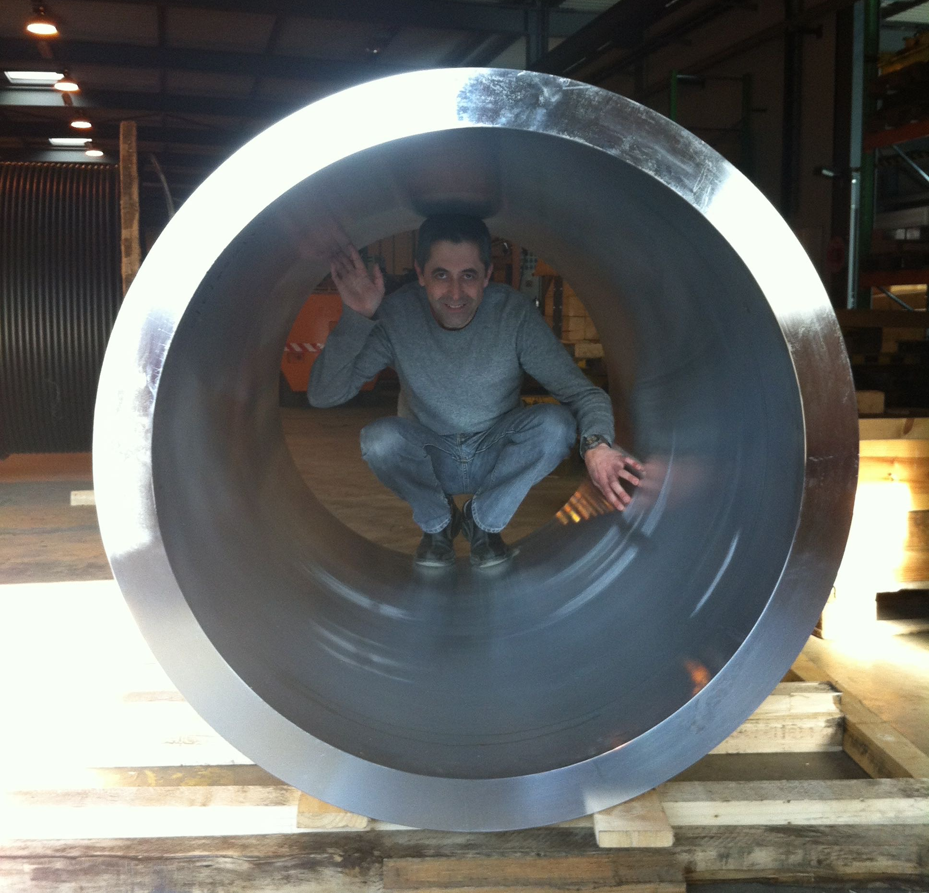
Features of superconducting magnets for accelerators
Resisitive magnets operate <5 A/mm², superconducting technology allows with 500 A/mm² a reduction of a factor 100 in the active part of the magnet
  Zero resistance as an ecologic device (no consumption, but cryogenics), but compactness as well means sustainability
  Small is beautiful … especially when you have to make thousands of them
A colleague in the structure for a large accelerator magnet

Slide 11
Requirements of superconducting magnets for accelerators
Field quality:
  <1 per mil relative error over two third of the aperture and over the operational range
  Accelerators increase the energy of a factor 5 to 20, and even at “low field” and during the energy ramp the relative error has to be < 1 per mil
  This needs fine filaments, twisting of filaments and twisting of strands in Rutherford cable
Protection:
  Energy extraction is not viable → energy has to be dumped in the coil
  How? Once a quench is detected, rapidly (order of 10 ms) induce a global resistive transition
Stress: locally, it is j×B
  The accumulation of high current density and high field induces a stress in the conductor of order of 100 MPa (unless it is intercepted)
  200 MPa is considered a limit that is better not to approach for a Nb₃Sn magnet to be produced in thousands units [F. Mangiarotti, 2LOr2E-02, experience on MQXF]

Slide 12


Contents
1975 to 2008: Nb-Ti technology in accelerators
1960
1970
1980
1990
2000
2010
2020
2030
2040
2050

Slide 13
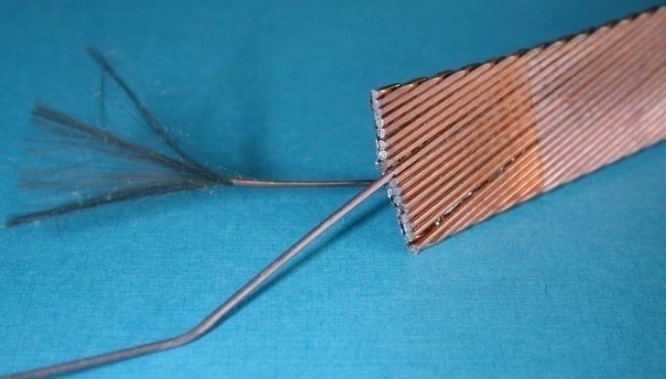
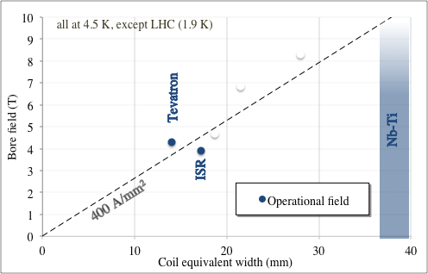
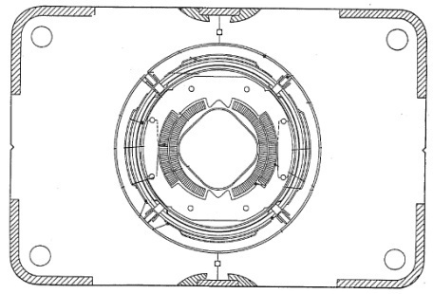
From ISR to LHC
1980-1986: Tevatron is the first collider using 4.3 T superconducting dipole magnets
  First use of Rutherford cable, first use of collars
  774 dipoles, 6-m-long magnets, in house production in FNAL
  [R. Hanft et al., TM-1182, 1630, 03/1983]
Tevatron dipole cross-section
Note: for ISR quad, G r=3.8 T is used as bore field, but coil peak field is 5.8 T - for the coil width see appendix

Slide 14
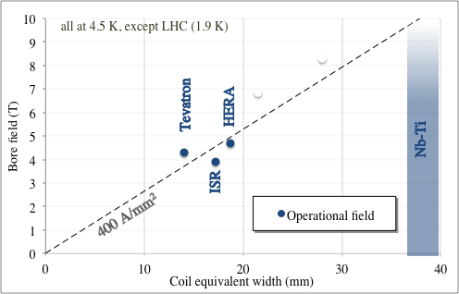
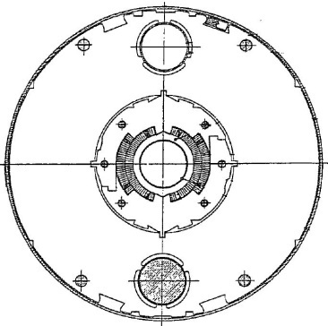
From ISR to LHC
1985-1990: HERA dipoles break the 4.5 T operational field barrier
  454 dipoles, 9-m-long magnets, industrial production, Al collars
  [R. Meinke, IEEE TAS 27, 1728 (1991)]
HERA dipole cross-section

Slide 15
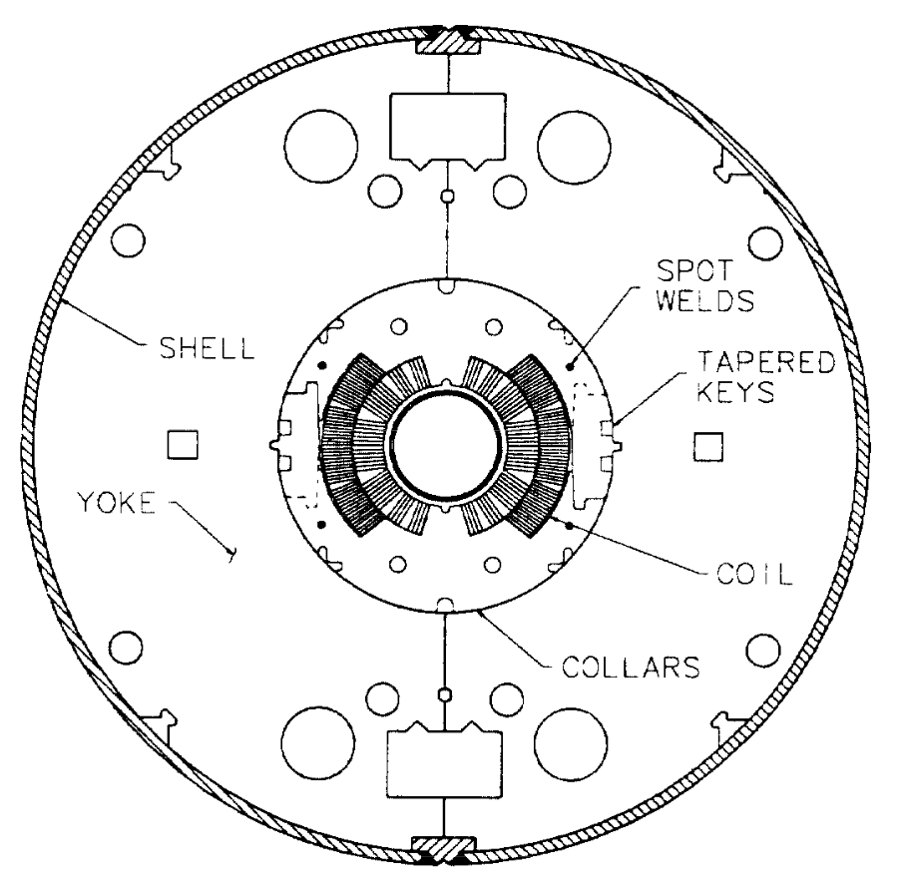
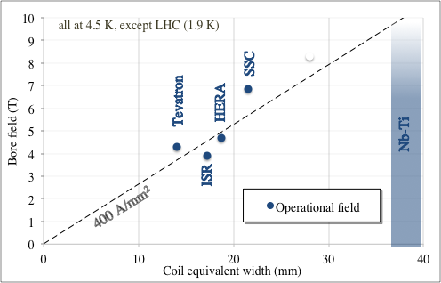
From ISR to LHC
1984-1995: SSC protoypes break the 6.5 T barrier and double the length, above 15 m
  19 dipole prototypes, 17-m-long magnets with 50 mm aperture
  15 dipole prototypes, 15-m-long magnets with 40 mm aperture
  [J. Strait, et al., IEEE Trans. Magn. 25 (1989)] Project canceled in 1993
SSC dipole cross-section

Slide 16
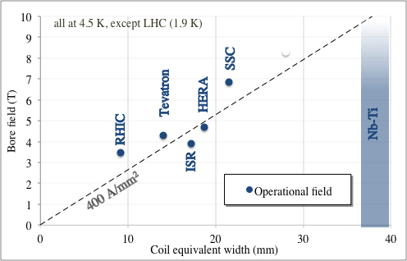
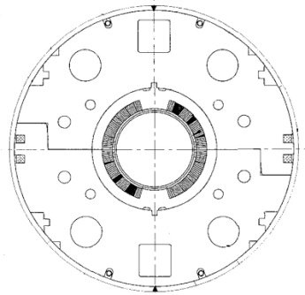
From ISR to LHC
1994-1996: RHIC dipoles (3.5 T) explore the option of a low-cost magnet, with large margin, not requiring test before installation
  300 units, 9.45 m long [M. Anerella, et al., NIM 499 (2003) 280-315]
RHIC dipole cross-section

Slide 17
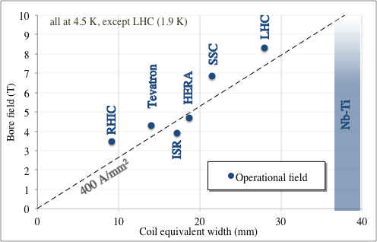
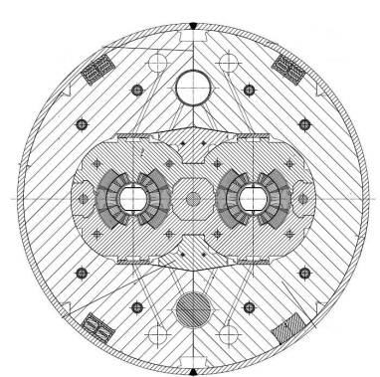
From ISR to LHC
2000-2005: LHC dipoles break the 8 T operational field barrier
  1278 dipoles, 14.3-m-long magnets, industrial production – towards the limit of Nb-Ti for main dipoles
  First operation at 1.9 K following Tore Supra experience
  [R. Perin, in Encyclopedia of Applied Superconductivity (IOP, London, 1998) 919–950 and L. Rossi, IEEE TAS 13, 1221 (2003) ]
LHC dipole cross-section

Slide 18
Lessons to be taken
Superconductivity allows not only zero consumption (except cryogenics), but for accelerator magnets gives a leap in the overall current density of two orders of magnitudes from ~5 to ~500 A/mm²: enabling technology
The history of Nb-Ti dipole magnets is a walk along the ~400 A/mm² line, increasing the coil width from ~15 mm (Tevatron) to ~30 mm (LHC dipoles) and the field from 4.3 T to 8.3 T

Slide 19
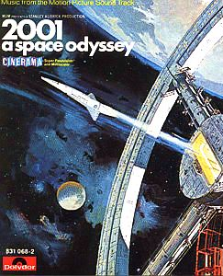

Contents
Nb₃Sn short model dipoles from 1987 to 2015
First solenoids
ISR
Tevatron
1960
1970
1980
1990
2000
2010
2020
2030
2040
2050

Slide 20
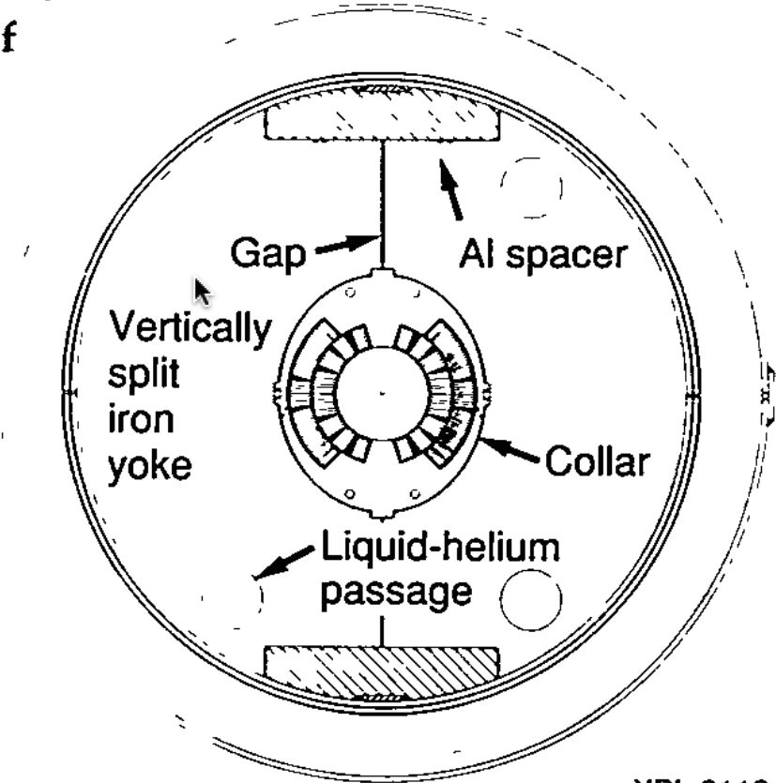
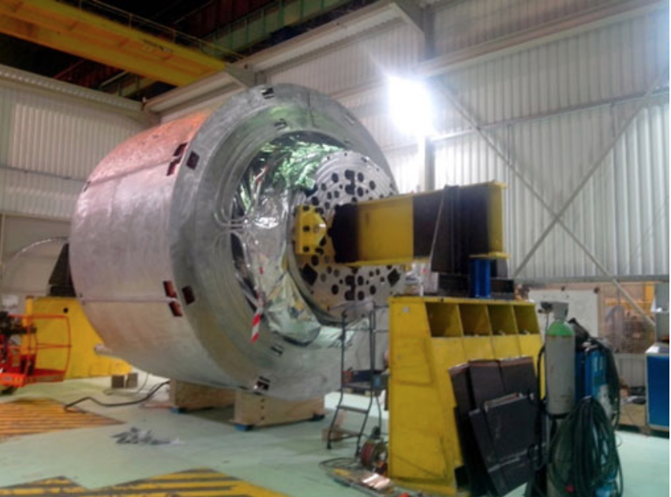
Above 10 T
10 T is the limit for Nb-Ti field in accelerator magnets (LBNL D19 went just above 10 T)
  However operational field must be much lower
Nb₃Sn, discovered before Nb-Ti, can tolerate higher field, at the price of a more complex process of coil manufacturing (reaction at 650 C, impregnation)
In the next slides we will show that the paradigm of «More field ? More coil !» that we have seen for the Nb-Ti magnets is kept
LBNL D19 cross-section
[S. Caspi, et al,] mid 90’s
Iseult 11.7 T solenoid
P. Vedrine, et al. IEEE TAS 18 (2008) 868
L. Quettier, et al. IEEE TAS 30 (2020) 4400604
Nb-Ti and Nb₃Sn critical surfaces

Slide 21
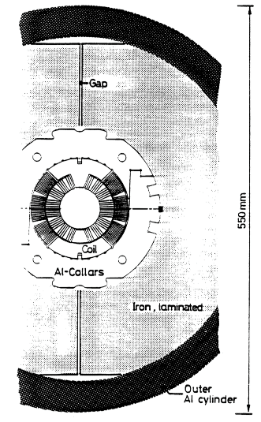
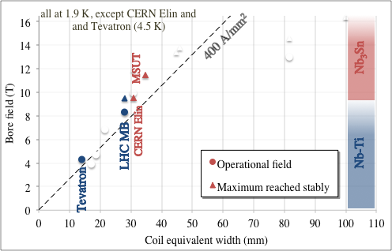
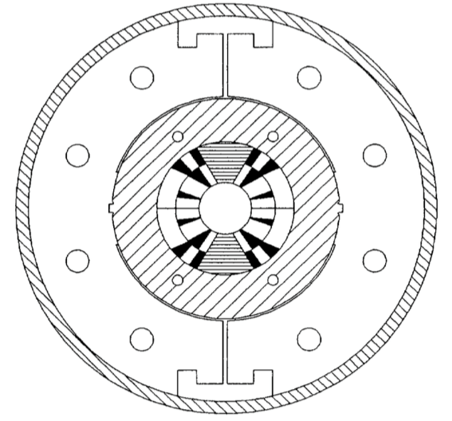
History of records in dipole field for Nb₃Sn
1989: CERN Elin reaches 9.5 T at 4.3 K (Nb₃Sn option for LHC)
1992-1997: MSUT reaches 11.3 T a 4.5 K, and >11.8 T a 1.9 K 25 years later
Note the difference: now we talk about achieved field
  The LHC has 8.3 T operational field but models, proto and series magnets >9.0, 9.5 T
CERN-Elin dipole cross-section
  [S. Wenger, et al., IEEE TAS 25 (1989)]
MSUT dipole cross-section
  [A. Den Ouden, et al. IEEE TAS 7 (1997)]

Slide 22
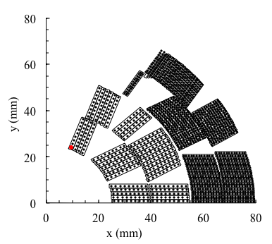
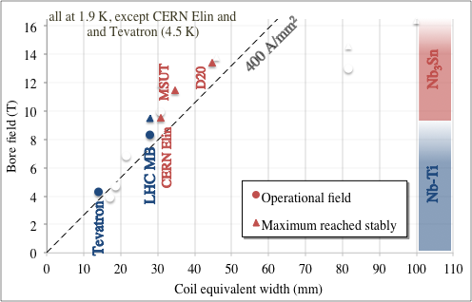
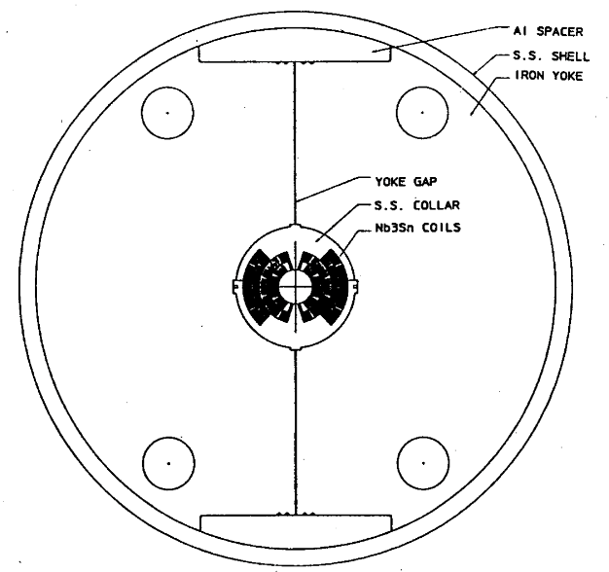
History of records in dipole field for Nb₃Sn
1993-1997: LBNL D20 reaches 13.4 T at 1.8 K
  Complex coil, four layers [D. dall’Orco, et al. IEEE TAS 3 (1993)]
  [A. McInturff, et al, Particle Acc. Conf. (1997)]
D20 dipole coil cross-section
D20 dipole cross-section

Slide 23
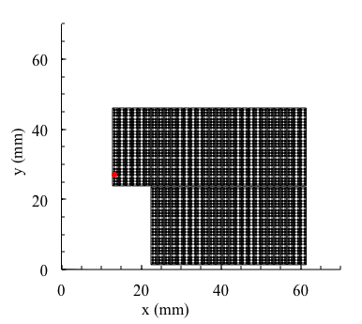
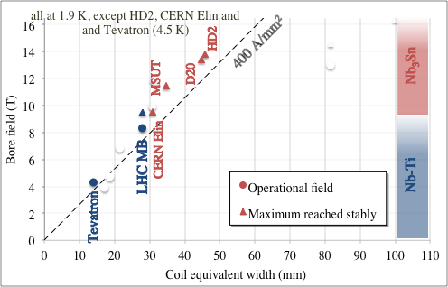
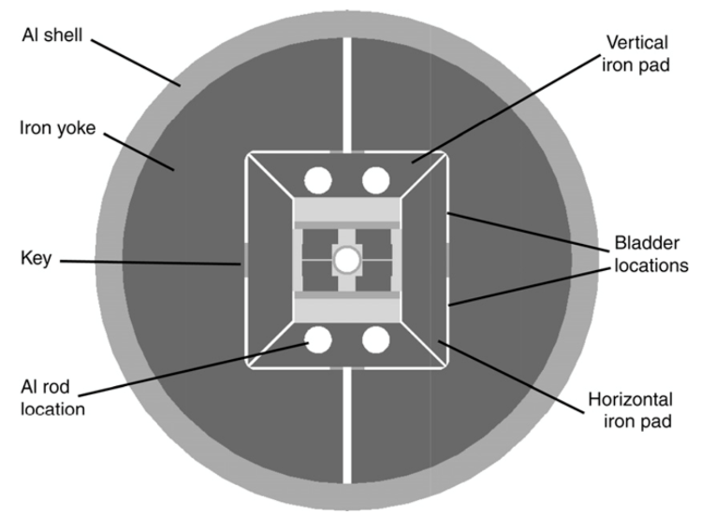
History of records in dipole field for Nb₃Sn
2005-2010: LBNL HD2 reaches 13.8 T at 4.5 K (never tested at 1.9 K)
  Block coil, flared ends [G. L. Sabbi, et al. IEEE TAS 15 (2005) 1128]
HD2 dipole coil cross-section
HD2 dipole cross-section

Slide 24
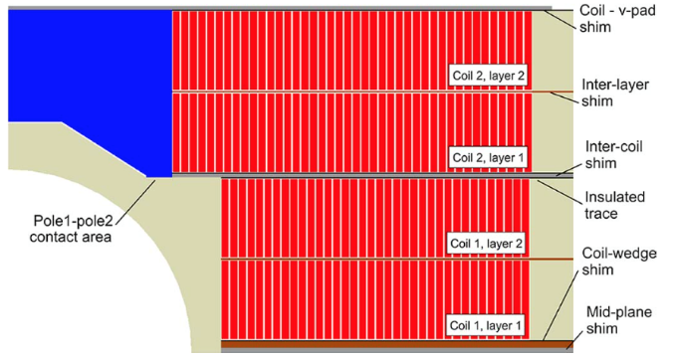
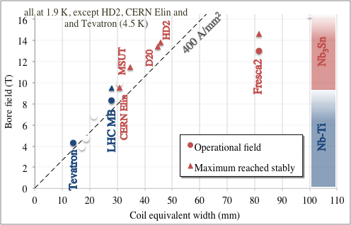
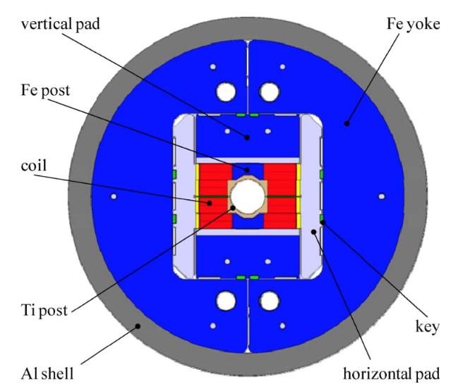
History of records in dipole field for Nb₃Sn
2012-2019: CERN-CEA Fresca2 reaches 14.5 T at 1.9 K
  Block coil with 4 layers – Very large aperture (80 mm)
  Large coil width, low current density
  This is not a magnet for accelerator, but proves the technology
  [A. Milanese, et al, IEEE TAS 22 (2012)] [G. Willering, et al, IEEE TAS 29 (2019)]
Fresca2 dipole coil cross-section
Fresca2 dipole cross-section

Slide 25
Lessons to be taken
Nb-Ti solenoids up to 12 T have been built: nevertheless, 8-9 T is the limit for applications to main dipole accelerators
Above 8-9 T operational field, one has to use Nb₃Sn, featuring a more complex manufacturing procedure
There is a 1-2 T difference between operational field in several hundreds (thousands) magnets and maximum achievable field in one magnet or in a short model: our community should be more clear on this distinction
As for Nb-Ti, for Nb₃Sn, the history of the short model dipoles walks around the 400 A/mm² line, exploring the 10 – 14 T range and coil widths from 30 to 50 mm, with the exception of Fresca2
  Note that MDPCT1 reached more than 14 T, with a 50 mm coil width (see next sections)

Slide 26
Contents
2004 to 2028: LARP and HL-LHC towards long lengths and mini-series
8 T LHC Nb-Ti dipoles
First solenoids
ISR
Tevatron 4.3 T Nb-Ti dipoles
1960
1970
1980
1990
2000
2010
2020
2030
2040
2050

Slide 27
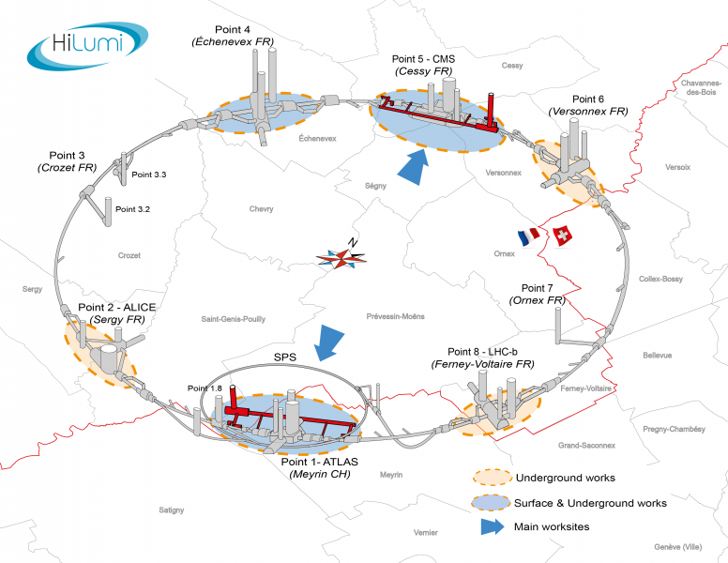
The high luminosity LHC (HL-LHC)
Scope: LHC upgrade to reach 10 times more collisions data in the period 2030-2045
  Same collision energy of 13.6 TeV center of mass
  LHC will accumulate order of 30×10¹⁵ collisions in the years 2010-2025 (300 fb⁻¹)
  HL-LHC will accumulate 10 times more data (3000 fb⁻¹)
  How ? [O. Bruning, L. Rossi, “The HL LHC” (2015) World Scientific]
  More protons in the beam
  Larger aperture magnets → More focussed beam
  Better geometry of the collisions (crab cavities)
Nb₃Sn technology will be used for the first time
in the interaction region of a collider
  [E. Todesco, et al., SUST 34 (2021) 053001]
  As it was done 45 years ago in ISR with Nb-Ti
A superconducting link in MgB₂ will be used
  This will be another prima in applications of SC to HEP
  [A. Ballarino, J. P. Burnet, “The HL LHC” (2015) World Scientific Chapter 8]
HL-LHC project [L.Rossi, O. Brüning et al]

Slide 28


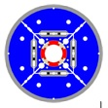
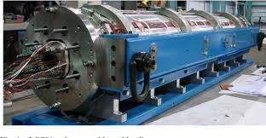
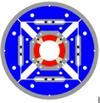
The US LHC accelerator R&D program
In 2004, US-DOE launched the LARP to support the LHC luminosity upgrade – direct R&D program
This program (2004-2015) paved the way to HL-LHC approval
  Proof of performance achivement, peak fields of 10-11 T
  Selection of the structure based on Al shell (so-called bladder and keys)
  [S. Caspi, et al. IEEE TAS 11 (2001) 2272]
  LARP proved the first scaling in length for Nb₃Sn to 3.4 m on TQ
[S. Gourlay, et al. IEEE TAS 16 (2006) 324]
TQS
HQ
3.4 m long Nb₃Sn magnet [G. Ambrosio, et al. IEEE TAS 17 (2007) 1035]

Slide 29
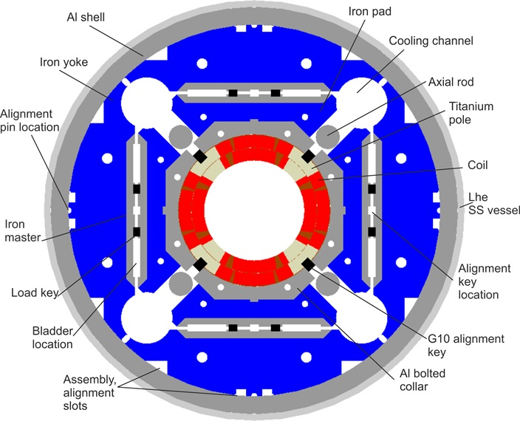
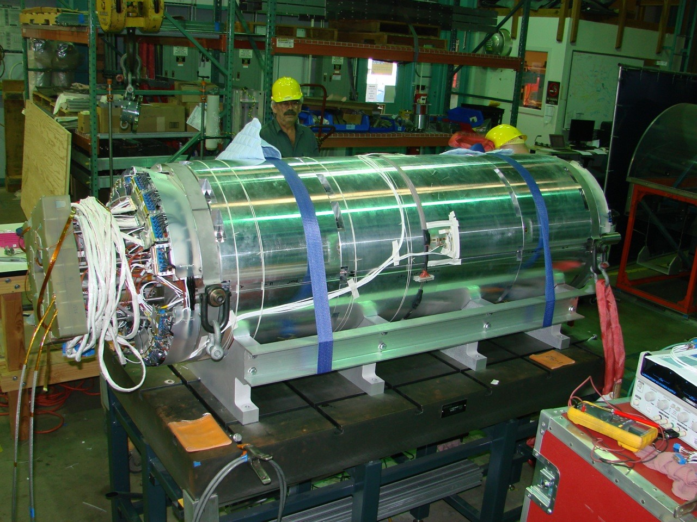

The Nb₃Sn triplet magnets MQXF
Large aperture: 150 mm diameter
    110 MPa of accumulation of stress in the midplane due to e.m. forces
US: 20 units of 4.2 m long quadrupoles
CERN: 10 units of 7.15 m long quadrupoles
Operational parameters (at 7 TeV)
  11.3 T peak field in the coil
  462 A/mm² overall j
  Operates at 77% on the loadline
Conductor: 40 strand cable, 0.85 mm strand
  High j_{c} Nb₃Sn strand RRP B-OST, 1280 A/mm² at 15 T, 4.22 K
  Production of more than 3000 km of 0.85 mm diameter strand, with cable unit lenghts of 500 m and 800 m
  [J. Fleiter, et al. 2LOr2E-03 ]
  [L. Cooley, et al. FCC week (2024) https://indico.cern.ch/event/1298458 ]
MQXF cross-section
(P. Ferracin, G. Ambrosio, et al. IEEE TAS 26 (2016))

Slide 30

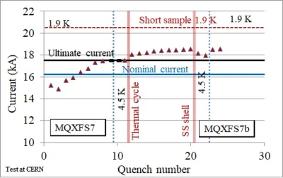
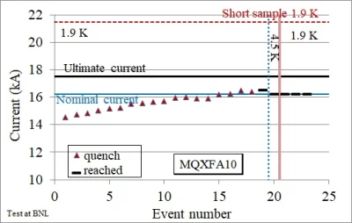
Results: reproducibility
1-m-long models: 6 reaching performance out of 7
4.2-m-long magnets:
  Two prototypes not reaching performance
  11 out of 12 series magnets reaching requirements
  (3 magnets required a coil replacement, one to be done)
  7.15-m-long magnets: [S. Izquierdo Bermudez et al. 2LOr2E-01]
  Two prototypes not reaching performance,
  4 out of 4 series magnets reaching requirements
  (issue with performance limitations has been solved)
Full statistics and timeline in the appendix

Slide 31
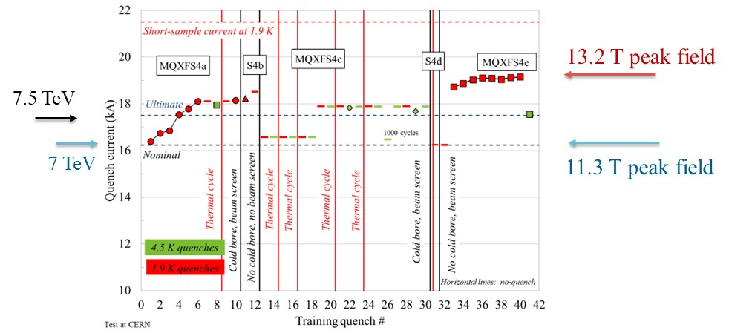

Results: operational margins
Short models
  Reached 1.5 – 2 T more than requirements (above 13 T) [F. Mangiarotti, et al. 2LOr2E-02]
  Reached systematically operational field also at 4.5 K
Long magnets are not powered above nominal
  Reached systematically operational field also at 4.5 K (>2.5 K temperature margin)
MQXFS4 test results [S. Izquierdo Bermudez, J. C. Perez, P. Ferracin, F. Mangiarotti, et al.]
One of the first 7-m.long Nb₃Sn magnets

Slide 32


Results: endurance and resiliance
Endurance:
  Several thermal cycles both on short and on long magnets, showing no degradation
Resiliance
  Accident during transport for MQXFA11, 10 g experienced, magnet reached performance
Powering test of first six conform MQXFA magnets
[J. Muratore, B. Ahia, S. Feher, G. Ambrosio et al. ]
Non conform MQXFA11 transport

Slide 33
Results: overcoming limitations
The first two 7-m-long prototypes did not reach requirements
  The following two reached requirement, but still show performance limitations at 4.5 K
  MQXFBP1 was disassembled, and longitudinally broken filaments were found in the limiting coil
  The issue was removed by not having the binder in the outer layer of the coil (note that the US collaboration kept the original baseline, not seeing this issue)
Broken filaments in coil 108, limiting MQXFBP1
[A. Moros, S. Sgobba, et al. IEEE TAS 33 (2023) 4000208]
[I. Santillana, et al. SUST 37 (2024) 085007]
MQXFB prototypes performance
[S. Izquierdo Bermudez, F. Mangiarotti, et al. IEEE TAS 33 (2023) 4001209]

Slide 34



Results: new paradigm for protection
HL-LHC uses CLIQ as a protection system, together with the standard technique of outer layer quench heaters
  CLIQ units provoke a quench in the coils via the discharge of a capacitor and the ensuing current pulse
  Developed at CERN by G. Kirby, V. Datskov, and E. Ravaioli in 2013-2018
This technique also used in China to protect short models magnets for SPPC
  CLIQ discharge in MQXF magnets [E. Ravaioli, et al, IEEE TAS 25 (2015) 4001305]

Slide 35
Lessons to be taken
HL-LHC project is proving the viability of Nb₃Sn magnets with 11.5 T peak field and up to 7 m long
  30 full size magnets are being produced, with the same design, in US and at CERN: we are halfway
  Magnets are compatible for operation in the HL-LHC in terms of performance, endurance, field quality, protection, etc ..
Short models reached systematically >13 T peak field, i.e. 1.5 T more
  For preload and limits in stress, see [F. Mangiarotti, et al., 2LOr2E-02 and G. Vallone, et al. 2LOr2E-05]
Magnets built in three production lines (two in the US and one at CERN): this is the first requirement for industrialization
Synergy betweeen US and CERN has been instrumental in the project success

Slide 36

Contents
2015 to 2050:
magnets for colliders towards 100 TeV
8 T LHC Nb-Ti dipoles
First solenoids
ISR
Tevatron 4.3 T Nb-Ti dipoles
CERN Elin Nb₃Sn 9.5 T
1960
1970
1980
1990
2000
2010
2020
2030
2040
2050

Slide 37

FCC-hh requirements: a 100 TeV collider at CERN
    First baseline: 16 T magnets, 100 km tunnel, 100 TeV [M. Benedikt, et al., FCC-hh CDR, EPJST 228 (2019)]
Nb₃Sn option for FCC-hh: a proton-proton collider for 90 TeV c.o.m energy in a 91 km tunnel, based on 14 T operational field magnets
  Note that to have 14 T operational field, the magnets should prove to be able to reach 15-15.5 T in standalone tests
An 100-120 TeV option based on HTS is also proposed (see last part), with 16-20 T field
FCC-hh parameters | CDR 2019 | 2024-Nb₃Sn | 2024-HTS
Dipole field (T) | 16.0 | 14.0 | 16-20
Tunnel length (km) | 100 | 90.7 | 90.7
Arc length (km) | 82.0 | 76.9 | 76.9
Arc filling factor (adim) | 0.80 | 0.87 | 0.85
Energy c.o.m (TeV) | 100 | 90 | 100-125
Loadline margin | 86% | 80% | TBD

Slide 38

SPPC requirements: a 100 TeV collider in China
A 100 km tunnel, initially with two options for the main dipoles [CDR of 2019]
  A 12 T magnet based on Nb₃Sn (and common coil design)
  A 20-24 T magnet based on HTS (IBS or REBCO conductor)
Updated version of CDR: 100 TeV with a 20 T magnet based on Nb₃Sn and HTS, with a common coil geometry http://cepc.ihep.ac.cn/CEPC_tdr.pdf
  13 T given by Nb₃Sn
  7 T by HTS insert (REBCO or IBS)
SPPC parameters | Nb₃Sn (2019) | HTS (2019) | Nb₃Sn/HTS (2023)
Dipole field (T) | 12.0 | 20-24 | 20 (13+7)
Tunnel length (km) | 100 | 100 | 100
Arc length (km) | 81.8 | 81.8 | 81.8
Arc filling factor (adim) | 0.79 | 0.79 | 0.79
Energy c.o.m (TeV) | 75 | 125-150 | 125

Slide 39

Superconductor needs
Order of 0.5 to 1 TA m: half to one million of km of cable carrying 1 kA
  Equivalent to 1 kA superconducting cable/wire connecting 1.5 to 3 times the distance of the Earth to the Moon
 |  | Energy c.o.m. | Field | Current density | Ampere turns per meter of magnet | Magnet lenght | Number of magnets | Total
 |  | (TeV) | (T) |  | (A) | (m) | (adim) | (TA m)
LHC | Nb-Ti | 7.0 | 8.3 | 380/480 | 3800 | 14.3 | 1232 | 0.067
FCC-hh | Nb₃Sn | 90 | 14 | 360 | ~8000 | 14.3 | ~4500 | ~0.5
FCC-hh | HTS | 125 | 20 | 400 | ~14000 | 14.3 | ~4500 | ~0.9
SPPC | HTS | 125 | 20 | ~400 | ~14000 | 14.3 | ~4500 | ~0.9

Slide 40


Three programs
MDP - US
  Generic R&D for high field dipoles for HEP
  20 T target, stress management design, reduction of training, operating towards ss
  Hybrid magnets HTS/Nb₃Sn
  >14 T proved with Nb₃Sn, but followed by degradation
EuroCirCol, followed by HFM programme - CERN
  Direct R&D for 14 T Nb₃Sn dipoles for FCC-hh
  Direct R&D for 16-20 T dipoles with HTS (hybrid or not)
  Focus on sustainability, and cost
  >16 T field proved in a magnet with 50 mm aperture but without flared ends
IHEP programme - China
  Direct R&D for 20 T dipoles for SPPC
  4.5 K operational temperature, hybrid Nb₃Sn/HTS, common coil
  12.5 T reached with 14 mm aperture diameter, common coil, racetracks
Programme
Programme

Slide 41



Cosθ designs
2011-2021: 11 T (CERN and FNAL)
  Efficient magnet with 490 A/mm² overall current density
  Some short models reached 12 T bore field, but with lack of reproducibility [see C. Abad Cabrera et al., 4LOr2E-06]
  First two-in-one Nb₃Sn dipole
  First Nb₃Sn dipole with all features for integration in an accelerator
  CERN made first scaling to 5.5 m, reaching >11 T, but many magnets showed performance degradation
12.0 T
11.3 T
[G. Willering, et al. IEEE TAS 28 (2018) 4007205]
[M. Karppinen, et al. IEEE TAS 22 (2012) 4901504]
[S. Zolbin, et al. IEEE TAS 25 (2015) 4002209]

Slide 42



Cosθ designs
2015-2020: MDPCT1 (FNAL) a four layer cosθ magnet
  World record of 14.0 T at 4.5 K, level also reached at 1.9 K – first magnet above 14 T with « reasonable » coil width (50 mm)
  Severe degradation after thermal cycle
FNAL abandoned this path, in EU this line is continued
  A two layer cosθ magnet aiming at 12 T at INFN and CERN, test foreseen in 2026
  A four layer cosθ magnet aiming at 14 T at INFN, test in 2029
14 T
Power tests of MDPCT1 [S. Stoynev, et al. IEEE TAS 32 (2022) 4000705]

Slide 43


How stress scales for sector coils
There are two different types of stress in a sector coil
  That have a totally different scaling on magnet parameters
Accumulation of azimuthal stress in the midplane
  Scales with r (aperture radius), B and j, times a shape factor
  Higher fields B can be compensated by lower j
Accumulation of radial stress
  Scales with magnetic pressure B²/2μ , factor in front is about 1.5
  At 14 T you get towards 150 MPa
Some cases | Tevatron | LHC | 14 T | 20 T
Field (T) | 4.4 | 8.3 | 14 | 20
Aperture radius (mm) | 38.05 | 28 | 25 | 25
Overall j (A/mm²) | 360 | 400 | 400 | 400
rBj/2 (MPa) | 31 | 46 | 70 | 100
B²/2μ (MPa) | 7 | 27 | 78 | 159

Slide 44


Block design
Block design has also an internal structure allowing to avoid azimuthal stress accumulation – so only the radial stress is left
2015-2023: RMM is a block magnet, without flared ends, that reached 16.4 T bore field in 50 mm aperture (but the coil is huge, not afforable for accelerator, as in FRESCA2)
Planned magnets (test in >2025)
  A double layer 14 T dipole «a la HD2» developed at CERN
  A four layer 14 T dipole «a la Fresca2» developed at CEA, but with grading
    RMM cross-section [S. Izquierdo Bermudez, et al. IEEE TAS 27 (2017) 4002004]
    RMM powering E. Gautheron, et al. IEEE TAS 33 (2023) 4004018]

Slide 45



Common coil
IHEP has chosen the common coil design
  Steps aiming at final 20 T increasing field and aperture
  2018-2023 LFP1: 12.5 T reached within 14 mm aperture
    ]
Ongoing or planned
  IHEP is building LFP3 (13 T of LTS)
  CIEMAT plans a 14 T common coil with Nb₃Sn only (see also C. Martins, 1LPO1G-08)
Common coil design [R. Gupta, IPAC 1997 3344]
LFP3 magnet [J. Shi, Q. Xu, et al., IEEE TAS 34 (2024) 4701405]
    LPF1 training [C. Wang, et al., SUST 36 (2023) 065006]

Slide 46




Stress management: cosθ and common coil
12.7 T peak field
Stress management consists in mixing the coil and the structure
  Advantage: (i) Stress is intercepted at each block of conductors and (ii) the structure enthalpy can contribute to protection
  Possible disadvantage: preload is not (or only partially)
FNAL: SMCT (stress managed cos theta)
  Cables blocks are wound in a former
  Cos theta configuration with radial and
  azimuthal stress interception
  Mirror reached 12.7 T peak field (87% ss))
PSI: SMCC (stress managed common coil)
  Racetracks wound in a former
  Subscale reached 7 T peak field
  Full scale magnet in 2025-2026
10.0 T peak field
[A. Zlobin, 4LOr2E-01] I. Novitski, et al. IEEE TAS 34 (2024) 4001305]
[D. Araujo, et al. ASC 2024]

Slide 47





Full stress management: CCT
Canted cos theta is the extreme case of stress management
  Winding on a former following the shape of a tilted solenoid: each cable turn is supportetd by the structure [D. Meyer, R. Flask, NIM (1970)] : less efficient use of conductor, but a modular design, allowing adding layers
LBNL worked on this design since 2010
  CCT5 in Nb₃Sn: 8.5 T in 90 mm aperture
  [D. Arbealez, et al. IEEE TAS 32 (2022) 4003207]
PSI reached 10.1 T in a 66 mm aperture
  Using Nb₃Sn, design based on CCT5
  [B. Auchmann, et al. IEEE TAS 34 (2024) 4000906]
MDP is also building HTS magnets
  1.5 T reached with Bi2212 CCT in 31 mm ap.
  2.9 T with REBCO CCT in 65 mm ap. (LBNL)
  1.5 T with REBCO COMB (FNAL)
  [P. Ferracin, et al. 4LOr1B-01]

Slide 48
Lessons to be taken
Stress managed structures are a new paradigm, mixing structure and coil : this allows avoiding stress accumulation and could ease protection since the structure could take part of the energy and increase the current density
  However, you lose the possibility of preloading the coil → training can become an issue
  Stress management can allow to use higher current densities, i.e go to more efficient magnets
  At 20 T stress managed magnets are mandatory: US-MDP and PSI are investing on this option
Up to 14 T operational field stress interception (management) is not mandatory, but can provide precious additional margin for a long production as for SPPC or FCC-hh
The worldwide efforts are focussed on different designs
Continuous (order of >10 years) and coherent efforts are the key to success

Slide 49


Muon collider requirements
Muon collider is an idea that is in the community since at least 30 years: colliding muons
  Muons have larger mass then electrons → much less synchrotron radiation
  Muons are not composite particles as protons → (cleaner events)
  Muons rapidly decay → they have to be accelerated very rapidly
Many interesting magnets
  High field solenoids (>>20 T)
  High field magnets
  [L. Bottura et al. IEEE TAS 34 (2024) 4005708, 1LOr2E-01 – B. Caiffi, 1LOr2E-02 ]

Slide 50
Contents
Features of superconducting magnets for accelerators
35 years of Nb₃Sn dipole magnets for accelerators: from 10 to 14 T
The HL-LHC achievements
Nb₃Sn dipoles for 100 TeV colliders
HTS: opportunities and challenges

Slide 51

The ideal superconductor would have …
… a critical current that does not decrease with field
… a critical current that does not increase at lower fields (to reduce hysteresis, persistent currents)
… 1500 A/mm² (just what is needed, nothing more) at high temperatures
Ideal superconductor,
at temperatures >> 70 K
[Raffaello et al., The School of Athens,
detail, Musei Vaticani (1510)]
… and
Cheap: 5 $/(kA m)
Stress resistent at least up to 200 MPa
Available in long (km) lengths

Slide 52

The ideal superconductor for accelerator magnets
… a critical current that does not decrease with field
… a critical current that does not increase at lower fields (to reduce hysteresis, persistent currents)
… 1500 A/mm² (just what is needed, nothing more) at high temperatures
HTS are the ideal superconductor ?
[Raffaello et al., The School of Athens,
detail, Musei Vaticani (1510)]
… and
Cheap: 5 $/(kA m)
Stress resistant at least up to 200 MPa
Available in long (km) lenghts
[courtesy of P. Lee]

Slide 53
Three conductors for HTS
BSSCO 2212 (mainly developed in the USA [T. Shen, 3MOr1A-01] )
  Available in round strand, dipole magnets reaching 1.5 T have been done in LBNL (1.5 T)
  Expensive, complicated manufacturing process (more than Nb₃Sn): reaction at 800 C in 100 bar of O₂
  REBCO (a hope for a very fast track to fusion, [see plenary talk of D. Dunn])
  Recently, large reduction of cost, but still one order of magnitude above what needed in the unfavorable direction, and with limited lengths
  Available in tape, cable geometries are being considered (Roebel, Corc®, Star ®)
  Hysteresis losses can be a showstopper: the filament is the tape width
  IBS (strong impulse from China) [see plenary talk of K. Iida]
  Critical current is improving
  Potentially cheaper than REBCO

Slide 54


Two options: hybrid or full HTS ?
All-HTS coil open the possibility of 20 K operation, which could consume less energy
  Beware of drawing « easy » conclusions on sustainability … it is a very complex computation that is notalways not totally intuitive
«Hybrid» makes use of HTS in higher field regions, and of cheaper Nb₃Sn up to 15 T
  This option is being developed in the US by MDP, and in China by IHEP
Hybrid design for 20 T magnet
[P. Ferracin, et al, IEEE TAS 33 (2023) 4002007
and 4LOr1B-01]
Hybrid design for 20 T magnet
[Q. Xu, et al, CEPC design report, pg 749]

Slide 55



The challenge of hysteresis for tapes
The larger temperature margin and lower j at low field, allows stability with very large filaments in one direction (up to 12 mm)
Hysteretic losses, that are today critical for the FCC-hh (target of 5 kJ/m is given), can be a showstopper in this case
In case of HTS insert, both common coil and cosθ have the cables perpendicular to the field: the ideal is the block, where they are parallel
Feather magnet tested in 2017
had block aligned: it reached 4.5 T
[L. Rossi, et al, Instruments 5 (2021) ]
Is REBCO tape a viable conductor for
HEP main dipole magnets ?
Aligned block design in Feather
[J. van Nugteren, G. Kirby, et al,
IEEE TAS 25 (2015) 4000705]
First powering of Feather
[L. Rossi, et al, IEEE TAS 28 (2018) 4001810]

Slide 56

The challenge of protection and detection
Thanks to the larger temperature margin the quench velocity in HTS is very small – detecting the quench is troublesome and takes much more time than in LTS
Moreover: magnetic pressure energy density enthalpy
Three strategies
  Have the structure participating to the removal of the heat (as in stress managed magnets?)
  Invent a cheap extraction system for long magnets that can be applied to every magnet
  [see ESC system, E. Raxaioli, et al, 1LPo1G-01]
  Avoid quench
Field | Pressure | Energy density
B (T) | B²/2μ (MPa) | B²/2μ (J/mm³)
5 | 10 | 0.010
10 | 40 | 0.040
15 | 90 | 0.090
20 | 160 | 0.160
  [see T. Salmi, et al, 1LPo1I-04]

Slide 57
Lessons to be taken
HTS opens a path towards operational fields higher than 15 T and higher operational temperatures
  This could also open the possibility of simpler cryogenic systems, and be more economical – however the global optimization of the systen is not trivial
Today the adaptability of present state of the art of HTS tapes to main magnets for HEP accelerators is not proven
  A large current cable, windable, is needed – many efforts in the past years but a clear solution is not yet available
  We are not sure that the conductor itself is viable for very special requirements needed by HEP applications – is the hysteresis due to large filaments a showstopper ?
  Field quality still very far from requirements
  Protection at 20 T requires new paradigms
The 20 T target makes us enter in «new physics», requiring a well defined strategy to prove within 5-10 years if HTS is a viable technology for HEP

Slide 58
Some personal final remarks
There is no free lunch: every tesla is gained with lot of effort, time, and technical advancements
Since our research timelines are very long, collaboration in space and in time between different teams is needed – competition does not work, joining the efforts is much more effective
To handle information between generations and between labs, journals (and conferences) are fundamental: (i) write, even about setbacks (ii) travel (iii) read, read, read … and forget, and then read again
Long time ago, colleagues were building magnets without computer codes: analytical methods are an essential tool that can give a lot of insight

Slide 59

Thanks !
First Nb3Sn quadrupole made in the US after reception at CERN, December 2023

Slide 60
Appendix
Timeline of HL-LHC
Timeline for FCC-hh
About preload and degradation with stress

Slide 61
MQXF short model timeline
2013-2023: 7 short models built, 6 conform
MQXFS1: ≥12.9 T
11.6 T peak field corresponds
to the gradient requirement
for 7 TeV operation
(also called nominal)
MQXFS3: ~10.6 T
MQXFS5: ≥12.7 T
MQXFS4: ≥13.1 T
T₀: aperture and cable selection
MQXFS6: ≥13.4 T
MQXFS7: ≥13.2 T
MQXFS8: ≥13.1 T
2013
2014
2015
2016
2017
2018
2019
2020
2021
2022
2023
2024
2025
2026
2027
T₀+3

Slide 62
MQXFA (4.2 m long) timeline
Green is conform : ≥11.6 T
Red is non conform
Cold mass 1
Magnets 07, 08 and 13
succesfully went through
coil replacement
11.6 T: requirement
for 7 TeV (nominal)
plus 300 A margin
MQXFAP1: ≥11.6 T, but electrical short
MQXFA10
MQXFAP2: ~10 T, structure failure
MQXFA11
MQXFA03
MQXFA08b
T₀+4
MQXFA04
MQXFA13: ~10.7 T
T₀: aperture and cable selection
MQXFA05
MQXFA14
Program
Project
MQXFA06
MQXFA07b
DOE approval
MQXFA07: ~10.7 T
MQXFA15
MQXFA08: ~9.5 T
MQXFA13b
2013
2014
2015
2016
2017
2018
2019
2020
2021
2022
2023
2024
2025
2026
2027
11 magnet tested, 10 more new magnets to test (9,12,16-23)

Slide 63

MQXFB (7.15 m long) timeline
Green: conform ≥ 11.6 T
Red: non conform
Grey: to come
MQXFBP1: ~10.5 T
This is the first Nb₃Sn magnet
above 5.5 m lenght
MQXFBP2: ~11.2 T
MQXFBP3
MQXFB02*
T₀: aperture and cable selection
MQXFB03
MQXFB04
2013
2014
2015
2016
2017
2018
2019
2020
2021
2022
2023
2024
2025
2026
2027
T₀+7
8 more magnets to test
* NC HV test, to be disassembled

Slide 64
Appendix
A conservative timeline of FCC-hh for Nb₃Sn
15 m long prototypes (>5 of each type)
5 m long prototypes of one selected design
(>5 of each type)
Short model program on two selected designs
(>5 of each type)
Ongoing 12 T and 14 T short models (seven designs, 1 or 2 of each type)
Selection of final design
to start long magnets
2024
2025
2026
2027
2028
2029
2030
2031
2032
2033
2034
2035
2036
2037
2038
2039
2040
2041
LHC RunIII
HL-LHC RunIV
HL-LHC RunV
HL-LHC RunVI

Slide 65
Appendix
A conservative timeline of FCC-hh for Nb₃Sn
Installation and commissioning
Production and test
Industrialization (pre-series magnets)
Tender for the series
2040
2041
2042
2043
2044
2045
2046
2047
2048
2049
2050
2051
2052
2053
2054
2055
2056
2057
LHC RunVI

Slide 66

Preload matters (for cosθ)
The structure based on Al shells aims at full preload just below nominal current
  Very low preload has also been tested, corresponding to preload at 70% of nominal current: magnet was tsill able to operate at nominal current, but nearly 2 kA of maximum reachable current were lost
  (S. I. Bermudez, et al., IEEE TAS 32 (2022) 4007106)
Preload experiment on MQXFS6 (S. Izquierdo Bermudez, F. Mangiarotti, et al.)

Slide 67

Stress limits (for cosθ)
Similar to what done in TQ magnet, higher preload were explored (up to 200 MPa)
  Test is ongoing, at 200 MPa nominal performance is still reachable, but signs of performance degradation in the range above 90% of short sample limit – we are now going back to 120 MPa
90% s.s.
at 1.9 K
171 MPa
190 MPa
7 TeV
80% s.s.
at 1.9 K
96 MPa
117 MPa
148 MPa
129 MPa
E. Todesco on behalf of WP3

