Slide 1
Instrumentation for 150 MeV line
16/10/24, 19th AWAKE BI meeting

Slide 2
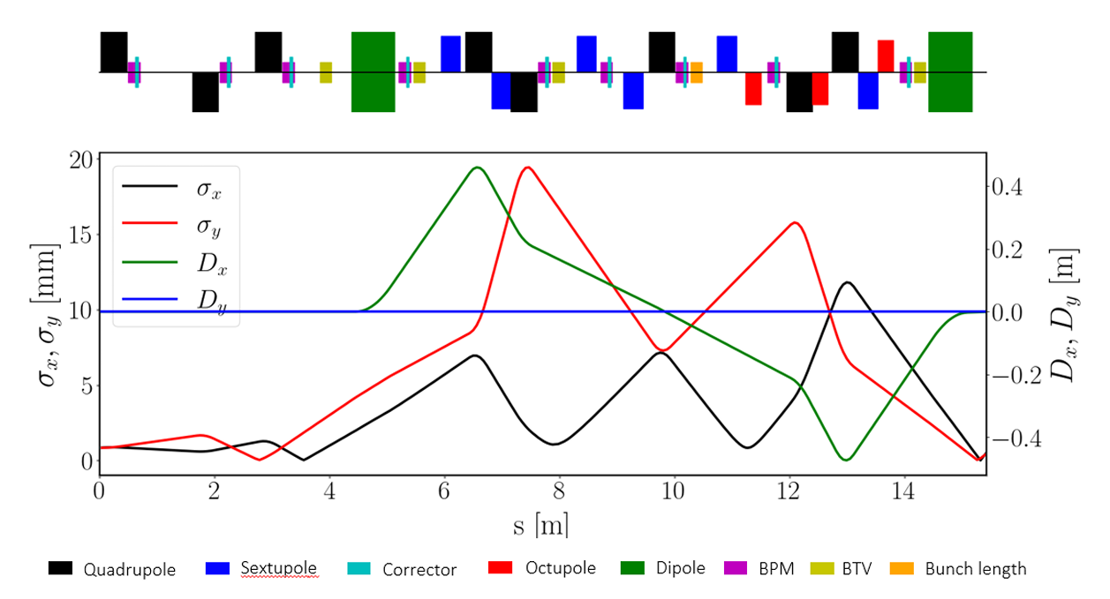
150 MeV e- line
From Vittorio’s draft EDMS 3153236 ‘150 MeV beamline description’
Shall be finalised soon. Similar document for gun will be produced (Steffen)
These will be basis for BI production

Slide 3
150 MeV e- line - BPMs
60
60
BI will produce 9 (7+2) total 40 mm, 3 (2+1) 60 mm for the whole line (installed + spares).
Quick CF flanges of BPMs not a problem for vacuum team as long as these are designed according to ISO standards to avoid incompatibility with tensioning chains

Slide 4
150 MeV e- line - BTVs
60
BI will produce 7 (5+2) BTVs (installed + spares). Standard: 1 OTR, 1 scintillator, 1 target.
Aperture / screen size of the BTVs: probably the BTV at 8 metres will need a larger screen so a custom screen holder will be needed. Proposal: design for 40 mm and adapt for the 8 metres one if needed.
BTV at 8 metres: 60 mm aperture flange?

Slide 5
150 MeV e- line – BL monitor
Clarify position of BL monitor. Present position best for accuracy. As part of gun: easier integration.
BL monitor type not decided yet. need to define interfaces and space reservation

Slide 6
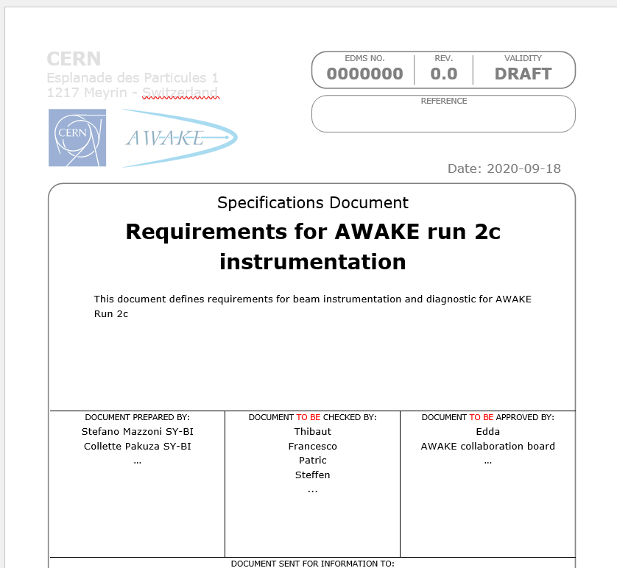
150 MeV e- line – requirements
BI (Stefano) will finalise requirements document ‘Requirements for AWAKE run 2c instrumentation’ (now draft and incomplete)
Basic requirements for 150 MeV line:
  BPMs: 10 um resolution
  BTVs: 50 um magnified pixel size (provided that injection size has 1 um resolution)
  bunch intensity: to be defined (BI proposal: in-flange Bergoz ICT )
  BL: 10 % resolution (20 fs)?

