Slide 1




Electron-bunch synchronisation for AWAKE Run 2c.
Joshua Gregory
October 2024
Notes:
Talking about synchronisation of electron bunches at AWAKE
Will form the majority of work at CERN
Numbers are subject to correction

Slide 2
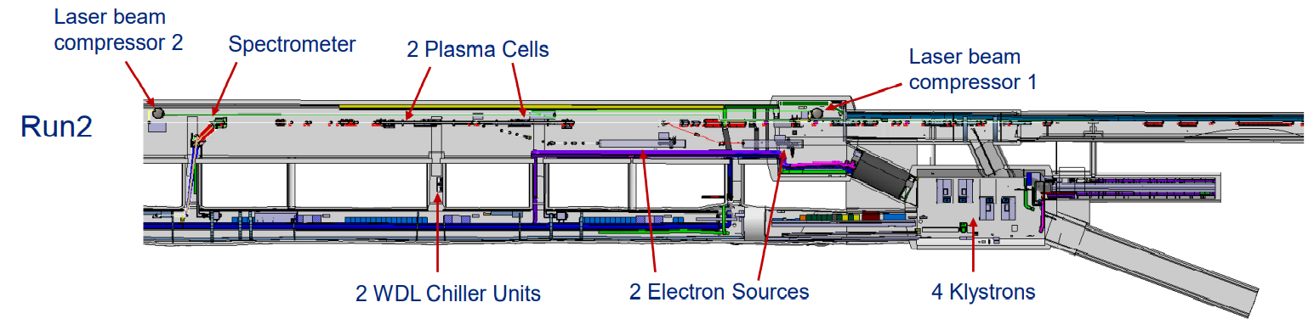






Run 2C
Seed Bunch
16-19 MeV - (S-Band Gun & Linac)
1.2mm length/4ps (@ AWAKE Run 2a)
Arrival-time in plasma influences proton modulation phase.
Witness Bunch
150-165 MeV - (S-Band Gun; X-Band Linac)
60um length/200fs - (@ 7e¹⁴ cm⁻³ plasma density)
Must be injected at the correct proton modulation phase
Notes:
Run 2c has two photoinjectors
Low energy for seeding of plasma wakefields
Witness bunch electrons injected and accelerated when slotted into plasma oscillations
Arrival-time monitoring to be performed at HF BPMs next to main beamline.

Slide 3
Tightly-synchronised Photoinjectors
Phase of seeded wakefields determined by arrival-time of seed-bunch.
Seed-bunch arrival time jitter δt phase-shifts wakefields.
Small witness bunch injected at incorrect phase - NO ACCELERATION!
Requirement for e-bunch synchronisation to <40fs.
t₀
δt
Modulated protons ~ 1.3mm
Modulated protons ~ 1.3mm
Modulated protons ~ 1.3mm
Seed Bunch ~1.3mm
Unmodulated protons ~ 8cm
Notes:
Reason why we care about electron bunch synchronisation
Wakefield phase from seed bunch
Seed bunch jitter phase-shifts wakefields
Witness bunch not injected properly.
No acceleration
E-bunch synchronisation to within 40fs.
Proton bunch long – ps jitter from SPS is not relevant
E-bunch phase stability sensitive
SPLIT WORK INTO ARRIVAL TIME & FEEDBACK

Slide 4
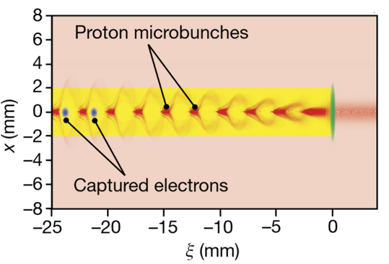
Tightly-synchronised Photoinjectors
Seed-bunch drives wakefields over short distance.
Plasma wavelength is ~1.3mm @ 7e¹⁴ cm⁻³
Long SPS proton bunch modulates with period set by plasma wavelength.
Witness electrons injected at accelerating phase.
Seed Bunch ~1.3mm
Modulated protons ~ 1.3mm
Witness Bunch ~60um
[1]
Notes:
Seed bunch drives wakefields over short distance.
Bunch length is matched to plasma wavelength
SPS proton bunch forms driving microbunches according to seeded fields.
Wakefields driven
Electrons accelerate
Energetic electrons
Blowout of plasma electrons requires >20 carrier density in bunch.
Need slim electron bunch with transverse bunch dimension of 5 or 6um.
Avoid emittance growth by space charge to maintain tolerance at energies >150MeV
Short electron bunch as must be much shorter than plasma wavelength – 1.3mm

Slide 5
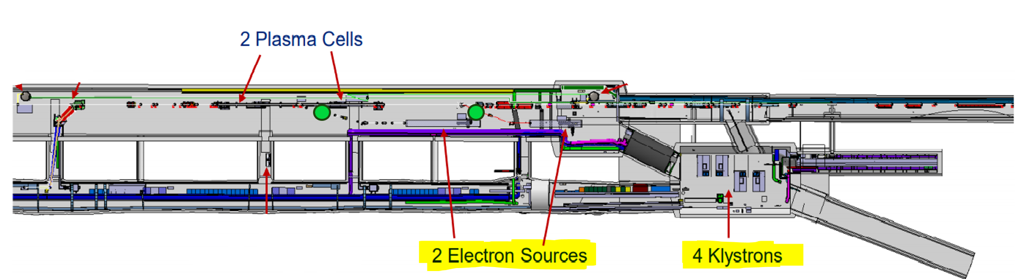
Arrival-time monitoring.
Arrival-time monitoring necessary – pulse tagging/feedback.
Electro-optic sampling of RF pickups.
Require arrival-time resolution to few 10s femtoseconds.
Notes:
Electron-line arrival-time monitoring close to injection point.
Avoids proton interference on main beamline.
Based on electro-optic sampling of pickups.
RF transport to external modulator.
Allows multiple channels of measurement.
Large dynamic range required.

Slide 6
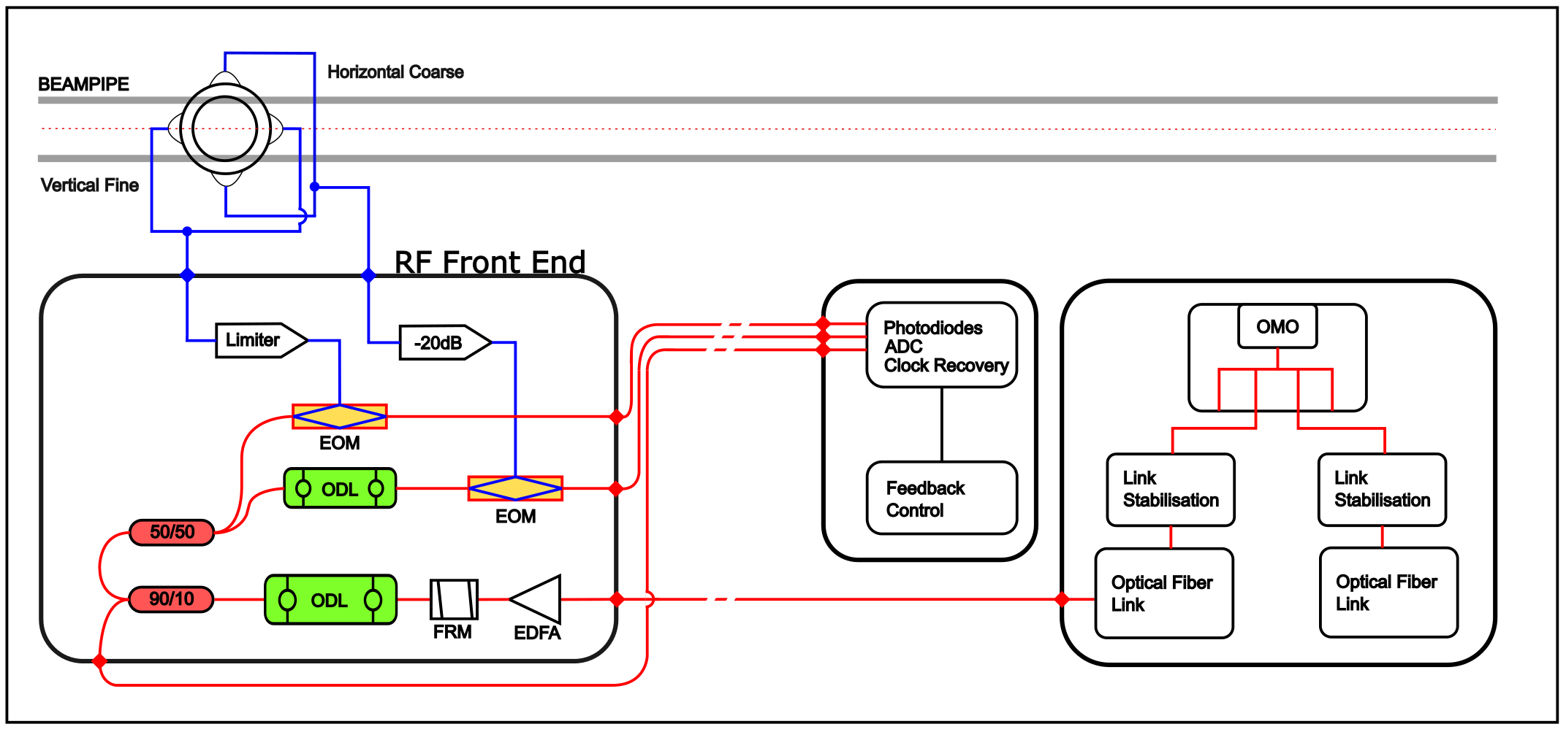
Proposed EOM Config
Notes:
Design influenced heavily by the work of MKB @ FLASH
Demonstrated system at FLASH, and at CLARA.
Exhibits sub-10fs resolution for 200pC+ - may be good way forward.
Walk through operation.

Slide 7
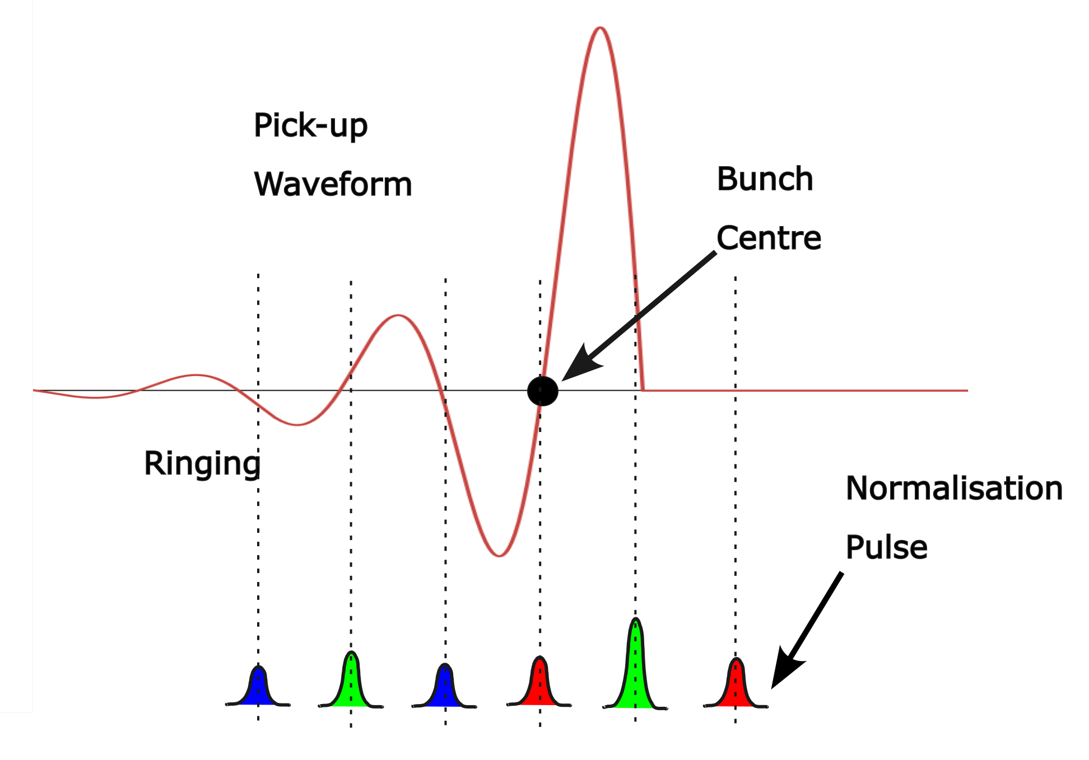
Proposed EOM Config
EOM modulates optical amplitude according to RF.
First zero crossing indicates bunch charge centre.
BPM ring supplements sampling.
Need adequate optical sampling frequency.
Notes:
Optical signals sample RF waveform at zero crossing
And for ringing nanoseconds after.
Initial pulse normalises with zero modulation.
Subsequent amplitude change indicates deviation from zero crossing.
First-rise picoseconds. Nanoseconds ringing

Slide 8
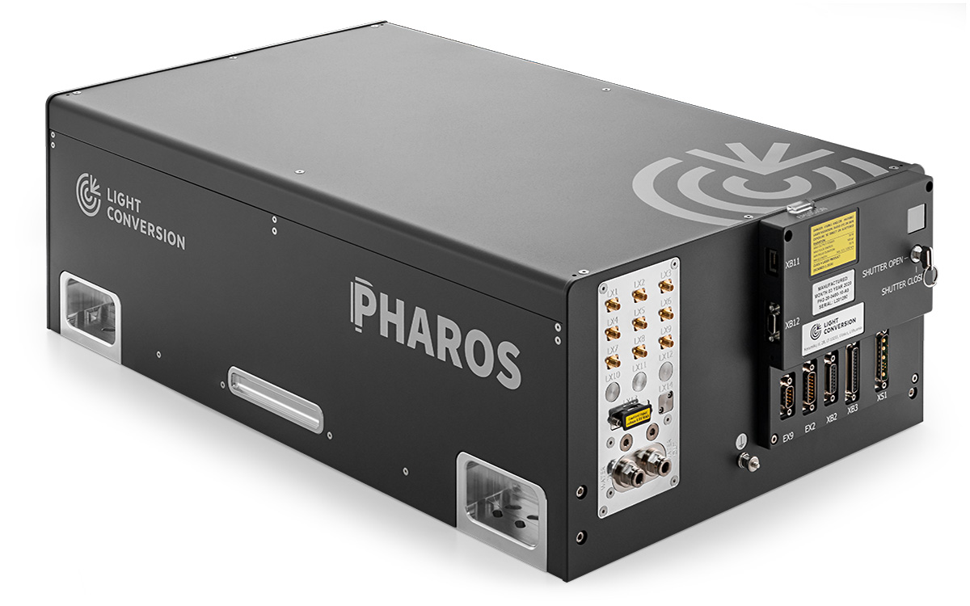
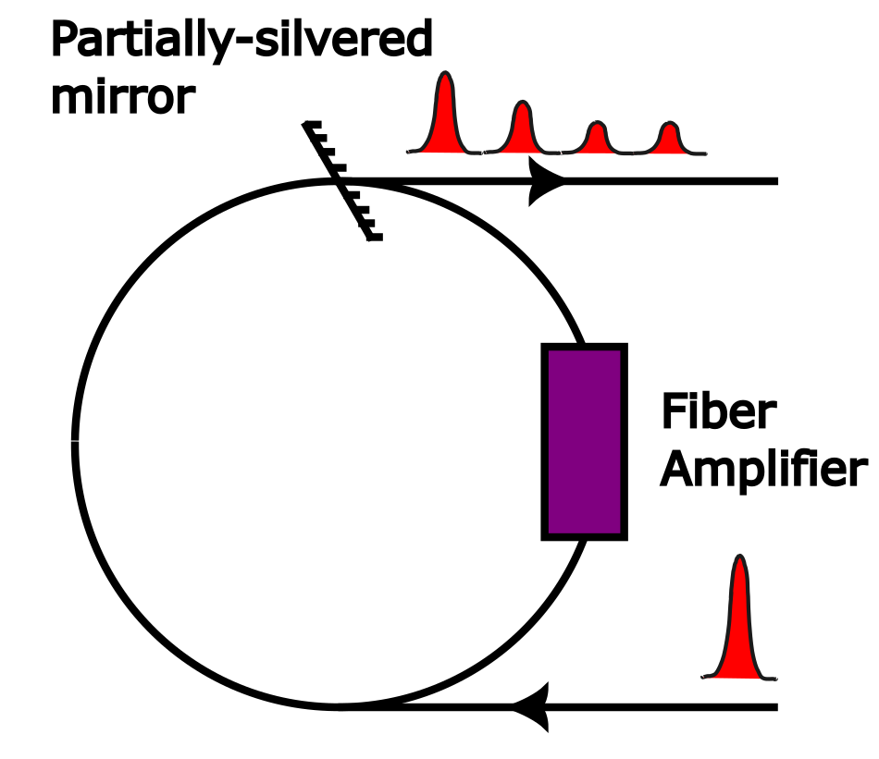
Challenges to implementation
Require sufficient optical rep-rate to sample RF pickup function – 200+ MHz
AWAKE fundamental frequency is 88MHz.
CTF2 optical rep-rate is 75MHz.
Potential use of Recirculating (Active) fiber-loop for high rep-rate bursts – documented to multiply from MHz to GHz with excellent intra-pulse stability.
Notes:
Optical rep-rate needs to be high
Existing laser system at 1030, Pharos @ CTF2 & AWAKE
Existing implementations 200MHz
Maybe <100Mhz enough
May need multiplier in fiber loop.
Walkthrough
Potentially active loop – amplifier – noisy.
Demonstrated inside laser systems.

Slide 9
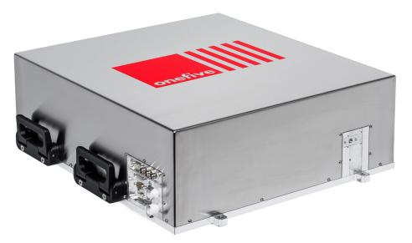
Challenges to Implementation
Requires time-of-flight stabilised links if long-distance distribution.
If insufficient optical-clock signal, secondary source may be needed.
Wide dynamic range needed – multiple channels of measurement.

Slide 10
Feedback
Notes:
Monitoring can at least provide indicator of true arrival-time.
Even if no feedback implemented; acceleration correlation possible. (Self-scanning.)
Feedback required for consistent witness bunch accelerating gradient.
Also challenging.

Slide 11
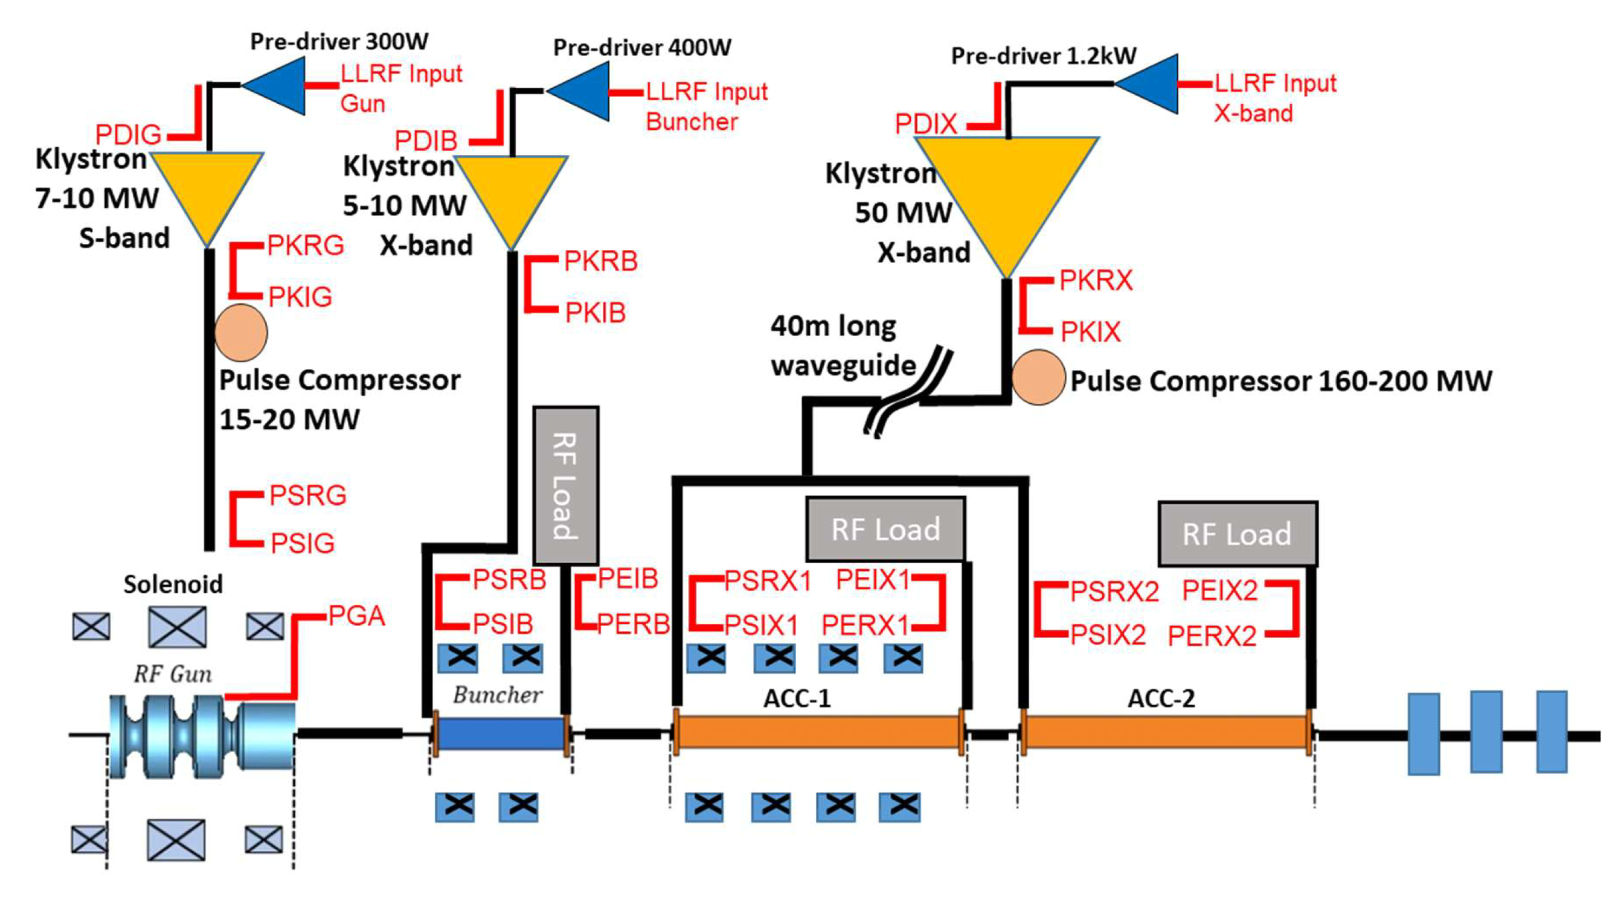
RF Feedback Options
Notes:
Planned RF system for witness bunch
Possible locations for feedback.
Possible for dynamic changes in RF timing system.

Slide 12
RF Feedback Options
Notes:
Possible to feedback on the gun solenoid
May affect buncher performance.

Slide 13
RF Feedback Options
Notes:
Tuning the buncher
Negatively affect emittance corrections later in the beamline.

Slide 14
RF Feedback Options
Notes:
Can feedback on the X-Band structure
May need to be stabilised anyway due to huge waveguide.
Requirement for >40fs.
Waveguide eats that with 0.02C temp variation.
Balance between stabilisation and accurate monitoring.
Can be enacted by phase control of pulse compressor.

Slide 15
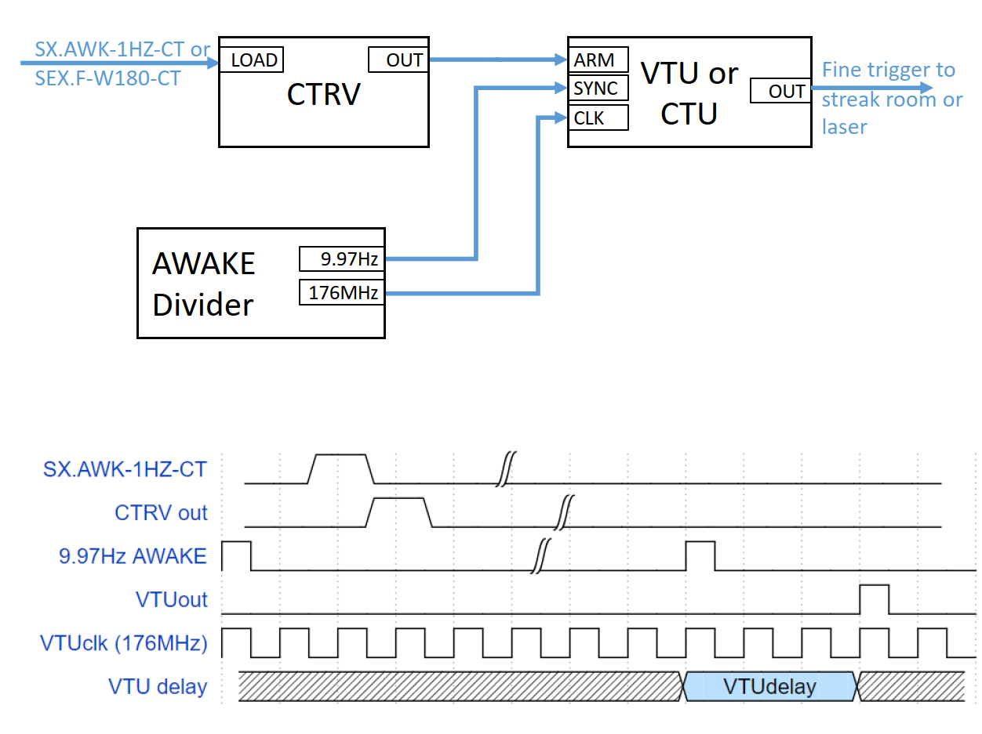
RF Feedback Options

Slide 16
Challenges to implementation
Waveguide length - 40m copper waveguide.
Complex witness bunch line – sensitive to feedback actions?
Witness-bunch line instabilities unknown – yet to be built.

Slide 17
Future/Ongoing work
Feasibility study examining arrival-time monitoring with 1030nm Yb-Er laser.
  Sampling with novel electro-optic modulators – new @1030nm.
  Stabilised link performance – new @ 1030nm.
  100s MHz signal generation using fiber-loop @ 1030nm.
  If new optical clock, converting MZI Interferometer (Amos Dexter) previously at AWAKE into lock-box.
Feedback options
  Can also feedback on photocathode illumination – options to be investigated.
  How acceptable is RF feedback at given locations.

