Slide 1
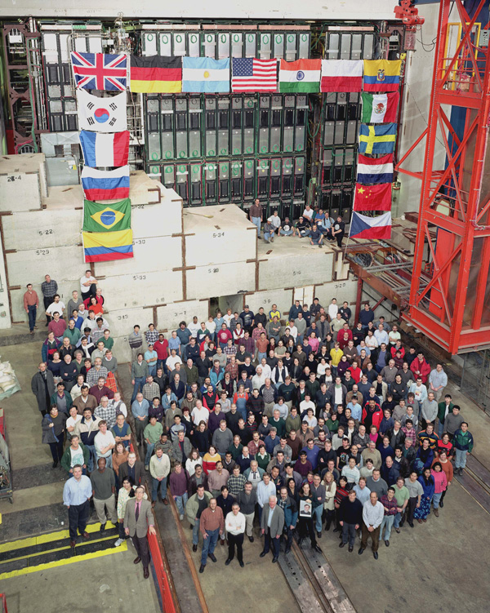

The Story of a W+Jets Mass Bump
G. Watts (UW/Seattle)
CPPM Seminar
27/6/2011

Slide 2
Disclaimer

Slide 3
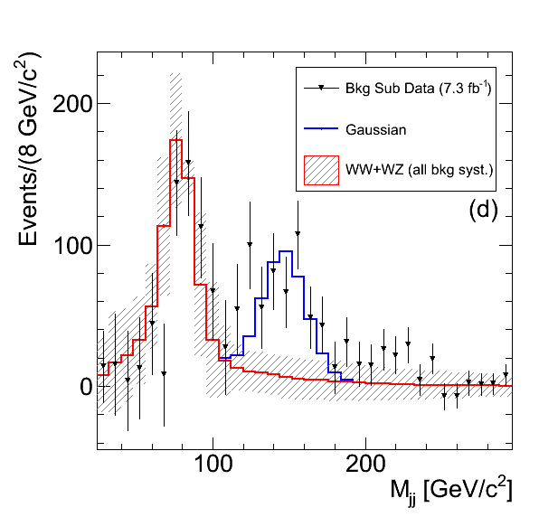


$$7.3 fb^{−1}$$
Notes:
Get a CDF logo for this page

Slide 4
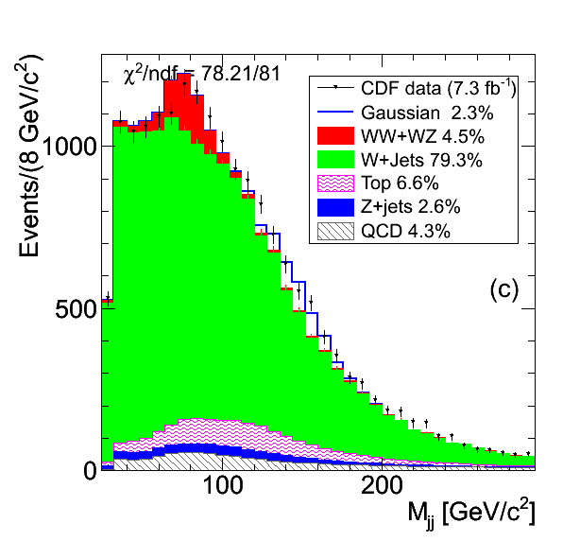

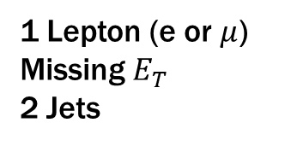
$$WW+WZ→lνjj$$
1 Lepton (e or $μ$)
Missing $E_{T}$
2 Jets
Background Subtracted
Notes:
The search, the channel we looked for it – a summary of what and where we are looking – very broad overview, and the plot of shrinking WW and WZ, etc.

Slide 5
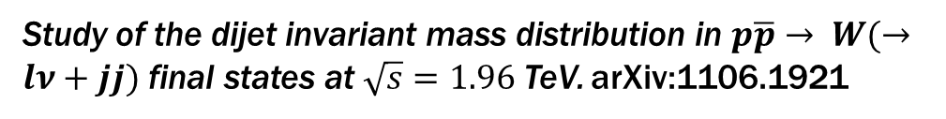
December 2010
Measurement of ww + wz production cross section and study of the dijet mass spectrum in the lnu + jets final state at CDF. Viviana Cavaliere (Siena)
A few theorists find the thesis…
April 2011
Invariant Mass Distribution of Jet Pairs Produced in Association with a W boson in ppbar Collisions at sqrt(s) = 1.96 TeV, arXiv:1104.0699
(60 citations)
June 2011
Study of the dijet invariant mass distribution in $p\overline{p}→ W(→lν+jj)$ final states at $\sqrt{s}=1.96$ TeV. arXiv:1106.1921
(1 citations)

Slide 6
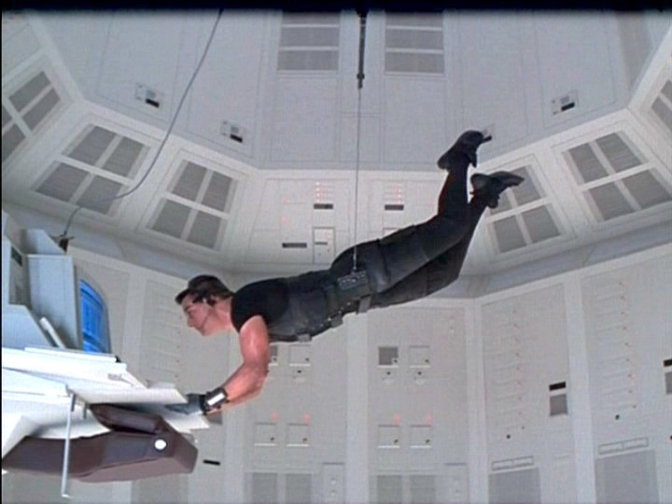
Does DØ See it??
Could DØ have seen it?
Can DØ rule it out?

Slide 7
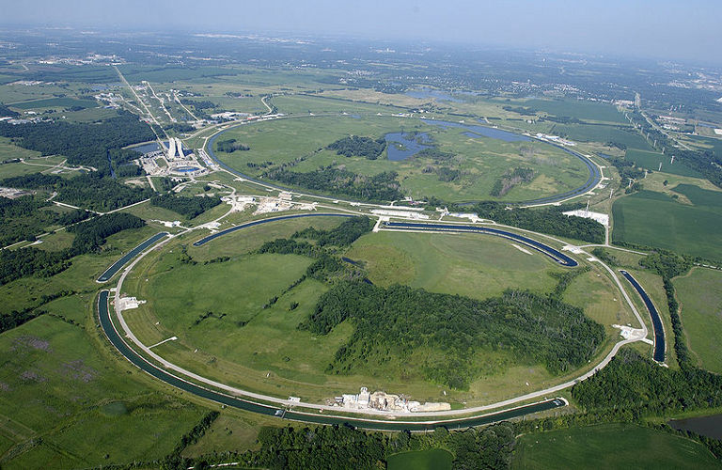

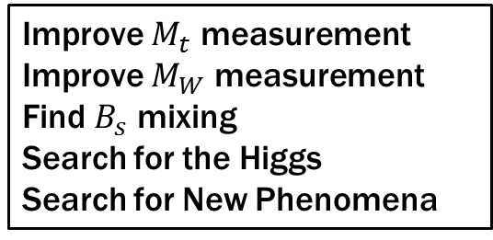
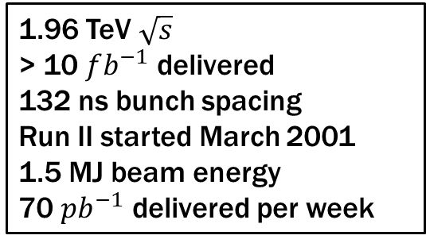
The Tevatron
1.96 TeV $\sqrt{s}$
> 10 $fb^{−1}$ delivered
132 ns bunch spacing
Run II started March 2001
1.5 MJ beam energy
70 $pb^{−1}$ delivered per week
Improve $M_{t}$ measurement
Improve $M_{W}$ measurement
Find $B_{s}$ mixing
Search for the Higgs
Search for New Phenomena
Tevatron
Main Injector
Recycler
Notes:
and a small Chicago picture, and a Fermilab emblem, peak lumi

Slide 8
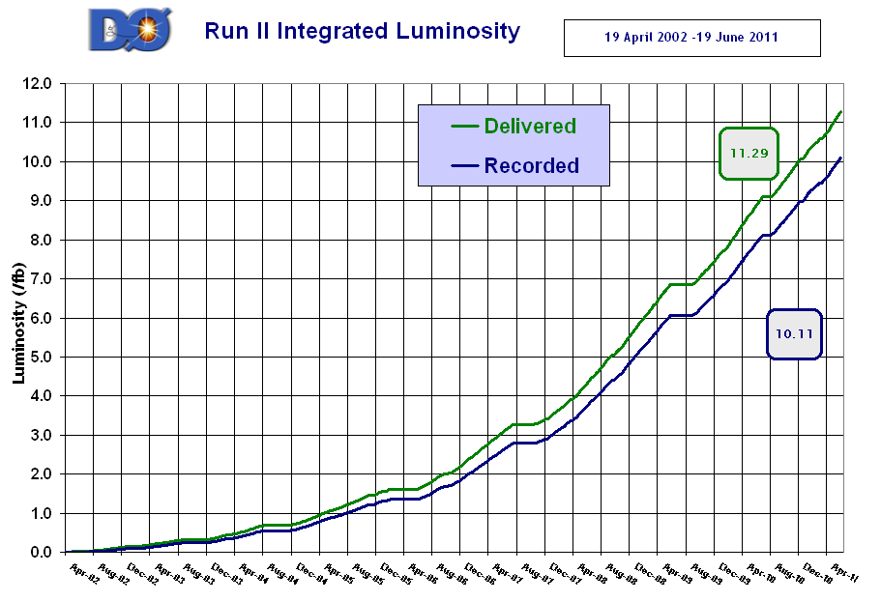

Slide 9
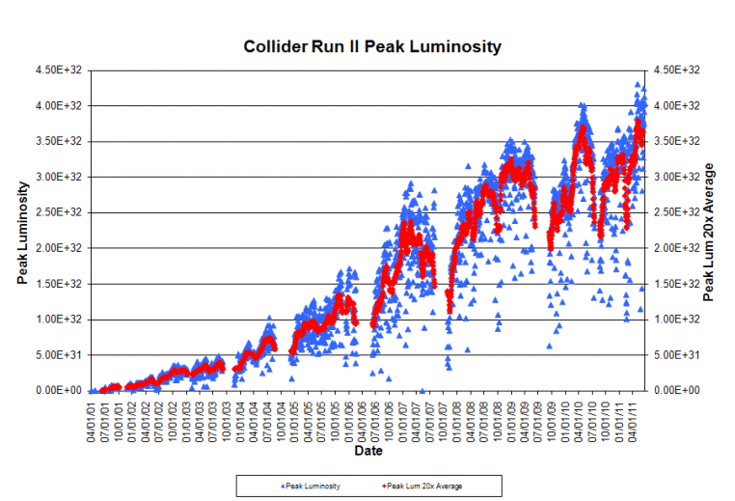
Peak Luminosity

Slide 10
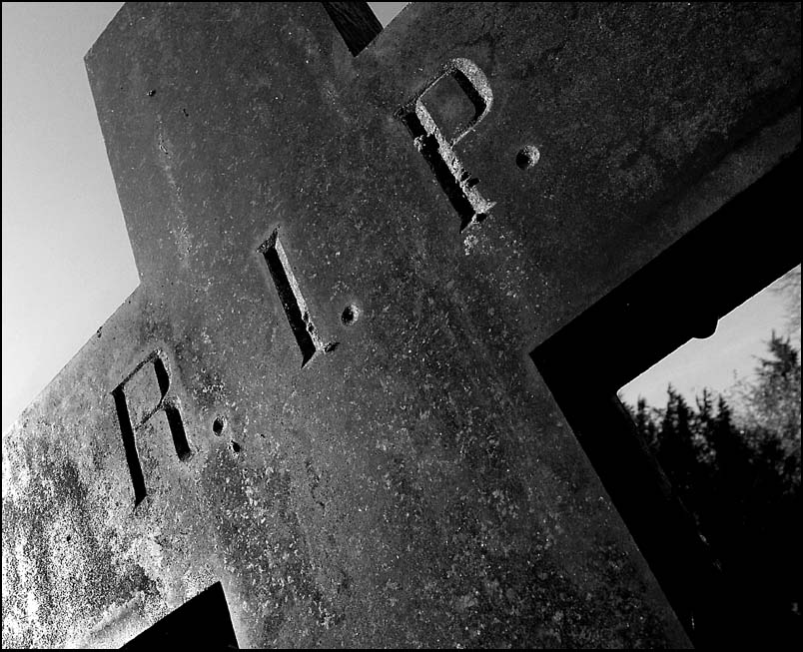

September 30
2011
Fondly remembered for ~12 $fb^{−1}$ delivered and countless papers published

Slide 11
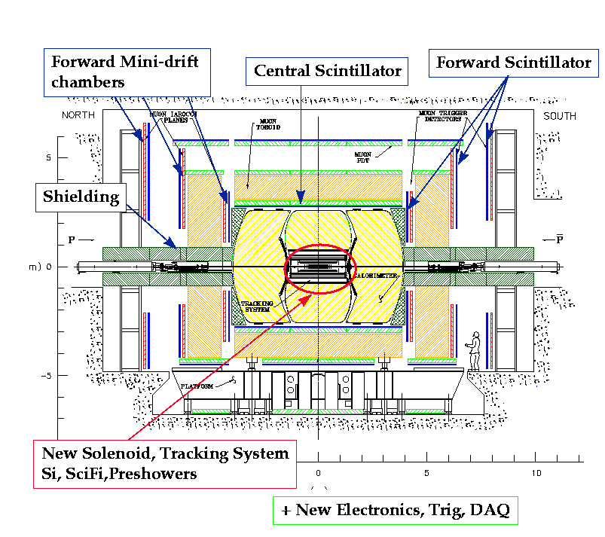
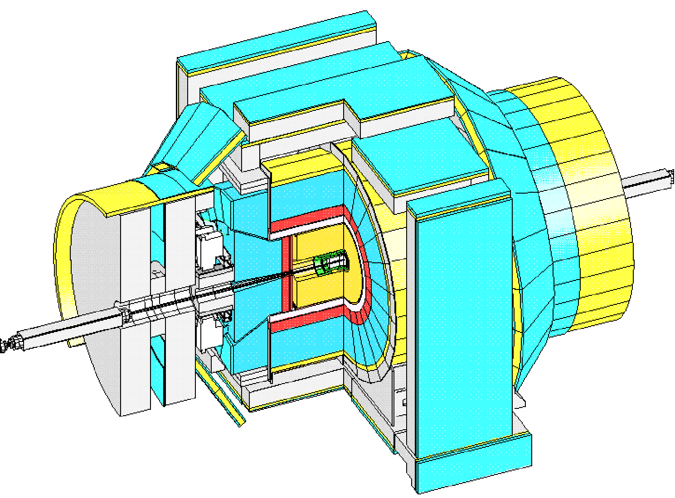
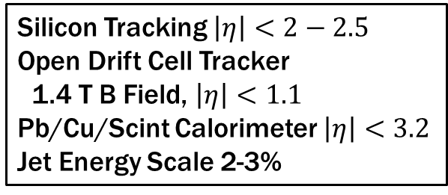
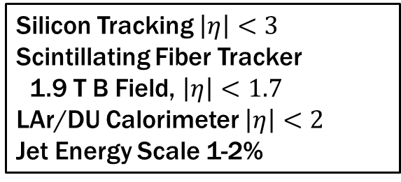
The Detectors
Silicon Tracking $\left|η\right|<3$
Scintillating Fiber Tracker
1.9 T B Field, $\left|η\right|<1.7$
LAr/DU Calorimeter $\left|η\right|<2$
Jet Energy Scale 1-2%
Silicon Tracking $\left|η\right|<2−2.5$
Open Drift Cell Tracker
1.4 T B Field, $\left|η\right|<1.1$
Pb/Cu/Scint Calorimeter $\left|η\right|<3.2$
Jet Energy Scale 2-3%

Slide 12

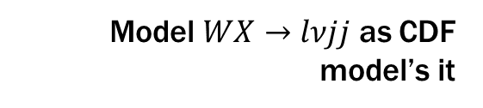
The DØ Analysis
Copy
DØ’s Normal Analysis opens up cuts to increase acceptance
Increased reweightings for Data/MC agreement
Copy CDF’s cuts
Eliminate most reweightings
Model $WX→lνjj$ as CDF model’s it
How big an excess does our data support?

Slide 13
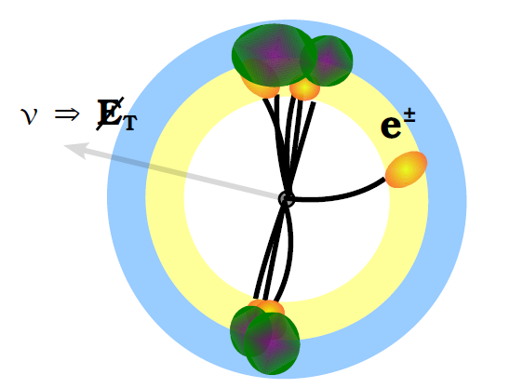
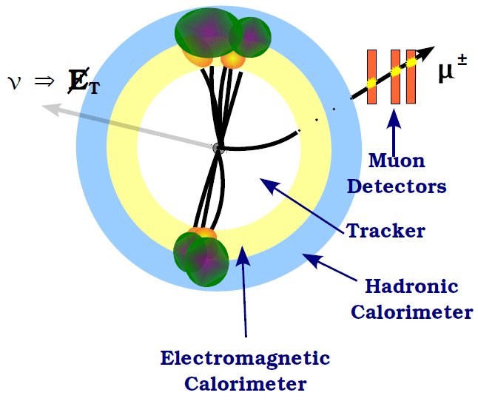



The $WX→lνjj$ Search
$$WX→eνjj$$
$$WX→μνjj$$
Thanks to J. Haley for figures

Slide 14
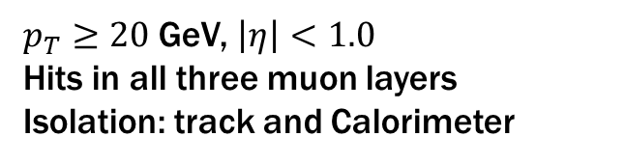

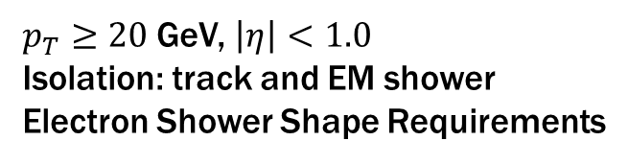
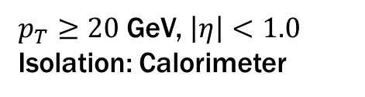
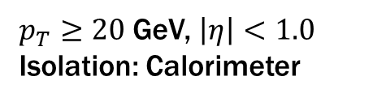
Selecting The $W→lν$
Electron
$p_{T}≥20$ GeV, $\left|η\right|<1.0$
Isolation: track and EM shower
Electron Shower Shape Requirements
$p_{T}≥20$ GeV, $\left|η\right|<1.0$
Isolation: Calorimeter
Muon
$p_{T}≥20$ GeV, $\left|η\right|<1.0$
Hits in all three muon layers
Isolation: track and Calorimeter
$p_{T}≥20$ GeV, $\left|η\right|<1.0$
Isolation: Calorimeter
(Isolation: kill off Heavy Flavor Decays)
Notes:
Get CDF’s cuts in here too

Slide 15


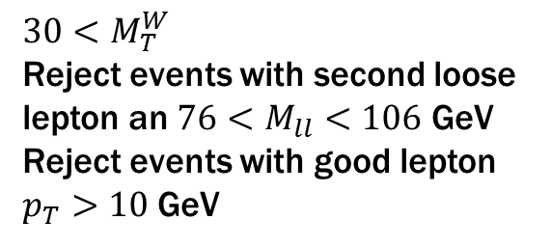
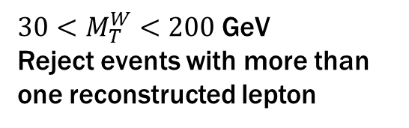

Selecting The $W→lν$
The Missing $E_{T}$
Missing $E_{T}>25$ GeV
Missing $E_{T}>25$ GeV
$M_{T}^{W}$ Cuts
$30<M_{T}^{W}<200$ GeV
Reject events with more than one reconstructed lepton
$$30<M_{T}^{W}$$
Reject events with second loose lepton an $76<M_{ll}<106$ GeV
Reject events with good lepton $p_{T}>10$ GeV
Notes:
CDF results as well

Slide 16
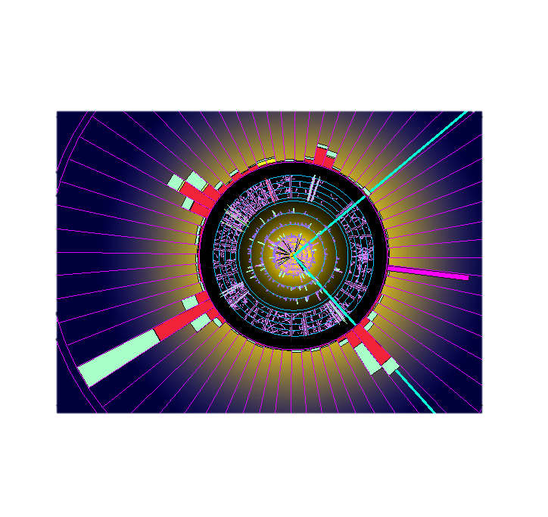
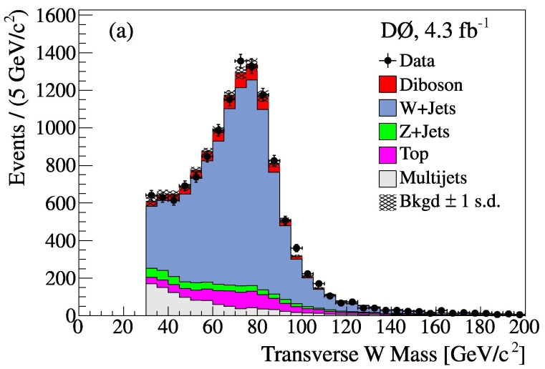
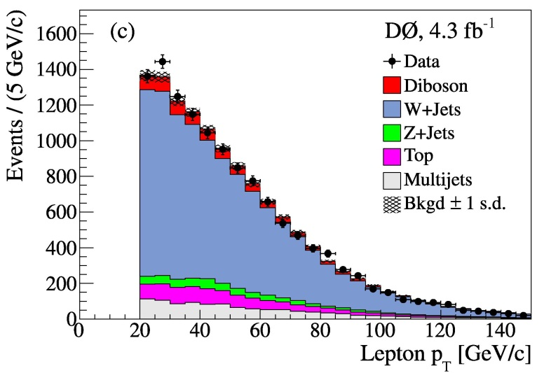
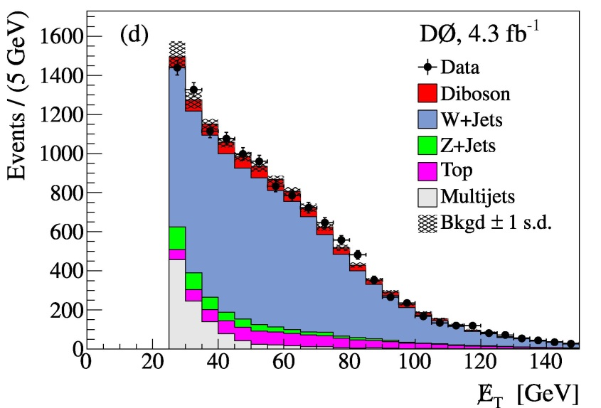
Selecting The $W→lν$

Slide 17
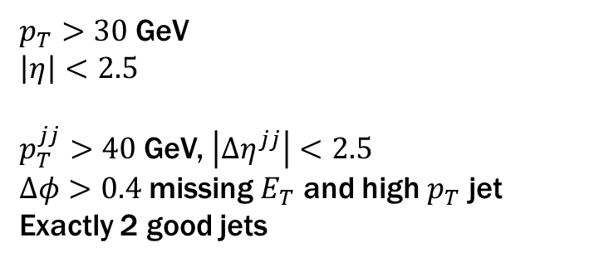
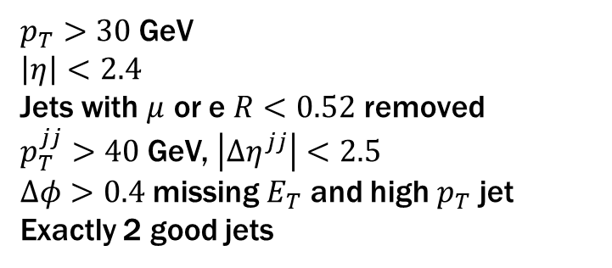
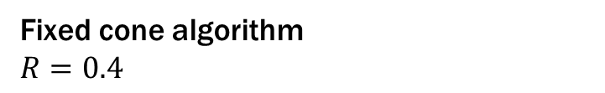
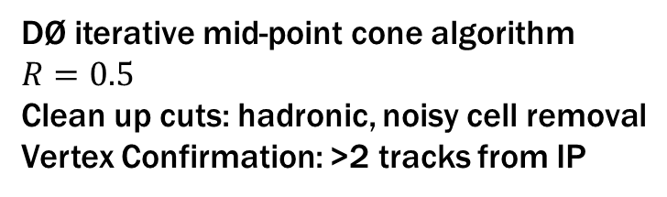
The Jets
Reconstruction
DØ iterative mid-point cone algorithm
$$R=0.5$$
Clean up cuts: hadronic, noisy cell removal
Vertex Confirmation: >2 tracks from IP
Fixed cone algorithm
$$R=0.4$$
Selection
$p_{T}>30$ GeV
$$\left|η\right|<2.5$$
$p_{T}^{jj}>40$ GeV, $\left|Δη^{jj}\right|<2.5$
$Δφ>0.4$ missing $E_{T}$ and high $p_{T}$ jet
Exactly 2 good jets
$p_{T}>30$ GeV
$$\left|η\right|<2.4$$
Jets with $μ$ or e $R<0.52$ removed
$p_{T}^{jj}>40$ GeV, $\left|Δη^{jj}\right|<2.5$
$Δφ>0.4$ missing $E_{T}$ and high $p_{T}$ jet
Exactly 2 good jets

Slide 18
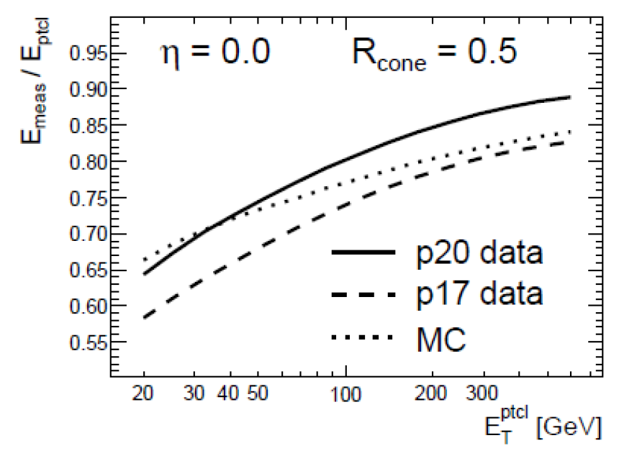
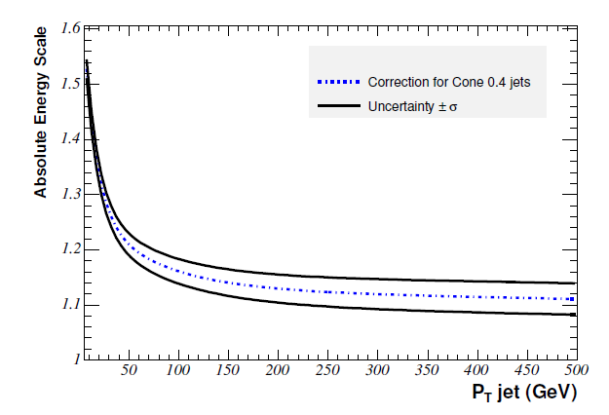

Jet Energy Scale
Both use $γ+jets$ and dijet events
Correct for response, out of cone showering, overlap/pileup
J. BackusMayes Thesis
V. Cavaliere Thesis
Corrections similar in size

Slide 19
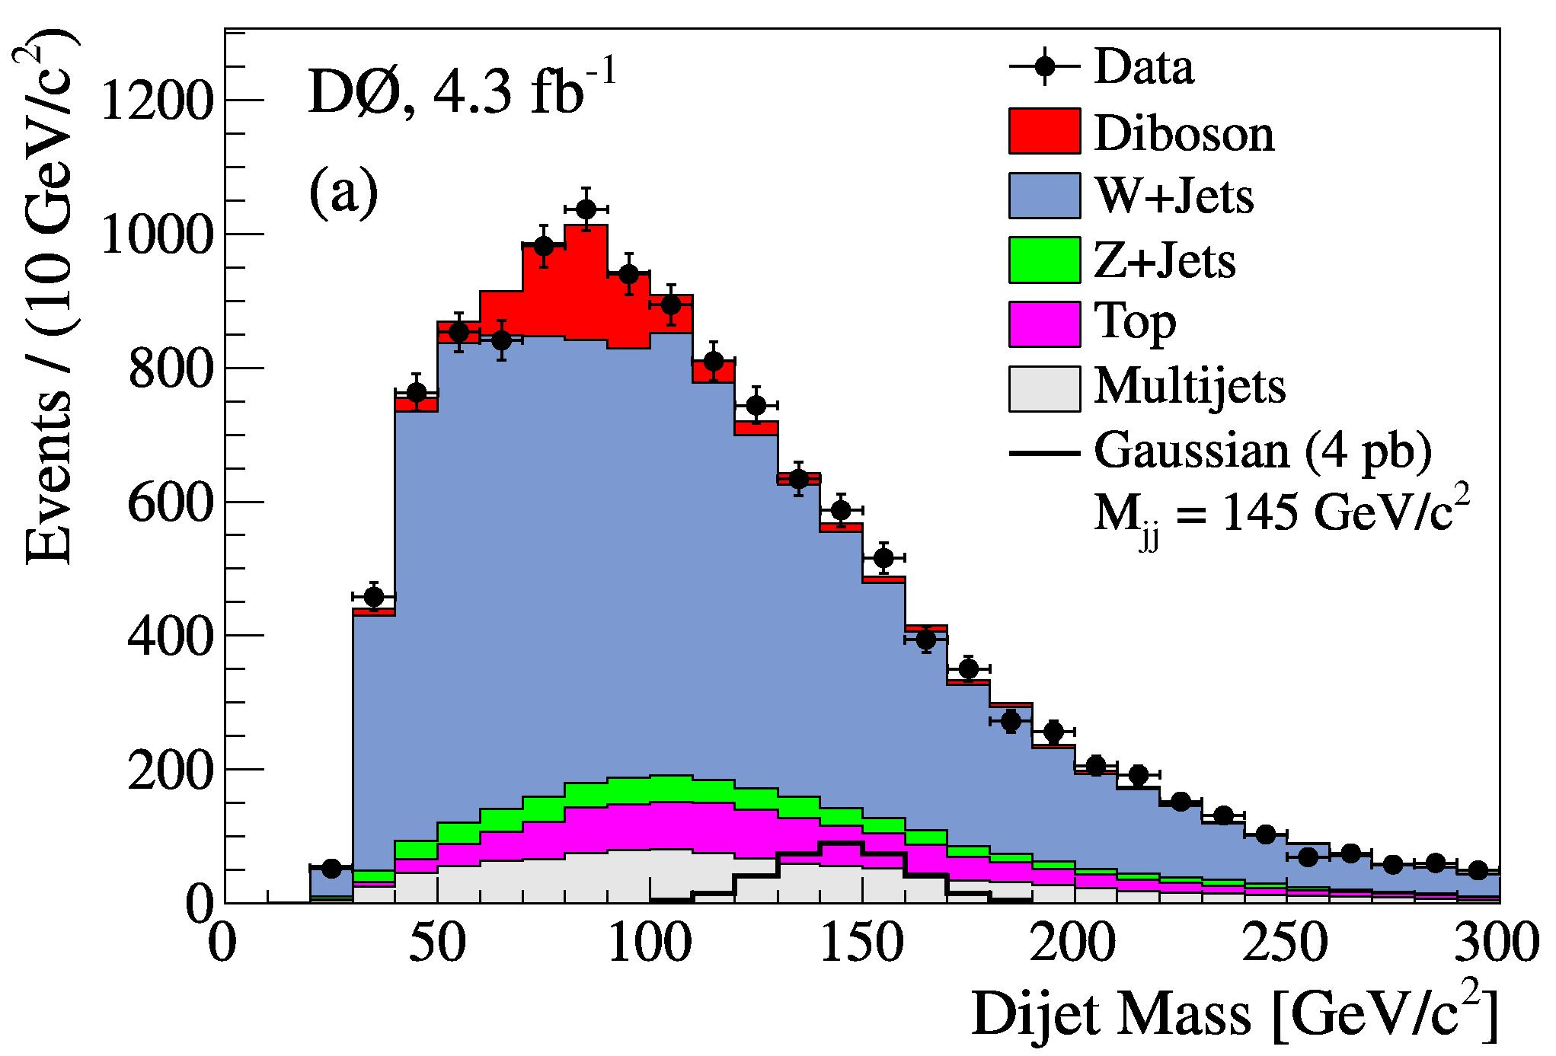

$$M_{JJ}$$

Slide 20
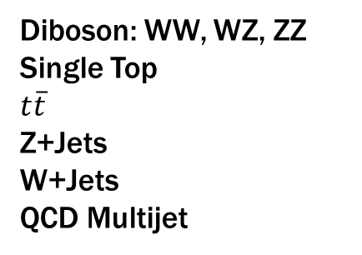

Modeling The SM Background
Background Shapes
Diboson: WW, WZ, ZZ
Single Top
$$t\overline{t}$$
W+Jets, Z+Jets
Monte Carlo Based
QCD Multijet
Data Driven
Background Normalization
Diboson: WW, WZ, ZZ
Single Top
$$t\overline{t}$$
Z+Jets
W+Jets
QCD Multijet
Theory NLO or NNLO cross sections
Fit to data

Slide 21

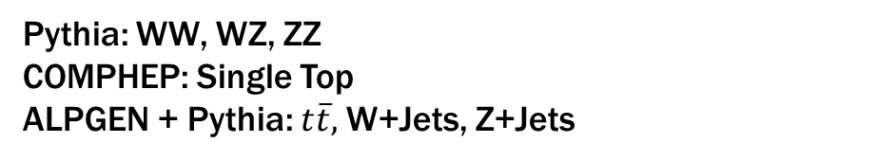
Generators
DØ:
CDF:
CDF:
Pythia: WW, WZ, ZZ
COMPHEP: Single Top
ALPGEN + Pythia: $t\overline{t},$W+Jets, Z+Jets
Pythia: WW, WZ, ZZ, $t\overline{t}$, single top
ALPGEN+Pythia: W+Jets, Z+Jets
 | DØ | CDF
PDF Set | CTEQ6L1 | CTEQ5L
Pythia | 6.409 | 6.326
Pythia Tune | DØ Tune A (tune A, PDF corrected) | Tune A
ALPGEN | V2.11_wcfix | V2.1
Private GEANT3 based detector models + reconstruction software!
Our handling of systematic errors for the generators is almost certainly different as well.

Slide 22
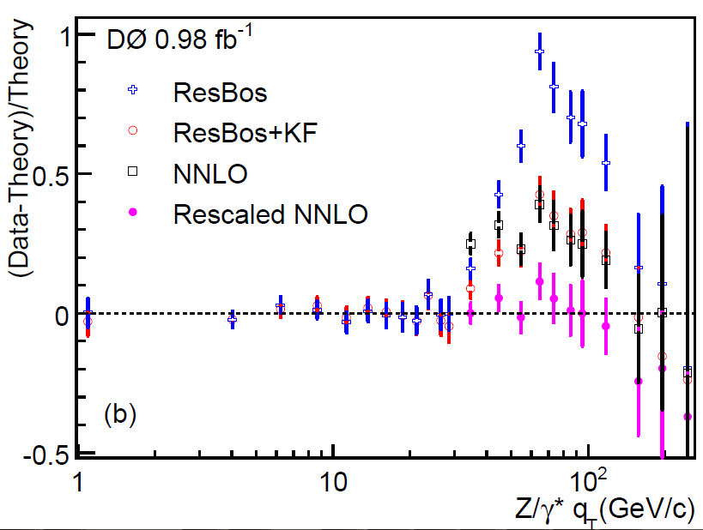

Reweightings
Luminosity Profile
Interaction Region Profile
Detector Based Reweighting's
Z $p_{T}$ reweighting
We checked does not affect the dijet mass distribution
Also correct MC for object ID
e.g. jet finding efficiency is too good
arXiv:0712.0803

Slide 23
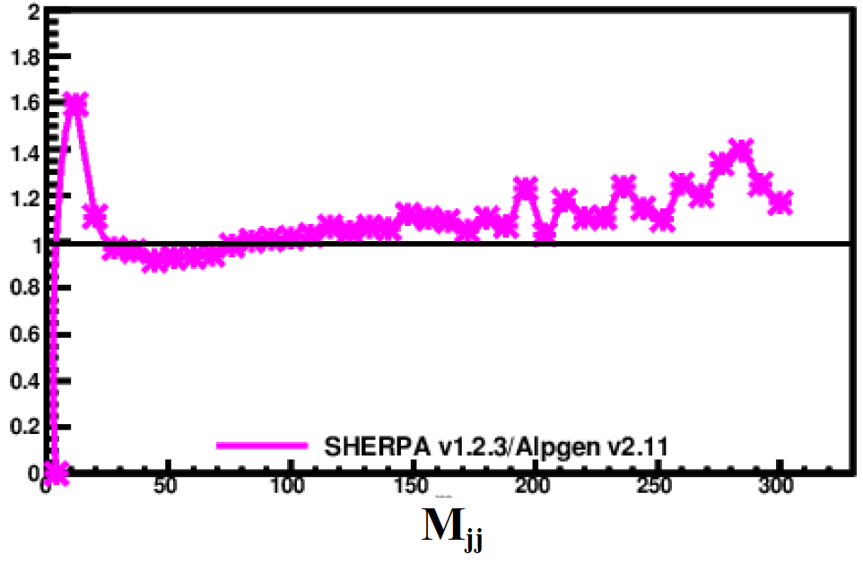

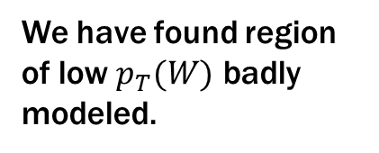

Getting W+Jets Right
We have found region of low $p_{T}(W)$ badly modeled.
Jet $η$, $p_{T}\left(W\right)$, $ΔR(j_{1},j_{2})$
However, CDF cuts mostly eliminate that region
(A. Martin)
No Other Reweightings Applied
But we take expected differences into account as uncertainties
We also cross-checked the effect of the reweightings on $M_{jj}$ as well as completing the complete analysis with and without these reweightings.

Slide 24

QCD MultiJet Background
Includes all manner of sins
Jets faking a lepton (electrons)
Heavy Flavor not removed otherwise (muons)
Instrumental Backgrounds
Mis-measured jet?
Difficult to simulate
Data Driven

Slide 25

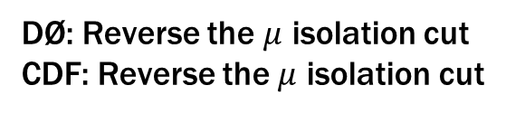
QCD Sideband Samples
Muons
DØ: Reverse the $μ$ isolation cut
CDF: Reverse the $μ$ isolation cut
Gives us the shape (template) of the QCD multijet background
Electrons
DØ: Matrix Method (remove EM shower shape cuts)
CDF: Anti-select on electron quality variables (low statistics issue)
Overall shape and normalization:
DØ: Fits the $M_{T}^{W}$ distribution
CDF: Fits the missing $E_{T}$ distribution (release cut first!)
DØ explicitly removes W+Jets contributions from their QCD templates. CDF probably does, but couldn’t find a reference.

Slide 26

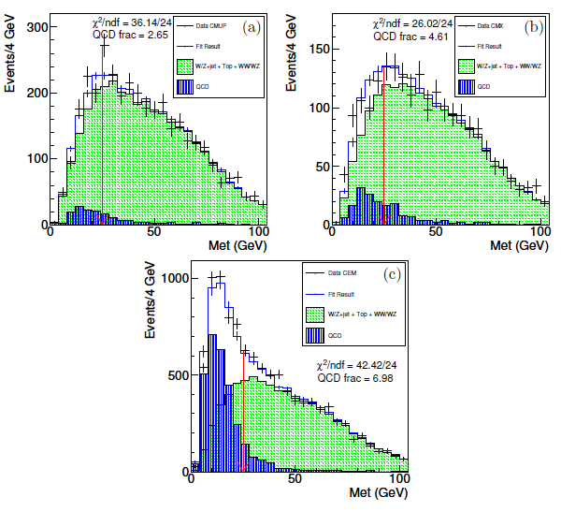


Normalization Fits
$μ$ central
$μ$ forward
combined
Let both the W+jets and the QCD multijet background float
e
(taken from V. Cavaliere’s thesis, but referenced in CDF PRL)

Slide 27
Hypocrite!

Slide 28
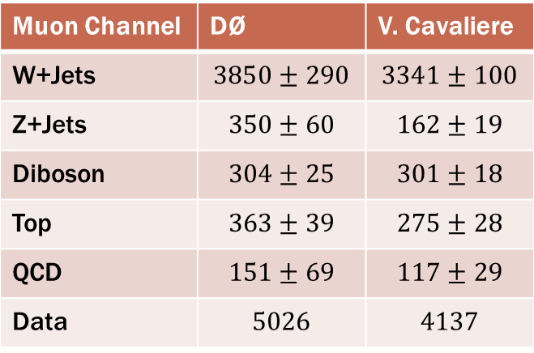
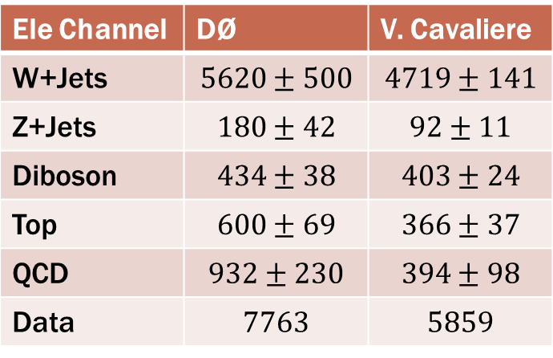
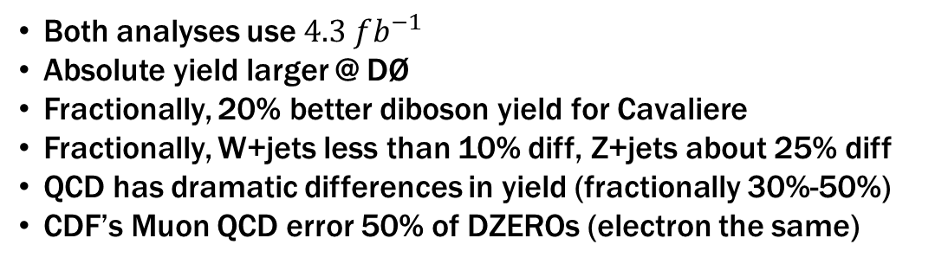
Final Background Tally
Ele Channel | DØ | V. Cavaliere
W+Jets | $$5620±500$$ | $$4719±141$$
Z+Jets | $$180±42$$ | $$92±11$$
Diboson | $$434±38$$ | $$403±24$$
Top | $$600±69$$ | $$366±37$$
QCD | $$932±230$$ | $$394±98$$
Data | $$7763$$ | $$5859$$
Muon Channel | DØ | V. Cavaliere
W+Jets | $$3850±290$$ | $$3341±100$$
Z+Jets | $$350±60$$ | $$162±19$$
Diboson | $$304±25$$ | $$301±18$$
Top | $$363±39$$ | $$275±28$$
QCD | $$151±69$$ | $$117±29$$
Data | $$5026$$ | $$4137$$
Both analyses use $4.3 fb^{−1}$
Absolute yield larger @ DØ
Fractionally, 20% better diboson yield for Cavaliere
Fractionally, W+jets less than 10% diff, Z+jets about 25% diff
QCD has dramatic differences in yield (fractionally 30%-50%)
CDF’s Muon QCD error 50% of DZEROs (electron the same)

Slide 29
QCD Comparison
J. Wacker had this idea originally, G. Brooijmans improved upon it

Slide 30
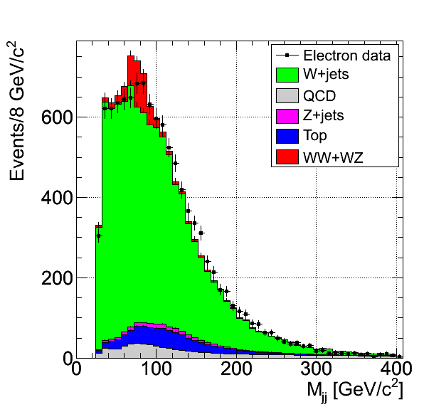
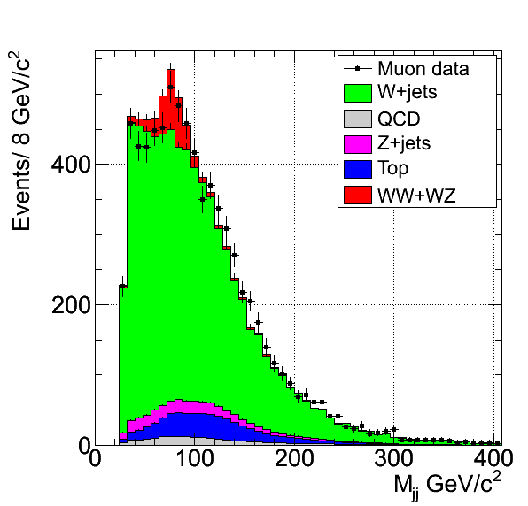
Channel Comparison

Slide 31
“Same Cuts”

Slide 32
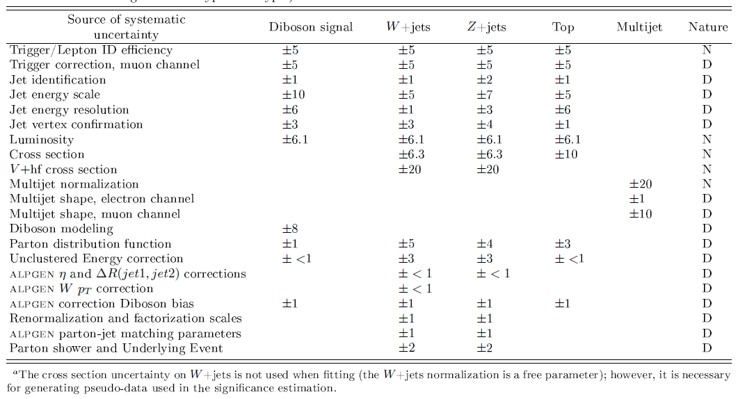
Systematic Uncertainties

Slide 33
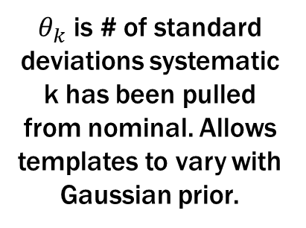


Does our Background Model Work?
Fit the dijet mass distribution
$$χ^{2}\left(θ,S,B;D\right)=2\sum_{i=0}^{N_{bins}}{\left(B_{i}+S_{i}−D_{i}\right)−D_{i}\ln\left(\frac{B_{i}+S_{i}}{D_{i}}\right)}+\sum_{k=0}^{N_{sys}}{θ_{k}^{2}}$$
Background, Signal, and observed Data
$θ_{k}$ is # of standard deviations systematic k has been pulled from nominal. Allows templates to vary with Gaussian prior.
The W+Jets and diboson cross sections are allowed to float for this fit (no $θ_{k}$).

Slide 34


Does our Background Model Work?

Slide 35




Could We Have Missed It?
Dijet mass fit, with a $WX→lνjj$ template, and set a limit
Narrow Bump @ Experimental Resolution
Simple mass scaling:
$$σ_{jj}=σ_{W→jj}×\sqrt{M_{jj}/M_{W→jj}}$$
At 145 GeV, $σ_{jj}=15.7$ GeV
Cross Section
$$BR\left(X→jj\right)=1.0$$
Efficiency from WH ($M_{H}=150$ GeV)
JES (changes mean by $±1.5$%)
JER (norm by $5\%$, width by $3\%$)

Slide 36



Fit With $WX→lνjj$ Template

Slide 37

Limit Setting
If we re-ran the experiment many times, how often would we see a “real” excess?
Frequentist
Generate ensembles of pseudo-experiments
Allow statistical and systematic fluctuations
Re-run the dijet mass fit
$LLR=−2\log\left(\frac{P\left(D;S+B\right)}{P\left(D;B\right)}\right)=χ^{2}\left(D | S+B\right)−χ^{2}(D|B)$
Signal+Background
Model
Background Model
Turn the LLR probability distributions into straight limits (95% CL).
D – Observed Events
S – Expected Signal
B – Expected Background

Slide 38




Limit
Rule out $1.9 pb^{−1}$ or larger @ 95% CL
Rule out $4 pb^{−1}$ or larger @ 4$σ$ (99.9999%)

Slide 39



Mock The Signal
Use the data plus the $WX$ template
Use the CDF $4 pb^{−1}$ cross section

Slide 40


LLR Plot
There is no way we would have missed a $4 pb^{−1}$ signal!

Slide 41
What about the LHC?

Slide 42
What could it be?
Gauged Baryon and Lepton Number in MSSM_4 Brane Worlds
A two-Higgs-doublet interpretation of a small Tevatron $Wjj$ excess
Subjects: High Energy Physics - Phenomenology (hep-ph)
Chiral Quirkonium Decays
Subjects: High Energy Physics - Phenomenology (hep-ph)
Top condensation as a motivated explanation of the top forward-backward asymmetry
Quirks at the Tevatron and Beyond
Hermitian Flavor Violation
A Higgsophilic s-channel Z' and the CDF W+2J Anomaly
Dissecting the Wjj Anomaly: Diagnostic Tests of a Leptophobic Z'
Theory and phenomenology of two-Higgs-doublet models
Deriving the mass of particles from Extended Theories of Gravity in LHC era
Direct detection and CMB constraints on light DM scenario of top quark asymmetry and dijet excess at Tevatron
Measurements of top quark properties at the Tevatron collider
Production of Charged Higgs Bosons in a 3-3-1 Model at the CERN LHC
NLO predictions for a lepton, missing transverse momentum and dijets at the Tevatron
An Explanation of the CDF Dijet Anomaly within a $U(1)_X$ Stueckelberg Extension
Experimental proposal to study the excess at Mjj=150 GeV presented by CDF at Fermilab
A light charged Higgs boson in two-Higgs doublet model for CDF $Wjj$ anomaly
Colored Scalars And The CDF $W+$dijet Excess
A Scalar Doublet at the Tevatron?
Reconciling anomalous measurements in $B_s-\bar{B}_s$ mixing: the role of CPT-conserving and CPT-violating new physics
Dijet Signature of Low Mass Strings in the Early LHC Data
The Prediction and Evidence for a New Particle - antiparticle Force and Intermediary Particle
Color-Octet-Electroweak-Doublet Scalars and the CDF Dijet Anomaly
Impact of extra particles on indirect Z' limits
Z' from SU(6)$\times$SU(2)_h GUT, Wjj anomaly and Higgs boson mass bound
Spontaneous Parity Violation in SUSY Strong Gauge Theory
Anomaly Puzzle, Curved-Spacetime Spinor Hamiltonian, and
String Phenomenology
Dimuon CP Asymmetry in B Decays and Wjj Excess in Two Higgs Doublet Models
Top quark asymmetry and Wjj excess at CDF from gauged flavor symmetry
W plus two jets from a quasi-inert Higgs doublet
Tevatron Signal for an Unmixed Radion
The New Dijet Particle in the Tevatron IS the Higgs
The CDF dijet excess and Z'_{cs} coupled to the second generation quarks
A Possible Common Origin of the Top Forward-backward Asymmetry and the CDF Dijet Resonance
An Effective Z'
W+Jets at CDF: Evidence for Top Quarks
Dijet resonance from leptophobic Z' and light baryonic cold dark matter
Standard model explanation of a CDF dijet excess in Wjj
B physics constraints on a flavor symmetric scalar model to account for the ttbar asymmetry and Wjj excess at CDF
Dark Forces At The Tevatron
Top quark asymmetry and dijet resonances
Twelve massless flavors and three colors below the conformal window
~115 GeV and ~143 GeV Higgs mass considerations within the Composite Particles Model
Weak-triplet, color-octet scalars and the CDF dijet excess
Stringy origin of Tevatron Wjj anomaly
A unified, flavor symmetric explanation for the t-tbar asymmetry and Wjj excess at CDF
A Possible Interpretation of CDF Dijet Mass Anomaly and its Realization in Supersymmetry
New Color-Octet Vector Boson Revisit
The CDF dijet excess from intrinsic quarks
No like-sign tops at Tevatron: Constraints on extended models and implications for the t tbar asymmetry
Baryonic Z' Explanation for the CDF Wjj Excess
$\mathscr{O}(100 GeV)$ Deci-weak $W^\prime/Z^\prime$ at Tevatron and LHC
Signatures of Resonant Super-Partner Production with Charged-Current Decays
Technicolor at the Tevatron
A Z' Model for the CDF Dijet Anomaly
Light Z' Bosons at the Tevatron
Forward-Backward t tbar Asymmetry from Anomalous Stop Pair Production
Searching for string resonances in e^+e^- and γγcollisions

Slide 43





LHC Implications
$p\overline{p}$ vs $pp$ interaction
To have the LHC weight in we need a production mechanism
There are a lot…
But we really need to wait for a $WW+WZ→lνjj$ search at the LHC!
Can Search For Secondary Effects Too…
A unified, flavor symmetric explanation for the $t\overline{t}$ asymmetry and Wjj excess at CDF(Nelson, Okui, Roy)
We present a simple, perturbative, and renormalizable model with a flavor symmetry which can explain both the t-tbar forward-backward asymmetry and the bump feature present in the dijet mass distribution of the W+jj sample in the range 120-160 GeV that was recently reported by the CDF collaboration.

Slide 44

Conclusions
With out DØ’s normal reweightings, rule out CDF bump of $1.9 pb$, with reweightings it is $1.5 pb$
Very hard to make the two experiments compatible
  CDF had a huge upwards fluctuation
  And DØ was very unlucky
Someone goofed??? ☺
  Both CDF and DØ have done lots of cross checks
  See CDF’s recent update for answers to many initial questions
There is now a task force trying to sort out the differences between the analyses
  Officially composed of theorist Estia Eichten and Keith Ellis and members of both experiments
  Meetings already have started
This analysis is very similar to a low-mass Higgs analysis
  Would be useful to compare background estimation techniques
The next 6 months should be fun (for this an other reasons)

